Slide 1
Predatory Journals
& Predatory Publishers
Margaret Vugrin, MSLS, AHIP,
MPH Candidate 2017
Margaret.vugrin@ttuhsc.edu

Slide 2
Predatory Publishing - Definition
In academic publishing, predatory open access publishing
is an exploitative open-access publishing business model
that involves charging publication fees to authors without
providing the editorial and publishing services associated
with legitimate journals (open access or not).

Slide 3
Predatory journals
“A predatory journal is a journal that deceptively takes from an author.”
  Deceptively takes???
    Article Processing Charges (APCs)
    Hidden fees to publish
    Loose opportunity to publish elsewhere when discovered
    Don’t offer legitimate supports
8 questions and answers about predatory journals: Protecting your research, reputation, and funding from theft and fraud : ThinkSCIENCE (株) toolshed – 科学、医学、技術分野の 英文校正・論文翻訳・プルーフリーディングサービス：論文翻訳・英文校正エキスパート. (). Retrieved from http://www.thinkscience.co.jp/toolshed/lang/en/2015/07/01/8-q-and-a-about-predatory-journals

Slide 4
Legitimate supports
Appropriate exposure of your work
Adequate peer review
  Are you published next week?
Qualified oversight – Respected Editorial Board
Acceptance by other scholars
  PubMed
  Scopus
  Other valid databases

Slide 5
COPE
Committee on Publication Ethics
A number of PDFs on issues with authorship
  Flow-charts e.g. plagiarism, duplicate publication etc.

Slide 6


https://web-beta.archive.org/web/20160313201852/http://scholarlyoa.com/2016/03/01/new-open-access-publisher-launches-with-65-unneeded-journals/#comment-404708

Slide 7
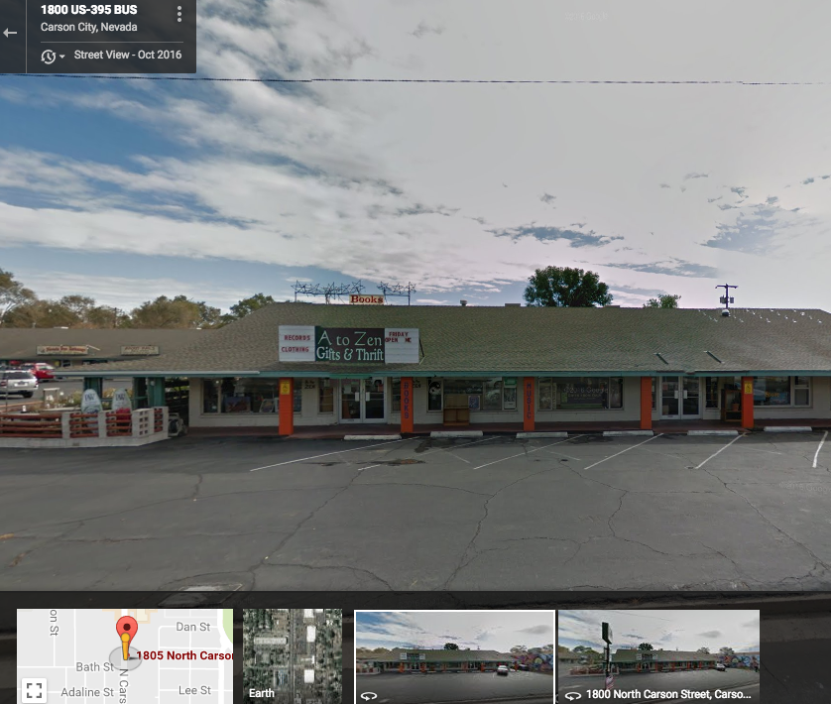
Google Maps
The Scientific Pages
1805 N Carson Street
Suite S, Carson City
Nevada 89701, USA

Slide 8
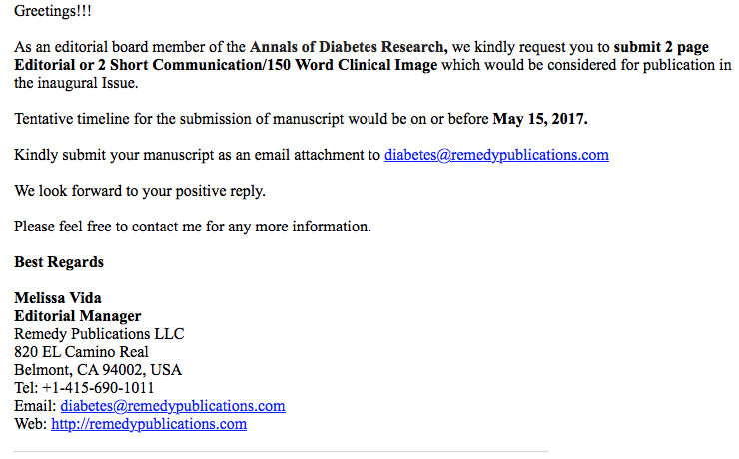
Invitation…Remedy Publications

Slide 9
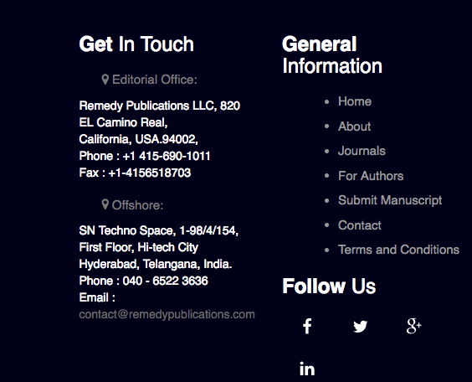
Remedy Publications website
Annals of Diabetes Research
What do you note that seems a bit strange?
There is no town/city listed.

Slide 10
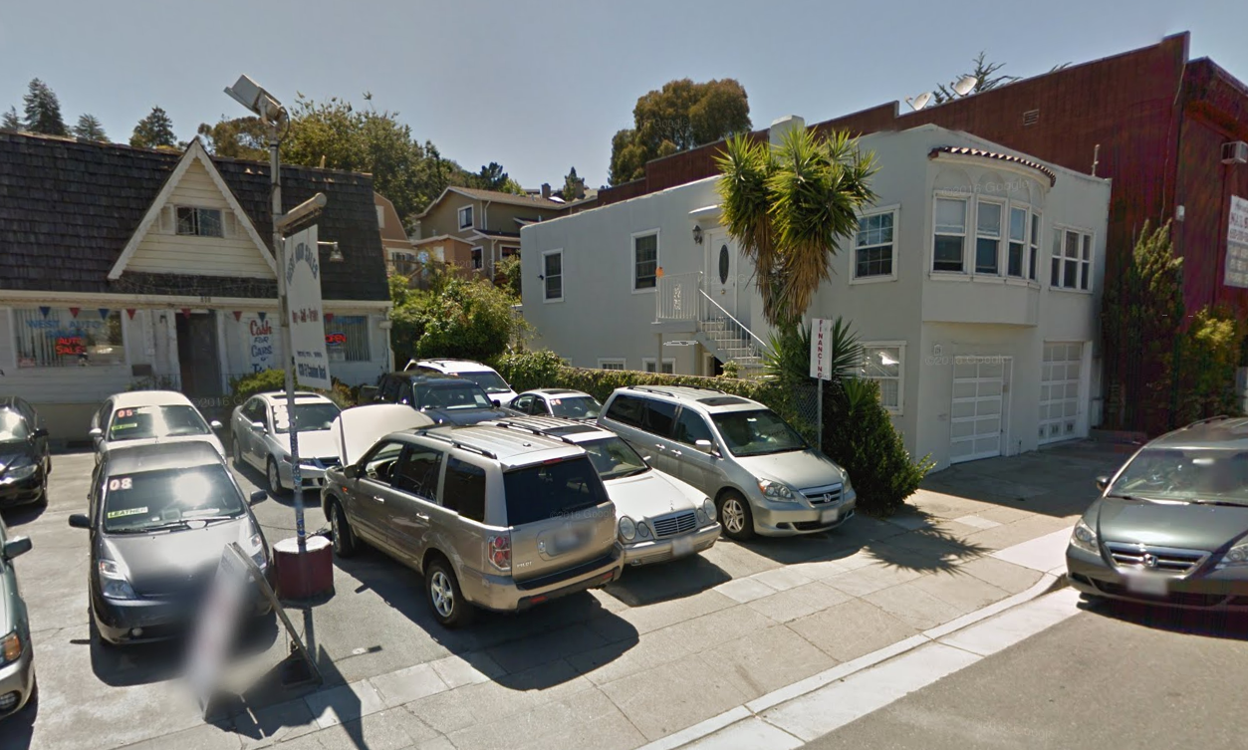
820 El Camino Real

Slide 11
How to Protect Yourself!

Slide 12
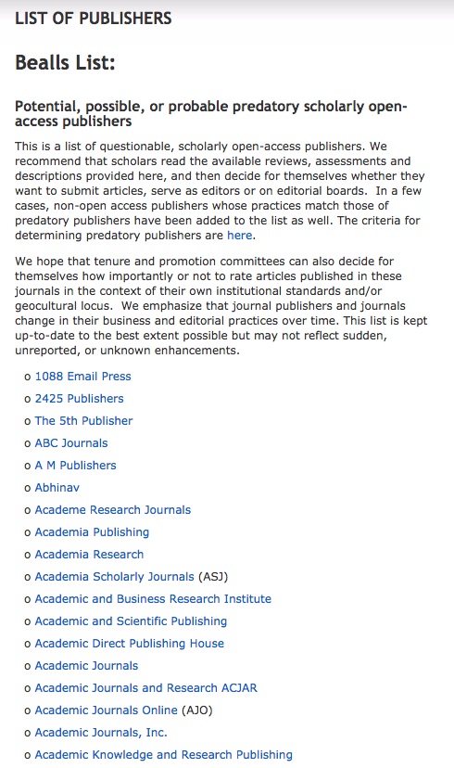
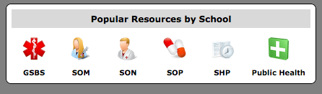
Wayback Machine
Only Available on the
WayBack Machine
List was removed in Jan 2017
TTUHSC archive available:
library homepage

Slide 13
How can databases help?

Slide 14
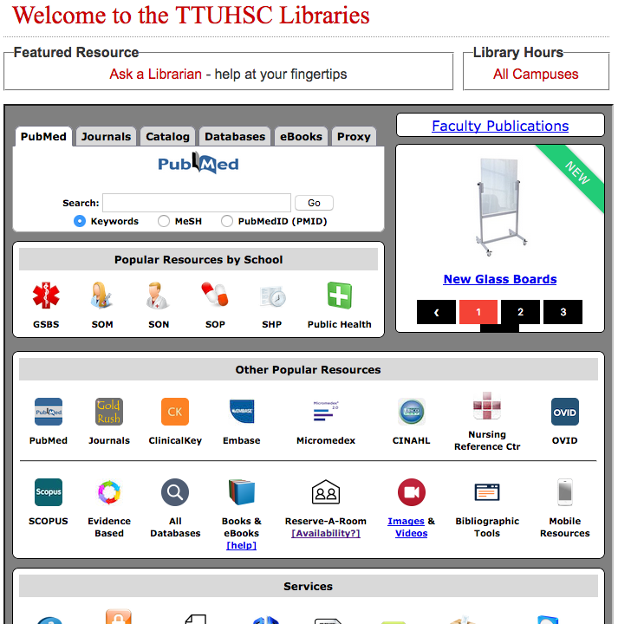
Check to see if citation indexed in PubMed
Does it have a PMID number?

Slide 15
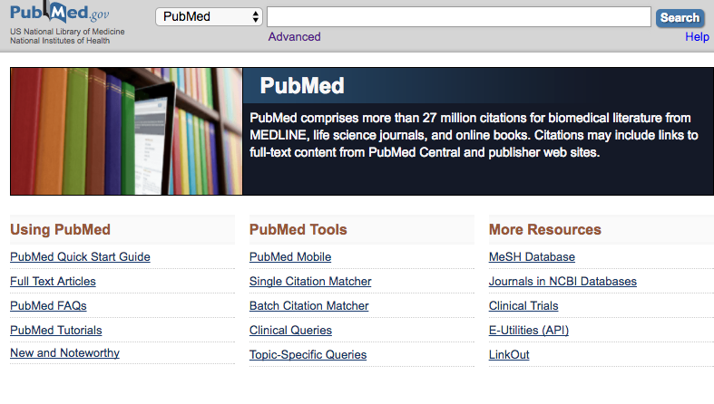
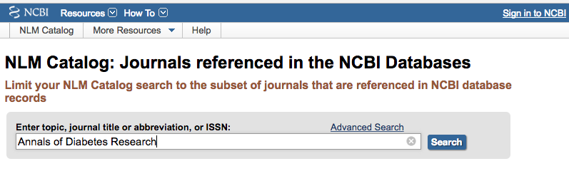
Check for Database Indexing
Locate listing of
Indexed journals
Enter journal name

Slide 16
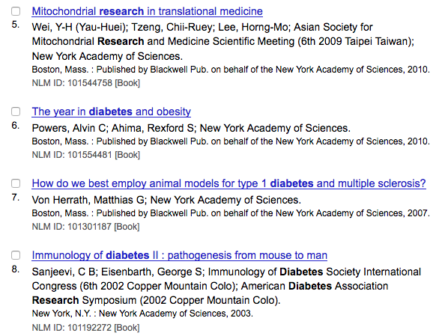
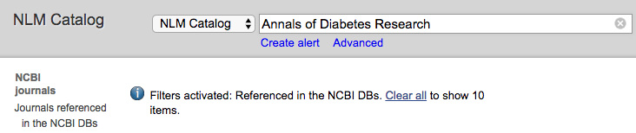
If you hit CLEAR ALL you just get journals with those words
anywhere in the title…
not the specific title you are looking for

Slide 17
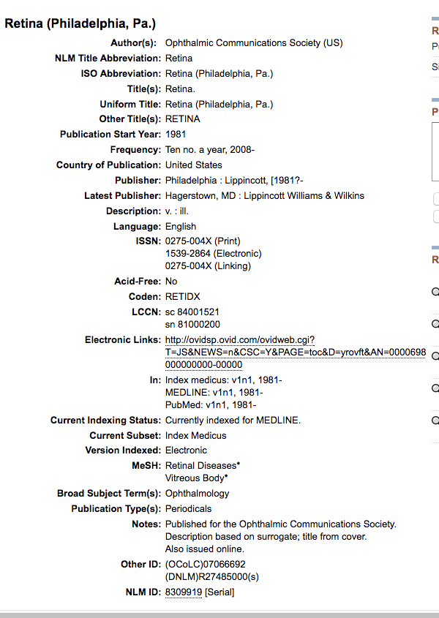
Retina
(Philadelphia, Pa.)
When you enter a legitimate journal
This is what the page will look like.

Slide 18
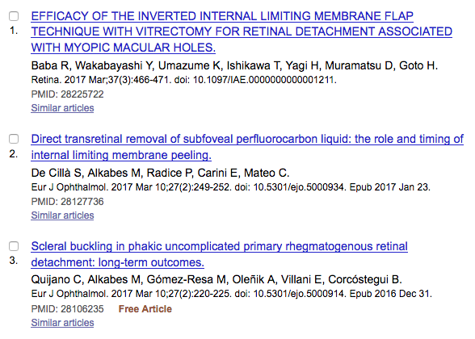
28225722
When you locate citations
They will have a PMID number
This is what the page will look like.
This is the summary format

Slide 19
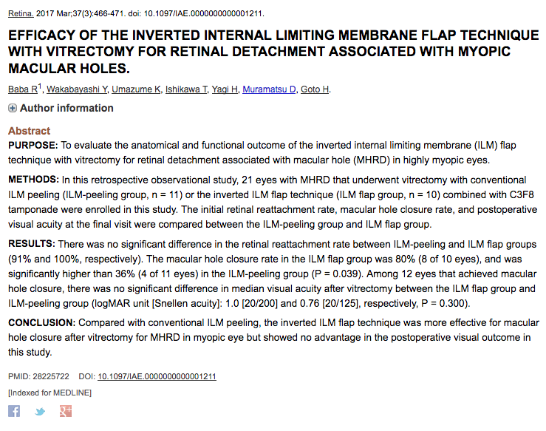
This is the abstract format with PMID

Slide 20
Scopus

Slide 21
SCOPUS covers
over 25,000 journals

Slide 22
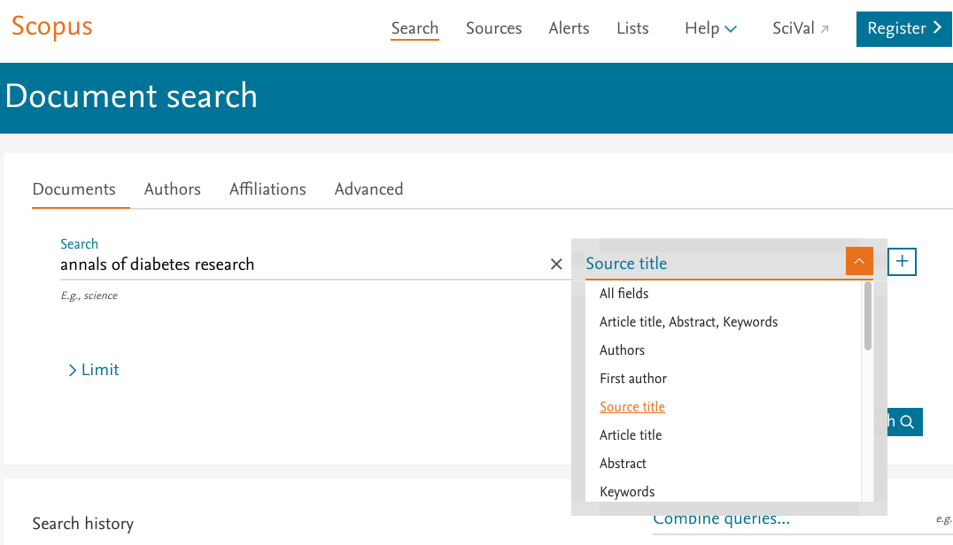
Scopus default search is…

Slide 23
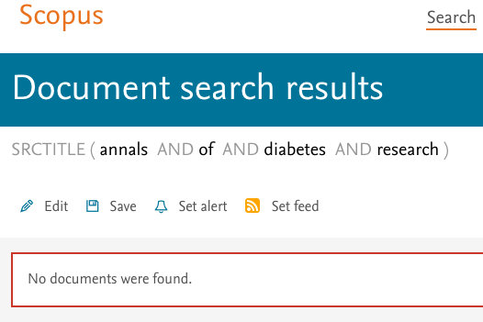

Slide 24
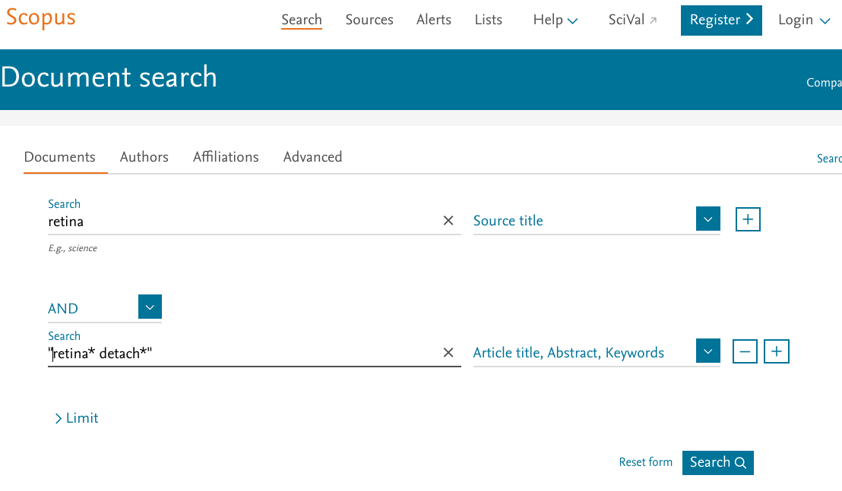
“ “ means search as phrase
* is wild card = give me anything that comes after *

Slide 25
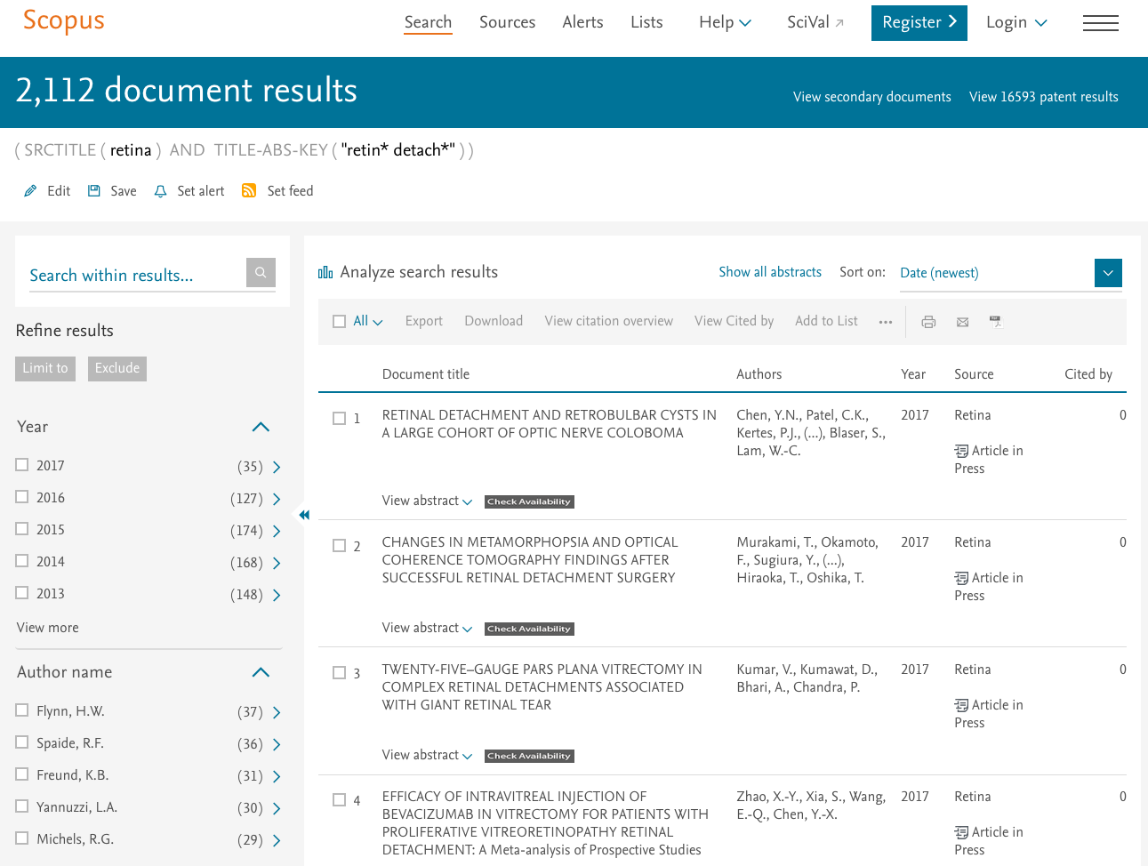

Slide 26
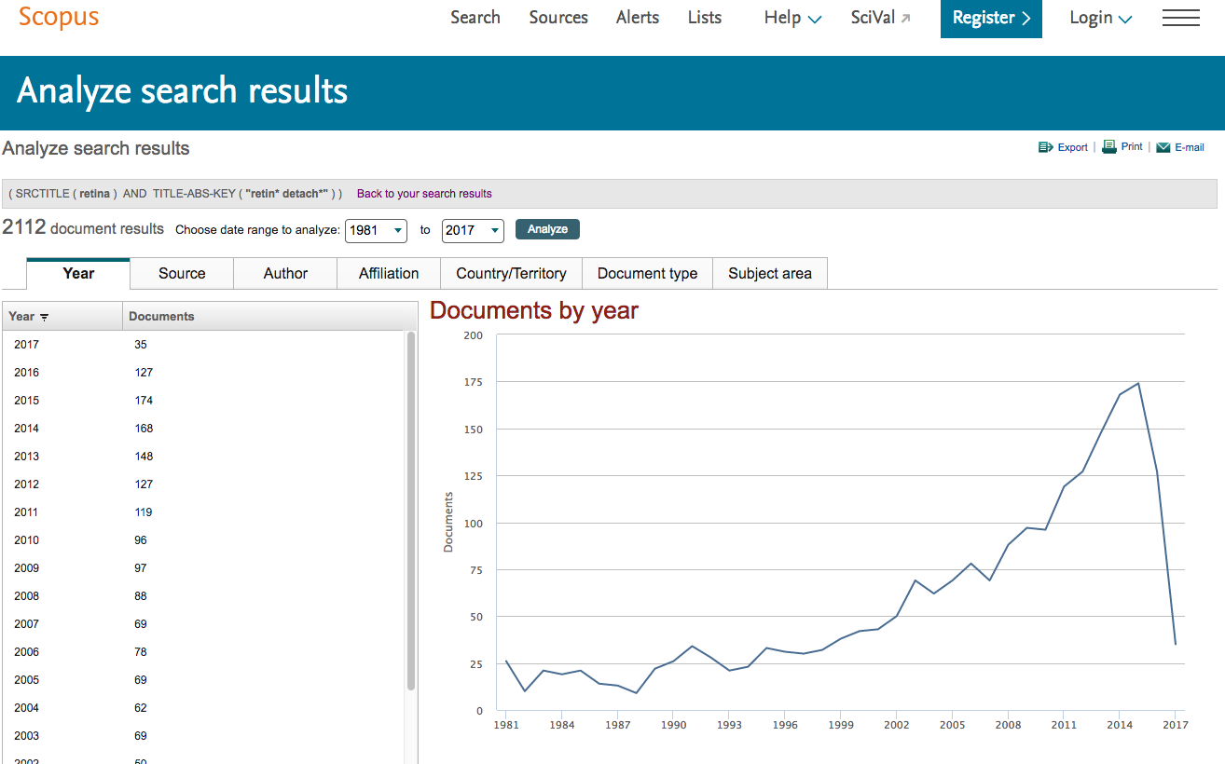

Slide 27
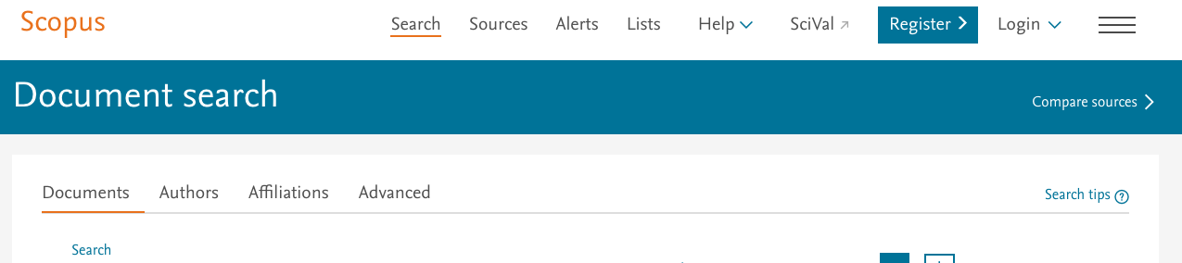
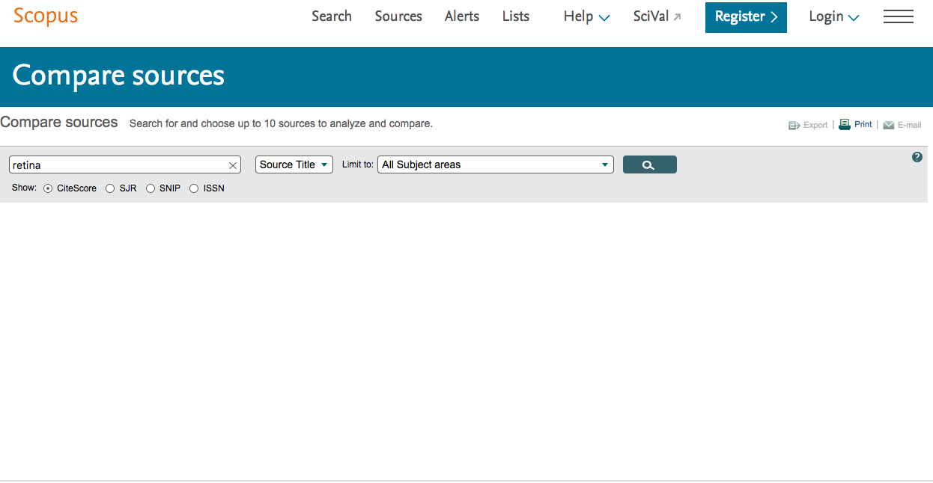

Slide 28
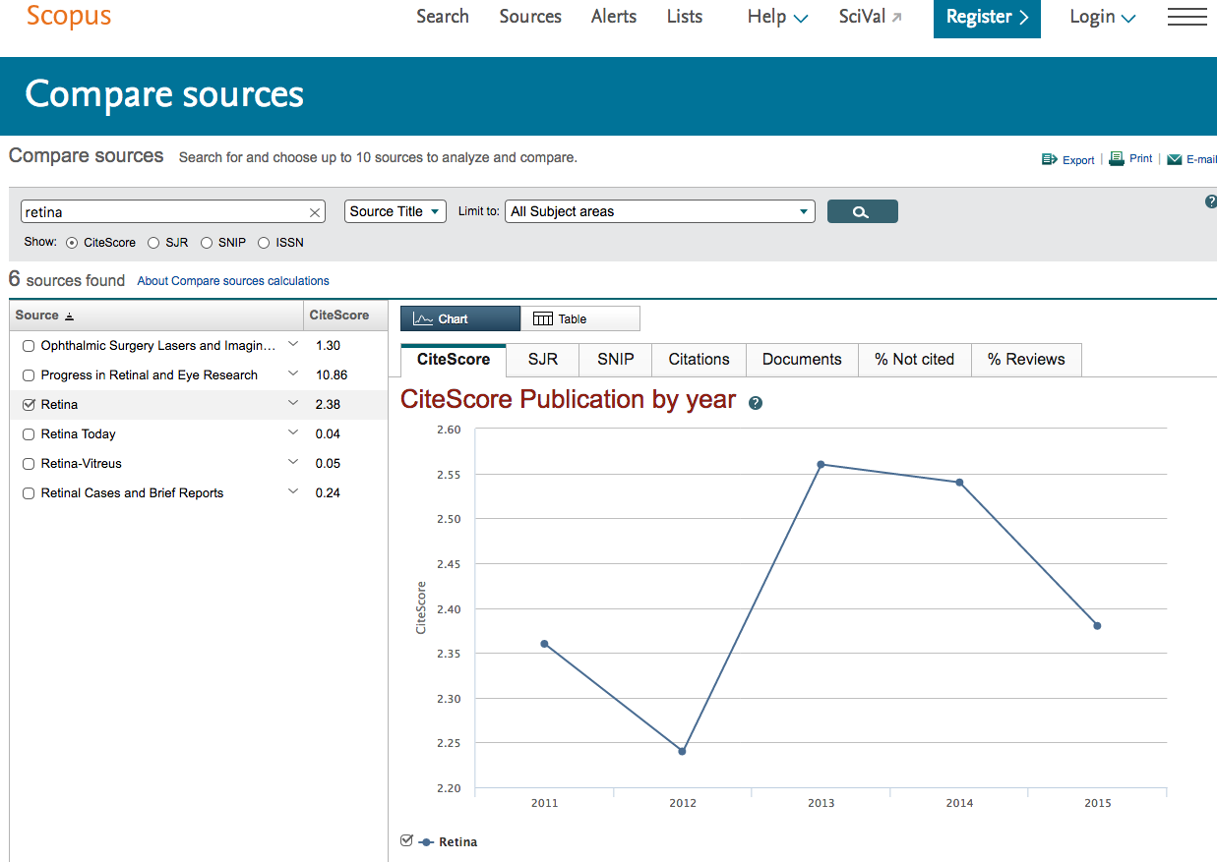
CiteScore, SJR, SNIP
All different ways to determine impact factors
scopus

Slide 29

Protection
Beall’s list – Wayback Machine
Indexed in
  PubMed
  Scopus
  Other valid databases
Ask a Librarian

Slide 30
Blobaum's checklist
Bonus Slide 1
Submissions for 2013
Blobaum, Paul M., "Blobaum’s Checklist for Review of Journal Quality for Submission of Scholarly Manuscripts" (2013). Faculty Research and Creative Activity. 27.
http://opus.govst.edu/faculty/27

Slide 31
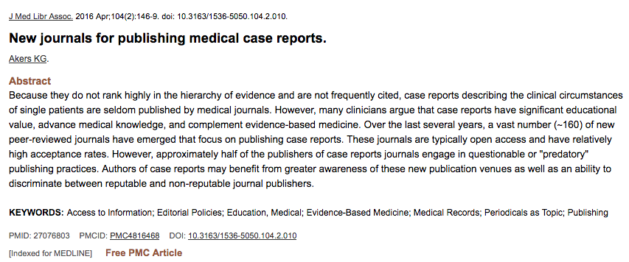

Bonus Slide 2

Slide 32
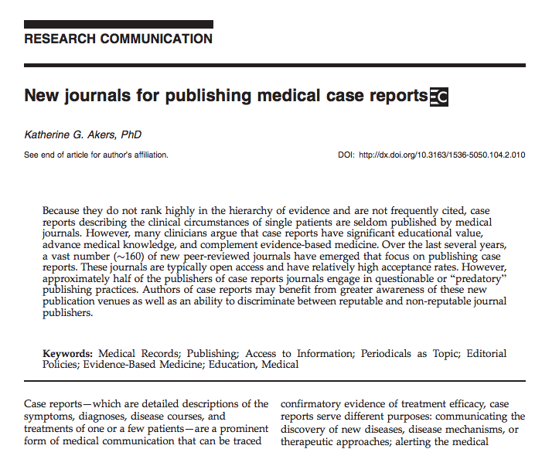
Will need to follow a few links to get to…

Slide 33
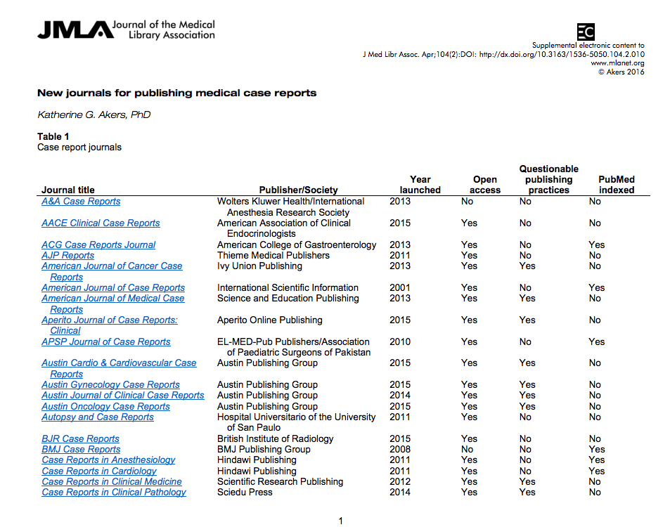

Slide 34
???????s
Thank you!
Ask A Librarian

