Slide 1
Welcome
Information Resources for Physical Therapy
Presenters:
Peggy Edwards and
Margaret Vugrin
from Preston Smith Library
June 2012

Slide 2
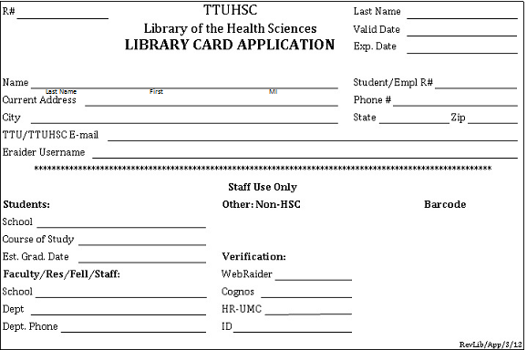
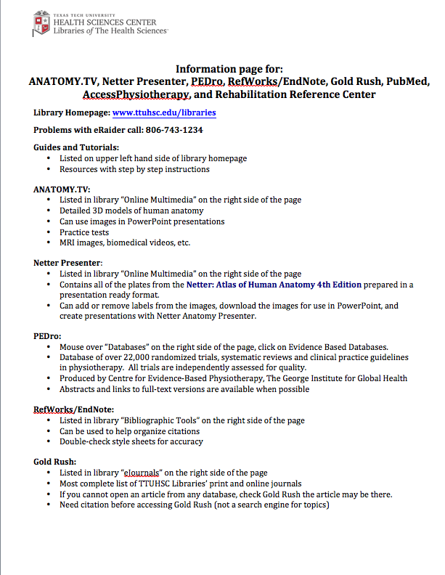
You Should Have
Library Card Application
Resource Information Page

Slide 3
Library Card Applications
Please fill out this information so we can
put you in the system.
Tear tan card off and keep – library card!
Sign back of white application card
Pass white card back in

Slide 4
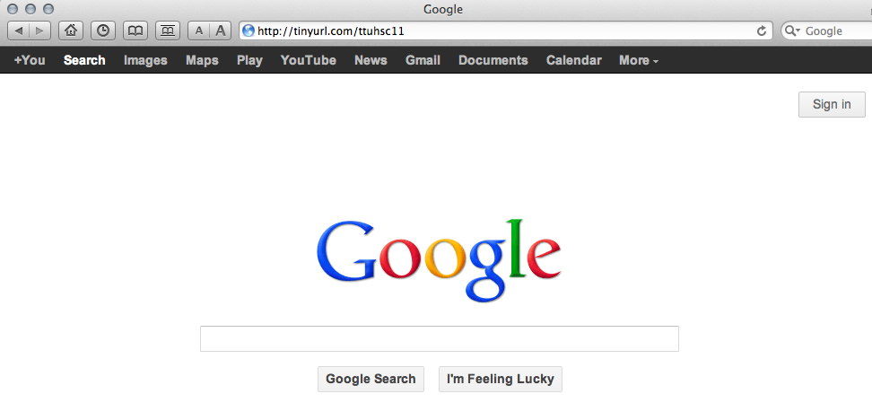
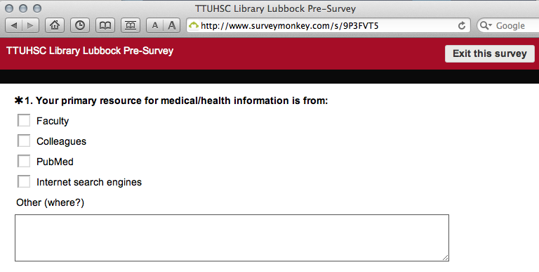
Pre-Survey
Go to http://tinyurl.com/ttuhsc11
Fill out survey

Slide 5
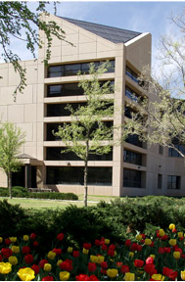
Welcome!
Preston Smith Library
located west of ACB

Slide 6
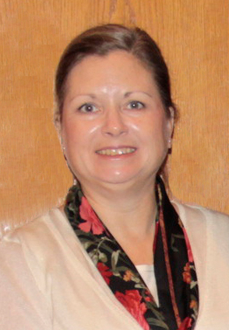

Reference Librarians - Lubbock
Carrie
Gassett
Peggy
Edwards
Available 8–5
Monday–Friday
Dawn
Kruse
Margaret
Vugrin

Slide 7
Hours:
Mon - Thurs: 7:30 am – 12:00 am
Sat: 9:00 am – 10:00 pm
Fri: 7:30 am – 10:00 am
Sun: 1:00 pm – 12:00 am
Circulation:
books – 2 weeks, 2 renewals
Fines:
pay cash or check at circulation desk
  $.50 cents per day per item
  3 day grace period
Library Cards:
Need for checking out materials,
and to use the Learning Resource Center computers

Slide 8
Group Study Rooms:
28 rooms
Learning Resource Center:
55 computers
Interlibrary Loans:
pick up and pay for at circulation desk
Printing Charges:
new students: one time $5.00 credit on their Papercut account to print in house
    $.10 cents a page self–service
    $.25 cents a page staff service
    $.50 cents a page rush staff service
Food and Drink Allowed:
microwave on 3rd floor

Slide 9
Agenda
1:00 – 1:05 Pre-survey
1:05 – 1:45 Peggy Welcome to the Library
ANATOMY.TV, Netter Presenter
PubMed’s Clinical Queries
PEDro
Mobile Resources
Practice Exercise
1:45 – 1:50 Break
1:50 – 2:55 Margaret AccessPhysiotherapy
Rehabilitation Reference Center
Gold Rush
Practice Exercises
Free Practice with Q&A
2:55 – 3:00 Evaluations

Slide 10
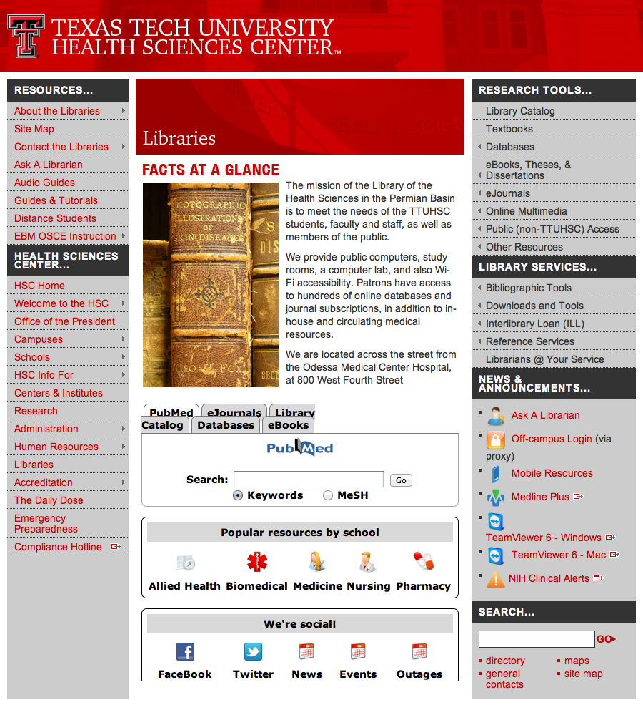

Library home page at www.ttuhsc.edu/libraries

Slide 11
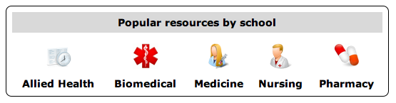
Popular Resources
Click
Allied Health

Slide 12
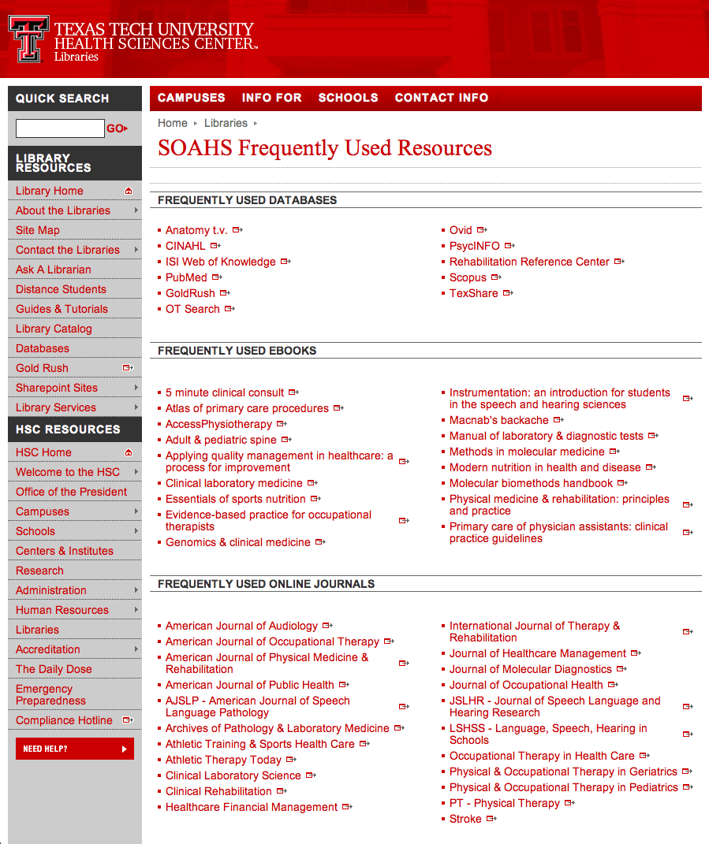

Slide 13
Library Catalog - Koha
Click

Slide 14
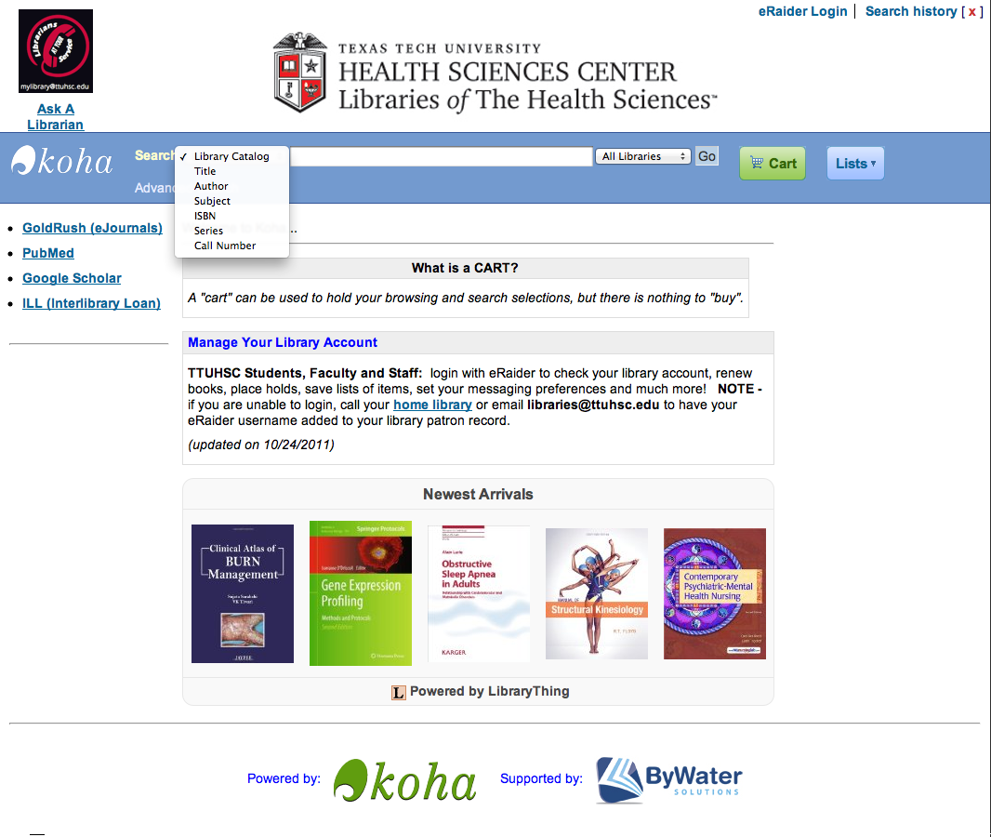
Basic Search Screen
Click Advanced
New Books

Slide 15
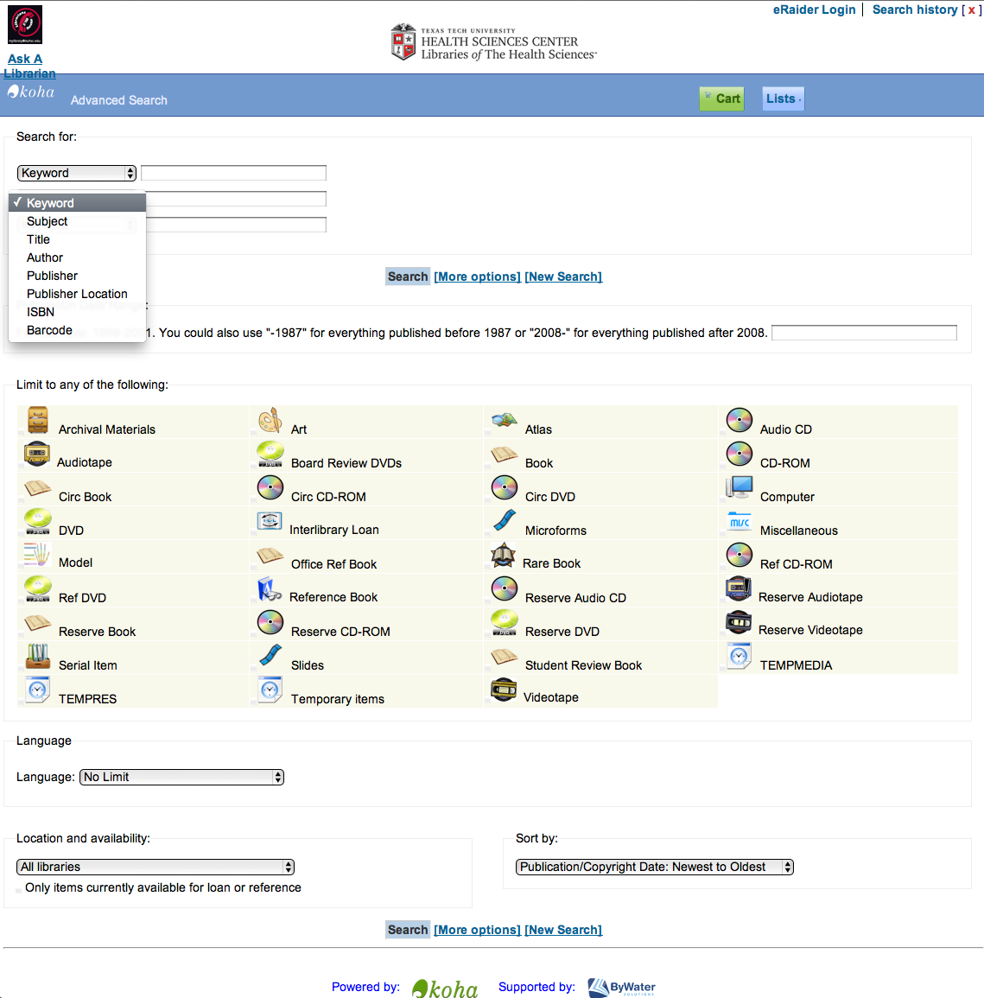
Variety of
search options

Slide 16
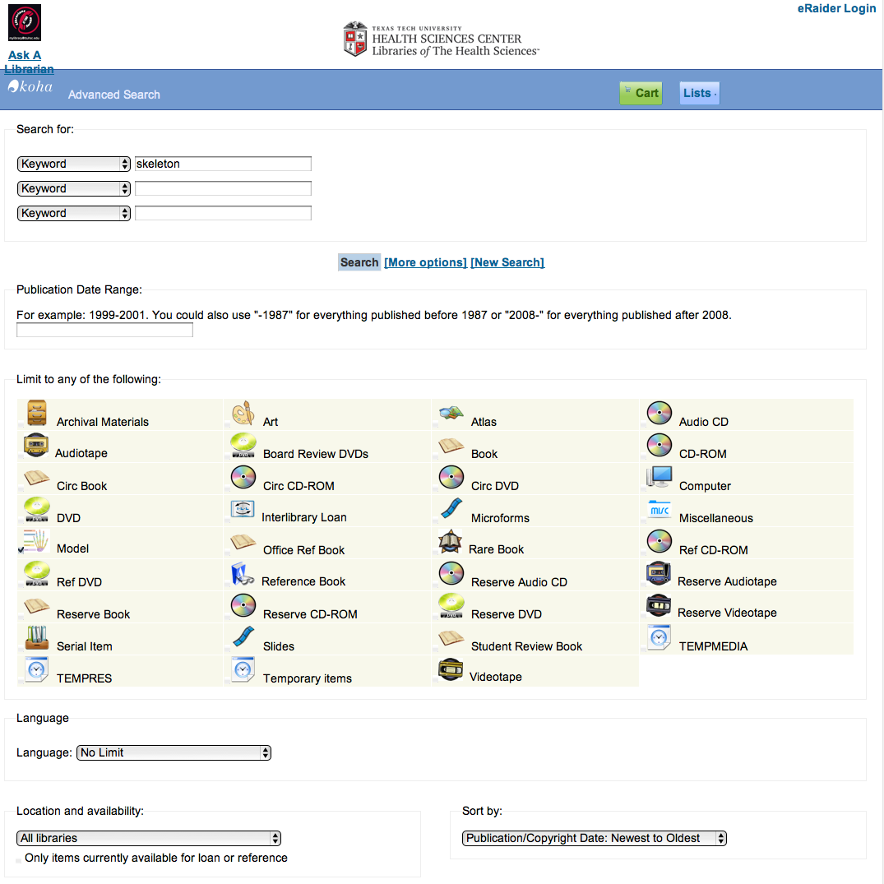
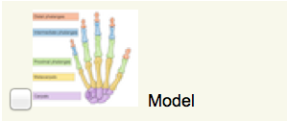
Search for skeleton models
skeleton
✓

Slide 17
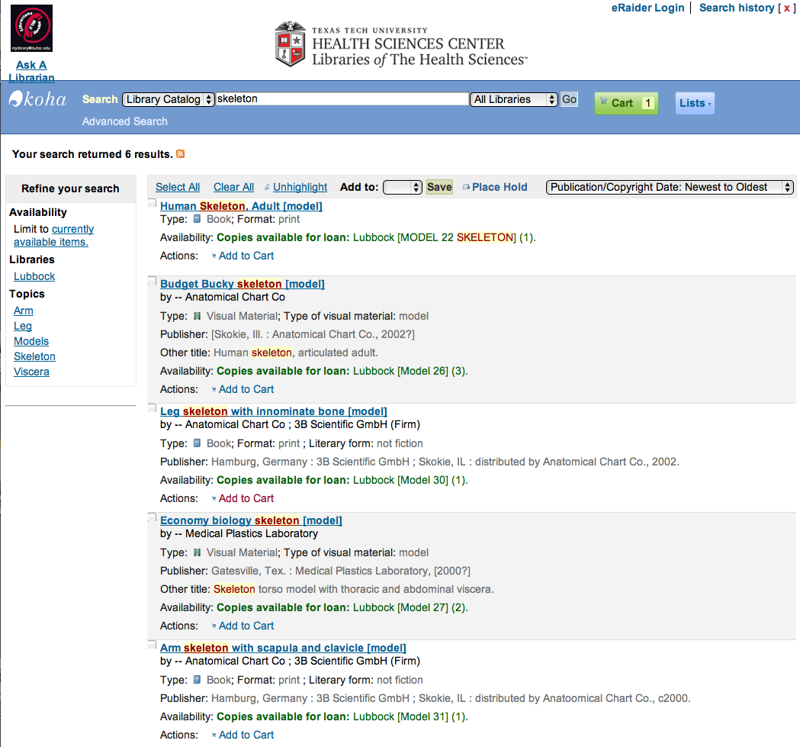
Results
Click Cart
Click Add to Cart

Slide 18
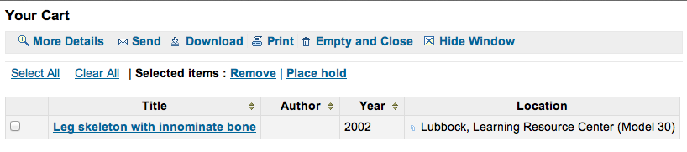
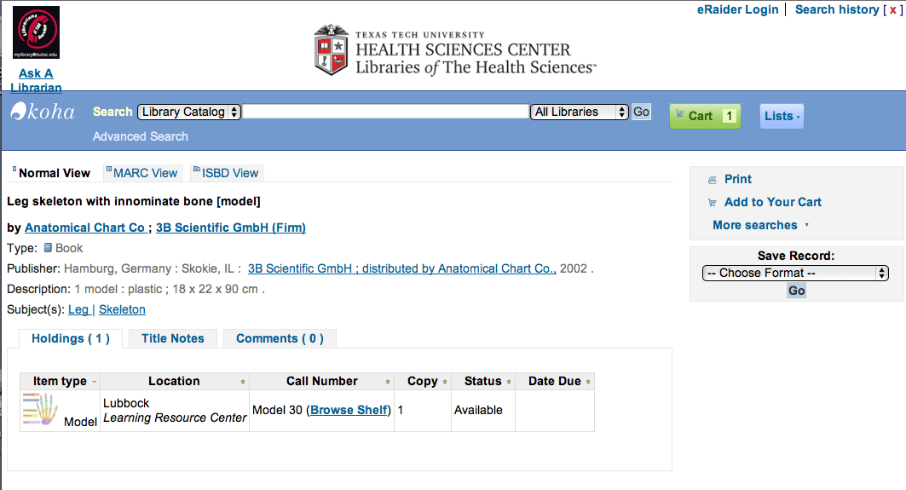
Click Title

Slide 19
Interlibrary Loan
Click

Slide 20
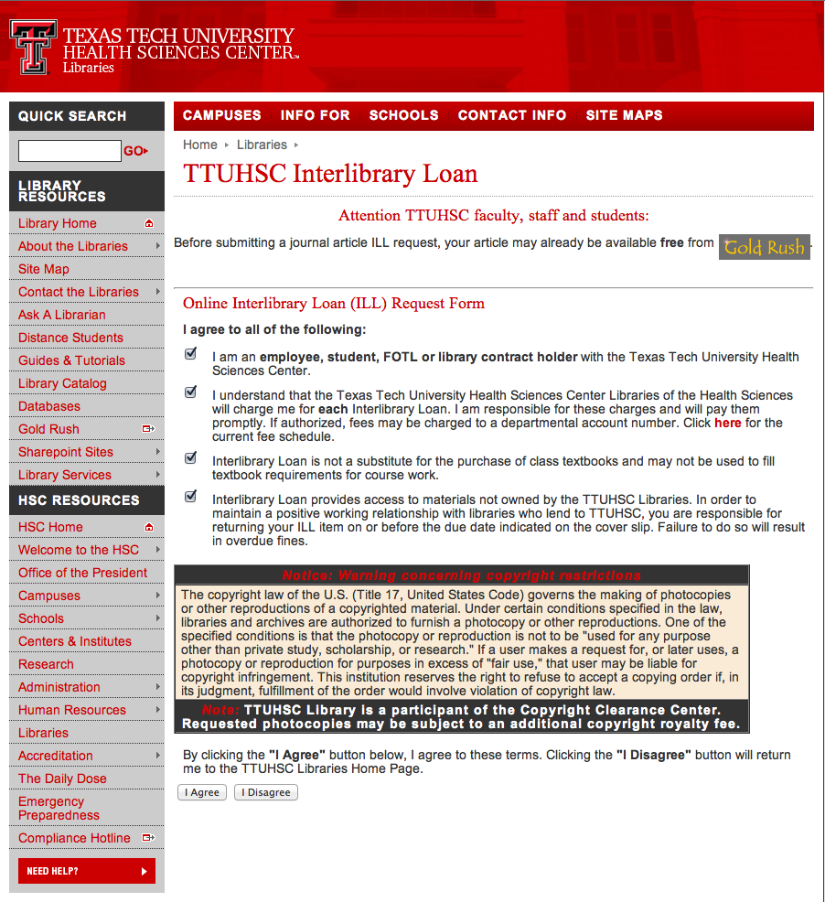
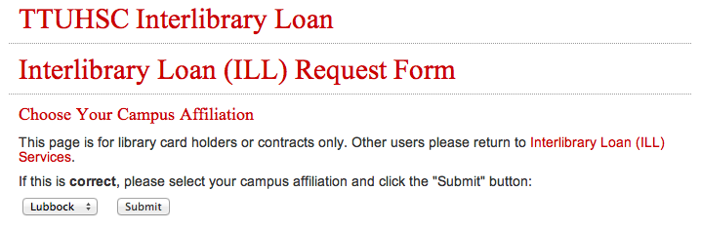
Click I Agree
Campus
Submit

Slide 21
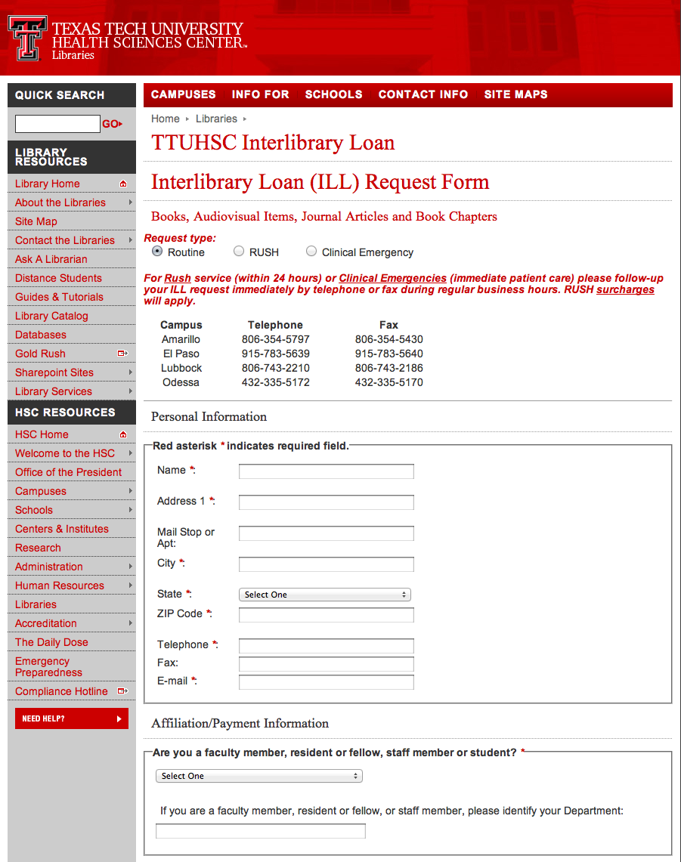
Borrowed within TTUHSC system
Books: free
Book arrives with return label
Articles: 25 cents/page
1-5 business days
Rush articles: 50 cents/page
Fill out form
Borrowed outside TTUHSC
Books: $4.00
Articles: $4.00
4-10 business days
Rush articles: $10.00

Slide 22

ANATOMY.TV
Hover over
Online Multimedia
Click

Slide 23
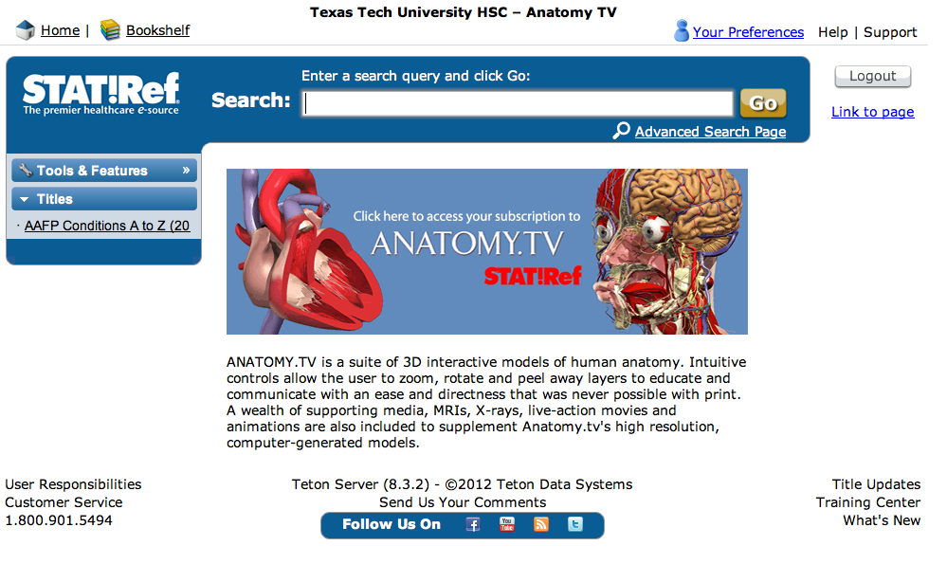
Click

Slide 24
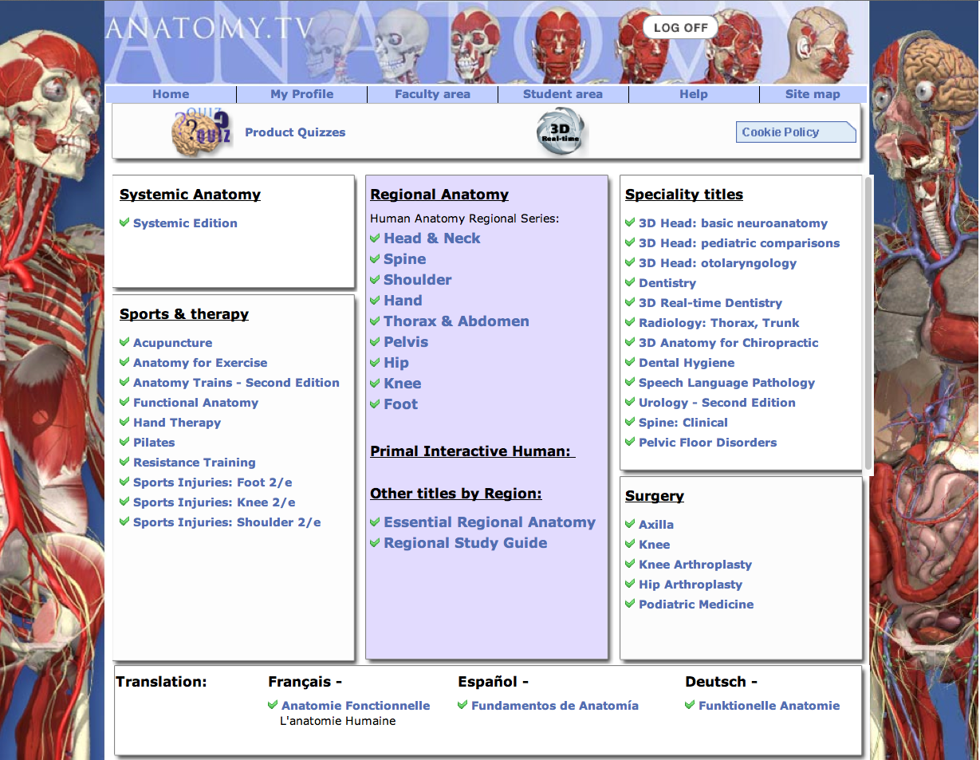
Select Region

Slide 25
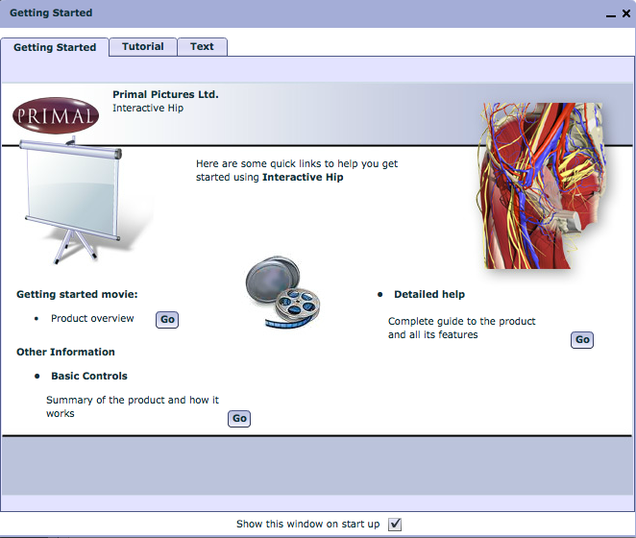
Great Tutorial –
view on own time
Close Screen

Slide 26
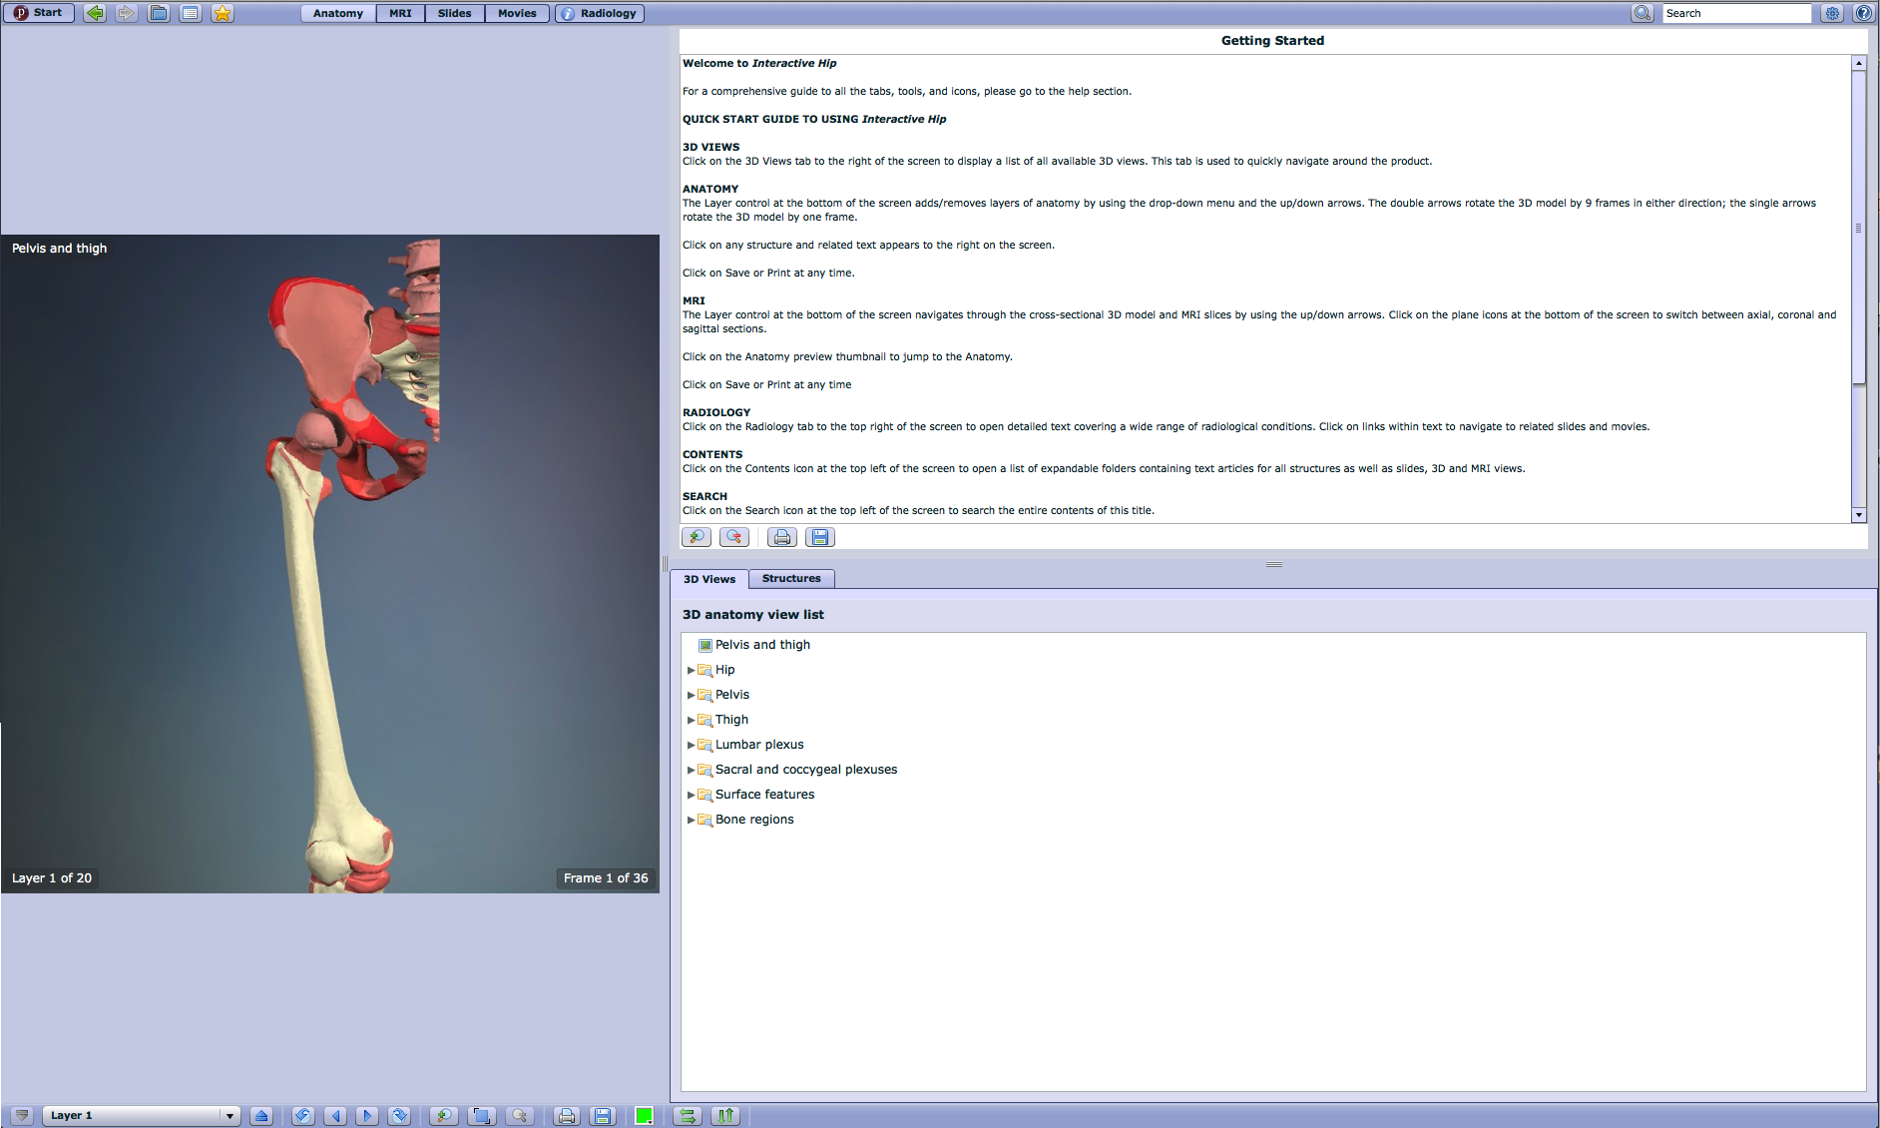
Layer 1
Select Layer 10

Slide 27
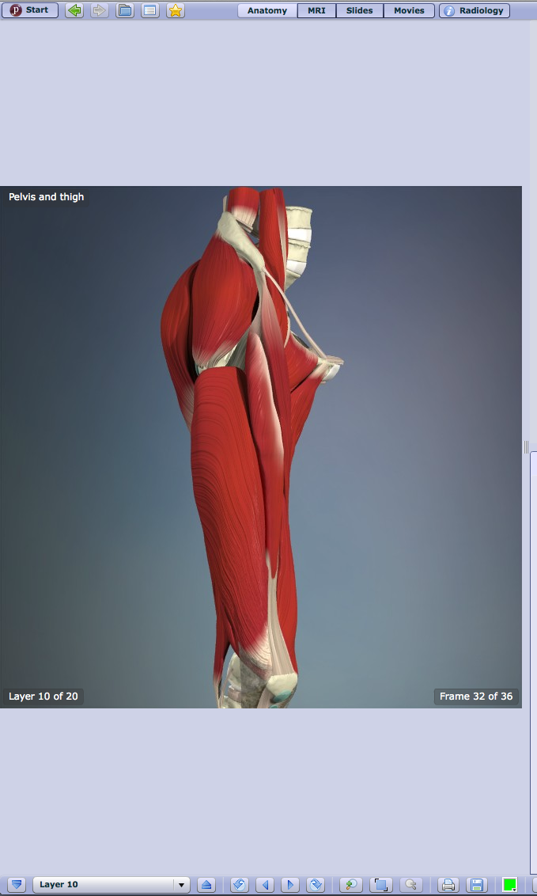
Click arrows
to rotate

Slide 28
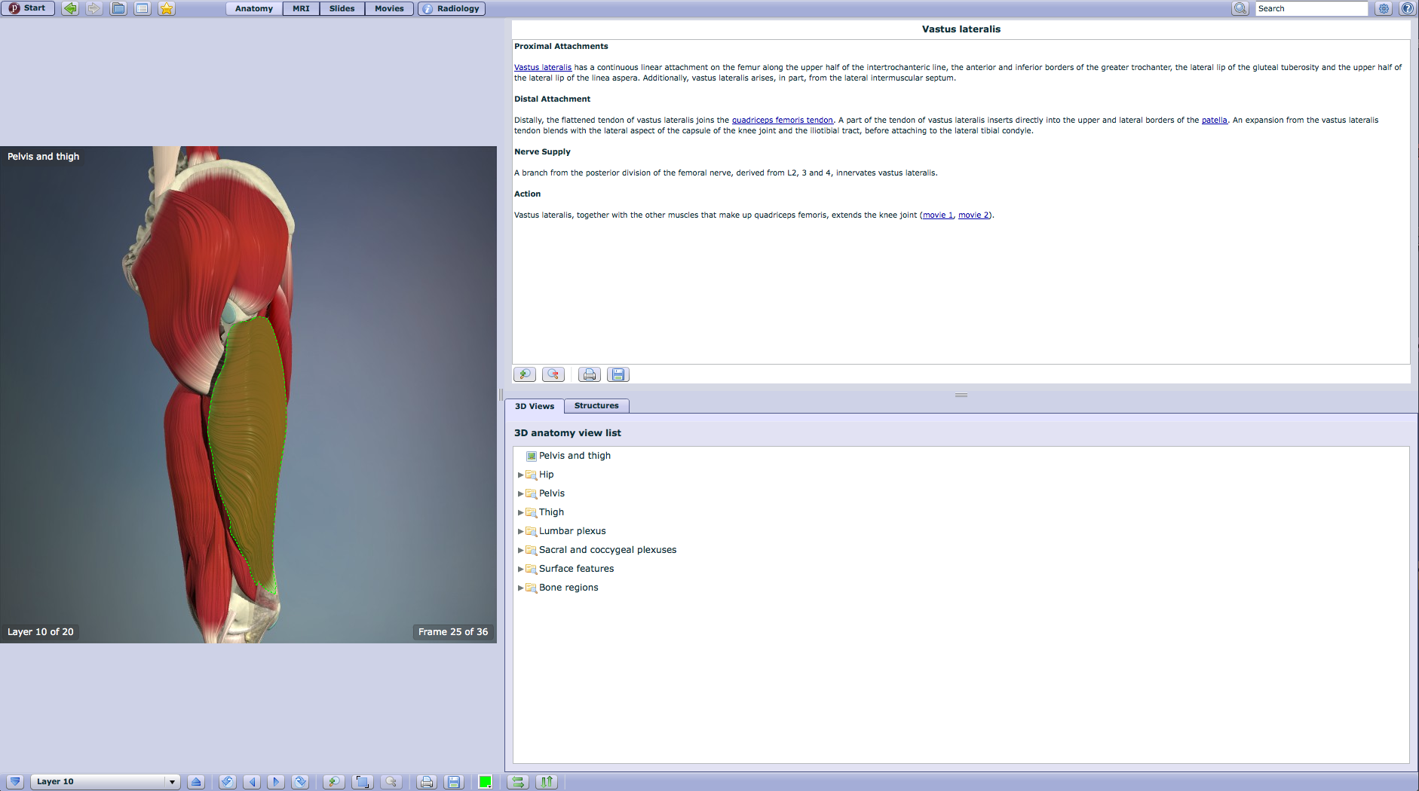
Structure name
and description
Click a
structure

Slide 29
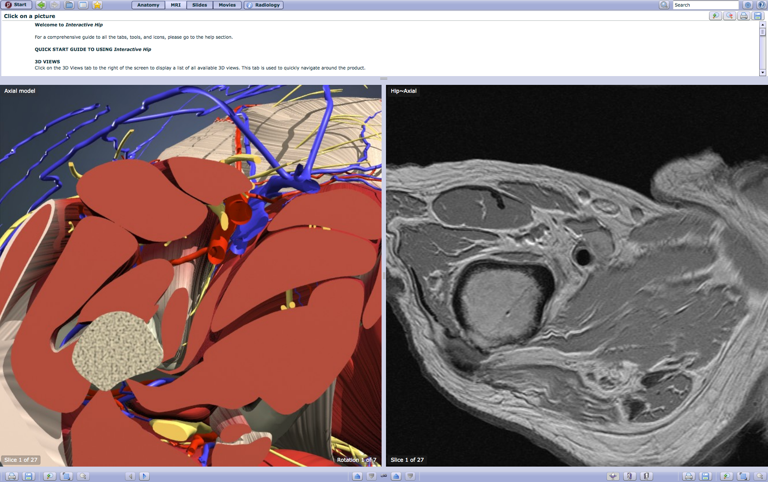
Click MRI

Slide 30
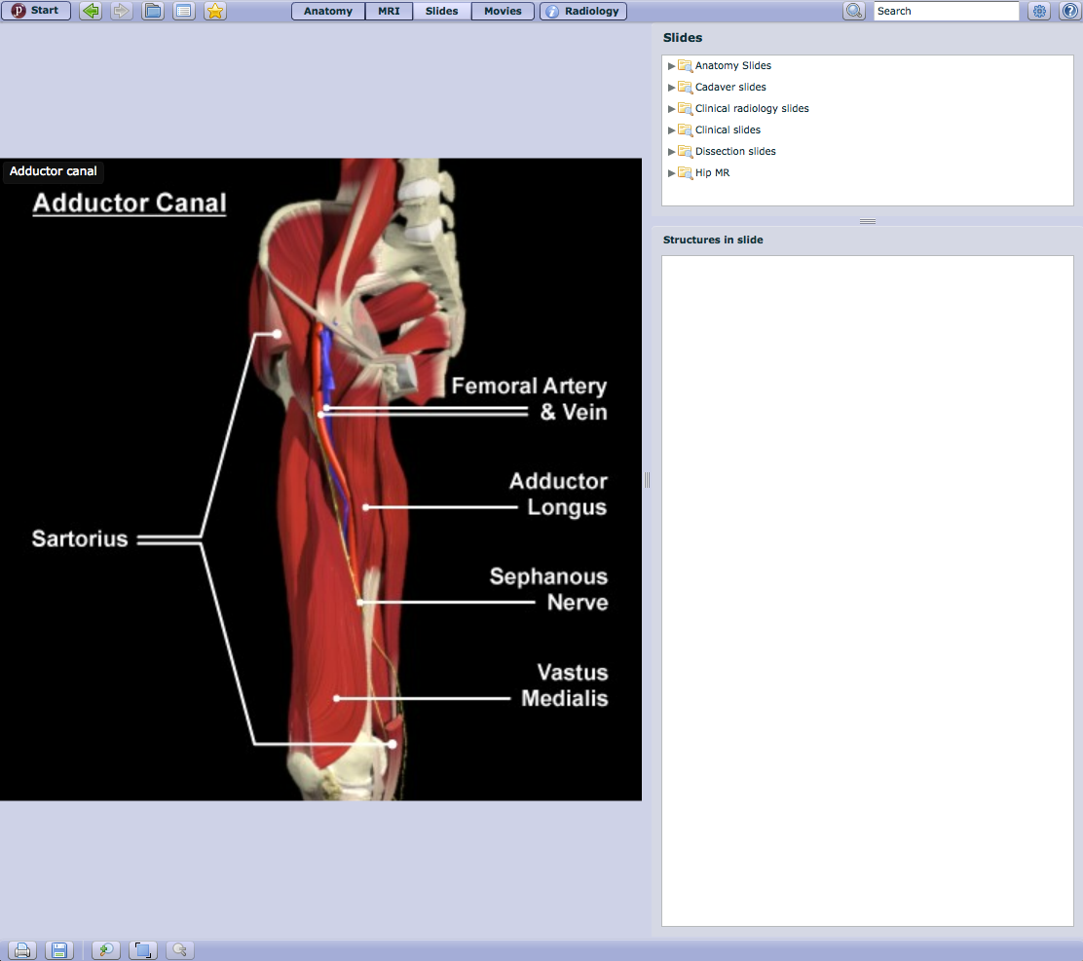
Click Slides

Slide 31
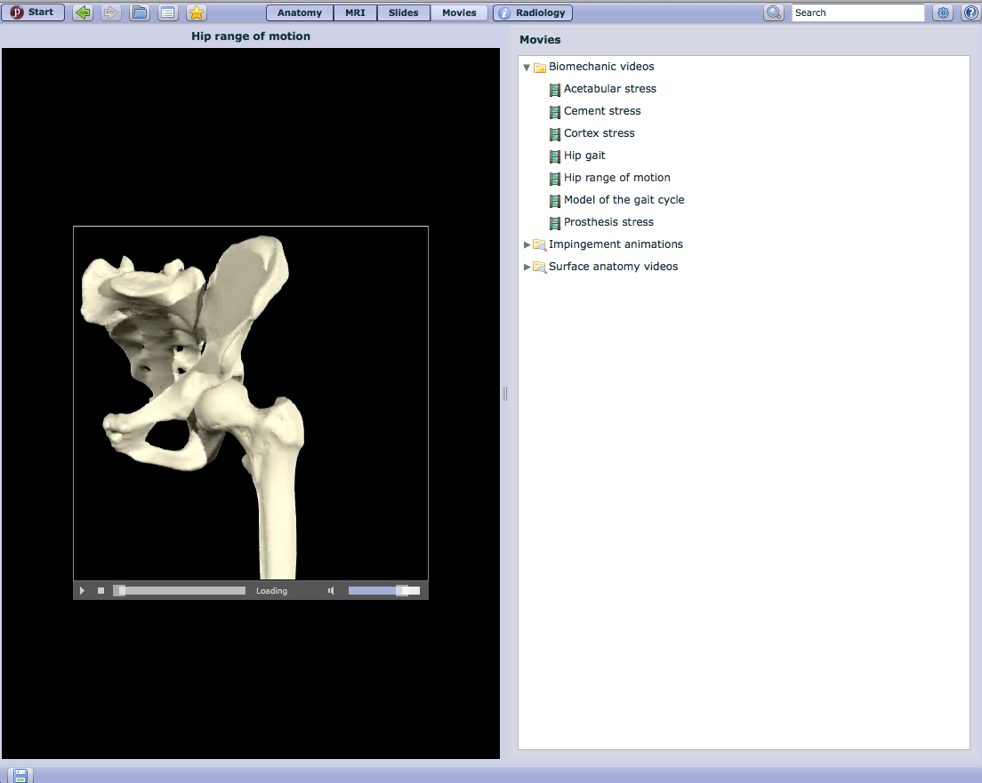
Click Movies

Slide 32
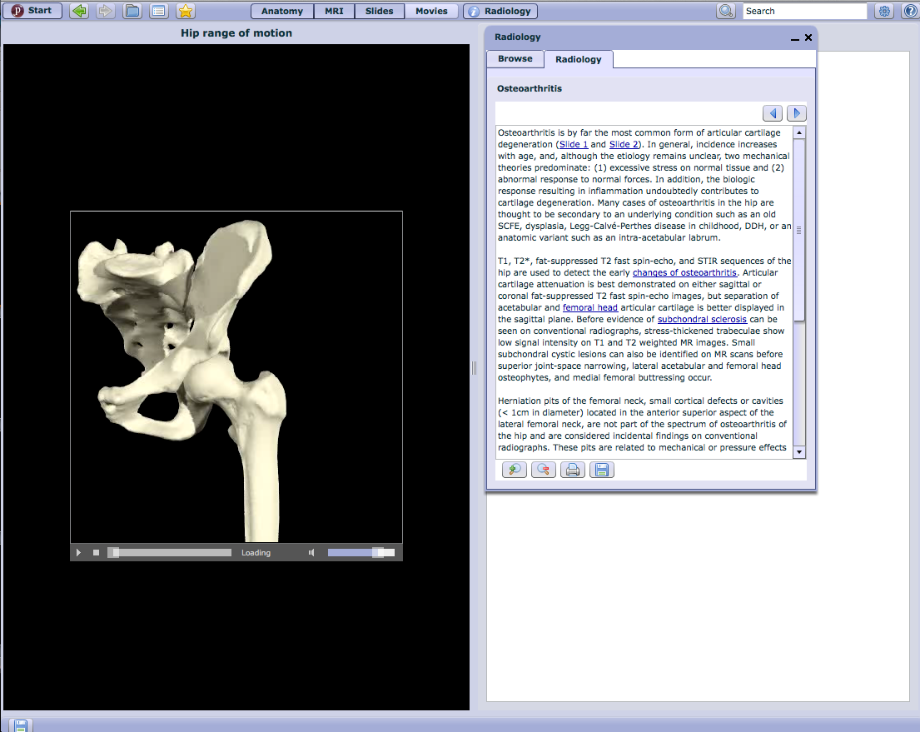
Click Radiology

Slide 33
Click Product Quizzes

Slide 34
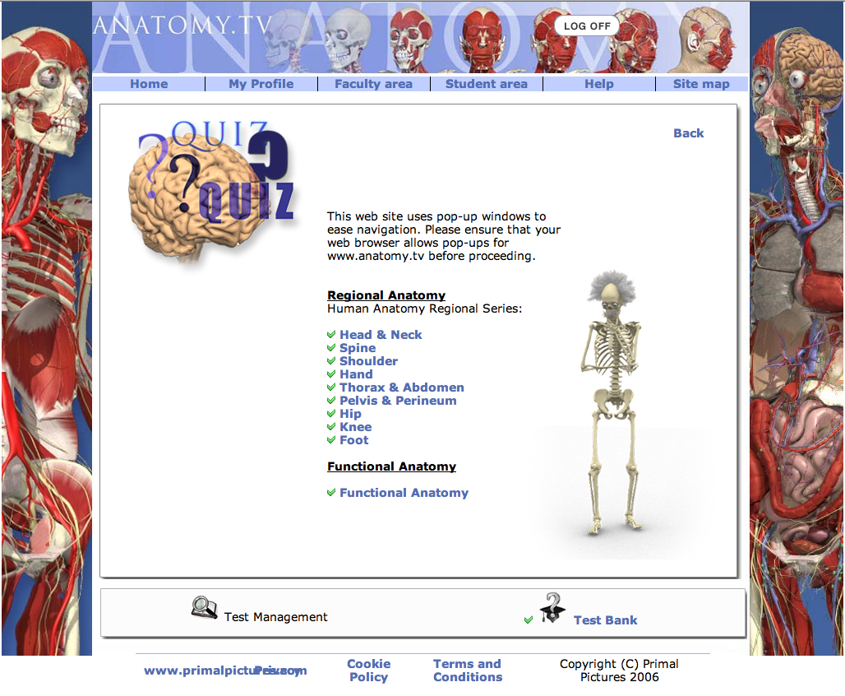

Slide 35
Netter Presenter
Hover over
Online Multimedia
Click

Slide 36
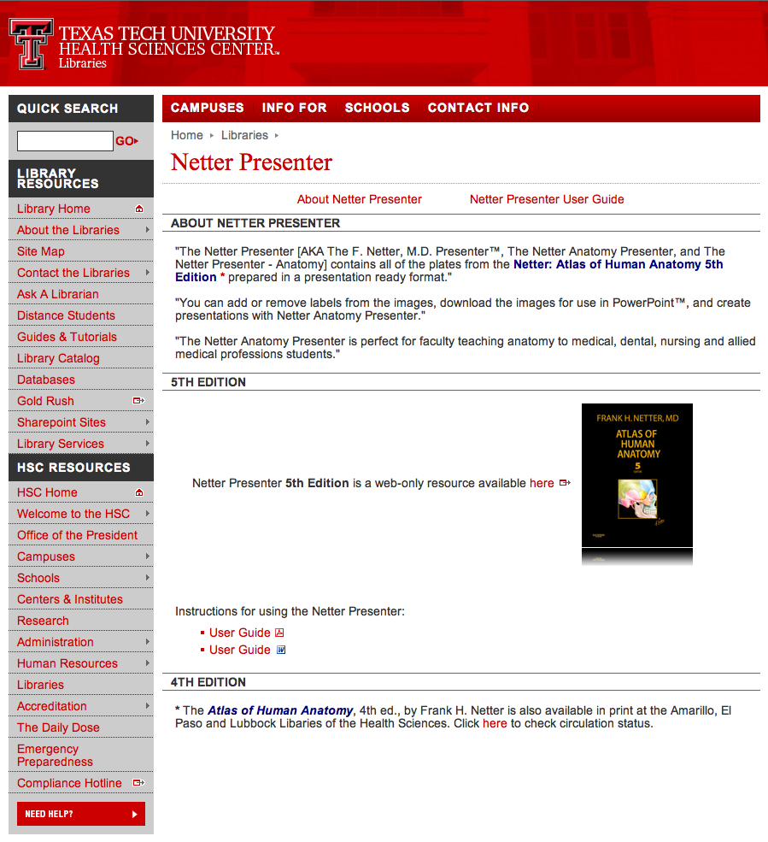
Click

Slide 37
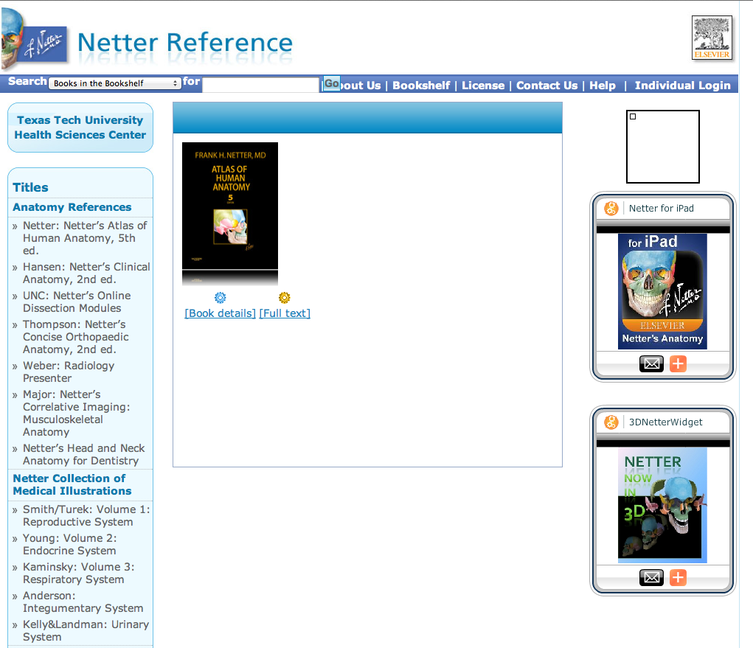
Click

Slide 38
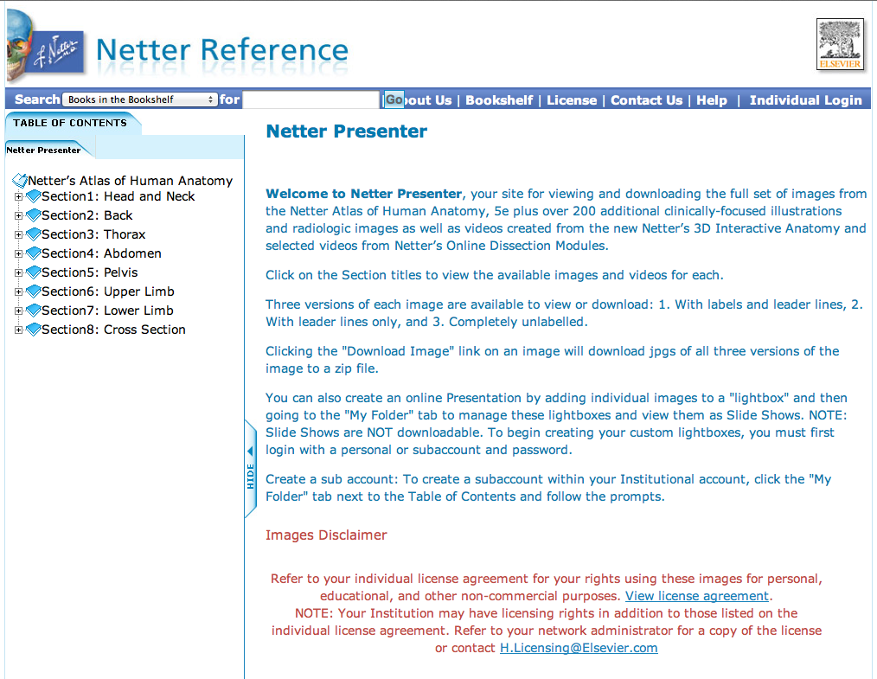
Instructions
Click Upper Limb

Slide 39
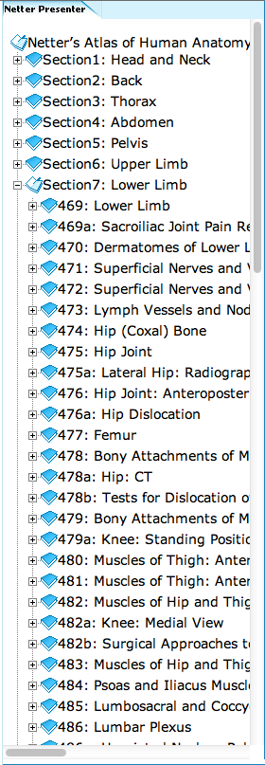
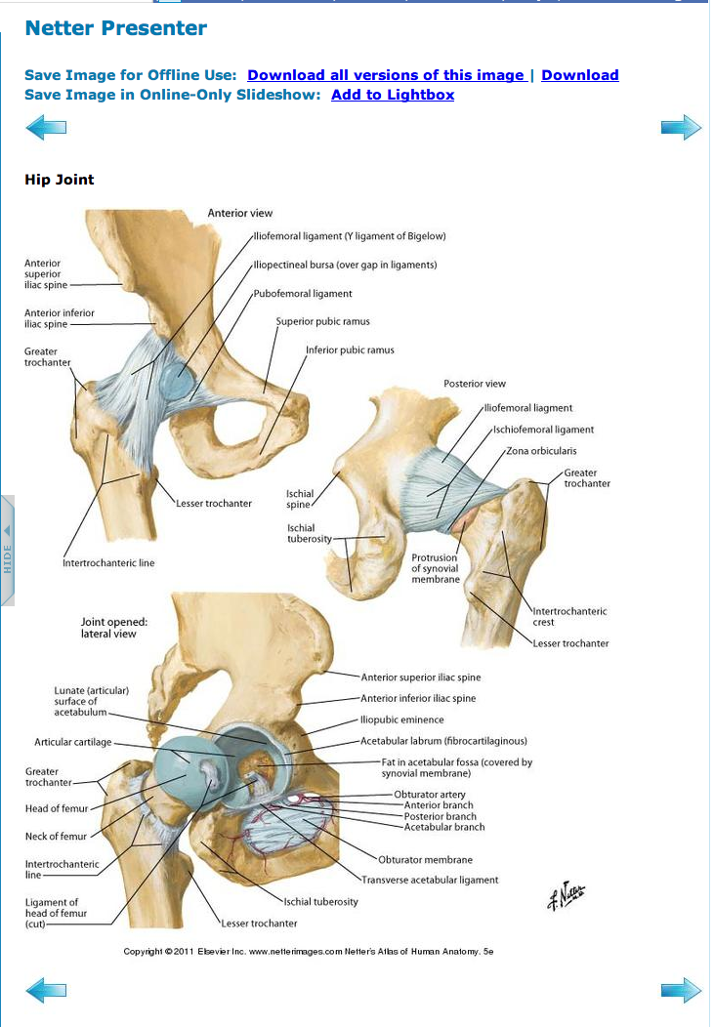
Hip Joint

Slide 40


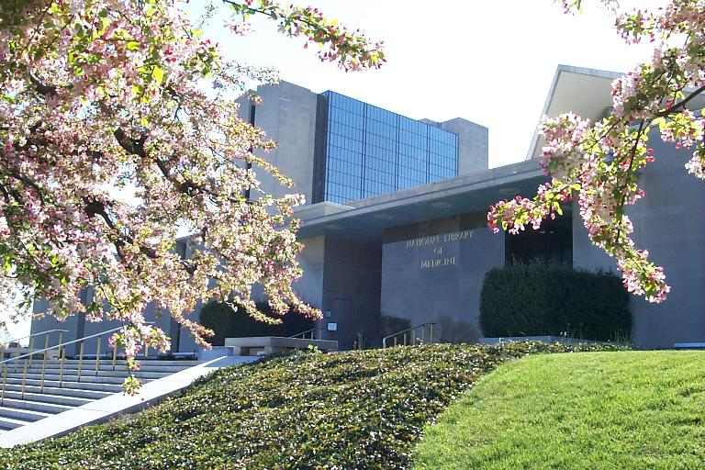
PubMed Database
Biomedical journal literature
International scope
Published by:
The National Library of Medicine

Slide 41

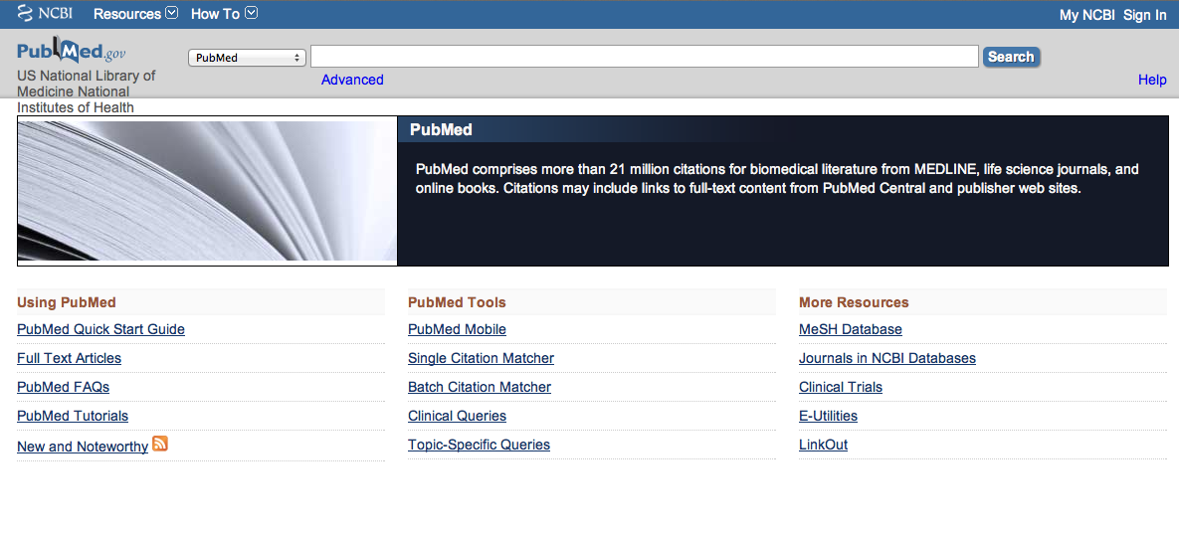
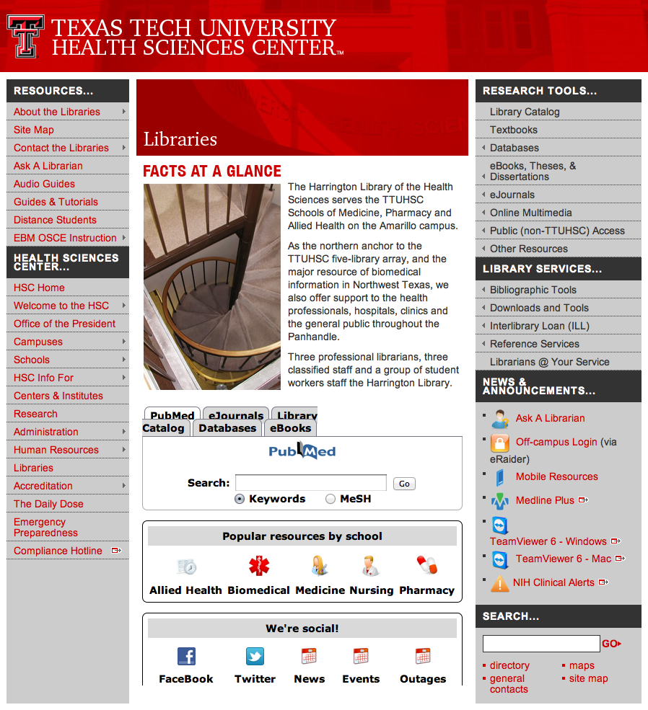
Accessing PubMed
Freely available over the Internet
@ www.pubmed.gov
Also through library’s home page

Slide 42


Evidence-Based Practice is guided by thoughtful integration
of the best available scientific knowledge with clinical expertise.

Slide 43
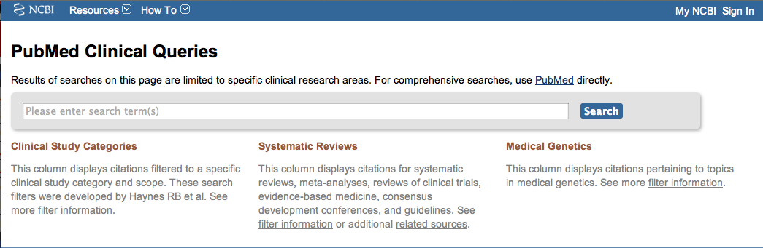
PubMed’s Clinical Queries
tool that searches for evidence-based literature

Slide 44

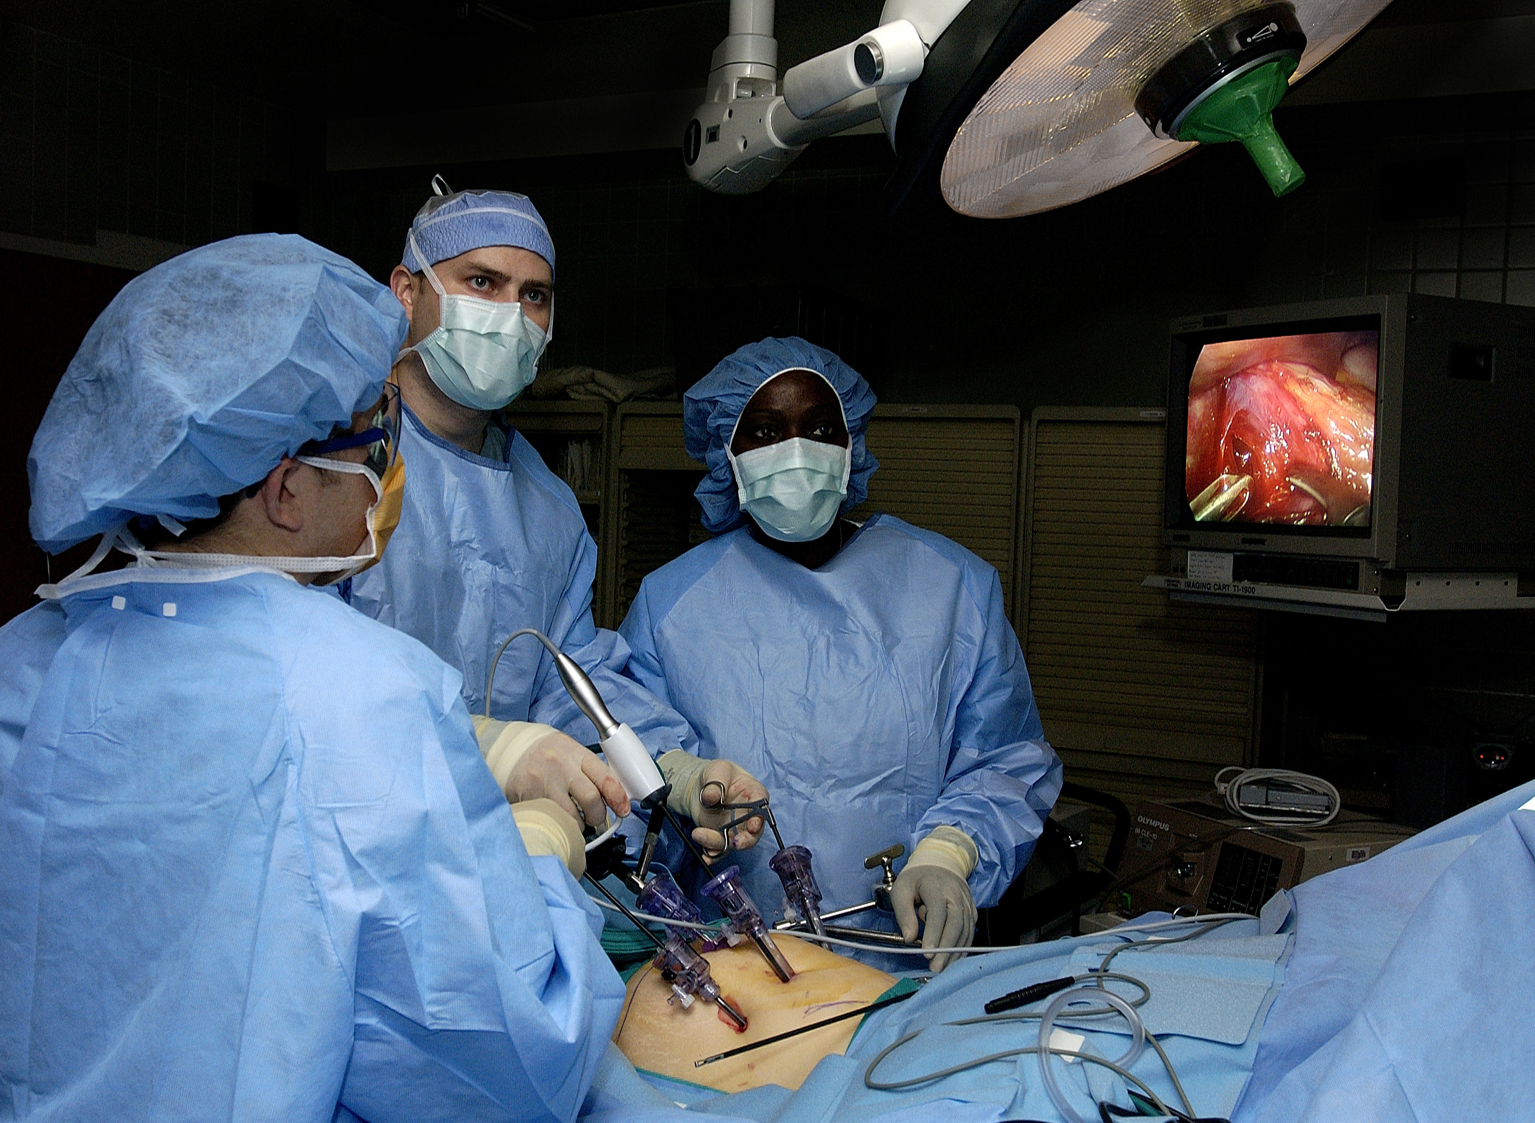
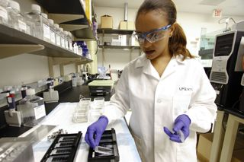
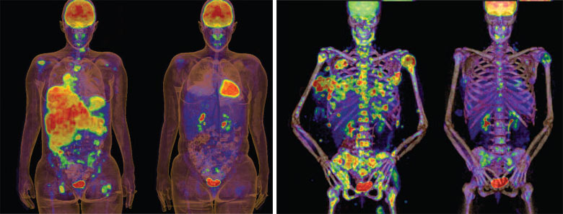
Clinical Queries Searchable by:
Diagnosis
Therapy
Prognosis (prediction of probable outcome)
Etiology (cause)

Slide 45
Clinical Queries Searchable by:
Diagnosis
Therapy
Prognosis (prediction of probable outcome)
Etiology (cause)

Slide 46
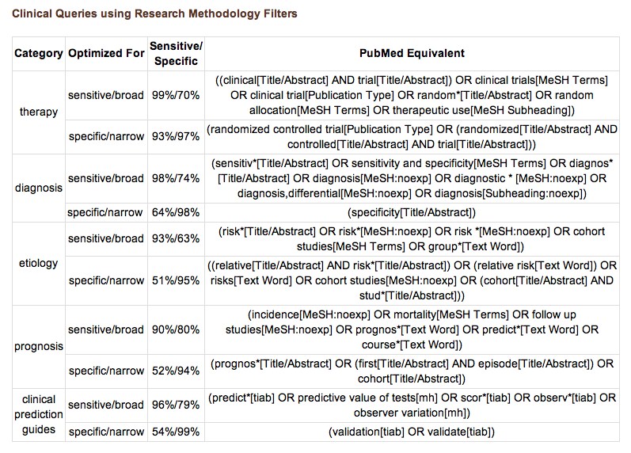
PubMed’s Clinical Queries
uses pre-formulated search strategies with a keyword search

Slide 47
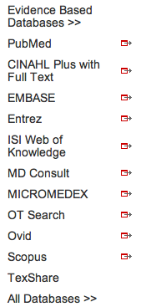
Mouse over Databases
Click PubMed

Slide 48
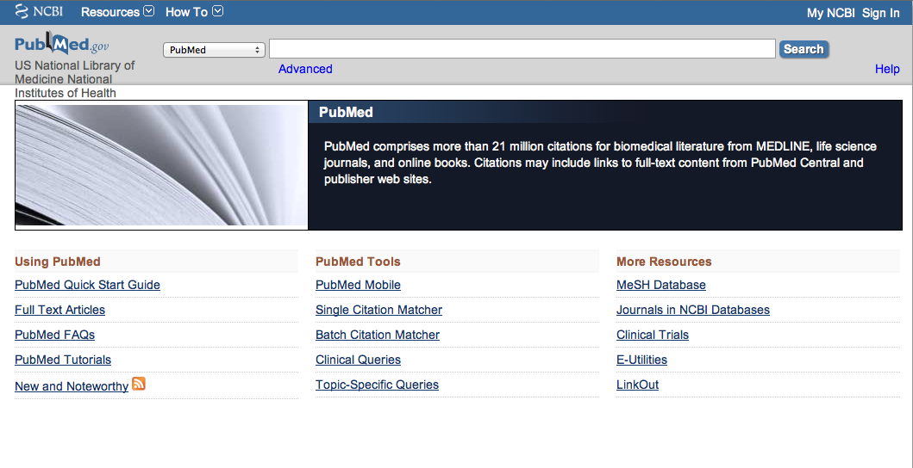
Click Clinical Queries

Slide 49
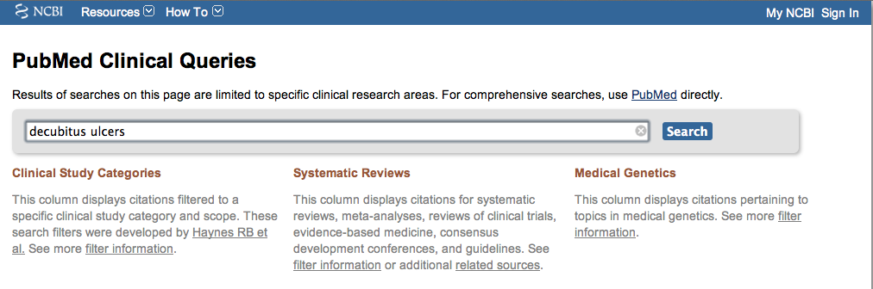
Enter decubitus ulcers
Click
Search

Slide 50
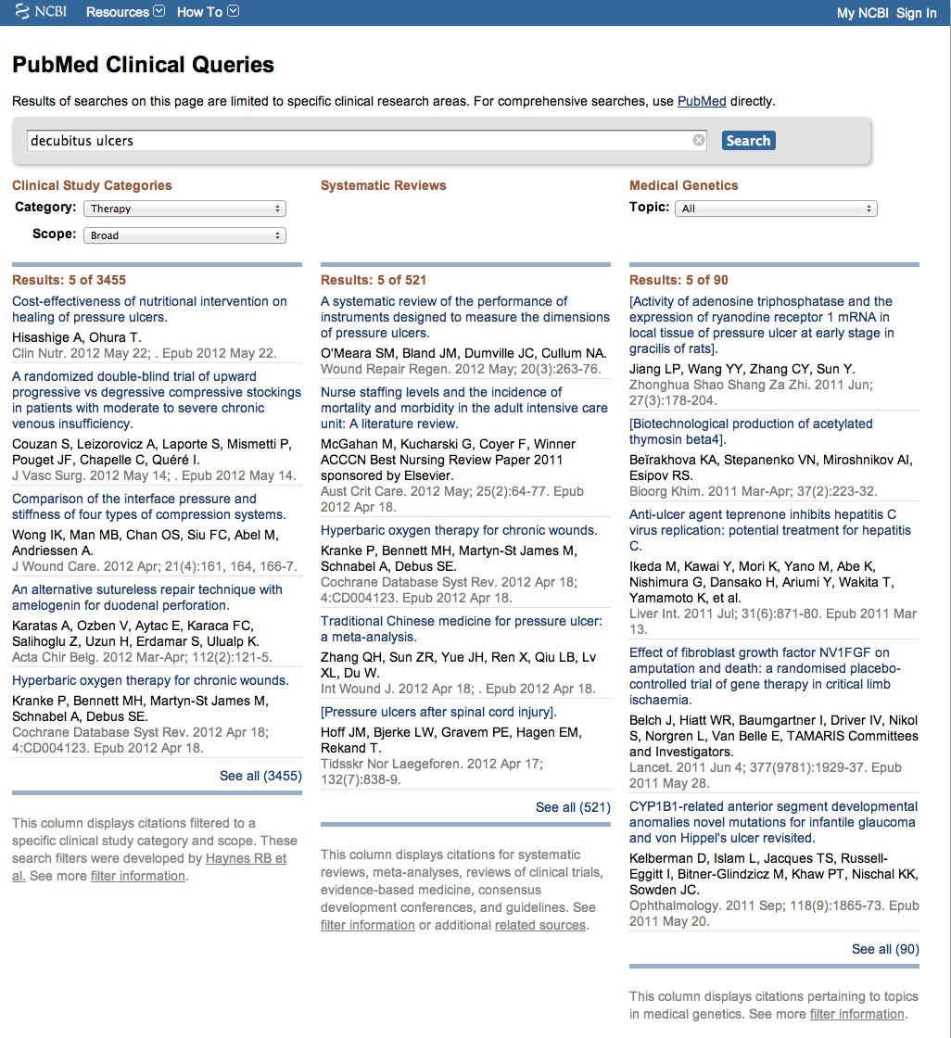
Results for Therapy and
Broad Scope
Change to Narrow Scope

Slide 51
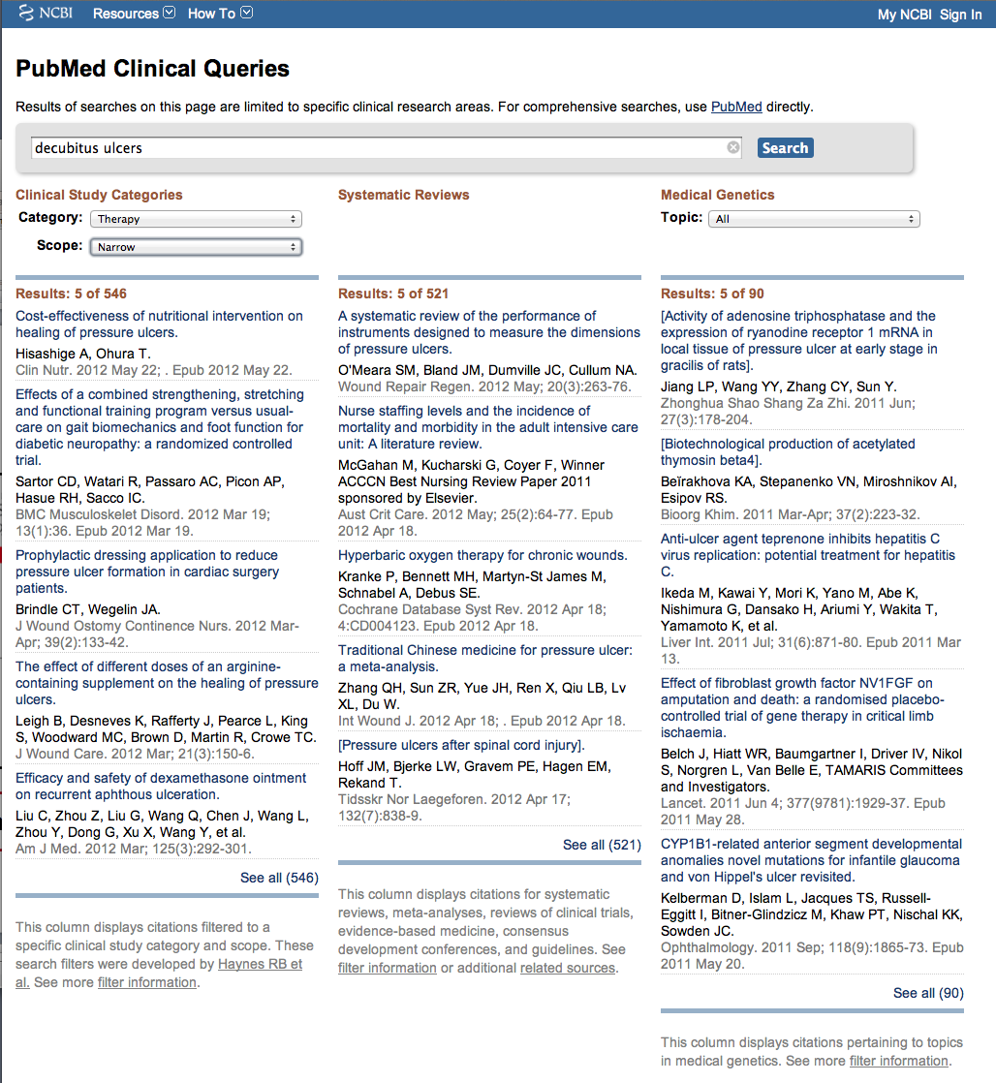
Results for Therapy and
Narrow Scope
Click See all (546)

Slide 52
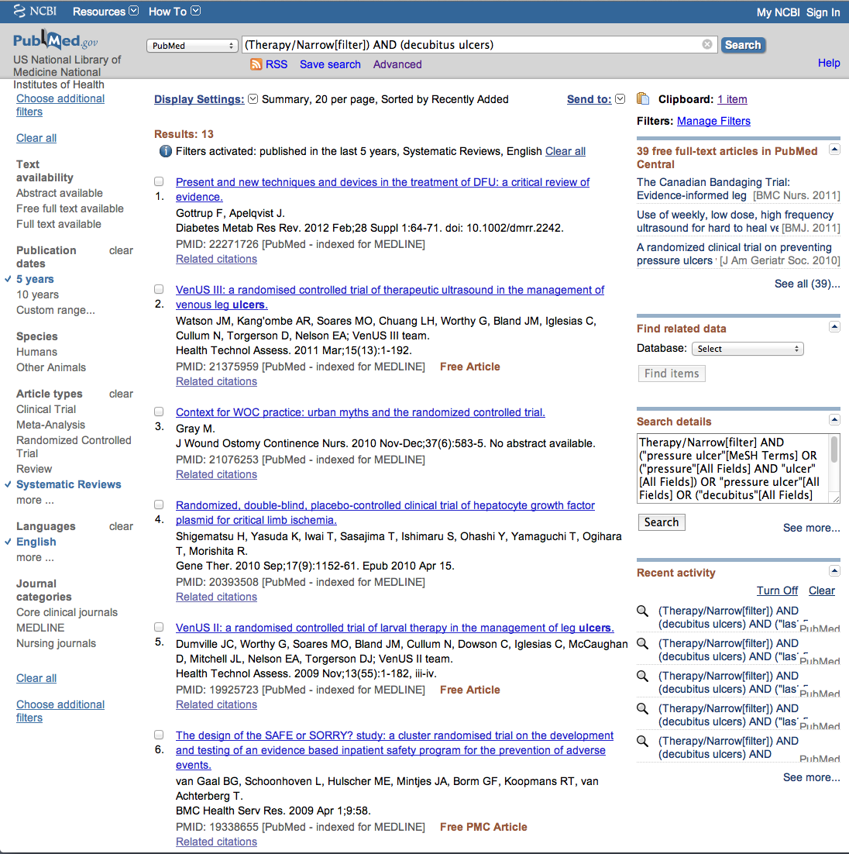
Select Limits

Slide 53
Click box(es) next to article(s) you wish to read

Slide 54
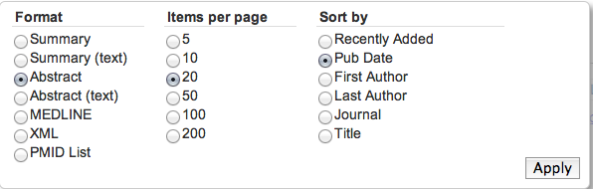
Click Display Settings
Select Abstract, Publication Date, and click Apply

Slide 55

Click for Full Text

Slide 56

TTUHSC Libraries - Proxy Server
When Searching from Off Campus:
Enter the
Eraider username and password
assigned to you
by Information Services.

Slide 57

Full Text

Slide 58
Problems with your eRaider?
Enter the
Eraider username and password
assigned to you
by Information Services.
A
Problems with eRaider call:
806-743-2870
or
806-743-2875
a

Slide 59


PEDro
Randomized Controlled Trials
Systematic Reviews
Practice Guidelines
Independently assessed quality ratings

Slide 60

Mouse Over Databases
Click
Evidence Based Databases

Slide 61

Click PEDro

Slide 62

Click Advanced Search

Slide 63

Key Word Search
Enter Words You Want in Titles and Abstracts

Slide 64

Search Options
Therapy

Slide 65

Search Options
Problem

Slide 66

Search Options
Body Part

Slide 67

Search Options
Subdiscipline

Slide 68

Search Options
Method

Slide 69

hip fracture
stretching…
muscle shortening
thigh or hip
gerontology
Click Start Search

Slide 70

Click article

Slide 71

Click For Full Text

Slide 72

Click for Full Text

Slide 73

Full Text Article

Slide 74

Many Information Resources
are Mobile!

Slide 75


Click

Slide 76

Click Resources

Slide 77


Scroll to resource
Click appropriate icon for your device

Slide 78
Have Questions
or
Need Help?

Slide 79
Library home page at www.ttuhsc.edu/libraries
Guides & Tutorials
Click Guides & Tutorials

Slide 80


Scroll to Databases

Slide 81

or email us

Slide 82

or contact us at:
Lubbock
(806) 743-2200
Amarillo
(806) 354-5448
El Paso
(915) 545-6652
Odessa
(432) 335-5171

Slide 83

Can Request a TeamViewer Session
We can see your desktop (not your hard disc)
Easy step by step instruction in real time!
Making appointment ahead of time Helps!!
Telephone or email a Reference Librarian

Slide 84

Select

Slide 85


Double Click
Team Viewer
Give ID and Password to Librarian you are speaking with

Slide 86
Hands-on Questions

Slide 87
Practice Questions
Low back pain and range of motion
Pain measurement of shoulder impingement syndrome
Carpal tunnel syndrome

Slide 88
The End
May 2012

Slide 90
Electronic Evaluations
www.tinyurl.com/ttuhsc8

