Slide 1

Physical Therapy
Library Orientation
June 6, 2014

Slide 2

Preferred Internet Browsers
Firefox
Chrome
Safari

Slide 3
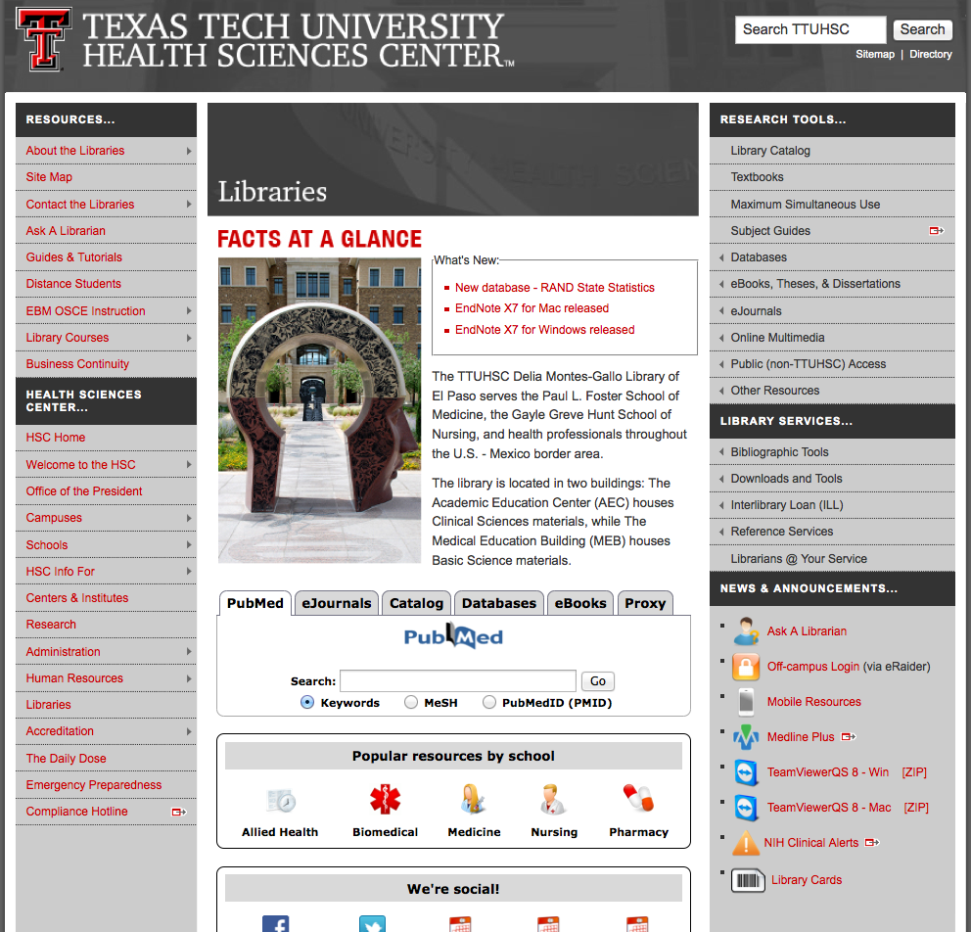
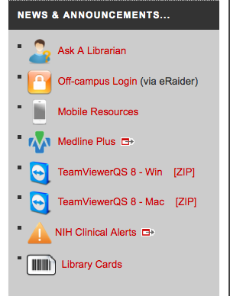
Library Cards

Slide 4
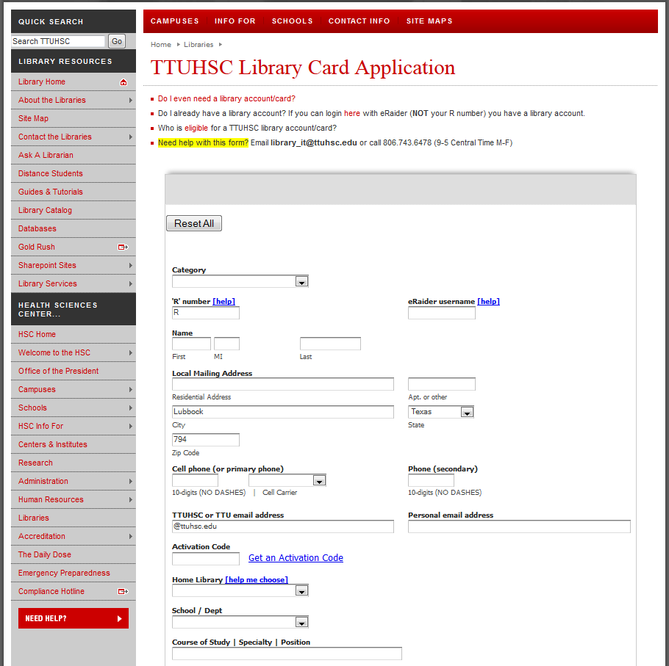

Slide 5
Library Cards
Stop by the library at your earliest convenience
Apply bar code sticker to the back of your ID Card

Slide 6



Reference Librarians
Available on 2nd floor of library, across from the Learning Resource Center and public computers
8am–5pm
Monday–Friday
Jennifer Teichelman
Peggy Edwards
Micah Walsleben
Margaret Vugrin
Notes:
These are the Reference Librarians at the Lubbock campus. Our office hours are Monday – Friday 8:00am – 5:00pm Central Time. Feel free to give us a call or send us an e-mail! We will be happy to help you.

Slide 7
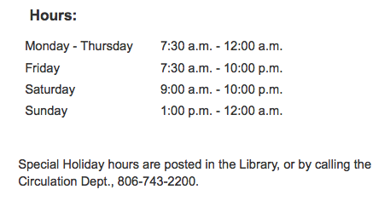

Library Hours
Phone: 806-743-2200
Holiday hours and early closings are also posted as announcements in your e-Raider portal.
Notes:
Here are the normal hours of operation for the Lubbock library. Any special holiday hours or early closing announcements are posted within the library itself and in the announcement section of your eRaider portal. Of course, you can always call the library at the number shown on this slide.

Slide 8

Library Facilities
28 study rooms available
All rooms are first come, first serve
Each room has a dry erase board, markers, and plenty of outlets!
Wireless internet available
Notes:
The Lubbock library has a total of 28 study rooms: 8 on the 2nd floor, 8 in the Learning Resource Center, also on the 2nd floor, and 12 on the 3rd floor. There is no reservation system for these rooms; all of them are available to groups or individuals on a “first come, first serve” basis. Each room has a dry erase board and markers as well as wireless or physical internet connectivity.

Slide 9
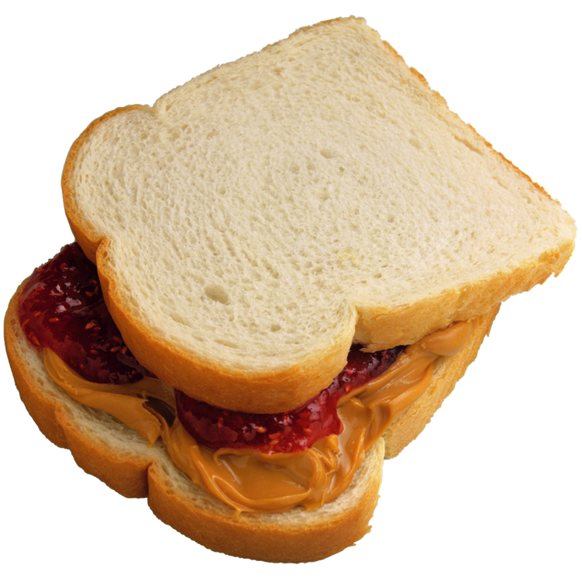

Library Facilities Cont.’d.
Food and drink allowed!
Notes:
Food and drink are allowed at the Lubbock library! Feel free to bring a lunch, a snack, or your morning coffee to sustain you through your study session!

Slide 10
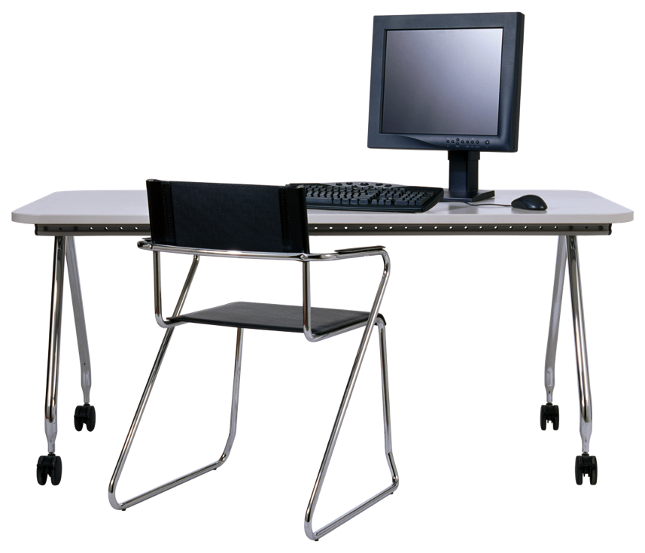
Learning Resource Center
Located on the 2nd floor of the library
Check out computer stations, anatomical models, and more!
Requires a library card
Notes:
The Learning Resource Center is located on the 2nd floor of the Lubbock library. Here, you can check out the library’s audiovisual materials, anatomical models, and computer stations. These materials, including the computer stations, require a library card in order to be checked out. Drinks only are allowed in the Learning Resource Center.

Slide 11
Borrowing Policies and Fines
Books/Audiovisuals/Journals:
Checkout period for books is two weeks, audiovisuals for 10 days. Journals in the print collection can be copied but not checked out.
May renew items twice in person, over the phone (806-742-2200), or online through the library catalog.
Fines for overdue items:
50 cents per day per item
Library privileges are lost until fines are paid
Notes:
Here are the library’s borrowing policies and fine system. You can check the status of your account at any time through the eRaider sign in within the library catalog, or by calling the main number.

Slide 12
Library Website
http://www.ttuhsc.edu/libraries

Slide 13
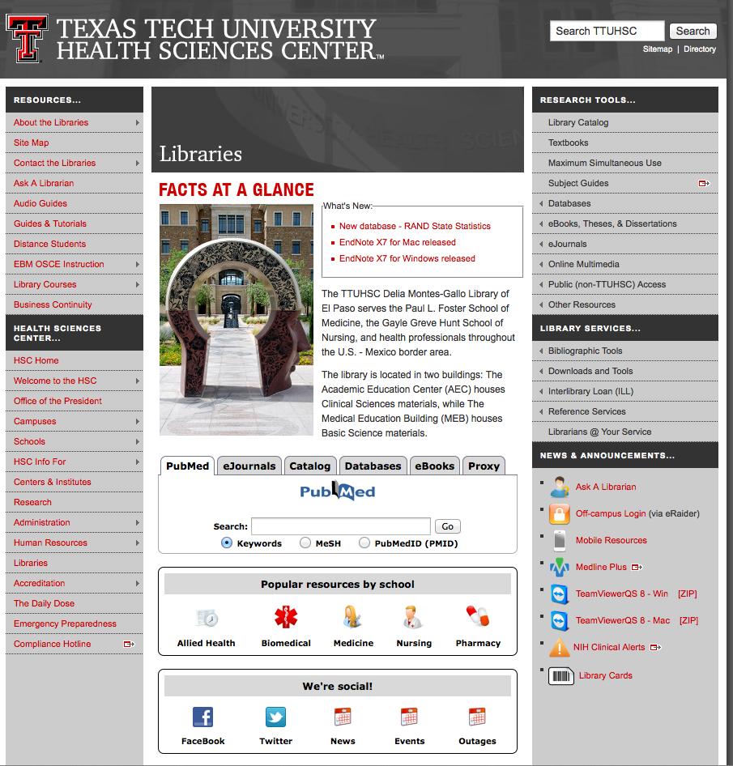
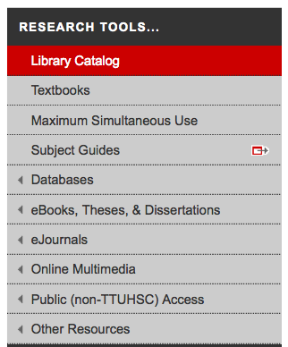
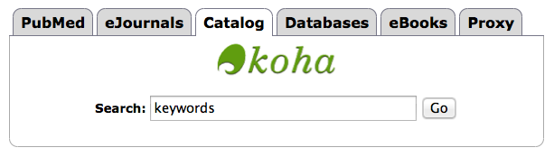
Library Catalog
Two points of access
Notes:
From the library website, there are two points of entry to the catalog. You can select “Catalog” from the toolbar on the right side of the page, or you can choose “Catalog” from the tabs in the middle of the page and either click on the green “Koha” logo or begin a keyword search from the box provided.

Slide 14
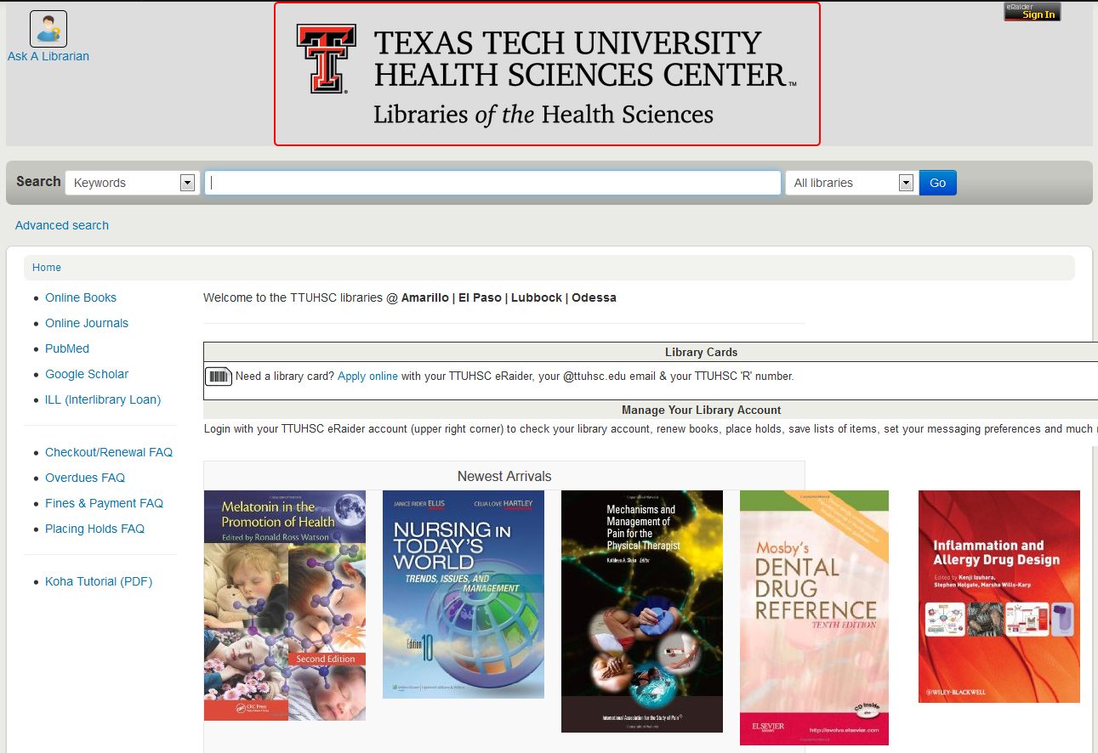


Sign in for your account information
Notes:
The is the main catalog page. From here, you can search the libraries at all our branches for the book that you need. We are also in the process of adding e-books to the catalog in the hopes of making the catalog the main searching tool for all books. In the upper right of the screen is an eRaider sign in button. Click and sign in with your eRaider username and password to access your library account. You can see when your materials are due, if you have any fines, and even renew the materials you have checked out.

Slide 15
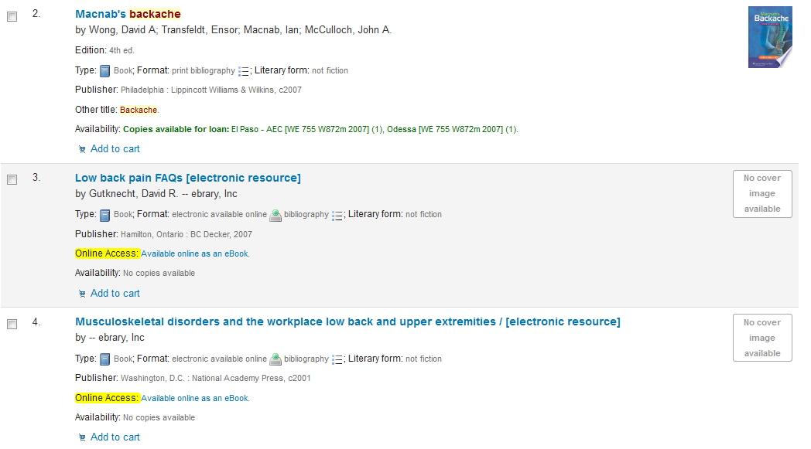


Slide 16
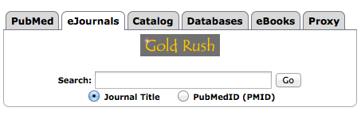
Gold Rush
Notes:
If you have a citation for a journal article and need to see if it’s in the library’s collection, Gold Rush is the place to go. The fastest way to access it is by selecting “eJournals” from the tabs in the middle of the library website. From here, you can search for the journal title, and now you can search for the article according to its PubMed I.D. number, if your article has one.

Slide 17
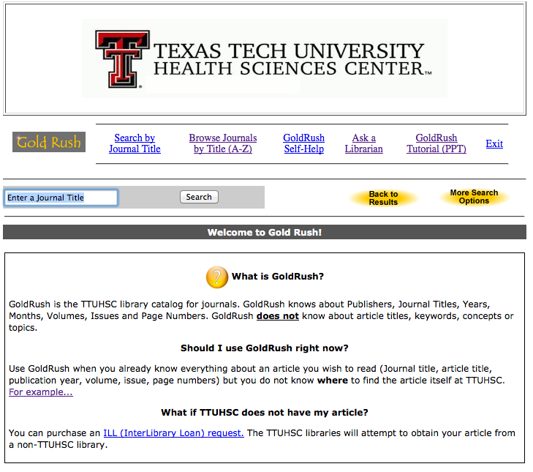
Notes:
This is the main Gold Rush page. It includes some additional information about this tool as well as links to tutorials and other helpful resources.

Slide 18
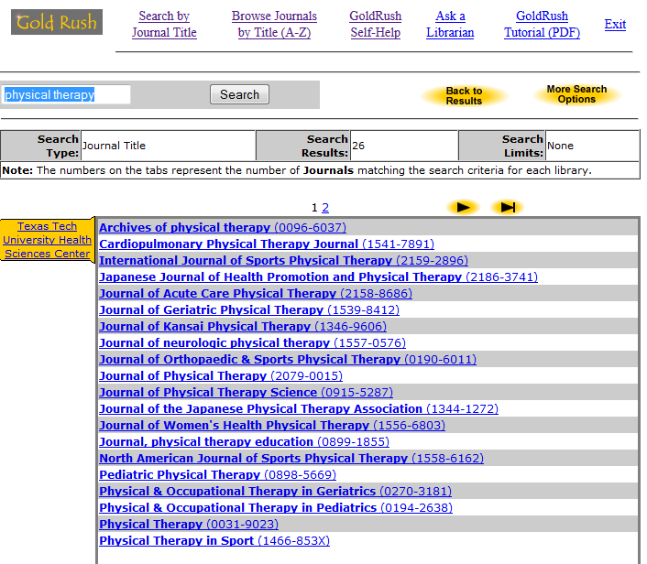

Slide 19
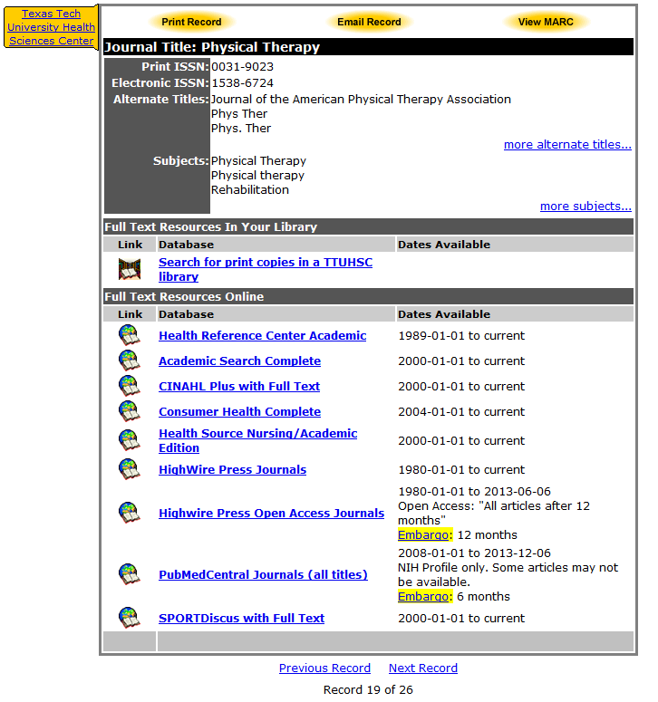

Slide 20
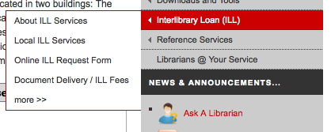
Interlibrary Loan (ILL)
Read all about it here!
Notes:
If you need a book or article that is not available at the library, you have the option of ordering it through our Interlibrary Loan system.

Slide 21
Basic ILL Information
Online ordering form makes submitting requests quick and easy
Response time for requests is anywhere from 2 – 10 business days, depending on location of the item
Books from any TTUHSC branch library are free, all others are $4.00
Journal articles are charged per page, but fees will not exceed $4.00
There is a rush option available, but at a higher fee rate
Notes:
Here is some basic information about our Interlibrary Loan system that will be useful for you to know. For distance students, it is important to note that if you need a book from any TTUHSC branch library, we will ship it to you for free. There is also an online ordering form grouped with the other Interlibrary Loan information on the library website for your convenience. This concludes this presentation. Please continue to the next presentation within this orientation, called “Online Multimedia and Mobile Resources”. Thank you!

Slide 22
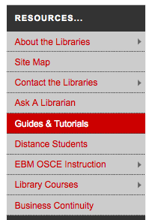
Guides and Tutorials
Notes:
From the library home page, click on the guides and tutorials tab. The is a very important place to remember. It has our most up to date step by step guides and tutorials. This is a great place to start if you have questions on how to work a specific database or resource.

Slide 23
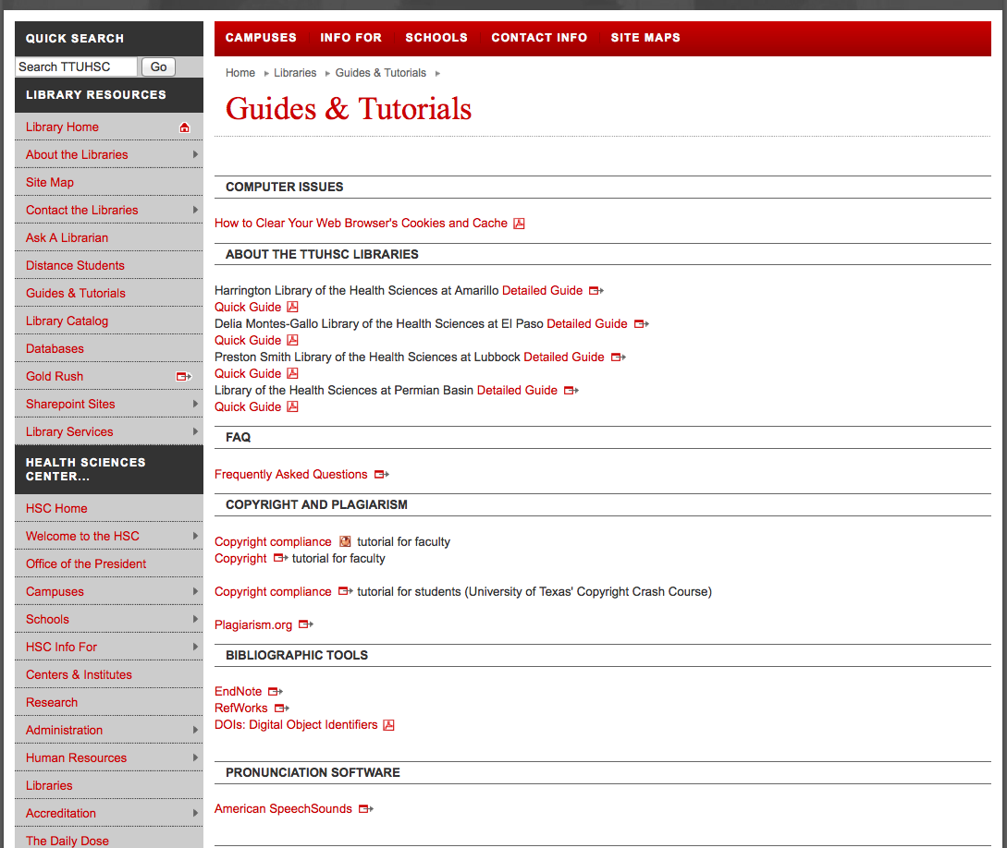
Scroll down to see additional tutorials
Notes:
This is what the guides and tutorials page looks like. If you are following along in your browser, if you scroll down the page there are additional tutorials.

Slide 24
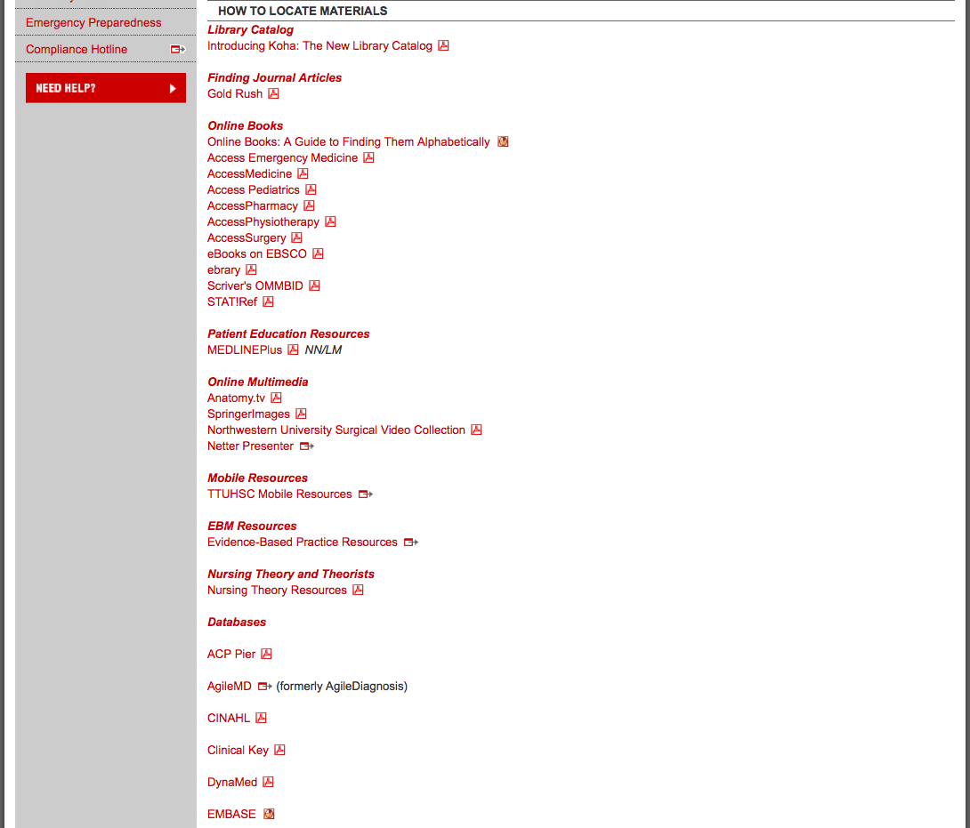

Slide 25
Ask A Librarian
Notes:
If the guides and tutorials page, doesn’t have the answer or you have an additional question or something just doesn’t make sense then please contact us through Ask a Librarian. It is located in 2 places. Click on it and fill out the form. The form will go to 21 librarians that work at all 4 libraries in the TTUHSC system. We usually answer fairly quickly but it depends on the question and whether it is in the evening or weekends. If you need research help we may write back to call us when you have time for one on one distance training.

Slide 26
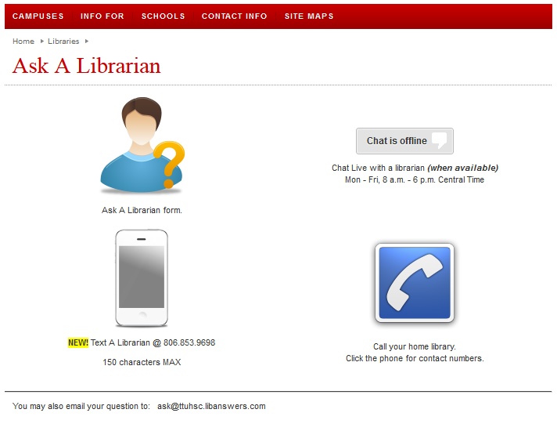


Slide 27
Team Viewer

Slide 28
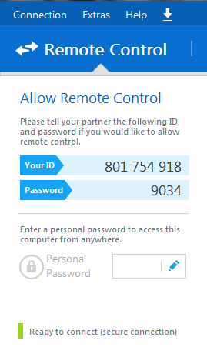
Give your ID and password to a librarian on the phone
We will be able to remotely control your desktop—we will see what you see as well as move your mouse, etc.
Please make an appointment in order to ensure plenty of time to work on your problem!

Slide 29
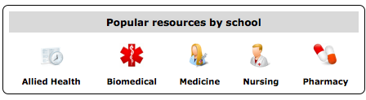
Resources just for you!
Notes:
The library has resources just for you! Starting at the library website, find the tab in the middle of the page labeled “Popular resources by school”. From there, click on the icon labeled “Nursing”.

Slide 30
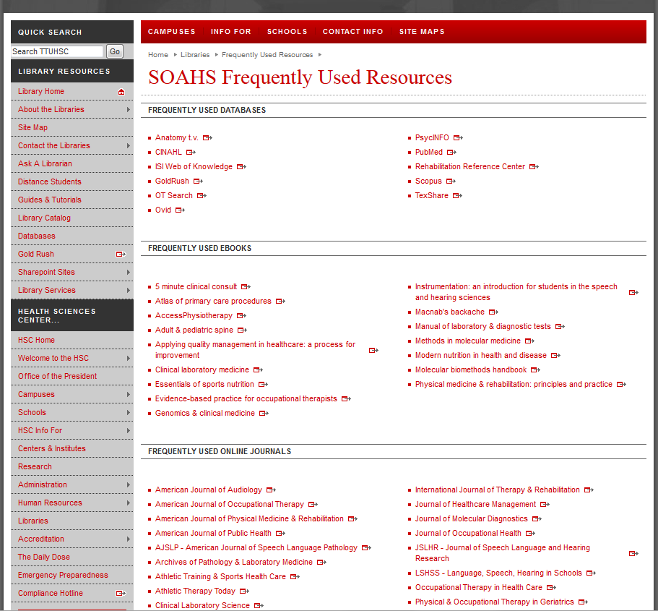

Slide 31
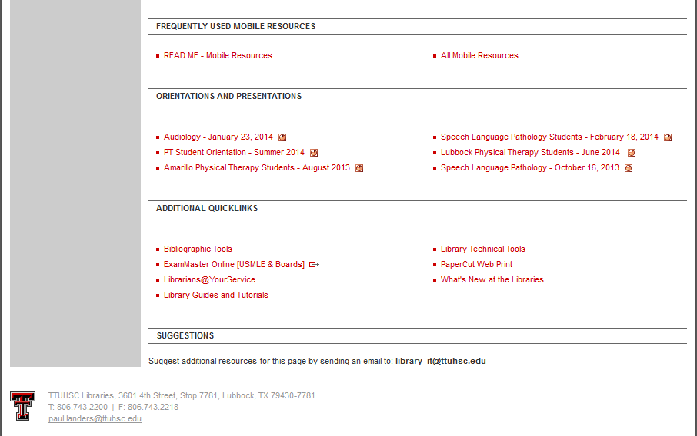
Today’s presentation will be here!

