Slide 1
Physical Therapy library orientation part 3
Margaret Vugrin, MSLS
Reference Librarian

Slide 2
Agenda
AccessPhysiotherapy
Rehab Reference Center
Introduction
  RefWorks/End Note
Mobile resources
Practice exercises
Q&A

Slide 3
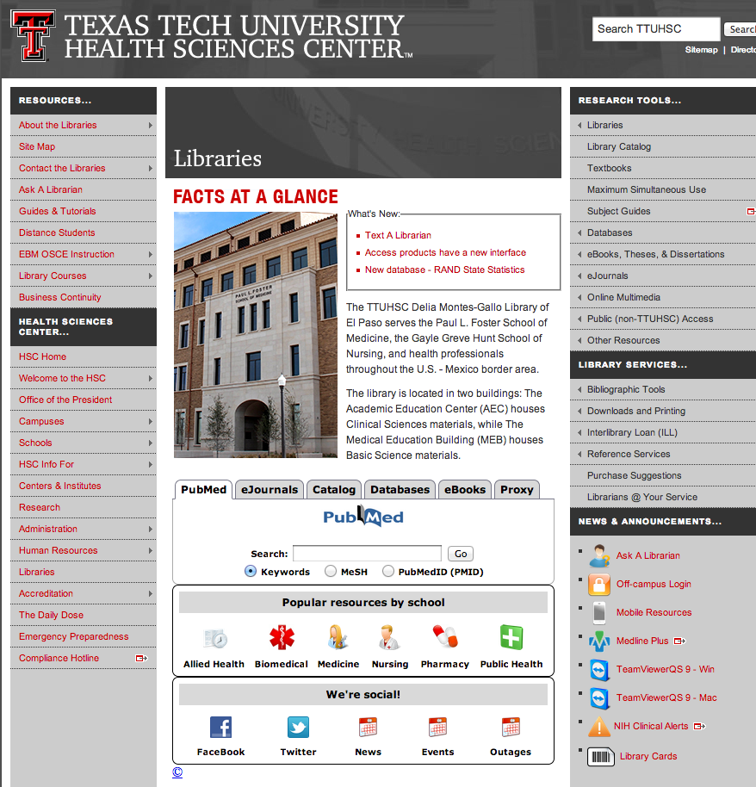

Slide 4
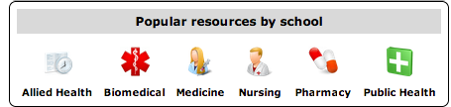
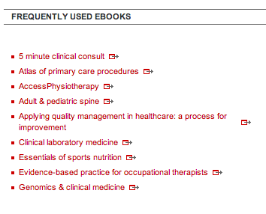

Slide 5
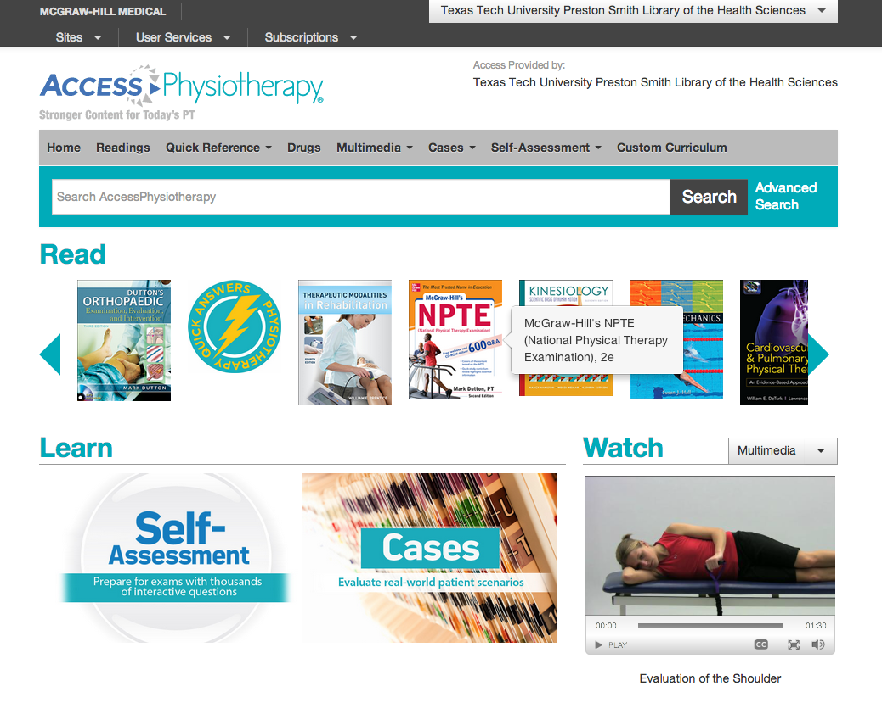

Slide 6
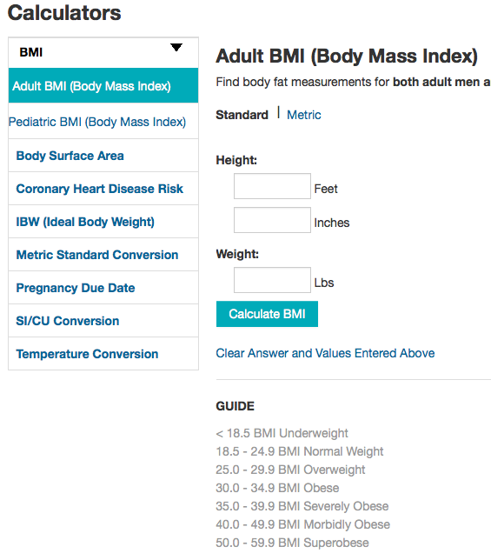
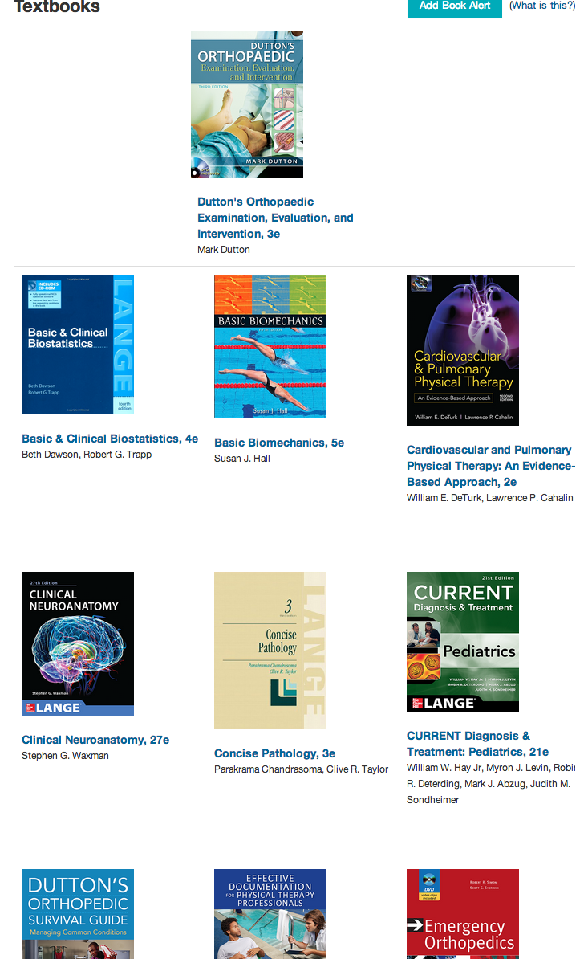
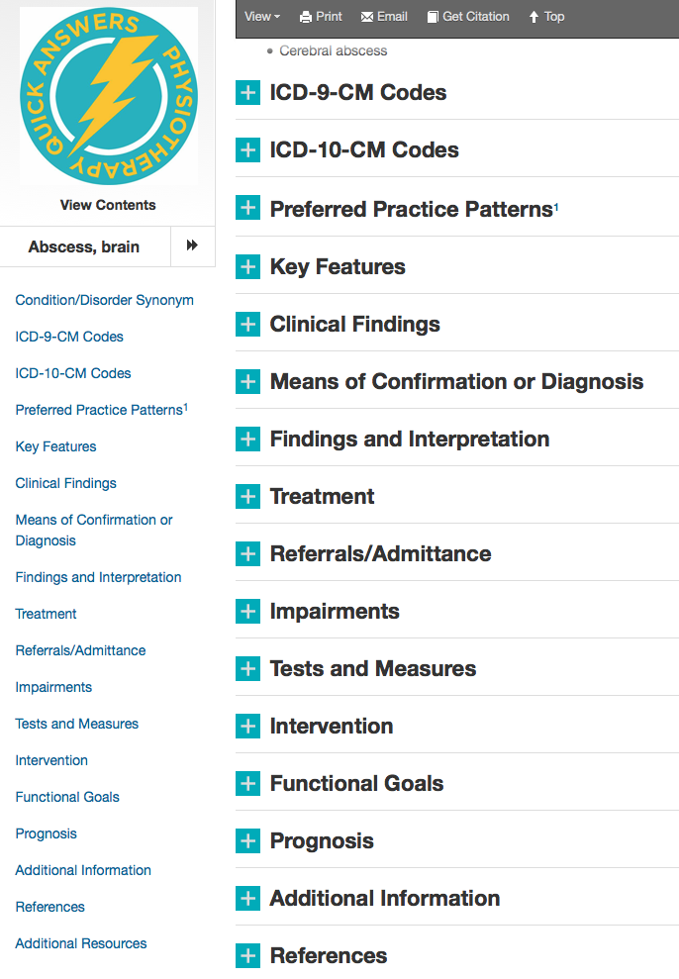

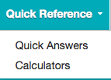

Slide 7
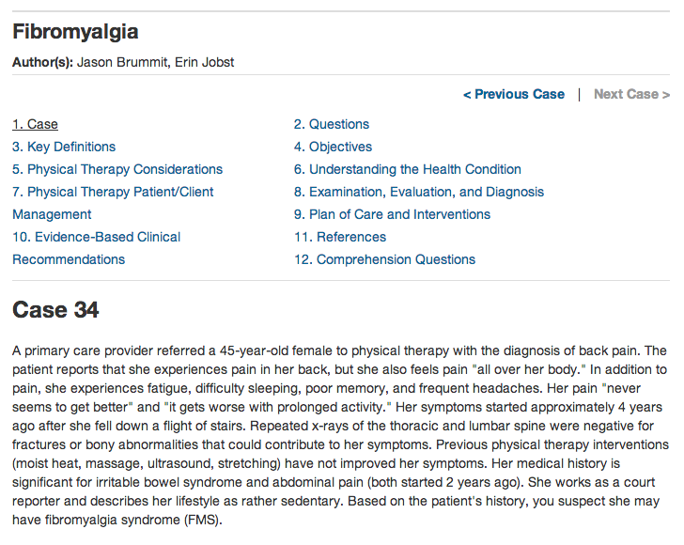
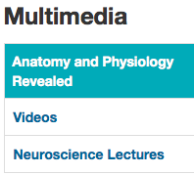
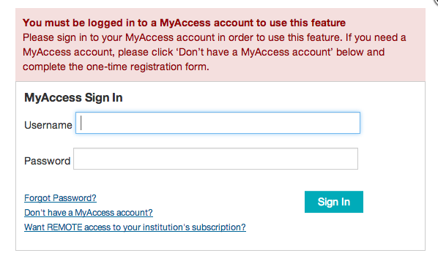
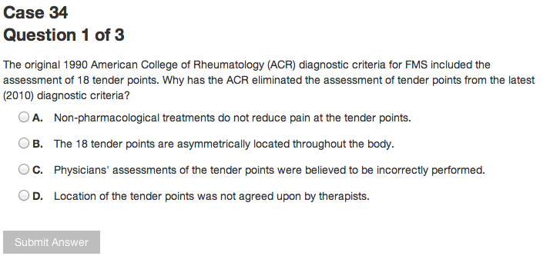

Slide 8


Slide 9
Exercises and answers
Can you locate a book to help study for the NPTE exam?
The NPTE text is one of the readings/textbooks available in AP.
How is fibromyalgia diagnosed? What are the tests?
Quick answers
Locate some images of how to do a correct lunge.
Type lunge into first screen, select images from left side options or under Multimedia tab.
Locate patient education and pricing information for lipitor?
Drugs >patient education >pricing information

Slide 10
Exercises and answers
How much grapefruit juice can I drink if on lipitor?
Less than a quart. Under Patient ed>Lipitor
Locate information on diagnosis and evaluation of SLAP tears of shoulder.
Pediatric practice: Sports medicine or other books

Slide 11
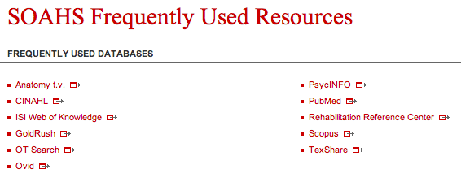

Slide 12
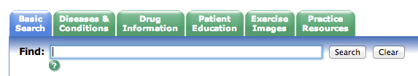
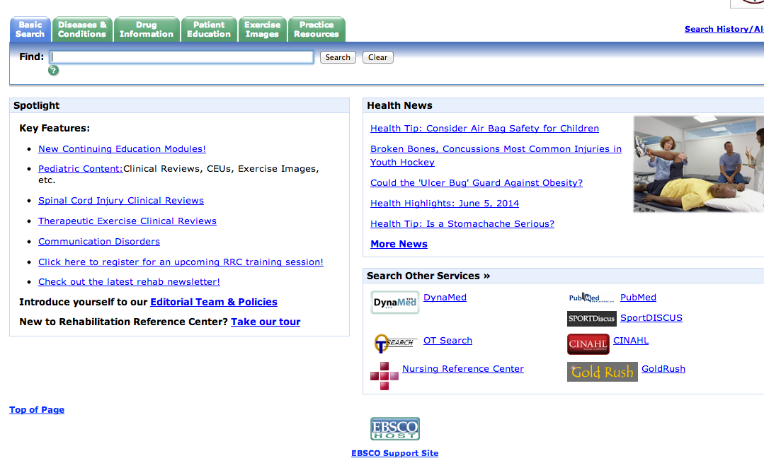
Soccer Injuries

Slide 13
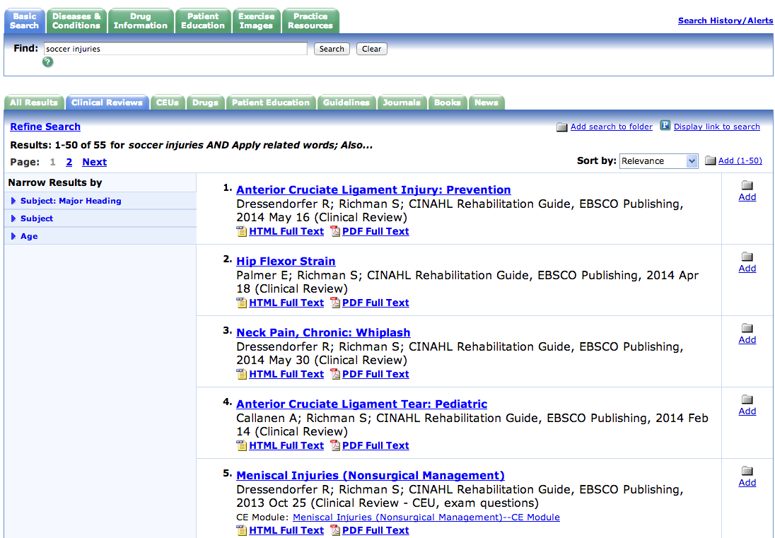
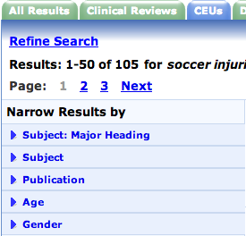
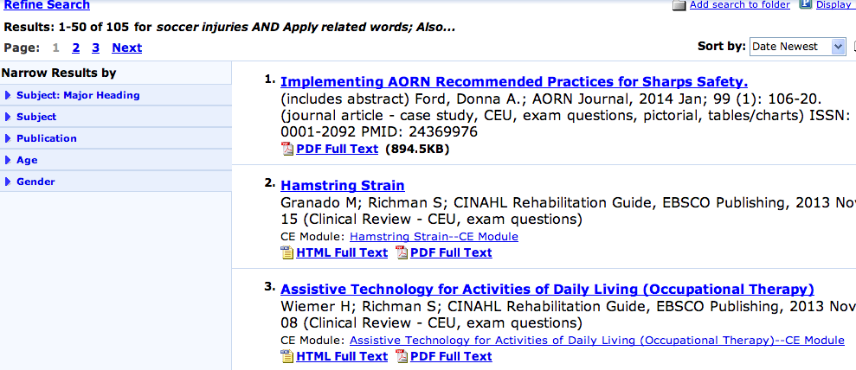
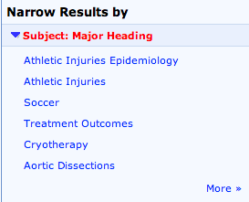

Soccer Injuries

Slide 14

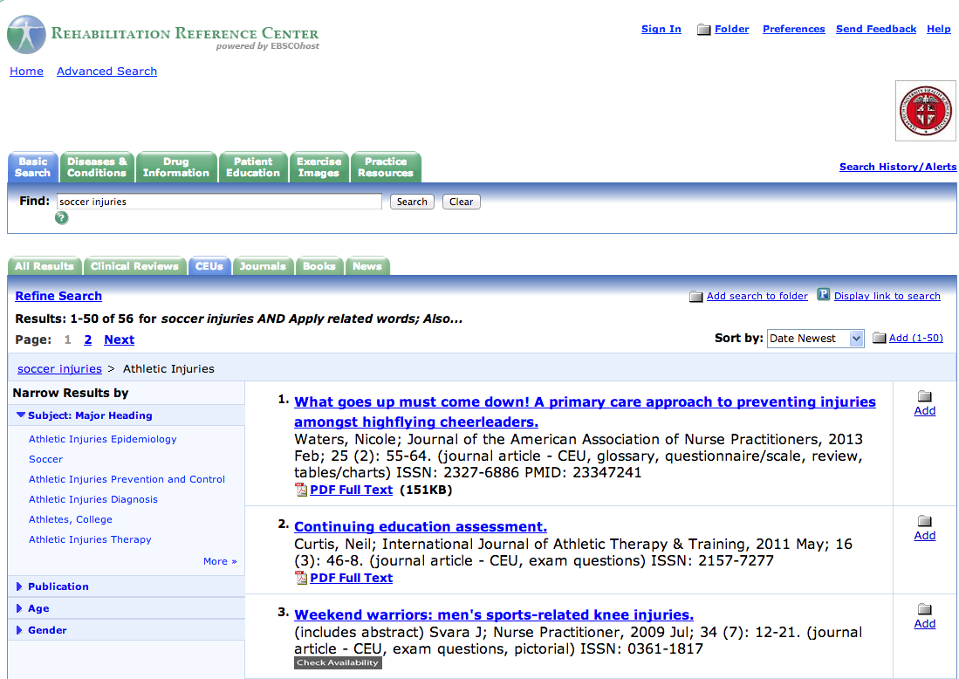


Slide 15
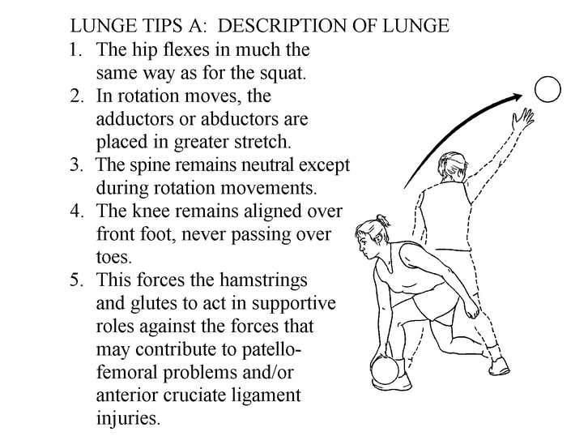
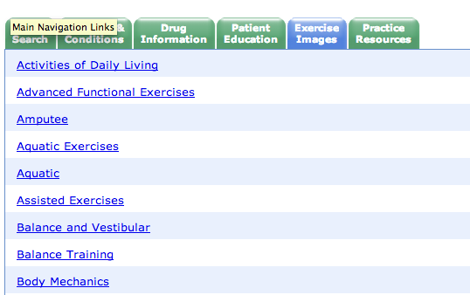
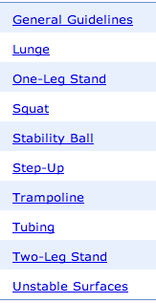
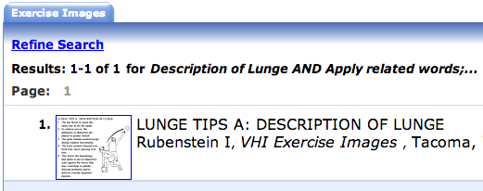

Slide 16

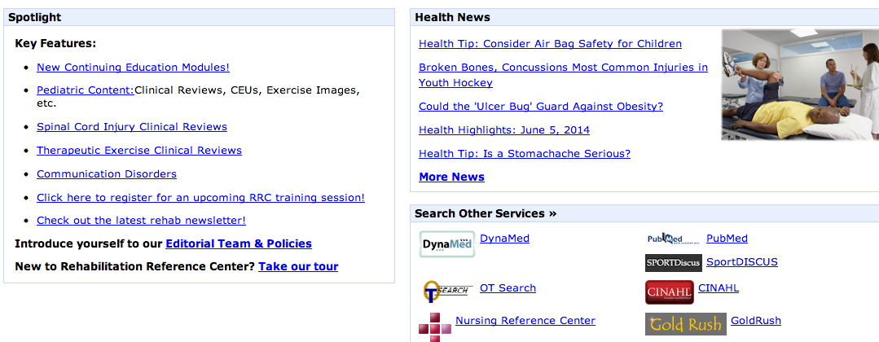

Slide 18
Exercises and answers
Locate some images of how to do a correct lunge.
Type lunge into first screen, select images from left side options or under Multimedia tab.
Locate patient information on Above the knee amputation.
In Spanish?
Patient education tab>”A”>link to English and Spanish

Slide 19
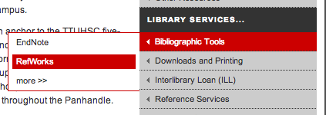

Slide 20
Bibliographic software managment
RefWorks
EndNote
Web based
Storage of citations
Write-n-cite
Embed citations into Word
Create bibliography
Web based
Desktop
Storage of citations
Cite-n-write
Embed citations into Word
Create bibliography
Library homepage

Slide 22
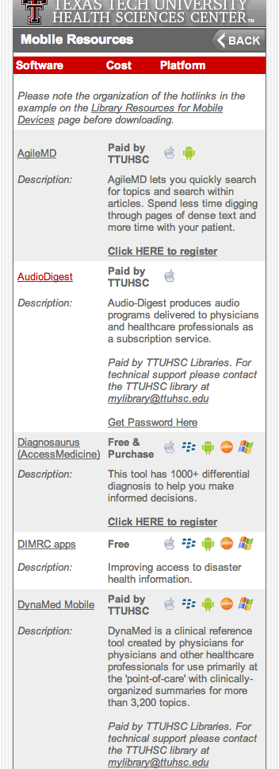
Library homepage

Slide 23
Thank you!

