Slide 1
Welcome
Information Resources for Physical Therapy
Peggy Edwards, AMLS
TTUHSC - Preston Smith Library
Lubbock, Texas 79430
June 2014

Slide 2



PubMed Database
Biomedical and life sciences journal literature
International scope
Developed and maintained by the:
National Center for Biotechnology Information
    at the U.S. National Library of Medicine
    at the National Institutes of Health

Slide 3

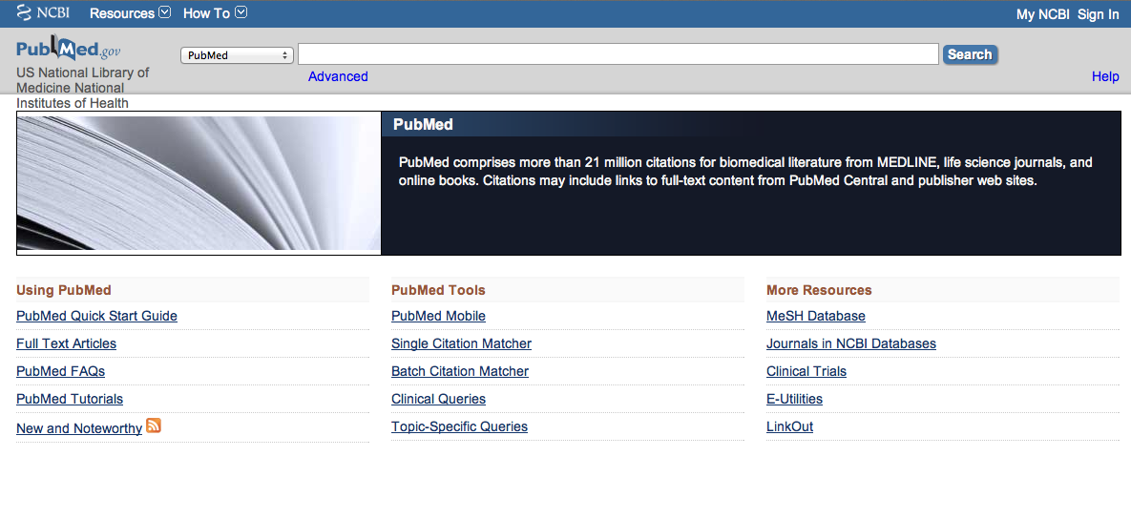

Accessing PubMed
Freely available over the Internet
@ www.pubmed.gov
Also through library’s home page

Slide 4
EBP Literature from
PubMed’s Clinical Queries

Slide 5


Evidence-Based Practice is guided by thoughtful integration
of the best available scientific knowledge with clinical expertise.

Slide 6
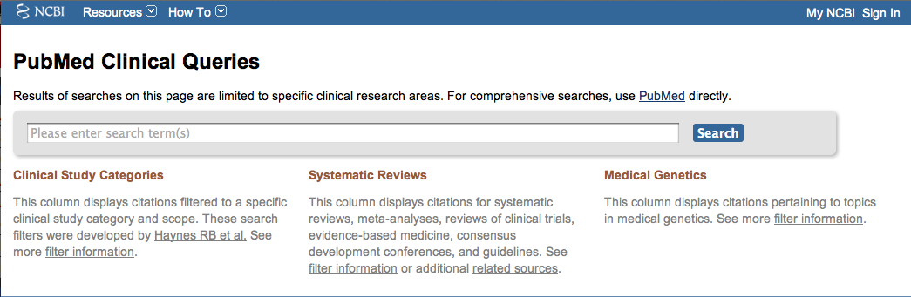
PubMed’s Clinical Queries
tool that searches for evidence-based literature

Slide 7

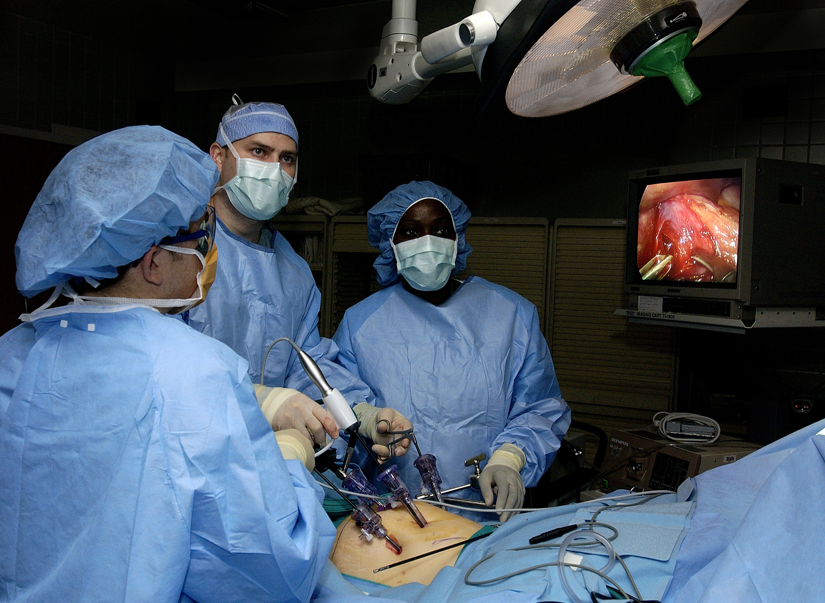
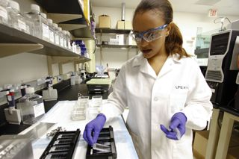
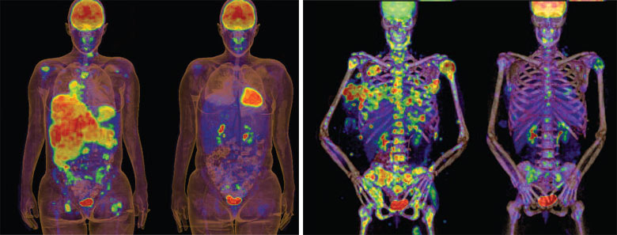
Clinical Queries Searchable by:
Diagnosis
Therapy
Prognosis (prediction of probable outcome)
Etiology (cause)

Slide 8
Clinical Queries Searchable by:
Diagnosis
Therapy
Prognosis (prediction of probable outcome)
Etiology (cause)

Slide 9
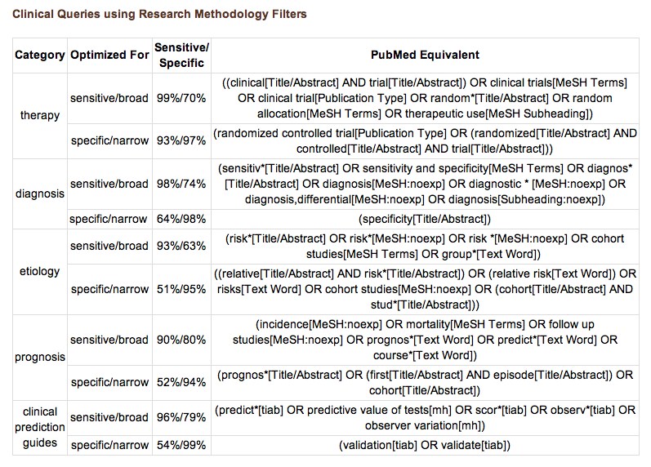
PubMed’s Clinical Queries
uses pre-formulated search strategies with a keyword search

Slide 10
To begin...

Slide 11
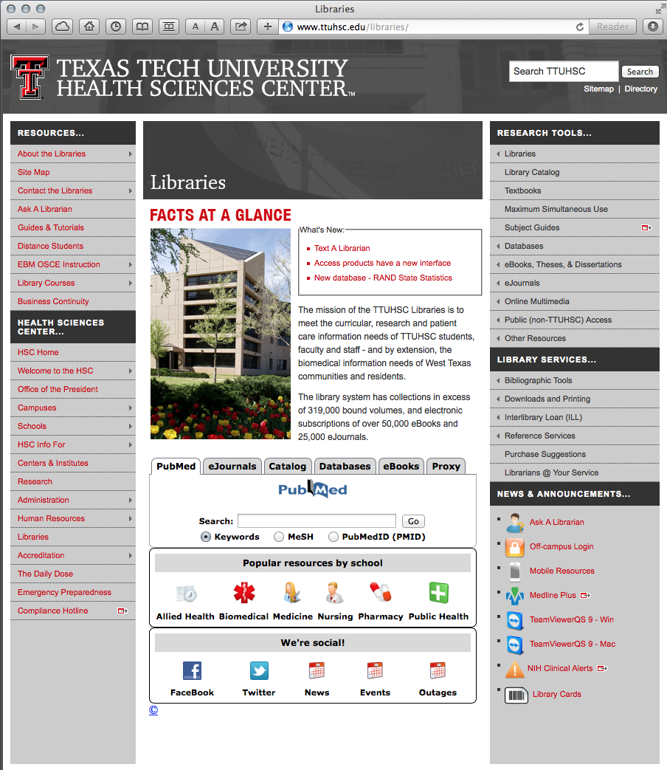
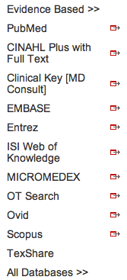
PubMed’s Clinical Queries
www.ttuhsc.edu/libraries
Mouse over Databases
Click PubMed

Slide 12
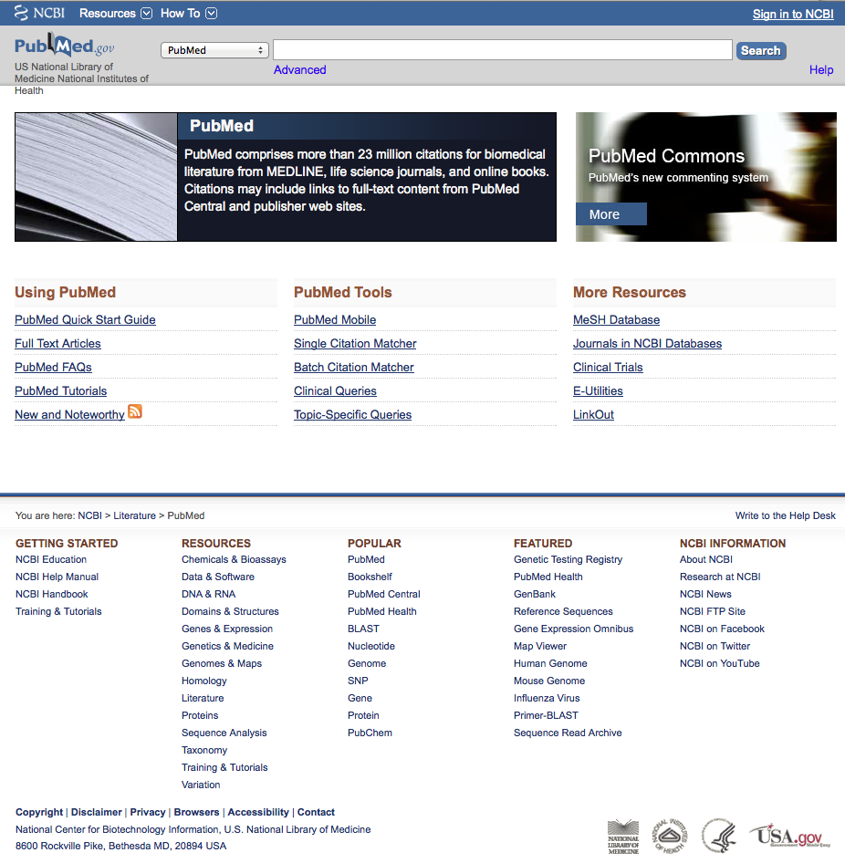
PubMed Home Page

Slide 13
Click Clinical Queries

Slide 14
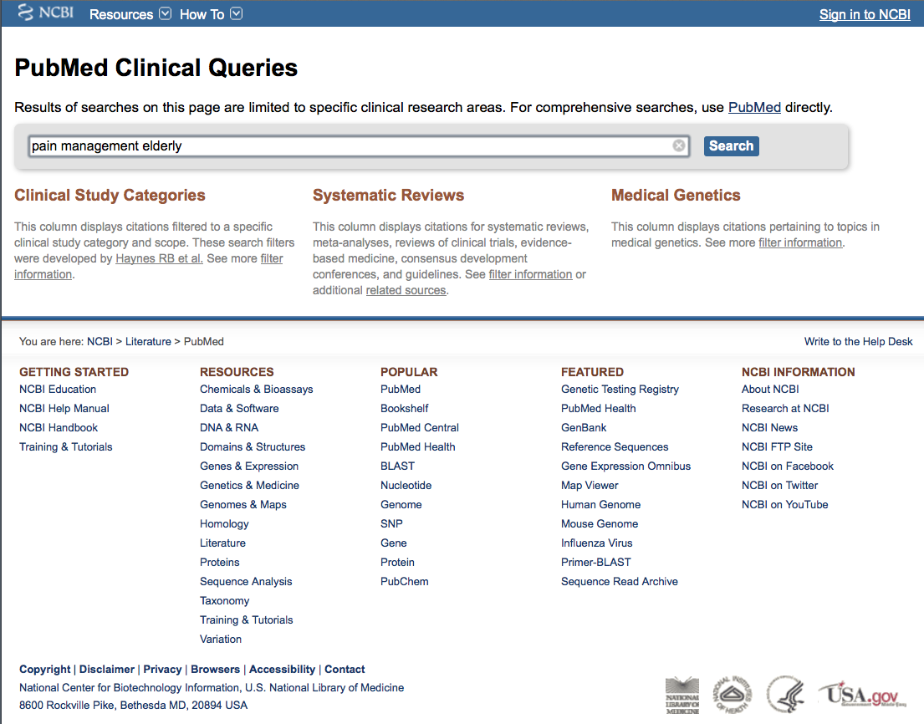
Enter pain management elderly
Click
Search

Slide 15
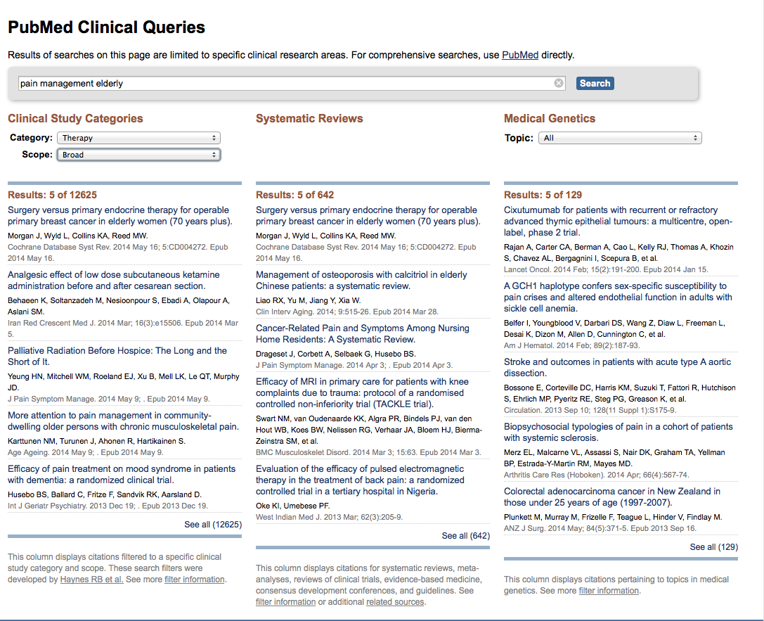
Change to Narrow Scope
Results for Therapy and
Broad Scope

Slide 16
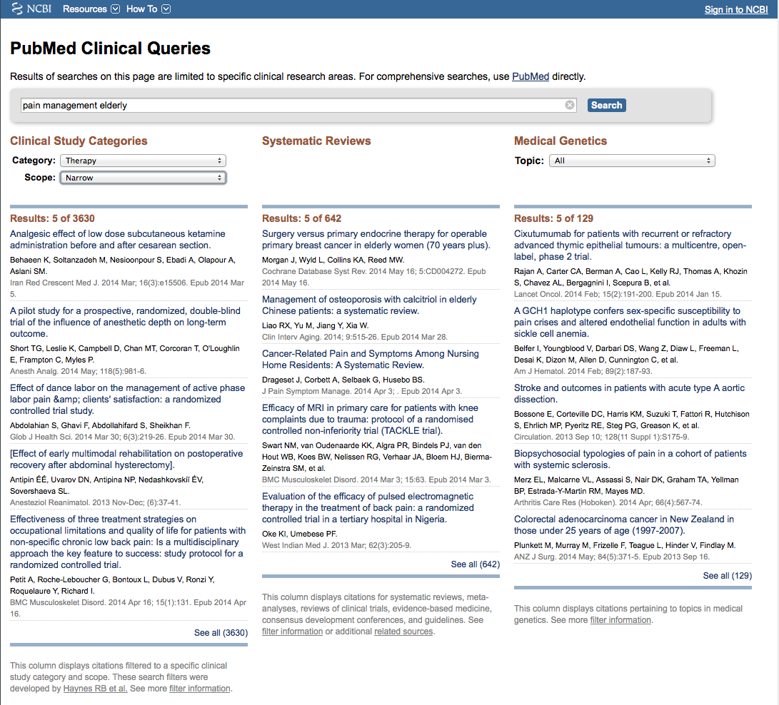
Results for Therapy and
Narrow Scope
Click See all (3630)

Slide 17
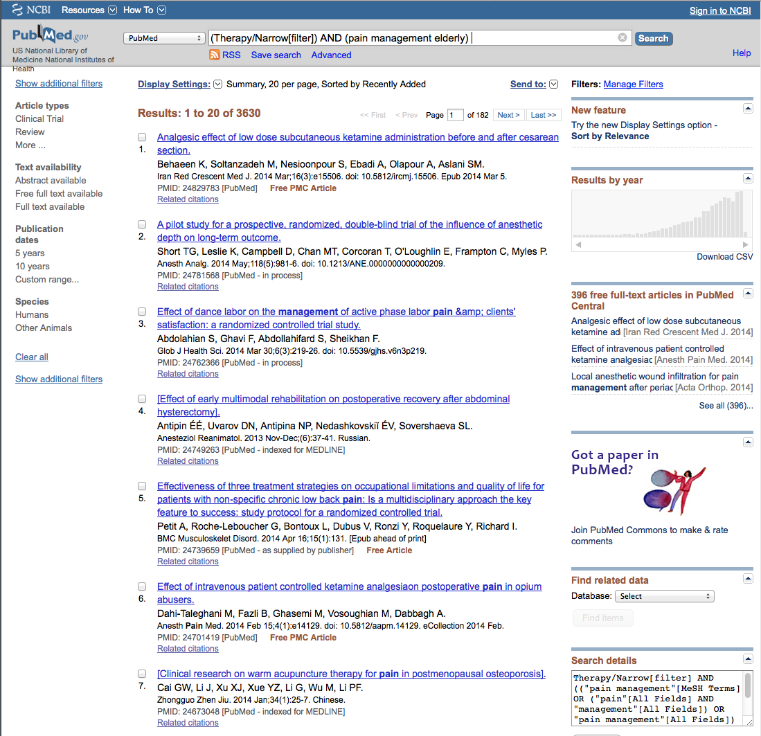
Select filters to narrow
Click Humans to select

Slide 18
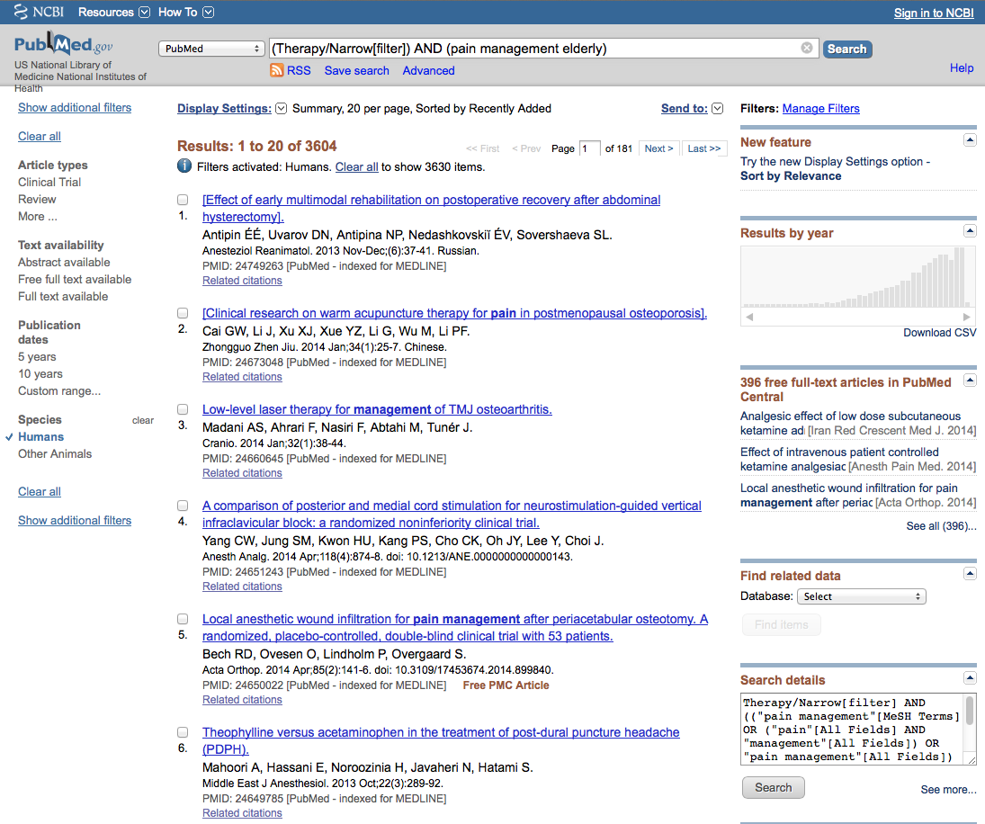
Selections will turn blue: ✓ Humans

Slide 19
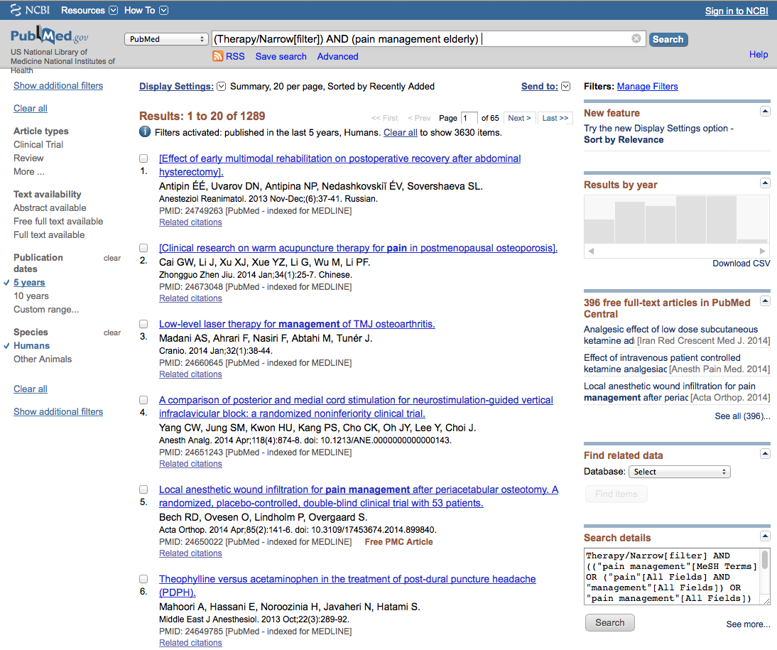
Click 5 years to limit

Slide 20
Click Show additional filters

Slide 21
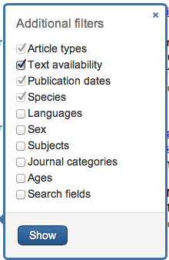
Select
Languages
✔
Click Show

Slide 22
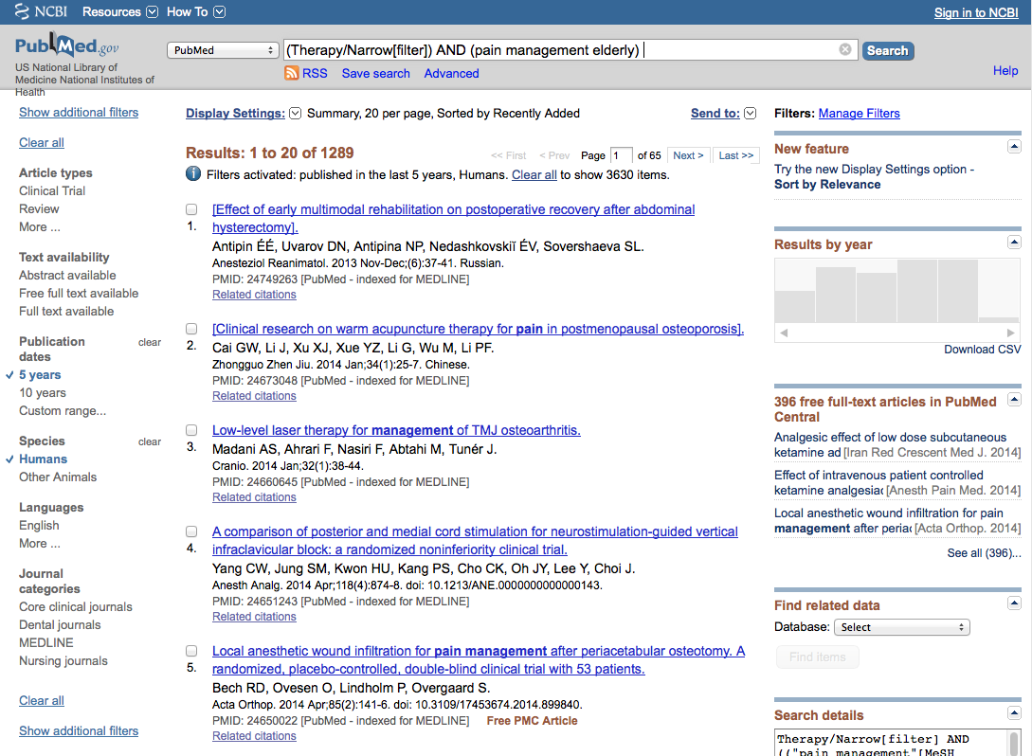
Click English

Slide 23
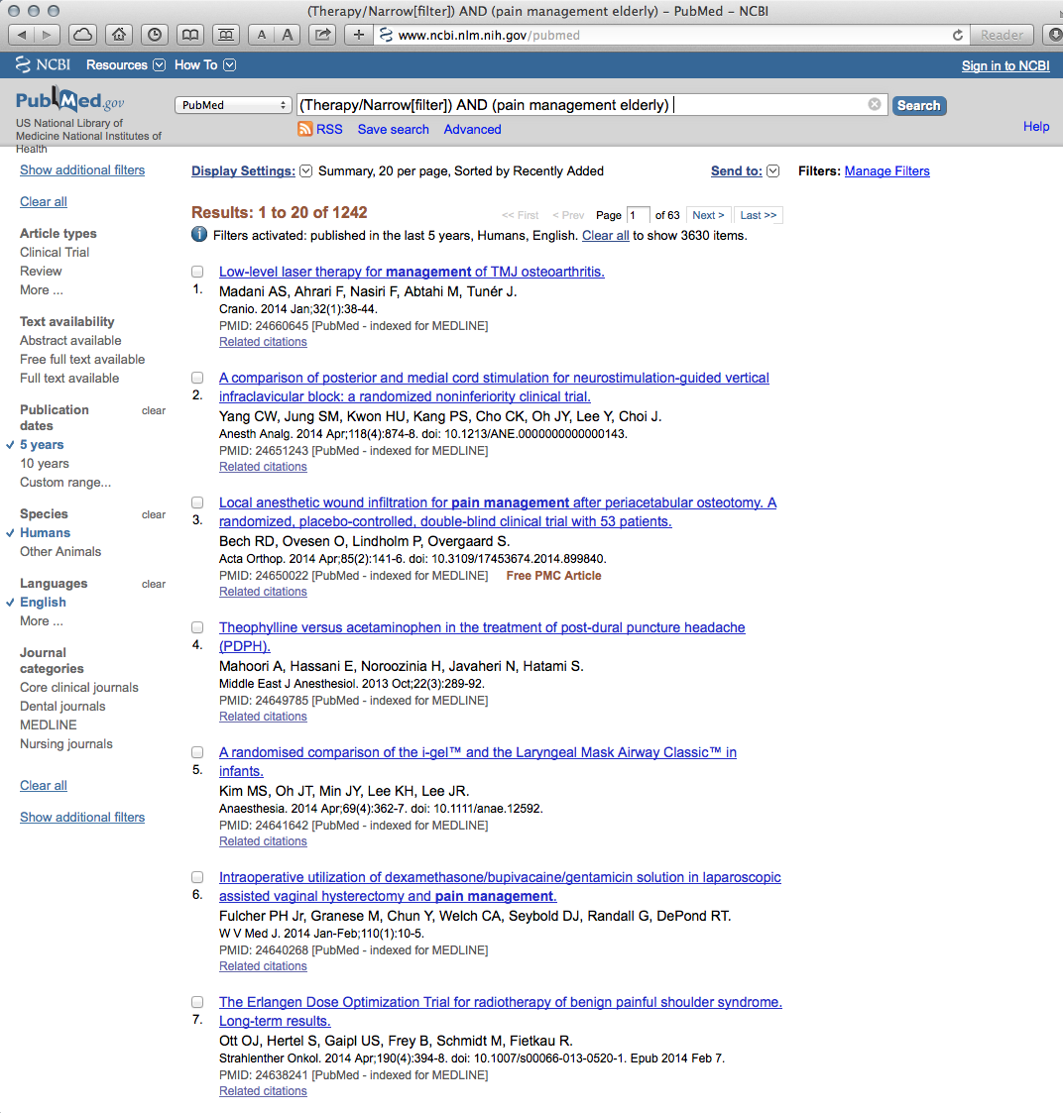
Selections turn blue: ✓ English

Slide 24

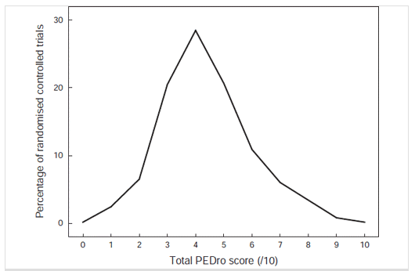
PEDro
Randomized Controlled Trials
Systematic Reviews
Practice Guidelines
Independently assessed quality ratings

Slide 25
www.ttuhsc.edu/libraries
Mouse over Databases
Click Evidence Based

Slide 26
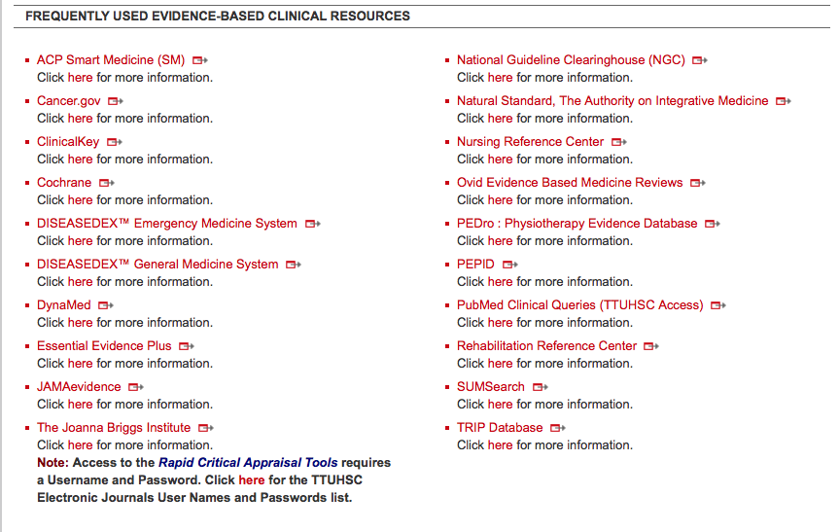
Click PEDro

Slide 27

Click Advanced Search

Slide 28
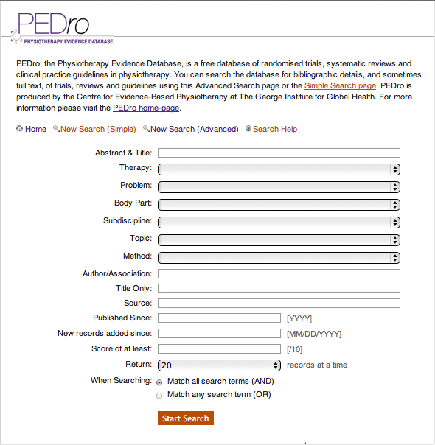
Advanced Search

Slide 29
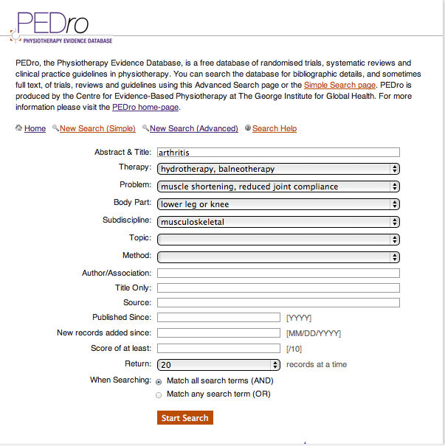
Enter Arthritis as a Title and/or Abstract word search
hydrotherapy…
muscle shortening
knee
musculoskeletal
Click Start Search

Slide 30

Click for Abstract

Slide 31
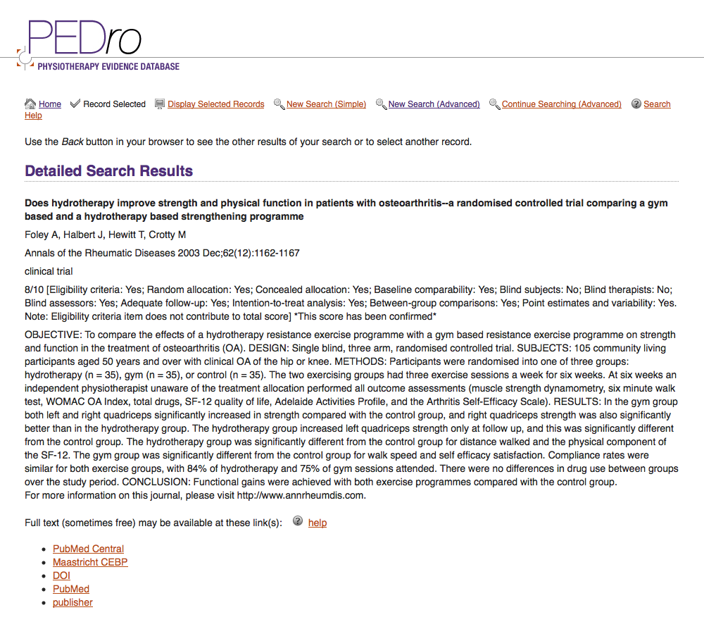
Click for Full-text

Slide 32
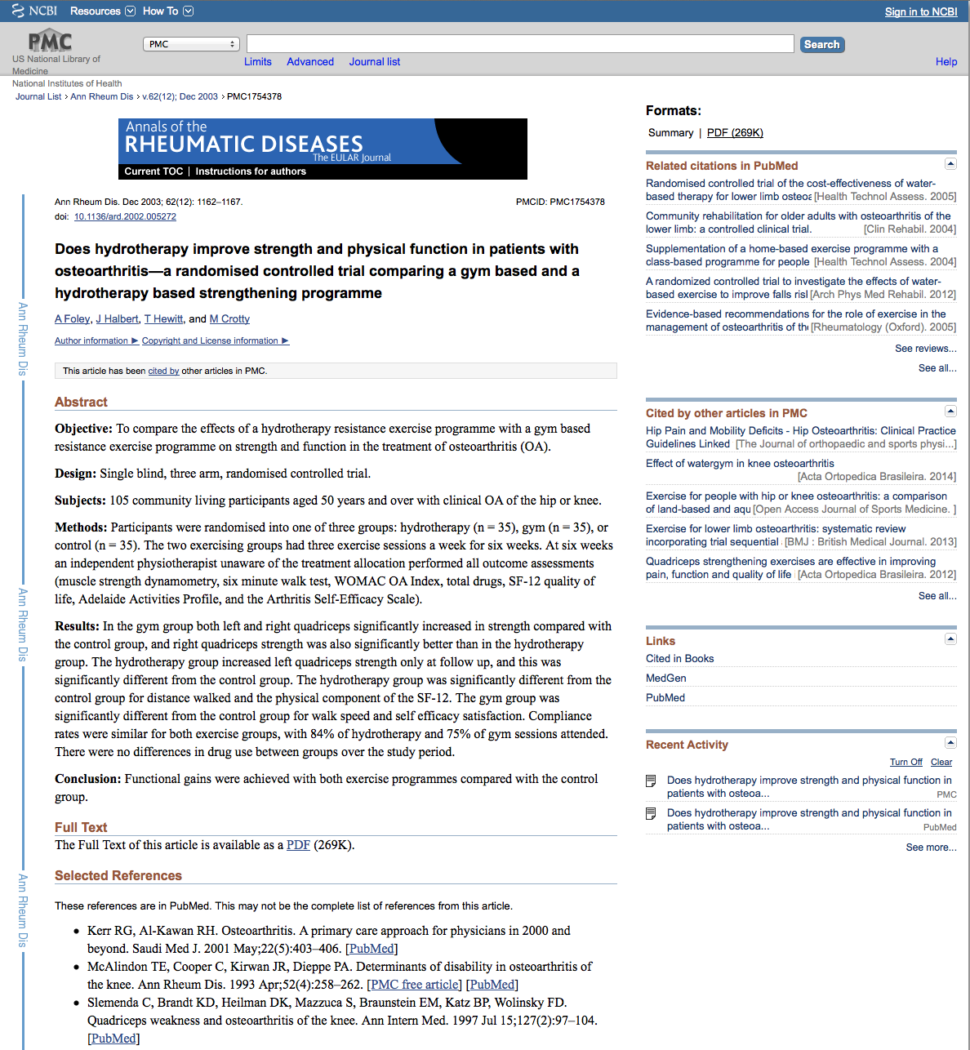
Click for PDF

Slide 33
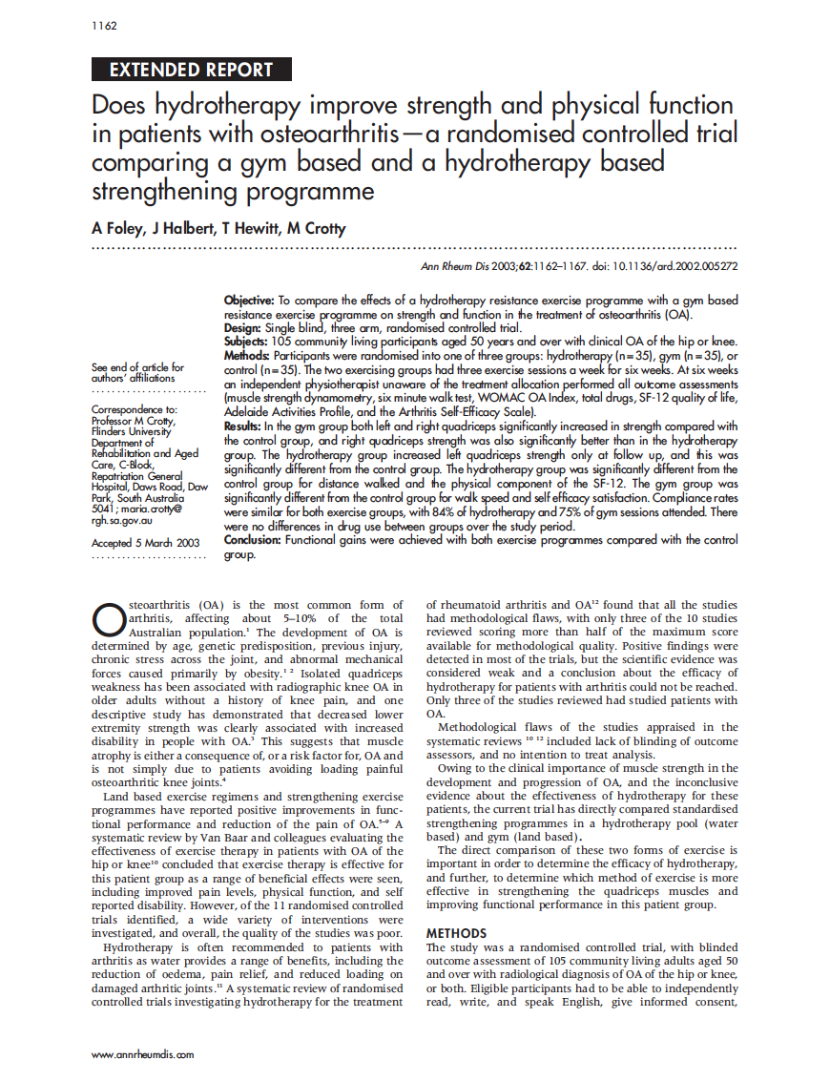
Full-Text

Slide 34
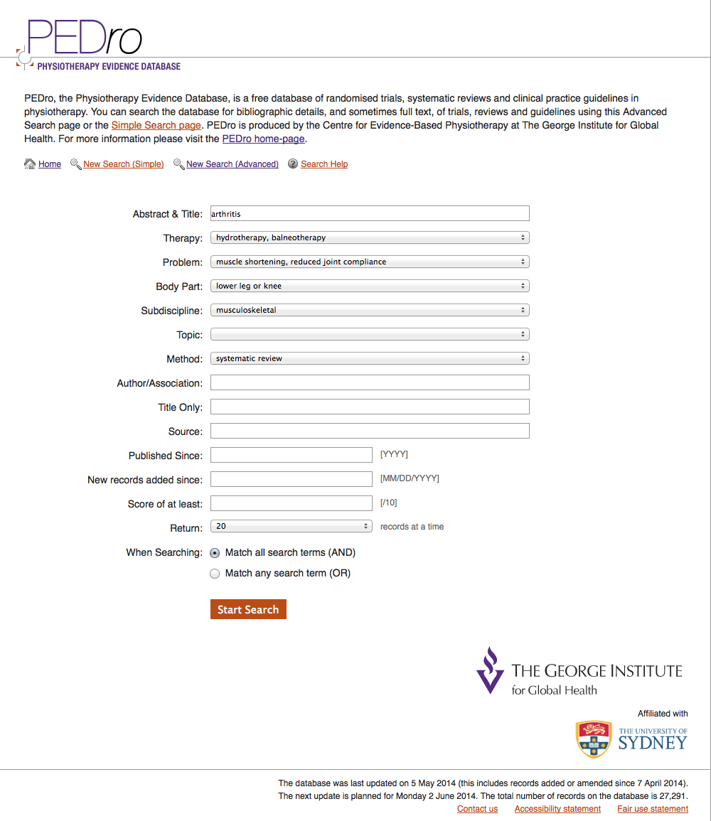

can further narrow results
Method

Slide 35
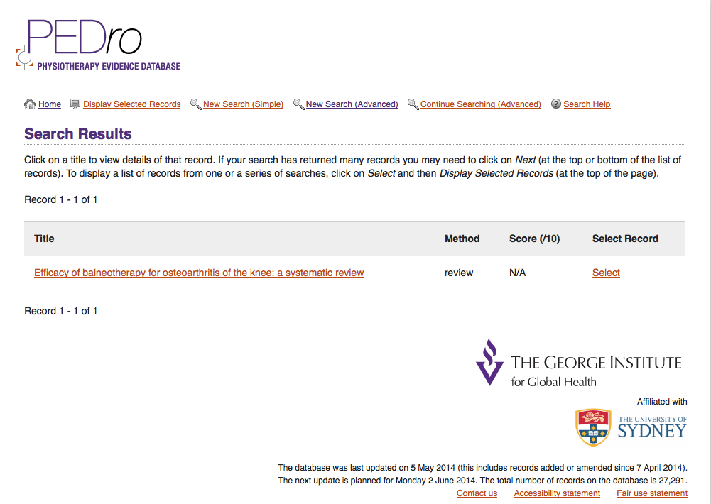
Results narrow to a systematic review

Slide 36
ANATOMY.TV

Slide 37

ANATOMY.TV
www.ttuhsc.edu/libraries
Hover over
Online Multimedia
Click Anatomy.tv

Slide 38
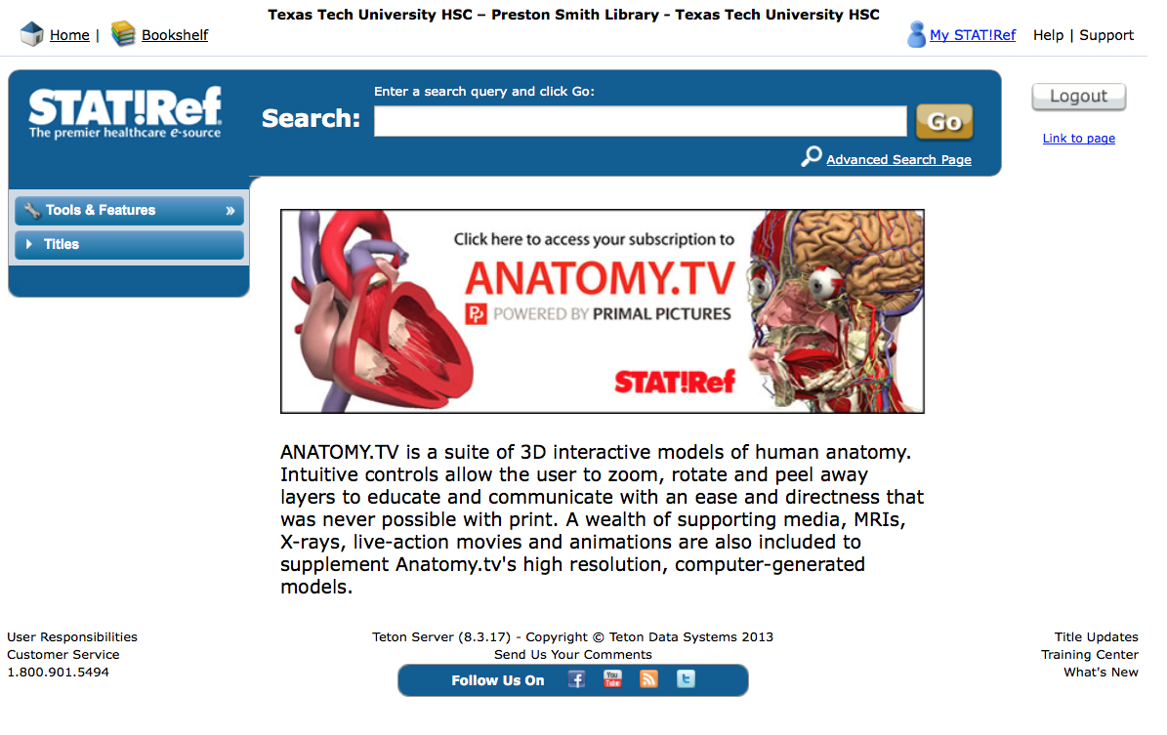
Click

Slide 39
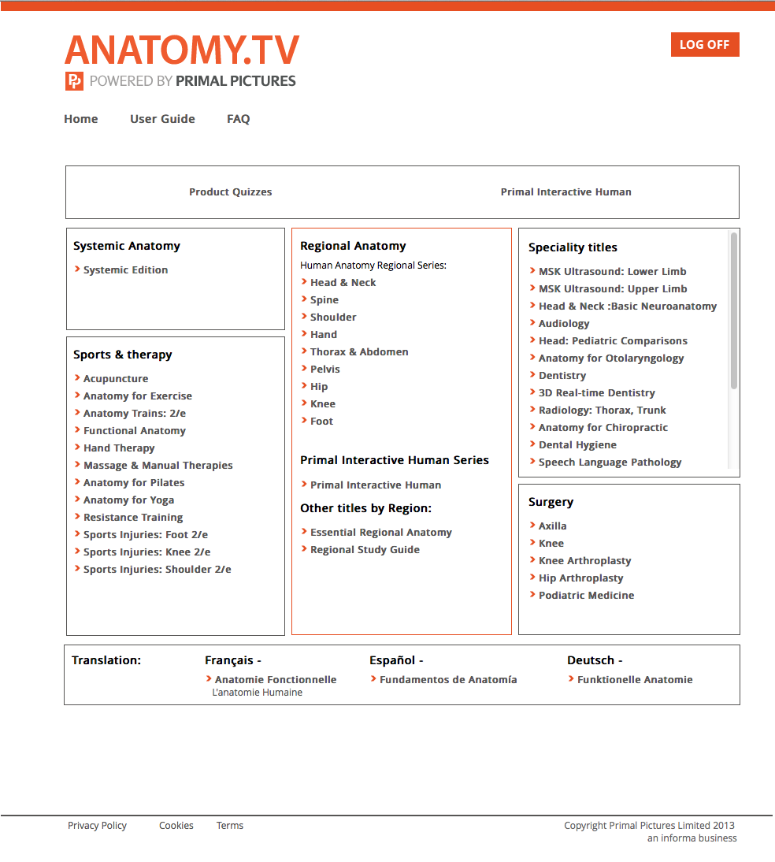
Select Hip for Region

Slide 40
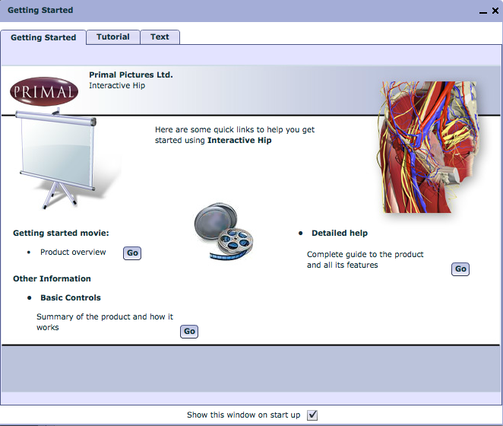
Great Tutorial –
view on own time
Close Screen

Slide 41
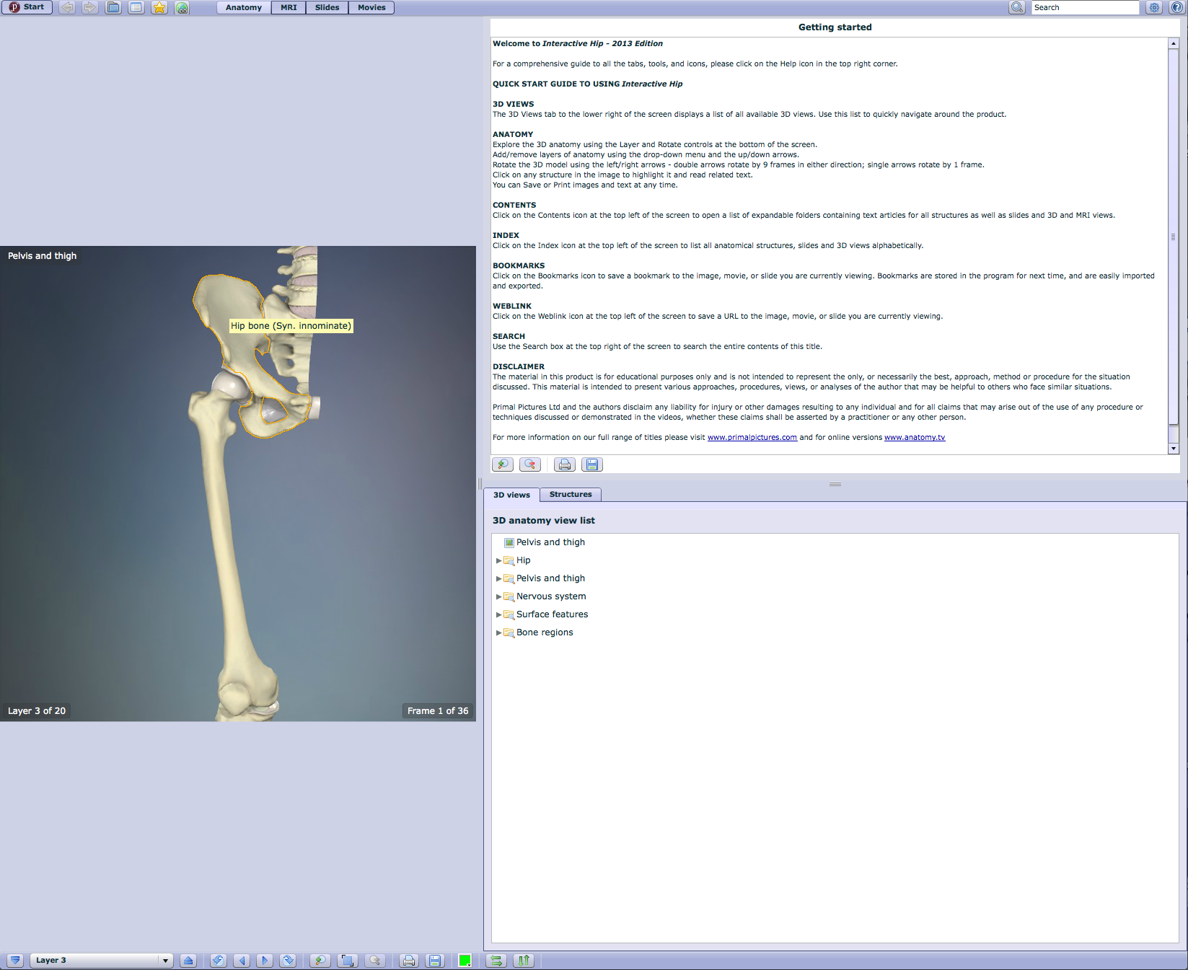
Hover mouse on feature for label
Instructions
Select Layer 10
Layer 3

Slide 42
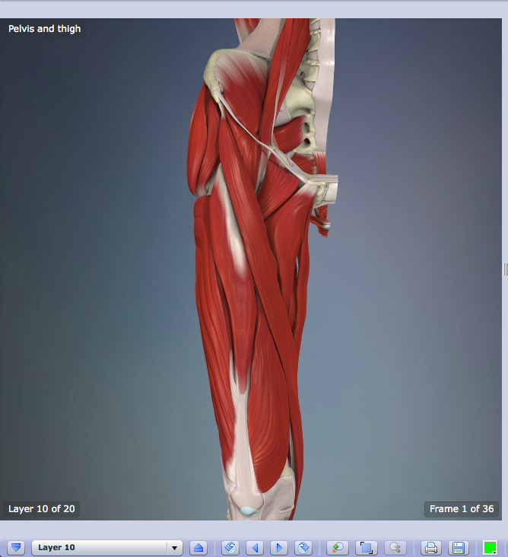
Click arrows
to rotate

Slide 43
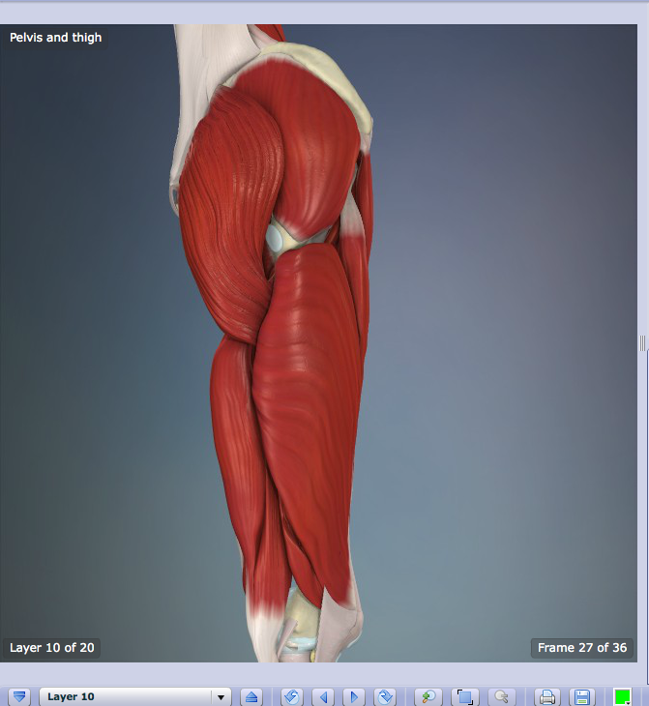
Rotated View

Slide 44
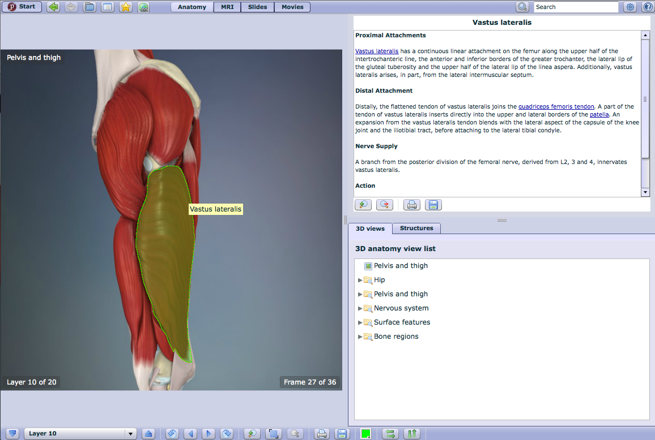
Structure name
and description
Click a
structure

Slide 45
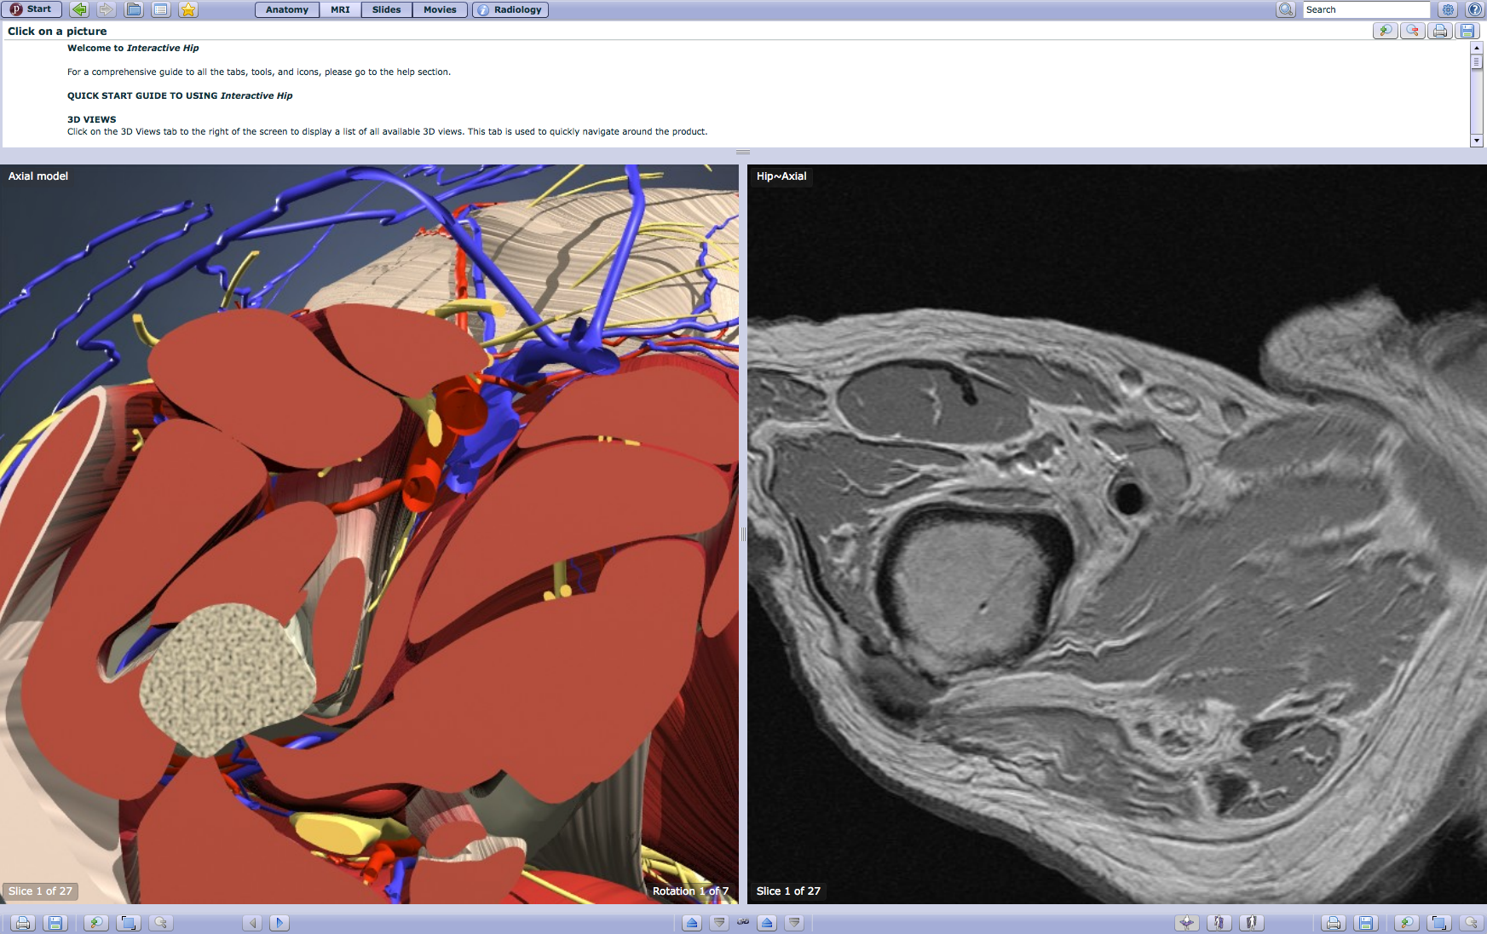
Click MRI

Slide 46
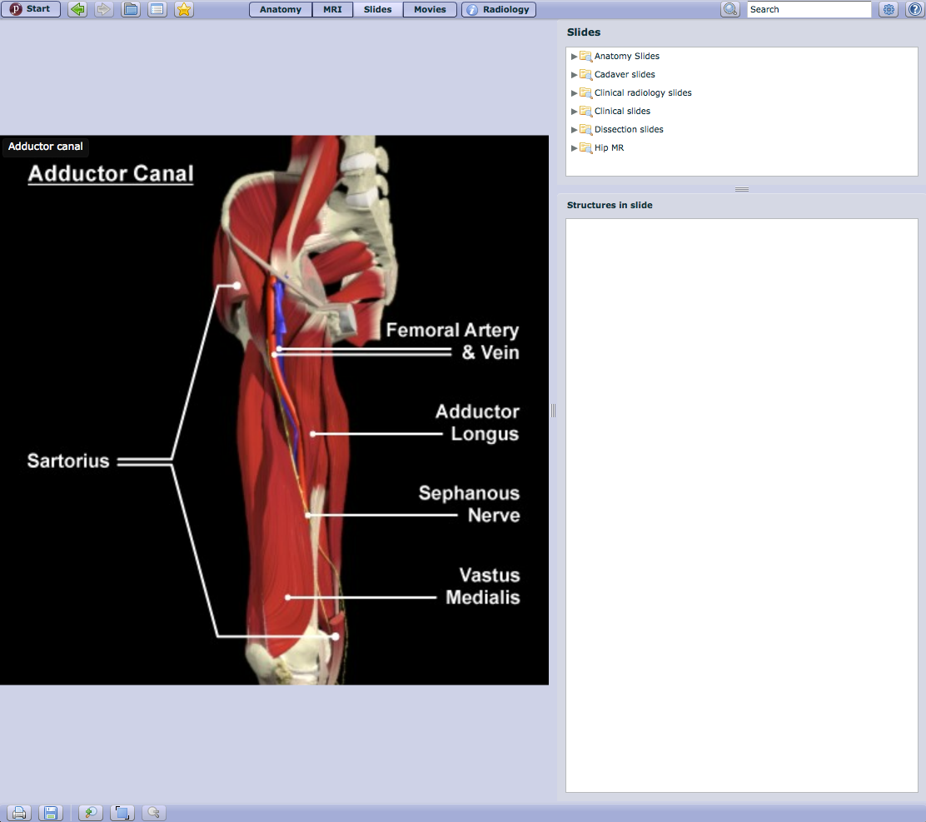
Click Slides

Slide 47
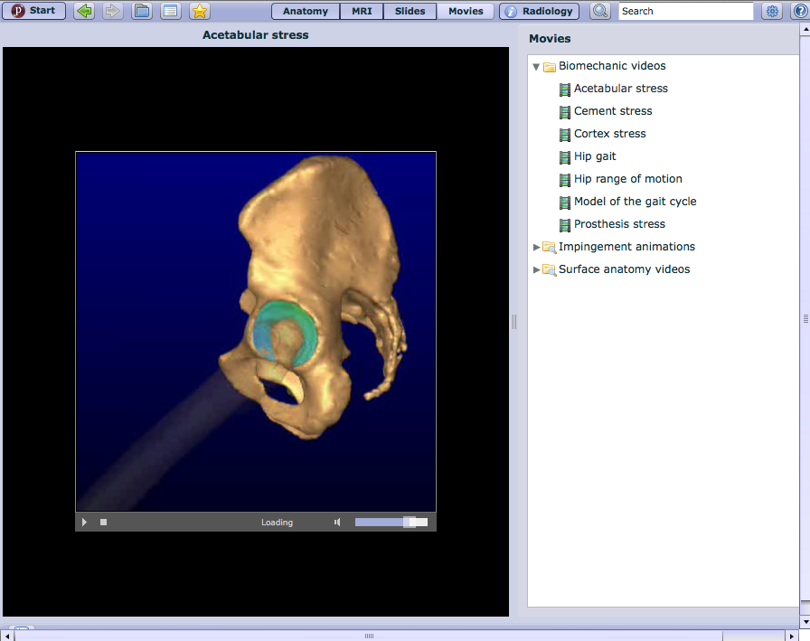
Click Movies

Slide 48
Click Product Quizzes

Slide 49
Netter Presenter
www.ttuhsc.edu/libraries
Hover over
Online Multimedia
Click Netter Presenter

Slide 50
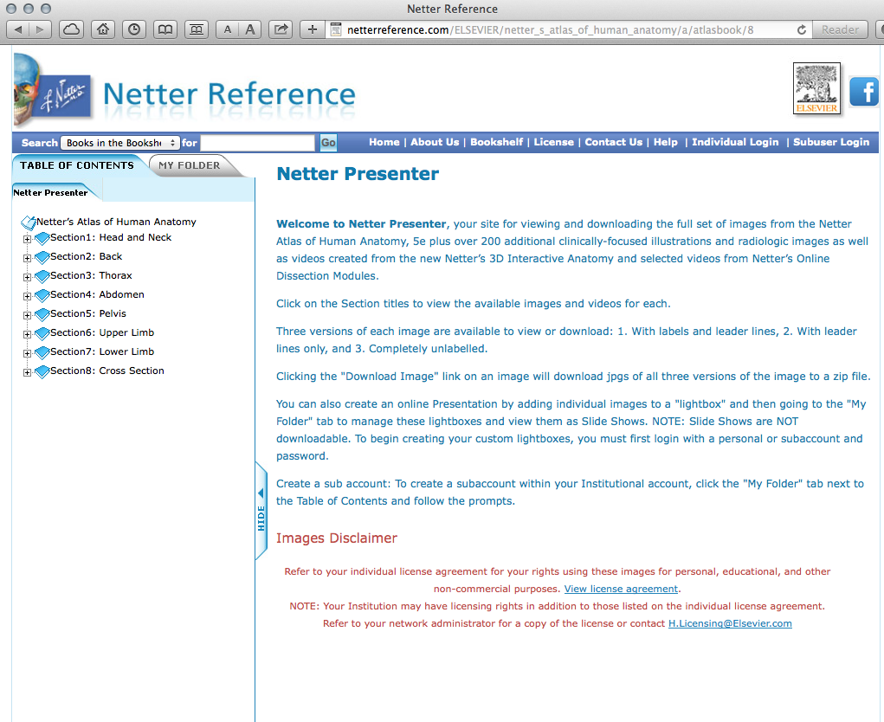
Instructions

Slide 51
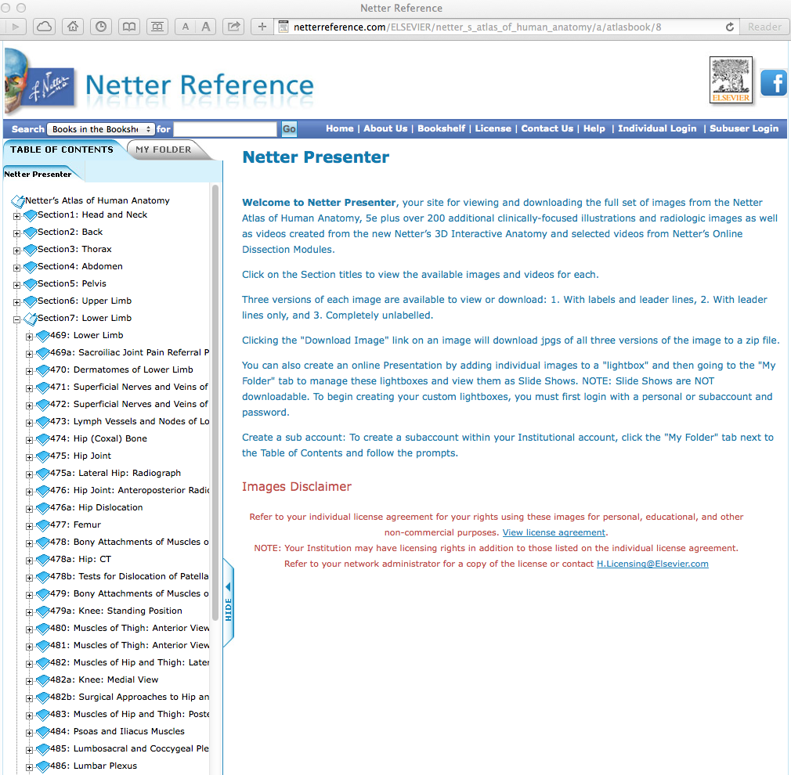
Click Hip Joint

Slide 52
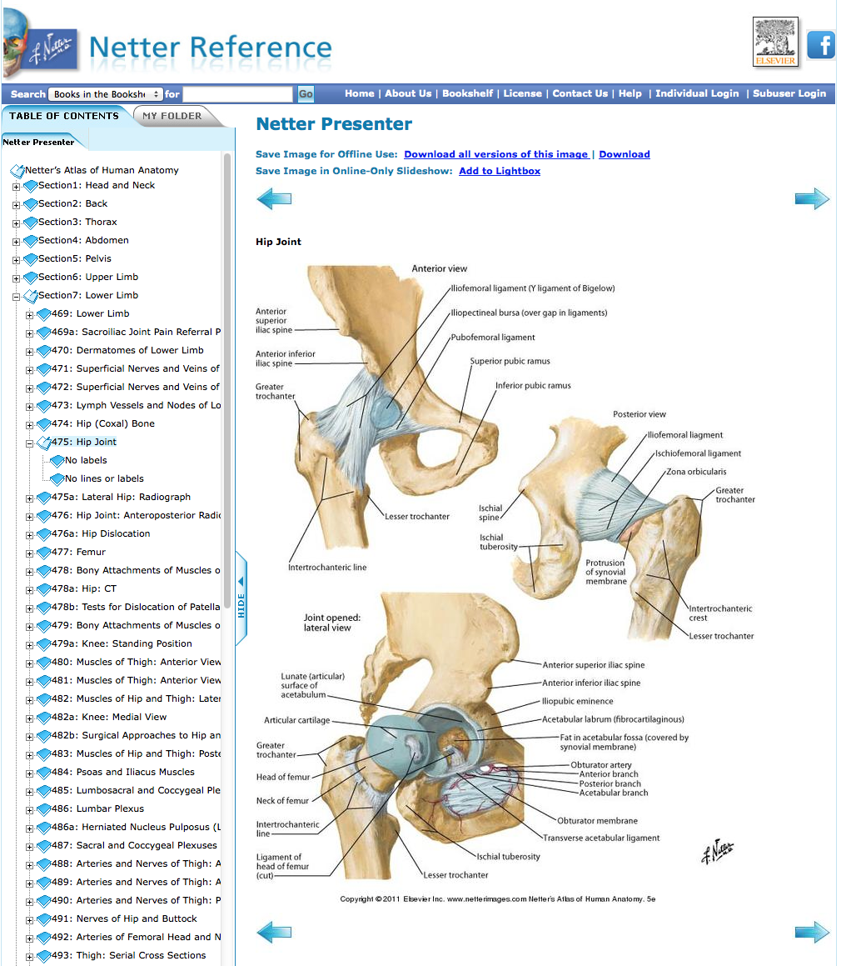

Slide 53
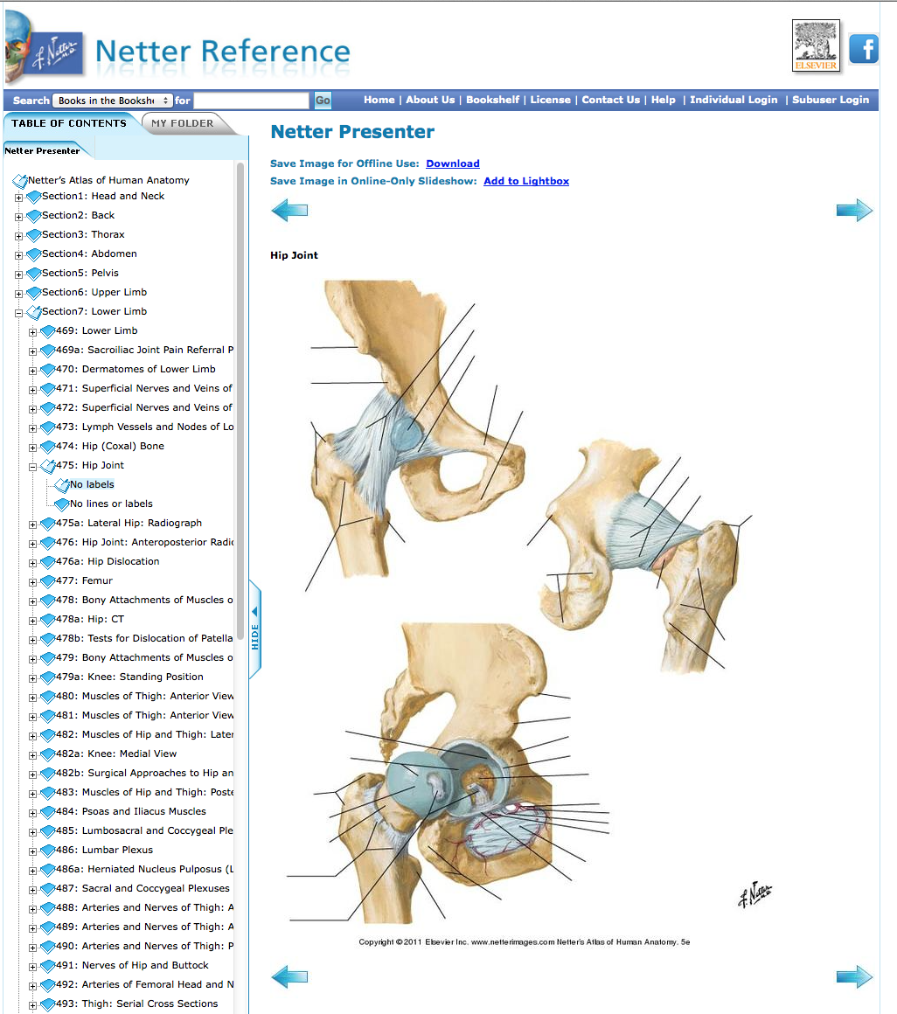
Click Hip Joint
No labels

Slide 54
Have Questions
or
Need Help?

Slide 55
Today’s PowerPoint
www.ttuhsc.edu/libraries
Click Popular
Resources
by School

Slide 56
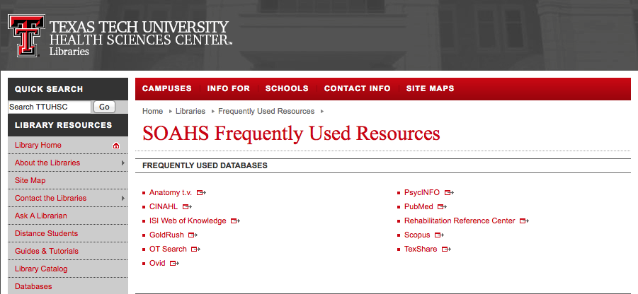
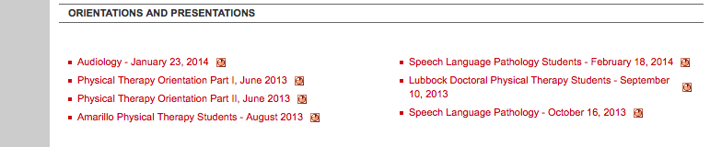
Select
Presentation

Slide 57

or contact us at:
Lubbock
(806) 743-2200
Amarillo
(806) 354-5448
El Paso
(915) 545-6652
Odessa
(432) 335-5171

Slide 58
Hands-on Questions

Slide 59
Practice Questions
Physical therapy for stroke rehabilitation
Pain measurement of shoulder impingement syndrome
Exercise and hip replacement

Slide 60
Suggested Answers

Slide 61
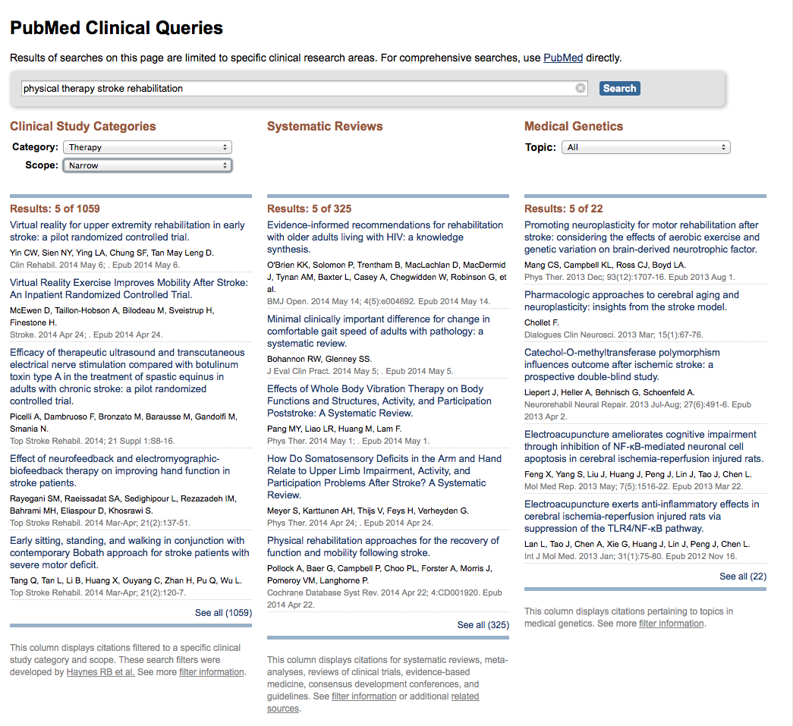
physical therapy stroke rehabilitation

Slide 62
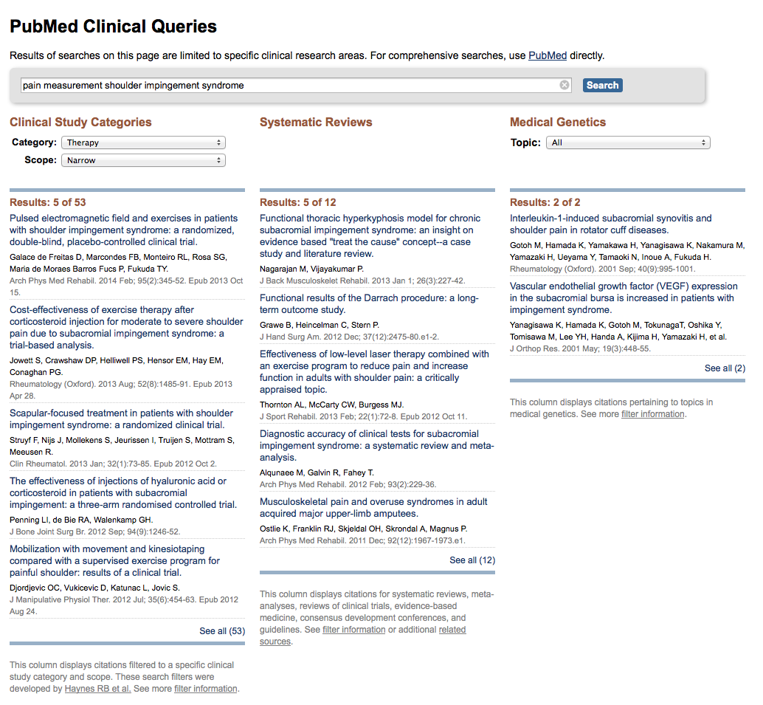
pain measurement
shoulder impingement syndrome

Slide 63
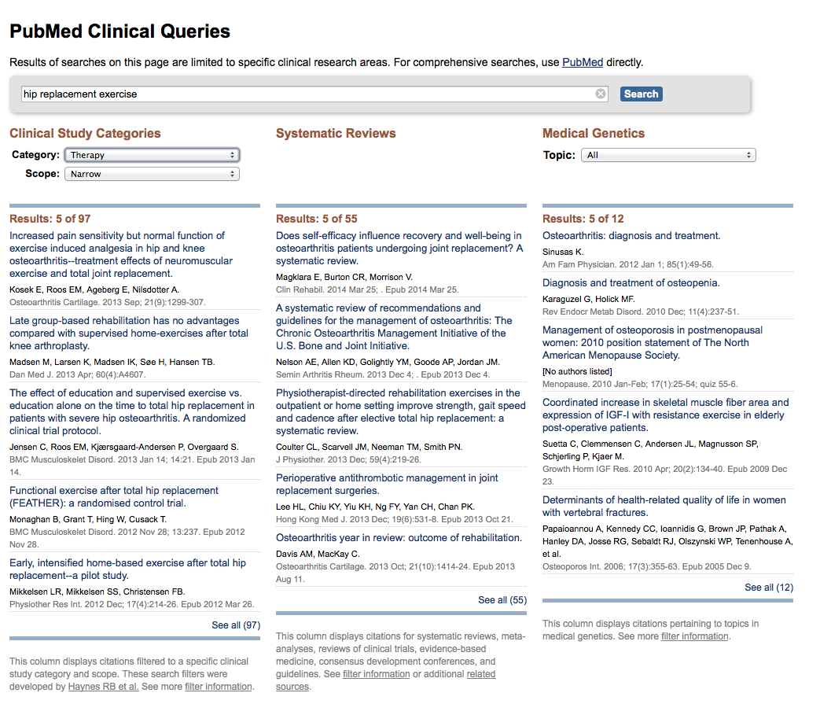
hip replacement exercise

Slide 64
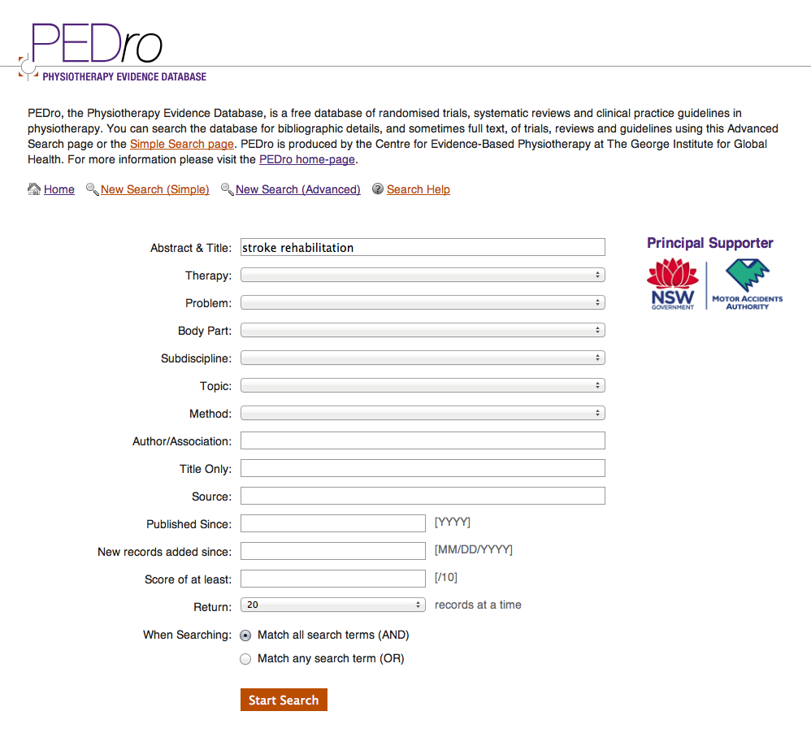
stroke rehabilitation

Slide 65
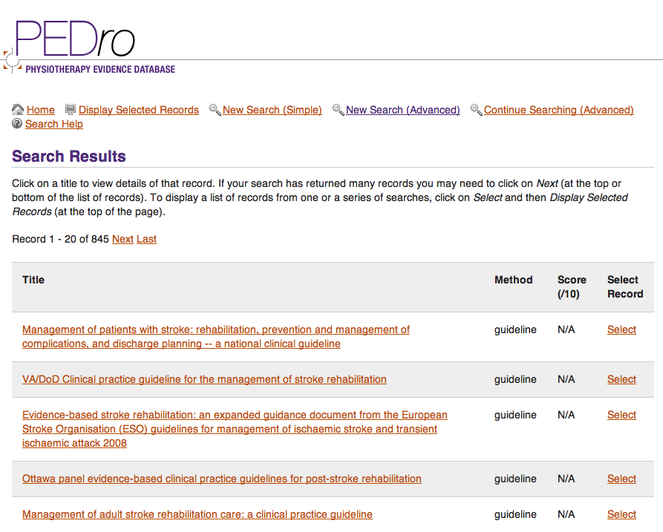

Slide 66
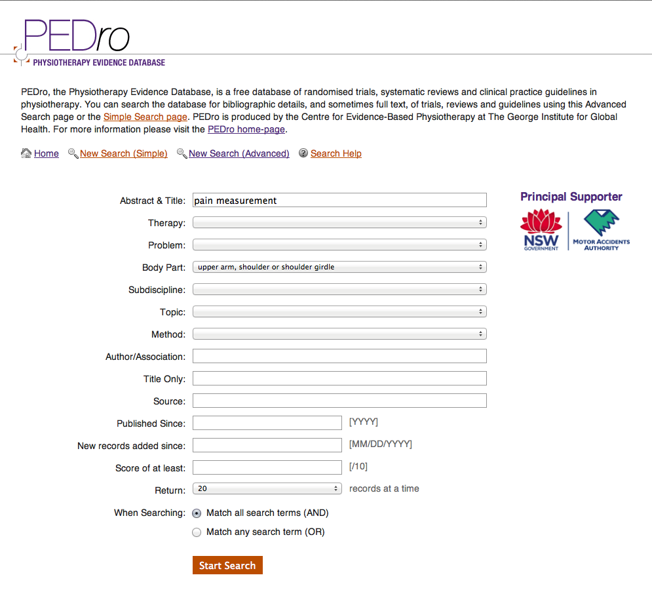
pain measurement
Body Part: upper arm…

Slide 67
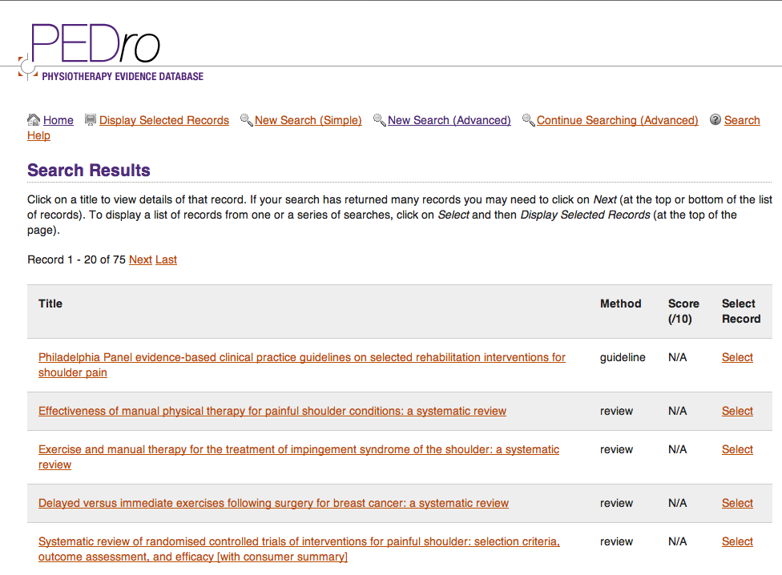

Slide 68

hip arthroplasty

Slide 69


Slide 70
The End
June 2013

