Slide 1
GSBS/Public Health:
Getting to Know Your Library
Jennifer Yack, MSIS
Micah Walsleben, MLS
August 18, 2015

Slide 2
Preferred Internet Browsers
Firefox
Chrome
Safari

Slide 3
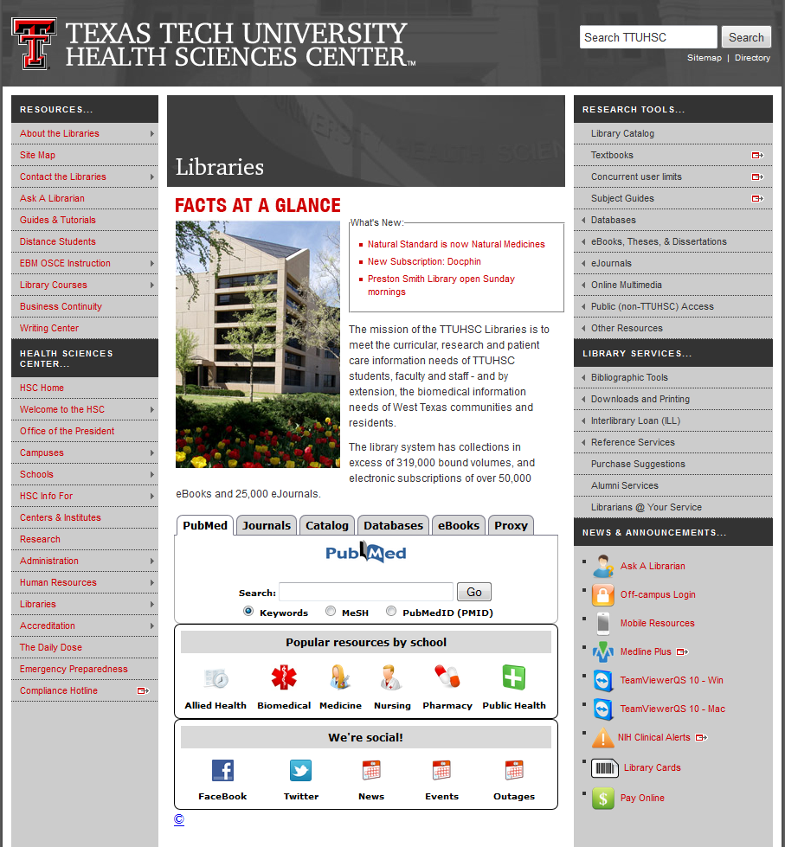
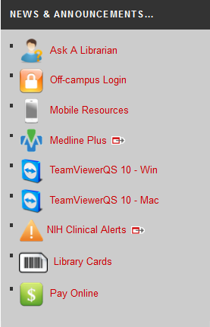
Library Cards

Slide 4
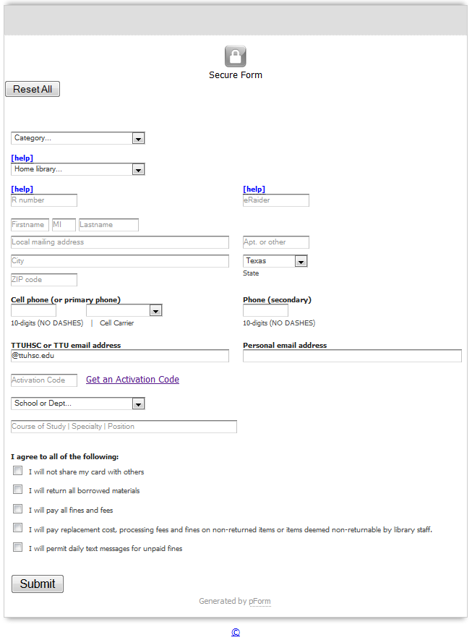
Library Card Application
Fill in “R number” with a capital “R” and your number. Ex: R00000000
Click “Get an Activation Code”, then check your e-mail for it.
Forms take 24 hours to be processed (longer on weekends).
IMPORTANT: You will not receive a physical card. You have the option of coming to the library for a barcode on the back of your ID badge.

Slide 5
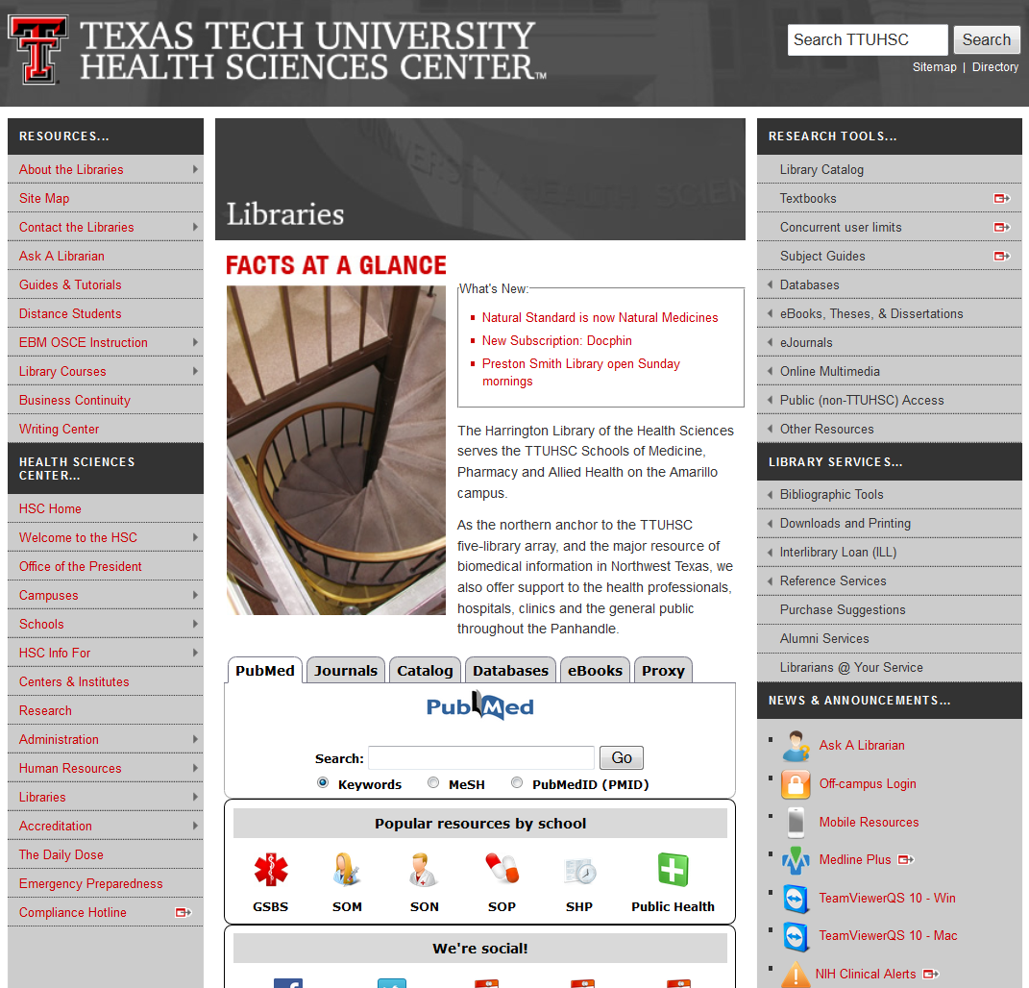
http://www.ttuhsc.edu/libraries/
Please go to the library home page when you have completed your library card application.

Slide 6

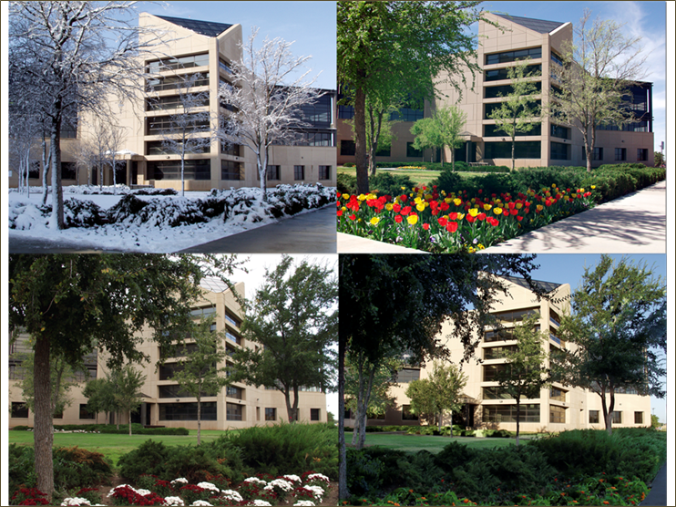


Slide 7

TTUHSC Libraries Statistics
There are libraries at all four campuses
(Amarillo, El Paso, Lubbock & Odessa)
321,952 volumes
62,963 electronic books
209 print journal subscriptions
24,439 electronic journals
17, 691 audiovisuals
574 databases
As of April 24, 2015

Slide 8

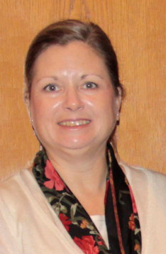

Reference Librarians
Available on 2nd floor of library, across from Learning Resource Center and public computers
8am–5pm
Monday–Friday
Jennifer Yack
Peggy Edwards
Micah Walsleben
Margaret Vugrin

Slide 9
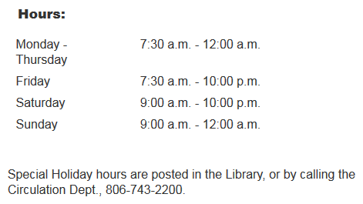
Library Hours
Phone: 806-743-2200
Holiday hours and early closings are also posted as announcements in your e-Raider portal.
Notes:
Here are the normal hours of operation for the Lubbock library. Any special holiday hours or early closing announcements are posted within the library itself and in the announcement section of your eRaider portal. Of course, you can always call the library at the number shown on this slide.

Slide 10
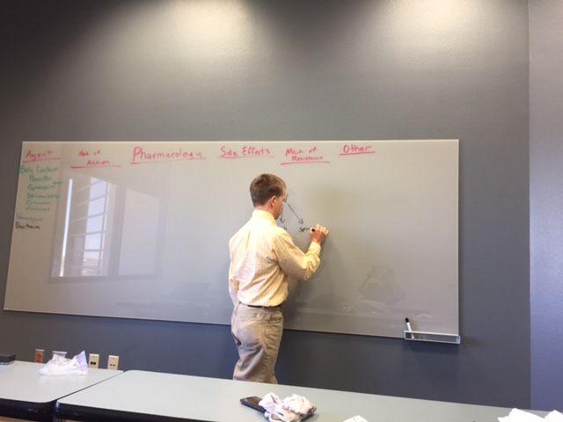
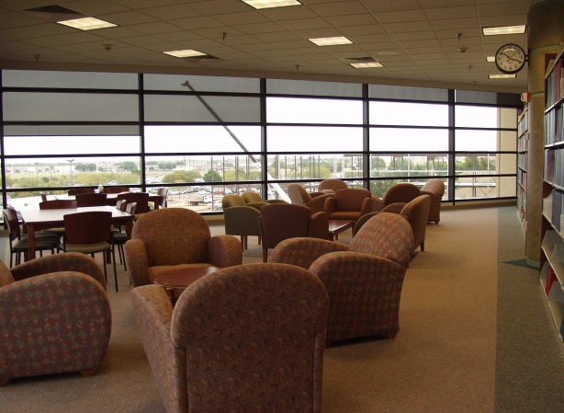
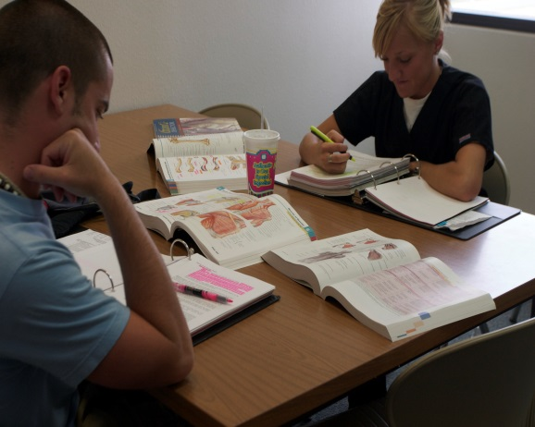
Library Facilities
29 study rooms available
All rooms are first come, first serve
Each room has a dry erase board and markers
The building is wireless, but physical hookups are also available
Notes:
The Lubbock library has a total of 29 study rooms. They are located on the 2nd floor, within the Learning Resource Center, also on the 2nd floor, and on the 3rd floor. There is no reservation system for these rooms; all of them are available to groups or individuals on a “first come, first serve” basis. Each room has a dry erase board and markers as well as wireless or physical internet connectivity.

Slide 11
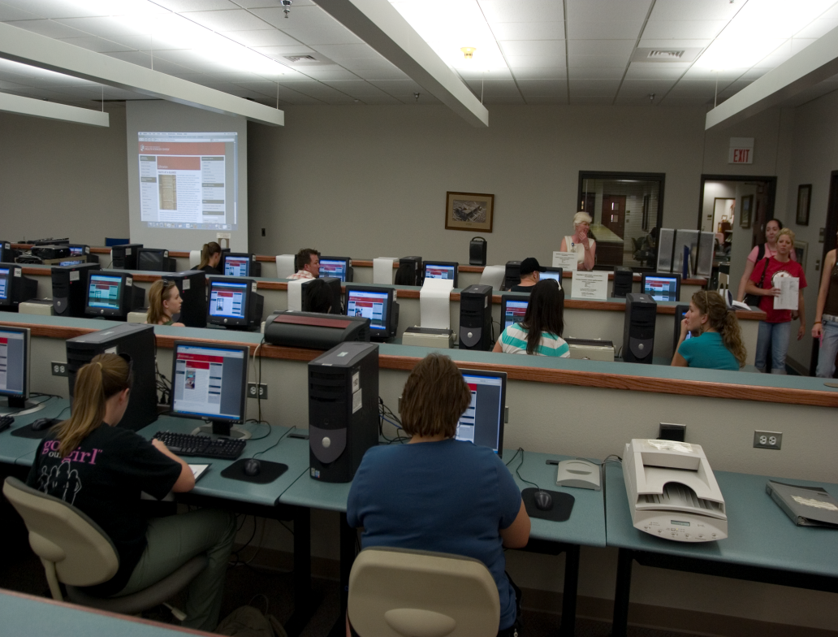
Learning Resource Center
Located on the 2nd floor of the library
Check out computer stations, anatomical models, and more!
3D Printer (available soon!)
Requires a library card
Notes:
The Learning Resource Center is located on the 2nd floor of the Lubbock library. Here, you can check out the library’s audiovisual materials, anatomical models, and computer stations. These materials, including the computer stations, require a library card in order to be checked out. Drinks only are allowed in the Learning Resource Center.

Slide 12


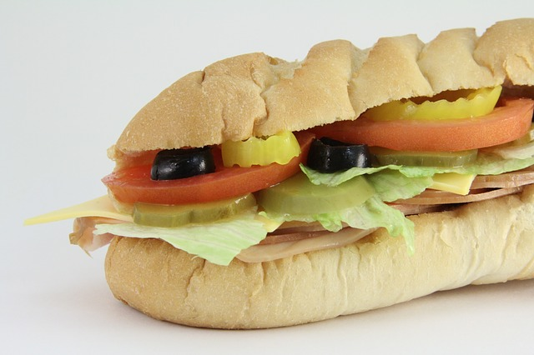

Library Policies
Food & beverage is allowed but please clean up!

Slide 13
Check out & Fines
Books/Audiovisuals/Journals:
Checkout period for books is two weeks, audiovisuals for 10 days.
Journals in the print collection can be scanned but not checked out.
May renew items twice in person, over the phone (806-742-2200), or online through the library catalog.
Fines for overdue items:
50 cents per day per item
Library privileges are lost until fines are paid.

Slide 14
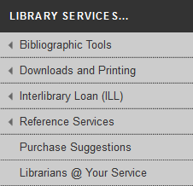
I.L.L. (Interlibrary Loan)
Notes:
Are you writing a paper and need help with APA format? We can’t tell you exactly how to cite your paper, but we do have a compilation of tools and websites to help you. In the middle of the left column of the library website, mouse over “Bibliographic Tools”, then click on “More”.

Slide 15
I.L.L. (Interlibrary Loan) continued
Online form makes submitting requests quick and easy
Response time for requests is anywhere from 2 – 10 business days, depending on location of the item
Books from any TTUHSC branch library are free.
All other locations are $4.00
Journal articles are charged per page, but fees will not exceed $4.00
There is a rush option available, but at a higher fee rate

Slide 16
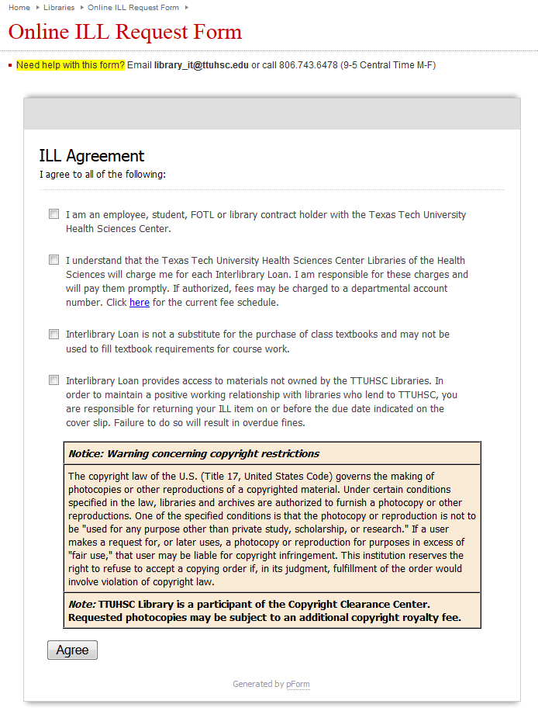
I.L.L. (Interlibrary Loan Form)
http://www.ttuhsc.edu/libraries/illform/

Slide 17
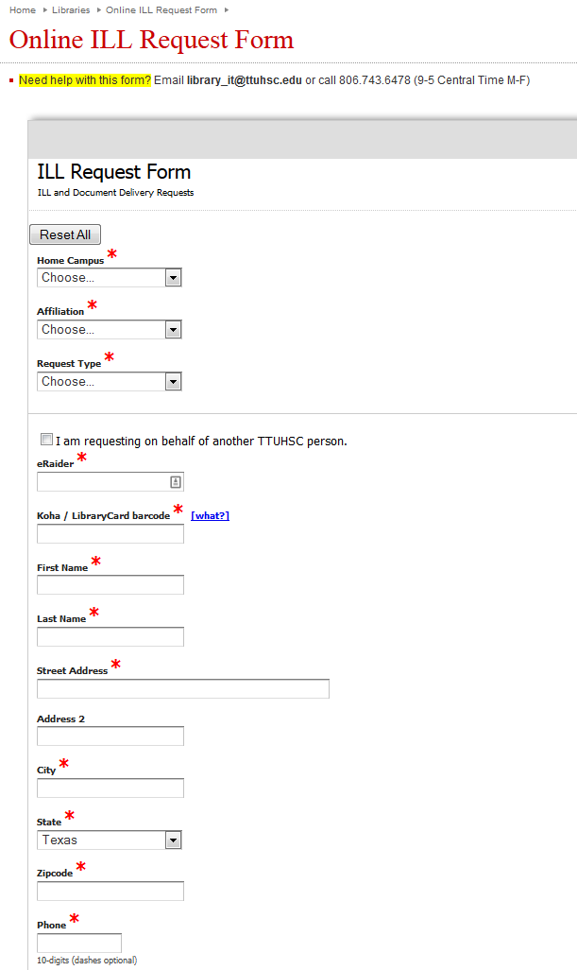
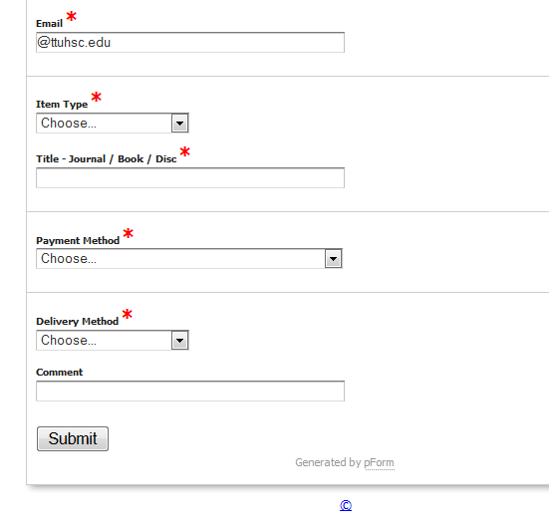
I.L.L. (Interlibrary Loan form) continued
http://www.ttuhsc.edu/libraries/illform/

Slide 18
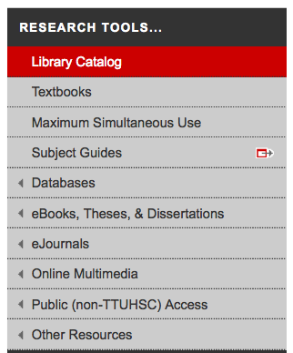
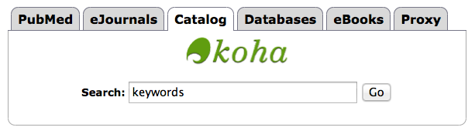
Library Catalog
Two points of access
Notes:
From the library website, there are two points of entry to the catalog. You can select “Catalog” from the toolbar on the right side of the page, or you can choose “Catalog” from the tabs in the middle of the page and either click on the green “Koha” logo or begin a keyword search from the box provided.

Slide 19
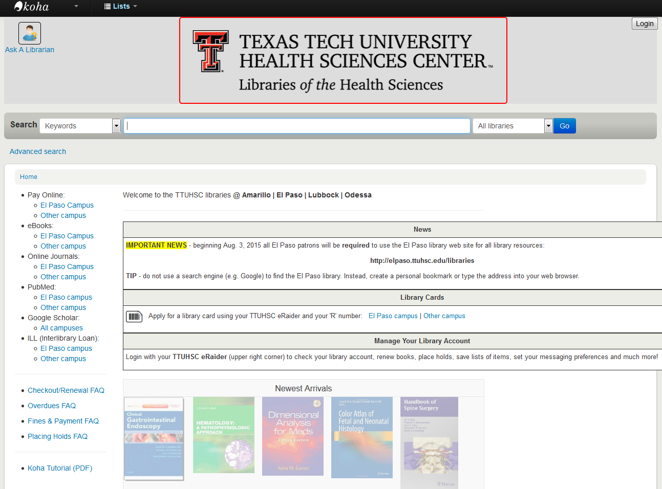
Sign in for your account information
Notes:
The is the main catalog page. From here, you can search the libraries at all our branches for the book that you need. We are also in the process of adding e-books to the catalog in the hopes of making the catalog the main searching tool for all books. In the upper right of the screen is an eRaider sign in button. Click and sign in with your eRaider username and password to access your library account. You can see when your materials are due, if you have any fines, and even renew the materials you have checked out.

Slide 20
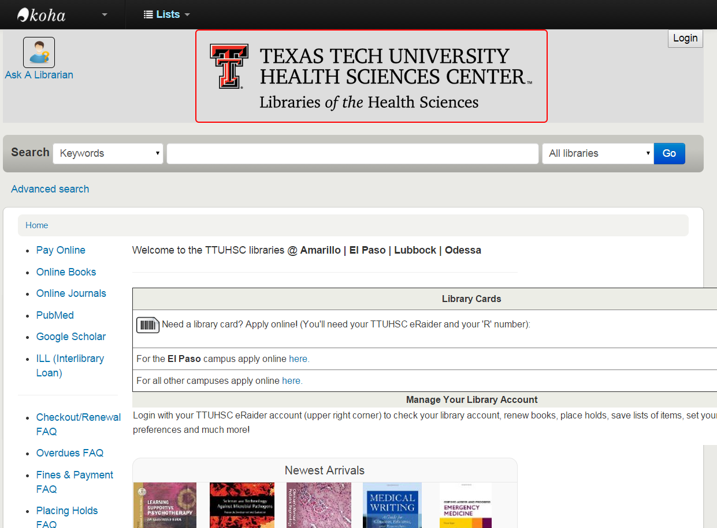
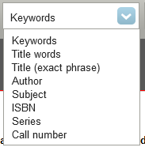
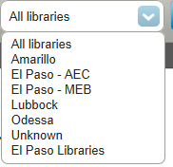
Library catalog
Enter bioinformatics and click Go
Search Box

Slide 21
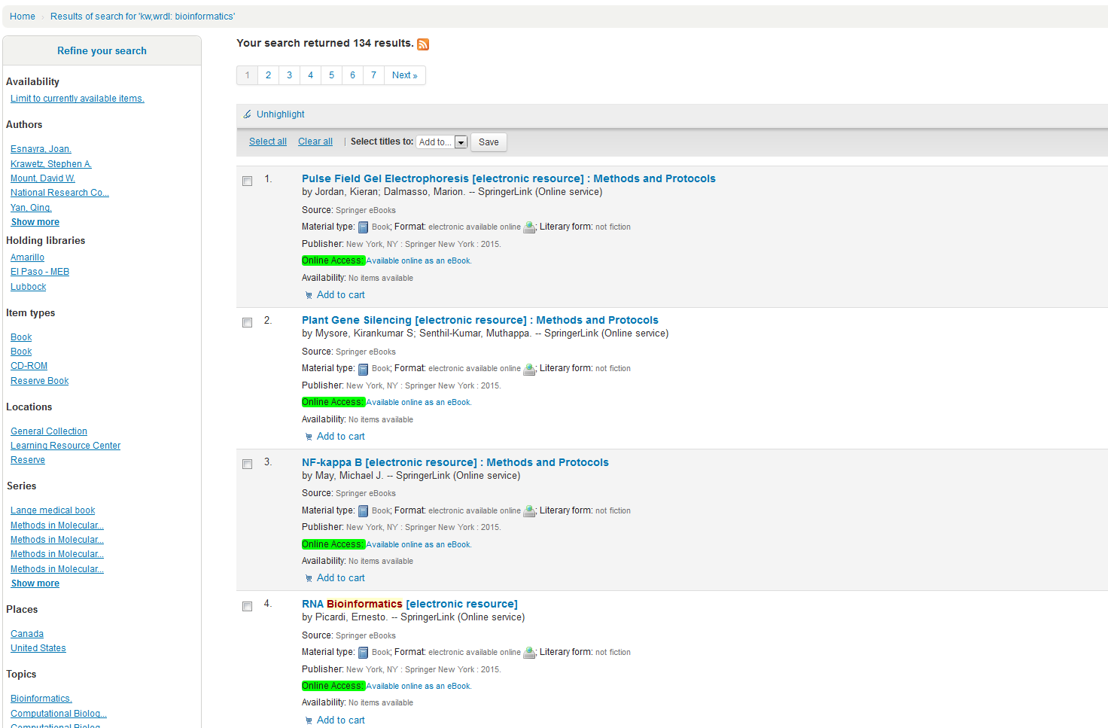

Click Result 4
Notes:
I typed cancer in the search box and left the filter boxes as keywords and All libraries. I received 3084 results. I clicked result 4. It gives me information about type of material it is, subject matter, length and if it is available to check out. No charge if the item is a book from another TTUHSC library. You click Back to results

Slide 22
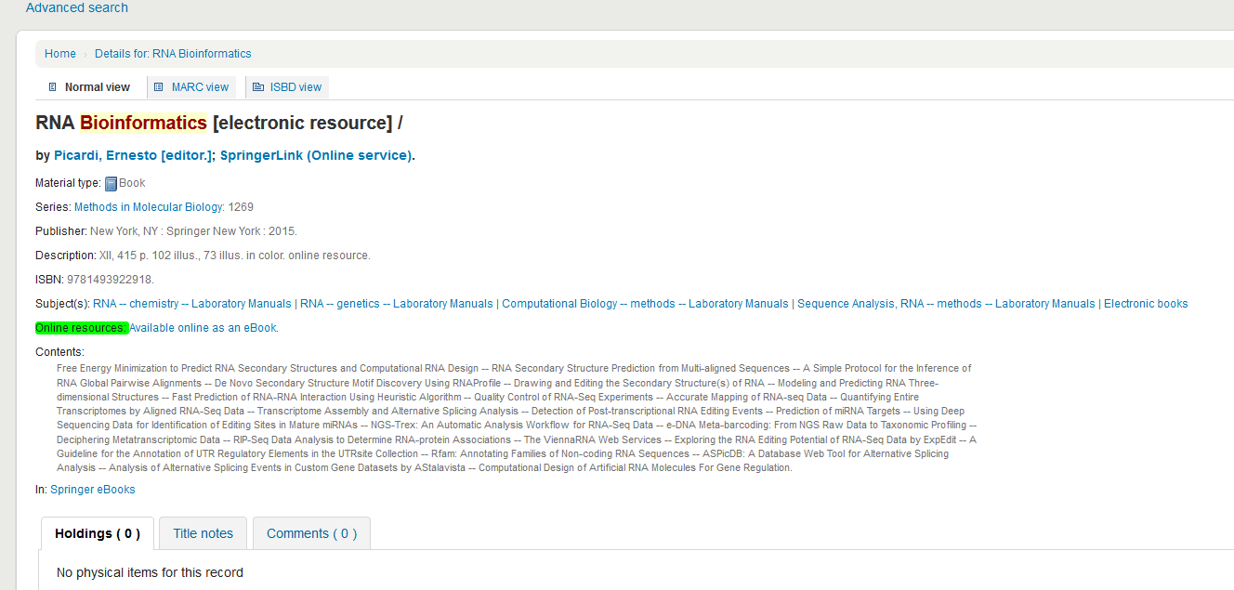
Click

Slide 23
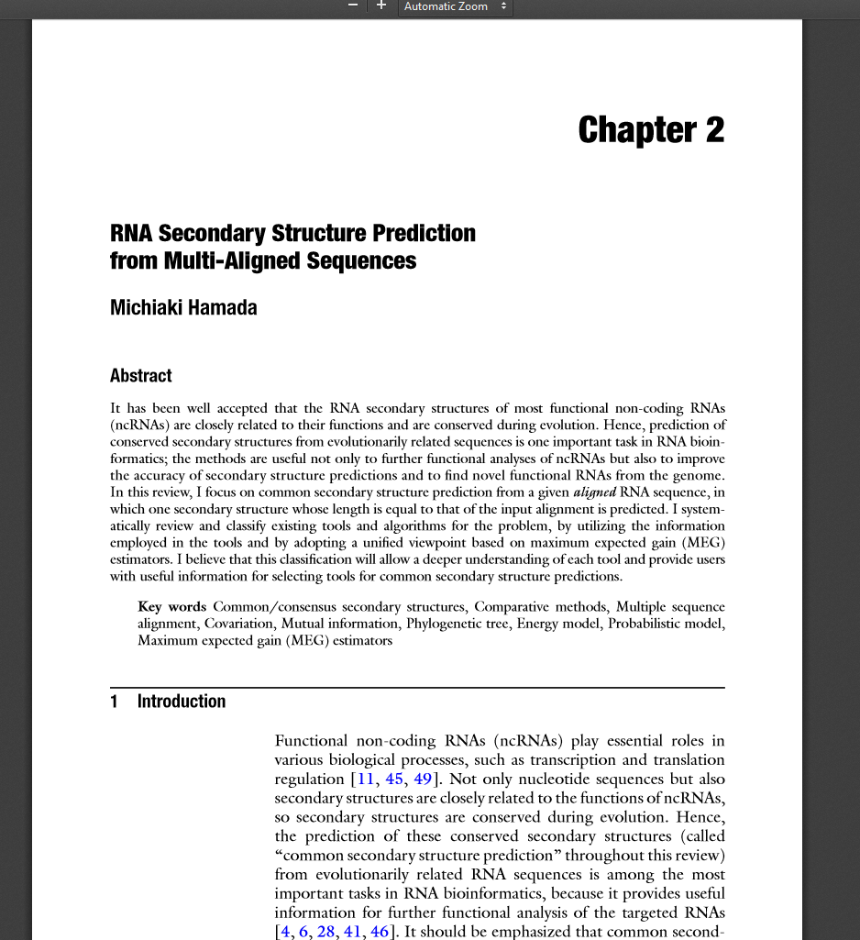
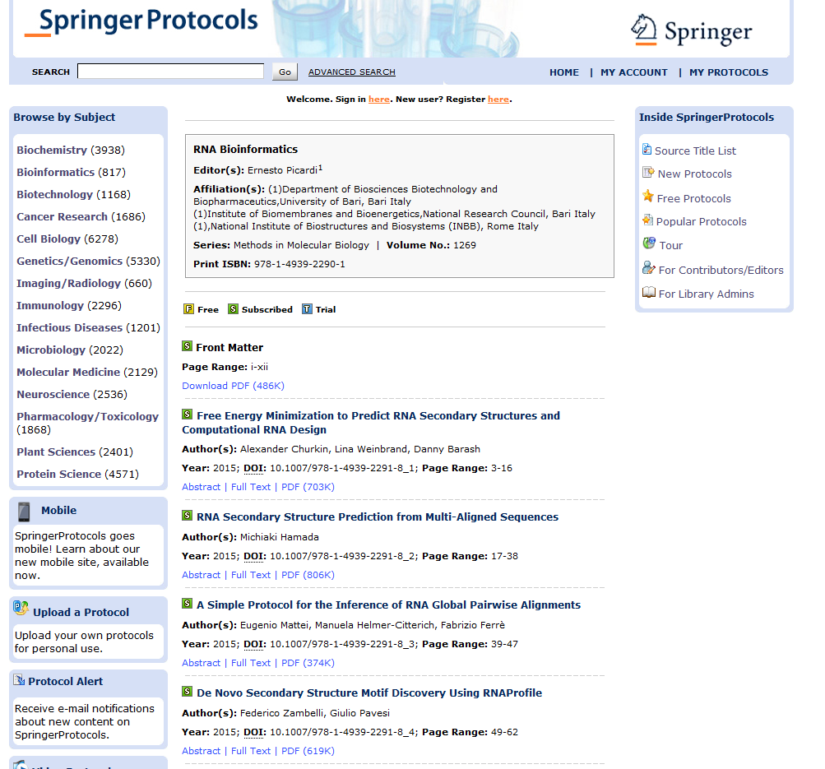

Slide 24
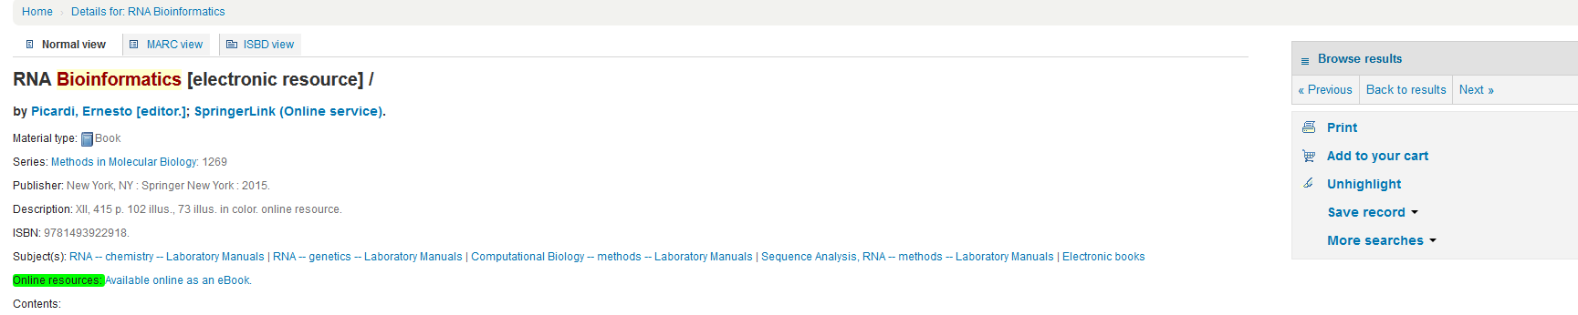
Library catalog
Notes:
I typed cancer in the search box and left the filter boxes as keywords and All libraries. I received 3084 results. I clicked result 4. It gives me information about type of material it is, subject matter, length and if it is available to check out. No charge if the item is a book from another TTUHSC library. You click Back to results

Slide 25
Click page 4

Slide 26
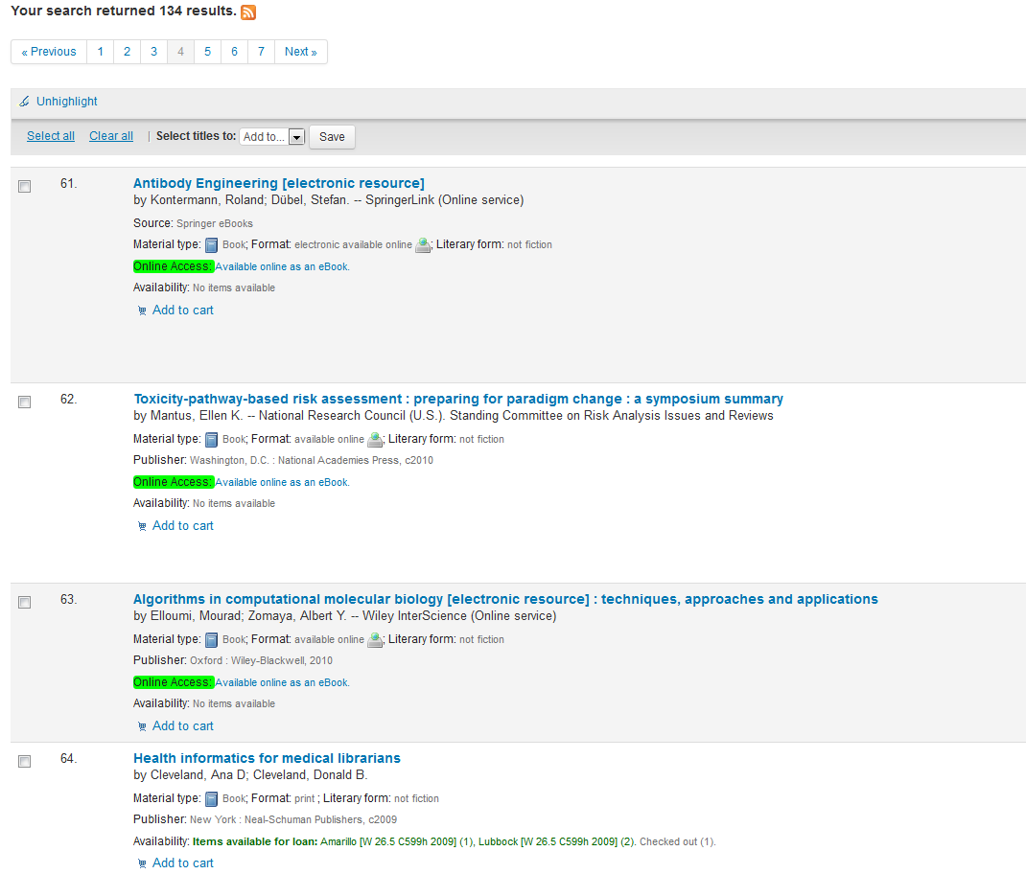
Click Health Informatics for medical librarians

Slide 27
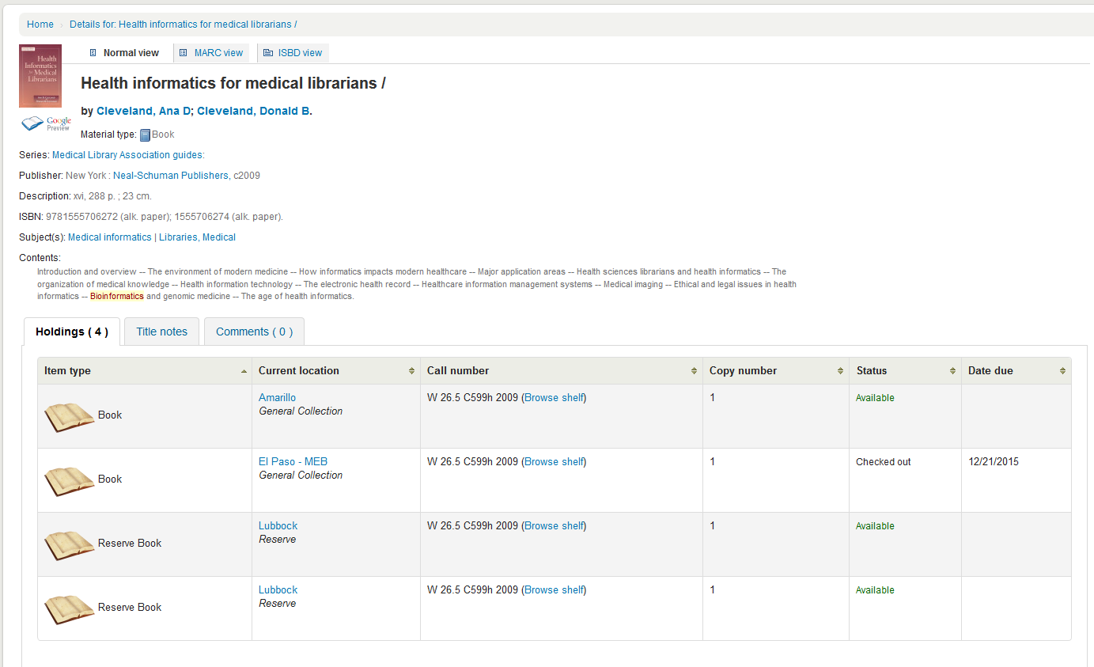
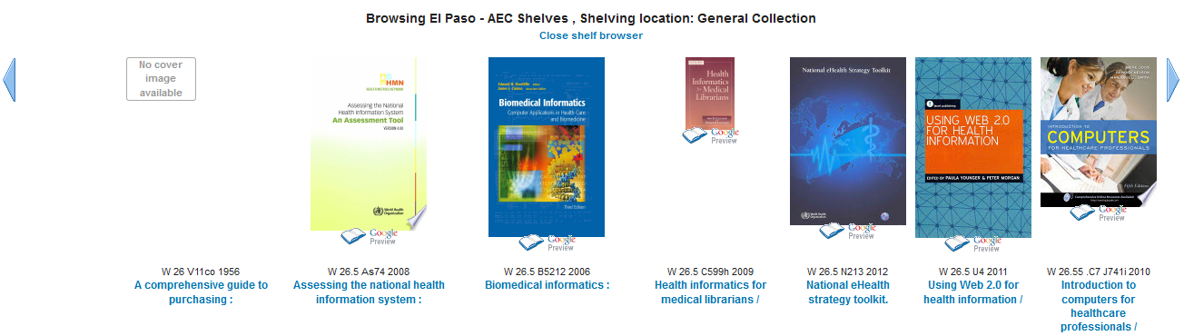

Slide 28
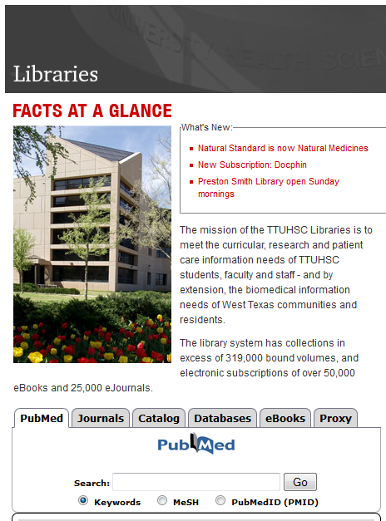
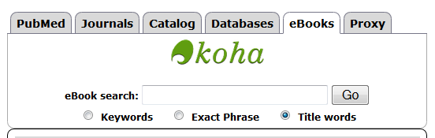
eBooks
Type public health in search box (select Title words) and then click Go

Slide 29
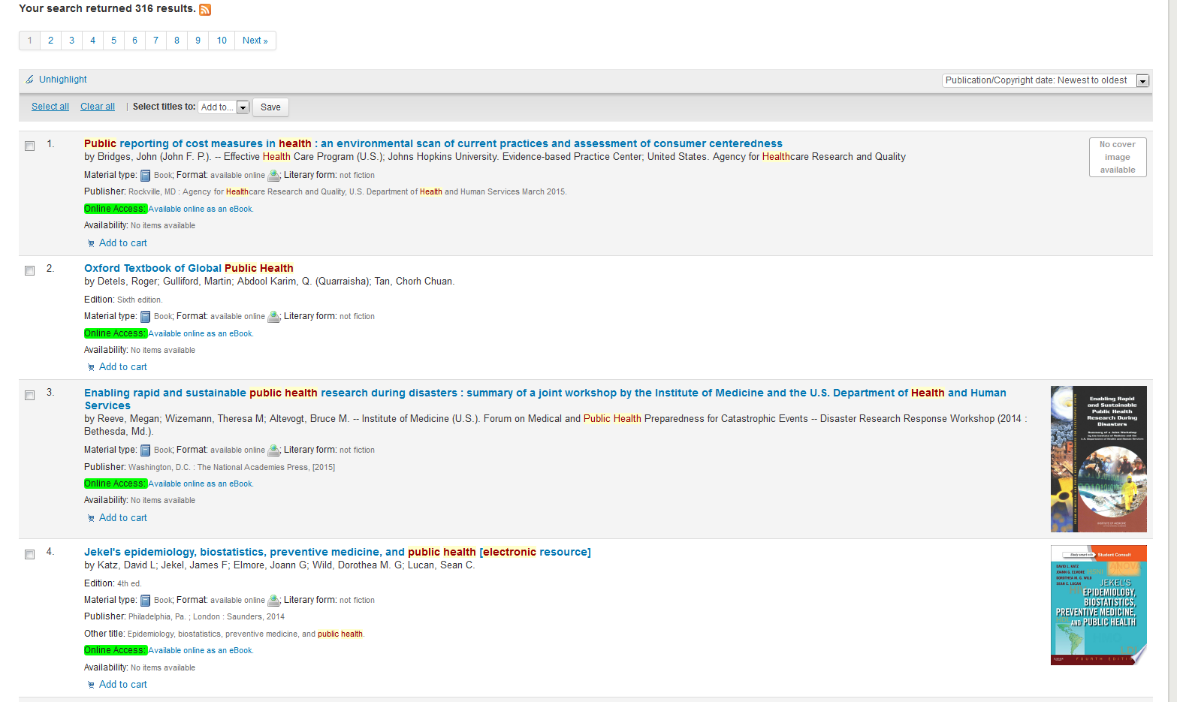

Slide 30


Slide 31
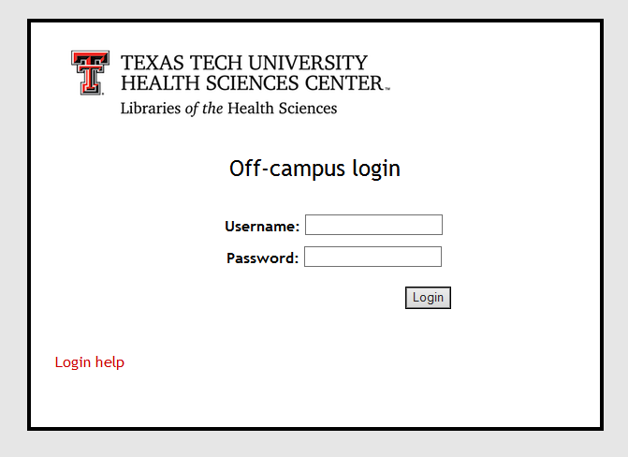
Proxy Server
Off-campus access for library resources:
Sign-in with your eRaider username & password
Problems with eRaider? Call: 806-743-1234
Notes:
All of the online resources provided by the library require that you log in with your eRaider username and password any time you are off campus. If you should ever encounter a problem logging in from off campus, please call the number on the slide as soon as possible.

Slide 32
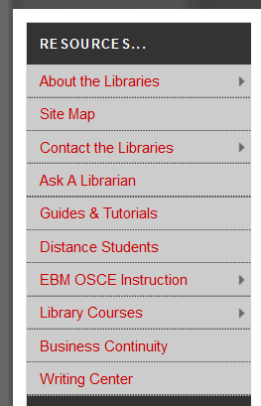
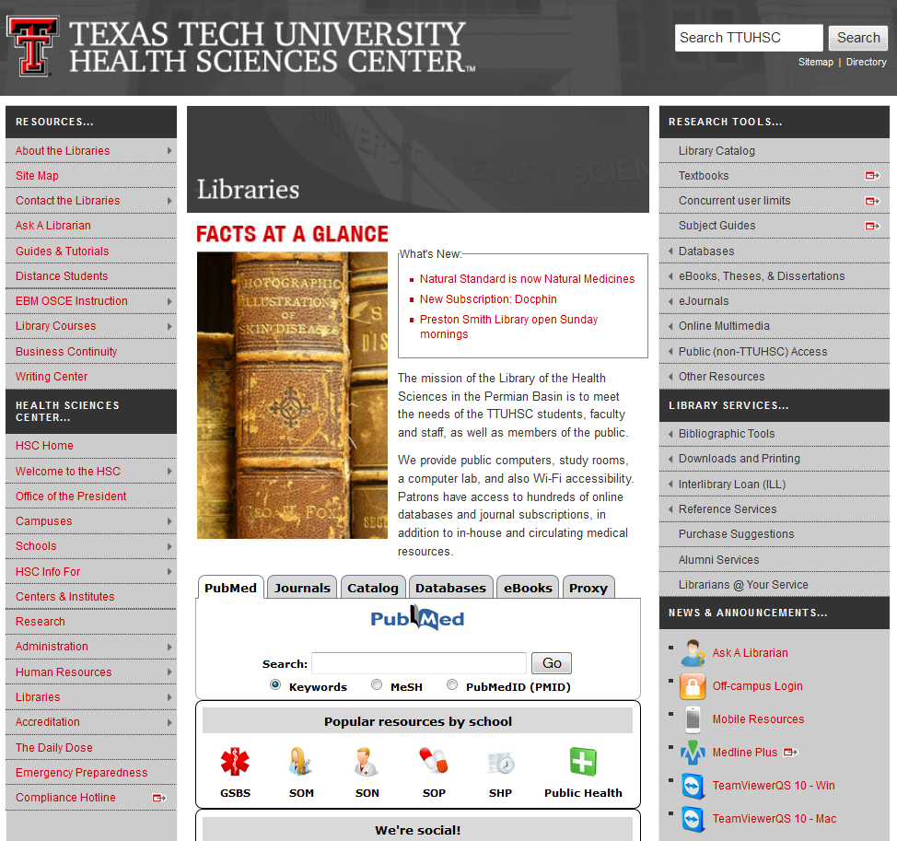
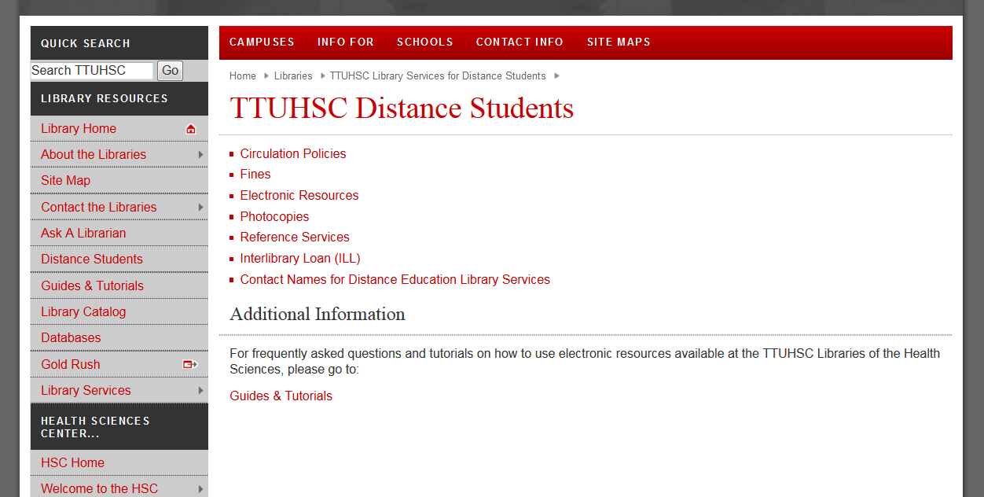

Slide 33
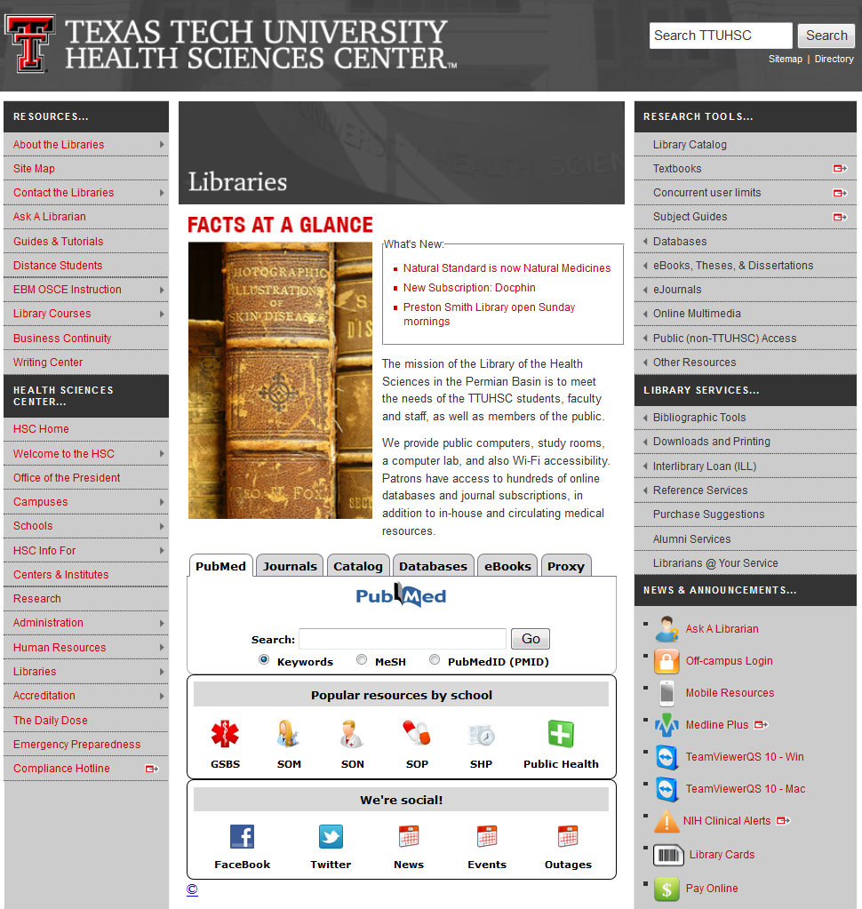
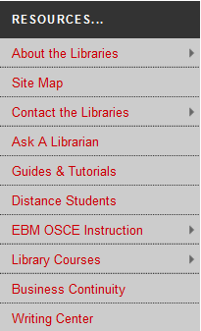
Guides and Tutorials
Online
step-by-step
guides
Notes:
Another place I’d like to point out is our “Guides and Tutorials” page. It’s located in the upper left corner of the library website in the section labeled “Resources”.

Slide 34
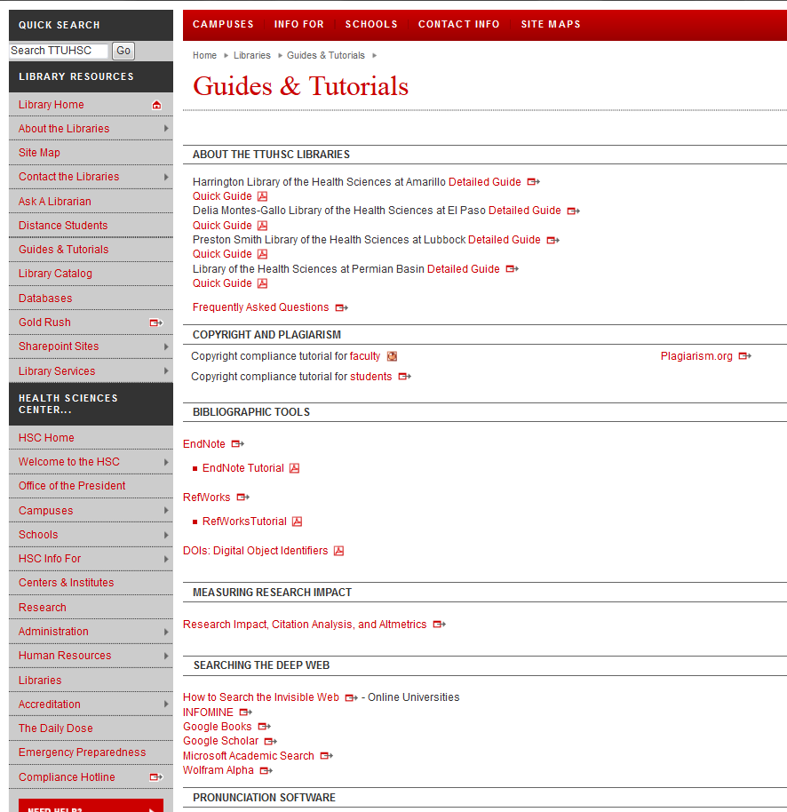
Scroll down to see additional tutorials
Notes:
Here is the “Guides and Tutorials” page. You’ll notice we have guides to all the branch libraries. If you plan to visit one of our libraries, this would be a good place to look up the library’s hours and policies before you go. Scrolling down the page will take you to helpful tutorials on our more popular databases and online resources.

Slide 35

Bibliographic Tools
Notes:
Are you writing a paper and need help with APA format? We can’t tell you exactly how to cite your paper, but we do have a compilation of tools and websites to help you. In the middle of the left column of the library website, mouse over “Bibliographic Tools”, then click on “More”.

Slide 36
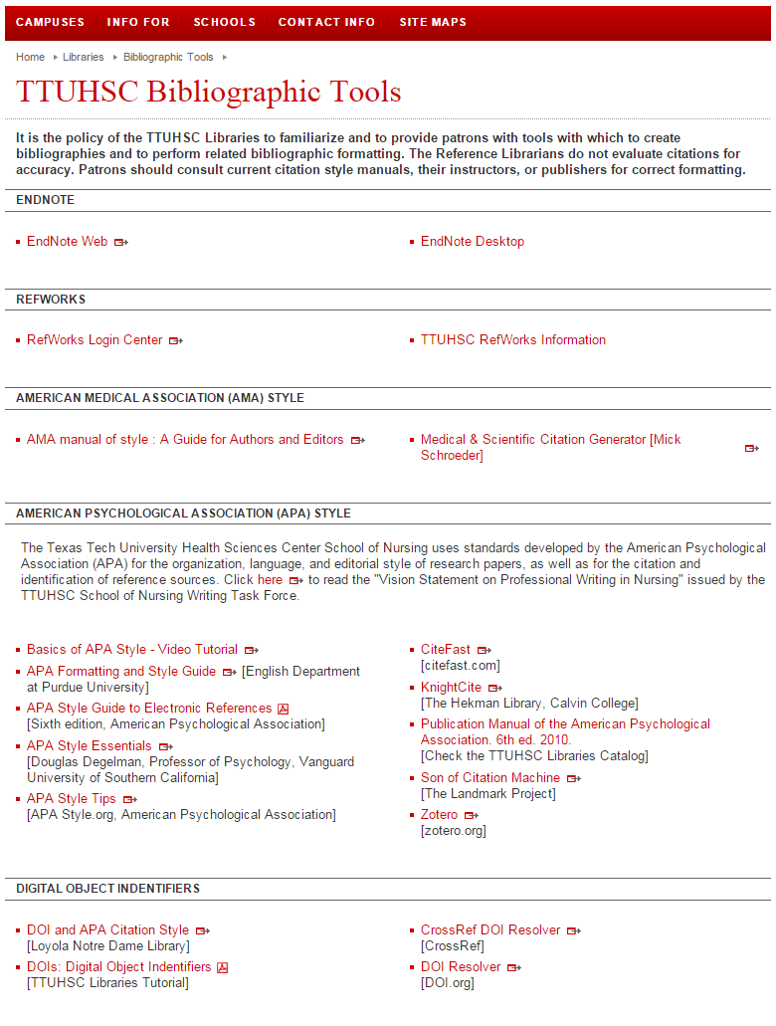
Notes:
Towards the middle of the “Bibliographic Tools” page is this information regarding APA. Here, we have online style manuals, various guides and tutorials, and a few online citation generator tools to help you format your citations.

Slide 37
Online Writing Center!
Notes:
The library has a list of information aimed specifically at distance students. It is available on the upper left side of the library website.

Slide 38
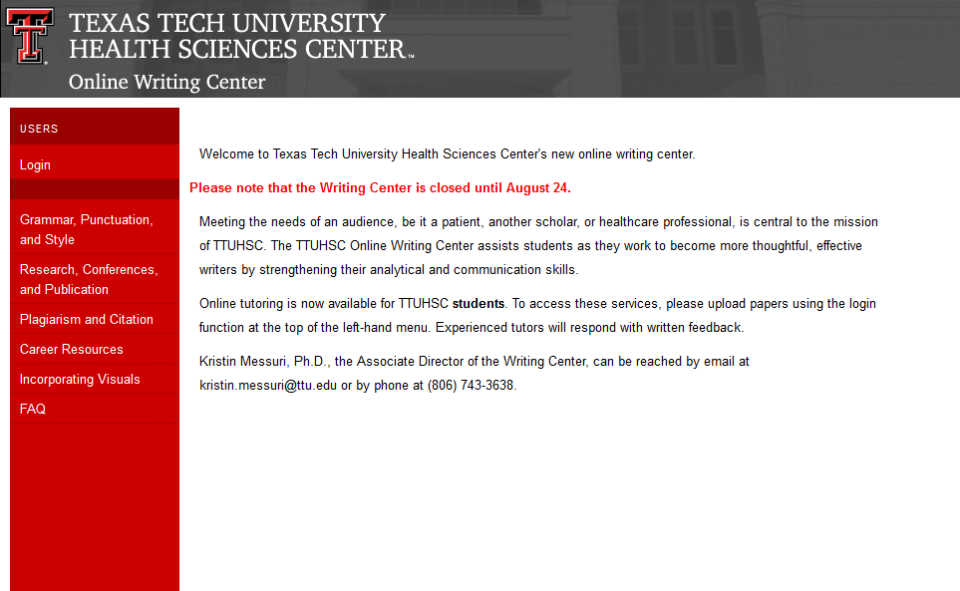

Slide 39
Ask A Librarian
Notes:
If you have a question or need assistance, please don’t hesitate to contact us through our “Ask A Librarian” service. The best way to access this is through the link on the lower right side of the library website.

Slide 40
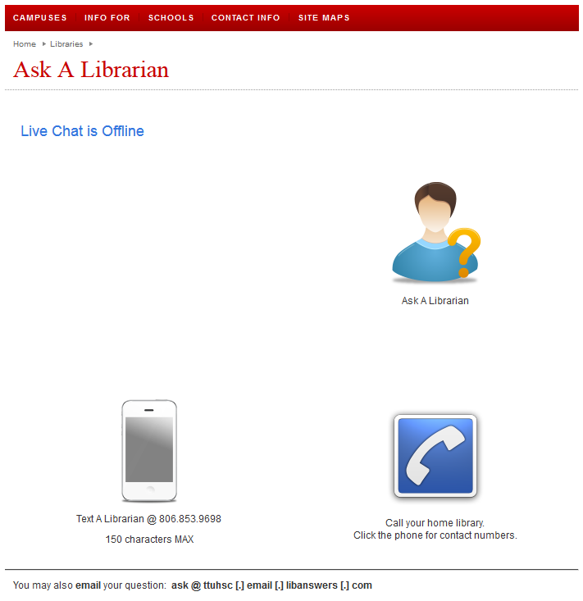
You can always email: mylibrary@ttuhsc.edu
Notes:
From here, there are several ways to contact us. You can submit your question through our Ask A Librarian e-mail form, call the library nearest you, or chat online with a librarian. You now also have the option of texting your question and receiving a text in response. Both the e-mails and texts received are sent to each librarian in all branches of the Health Sciences Center, so you can be assured that your question will be answered in a timely manner.

Slide 41
Team Viewer
Notes:
Another option for receiving additional help from the library is through Team Viewer. Team Viewer is a program that allows the librarian to view your computer desktop remotely in order to help you with your research and other questions in real time. This program is located on the lower right side of the library website. Download options are available for both Windows and Mac systems.

Slide 42

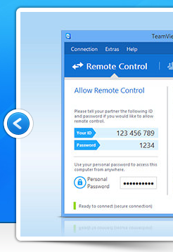


TeamViewer
Remote support
With computer and phone!

Slide 43
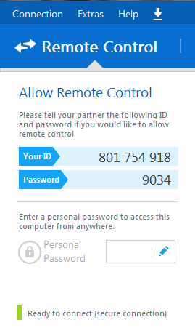
Give your ID and password to a librarian on the phone
We will be able to remotely control your desktop—we will see what you see as well as move your mouse, etc.
Please make an appointment in order to ensure plenty of time to work on your problem!
Notes:
Once you’ve downloaded Team Viewer, an I.D. and password is shown. Give these to a librarian over the phone to allow remote control of your desktop. We will be able to see anything on your screen as well as move your computer’s mouse and click on links. It’s the next best thing to having a librarian at your side! In order to get the most from this service, please call and schedule an appointment in advance. This ensures that there is plenty of time to address your questions.

Slide 44
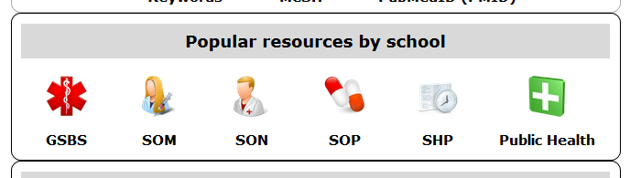
Resources just for you!
Notes:
The library has resources just for you! Starting at the library website, find the tab in the middle of the page labeled “Popular resources by school”. From there, click on the icon labeled “Nursing”.

Slide 45
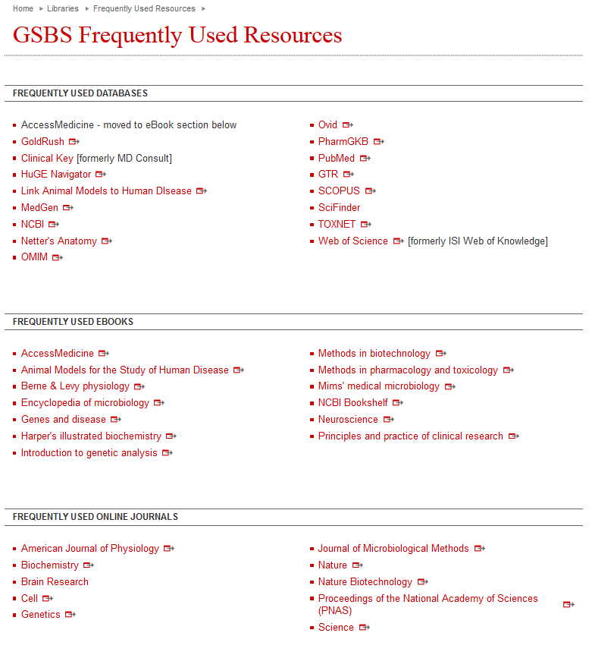
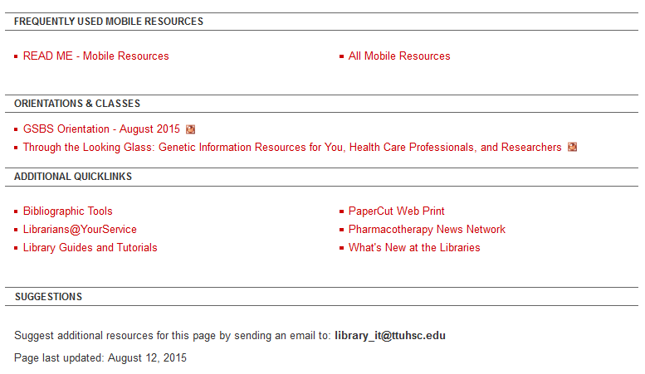
Frequently Used Resources
Today’s presentation will be up in a week or two.
Notes:
This is a list of resources that the School of Nursing faculty has deemed the most important and helpful to their students, although it is by no means a comprehensive list of the resources available to you. It is a great place to start when conducting research for an assignment.

Slide 46
Resources just for you!
Notes:
The library has resources just for you! Starting at the library website, find the tab in the middle of the page labeled “Popular resources by school”. From there, click on the icon labeled “Nursing”.

Slide 47
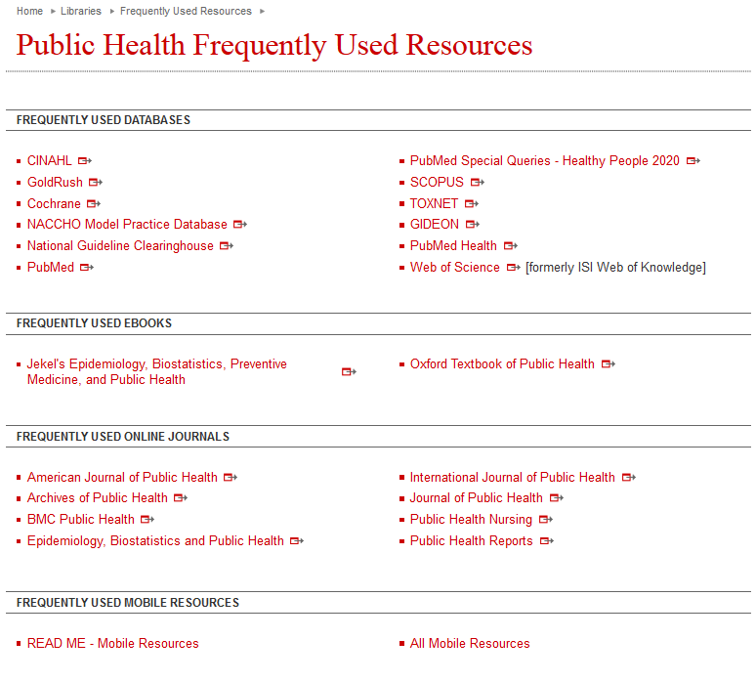
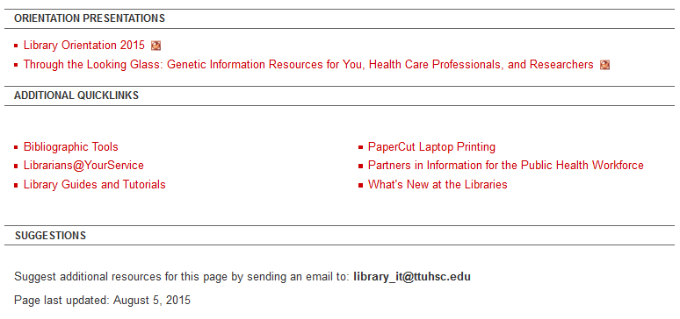
Frequently Used Resources
Today’s presentation will be up in a week or two.
Notes:
This is a list of resources that the School of Nursing faculty has deemed the most important and helpful to their students, although it is by no means a comprehensive list of the resources available to you. It is a great place to start when conducting research for an assignment.

Slide 48

Any Questions?

