Slide 1
TTUHSC Preston Smith Library
presents
Searching PubMed®
Medical Focus
Rev. 09/02/14

Slide 2
To begin...

Slide 3
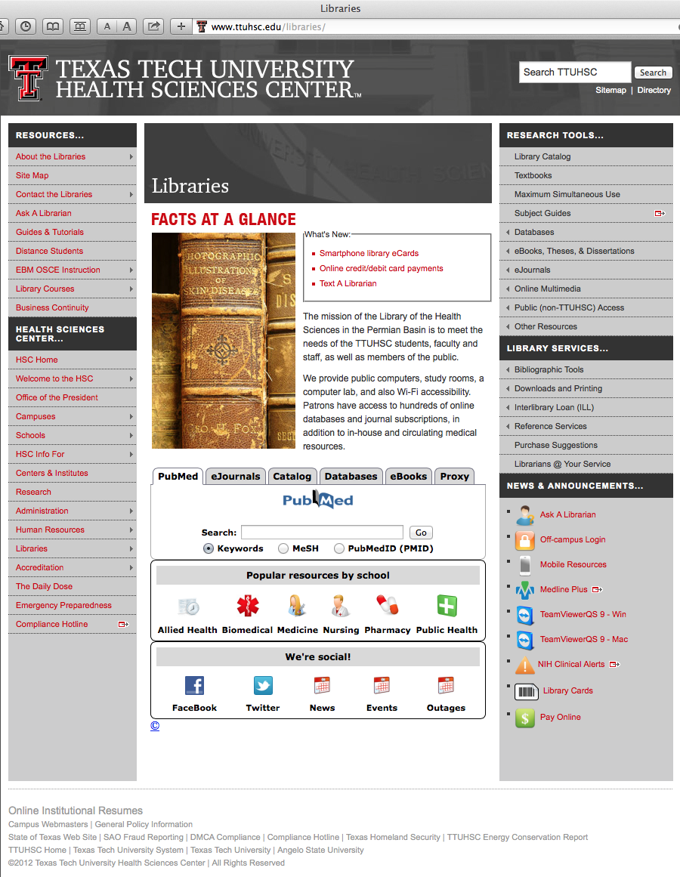
Hover mouse over Databases

Slide 4
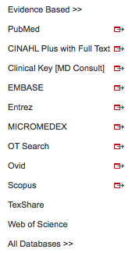
Click PubMed

Slide 5



PubMed Database
Biomedical & life sciences journal literature - @6,000 journals
International scope
Developed and maintained by the:
National Center for Biotechnology Information
    at the U.S. National Library of Medicine
    at the National Institutes of Health

Slide 6

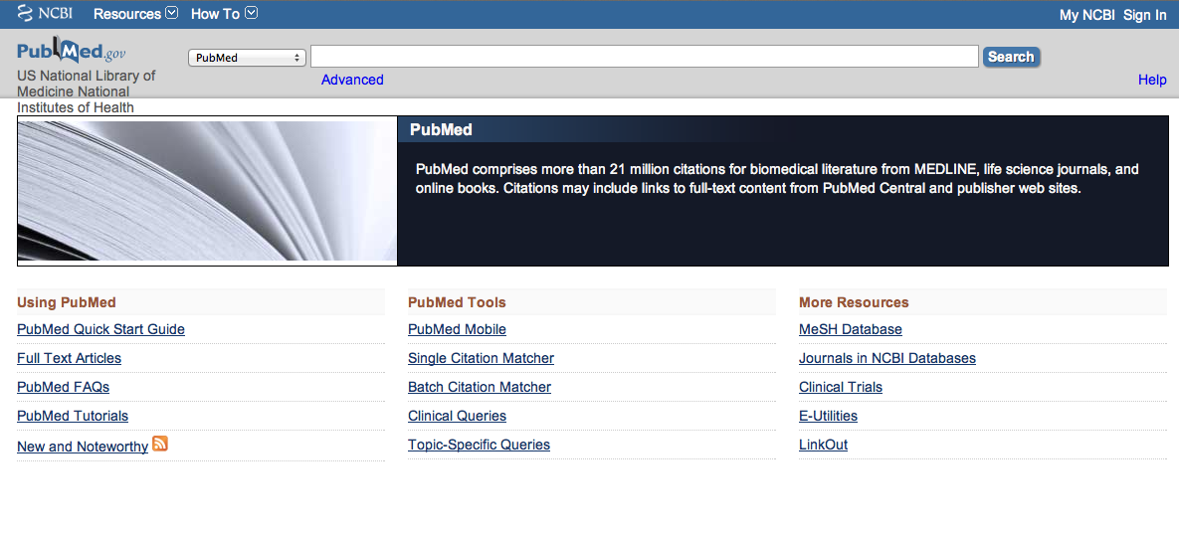
Accessing PubMed
Freely available over the Internet
@ www.pubmed.gov
Also through library’s home page

Slide 7
Creating a
My NCBI Account

Slide 8
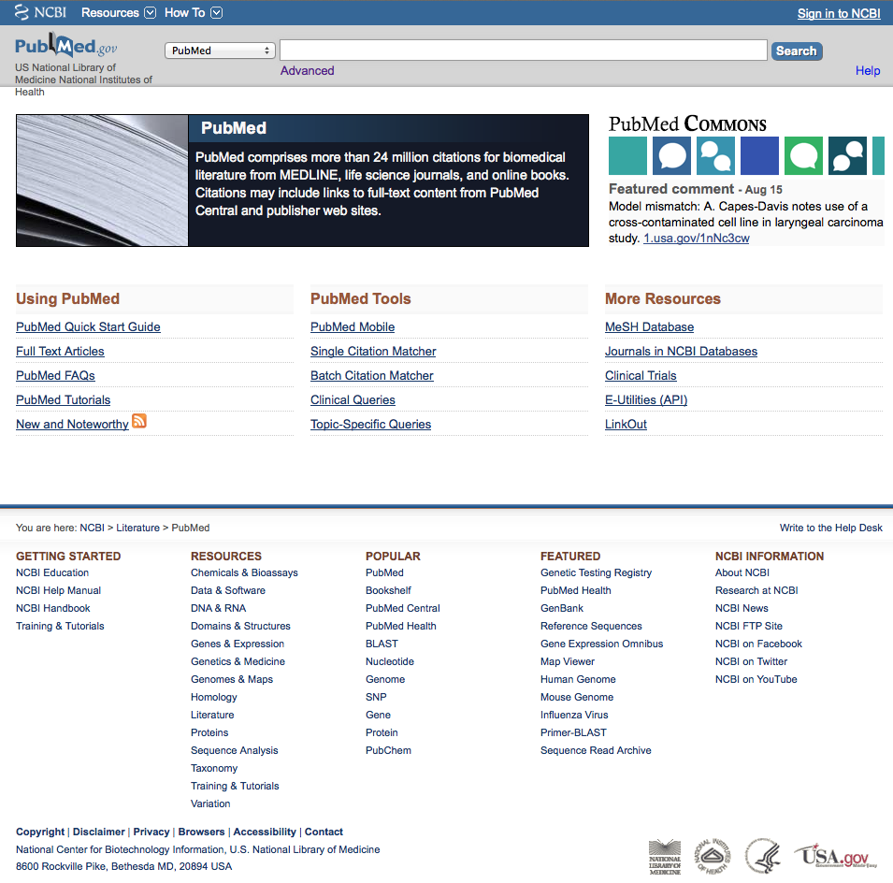
Click
Sign in to NCBI
PubMed Home Page

Slide 9
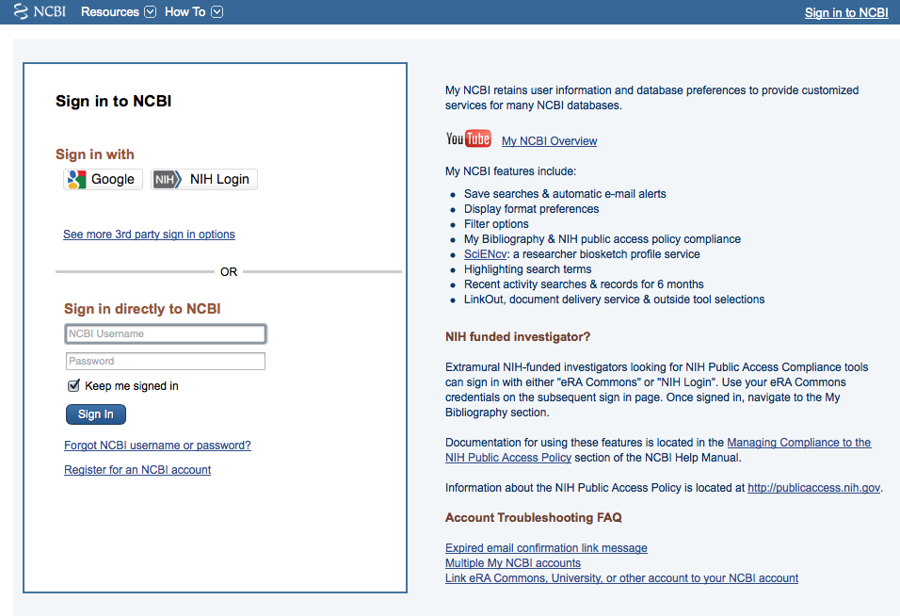
Click
Register for an NCBI account

Slide 10
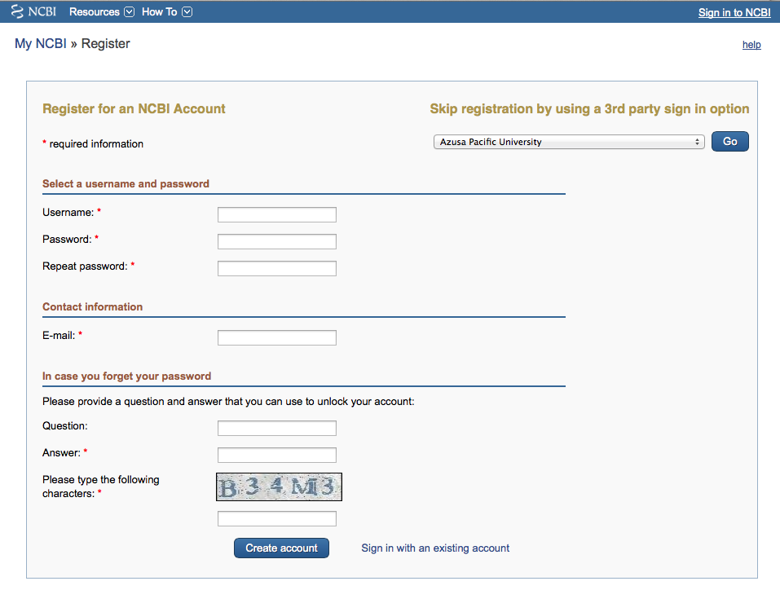
Fill out form
and click
Create account

Slide 11
Verifying your MY NCBI Account
Open the email you used in the account:
1) Locate the link from NCBI
2) Clink the link
3) Tells NCBI you are a real user requesting the account
(not computer generated)
4) Your user name will now appear on the top right-hand side

Slide 12
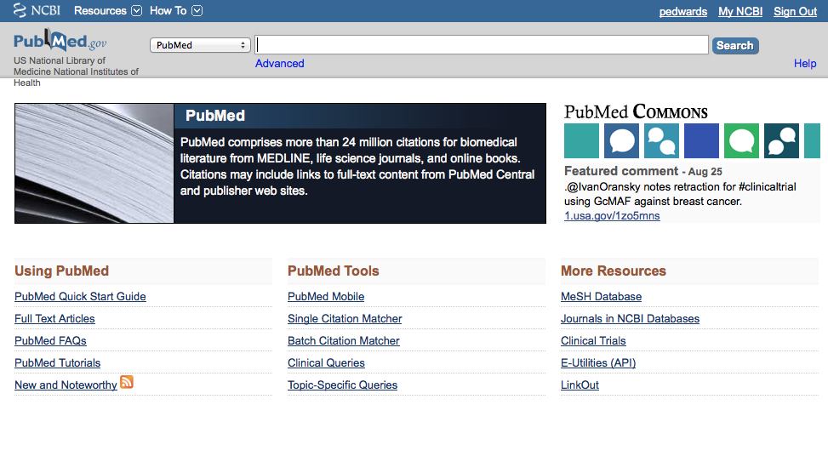
Your username
Click My NCBI
username

Slide 13
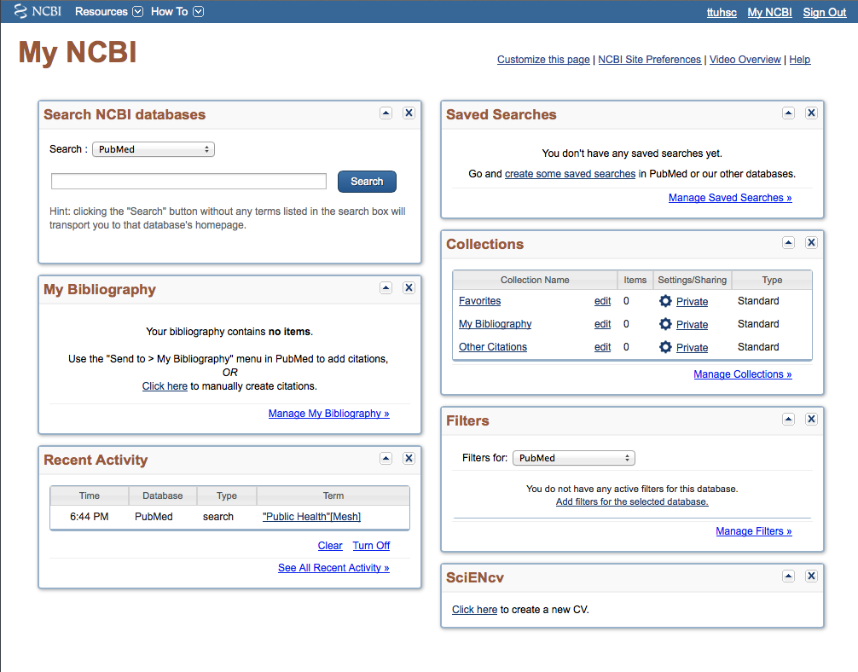
Click Manage Filters

Slide 14
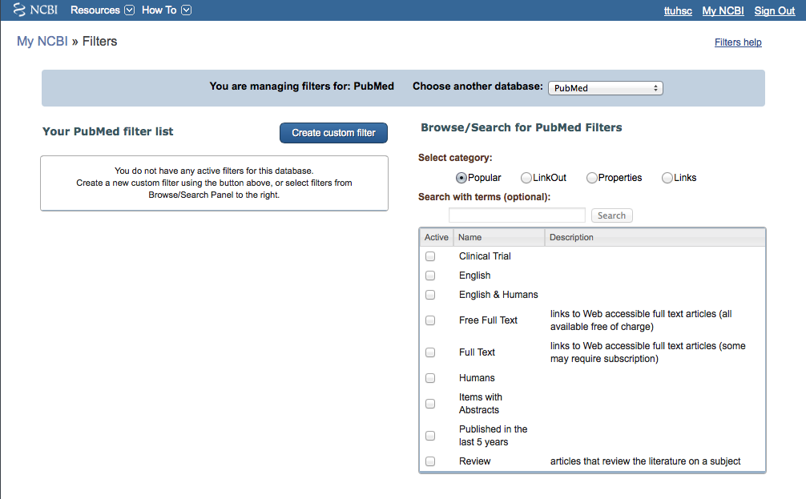
Select database
✔
Select filters

Slide 15
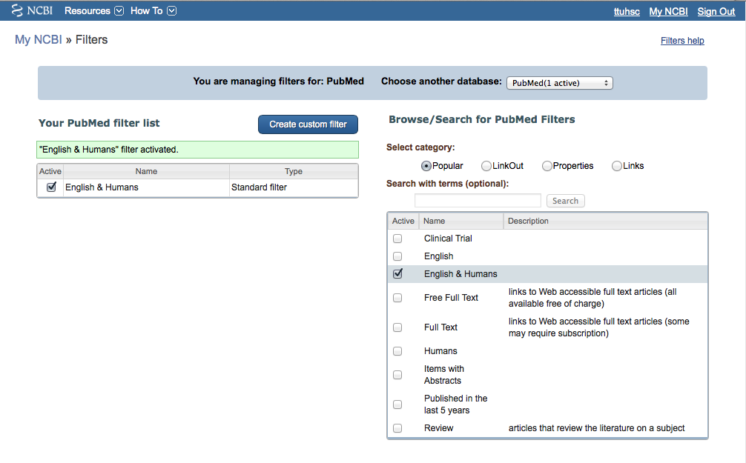
Filter activated

Slide 16
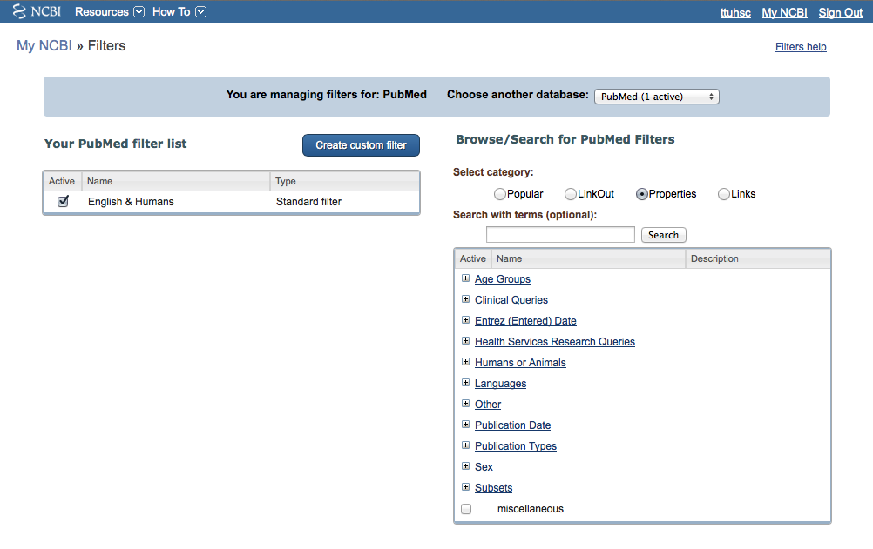
Click Properties
Selections

Slide 17
Click Publication Types

Slide 18
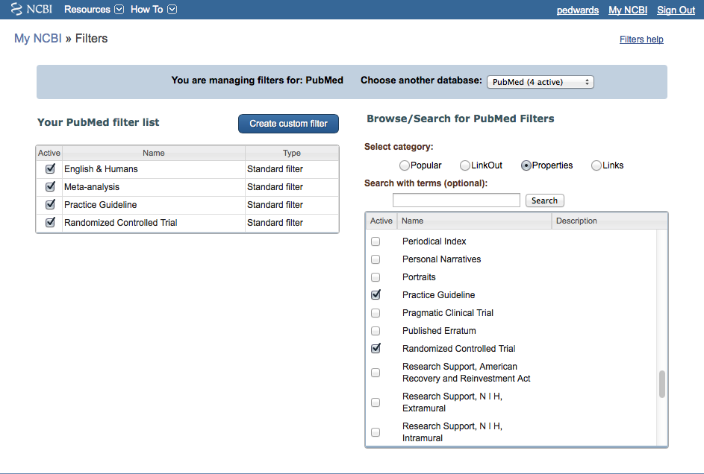
Active
Name
Description
✔
Meta-analysis
Multicenter Study
News
Newspaper Article
Observational Study
Overall
Patient Education Handout
Periodical Index
Personal Narratives
Portraits
Practice Guideline
Pragmatic Clinical Trial
Published Erratum
Randomized Controlled Trial
Select
Meta-analysis
Practice Guideline
Randomized Controlled Trial
✔
✔

Slide 19
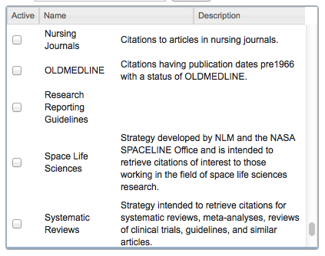
Scroll to
and select
Systematic Reviews
-
Subsets
✔

Slide 20
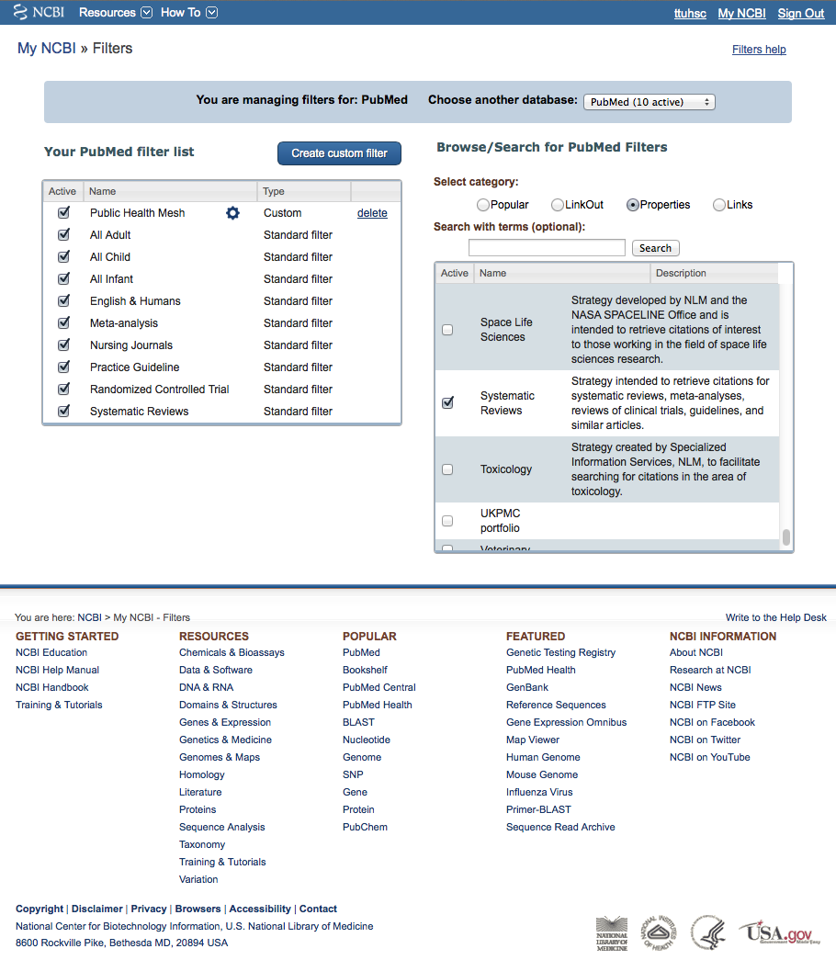
Click PubMed

Slide 21
Create a Search Strategy Plan
Identify the question and key concepts:
prevention and control of
hypertension with life style changes
Write the search program using
medical subject headings (MeSH)

Slide 22
Using MeSH Database

Slide 23
MeSH Database
is a “controlled vocabulary list” of more than
25,000 subject headings.
Terms in the database are called
Medical Subject Headings or MeSH.
The 10-15 MeSH assigned to each article
in PubMed is like a keyword abstract
of the article.

Slide 24
Click MeSH Database

Slide 25
Frequently Used Mesh Categories – 2011
A Anatomy
C Diseases
D Chemicals & Drugs
A1 Body Regions
A2 Musculoskeletal System
A3 Digestive System
A4 Respiratory System
A5 Urogenital System
A6 Endocrine System
A7 Cardiovascular System
A8 Nervous System
A9 Sense Organs
A10 Tissues
A11 Cells
A12 Fluids and Secretions
A13 Animal Structures
A14 Stomatognathic System
A15 Hemic and Immune Systems
A16 Embryonic Structures
A17 Integumentary System
A18 Plant Structures
A19 Fungal Structures
A20 Bacterial Structures
A21 Viral Structures
C1 Bacterial Infections & Mycoses
C2 Virus Diseases
C3 Parasitic Diseases
C4 Neoplasms
C5 Musculoskeletal Diseases
C6 Digestive System Diseases
C7 Stomatognathic Diseases
C8 Respiratory Tract Diseases
C9 Otorhinolaryngologic Diseases
C10 Nervous System Diseases
C11 Eye Diseases
C12 Male Urogenital Diseases
C13 Female Urogenital Diseases
& Pregnancy Complications
C14 Cardiovascular Diseases
C15 Hemic & Lymphatic Diseases
C16 Congenital, Hereditary, &
Neonatal Diseases & Abnormalities
C17 Skin & Connective Tissue Diseases
C18 Nutritional & Metabolic Diseases
C19 Endocrine System Diseases
C20 Immune System Diseases
C21 Disorders of Environmental Origin
C22 Animal Diseases
C23 Pathologic Conditions,
Signs, and Symptoms
C24 Occupational Diseases
C25 Substance-Related Disorders
C26 Wounds and Injuries
D1 Inorganic Chemicals
D2 Organic Chemicals
D3 Heterocyclic Compounds
D4 Polycyclic Compounds
D5 Macromolecular Substances
D6 Hormones, Hormone Substitutes,
& Hormone Antagonists
D8 Enzymes, & Coenzymes
D9 Carbohydrates
D10 Lipids
D12 Amino Acids, Peptides,
& Proteins
D13 Nucleic Acids, Nucleotides,
& Nucleosides
D20 Complex Mixtures
D23 Biologic Factors
D25 Biomedical and Dental Materials
D26 Pharmaceutical Preparations
D27 Chemical Actions and Uses
B Organisms
B1 Eukaryota
B2 Archaea
B3 Bacteria
B4 Viruses
B5 Organism Forms

Slide 26
Other Categories Include:
Analytical, Diagnostic, & Therapeutic Techniques & Equipment
Psychiatry and Psychology
Biological Sciences
Natural Sciences
Anthropology, Education, Sociology & Social Phenomena
Technology, Industry, Agriculture
Information Science
Named Groups
Health Care
Publication Characteristics
Geographic Locations

Slide 27
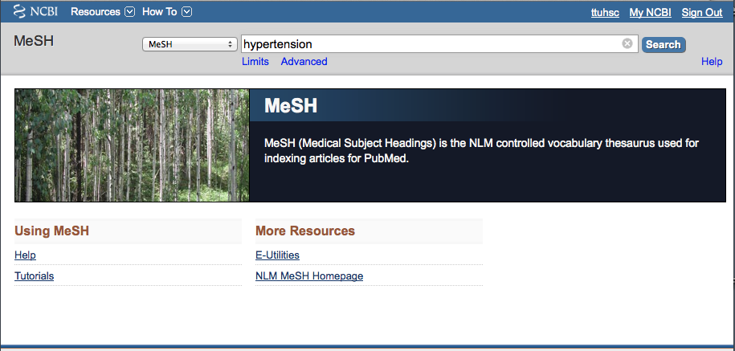
Enter and click a
a
Search
hypertension
(Note: If there is a Boolean OR
relationship, start with the
“OR” statement first.)

Slide 28
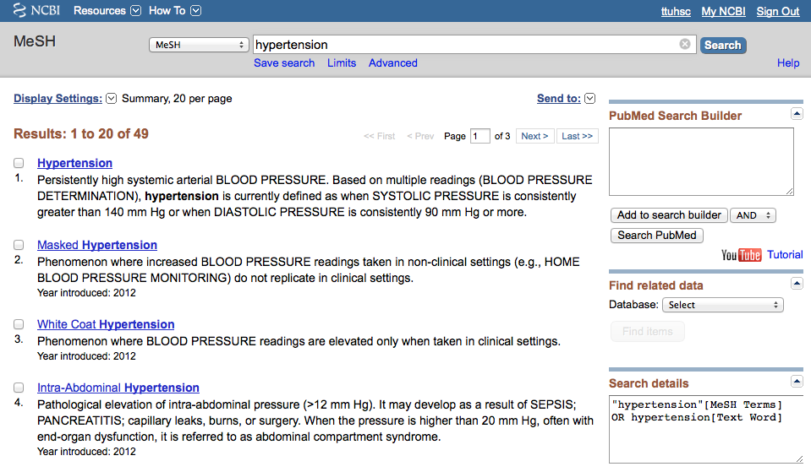
Term Definitions

Slide 29
Click the underlined term

Slide 30
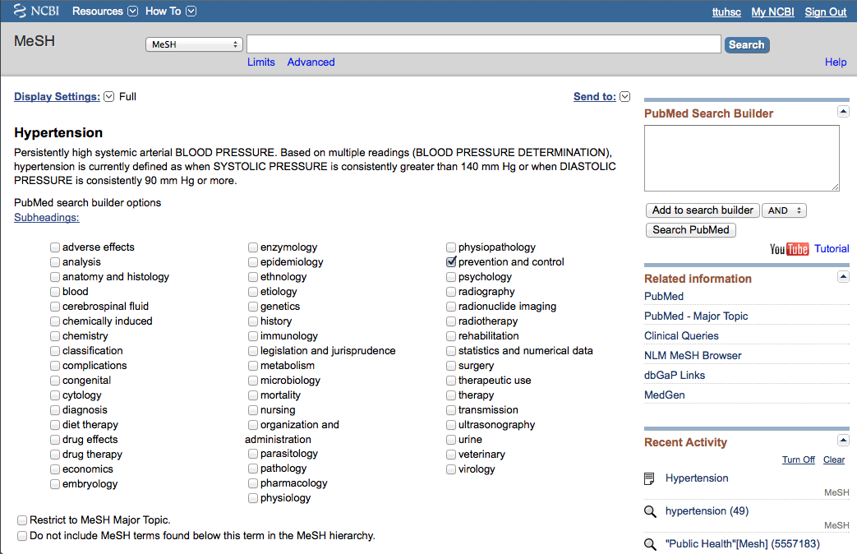
Sub-headings narrow the “meaning” of a
MeSH term.
M They are a “subset” of all the
articles under the MeSH term: Hypertension.

Slide 31
embryology
abnormalities enzymology poisoning
administrations & dosage epidemiology
adverse effects ethics prevention & control
agonists ethnology
analogs & derivatives etiology psychology
analysis genetics radiation effects
anatomy & histology growth & development radiography
antagonists & inhibitors history radionuclide imaging
biosynthesis immunology radiotherapy
blood injuries rehabilitation
blood supply innervation secondary
cerebrospinal fluid instrumentation secretion
chemical synthesis isolation & purification standards
chemically induced legislation & jurisprudence statistics & numerical data
chemistry manpower supply & distribution
classification metabolism surgery
complications methods therapeutic use
congenital microbiology therapy
contraindications mortality toxicity
cytology nursing transmission
deficiency organization & administration transplantation
diagnosis parasitology trends
diagnostic use pathogenicity ultrasonography
diet therapy pathology ultrastructure
drug effects pharmacokinetics urine
drug therapy pharmacology utilization
economics physiology veterinary
education physiopathology virology
83 SUBHEADINGS:

Slide 32
2) Select
AND
1) Check the box next
to the subheadinga
✔
3) Then click
Add to search builder

Slide 33
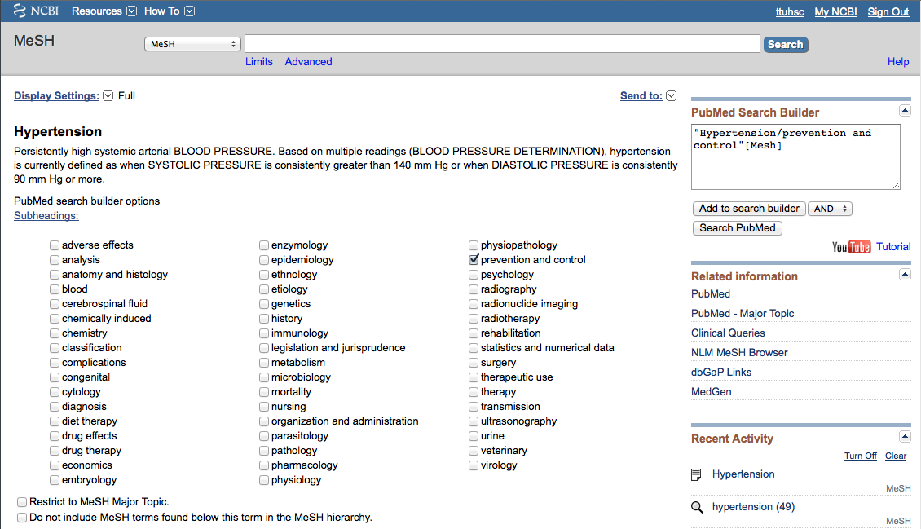
MeSH
The first term is in
the search program “box”

Slide 34
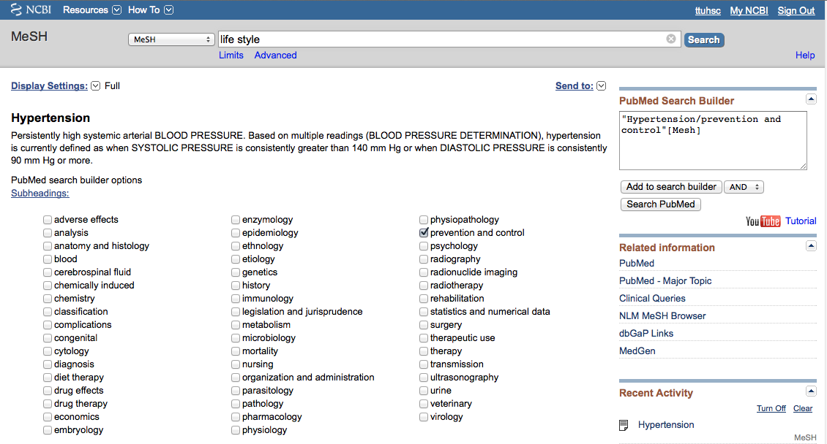
Enter and click a
a
Search
life style
(Note: If there is a Boolean OR
relationship, start with the
“OR” statement first.)

Slide 35
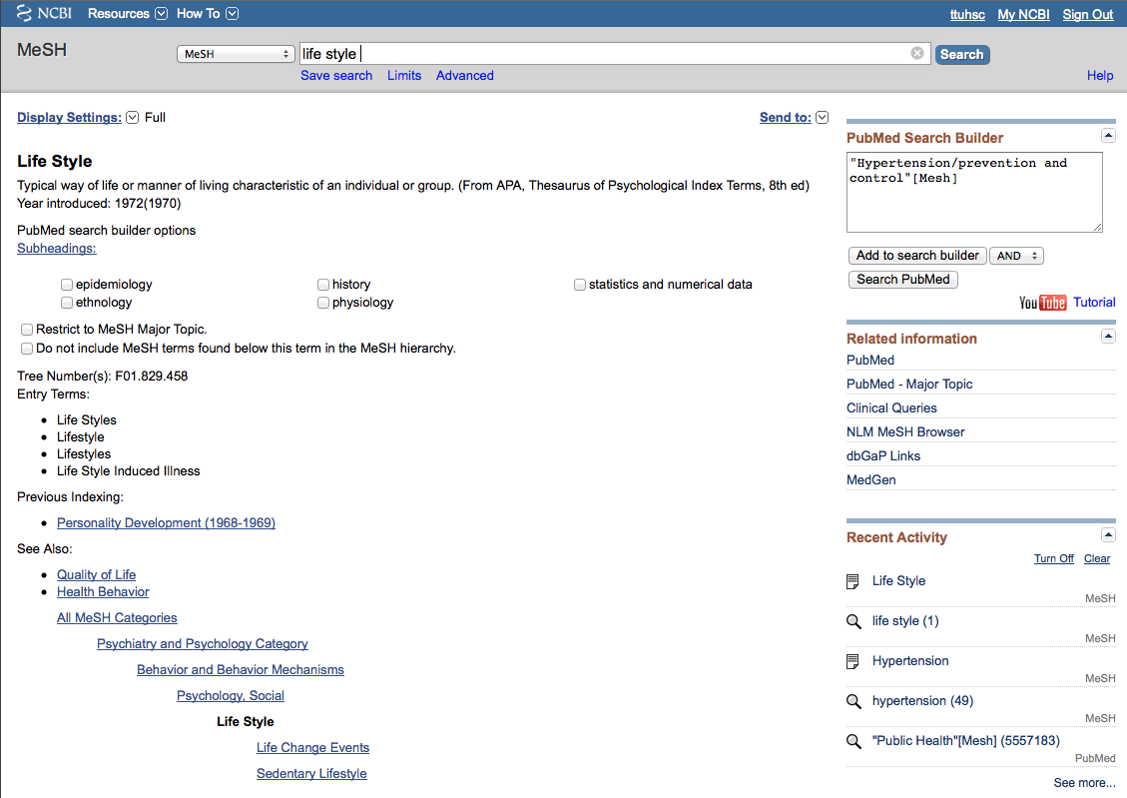
terms arranged in
tree structure hierarchy
MeSH
Terms are listed from
broadest to narrowest.
If Life Style
yields zero results, try using a
broader term: Psychology, Social.

Slide 36
… unless you select
the following command
✓
Note:
PubMed automatically
OR’s indented terms
under a broader term…

Slide 37
Click
Add to search builder

Slide 38
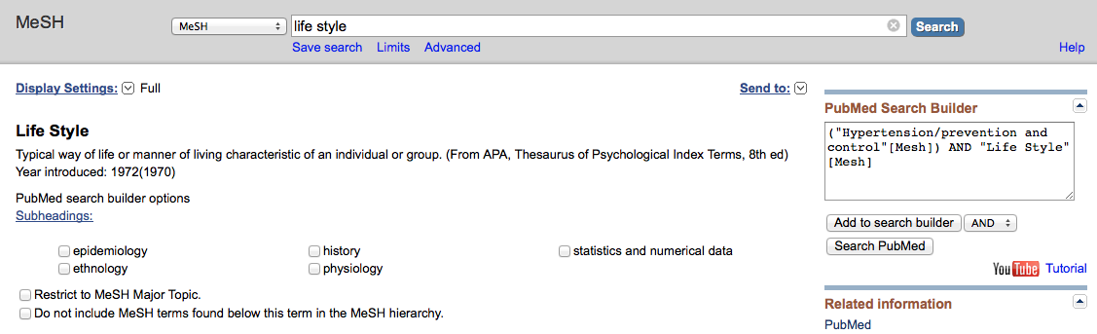
MeSH
The second term is in
the search program “box”

Slide 39
Boolean Logic - AND
hypertension/
prevention & control
and
life style

Slide 40
Boolean Logic - OR
life
style
diet
OR

Slide 41
The search program is complete.
Click
Search PubMed

Slide 42
Search Results

Slide 43
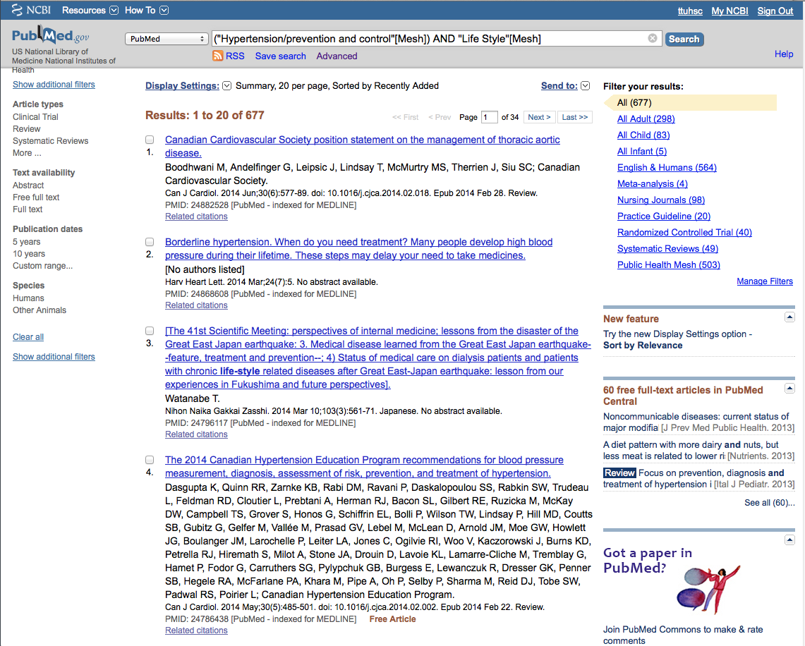
PubMed identifies
677 articles

Slide 44
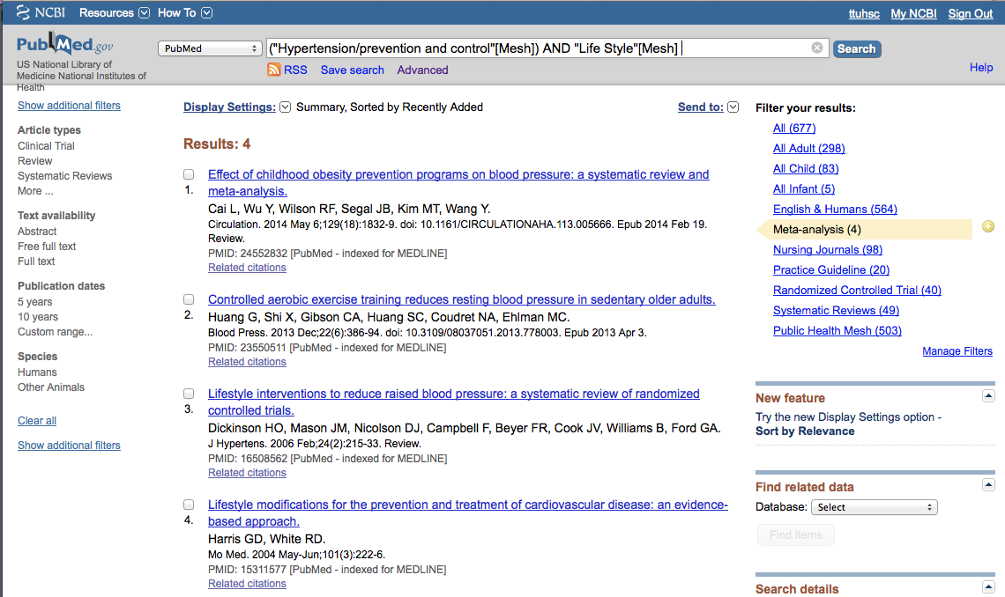
NOTE: Custom Filters set up
in you’re my NCBI account.

Slide 45
Filters include:a
A
Article types
Text availability
Publication date
Species such as:
(human or animal)
Languages
Sex
Subjects
Journal categories
Ages
Search fields

Slide 46
Limit to articles that were
written in the past 5 years by
clicking the selection on the left.

Slide 47
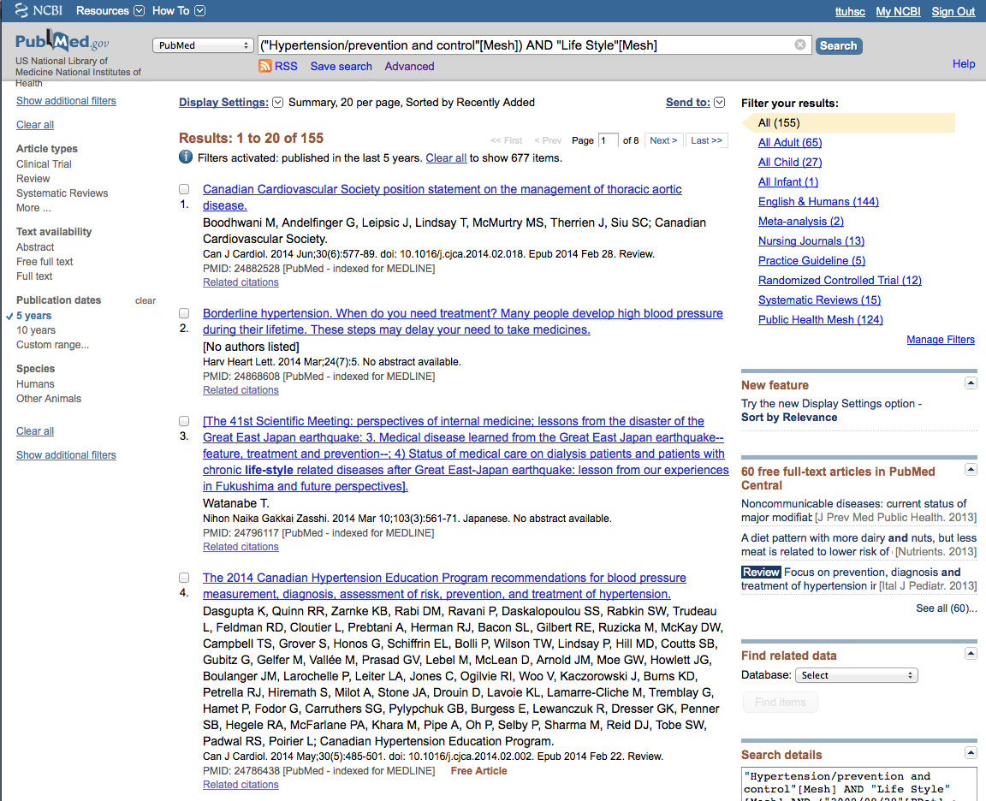
Selection will turn blue:
✓ 5 years
Click
Show additional filters

Slide 48
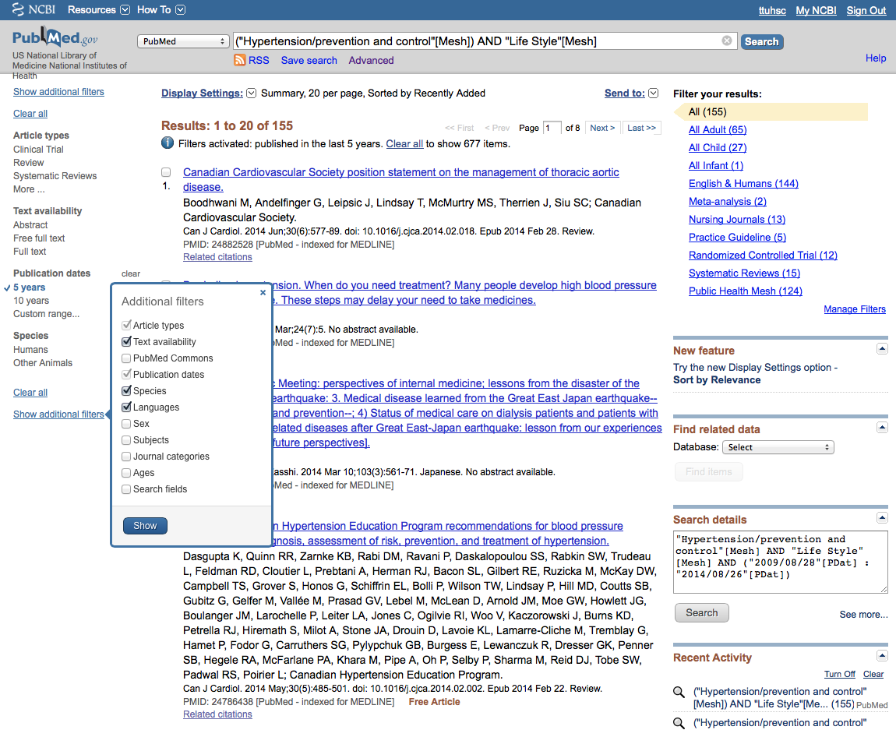
Select
Languages
and click
✔
Show

Slide 49
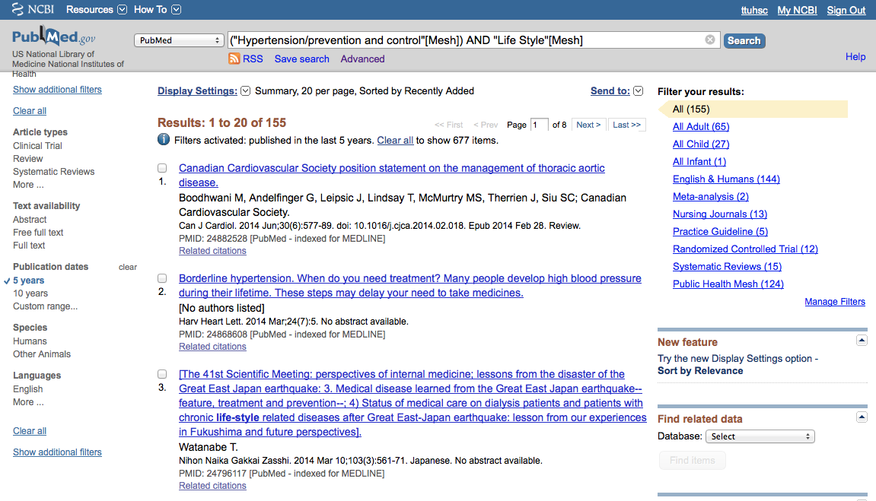
Click English

Slide 50
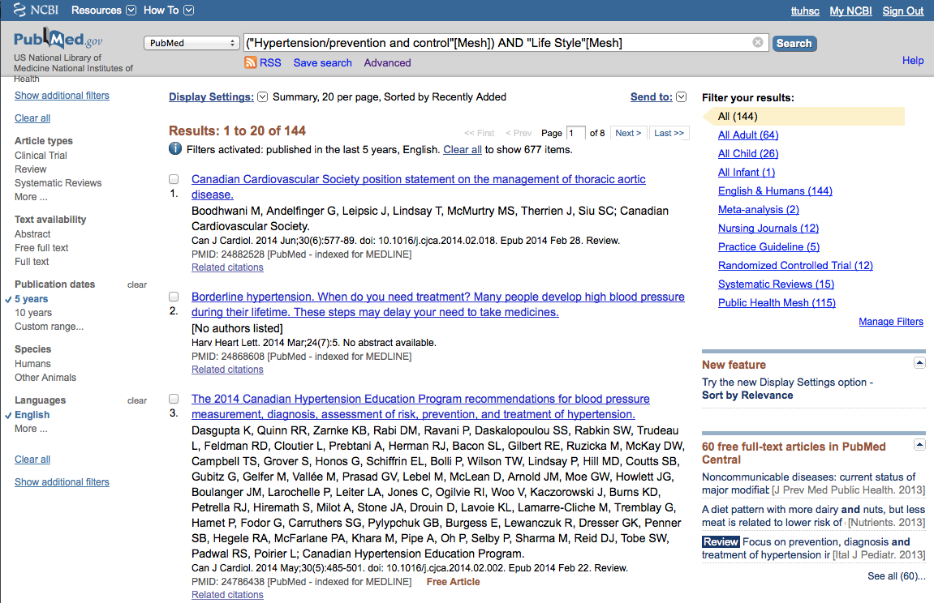
Results are reduced
From 155 to 144

Slide 51
Change [Mesh] to [Majr]

Slide 52
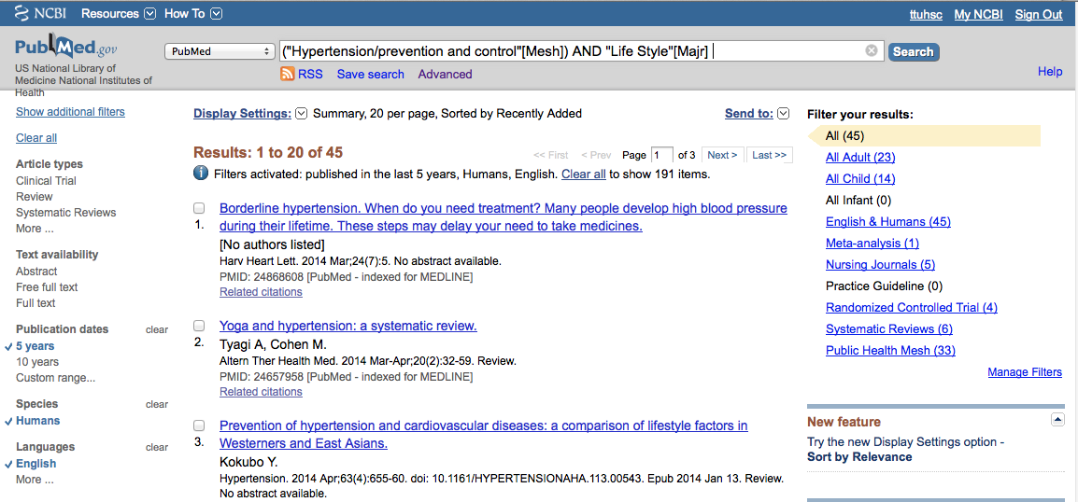
Results are reduced
From 144 to 45

Slide 53

Click

Slide 54
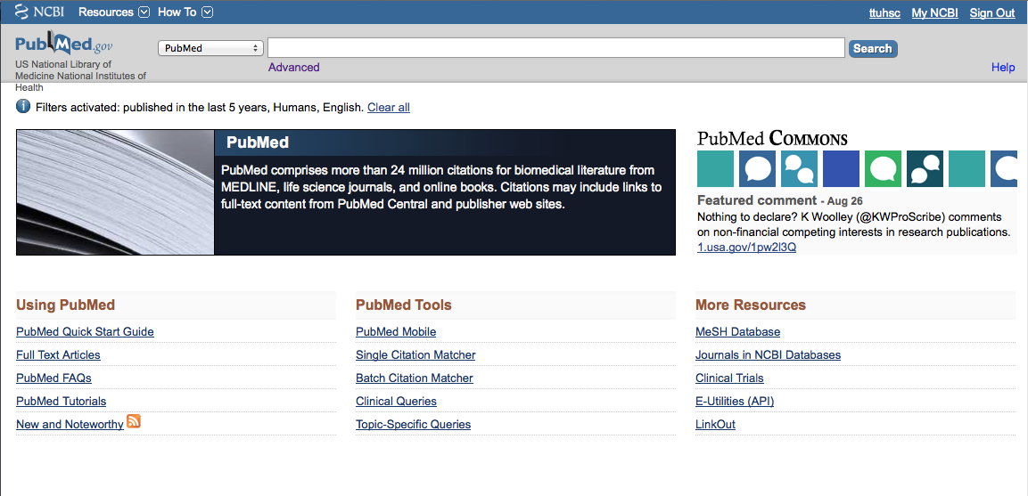
Click Clear all

Slide 55
Click MeSH Database

Slide 56
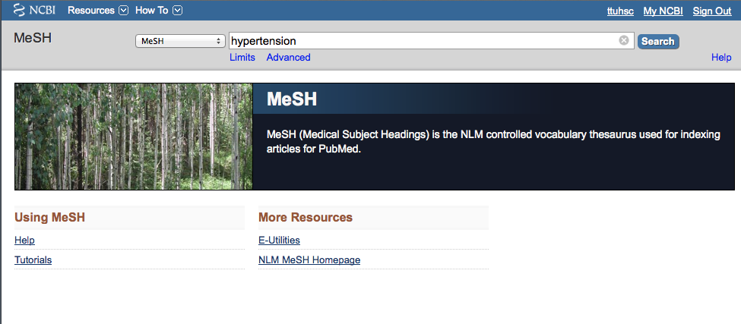
a
a
Search
Enter
hypertension
and click

Slide 57
Click the underlined term

Slide 58
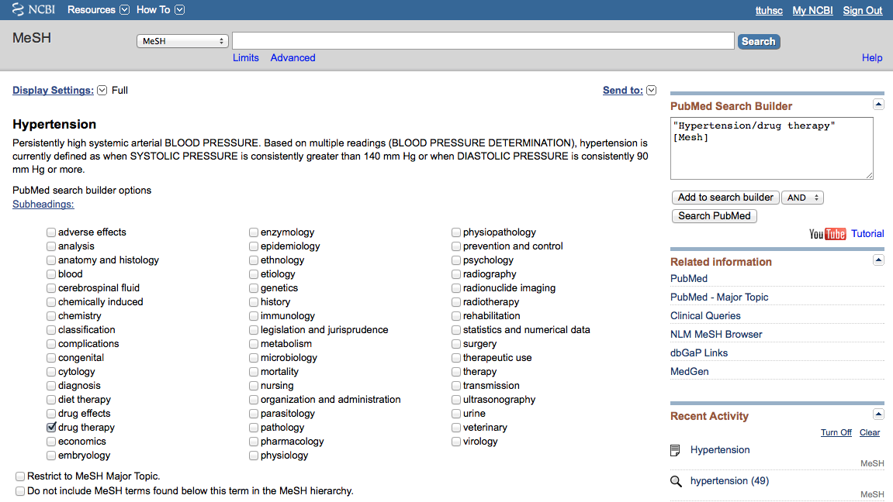
2) Select
AND
1) Check the box next
to the subheadinga
✔
3) Then click
Add to search builder

Slide 59
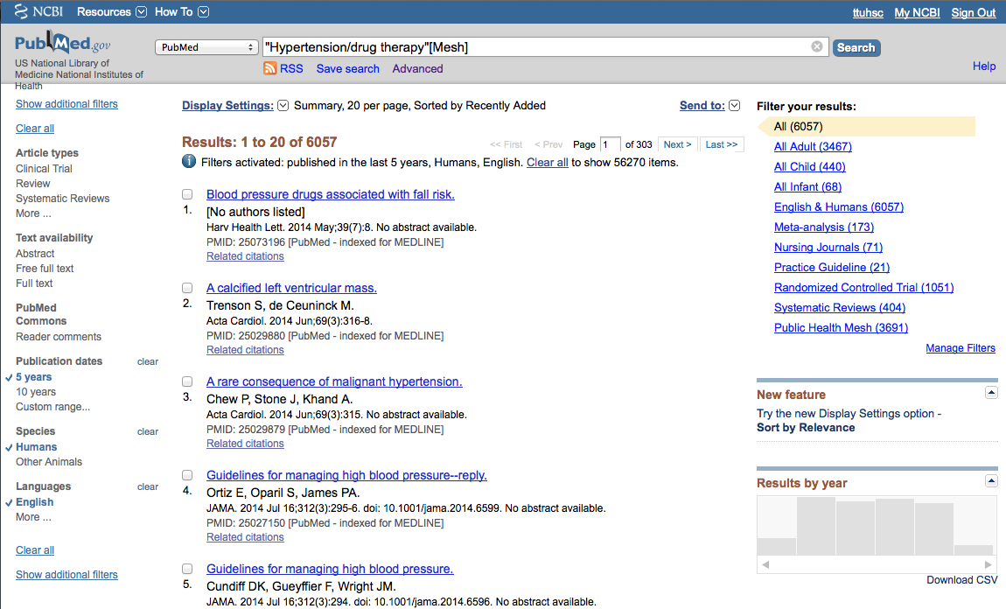
Click Advanced

Slide 60
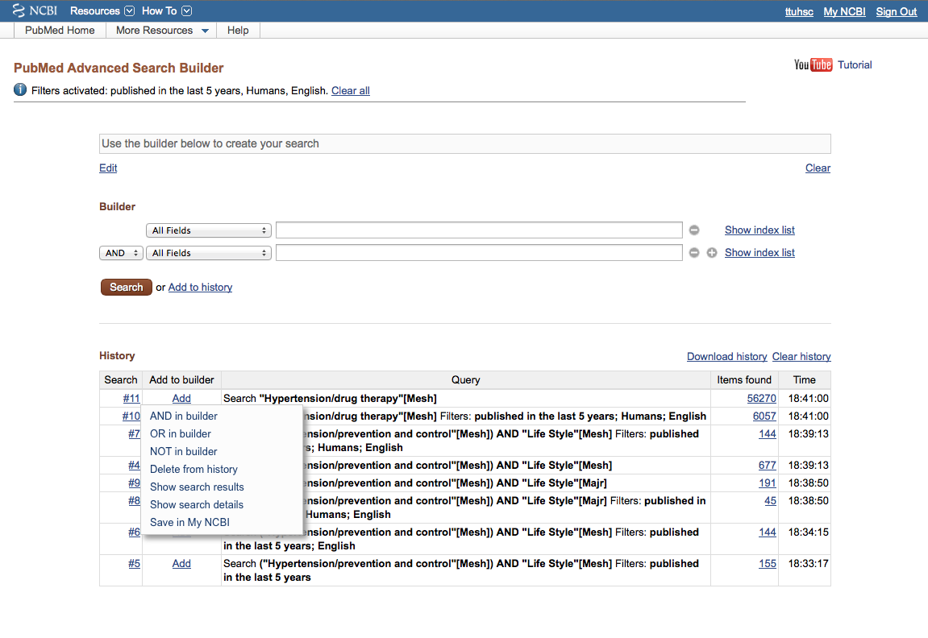
Hover your mouse over the search number
Click AND in builder

Slide 61
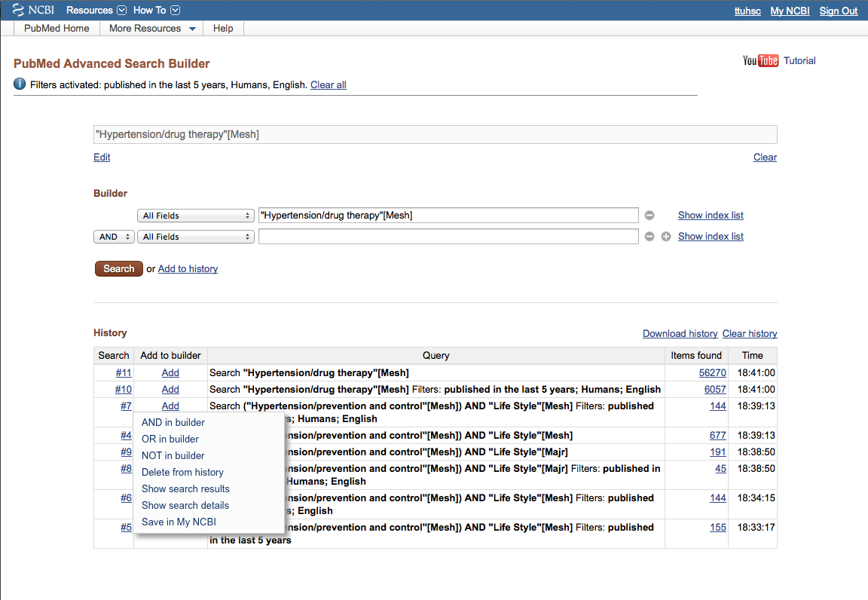
Hover your mouse over the second search set
Click AND in builder

Slide 62
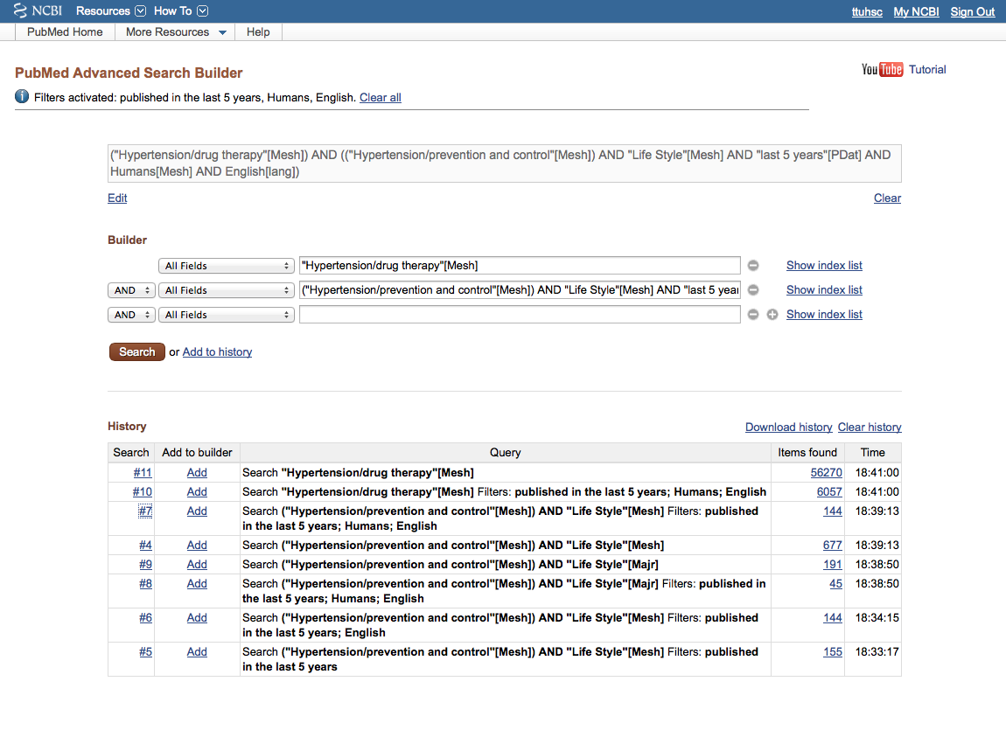
New Strategy in Search Builder
Click Search

Slide 63
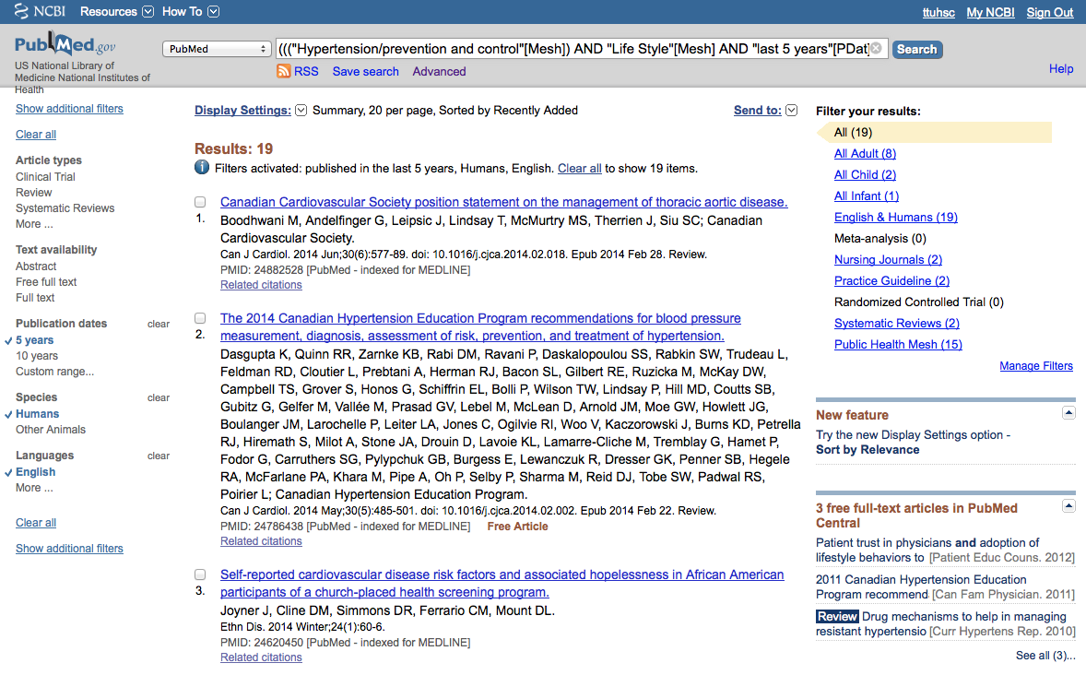
Results from different
search strategy

Slide 64
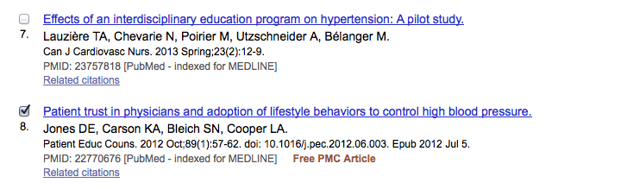
Select article # 8.
X

Slide 65
Click Display Settings

Slide 66
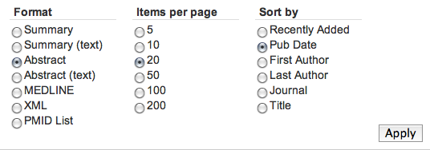
Select Abstract,
change to Pub Date to
sort to most recent articles appearing first,
then click
Apply

Slide 67
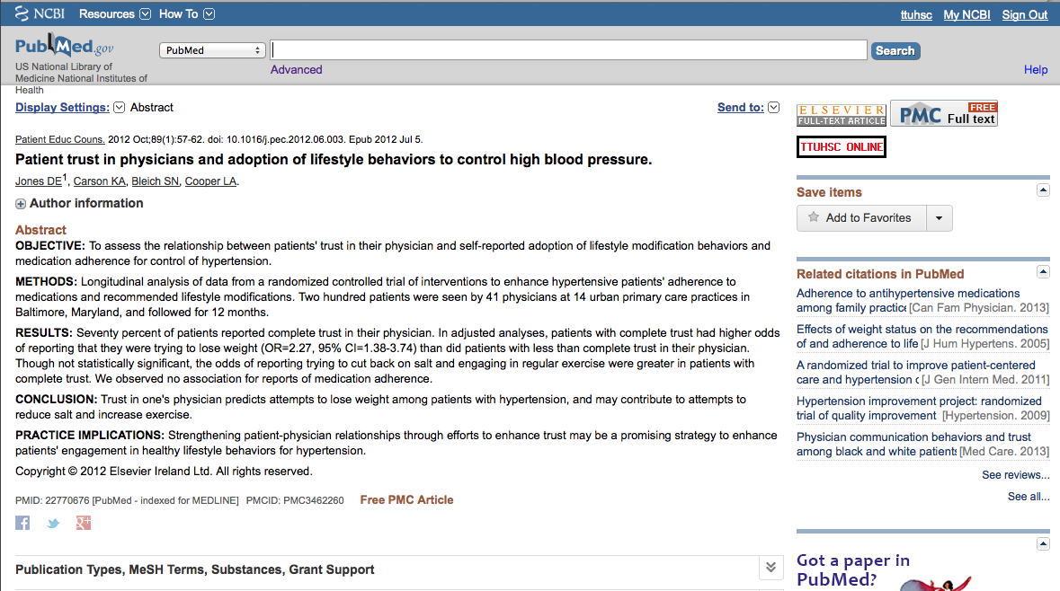
Icons for full text.

Slide 68
Click for MeSH terms.
∨∨

Slide 69
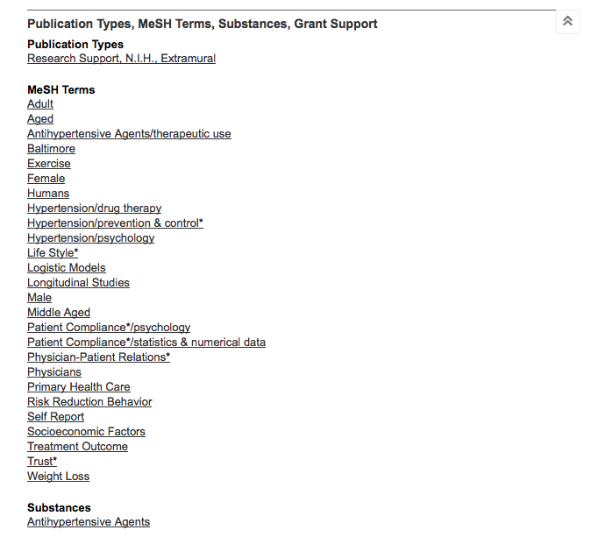
MeSH Database
searches only
the MeSH terms for:
hypertension/dt
AND
hypertension/pc
AND
life style

Slide 70
Look at subject headings
in the
MeSH Terms Index
for additional terms.
You may want to
write a new search
program using:
Risk Reduction
Behavior

Slide 71
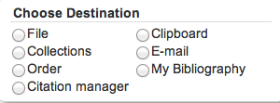
.
Click Send to: and select
File to save citations to a file on your computer or
Clipboard to temporarily store selected citations or
E-mail to send citations to self or colleague

Slide 72
…or click icon for full text.

Slide 73
Linking to
Full-Text Articles
in Electronic Journals

Slide 74
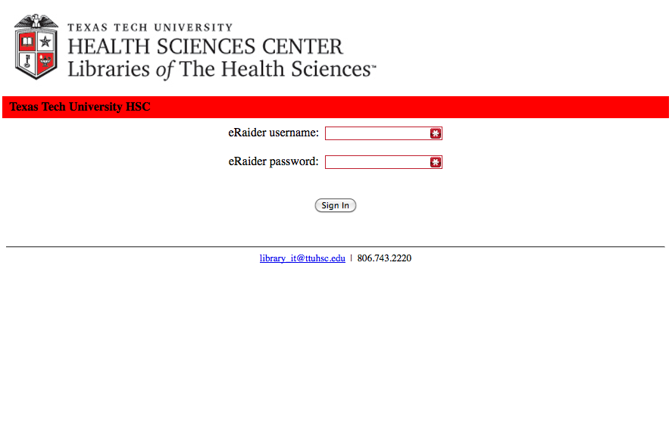
When Searching from Off Campus:
Enter the
Eraider username and password
assigned to you
by Information Services.
A
Problems with eRaider? Call: 806-743-1234 a

Slide 75
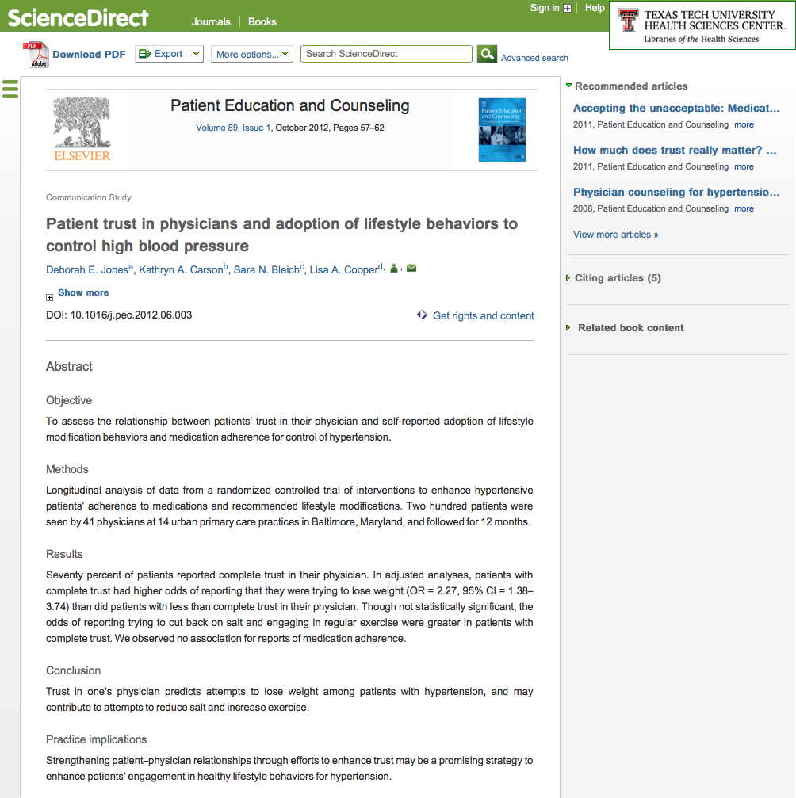
Click PDF

Slide 76
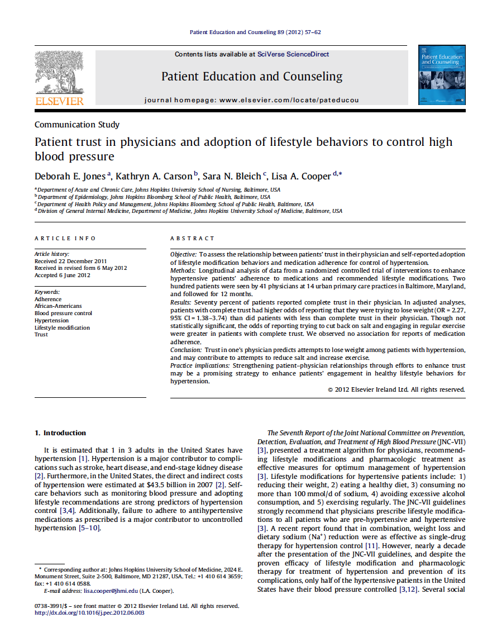
Full Text Article
Close Article

Slide 77
Saving Searches

Slide 78
Click Advanced.

Slide 79
Click 144

Slide 80
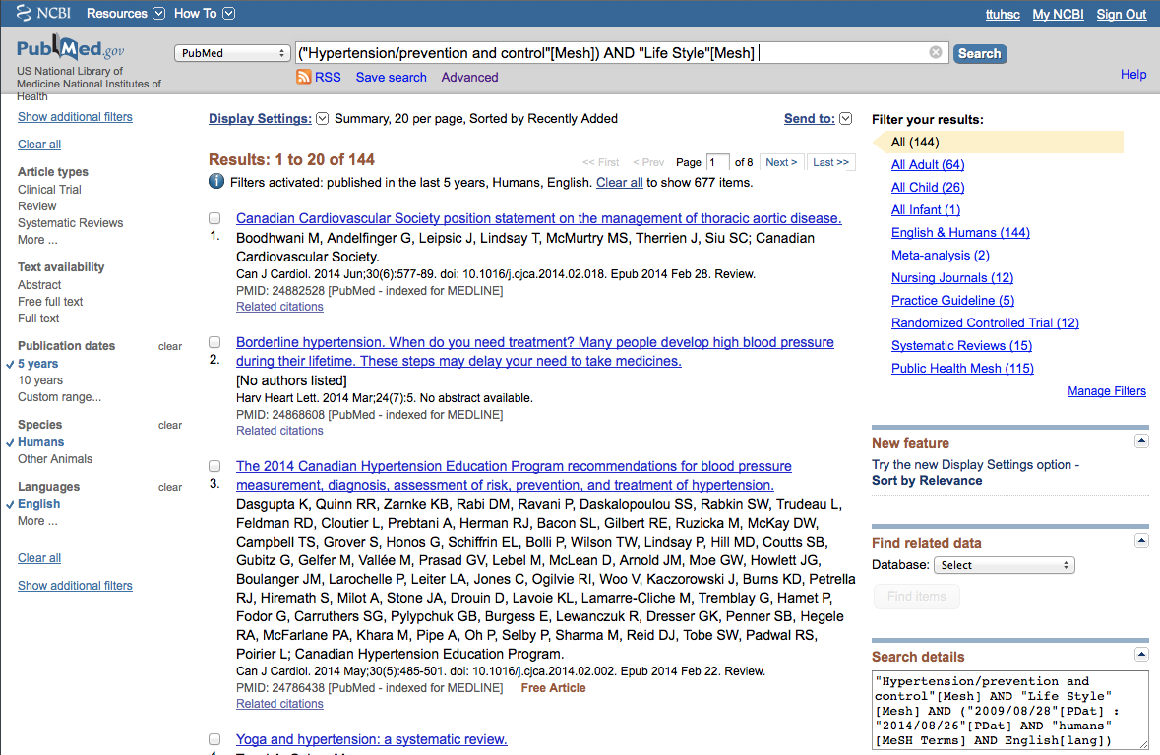
Click Save search

Slide 81
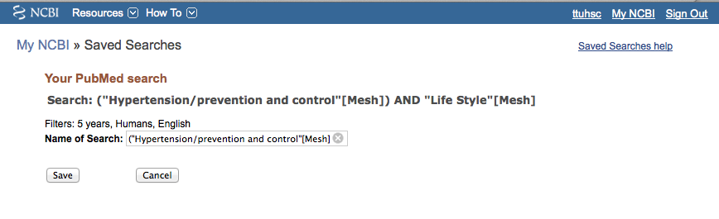
Click
Save

Slide 82
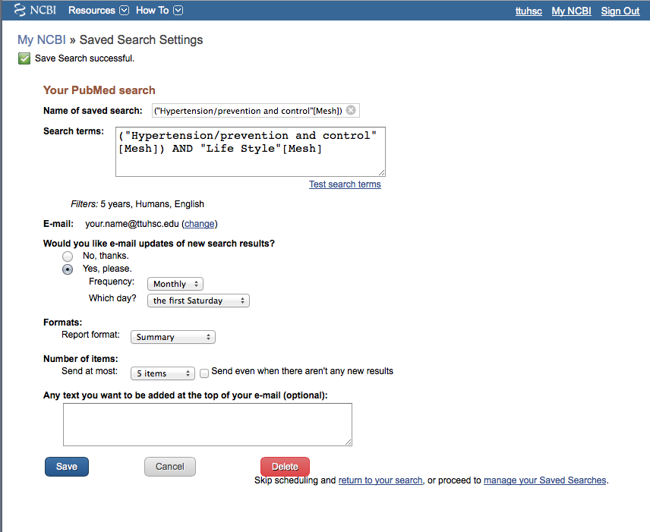
Click
•
Yes, please.

Slide 83

Select frequency

Slide 84
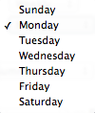
Select day

Slide 85

Select Report format

Slide 86

Select Number of items:
Click
Save

Slide 87
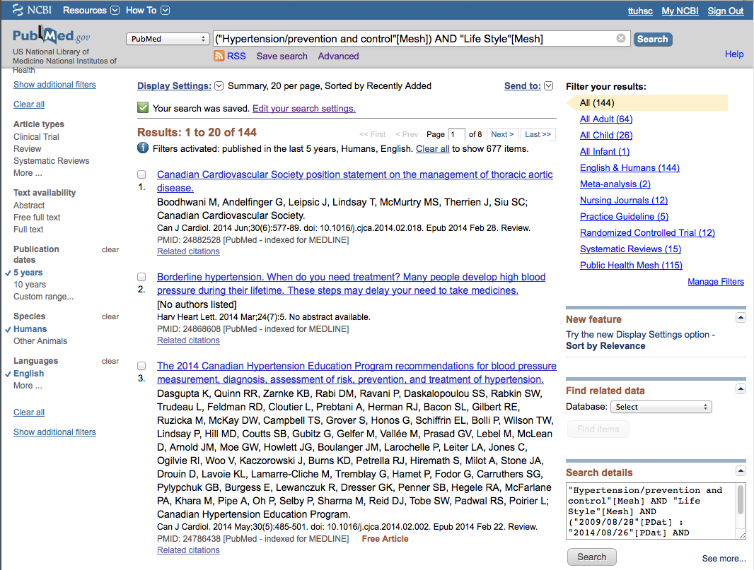
Click My NCBI
Search is saved.

Slide 88
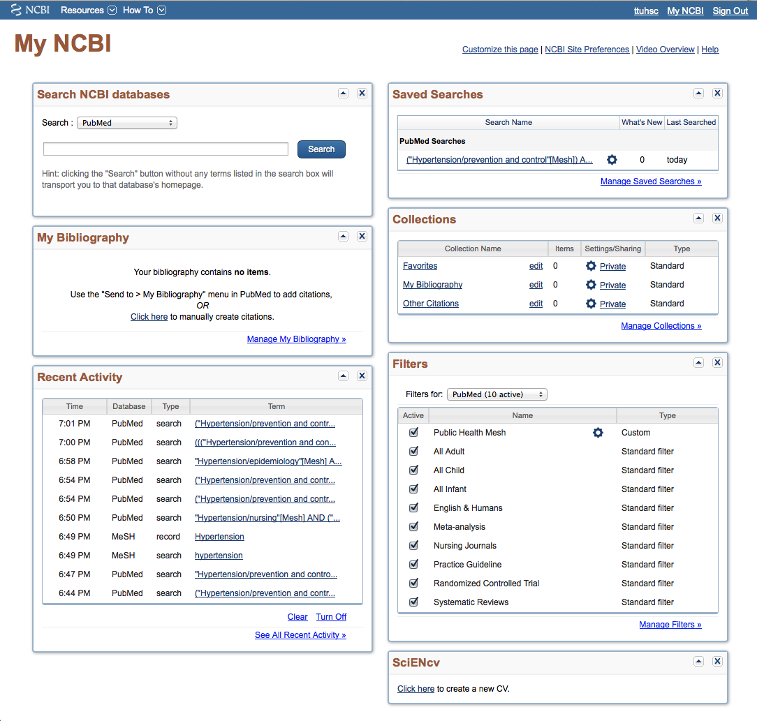
Click Manage Saved Searches

Slide 89

Delete
saved search(es).
See
What’s new
Click to re-run search.

Slide 90
Formatting for
Bibliographic Management

Slide 91

Do you use Bibliographic Management Software?
Bibliographic Management Software Examples:
  EndNote
  RefWorks
To format PubMed citations for export:
  use the MEDLINE format (see below and next 2 screens)

Slide 92

Select MEDLINE format,
change to Pub Date
to sort to most recent articles appearing first,
then click
Apply

Slide 93

In Saved Searches
Select Report format

Slide 94

ENDNOTE® - Additional Information

Slide 95


RefWorks - Additional Information

Slide 96
a
Other Searching Features
MeSH, phrase, & title word searching
    using the [ti] pneumonic
Truncation

Slide 97

Enter and click a
a
Search
human genome

Slide 98

1) Check the box next
to the MeSH heading
2) Select
AND
✔
3) Then click
Add to search builder
Click
Search PubMed

Slide 99

PubMed identifies
19291 articles

Slide 100

Enter and click
Search
AND “dark matter”

Slide 101

PubMed identifies
8 articles

Slide 102

Enter and click
Search
“dark matter” [ti]

Slide 103

Results are narrowed to 6

Slide 104
Truncation

Slide 105

Enter gene* to truncate.
PubMed locates:
gene
genes
genetically
generalization
generation and
generator
are “false drops”

Slide 106
Online Tutorial

Slide 107
Click Training & Tutorials for hands-on learning.

Slide 108

Please contact us at:
Lubbock
(806) 743-2200
Amarillo
(806) 354-5448
El Paso
(915) 545-6652
Odessa
(432) 335-5171

Slide 109

www.ttuhsc.edu/libraries
Ask-A-Librarian

Slide 110
The End

