Slide 1
TTUHSC Preston Smith Library
presents
Searching PubMed®
Medical Focus
Rev. 08/2017

Slide 2
To begin...

Slide 3
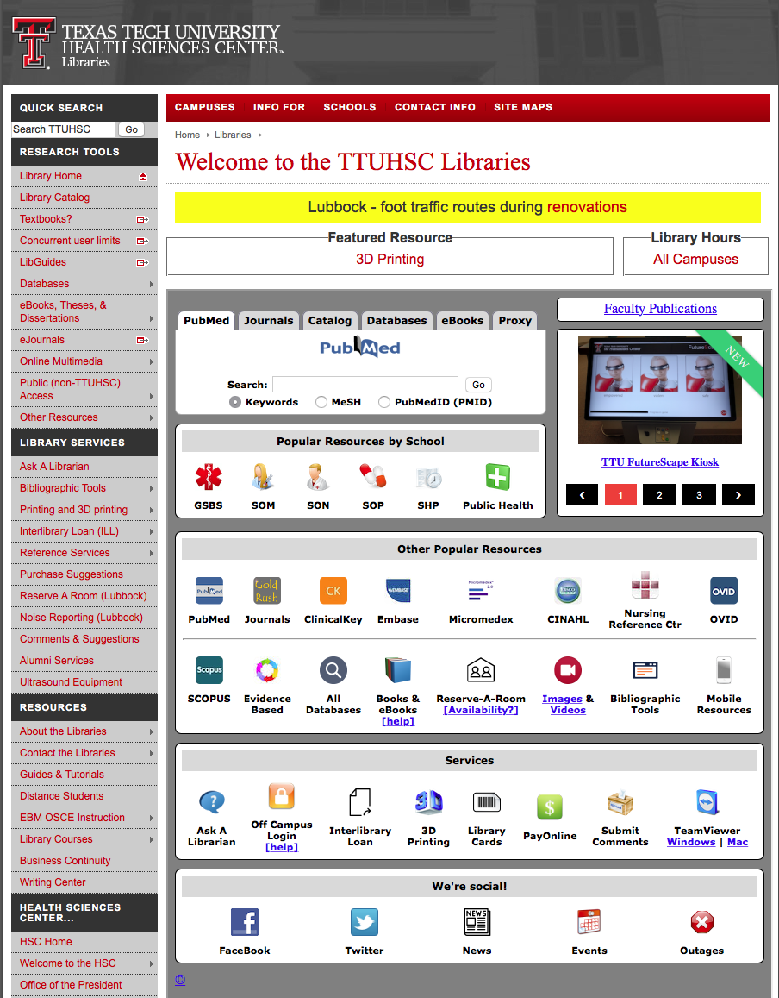

www.ttuhsc.edu/libraries
Click

Slide 4



PubMed Database
Biomedical and life sciences journal literature
International scope
Developed and maintained by the:
National Center for Biotechnology Information
    at the U.S. National Library of Medicine
    at the National Institutes of Health

Slide 5

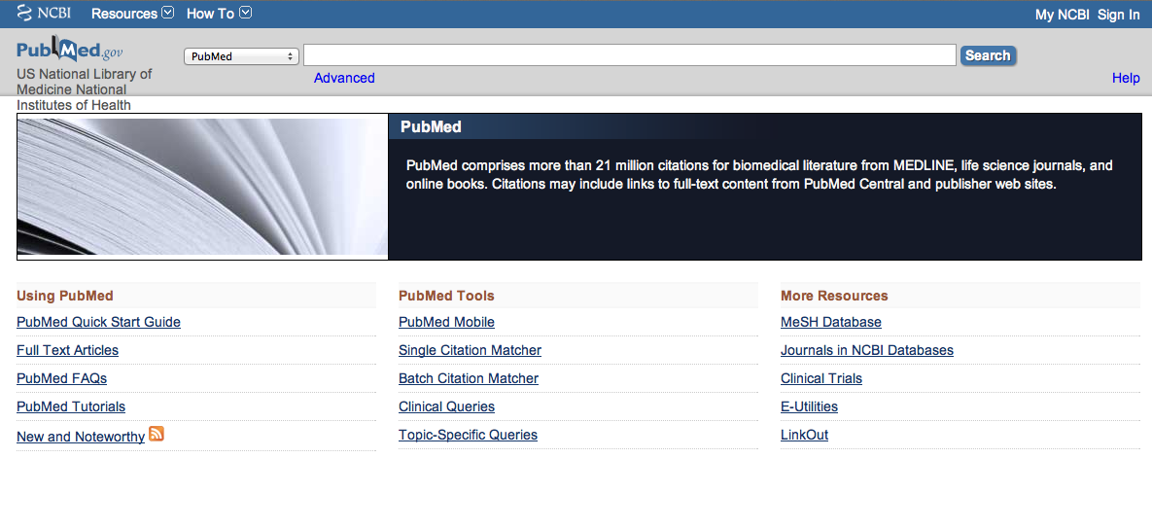
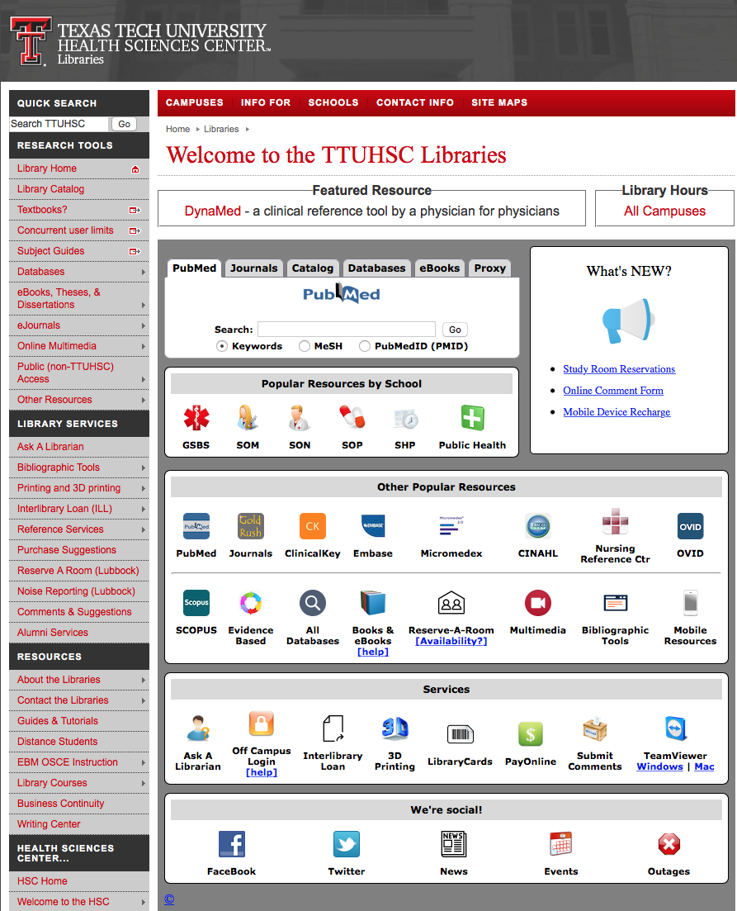
Accessing PubMed
Freely available over the Internet
@ www.pubmed.gov
Also through library’s home page

Slide 6
Creating a
My NCBI Account

Slide 7
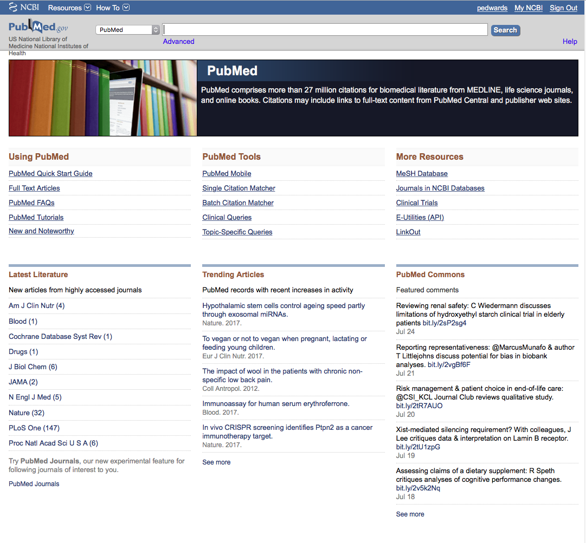
Your user name
Click
Sign in to NCBI
PubMed Home Page

Slide 8
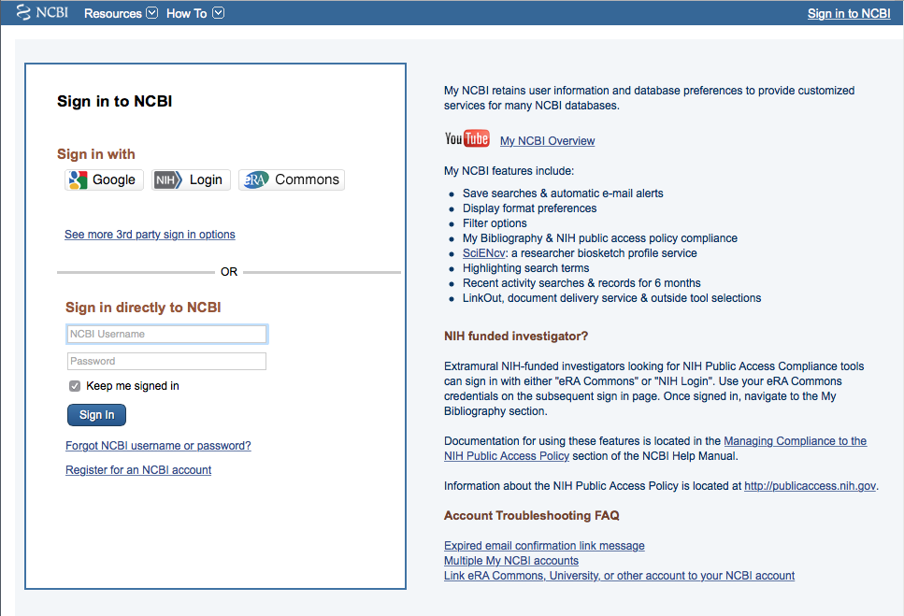
Click
Register for an NCBI account

Slide 9
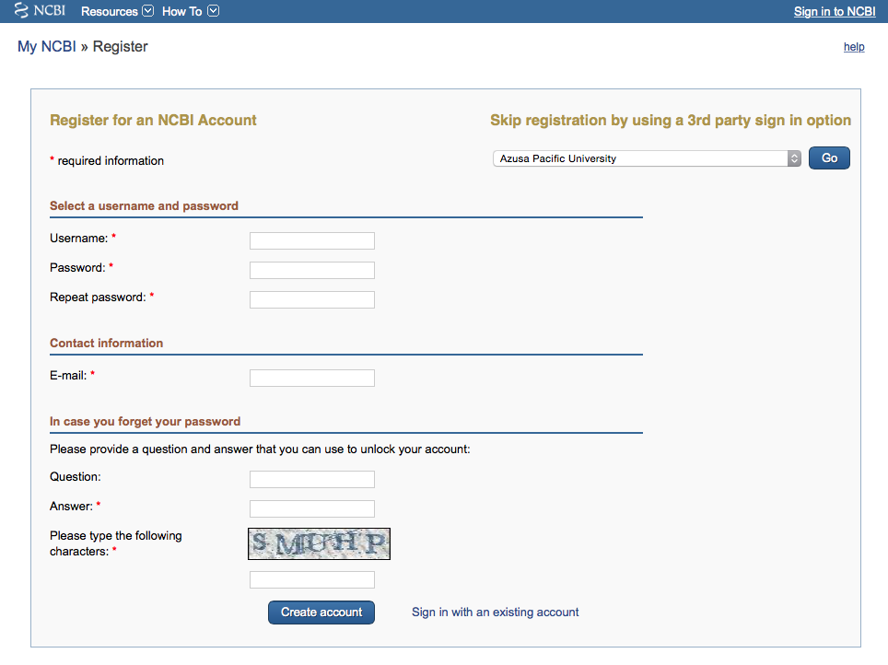
Fill out form
and click
Create account

Slide 10
Verifying your MY NCBI Account
Open the email you used in the account:
1) Locate the link from NCBI
2) Click the link
3) Tells NCBI you are a real user requesting the account
(not computer generated)
4) Your user name will now appear on the top right-hand side

Slide 11
Your username
Your user name
Click My NCBI

Slide 12
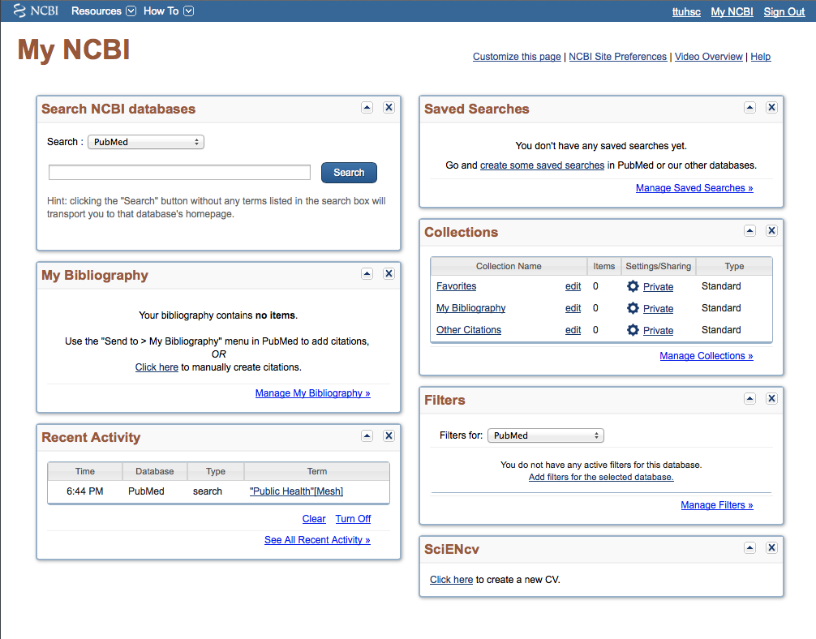
Click Manage Filters

Slide 13
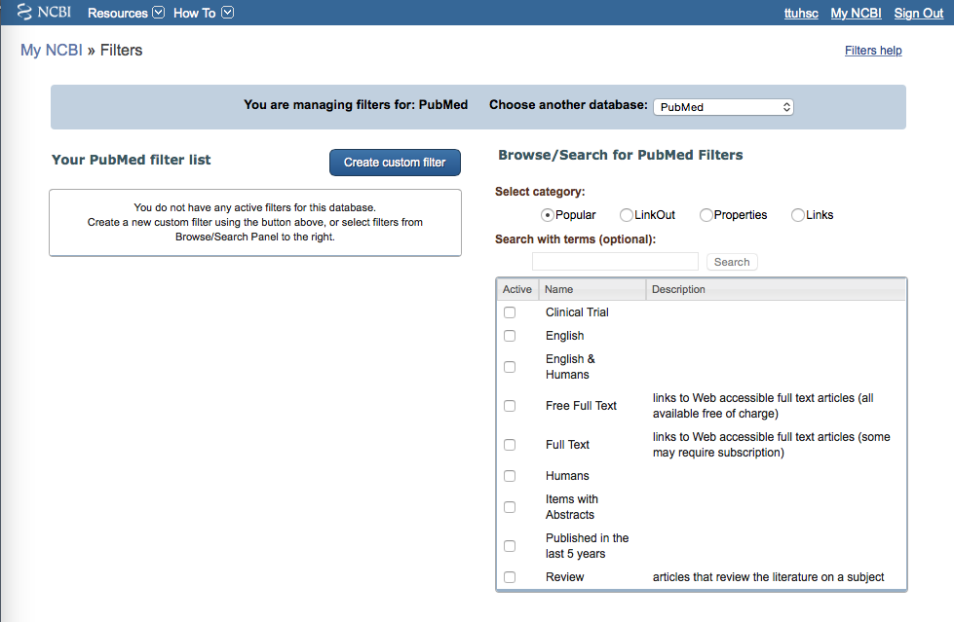
Select database
✔
Select up to 15 filters

Slide 14
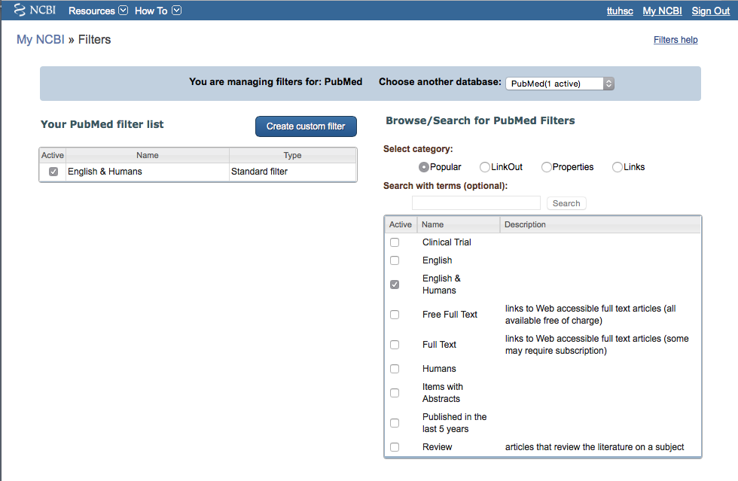
Click Properties
Filter activated

Slide 15
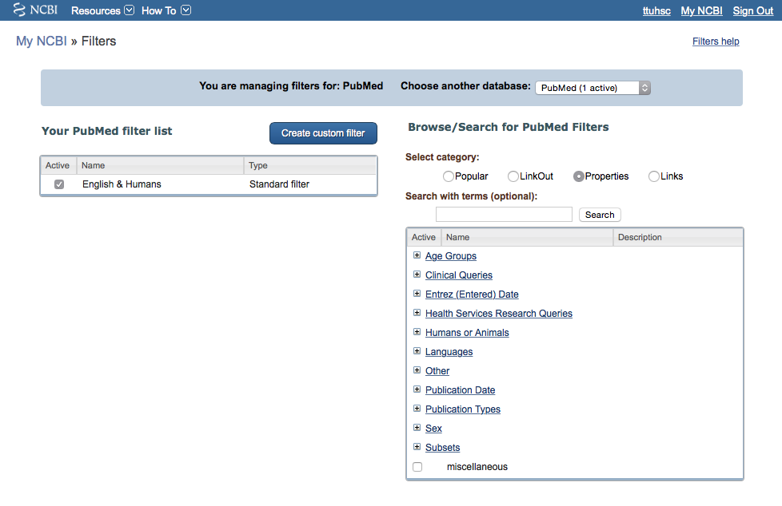
Selections

Slide 16
Open Age Groups
+

Slide 17
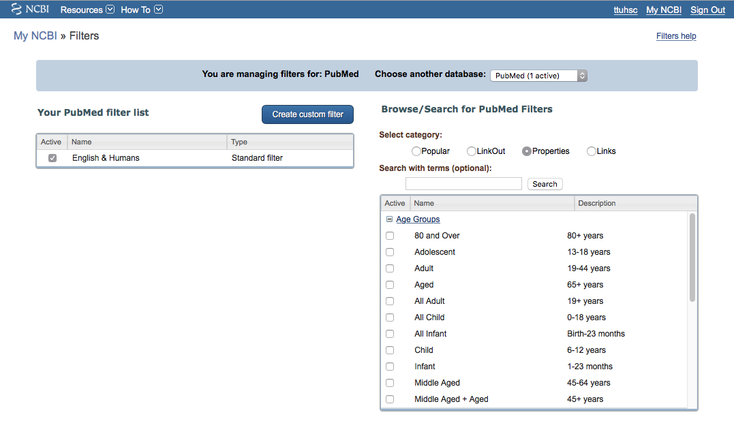
Select:
80 and Over 80+
Adolescent 13-18
Adult 19-44
Aged 65+
All Adult 19+
Middle Aged 45-64
Middle Aged + Aged 45+

Slide 18
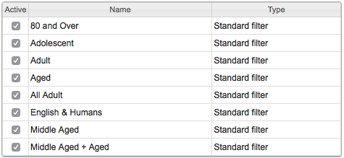
+
Open Publication Types

Slide 19
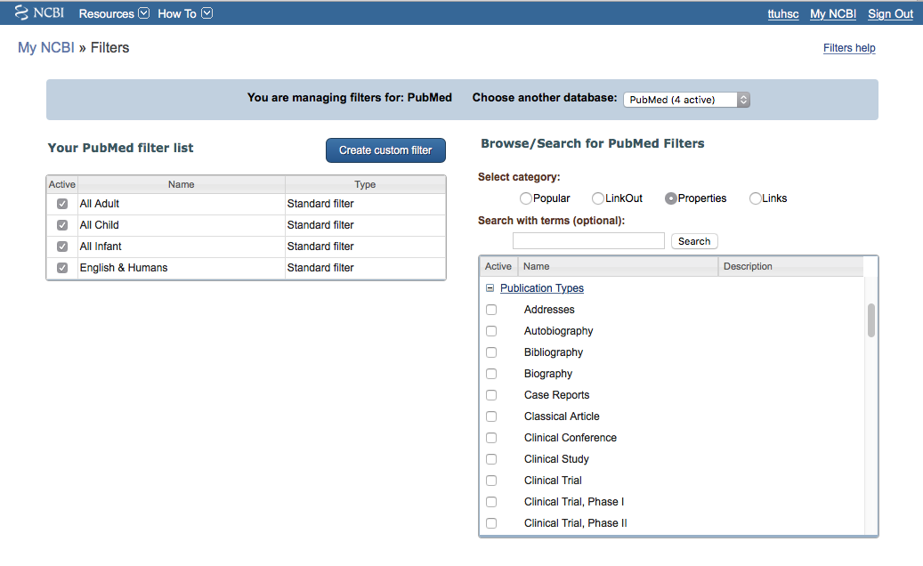
Select
Clinical Trial
✔
Scroll to make more selections

Slide 20
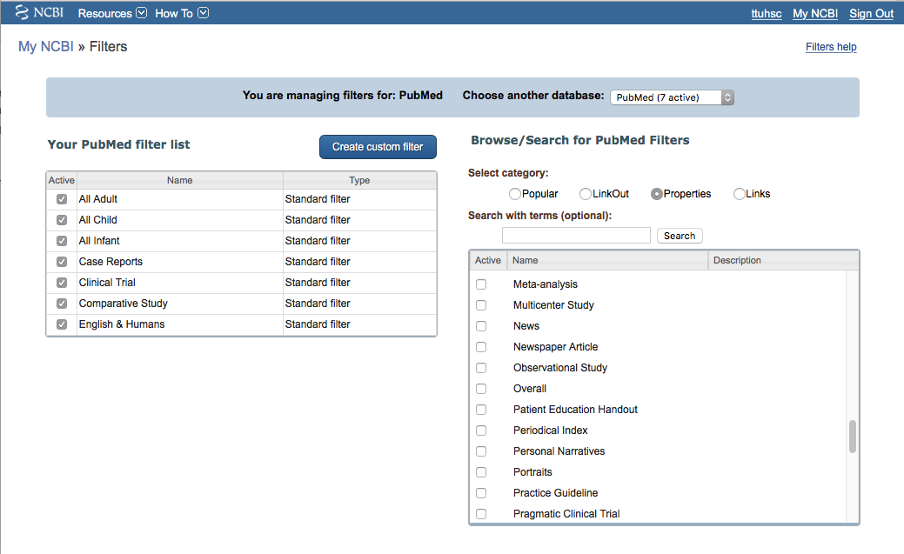
✔
✔
Select
Meta-analysis
Multicenter Study
Practice Guideline
✔

Slide 21
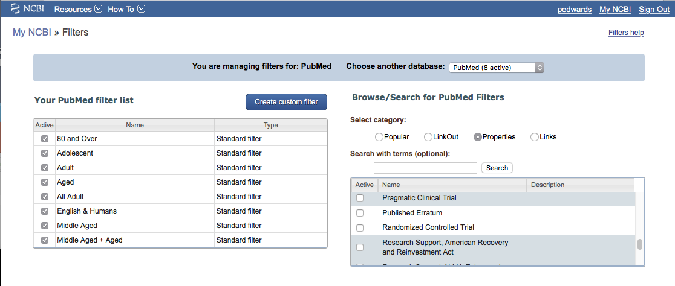
Your user name
✔
Select
Randomized Controlled Trial

Slide 22
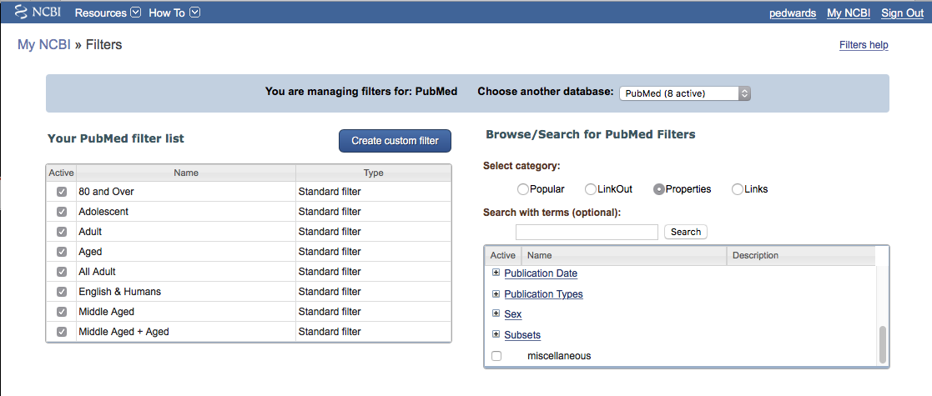
Your user name
Open Subsets
+

Slide 23
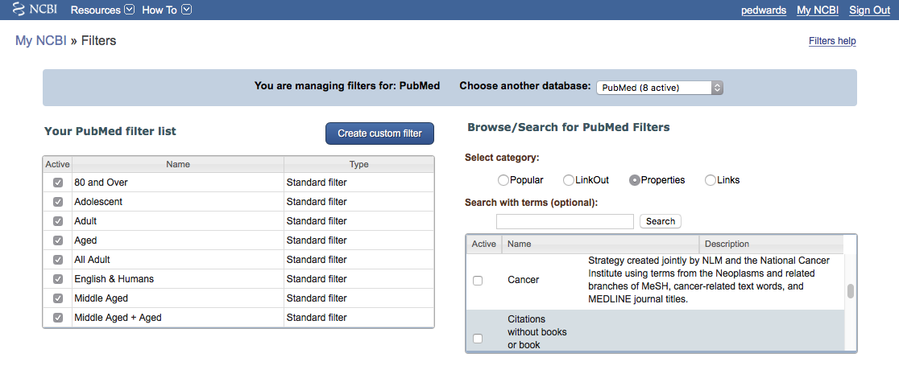
Your user name
✔
Select
Cancer

Slide 24
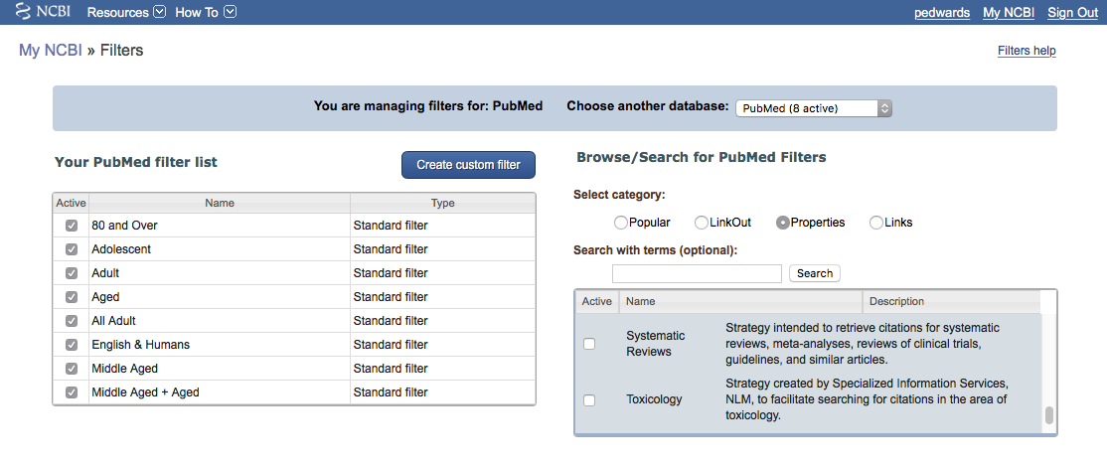
Your user name
✔
Select
Systematic Reviews

Slide 25
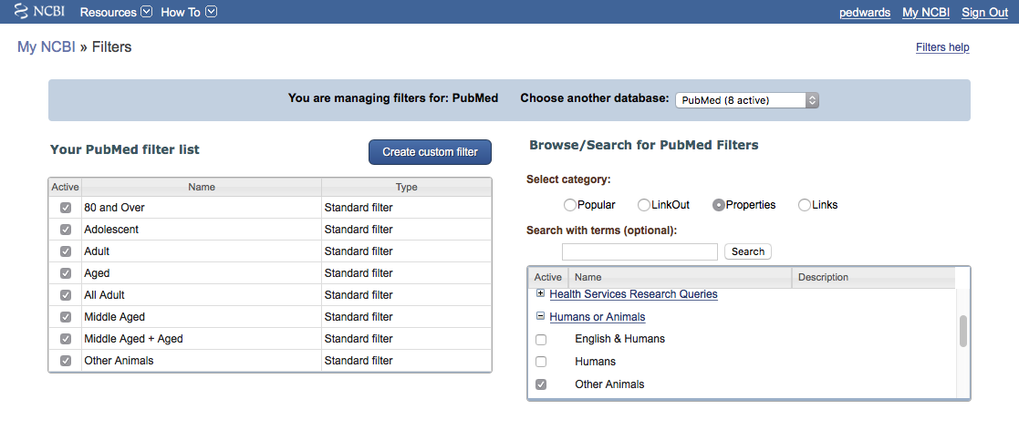
Your user name
If you do research,
Other Animals is a filter.

Slide 26
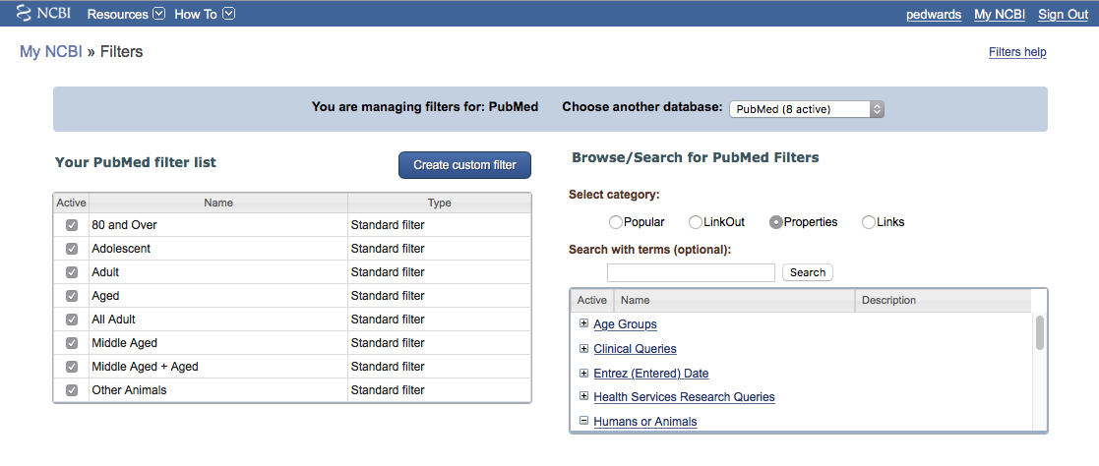
Click to create a custom filter
Your user name

Slide 27
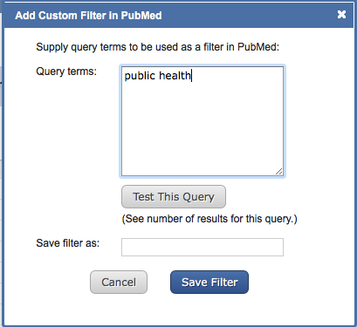
Enter term
Click
Test This Query

Slide 28
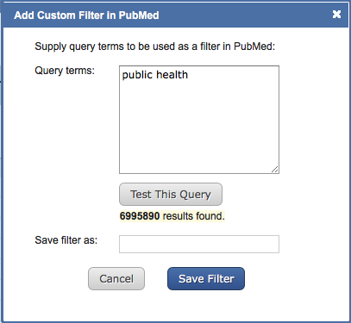
Click the box
to save the filter name
Click
Save Filter

Slide 29
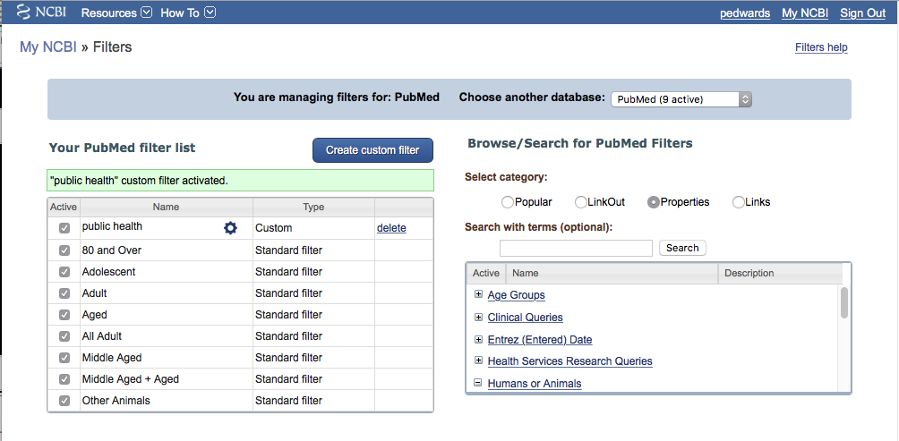
To activate,
click
✓
public health
Your user name

Slide 30
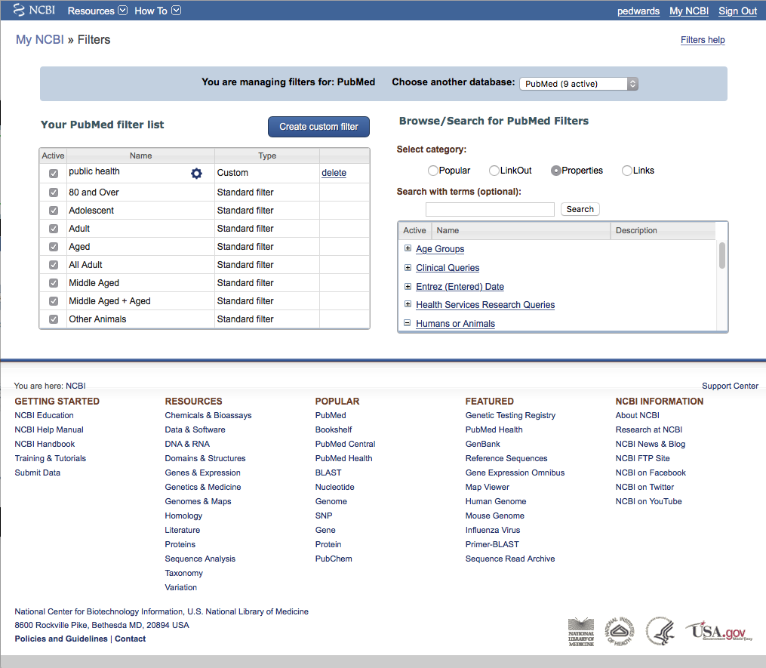
Your user name
Click PubMed

Slide 31
Create a Search Strategy Plan
Identify the question and key concepts:
prevention and control of pain OR
pain measurement in metastatic bone neoplasms
Write the search program using
medical subject headings (MeSH)

Slide 32
MeSH Database
is a “controlled vocabulary list” of more than
25,000 subject headings.
Terms in the database are called
Medical Subject Headings or MeSH.
The 10-15 MeSH assigned to each article
in PubMed is like a keyword abstract
of the article.

Slide 33
Using
MeSH Database

Slide 34
Your User Name
Click MeSH Database

Slide 35
Frequently Used Mesh Categories – 2011
A Anatomy
C Diseases
D Chemicals & Drugs
A1 Body Regions
A2 Musculoskeletal System
A3 Digestive System
A4 Respiratory System
A5 Urogenital System
A6 Endocrine System
A7 Cardiovascular System
A8 Nervous System
A9 Sense Organs
A10 Tissues
A11 Cells
A12 Fluids and Secretions
A13 Animal Structures
A14 Stomatognathic System
A15 Hemic and Immune Systems
A16 Embryonic Structures
A17 Integumentary System
A18 Plant Structures
A19 Fungal Structures
A20 Bacterial Structures
A21 Viral Structures
C1 Bacterial Infections & Mycoses
C2 Virus Diseases
C3 Parasitic Diseases
C4 Neoplasms
C5 Musculoskeletal Diseases
C6 Digestive System Diseases
C7 Stomatognathic Diseases
C8 Respiratory Tract Diseases
C9 Otorhinolaryngologic Diseases
C10 Nervous System Diseases
C11 Eye Diseases
C12 Male Urogenital Diseases
C13 Female Urogenital Diseases
& Pregnancy Complications
C14 Cardiovascular Diseases
C15 Hemic & Lymphatic Diseases
C16 Congenital, Hereditary, &
Neonatal Diseases & Abnormalities
C17 Skin & Connective Tissue Diseases
C18 Nutritional & Metabolic Diseases
C19 Endocrine System Diseases
C20 Immune System Diseases
C21 Disorders of Environmental Origin
C22 Animal Diseases
C23 Pathologic Conditions,
Signs, and Symptoms
C24 Occupational Diseases
C25 Chemically-Induced Disorders
C26 Wounds and Injuries
D1 Inorganic Chemicals
D2 Organic Chemicals
D3 Heterocyclic Compounds
D4 Polycyclic Compounds
D5 Macromolecular Substances
D6 Hormones, Hormone Substitutes,
& Hormone Antagonists
D8 Enzymes, & Coenzymes
D9 Carbohydrates
D10 Lipids
D12 Amino Acids, Peptides,
& Proteins
D13 Nucleic Acids, Nucleotides,
& Nucleosides
D20 Complex Mixtures
D23 Biologic Factors
D25 Biomedical and Dental Materials
D26 Pharmaceutical Preparations
D27 Chemical Actions and Uses
B Organisms
B1 Eukaryota
B2 Archaea
B3 Bacteria
B4 Viruses
B5 Organism Forms

Slide 36
Other Categories Include:
Analytical, Diagnostic, & Therapeutic Techniques & Equipment
Psychiatry and Psychology
Physical Phenomena
Natural Sciences
Anthropology, Education, Sociology & Social Phenomena
Technology, Industry, Agriculture
Humanities
Information Science
Persons
Population Characteristics
Publication Components
Geographic Locations

Slide 37
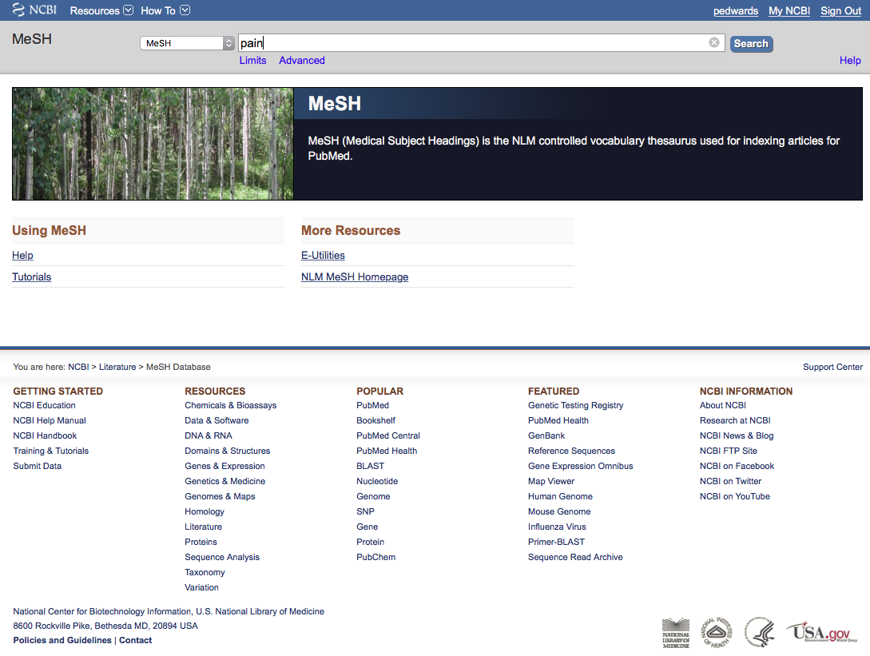
Your user name
Enter and click a
a
Search
pain
(Note: If there is a Boolean OR
relationship, start with the
“OR” statement first.)

Slide 38
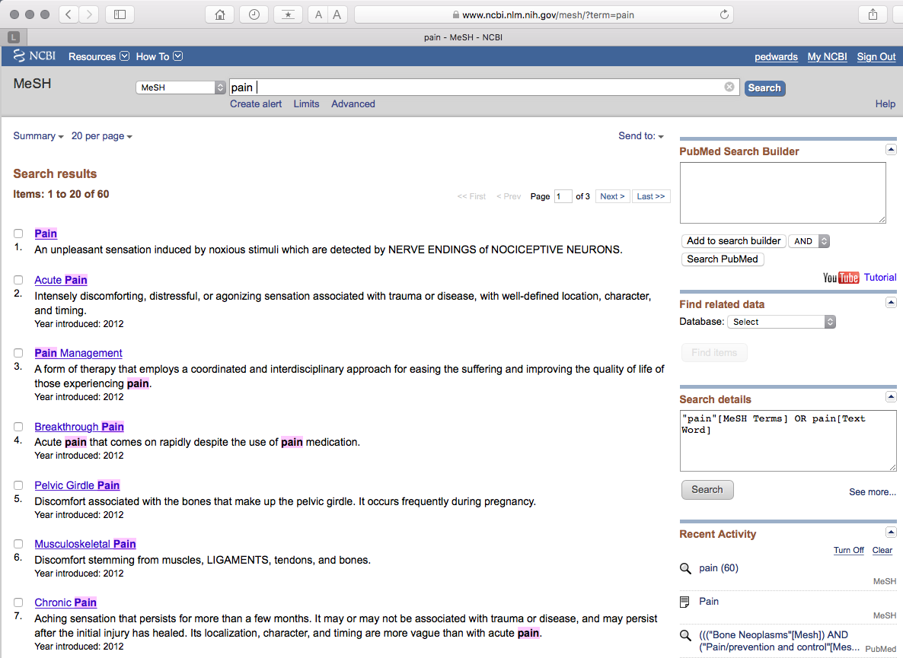
Your user name
Term Definitions

Slide 39
Your user name
Click the underlined term

Slide 40
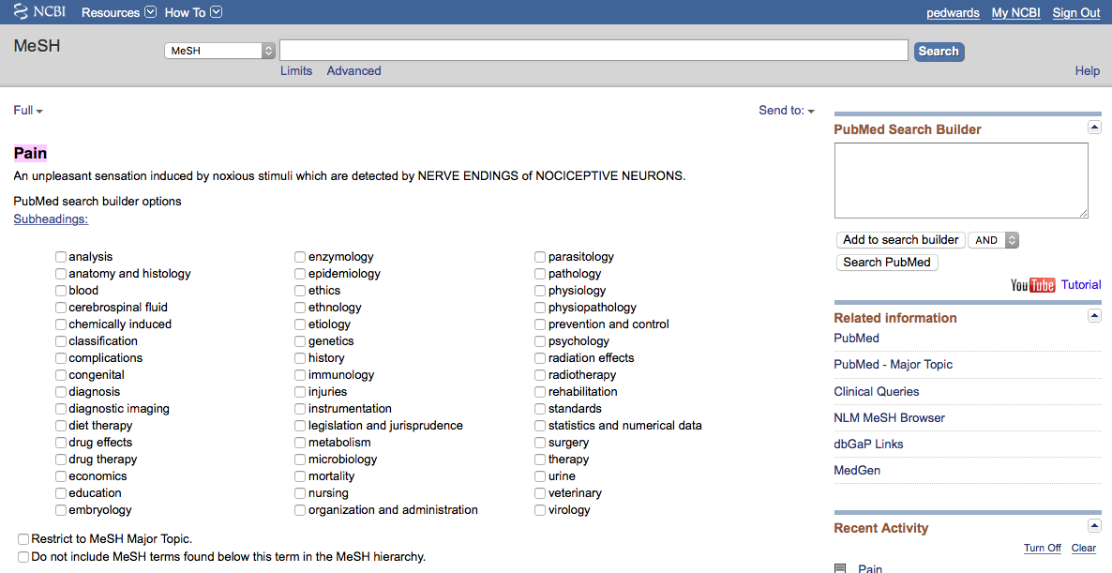
Your user name
Scroll to the
Tree Structures

Slide 41
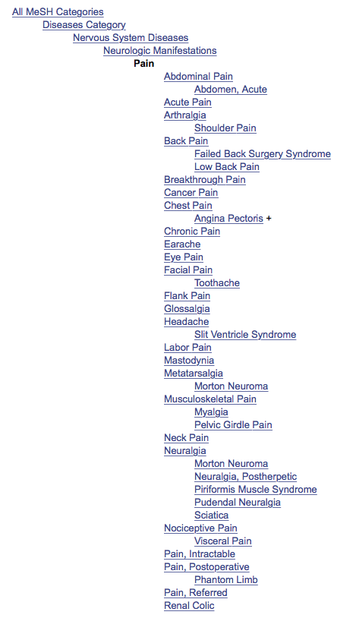
terms arranged in
tree structure hierarchy
MeSH
Terms are listed from
broadest to narrowest.
If Cancer Pain yields zero results,
try using a broader term: Pain.

Slide 42
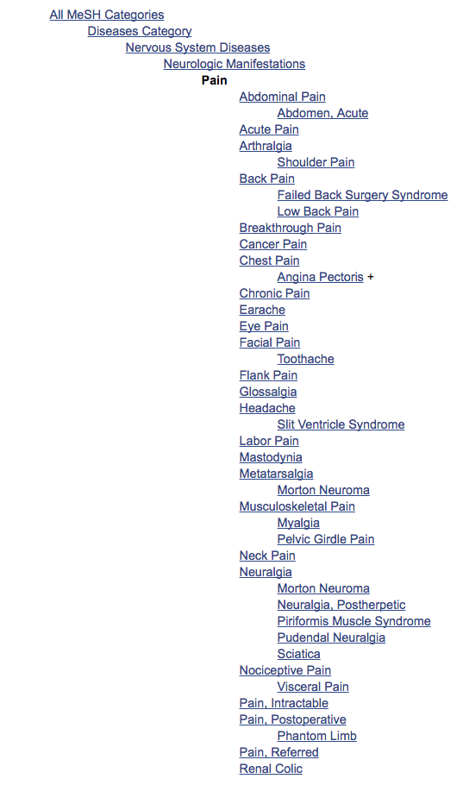
Note:
PubMed automatically
OR’s indented terms
under a broader term…

Slide 43
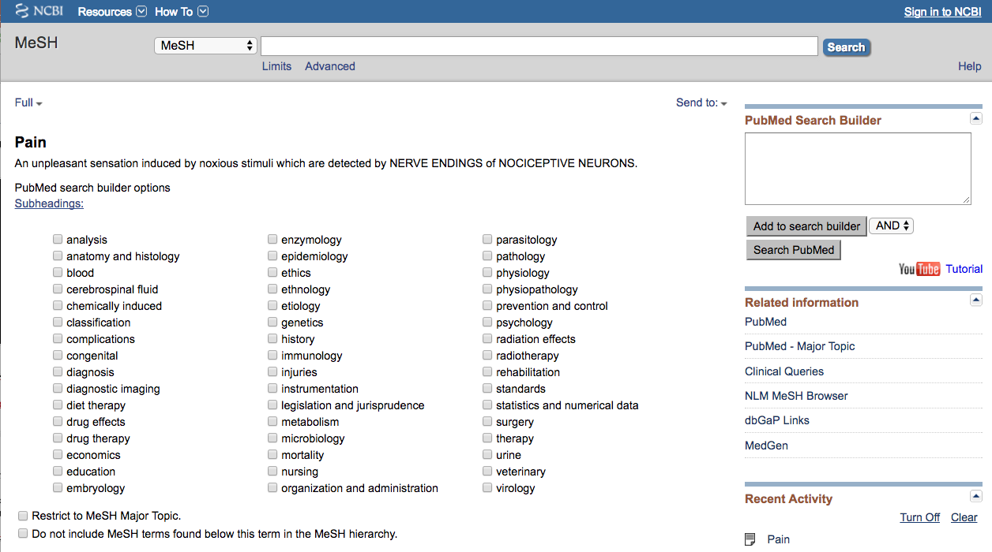
… unless you select
the following command
✓

Slide 44
Your user name
Sub-headings narrow the “meaning” of a
MeSH term.
M They are a “subset” of all the
articles under the MeSH term: Pain.

Slide 45
82 SUBHEADINGS:
abnormalities enzymology poisoning
administrations & dosage epidemiology
adverse effects ethics prevention & control
agonists ethnology
analogs & derivatives etiology psychology
analysis genetics radiation effects
anatomy & histology growth & development radiography
antagonists & inhibitors history radionuclide imaging
biosynthesis immunology radiotherapy
blood injuries rehabilitation
blood supply innervation secondary
cerebrospinal fluid instrumentation secretion
chemical synthesis isolation & purification standards
chemically induced legislation & jurisprudence statistics & numerical data
chemistry manpower supply & distribution
classification metabolism surgery
complications methods therapeutic use
congenital microbiology therapy
contraindications mortality toxicity
cytology nursing transmission
deficiency organization & administration transplantation
diagnosis parasitology trends
diet therapy pathogenicity ultrasonography
drug effects pathology ultrastructure
drug therapy pharmacokinetics urine
economics pharmacology utilization
education physiology veterinary
embryology physiopathology virology

Slide 46
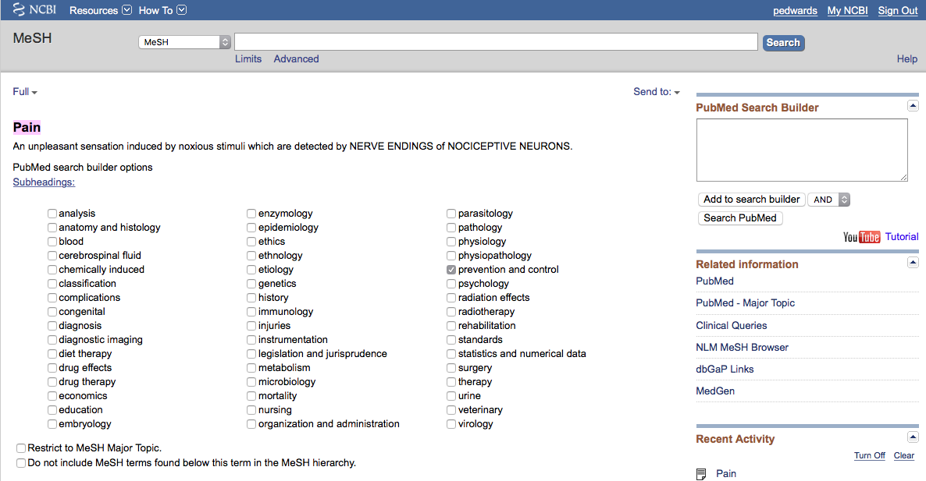
1) Check the box next
to the subheadinga
2) Select
AND
Your user name
✔
3) Then click
Add to search builder

Slide 47
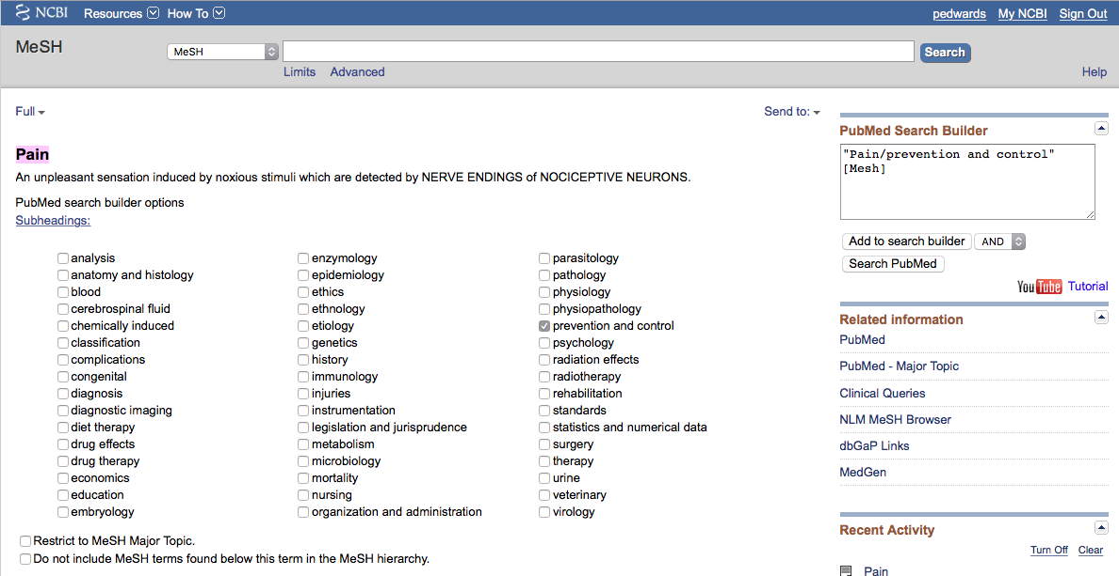
Your user name
MeSH
The first term with the
/sub-heading is in the search program “box”

Slide 48
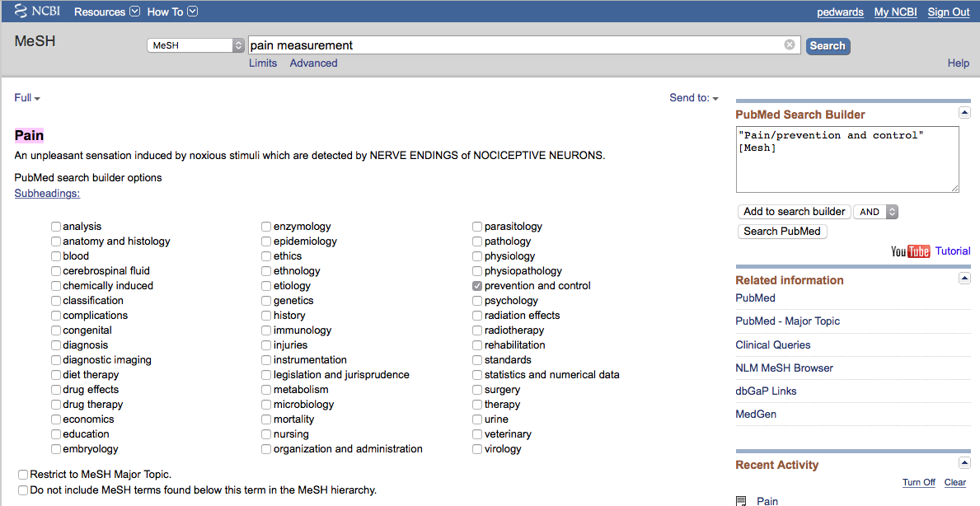
Your user name
Enter and click a
a
Pain measurement
Search
Since there is a Boolean OR relationship in this question,
start with those concepts first. PubMed algebraically
processes OR relationships first, then processes the AND’s.

Slide 49
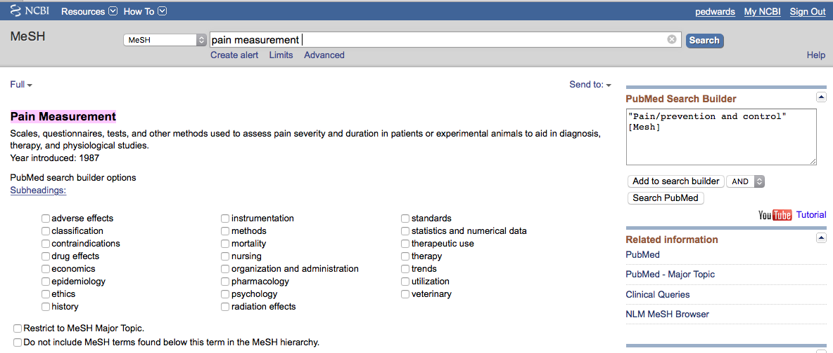

1) Select
OR
Your user name
2) Then click
Add to search builder

Slide 50
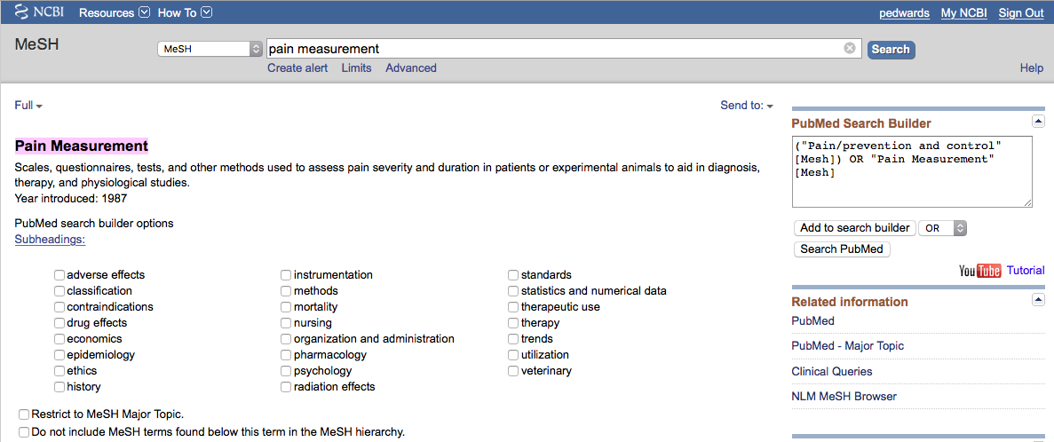
Your user name
MeSH
The second term is in
the search program “box”

Slide 51
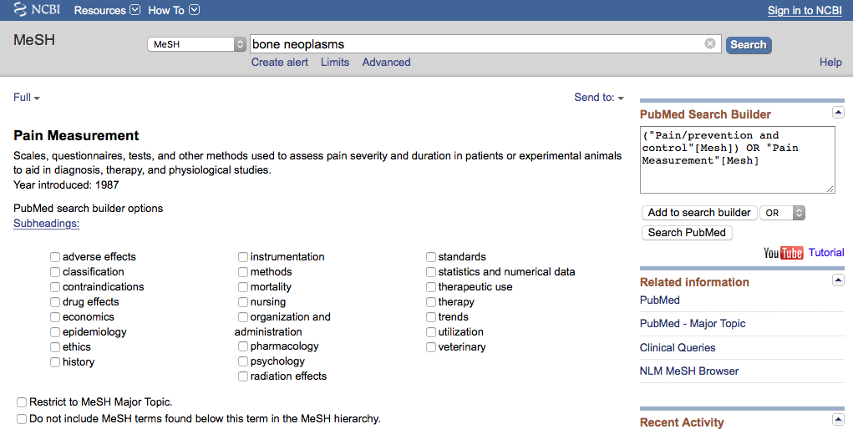
Your user name
a
a
Enter
and click
Search
bone neoplasms

Slide 52
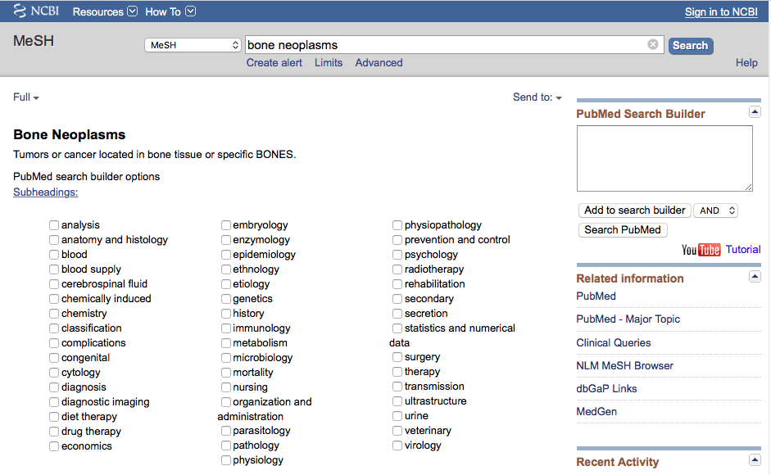
1) Check the box next
to the subheadinga
2) Select
Your user name
AND
✔
3) Then click
Add to search builder

Slide 53
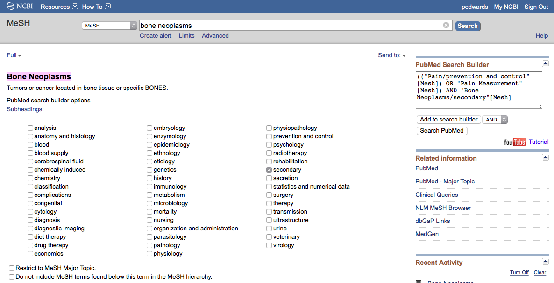
Your user name
MeSH
The third term with the
/sub-heading is in the search program “box”

Slide 54
Boolean Logic - OR
Pain/
prevention
and control
Pain
measurement
OR

Slide 55
Boolean Logic - AND
Pain/
prevention & control
OR
Pain measurement
Bone
Neoplasms/
secondary
and

Slide 56
Your user name
The search program is complete.
Click
Search PubMed

Slide 57
Search Results

Slide 58
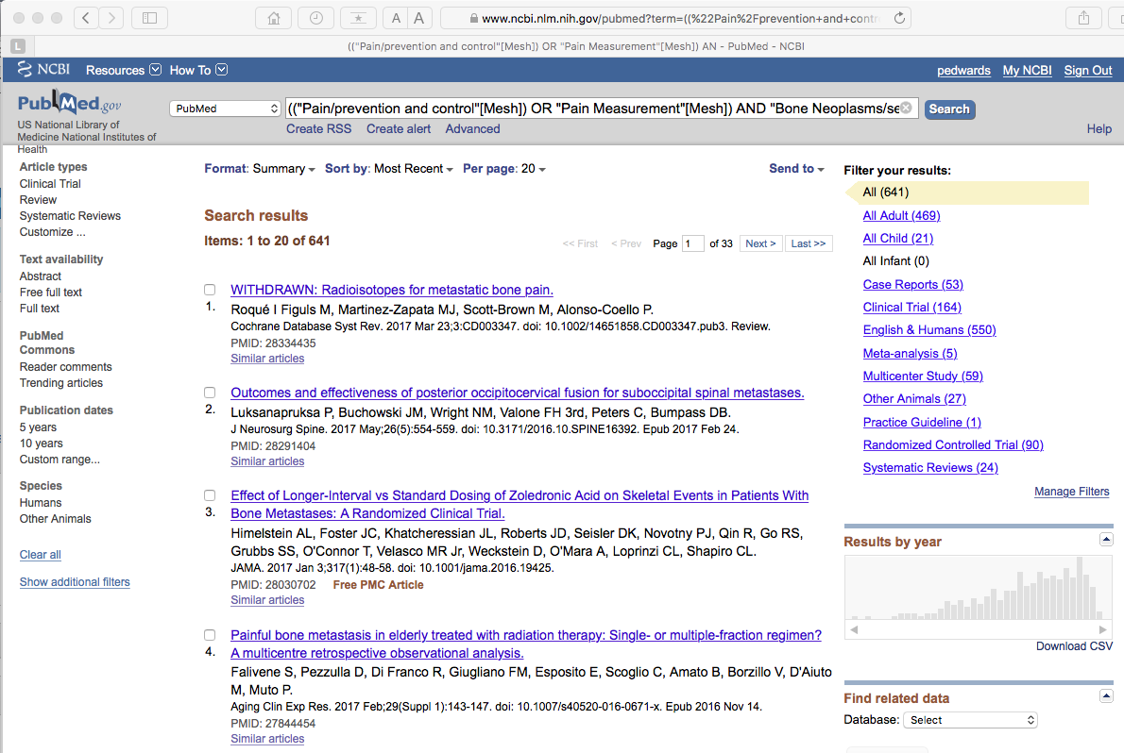
Your user name
PubMed identifies
641 articles

Slide 59
Your user name
NOTE: Custom Filters appear when
you’re in your My NCBI account.

Slide 60
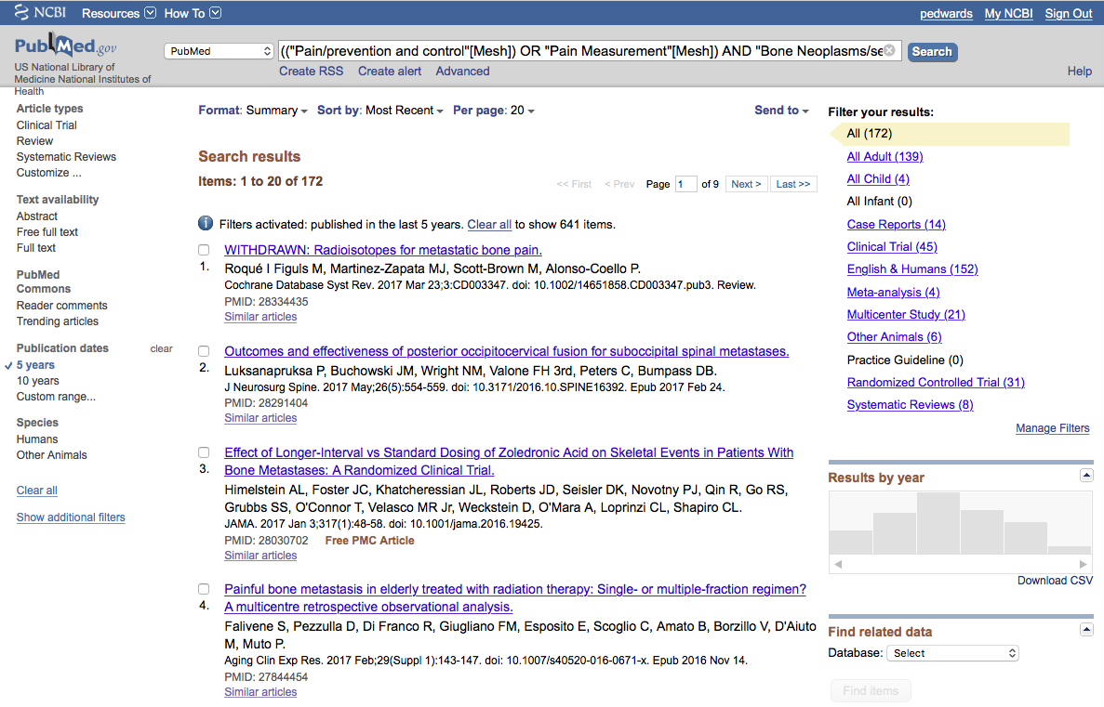
Your user name
Limit to articles that were
written in the past 5 years by
clicking the selection on the left.
Humans is a standard filter

Slide 61
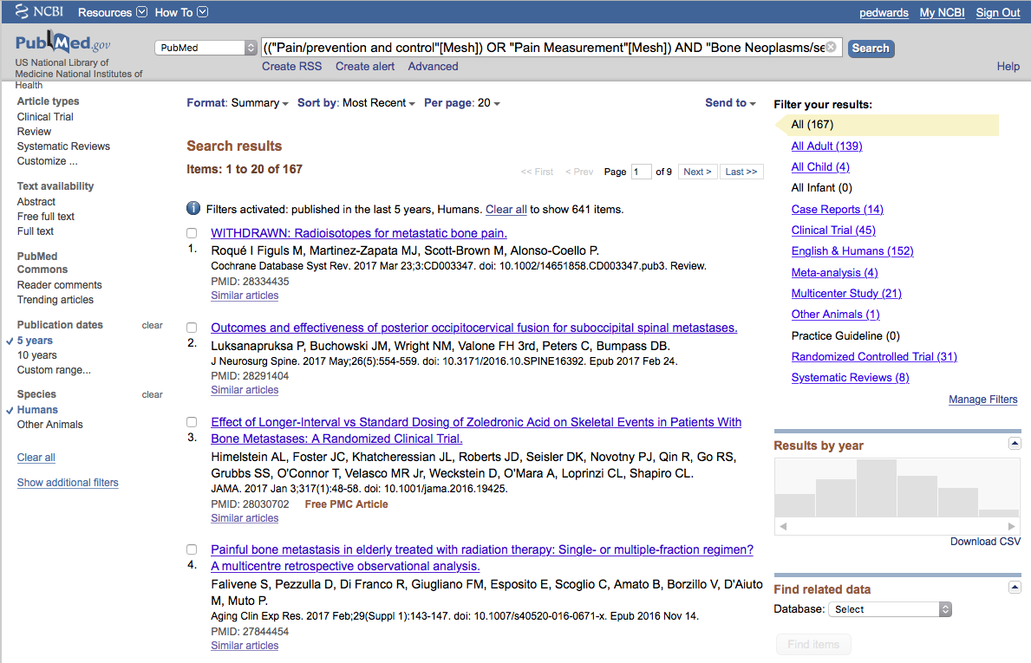
Your user name
Click
Show additional filters

Slide 62
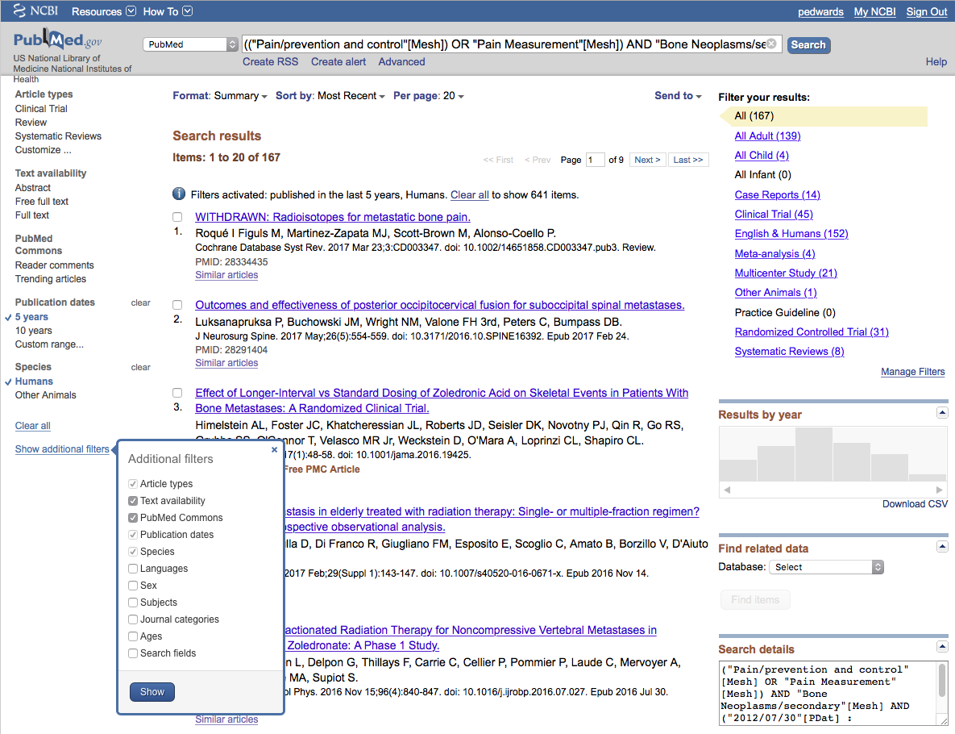
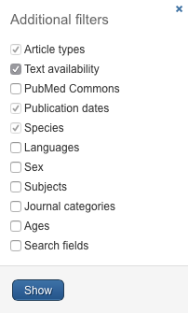
Your user name
Select
Languages
✔
and click
Show

Slide 63
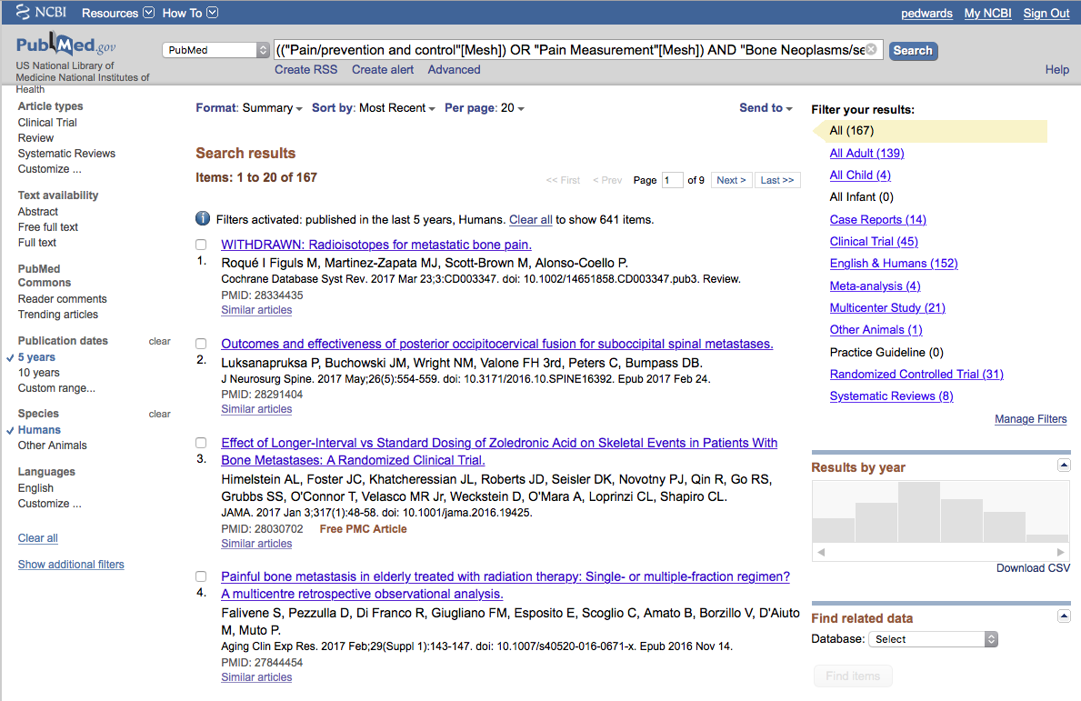
Your user name
Click English to activate filter

Slide 64
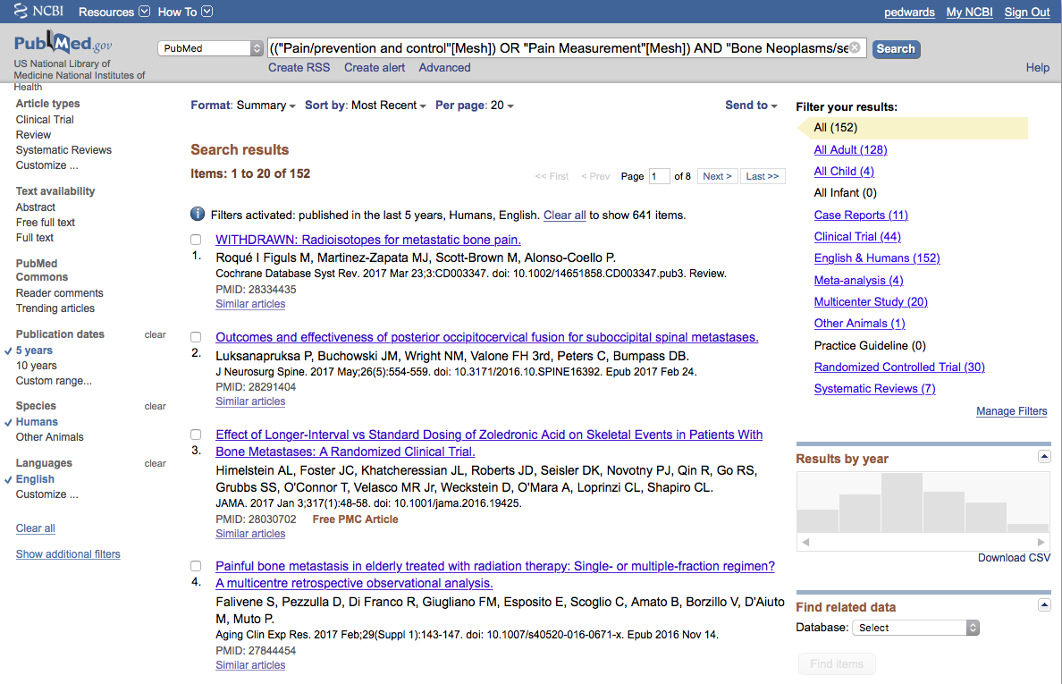
Your user name
By applying filters,
results are reduced
From 641 to 152

Slide 65
Your user name
Change [Mesh] to [Majr]
a
a
Click
Search

Slide 66
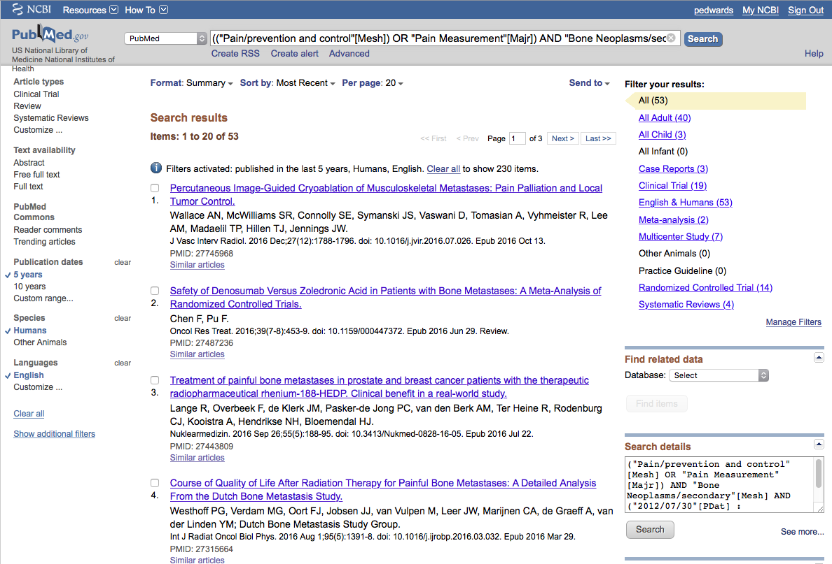
Your user name
Results are reduced
From 152 to 53

Slide 67

Your user name
Click

Slide 68
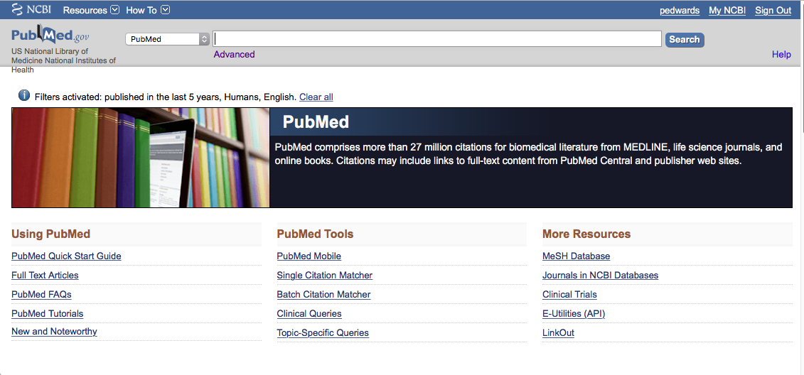
Your user name
Click MeSH Database

Slide 69
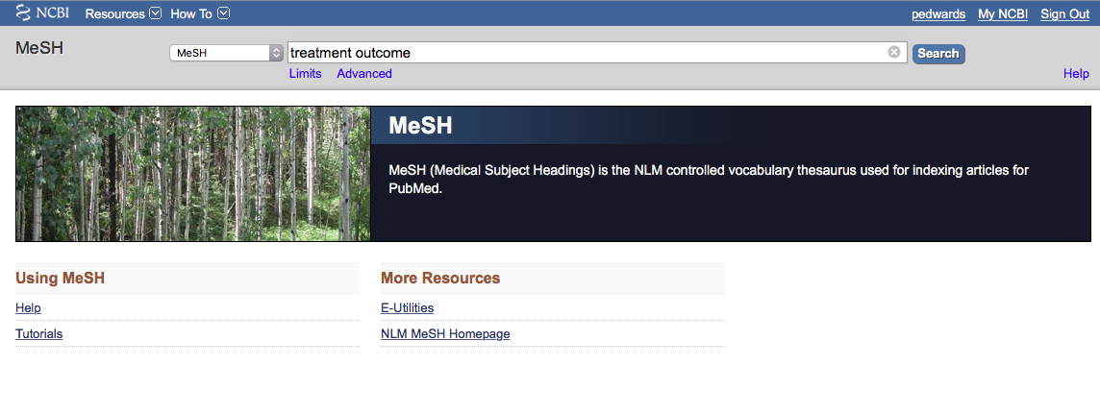
Your user name
a
a
Search
Enter
treatment outcome
and click

Slide 70
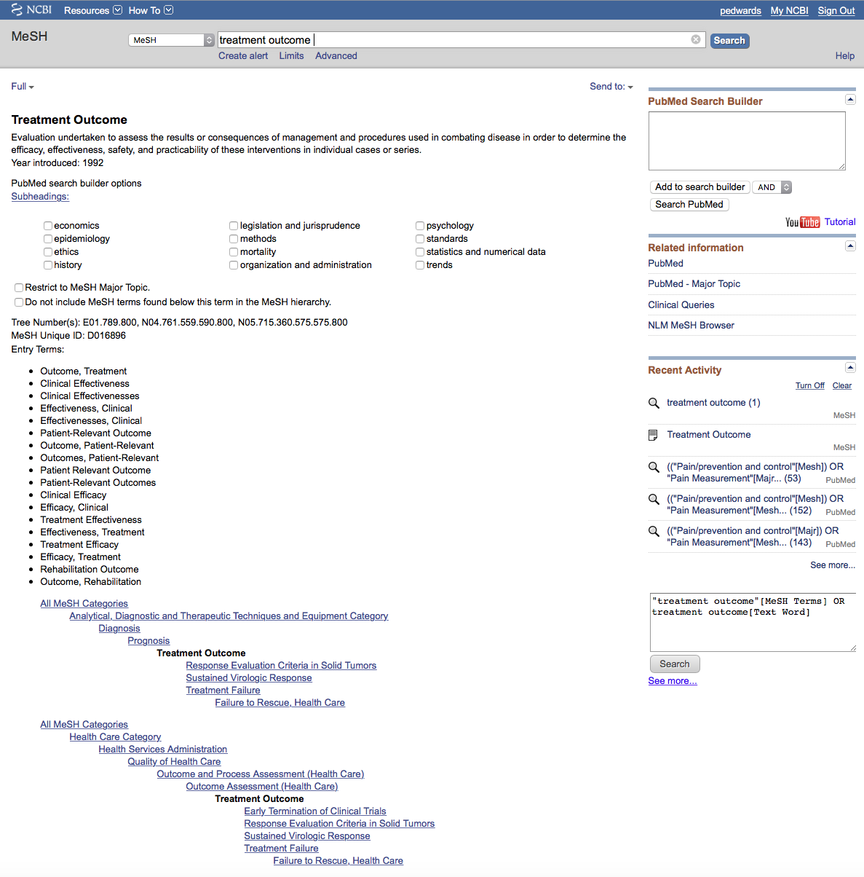
Your user name
Click
Add to search builder
Click
Search PubMed

Slide 71
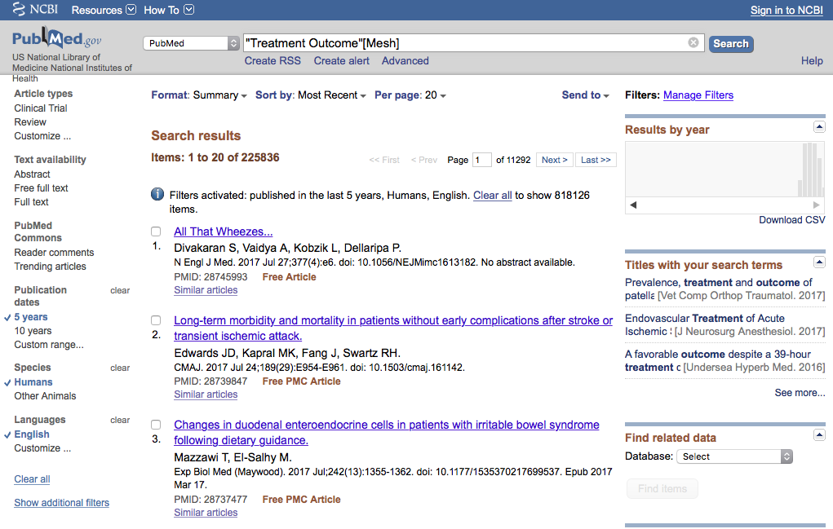
Your user name
Click Advanced

Slide 72


Your user name
Click the search number
Click AND in builder

Slide 73

Your user name
Strategy is in the search builder

Slide 74
Your user name
Click the search number
Click AND in builder

Slide 75

Your user name
Click Search
Strategy is in the search builder

Slide 76

Your user name
Results from different
search strategy

Slide 77
Your user name
Select article # 4.
X

Slide 78

Your user name
1) Click Summary
2) Select Abstract

Slide 79

Icon for full text.

Slide 80
Click for MeSH terms
+

Slide 81

Mesh Terms Index

Slide 82
MeSH Database
searches only
the MeSH terms for:
The * indicates Major focus
Pain/pc
OR
Pain measurement
AND
Bone Neoplasms/sc
AND
Treatment Outcome

Slide 83
Look at subject headings
in the
MeSH Terms Index
for additional terms.
You may want to
write a new search
program using:
Palliative Care

Slide 84


Your user name
.
Click Send to: and select
File to save citations to a file on your computer or
Clipboard to temporarily store selected citations or
E-mail to send citations to self or colleague

Slide 85
Your user name
Click Icon for full text.

Slide 86
Linking to
Full-Text Articles
in Electronic Journals

Slide 87

When Searching from Off Campus:
Enter the
Eraider username and password
assigned to you
by Information Services.
A
Problems with eRaider? Call: 806-743-1234 a

Slide 88

Click PDF

Slide 89

Full Text Article
Close Article

Slide 90
Saving Searches

Slide 91
Your user name
Click Create alert

Slide 92

Your user name
Click
•
Yes, please.

Slide 93


Your user name
Select frequency

Slide 94

Your user name
Select day

Slide 95

Your user name
Select Report format

Slide 96

Your user name
Select Number of items:
Click
Save

Slide 97

Your user name
Click My NCBI
Search is saved.

Slide 98

Click Manage Saved Searches

Slide 99

Delete
saved search(es).
See
What’s new
Your user name
Click to re-run search.

Slide 100
Other Searching Features
MeSH, phrase, & title word searching
    using the [ti] pneumonic
Truncation

Slide 101

Your user name
Click PubMed

Slide 102
Your User Name
Click MeSH Database

Slide 103

Your user name
Enter and click a
a
Search
human genome

Slide 104

Click box to select term
Your user name
✔
✔
Click
Add to search builder
Click
Search PubMed

Slide 105

Your user name
PubMed identifies 6780 articles
Note: filters are activated

Slide 106

Your user name
Search
Enter
AND “dark matter”
and click
Note: “dark matter” is not a MeSH term.

Slide 107

Your user name
PubMed identifies
5 articles

Slide 108

Your user name
Enter and click
Search
“dark matter” [ti]

Slide 109

Results are narrowed to 4
Your user name
Note: all articles have
”dark matter” in the title

Slide 110
Truncation

Slide 111

Your user name
Enter gene* to truncate.

Slide 112

Truncation searches for all suffixes such as: gene genes genetics, etc.
General and generations are “false drops”

Slide 113
Online Tutorial

Slide 114
Your user name
Click for more hands-on learning.

Slide 115

www.ttuhsc.edu/libraries
Click

Slide 116
The End

