Slide 1
TTUHSC Preston Smith Library
presents
Searching PubMed®
Medical Focus
Rev. 06/2016

Slide 2
To begin...

Slide 3
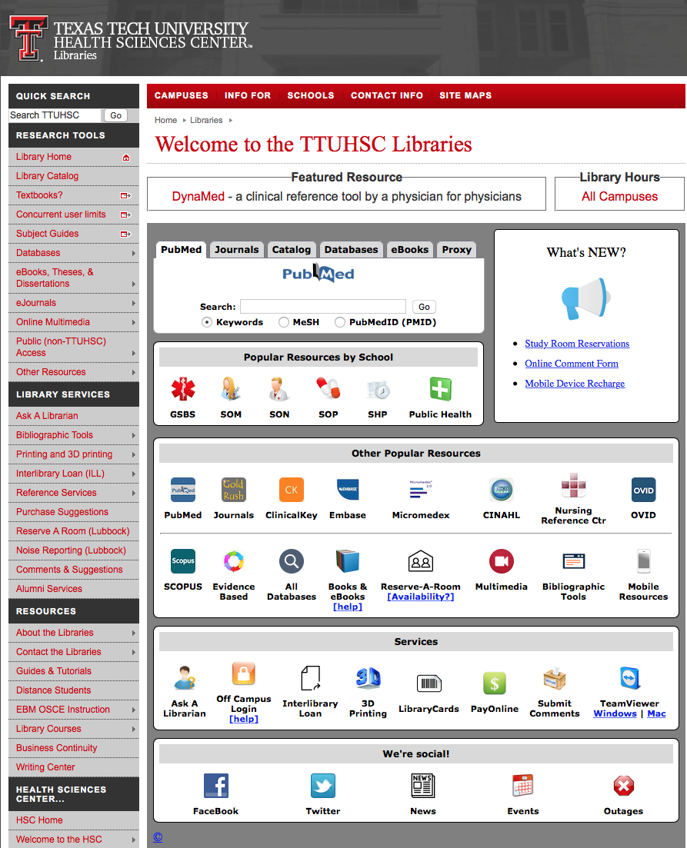

www.ttuhsc.edu/libraries
Click

Slide 4



PubMed Database
Biomedical and life sciences journal literature
International scope
Developed and maintained by the:
National Center for Biotechnology Information
    at the U.S. National Library of Medicine
    at the National Institutes of Health

Slide 5

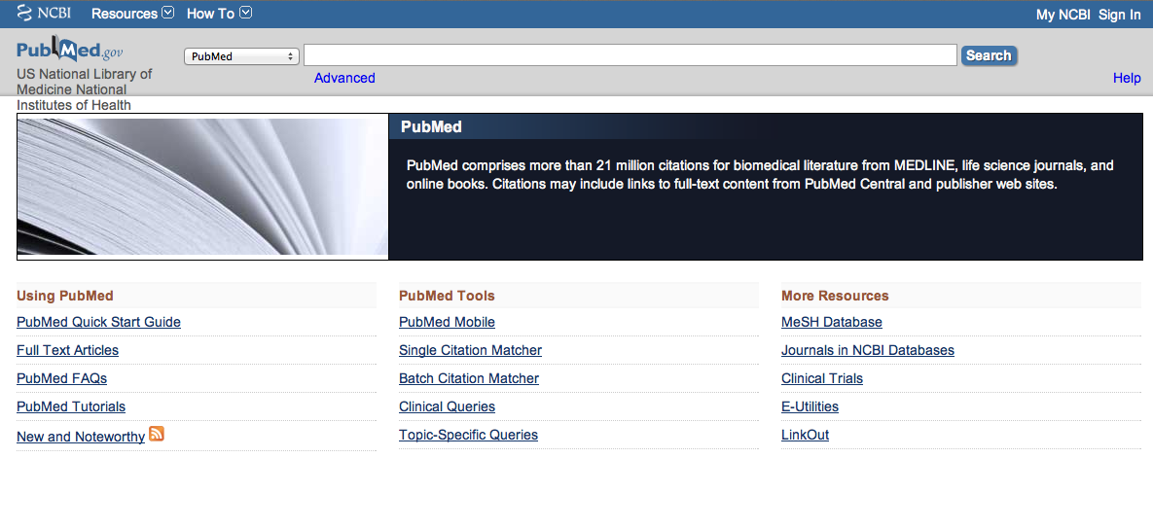
Accessing PubMed
Freely available over the Internet
@ www.pubmed.gov
Also through library’s home page

Slide 6
Creating a
My NCBI Account

Slide 7
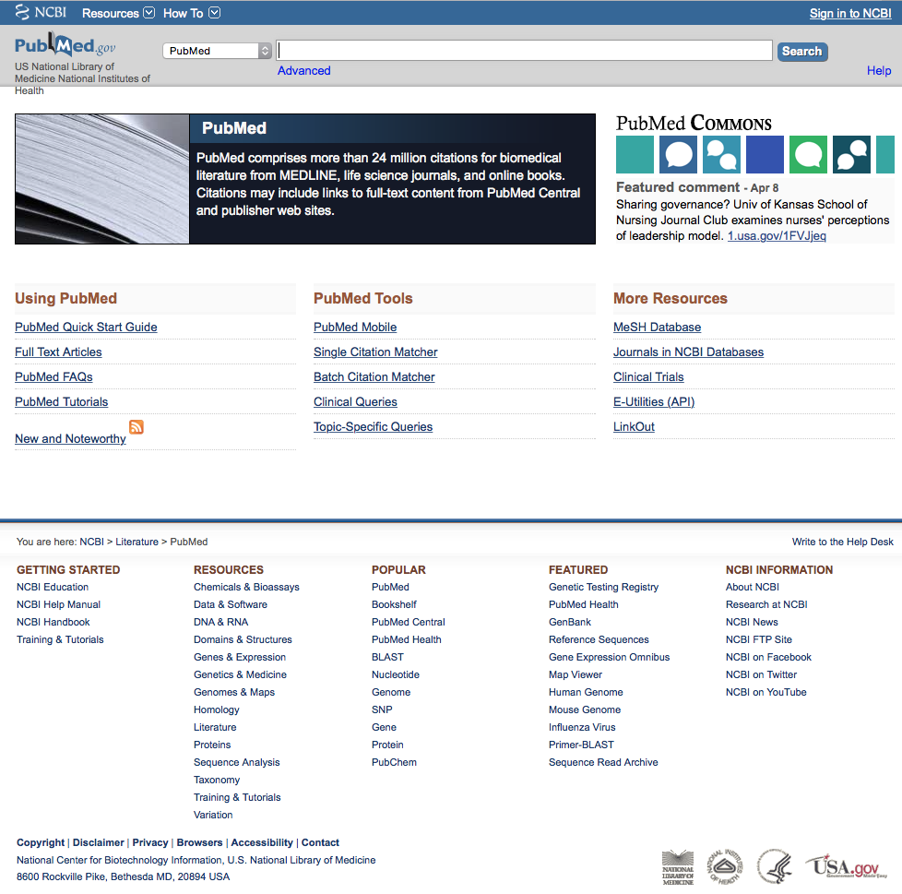
Click
Sign in to NCBI
PubMed Home Page

Slide 8
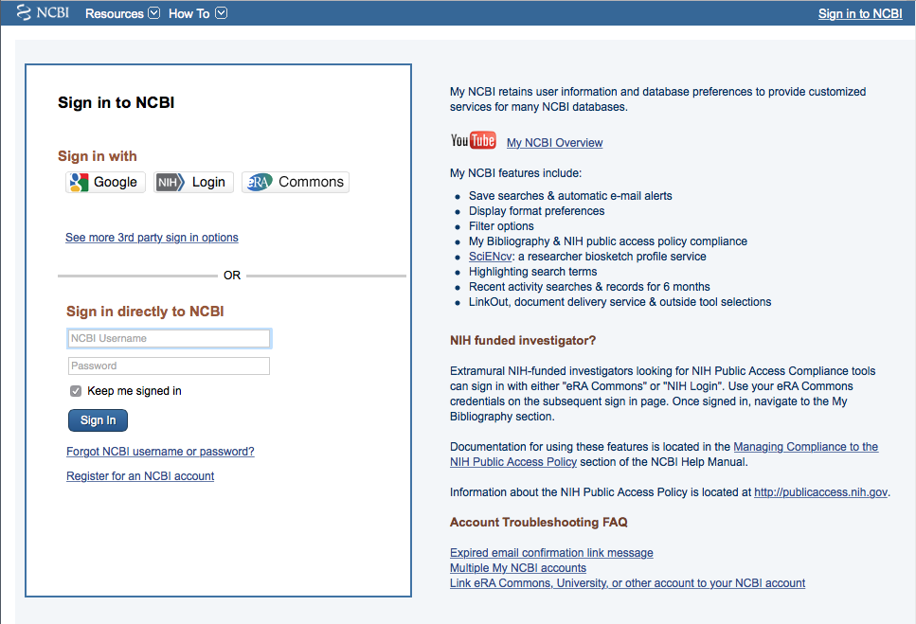
Click
Register for an NCBI account

Slide 9
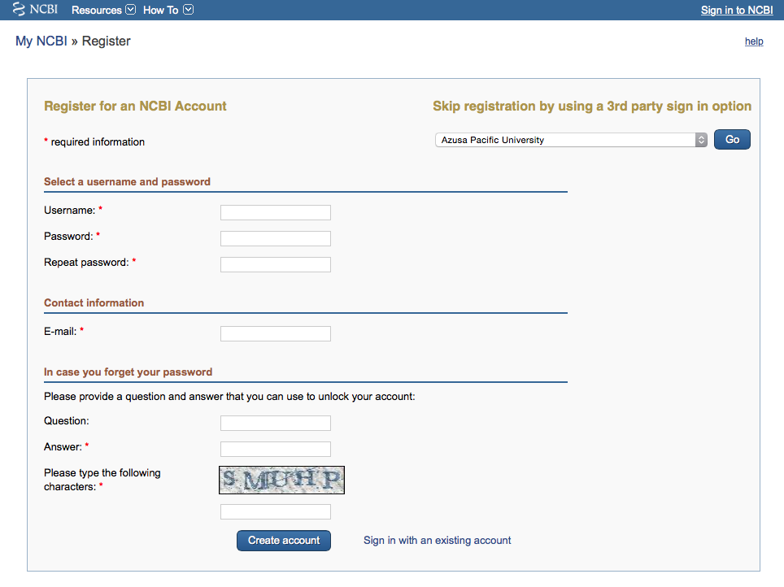
Fill out form
and click
Create account

Slide 10
Verifying your MY NCBI Account
Open the email you used in the account:
1) Locate the link from NCBI
2) Click the link
3) Tells NCBI you are a real user requesting the account
(not computer generated)
4) Your user name will now appear on the top right-hand side

Slide 11
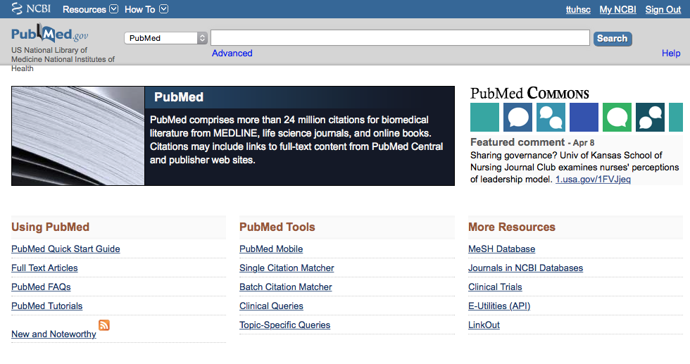
Click My NCBI
Your username
Your user name

Slide 12
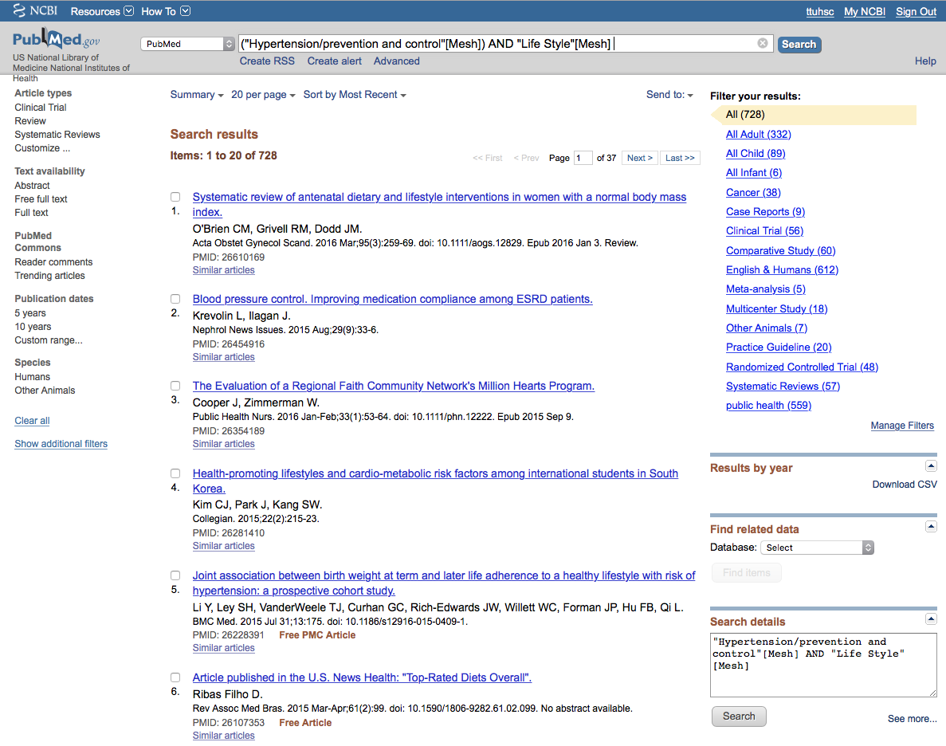
For quick access to filtered results, create custom filters!

Slide 13
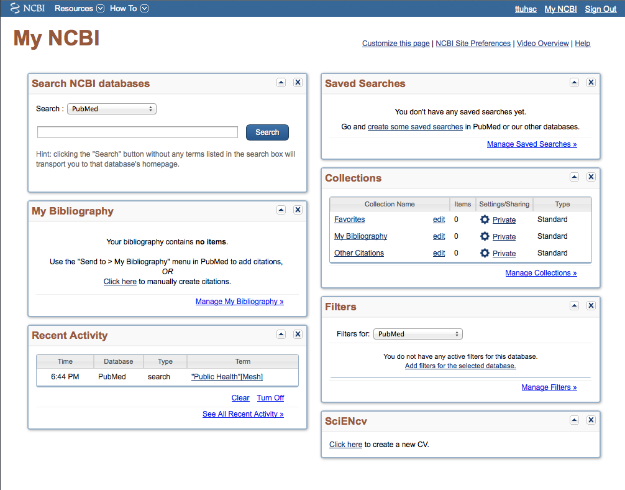
Click Manage Filters

Slide 14
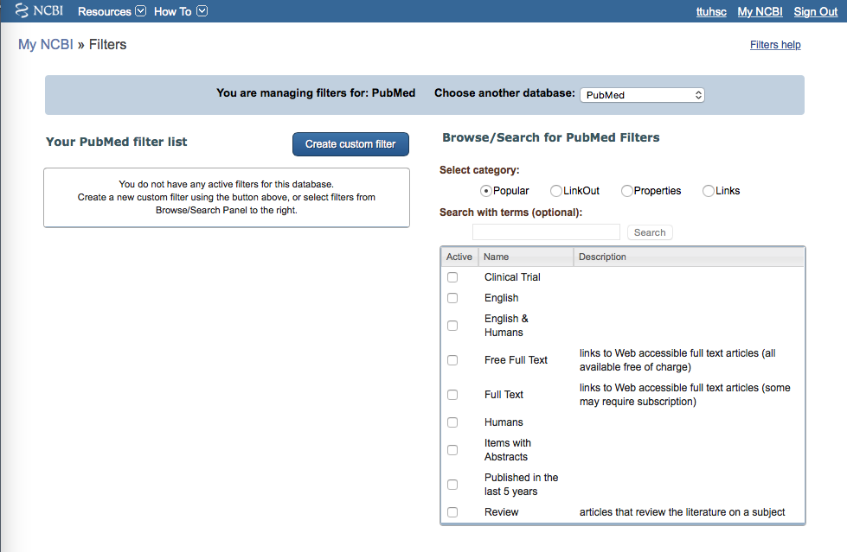
Select database
✔
Select up to 15 filters

Slide 15
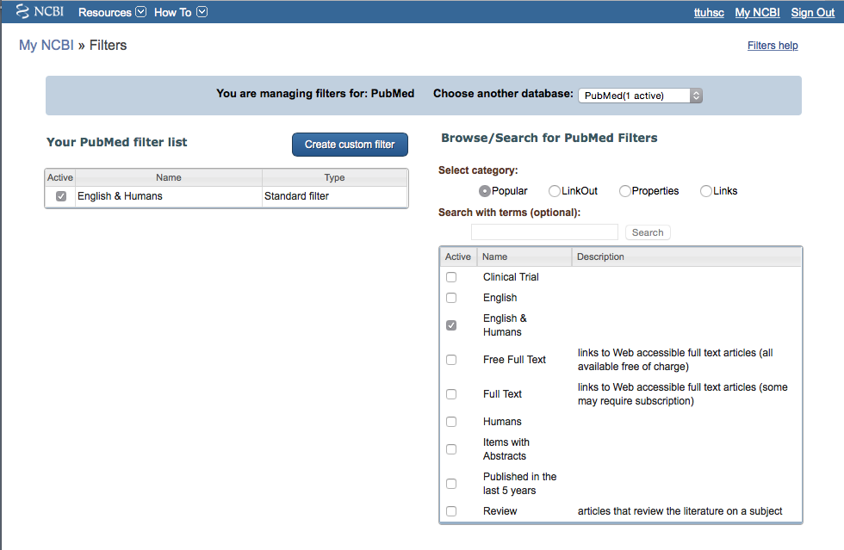
Click Properties
Filter activated

Slide 16
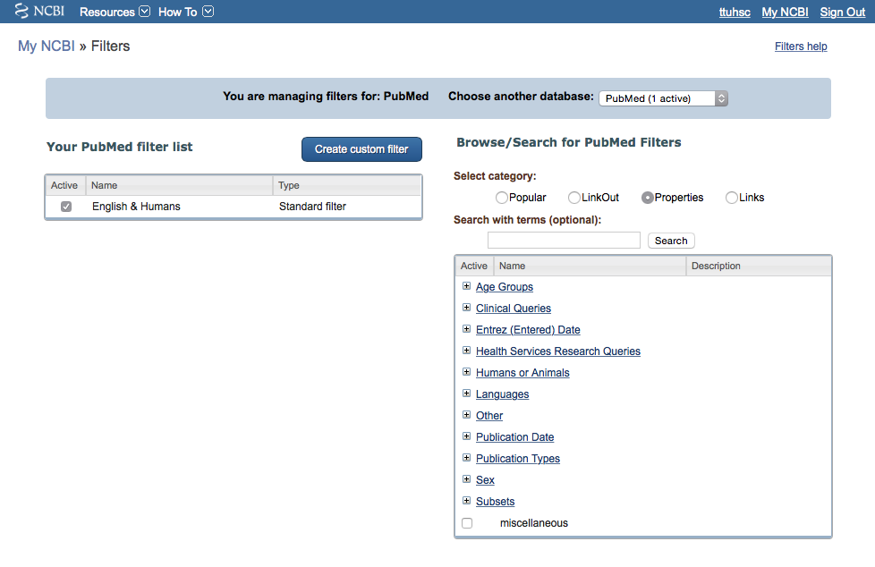
Selections

Slide 17
Open Age Groups
+

Slide 18
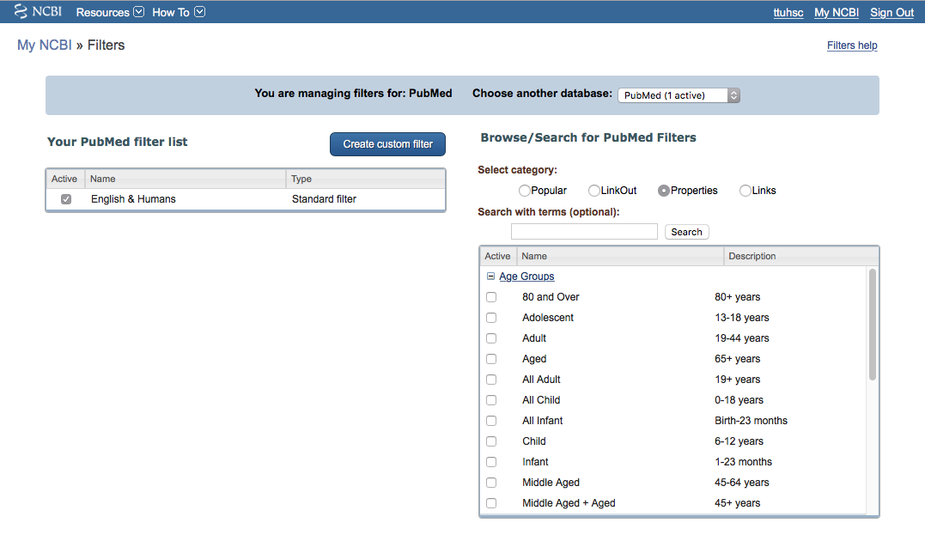

Select appropriate ages

Slide 19
+
Open Publication Types

Slide 20
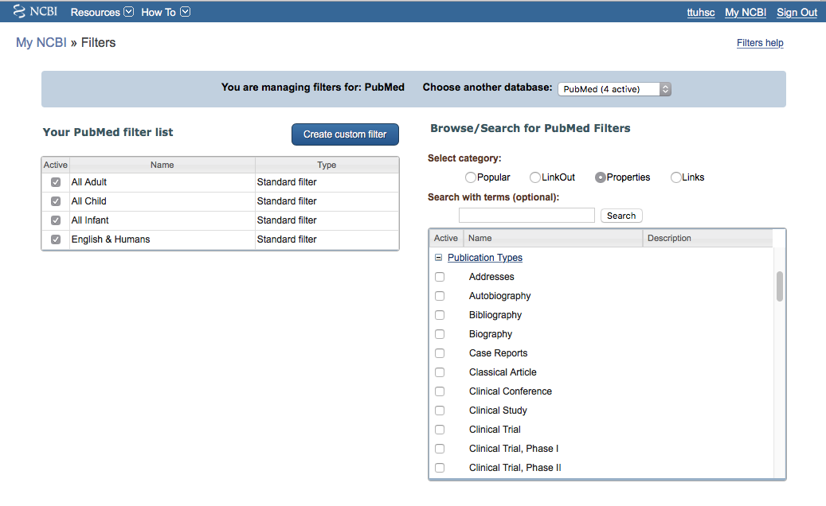
Select
Case Reports
Clinical Trial
✔
✔
Scroll to make more selections

Slide 21
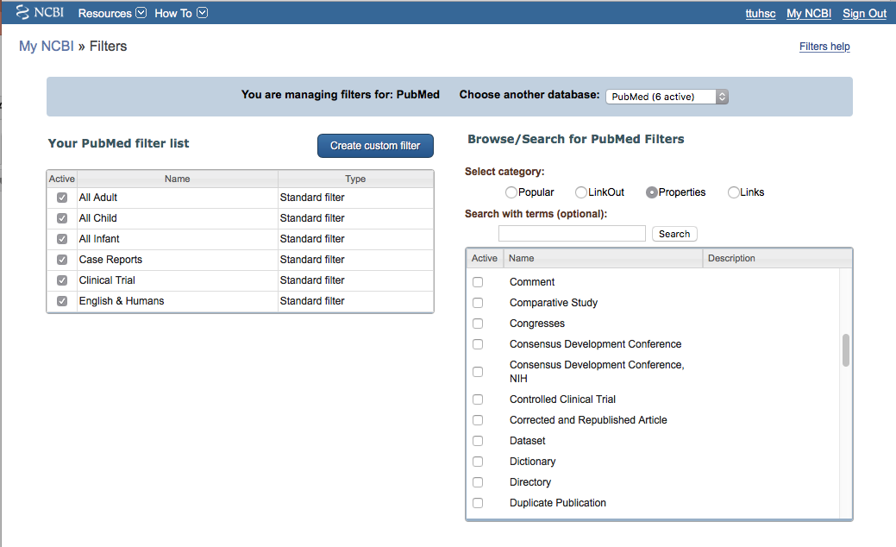
✔
Select
Comparative Study

Slide 22
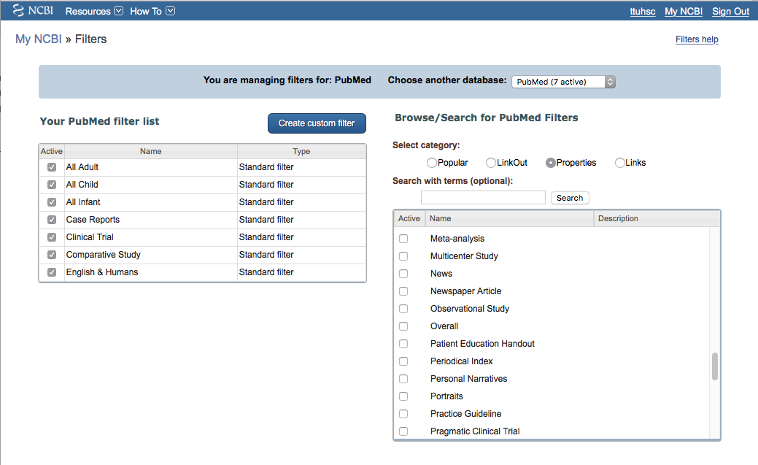
✔
✔
Select
Meta-analysis
Multicenter Study
Practice Guideline
✔

Slide 23
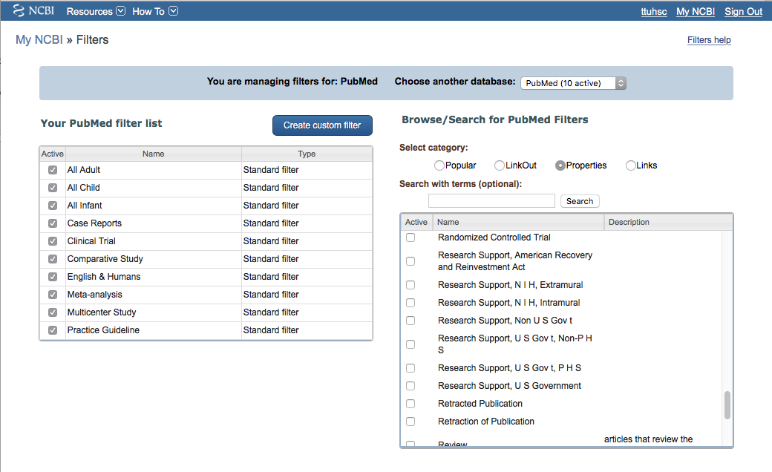
Select
Randomized Controlled Trial
✔

Slide 24
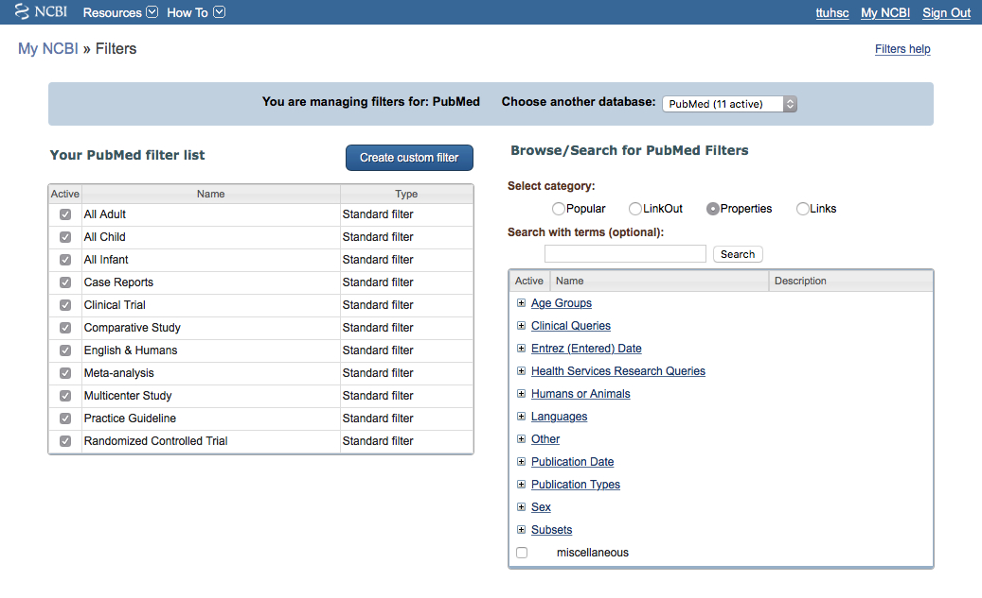
Open Subsets
+

Slide 25
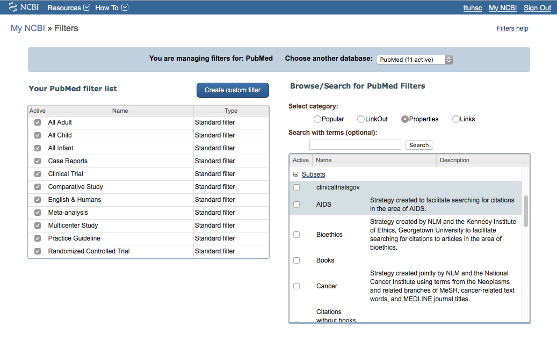
Select
Cancer
✔

Slide 26
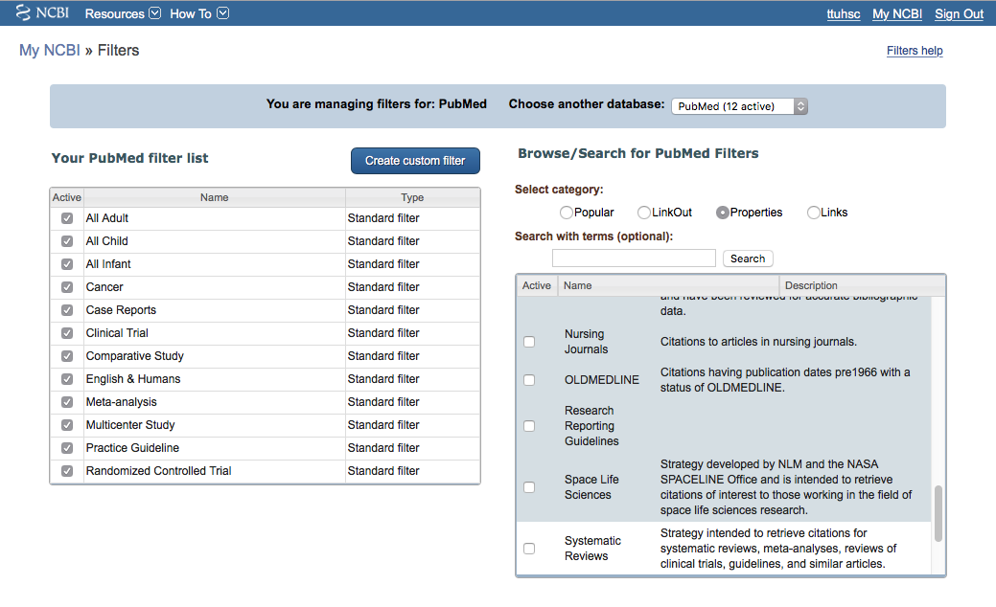
Select
Systematic Reviews
✔

Slide 27
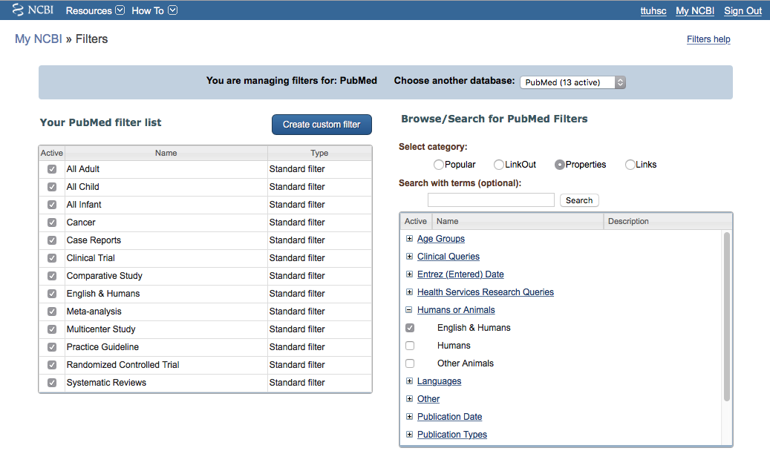
If you do research, Other Animals is a filter.

Slide 28
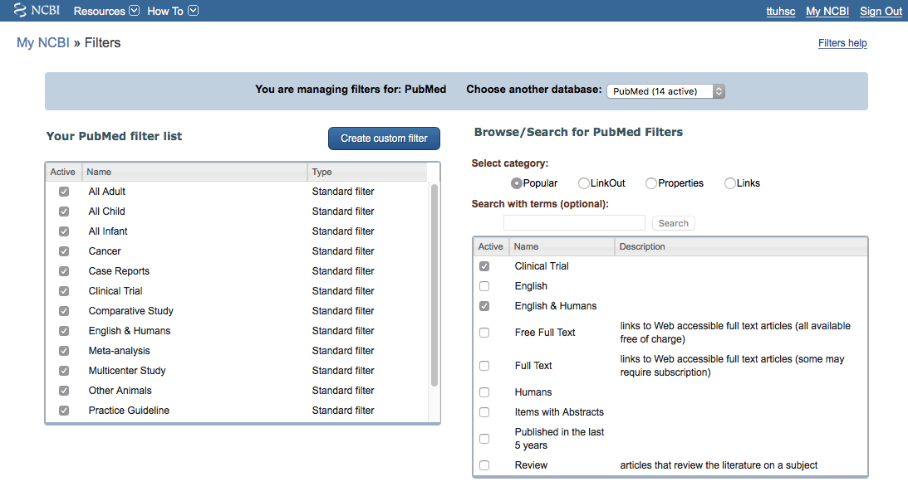
To create a custom filter

Slide 29
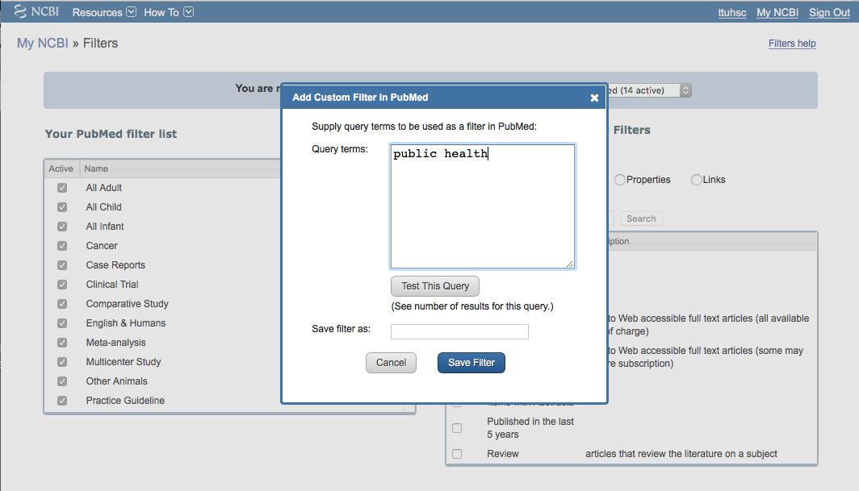
Enter term
Click

Slide 30
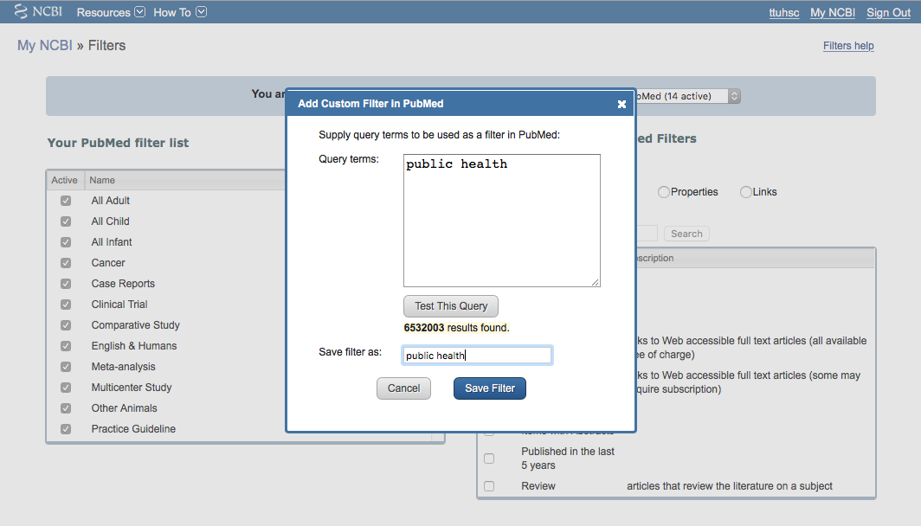
Click the box
to save the filter name
Click
Save Filter

Slide 31
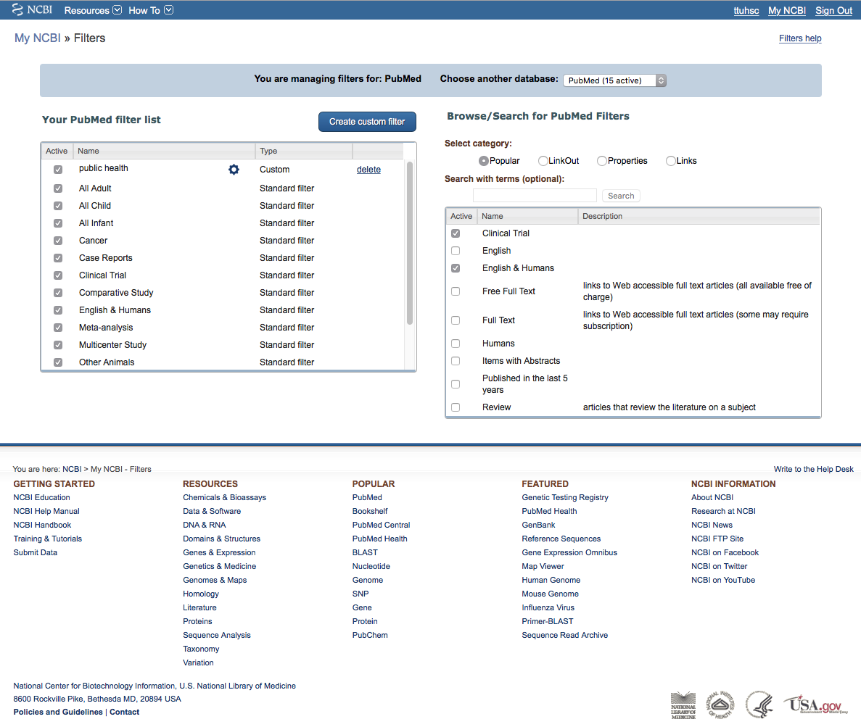
Click PubMed

Slide 32
Create a Search Strategy Plan
Identify the question and key concepts:
prevention and control of
hypertension with life style changes
Write the search program using
medical subject headings (MeSH)

Slide 33
MeSH Database
is a “controlled vocabulary list” of more than
25,000 subject headings.
Terms in the database are called
Medical Subject Headings or MeSH.
The 10-15 MeSH assigned to each article
in PubMed is like a keyword abstract
of the article.

Slide 34
Using
MeSH Database

Slide 35
Your user name
Click MeSH Database

Slide 36
Frequently Used Mesh Categories – 2011
A Anatomy
C Diseases
D Chemicals & Drugs
A1 Body Regions
A2 Musculoskeletal System
A3 Digestive System
A4 Respiratory System
A5 Urogenital System
A6 Endocrine System
A7 Cardiovascular System
A8 Nervous System
A9 Sense Organs
A10 Tissues
A11 Cells
A12 Fluids and Secretions
A13 Animal Structures
A14 Stomatognathic System
A15 Hemic and Immune Systems
A16 Embryonic Structures
A17 Integumentary System
A18 Plant Structures
A19 Fungal Structures
A20 Bacterial Structures
A21 Viral Structures
C1 Bacterial Infections & Mycoses
C2 Virus Diseases
C3 Parasitic Diseases
C4 Neoplasms
C5 Musculoskeletal Diseases
C6 Digestive System Diseases
C7 Stomatognathic Diseases
C8 Respiratory Tract Diseases
C9 Otorhinolaryngologic Diseases
C10 Nervous System Diseases
C11 Eye Diseases
C12 Male Urogenital Diseases
C13 Female Urogenital Diseases
& Pregnancy Complications
C14 Cardiovascular Diseases
C15 Hemic & Lymphatic Diseases
C16 Congenital, Hereditary, &
Neonatal Diseases & Abnormalities
C17 Skin & Connective Tissue Diseases
C18 Nutritional & Metabolic Diseases
C19 Endocrine System Diseases
C20 Immune System Diseases
C21 Disorders of Environmental Origin
C22 Animal Diseases
C23 Pathologic Conditions,
Signs, and Symptoms
C24 Occupational Diseases
C25 Chemically-Induced Disorders
C26 Wounds and Injuries
D1 Inorganic Chemicals
D2 Organic Chemicals
D3 Heterocyclic Compounds
D4 Polycyclic Compounds
D5 Macromolecular Substances
D6 Hormones, Hormone Substitutes,
& Hormone Antagonists
D8 Enzymes, & Coenzymes
D9 Carbohydrates
D10 Lipids
D12 Amino Acids, Peptides,
& Proteins
D13 Nucleic Acids, Nucleotides,
& Nucleosides
D20 Complex Mixtures
D23 Biologic Factors
D25 Biomedical and Dental Materials
D26 Pharmaceutical Preparations
D27 Chemical Actions and Uses
B Organisms
B1 Eukaryota
B2 Archaea
B3 Bacteria
B4 Viruses
B5 Organism Forms

Slide 37
Other Categories Include:
Analytical, Diagnostic, & Therapeutic Techniques & Equipment
Psychiatry and Psychology
Physical Phenomena
Natural Sciences
Anthropology, Education, Sociology & Social Phenomena
Technology, Industry, Agriculture
Humanities
Information Science
Persons
Population Characteristics
Publication Components
Geographic Locations

Slide 38
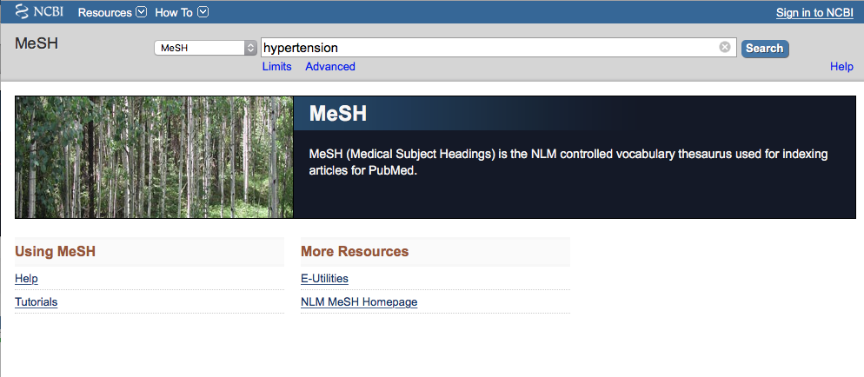
Enter and click a
a
Search
hypertension
(Note: If there is a Boolean OR
relationship, start with the
“OR” statement first.)

Slide 39
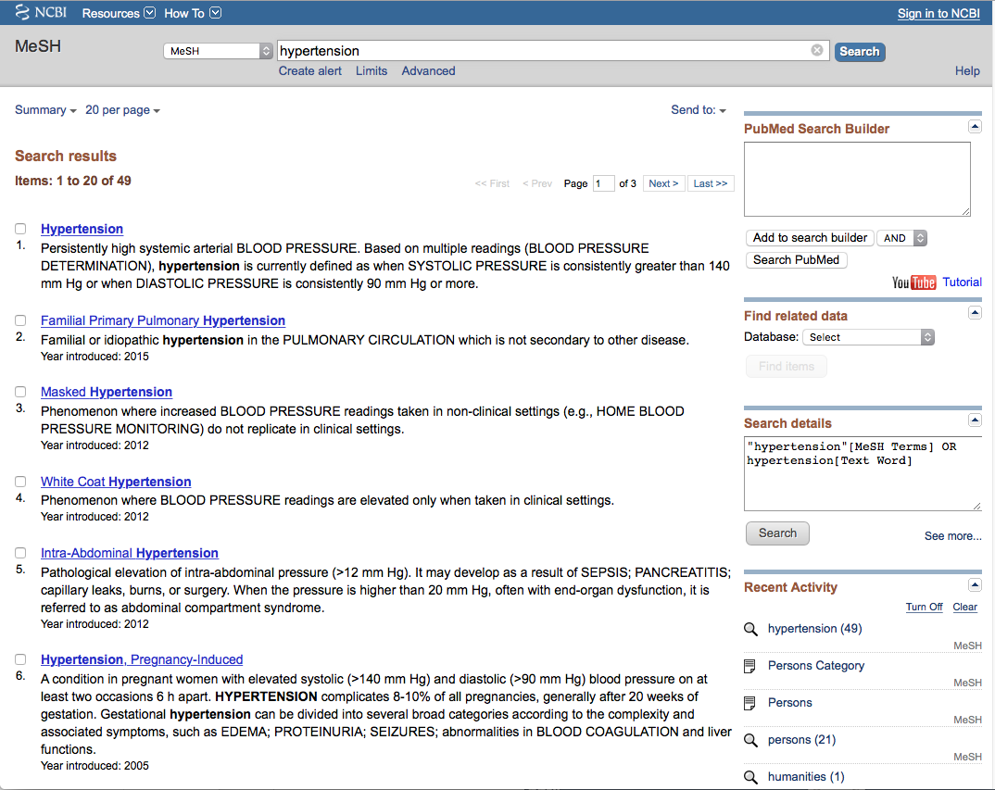
Term Definitions

Slide 40
Click the underlined term

Slide 41
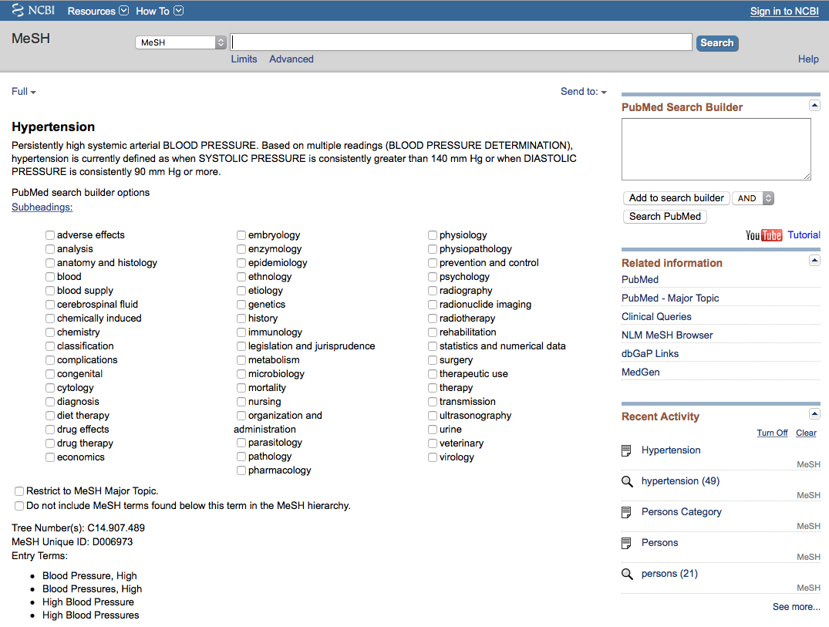
Sub-headings narrow the “meaning” of a
MeSH term.
M They are a “subset” of all the
articles under the MeSH term: Hypertension.

Slide 42
82 SUBHEADINGS:
abnormalities enzymology poisoning
administrations & dosage epidemiology
adverse effects ethics prevention & control
agonists ethnology
analogs & derivatives etiology psychology
analysis genetics radiation effects
anatomy & histology growth & development radiography
antagonists & inhibitors history radionuclide imaging
biosynthesis immunology radiotherapy
blood injuries rehabilitation
blood supply innervation secondary
cerebrospinal fluid instrumentation secretion
chemical synthesis isolation & purification standards
chemically induced legislation & jurisprudence statistics & numerical data
chemistry manpower supply & distribution
classification metabolism surgery
complications methods therapeutic use
congenital microbiology therapy
contraindications mortality toxicity
cytology nursing transmission
deficiency organization & administration transplantation
diagnosis parasitology trends
diet therapy pathogenicity ultrasonography
drug effects pathology ultrastructure
drug therapy pharmacokinetics urine
economics pharmacology utilization
education physiology veterinary
embryology physiopathology virology

Slide 43
2) Select
AND
1) Check the box next
to the subheadinga
✔
3) Then click
Add to search builder

Slide 44
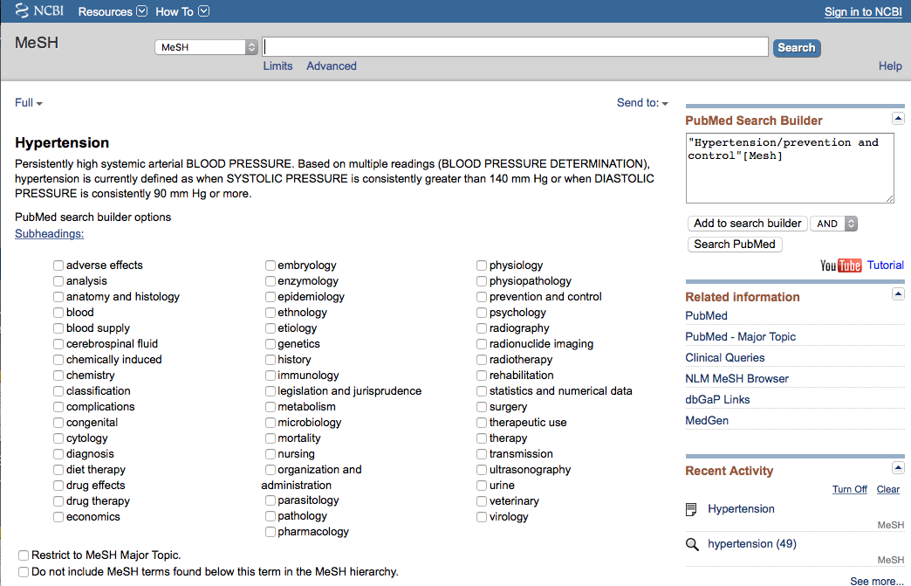
MeSH
The first term is in
the search program “box”

Slide 45
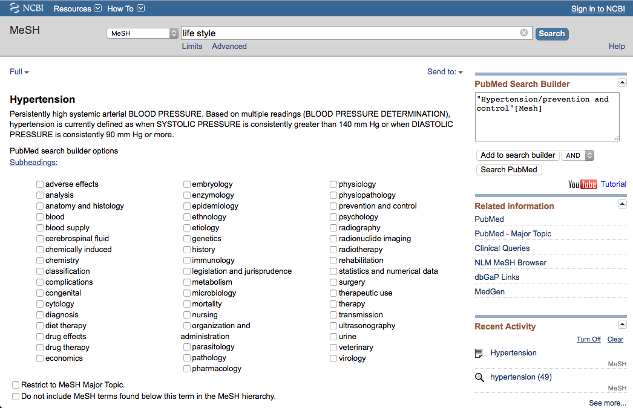
Enter and click a
a
Search
life style
(Note: If there is a Boolean OR
relationship, start with the
“OR” statement first.)

Slide 46
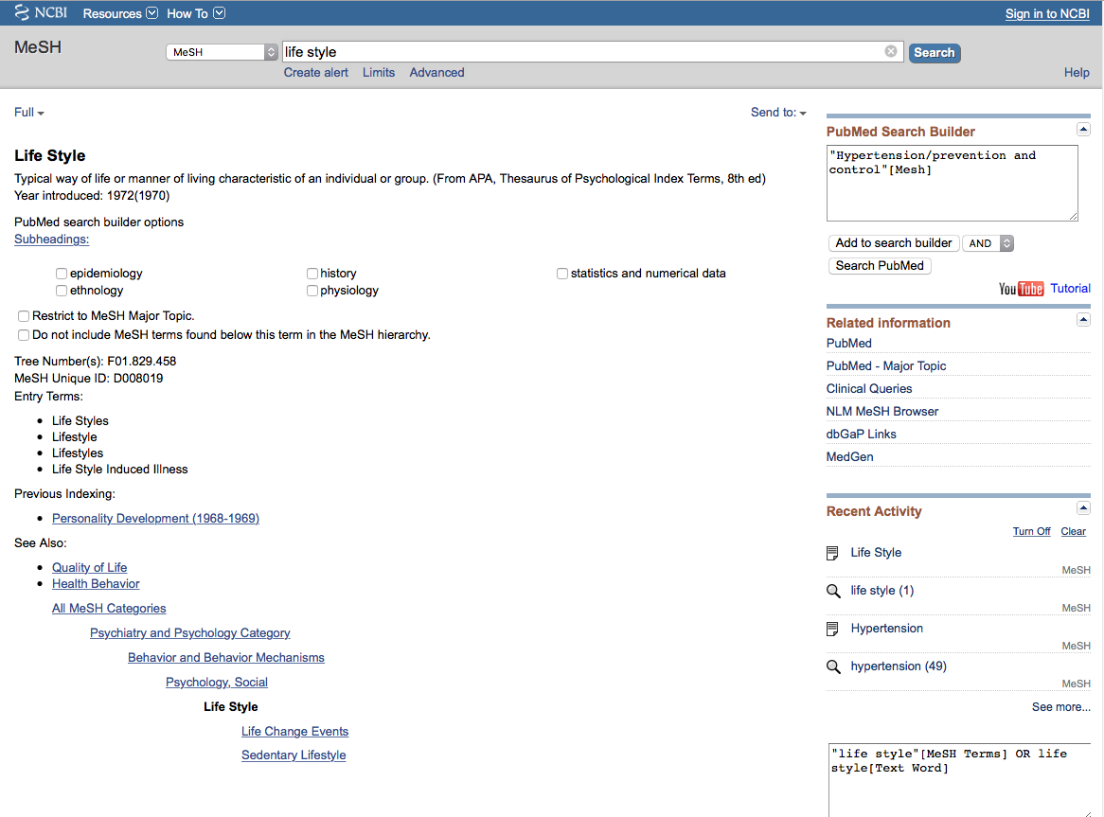
Full Display of Term Information

Slide 47
terms arranged in
tree structure hierarchy
MeSH
Terms are listed from
broadest to narrowest.
If Life Style
yields zero results, try using a
broader term: Psychology, Social.

Slide 48
… unless you select
the following command
✓
Note:
PubMed automatically
OR’s indented terms
under a broader term…

Slide 49
Click
Add to search builder

Slide 50
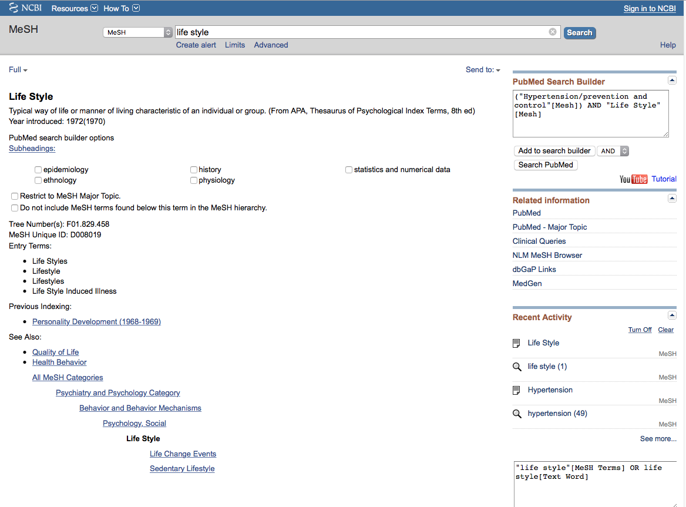
MeSH
The second term is in
the search program “box”

Slide 51
Boolean Logic - AND
hypertension/
prevention & control
and
life style

Slide 52
Boolean Logic - OR
life
style
diet
OR

Slide 53
The search program is complete.
Click
Search PubMed

Slide 54
Search Results

Slide 55
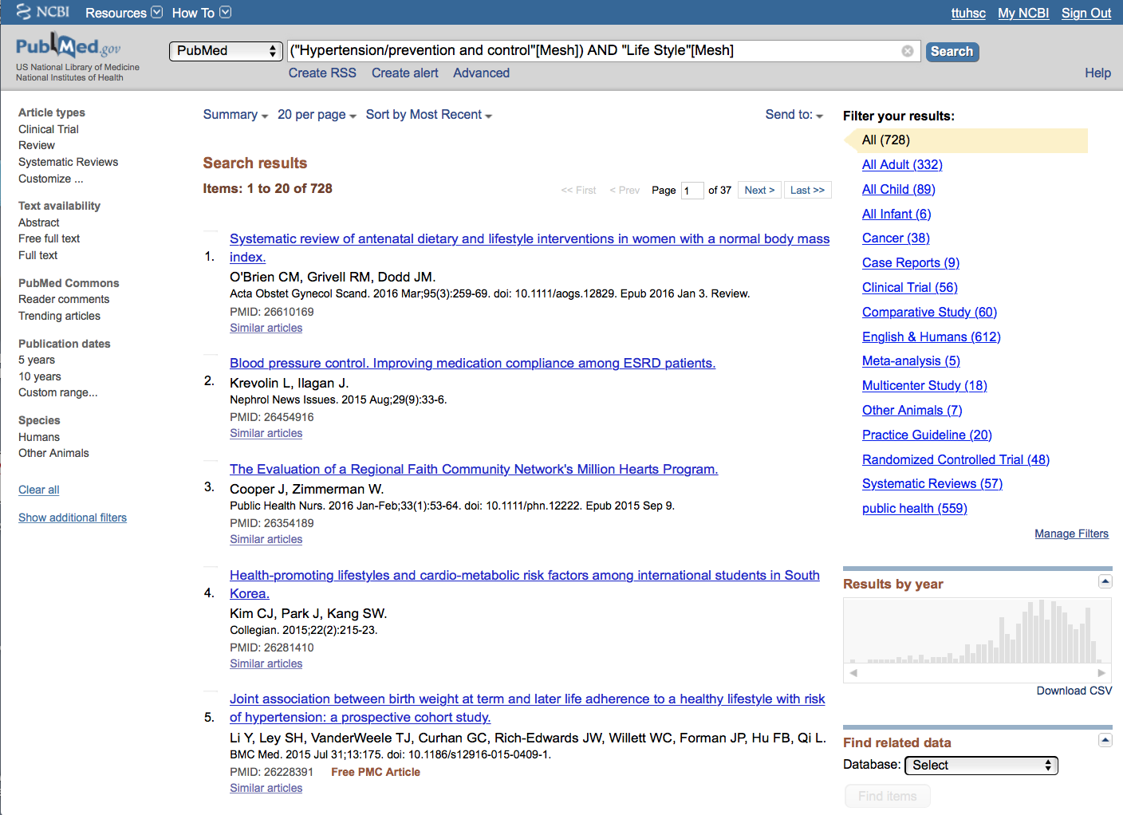
PubMed identifies
728 articles

Slide 56
NOTE: Custom Filters appear when
you’re in your My NCBI account.

Slide 57
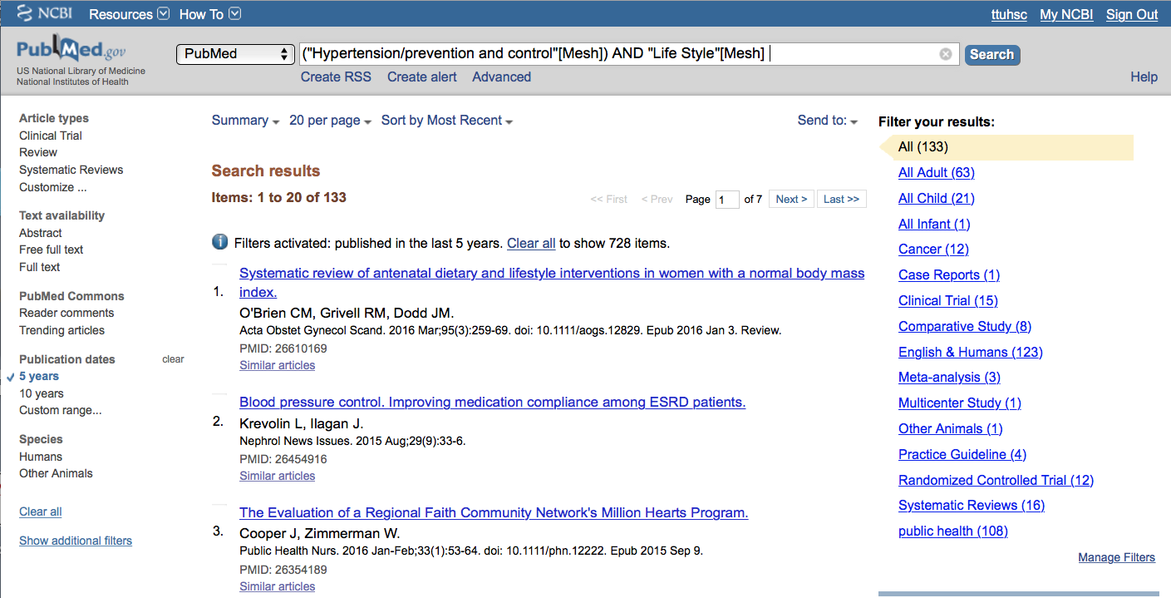
Limit to articles that were
written in the past 5 years by
clicking the selection on the left.
Humans is a standard filter

Slide 58
Click
Show additional filters

Slide 59
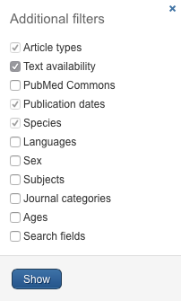
Select
Languages
✔
and click
Show

Slide 60
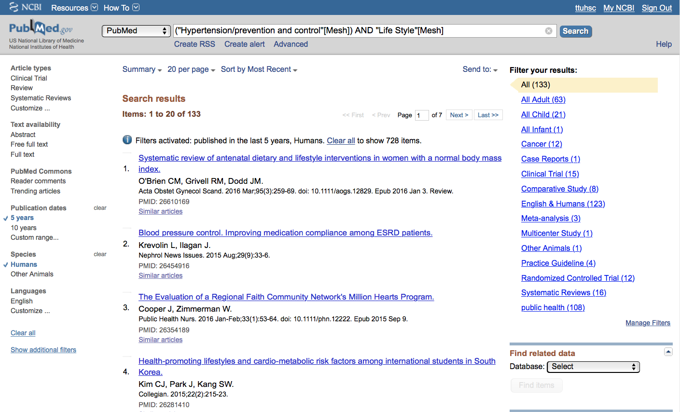
Click English to activate filter

Slide 61
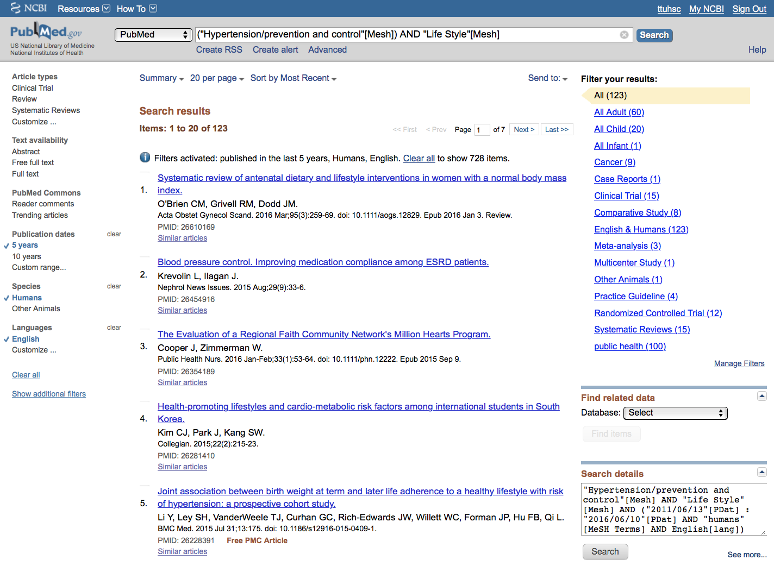
Results are reduced
From 728 to 123

Slide 62
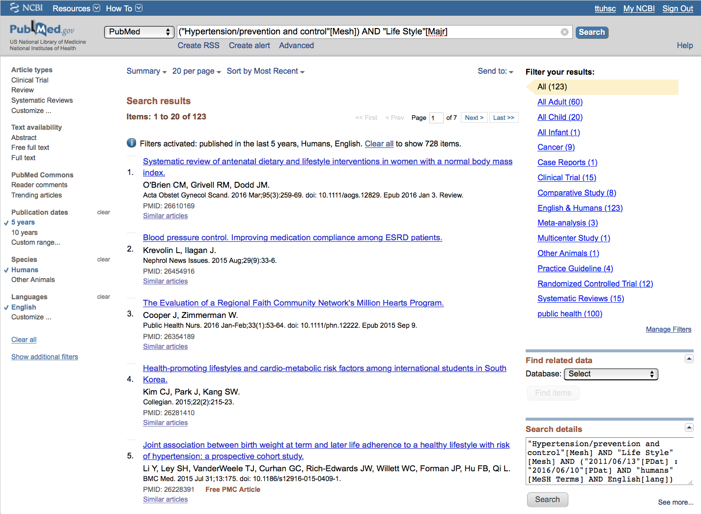
Change [Mesh] to [Majr]

Slide 63
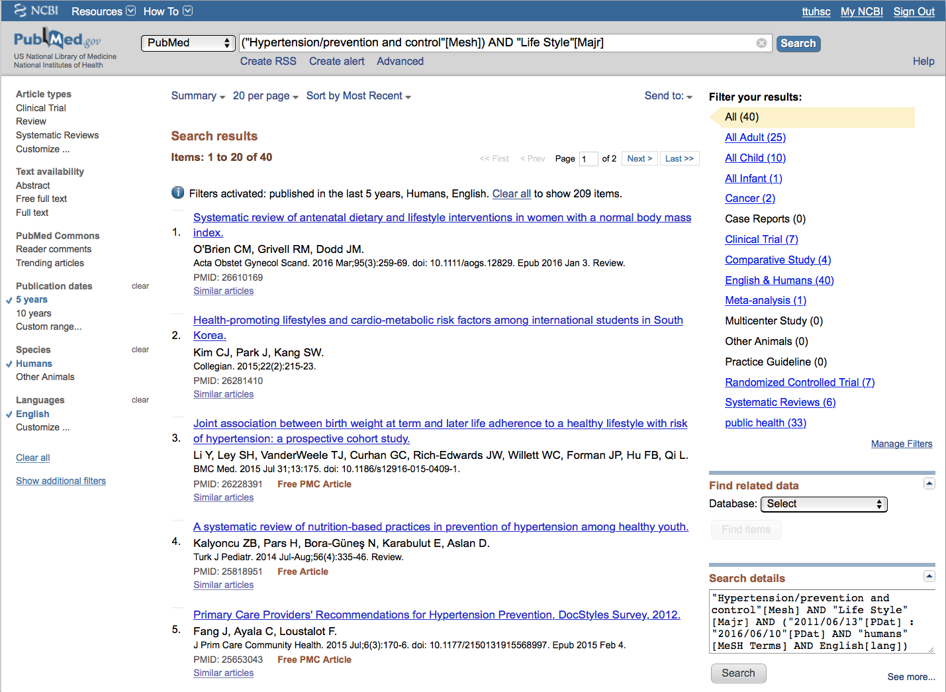
Results are reduced
From 123 to 40

Slide 64

Click

Slide 65
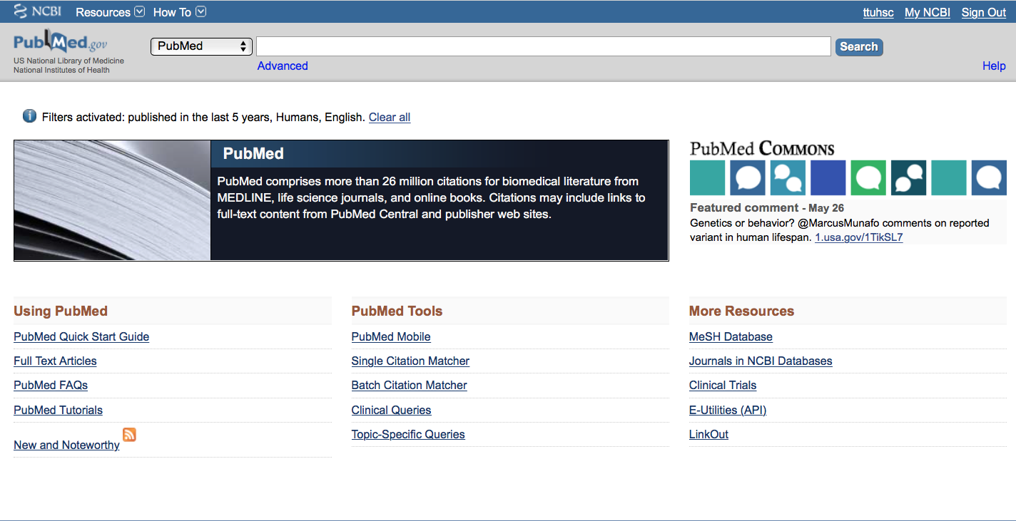
Click MeSH Database

Slide 66
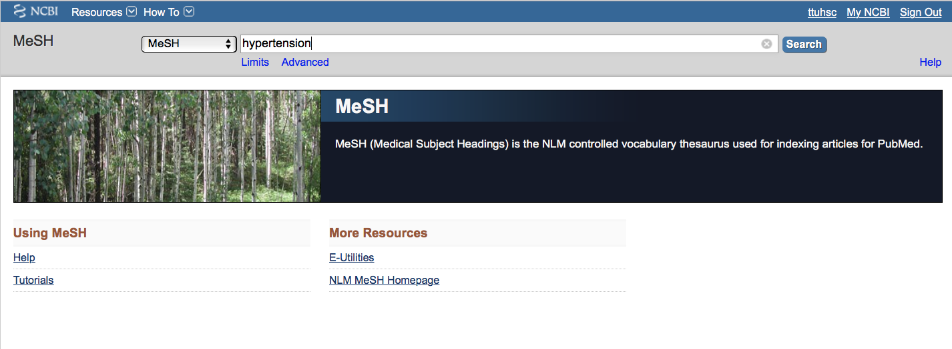
a
a
Search
Enter
hypertension
and click

Slide 67
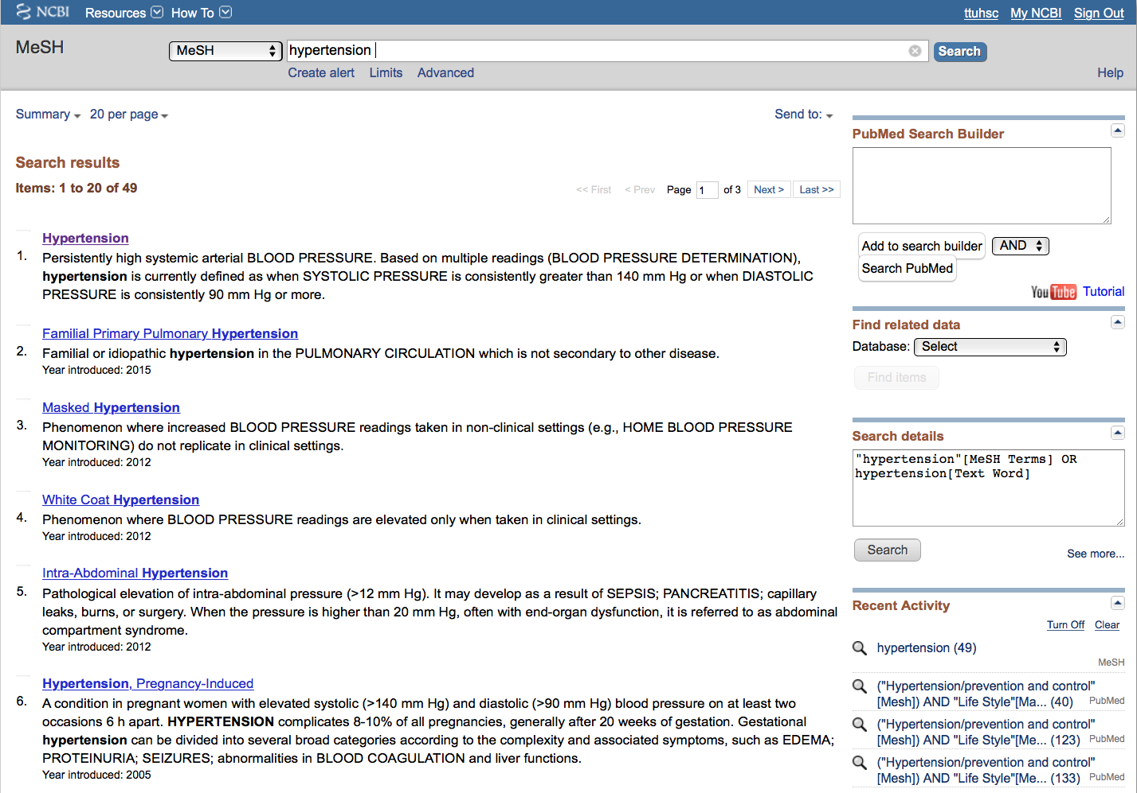
Click the underlined term

Slide 68
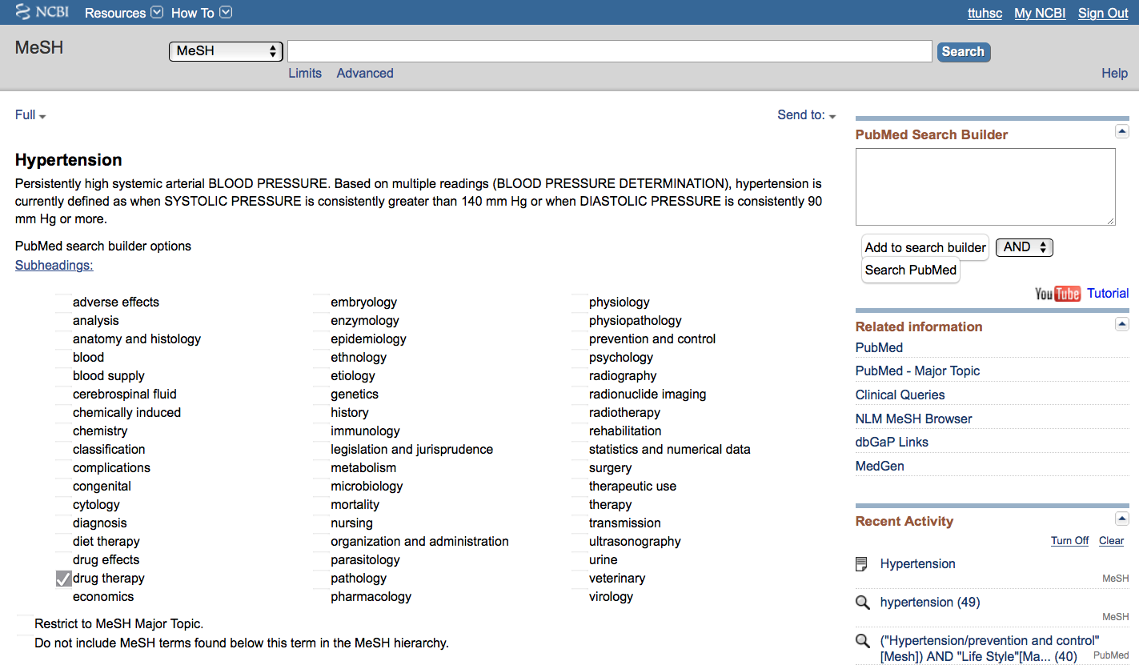
2) Select
AND
1) Check the box next
to the subheadinga
✔
3) Then click
Add to search builder

Slide 69
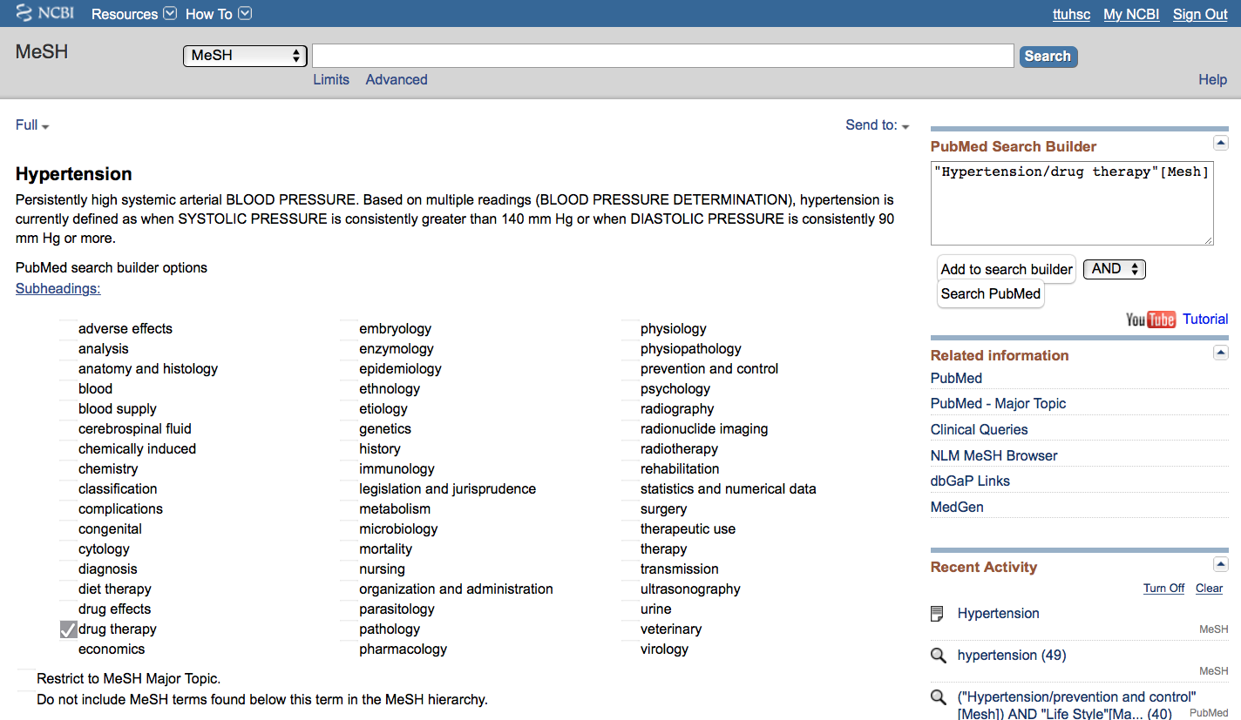
Click
Search PubMed

Slide 70
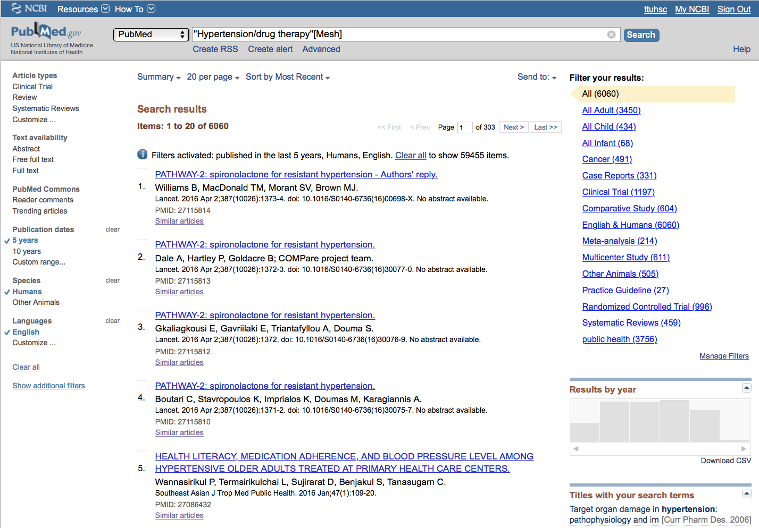
Click Advanced

Slide 71
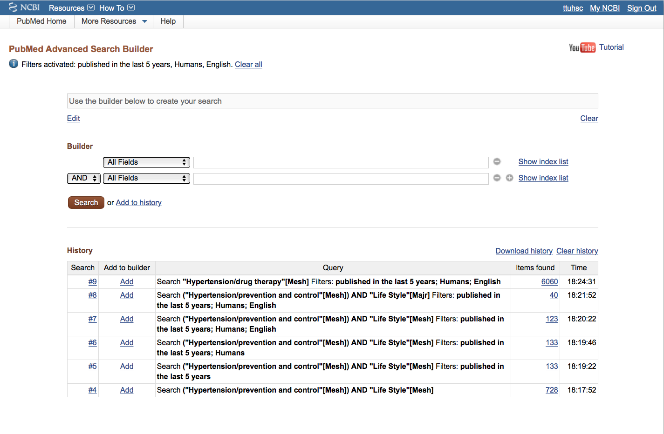

Slide 72
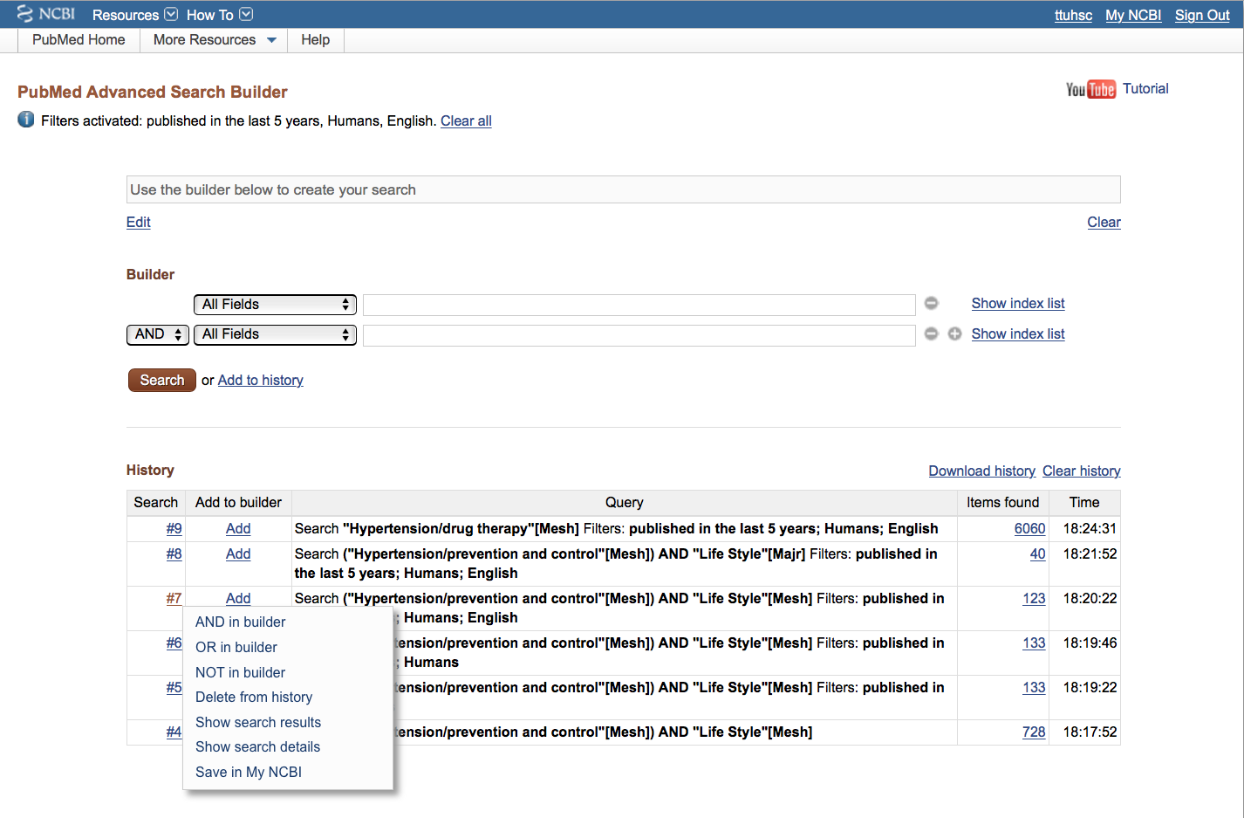
Click the search number
Click AND in builder

Slide 73
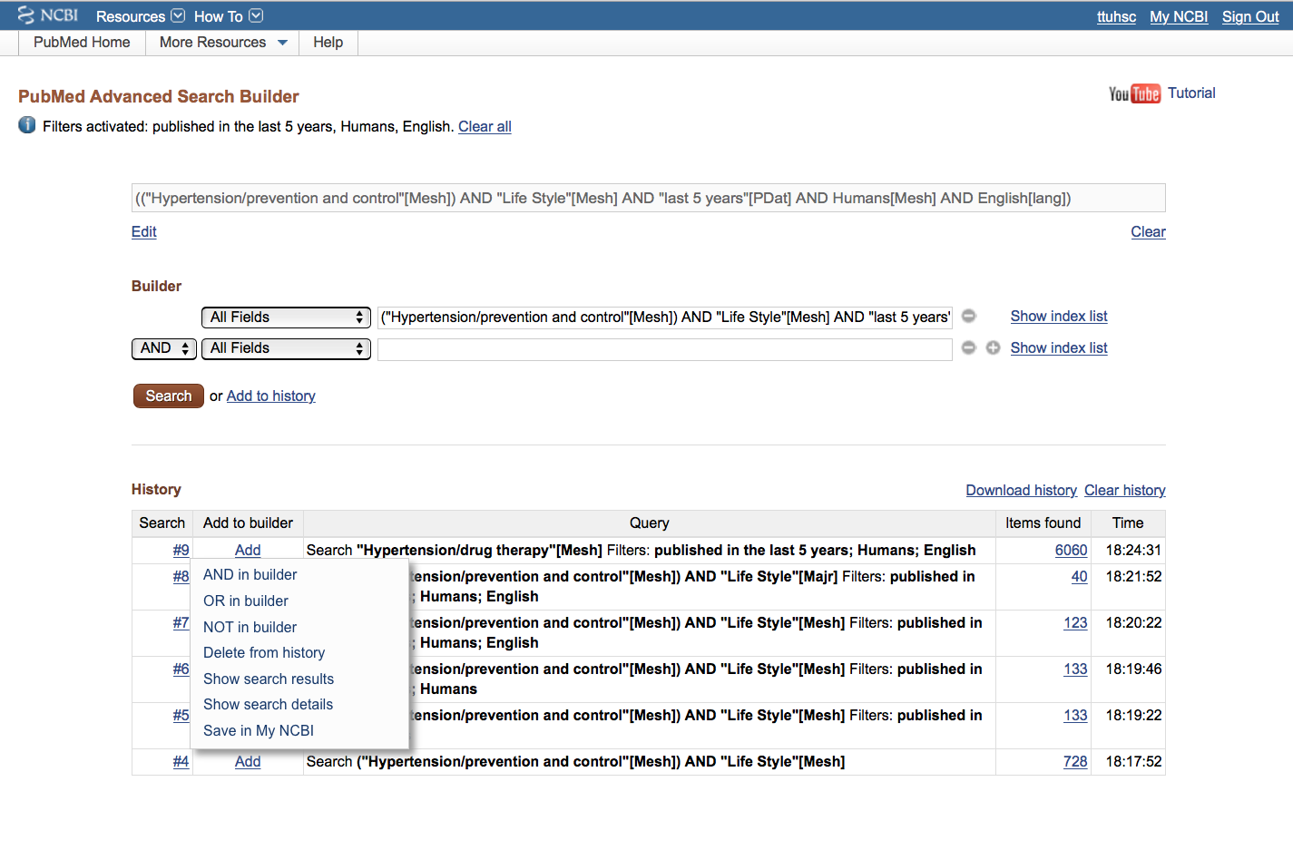
Click the search number
Click AND in builder

Slide 74
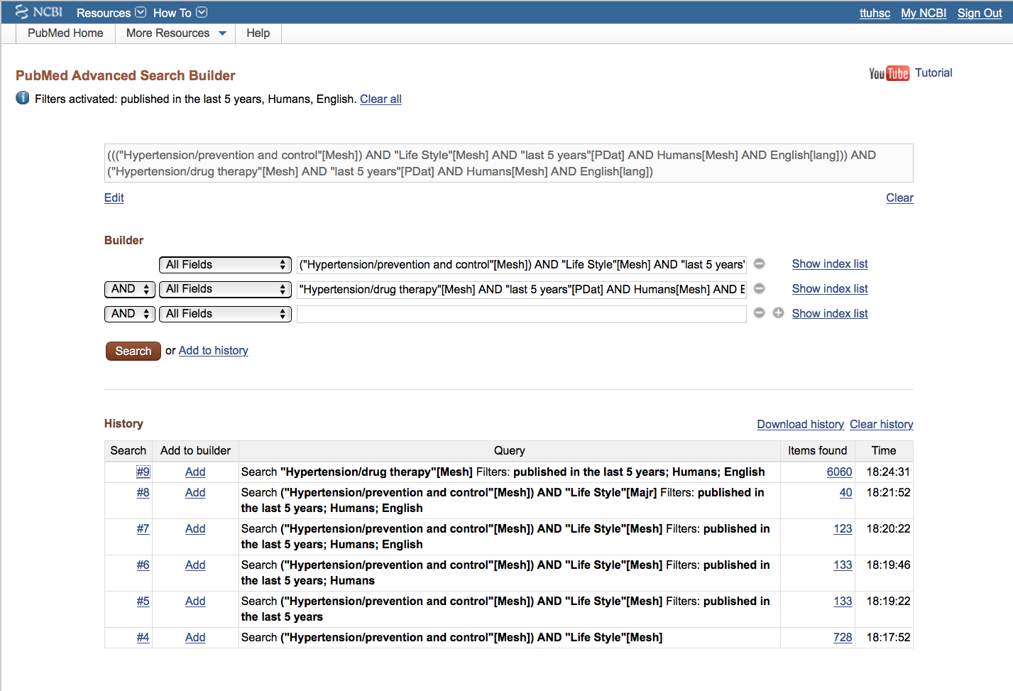
New Strategy in Search Builder
Click Search

Slide 75
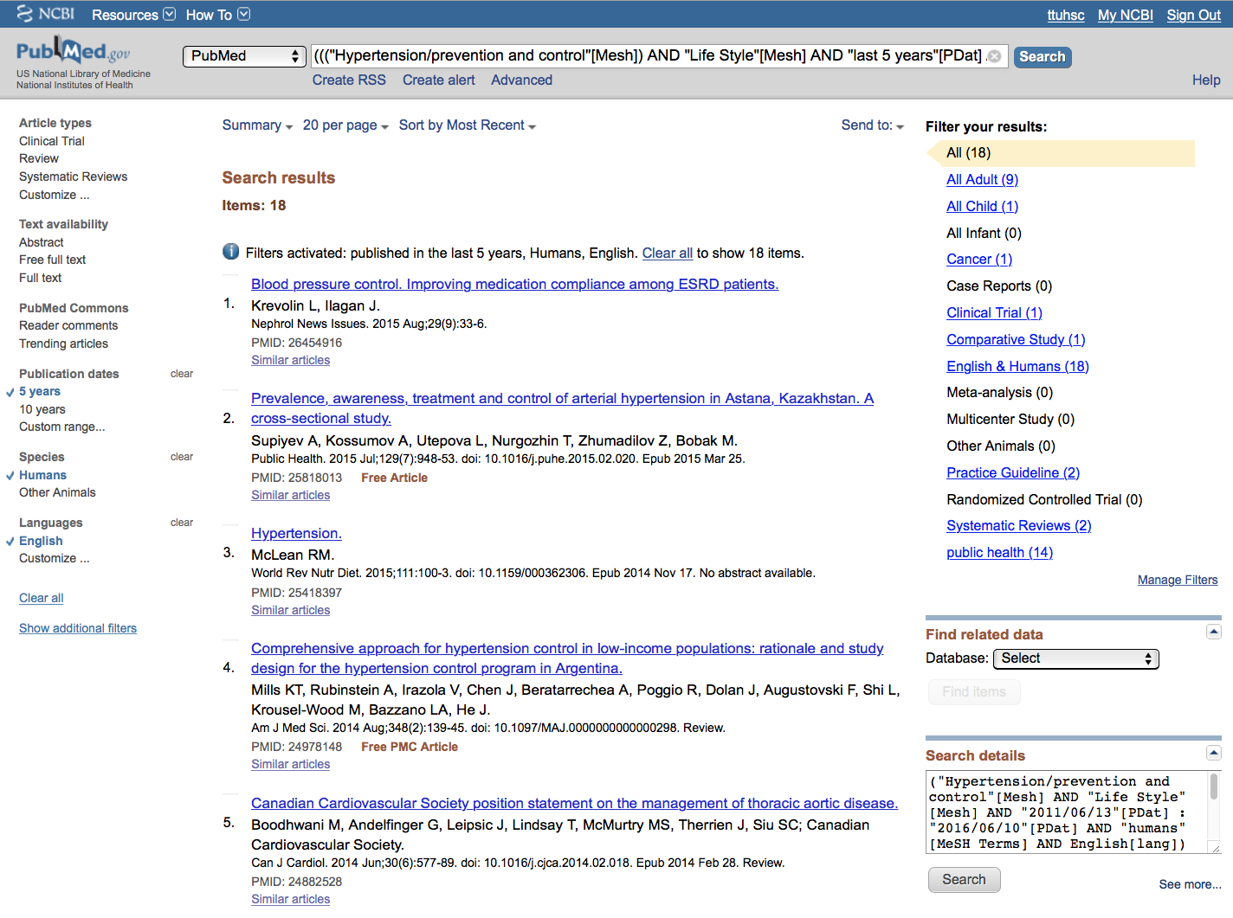
Results from different
search strategy

Slide 76
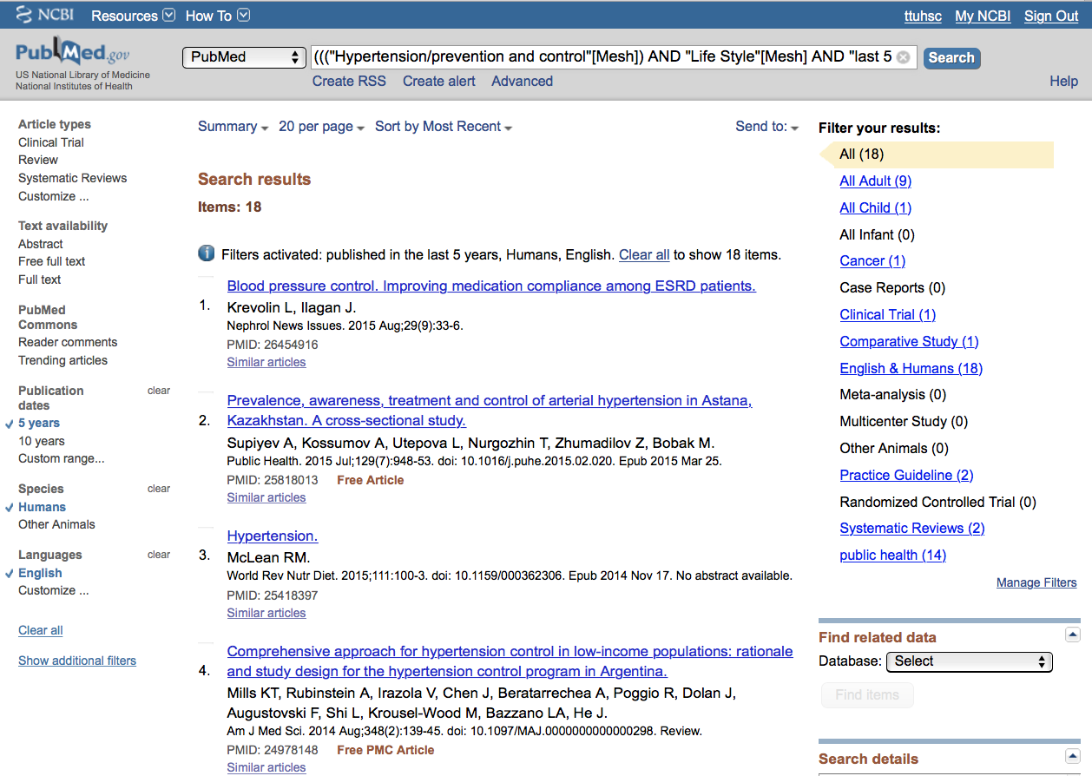
Select article # 4.
X

Slide 77

Click Summary
Select Abstract

Slide 78

Icons for full text.

Slide 79
Click for MeSH terms.
∨∨

Slide 80

Mesh Terms Index

Slide 81
MeSH Database
searches only
the MeSH terms for:
hypertension/dt
AND
The * indicates Major focus
hypertension/pc
AND
life style

Slide 82
Look at subject headings
in the
MeSH Terms Index
for additional terms.
You may want to
write a new search
program using:
Poverty

Slide 83

.
Click Send to: and select
File to save citations to a file on your computer or
Clipboard to temporarily store selected citations or
E-mail to send citations to self or colleague

Slide 84

…or click icon for full text.

Slide 85
Linking to
Full-Text Articles
in Electronic Journals

Slide 86

When Searching from Off Campus:
Enter the
Eraider username and password
assigned to you
by Information Services.
A
Problems with eRaider? Call: 806-743-1234 a

Slide 87

Click PDF

Slide 88

Full Text Article
Close Article

Slide 89
Saving Searches

Slide 90

Click Advanced.

Slide 91

Click 40

Slide 92

Click Create alert

Slide 93


Click
•
Yes, please.
Select frequency

Slide 94


Select day

Slide 95

Select Report format

Slide 96

Select Number of items:
Click
Save

Slide 97

Click My NCBI
Search is saved.

Slide 98

Click Manage Saved Searches

Slide 99

Delete
saved search(es).
See
What’s new
Click to re-run search.

Slide 100

Click to go to PubMed home page.

Slide 101
Other Searching Features
MeSH, phrase, & title word searching
    using the [ti] pneumonic
Truncation

Slide 102

Click MeSH Database

Slide 103

Enter and click a
a
Search
human genome

Slide 104

Click box to select term
✔
✔
Click
Add to search builder
Click
Search PubMed

Slide 105

PubMed identifies 6997 articles
Note: filters are activated

Slide 106

Search
Enter
AND “dark matter”
and click
Note: “dark matter” is not a MeSH term.

Slide 107

PubMed identifies
5 articles

Slide 108

Enter and click
Search
“dark matter” [ti]

Slide 109

Results are narrowed to 4
Note: all articles have
”dark matter” in the title

Slide 110
Truncation

Slide 111

Enter gene* to truncate.
Truncation searches for all suffixes
such as: gene
genes
genetic
genetics, etc.
general
and
generation
are “false drops”

Slide 112
Online Tutorial

Slide 113

Click for more hands-on learning.

Slide 114

www.ttuhsc.edu/libraries
Click

Slide 115
The End

