Slide 1
Welcome
Searching PubMed for Research
Peggy Edwards, AMLS
TTUHSC - Preston Smith Library
Lubbock, Texas 79430
April 2017

Slide 2


When searching library applications, use
Chrome is TTUHSC IT’s supported browser!

Slide 3
Link
Today’s power point Searching PubMed for Research:
under Orientations and Presentations
http://www.ttuhsc.edu/libraries/schools/som.aspx

Slide 4
Research Question Teaching Example

Slide 5

https://www.ted.com/talks/francis_collins_we_need_better_drugs_now
“Today, we know the molecular cause of 4,000 diseases, but treatments are available for only 250 of them.”

Slide 6
Searching Research Questions
To be complete, need to search:
PubMed
Embase
Cochrane Database of Systematic Reviews
Cochrane Central Register of Controlled Trials
Scopus
Web of Science

Slide 7
Searching PubMed

Slide 8



PubMed Database
Biomedical and life sciences journal literature
International scope
Developed and maintained by the:
National Center for Biotechnology Information
    at the U.S. National Library of Medicine
    at the National Institutes of Health

Slide 9

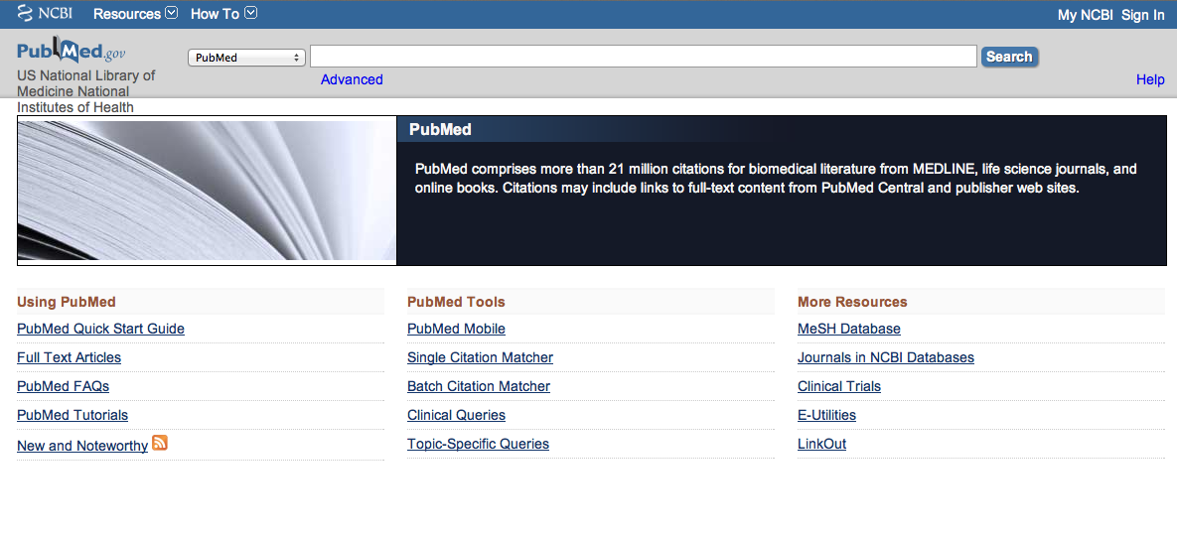
Accessing PubMed
Freely available over the Internet
@ www.pubmed.gov
Always access through ttuhsc.edu/libraries
for free access to journals the
libraries subscribe to!

Slide 10
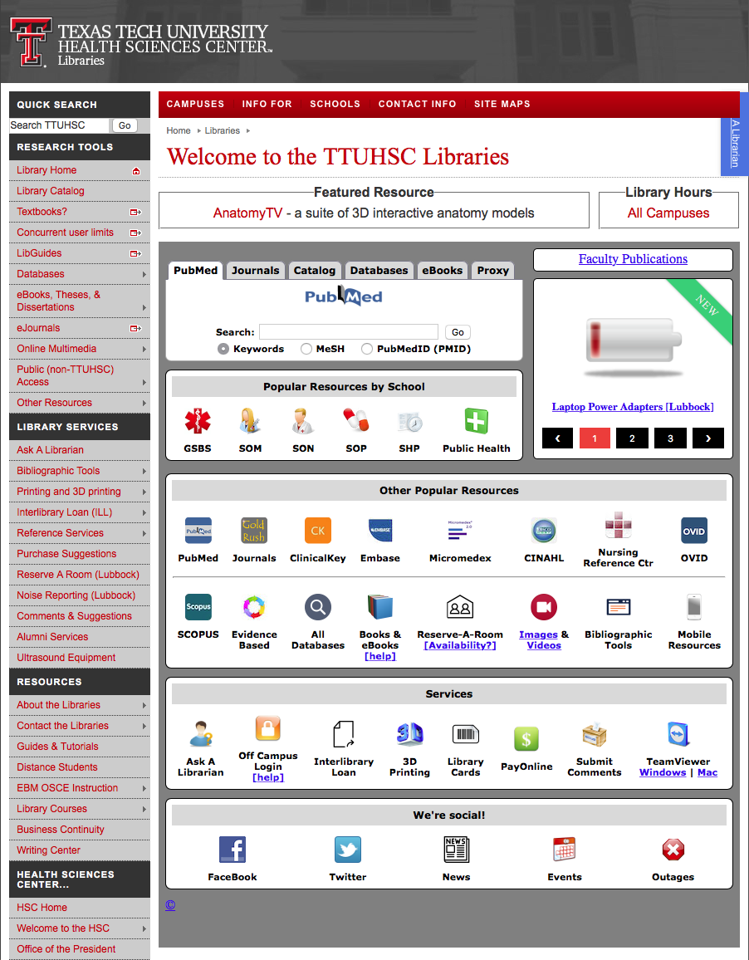

www.ttuhsc.edu/libraries
Click PubMed

Slide 11
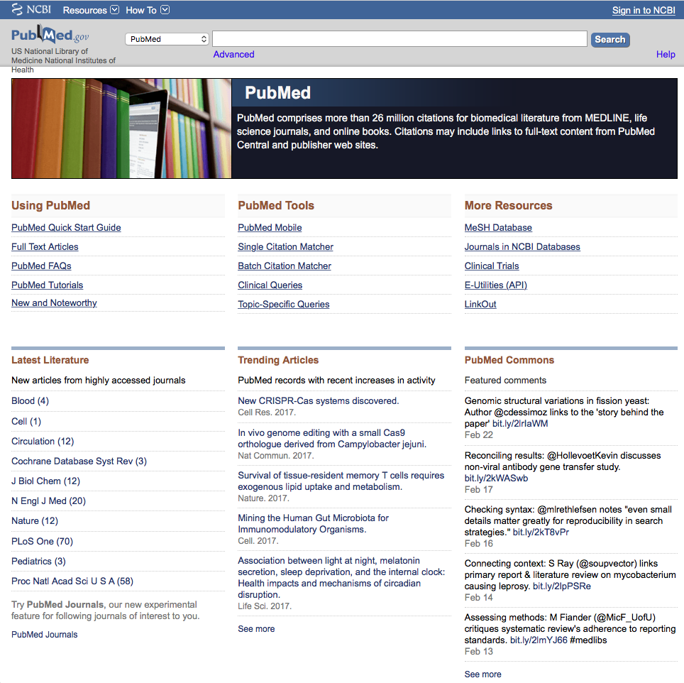
PubMed
Home Page

Slide 12
Vocabulary:
Using
MeSH Database

Slide 13
MeSH Database
Terms in the database are called
Medical Subject Headings or MeSH.
is a “controlled vocabulary list” of more
than 25,000 subject headings.
MeSH Database is updated annually.

Slide 14
Frequently Used Mesh Categories – 2011
A Anatomy
C Diseases
D Chemicals & Drugs
A1 Body Regions
A2 Musculoskeletal System
A3 Digestive System
A4 Respiratory System
A5 Urogenital System
A6 Endocrine System
A7 Cardiovascular System
A8 Nervous System
A9 Sense Organs
A10 Tissues
A11 Cells
A12 Fluids and Secretions
A13 Animal Structures
A14 Stomatognathic System
A15 Hemic and Immune Systems
A16 Embryonic Structures
A17 Integumentary System
A18 Plant Structures
A19 Fungal Structures
A20 Bacterial Structures
A21 Viral Structures
C1 Bacterial Infections & Mycoses
C2 Virus Diseases
C3 Parasitic Diseases
C4 Neoplasms
C5 Musculoskeletal Diseases
C6 Digestive System Diseases
C7 Stomatognathic Diseases
C8 Respiratory Tract Diseases
C9 Otorhinolaryngologic Diseases
C10 Nervous System Diseases
C11 Eye Diseases
C12 Male Urogenital Diseases
C13 Female Urogenital Diseases
& Pregnancy Complications
C14 Cardiovascular Diseases
C15 Hemic & Lymphatic Diseases
C16 Congenital, Hereditary, &
Neonatal Diseases & Abnormalities
C17 Skin & Connective Tissue Diseases
C18 Nutritional & Metabolic Diseases
C19 Endocrine System Diseases
C20 Immune System Diseases
C21 Disorders of Environmental Origin
C22 Animal Diseases
C23 Pathologic Conditions,
Signs, and Symptoms
C24 Occupational Diseases
C25 Chemically-Induced Disorders
C26 Wounds and Injuries
D1 Inorganic Chemicals
D2 Organic Chemicals
D3 Heterocyclic Compounds
D4 Polycyclic Compounds
D5 Macromolecular Substances
D6 Hormones, Hormone Substitutes,
& Hormone Antagonists
D8 Enzymes, & Coenzymes
D9 Carbohydrates
D10 Lipids
D12 Amino Acids, Peptides,
& Proteins
D13 Nucleic Acids, Nucleotides,
& Nucleosides
D20 Complex Mixtures
D23 Biologic Factors
D25 Biomedical and Dental Materials
D26 Pharmaceutical Preparations
D27 Chemical Actions and Uses
B Organisms
B1 Eukaryota
B2 Archaea
B3 Bacteria
B4 Viruses
B5 Organism Forms

Slide 15
Other Categories Include:
Analytical, Diagnostic, & Therapeutic Techniques & Equipment
Psychiatry and Psychology
Physical Phenomena
Natural Sciences
Anthropology, Education, Sociology & Social Phenomena
Technology, Industry, Agriculture
Humanities
Information Science
Persons
Population Characteristics
Publication Components
Geographic Locations

Slide 16
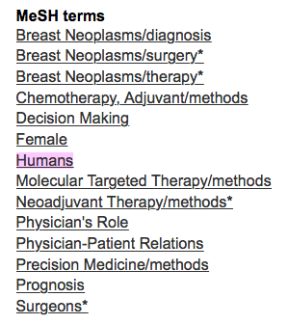
MeSH Terms Index
Each article in PubMed is assigned 10-15 MeSH
and are listed in the MeSH Terms Index.

Slide 17
Why use MeSH?
When searching from PubMed’s home page,
the computer searches words in titles & abstracts
When using MeSH Database, PubMed
searches the MeSH Terms Index, NOT words in
titles and/or abstracts.
Using MeSH brings together similar terms/tags;
thus brings similar articles together
Examples: AIDS, blood
Most accurate, effective and efficient way to search!

Slide 18
Create a Search Strategy Plan
Identify the question and key concepts:
Molecular targeted therapy
of breast neoplasms
Write the search program using
medical subject headings (MeSH)

Slide 19
Search Example

Slide 20
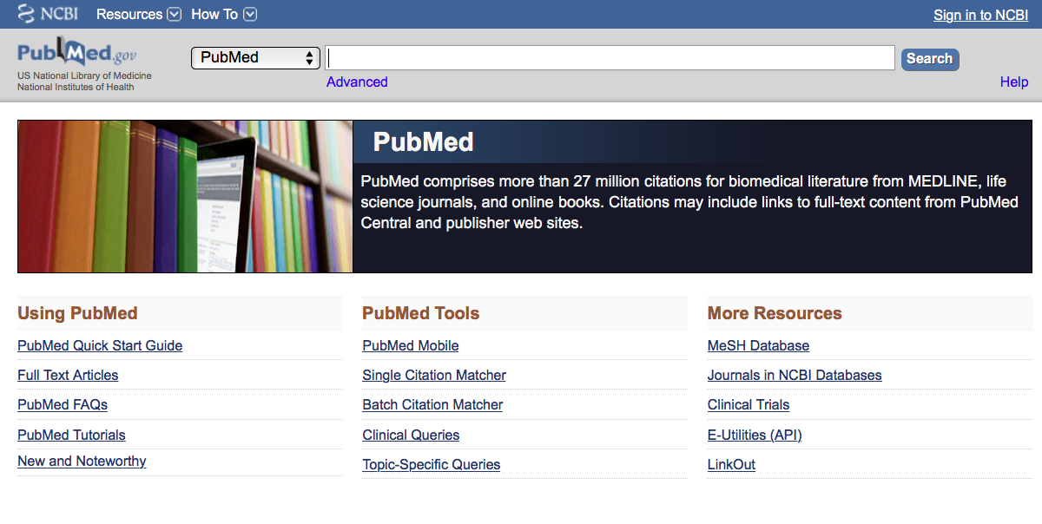
Click MeSH Database

Slide 21
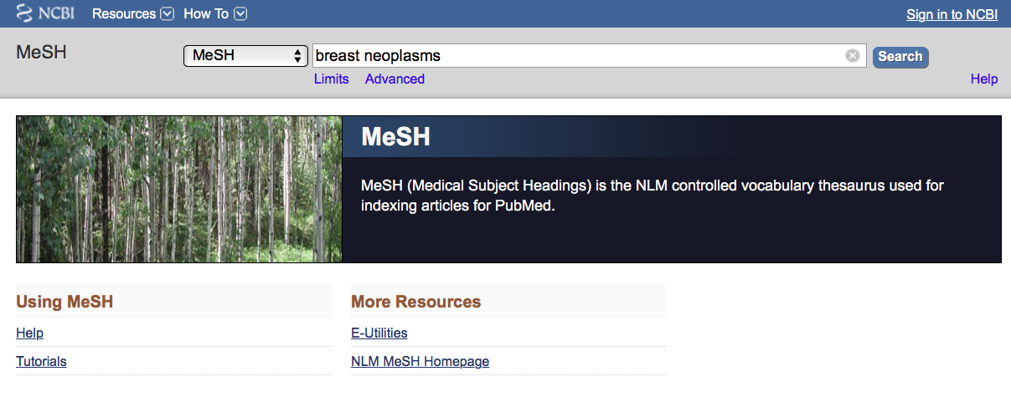
Enter and click a
a
Breast
neoplasms
Search
(Note: If there is a Boolean OR
relationship, start with the
“OR” statement first.)

Slide 22
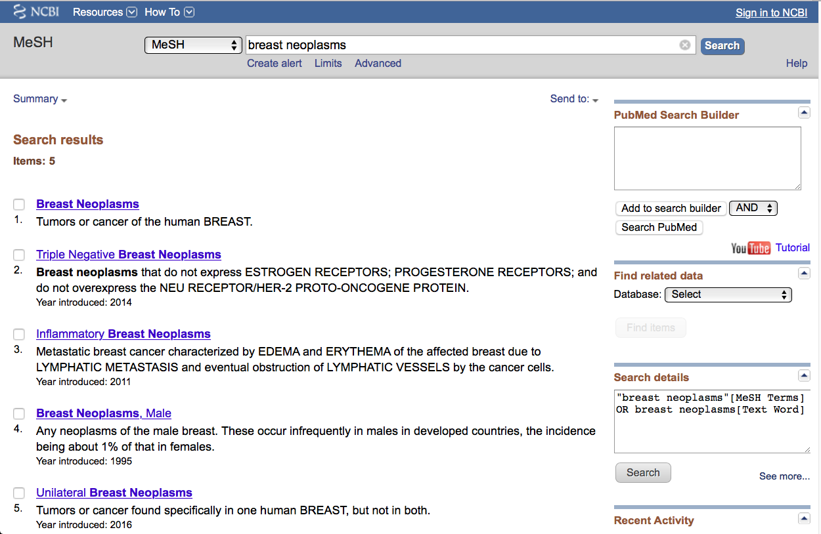
Terms and Definitions

Slide 23
Click the underlined term

Slide 24
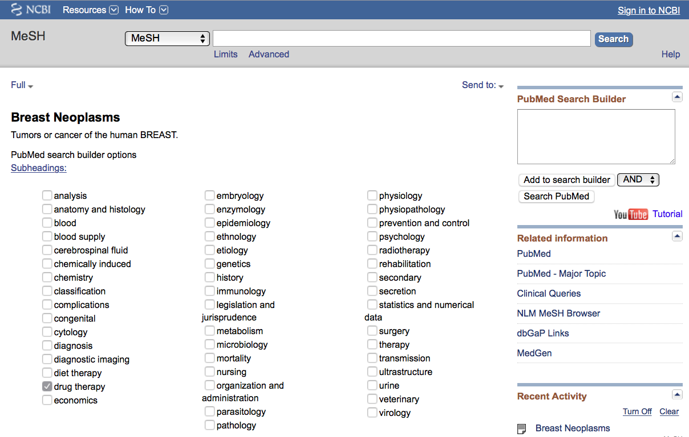
Click the box next to drug therapy.
Sub-headings narrow the “meaning” of a
MeSH term.
They are a “subset” of all the
✔
articles under the MeSH term:
breast neoplasms.

Slide 25
82 SUBHEADINGS:
abnormalities enzymology
administrations & dosage epidemiology
adverse effects ethics poisoning
agonists ethnology prevention & control
analogs & derivatives etiology psychology
analysis genetics radiation effects
anatomy & histology growth & development radiography
antagonists & inhibitors history radionuclide imaging
biosynthesis immunology radiotherapy
blood injuries rehabilitation
blood supply innervation secondary
cerebrospinal fluid instrumentation secretion
chemical synthesis isolation & purification standards
chemically induced legislation & jurisprudence statistics & numerical data
chemistry manpower supply & distribution
classification metabolism surgery
complications methods therapeutic use
congenital microbiology therapy
contraindications mortality toxicity
cytology nursing transmission
deficiency organization & administration transplantation
diagnosis parasitology trends
diet therapy pathogenicity ultrasonography
drug effects pathology ultrastructure
drug therapy pharmacokinetics urine
economics pharmacology utilization
education physiology veterinary
embryology physiopathology virology

Slide 26
AND
is the default
✔
Click
Add to search builder

Slide 27
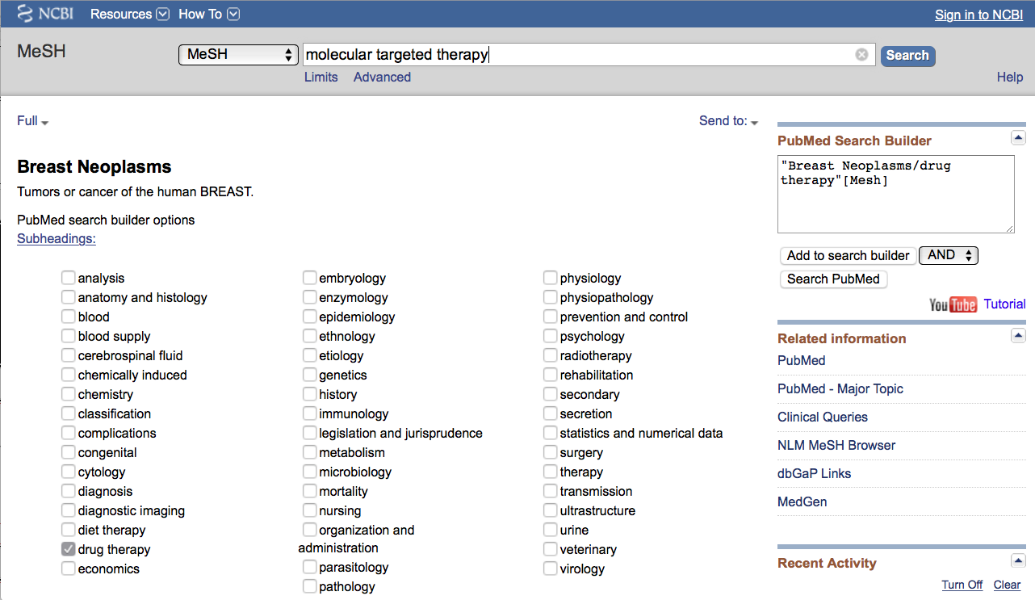
The MeSH term and subheading is in the
search builder. This is the first step in
writing the search program.

Slide 28
a
a
Enter
Molecular targeted therapy
and click
Search

Slide 29
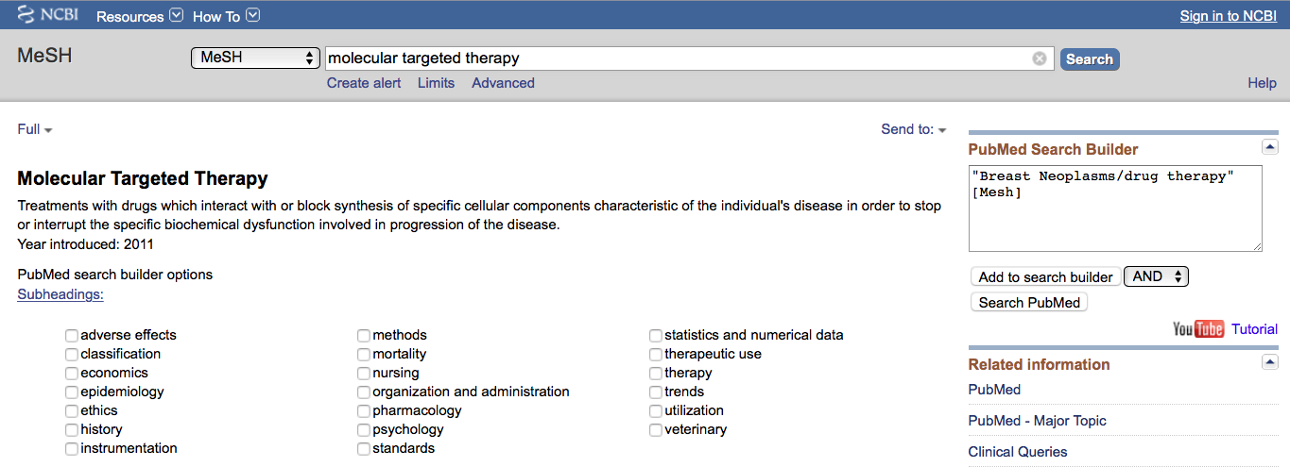
Click
Add to search builder

Slide 30
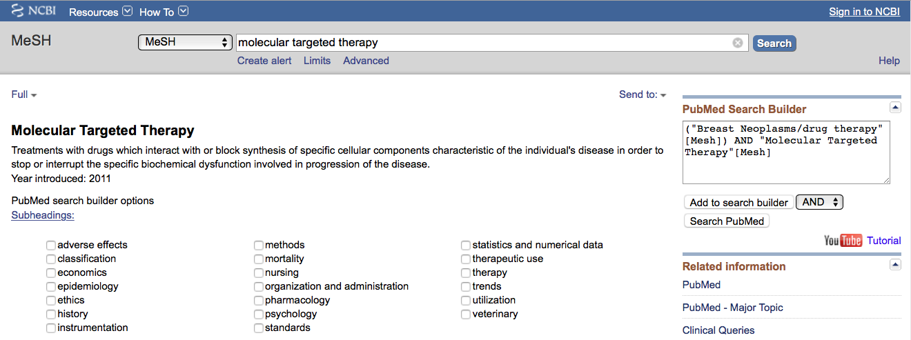
MeSH
The second term is in
the search program “box”

Slide 31
The search program is complete.
Click
Search PubMed

Slide 32
Boolean Logic - AND
Breast neoplasms/
drug therapy
Molecular targeted
therapy
and

Slide 33
Boolean Logic - OR
molecular
targeted
therapy
chemotherapy
OR

Slide 34
Search Results

Slide 35
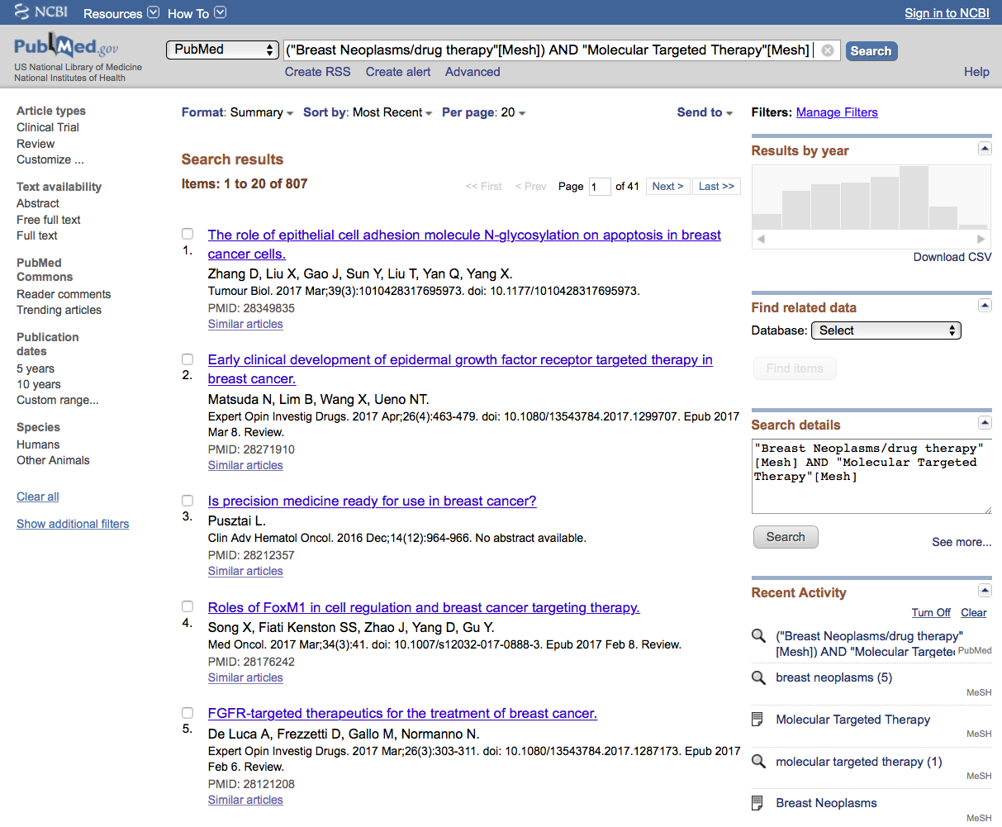
PubMed identifies
807 articles

Slide 36
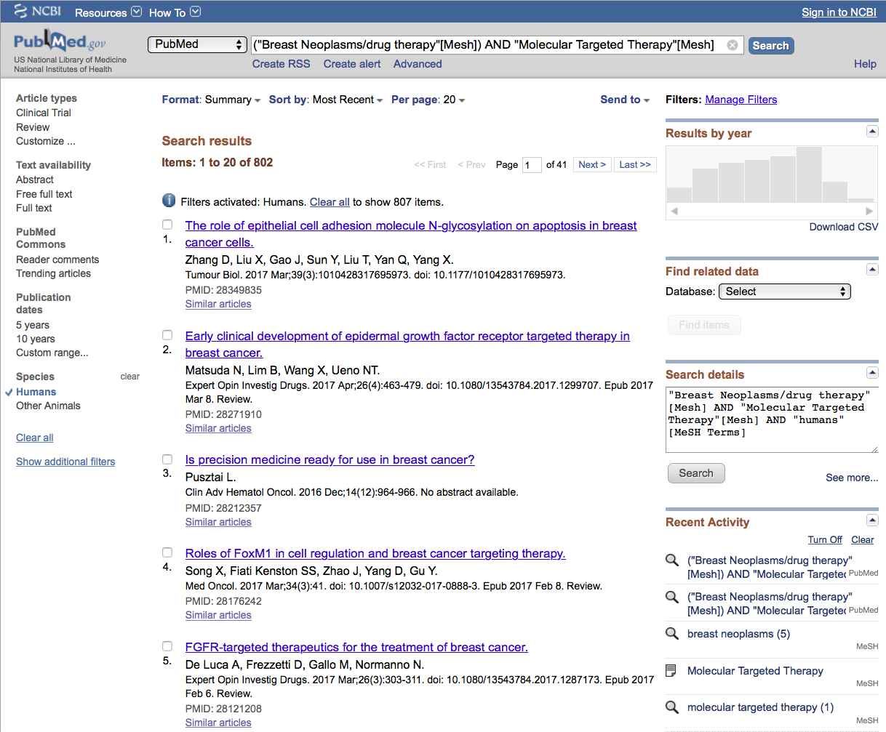
Limit to humans by clicking
the selection on the left.

Slide 37
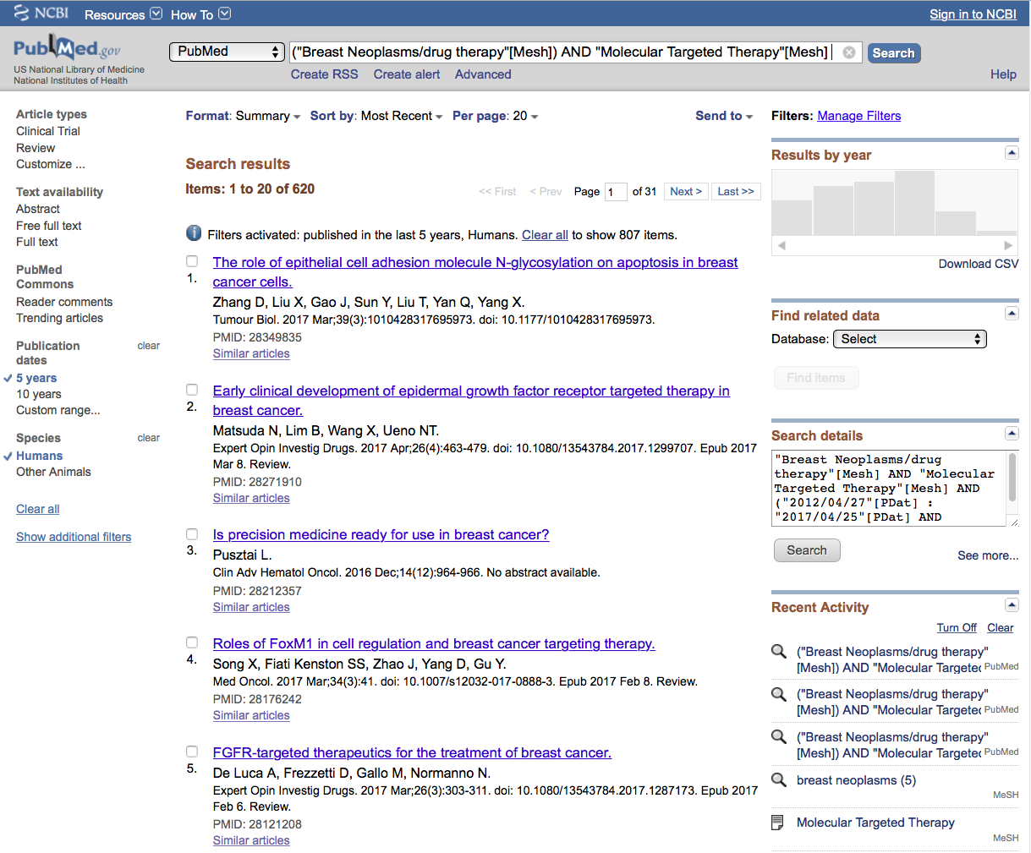
Results are reduced
From 807 to 620

Slide 38
Limit to articles that were
written in the past 5 years.

Slide 39
Click
Show additional filters

Slide 40
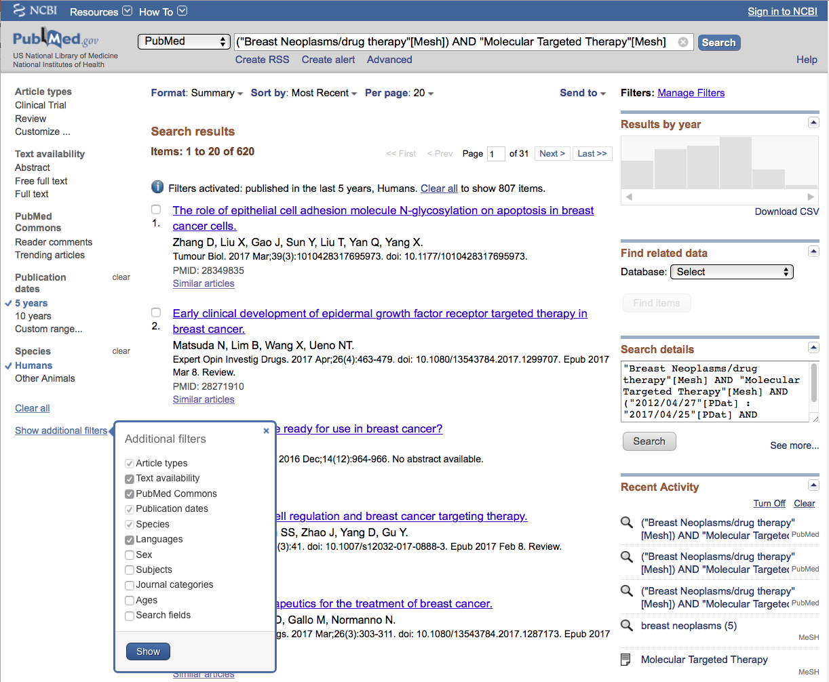
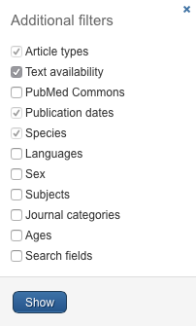
Select
Languages
✔
and click
Show

Slide 41
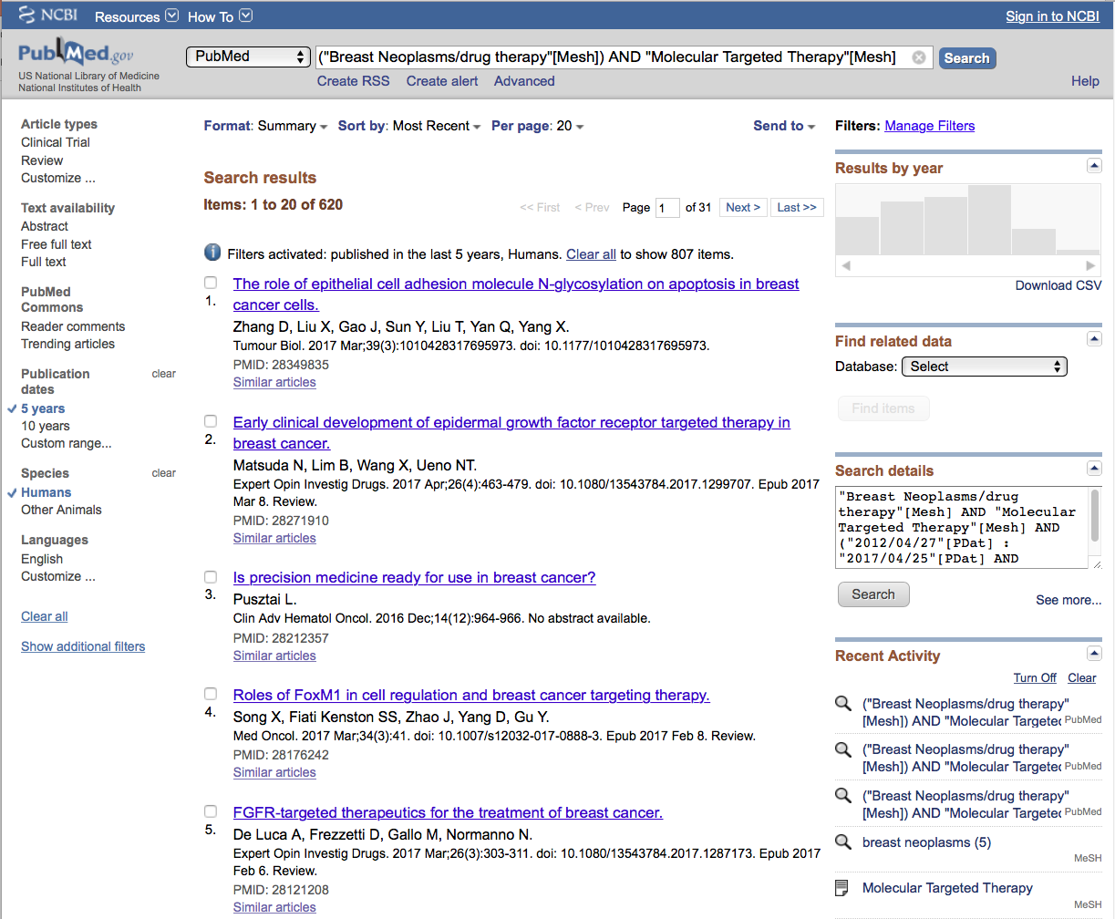
Click English to activate filter

Slide 42
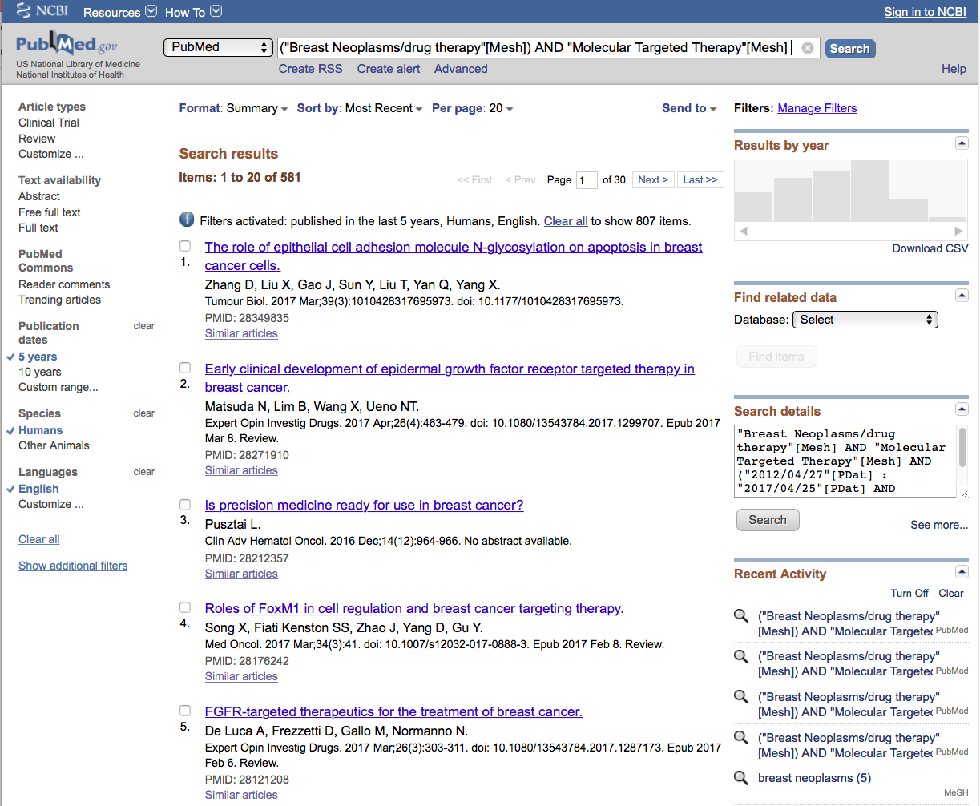
Results are now
reduced to 581

Slide 43
Creating a
My NCBI Account

Slide 44
Sign in to NCBI

Slide 45
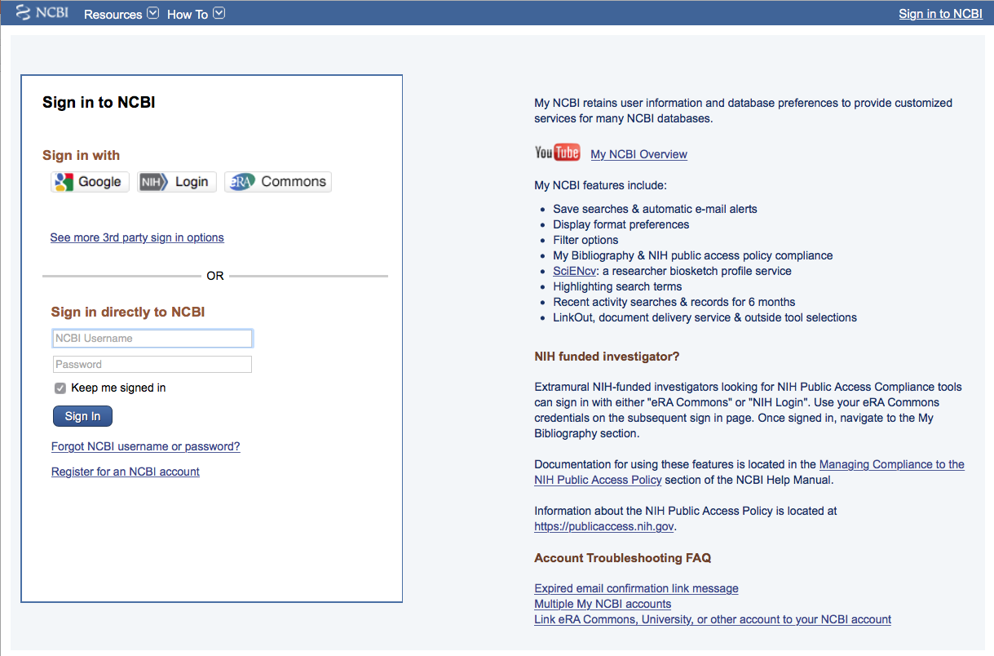
Click
Register for an NCBI account

Slide 46
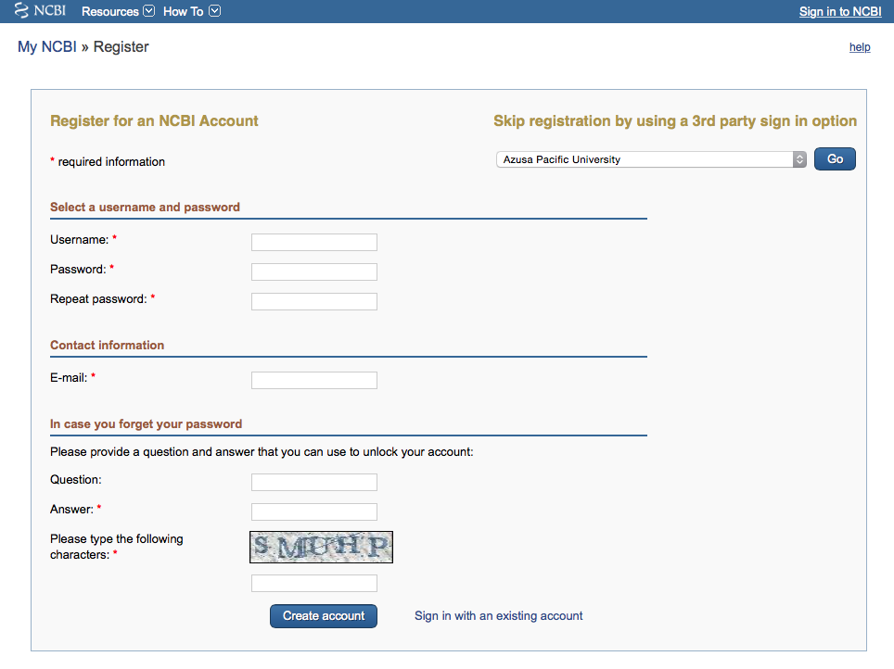
Fill out form
and click
Create account

Slide 47
Verifying your MY NCBI Account
Open the email you used in the account:
1) Locate the link from NCBI
2) Click the link
3) Tells NCBI you are a real user requesting the account
(not computer generated)
4) Your user name will now appear on the top right-hand side

Slide 48
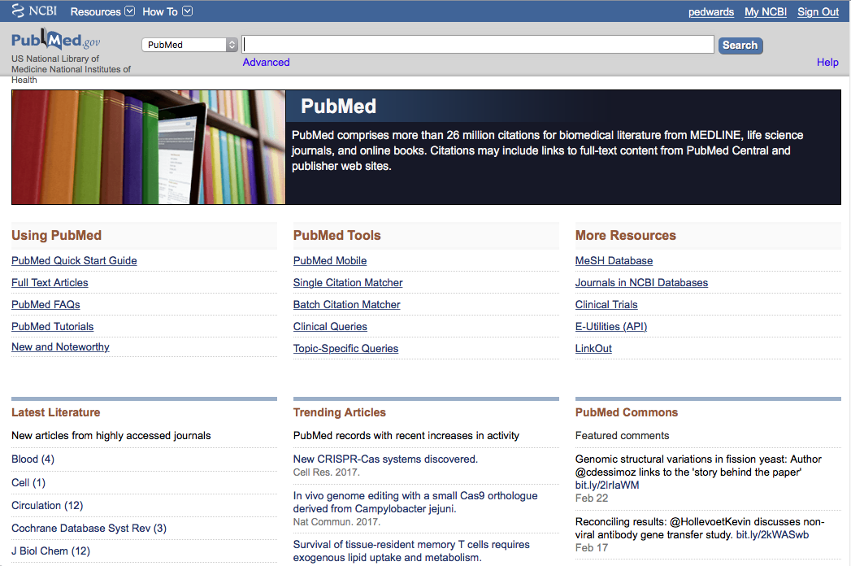
Your username
Your user name
Click My NCBI

Slide 49
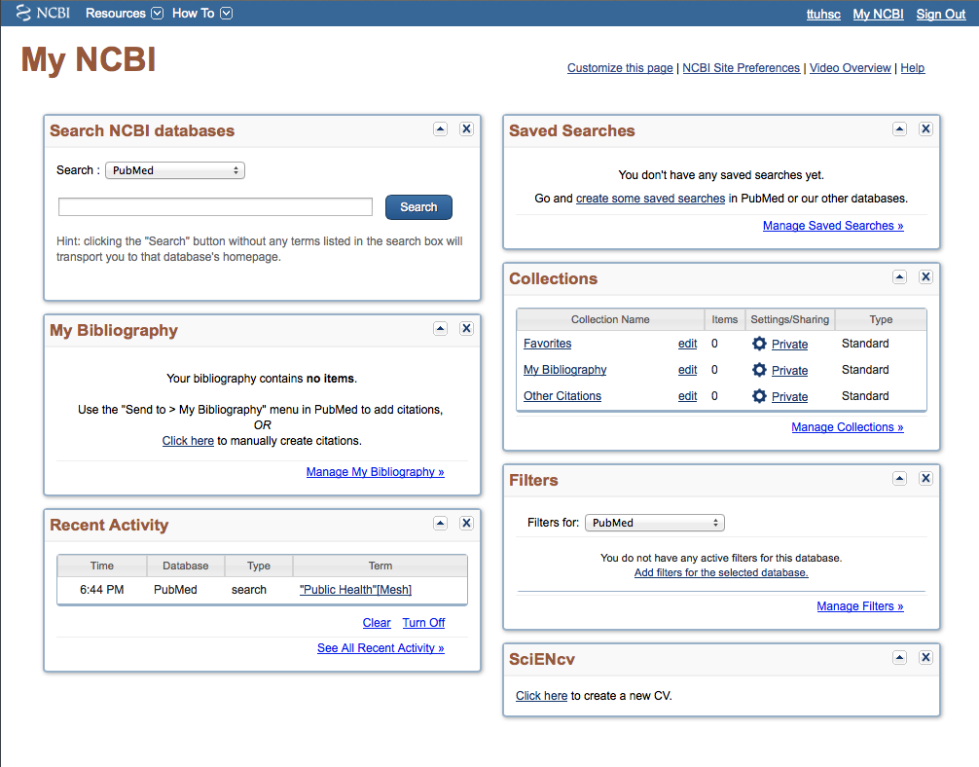
Click Manage Filters

Slide 50
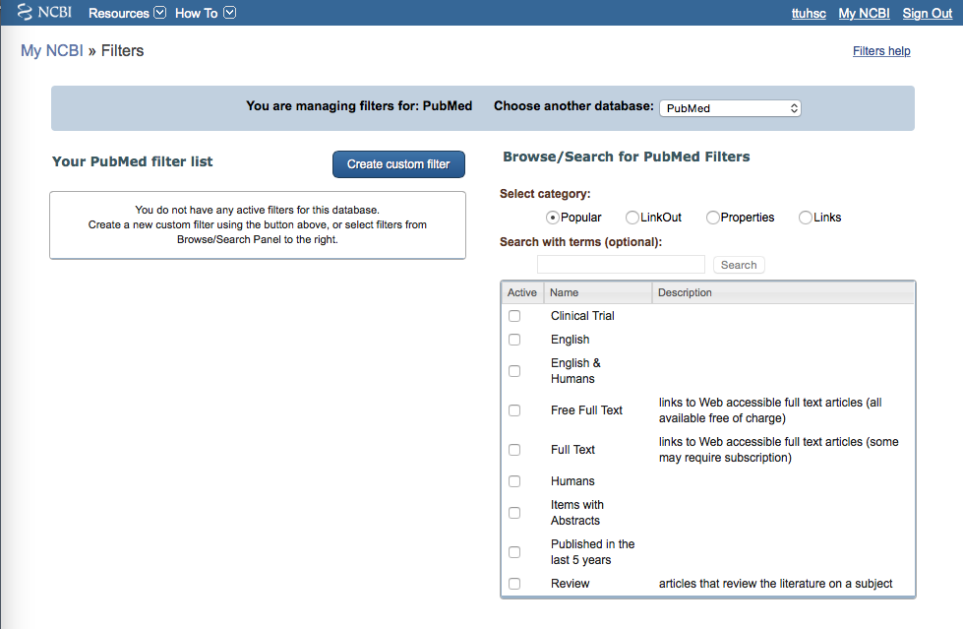
Database is PubMed
Select
English & Humans
✔

Slide 51
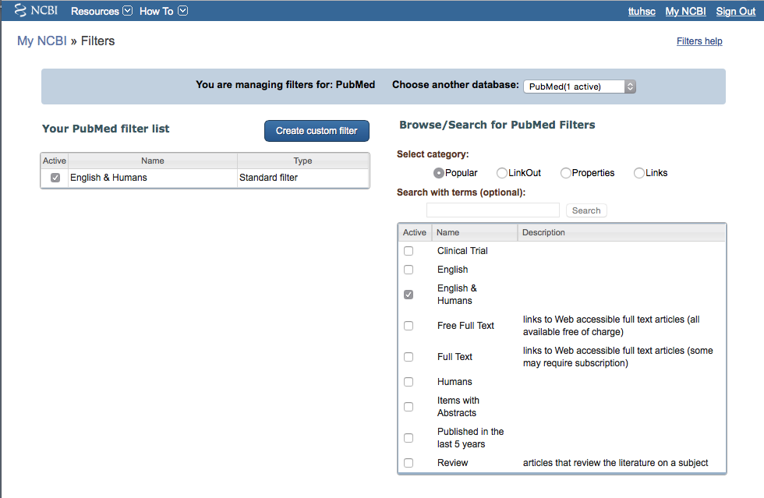
Filter activated
You may set up to 15 filters

Slide 52
Click Properties

Slide 53
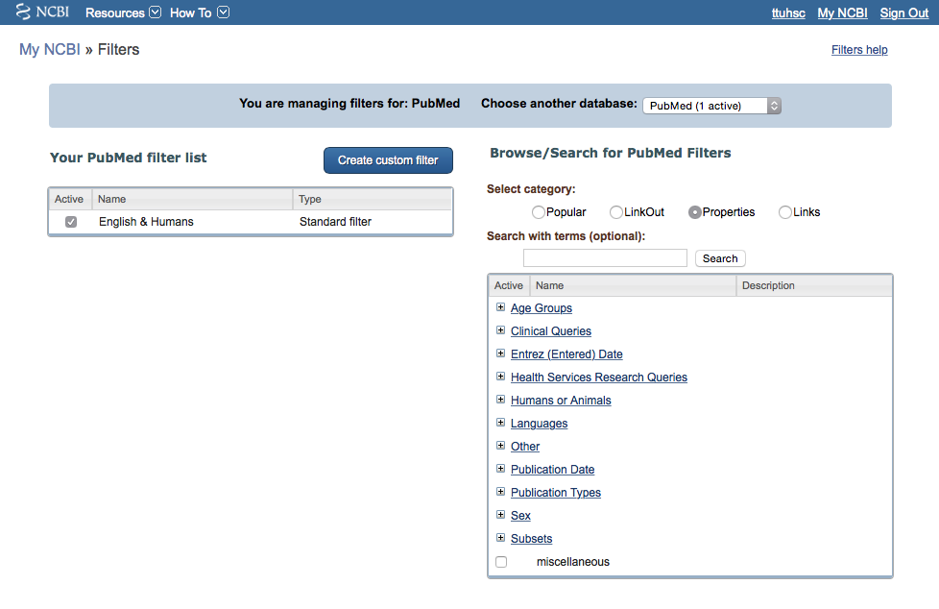
Click
+
Age Groups

Slide 54
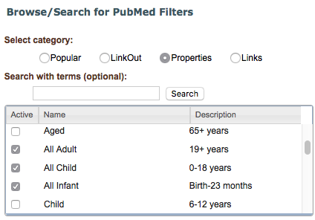
Select
✔
All Adult
✔
All Child
✔
All Infant

Slide 55
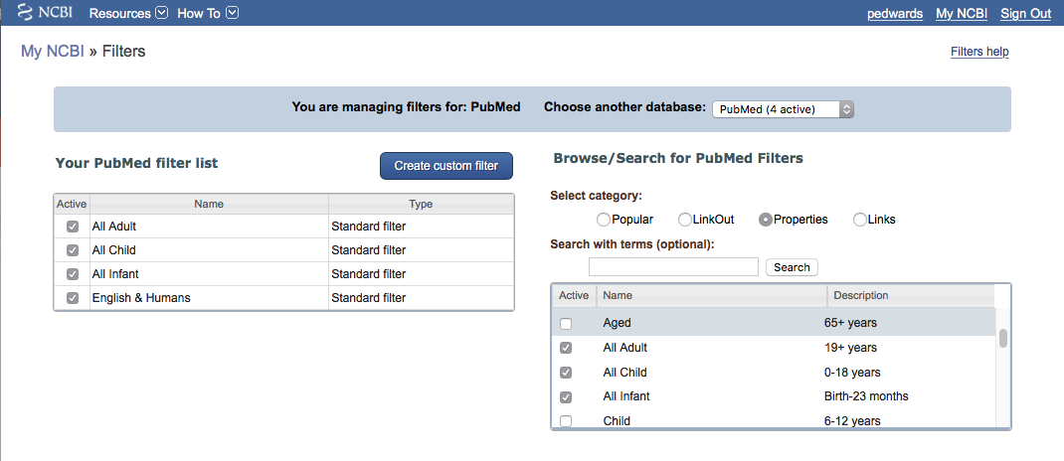
Scroll
Check to see if all selected filters are activated

Slide 56
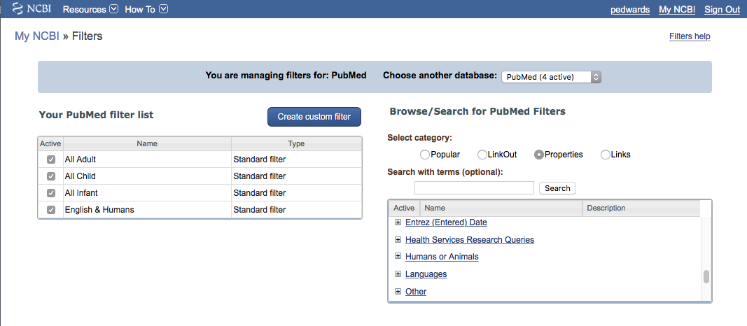
Click
+
Humans or Animals

Slide 57
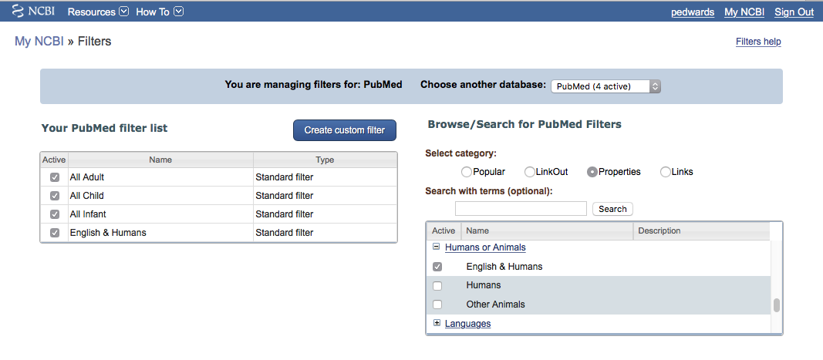
ttuhsc
User name
Select
✔
Other Animals

Slide 58
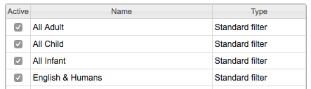
User name
Scroll
Click
+
Publication Types

Slide 59
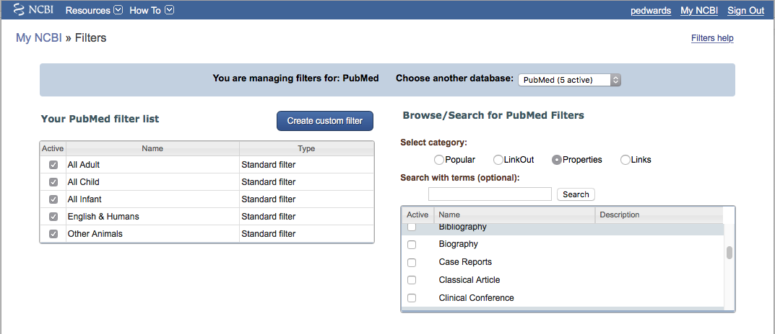
User name
Select
Case Reports
✔

Slide 60
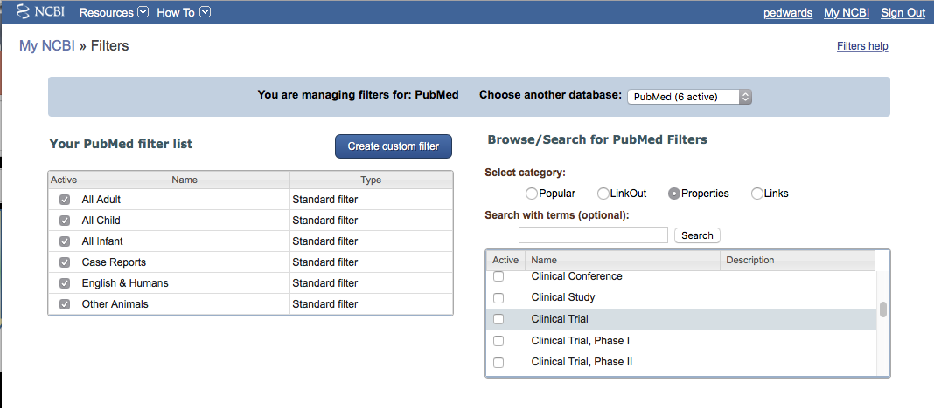
User name
Select
Clinical Trial
✔

Slide 61
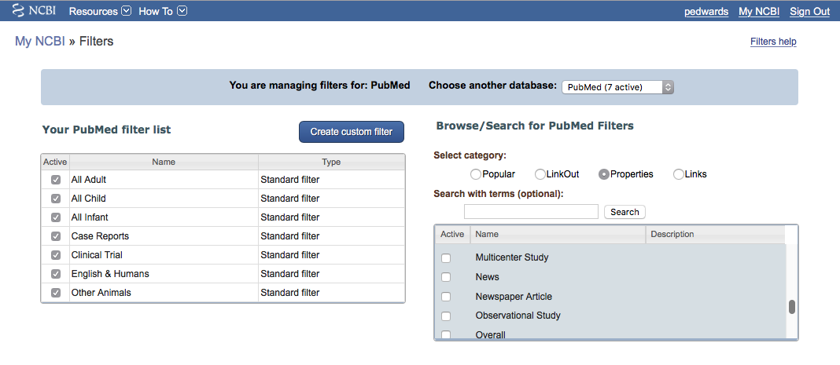
User name
Active
Name
Description
✔
Meta-analysis
Multicenter Study
News
Newspaper Article
Observational Study
Overall
Patient Education Handout
Periodical Index
Personal Narratives
Portraits
Practice Guideline
Pragmatic Clinical Trial
Published Erratum
Randomized Controlled Trial
✔
Select
Meta-analysis
Multicenter Study
Practice Guideline
Randomized Controlled Trial
✔
✔

Slide 62
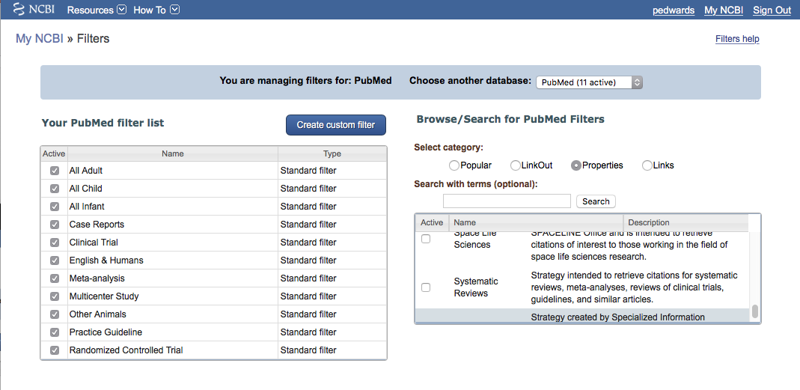
User name
✔
Scroll to
Subsets
-
and select
Systematic Reviews

Slide 63
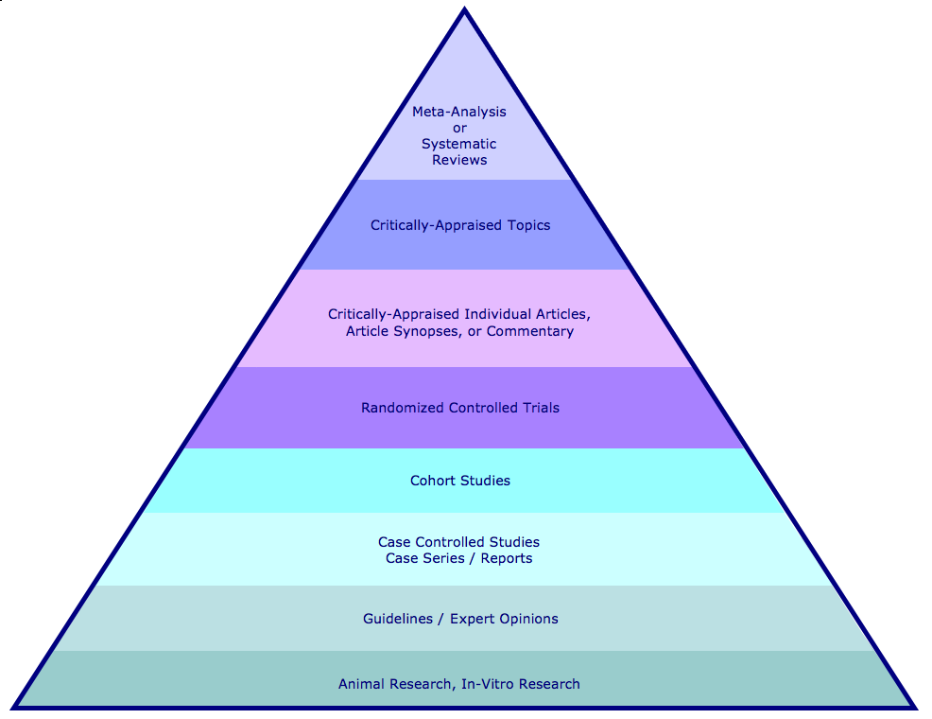
Hierarchy of Evidence
Meta-Analysis or Systematic Reviews
Critically Appraised Topics or Articles are found in the Cochrane Library
Randomized Controlled Trials
Case Reports
Practice Guidelines

Slide 64
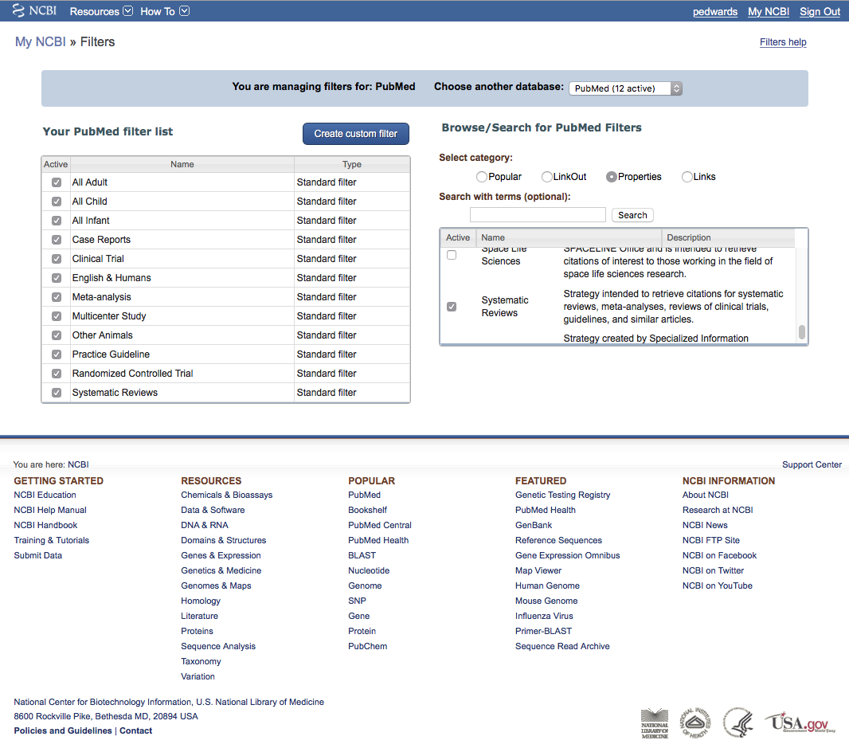
User name
Click PubMed

Slide 65
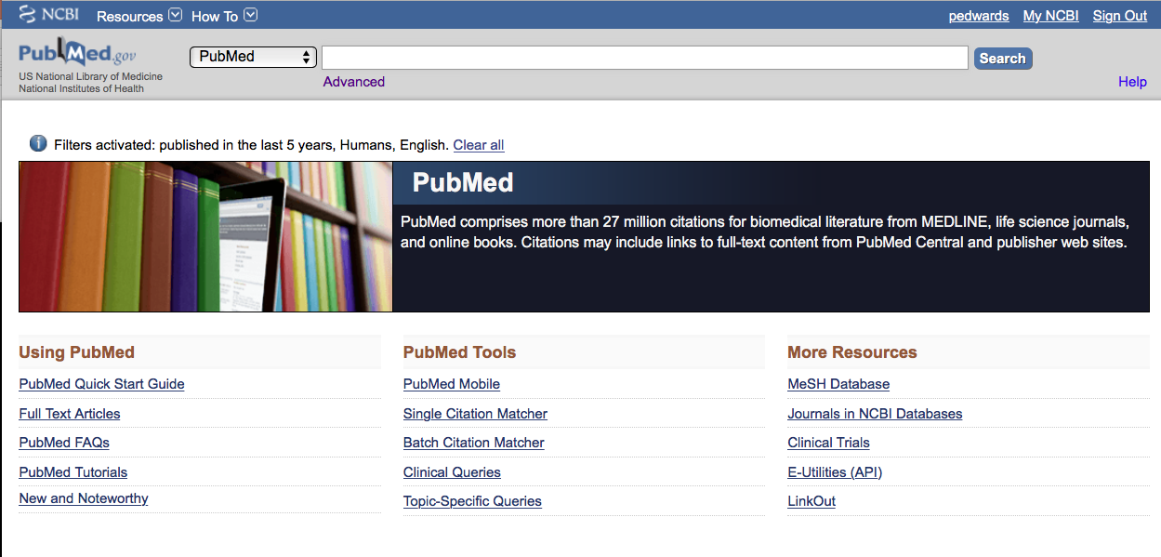
Click Advanced
User name

Slide 66
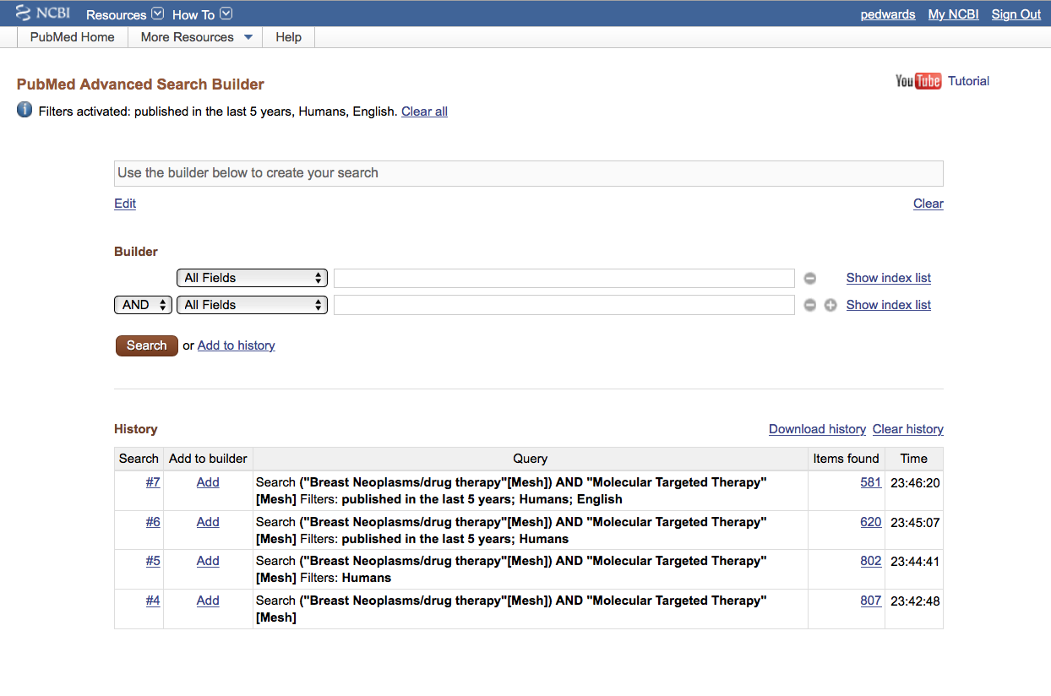
User name
Click results link

Slide 67
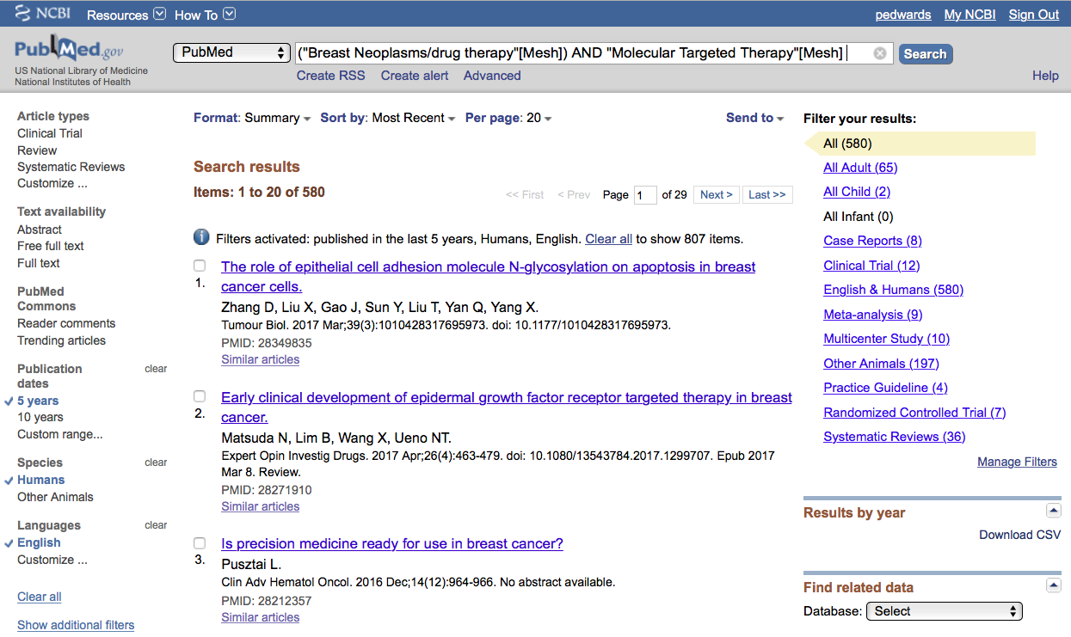
User name
Results from
custom filters!
NOTE: Custom Filters appear when
you’re in your My NCBI account.

Slide 68
Always
Sign in to NCBI

Slide 69
What questions do you have?

Slide 70
User name
Click
Meta-analysis

Slide 71
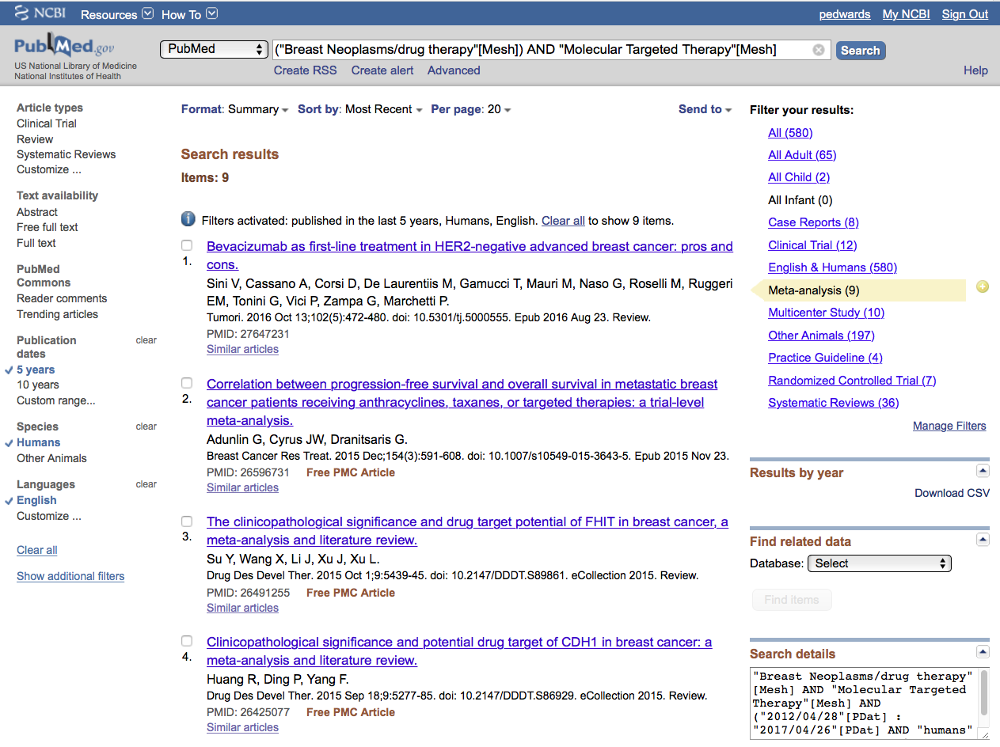
User name
Select article # 3.
X

Slide 72
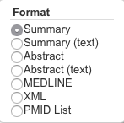
User name
1) Click Summary
2) Select Abstract

Slide 73
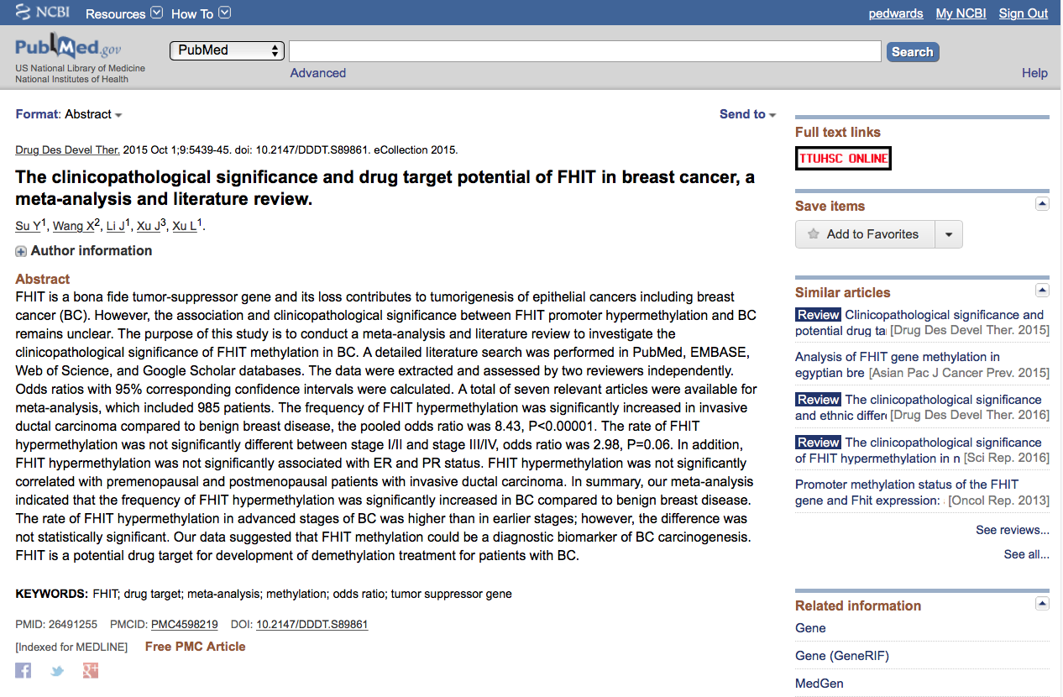
User name
Click icons for full text.

Slide 74
Linking to
Full-Text Articles
in Electronic Journals

Slide 75
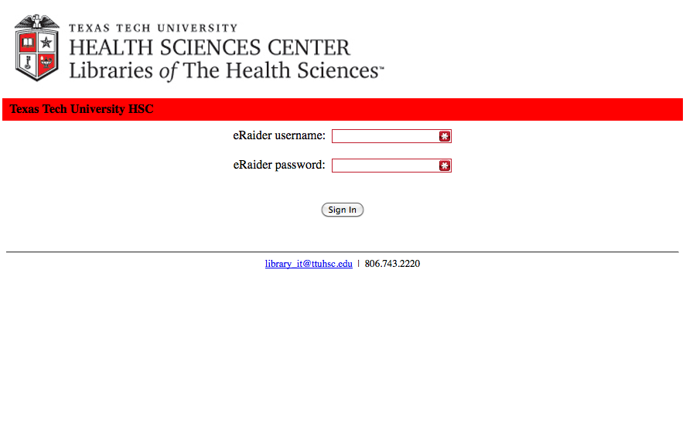
When Searching from Off Campus:
Enter the
Eraider username and password
assigned to you
by Information Services.
A
Problems with eRaider? Call: 806-743-1234 a

Slide 76
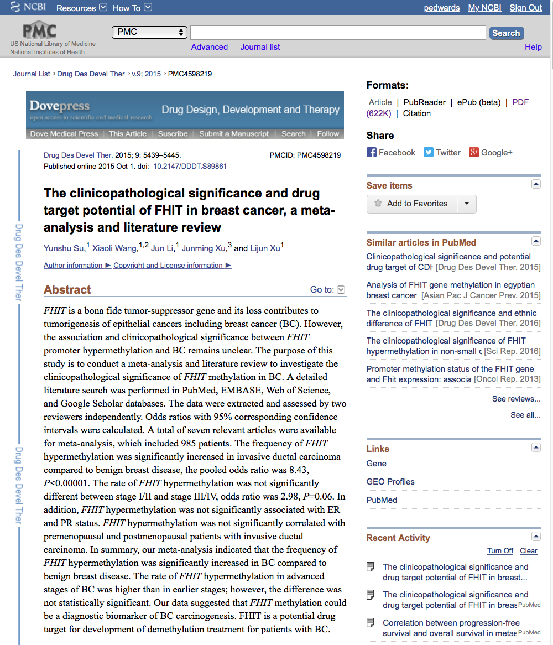
User name
Click PDF

Slide 77
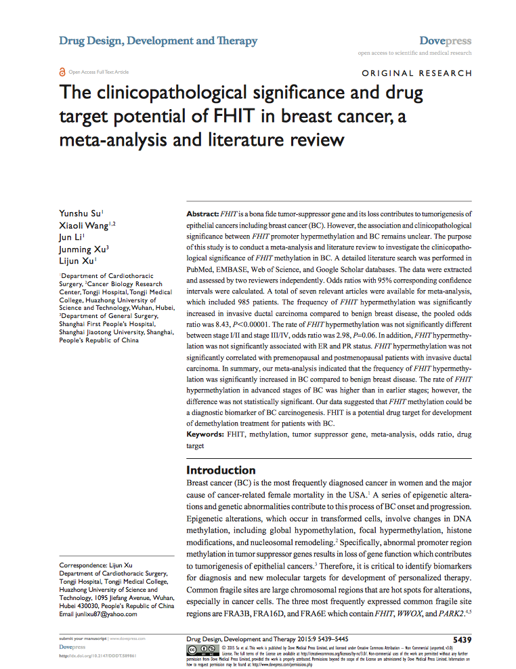
Full Text Article
Close Article

Slide 78
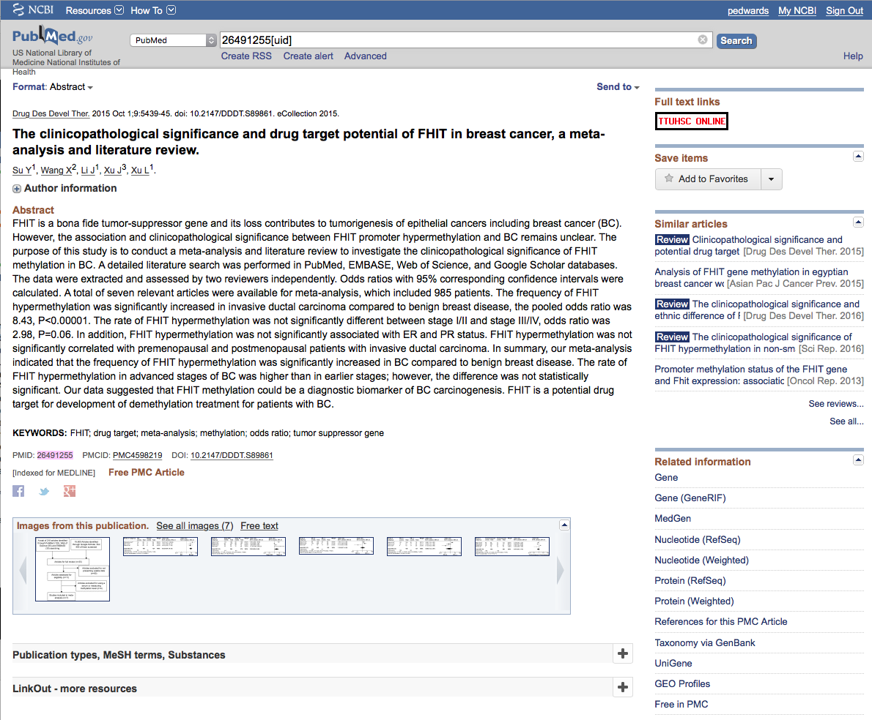
User Name
Click for MeSH Terms Index!

Slide 79
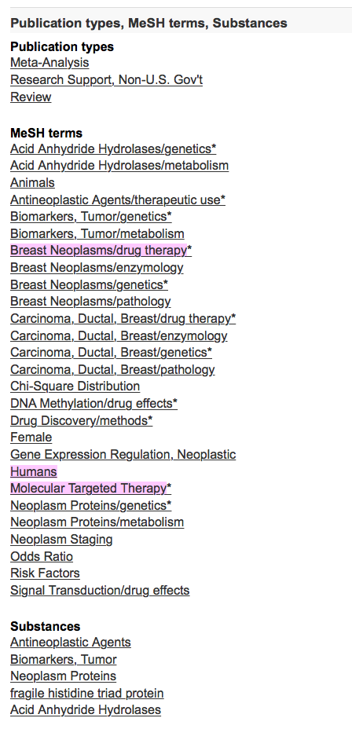
The * indicates Major focus
MeSH Database
searches only
the MeSH terms for:
Breast neoplasms/dt
AND
Molecular Targeted Therapy

Slide 80
Look at subject headings
in the
MeSH Terms Index
for additional terms.
You may want to
write a new search
program using:
Gene Expression
Regulation,
Neoplastic

Slide 81
What questions do you have?

Slide 82
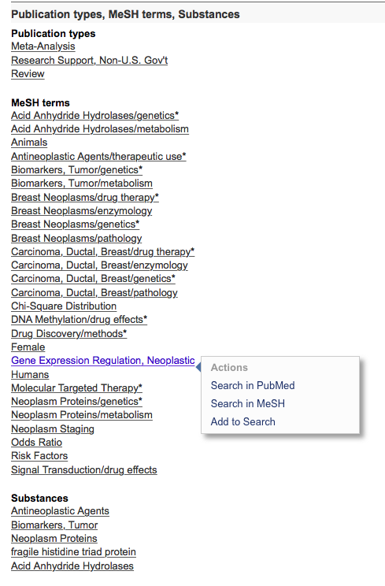
Click Gene Expression Regulation, Neoplastic
Click Search in MeSH

Slide 83
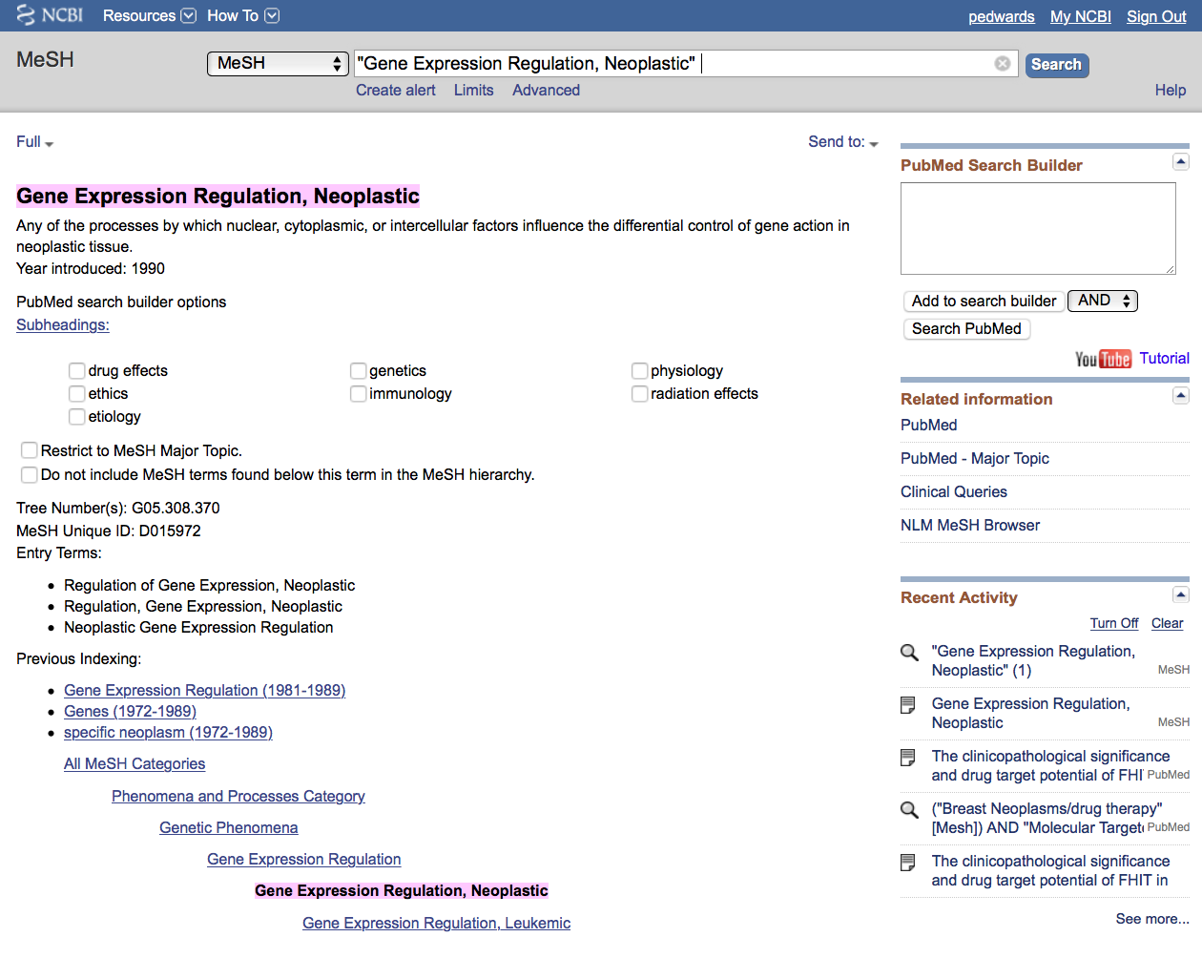
User Name
Can now use new
term in a new strategy!
MeSH

Slide 84
User Name
MeSH
Terms are listed from broadest to
narrowest. If Gene Expression
Regulation, Neoplastic yields zero
results, try using a broader term:
Gene Expression Regulation.
terms arranged
In tree structure
hierarchy

Slide 85
User Name
… unless you select
the following command
✓
Note:
PubMed automatically
OR’s indented terms
under a broader term…

Slide 86
What questions do you have?

Slide 87
User Name
1) Click
Add to search builder
2) Click
Search PubMed

Slide 88
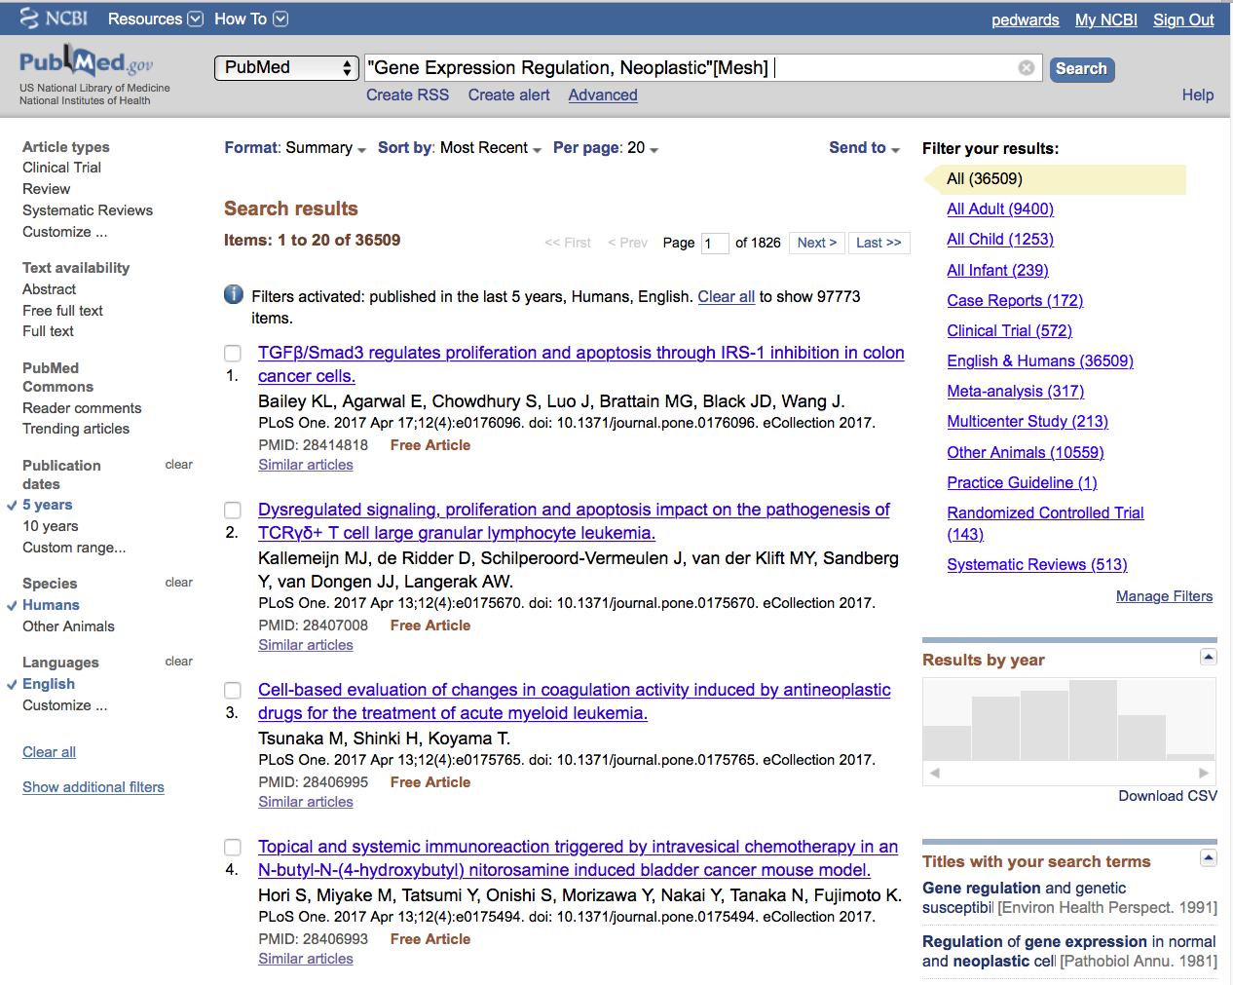
User Name
Click Advanced

Slide 89

User Name
Click the search number
Click AND in builder

Slide 90

Puts strategy in Search Builder

Slide 91
Click ADD

Slide 92

New Strategy in Search Builder
Click Search

Slide 93

Results from different
search strategy

Slide 94

Change [Mesh] to [Majr]

Slide 95

Results are reduced
From 82 to 49

Slide 96
Click Meta-analysis

Slide 97

.
Click Send to: and select
File to save citations to a file on your computer or
Clipboard to temporarily store selected citations or
E-mail to send citations to self or colleague

Slide 98
What questions do you have?

Slide 99
Saving Searches

Slide 100
Click Advanced

Slide 101

Click results link of search you wish toa
areceive emails updates from.

Slide 102

Click Create alert

Slide 103





Click
•
Yes, please.
Select frequency
Select Number of items:
Select Report format
Select day
Click
Save

Slide 104

Click My NCBI
Search is saved.

Slide 105

Click Manage Saved Searches

Slide 106

Delete
saved search(es).
See
What’s new
Click to re-run search.

Slide 107

Scroll
Click PubMed

Slide 108
What questions do you have?

Slide 109
Other Searching Features
MeSH, phrase, & title word searching
    using the [ti] pneumonic
Truncation

Slide 110

Click MeSH Database

Slide 111

Enter and click a
a
human genome
Search

Slide 112

Click box to select term
✔
✔
Click
Add to search builder
Click
Search PubMed

Slide 113

PubMed identifies 6730 articles
Note: filters are activated

Slide 114

Search
Enter
AND “dark matter”
and click
Note: “dark matter” is not a MeSH term.

Slide 115

PubMed identifies
6 articles

Slide 116

Enter and click
Search
“dark matter” [ti]

Slide 117

Results are narrowed to 5
Note: all articles have
”dark matter” in the title

Slide 118
Truncation

Slide 119

Enter gene* to truncate.
Truncation searches for all suffixes
such as: gene
genes
genetic
genetics, etc.
general
and
generation
are “false drops”

Slide 120
What questions do you have?

Slide 121
Online Tutorial

Slide 122

Click for more hands-on learning.

Slide 123
Web of Science

Slide 124

www.ttuhsc.edu/libraries
Click All Databases

Slide 125

A
aClick “W”

Slide 126

A
aClick Web of Science

Slide 127

a
a
Enter
molecular therapy
and click
Search

Slide 128

A
aClick Analyze Results

Slide 129

A
aSelect Source Titles
A
aClick Analyze

Slide 130

Journals topic has
been published in

Slide 131
What questions do you have?

Slide 132
LibGuides Tutorials

Slide 133
www.ttuhsc.edu/libraries
Click
LibGuides

Slide 134


Scroll and select
Searching PubMed:
Medicine Focus
Link:
http://ttuhsc.libguides.com/pubmed1

Slide 135


www.ttuhsc.edu/libraries
Click

Slide 136
The End

Slide 138
Critical Assessment of the
Biomedical Literature

Slide 139

What is Critical Appraisal?
“The process of assessing and interpreting
evidence by systematically considering its
validity, results, and relevance.”
The Cochrane Collaboration Glossary http://www.cochrane.org/glossary/5#letterc

Slide 140

http://www.ebm.med.ualberta.ca/

Slide 141


Mouse over
Domains,
Study Category,
and select
Worksheet.
Look at Calculations.
Then look at
Systematic Review.

Slide 142

Critical Appraisal Worksheet

Slide 143


