Slide 1
Welcome
Comparative Effectiveness and PubMed Health
MSIII Surgery EBM
Peggy Edwards, AMLS
TTUHSC - Preston Smith Library
Lubbock, Texas 79430
July 2014

Slide 2
Federal Coordinating Council for Comparative Effectiveness Research
Comparative Effectiveness:
conduct and synthesize research
compares benefits and harms of different interventions/strategies
prevent, diagnose, treat and monitor health conditions in "real world”
Purpose:
improve health outcomes
develop and disseminate evidence-based information
Determine:
which interventions are most effective
for which patients under specific circumstances

Slide 3
Federal Coordinating Council for Comparative Effectiveness Research
Compared Defined Interventions may include:
medications
procedures
medical and assistive devices and technologies
diagnostic testing
behavioral change
delivery system strategies
Comparative Effectiveness Research necessitates:
development, expansion, and use of a variety of:
data sources
assessment methods
This definition is not meant to exclude randomized trials:
these trials would need comparator arms other than placebo
be representative of populations seen in "real world" practice

Slide 4
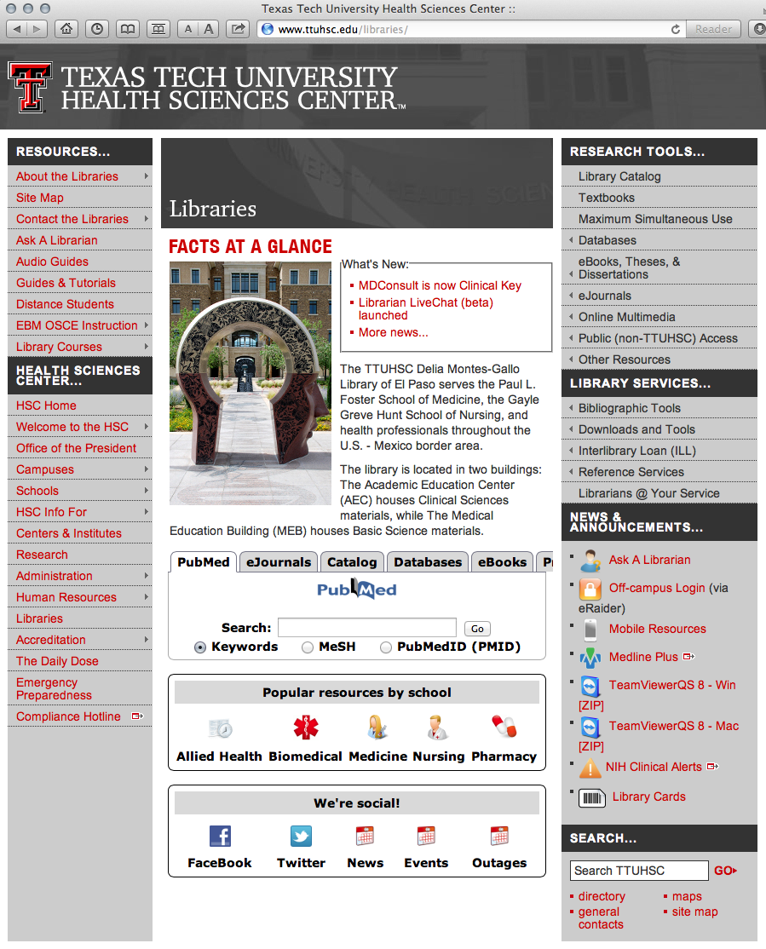
Hover mouse over Databases

Slide 5
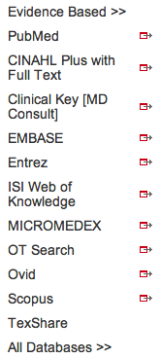
Click PubMed

Slide 6
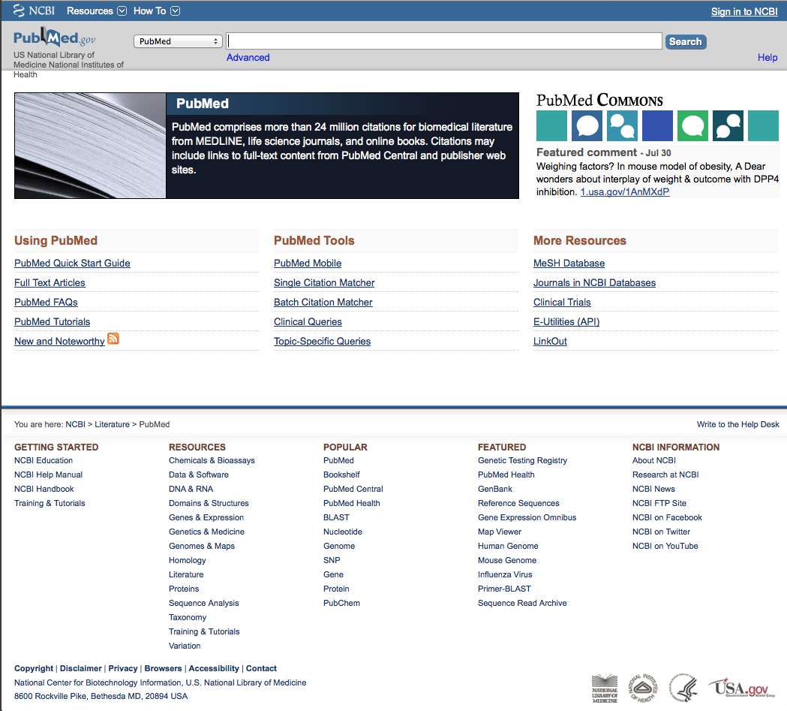
Click Topic-Specific Queries

Slide 7
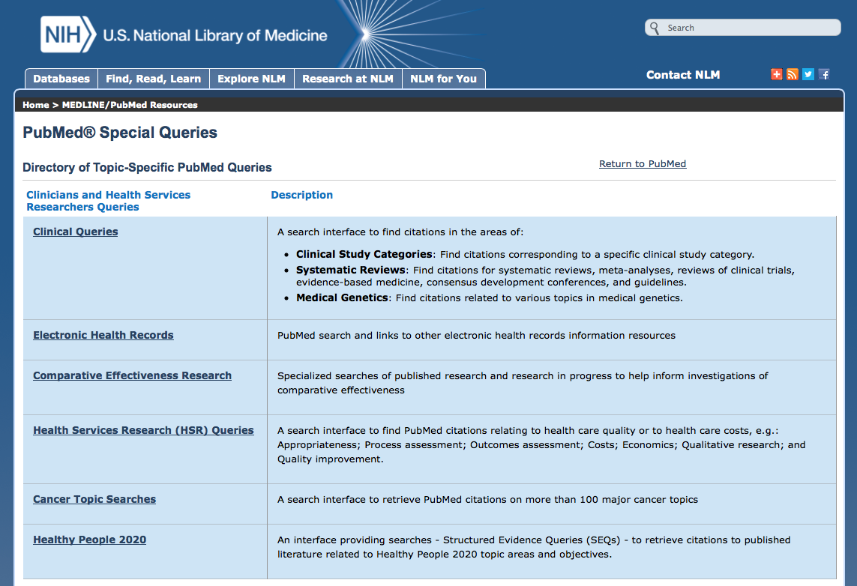

Slide 8
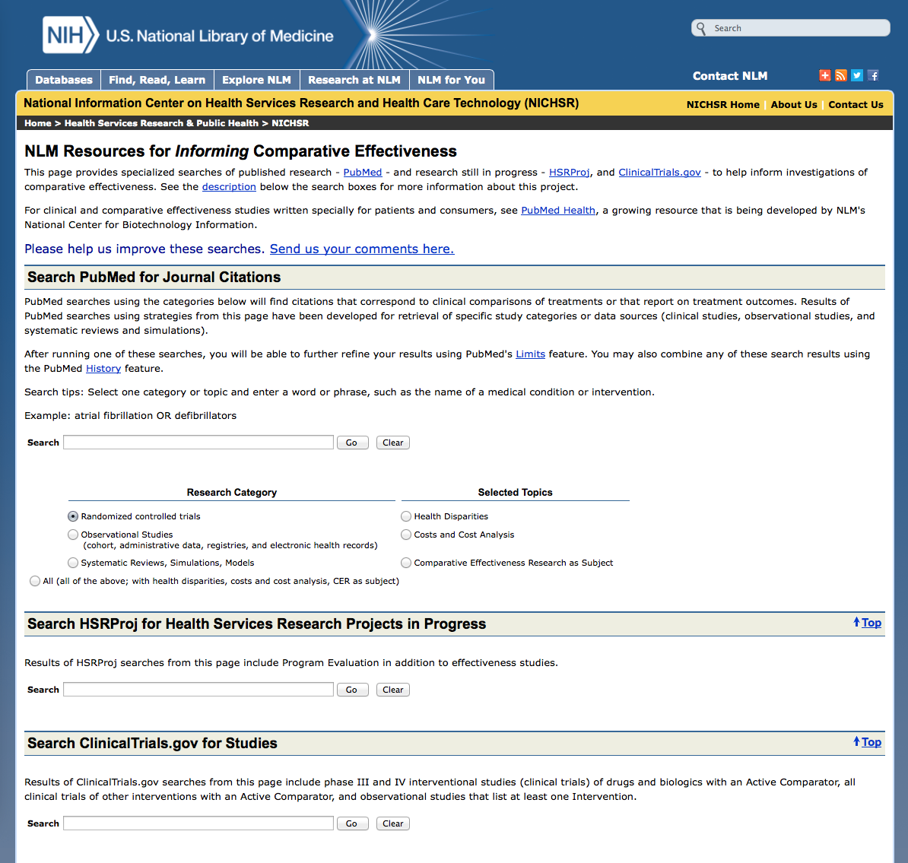
www.nlm.nih.gov/nichsr/cer/cerqueries.html#pubmed

Slide 10
Hover mouse over Databases

Slide 11
Click PubMed

Slide 12
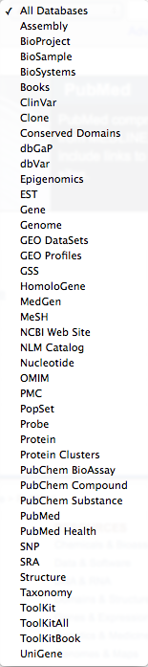
Click PubMed Health

Slide 13


Slide 14
PubMed Health
* clinical effectiveness resource for practitioners & consumers
* find and understand systematic reviews more easily
* systematic reviews of interventions only
* quantitative studies, diagnosis, prognosis, and etiology are NOT included
* abstracts from DARE
* currently has 32,000 reviews
* database will grow a lot over the next year
* free through NCBI and the National Library of Medicine

Slide 15
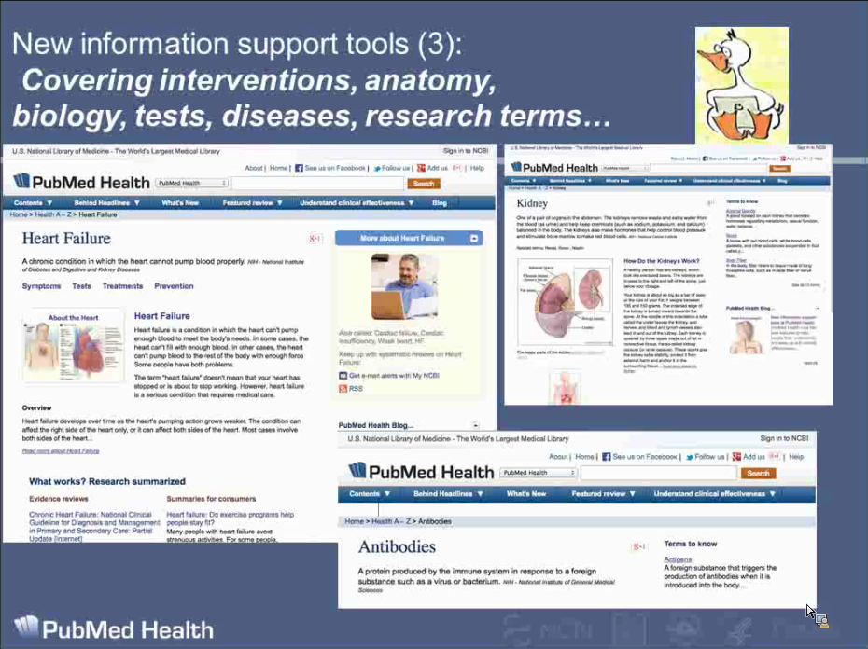
https://webmeeting.nih.gov/p2r92nyqy7k/?launcher=false&fcsContent=true&pbMode=normal

Slide 16
The End

