Slide 1
PubMed BASICS: MESH and
How to search for:
Randomized Controlled Trials, Guidelines, and Meta-analyses
Margaret Vugrin MSLS, AHIP, MPH
Texas Tech University Health Sciences Center Library
Fall 2017

Slide 2
Instructions
Get a piece of paper and something to write with; preferably colored markers.
Then cover the sheet of paper with dots all over it.

Slide 3
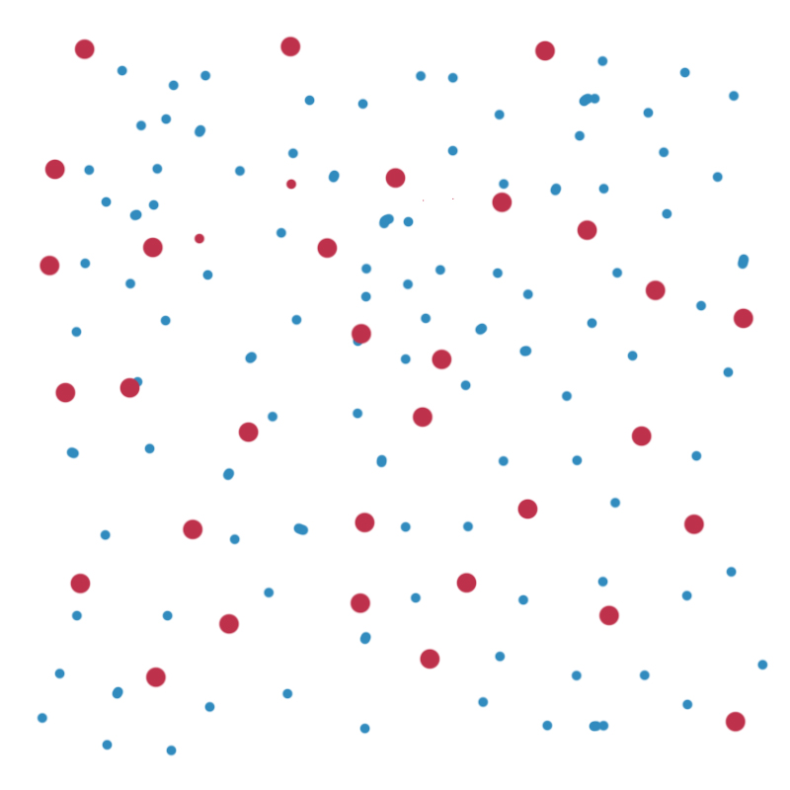
This is an example of: “All the published literature” each dot represents a journal…
We can’t see all of them but I’m sure you get the idea...there are lots, and lots of journals and lots, and lots of published articles within these journals.
Notes:
This is an example of: “All the published literature” each dot represents a journal…and we can’t see all of them but I’m sure you get the idea...there are lots, and lots of journals and lots, and lots of published articles.

Slide 4
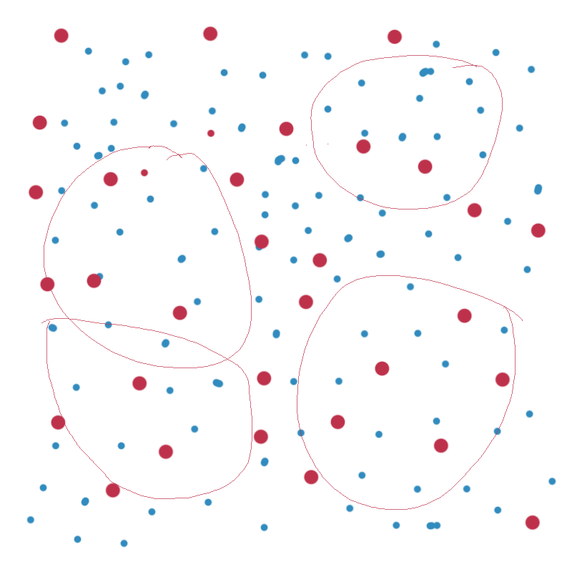
Different Databases = Different Journals
Databases index journal articles
so that the articles can be located.
Some journals are unique and these articles are indexed only in one database like the ones on the right side.
Other journals may be indexed in more than one database as in the overlapping circles on the left side.
Indexing refers to the organization of data according to a specific plan…like “tags” in Twitter.
Notes:
Databases index journal citations. Some journals are unique and are indexed only in a databases like the ones on the right side, while other journals may have an overlap of subjects and thus the same journal may be in more than one database as in the overlapping circles on the left side.

Slide 5
PubMed
For this exercise we will be looking at just one database, PubMed. Just one of the circles on the previous screen.
As of 2017, it contained over 27 million articles going back to the 1960s.
The next slide begins the exercise that you will be doing today with the dots on your paper and following along on the database screens.

Slide 6
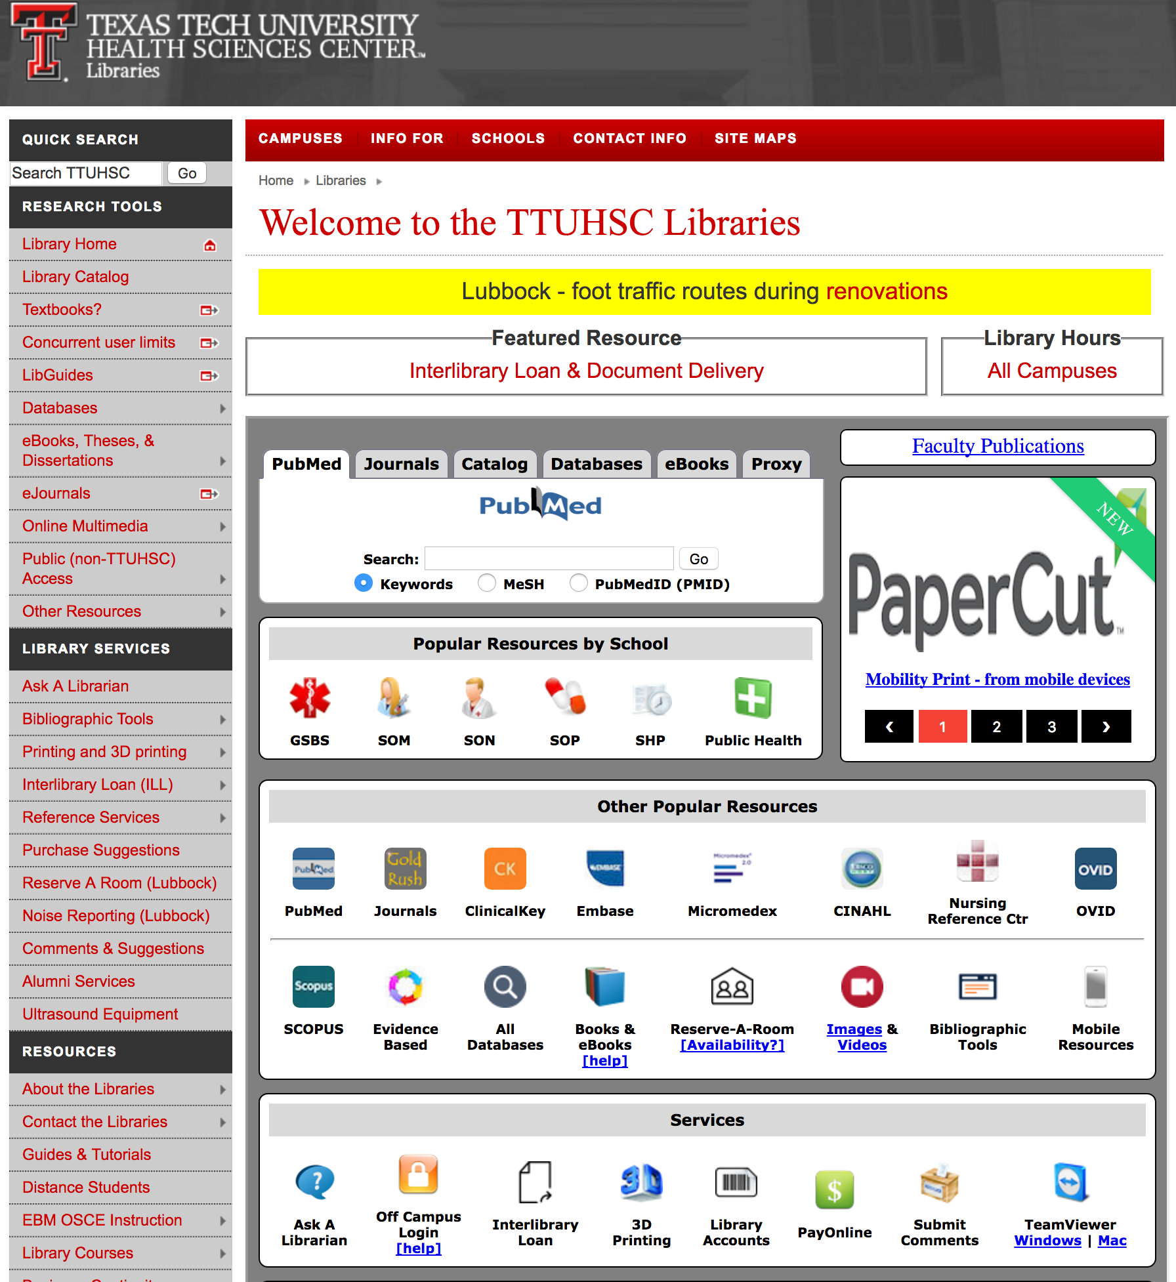

The library homepage is at:
http://www.ttuhsc.edu/libraries
Click on the PubMed Icon:
This will bring you to the PubMed Homepage.
For full functionality of the databases, including access to full-text, one must start at the library home page.

Slide 7
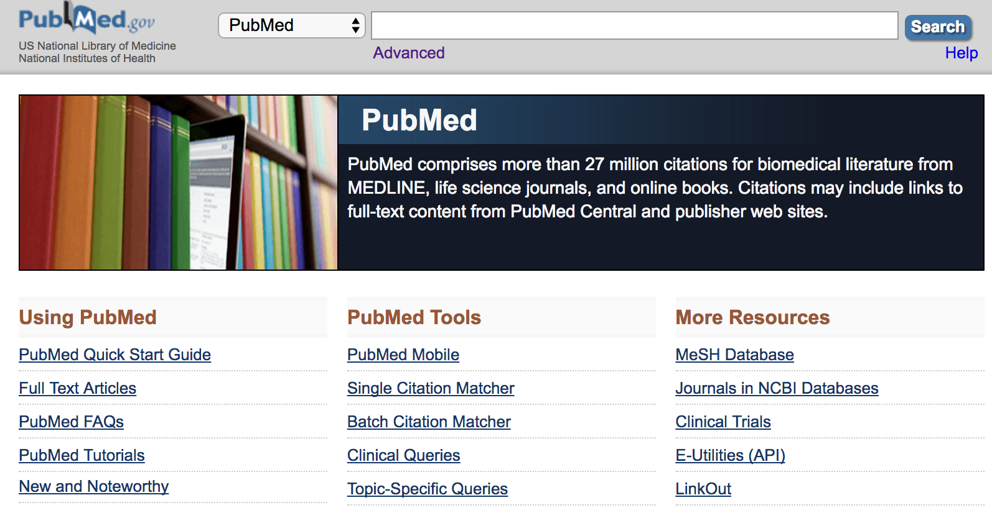
diabetes
In the search box type in the “combination of letters” that create: diabetes
The database doesn’t recognize “words” but just the “combination of letters.”
Let’s see how PubMed interprets this request for articles on the next screen.

Slide 8
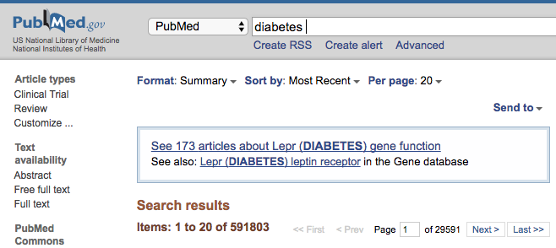
Diabetic
The database searches for this “combination of letters” anywhere in the electronic record, including in the journal title, the article title, the author’s name, also in the abstract…
Will it locate DIABETIC using this search?
NO! it only looks for the “combination of letters”…not the meaning of the word.
NOTE: Your numbers will be different because the database is updated daily.
PubMed
Diabetes
Diabetic!
Diabetes
Diabetes
Diabetic
Diabetes
Diabetes
Diabetic
Diabetes…
Diabetic
Notes:
Let’s just look at one of those databases: PubMed…the dots here show us the over 6,000+ journals, that contain over 27 million citations that make up the PubMed database. When you type in a “combination of letters” into the PubMed search box…it looks for that combination of letters anywhere in the electronic record: Journal title, article title, author’s name, word in the abstract. Will it locate DIABETIC using this search? NO! as it’s only looking for the combination of letters…not the meaning of the word.

Slide 9
Return to the PubMed homepage, click on “MeSH Database.”
MeSH stands for Medical Subject Headings. One can search by CONCEPT when using MeSH.

Slide 10
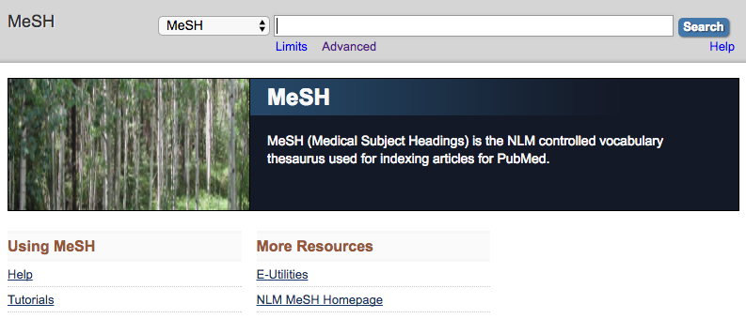
diabetes
On the MeSH page, type “diabetes” into the search box.
MeSH is the controlled vocabulary used for indexing articles.
Click on “Search.” If there is a match, it will show up on the next screen.

Slide 11
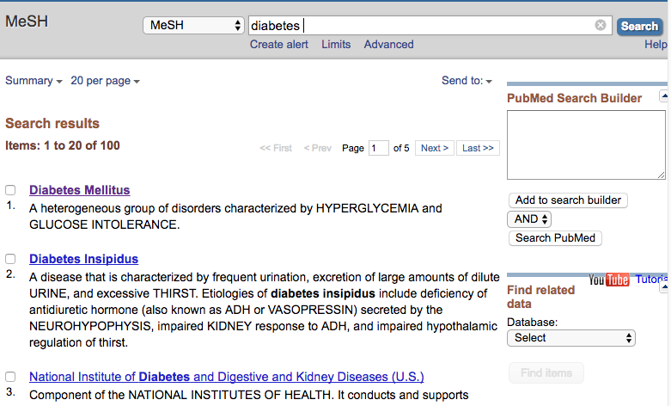
There are 100 possible matches.
Select the appropriate one. Click on the word(s) themselves.
The next screen helps to refine your topic, if needed.

Slide 12
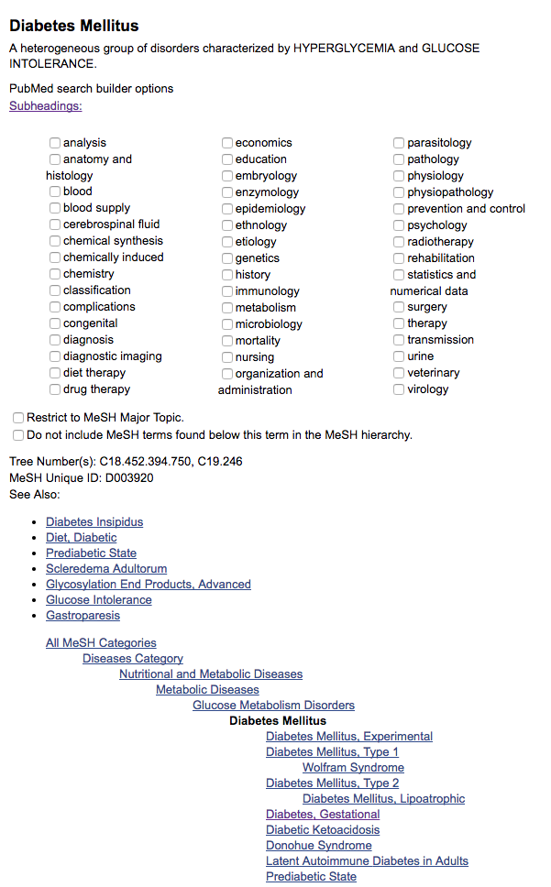
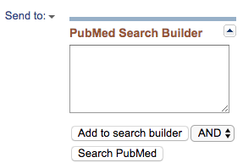
If you want EVERYTHING about your subject all you have to do is :
“Add to search Builder” then
“Search PubMed”
The next screen shows our actions on the dots page.

Slide 13
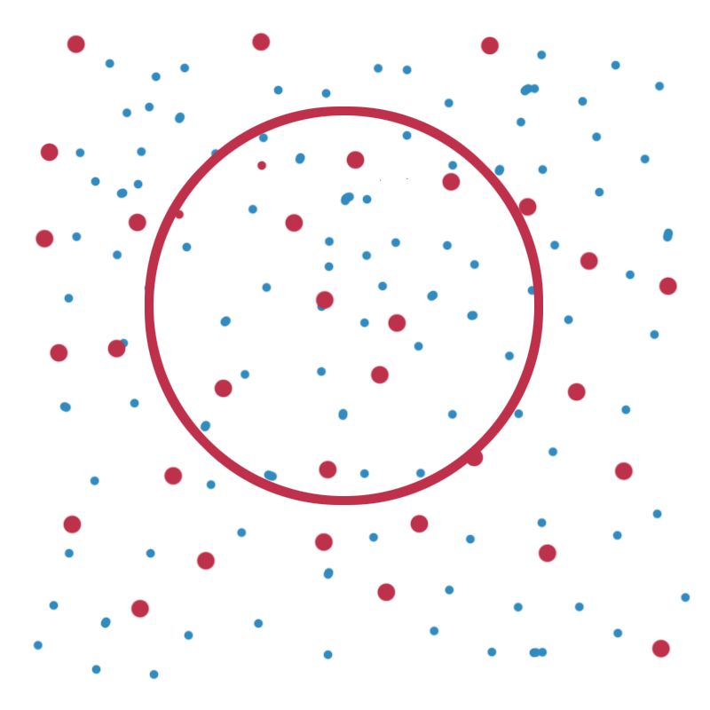
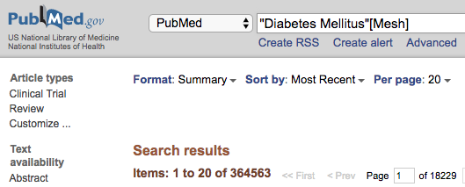
PubMed — MeSH (Medical Subject Headings)
Using PubMed’s-MeSH feature, we will only search for those articles that are tagged or indexed for our subject term, only those inside of the circle, inside of the MeSH circle.
The numbers in the screen shot show how many articles are within the entire MeSH circle/pie.
Diabetes Mellitus
Notes:
Using PubMed’s-MeSH feature, we will only search for those articles that are tagged or indexed for our subject term, only those inside of the circle, inside of the MeSH circle. When I’m doing this example with students we go thru all the steps to locate the appropriate subject heading…here we are just showing the results. The numbers show how many articles are in the entire pie…

Slide 14
Click the back arrow until you return to this page:
There are small boxes next to subheadings or adjectives (because they modify the subject).
Using these terms we can make our research more precise and more accurate.
There are 88 different subheadings; there are different possible combinations, not all subject headings and subheading combinations are always applicable.

Slide 15
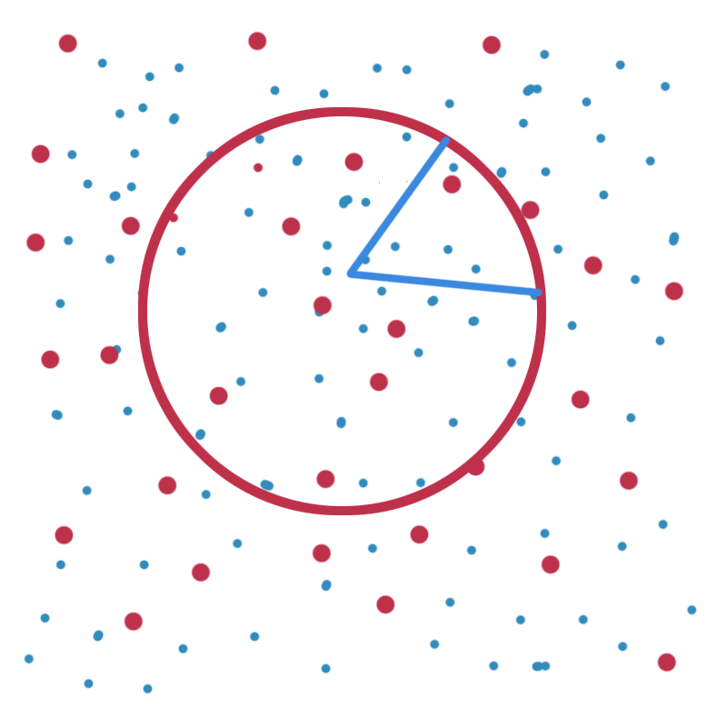
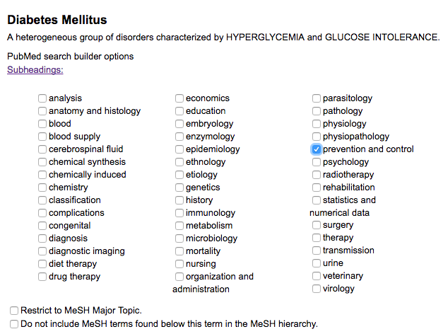
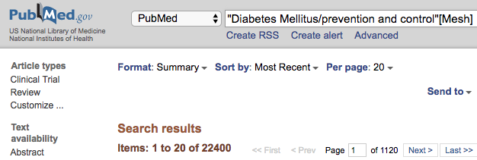
PubMed — Subheading/adjective
Choosing one subheading: “prevention and control” narrows our search to just a piece of the pie. More choices can be made if needed.
Notice our numbers are much less than when we searched the entire circle.
Notes:
When I want to narrow my subject…I can easily do that using the subheadings/adjectives for the subject heading…adjectives describe their subject as they do here…you can make multiple selections by clicking on the box next to the term(s). If you don’t choose any subheadings you will get all the entire pie. But here we have just selected one one piece of pie.

Slide 16
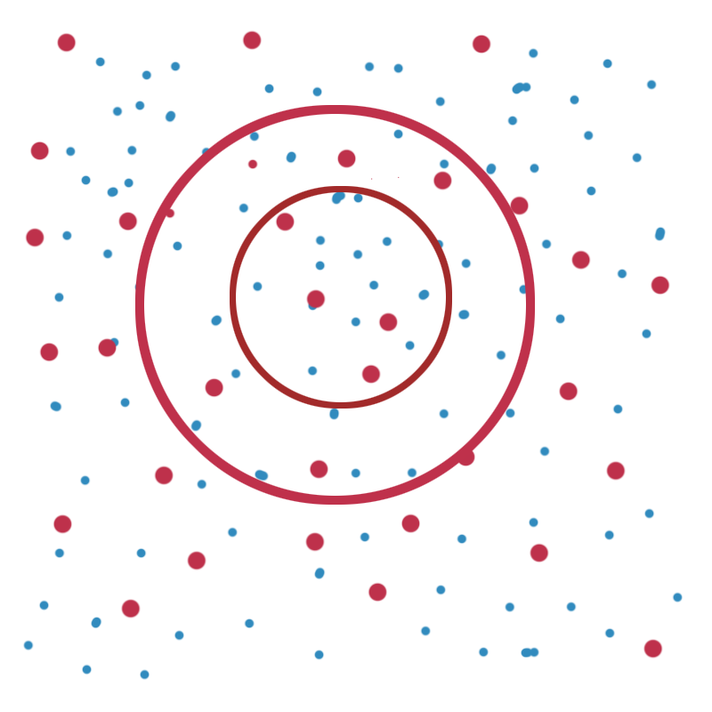
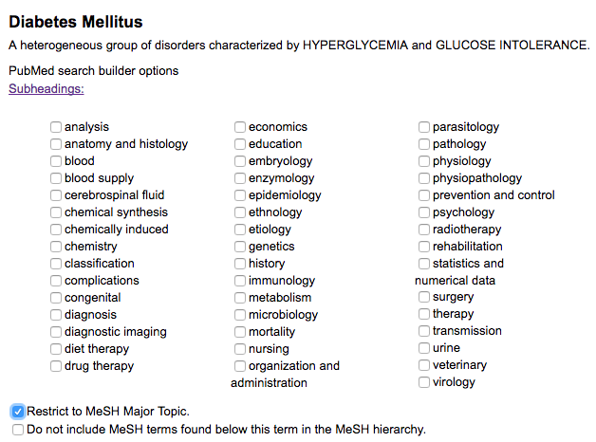
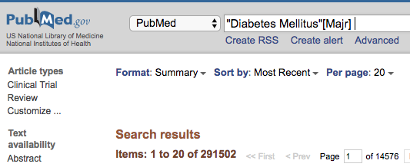
PubMed — Inner Circle = Major
If you want to focus your topic…then select the option “Restrict to MeSH Major Topic.”
As when horses wear blinders to help them focus on the race and not be distracted…
This option will search only the narrower more focused articles found in the inner circle.
Inner
c I
rc le
Notes:
If you want to focus your topic…then select the option “Restrict to MeSH Major Topic.” As when horses wear blinders to help them focus on the race and not be distracted…this option will search only the narrower more focused articles found in the inner circle.

Slide 17
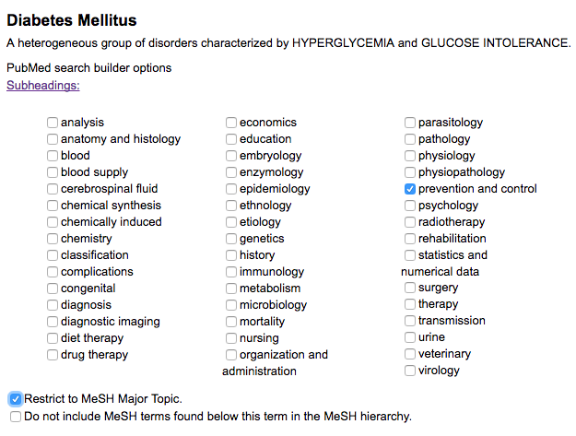
Here we have selected: a “subheading” and
a “Major focus”

Slide 18
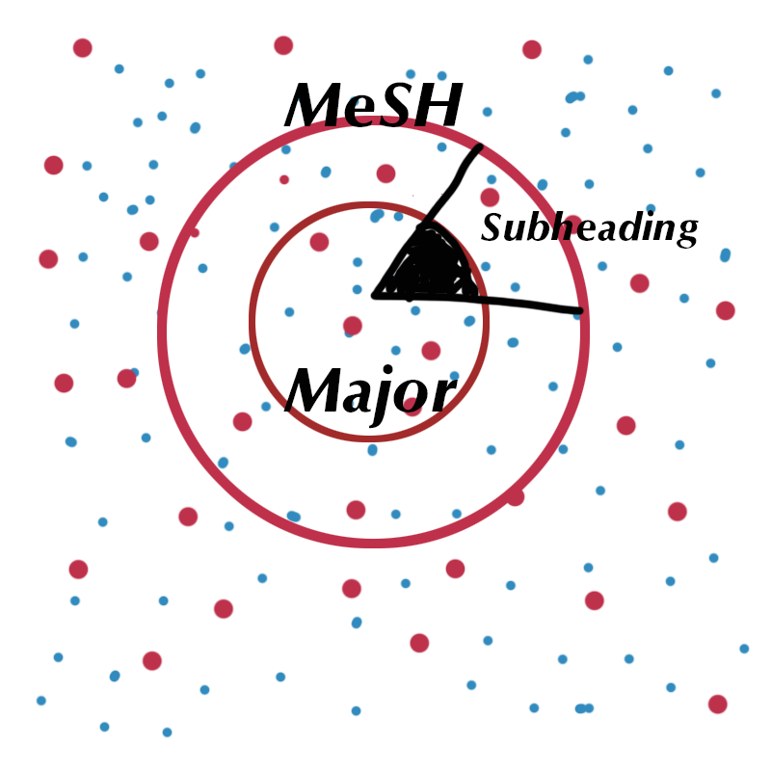
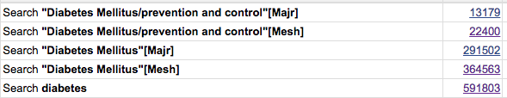
As you see here, now we are only retrieving the
“Tip of the Iceberg” (the small black triangle)!
Here you see the numbers for each section. This is still too many.
Tip of iceberg
Entire triangle
Inner Circle
Big circle
All the dots

Slide 19
Once you have strategized your concept then you can figure out ways to narrow your topic down.
Typically you may want to combine two or more concepts…
How you combine your concepts will make a difference in results!

Slide 20
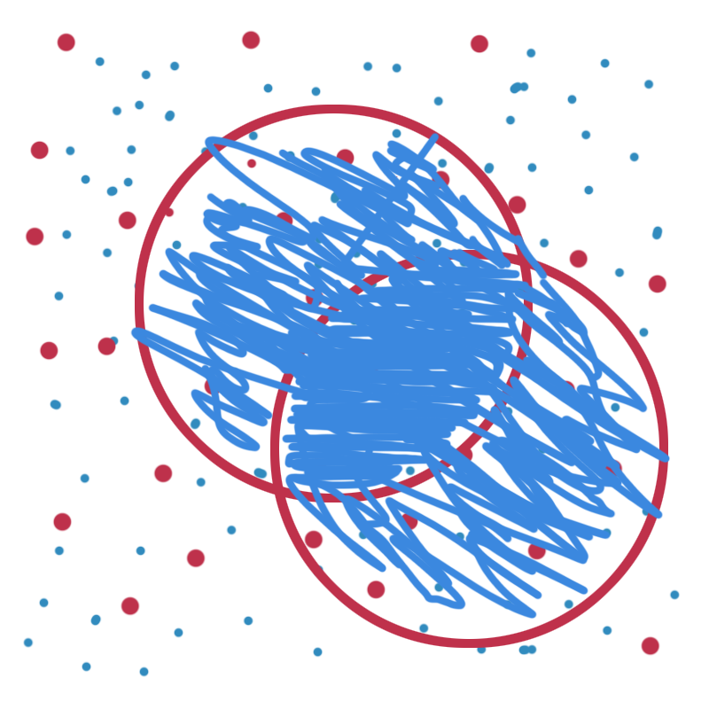
OR
Using the “OR” sometimes called “Boolean OR”…you will get all variations of your concepts, those that deal with one concept “OR” the other “OR” even those citations that have both concepts in the same article. For example, if you had concept A as well as concept B…having overlapping circles…the searcher would get the citations that have “A” concept OR the ones that have “B” concept and even those articles that have both “A” and “B” in the intersection of the circles.
A OR B
Notes:
Using the “OR” sometimes called “Boolean OR”…you will get all variations of your concepts, those that deal with one concept “OR A” the other “OR B” even those citations that have both concepts in the same article. For example, if you had concept A as well as concept B…having overlapping circles…the searcher would get the citations that have “A” concept OR the ones that have “B” concept and even those articles that have both “A” and “B” in the intersection of the circles.

Slide 21
OR
You might be interested in “Either” “Diabetes Mellitus” OR “Hypertension”
You could then “AND” these articles to narrow down to just the intersection as shown in the next slide.
DM2 OR hypertension
Notes:
Using the “OR” sometimes called “Boolean OR”…you will get all variations of your concepts, those that deal with one concept “OR A” the other “OR B” even those citations that have both concepts in the same article. For example, if you had concept A as well as concept B…having overlapping circles…the searcher would get the citations that have “A” concept OR the ones that have “B” concept and even those articles that have both “A” and “B” in the intersection of the circles.

Slide 22
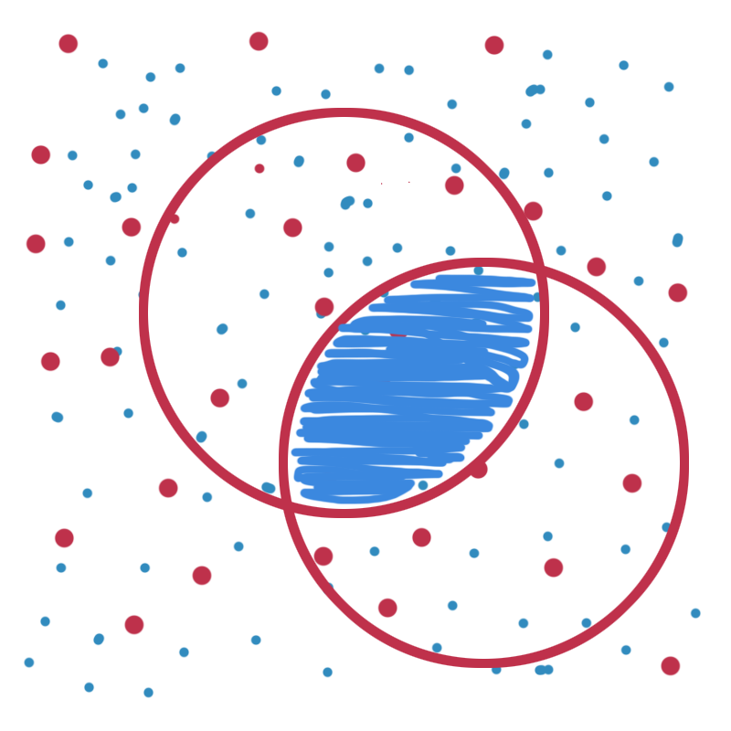
AND
AND will only give you the articles that appear in the overlap area.
“A AND B”
A
A AND B
B
Notes:
However AND will only give you the articles that appear in the overlap area. A AND B

Slide 23
AND
So we have “A” OR “B” and now we want to add a concept: e.g. Hispanic Americans
(the Blue circle).
”A” OR “B” AND “C” Hispanic Americans
We would retrieve only these articles in dark blue zig zag area.
A
A AND B
B
C

Slide 24
So how do you use these skills?
You need to follow on your computer the following steps!

Slide 25
The library homepage is at:
http://www.ttuhsc.edu/libraries
Click on the PubMed Icon:
Start at the library home page>click on the PubMed Icon, then on the next screen …locate the link to MeSH database

Slide 26
Repeat the steps that we used to locate articles on prevention of Diabetes.
Then using the same steps locate articles on the prevention of Hypertension.
Then locate articles on Hispanic Americans.
Do these steps one at a time, do not try to combine.
Refer to the earlier slides if you need a refresher.

Slide 27
After you have searched for all three concepts…on the PubMed Homepage click on “ADVANCED”, you will see something like this below…remember the numbers will be different.

Slide 28
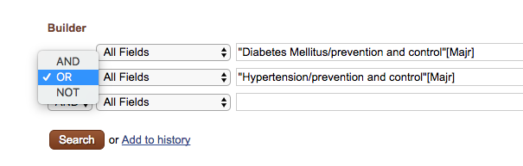
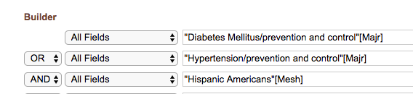
1)
2)
“ADD” the terms you want to combine, start with the concepts that are to be “ORed”
Then “ADD” the concept to be “ANDed” and then “SEARCH” using the red button.

Slide 29
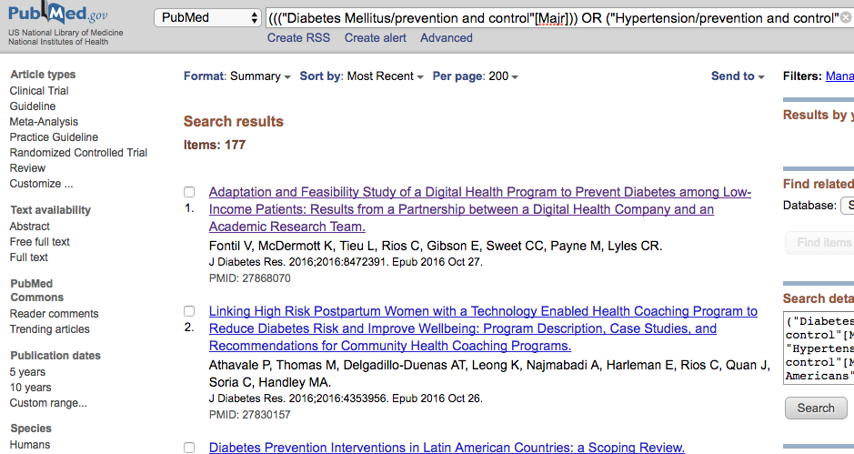
This will be your new strategy…and the results will look something like this:

Slide 30
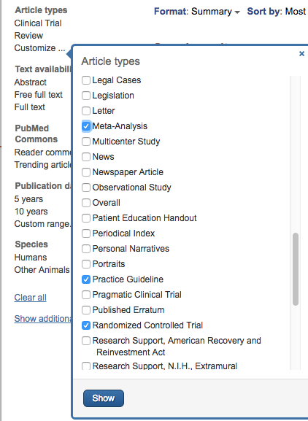

In the upper left corner…
LOCATE: “Article Types”
Select ”CUSTOMIZE”
Then select:
Guideline
Meta-analysis
Practice Guideline
Randomized controlled trials
Then click on the Blue “SHOW” button
The results do not change until you activate the filter(s).

Slide 31
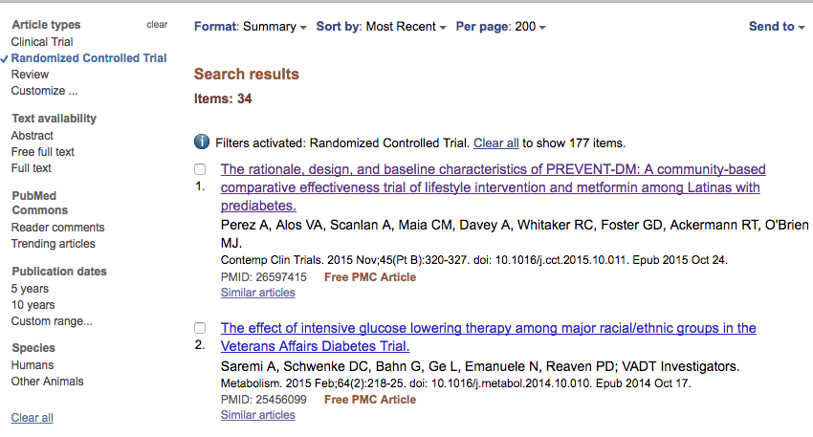
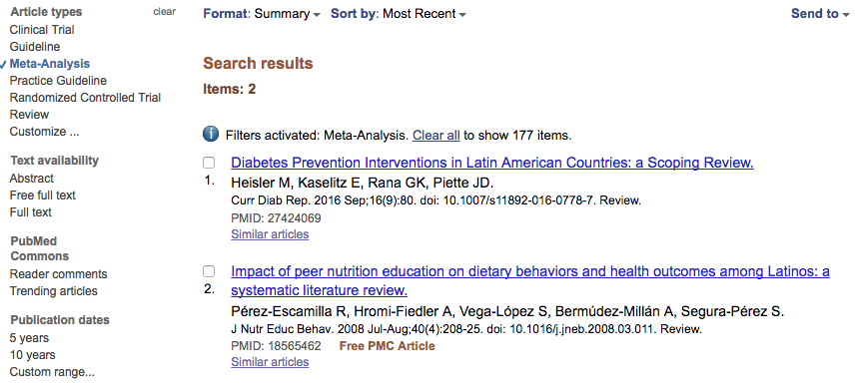

The filters are activated when you click on them. Here we see some of the results where RCTs have been activated.
When you change format to “ABSTRACT” you will be able to see the abstract and
links to full-text

Slide 32
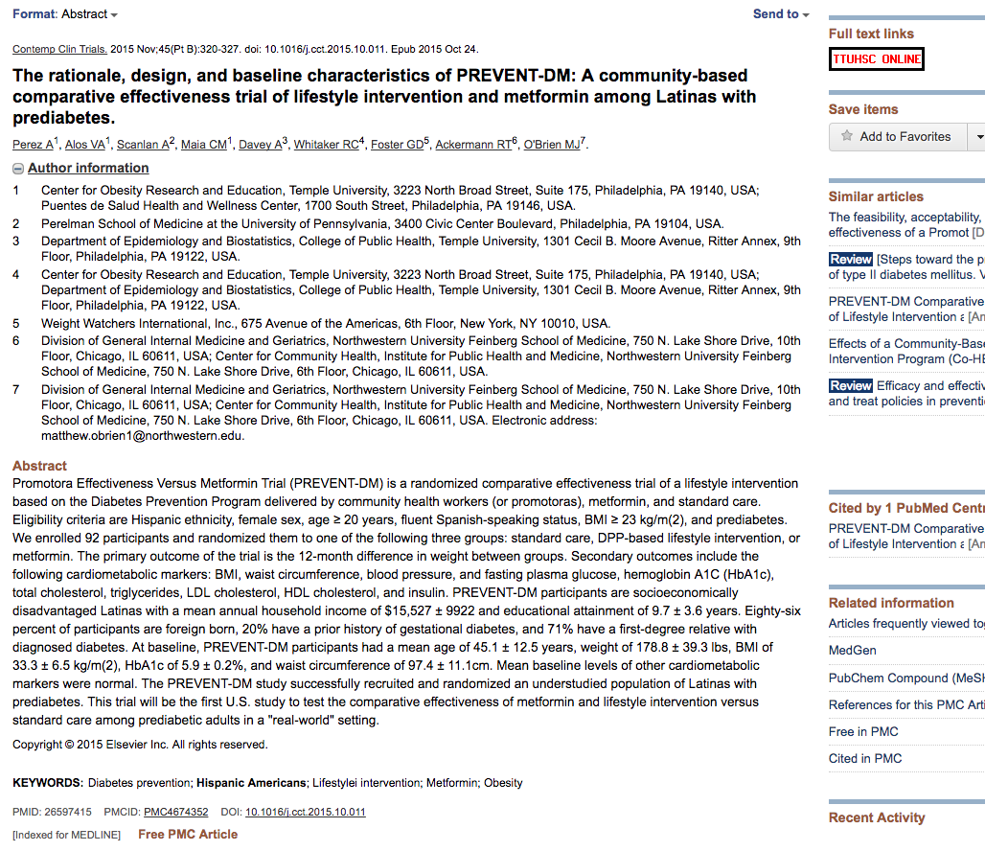

Slide 33
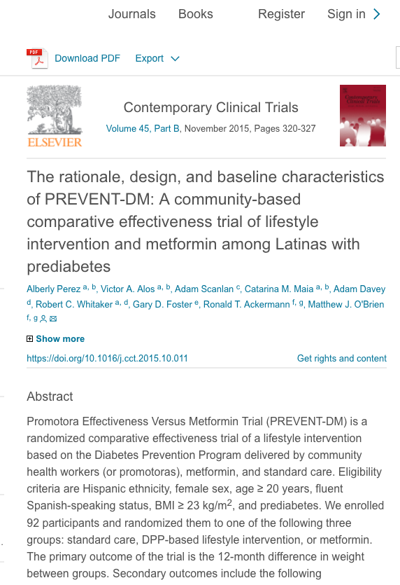

Slide 34
What other information does the article help you with?
Lists of indexing terms (MeSH) terms that can be used for refining your search!

Slide 35
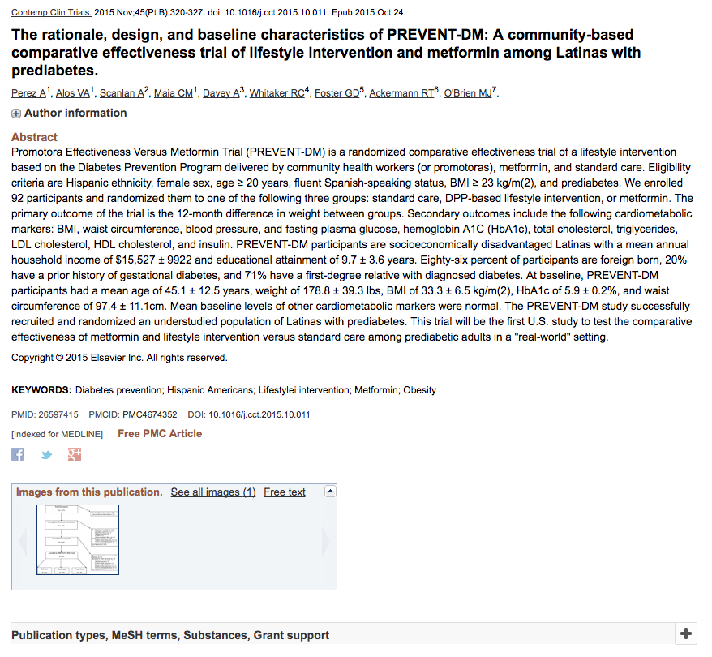
Click on the MeSH terms which you will find under the full citation of most of your articles. When you click on that it will show you the headings that have been used to tag this article. See the next slide.

Slide 36
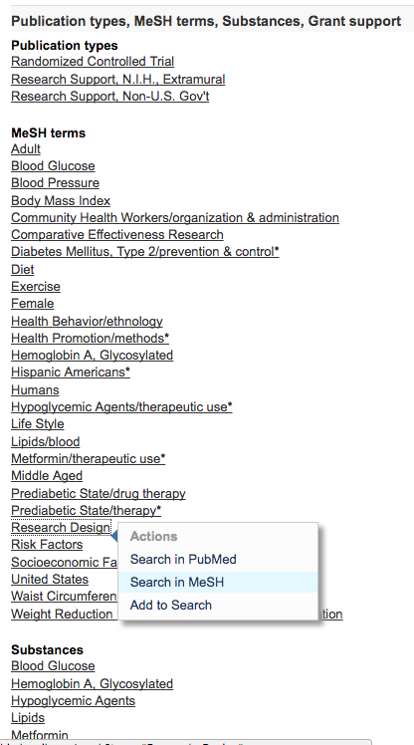
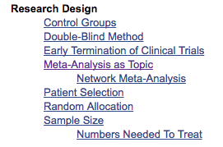
Here are the MeSH headings for the article that was just located. When you click on a individual heading it will give you a number of options. When you choose the option to “Search in MeSH” you will find more information on the term. Notice under “Research Design” there is the more specific term: “Numbers Needed to Treat”, one of the concept needed for your exercise.
Indexers index to the most specific term, so you may consider choosing this term and “AND”ing with your other subject headings.

Slide 37
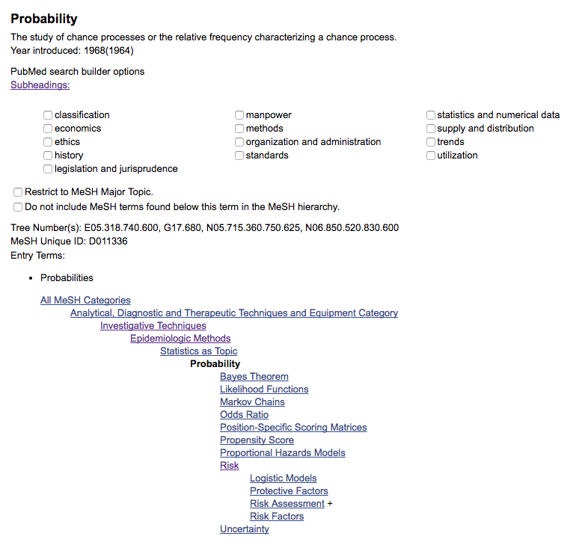
Now that you know how to manipulate the database…you can locate other MeSH subject headings to assist with your research. Here are a few examples:

Slide 38
Remember:
You can search your PDF for ARR, RR, OR, NTT or the Full-text of these acronyms by using the “FIND” option usually found under “EDIT.”

Slide 39
Before you search… play the matching game!

Slide 40
Enter your question here…
Subject
_____________________
_____________________
_____________________
_____________________
_____________________
_____________________
SH subheading
Filter
These are pieces that you have to work with.
Filters will be types of articles, or age of patient, language etc.

Slide 41
Review articles on the prevention of knee injuries in female adolescent soccer players.
Subject
_____review__________
_____prevention_______
____knee injuries______
_____female__________
___adolescent_________
____soccer players_____
SH subheading
Filter
This is a matching game!
Here is an example!
I always suggest that all the subject terms are searched before any filters are applied.

Slide 42
Enter your question here…
Subject
_____________________
_____________________
_____________________
_____________________
_____________________
_____________________
SH subheading
Create this on a sheet of paper
Filter

Slide 43
Now…it’s your turn!
Take another sheet of paper and create a picture with circles and triangles “AND”s and “OR”s how you would search for this topic: I need an RCT that deals with therapy of middle aged 45+ year old breast cancer patients who have sexual dysfunctions.

Slide 44
Put your name on both sheets of paper and then run your search strategy.
Take pictures or screen captures of:
the matching exercise
the circles and triangles which you have labeled with the subject terms
the “ADVANCED” strategy in PubMed
and your results page
Then submit these to the Sakai assignment page.

Slide 45
Thank you!
If you have any questions please contact Margaret Vugrin at
margaret.vugrin@ttuhsc.edu or 806-743-2241

