Slide 1
TTUHSC Preston Smith Library
presents
Searching PubMed®
Rev. 04/03/13

Slide 2
To begin...

Slide 3
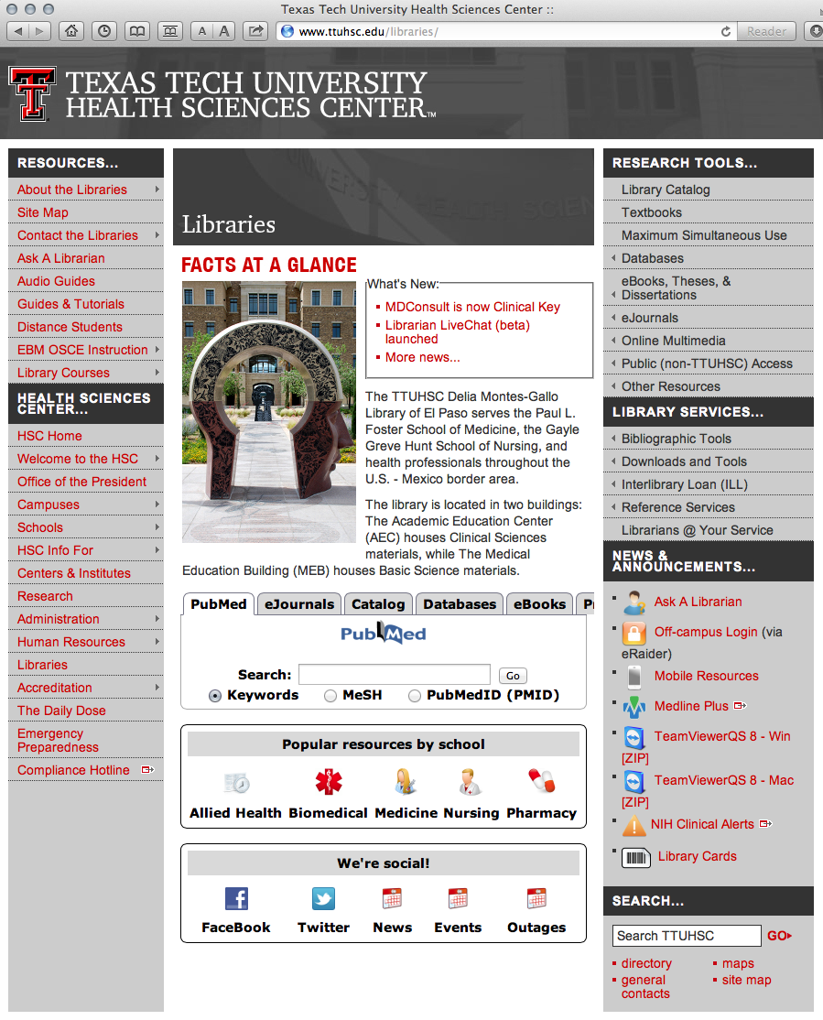
Hover mouse over Databases

Slide 4
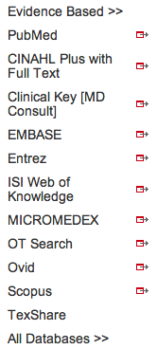
Click PubMed

Slide 5
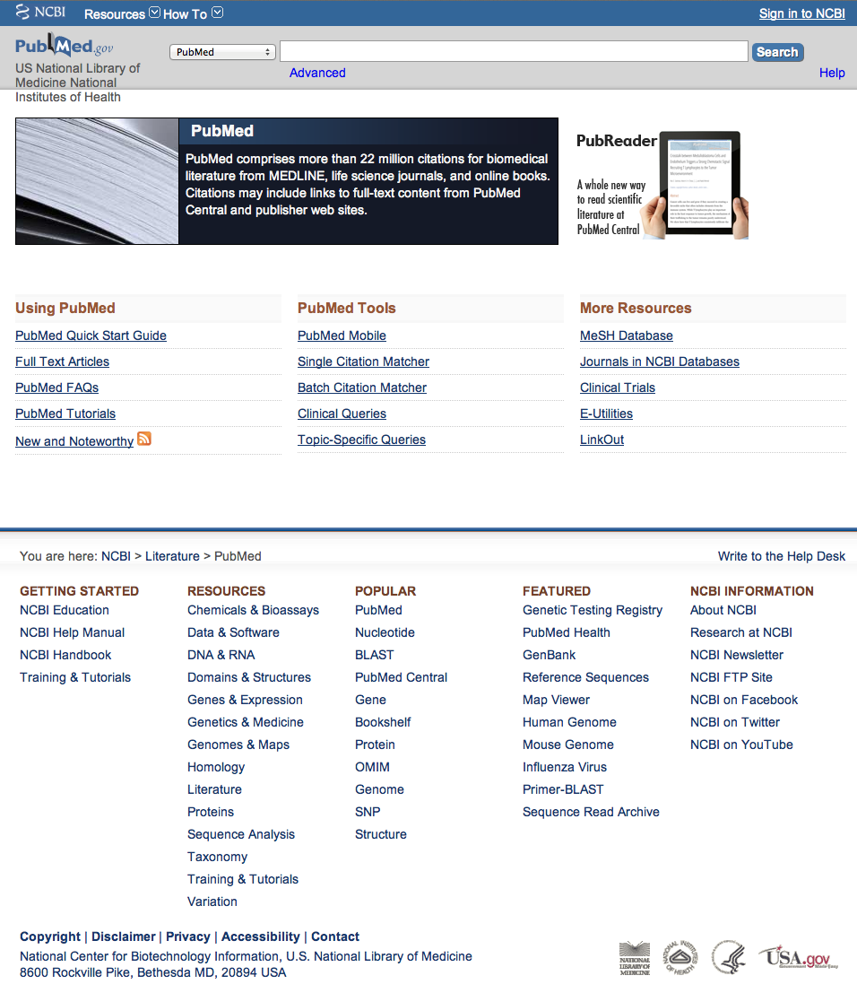
PubMed Home Page

Slide 6
Searching PubMed

Slide 7
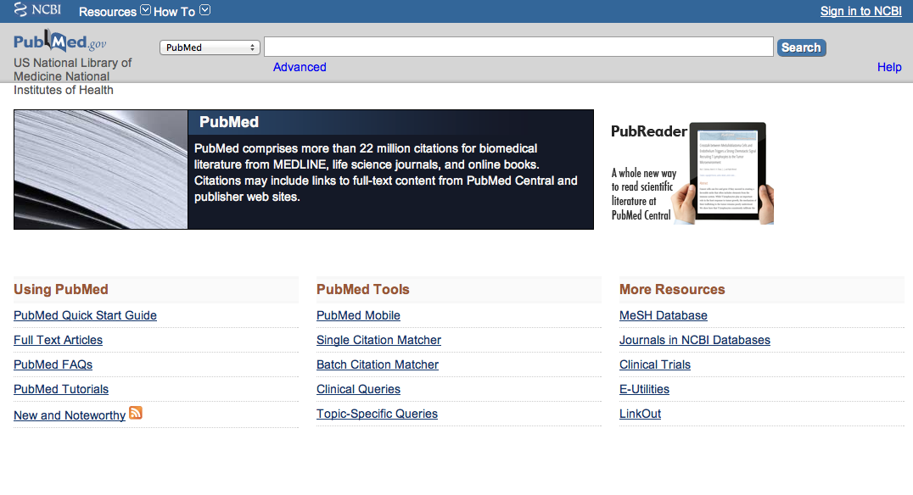
Click MeSH Database

Slide 8
MeSH Database
Terms in the database are called
Medical Subject Headings or MeSH.
is a “controlled vocabulary list” of more than
25,000 subject headings.
10-15 MeSH are assigned to each article
in PubMed.
The MeSH index of 10-15 subject headings
is like a keyword abstract of the article.
MeSH are updated annually in December.

Slide 9
Frequently Used Mesh Categories – 2011
A Anatomy
C Diseases
D Chemicals & Drugs
A1 Body Regions
A2 Musculoskeletal System
A3 Digestive System
A4 Respiratory System
A5 Urogenital System
A6 Endocrine System
A7 Cardiovascular System
A8 Nervous System
A9 Sense Organs
A10 Tissues
A11 Cells
A12 Fluids and Secretions
A13 Animal Structures
A14 Stomatognathic System
A15 Hemic and Immune Systems
A16 Embryonic Structures
A17 Integumentary System
A18 Plant Structures
A19 Fungal Structures
A20 Bacterial Structures
A21 Viral Structures
C1 Bacterial Infections & Mycoses
C2 Virus Diseases
C3 Parasitic Diseases
C4 Neoplasms
C5 Musculoskeletal Diseases
C6 Digestive System Diseases
C7 Stomatognathic Diseases
C8 Respiratory Tract Diseases
C9 Otorhinolaryngologic Diseases
C10 Nervous System Diseases
C11 Eye Diseases
C12 Male Urogenital Diseases
C13 Female Urogenital Diseases
& Pregnancy Complications
C14 Cardiovascular Diseases
C15 Hemic & Lymphatic Diseases
C16 Congenital, Hereditary, &
Neonatal Diseases & Abnormalities
C17 Skin & Connective Tissue Diseases
C18 Nutritional & Metabolic Diseases
C19 Endocrine System Diseases
C20 Immune System Diseases
C21 Disorders of Environmental Origin
C22 Animal Diseases
C23 Pathologic Conditions,
Signs, and Symptoms
C24 Occupational Diseases
C25 Substance-Related Disorders
C26 Wounds and Injuries
D1 Inorganic Chemicals
D2 Organic Chemicals
D3 Heterocyclic Compounds
D4 Polycyclic Compounds
D5 Macromolecular Substances
D6 Hormones, Hormone Substitutes,
& Hormone Antagonists
D8 Enzymes, & Coenzymes
D9 Carbohydrates
D10 Lipids
D12 Amino Acids, Peptides,
& Proteins
D13 Nucleic Acids, Nucleotides,
& Nucleosides
D20 Complex Mixtures
D23 Biologic Factors
D25 Biomedical and Dental Materials
D26 Pharmaceutical Preparations
D27 Chemical Actions and Uses
B Organisms
B1 Eukaryota
B2 Archaea
B3 Bacteria
B4 Viruses
B5 Organism Forms

Slide 10
Other Categories Include:
Analytical, Diagnostic, & Therapeutic Techniques & Equipment
Psychiatry and Psychology
Biological Sciences
Natural Sciences
Anthropology, Education, Sociology & Social Phenomena
Technology, Industry, Agriculture
Information Science
Named Groups
Health Care
Publication Characteristics
Geographic Locations

Slide 11
Create a Search Strategy Plan
Identify the question and key concepts:
alanine or threonine in the
genetics of neoplasms
Write the search program using
medical subject headings (MeSH)

Slide 12
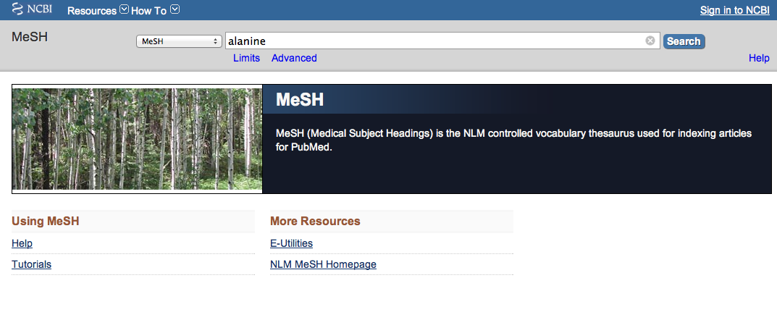
Enter and click a
a
Search
alanine
(Note: If there is a Boolean OR
relationship, start with the
“OR” statement first.)

Slide 13
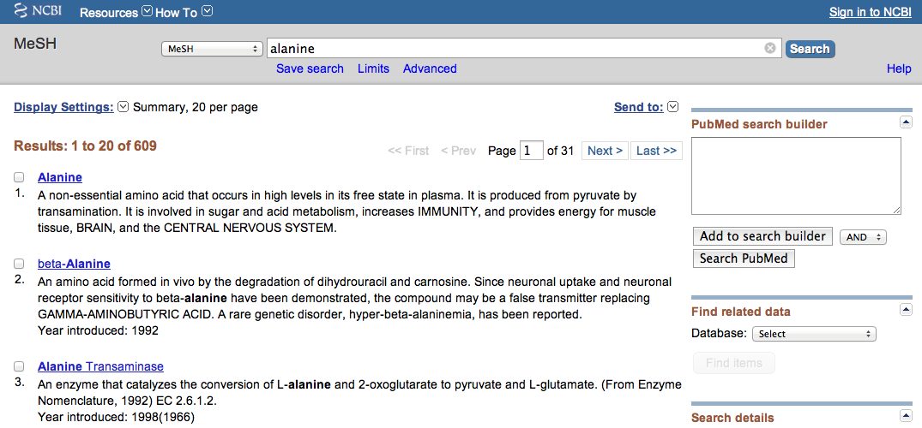
Term Definitions

Slide 14
1) Check the box next
to the MeSH headinga
✔
2) Then click
Add to search builder

Slide 15
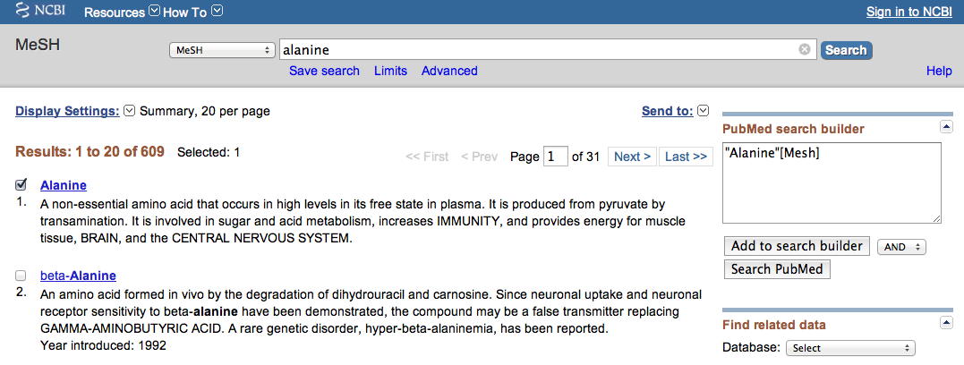
MeSH
The first term is in
the search program “box”

Slide 16

Enter and click a
a
Search
threonine
(Note: If there is a Boolean OR
relationship, start with the
“OR” statement first.)

Slide 17
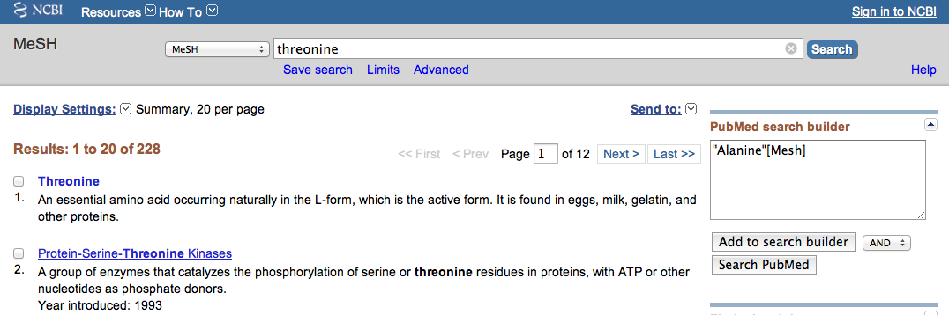
1) Check the box next
to the MeSH headinga
2) Select
OR
✔
OR
3) Then click
Add to search builder

Slide 18
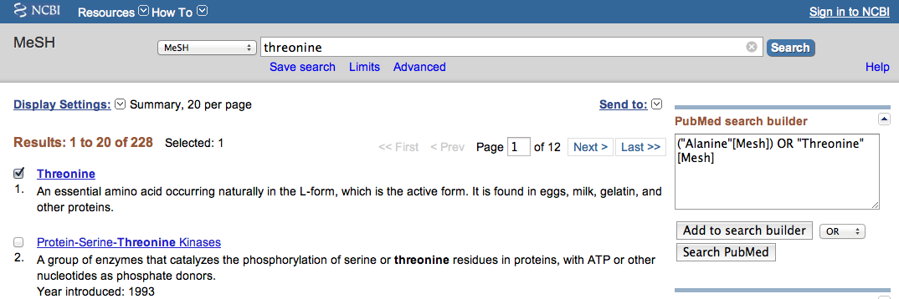
MeSH
The second term is in
the search program “box”

Slide 19
Boolean Logic - OR
alanine
threonine
OR

Slide 20

a
a
Enter
neoplasms
and click
Search

Slide 21
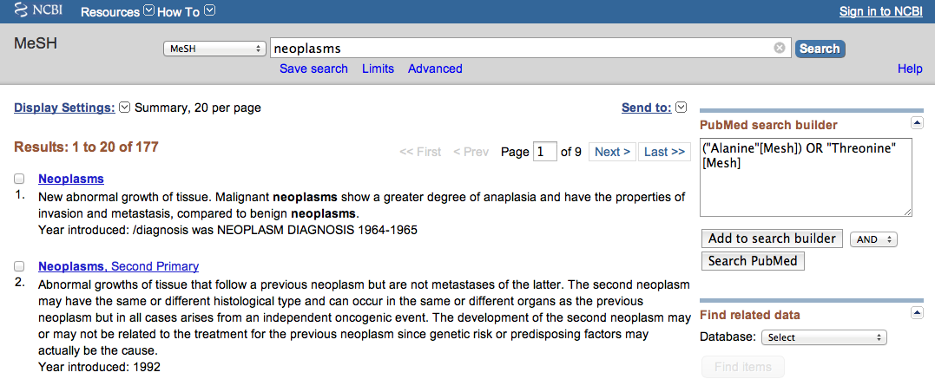
Click the underlined term

Slide 22
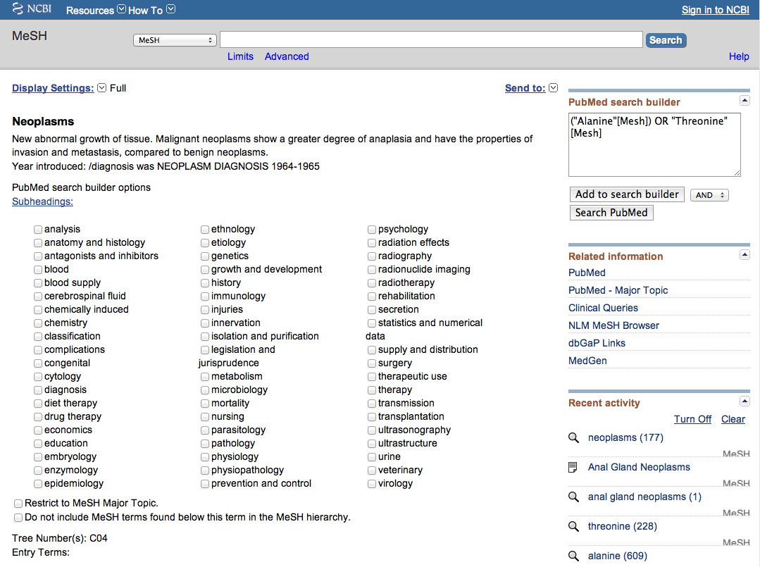
Scroll screen down to view…

Slide 23
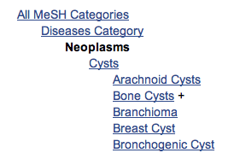
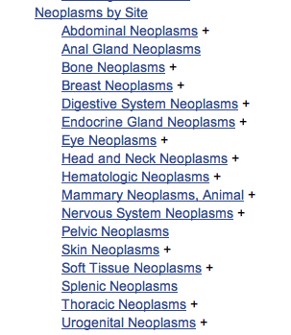
terms arranged in
tree structure hierarchy
MeSH
Terms are listed from
broadest to narrowest.
If Abdominal Neoplasms
yields zero results, try using a
broader term: Neoplasms by Site.

Slide 24
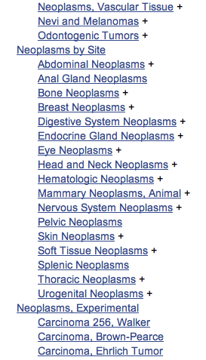

Note:
PubMed automatically
OR’s indented terms
under a broader term…
… unless you select
the following command
☑

Slide 26
Sub-headings narrow the “meaning” of a
MeSH term.
M They are a “subset” of all the
articles under the MeSH term: Neoplasms.

Slide 27
embryology physiology
abnormalities enzymology physiopathology
administrations & dosage epidemiology poisoning
adverse effects ethics prevention & control
agonists ethnology psychology
analogs & derivatives etiology radiation effects
analysis radiography
anatomy & histology genetics radionuclide imaging
antagonists & inhibitors radiotherapy
biosynthesis growth & development rehabilitation
blood history secondary
blood supply immunology secretion
cerebrospinal fluid injuries standards
chemical synthesis innervation statistics & numerical data
chemically induced instrumentation supply & distribution
chemistry isolation & purification surgery
classification legislation & jurisprudence therapeutic use
complications manpower therapy
congenital metabolism toxicity
contraindications methods transmission
cytology microbiology transplantation
deficiency mortality trends
diagnosis nursing ultrasonography
diagnostic use organization & administration ultrastructure
diet therapy parasitology urine
drug effects pathogenicity utilization
drug therapy pathology veterinary
economics pharmacokinetics virology
education pharmacology
83 SUBHEADINGS:

Slide 28
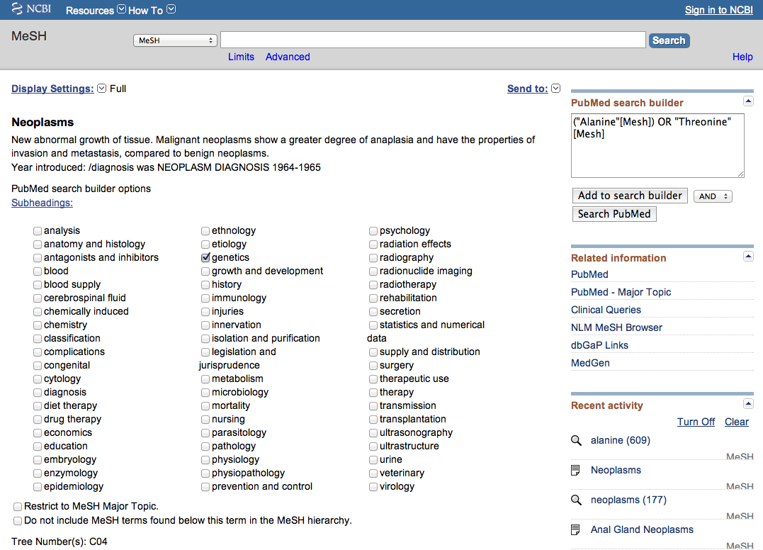
2) Select
AND
✔
1) Check the box next
to the subheadinga
3) Then click
Add to search builder

Slide 29
Boolean Logic - AND
alanine
OR
threonine
neoplasms/
genetics
and

Slide 30
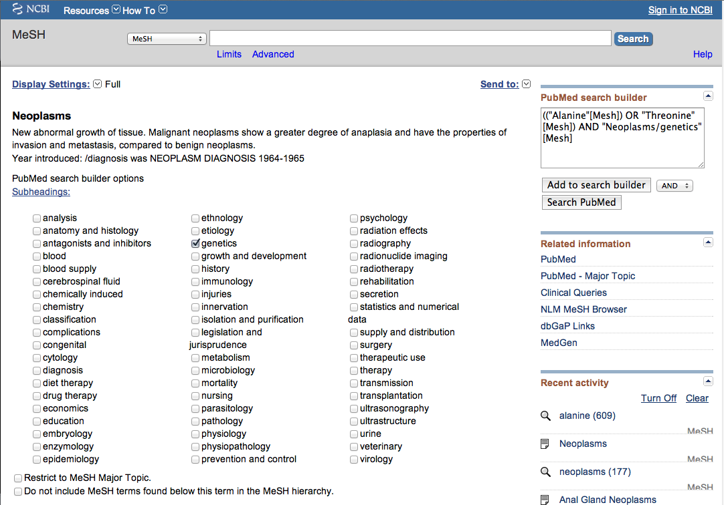
The search program is complete.
Click
Search PubMed

Slide 31
Search Results

Slide 32
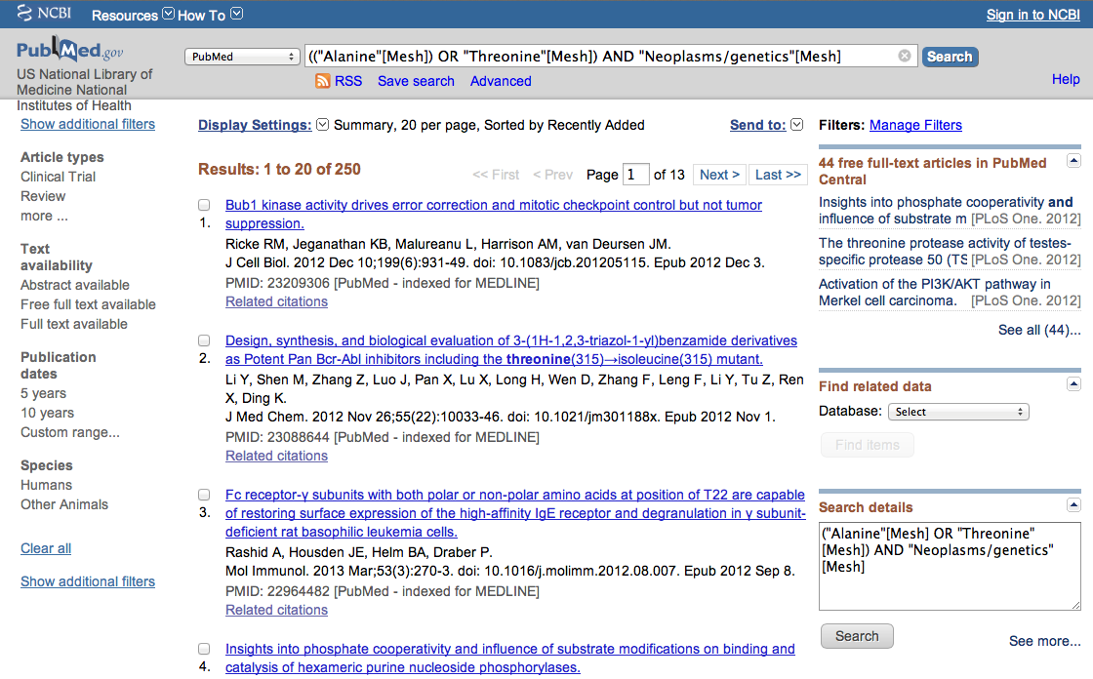
PubMed identifies
250 articles

Slide 33
Limiting Filters

Slide 34
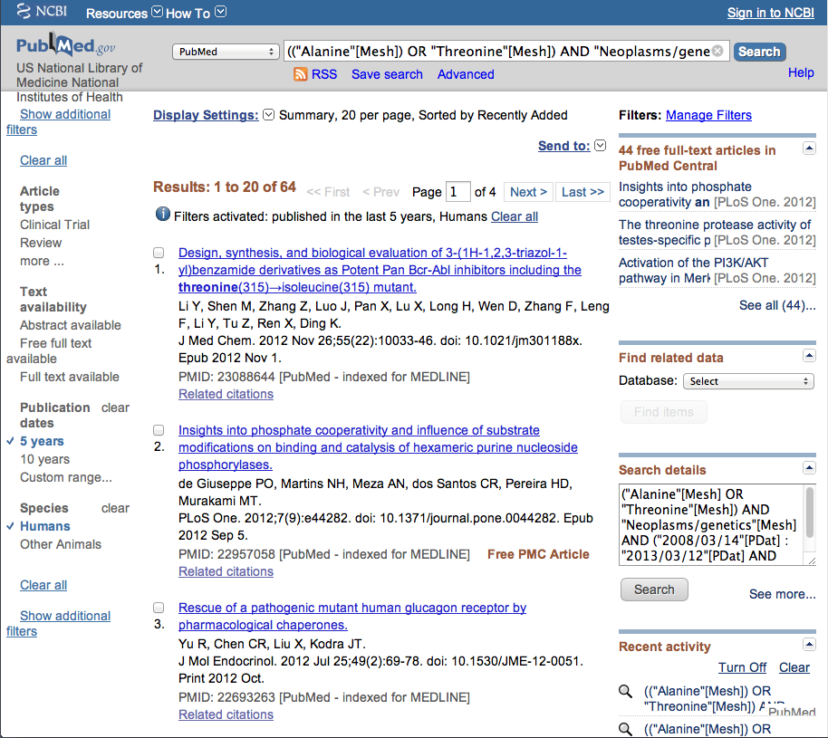
Limit to articles that are
human studies and
written in the past 5 years by
clicking the selections on the left.
Selections will turn blue: ✓ 5 years

Slide 35
Then Click
Show additional filters

Slide 36
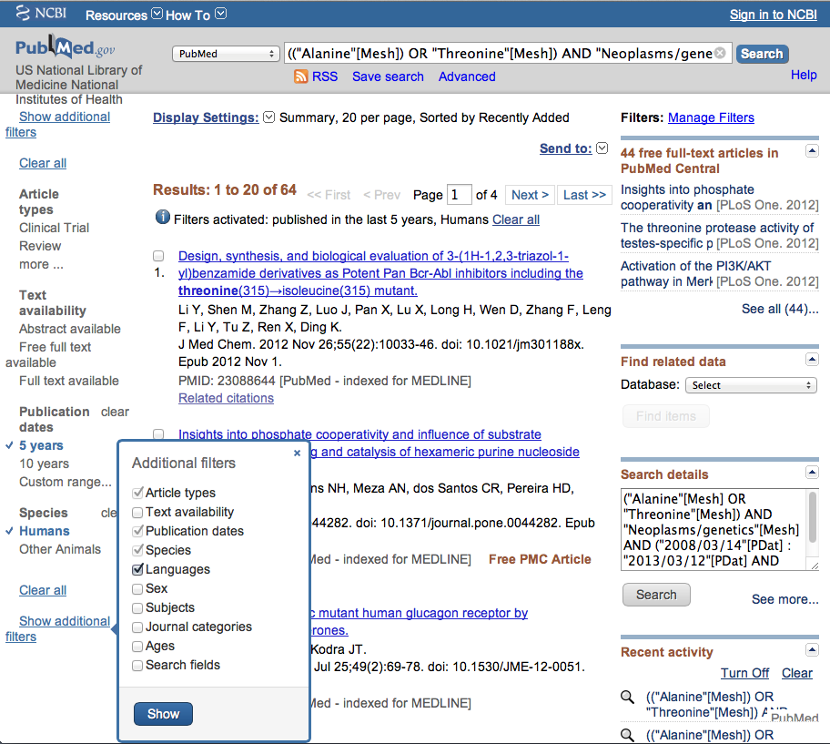
Filters include:a
A
Article types
Text availability
Publication date
Species such as:
(human or animal)
Languages
Sex
Subjects
Journal categories
Ages
Search fields

Slide 37
De-select limits
you do not wish
to use.
Then select
Languages and
click
Then select
Languages and
click
✔
Show
Show

Slide 38
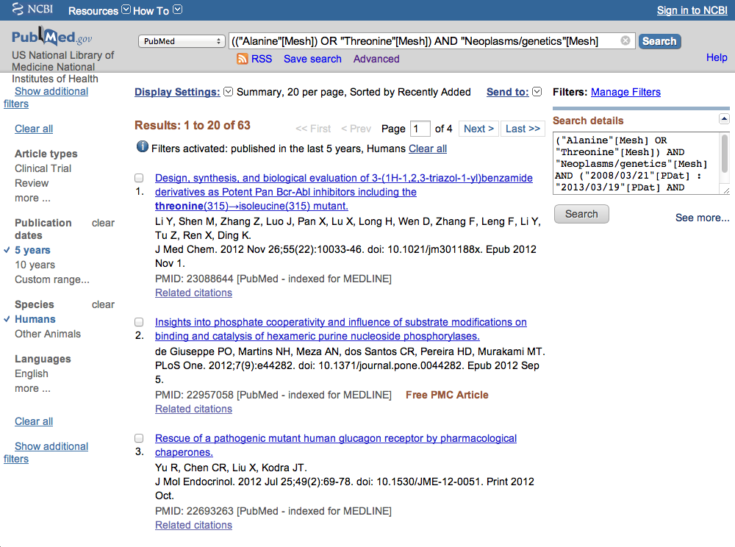
Click English

Slide 39
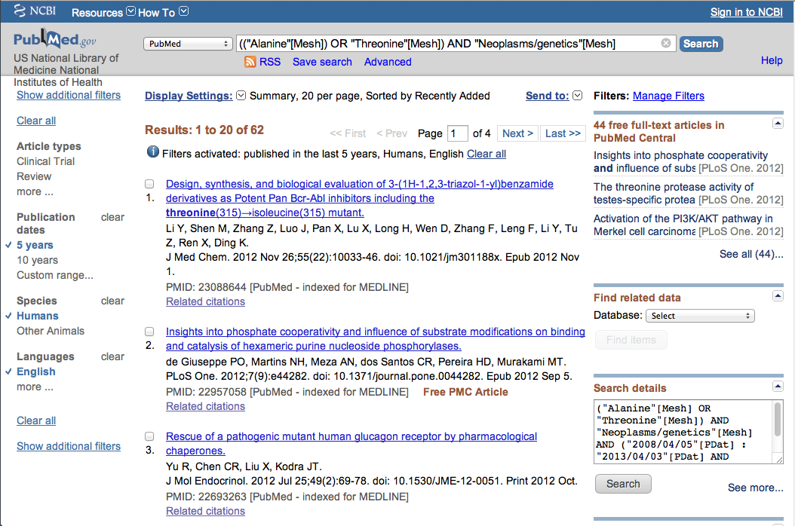
Limits are now activated!

Slide 40
Results are reduced
From 250 to 62

Slide 41
X
Select article #2.

Slide 42
Click Display Settings

Slide 43
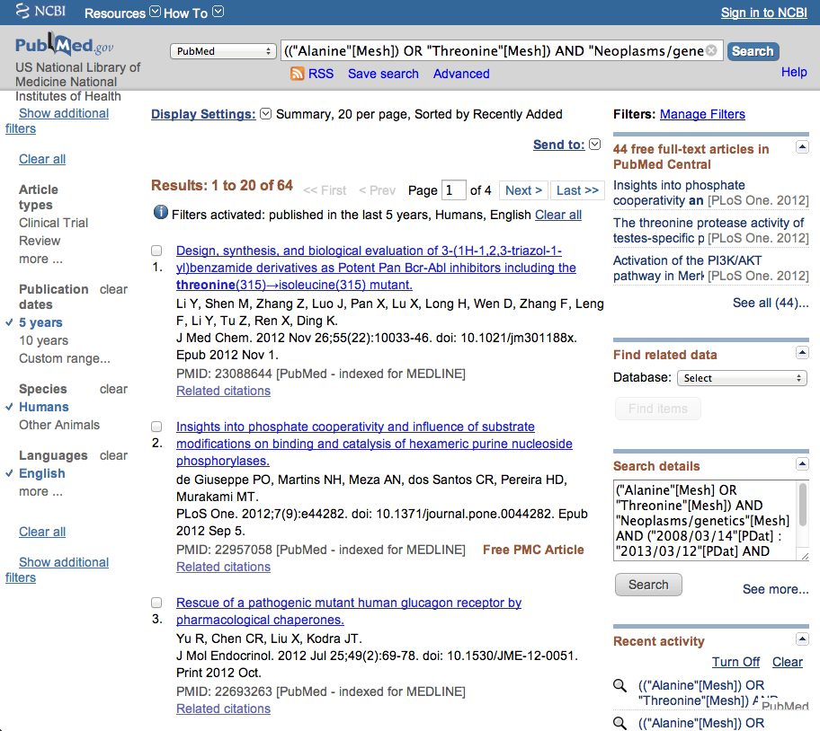
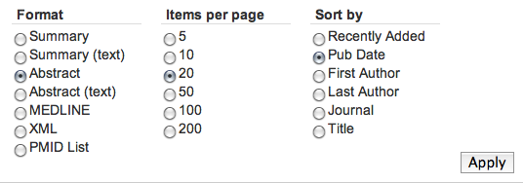
Select Abstract,
change to Pub Date to
sort to most recent articles appearing first,
then click
Apply

Slide 44
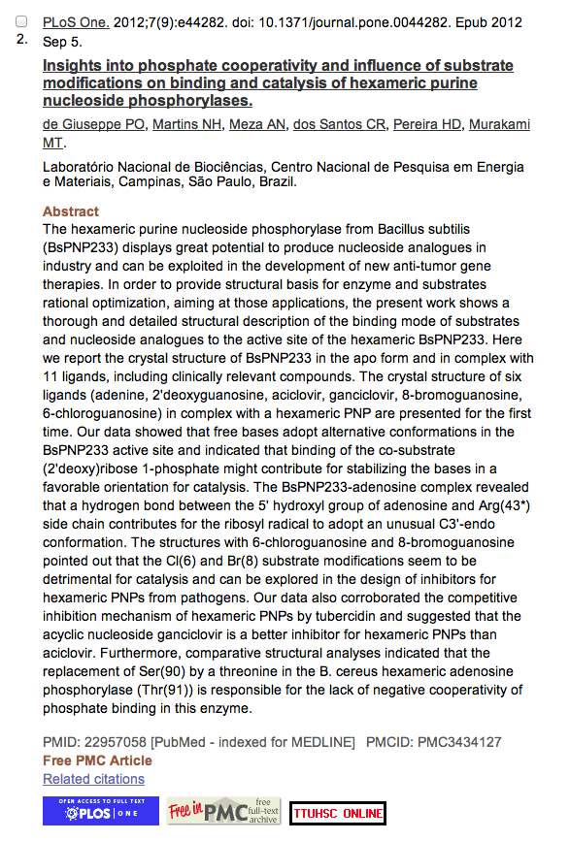
Icons for full text.

Slide 45
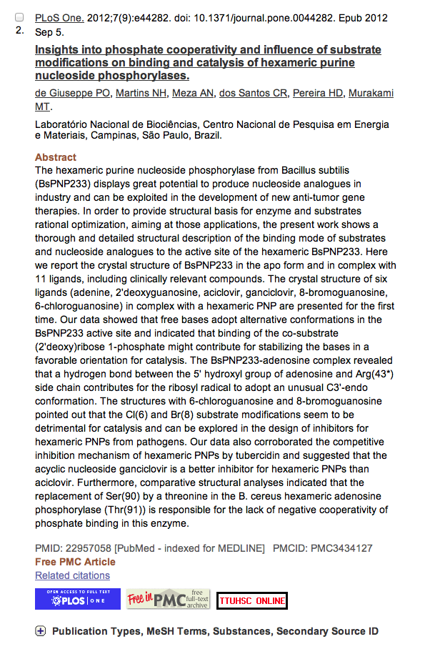
Click for MeSH terms.
+

Slide 46
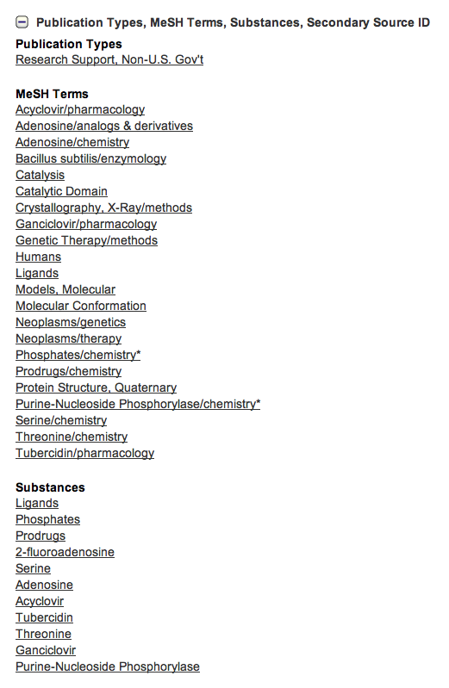
MeSH Database
searches only
the MeSH terms for:
alanine
OR
threonine
AND
neoplasms/genetics

Slide 47
Look at subject headings
in the
MeSH Terms Index
for additional terms.
You may want to
write a new search
program using:
Genetic Therapy

Slide 48
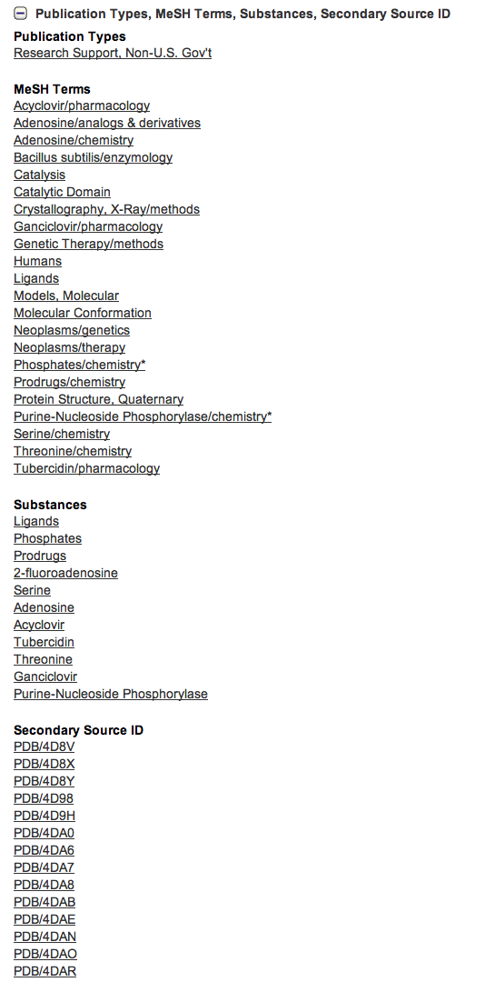
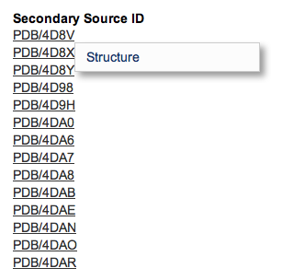
Links from this record
to NCBI databases.
Click Structure.

Slide 49
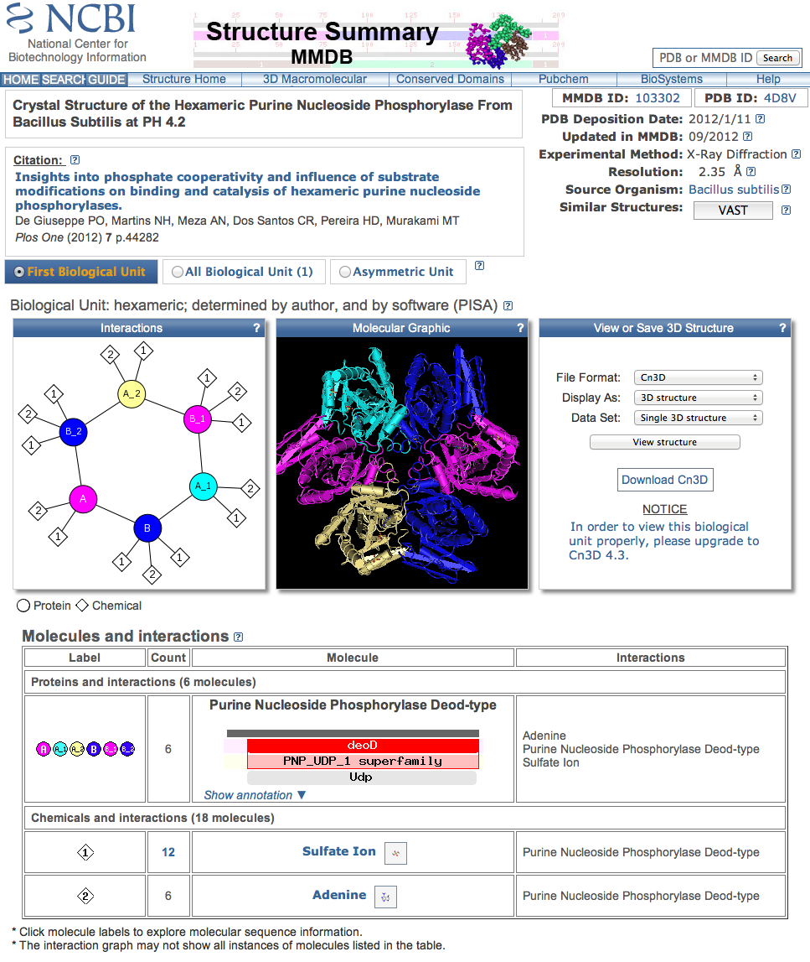
Entrez Structure record
Click the back button.

Slide 50
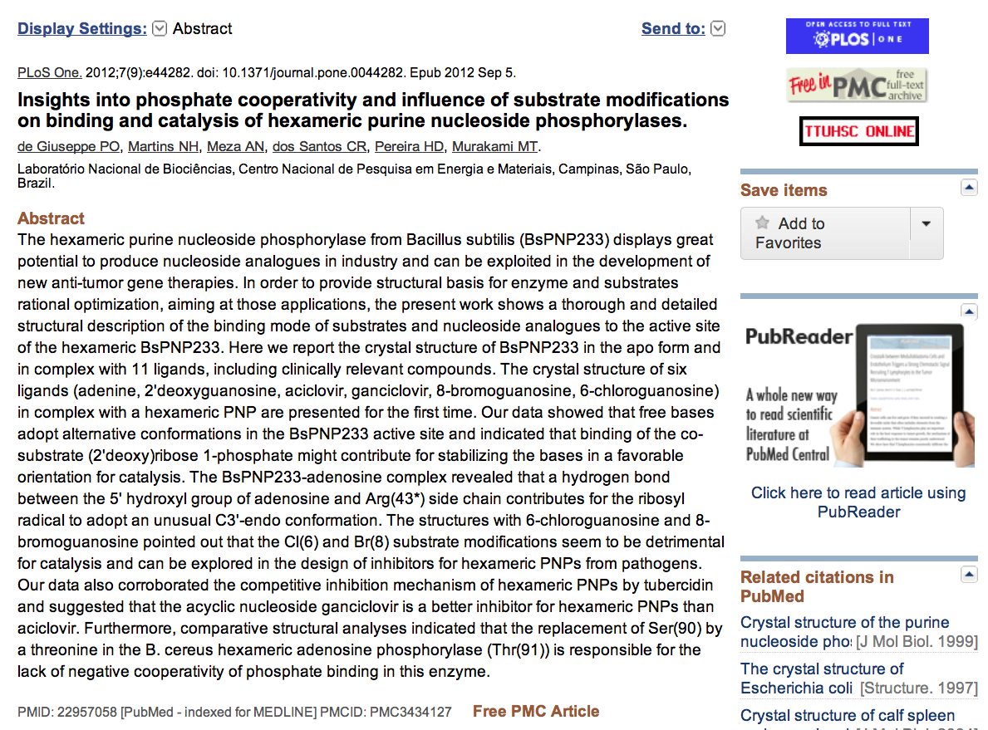
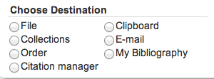
.
Click Send to: and select
File to save citations to a file on your computer or
Clipboard to temporarily store selected citations or
E-mail to send citations to self or colleague

Slide 51
…or click icon for full text.

Slide 52
Linking to
Full-Text Articles
in Electronic Journals

Slide 53
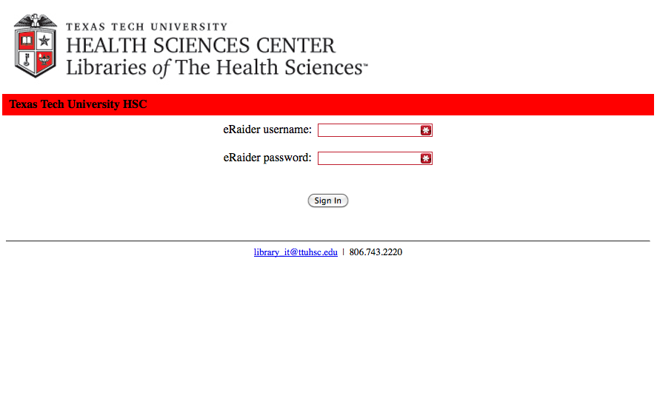
When Searching from Off Campus:
Enter the
Eraider username and password
assigned to you
by Information Services.
A
Problems with eRaider? Call: 806-743-1234 a

Slide 54
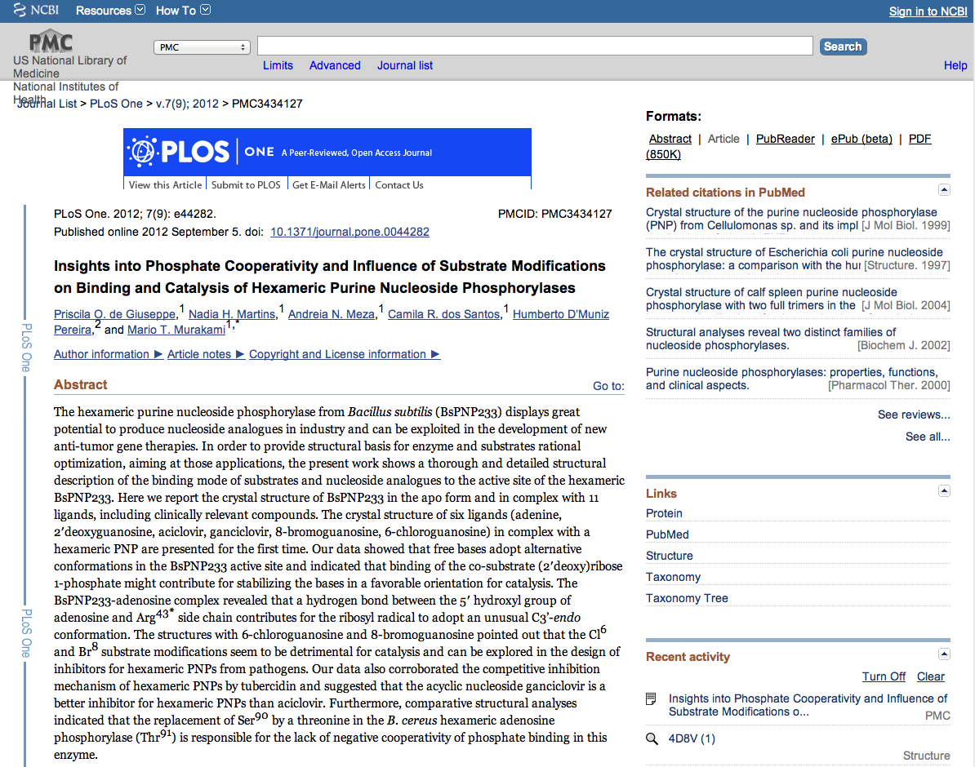
Click PDF

Slide 55
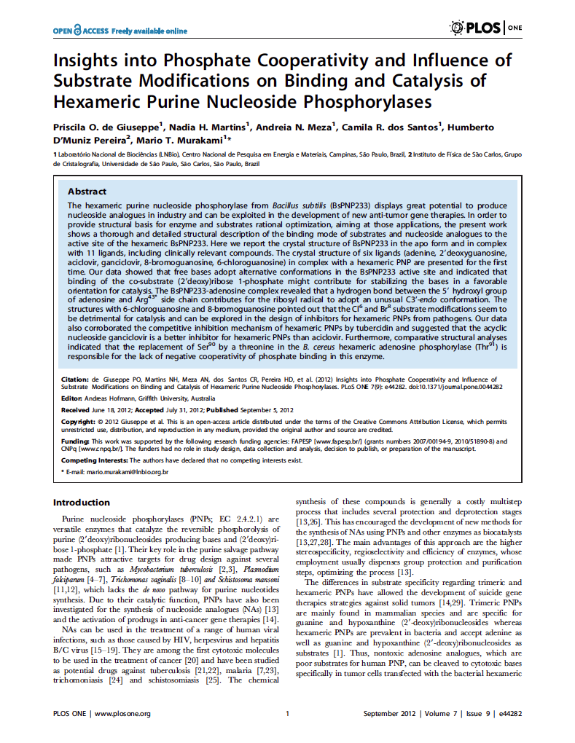
Full Text Article
Close Article

Slide 56
Other Searching Featuresa
a
    MeSH, phrase, & title word searching
    Truncation

Slide 57
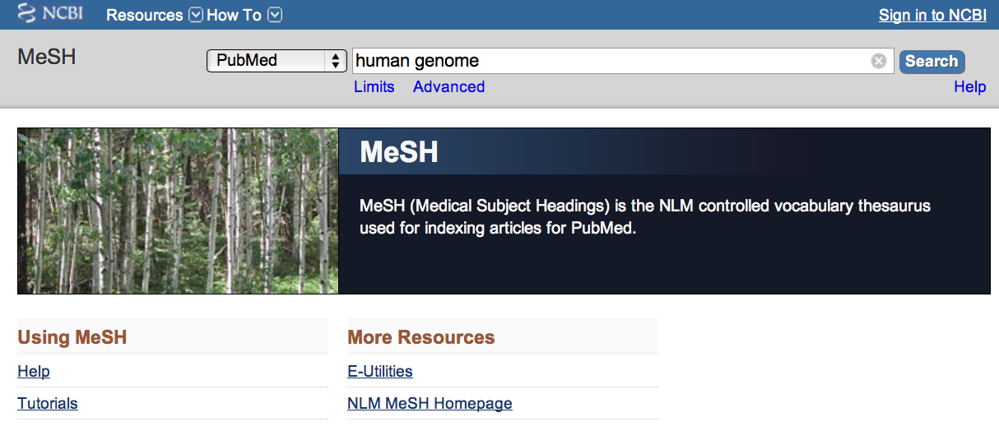
Enter and click a
a
Search
human genome

Slide 58
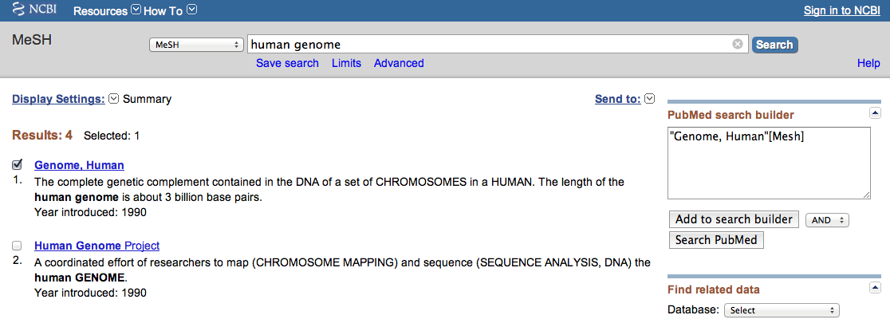
2) Select
1) Check the box next
to the MeSH heading
AND
✔
3) Then click
Add to search builder
Click
Search PubMed

Slide 59
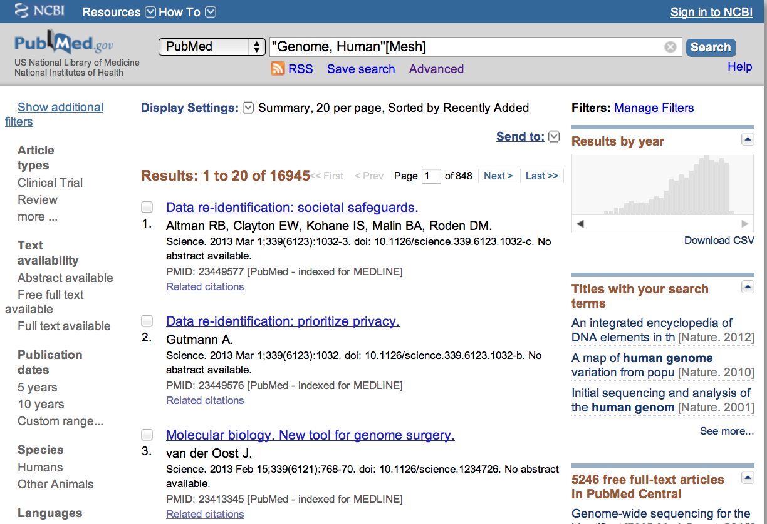
PubMed identifies
16945 articles

Slide 60
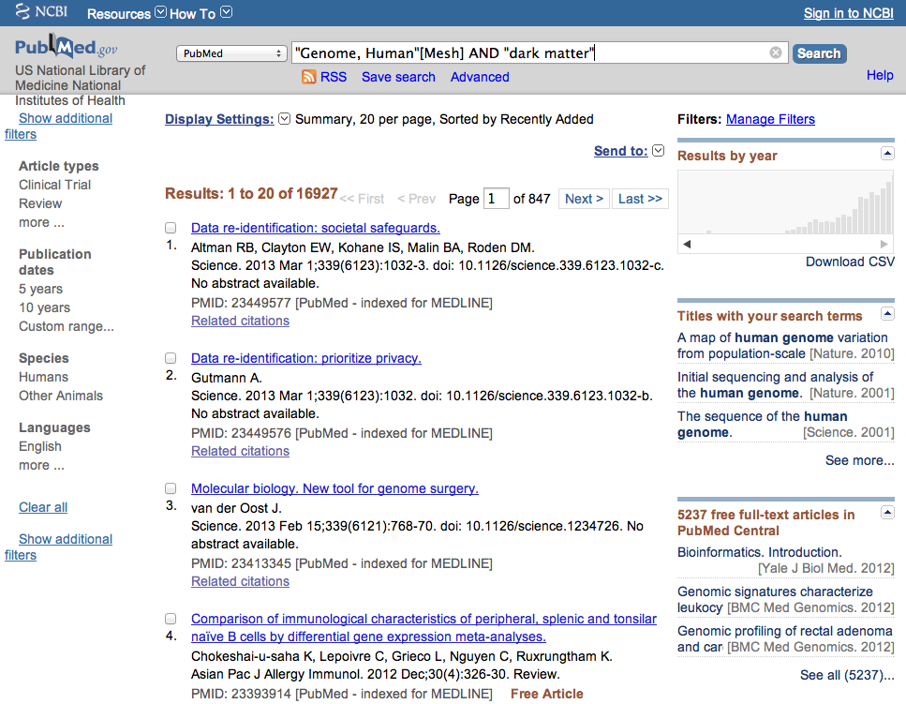
Enter and click
Search
AND “dark matter”

Slide 61
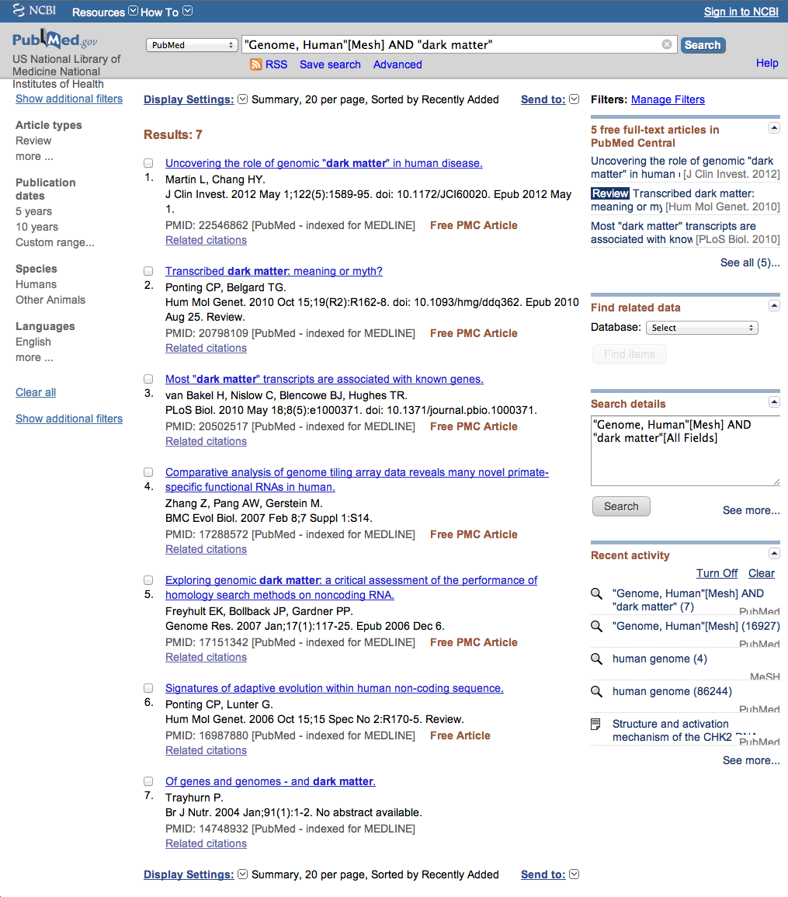
PubMed identifies
7 articles

Slide 62
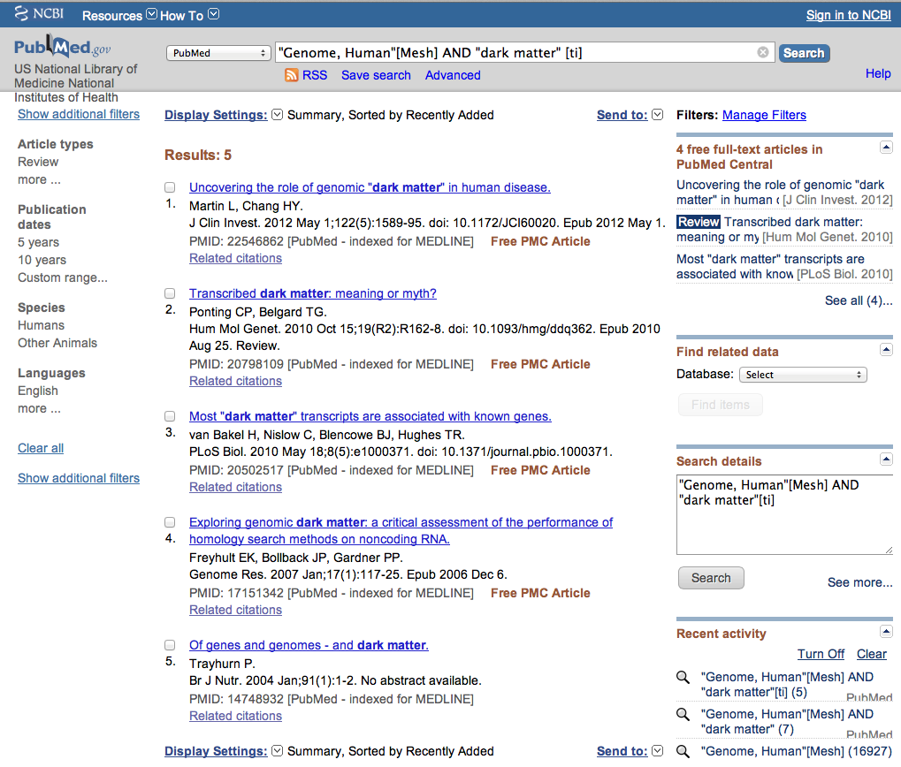
Enter and click
Search
“dark matter” [ti]

Slide 63
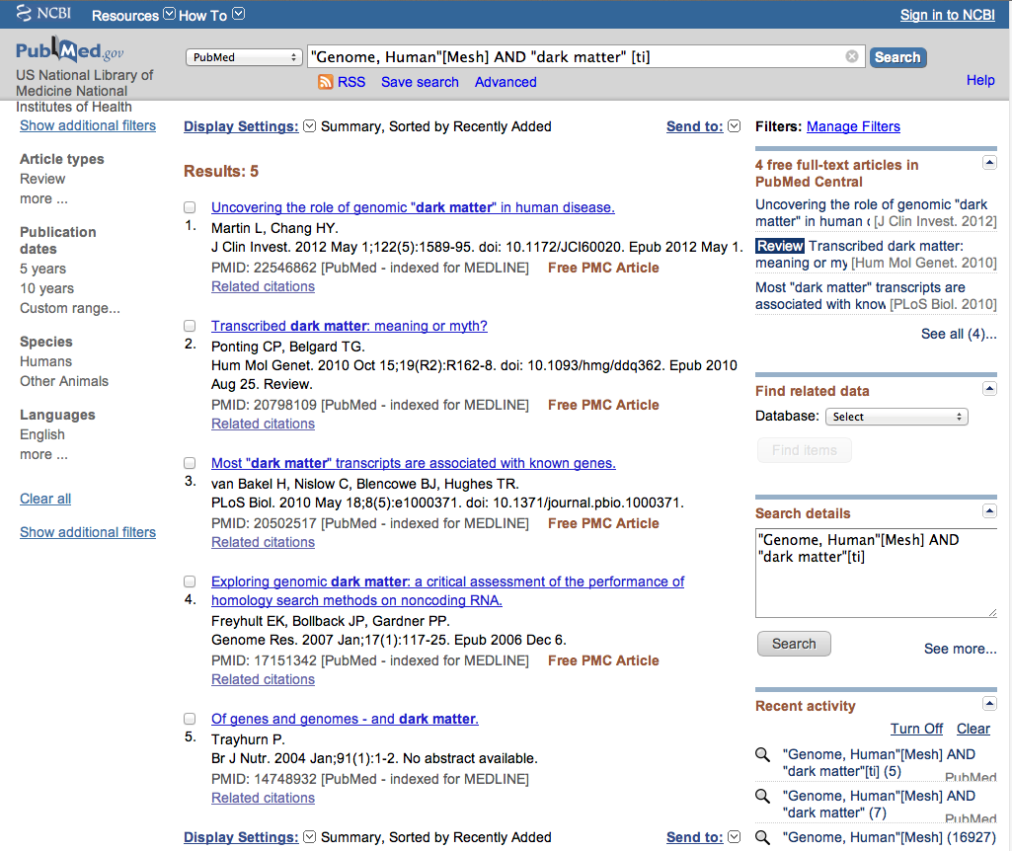
Results are narrowed to 5

Slide 64
Truncation

Slide 65
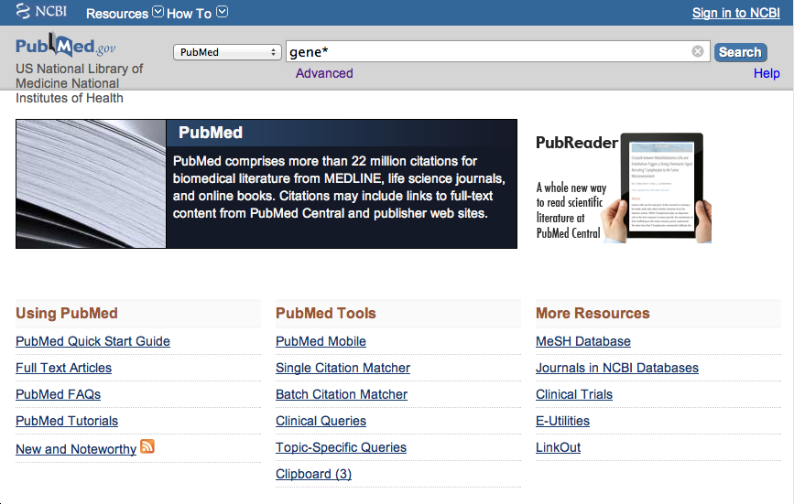
Enter gene* to truncate.

Slide 66
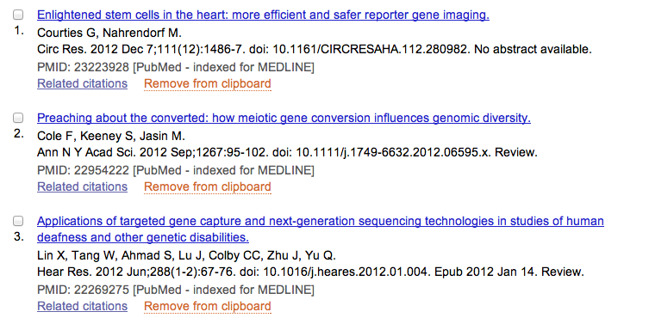
PubMed locates:
gene
genomic
generation

Slide 67
Online Tutorial

Slide 68
Click Training & Tutorials for hands-on learning.

Slide 69

Please contact us at:
Lubbock
(806) 743-2200
Amarillo
(806) 354-5448
El Paso
(915) 545-6652
Odessa
(432) 335-5171

Slide 70
The End

