Slide 1
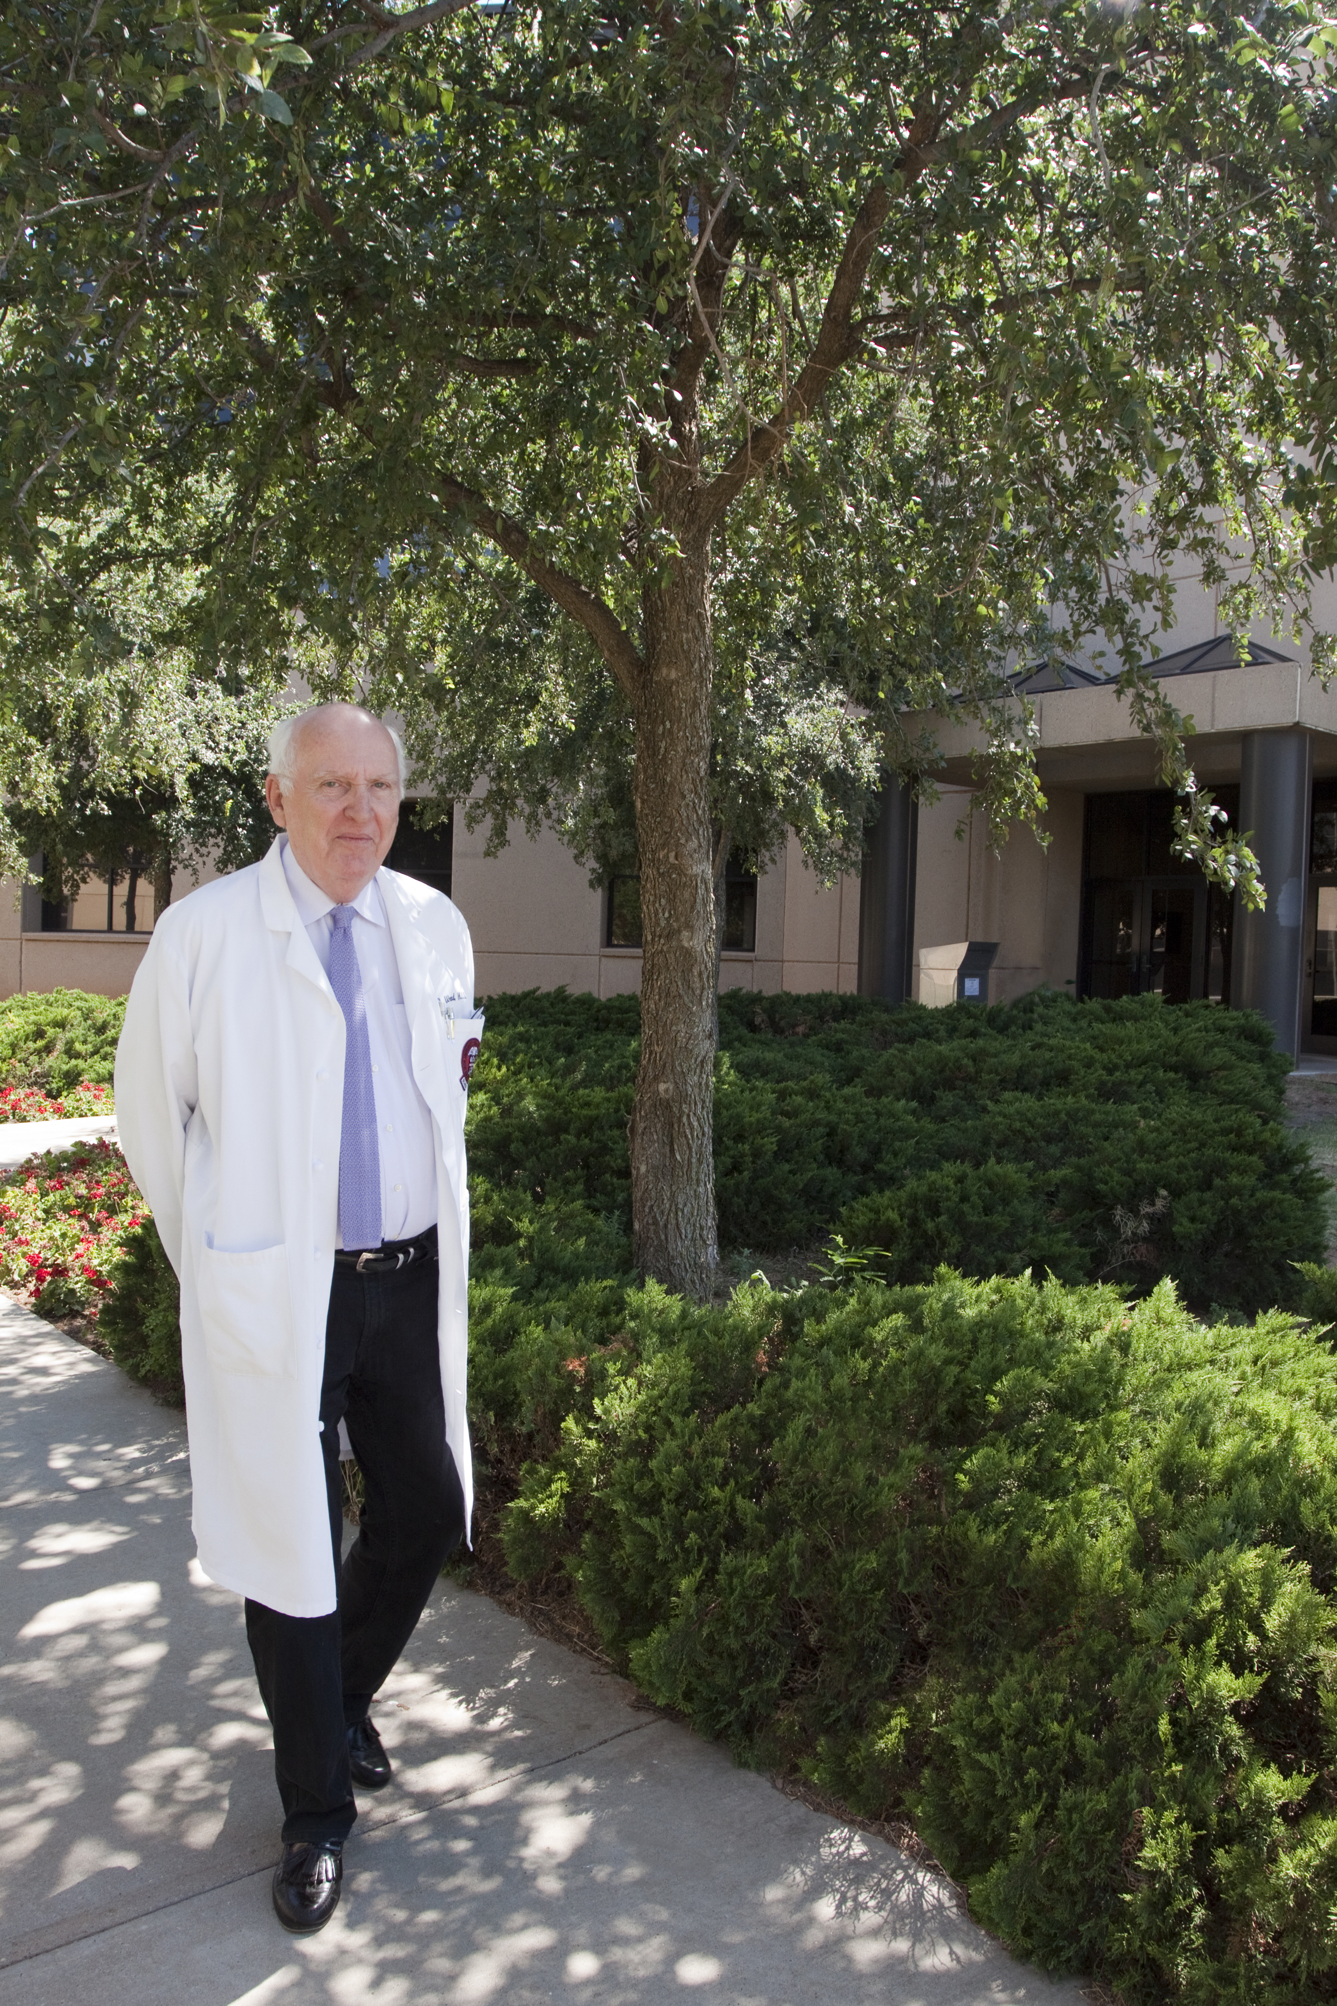
We look forward to seeing YOU
at the
Library!
Richard Wood MLS
Executive Director of Libraries

Slide 2
Welcome
The Preston Smith Library of the Health Sciences

Slide 3
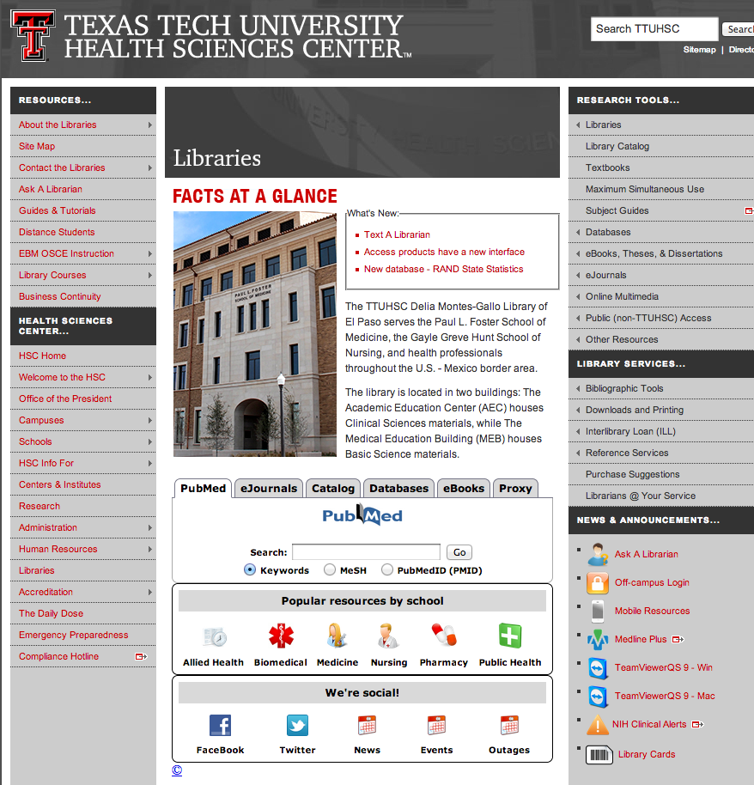
Please
pull out
from your
packet! or
http://www.ttuhsc.edu/libraries

Slide 4
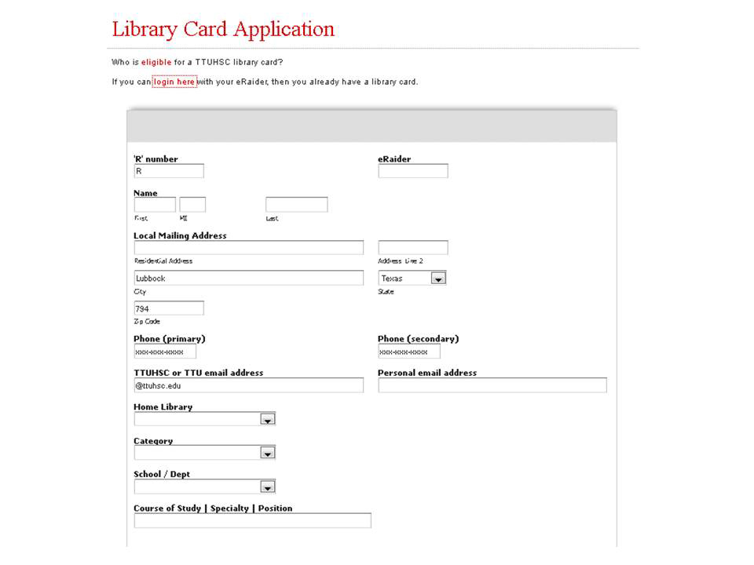

Slide 5
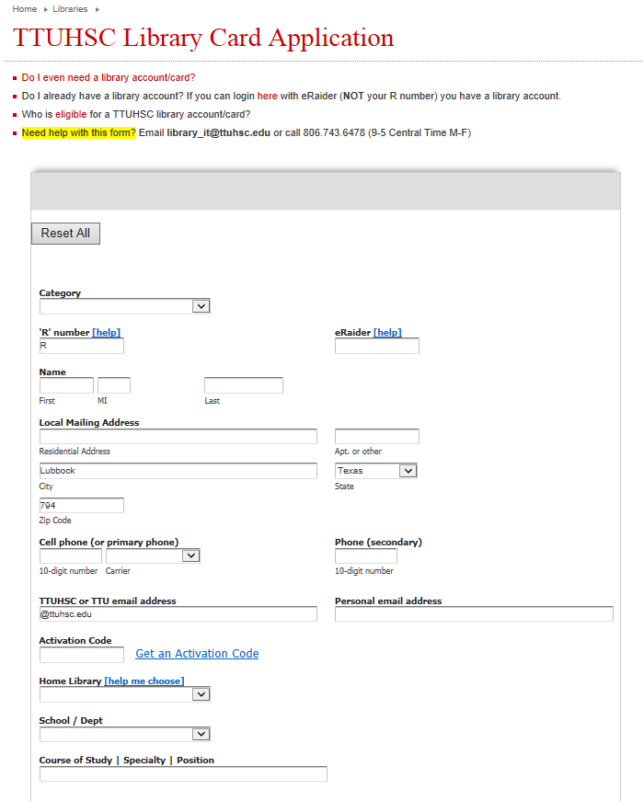
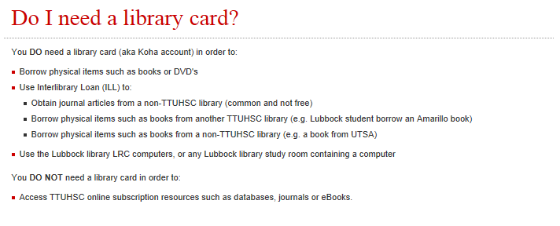
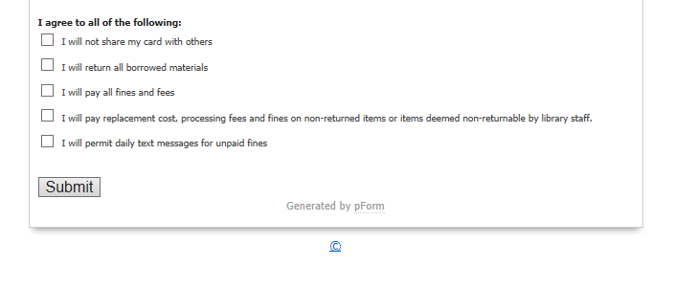
Library card application
• If you only have a cell phone,
repeat number in 2ndary phone space

Slide 6
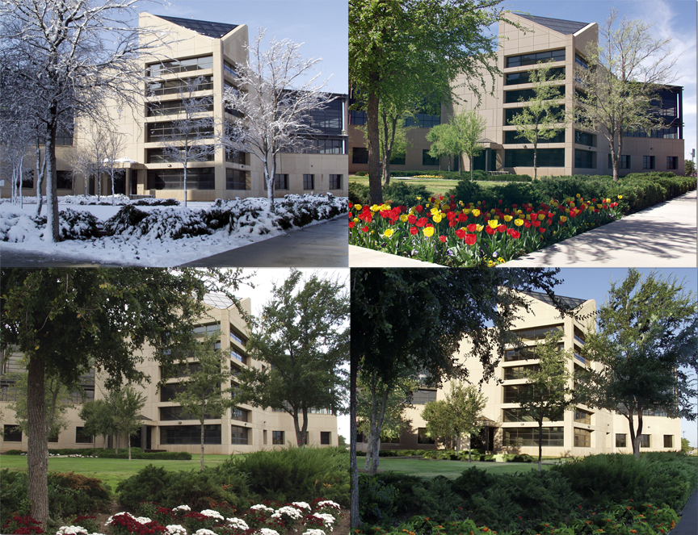
3601 4th just West of the main TTUHSC buildings and in front of E1 Parking Lot
24hr access
is provided
via your badges…
…for emergency
needs
Where?

Slide 7
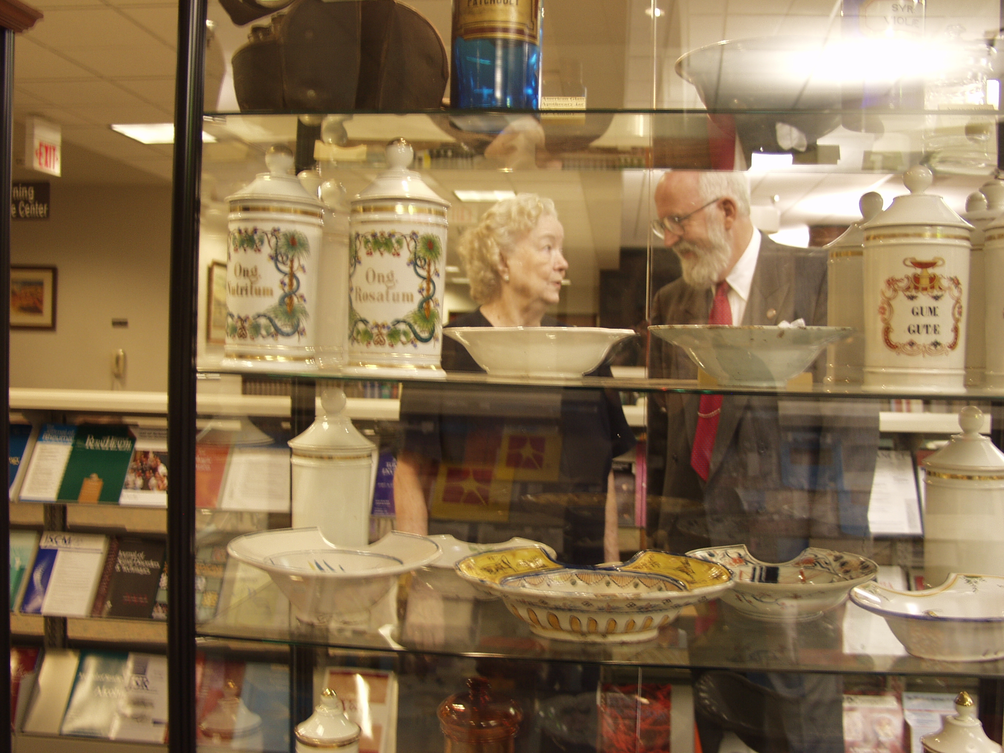

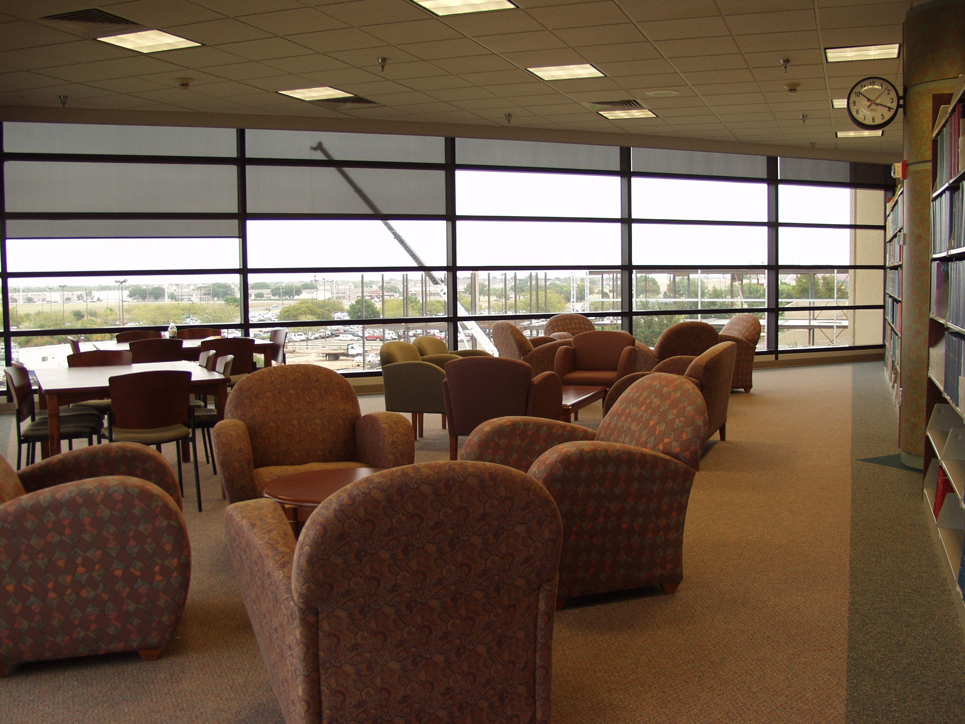

Slide 8
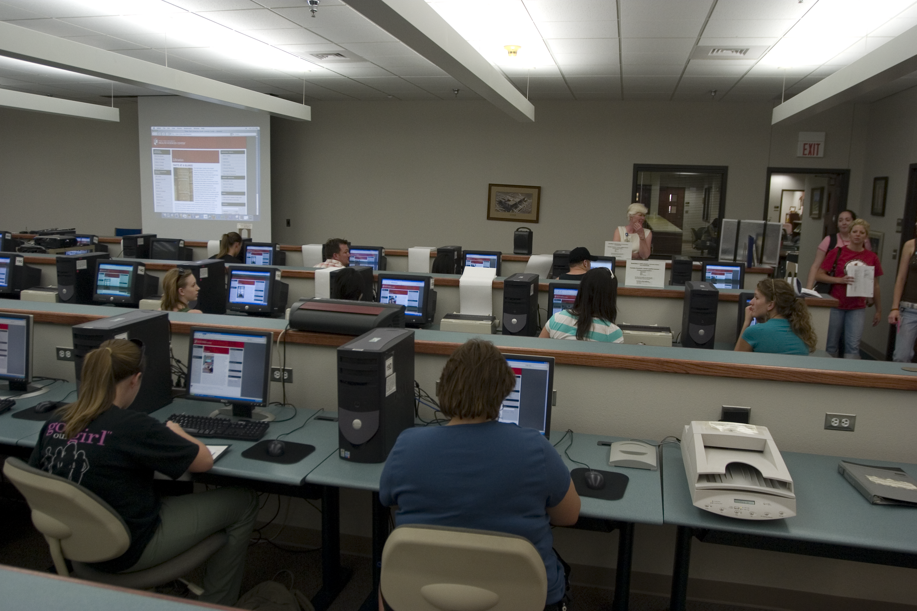
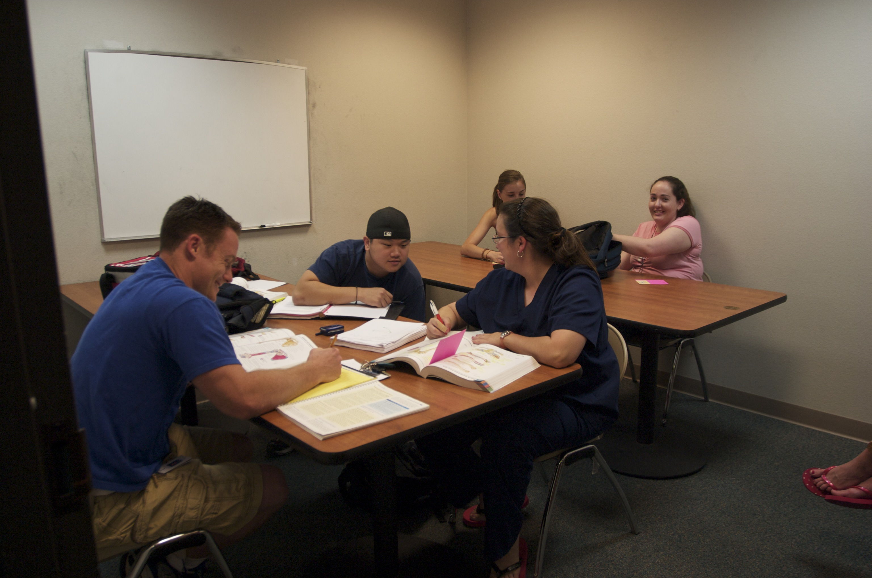

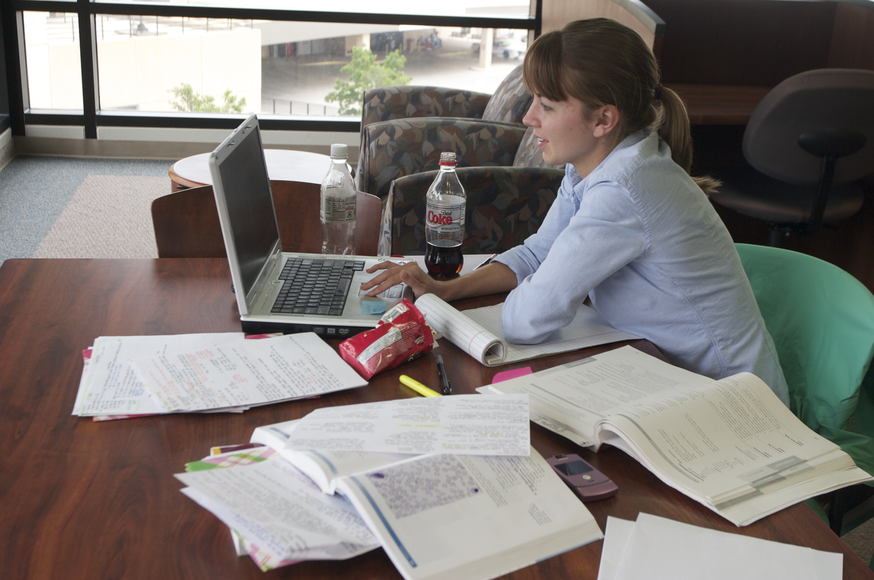
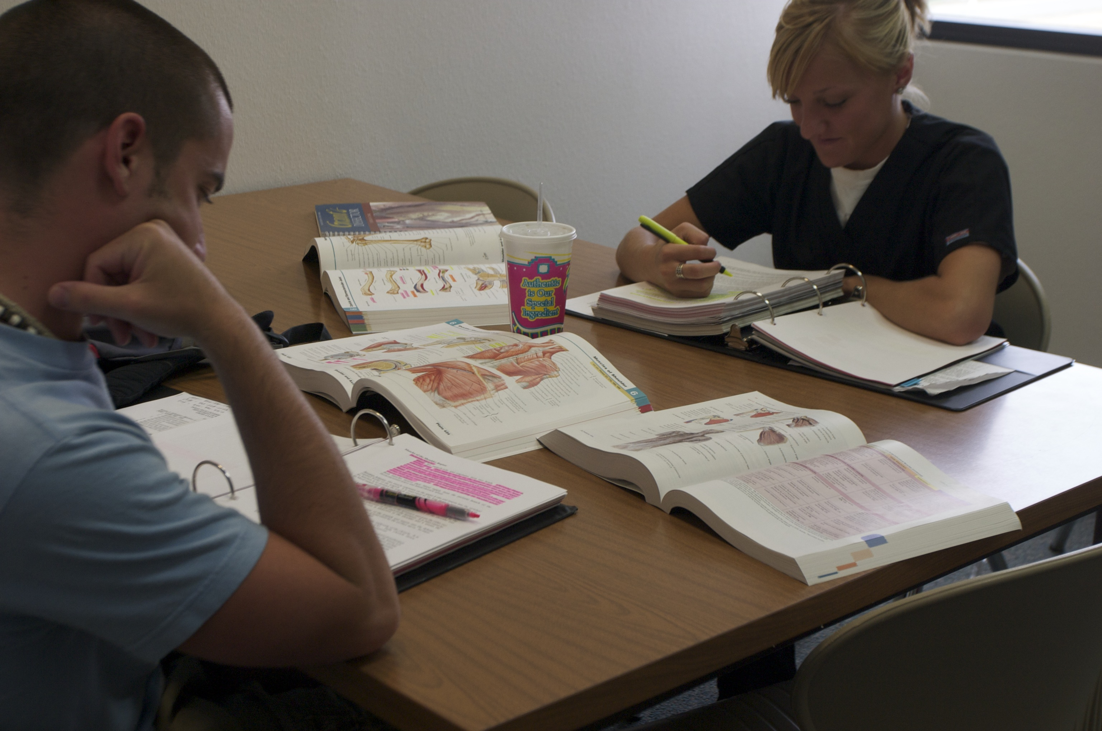

Slide 9


TTUHSC libraries statistics
There are libraries at all four campuses
(Amarillo, El Paso, Lubbock & Odessa)
321,147 print books
209 print journal subscriptions
17,446 audiovisuals
28,751 electronic journals
612 databases
55,182 electronic books
As of April 29, 2014

Slide 10

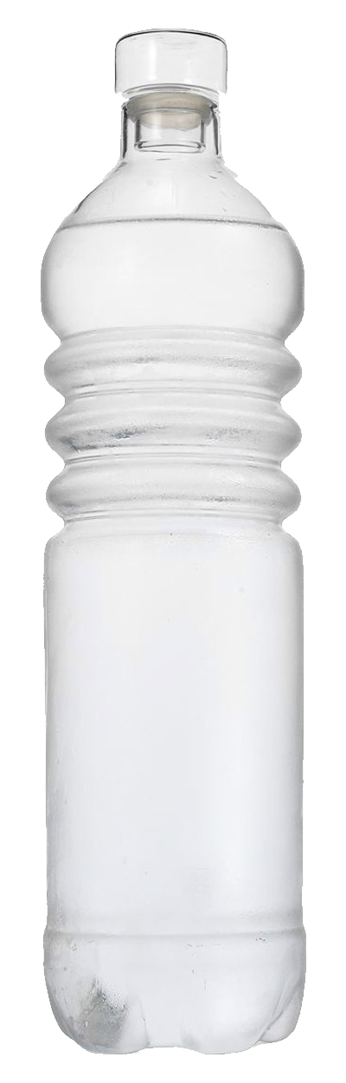


Eat, drink and be merry!
Please
Clean Up… Thank YOU!

Slide 11

Need Help?
from library homepage
mylibrary@ttuhsc.edu
806-743-2200

Slide 12

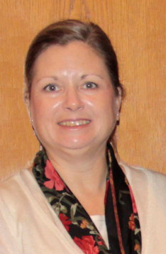

Reference Librarians
Available on 2nd floor of library, across from circulation and reading room area
8am–5pm
Monday–Friday
Jennifer Teichelman
Peggy Edwards
Micah Walsleben
Margaret Vugrin
Notes:
These are the Reference Librarians at the Lubbock campus. Our office hours are Monday – Friday 8:00am – 5:00pm Central Time. Feel free to give us a call or send us an e-mail! We will be happy to help you.

Slide 13
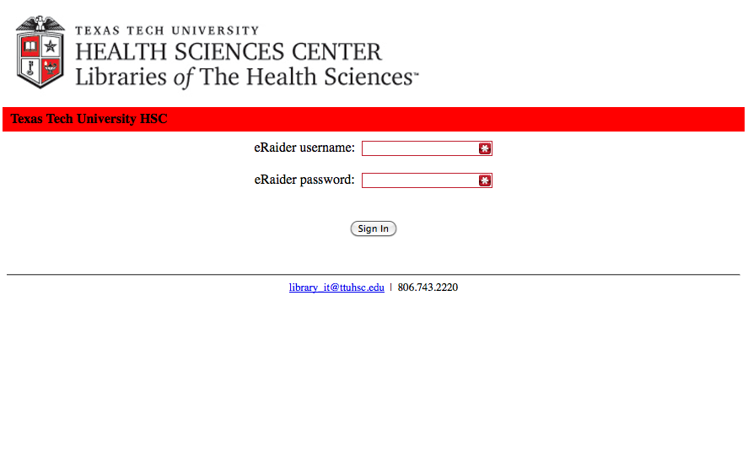
Proxy server
(off campus)
eRaider Username eRaiderPassword

Slide 14
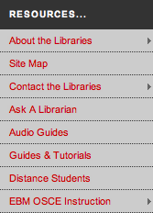
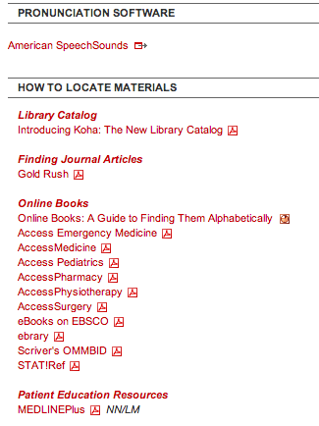
Upper
Left

Slide 15
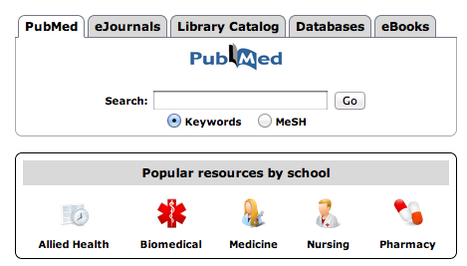
Databases = 600+

Slide 16
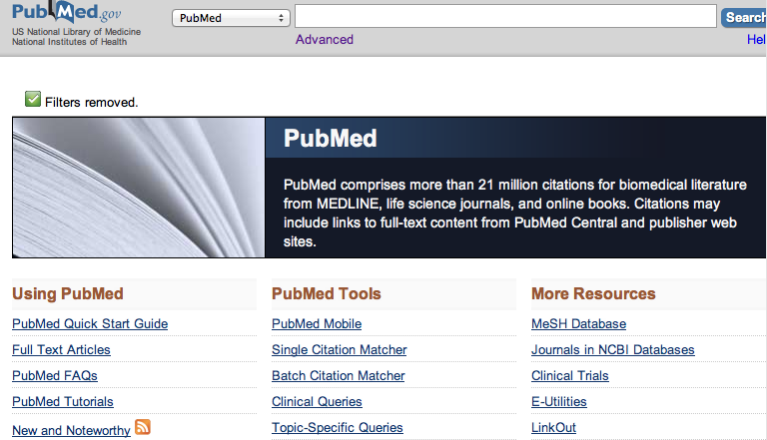
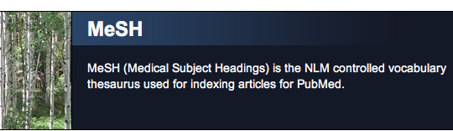

Slide 17
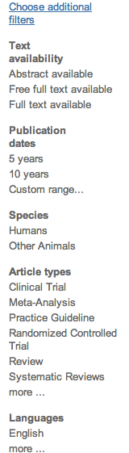
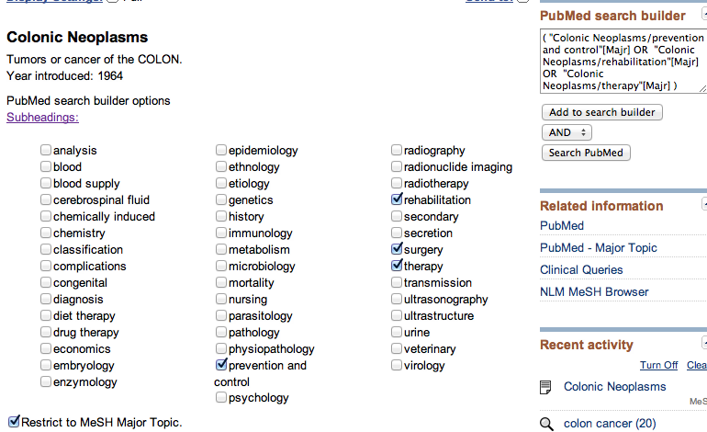
Why MESH?
Colon Cancer (Keyword) Results: 107,714
Colonic Neoplasms + 4 subheadings + Major concept = Results: 14,653

Slide 18

Follow these links to PDFs
PAPER
Visible in PubMed: Abstract format ONLY

Slide 19
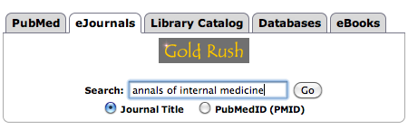
How to locate articles?
Gold Rush –
Most complete record
of TTUHSC Journals
Have your citation before you start looking!

Slide 20
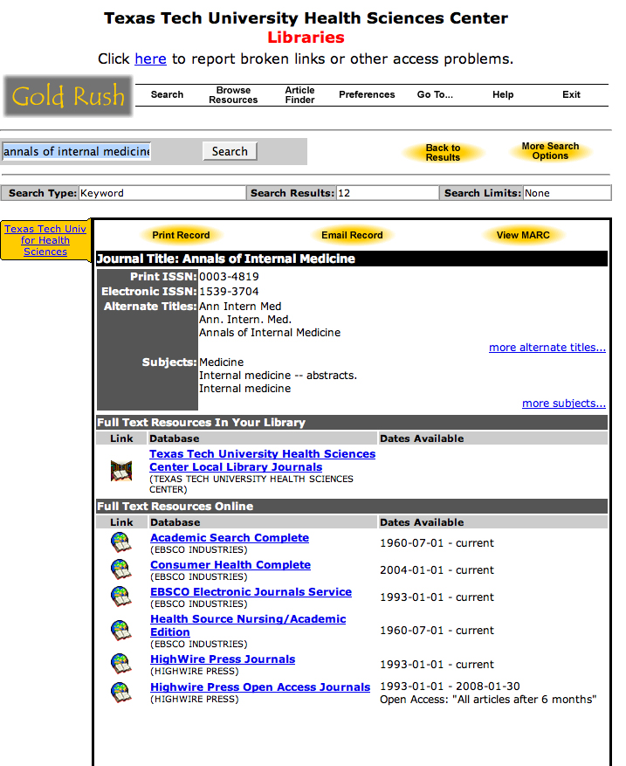
Gold Rush–Journal Records
Multiple electronic access options
Print
Full-text Electronic
Check dates!
Follow links!

Slide 21
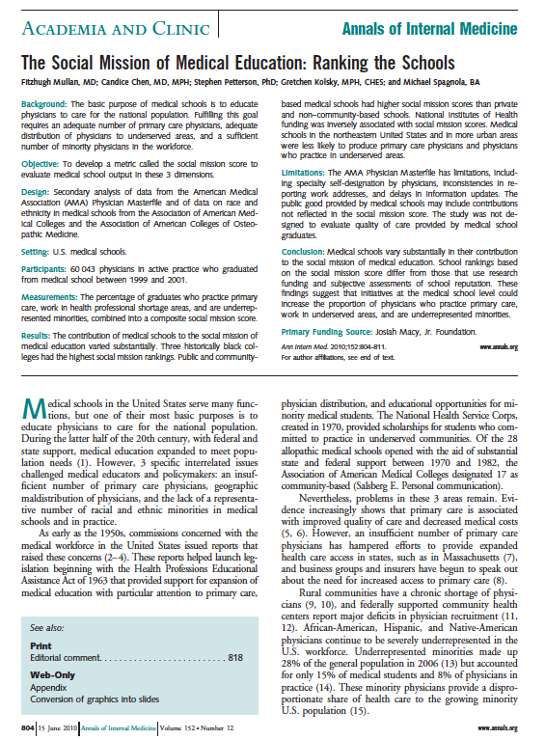
Gold Rush–
Journal Article
– PDF
PMID: 20547907

Slide 22
Still can’t find it!

Slide 23
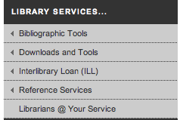
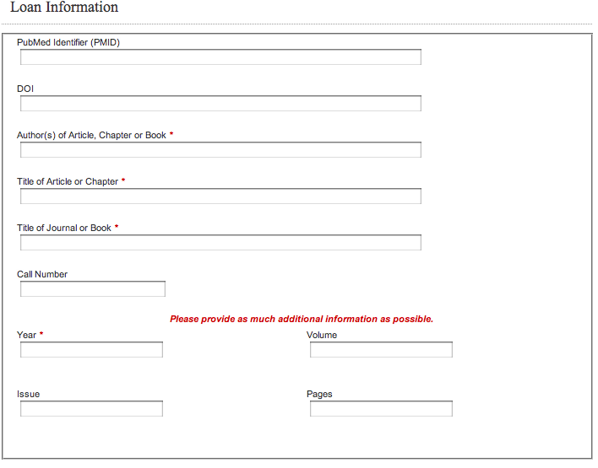
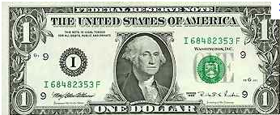
Middle right side

Slide 24


Slide 25
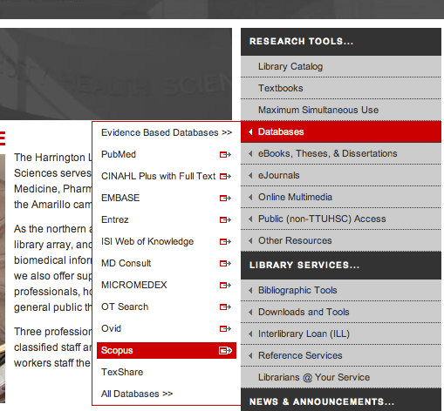
Scopus
Sort by Relevance
Locate landmark articles
Who has cited the article?
Keyword searching
Exporting available
5654

Slide 26

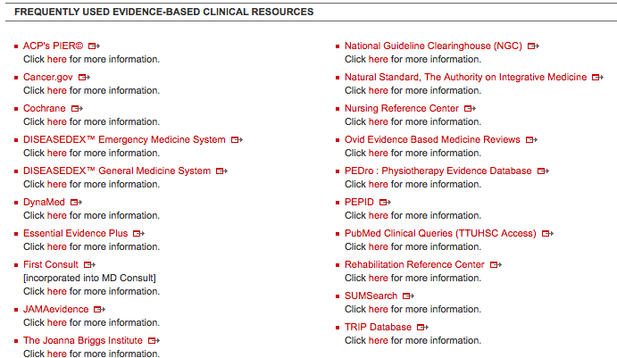
DATABAses
Cochrane
OVID Evidence Based
Dynamed
Essential Evidence Plus

Slide 27
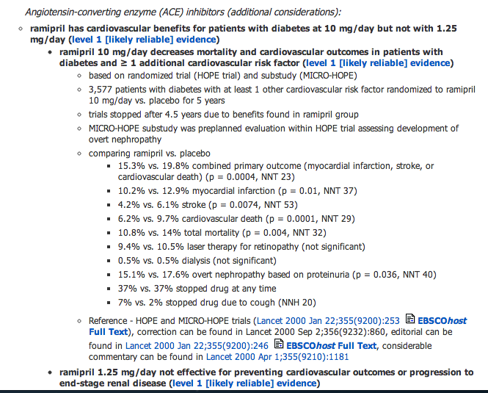

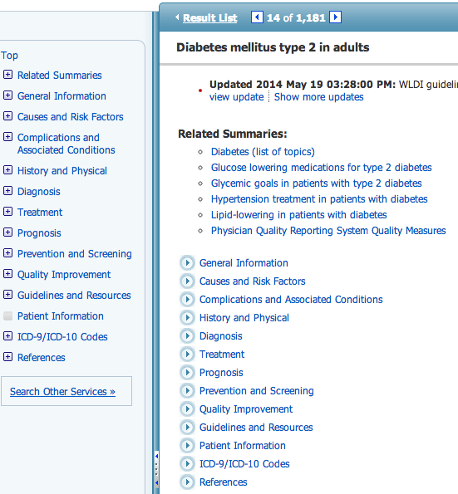
MOST CURRENT Point-of-care tool (BMJ 2011Sep 23)
7-step Evidence-Based Methodology
  Identify, select, appraise, report, synthesize, derive conclusions and UPDATED DAILY
Practice changing updates
MOBILE APP
MOBILE:
Download OMNIO from app store
Go to Settings,
Do you have serial #?
Enter # passed out today.

Slide 28

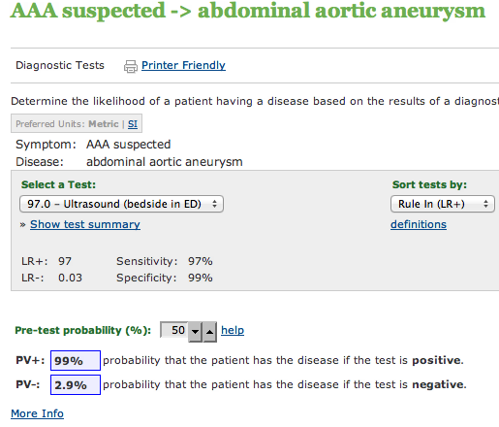
Is an evidence-based, point-of-care clinical decision support system (over 2,000 calculators) with access to over 13,000 topics, abstracts, guidelines, and summaries

Slide 29
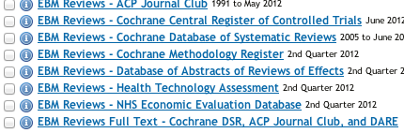
Evidence-Based
EBM Reviews
presented by OVID
Up-to-Date
From UMC Hospital ONLY

Slide 30
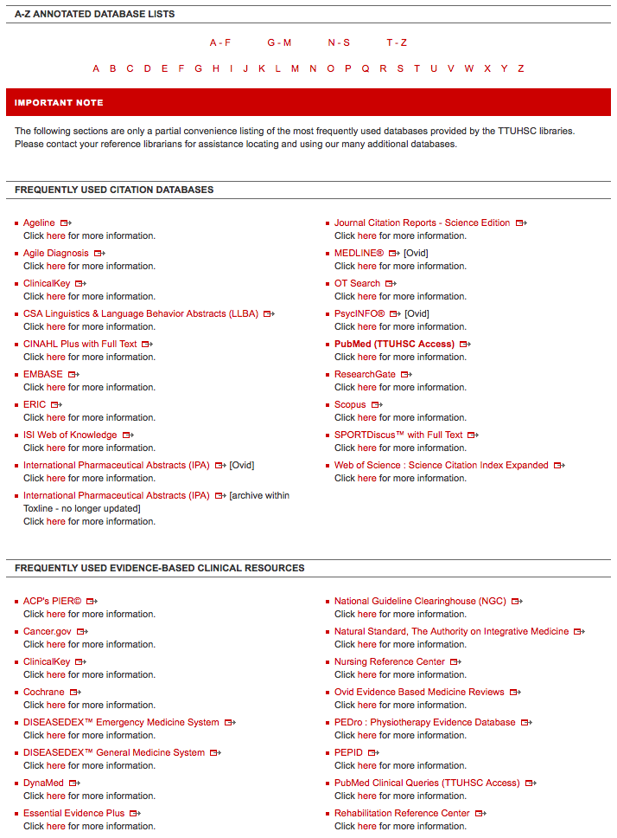

AgileMD
Join for free!

Slide 31

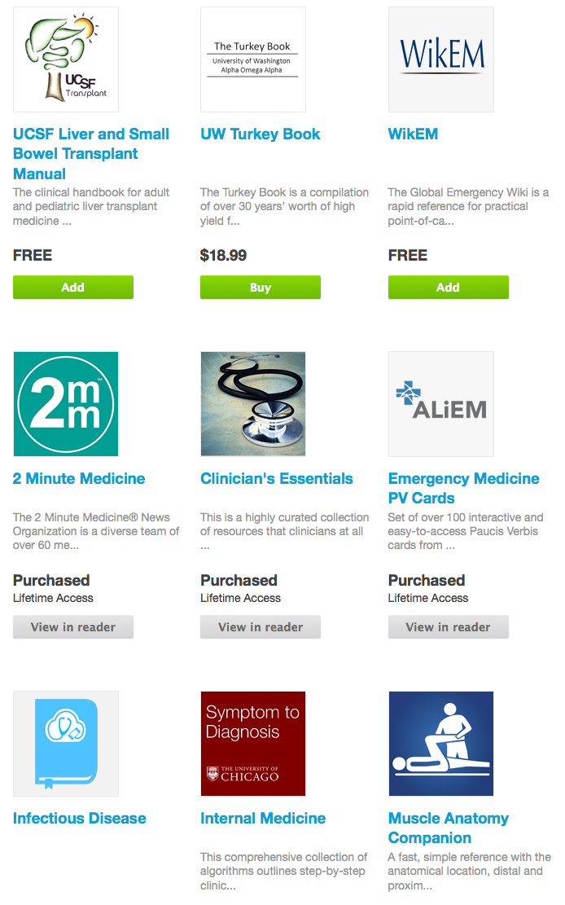
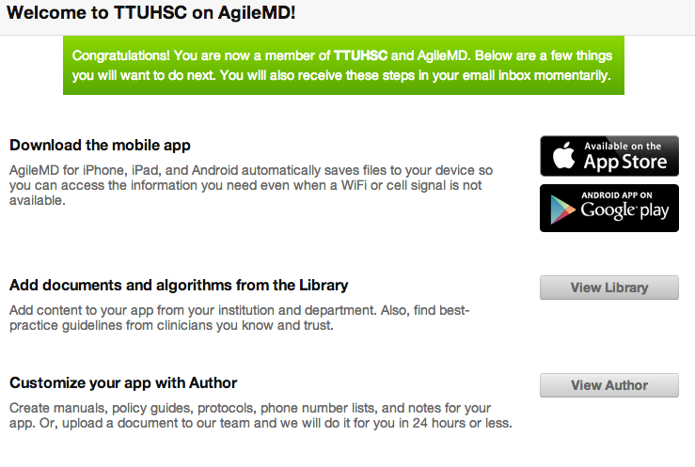
Symptom to Diagnosis

Slide 32
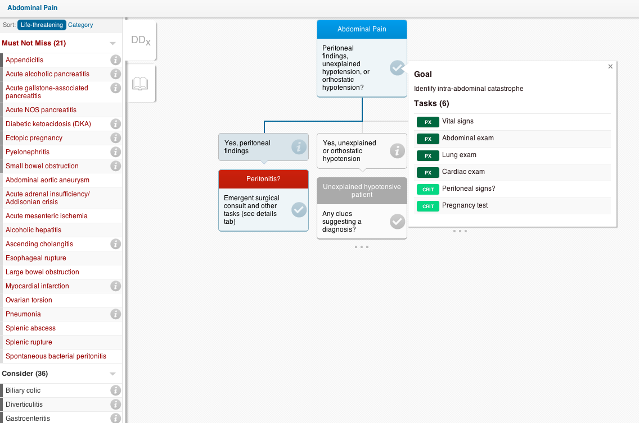

Slide 33
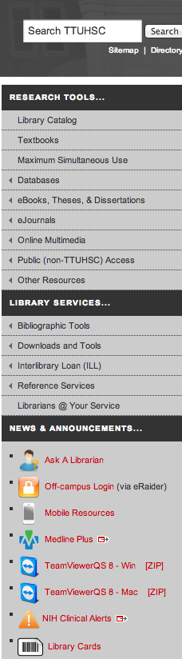
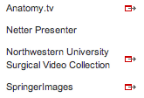
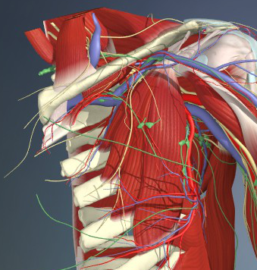
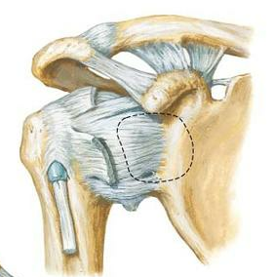
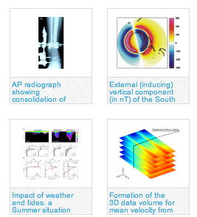
Upper right side

Slide 34
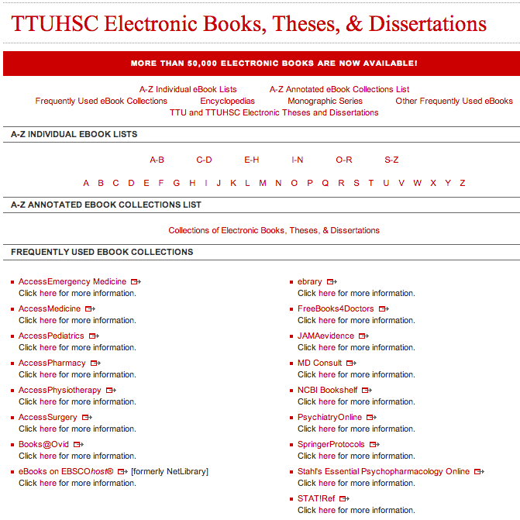
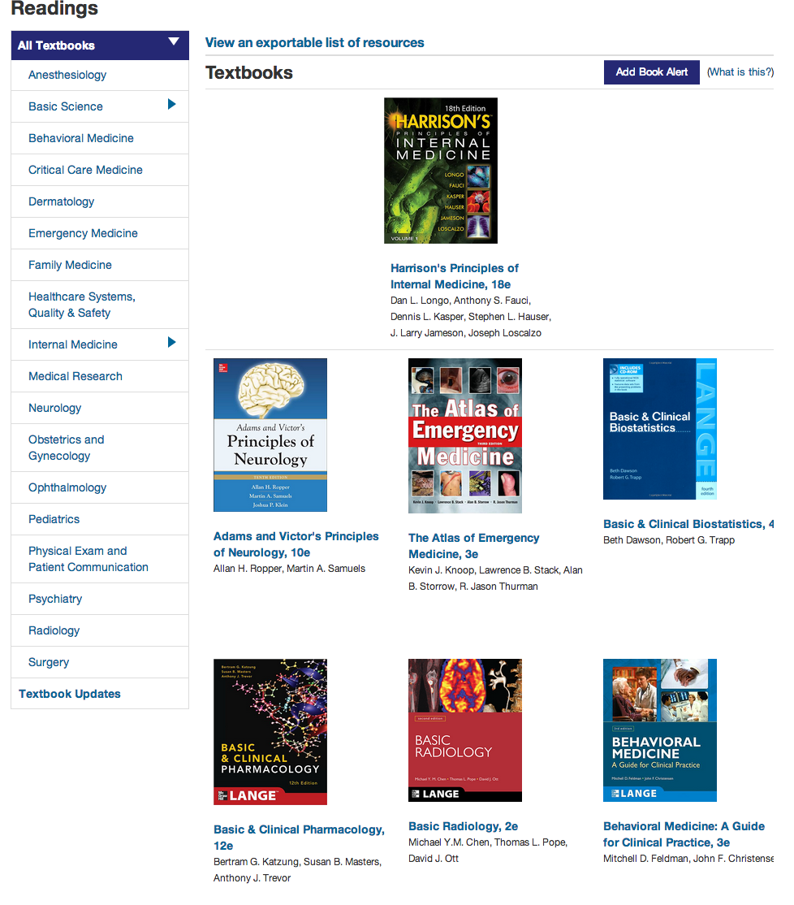
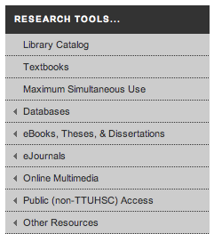
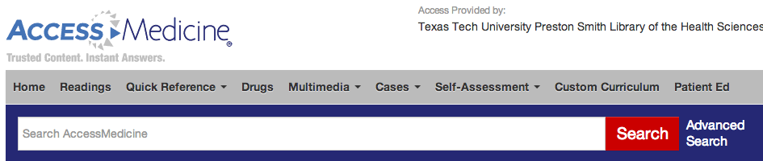
E-books
UNLIMTED ACCESS
Access
EmergencyMedicine
Over 55,000 eBooks
AccessMedicine
AccessPediatrics
AccessPharmacy
AccessPhysiotherapy
AccessSurgery

Slide 35
Drugs?

Slide 36

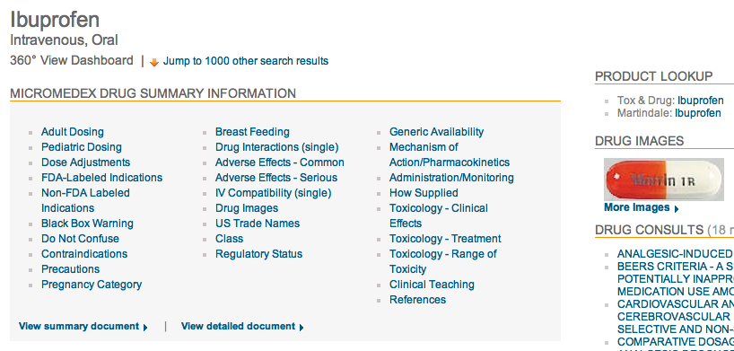

Slide 37
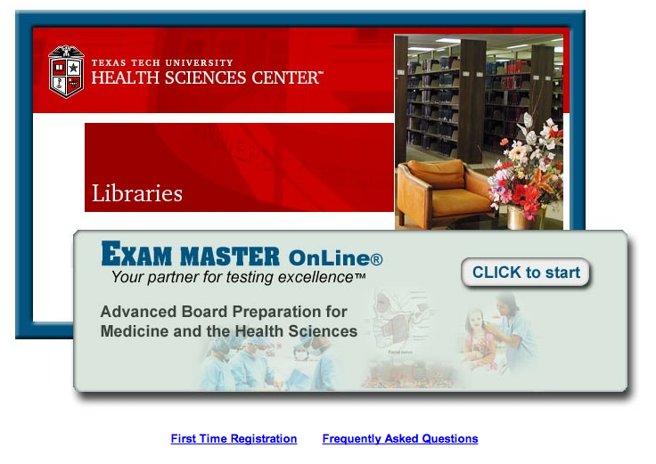
Exam Master

Slide 38


Right bottom

Slide 39

Need
help?

Slide 40
Right bottom

Slide 41

Right bottom

Slide 42




Team viewer
Remote support
With computer and phone!

Slide 43

Team Viewer
Librarian can see your screen…
Need telephone for audio
Both can move mouse around
One Time Use!
Your info
Librarian info
Once the ID & password are entered on our computer…
we have one time access to your desktop!

Slide 44


Middle right side
For training with
Bibliographic Software Management contact one of the Reference Librarians at:
mylibrary@ttuhsc.edu or
the Ask a Librarian link

Slide 46


Team Viewer & Ask a Librarian

Slide 47
Thank you!

