Slide 1
Welcome
Resources for
NRSG 4322
Evidence-Based Practice
Peggy Edwards, AMLS
TTUHSC - Preston Smith Library
Lubbock, Texas 79430
Jan 2017

Slide 2
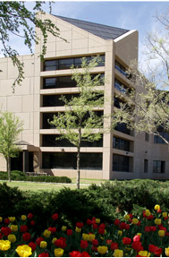
Welcome!
Preston Smith Library
located west of the
Academic Classroom
Building

Slide 3

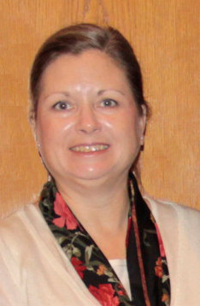

Available on 2nd floor of library, across from the Learning Resource Center and public computers
8am–5pm
Monday–Friday
Peggy Edwards
Micah Walsleben
Margaret Vugrin

Slide 4
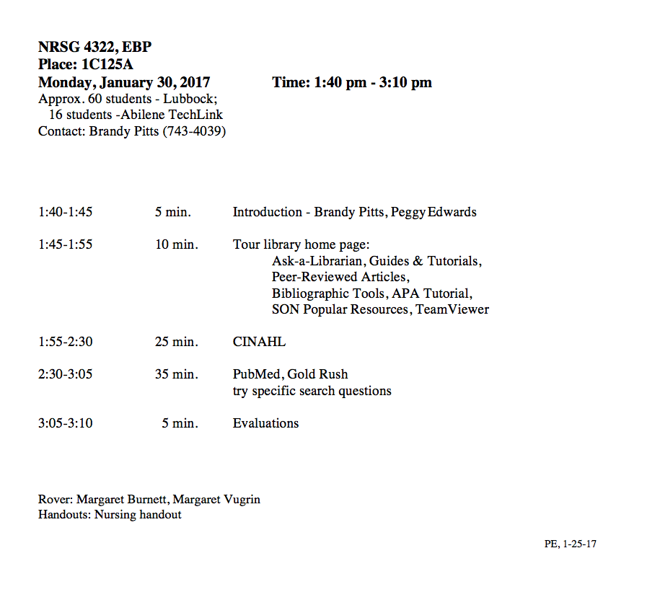
A
G
E
N
D
A

Slide 5




When searching library applications, use
Mozilla Firefox
Safari

Slide 6
Library Home Page

Slide 7
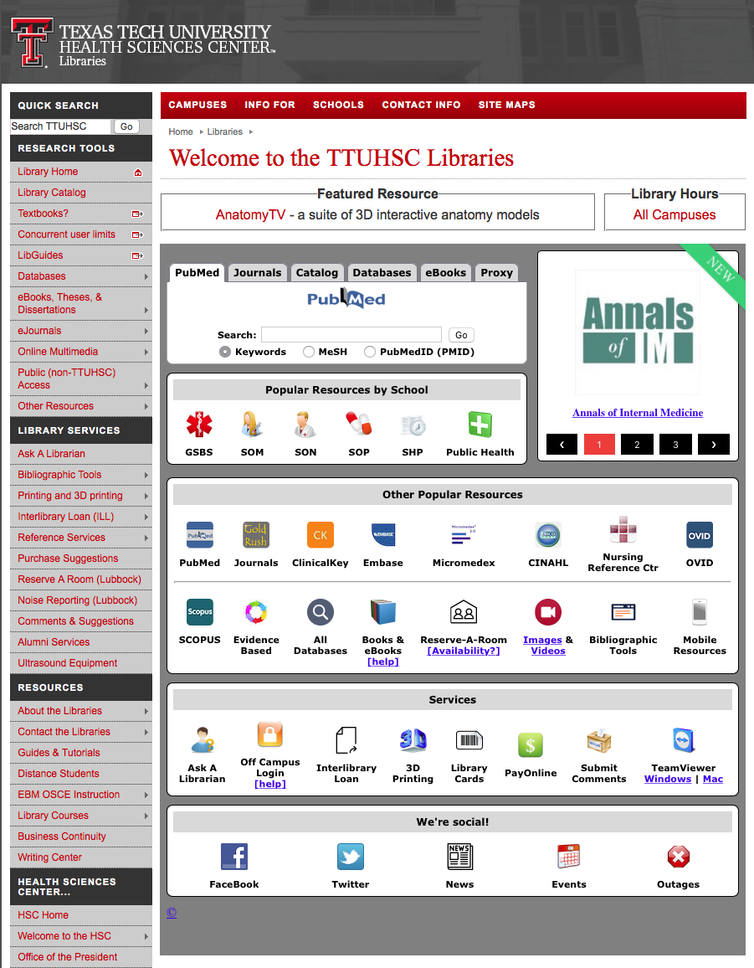
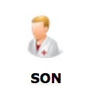
Popular Resources is a good starting point.
www.ttuhsc.edu/libraries
Click

Slide 8
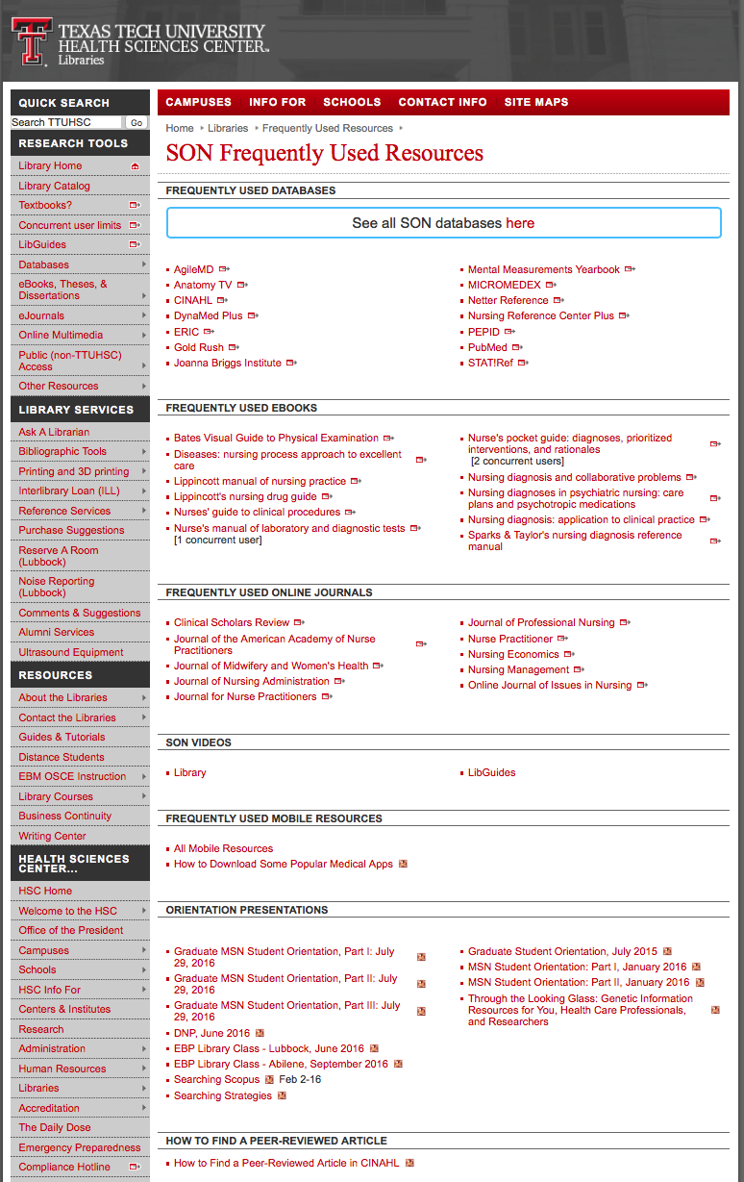
PowerPoint for
Resources for NRSG 4322

Slide 9
APA Style

Slide 10

Bibliographic Tools
www.ttuhsc.edu/libraries
Click

Slide 11
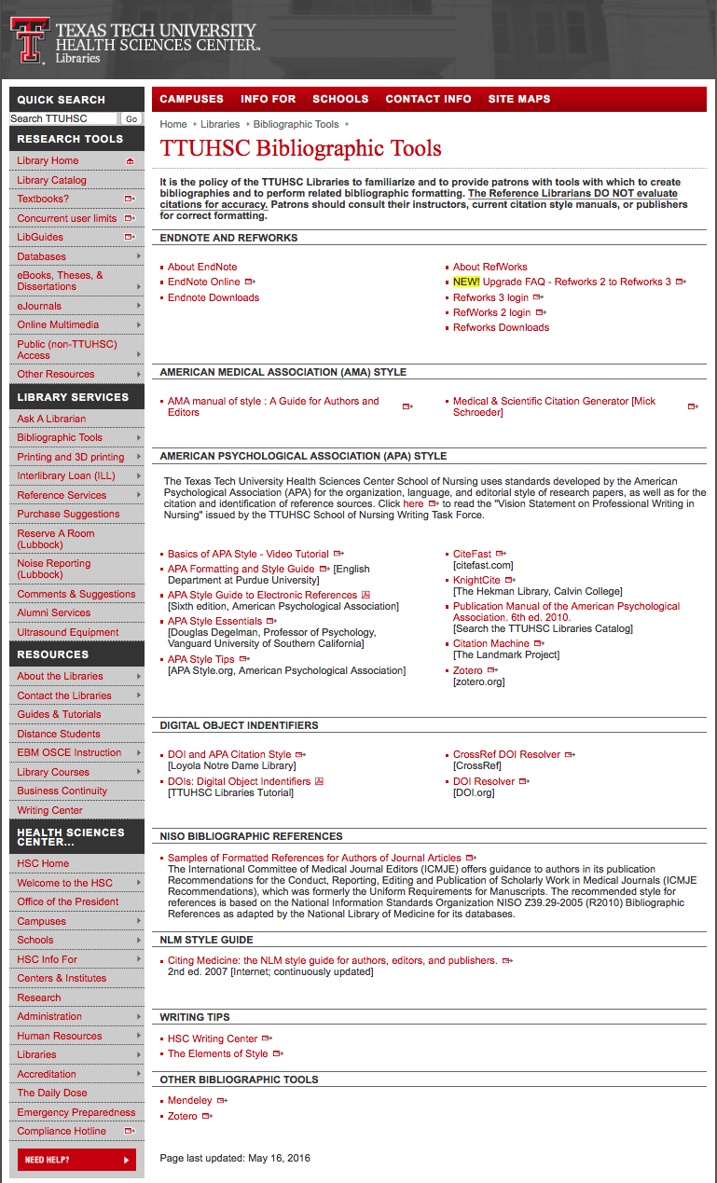

Free subscriptions
Link to Basics of APA Style – Video Tutorial

Slide 12
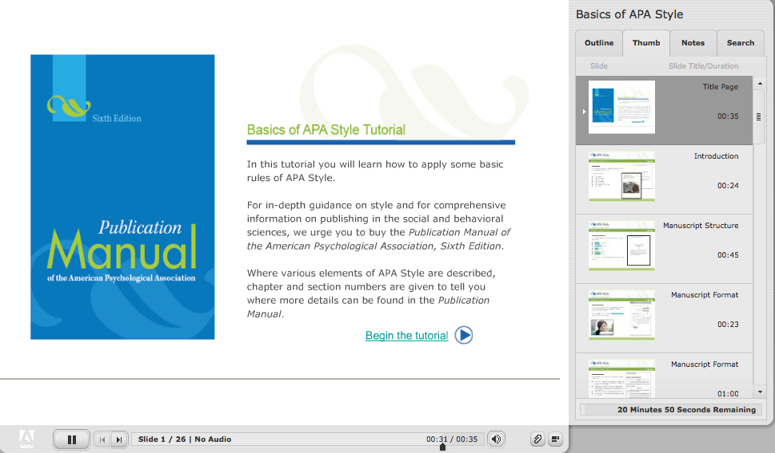

Slide 13
Identifying Citations
A citation is the:
author(s) of the article
title of the article
journal, volume, issue, pages where the article is located

Slide 14
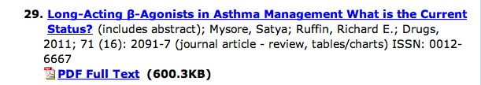
Article Title
Authors
Journal Article
Journal Title
Year, Volume, Issue, Page

Slide 15
Have Questions
or
Need Help?

Slide 16
Guides & Tutorials
www.ttuhsc.edu/libraries
Guides &
Tutorials

Slide 17

www.ttuhsc.edu/libraries
Click

Slide 18
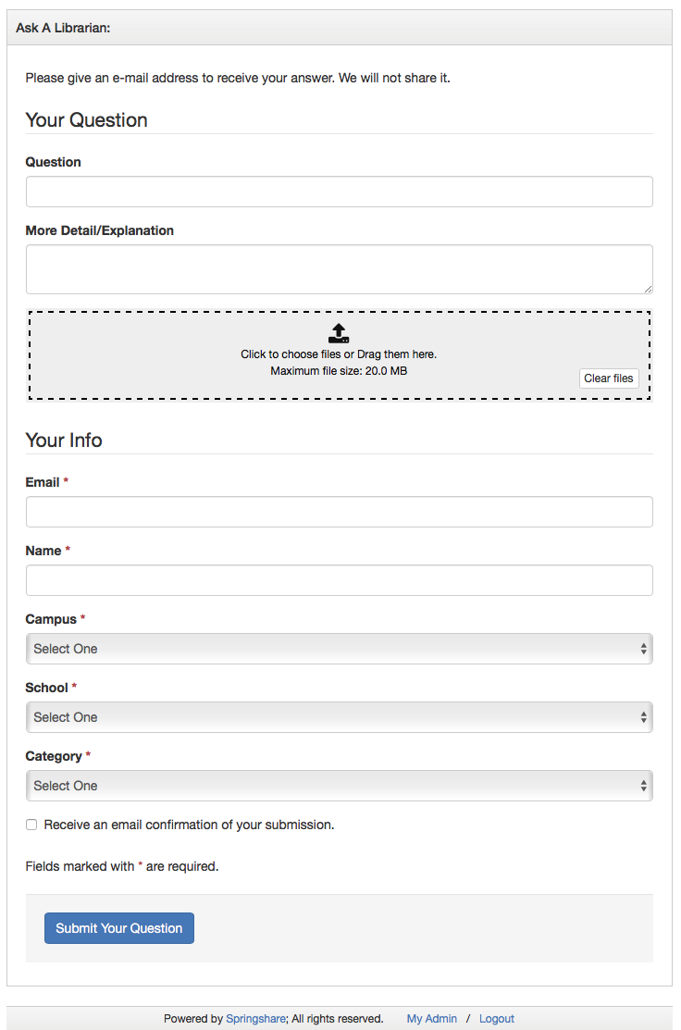
Fill out the form to email us a question!

Slide 19
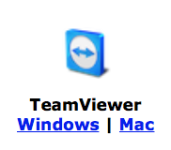
www.ttuhsc.edu/libraries
Download

Slide 20

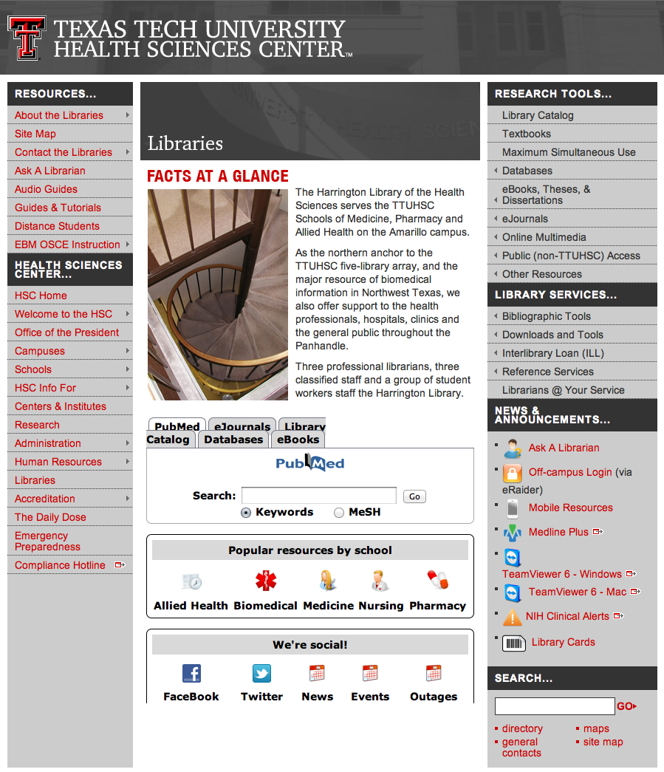

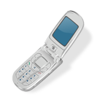
Call your TTUHSC Librarian

Slide 21
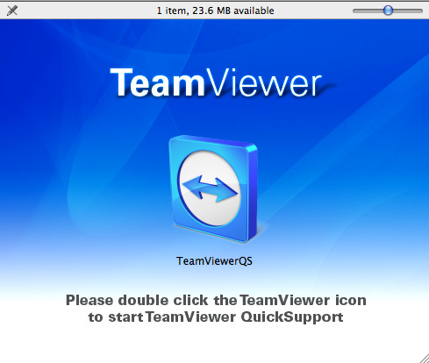
Double click the icon and follow the directions

Slide 22
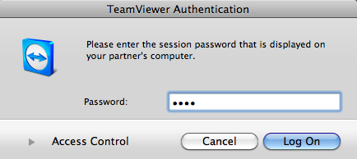
Give the id and password to the librarian to enter.
Log On
After logging on, the librarian can see your computer screen!
At the end of the session after logging off,
the librarian will not have access to your computer!
TeamViewer generates a new password each time it is used!

Slide 23
Search Question

Slide 24
PRO
Breastfeeding exclusively
(benefits for baby/mom)
CON
Formula feeding
(benefits for baby/mom)

Slide 25
Searching CINAHL

Slide 26

www.ttuhsc.edu/libraries
Click

Slide 27
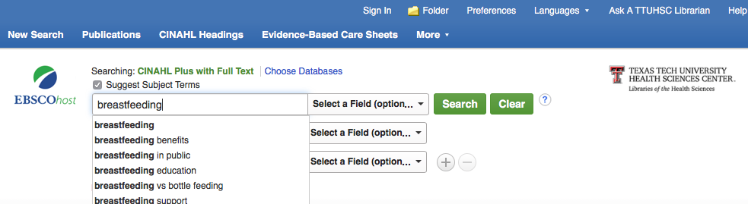
Enter breastfeeding
Suggested
Subject Headings
click
Search

Slide 28
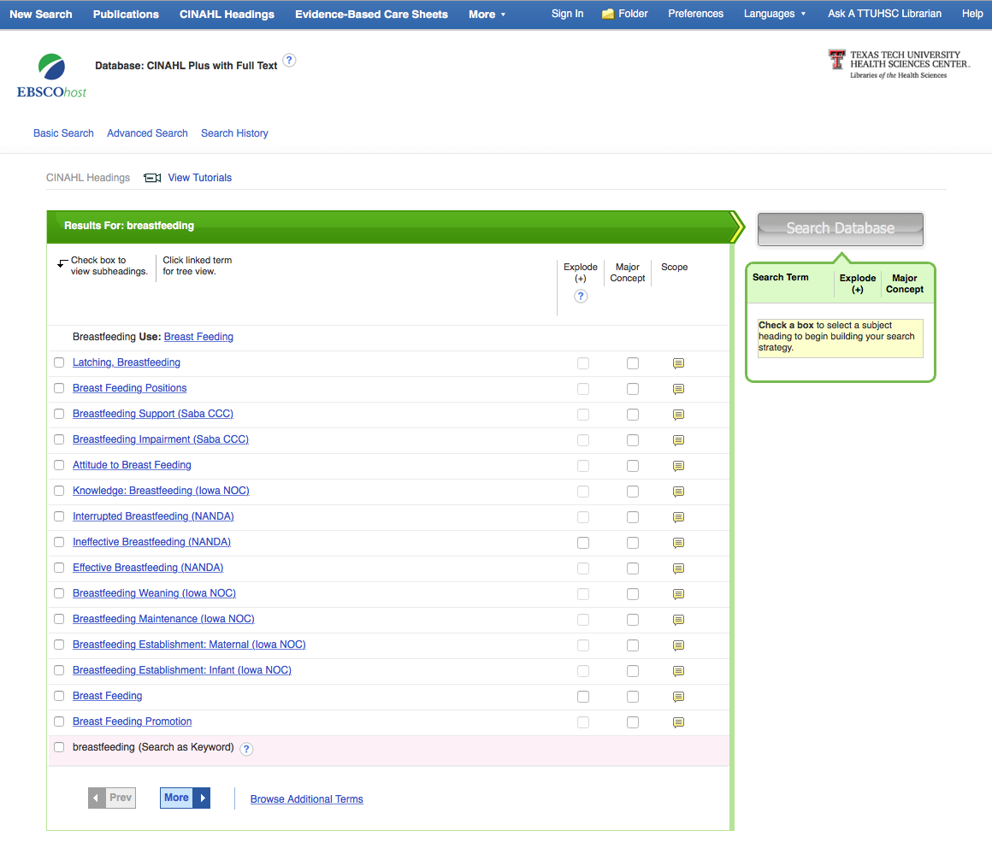
Click the box next to
Breast Feeding

Slide 29
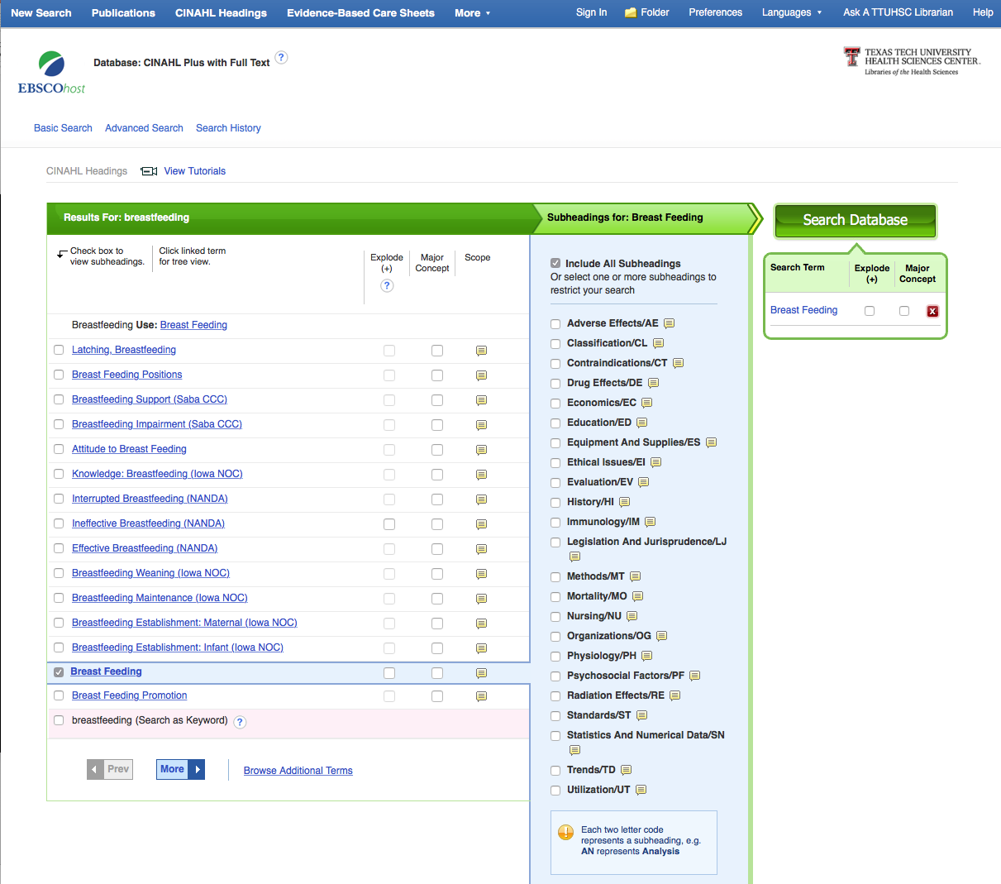
Subheadings
Appear
(Don’t select one
for this search.)

Slide 30
click
Search Database

Slide 31
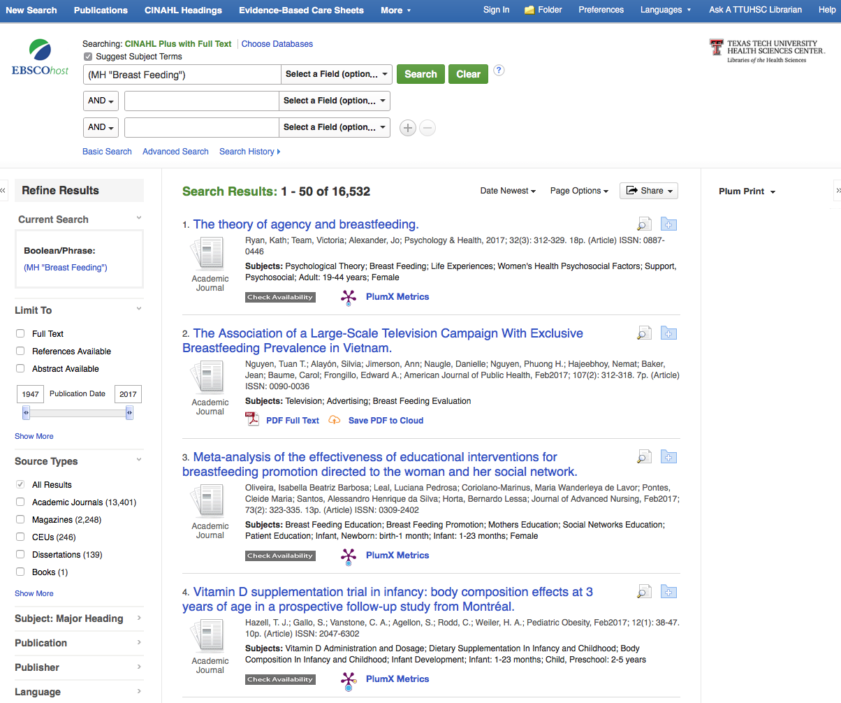
Click
Advanced Search

Slide 32
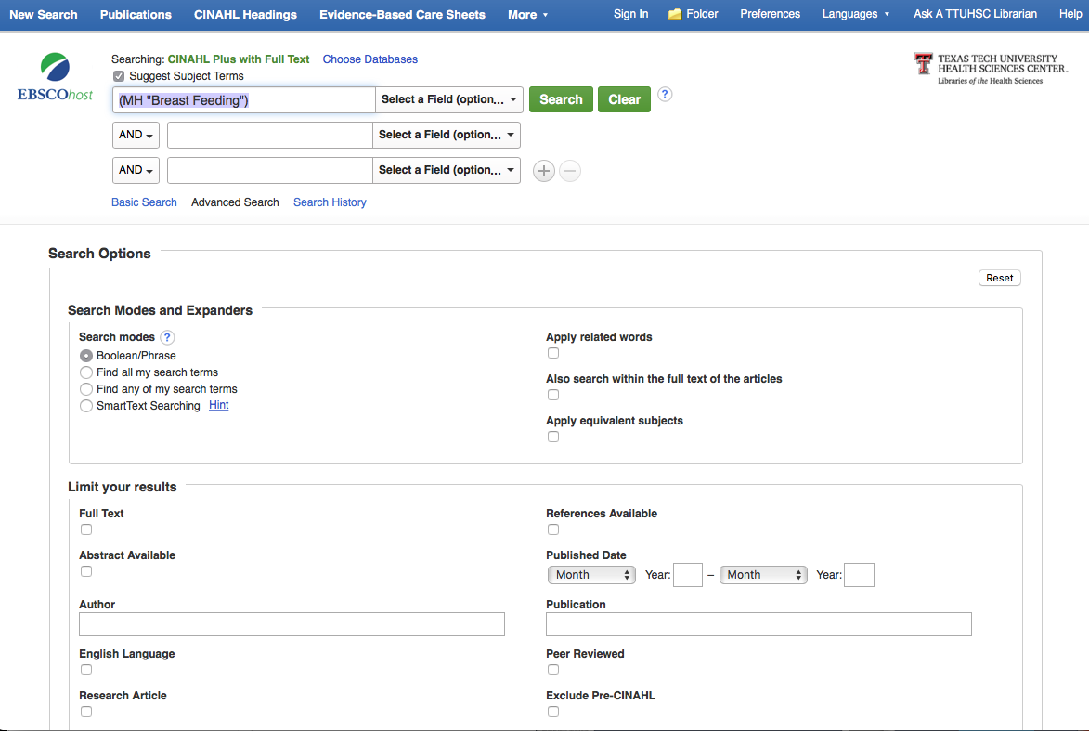
Select
Peer Reviewed

Slide 33
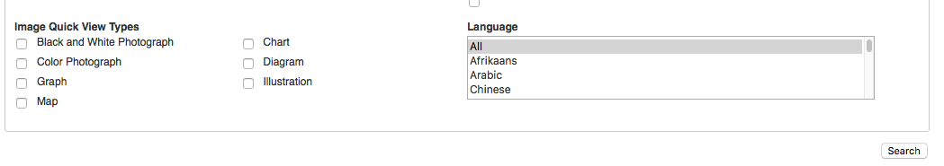
Scroll to the bottom of the screen and click Search

Slide 34
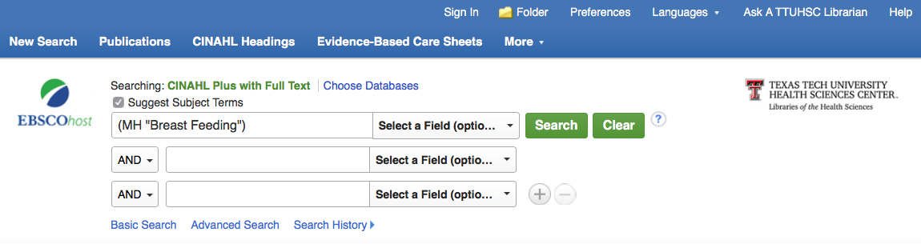
click
Clear

Slide 35
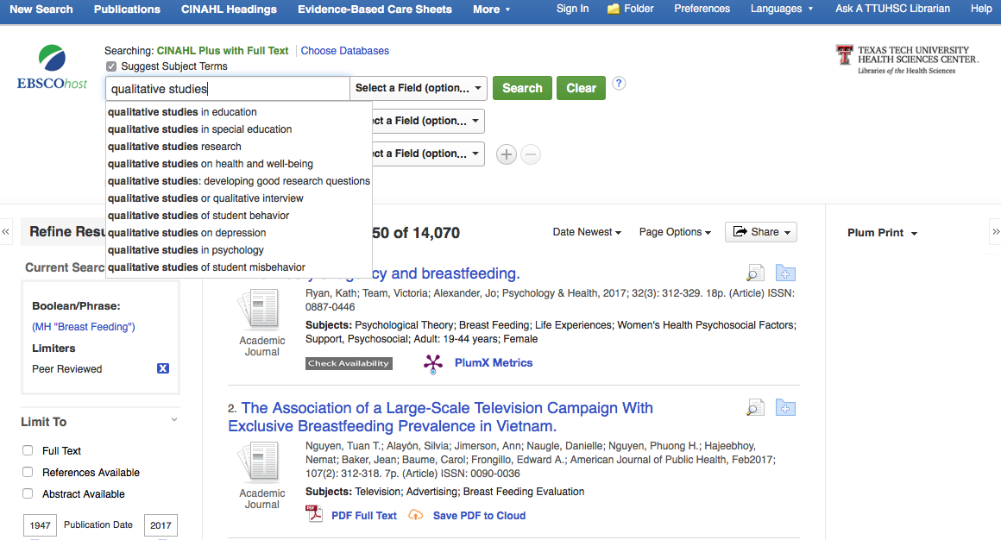
Enter qualitative studies
click
Search

Slide 36
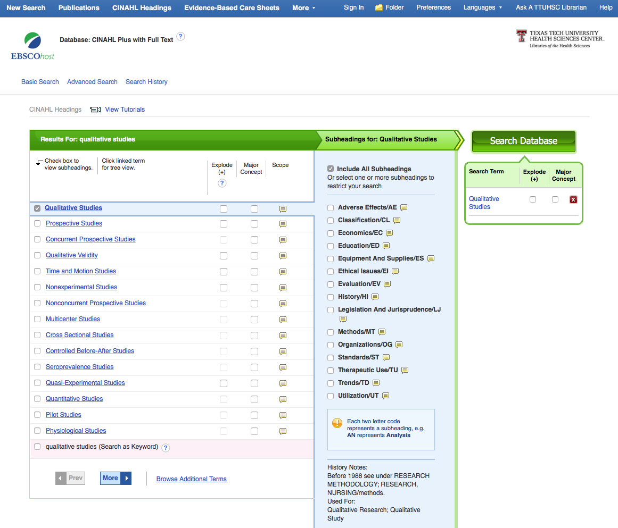
click
Search Database
Click the box next to
Qualitative Studies

Slide 37
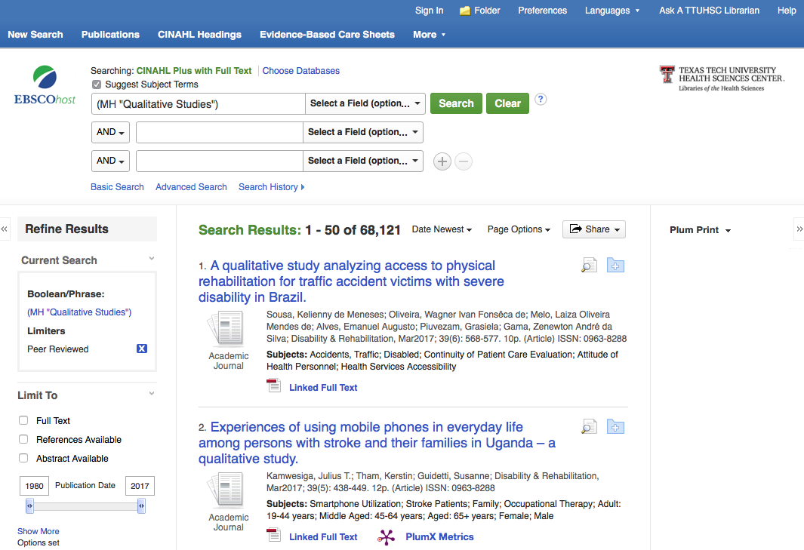
Click Search History

Slide 38
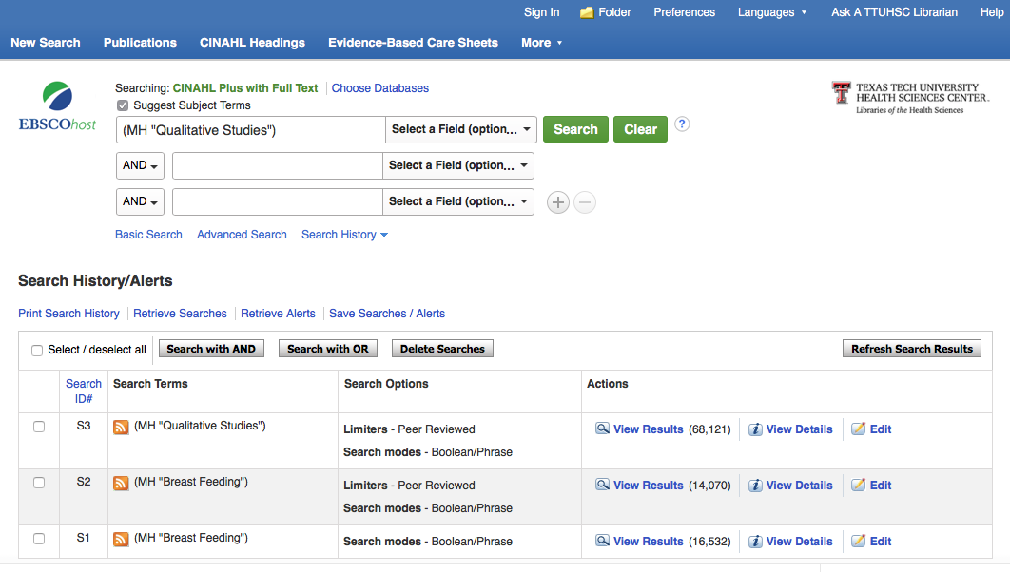
click
Clear

Slide 39
Select sets S2 & S3 and click
Search with AND
✔
✔

Slide 40
Boolean Logic – AND - narrows
qualitative
studies
breastfeeding
AND

Slide 41
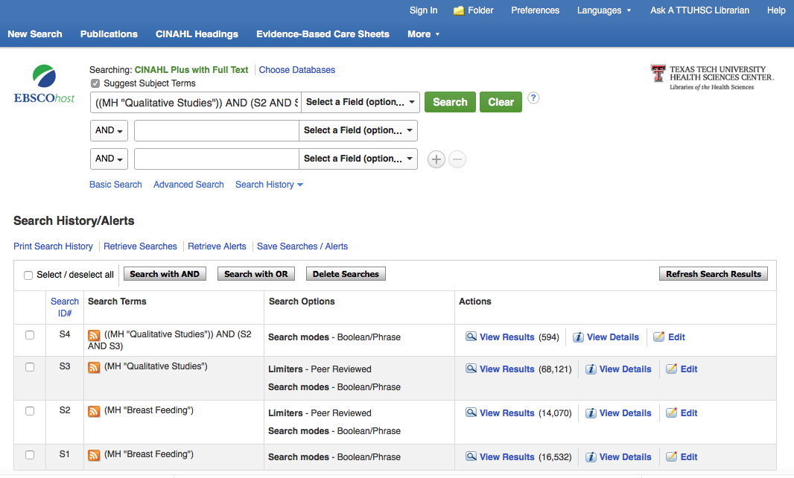
S2 AND S3
S2 AND S3
Results have
narrowed down

Slide 42
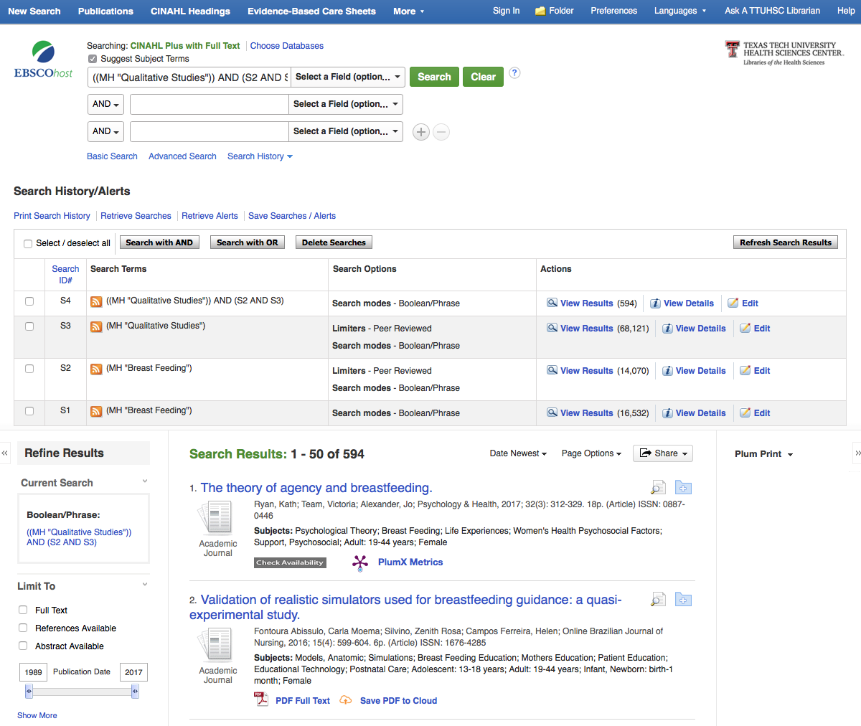
Follow instructions exactly!
Put 2011 in the Date Selector
and tap the enter/return key
2011

Slide 43
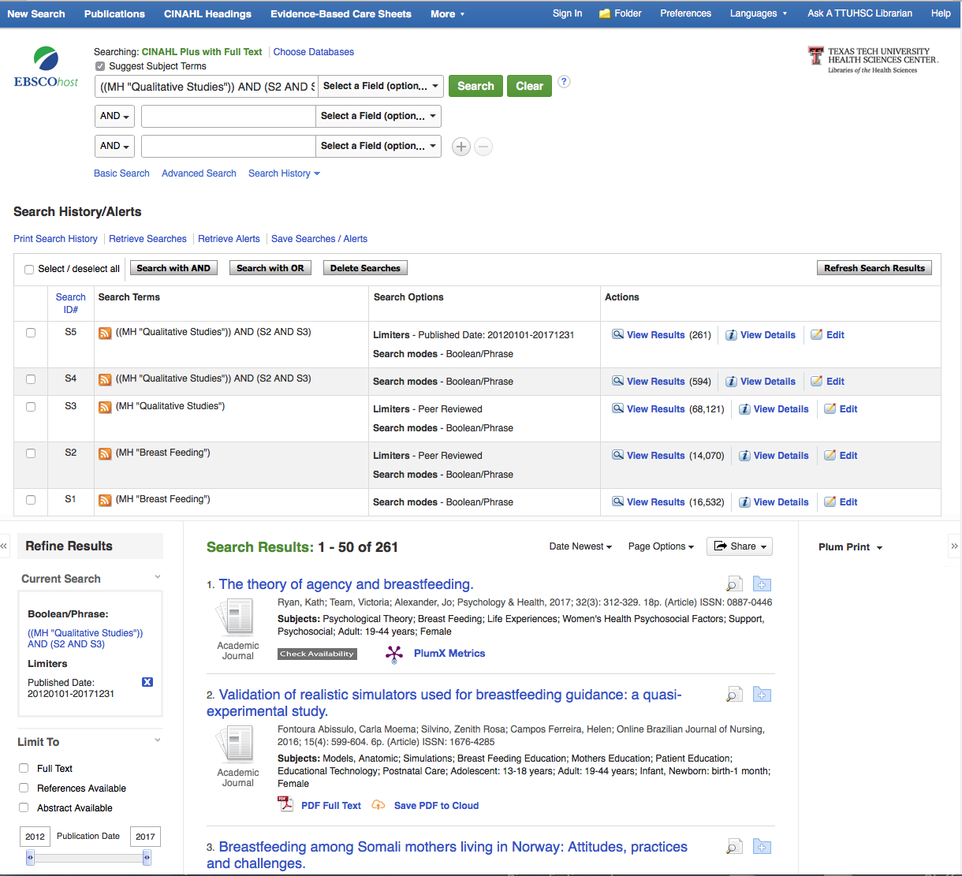
✔
Full Text

Slide 44
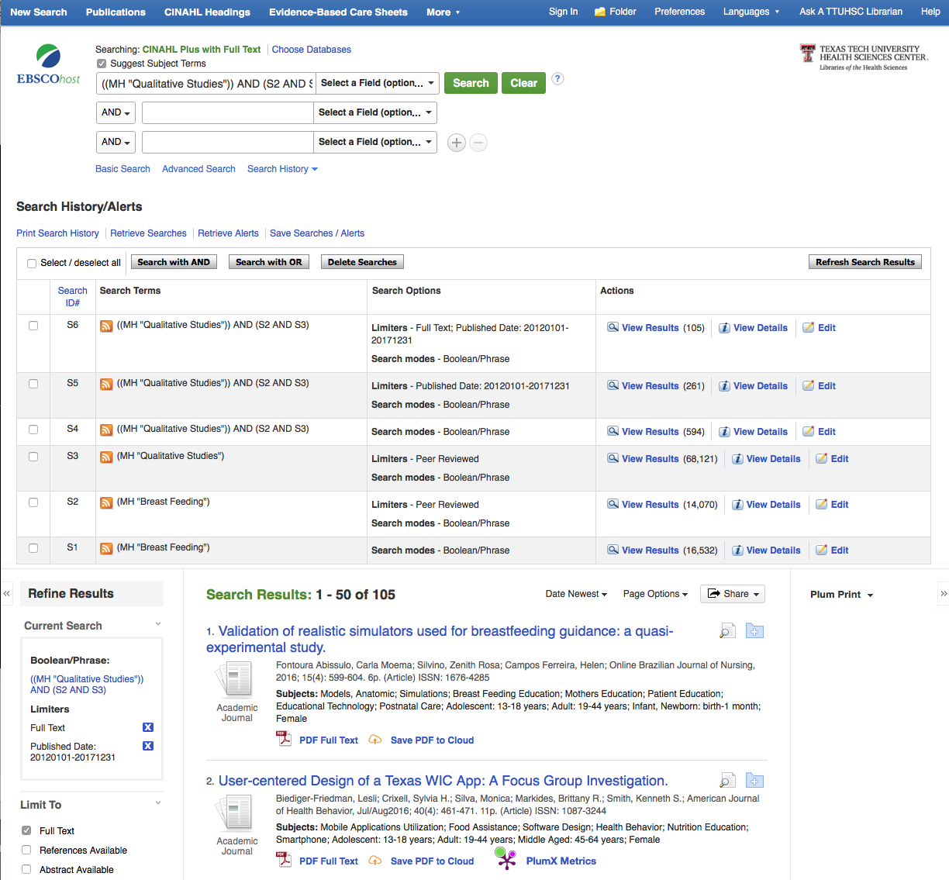
Click View Results

Slide 45
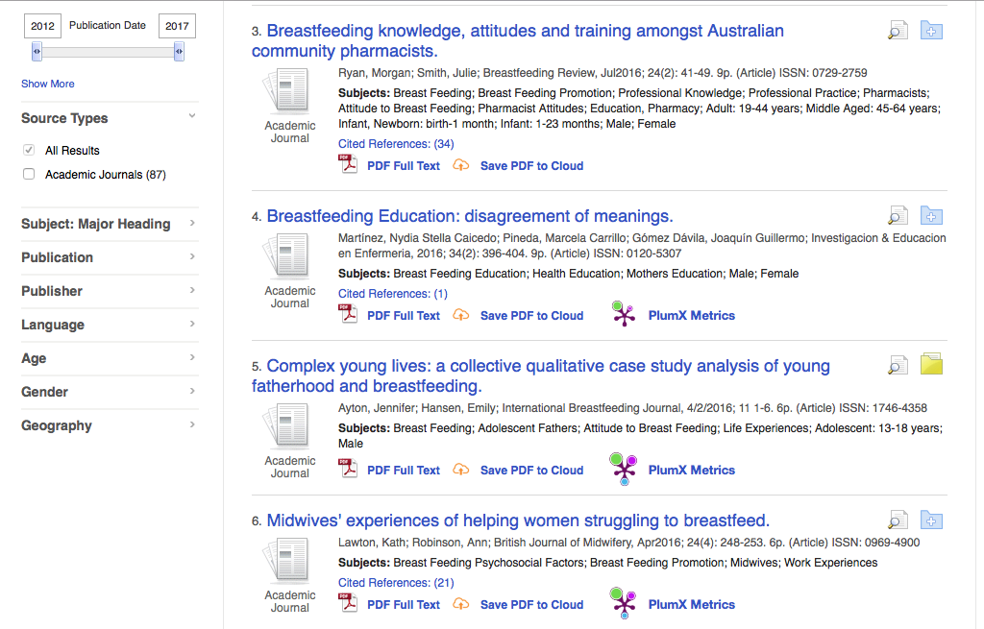
Click folder to save appropriate article

Slide 46
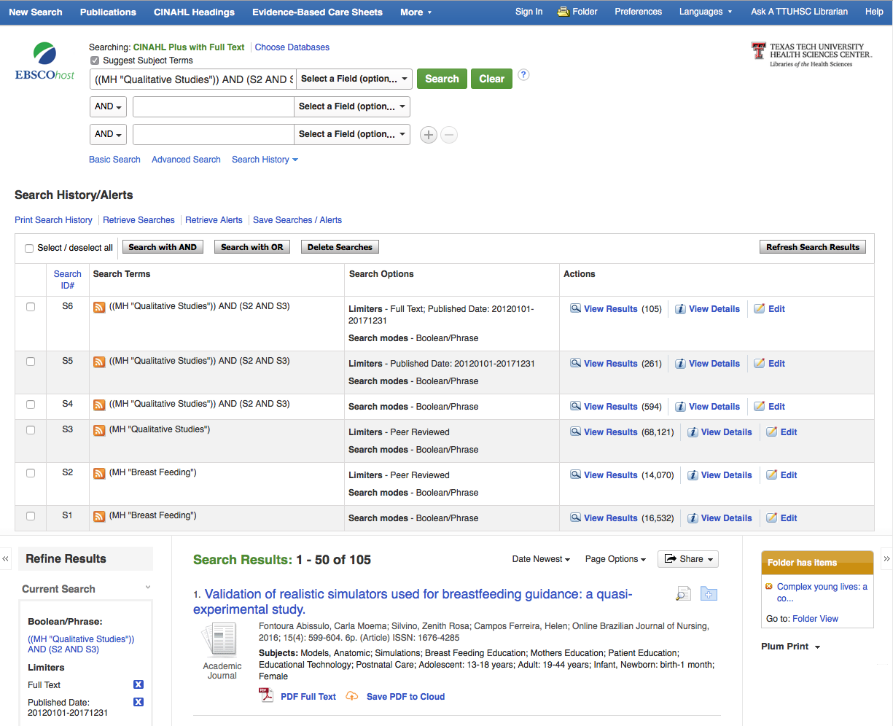
Click folder

Slide 47
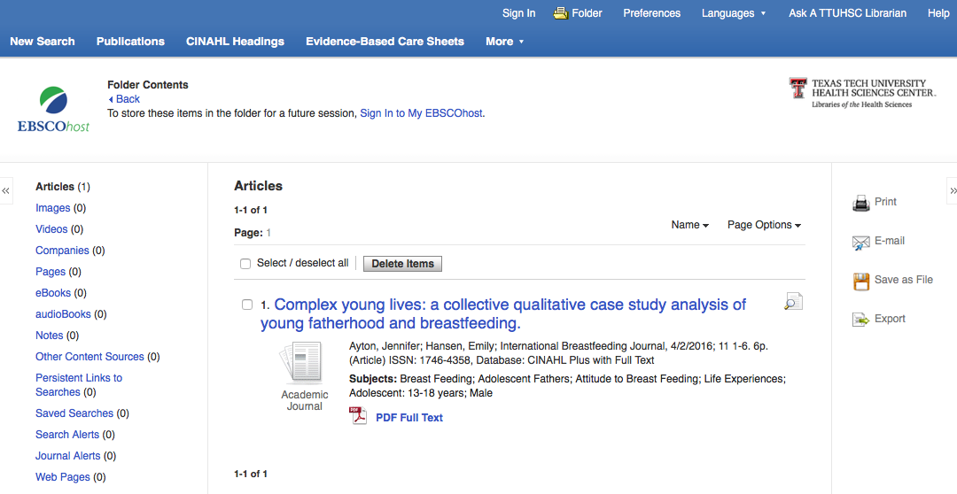
Click Select
Click E-mail

Slide 48
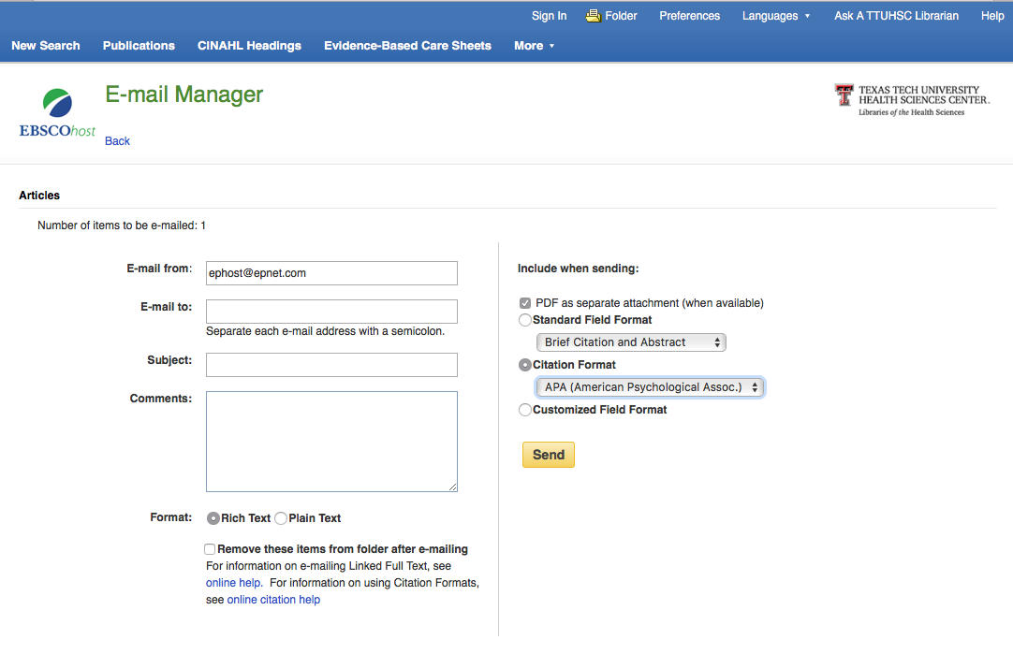
Brief Citation and Abstract
Select
Click Send

Slide 49
Click New Search

Slide 50
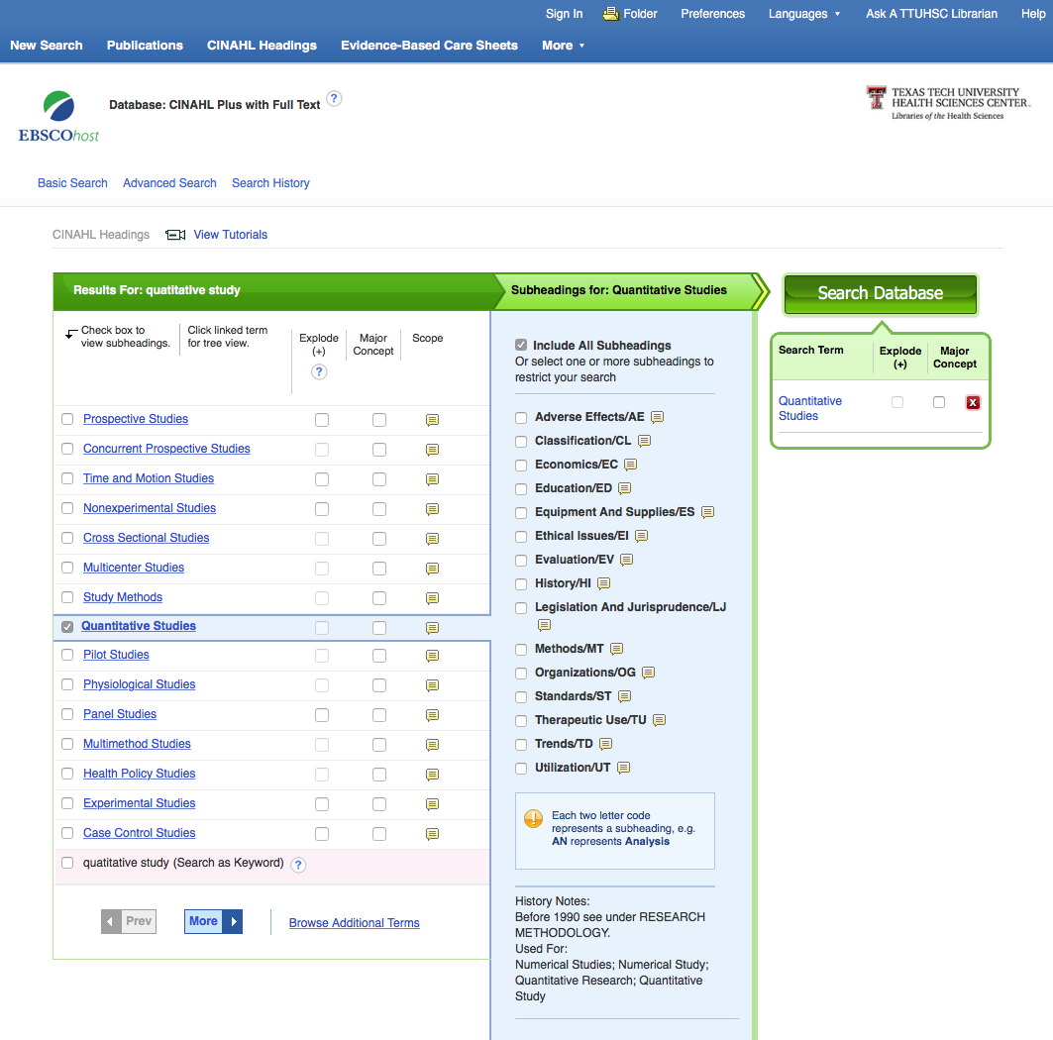
Repeat the process using
the Quantitative Studies
subject heading.

Slide 51
What questions do you have?

Slide 52
Searching PubMed

Slide 53

www.ttuhsc.edu/libraries
Click

Slide 54
Creating a
My NCBI Account

Slide 55
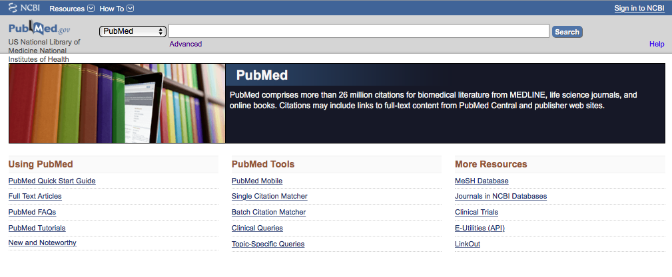
Click
Sign in to NCBI
PubMed Home Page

Slide 56
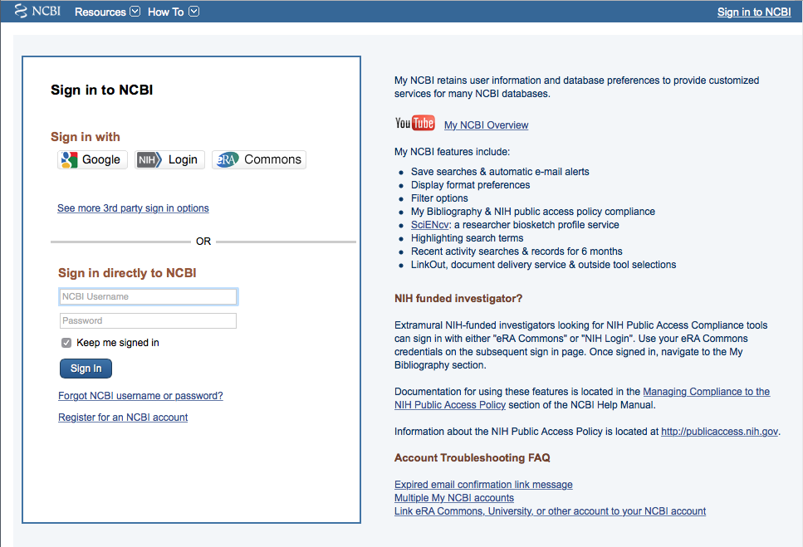
Click
Register for an NCBI account

Slide 57
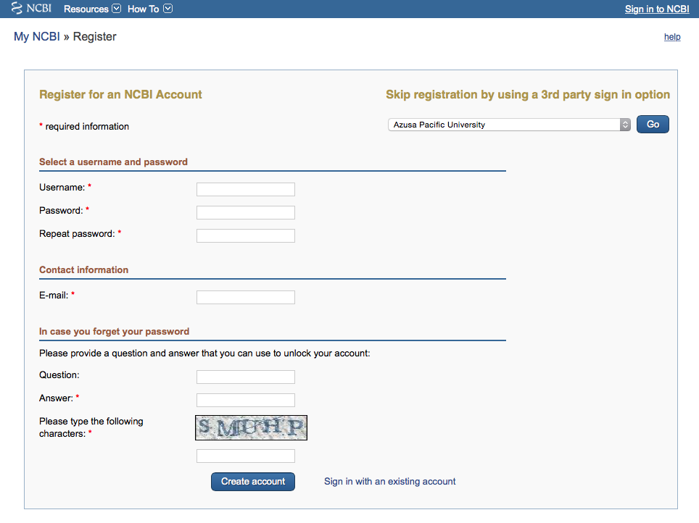
Fill out form
and click
Create account

Slide 58
Verifying your MY NCBI Account
Open the email you used in the account:
1) Locate the link from NCBI
2) Click the link
3) Tells NCBI you are a real user requesting the account
(not computer generated)
4) Your user name will now appear on the top right-hand side

Slide 59

Click My NCBI
Your username
Your user name

Slide 60
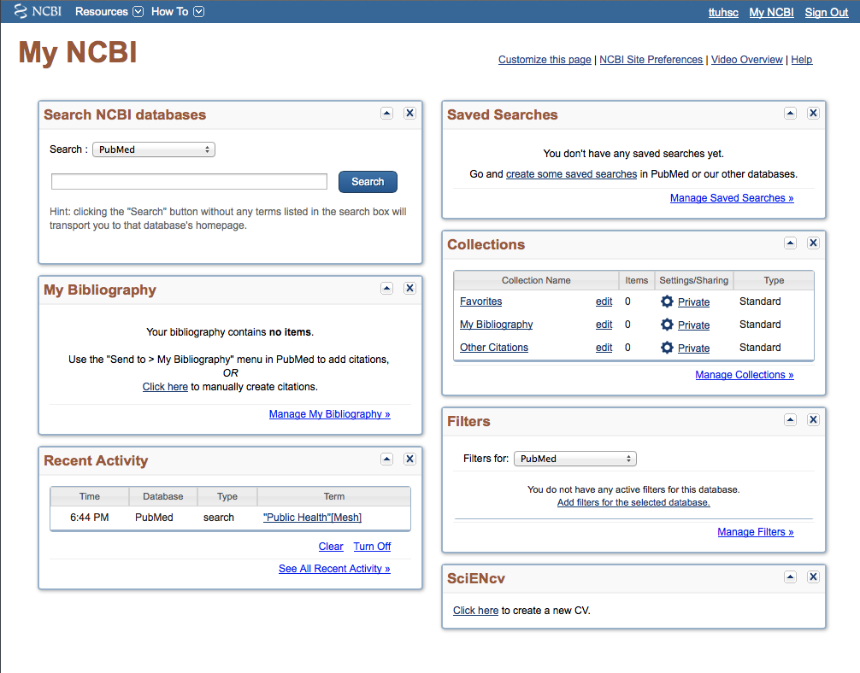
Click Manage Filters

Slide 61
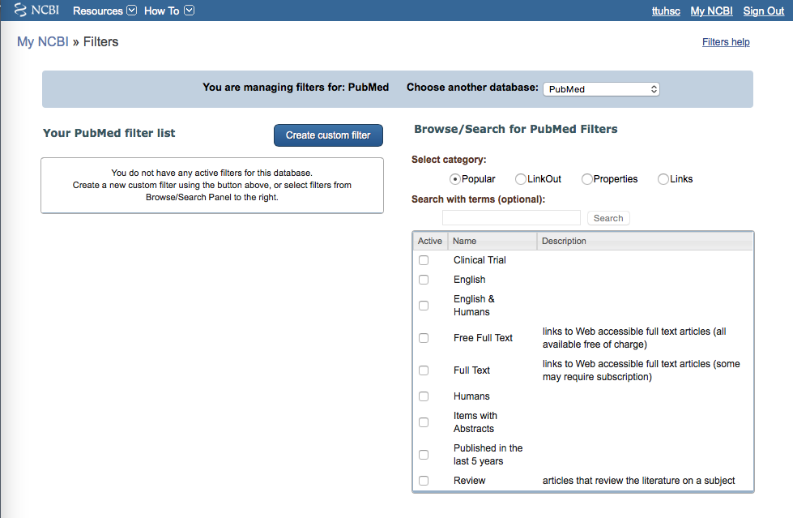
Select database
✔
Select up to 15 filters

Slide 62
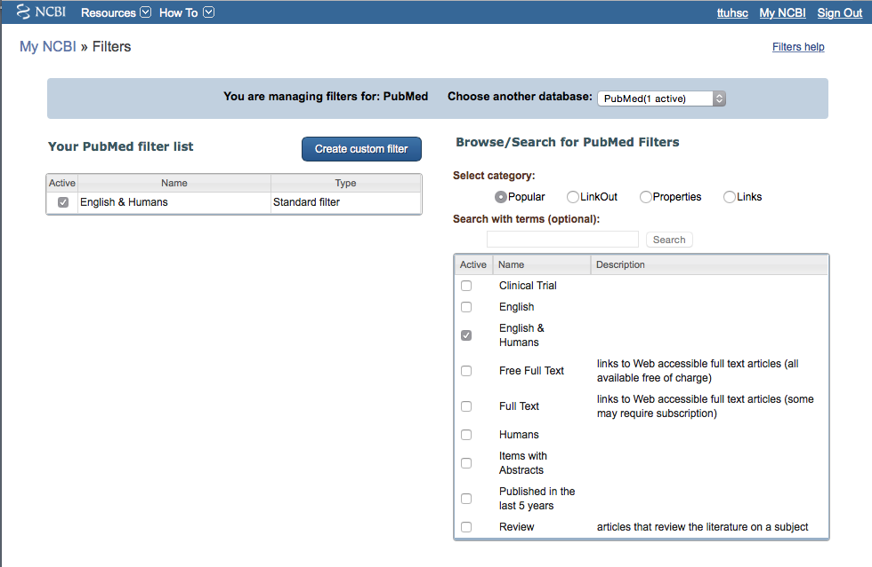
Click Properties
Filter activated

Slide 63
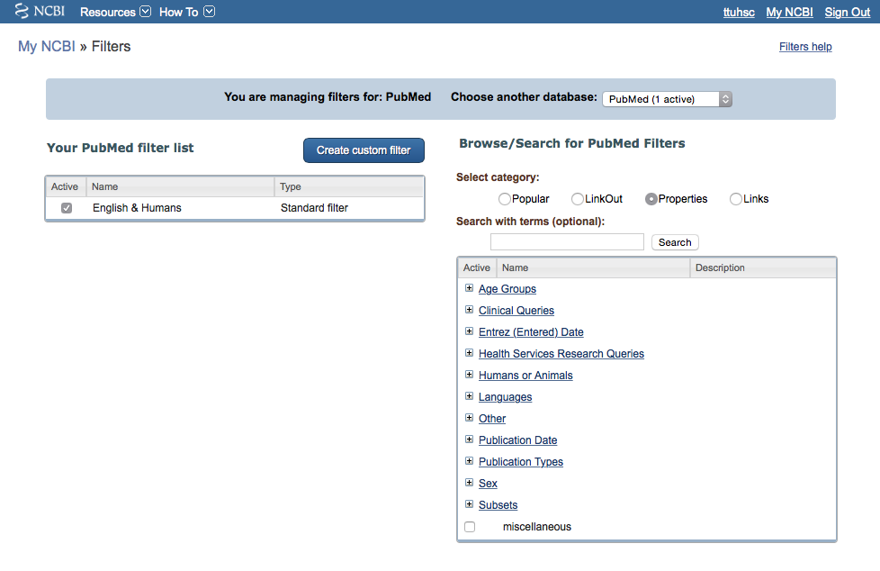
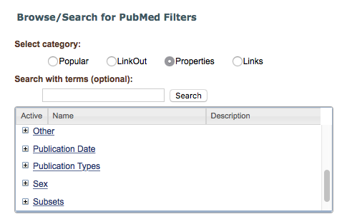
Scro
l
l
Open Publication Types
+

Slide 64
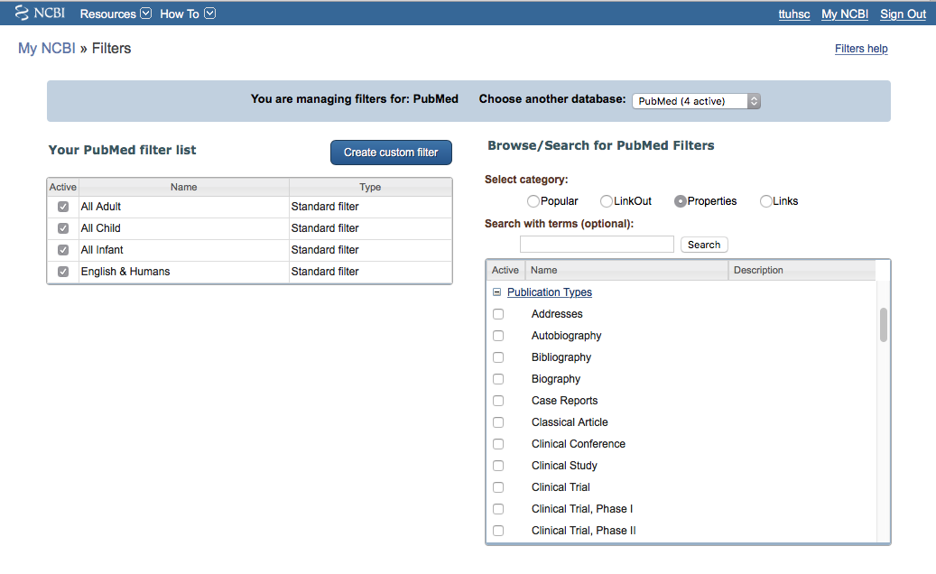
Select
Clinical Trial
✔
Scroll to make more selections

Slide 65
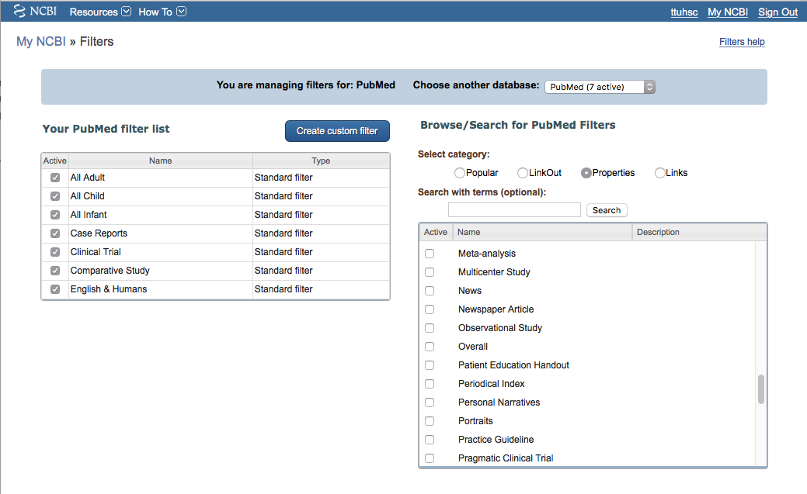
✔
Select
Meta-analysis

Slide 66
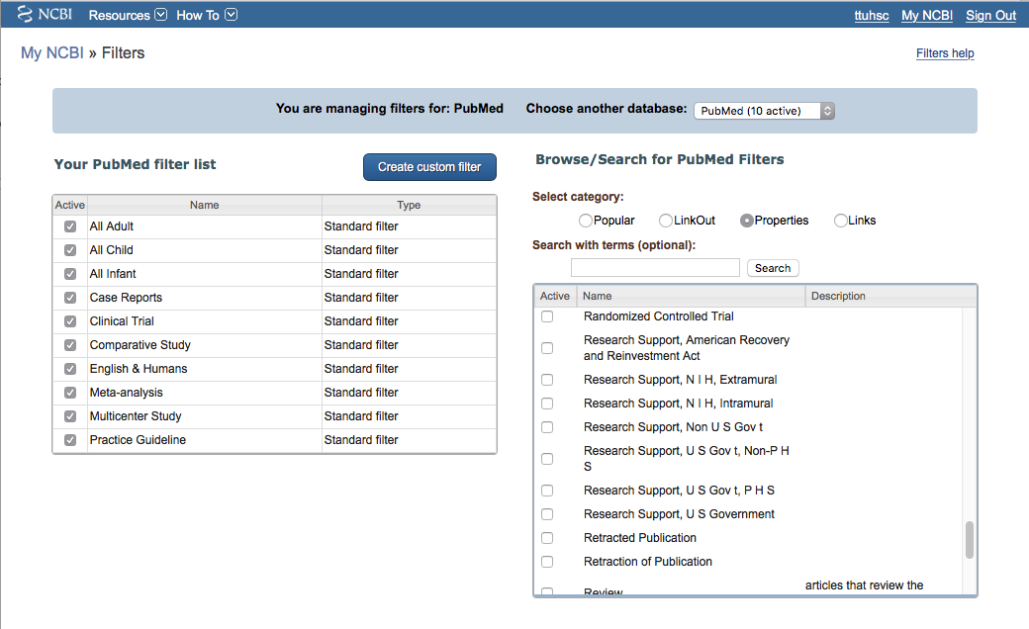
✔
Select
Randomized Controlled Trial

Slide 67
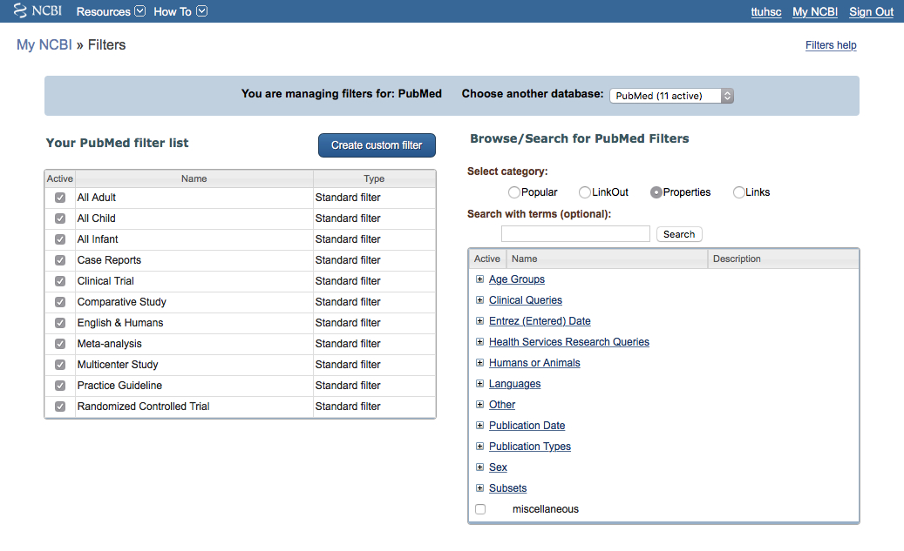
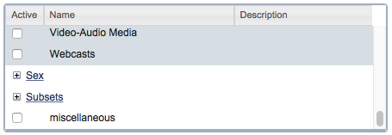
Open Subsets
+

Slide 68
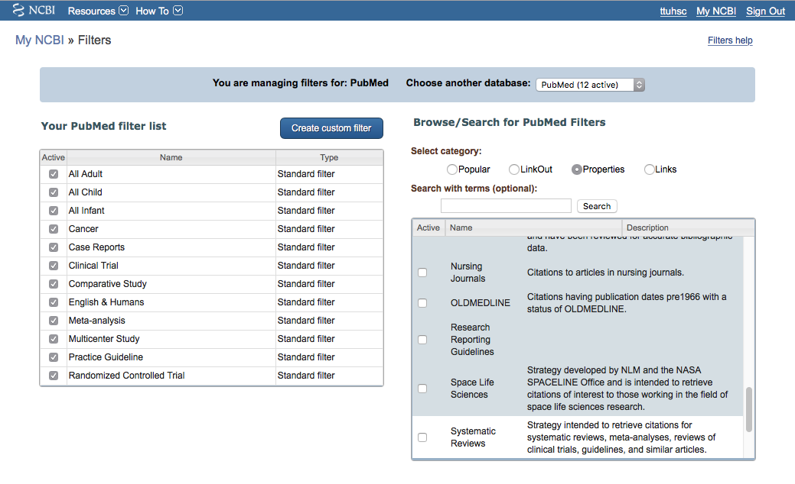
Select
Nursing Journals
✔
Select
Systematic Reviews
✔

Slide 69
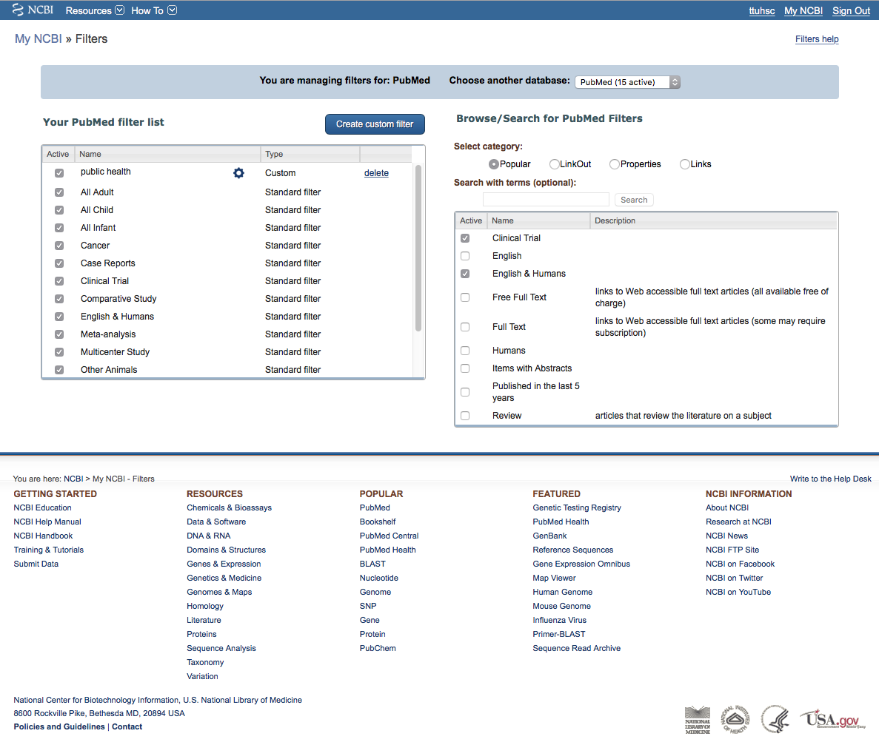

Click PubMed

Slide 70
Your user name
Click MeSH Database

Slide 71

Enter and click a
a
Search
hyperlipidemia

Slide 72

Term Definitions

Slide 73
Click the underlined term

Slide 74

Select drug therapy.
X
Sub-headings narrow the “meaning” of a
MeSH term.
M They are a “subset” of all the
articles under the MeSH term: Hyperlipidemias.

Slide 75

Click
Add to search builder
Click
Search PubMed

Slide 76

Search Results
Click Humans and 5 years

Slide 77

Results are reduced
from 16271 to 2033

Slide 78

Click Show additional filters

Slide 79

Select
Languages
✔
Journal categories
✔
Click Show

Slide 80

Click English and
Nursing journals

Slide 81

Results are reduced
from 2033 to 14

Slide 82
Click the custom filters to access
Quantitative Studies:
Clinical Trial
Meta-analysis
Randomized Controlled Trial
Systematic Reviews

Slide 83

Click on the title of the article you wish to read

Slide 84

Click icon for full text.

Slide 85

When Searching from Off Campus:
Enter the
Eraider username and password
assigned to you
by Information Services.
A
Problems with eRaider? Call: 806-743-1234 a

Slide 86

Click to download PDF

Slide 87

.
or click Send to: and select
File to save citations to a file on your computer or
Clipboard to temporarily store selected citations or
E-mail to send citations to self or colleague

Slide 88
Repeat the process using the Mesh term
“qualitative research”.

Slide 89
What questions do you have?

Slide 90
Finding e-journals in Gold Rush

Slide 91

www.ttuhsc.edu/libraries
Click Gold Rush

Slide 92

For instructions,
Click
What is Gold Rush?

Slide 93

Enter journal title, click
Search
nursing research

Slide 94

Click Nursing Research

Slide 95

1) Check Dates Available
2) Click Publisher

Slide 96

Locate article and click full text link
Select Year
Select Volume, Issue

Slide 97

Full-text

Slide 98
What questions do you have?

Slide 99


www.ttuhsc.edu/libraries
Click

Slide 100
The End

