Slide 1
Welcome
Scholarship for
Evidence-Based Practice
Peggy Edwards, AMLS
TTUHSC - Preston Smith Library
Lubbock, Texas 79430
Sept 2013

Slide 2
Please complete the
pre-survey on your desktop.

Slide 3
Online Library Card

Slide 4
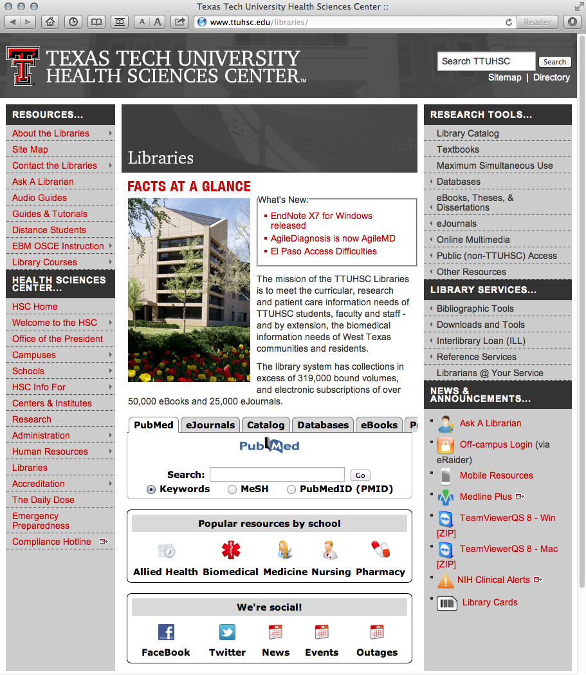
Click for electronic application

Slide 5
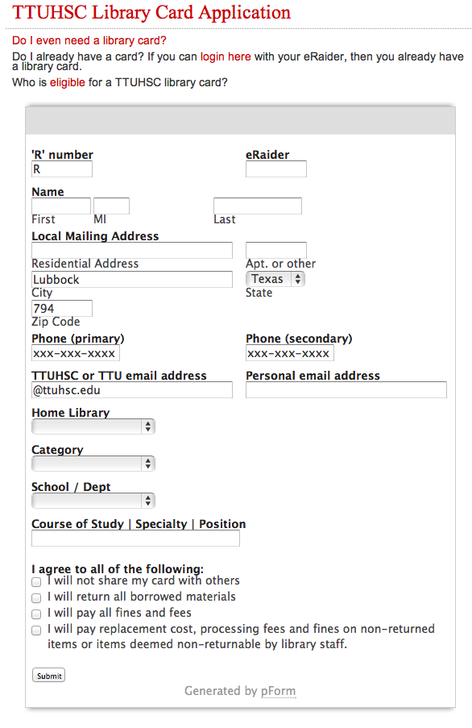
Do I already have a library card?
Click here to check!
You need a library card to:
Borrow books
Request an interlibrary loan
Use library computers in
  * the LRC
  * in library study rooms
Fill out application
Click Submit

Slide 6
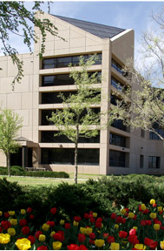
Welcome!
Preston Smith Library
located west of the
Academic Classroom
Building

Slide 7


Reference Librarians - Lubbock
Carrie
Gassett
Peggy
Edwards
Available 8–5
Monday–Friday
Dawn
Kruse
Field
Margaret
Vugrin

Slide 8
A
G
E
N
D
A
2:00-2:10 10 min. Welcome/introduction - Ann Hagstrom
pre-survey, library cards?, sign-up sheet - Peggy
2:10-2:15 5 min. Tour library home page:
Ask-a-Librarian, Guides & Tutorials,
Bibliographic Tools, APA Tutorial,
SoN Popular Resources, TeamViewer
2:15-2:35 20 min. CINAHL, Nursing Reference Center- Peggy
2:35-2:45 10 min. PubMed Clinical Queries, Gold Rush
mention Micromedex, Natural Standards – Peggy
2:45-2:55 10 min. Search Strategy Worksheet example
Boolean Logic, Subheadings - Peggy
2:55-13:00 5 min. Break
3:00-3:45 45 min. PICO Question Hands-on Searching – Class
3:45-3:50 5 min. Evaluations / Tell them status of library cards – Peggy

Slide 9
A
G
E
N
D
A
10:00-10:10 10 min. Welcome/introduction - Ann Hagstrom
pre-survey, library cards?, sign-up sheet - Peggy
10:10-10:15 5 min. Tour library home page:
Ask-a-Librarian, Guides & Tutorials,
Bibliographic Tools, APA Tutorial,
SoN Popular Resources, TeamViewer
10:15-10:35 20 min. CINAHL, Nursing Reference Center- Peggy
10:35-10:45 10 min. PubMed Clinical Queries, Gold Rush
  mention Micromedex, Natural Standards – Peggy
10:45-10:55 10 min. Search Strategy Worksheet example
Boolean Logic, Subheadings - Peggy
10:55-11:00 5 min. Break
11:00-11:45 45 min. PICO Question Hands-on Searching – Class
11:45-11: 50 5 min. Evaluations / Tell them status of library cards – Peggy

Slide 10
Library Home Page

Slide 11
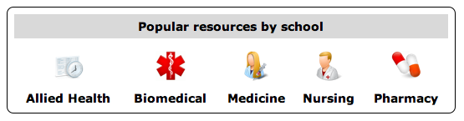
Popular Resources is a good starting point.

Slide 12
Search Question

Slide 13
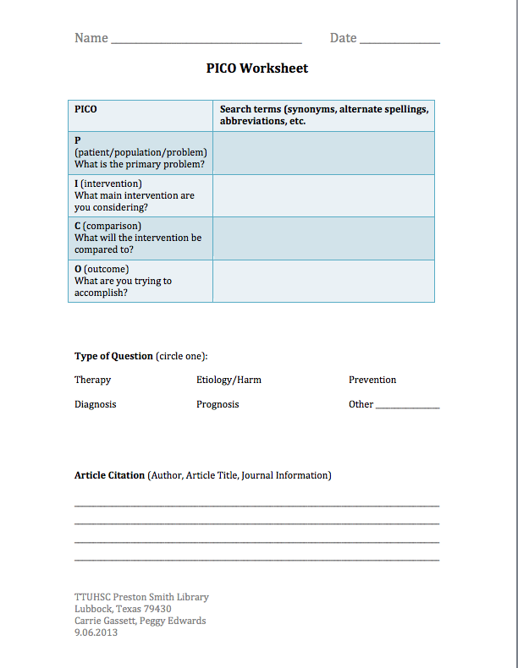
In adult patients with headache recurrence,
is sumatriptan or naproxen the most effective drug therapy?
P
adult patients with headache recurrence
I
sumatriptan
C
naproxen
O
the most effective drug therapy

Slide 14
Search Strategy

Slide 15
Search
Question:
In adult patients with headache recurrence,
is sumatriptan or naproxen the most effective drug therapy?
Databases:
1
AND
2
AND
3
AND
4
headache
recurrence
sumatriptan
naproxen
OR
Do you need… ?
limiters such as:
age groups
adult
subheadings
drug therapy
language
English
publication types
peer reviewed
dates
last 5 years
human or animal
journal subsets

Slide 16
Boolean Logic – OR - broadens
sumatriptan
naproxen
OR

Slide 17
Boolean Logic – AND - narrows
sumatriptan
OR
naproxen
headache/
drug therapy
and

Slide 18
Boolean Logic – AND - narrows
headache/
drug therapy
sumatriptan
and
naproxen
and

Slide 19
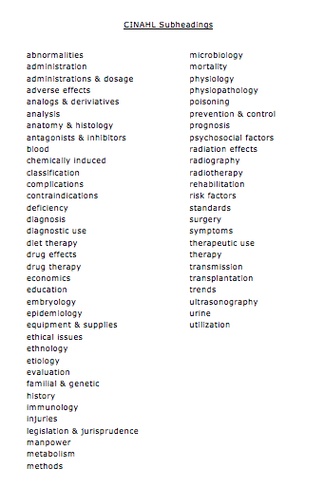
Sub-headings narrow the “meaning” of a
subject heading. They are a “subset” of all the
articles under the subject heading: headache.

Slide 20
Searching CINAHL

Slide 21
Hover-over Databases

Slide 22
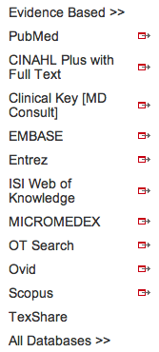
Click CINAHL

Slide 23
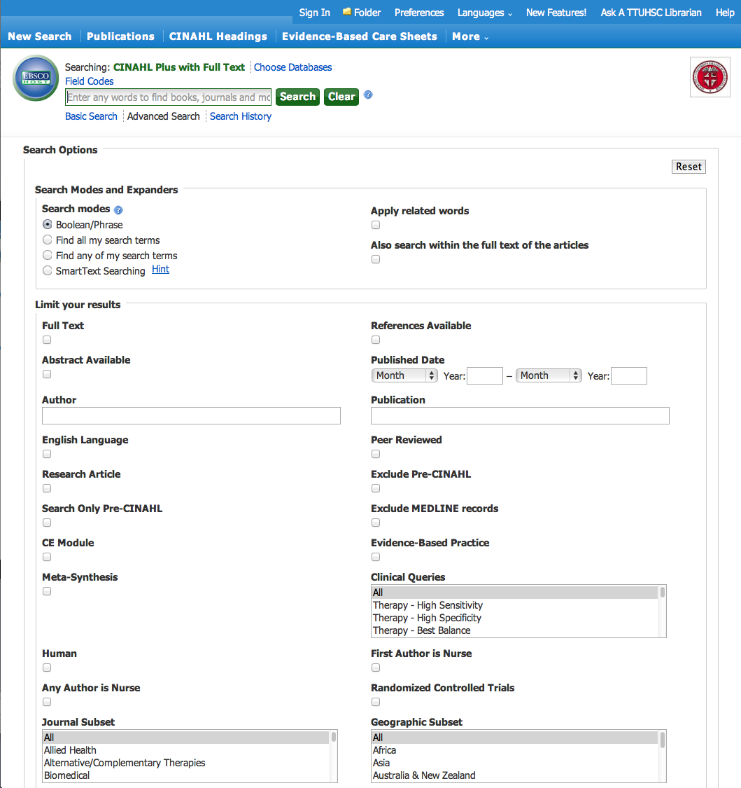
Click CINAHL Headings

Slide 24
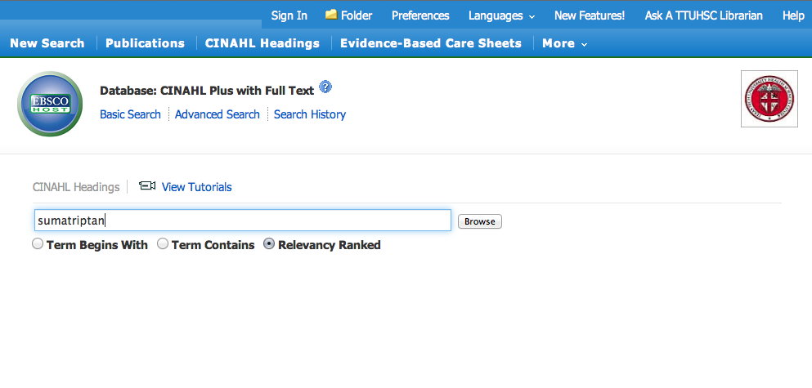
Enter
sumatriptan
and click
Browse

Slide 25
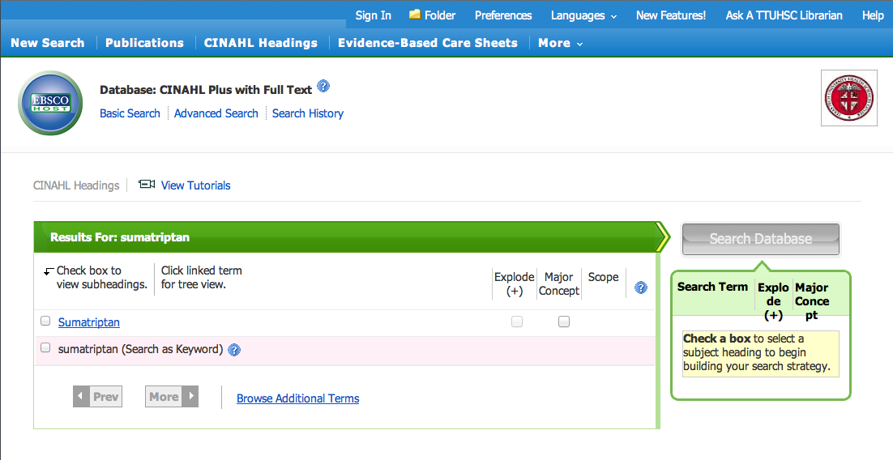
✔
Check the subject heading

Slide 26
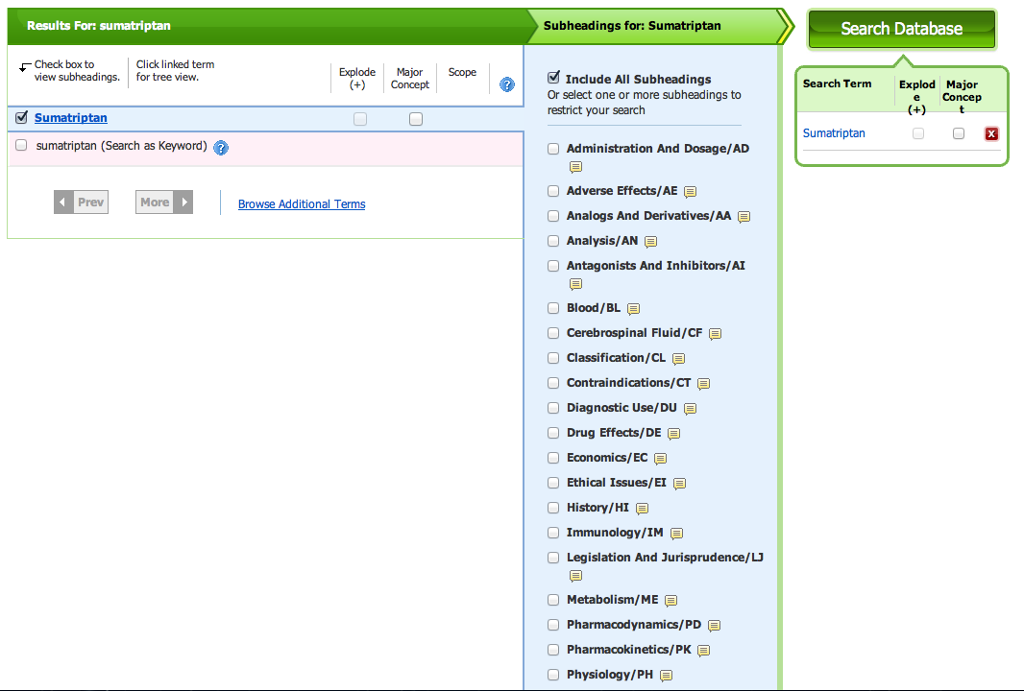
Subheadings
appear
Sub-headings narrow the “meaning” of a
subject heading. They are a “subset” of all
the articles under the term: Sumatriptan.

Slide 27
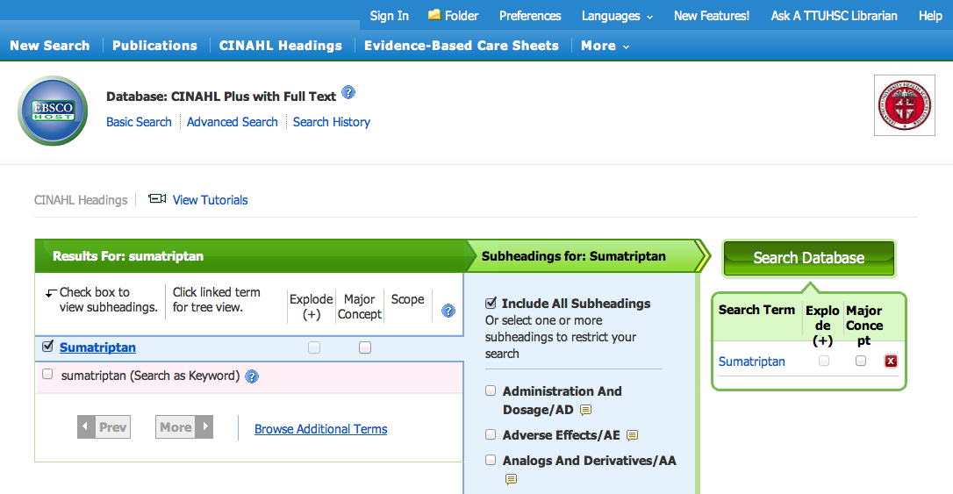
click
Search Database

Slide 28
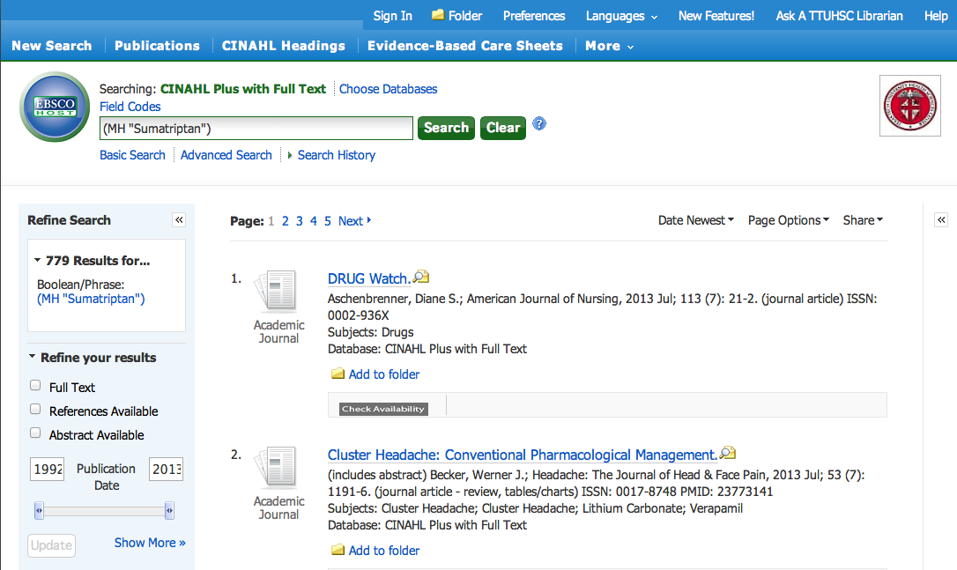
Click CINAHL Headings

Slide 29
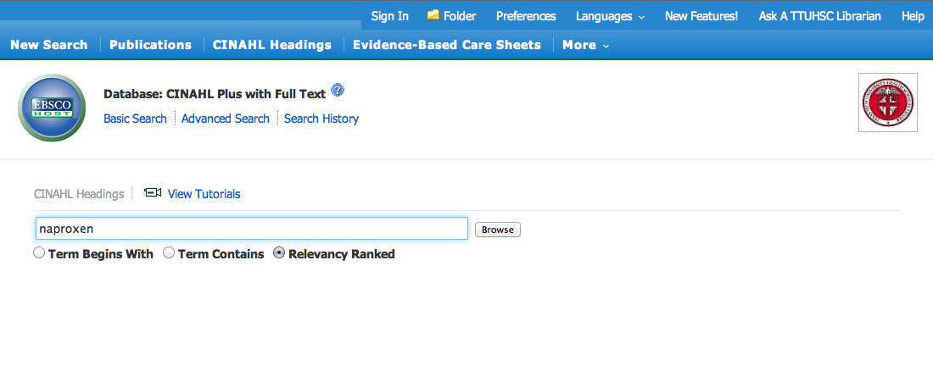
Enter
naproxen
and click
Browse

Slide 30
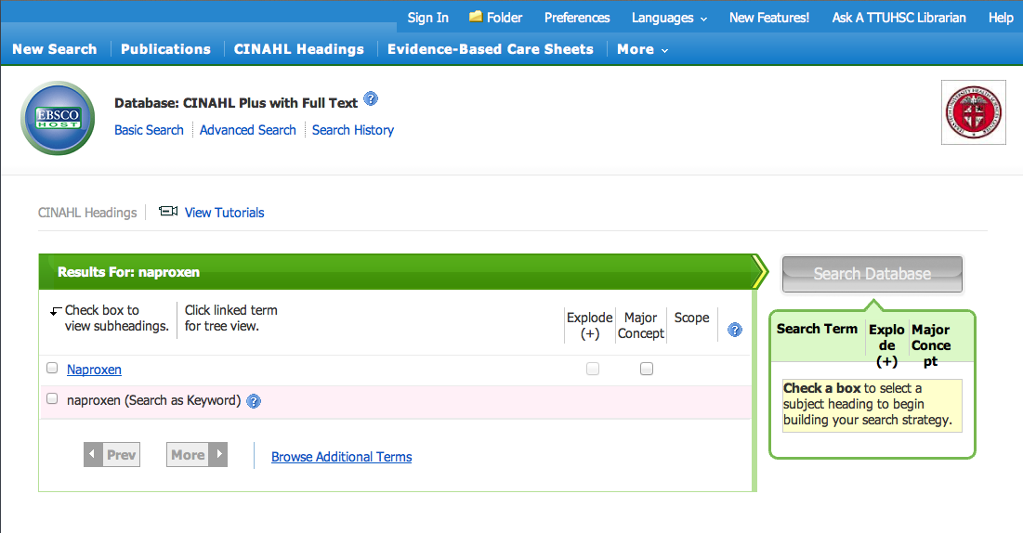
✔
Check the subject heading

Slide 31
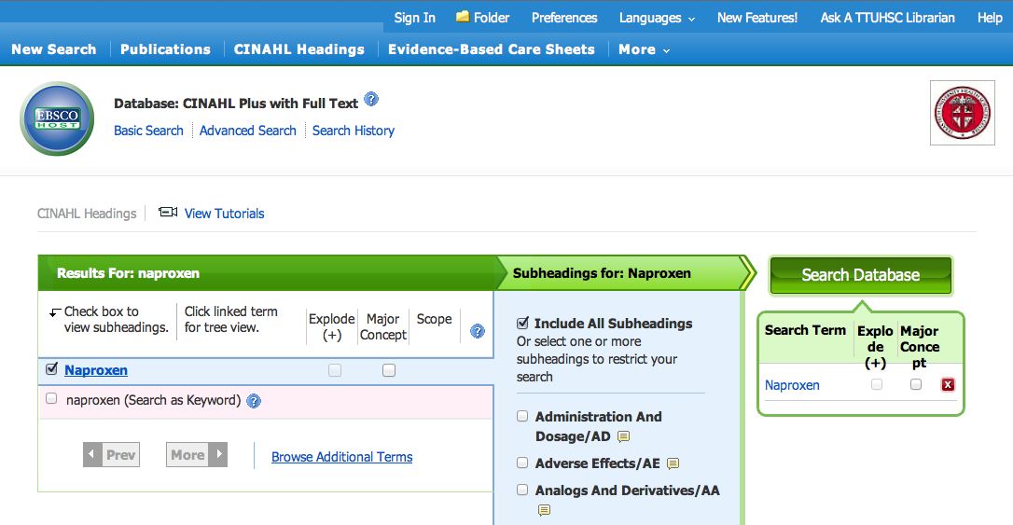
click
Search Database

Slide 32
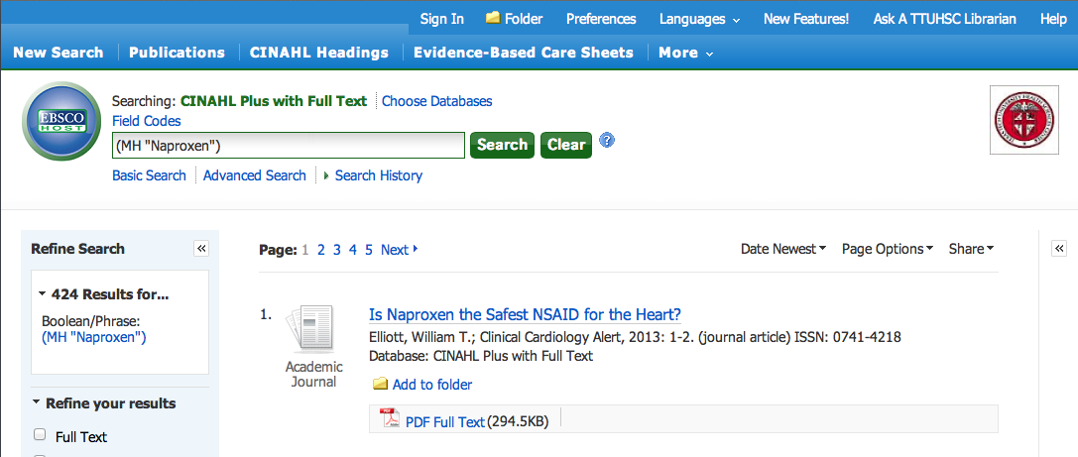
Click Search History

Slide 33
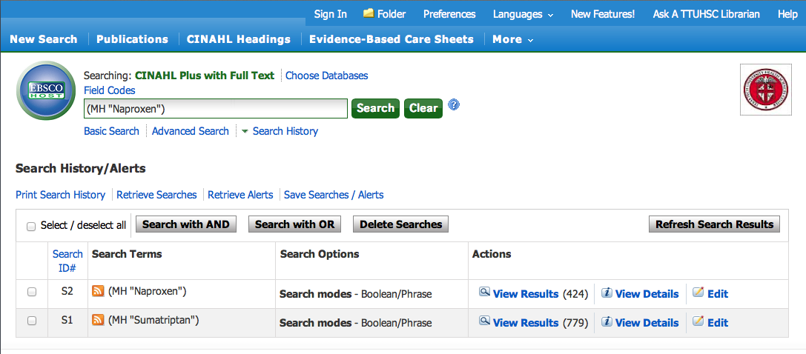
Click
Clear

Slide 34
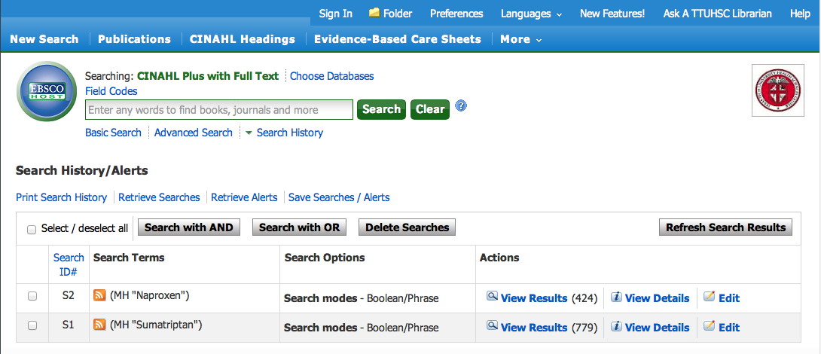
Select sets and click
Search with AND
✔
✔

Slide 35
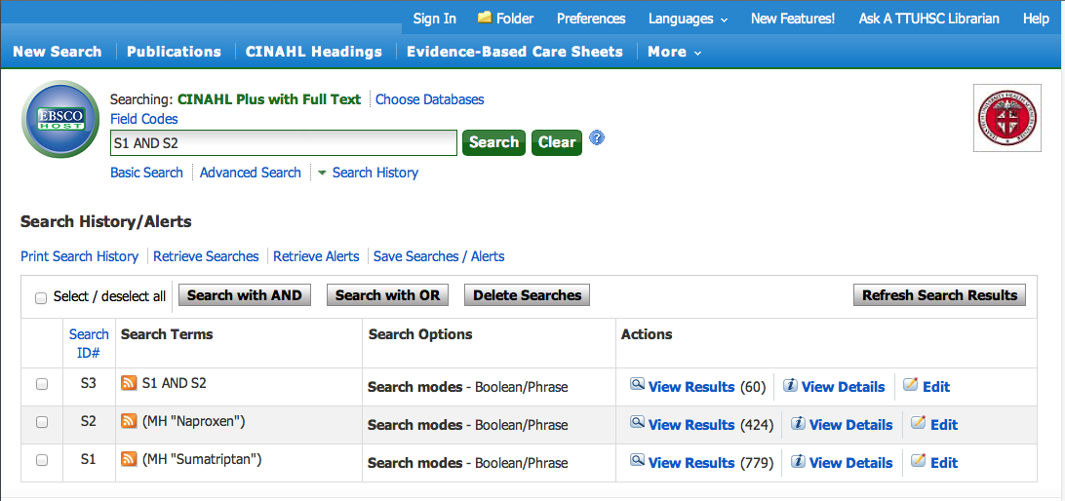
Results of AND combination

Slide 36
Click CINAHL Headings

Slide 37
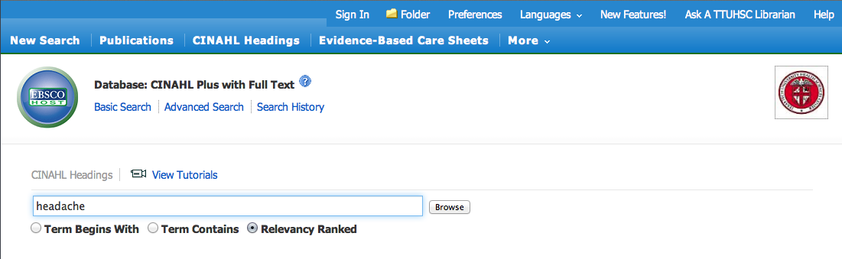
Enter
headache
and click
Browse

Slide 38
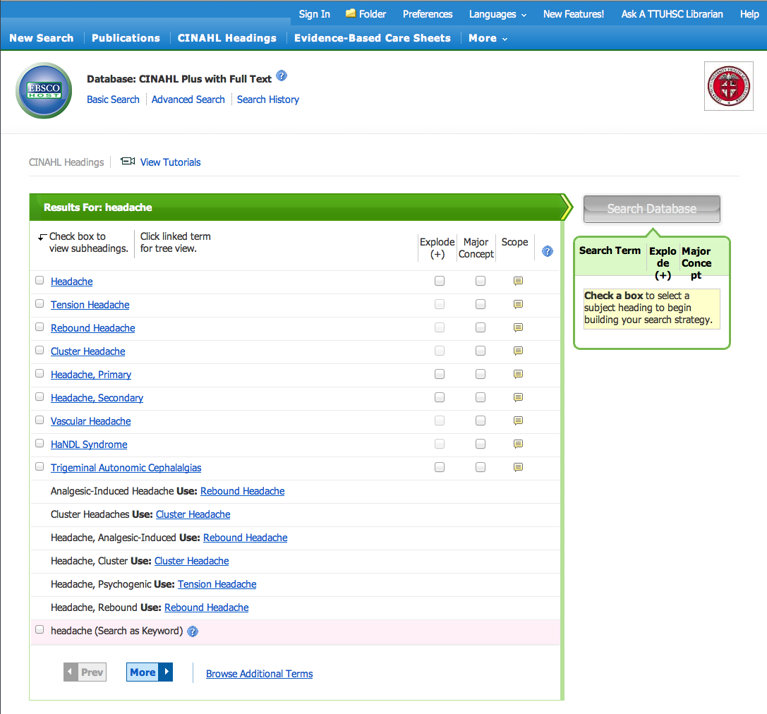
Click Headache, Primary for Tree Structure hierarchy

Slide 39
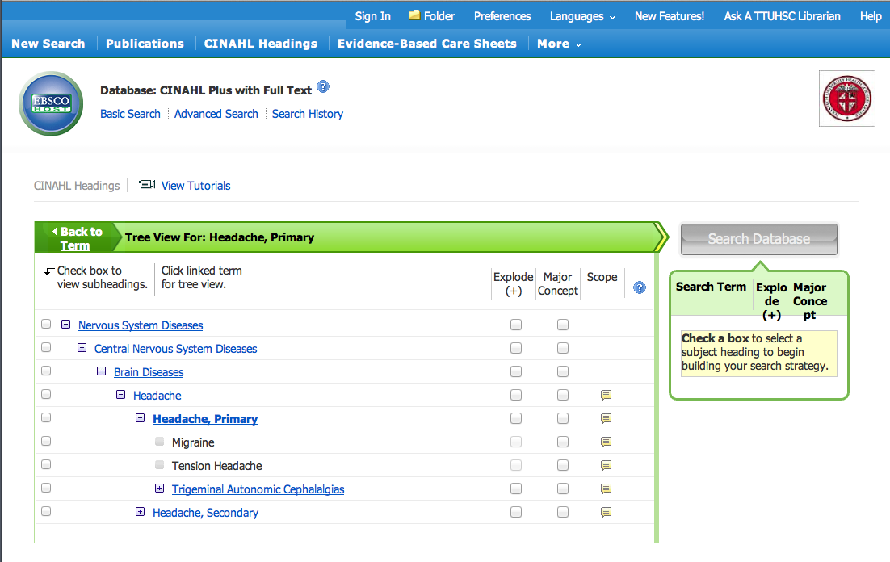
Terms are listed from
broadest to narrowest.
If Migraine yields zero results,
try using a broader term:
Headache, Primary.

Slide 40
✔
Click the box under “Explode” to include articles indexed
to Headache, Primary; Migraine; & Tension Headache

Slide 41
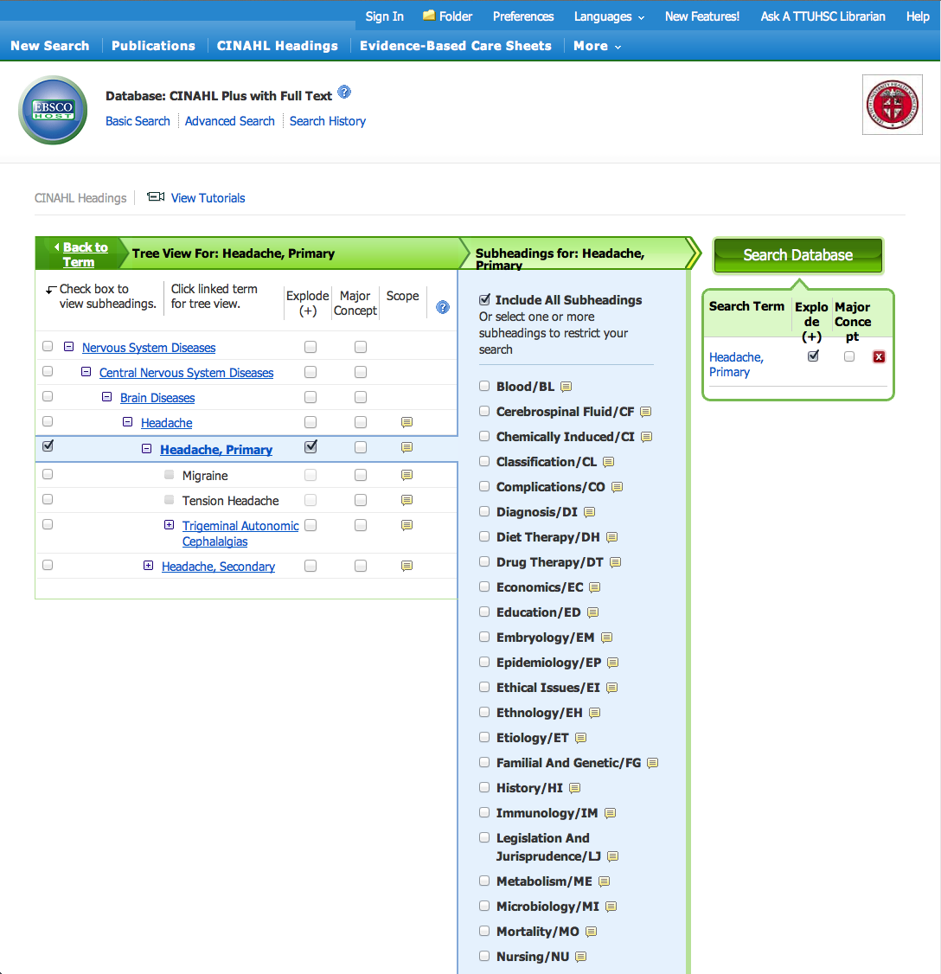
Subheadings
appear

Slide 42
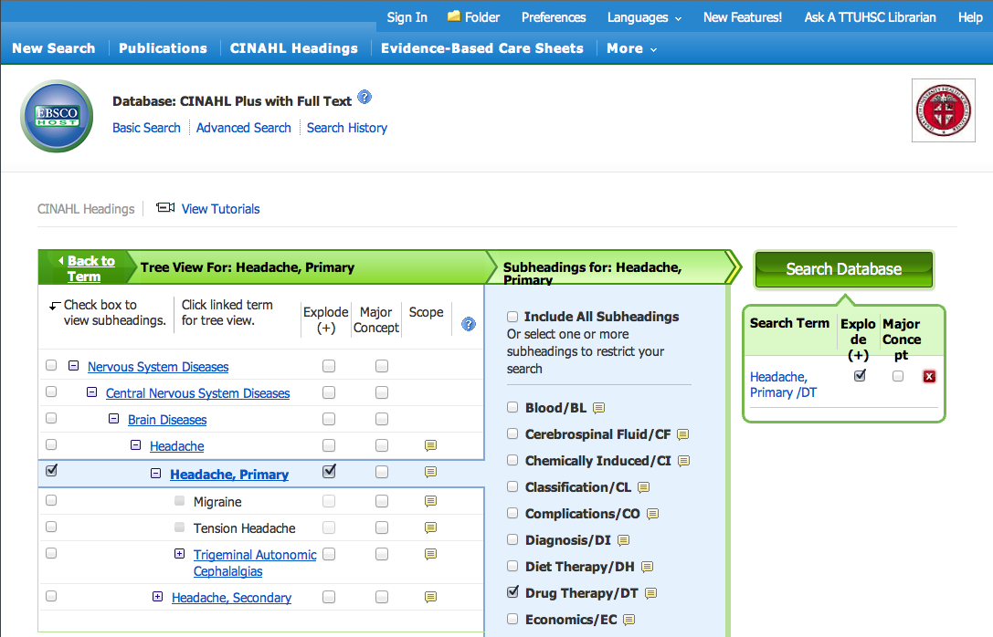
Select the subheading drug therapy
✔
click
Search Database

Slide 43
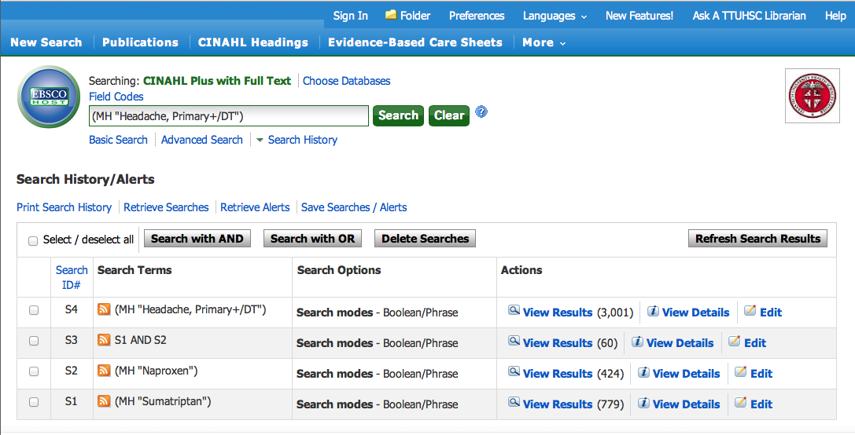
Click
Clear

Slide 44
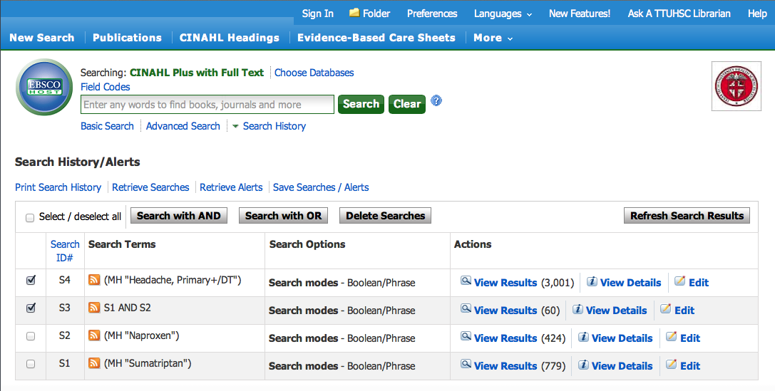
Select sets and click
Search with AND
✔
✔

Slide 45
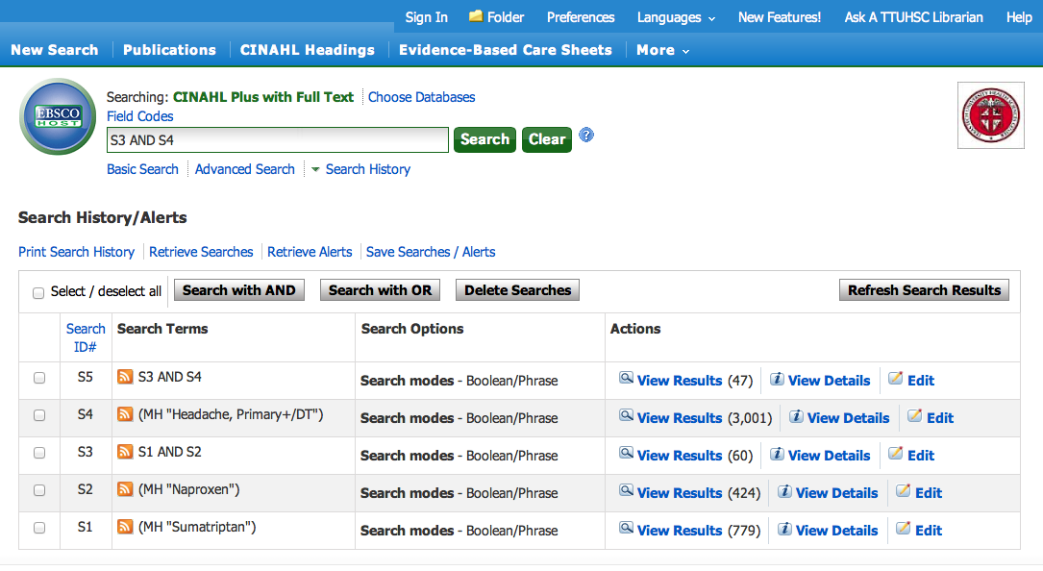
Click
Clear
Results

Slide 46
Refining Results

Slide 47
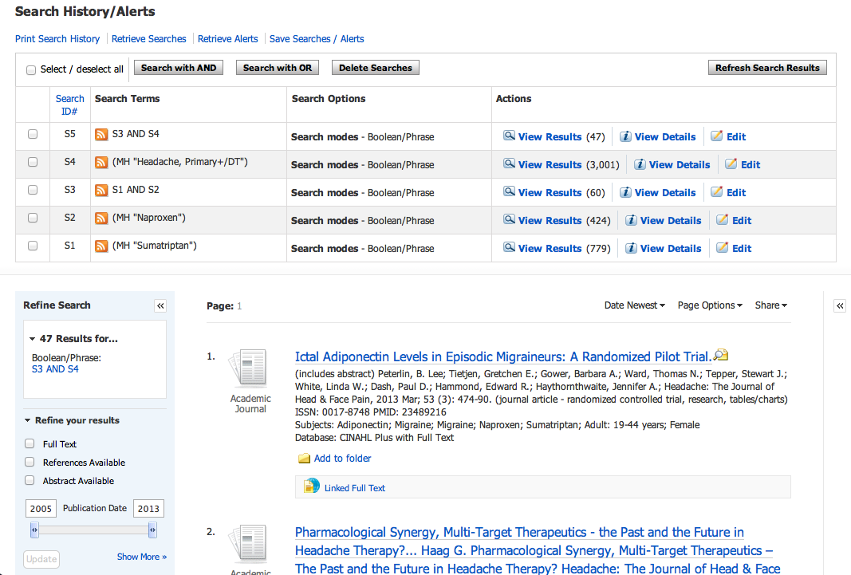
Refine the Results
Adjust the left-hand slider until the left-hand date reads 2008. This will narrow to articles published in the last 5 years.

Slide 48
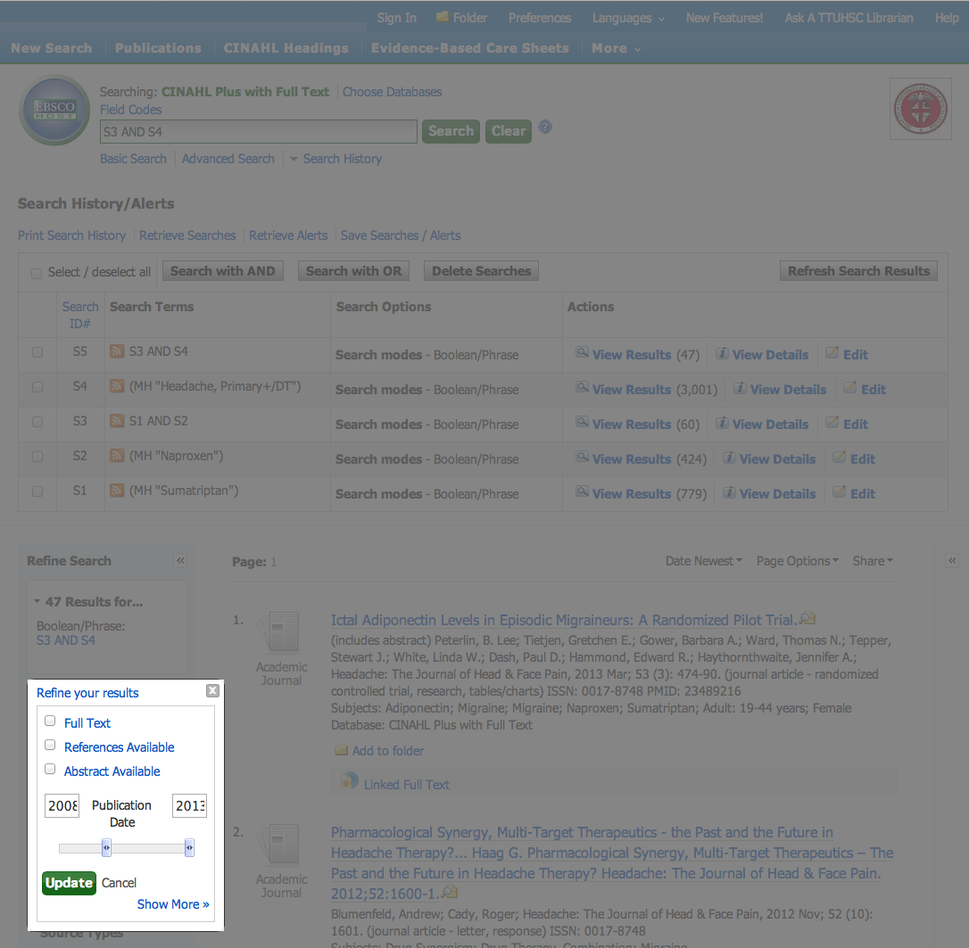
Screen will gray out. Adjust slider. Click Update.

Slide 49
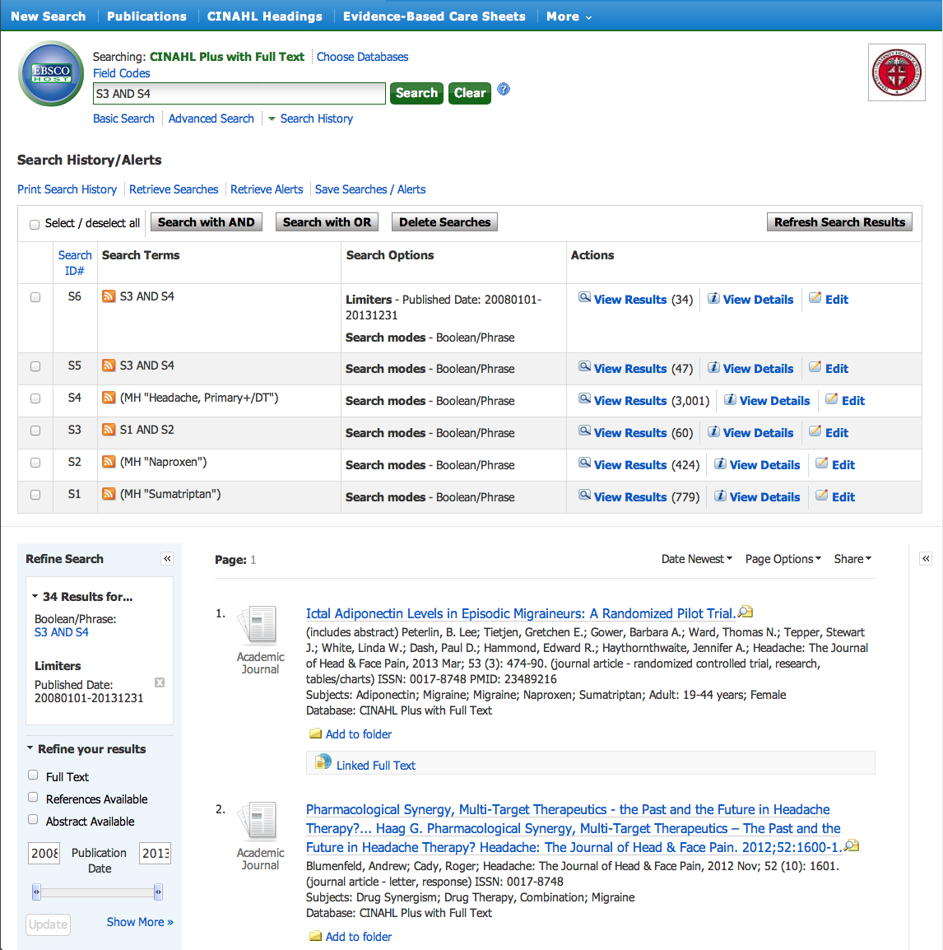
Results
Click Show More

Slide 50
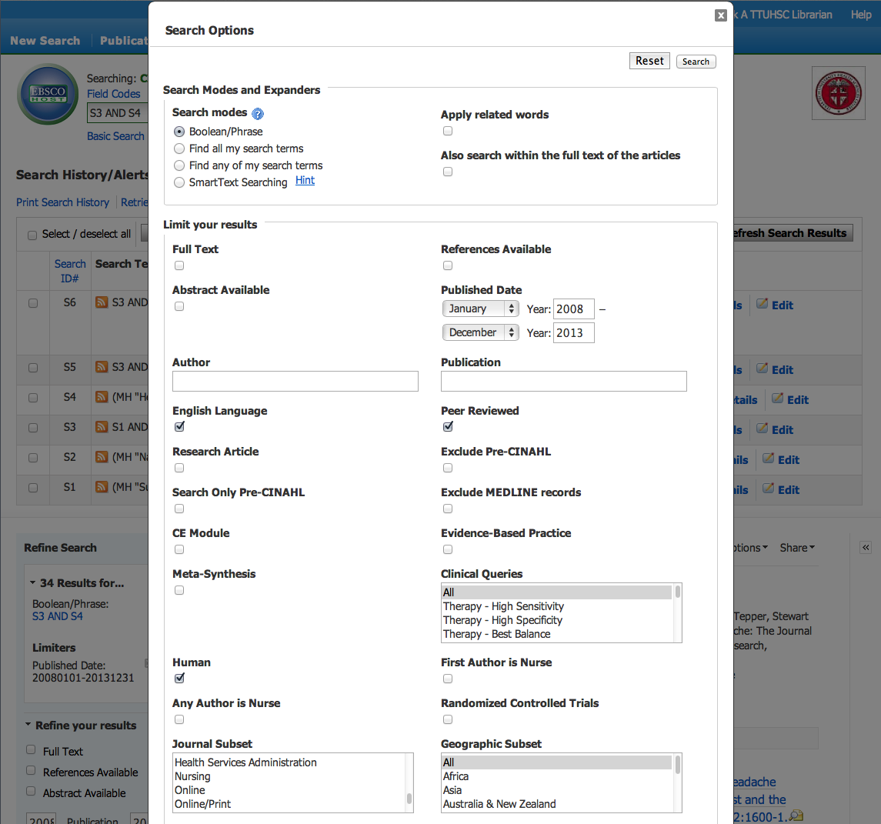
Select filters relevant to search.

Slide 51
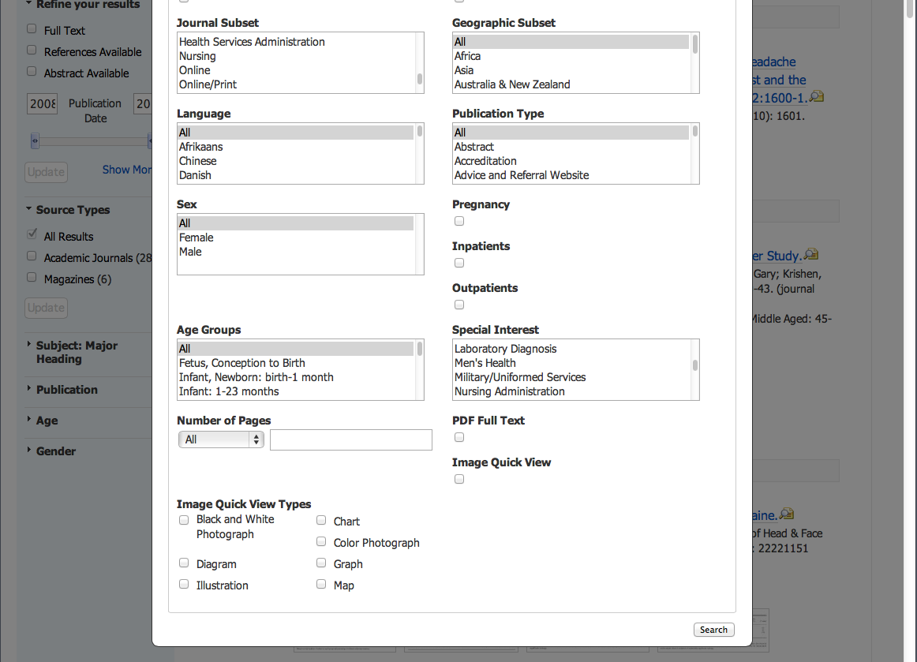
Click Search to apply

Slide 52
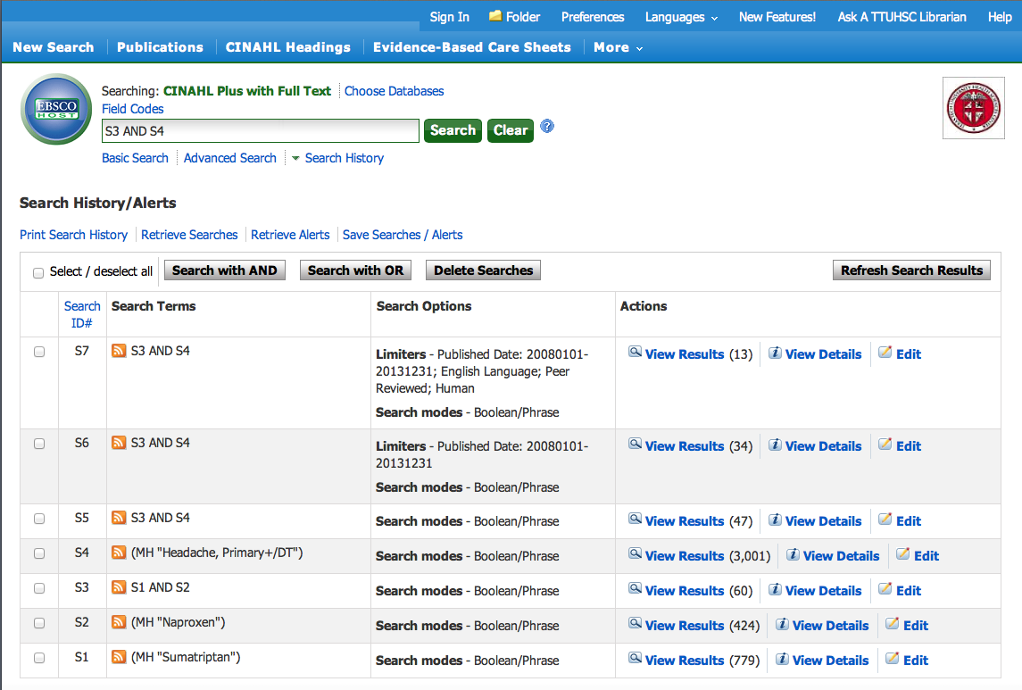
Results have narrowed
to 13 articles
Click View Results

Slide 53
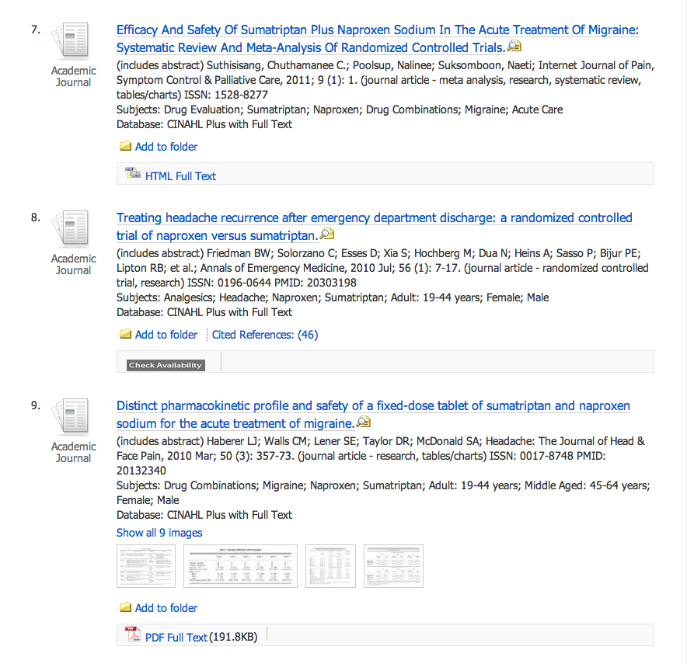
Scroll to article 8, click article title.

Slide 54
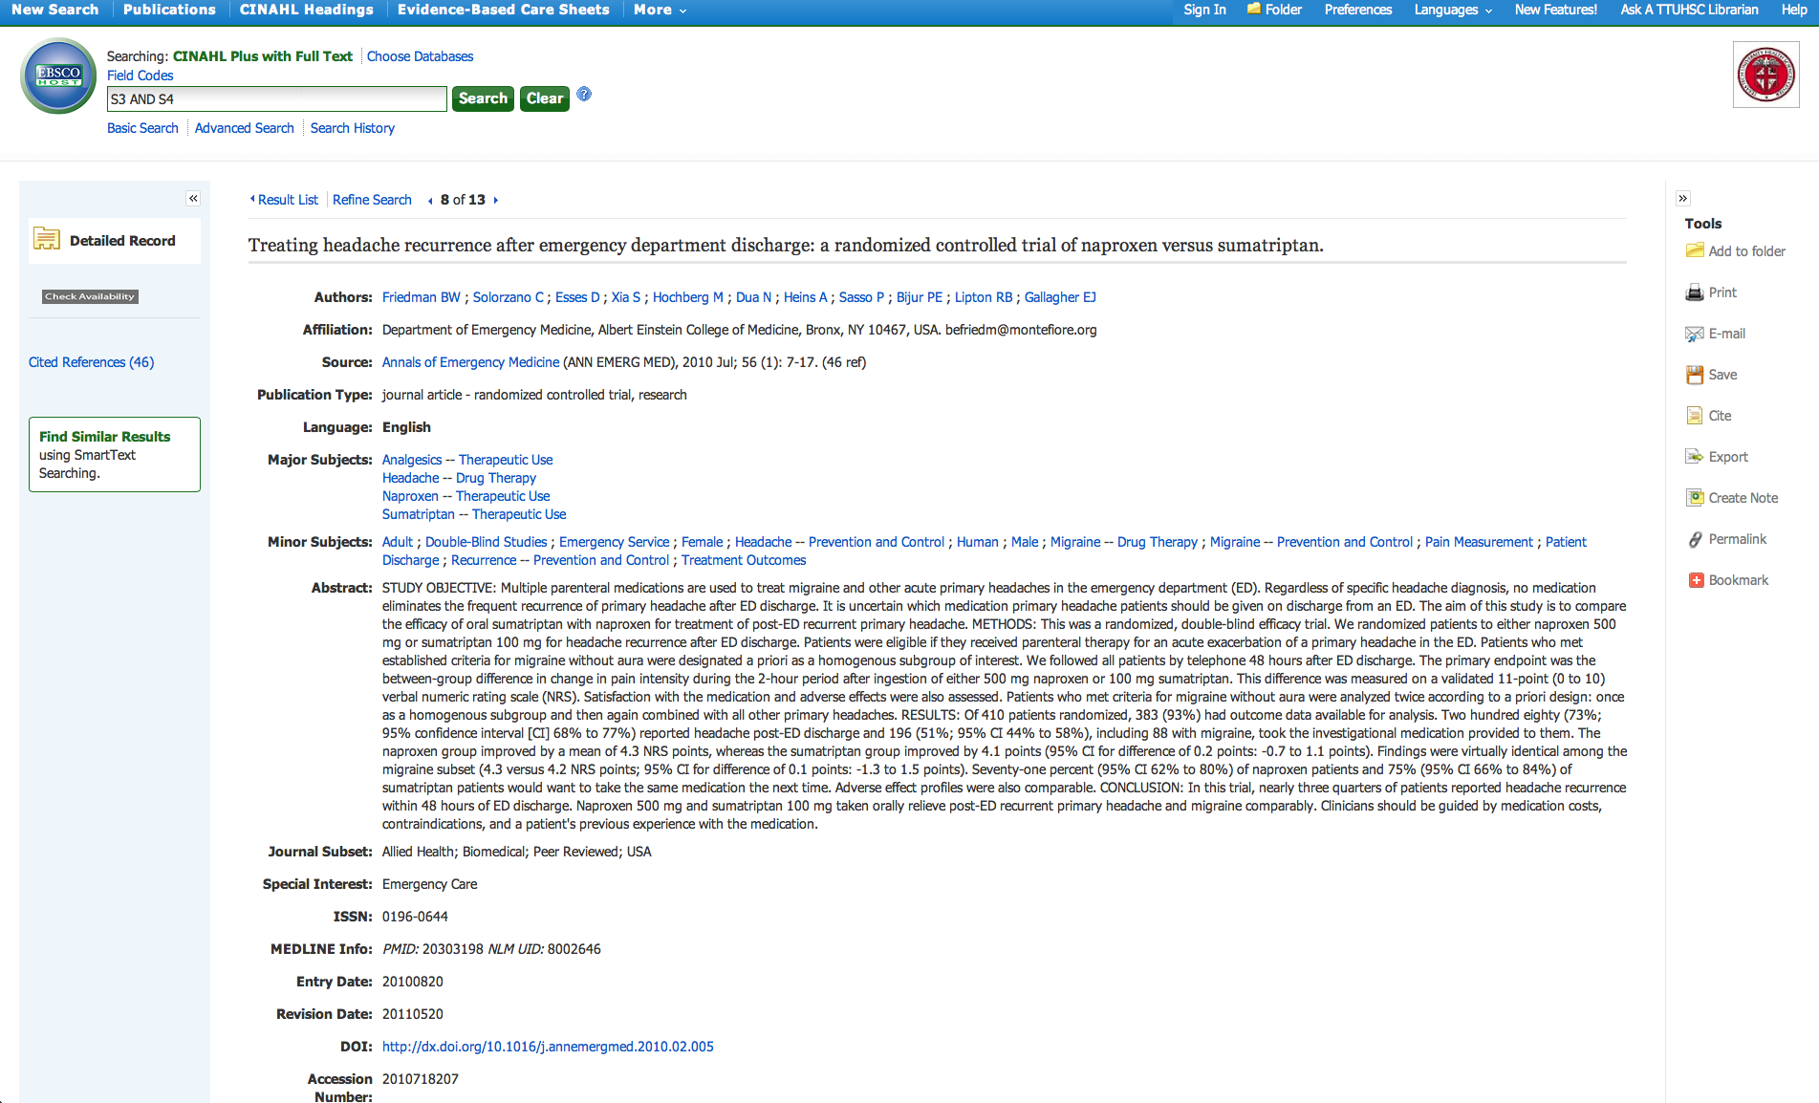
Click E-mail
Note the subject headings indexed to this article.

Slide 55
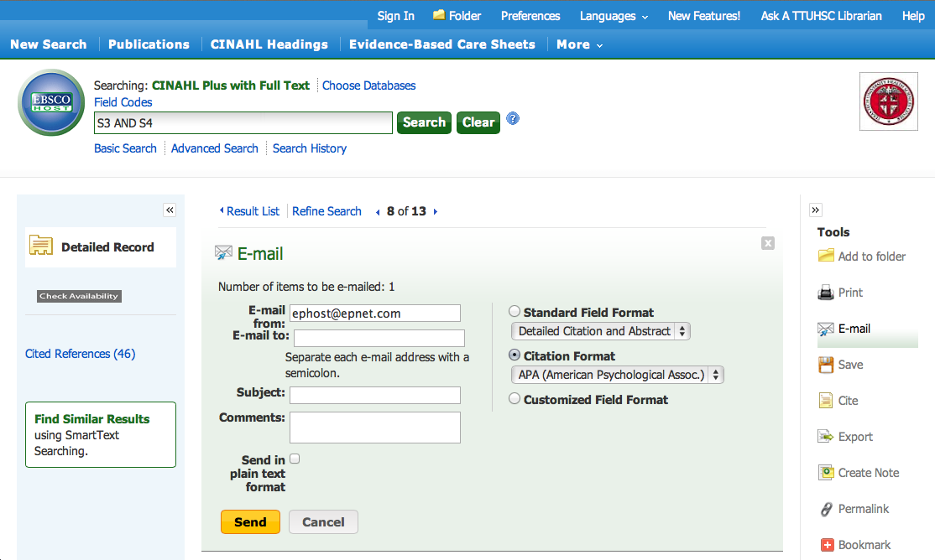
Type E-mail
address
Click Send

Slide 56
Click Search History

Slide 57
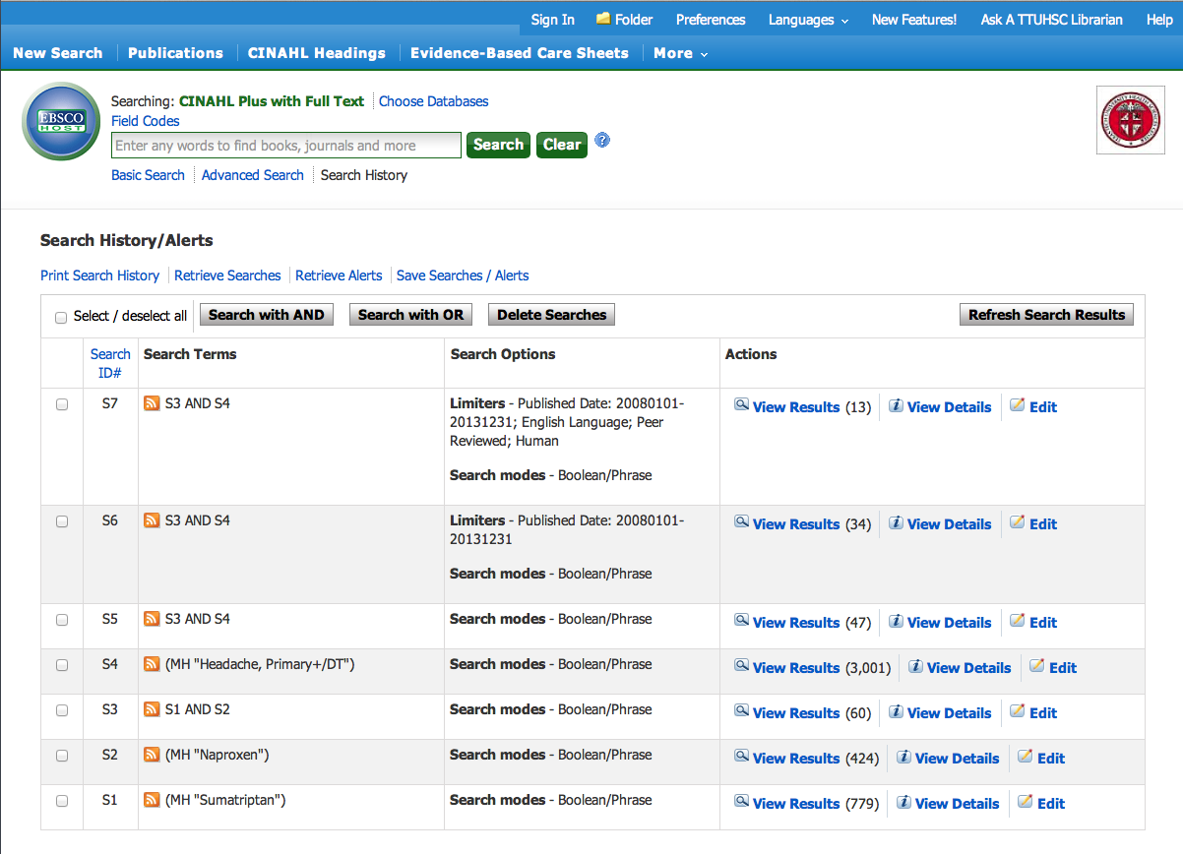
Print Search History or save as a PDF

Slide 58
What questions do you have?

Slide 59
Searching
Nursing Reference Center

Slide 60


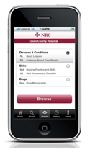

clinical information
at the point-of care…
…and comprehensive
scholarly literature.

Slide 61


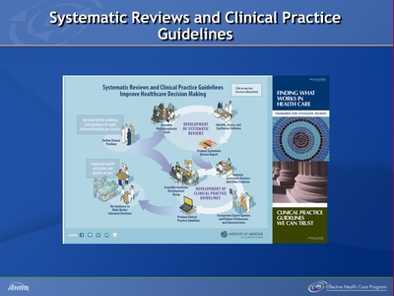
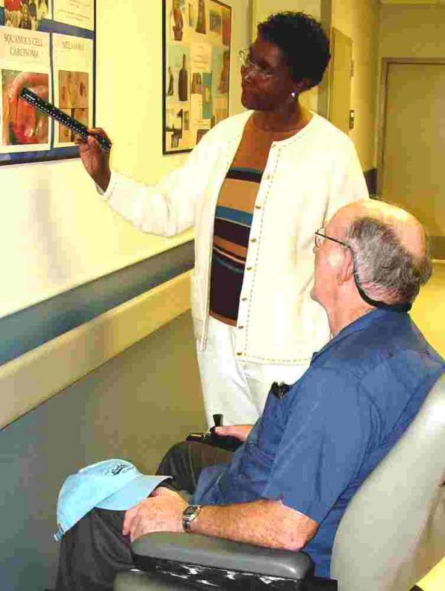
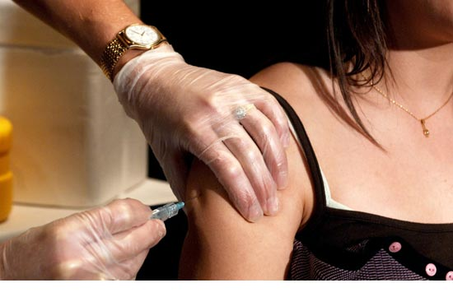
drug information
conditions and diseases
practice guidelines
bilingual patient ed
resources
skills and procedures

Slide 62
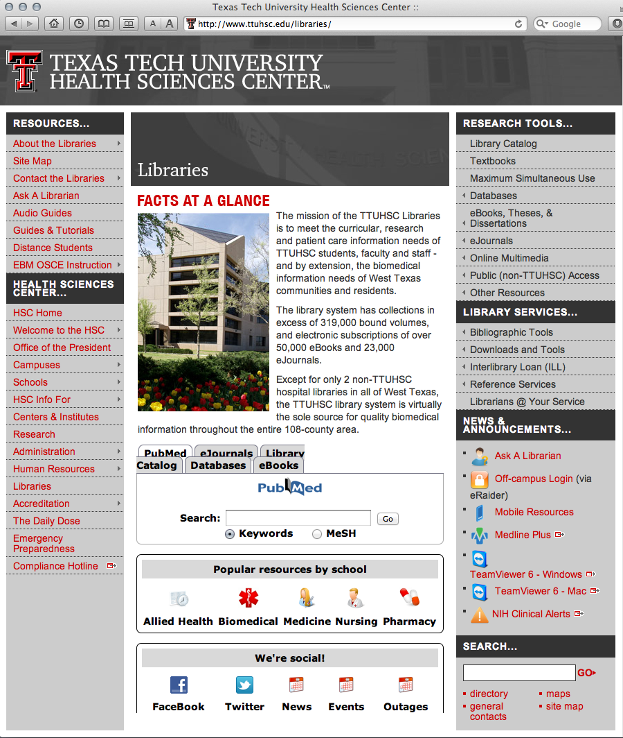
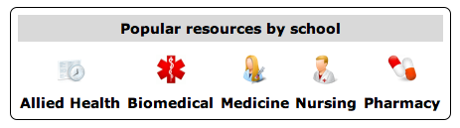
www.ttuhsc.edu/libraries
Click Nursing

Slide 63
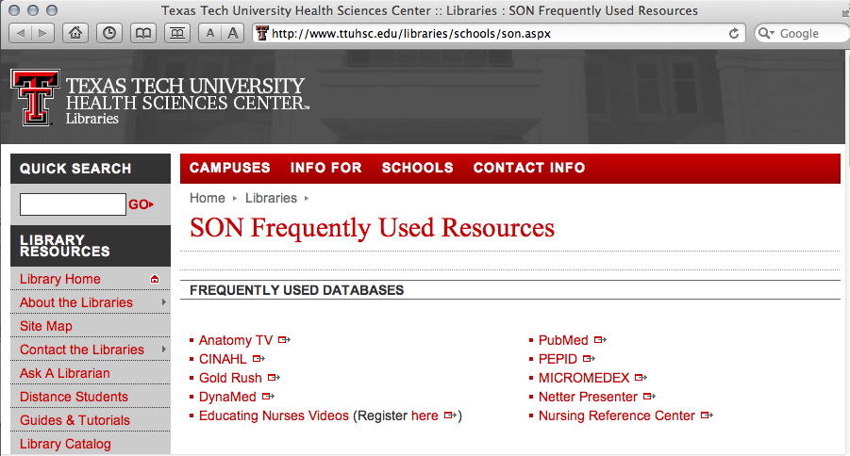
Click Nursing Reference Center

Slide 64
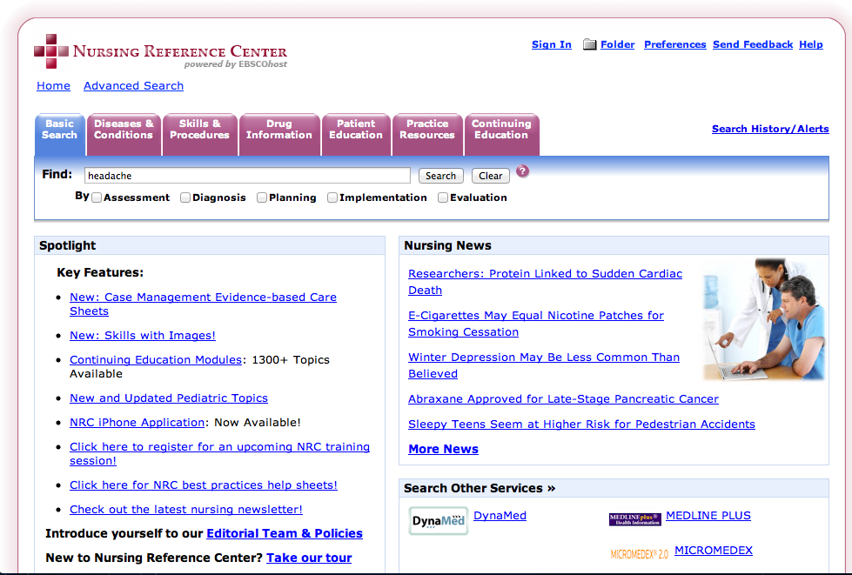
Home Page

Slide 65
Enter headache
Click Search

Slide 66
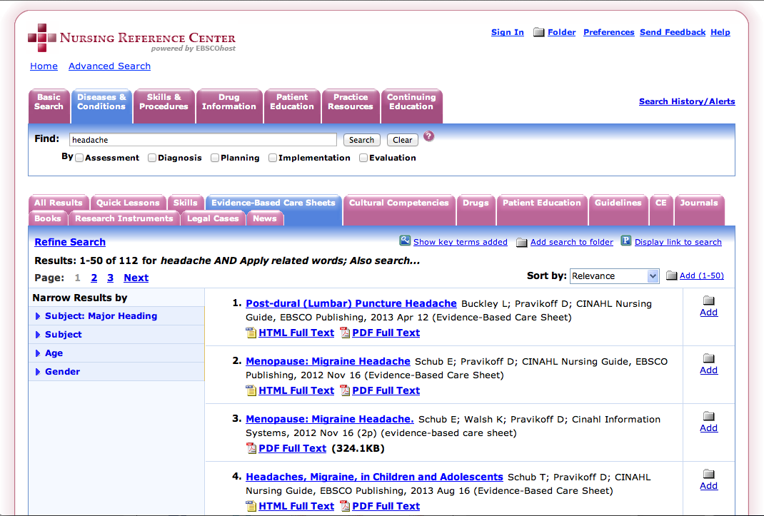
Click Document Type: Evidence-Based Care Sheets

Slide 67
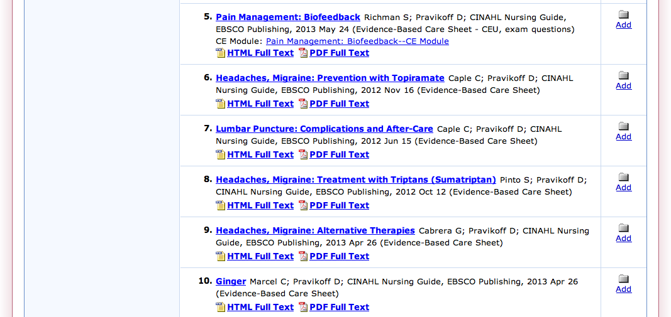
Scroll to #8 and click
PDF Full Text

Slide 68
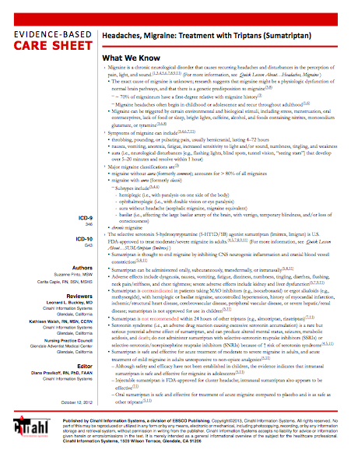
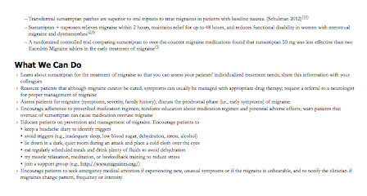


Slide 69

Click Quick Lesson.
Open the PDF for # 1

Slide 70


Slide 71

Enter hand washing
Click Search

Slide 72

Click Skills

Slide 73

Click Document You Wish to Read

Slide 74

Article Title
skill competency checklist

Slide 75
What questions do you have?

Slide 76
EBP Literature from
PubMed’s Clinical Queries

Slide 77



PubMed Database
Biomedical journal literature
International scope
Published by:
The National Library of Medicine

Slide 78



Accessing PubMed
Freely available over the Internet
@ www.pubmed.gov
Also through library’s home page

Slide 79


Evidence-Based Practice is guided by thoughtful integration
of the best available scientific knowledge with clinical expertise.

Slide 80

PubMed’s Clinical Queries
tool that searches for evidence-based literature

Slide 81




Clinical Queries Searchable by:
Diagnosis
Therapy
Prognosis (prediction of probable outcome)
Etiology (cause)

Slide 82
Clinical Queries Searchable by:
Diagnosis
Therapy
Prognosis (prediction of probable outcome)
Etiology (cause)

Slide 83

PubMed’s Clinical Queries
uses pre-formulated search strategies with a keyword search

Slide 84

PubMed’s Clinical Queries
www.ttuhsc.edu/libraries
Mouse over Databases
Click PubMed

Slide 85

PubMed Home Page

Slide 86
Click Clinical Queries

Slide 87

Enter asthma
Click
Search

Slide 88

Change to Narrow Scope
Results for Therapy and
Broad Scope

Slide 89

Results for Therapy and
Narrow Scope
Click See all (8069)

Slide 90

Select filters
Click Humans to select

Slide 91

Selections will turn blue: ✓ Humans

Slide 92

Click 5 years to limit

Slide 93
Click Show additional filters

Slide 94

Select
Languages
Journal Categories
✔
✔
Click Show

Slide 95

Click English
Click Nursing Journals

Slide 96

Selections turn blue: ✓ English, Nursing journals

Slide 97
Results have narrowed to 12
Click on the title of the article you wish to read

Slide 98

Click for Free Full Text
TTUHSC ONLINE

Slide 99

TTUHSC Libraries - Proxy Server
When Searching from Off Campus:
Enter the
Eraider username and password
assigned to you
by Information Services.
Problems with eRaider call: 806-743-1234
a

Slide 100


Click

Slide 101

Full Text

Slide 102
What questions do you have?

Slide 103
Drug Information in
MICROMEDEX

Slide 104


MICROMEDEX
Authoritative drug information

Slide 105
www.ttuhsc.edu/libraries
Click Nursing

Slide 106

Click MICROMEDEX

Slide 107

warfarin
Begin entering drug name.
Select correct drug.

Slide 108

Select detailed document

Slide 109

Drug Monograph

Slide 110

Special Tools
A

Slide 111

Interactions table includes:

Slide 112




MICROMEDEX – drug identification

Slide 113


MICROMEDEX – toxicology info

Slide 114

Customized print-out

Slide 115



MICROMEDEX: also includes
Diseases and Acute Care
Alternative Medicines
Patient Education

Slide 116
APA Style

Slide 117

Bibliographic Tools
www.ttuhsc.edu/libraries
Mouse over Bibliographic Tools
Bibliographic Tools
Click more>>

Slide 118

Link to Basics of APA Style

Slide 119


Slide 120
Identifying Citations
A citation is the:
author(s) of the article
title of the article
journal, volume, issue, pages where the article is located

Slide 121

Article Title
Authors
Journal Article
Journal Title
Year, Volume, Issue, Page

Slide 122
Have Questions
or
Need Help?

Slide 123

Library home page at www.ttuhsc.edu/libraries

Slide 124
Today’s PowerPoint
Click Popular
Resources
by School

Slide 125

PowerPoint for
Scholarship for Evidence-Based Practice

Slide 126
Guides & Tutorials
Click
Guides & Tutorials

Slide 127


Scroll to Databases

Slide 128

www.ttuhsc.edu/libraries
Fill out the form to email us a question!

Slide 129

www.ttuhsc.edu/libraries
Download TeamViewer

Slide 130




Call your TTUHSC Librarian

Slide 131

Double click the icon and follow the directions

Slide 132

Give the password to the librarian to enter.
Log On
After logging on, the librarian can see your computer screen!
At the end of the session after logging off,
the librarian will not have access to your computer!
TeamViewer generates a new password each time it is used!

Slide 133

or contact us at:
Lubbock
(806) 743-2200
Amarillo
(806) 354-5448
El Paso
(915) 545-6652
Odessa
(432) 335-5171

Slide 134
Hands-On Exercises

Slide 135
PICO Question

Slide 136


How to Develop a PICO Question

Slide 138
Search
Question:
Databases:
1
AND
2
AND
3
AND
4
OR
Do you need… ?
limiters such as:
age groups
subheadings
language
publication types
dates
human or animal
journal subsets

Slide 139
What questions do you have?

Slide 140
Please…
locate the Evaluations icon on your desktop and fill it out.
Thank-you…
we appreciate your feedback!

Slide 142
The End

Slide 143


