Slide 1
Welcome
Information Resources for Speech Language Pathology
Peggy Edwards, AMLS
TTUHSC - Preston Smith Library
Lubbock, Texas 79430
Oct 2013

Slide 2
On your desktop locate the pre-survey and complete it.

Slide 3
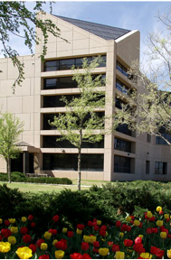
Welcome!
Preston Smith Library
located west of the
Academic Classroom
Building

Slide 4
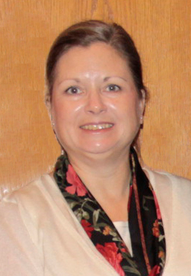


Reference Librarians - Lubbock
Carrie
Gassett
Peggy
Edwards
Available 8–5
Monday–Friday
Margaret
Vugrin
Eratosthenes
ai r - uh - T AW S - th uh - n ee z.

Slide 5
A
G
E
N
D
A
Speech Language Pathology
Wednesday, October 16, 2013
Time: 11:30 am – 12:20 pm, LRC
11:30-11:35 5 min. Welcome, pre-survey
11:35-11:50 15 min. CINAHL, ERIC - Peggy
11:50-12:05 15 min. PsychInfo,
Linguistics & Language Behavior Abstracts
12:05-12:15 10 min. PubMed's Clinical Queries, Gold Rush
12:15-12:20 5 min. Evaluations

Slide 6
Library Home Page

Slide 7
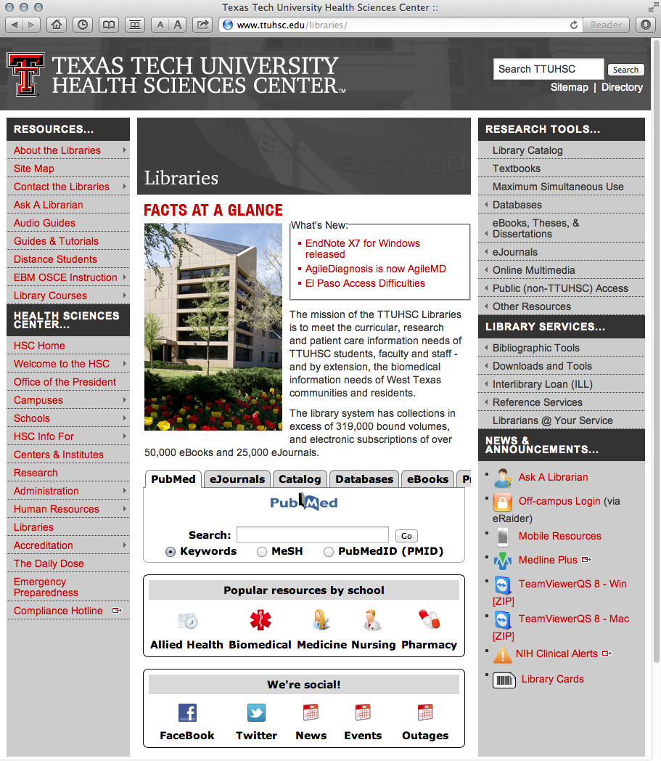
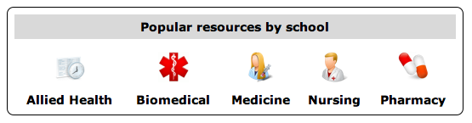
Popular Resources is a good starting point.

Slide 8
CINAHL Plus with Full Text

Slide 9
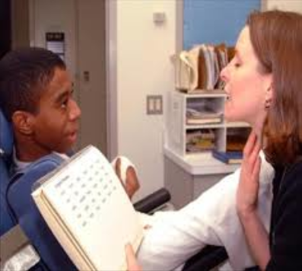

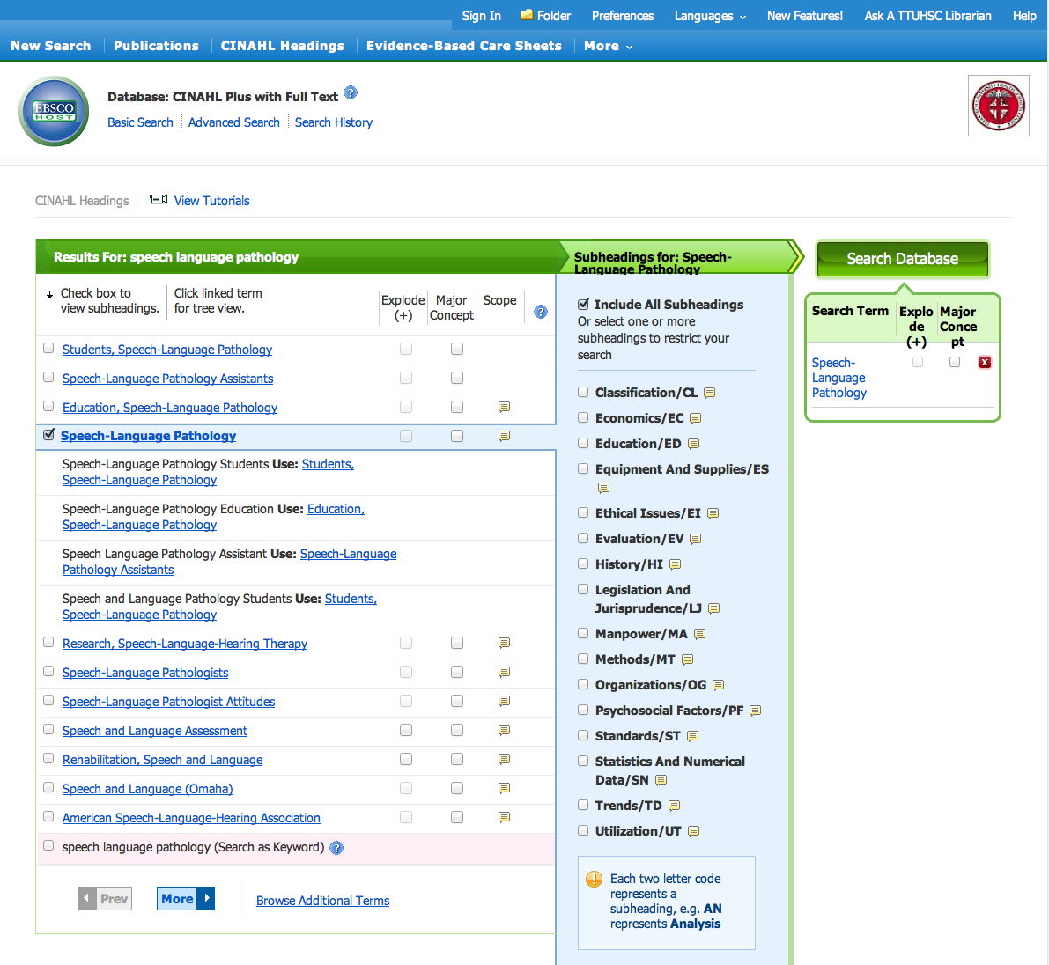
CINAHL Plus with Full-Text
Nursing and
Allied Health literature
Electronic full-text for more than 760 journals and 300 books
Searchable with CINAHL Subject Headings

Slide 10
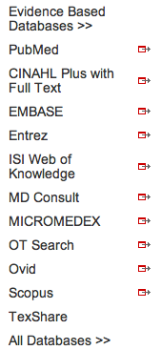
www.ttuhsc.edu/libraries
Mouse over Databases
Click CINAHL Plus with Full Text

Slide 11
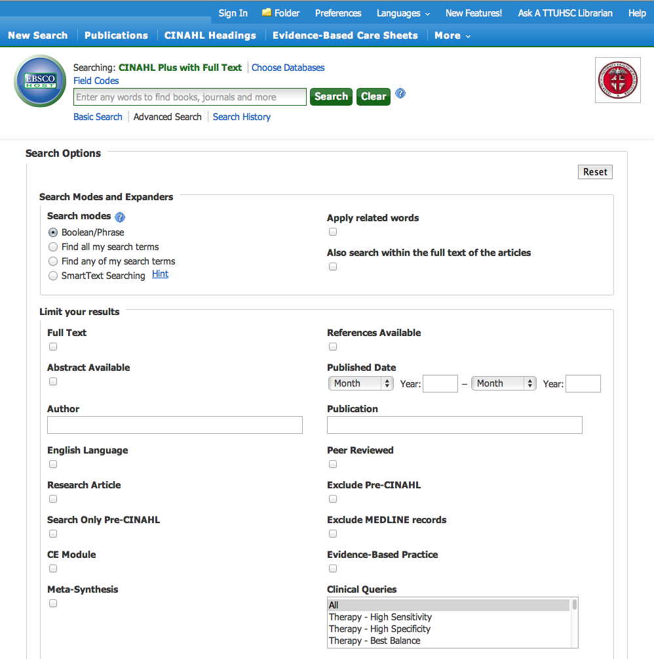
Click CINAHL Headings

Slide 12
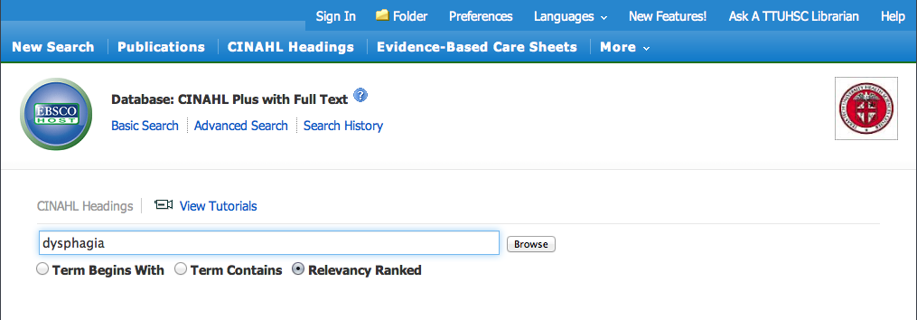
Enter
dysphagia
and click
Browse

Slide 13
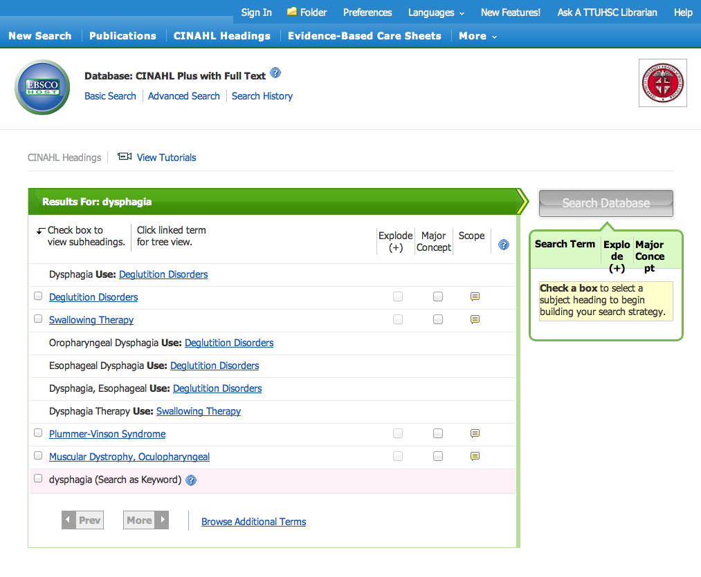
✓
Click appropriate heading

Slide 14
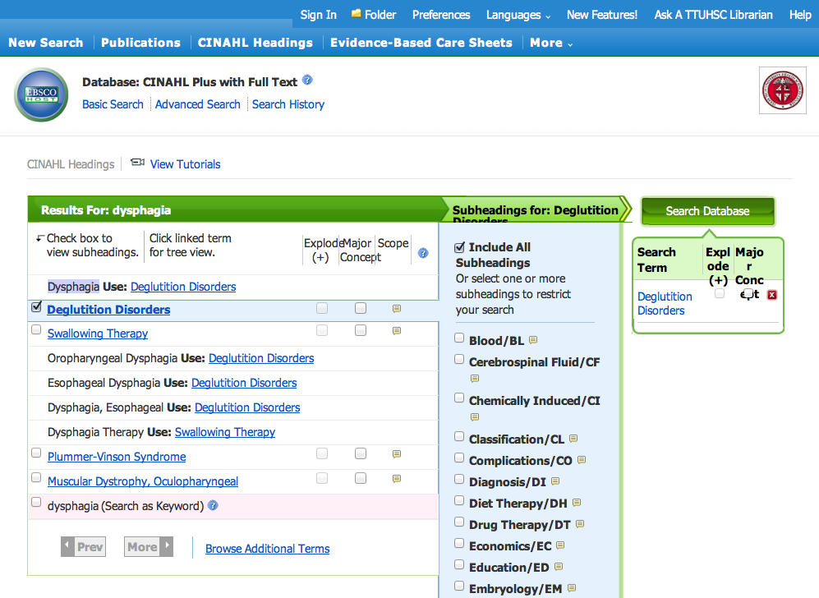
Subheadings appear

Slide 15
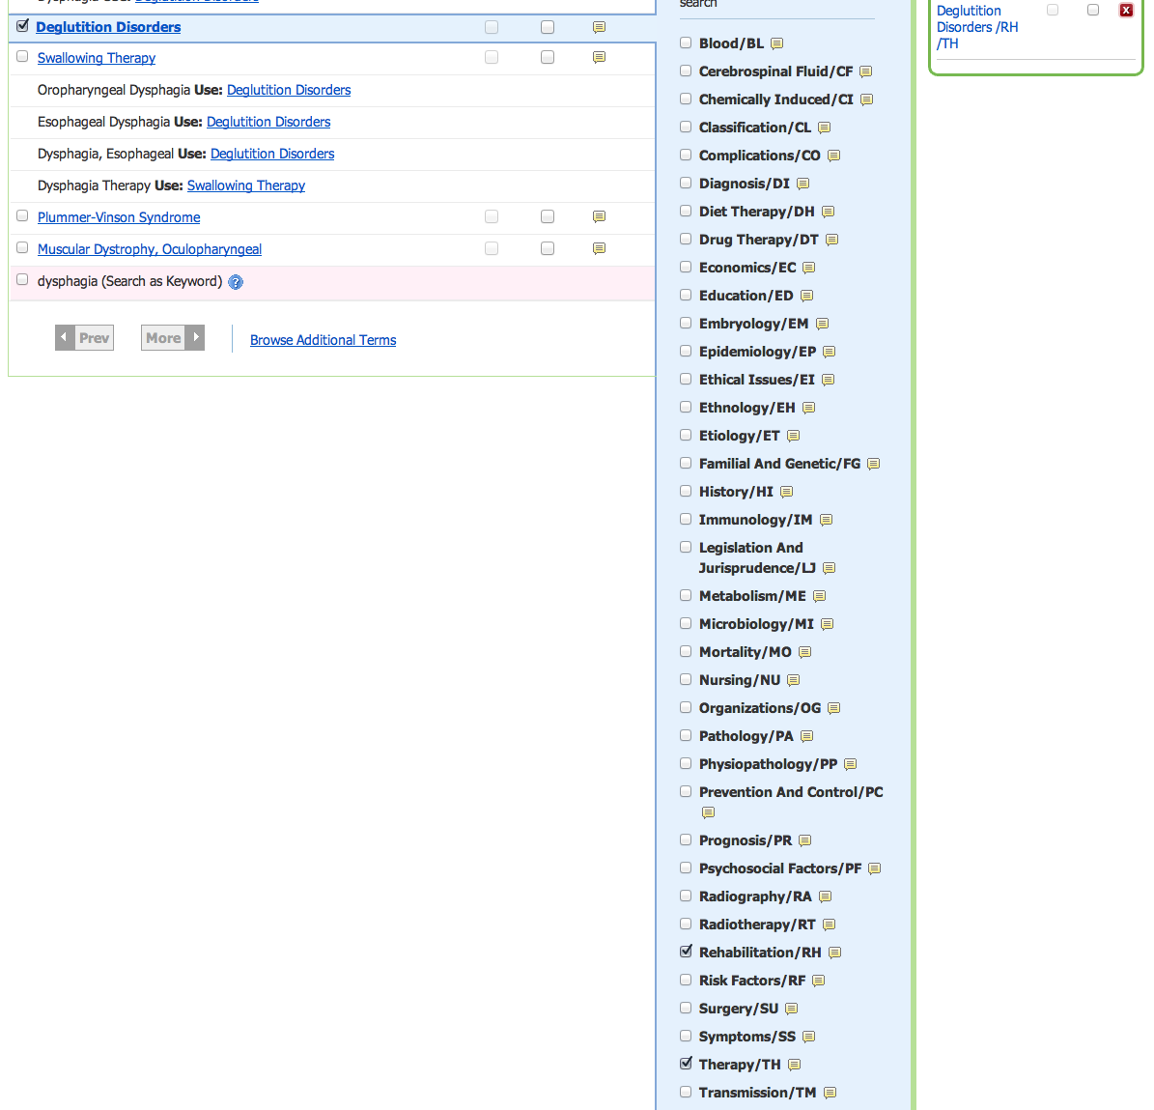

Select:
rehabilitation
and
therapy
✔
✔

Slide 16
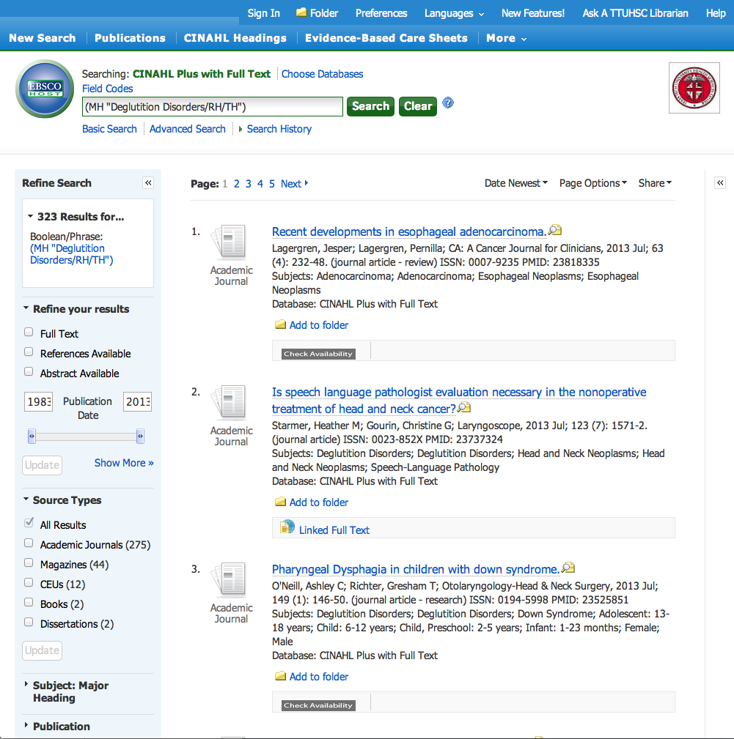
Using the sliders,
Limit Publication Date to 2008 - 2013

Slide 17
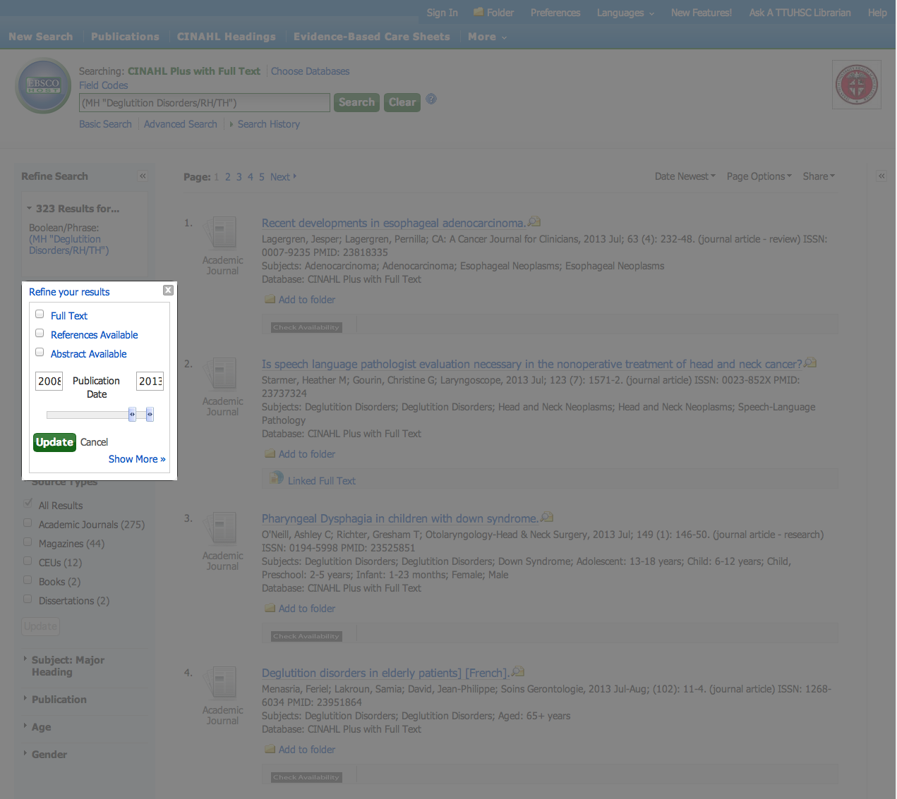
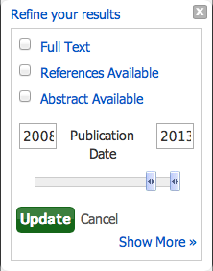
Click Update

Slide 18
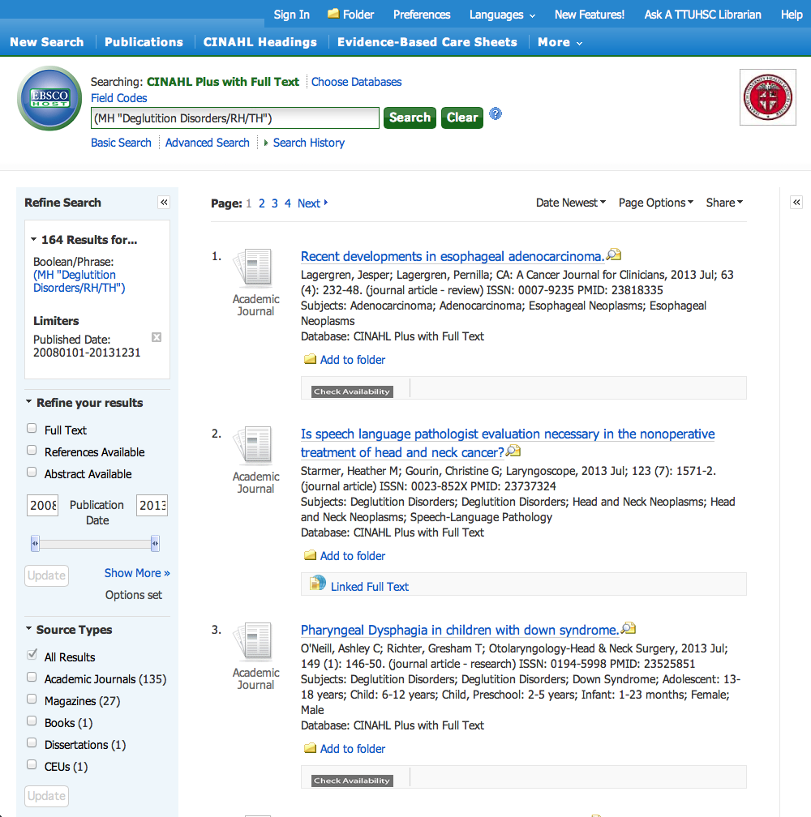
164 Results
Click Show More

Slide 19
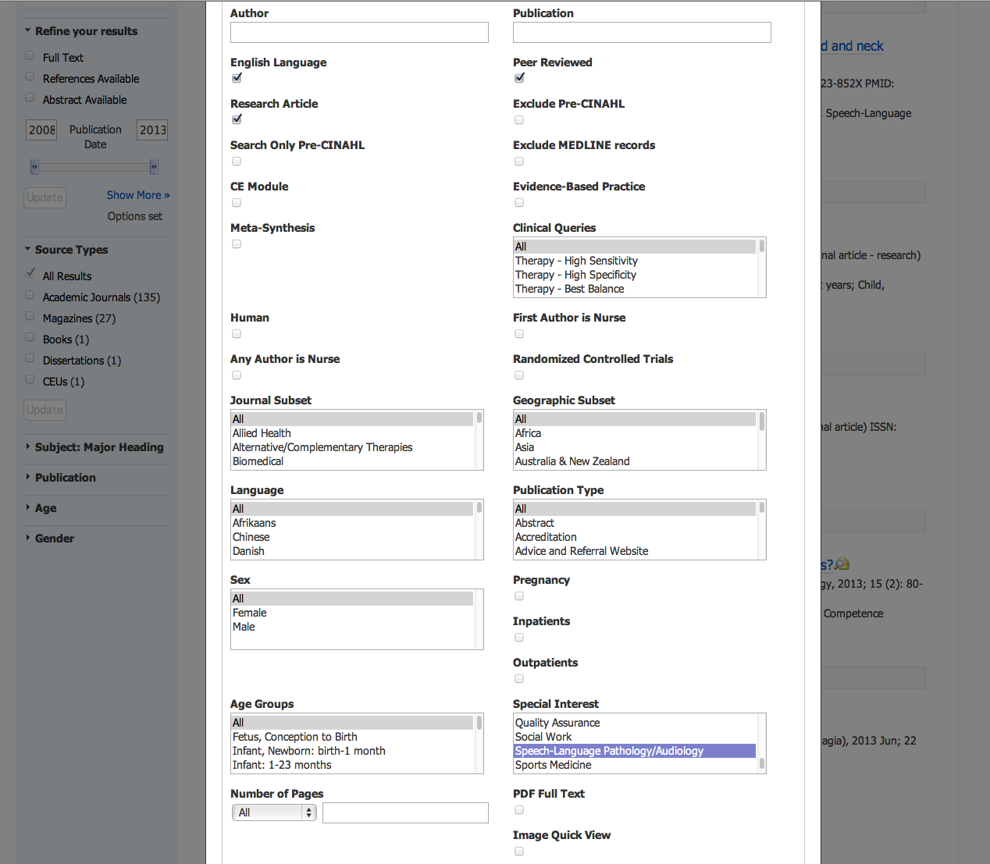
Select Limits

Slide 20
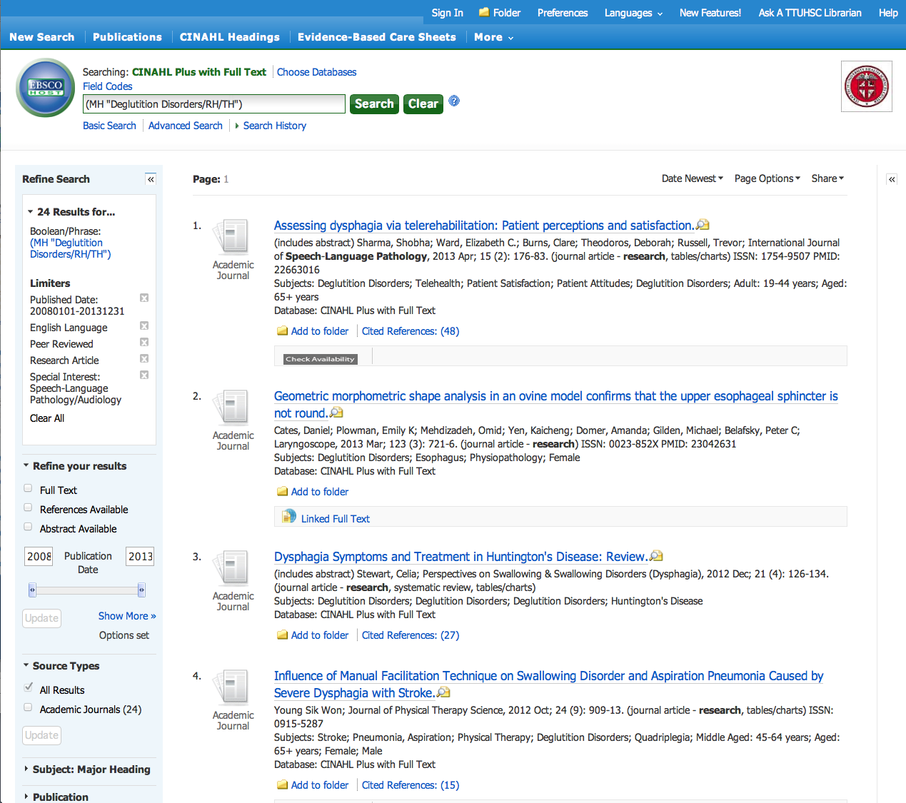
Results have narrowed to 24 articles
Scroll to article # 6

Slide 21
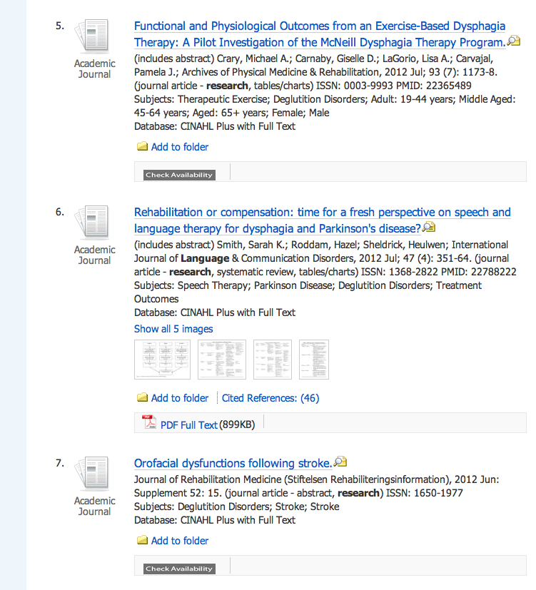
Click PDF Full Text

Slide 22
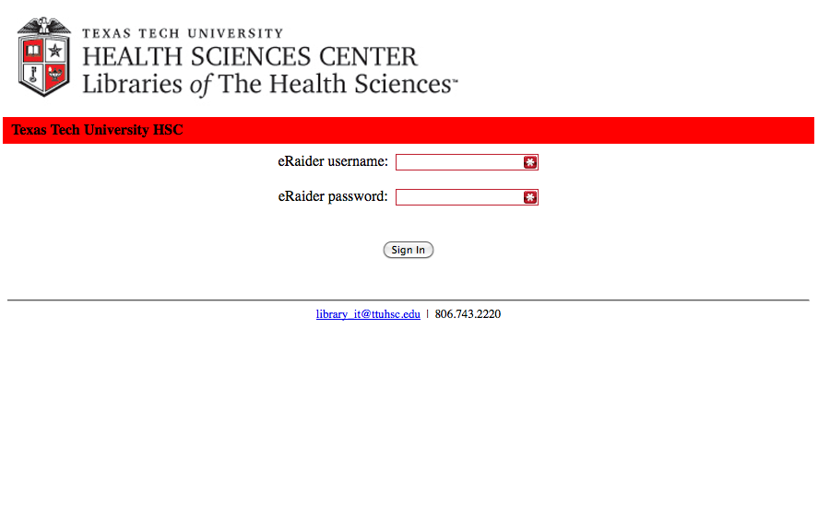
When Searching from Off Campus:
Enter the
Eraider username and password
assigned to you
by Information Services.

Slide 23
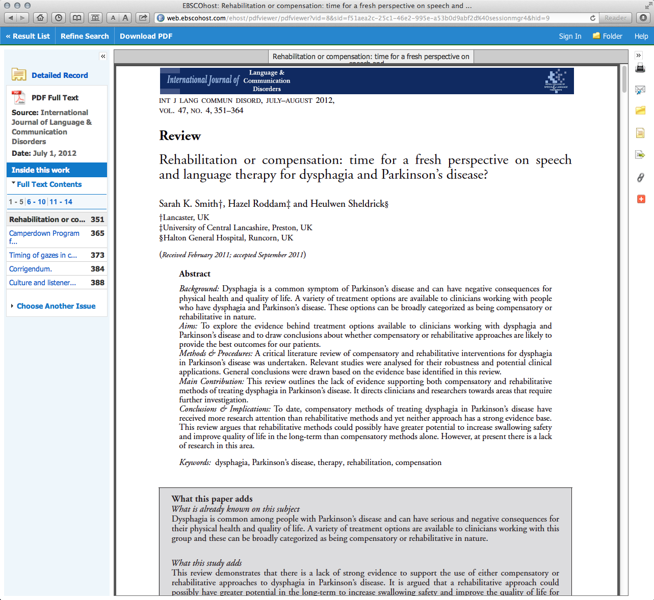
Full-Text Article

Slide 24
ERIC

Slide 25
www.ttuhsc.edu/libraries
Click
Databases

Slide 26
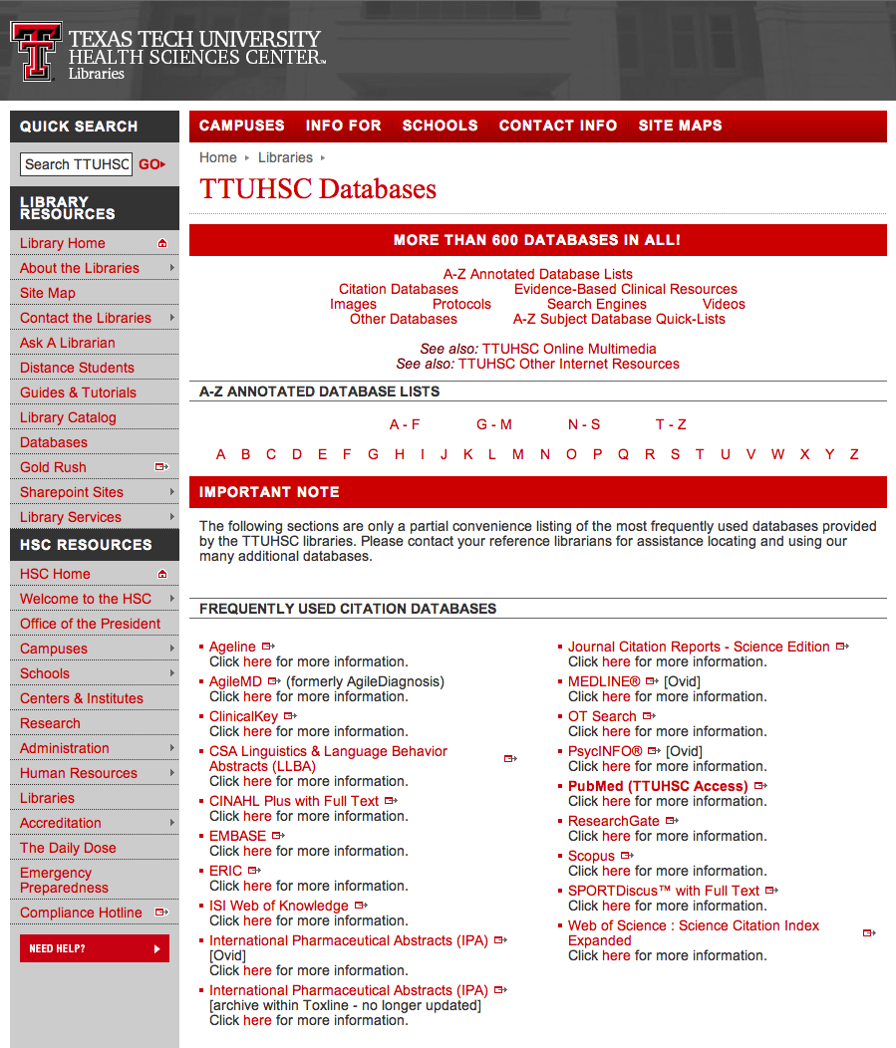
Click ERIC

Slide 27
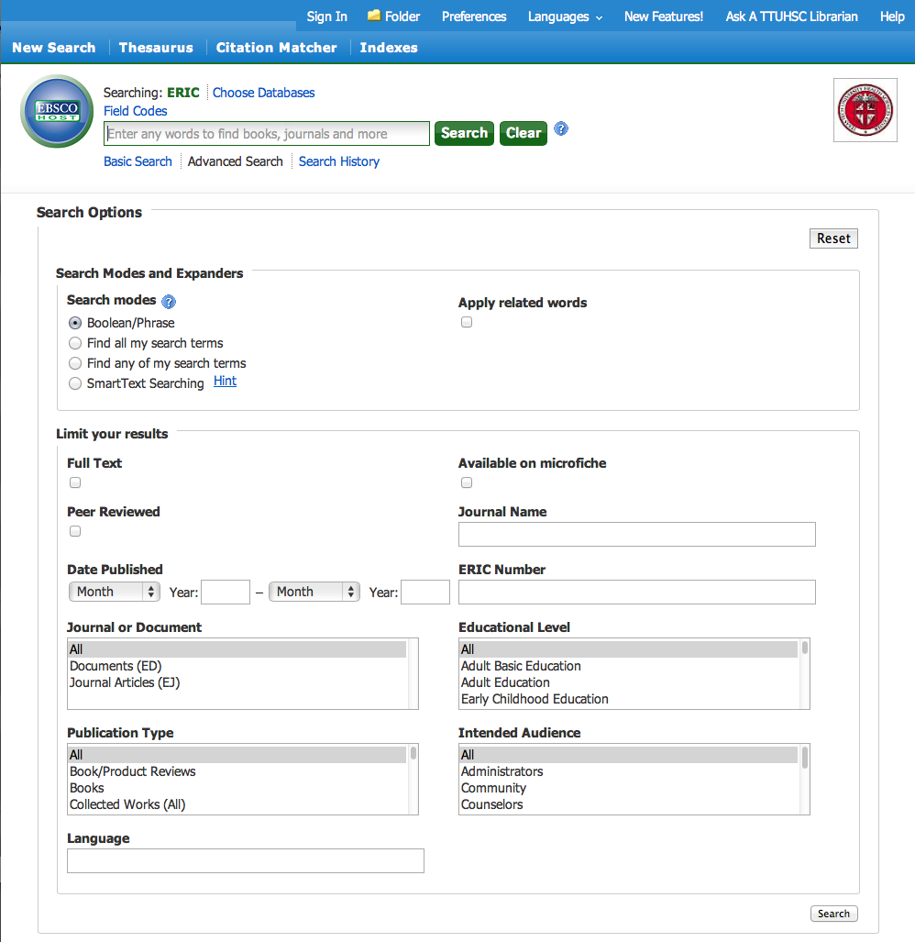
Click Thesaurus

Slide 28
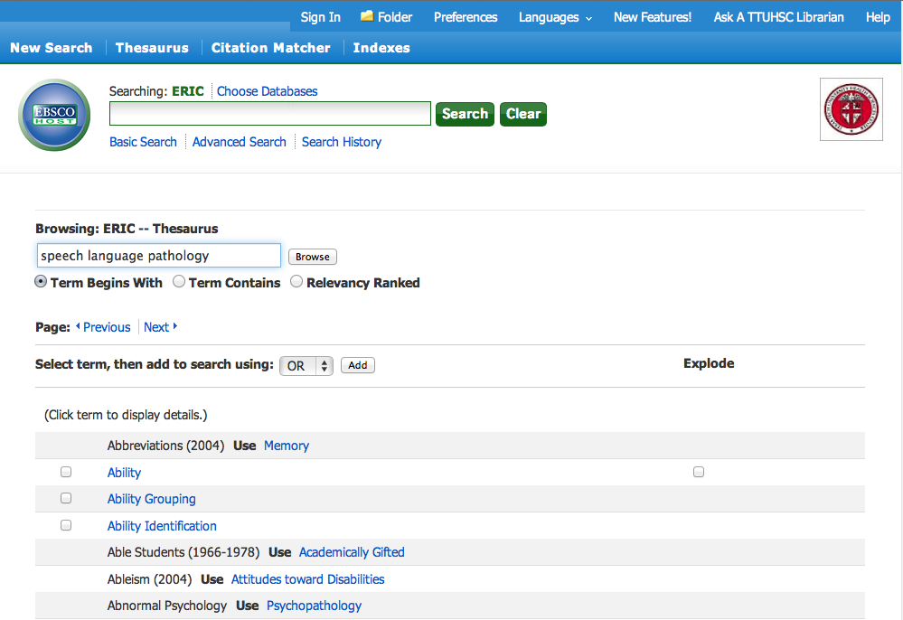
Enter
speech language pathology
and click
Browse

Slide 29
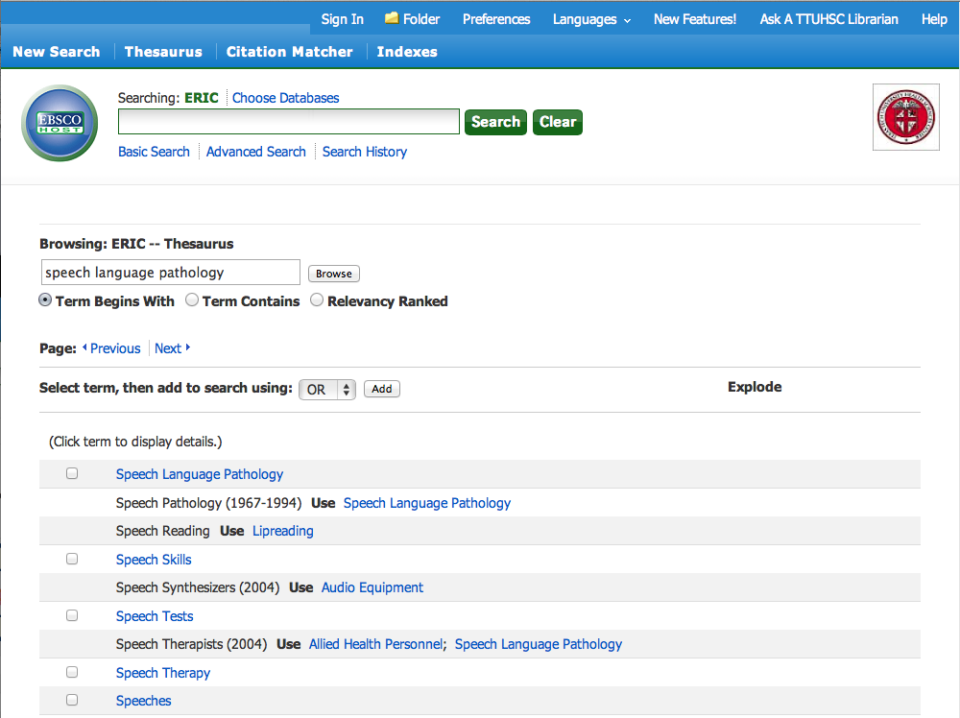
Click add
✔
Select heading

Slide 30
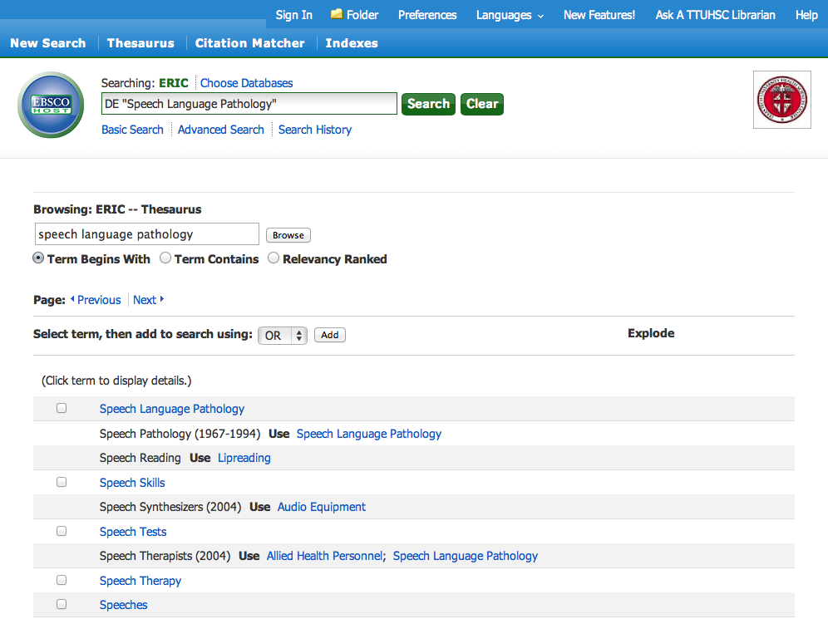
Click Search

Slide 31
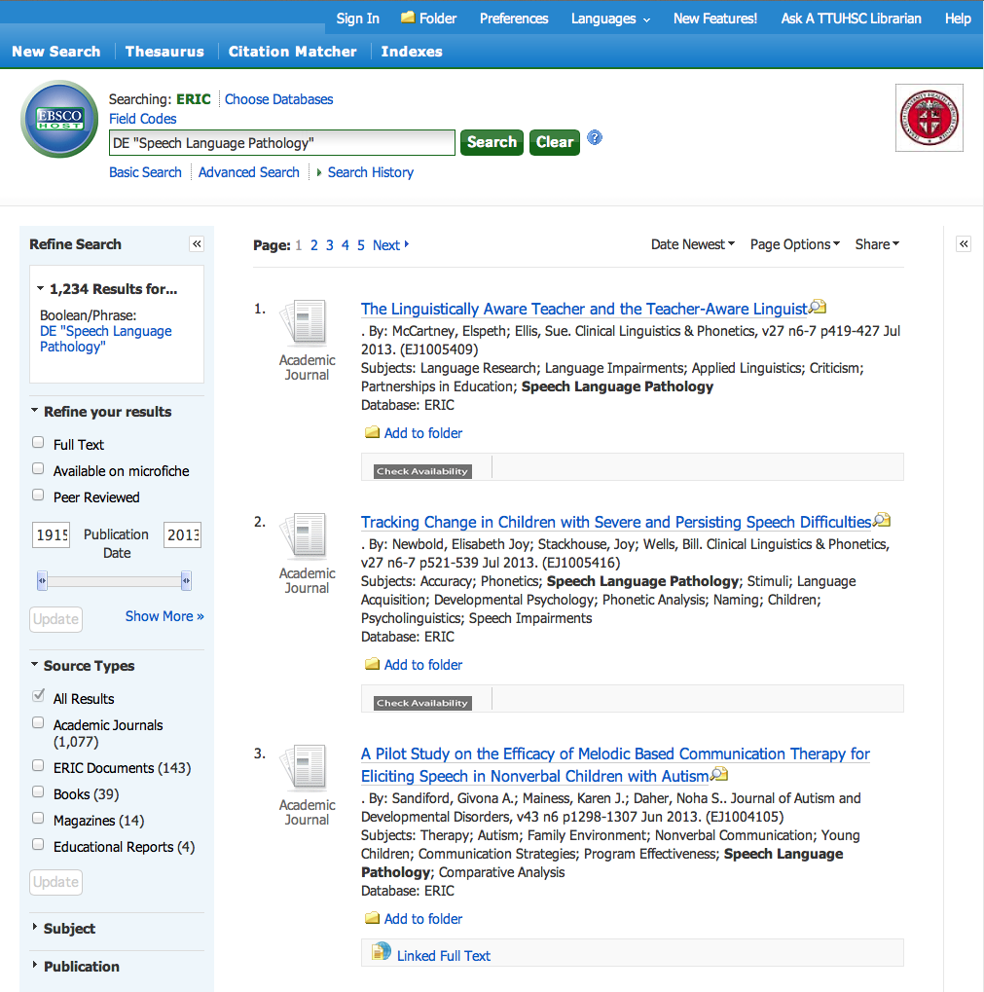
Click Show More

Slide 32
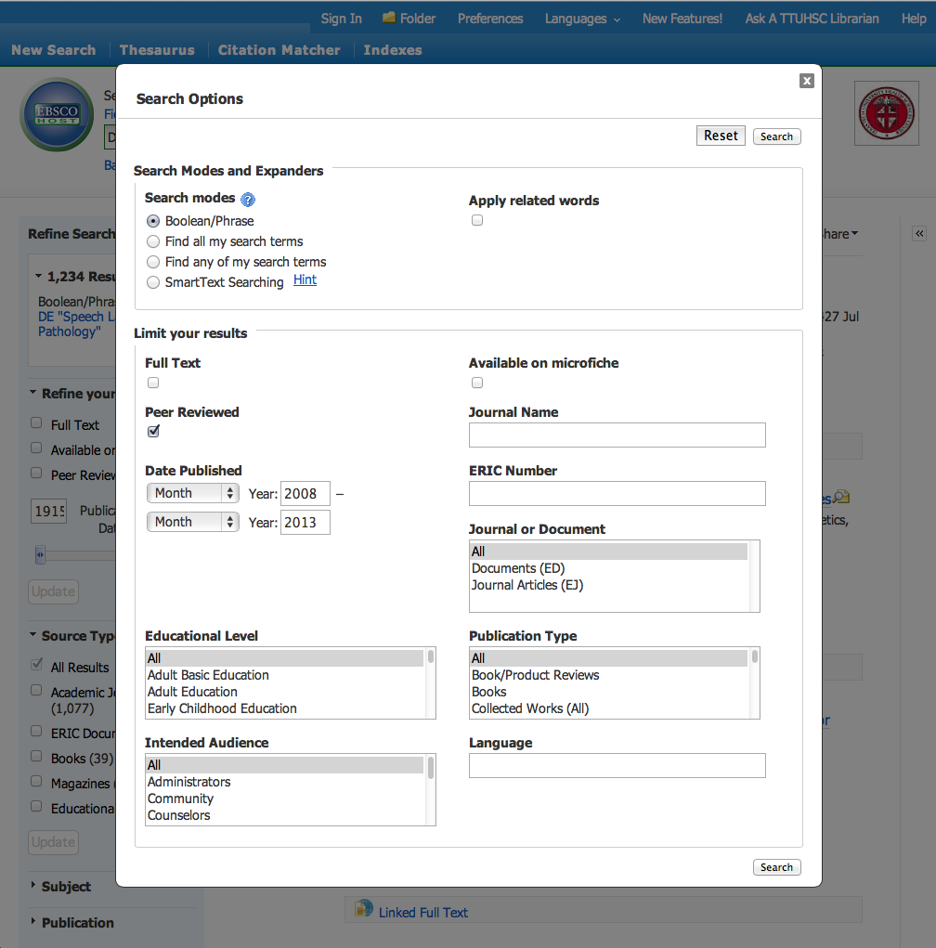
Select Limits
Click Search

Slide 33
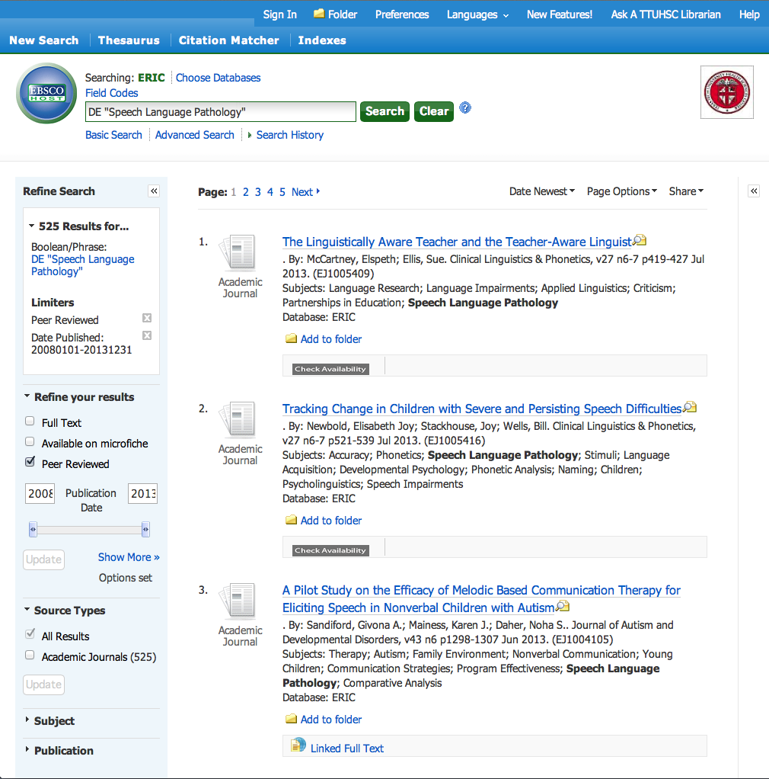
Click Full Text

Slide 34
Linguistics and Language Behavior Abstracts

Slide 35
www.ttuhsc.edu/libraries
Click
Databases

Slide 36

Click CSA Linguistics & Language Behavior Abstracts

Slide 37
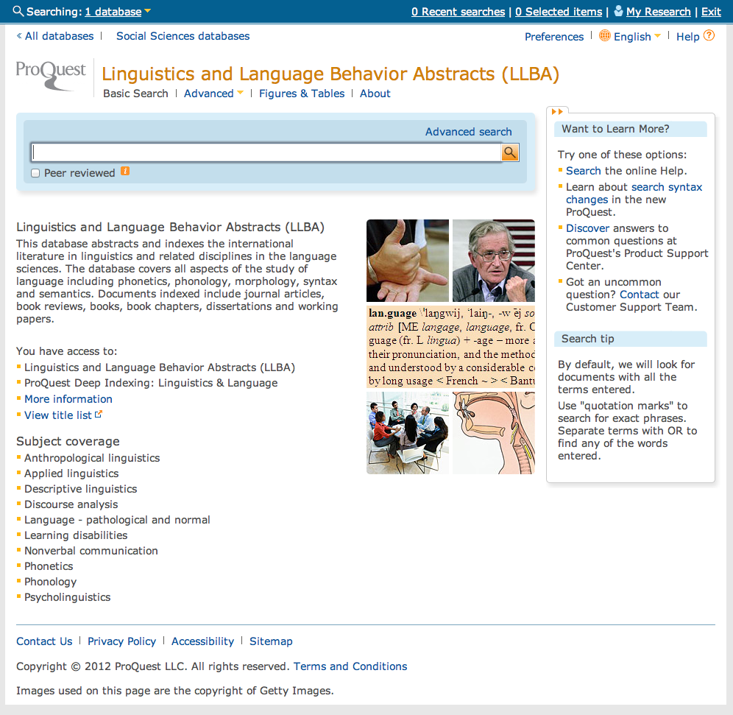
Click Advanced
Home Page

Slide 38
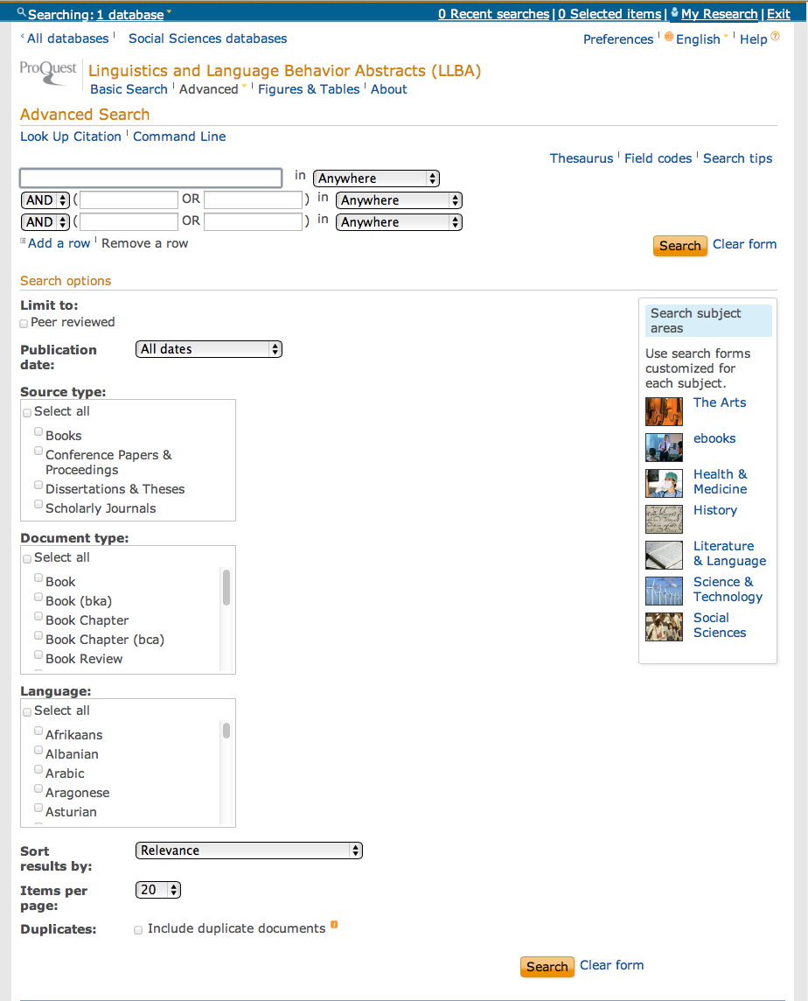
Click Thesaurus

Slide 39
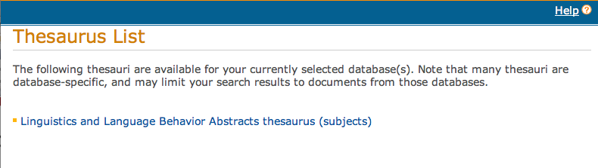
Click Link to Thesaurus

Slide 40
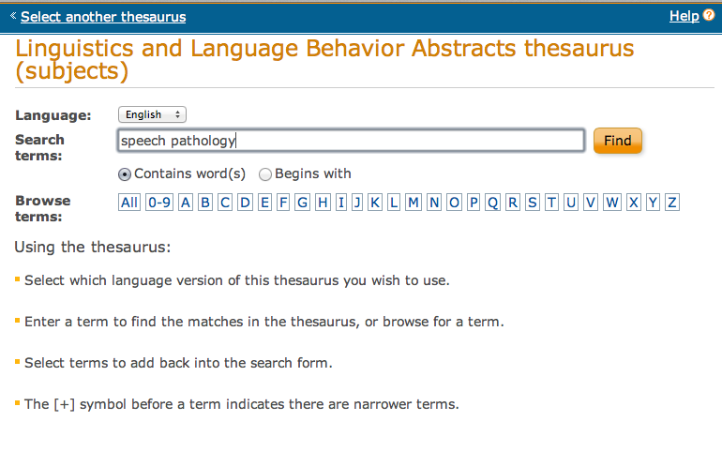
Enter Term
Click
Find

Slide 41
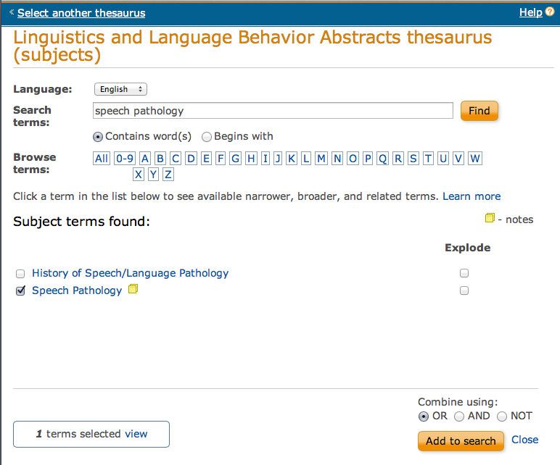
Click
Add to Search
Select Term

Slide 42
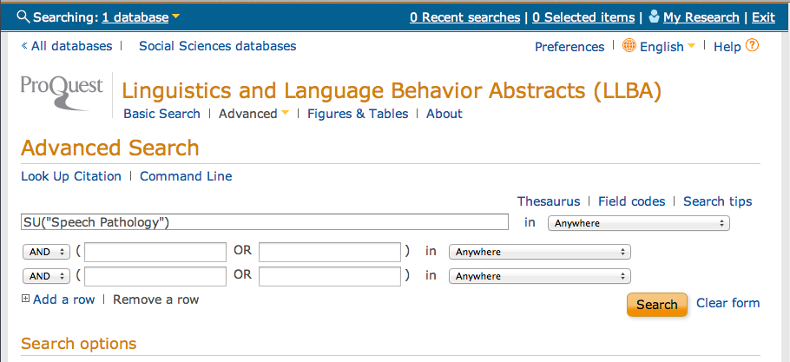
Click Thesaurus

Slide 43
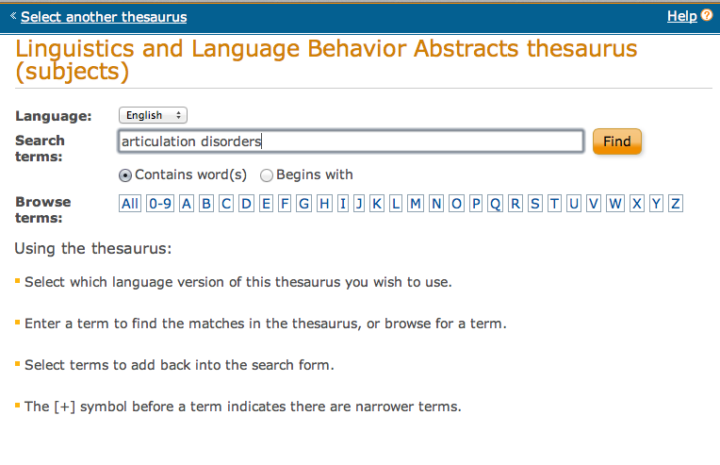
Enter Term
Click
Find

Slide 44
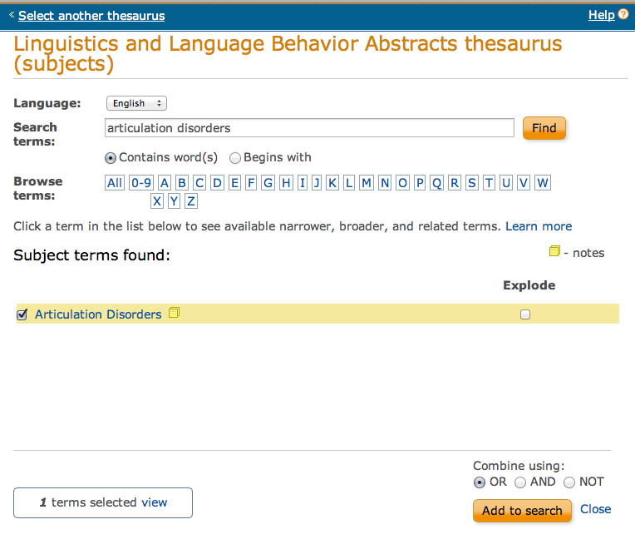
Click
Add to Search
Select Term

Slide 45
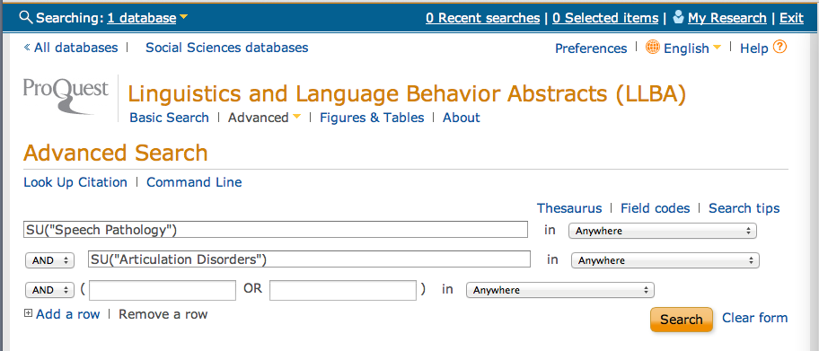
Click
Search

Slide 46
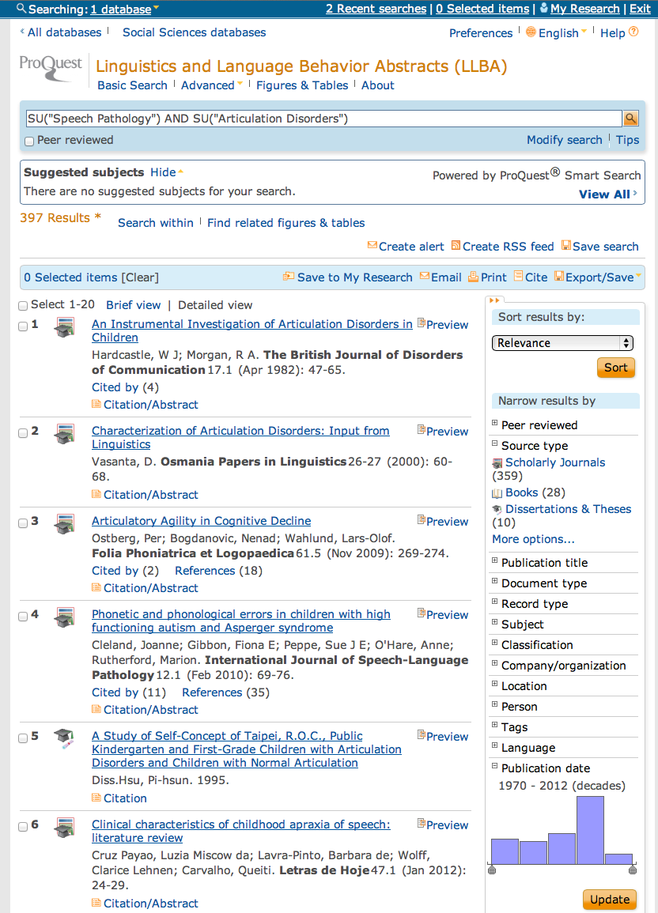
Results of AND combination.
(Note that AND narrows results.)

Slide 47
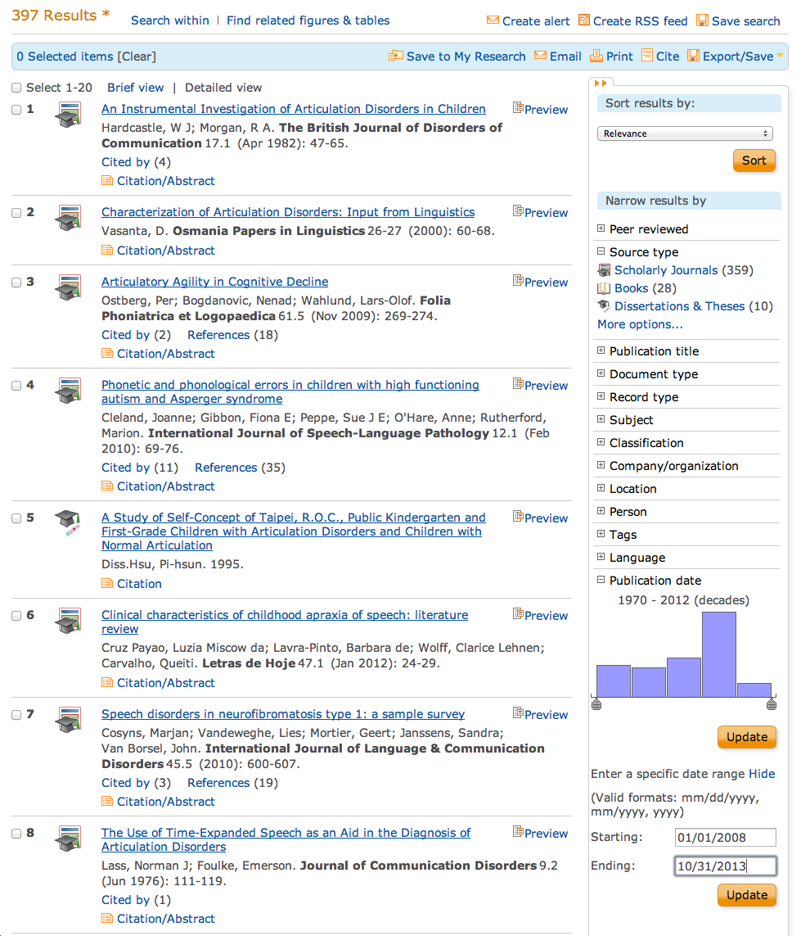
Enter
Starting: 01/01/2008
Ending: 10/31/2013
Click
Update

Slide 48
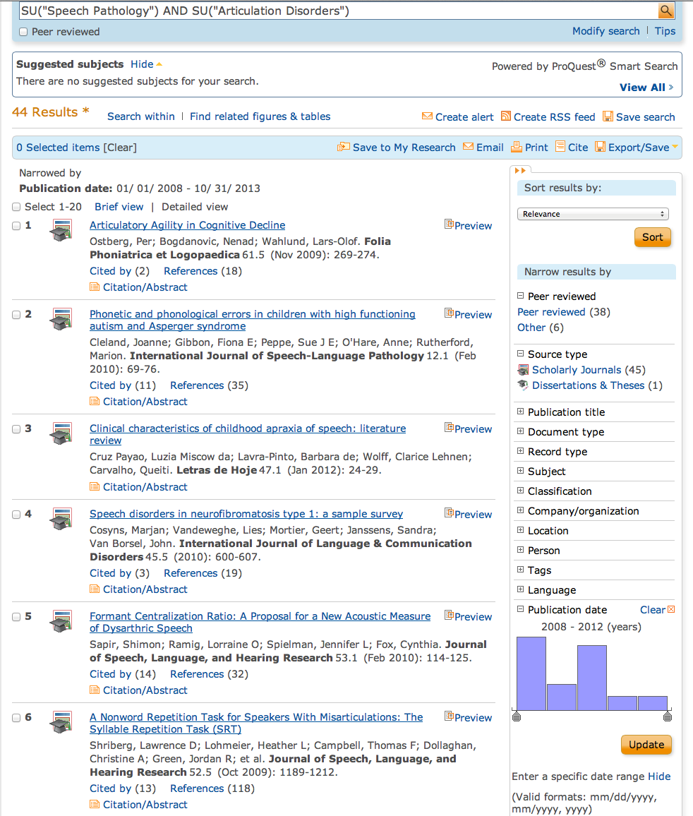
Select Peer reviewed

Slide 49
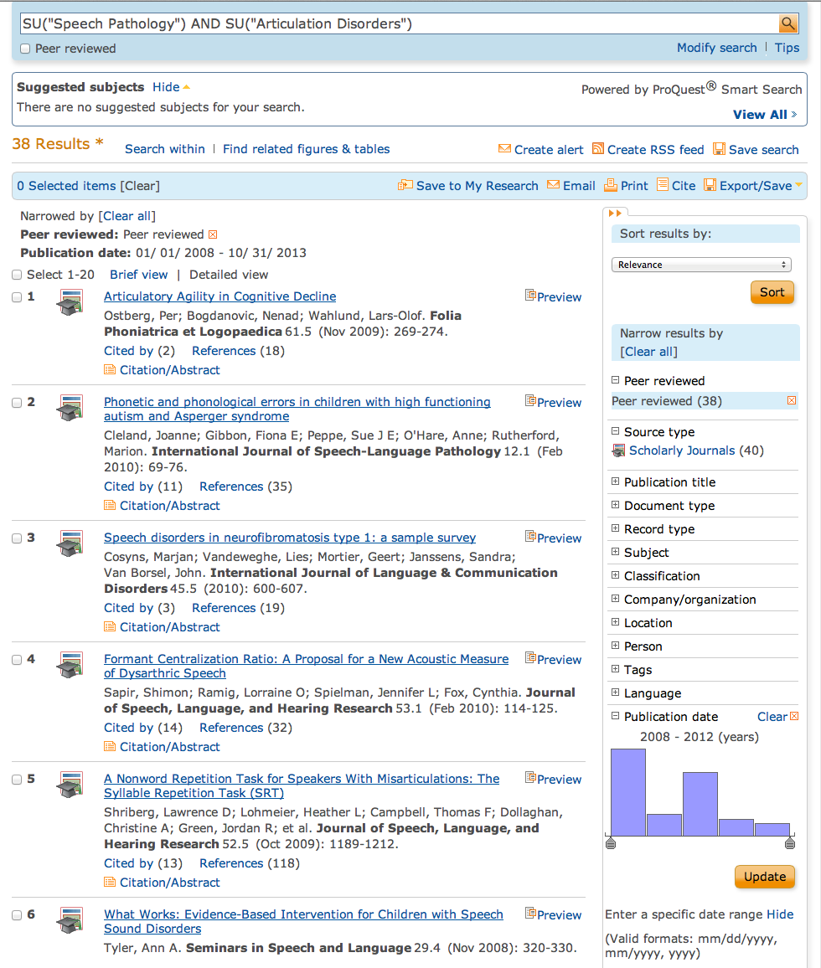
Click Language

Slide 50
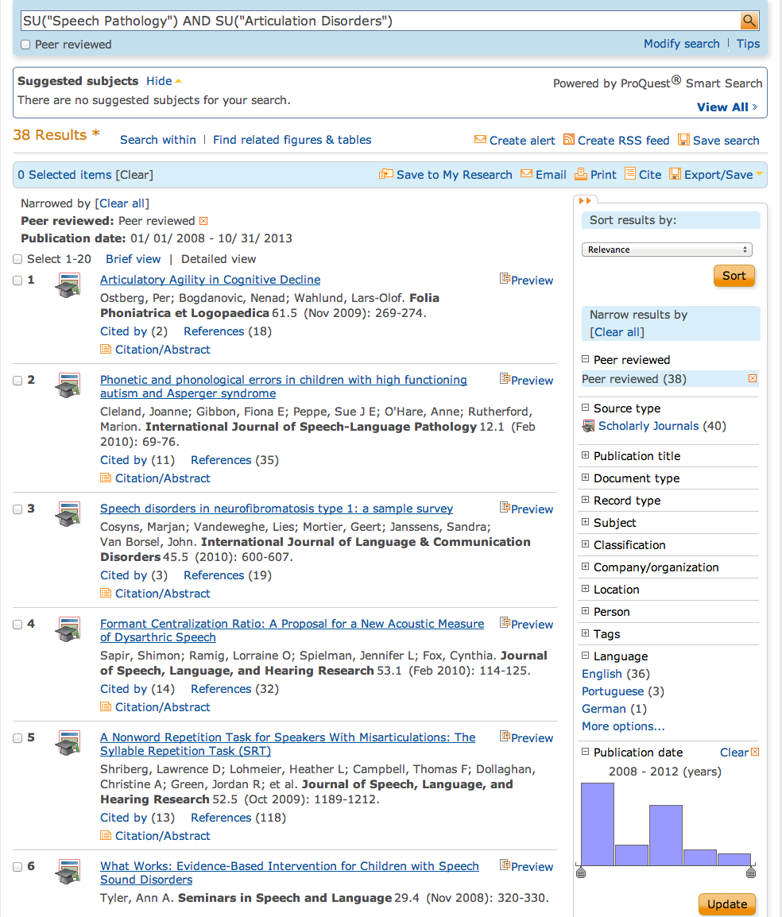
Select English

Slide 51
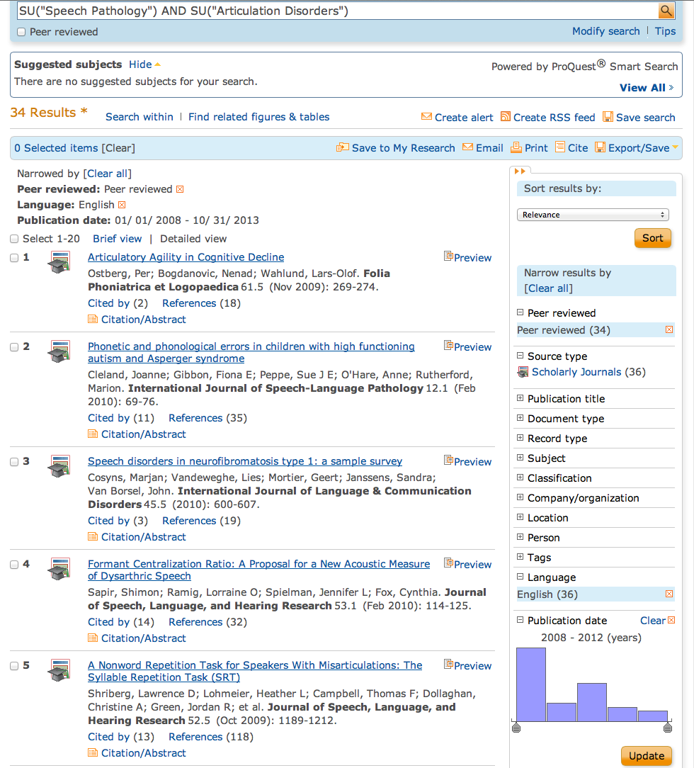
Results are narrowed to 34 articles.
Use Gold Rush to access full-text.

Slide 52
PsychInfo

Slide 53
www.ttuhsc.edu/libraries
Mouse over Databases

Slide 54
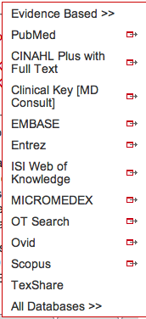
www.ttuhsc.edu/libraries
and click OVID®

Slide 55
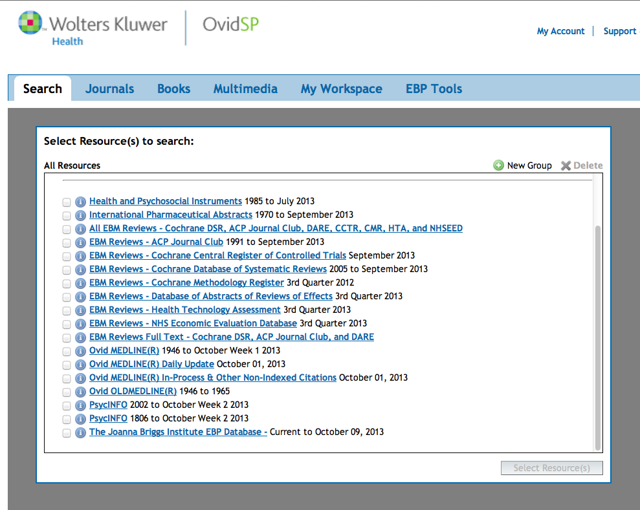
Click PsycINFO

Slide 56
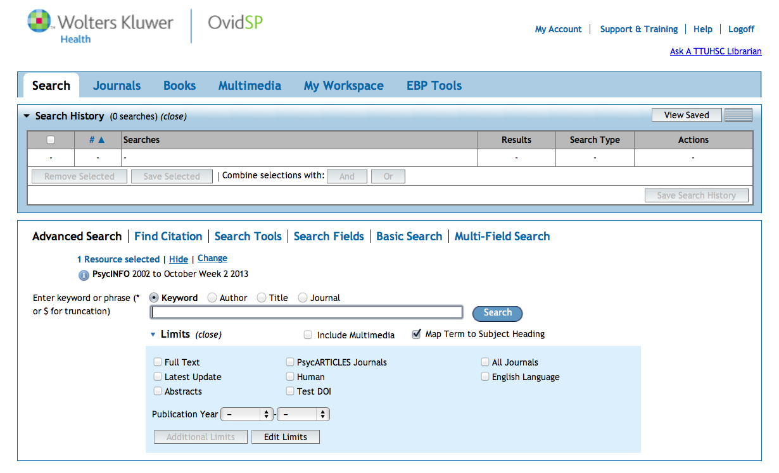
Home Page

Slide 57
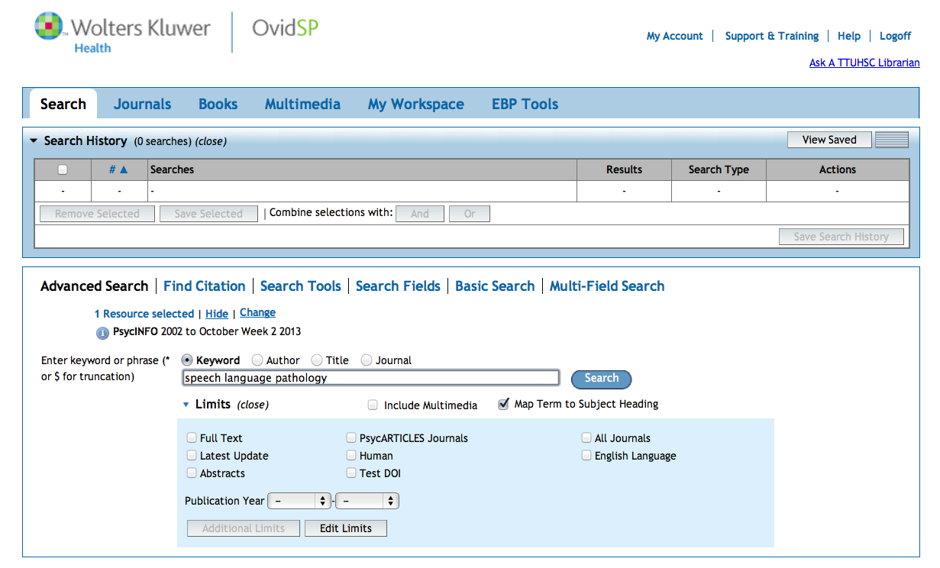
Click Search
Enter
as the first keyword search.
speech language pathology

Slide 58
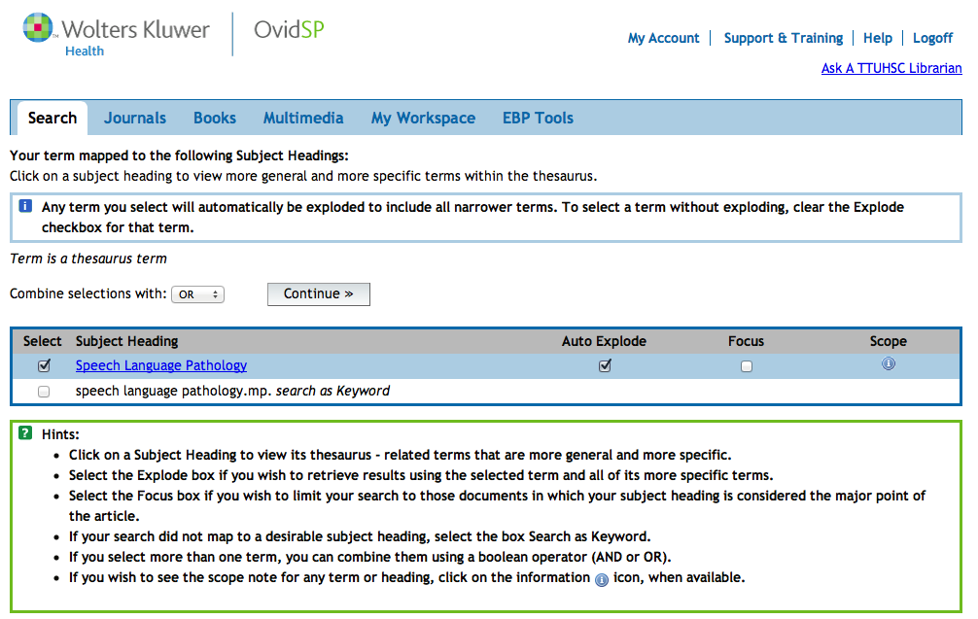
Select Subject Heading
Click Continue

Slide 59
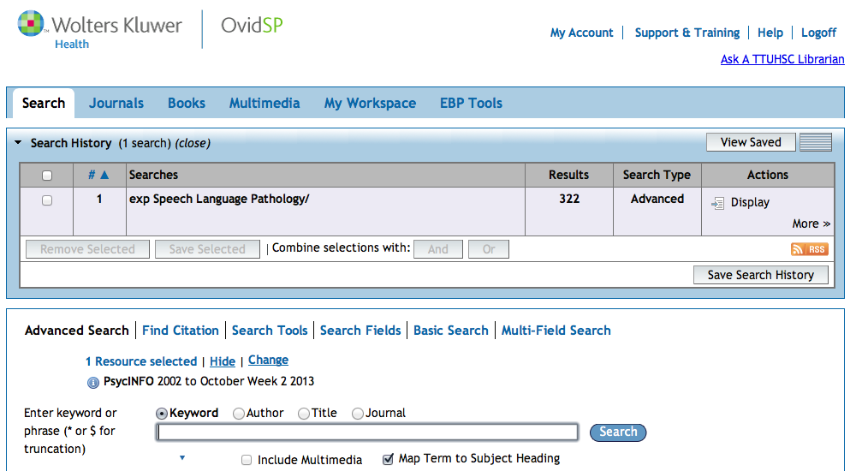
Results in the
first search set.

Slide 60

Click Search
Enter
as the second keyword search.
developmental disorders

Slide 61

Select Subject Heading
Click Continue

Slide 62

Click And
X
X
AND
Click on the boxes
next to set 1 and set 2.

Slide 63
Boolean Logic - AND
speech
language
pathology
developmental
disorders
and

Slide 64

Results of AND combination.
(Note that AND narrows results.)

Slide 65
Click Display
to view articles

Slide 66

Select Articles
Check Availability
will often lead to the article.

Slide 67

Click Your article from CINAHL Plus with Full Text

Slide 68

Click PDF Full Text

Slide 69

Full-Text Article

Slide 70
EBP Literature from
PubMed’s Clinical Queries

Slide 71


PubMed Database
Biomedical journal literature
International scope
Published by:
The National Library of Medicine

Slide 72



Accessing PubMed
Freely available over the Internet
@ www.pubmed.gov
Also through library’s home page

Slide 73


Evidence-Based Practice is guided by thoughtful integration
of the best available scientific knowledge with clinical expertise.

Slide 74

PubMed’s Clinical Queries
tool that searches for evidence-based literature

Slide 75




Clinical Queries Searchable by:
Diagnosis
Therapy
Prognosis (prediction of probable outcome)
Etiology (cause)

Slide 76
Clinical Queries Searchable by:
Diagnosis
Therapy
Prognosis (prediction of probable outcome)
Etiology (cause)

Slide 77

PubMed’s Clinical Queries
uses pre-formulated search strategies with a keyword search

Slide 78

PubMed’s Clinical Queries
www.ttuhsc.edu/libraries
Mouse over Databases
Click PubMed

Slide 79

PubMed Home Page

Slide 80

Click Clinical Queries

Slide 81

Enter communication disorders speech language pathology
Click
Search

Slide 82

Results for Therapy and
Broad Scope
Click See all (174)

Slide 83

Click Filters to Narrow Results
Click 5 Years

Slide 84

Results have narrowed to 64
Selections will turn blue: ✓ 5 Years

Slide 85
Click Show additional filters

Slide 86

Select
Languages
✔
Click Show

Slide 87

Click English

Slide 88


Slide 89
Results have narrowed 62
Click on the title of the article you wish to read

Slide 90

Click for Free Full Text
TTUHSC ONLINE

Slide 91
TTUHSC Libraries - Proxy Server
When Searching from Off Campus:
Enter the
Eraider username and password
assigned to you
by Information Services.
Problems with eRaider call: 806-743-1234
a

Slide 92


Click

Slide 93
Finding e-journals in Gold Rush

Slide 94

www.ttuhsc.edu/libraries
Mouse over eJournals
Click Gold Rush

Slide 95

Instructions for using

Slide 96

Enter journal title, click
Search
american journal of speech pathology

Slide 97

1) Check Dates Available
2) Select Publisher

Slide 98

Select Year, Issue

Slide 99

Locate article and click PDF

Slide 100
Have Questions
or
Need Help?

Slide 101


Today’s PowerPoint
Click the Allied Health Icon to go to Popular Resources

Slide 102

Speech Language Pathology PowerPoint
Graduate Students
October 16, 2013

Slide 103
www.ttuhsc.edu/libraries
Guides & Tutorials
Click

Slide 104



Slide 105

www.ttuhsc.edu/libraries
Click the
Ask a Librarian Icon

Slide 106

What is your question?

Slide 107

www.ttuhsc.edu/libraries
Download TeamViewer

Slide 108




Call your TTUHSC Librarian

Slide 109

Double click the icon and follow the directions

Slide 110

Give the password to the librarian to enter.
Log On
After logging on, the librarian can see your computer screen!
At the end of the session after logging off,
the librarian will not have access to your computer!
TeamViewer generates a new password each time it is used!

Slide 111

OR contact us at:
Lubbock
(806) 743-2200
Amarillo
(806) 354-5448
El Paso
(915) 545-6652
Odessa
(432) 335-5171

Slide 112
Please…
locate the Evaluations icon on your desktop and fill it out.
Thank-you…
we appreciate your feedback!

Slide 113
The End

