Slide 1
Speech Pathology: An Introduction to Systematic Reviews
Micah Walsleben, MLS
February 18, 2014

Slide 2
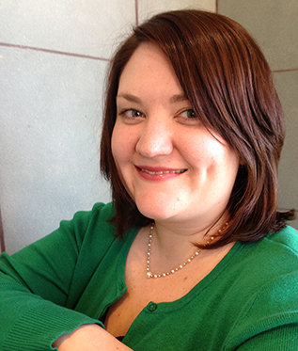
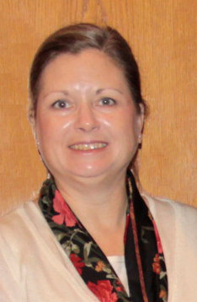
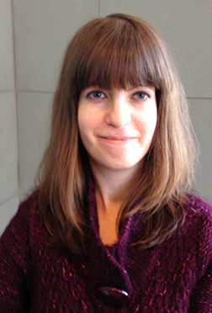

Reference Librarians
2nd floor of library, across from circulation and reading room area
8am–5pm
Monday–Friday
Carrie Gassett
Peggy Edwards
Micah Walsleben
Margaret Vugrin

Slide 3
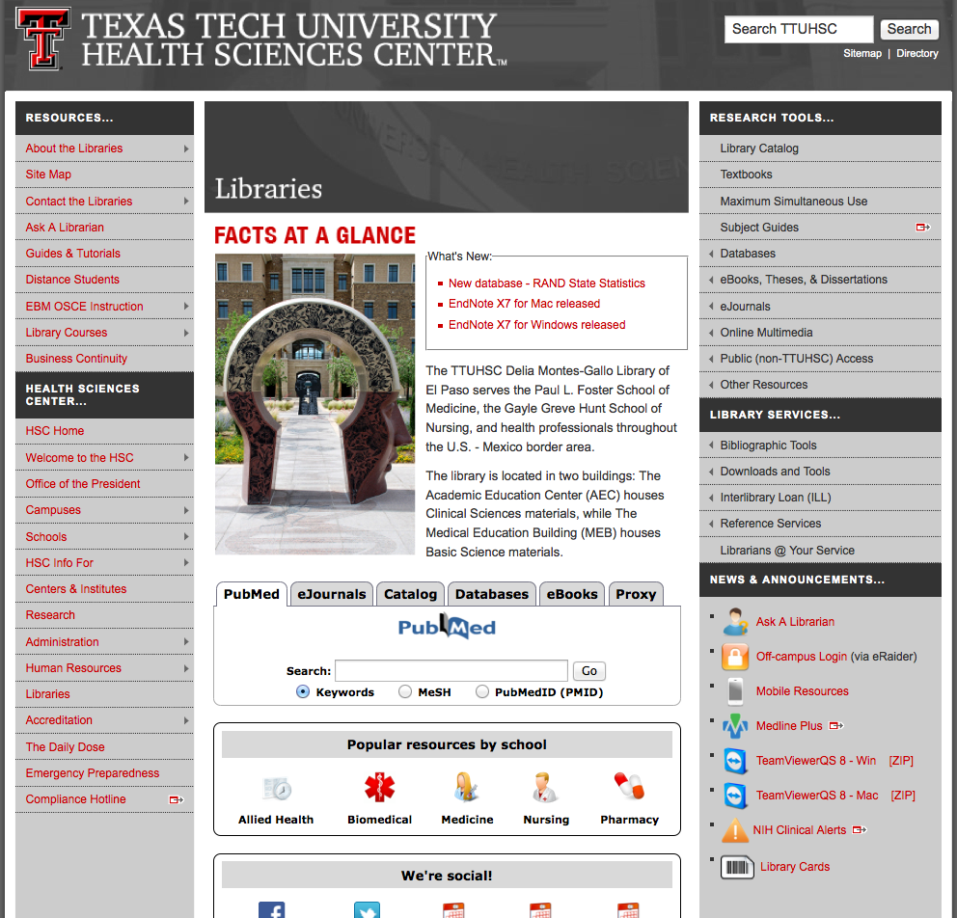
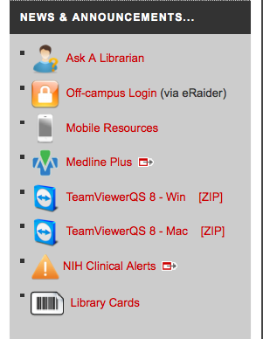
We’re here to help you!

Slide 4
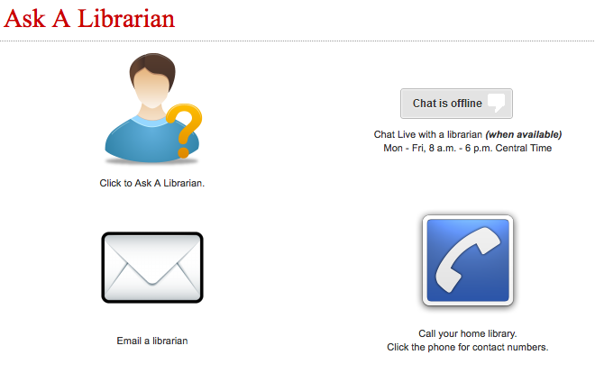

Slide 5
What is a systematic review?
“A systematic review is a critical assessment and evaluation of all research studies that address a particular clinical issue. The researchers use an organized method of locating, assembling, and evaluating a body of literature on a particular topic using a set of specific criteria.
A systematic review typically includes a description of the findings of the collection of research studies. The systematic review may also include a quantitative pooling of data, called a meta-analysis.”
-U.S. Agency for Healthcare Research and Quality

Slide 6
What is a systematic review?
“A systematic review uses transparent procedures to find, evaluate, and synthesize the results of relevant research. Procedures are explicitly defined in advance in order to ensure that the exercise is transparent and can be replicated. This practice is also designed to minimize bias.”
-The Campbell Collaboration

Slide 7
A Systematic Review…
…sums up the best available research on a specific question by synthesizing the results of multiple studies
…must be peer-reviewed
…needs to screen included studies for quality so that the individual findings can be successfully combined
…must have the following:
    clear inclusion and exclusion criteria
    detailed search strategy
    systematic coding and analysis of the included studies
    Meta-analysis (where possible)

Slide 8
The Campbell Collaboration
Let’s explore…

Slide 9
Go to this website!
http://www.campbellcollaboration.org

Slide 10


Slide 11
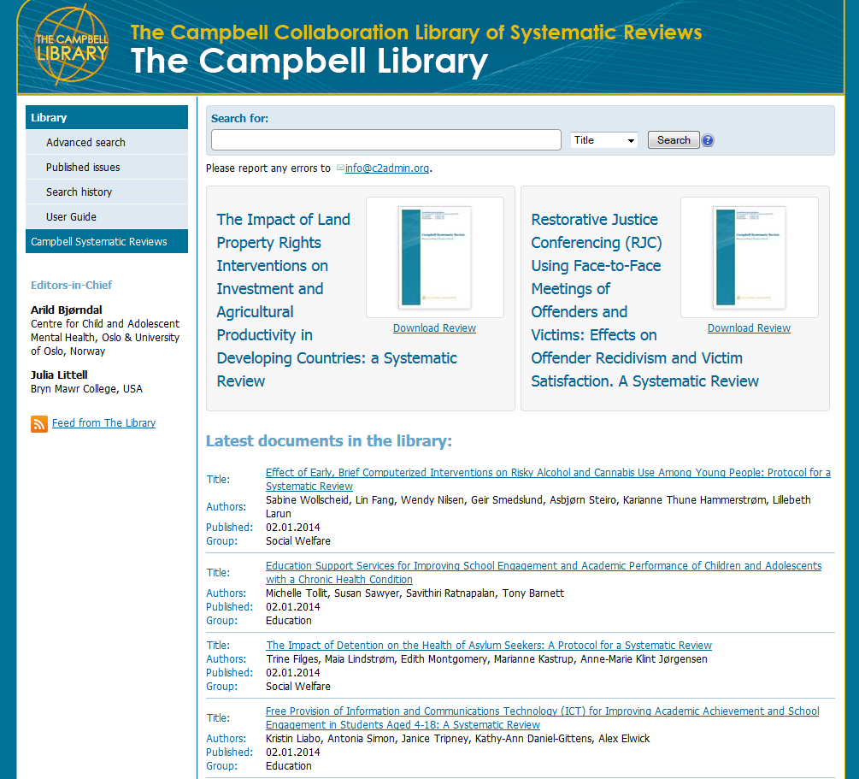
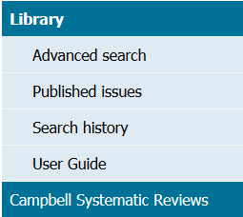

Slide 12
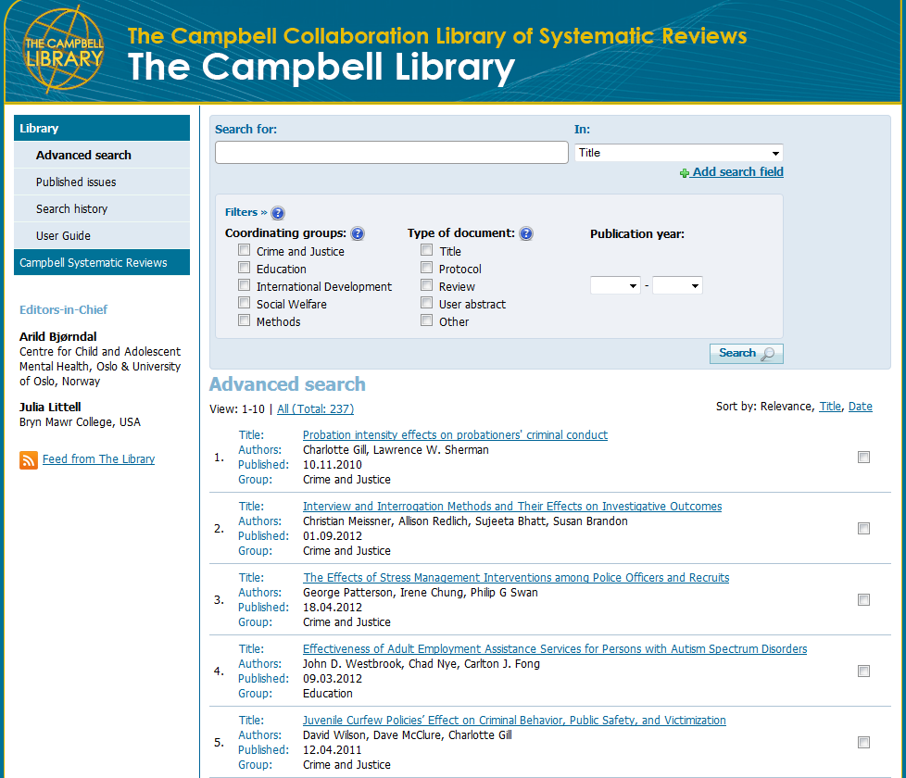
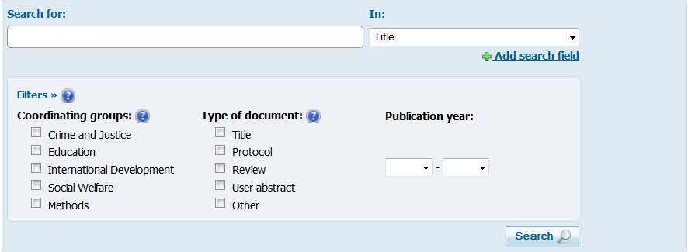


Slide 13
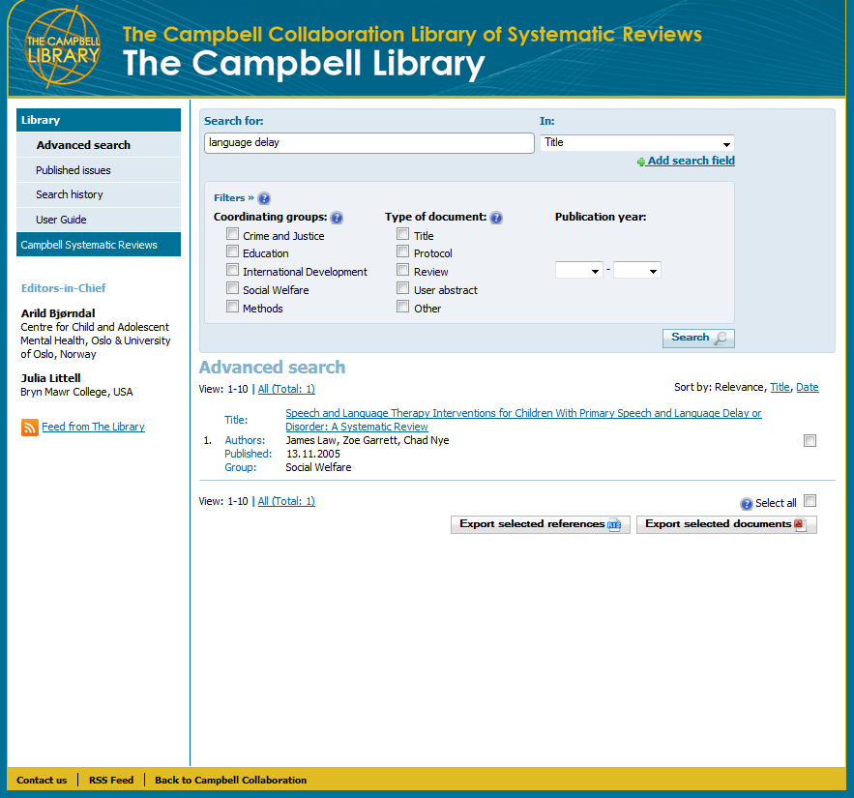
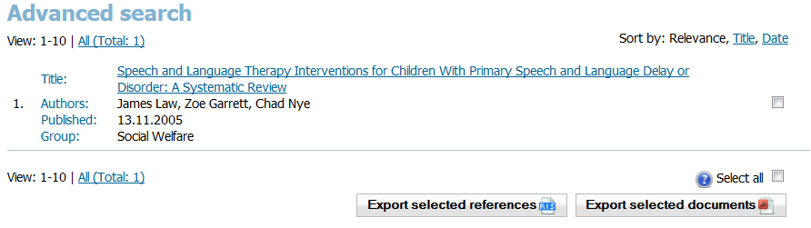

Slide 14
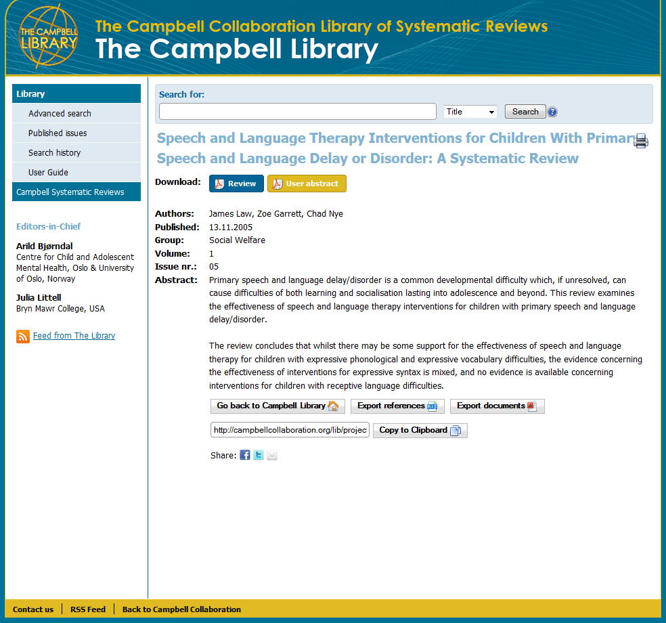

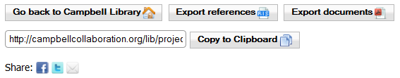

Slide 15
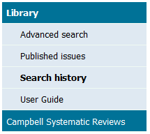

Slide 16
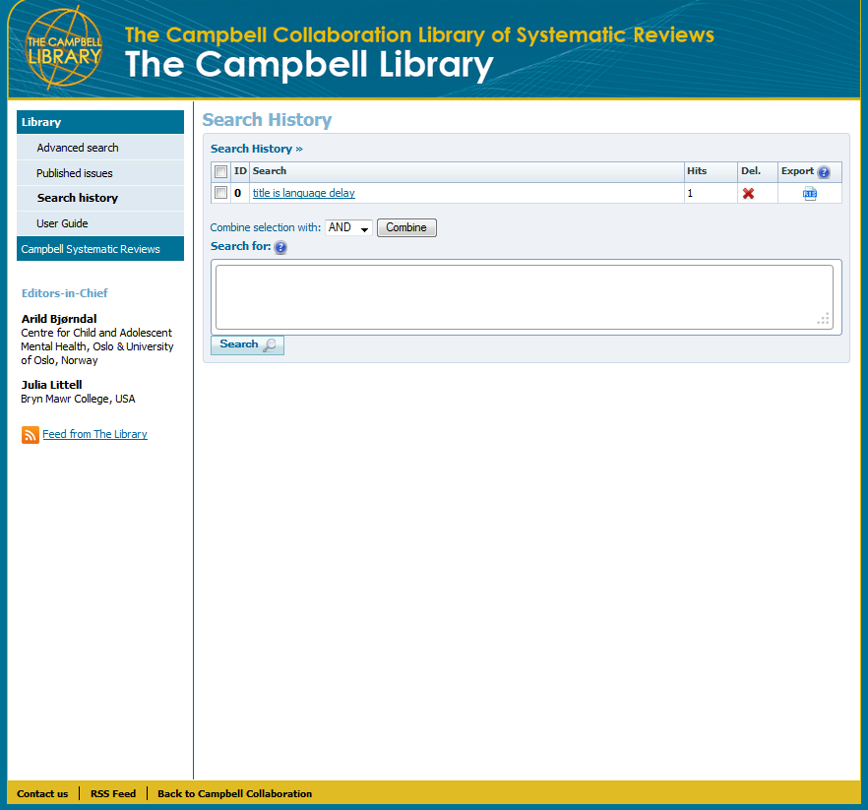
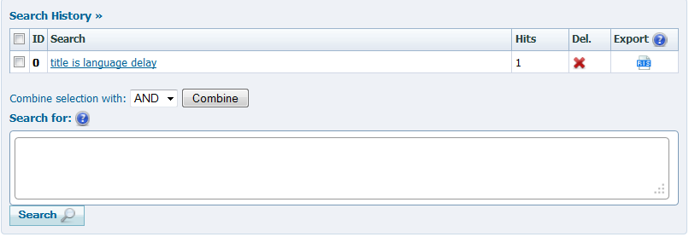

Slide 18
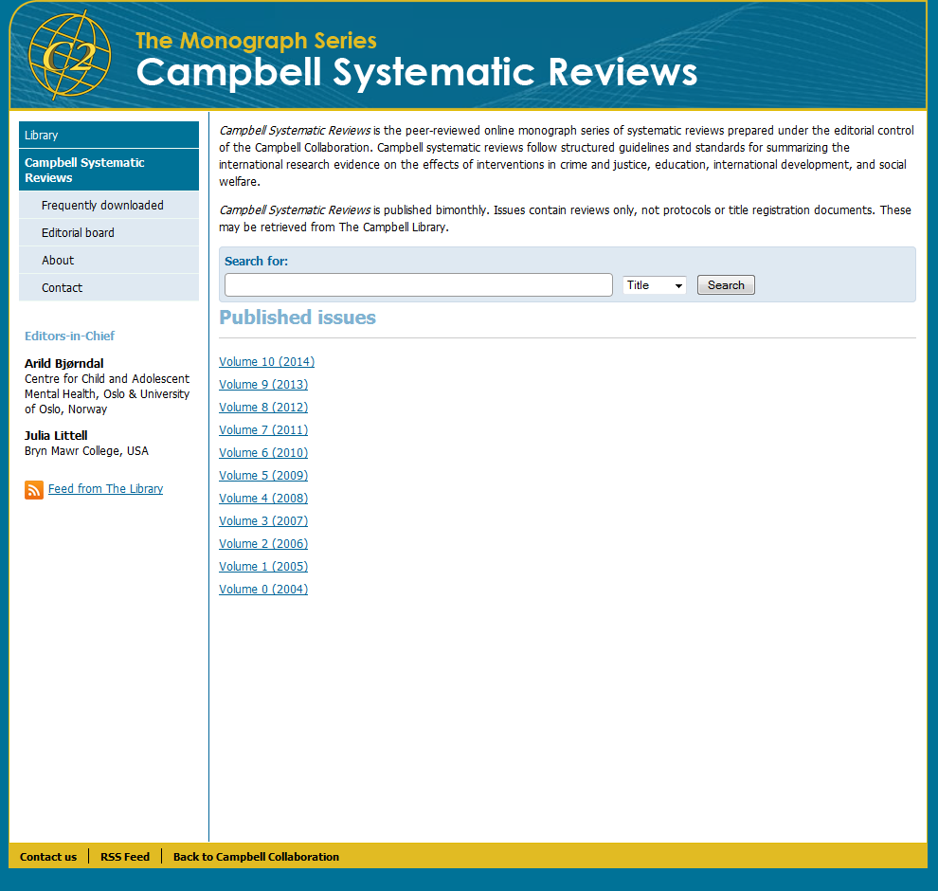

Slide 19
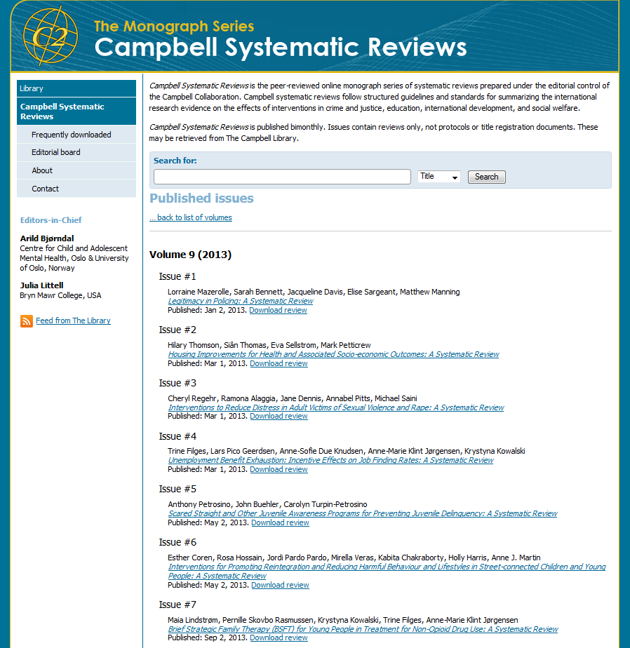

Slide 20
National Guideline Clearinghouse(NGC)
Let’s explore…

Slide 21
Start at the library website!
http://www.ttuhsc.edu/libraries

Slide 22
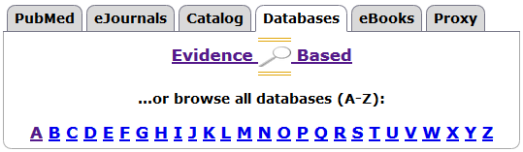

Slide 23
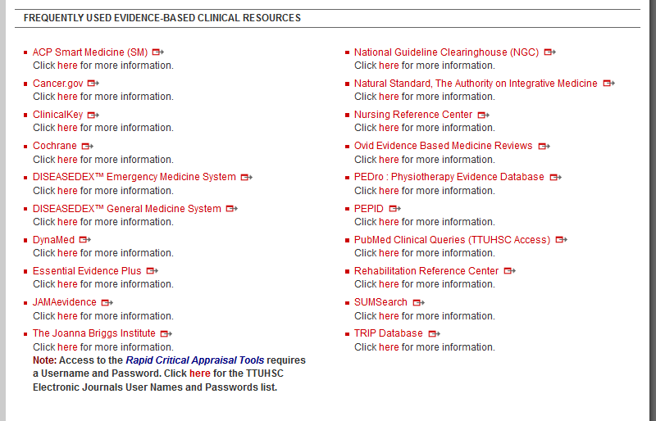


Slide 24
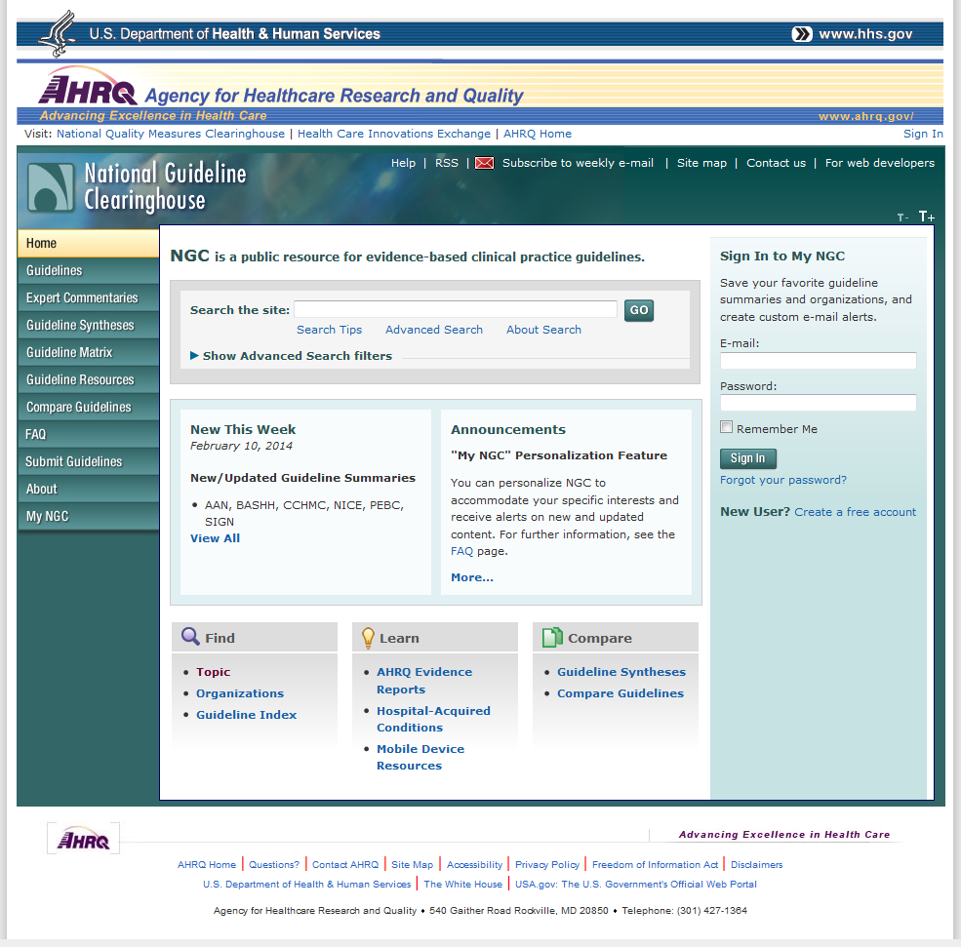
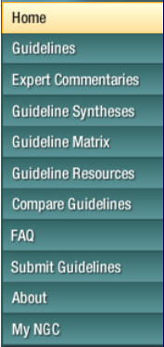


Slide 25
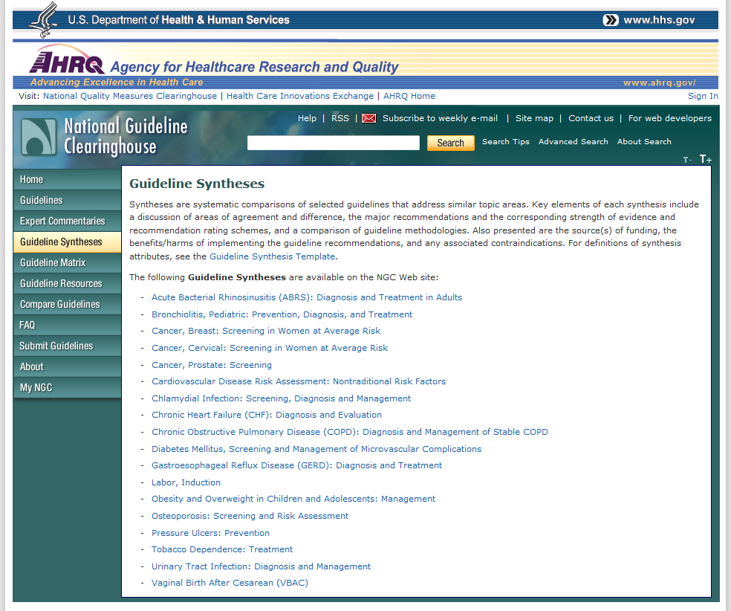


Slide 26
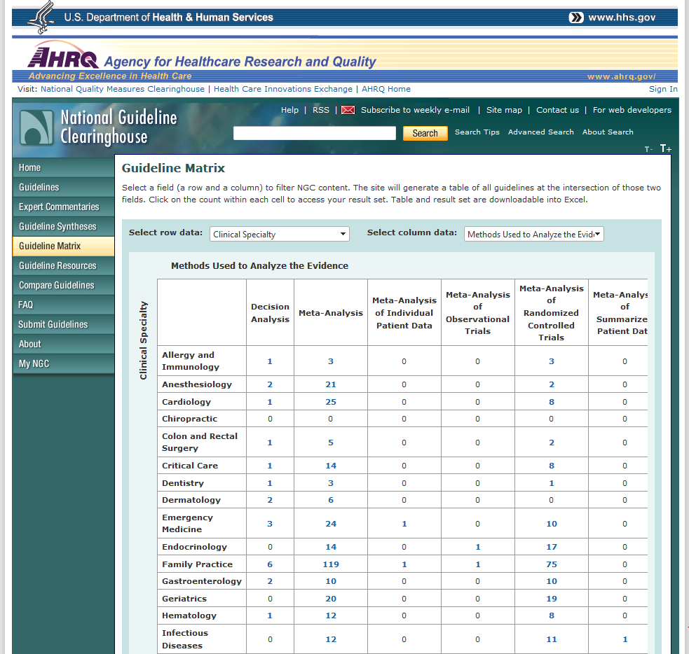

Slide 27
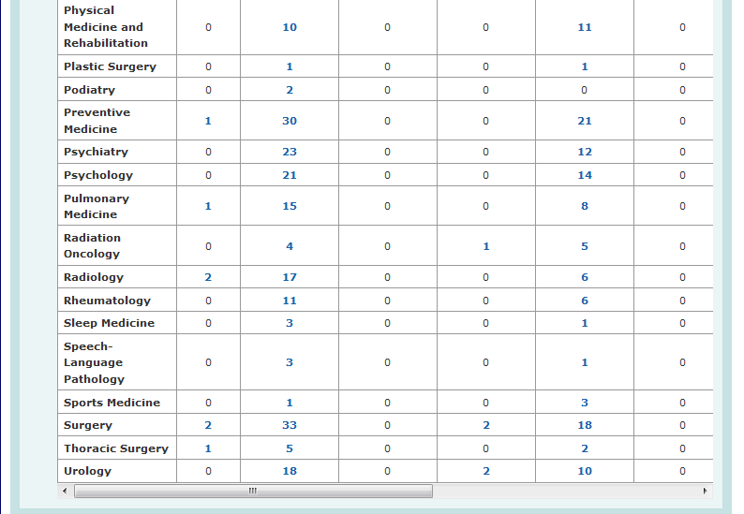


Slide 28
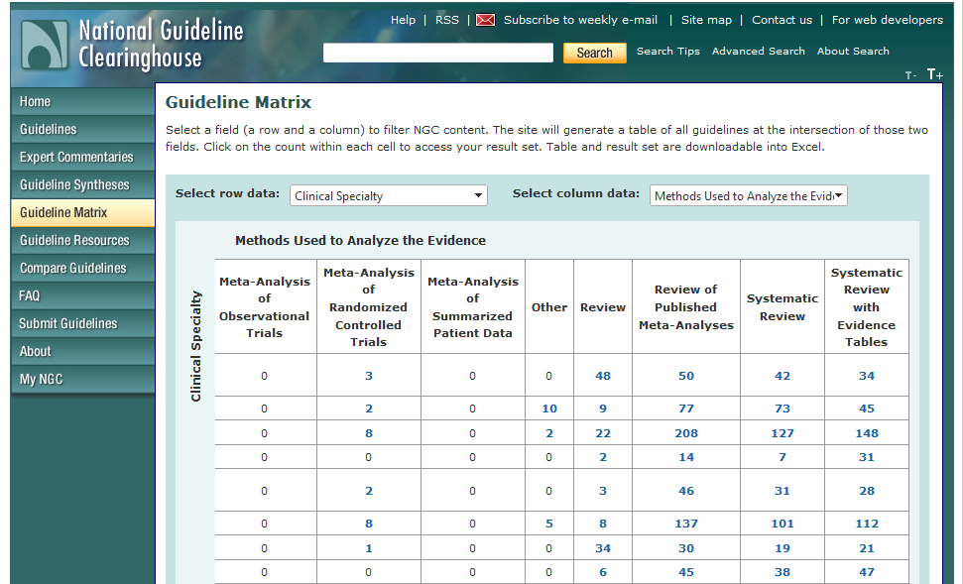
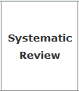

Slide 29
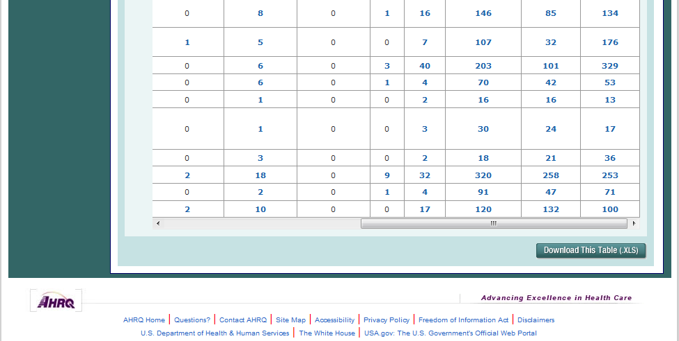


Slide 30
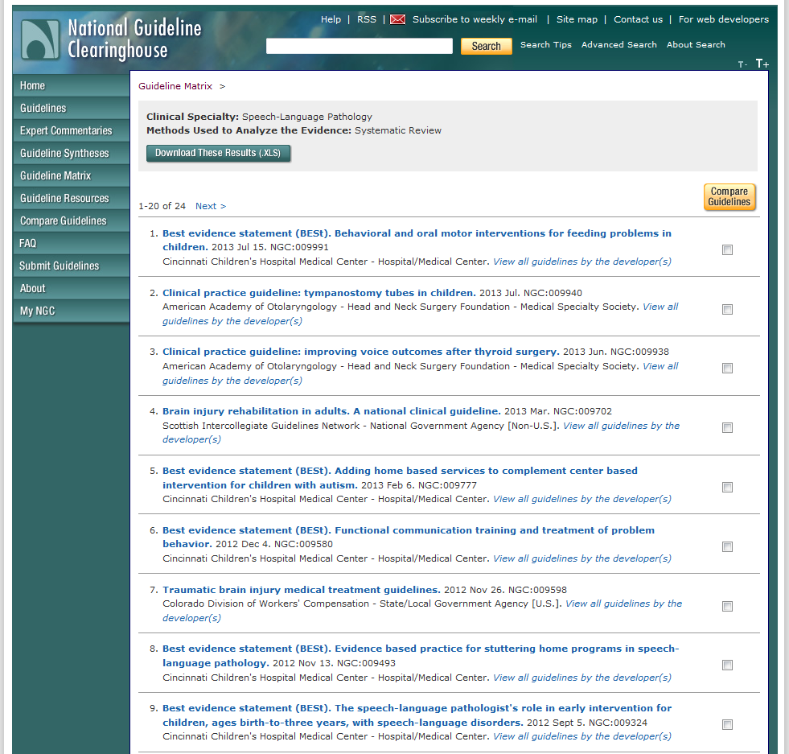


Slide 31
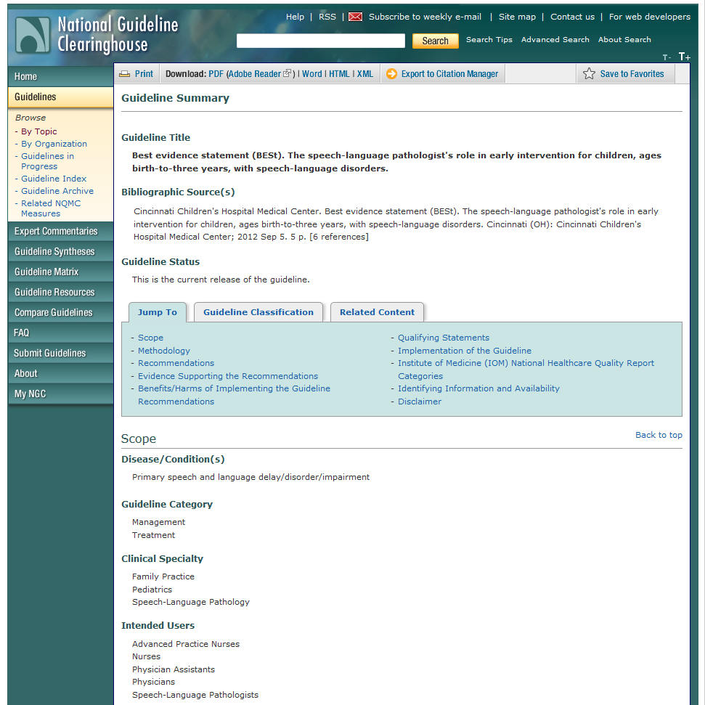
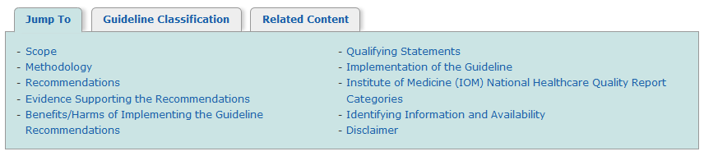

Slide 32
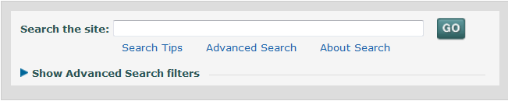
Advanced Search Option

Slide 33
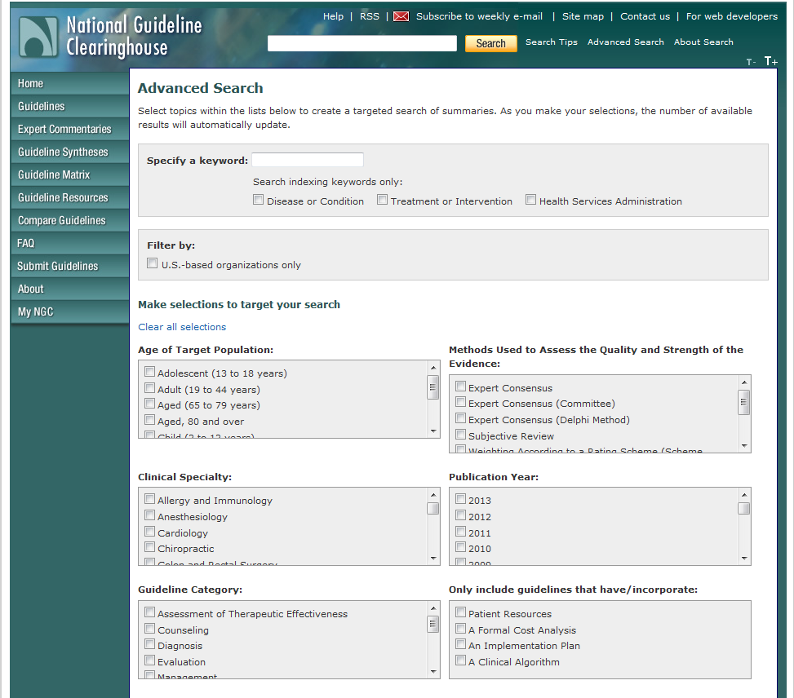
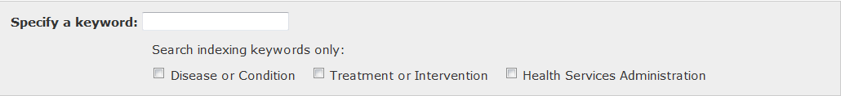

Slide 34
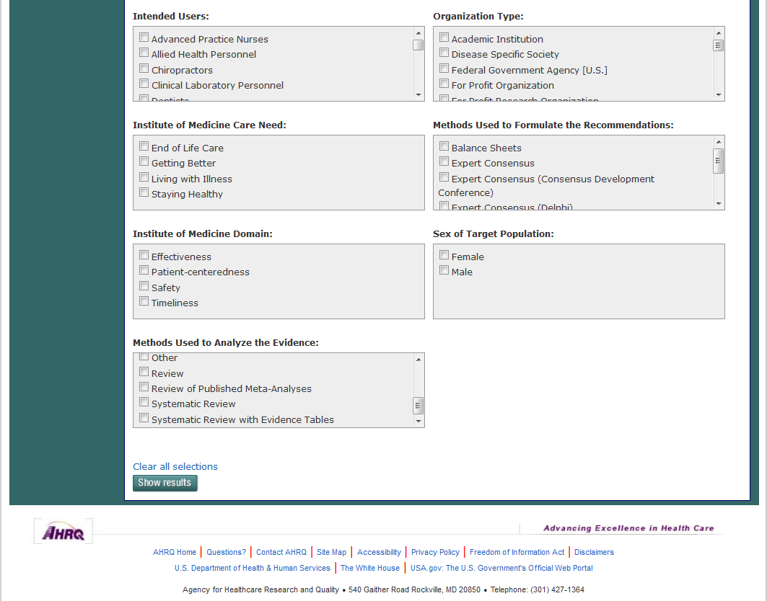
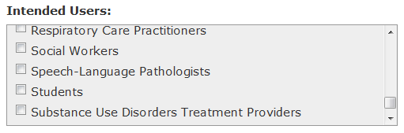

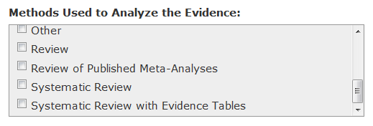


Slide 35
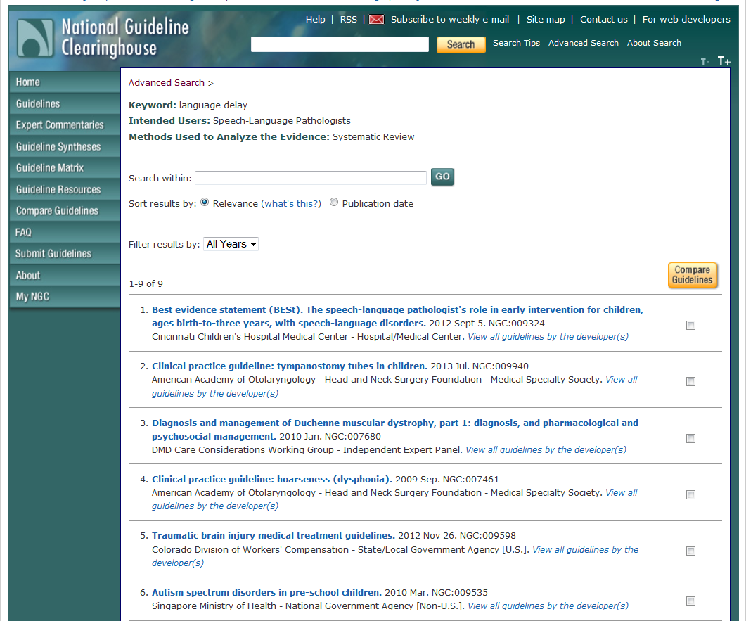


Slide 36
Welcome
Information Resources for Speech Language Pathology
Peggy Edwards, AMLS
TTUHSC - Preston Smith Library
Lubbock, Texas 79430
Feb 2014

Slide 37
Cochrane Database of Systematic Reviews
and
DARE: Database of Reviews of Effects
via
OVID

Slide 38
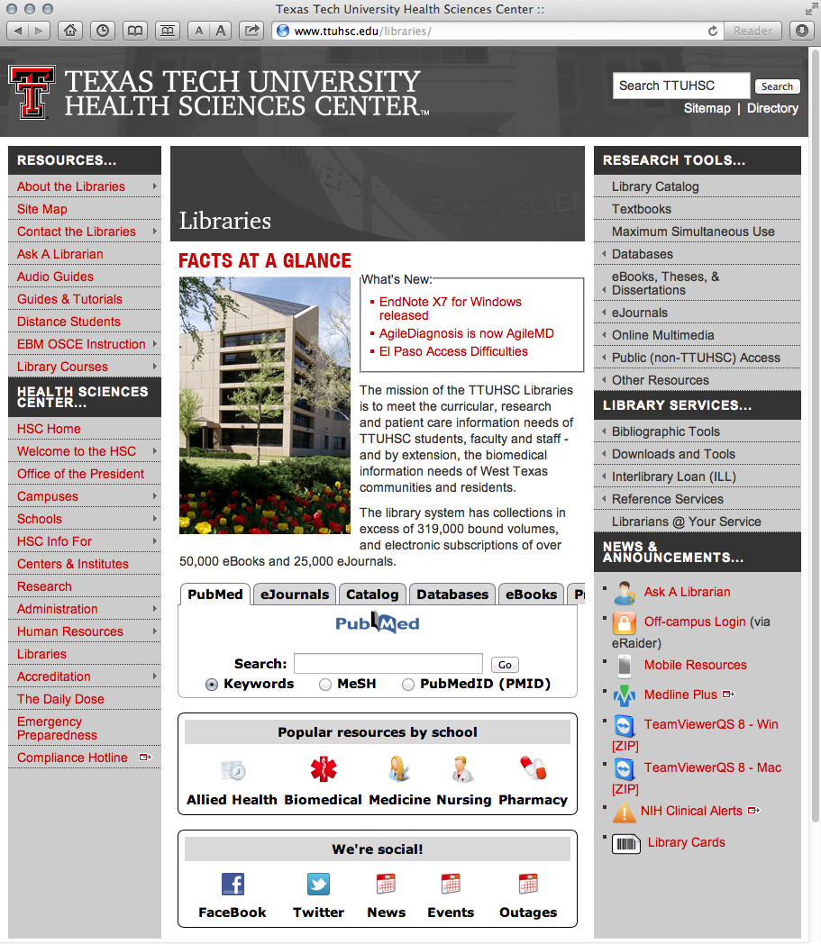
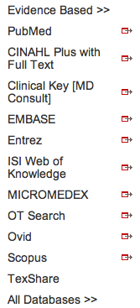
EBM Reviews via OVID
www.ttuhsc.edu/libraries
Mouse over Databases
and click OVID

Slide 39
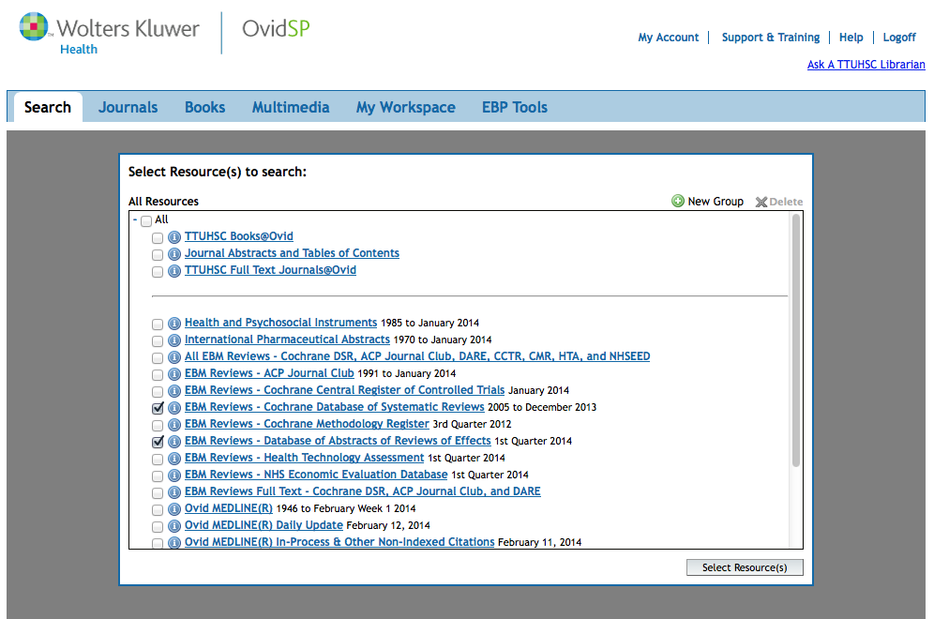
Select Cochrane Database of Systematic Reviews and
DARE: Database of Abstracts of Reviews of Effects
✔
✔

Slide 40
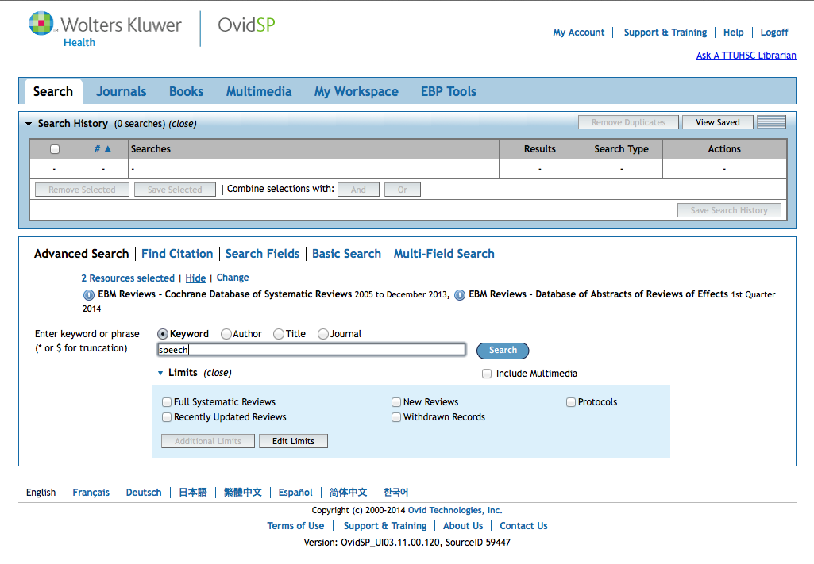
Click Search
Enter
speech
as the
first keyword search.

Slide 41
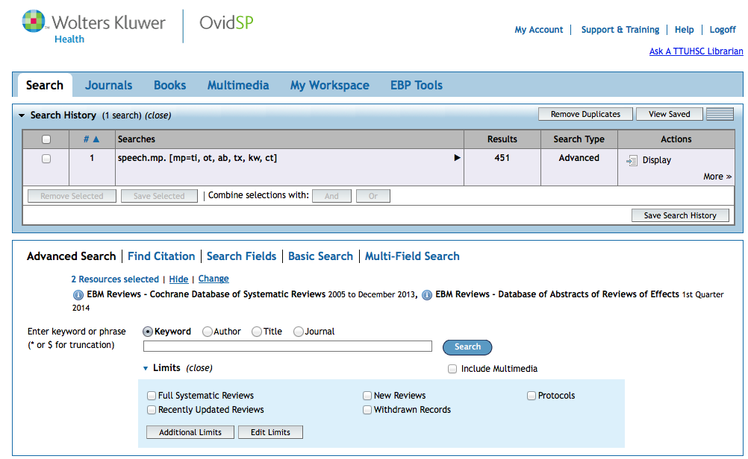
Results in the
first search set.

Slide 42
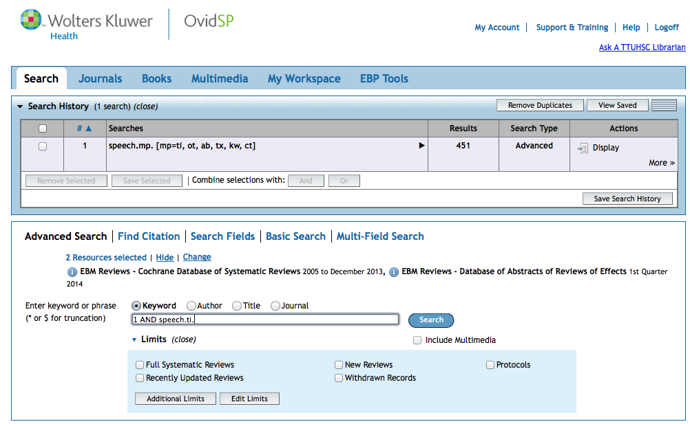
Click Search
Enter
1 AND speech.ti.
to narrow to
articles with speech as a word in the title.

Slide 43
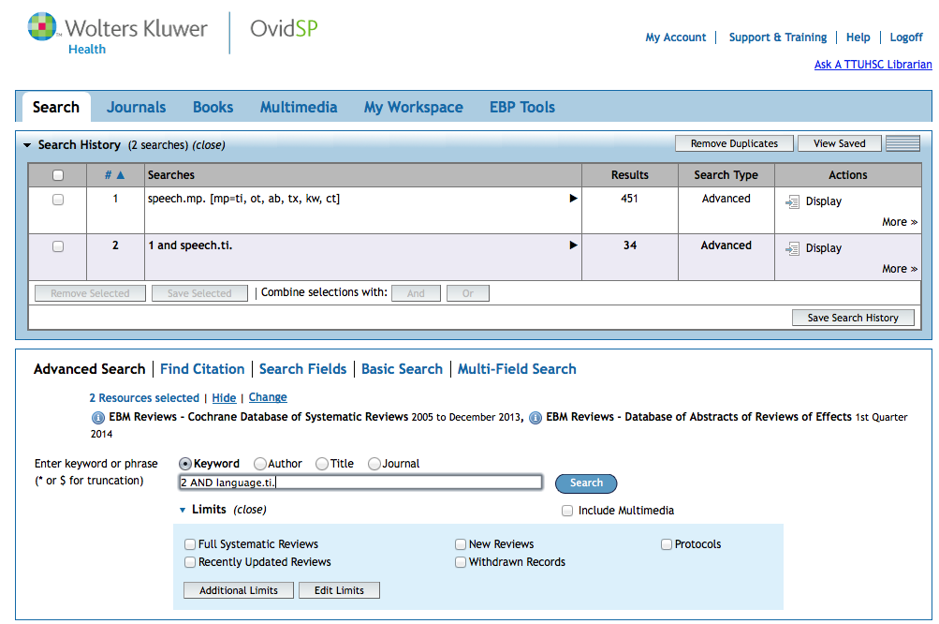
Click Search
Enter
2 AND language.ti.
to narrow to
articles with language as a word in the title.

Slide 44
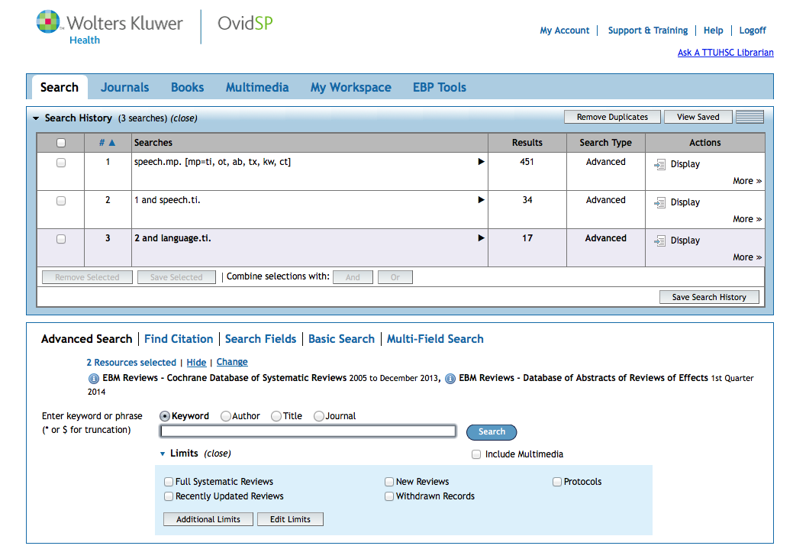
Results of AND combination narrows to 17 articles.

Slide 45
By entering an asterisk*after a word, the computer searches for any suffix of a word.
Example: gene* will retrieve
genes, genetic, generation, etc.
This is called truncation.

Slide 46
Search Results

Slide 47
Click Display
to view articles

Slide 48
Cochrane Database of Systematic Reviews

Slide 49
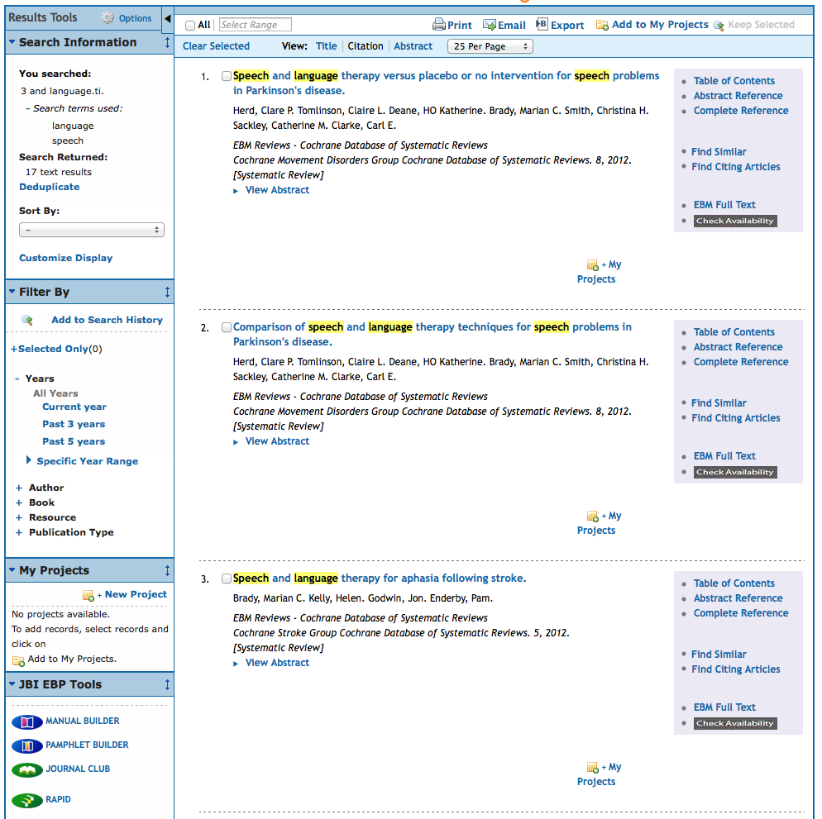
Click EBM Full Text

Slide 50
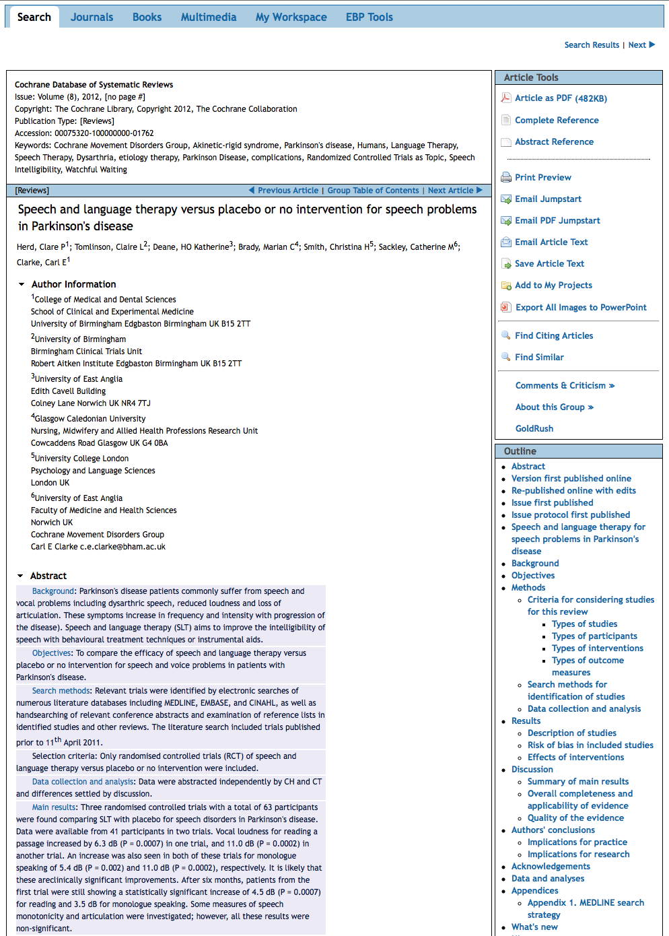
click Search
Article as PDF

Slide 51
DARE

Slide 52
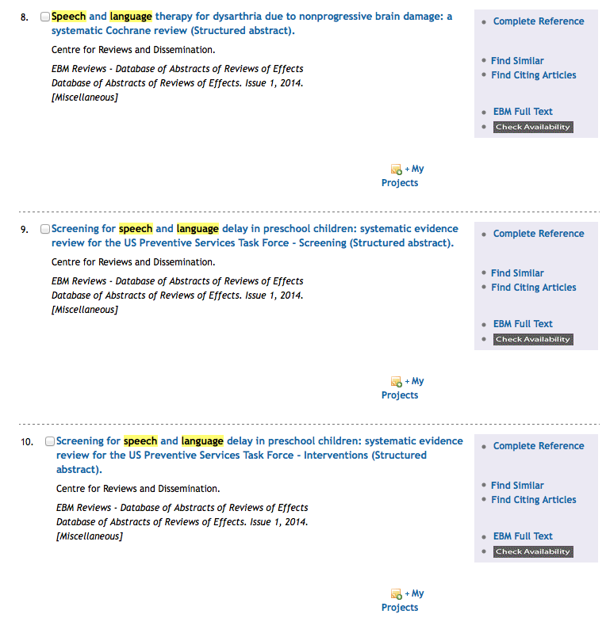
Scroll to article # 9
Click EBM Full Text

Slide 53


Slide 54
EBP Literature from
PubMed’s Clinical Queries

Slide 55



PubMed’s Clinical Queries
Biomedical journal literature
Tool that searches for
evidence-based literature
Published by:
The National Library of Medicine

Slide 56




Clinical Queries Searchable by:
Diagnosis
Therapy
Prognosis (prediction of probable outcome)
Etiology (cause)

Slide 57

PubMed’s Clinical Queries
www.ttuhsc.edu/libraries
Mouse over Databases
Click PubMed

Slide 58

PubMed Home Page
Click Clinical Queries

Slide 59

Enter speech therapy stroke
Click
Search

Slide 60

Results for Therapy
and Broad Scope
Click See all (50)

Slide 61

Select filters
Click 5 years and Humans

Slide 62

Selections will turn blue: ✓ 5 Years, ✓ Humans
Click Show additional filters

Slide 63

Select Languages
✔
Click Show

Slide 64

Click English

Slide 65

Results have narrowed to 18
To access full-text, click on the title of the article you wish to read

Slide 66

Clicking accesses Free Full Text
TTUHSC ONLINE

Slide 67

TTUHSC Libraries - Proxy Server
When Searching from Off Campus:
Enter the
Eraider username and password
assigned to you
by Information Services.
Problems with eRaider call: 806-743-1234
a

Slide 68

Full Text

Slide 69
Have Questions
or
Need Help?

Slide 70


Today’s PowerPoint
Click the Allied Health Icon to go to Popular Resources

Slide 71

Speech Language Pathology PowerPoint
Graduate Students
February 18, 2014

Slide 72

www.ttuhsc.edu/libraries
Download TeamViewer

Slide 73





Call your TTUHSC Librarian

Slide 74

Double click the icon and follow the directions

Slide 75

Give the password to the librarian to enter.
Log On
After logging on, the librarian can see your computer screen!
At the end of the session after logging off,
the librarian will not have access to your computer!
TeamViewer generates a new password each time it is used!

Slide 76

OR contact us at:
Lubbock
(806) 743-2200
Amarillo
(806) 354-5448
El Paso
(915) 545-6652
Odessa
(432) 335-5171

Slide 77
The End

