Slide 1
Welcome
Step Prep:
Going Beyond UWorld!
Peggy Edwards, AMLS
TTUHSC - Preston Smith Library
Lubbock, Texas 79430
March, 2017

Slide 2
Link and Download
Today’s power point:
Step Prep: Going Beyond UWorld!
under Orientations and Presentations
http://www.ttuhsc.edu/libraries/schools/som.aspx

Slide 3
Some Learning Goals for P3
Demonstrate skills in:
  self-assessment of personal learning needs
  independent identification, analysis and synthesis of
  relevant information for purposes of lifelong learning
  USMLE Easy is a tool you can use to help you do this
  Practice evidence-based medicine
  First Consult is an EBM tool you can use to answer questions you may have or for additional learning needs

Slide 4
Self-Assessment
of
Learning Needs

Slide 5
Research Articles About Step 1
I will be highlighting the data in a moment
Due to time constraints, please look at them later
How to access: Full-text is available through PubMed
Go to PubMed through the libraries home page:
TTUHSC.edu/libraries
Enter the PMID: 27500163
Click the article title, click the link to the full-text

Slide 6
Data from Bonasso
Bonasso P, Lucke-Wold B 3rd, Reed Z, Bozek J, Cottrell S. Investigating the Impact of Preparation Strategies on USMLE Step 1 Performance. MedEdPublish. 2015;4(1). pii: 5. PubMed PMID: 27500163; PubMed Central PMCID: PMC4975378.
Interactive study options, (such as the USMLE World Question Bank) offer the best choice to improve USMLE Step 1 scores
Timing of when the exam was taken was not associated with significant differences in scores

Slide 7
Data from Kumar
Kumar AD, Shah MK, Maley JH, Evron J, Gyftopoulos A, Miller C. Preparing to take the USMLE Step 1: a survey on medical students' self-reported study habits. Postgraduate Medical Journal. 2015 May;91(1075):257-61. doi: 10.1136/postgradmedj-2014-133081.
PubMed PMID: 25910497.
475 3rd year medical students at Tulane 2009-2011 who had taken the exam in the last 3 months; 256 responses
studying 8-11 hours per day yielded higher scores versus study fewer hours
studying more than 11 hours per day did not significantly yield higher scores (mean 10.6 hours)

Slide 8
Data from Kumar continued
The mean Step 1 score was higher in those who reported spending less than or = to 20 days versus those who spent more than 40 days
Similarly, the mean Step 1 score was higher in those who spent 21-40 days compared to those who spent more than 40 days
There was no significant difference in score for those who reported spending less than 20 days compared with those who spent 21-40 days

Slide 9
Data from Kumar continued
the greater the number of practice questions the higher the Step 1 scores
But, a greater portion of total study time on practice questions did not have significantly higher scores
Study offers two explanations for this apparent contradiction

Slide 10
Data from Kumar continued
1) practice questions take considerable concentration thus fatigue may limit the amount of questions attempted per day
2) it has been shown that students who use review books or class notes score higher on USMLE Step 1.⁸
Therefore, if there is a benefit from doing a maximal amount of practice questions, this benefit may be offset by not spending precious study time on other resources, i.e. review books or class notes

Slide 11
Data from Li
Li ST, Paterniti DA, Co JP, West DC. Successful self-directed lifelong learning in medicine: a conceptual model derived from qualitative analysis of a national survey of pediatric residents.
Academic Medicine. 2010 Jul;85(7):1229-36.
doi: 10.1097/ACM.0b013e3181e1931c. PubMed PMID: 20592521.
Have a learning plan!
Strategies for effective self-directed learning:
  dedicating time to study
  creating accountability
  Get help with goal generation
    through mentorship or
    from external assessments vs self-assessments

Slide 12
Li created a strategy of goals and plans:
ISMART
Important:
To choose goals relevant to the learner
To prioritize achievement of learning goals
Specific:
To break broader goals into incremental steps To plan how to accomplish incremental steps
Measurable:
To set a measurable outcome

Slide 13
Data from Li continued
To use a reminder and tracking system
To build in external accountability
To establish internal accountability
Accountable:
To create achievable goals
To seek out and use available opportunities
To self-adjust
Realistic:
Timeline:
To develop timeline for achieving goals
To incorporate goals into daily routine
USMLE Easy has a built-in learning plan!

Slide 14
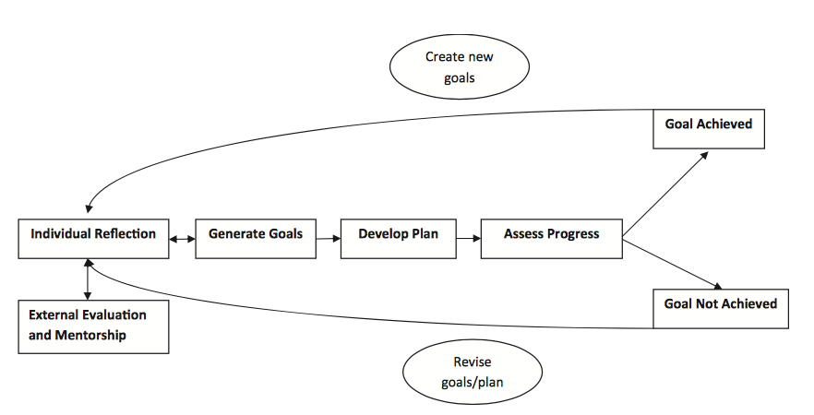
Data from Li continued
Li, S. T., Paterniti, D. A., & West, D. C. (2010). Successful self-directed lifelong learning in medicine: a conceptual model derived from qualitative analysis of a national survey of pediatric residents. Academic Medicine, 85(7), 1229-36. doi:10.1097/ACM.Ob013e3181e1931c

Slide 15
What questions do you have?

Slide 16
USMLE Easy

Slide 17
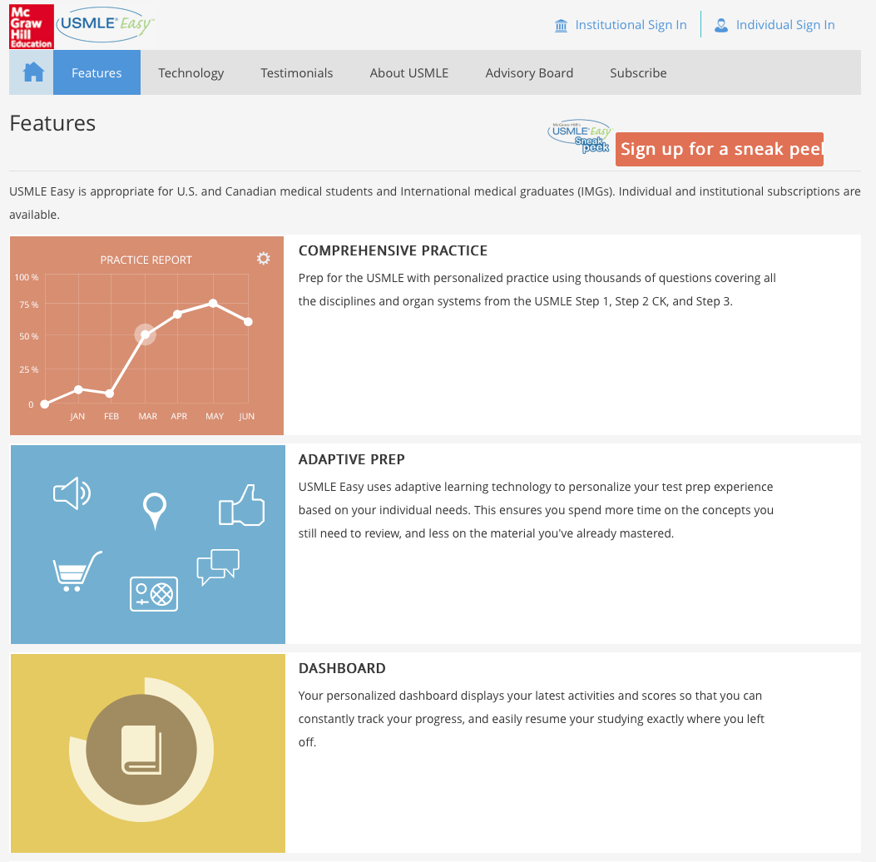
Thousands of practice questions
Practice Report
Adaptive learning technology based on your individual learning needs
Personal Dashboard

Slide 18
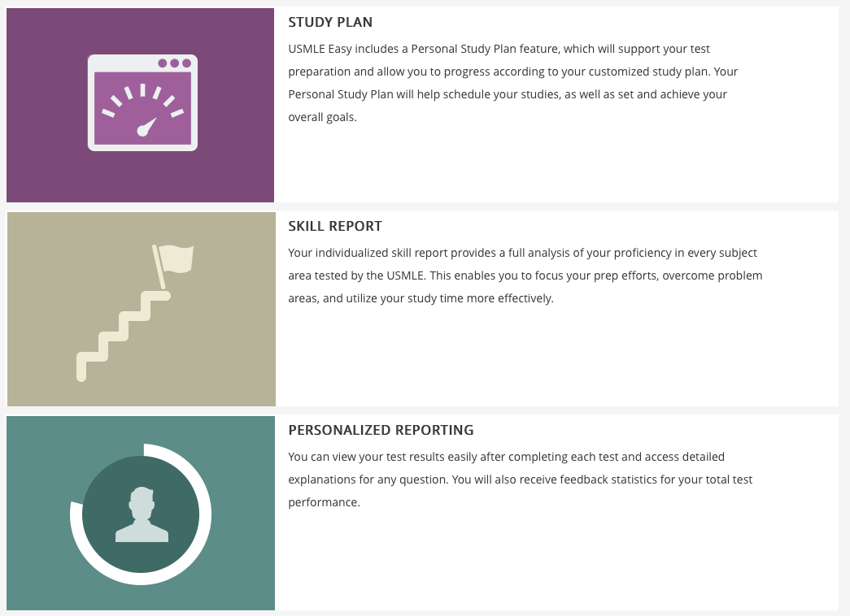
Schedule studies
Set and achieve goals
Proficiency analysis in every subject area
View test results
Detailed explanations for any question
Feedback stats

Slide 19
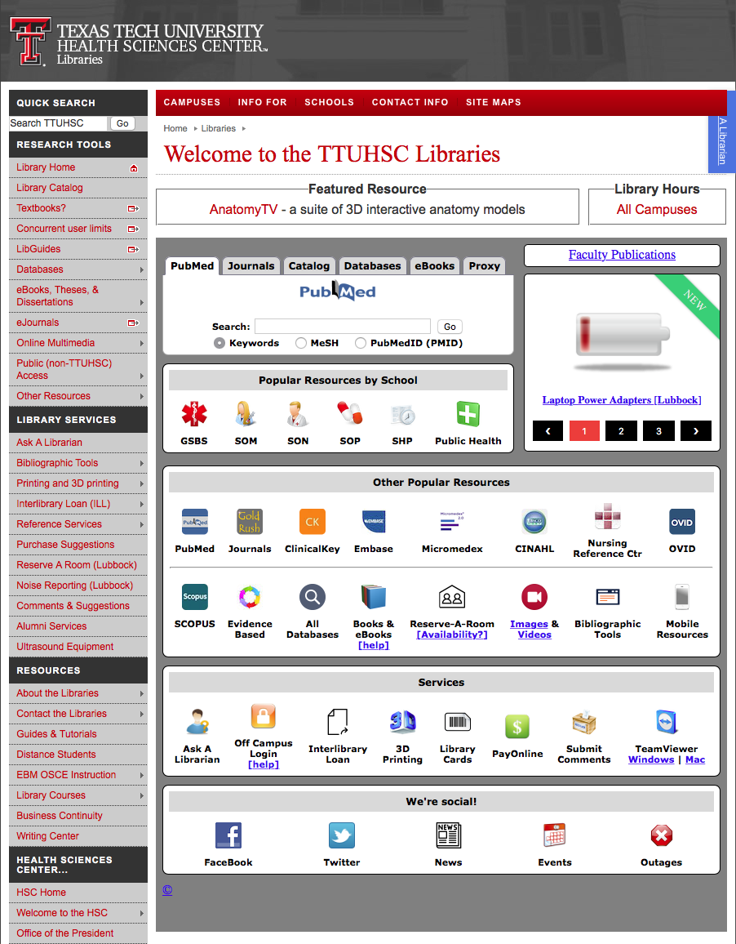
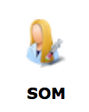
www.ttuhsc.edu/libraries
Click SoM

Slide 20
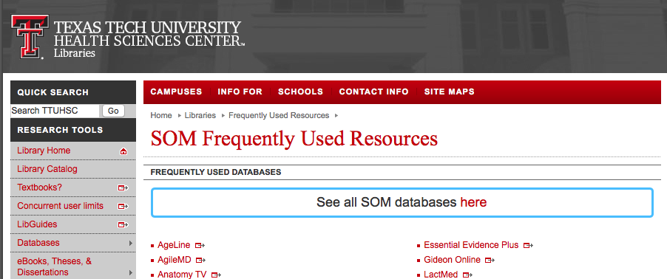
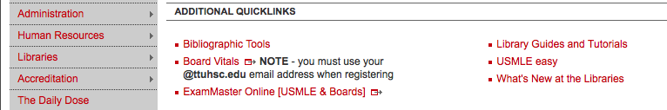
Scroll
Click
USMLE easy

Slide 21
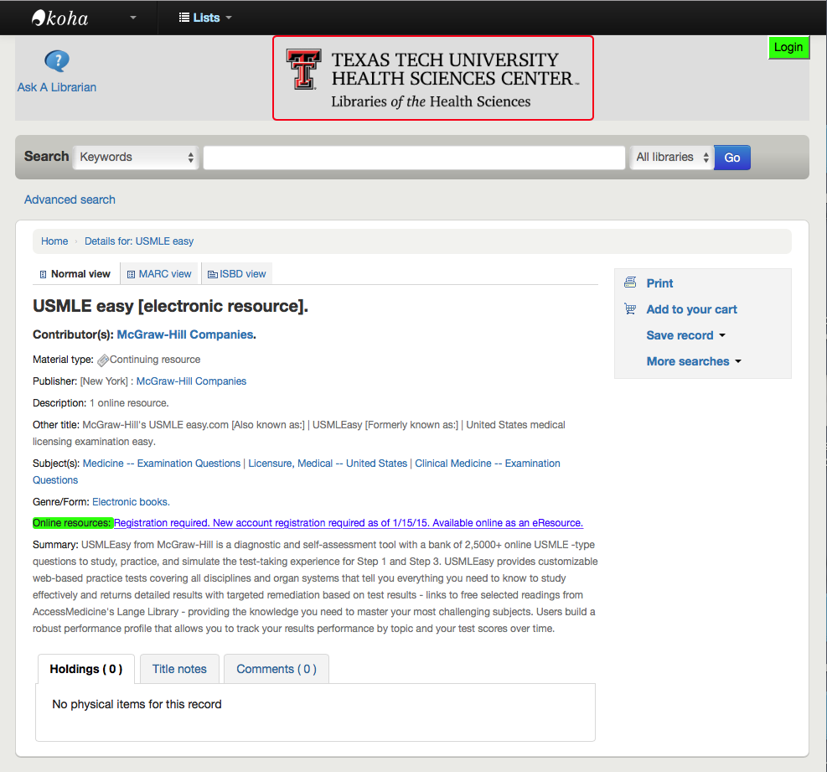
Click and Register

Slide 22
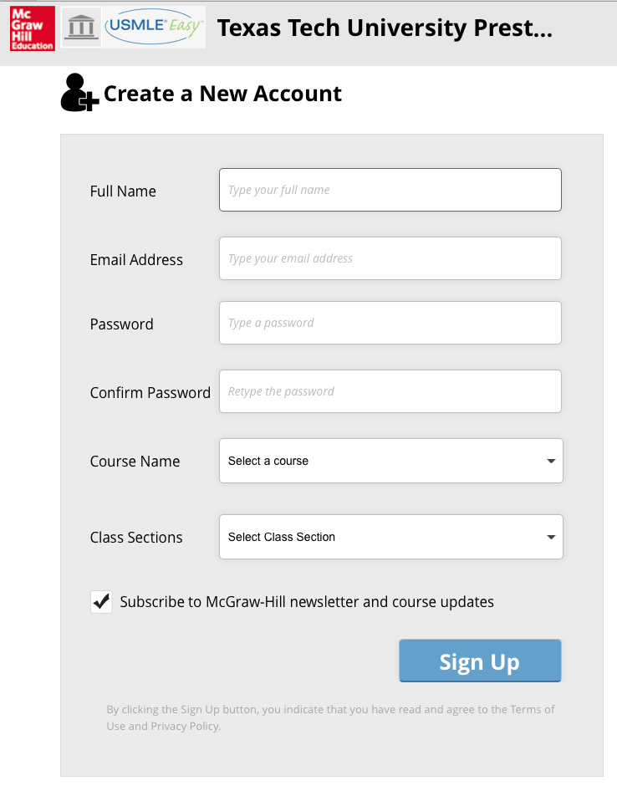
Register for Account

Slide 23
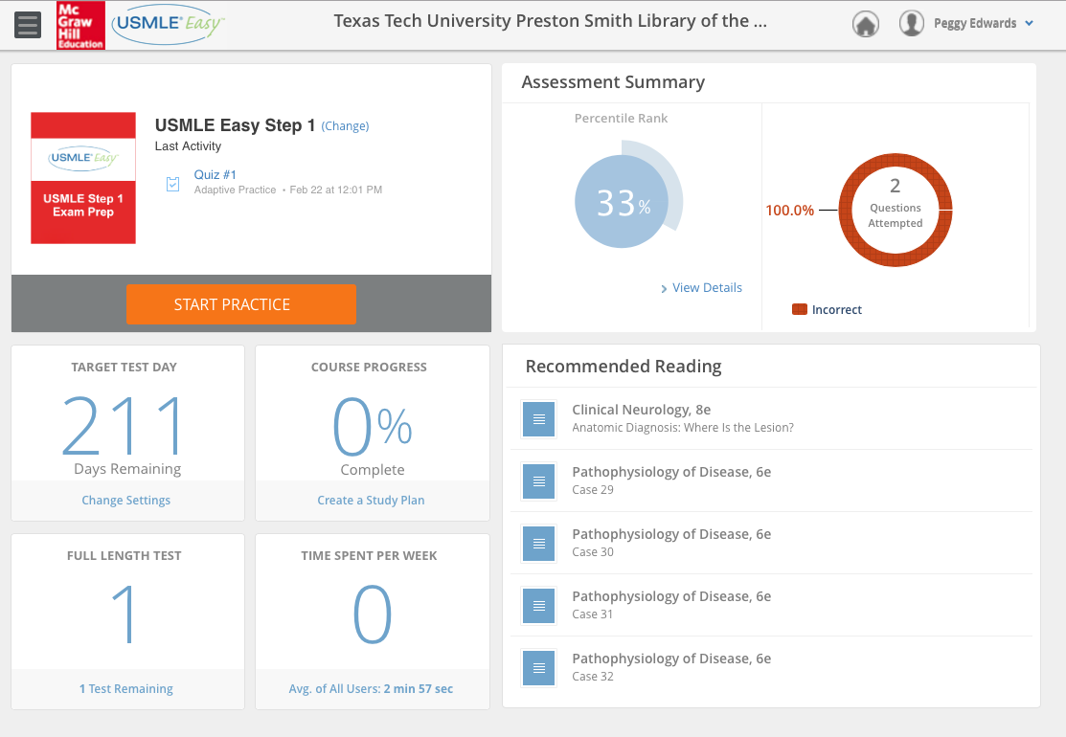
Dashboard

Slide 24
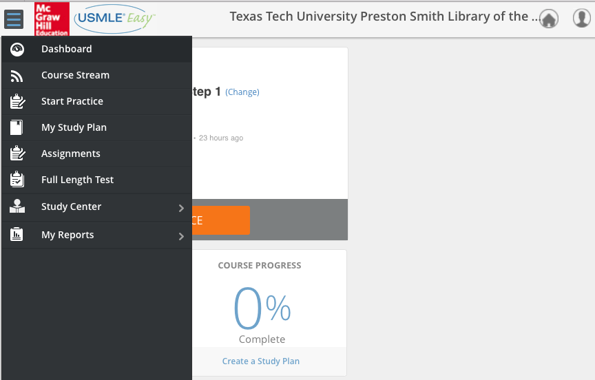
Click Menu

Slide 25
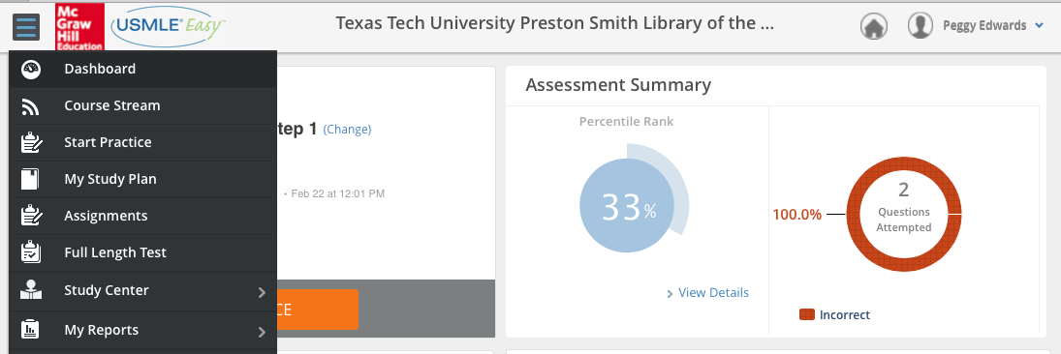
Start Practice

Slide 26
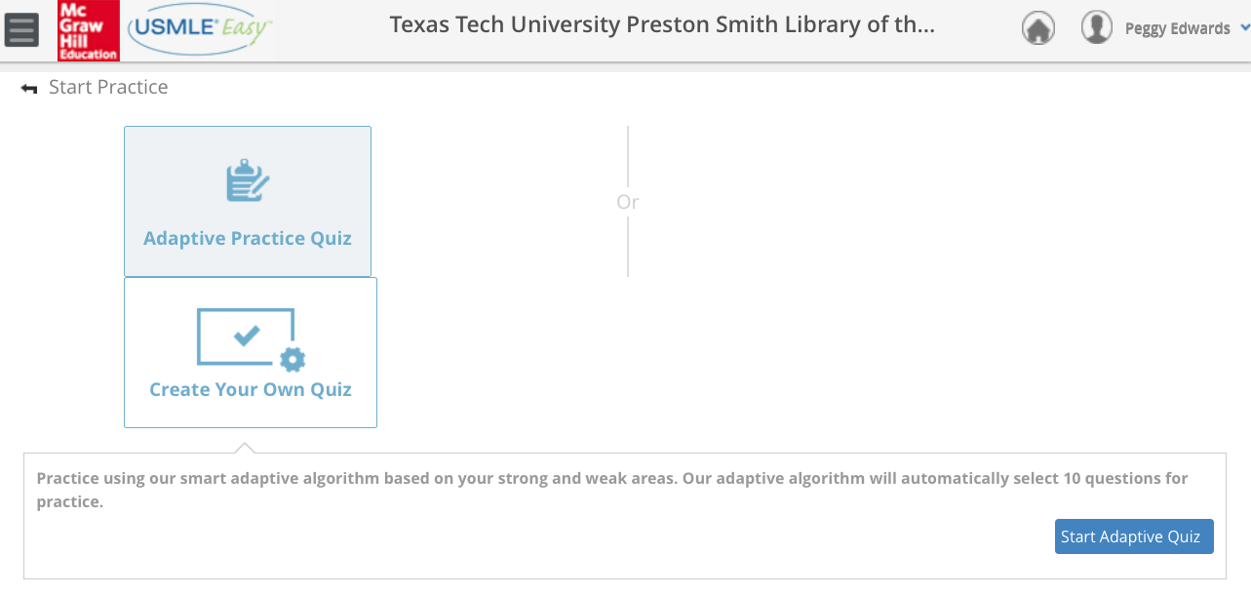
The Adaptive Quiz uses an algorithm, based on your strong and weak areas, to select 10 practice questions.

Slide 27
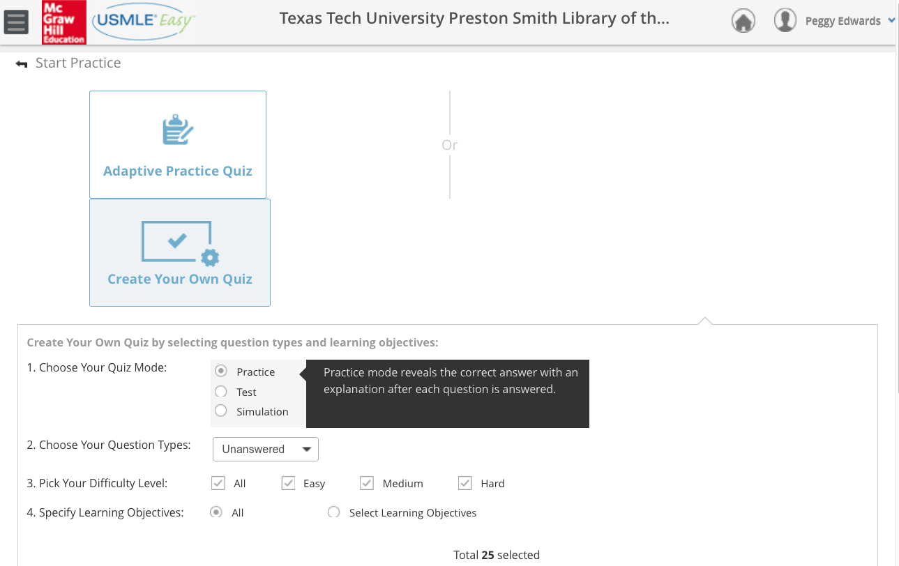
Create Your Own Quiz by selecting question types and learning objectives

Slide 28
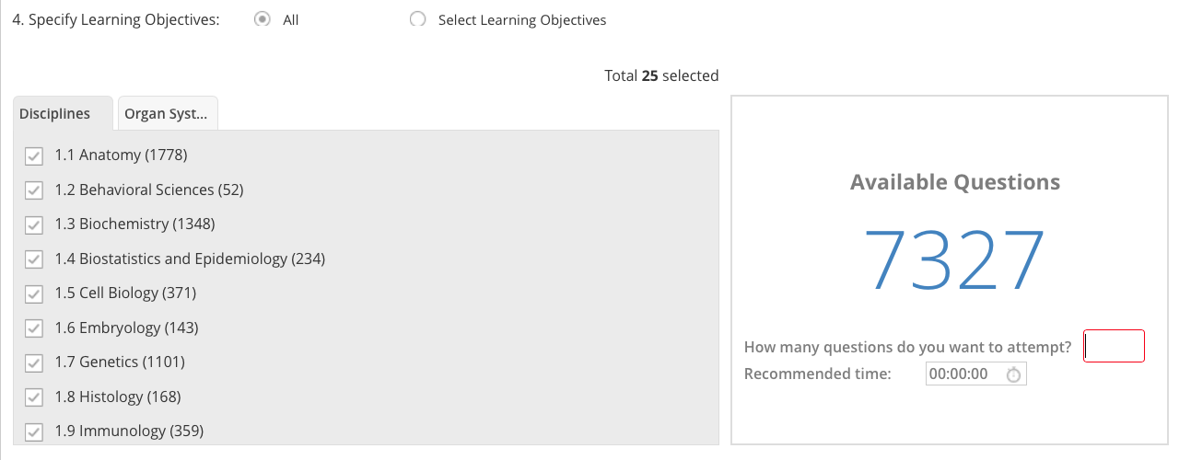
by Disciplines

Slide 29
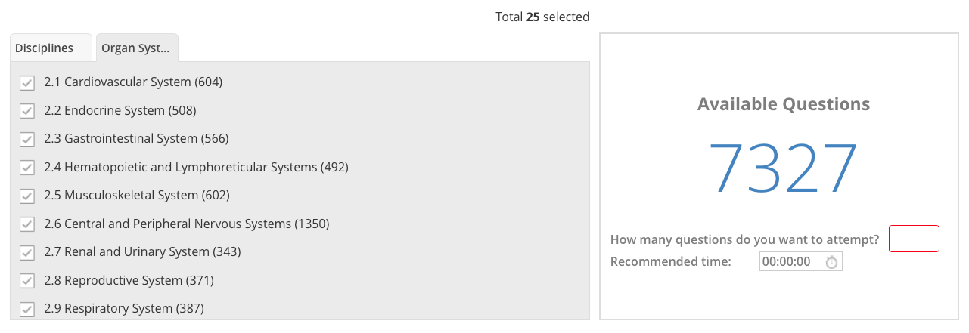
by Organ System

Slide 30
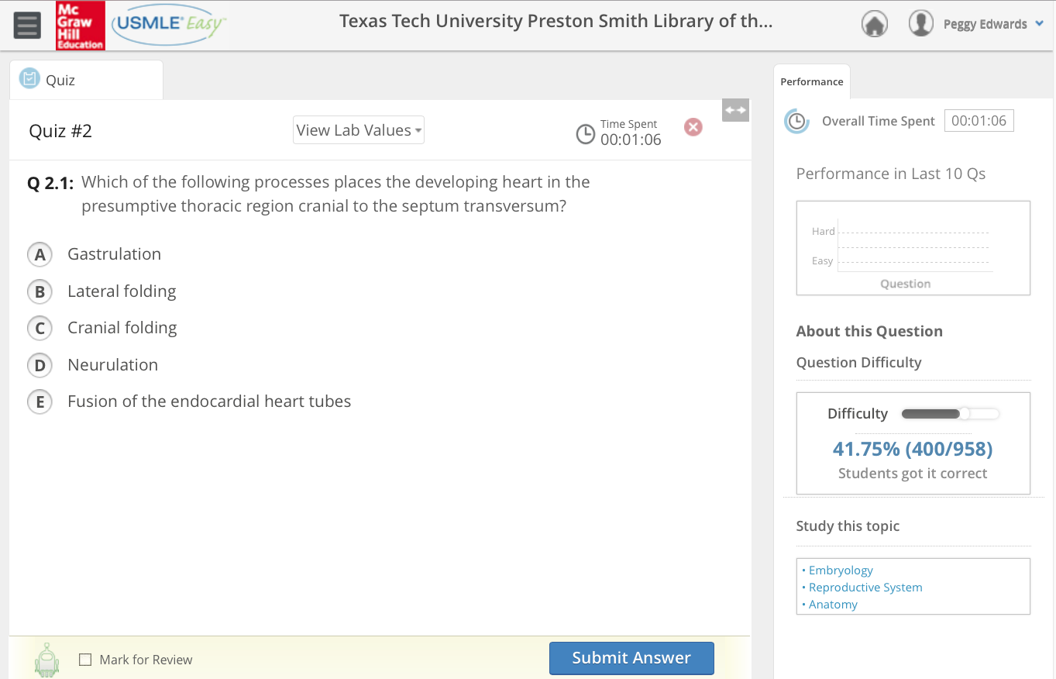
Question

Slide 31
Time Spent

Slide 32
Overall Time Spent

Slide 33
Performance in Last 10 Qs

Slide 34
About this Question

Slide 35
Question Difficulty

Slide 36
Study this topic

Slide 37
Mark for Review

Slide 38
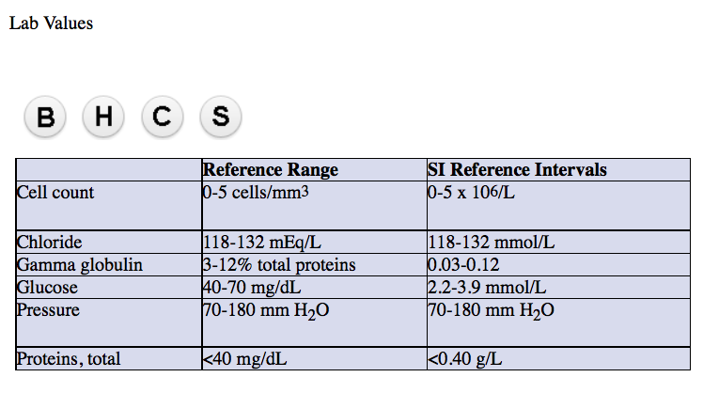
View Lab Values

Slide 39
Click Menu
My Study Plan

Slide 40
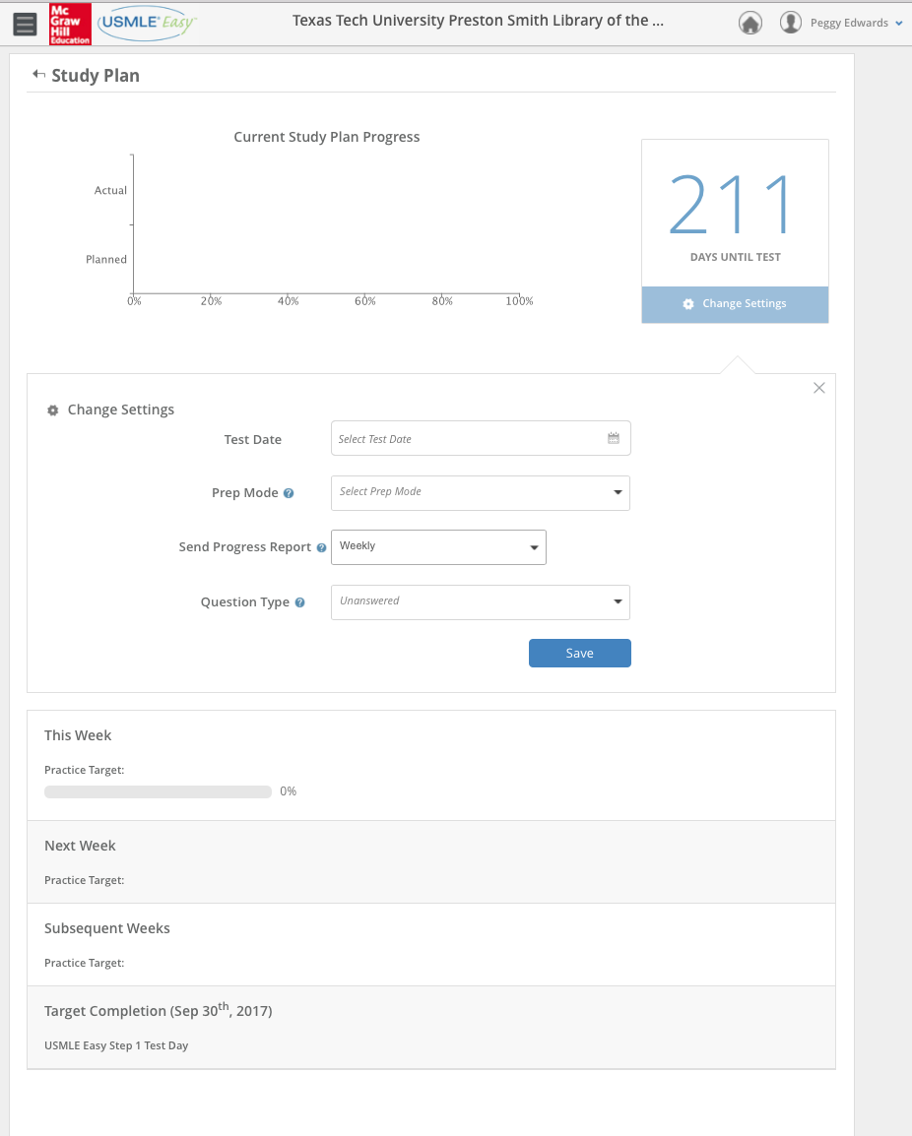
Study Plan
Current Plan Progress
Settings
Practice Target Progress

Slide 41
Click Menu
Full Length Test

Slide 42
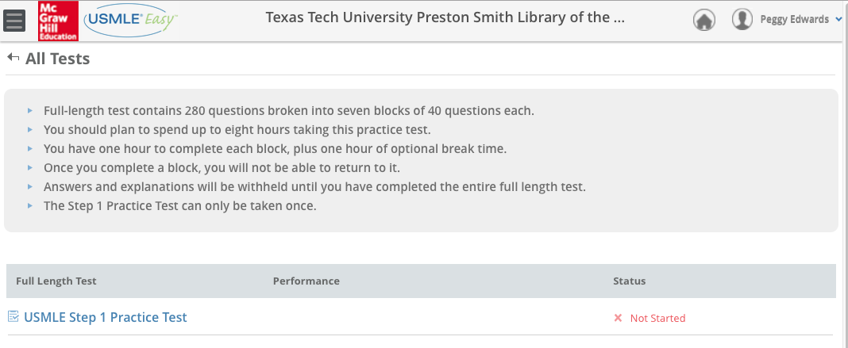
*Full-length test
280 questions 7 blocks 40 questions each
*Spend 8 hours on test
1 hour per block 1 hour optional break time
*Cannot return to a completed block
*Answers & explanations available only after entire test completed
*Step 1 Practice can only be taken once

Slide 43

Click Menu
Study Center

Slide 44
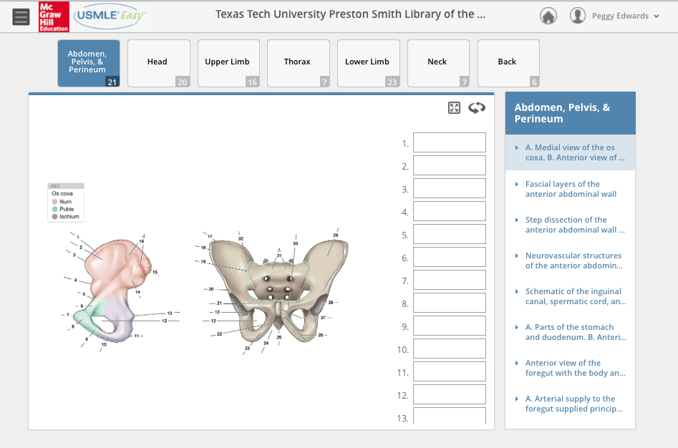
Flash Cards

Slide 45
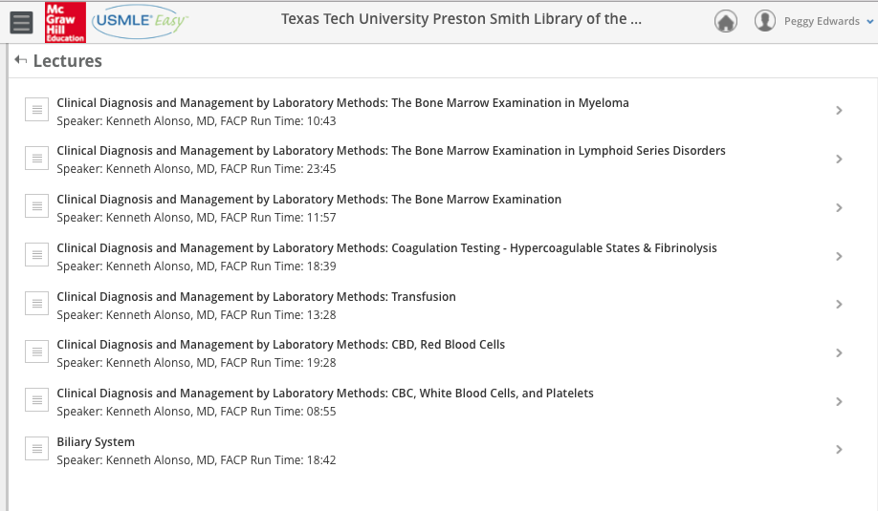
Lectures

Slide 46
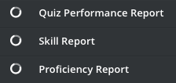
Click Menu
My Reports

Slide 47
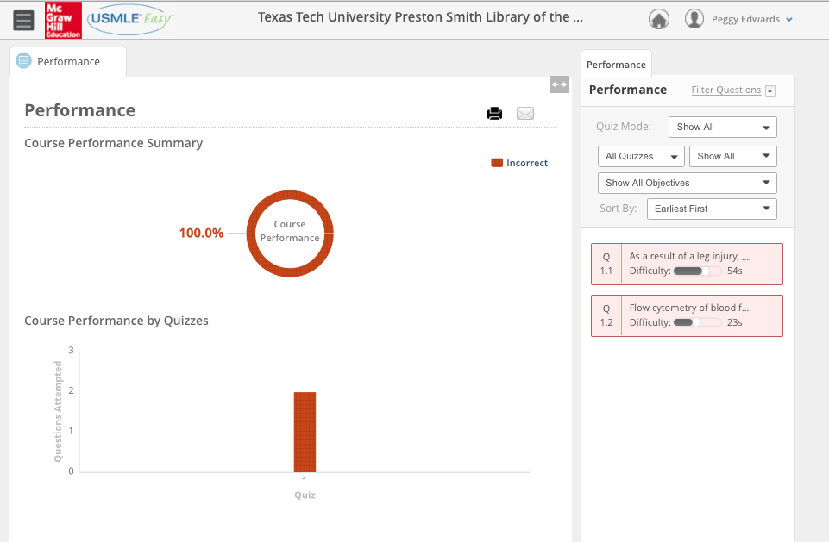
Quiz Performance Reports
Summary

Slide 48
Quiz Performance Reports
Select for Specific Reports

Slide 49
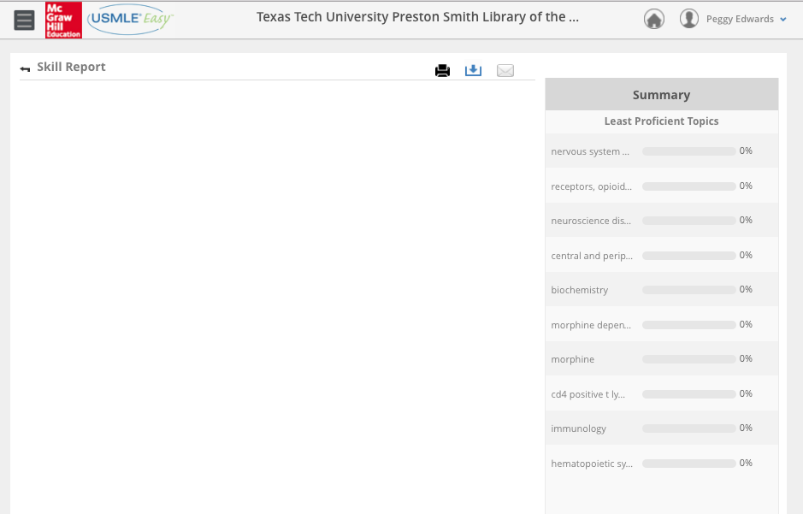
Skill Report

Slide 50
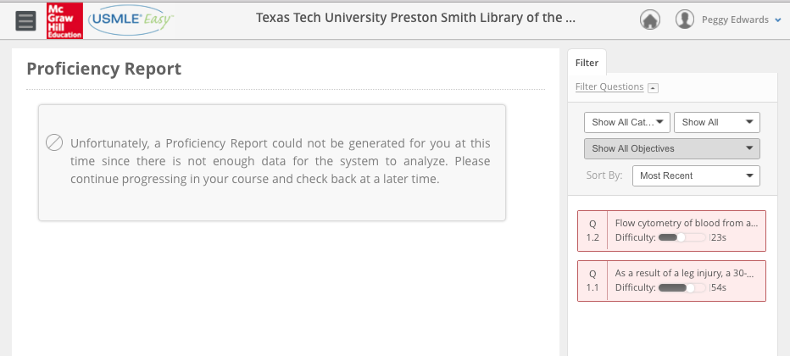
Proficiency Report

Slide 51
Take some time to explore USMLE Easy!
Note:
We will go over First Consult after the exploration time period!

Slide 52
What questions do you have?

Slide 53
Evidence-Based
Medicine

Slide 54
Clinical Key
* content from books, journals, and videos
First Consult
*point of care decision support tool within Clinical Key
* main source of information is from the
evidence based organization:
The Cochrane Collaboration where possible

Slide 55
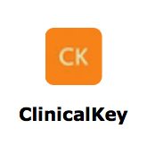
www.ttuhsc.edu/libraries
Click

Slide 56
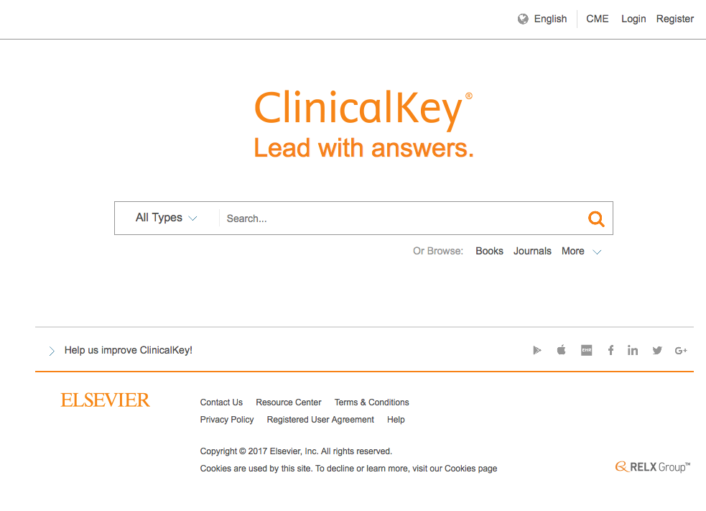
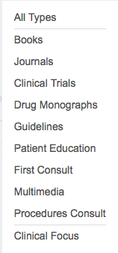
Click
<
Select First Consult

Slide 57
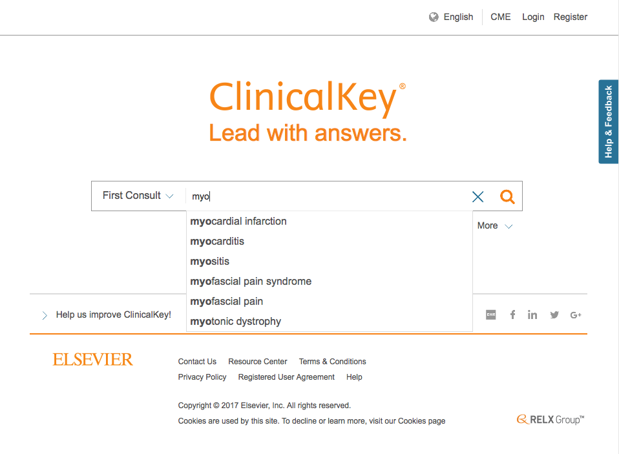
Start entering myo
Select myocardial infarction

Slide 58
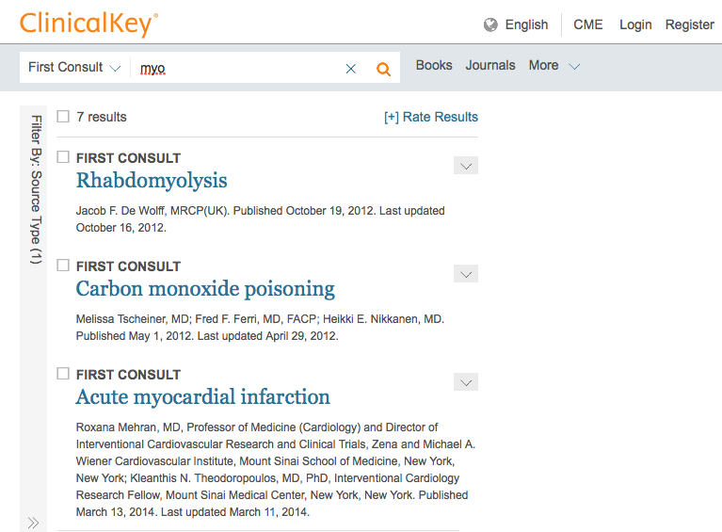
Click acute myocardial infarction

Slide 59
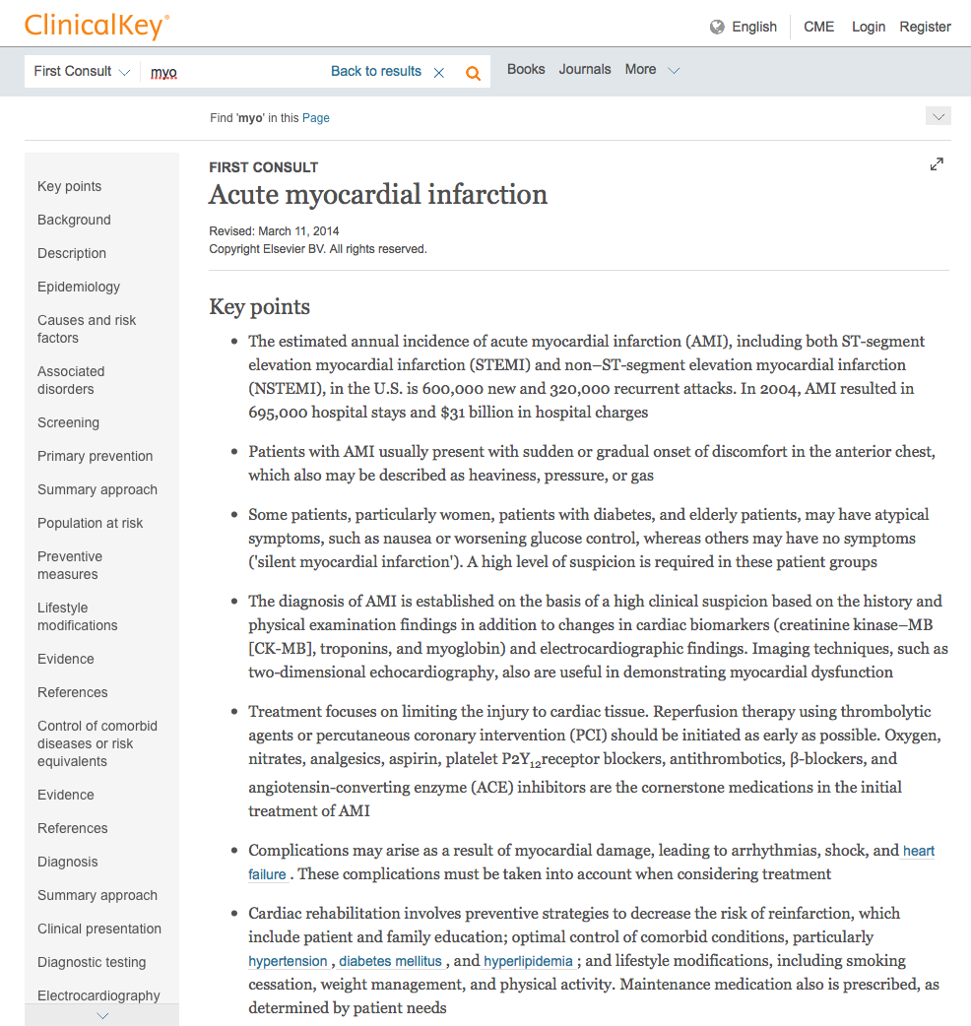
Click Clinical presentation

Slide 60
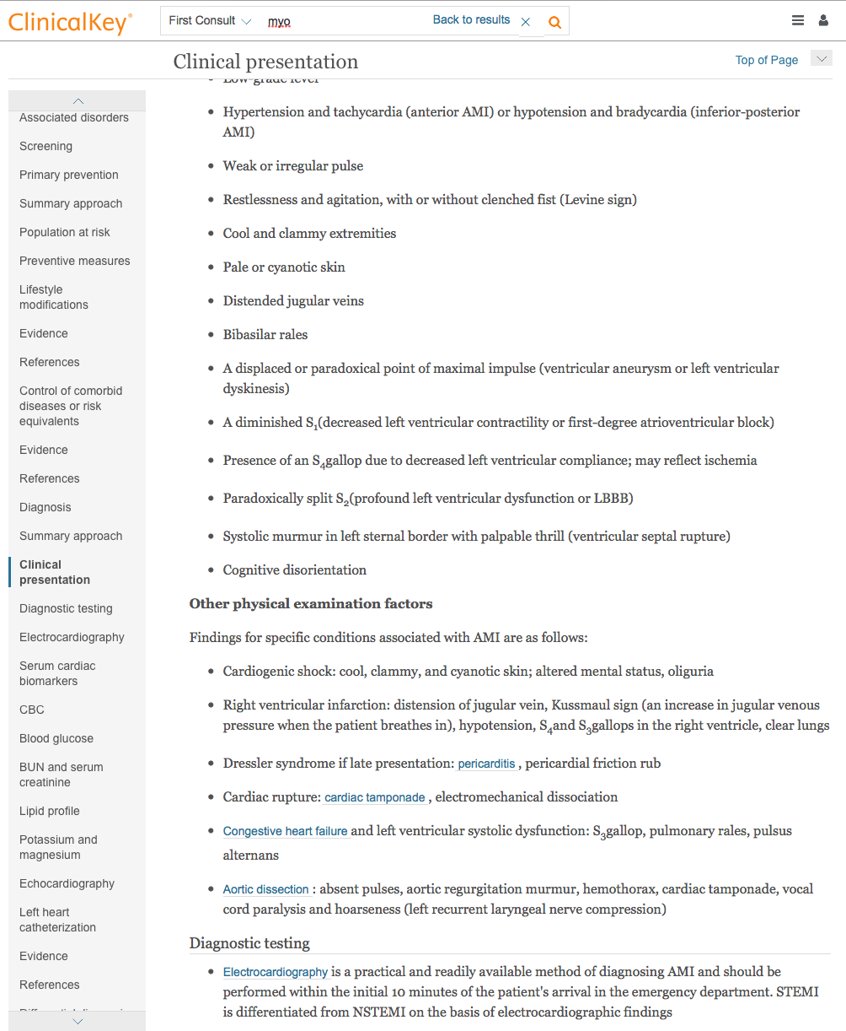
Clinical presentation
Other physical exam factors
Diagnostic testing

Slide 61
What questions do you have?

Slide 62
Life Long Learning

Slide 63
LibGuides Tutorials

Slide 64
www.ttuhsc.edu/libraries
Click
LibGuides

Slide 65
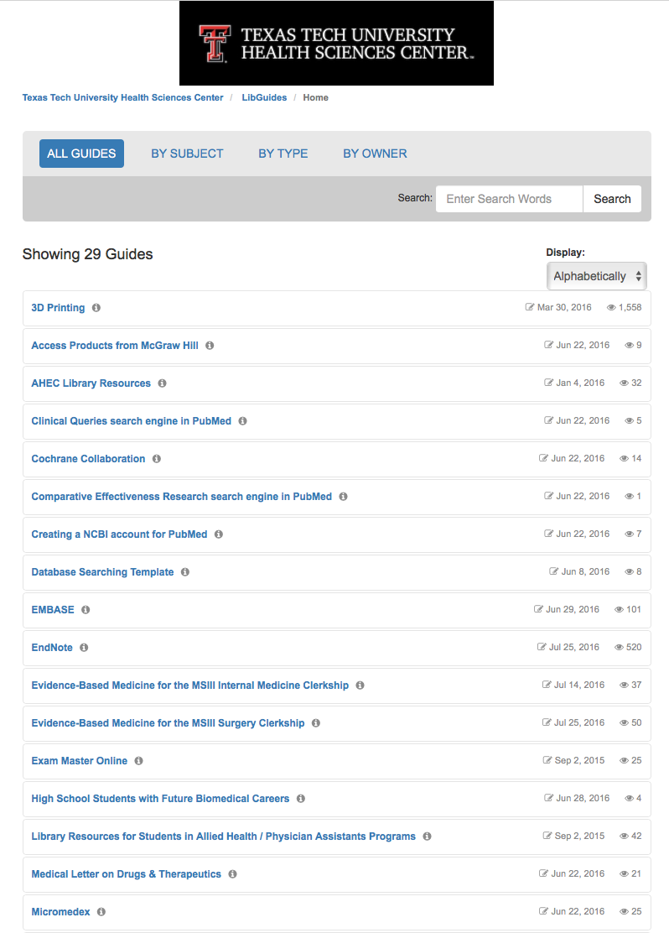
Tutorials

Slide 66
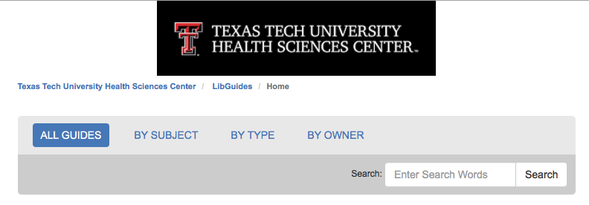
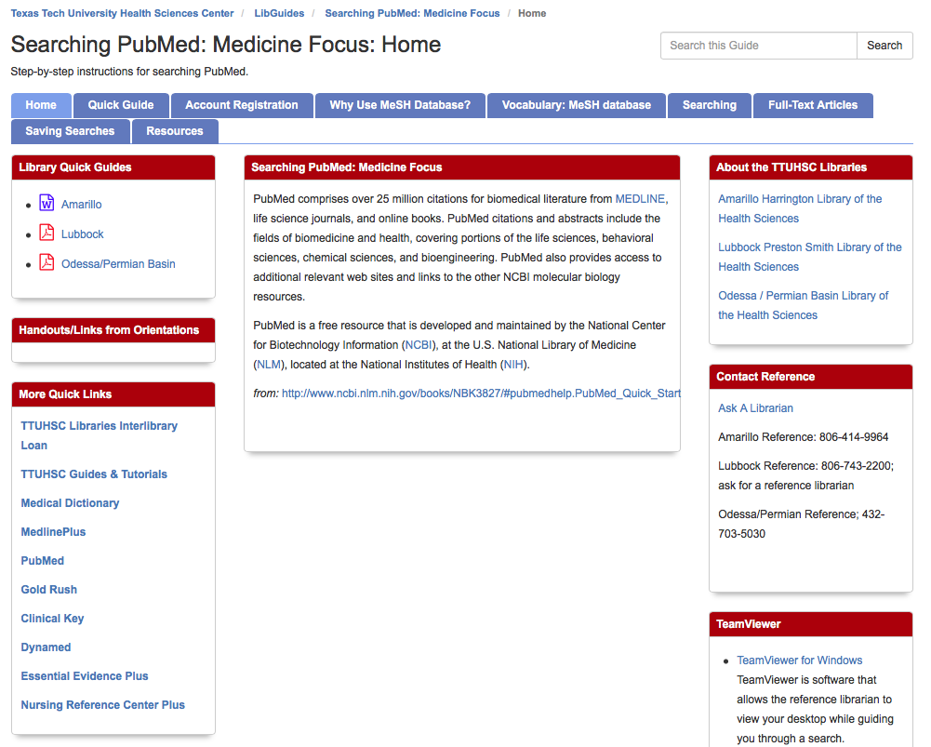
NOTE:
Searching PubMed:
Medicine Focus

Slide 67
What questions do you have?

Slide 68
Please…
fill out the evaluation at
http://tinyurl.com/ttuhsc17
Thank-you…
we appreciate your feedback!

Slide 69
The End

Slide 70
Course Stream
Option to become a student reviewer to test new and upcoming on McGraw-Hill products.

Slide 71
Assignments
Assignments made by an instructor.

