Slide 1
Study Category
Suggested Best Method of Investigation
Therapy
RCT>cohort>case control>case series
Diagnosis
prospective, blind comparison to a gold standard
Etiology/Harm
RCT>cohort>case control>case series
Prognosis
cohort>case control>case series
Prevention
RCT>cohort>case control>case series
Clinical Exam
prospective, blind comparison to a gold standard
Cost
Economic Analysis
Medical Library Association. MLANET, Education, Web-based Learning. Hp. Nov, 2001.
Web-based Courses: EBM and the Medical Librarian.
Available: http://www.mlanet.org/education/web/web_courses.html 10 Apr. 2005.

Slide 2
Learning Goals
1) Determine database search results differences between:
  Cochrane Central Register of Controlled Trials
  Cochrane Database of Systematic Reviews
  Database of Abstracts of Reviews of Effects (DARE)
  Comparative Effectiveness Research
2) Determine the depth of information in the articles from each database.
3) Determine the level of evidence.
See hand-outs

Slide 3
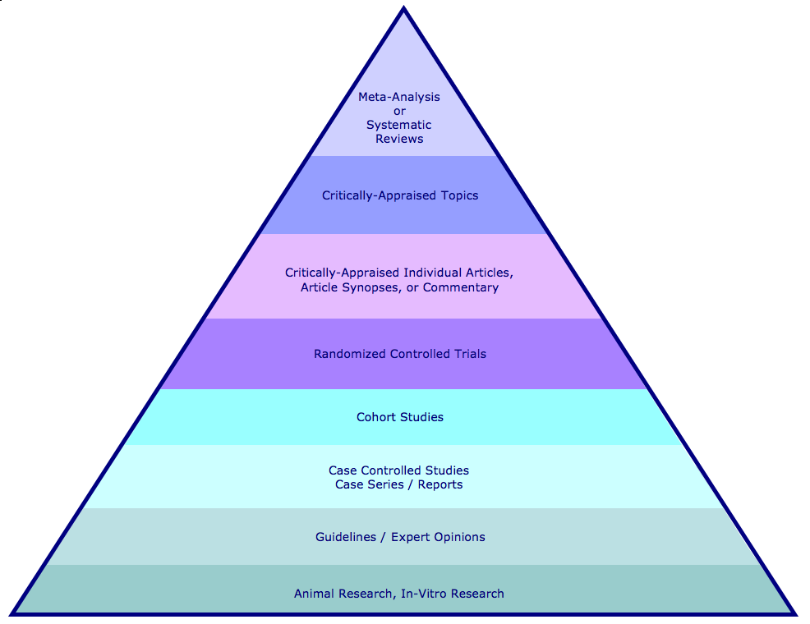
Hierarchy of Evidence and Corresponding Databases
Cochrane Database of Systematic Reviews and DARE
ACP Journal Club
Cochrane Database of Randomized Controlled Trials

Slide 4
Learning Activities I
Select a topic and run in the Cochrane Databases:
  1) Screening for breast cancer
  2) Screening for cervical cancer
  3) Screening for colorectal cancer
  4) Educational interventions for asthma
  5) Diabetes and glucose/glycemic/glycaemic control
  6) Diabetes and foot ulcers/wounds/infections
  7) Cytoreductive surgery
  8) Post-operative pain management
  9) Pain management in arthritis
  10) Pain management in fractures
What kind of results did you retrieve in the different databases?

Slide 5
Learning Activities II
1) Run your PICO question in:
Cochrane Central Register of Controlled Trials
2) Then, re-run the same search strategy in:
Cochrane Database of Systematic Reviews
Database of Abstracts of Reviews of Effects
Comparative Effectiveness Research
3) In which database or databases did you find the article that answers your PICO question?
4) Record your results and answer the questions on the Retrieval Worksheet.

Slide 6
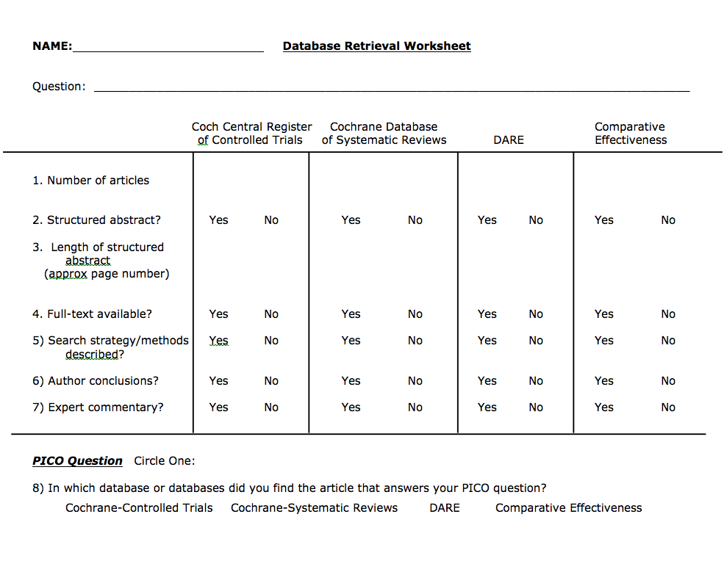
Retrieval Worksheet

Slide 7
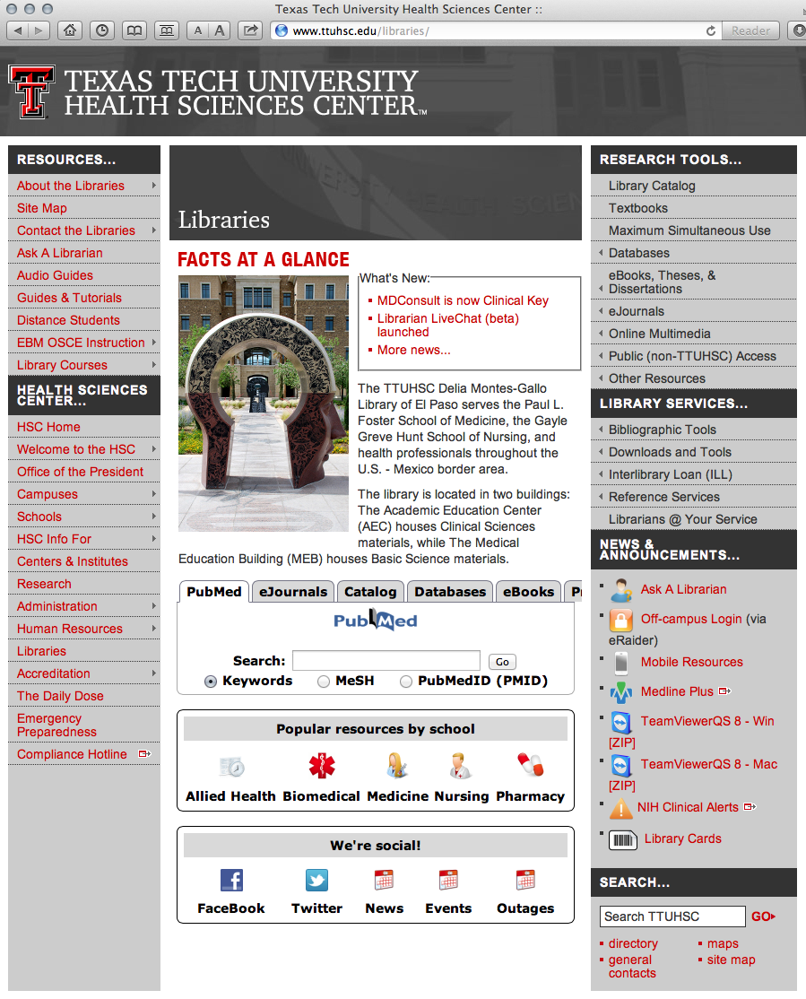
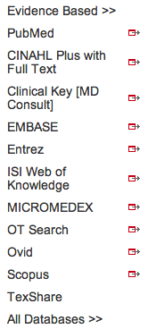
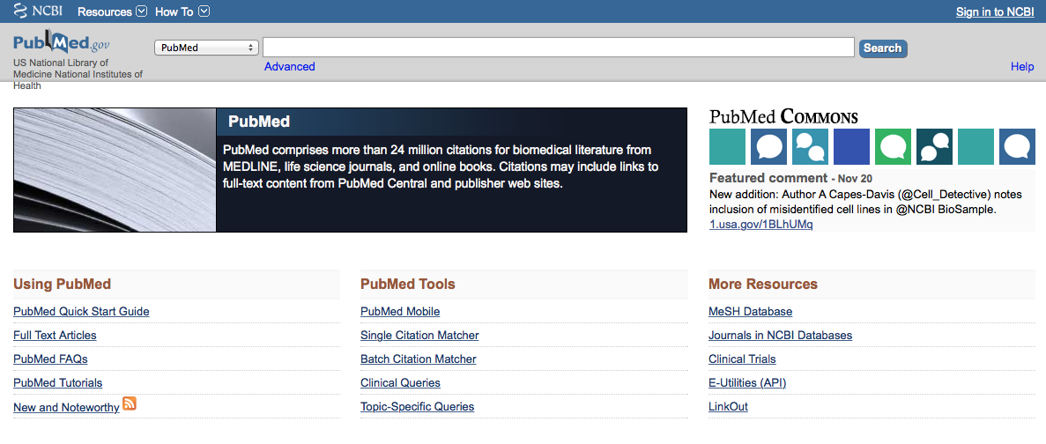
Click PubMed
Click Topic-Specific Queries

