Slide 1
Welcome
Database Searching for
Evidence Based Medicine
Literature
Peggy Edwards, AMLS
TTUHSC - Preston Smith Library
Lubbock, Texas 79430
July 22, 2016

Slide 2




When searching library applications, use
Mozilla Firefox
Safari

Slide 3
Learning Goals
1) Determine database search results differences between:
  ACP Journal Club
  Cochrane Central Register of Controlled Trials
  Cochrane Database of Systematic Reviews
  Comparative Effectiveness Research
2) Determine the depth of information in the articles from each database.
3) Determine the level of evidence.
4) Use the 5 steps of the EBM process.

Slide 4
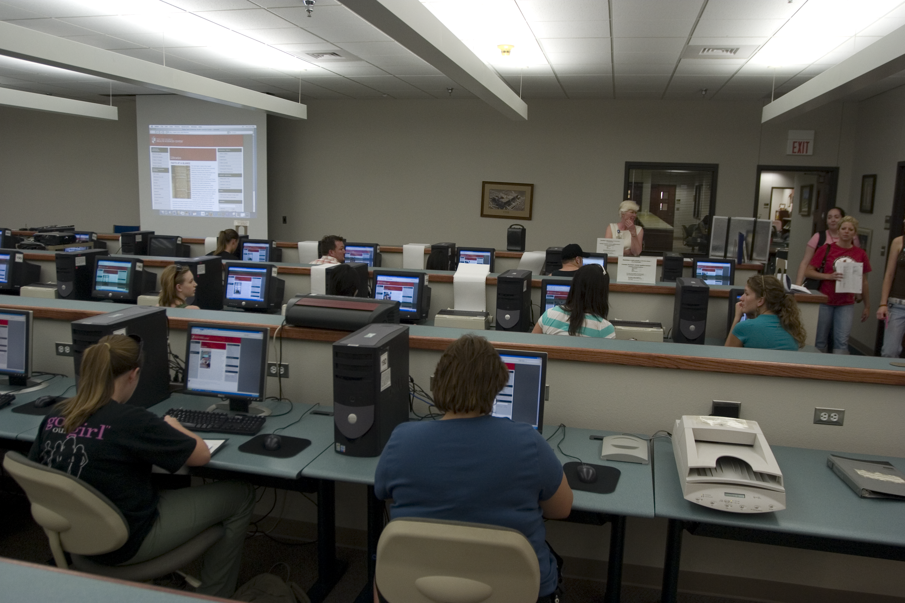
1) Database Searching- Mandatory Attendance J
  how to search the Cochrane EBM Databases &
    Comparative Effectiveness Research
  PowerPoint lecture and hands-on follow along
  search for article(s) that answer your question
  one-on-one searching guidance with assigned librarian

Slide 5
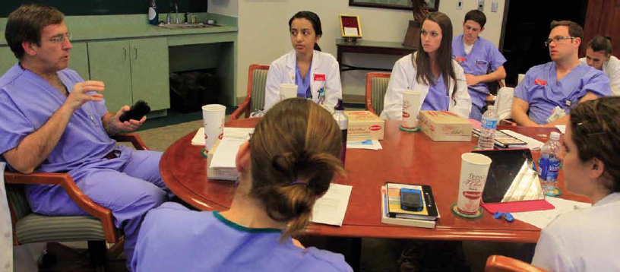
Group Discussion “EBM Journal Club” with Dr. Griswold
  in the Library’s Rare Books Conference Room
  state your focused, well-articulated PICO question
  describe databases searched and search strategy
  state author, article title, journal, and date published
  discuss study design, validity and reliability, research findings
  commentary and q & a from Dr. Griswold
  turn in your EBM report including PICO question worksheet, critical appraisal worksheet, copy of the article, and cover sheet
  casual atmosphere and bring your own lunch!

Slide 6
Course Materials

Slide 7
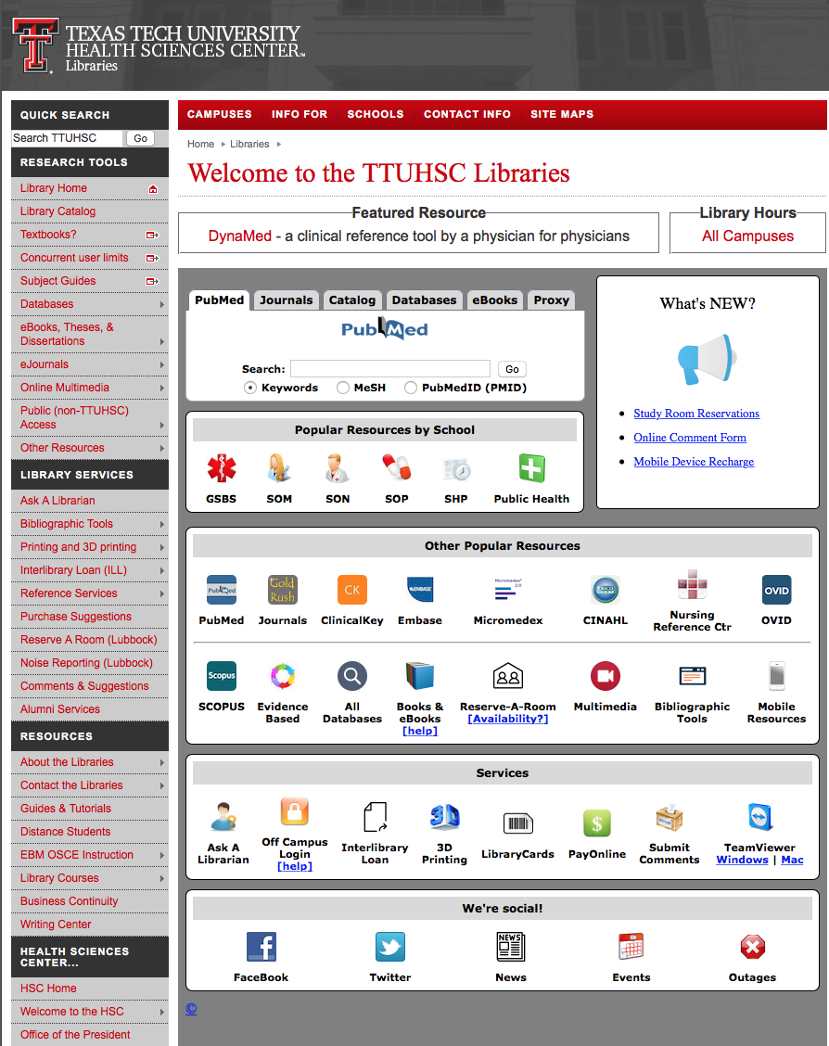
www.ttuhsc.edu/libraries
Click
Library Courses

Slide 8
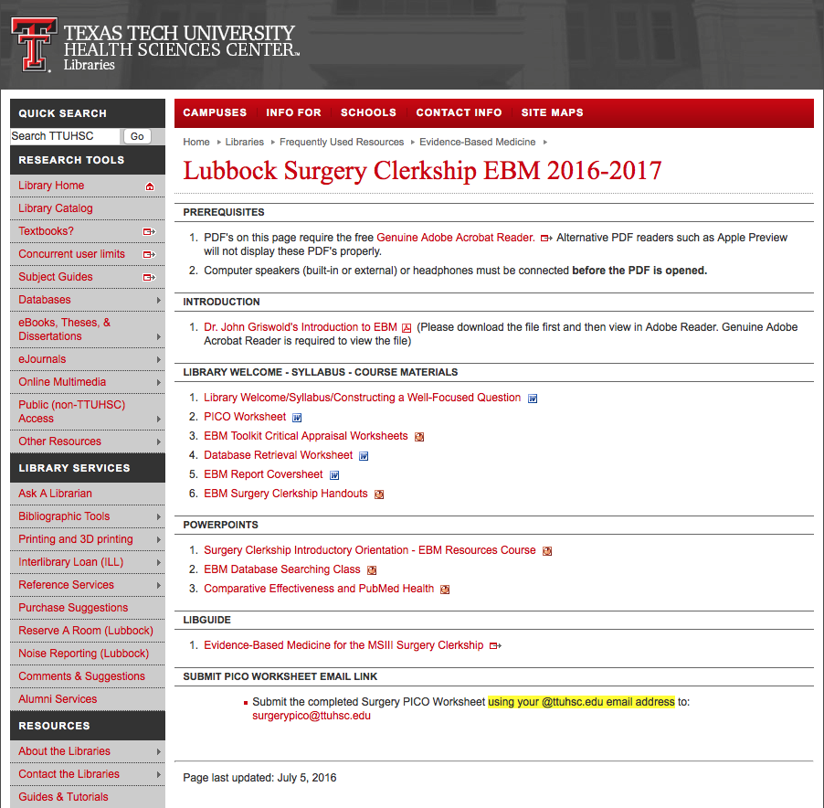
Course Materials

Slide 9
Dr. Griswold’s video

Slide 10
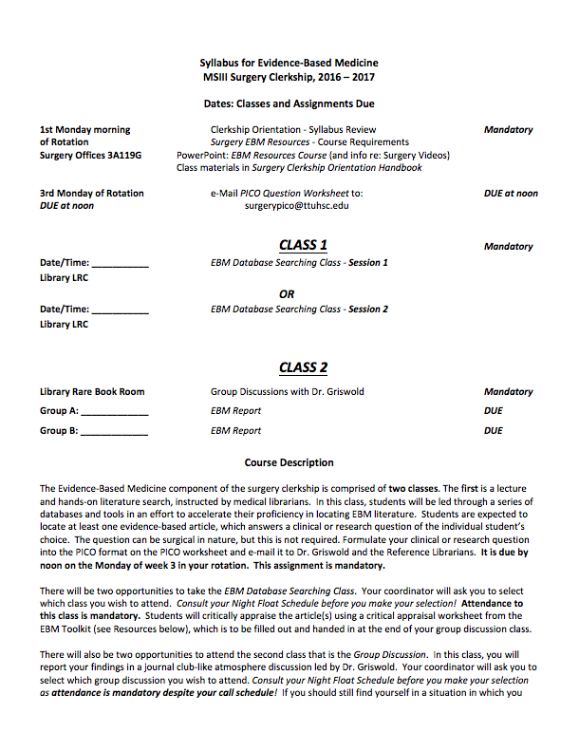
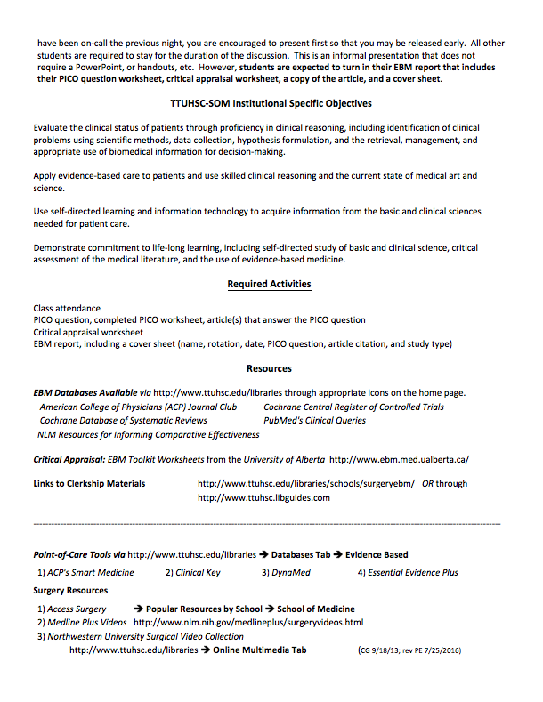
Syllabus

Slide 11
www.ttuhsc.edu/libraries
or Go to LibGuides
under Subject Guides

Slide 12
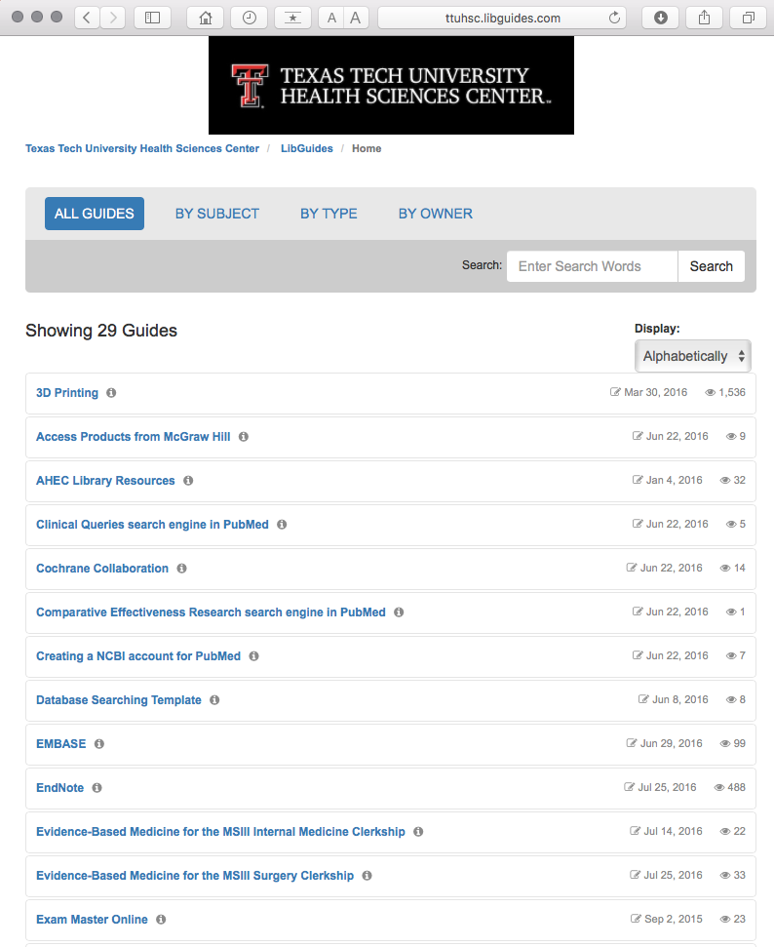
Select Evidence-Based Medicine for the MSIII Surgery Clerkship

Slide 13
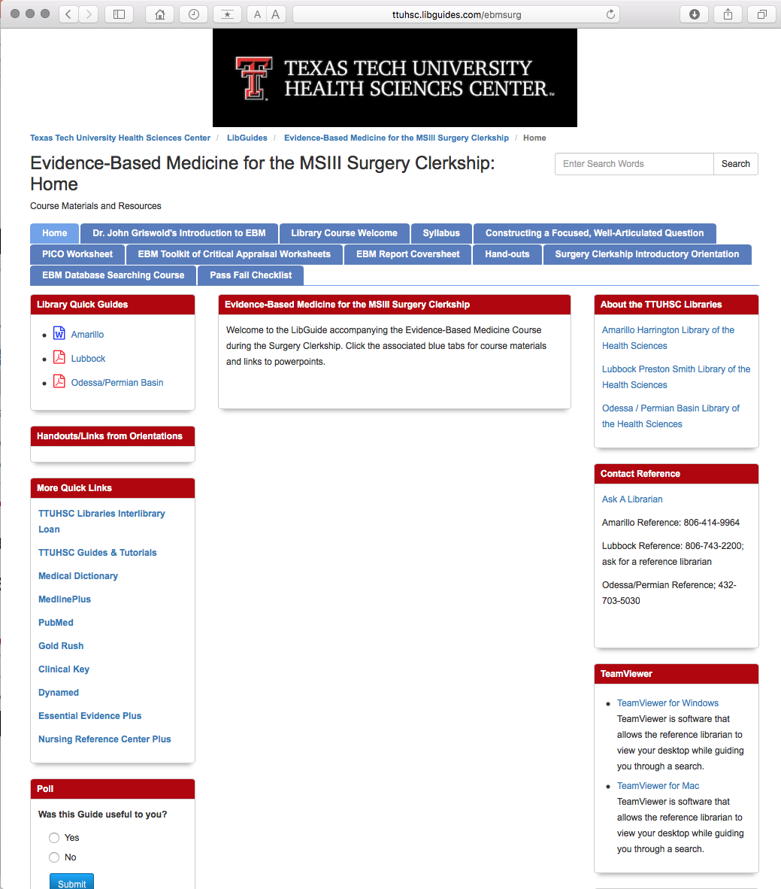

Slide 14
EBM Report

Slide 15
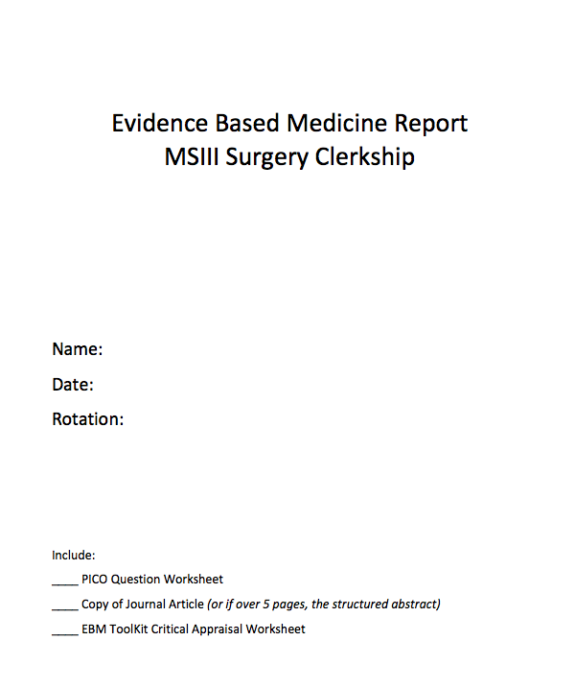
Cover Sheet

Slide 16
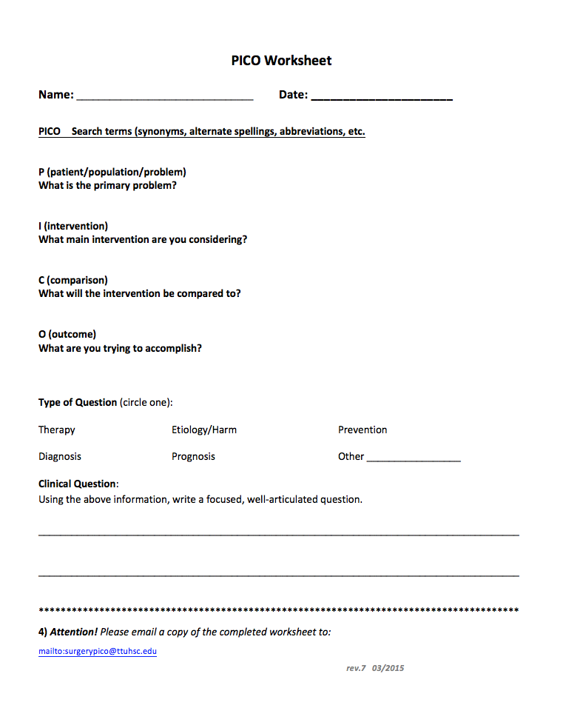
PICO Worksheet

Slide 17
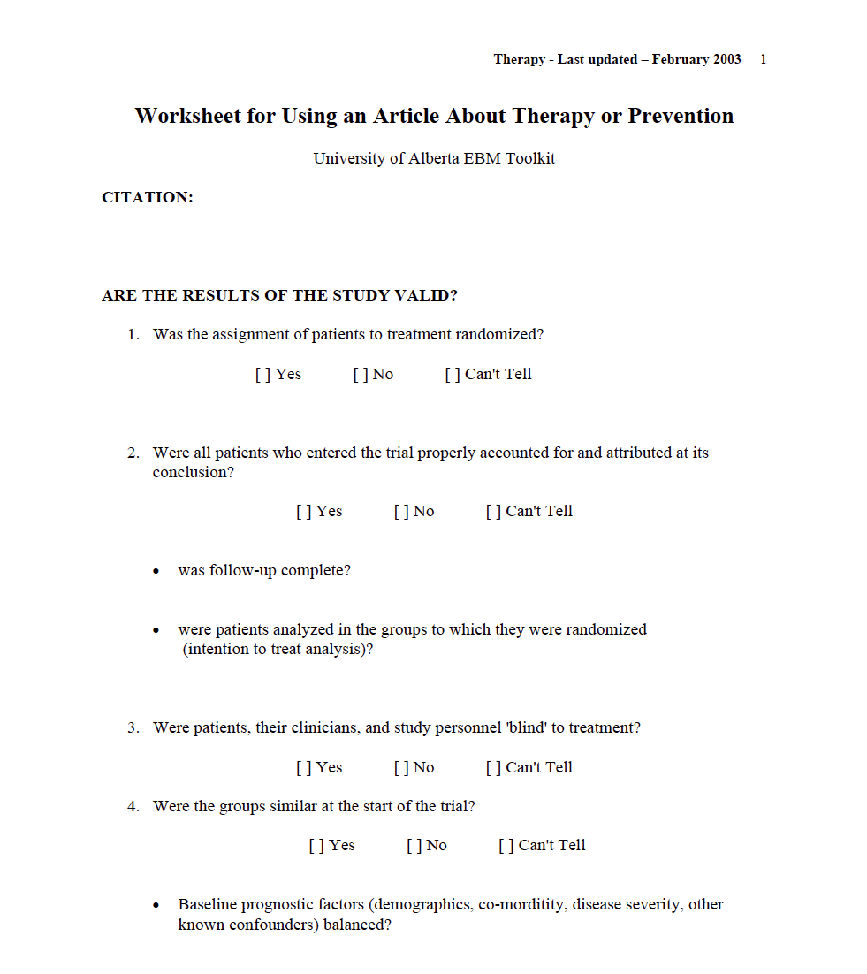
Critical Appraisal Worksheet

Slide 18
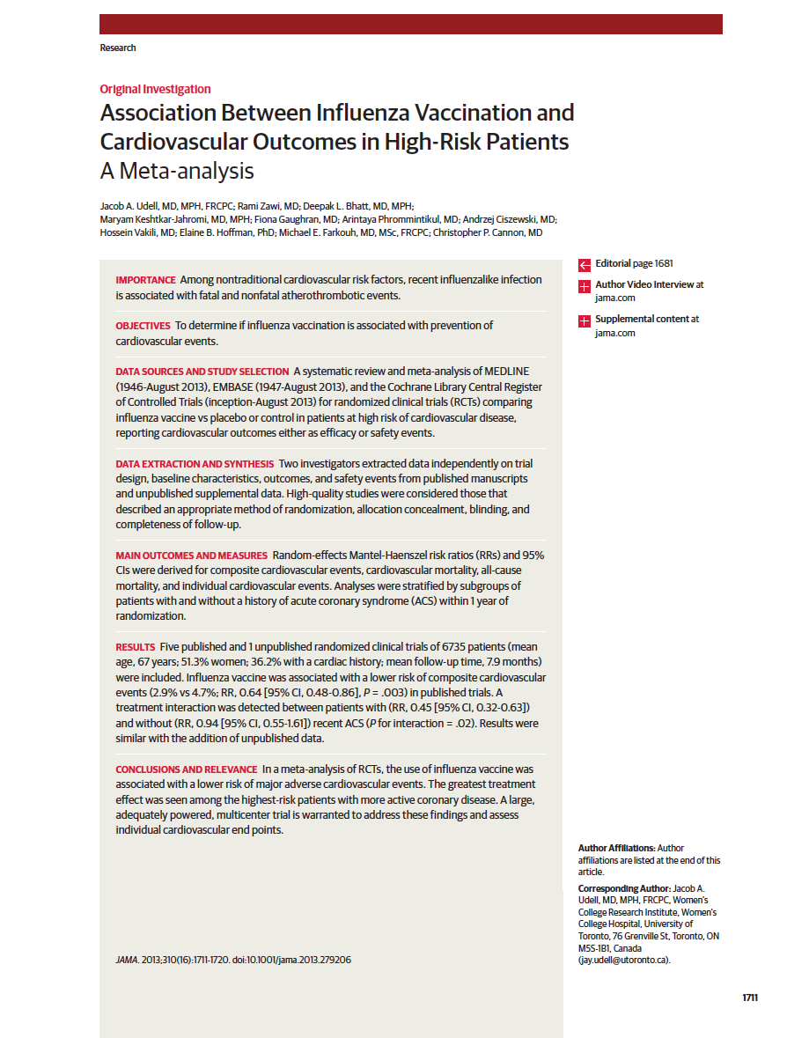
Full-Text Article or Structured Abstract

Slide 19


Evidence-Based Practice is guided by thoughtful integration
of the best available scientific knowledge with clinical expertise.

Slide 20
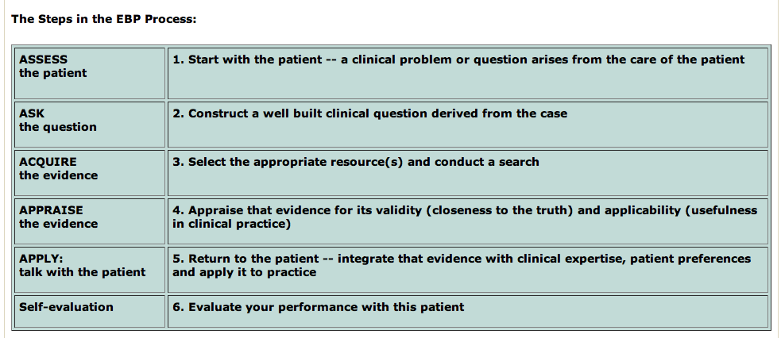
Steps in the Evidence-Based Process are:
(Duke University Medical Center, accessed 8/2/2013)
http://guides.mclibrary.duke.edu/content.php?pid=431451&sid=3529499

Slide 21
1. Assess the patient

Slide 22
How can you recognize and formulate clinical questions as they occur?
pay careful attention to the questions that spontaneously occur to you
questions often are about:
diagnosis therapy etiology prognosis
mentally formulate a PICO question

Slide 23
2. Ask the question

Slide 24
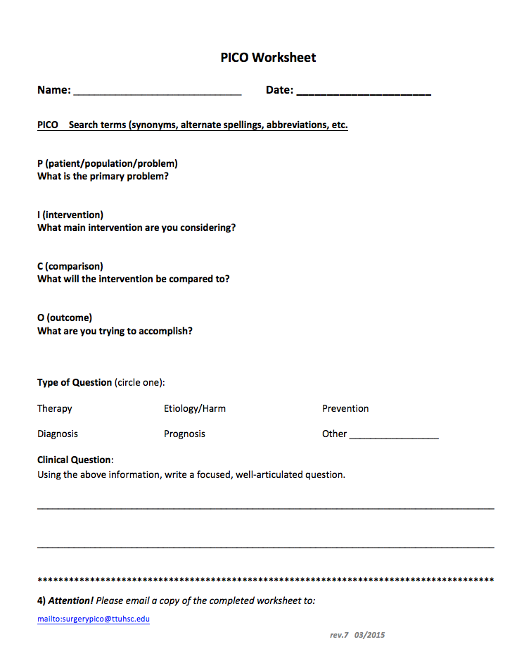
Does influenza vaccination reduce cardiovascular events in adults?
P
adults
I
influenza vaccination
C
non-vaccination
O
reduction of cardiovascular events

Slide 25
What if too many questions arise?
Patients may have several active problems:
  your questions may be too numerous to even ask, let alone answer.
What is the most important issue for this patient now?
Which question, when answered, will help me most?
Select from the many questions
the few questions that are most important to answer right away.
Dawes, Martin. Centre for Evidence-Based Medicine, Learning EBM. Hp. April 9, 2001.
Powerpoint: Practice of Evidence-Based Medicine. University of Oxford.
Available: http://www.cebm.net/learning_ebm.asp. 10 Apr. 2005.

Slide 26
What is the study category?
Determine if your PICO question is about:
diagnosis
therapy
etiology
prognosis

Slide 27
Study Category
Suggested Best Method of Investigation
Therapy
RCT>cohort>case control>case series
Diagnosis
prospective, blind comparison to a gold standard
Etiology/Harm
RCT>cohort>case control>case series
Prognosis
cohort>case control>case series
Prevention
RCT>cohort>case control>case series
Clinical Exam
prospective, blind comparison to a gold standard
Cost
Economic Analysis
Medical Library Association. MLANET, Education, Web-based Learning. Hp. Nov, 2001.
Web-based Courses: EBM and the Medical Librarian.
Available: http://www.mlanet.org/education/web/web_courses.html 10 Apr. 2005.
See hand-out

Slide 28
3. Acquire the evidence
Comparative Effectiveness Research
Cochrane Collaboration Databases

Slide 29
Comparative Effectiveness
Research

Slide 30
Federal Coordinating Council for
Comparative Effectiveness Research
Comparative Effectiveness:
conduct and synthesize research
compares benefits and harms of different interventions/strategies
prevent, diagnose, treat and monitor
health conditions in ‘real world’
Purpose:
improve health outcomes
develop and disseminate evidence-based information
Determine:
which interventions are most effective
for which patients under specific circumstances

Slide 31
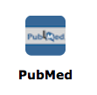
www.ttuhsc.edu/libraries
Click PubMed

Slide 32
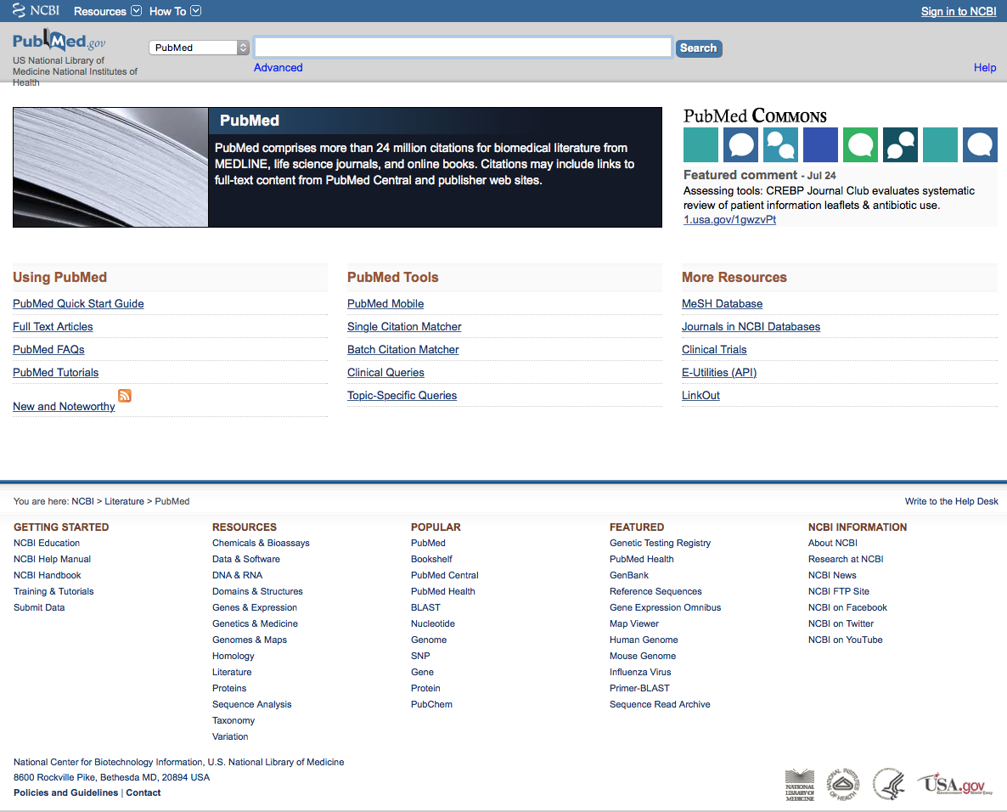
Click Topic-Specific Queries

Slide 33
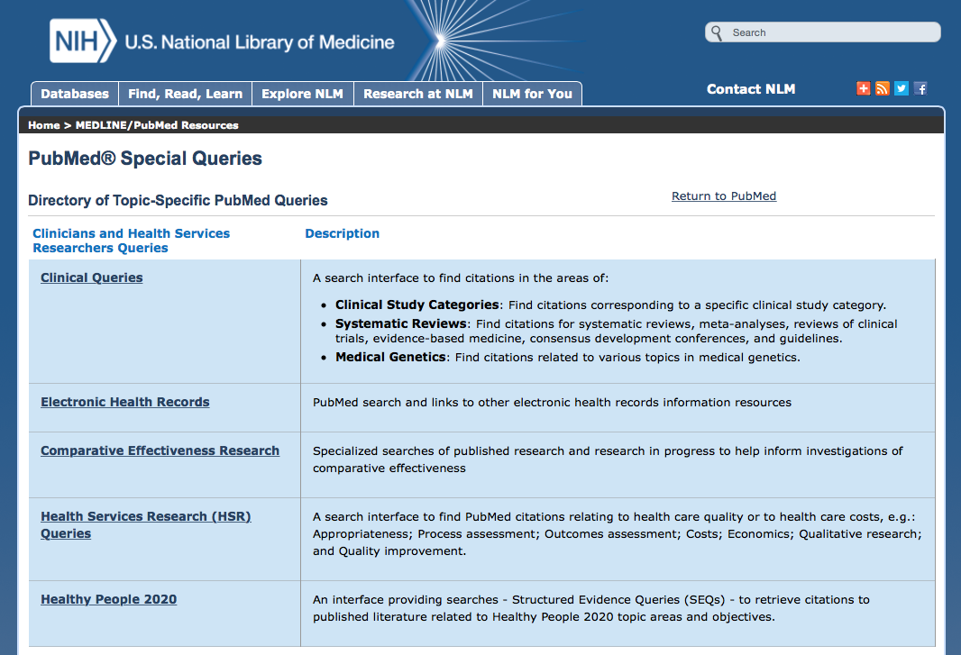
Click

Slide 34
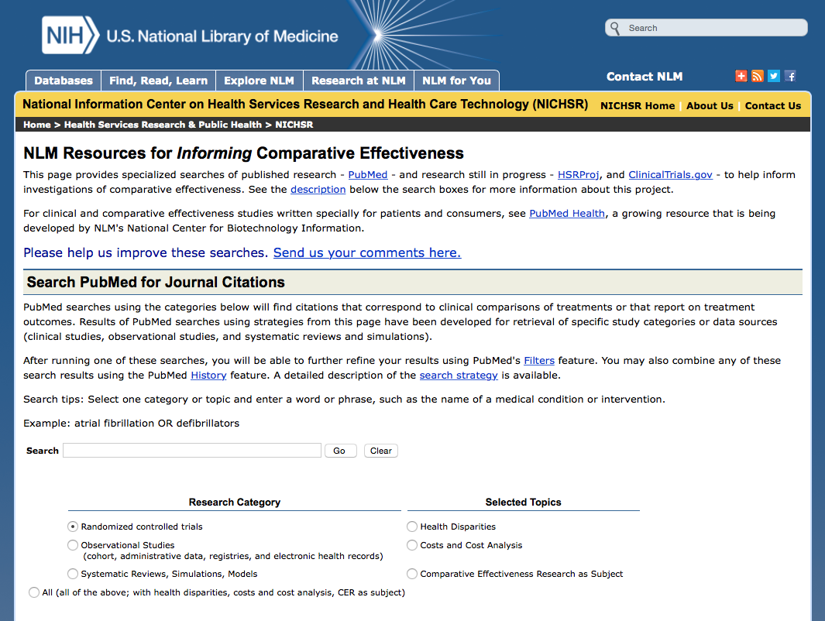
Search PubMed for articles on:
clinical comparisons of treatments
OR
reports of treatment outcomes

Slide 35
Select Research Category:
clinical studies
randomized controlled trials
observational studies
systematic reviews
simulations

Slide 36
Select Topics:
Health Disparities
Costs and Cost Analysis
Comparative Effectiveness Research
as Subject
or

Slide 37
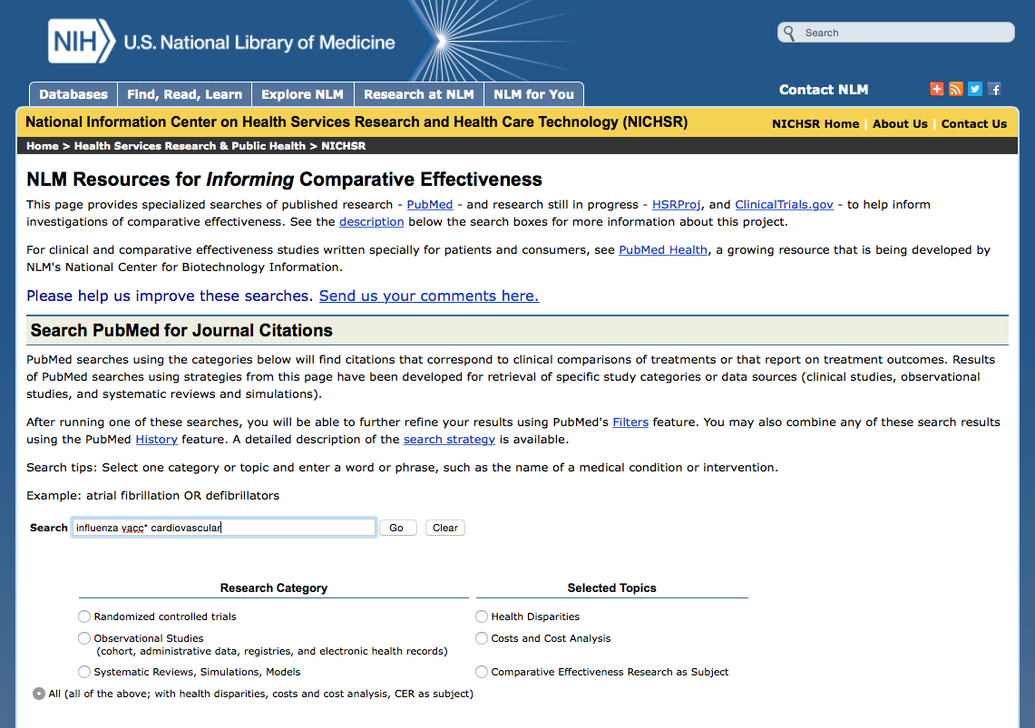
Enter influenza vacc* cardiovascular
OR
keywords for your search question

Slide 38
Click
Go
Select:
All (of the above; with health disparities, costs and cost analysis, CER as subject)

Slide 39
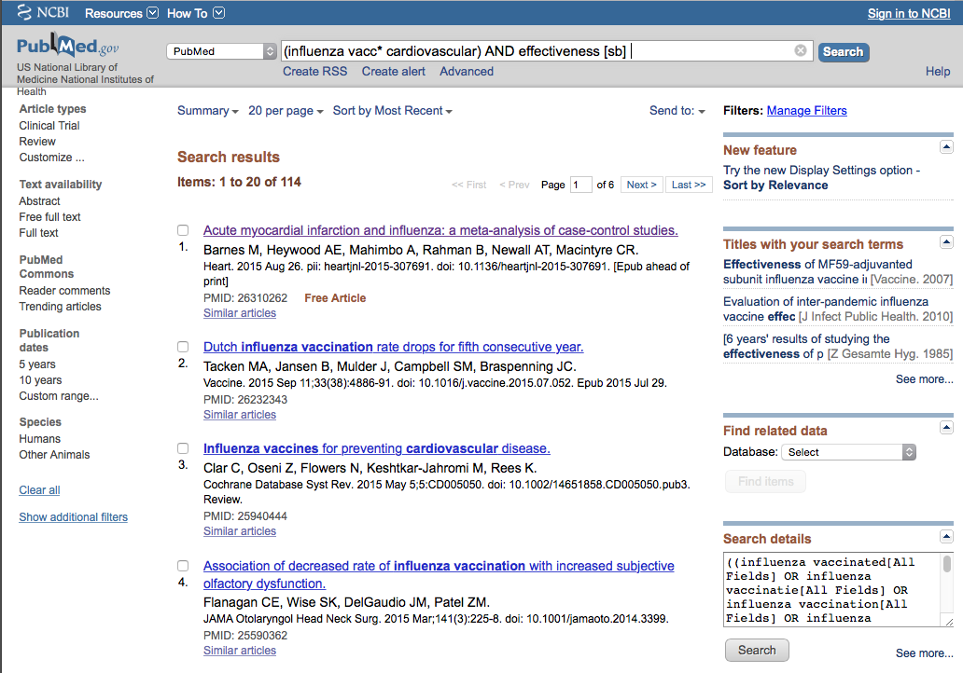
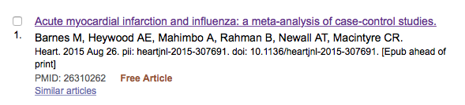
Cl
ick
Search Results

Slide 40
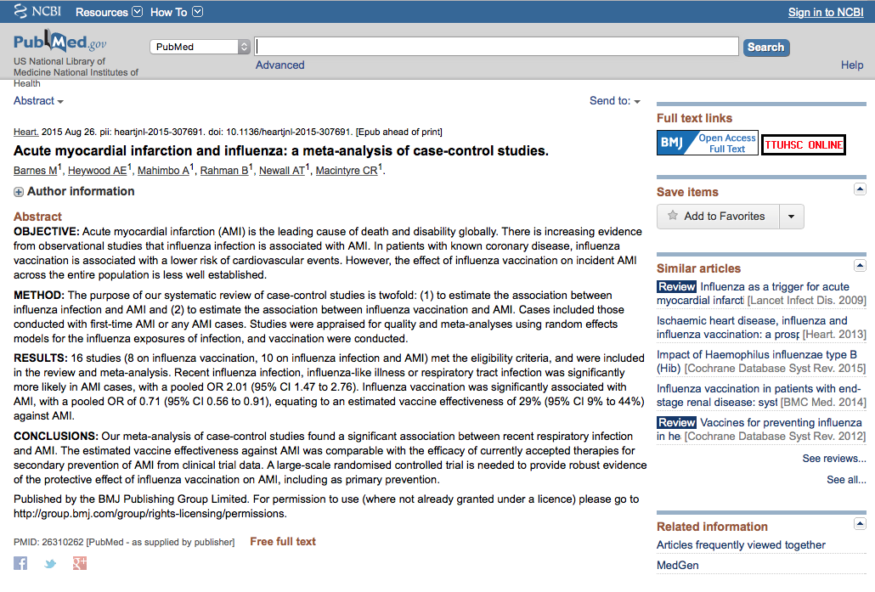
Click for full-text
TTUHSC ONLINE

Slide 41
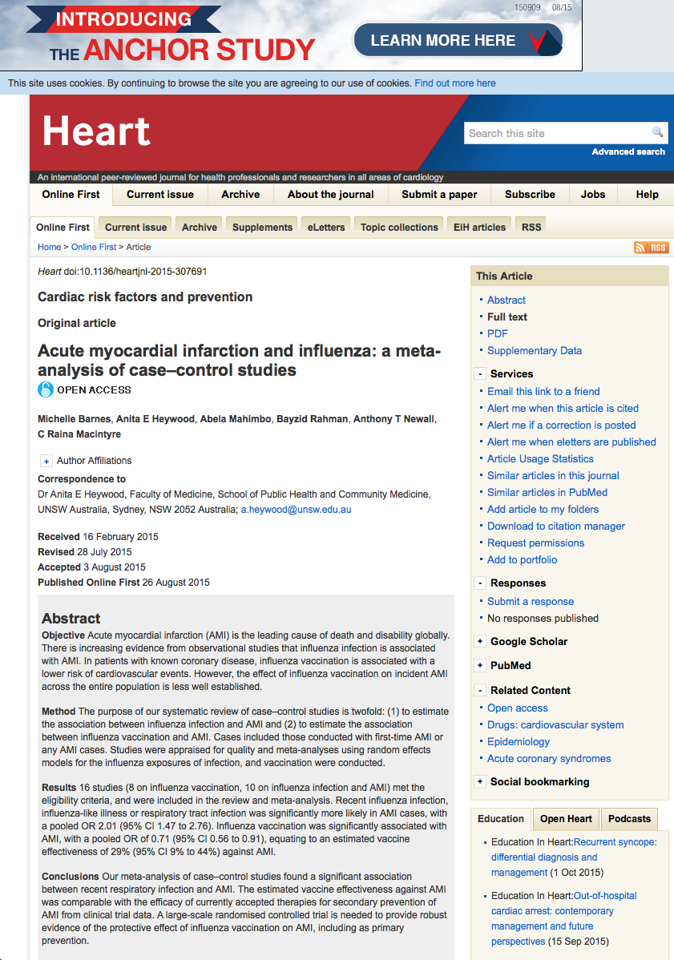
PDF link

Slide 42
Questions?

Slide 43
EBM and the
Cochrane Databases

Slide 44
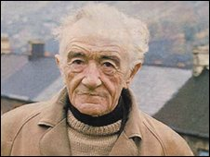
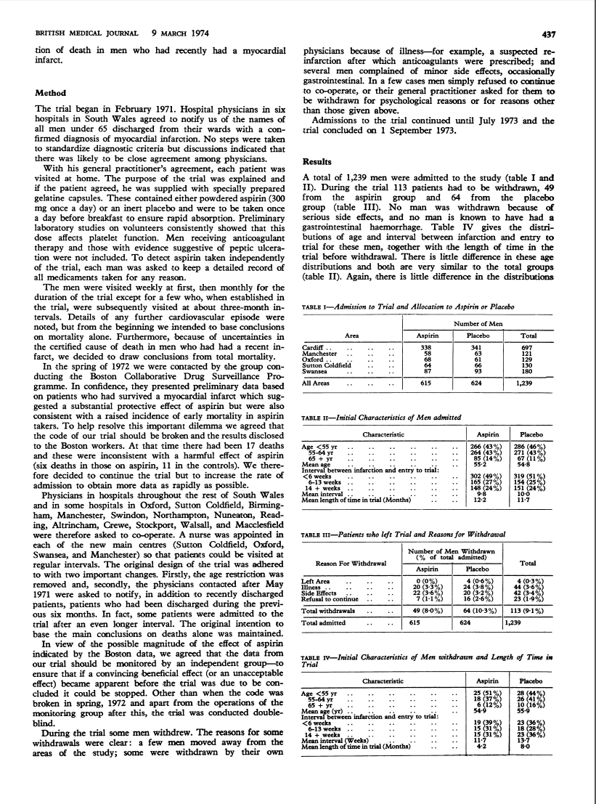
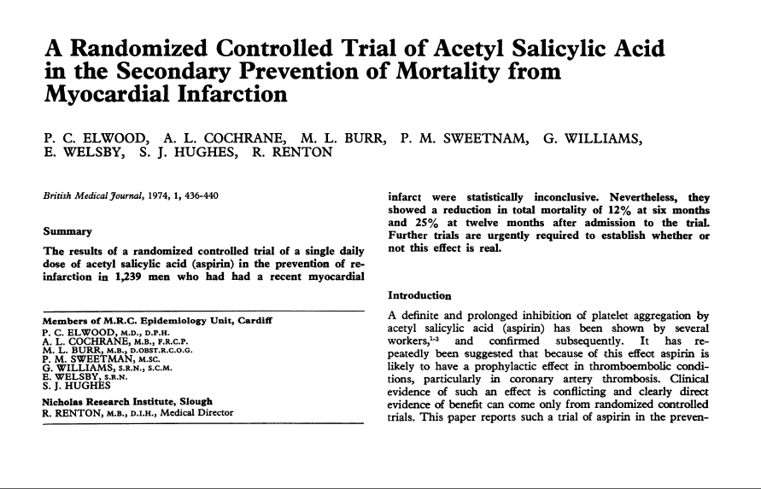
How EBM and the Cochrane Databases Got Started
by Archie Cochrane, M.D.

Slide 45
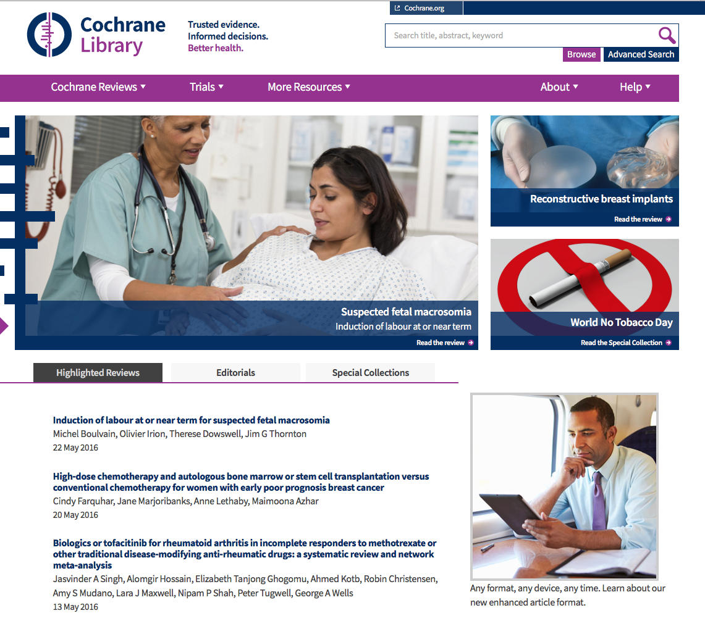
www.thecochranelibrary.com

Slide 46
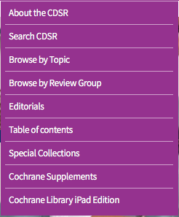
Click:
Cochrane Reviews
Select:
Search CDSR

Slide 47
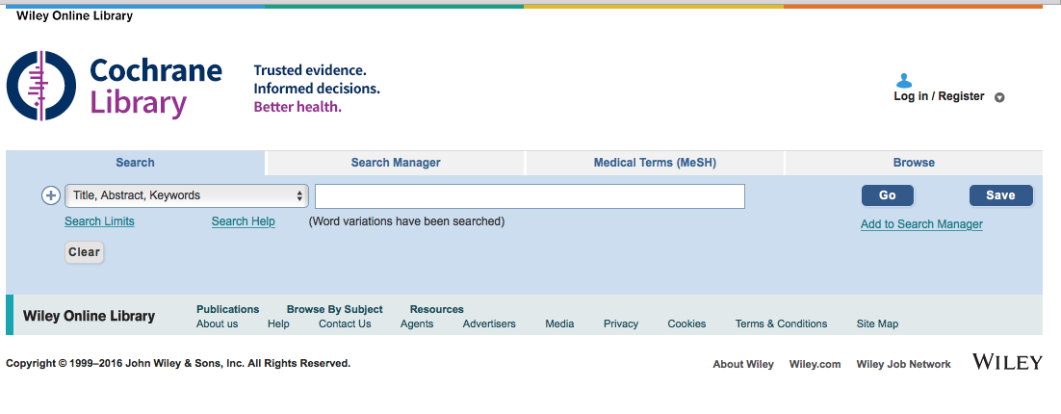

Slide 48


Slide 49
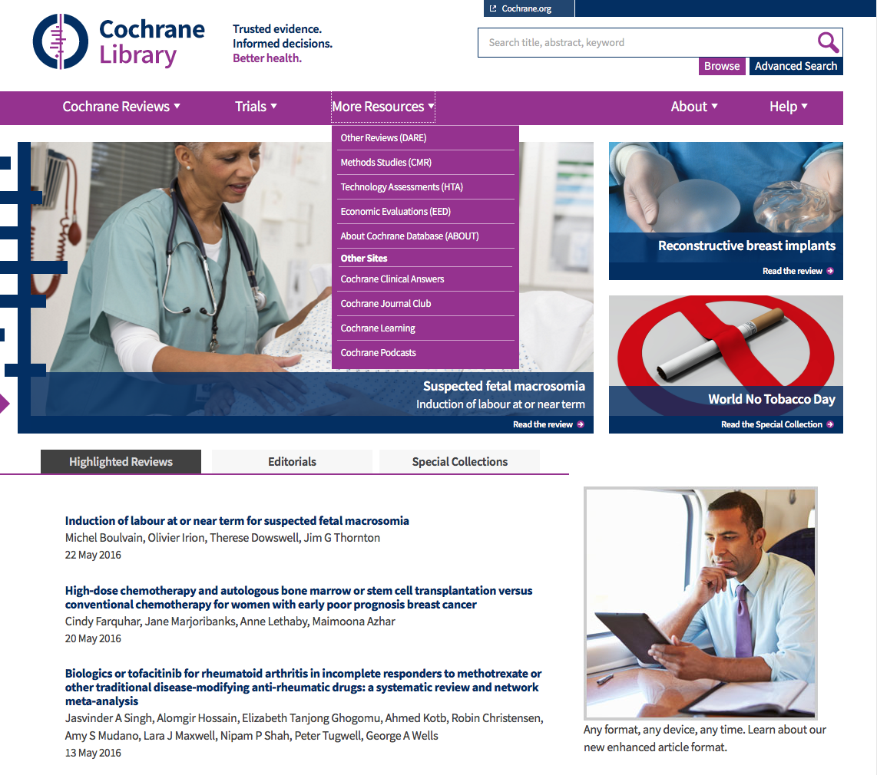
Scroll to Browse by Topic

Slide 50
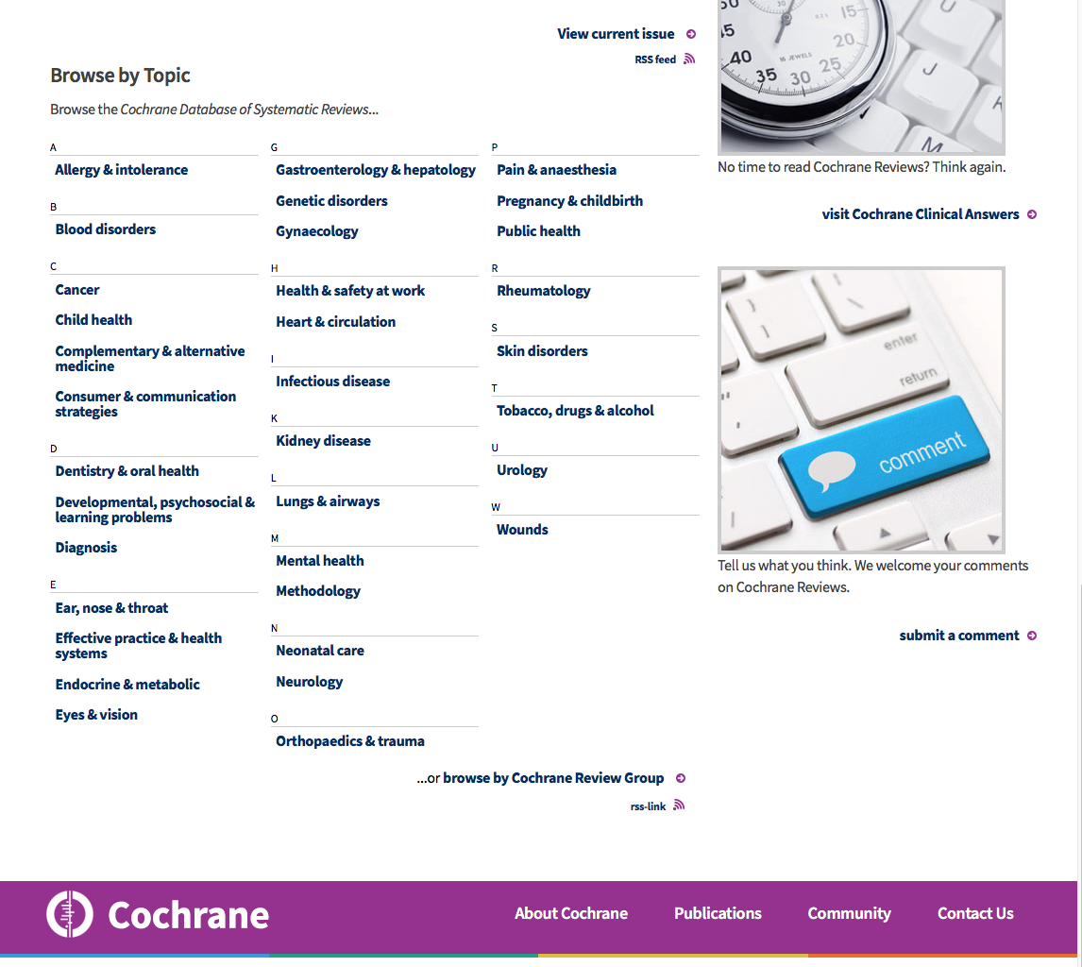
Browse by Topic
Browse by Group

Slide 51

www.cochrane.org/evidence
Evidence summaries are free

Slide 52
ACP Journal Club

Slide 53
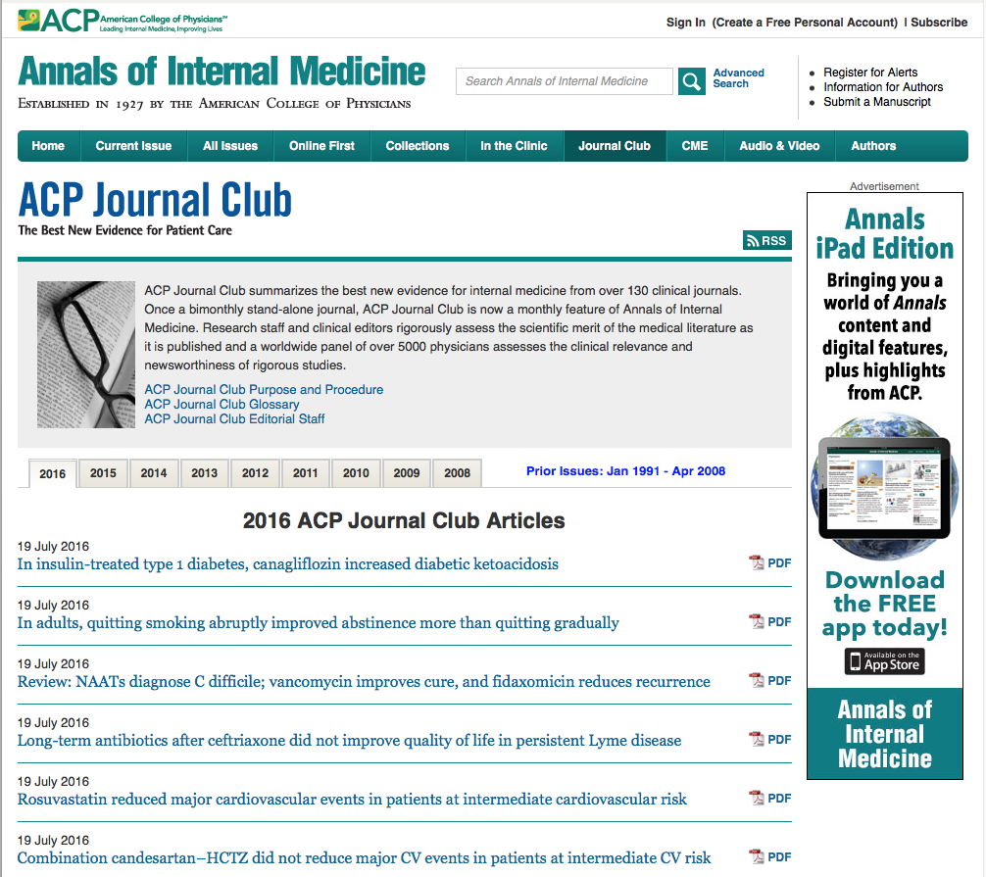
Create Account
www.annals.org/journalclub.aspx

Slide 54
ACP Journal Club: The Best New Evidence for Patient Care
online journal:
ACP Journal Club by the American College of Physicians
Screens over 110 top clinical journals:
original studies and systematic reviews
methodologically sound clinically relevant
warrant immediate to important advances in Internal Medicine and sub-specialties
Identifies Study Categories:
Diagnosis Etiology
Prognosis Prevention or treatment
Information summarized in structured abstracts
Objectives Methods
Results Evidence-based conclusions
Brief commentaries by clinical experts:
context methods
clinical application of findings
Use ACP Journal Club to keep current!

Slide 55
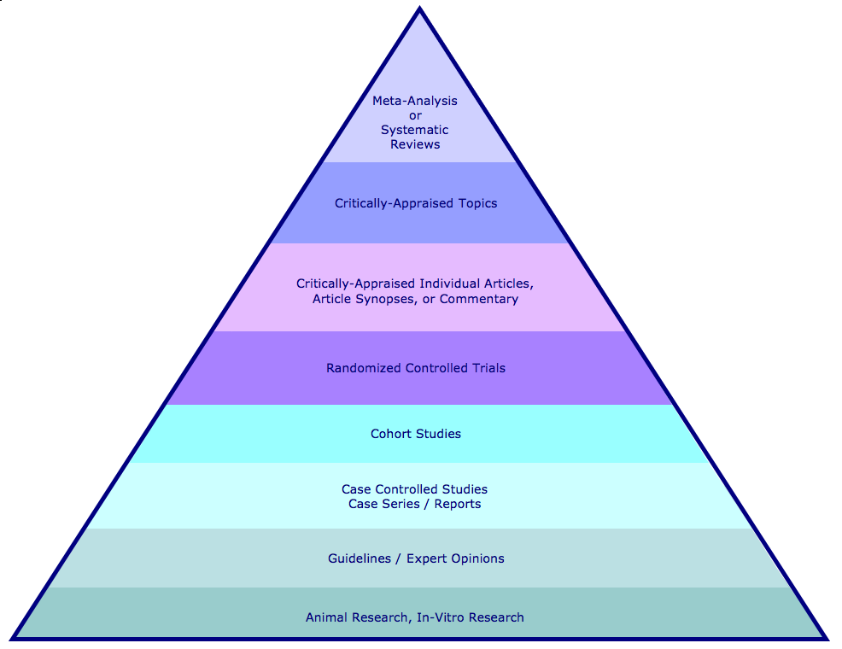
Hierarchy of Evidence and Corresponding Databases
Cochrane Database of Systematic Reviews
ACP Journal Club
Cochrane Database of Randomized Controlled Trials

Slide 56

www.ttuhsc.edu/libraries
Normally you would
Click OVID

Slide 57
Go to the training site at http://ovidsp.ovid.com

Slide 58
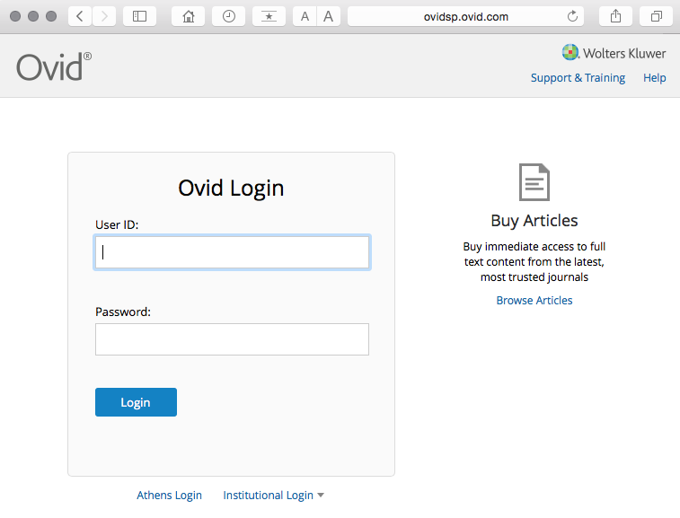
Web Address: http://ovidsp.ovid.com
ID: thsclibtrain
Password: learn99

Slide 59
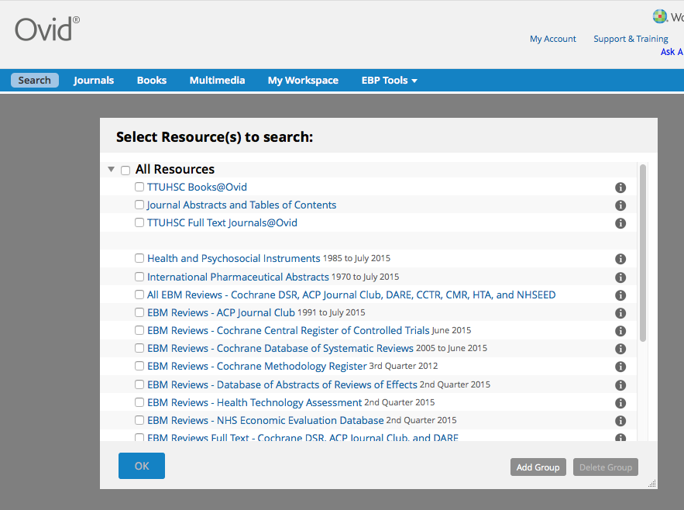
Select ACP Journal Club
✔
Click
OK

Slide 60
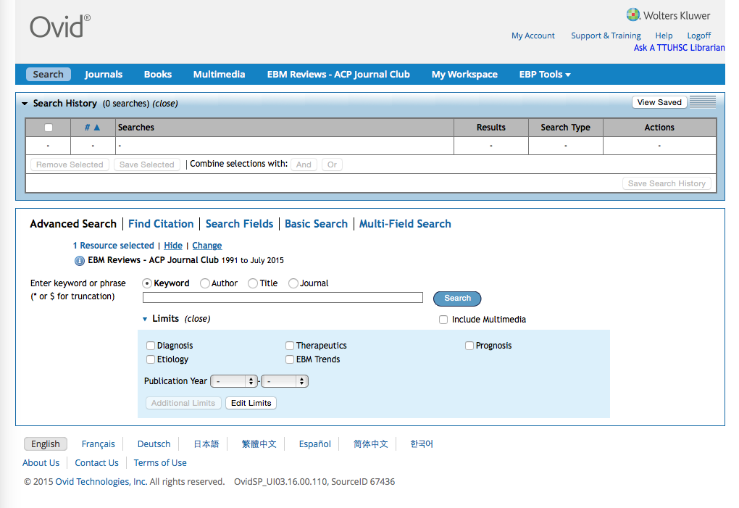
Database(s) selected to search
Home Page

Slide 61
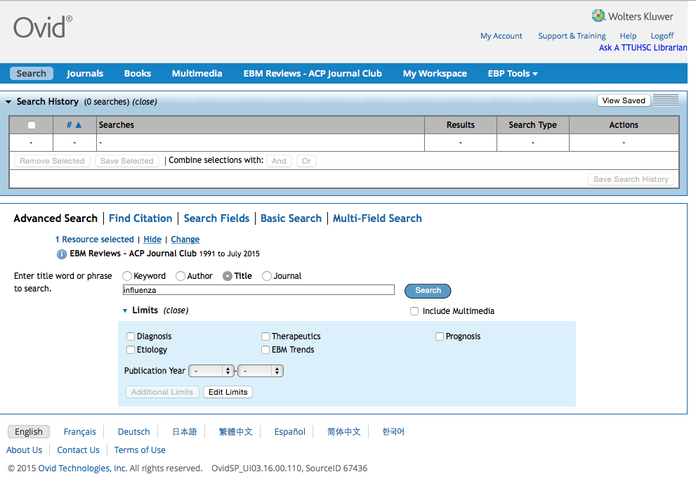
Click Search
Limit the search for words appearing
only in the Title.
Enter
influenza

Slide 62
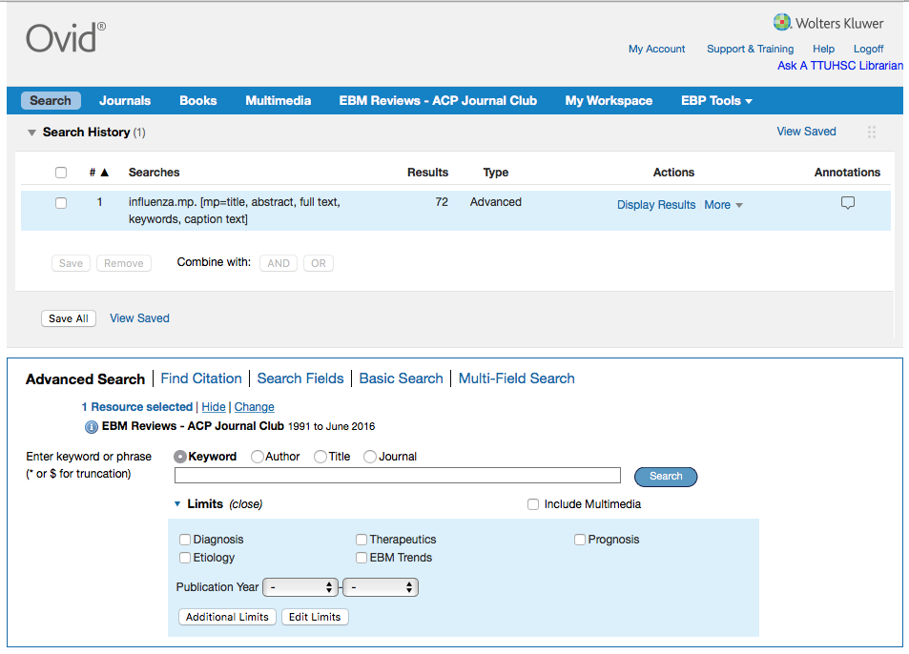
Results in the
first search set.

Slide 63
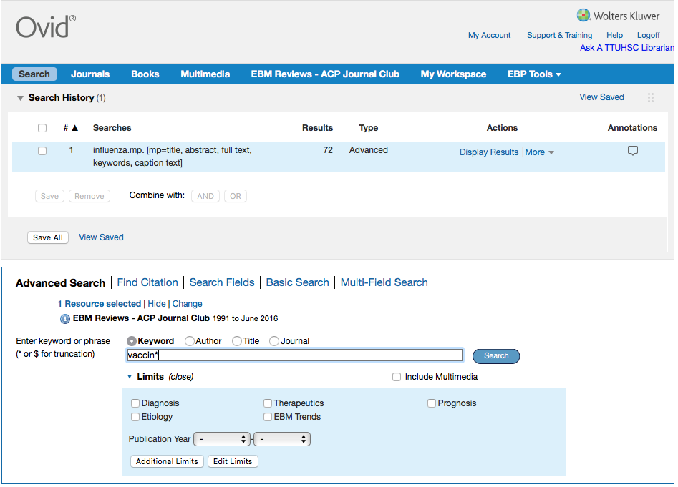
Click Search
Enter
vaccin*
as the
second keyword search.

Slide 64
Truncation locates suffix variations in one step!
Enter an asterisk * after the prefix.
vaccine retrieves 82 articles
vaccines retrieves 58 articles
vaccinate retrieves 9 articles
vaccinated retrieves 25 articles
vaccination retrieves 80 articles
vaccin* retrieves all the variants!

Slide 65
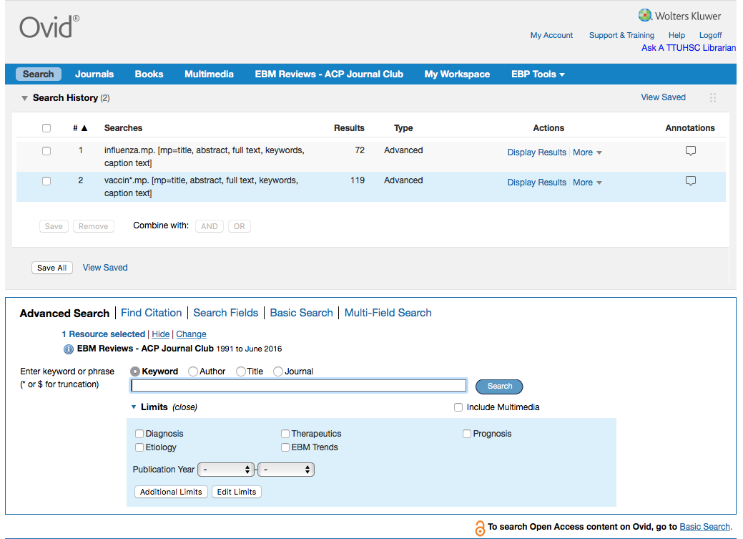
Click And
X
X
AND
Click on the boxes
next to set 1 and set 2.

Slide 66
Boolean Logic - AND
influenza
vaccin*
and

Slide 67
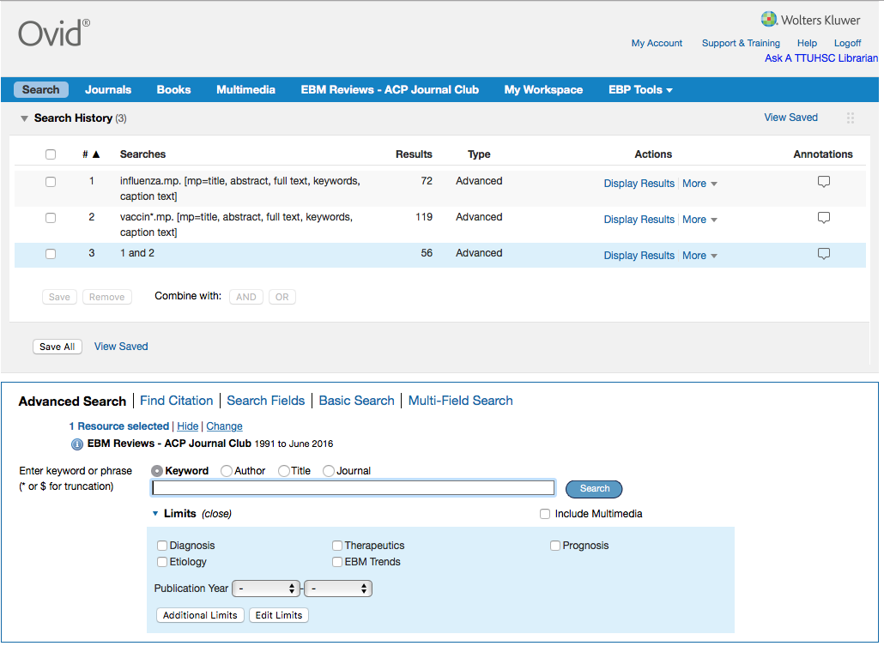
Results of AND combination.
(Note that AND narrows results.)

Slide 68
Other search techniques:
intradermal OR intranasal
Use Boolean OR
Note: “OR” broadens a result
intradermal
or
intranasal

Slide 69
Search Results

Slide 70
Scroll screen to
view results

Slide 71
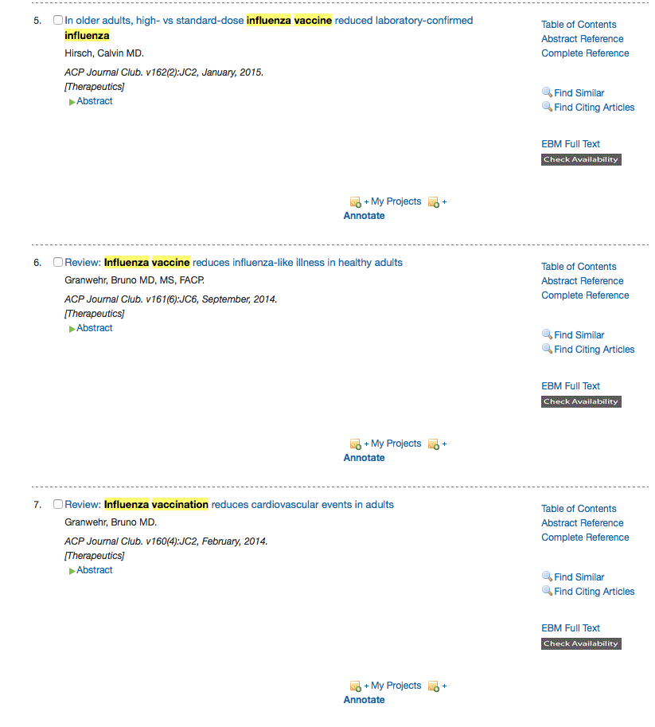
Click EBM Full Text

Slide 72
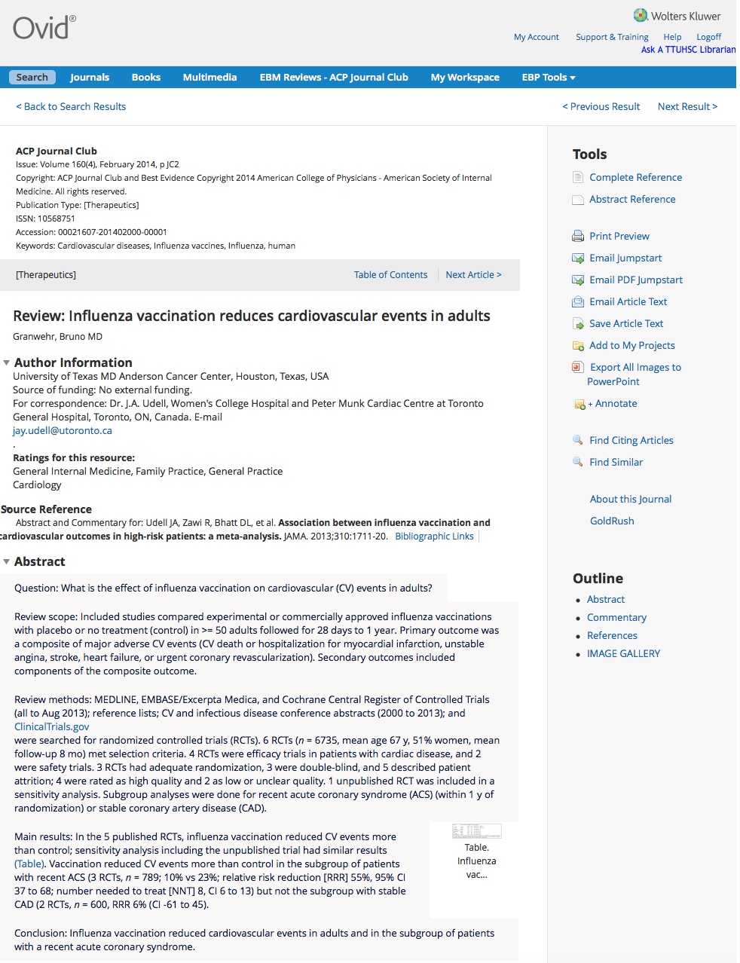
Use GoldRush
under E-journals
on the library homepage to access
full-text
brief
structured abstract

Slide 73
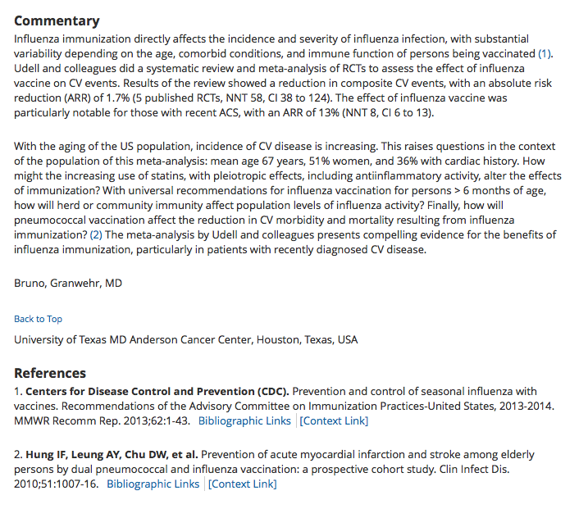
Commentary by clinical experts

Slide 74
Click to start a
new Search
Can Email results

Slide 75
What is a Systematic Review?
Systematic review
reviews a clearly formulated question
uses systematic and explicit methods to:
select and critically appraise relevant research
collect and analyze data from studies included in the review
Meta-analysis
uses statistical techniques in a systematic review to integrate the results
When searching for evidence-based literature
start by trying to locate a meta-analysis or a systematic review
From: Cochrane Collaboration Glossary at http://www.cochrane.org/resources/glossary.htm

Slide 76
Cochrane Central Register of Controlled Trials
3/5th’s from PubMed
relevant records from Embase
other published and unpublished sources
conference proceedings
Cochrane Database of Systematic Reviews
contains systematic review assessments of randomized trials combines data to produce a more statistically reliable result
screens over 800 international journals
structured abstracts created by the Cochrane Collaboration Groups
contains appraised and synthesized evidence

Slide 77
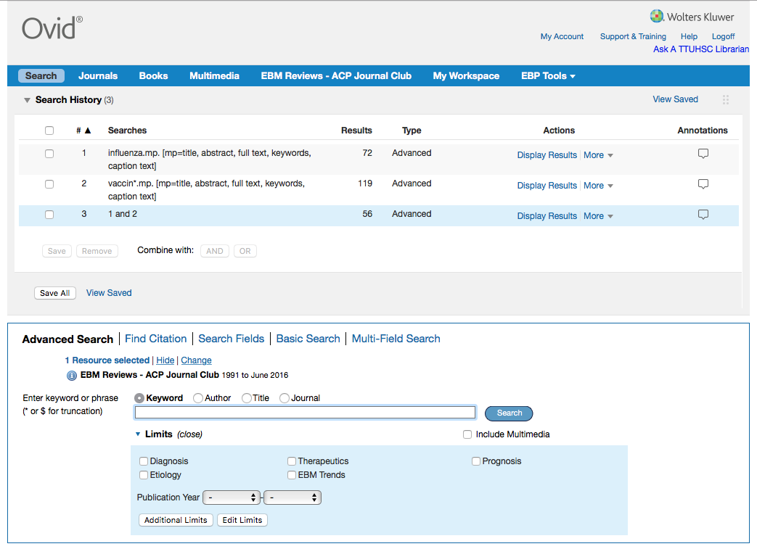
Change
Click

Slide 78
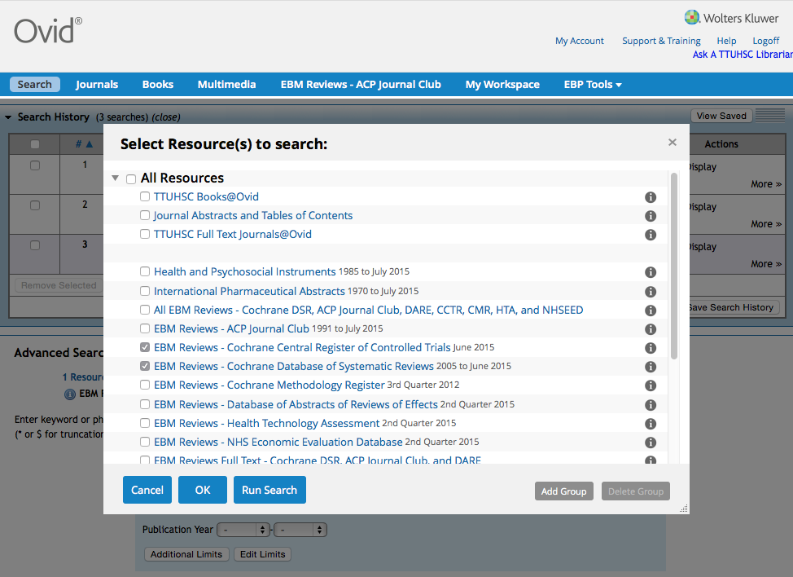
Select
Cochrane Central Register of Controlled Trials
and
Cochrane Database of Systematic Reviews
✔
✔
Click
Run Search

Slide 79
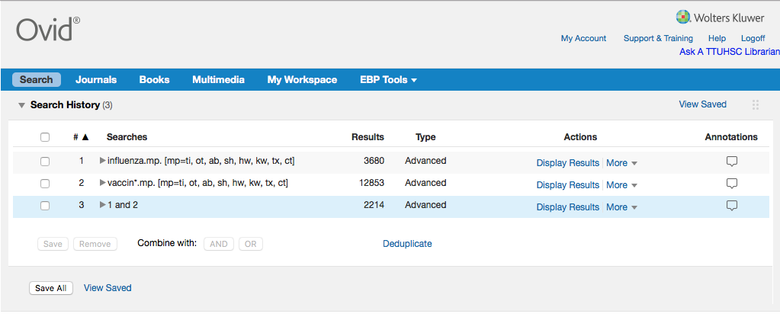
Scroll screen to
view results

Slide 80
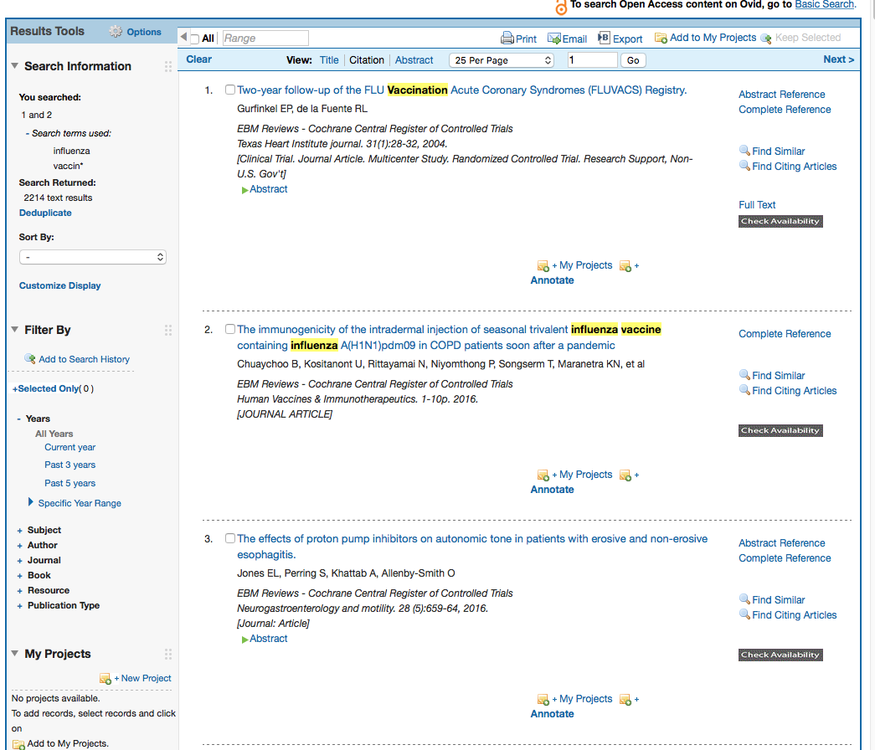
Results from CCRCT

Slide 81
Enter 2111 and click GO

Slide 82
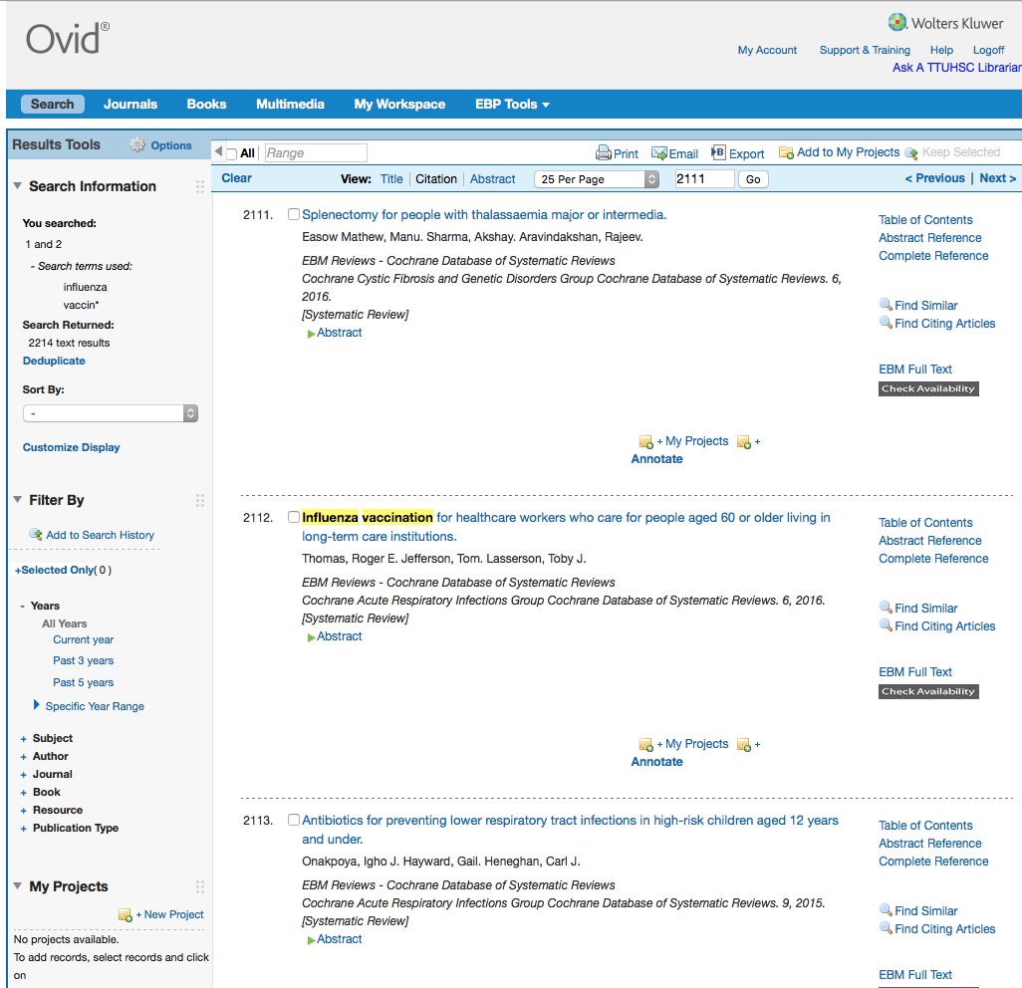
Results from CDSR

Slide 83
Click Search

Slide 84
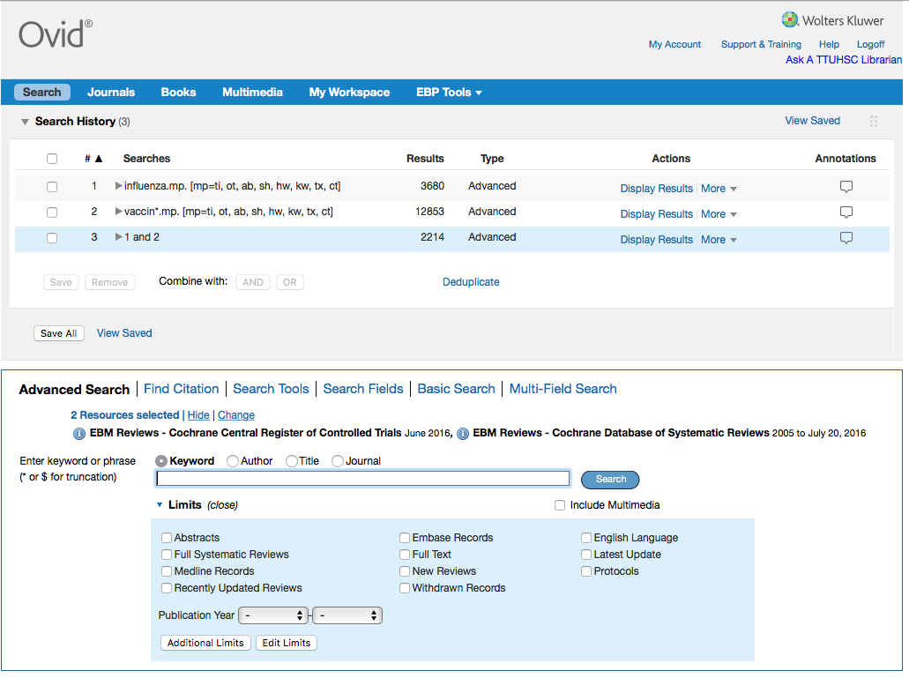
Click box
to select all
✔
Remove
Click

Slide 85
4. Appraise the evidence

Slide 86

What is Critical Appraisal?
“The process of assessing and interpreting
evidence by systematically considering its
validity, results, and relevance.”
The Cochrane Collaboration Glossary http://www.cochrane.org/glossary/5#letterc

Slide 87

“Critical appraisal is the first step in transferring research knowledge into practice.”
Das, K., Malick, S., & Khan, K. (2008). Tips for teaching evidence-based medicine in a clinical setting: lessons from adult learning theory. part one. Journal of the Royal Society of Medicine, 101(10), 493-500. doi: 10.1258/jrsm.2008.080712 web address: http://www.ncbi.nlm.nih.gov/pmc/articles/PMC2586873/?tool=pubmed

Slide 88

Purpose of Critical Appraisal
“Randomized controlled trials and systematic reviews are the highest levels of evidence but they are not automatically of good quality and should always be appraised critically.”
Das, K., Malick, S., & Khan, K. (2008). Tips for teaching evidence-based medicine in a clinical setting: lessons from adult learning theory. part one. Journal of the Royal Society of Medicine, 101(10), 493-500. doi: 10.1258/jrsm.2008.080712 web address: http://www.ncbi.nlm.nih.gov/pmc/articles/PMC2586873/?tool=pubmed
A Consultation of Surgeons, old negative no. 62-116 [engraving]. [Bethesda, MD., United States of America]: Images from the History of Medicine, U.S. National Library of Medicine, National Institutes of Health; accessed June 12, 2012. The National Library of Medicine believes this item to be in the public domain. print: 11 x 16 cm.

Slide 89

http://www.ebm.med.ualberta.ca/

Slide 90


Mouse over
Domains,
Study Category,
and select
Worksheet.
Look at Calculations.
Then look at
Systematic Review.

Slide 91
Critical Appraisal Worksheet

Slide 92
PICO Question Search

Slide 93

Searching Tips
1) Select both the Cochrane Central of Controlled Trials and the Cochrane Database of Systematic Reviews
2) Enter different concepts separately then combine as below:
X
X
AND
3) The truncation symbol is the asterisk *
4) Narrow results by searching for words only in titles.

Slide 94
5. Apply the evidence

Slide 95
2) Group Discussion “EBM Journal Club” with Dr. Griswold
Turn in your EBM Report!

Slide 96
Have Questions?

Slide 97


www.ttuhsc.edu/libraries
Click

Slide 98
Evaluation

Slide 99





Instructors:
Peggy Edwards
Margaret Vugrin
Micah Walsleben
Jennifer Yack

Slide 100
Thank You!

Slide 101
Learning Activities

Slide 102
Learning Activities I: Quick Search & Discussion
Select a topic and run in Cochrane Central of Controlled Trials and the Cochrane Database of Systematic Reviews
1) Screening for breast cancer
2) Screening for cervical cancer
3) Screening for colorectal cancer
4) Educational interventions for asthma
5) Diabetes and glucose/glycemic/glycaemic control
6) Diabetes and foot ulcers/wounds/infections
7) Cytoreductive surgery
8) Post-operative pain management
9) Pain management in arthritis
10) Pain management in fractures
What was your search strategy? How many articles were retrieved?

Slide 103
Learning Activities II
1) Run your PICO question in:
Cochrane Central Register of Controlled Trials
and Cochrane Database of Systematic Reviews

