Slide 1
Welcome
Surgery Clerkship
Introductory Orientation
EBM Resources Course
Peggy Edwards, AMLS
TTUHSC - Preston Smith Library
Lubbock, Texas 79430
7/2017

Slide 2
Welcome to the
Surgery Clerkship Orientation
EBM Searching Course!

Slide 3
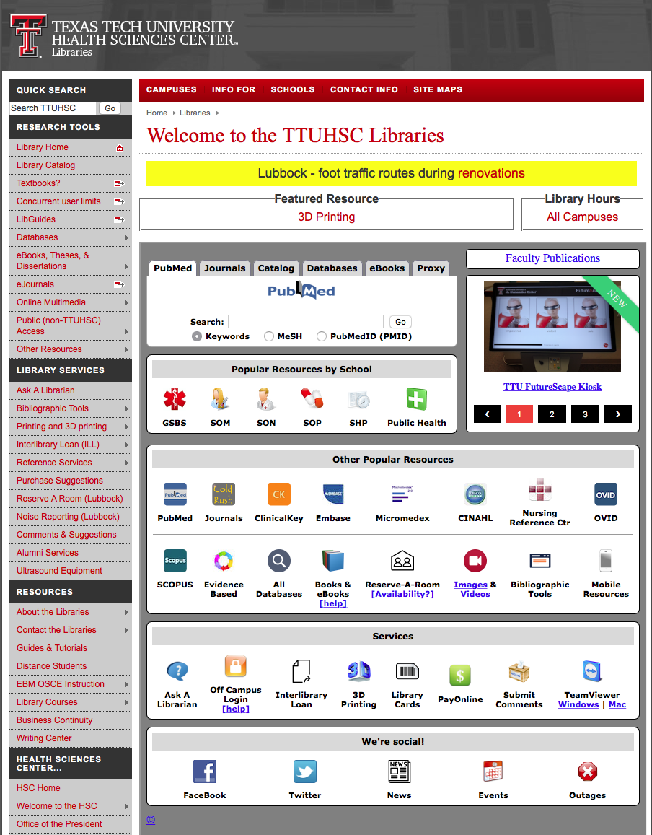
www.ttuhsc.edu/libraries
Click LibGuides

Slide 4
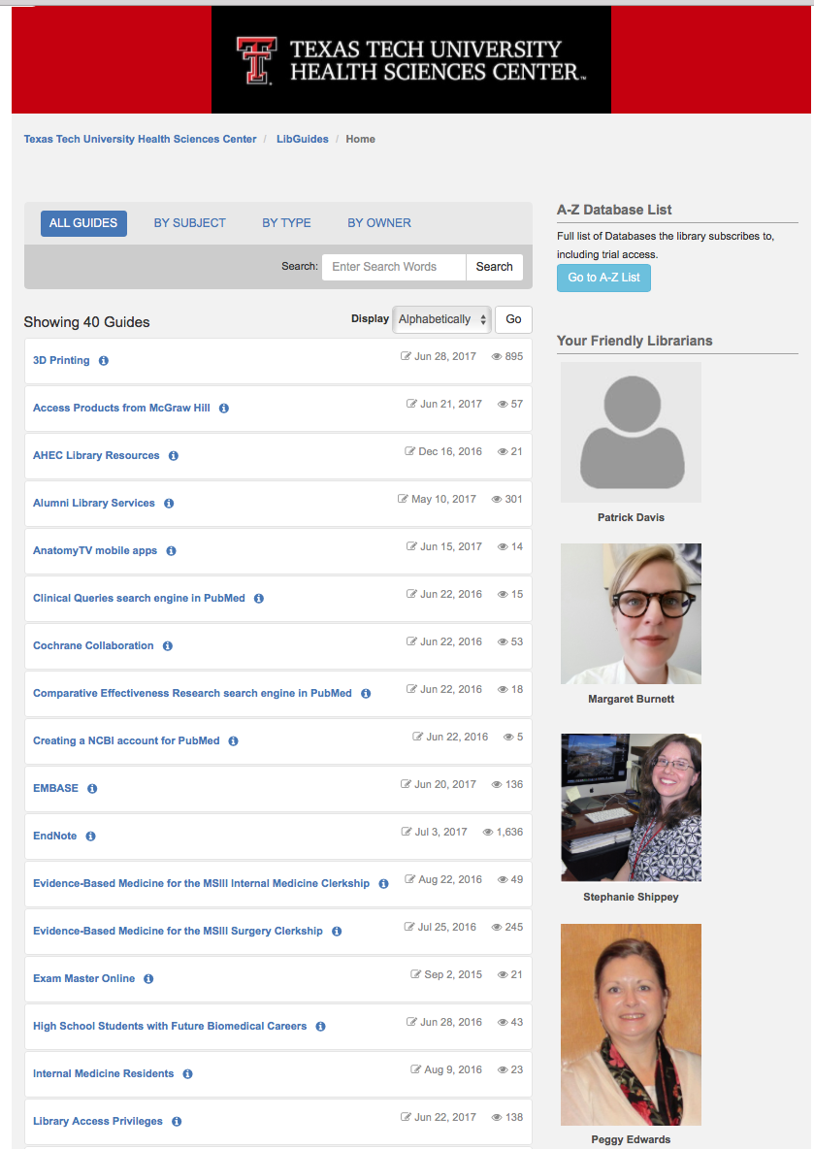
Click EBM for MSIII Surgery Clerkship

Slide 5
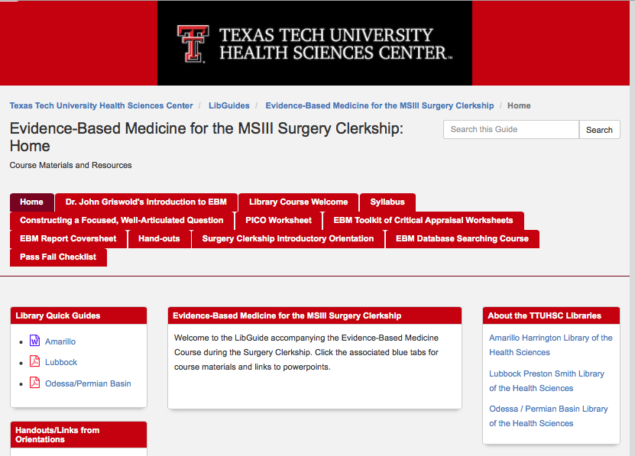

Slide 6
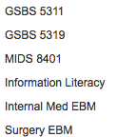
www.ttuhsc.edu/libraries
Click
Library Courses
Click

Slide 7
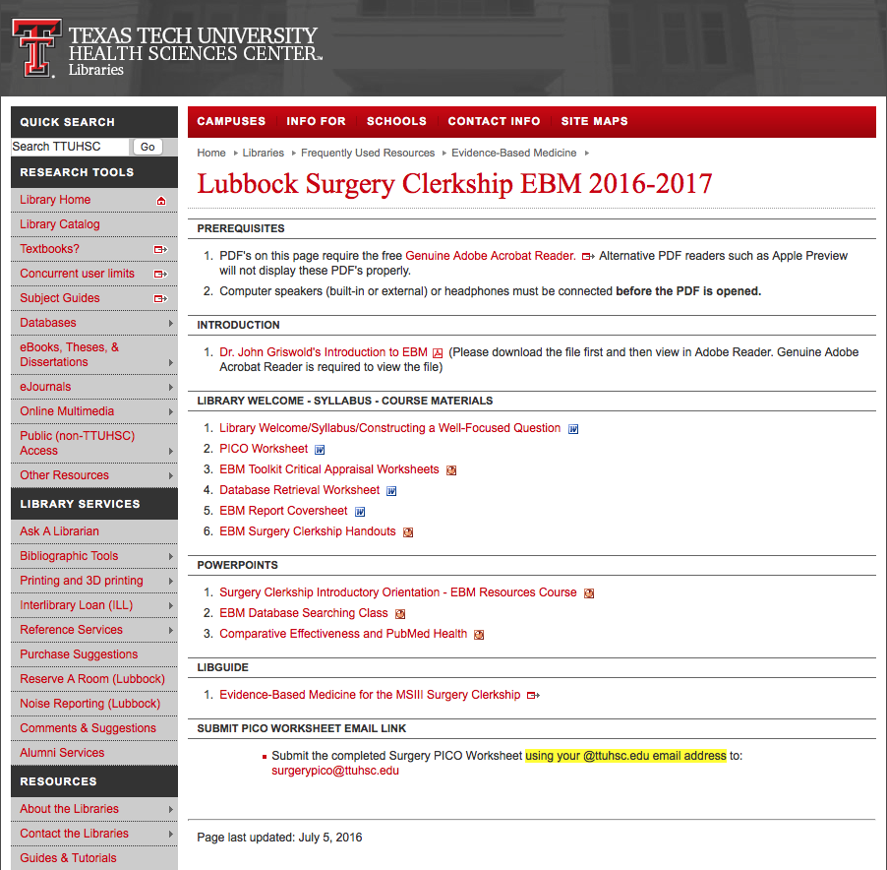
Course Materials

Slide 8
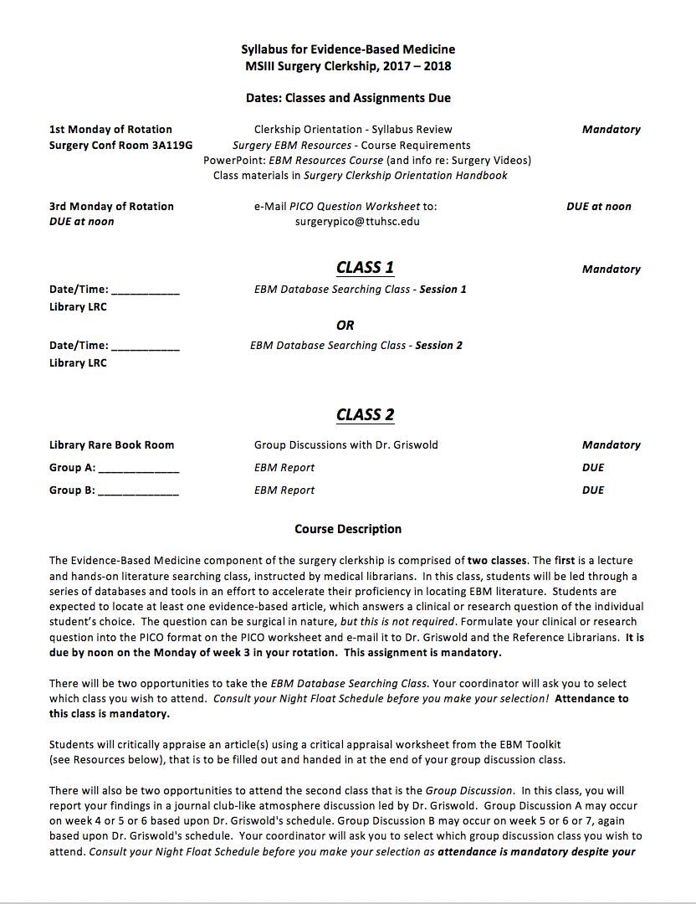
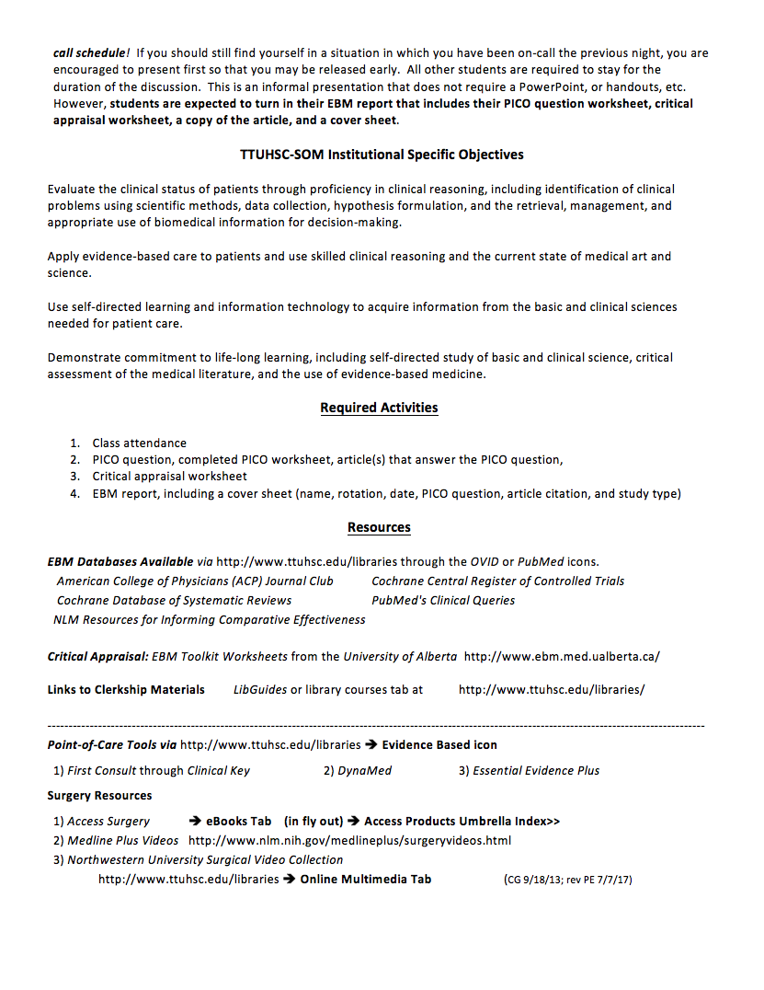
Syllabus

Slide 9
Two Classes:
1. EBM Database Searching
2. Group Discussion

Slide 10
EBM Database
Searching Class

Slide 11
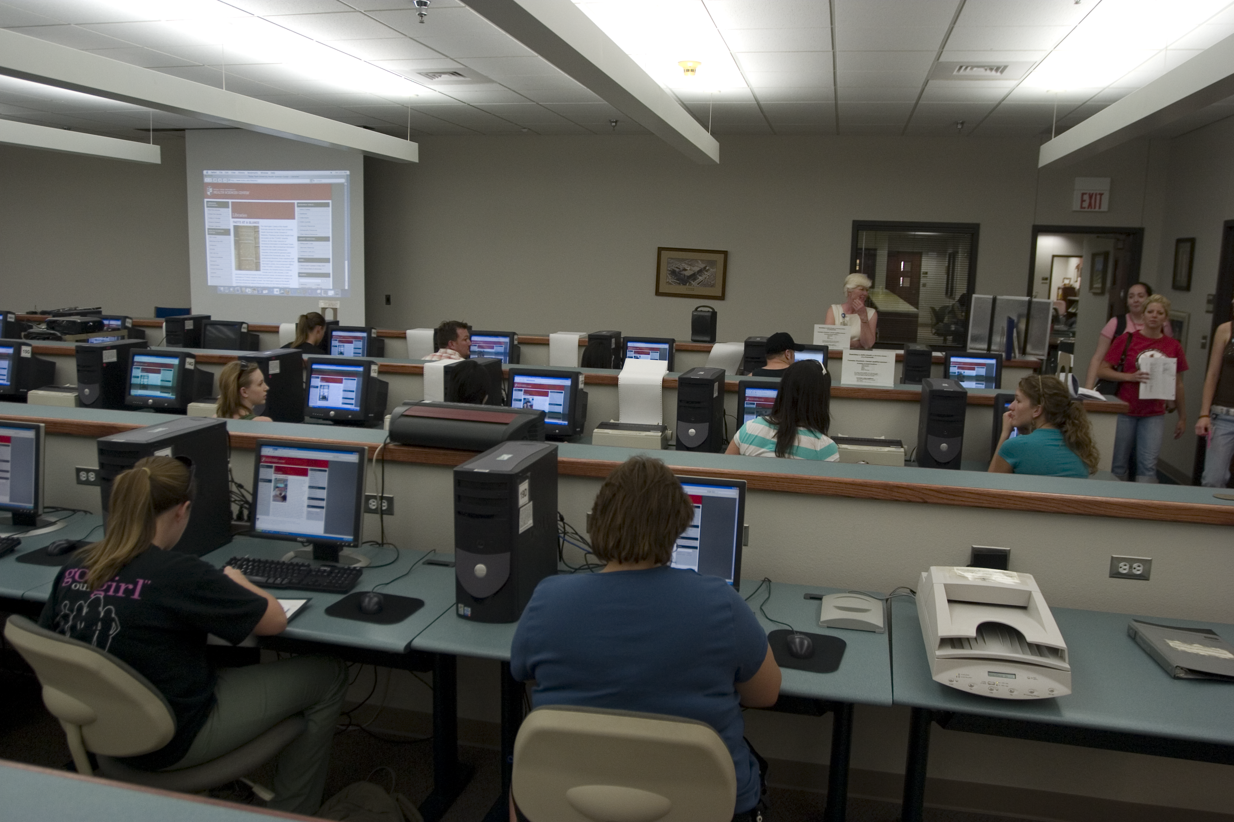
1) EBM Database Searching Class - Mandatory Attendance J
  1 Session for Group 1 and 1 Session for Group 2 (on separate weeks)
  in the Learning Resources Center
  how to search the Cochrane EBM Databases & NLM’s Comparative Effectiveness
  PowerPoint lecture and hands-on follow along
  search for article(s) that answer your PICO question
  searching guidance from assigned librarian

Slide 12
Group Discussion
Class

Slide 13
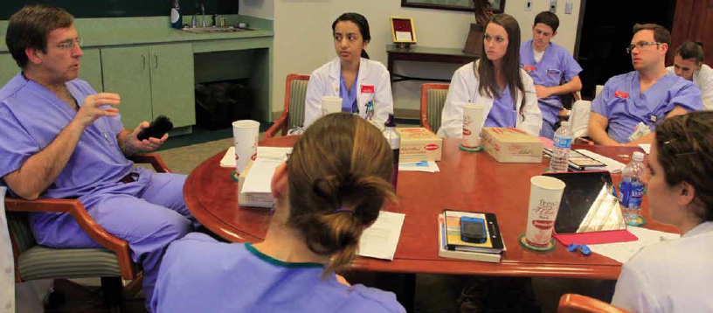
2) Group Discussion “EBM Journal Club” with Dr. Griswold
  in the Library’s Rare Books Conference Room
  state your focused, well-articulated PICO question
  describe databases searched and search strategy
  state author, article title, journal, and date published
  discuss study design, validity and reliability, research findings
  commentary and q & a from Dr. Griswold
  turn in your EBM report including PICO question worksheet, critical appraisal worksheet, copy of the article, and cover sheet
  casual atmosphere and bring your own lunch!

Slide 14
Learning Activities

Slide 15
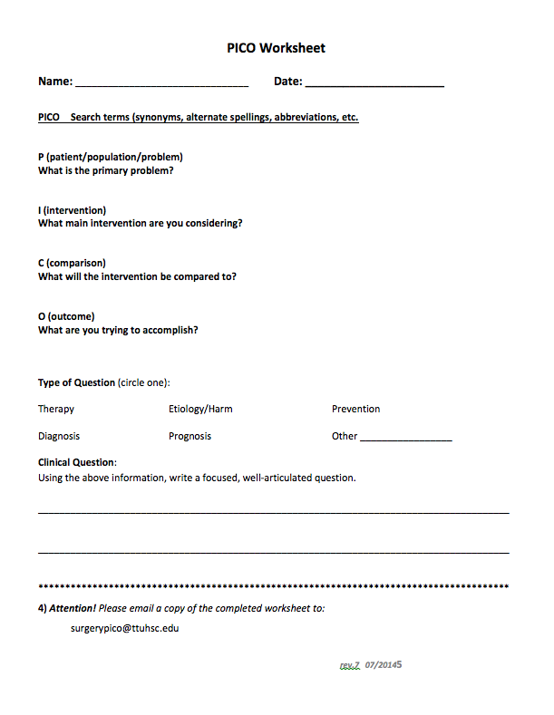
In adult male patients with recent myocardial infarction, does a
single daily dose of 300 mg of aspirin prevent re-infarction?
P
adult male patients with recent MI
I
daily dose of 300 mg of aspirin
C
placebo
O
prevent re-infarction

Slide 16
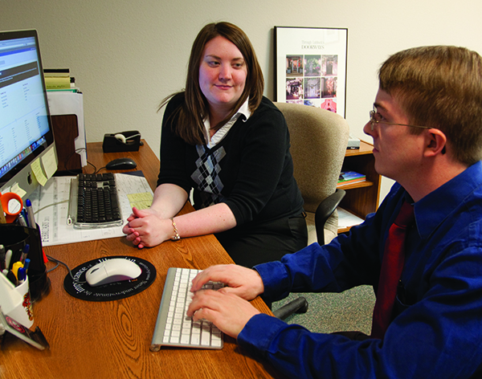
EBM Database Searching Class
Hands-on follow along searching practice
With help from librarian, locate an article answering your PICO question

Slide 17
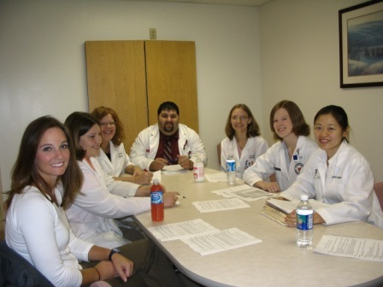
What is Critical Appraisal?
“The process of assessing and interpreting
evidence by systematically considering its
validity, results, and relevance.”
The Cochrane Collaboration Glossary http://www.cochrane.org/glossary/5#letterc

Slide 18
EBM Report a
a
Turned in at end of
Group Discussion Class

Slide 19
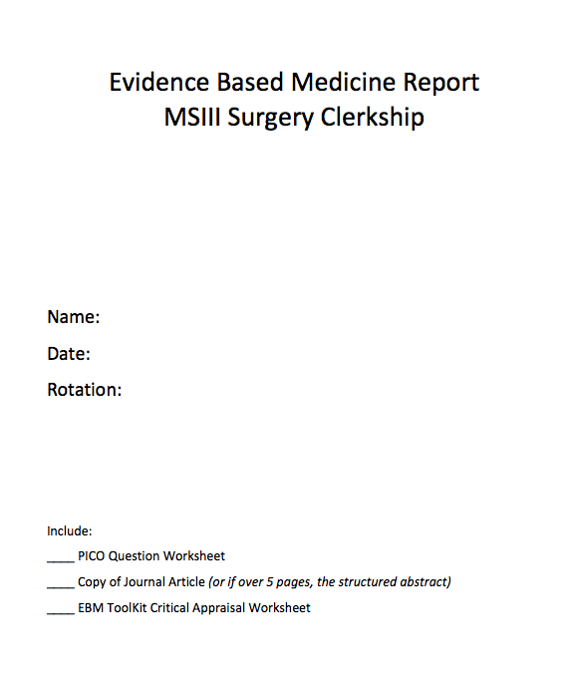

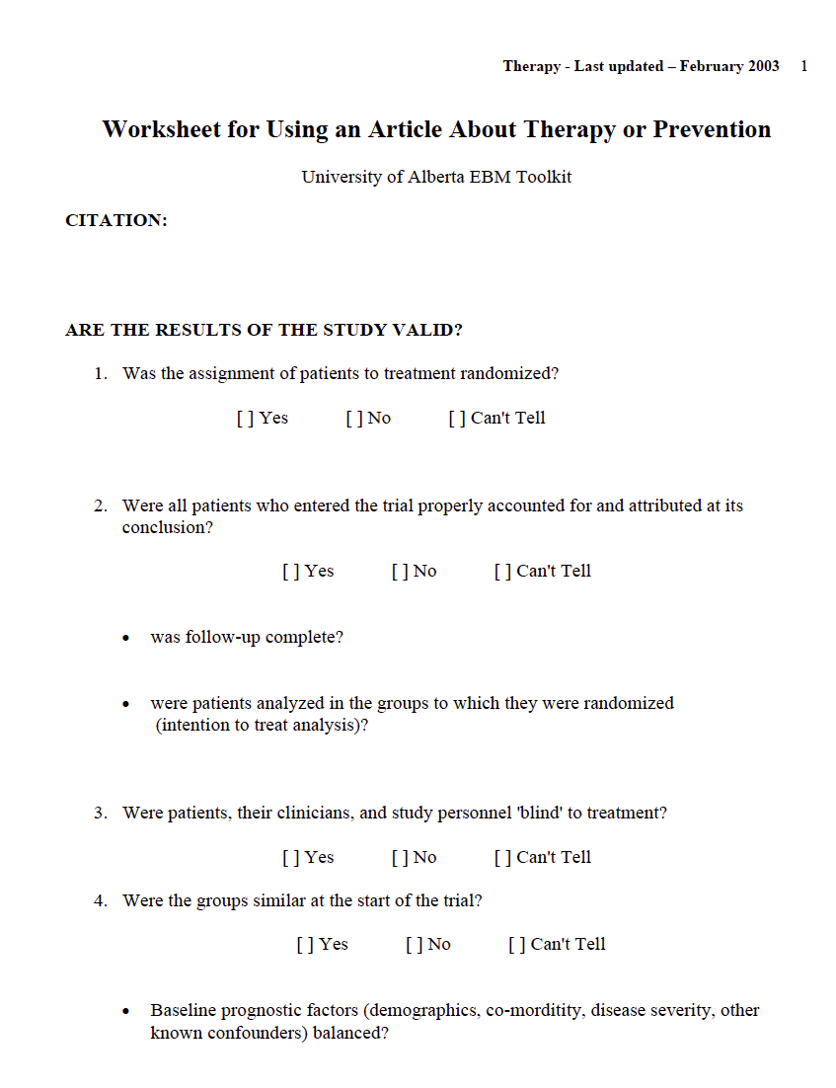
EBM Report
Cover Sheet
PICO Worksheet
Article
Critical Appraisal

Slide 20
Questions?

Slide 21
Surgery Resources

Slide 22
Access Surgery

Slide 23
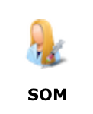
Under Popular Resources by School
www.ttuhsc.edu/libraries
Click

Slide 24
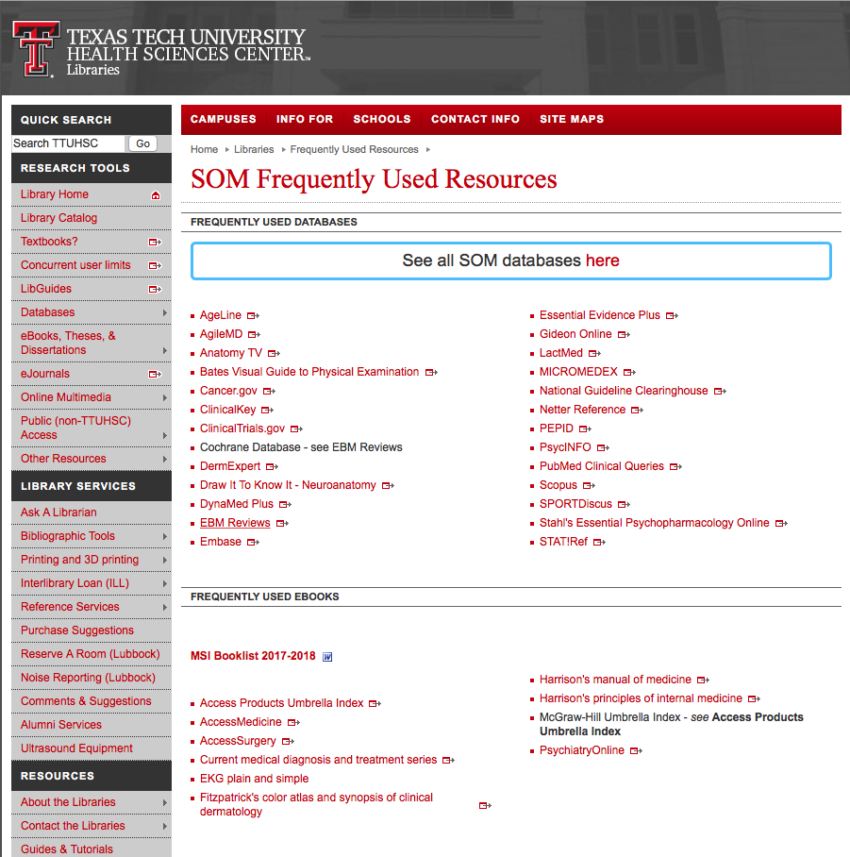
Click Access Surgery

Slide 25

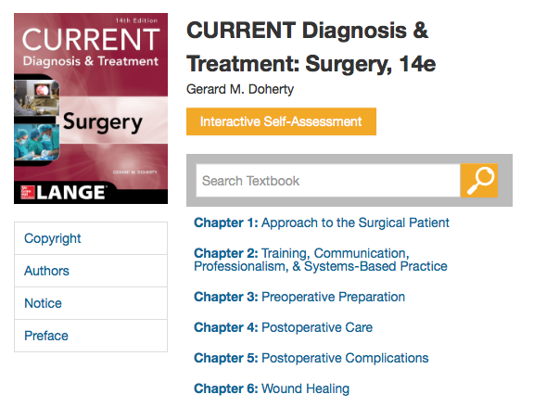
Major Surgical Electronic Textbooks- free!

Slide 26
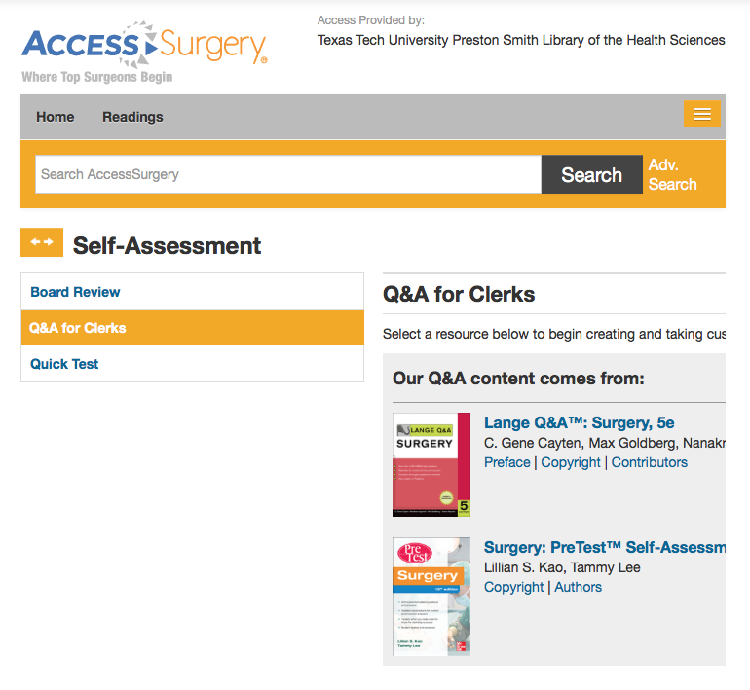
Click

Slide 27
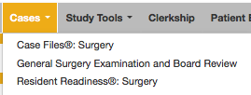

Slide 28
Medline Plus Videos

Slide 29

www.medlineplus.gov

Slide 30
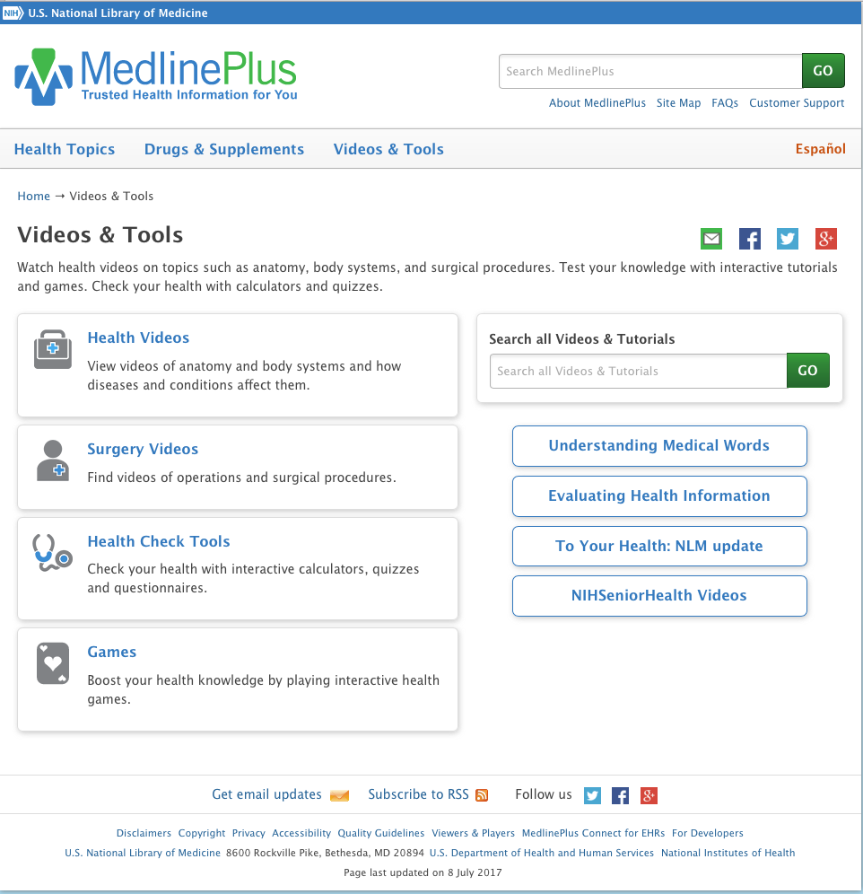

Slide 31
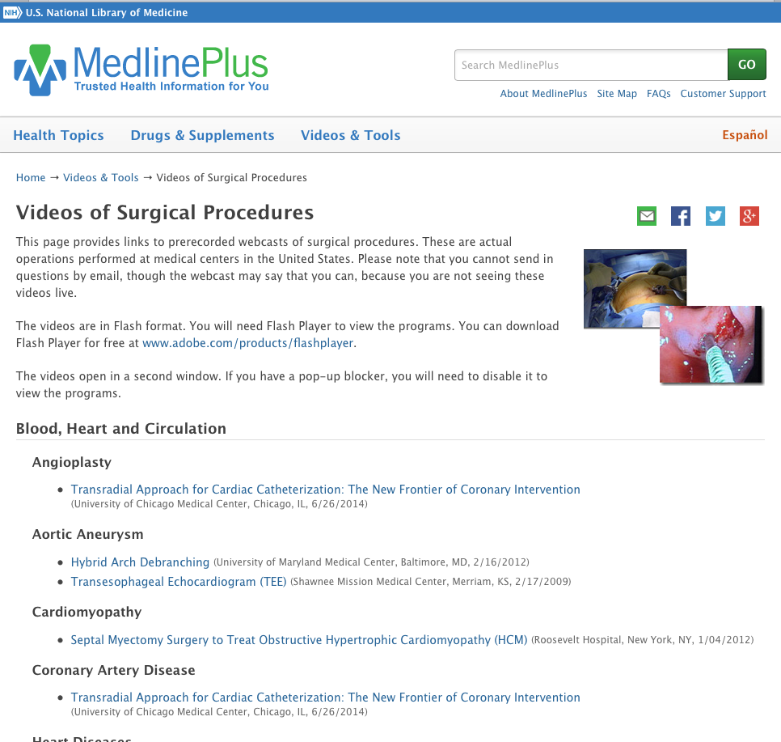

Slide 32
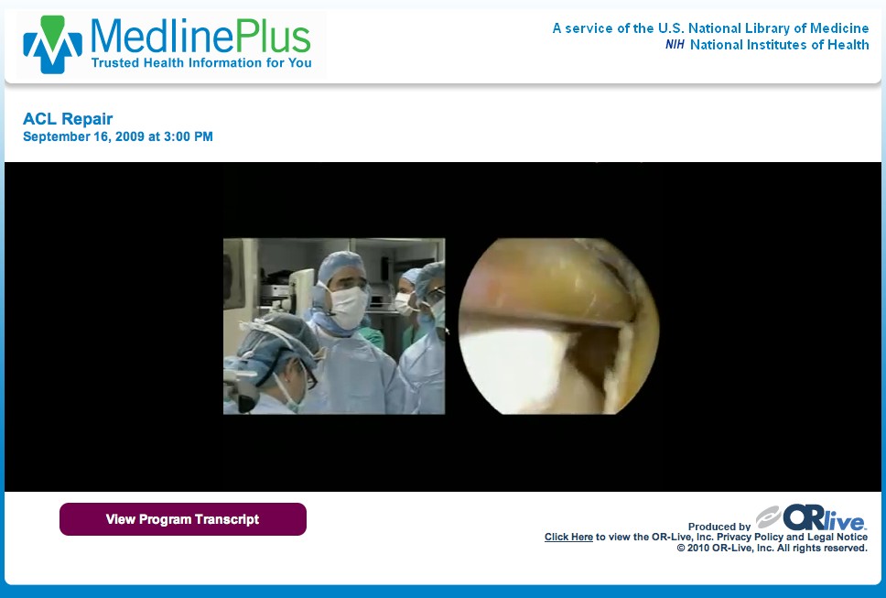

Slide 33
EBM Point of Care Tools
decision support information accessible at the patient’s bedside or the “point of care”
data that is evaluated and rated with levels of evidence
clinical information including
  history and physical
  signs and symptoms
  differential diagnosis
  diagnosis
  therapy
  follow-up
  guidelines

Slide 34
www.ttuhsc.edu/libraries
Click Clinical Key

Slide 35
Clinical Key
* content from books, journals, and videos
First Consult
*point of care decision support tool within Clinical Key
* main source of information is from the
Cochrane Collaboration where possible

Slide 36
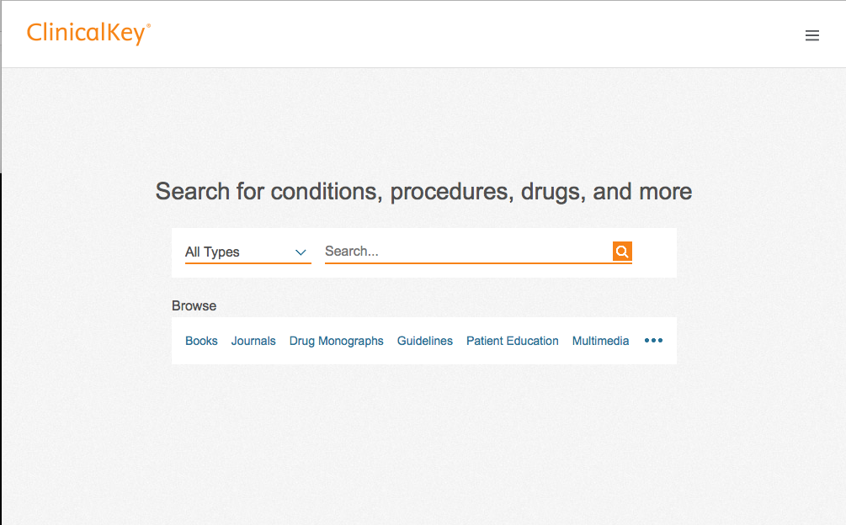
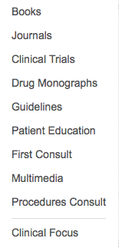
Click All Types
Select First Consult

Slide 37
Click Search
Enter topic
leukemia

Slide 38
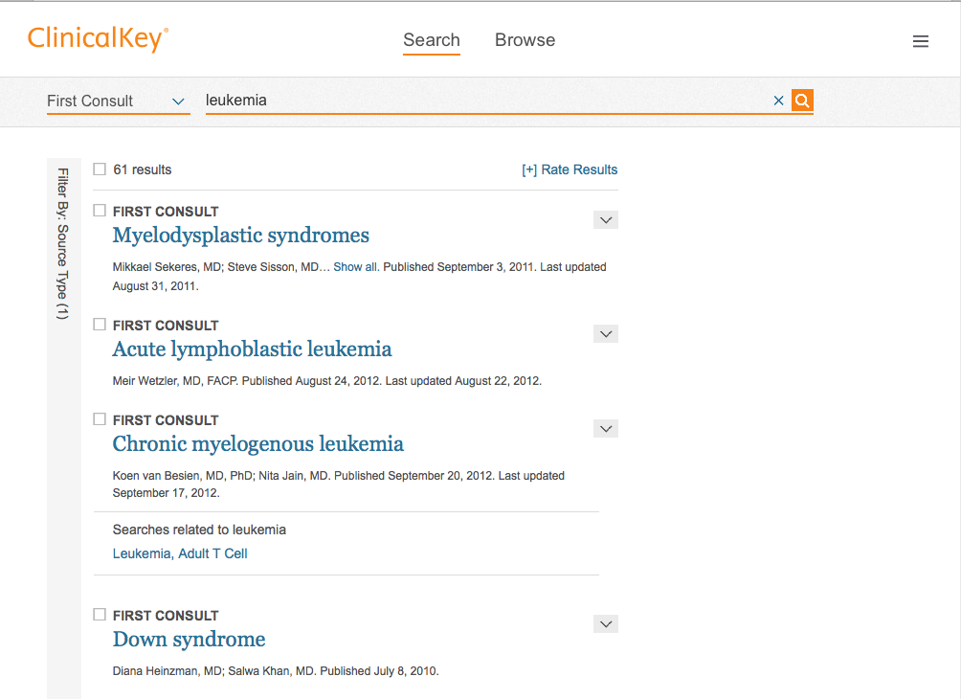
Click Chronic myelogenous leukemia

Slide 39
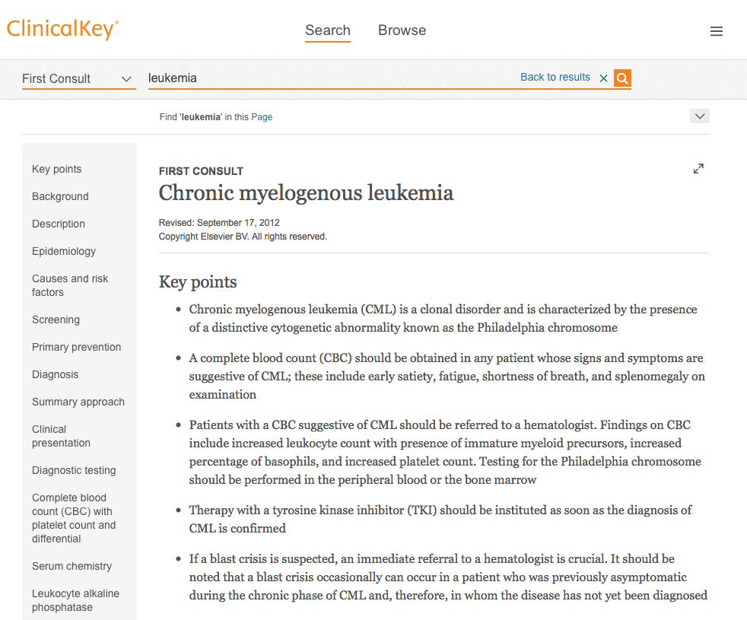

Slide 40
www.ttuhsc.edu/libraries
Click Evidence Based

Slide 41
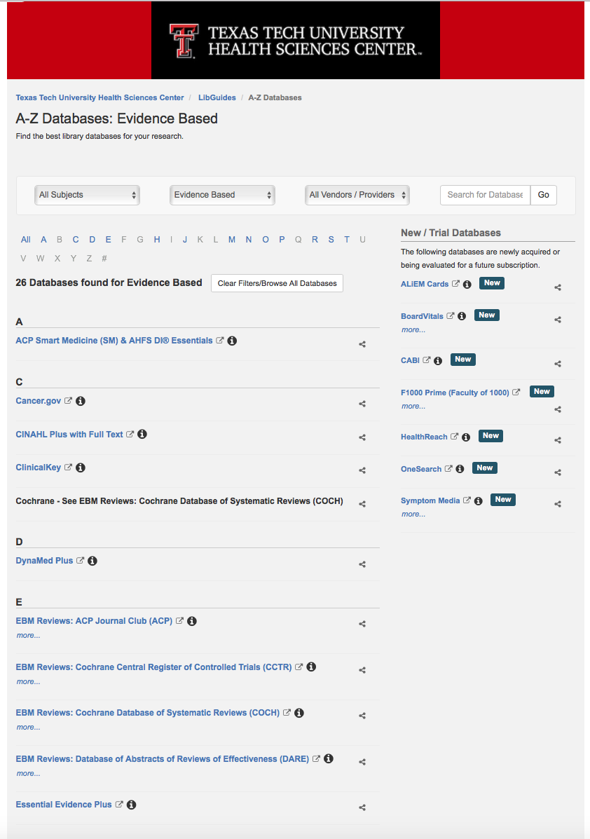
Click DynaMed

Slide 42
DynaMed Plus
Updated daily
Monitors the content of over 500 medical journals
New evidence is integrated with existing content
Overall conclusions represent a synthesis of the
best available evidence.

Slide 43
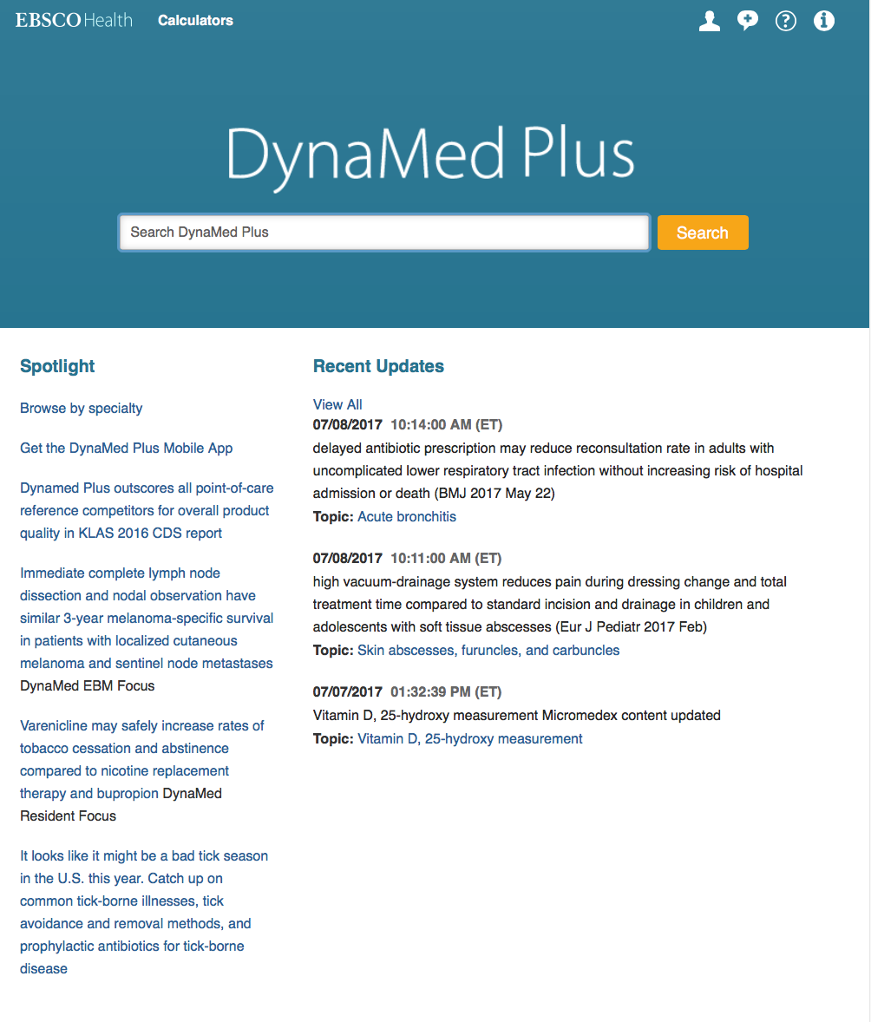
asthma
Enter search query
Home Page

Slide 44
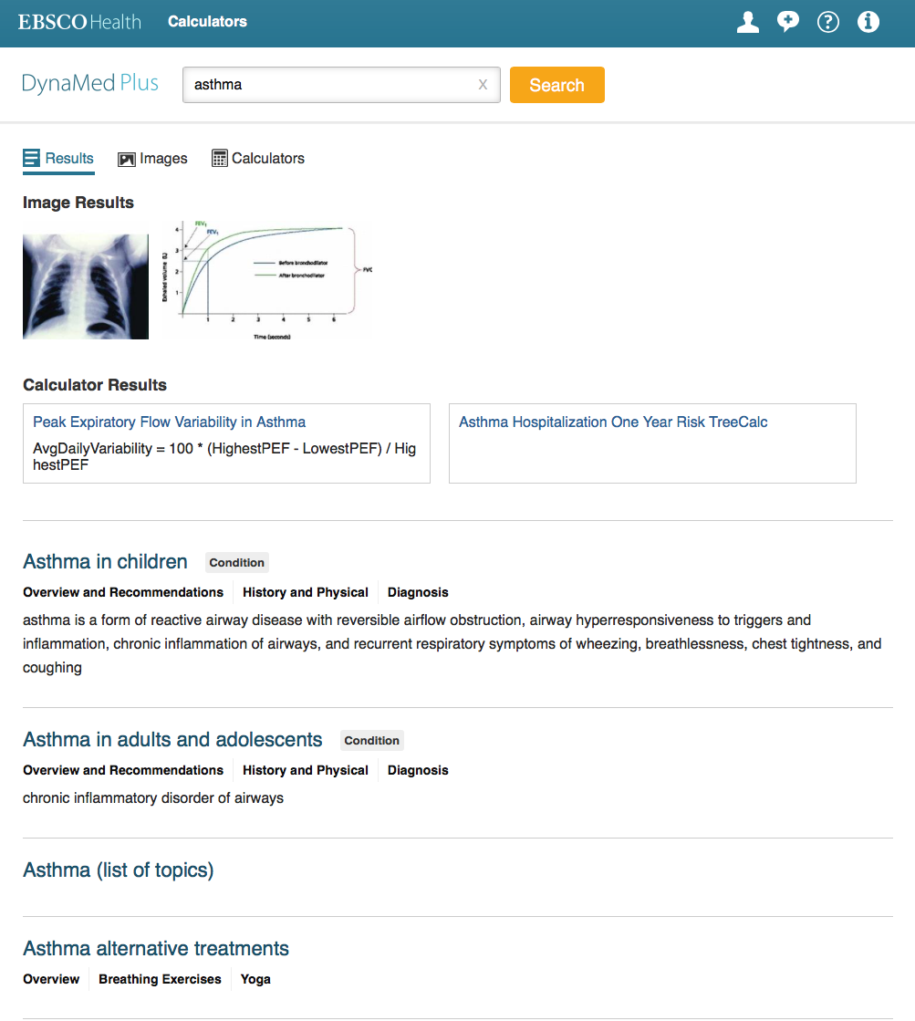
Click Links
To Topic

Slide 45
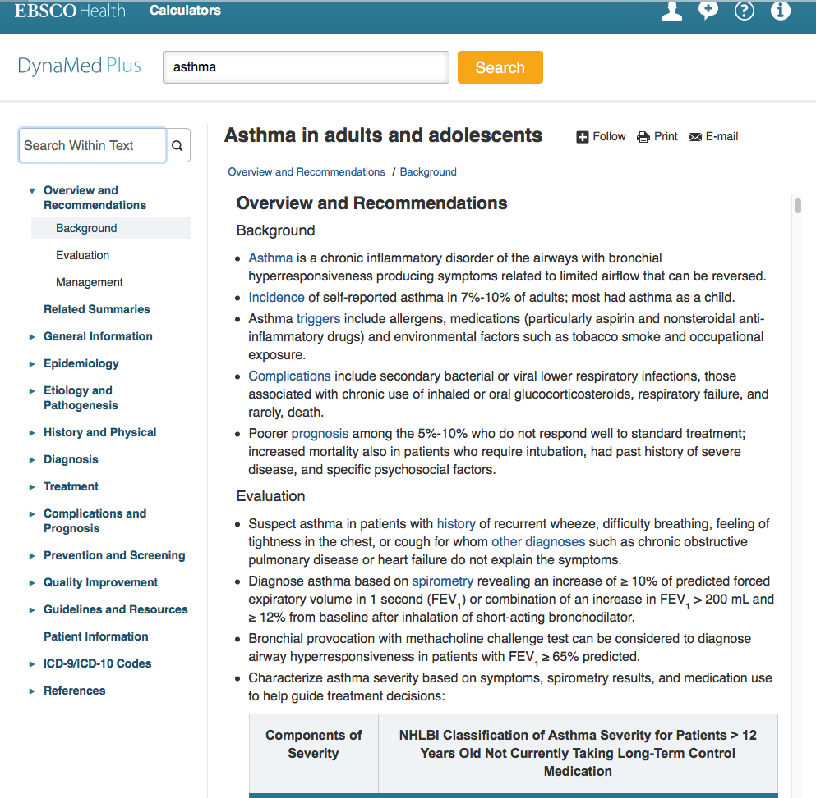

Slide 46
www.ttuhsc.edu/libraries
Click Evidence Based

Slide 47
Click Essential Evidence Plus

Slide 48
ESSENTIAL EVIDENCE PLUS
  over 13,000 topics
  guidelines, abstracts, and summaries
  Systematic Reviews from Cochrane Collaboration
  Daily POEMS
  Calculators
  Derm Expert

Slide 49
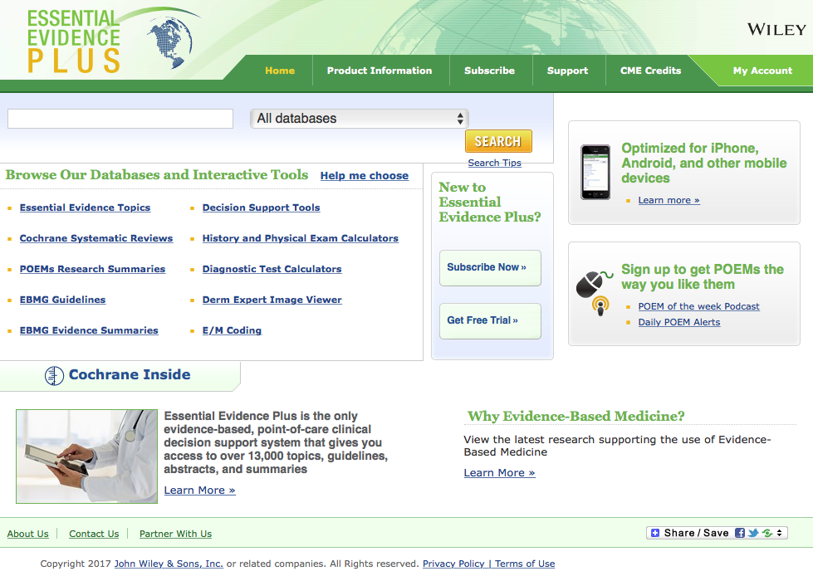
Home Page

Slide 50
Enter asthma and
click SEARCH
asthma

Slide 51
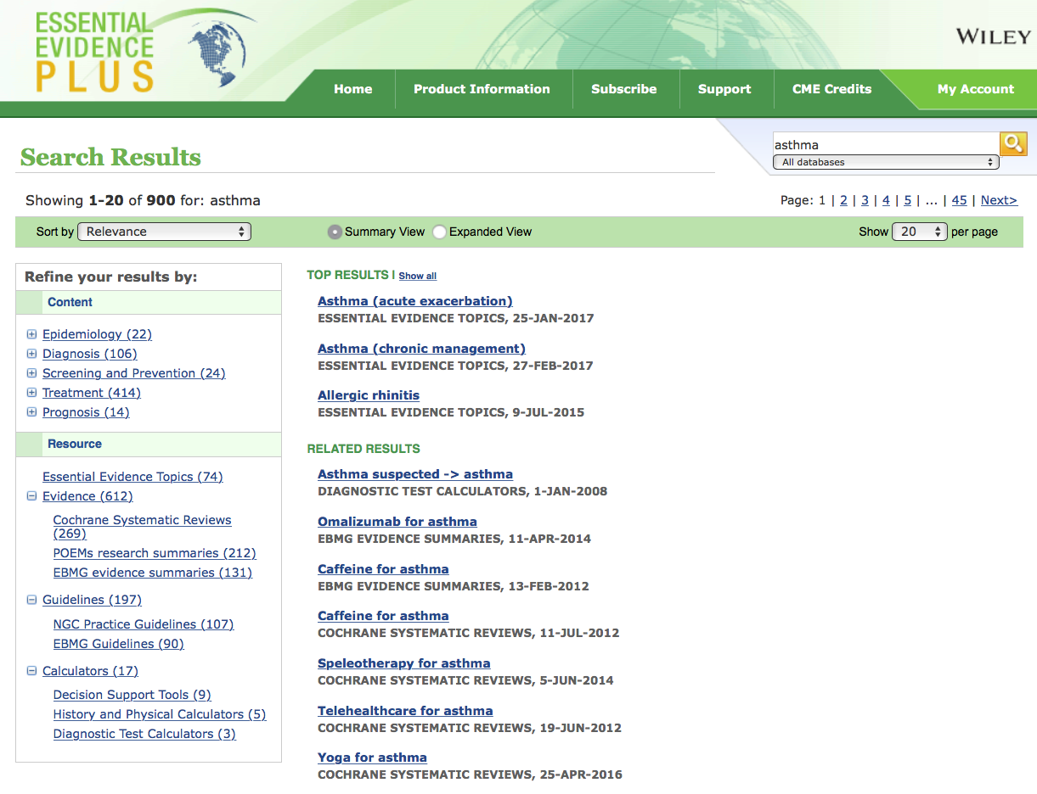
To access the disease information overview module, always select from Essential Evidence Topics
Click link

Slide 52
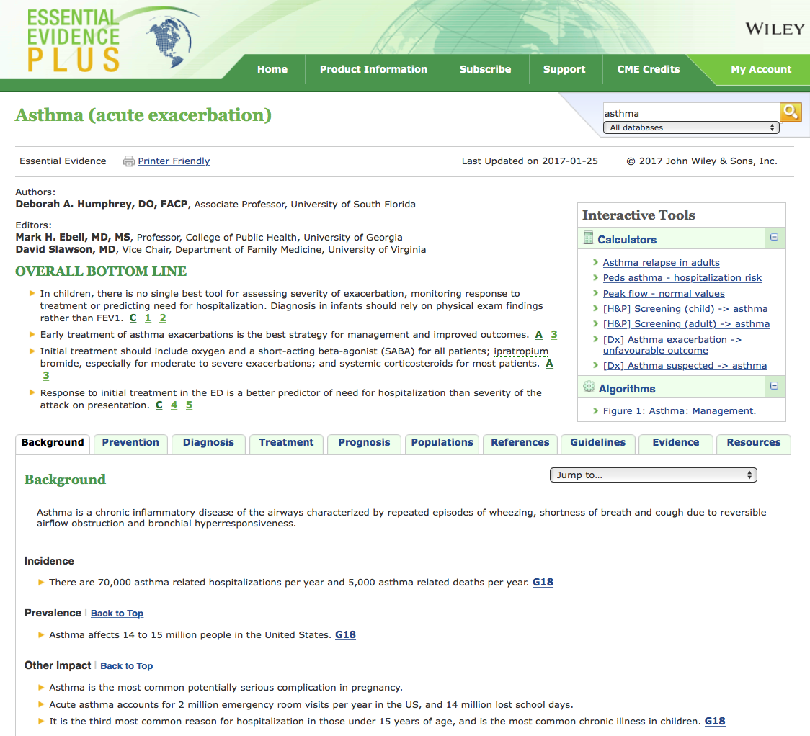
Information Index

Slide 53

Click
to return to home page

Slide 54
Calculators & Tools

Slide 55
Select
Diagnostic Test Calculators

Slide 56
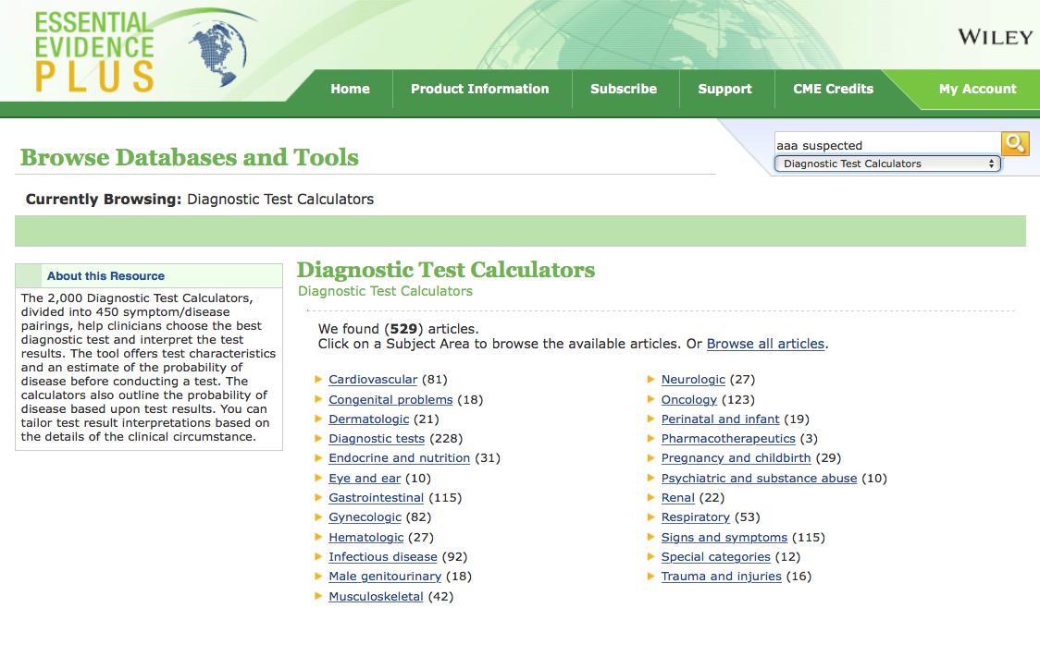
Search “aaa suspected”
then select
Diagnostic Test Calculators

Slide 57
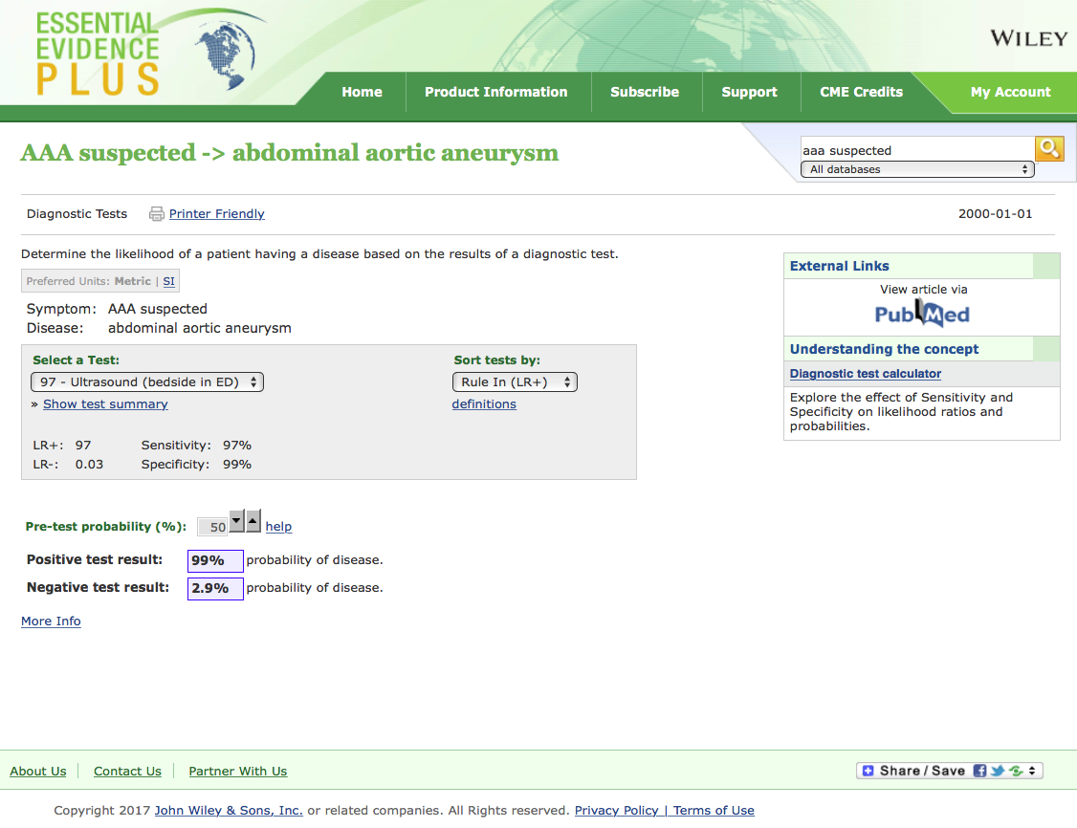

Slide 58
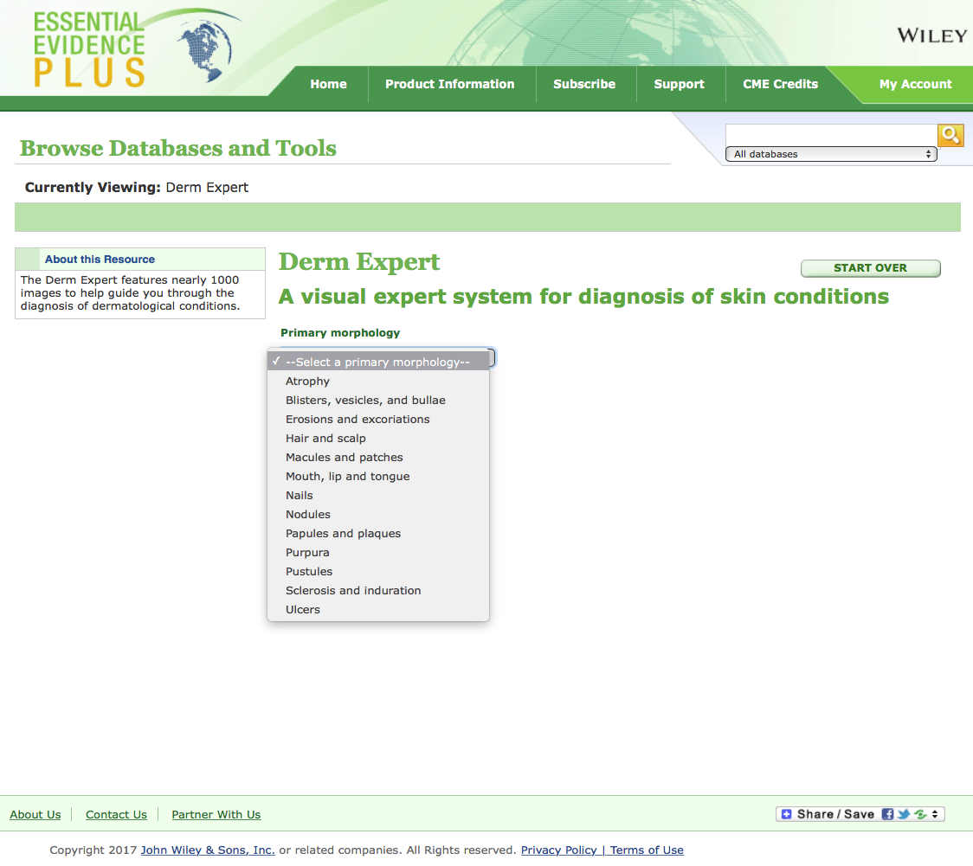
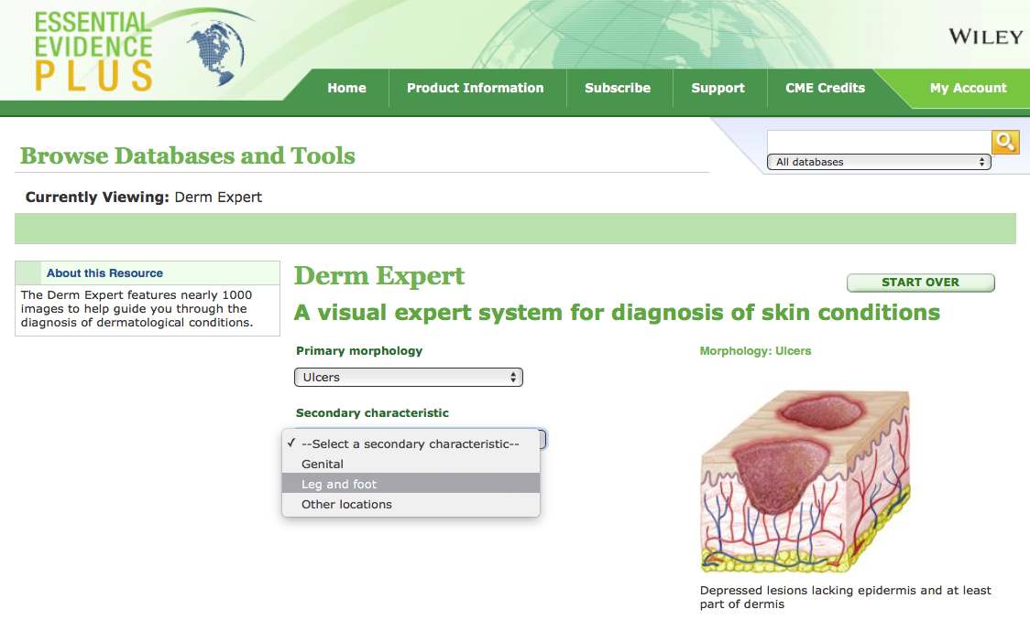
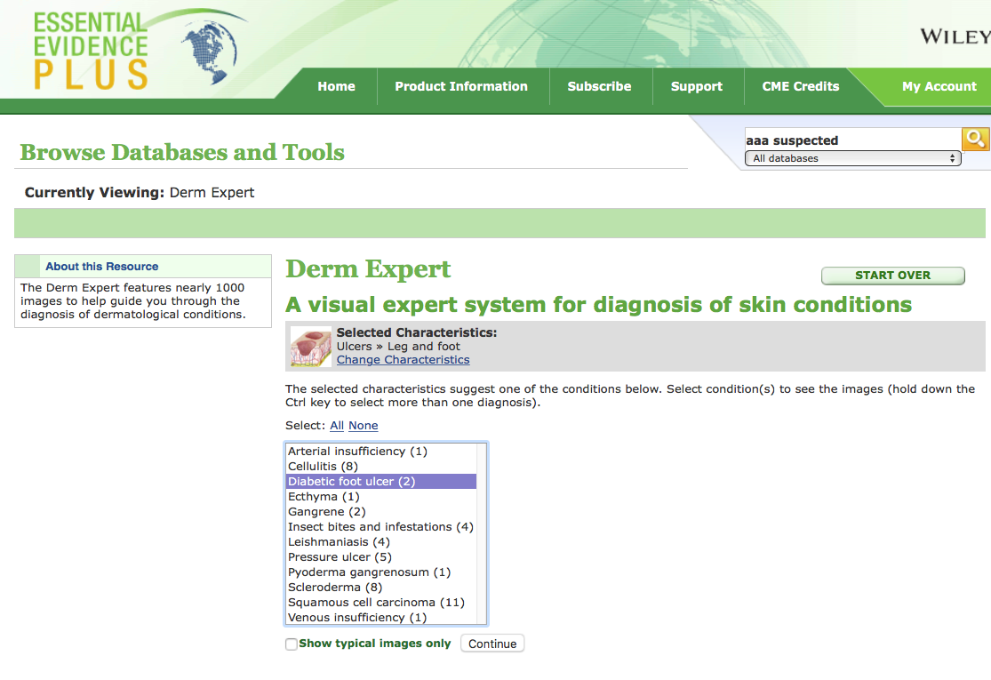
Click
Continue

Slide 59
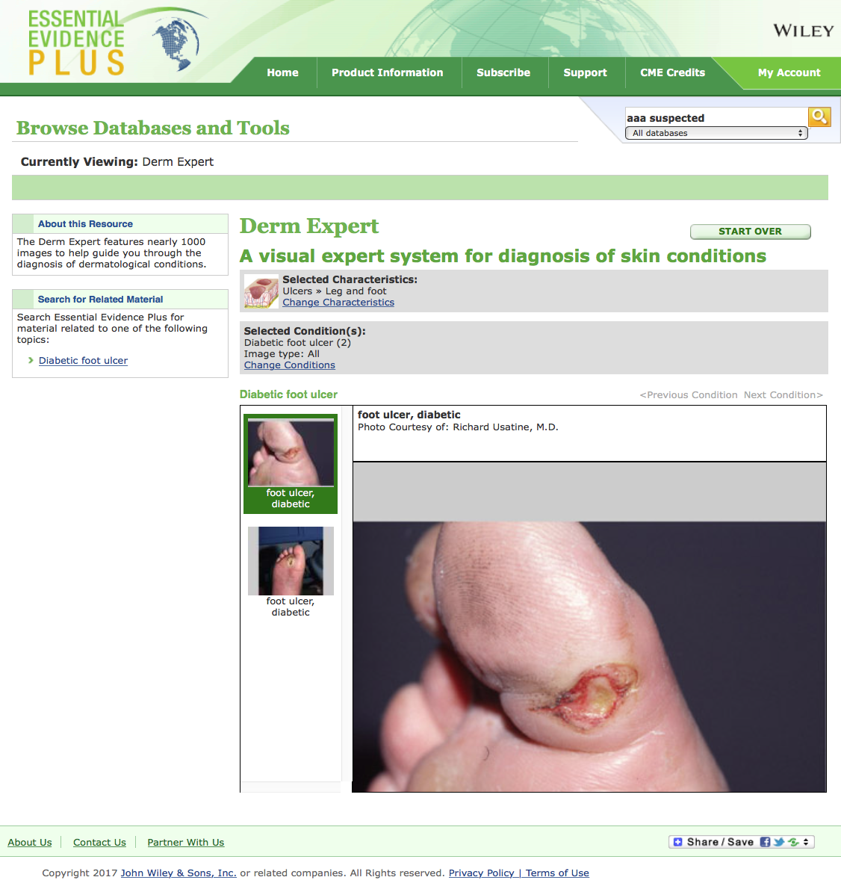

Slide 60
Practice Guidelines

Slide 61
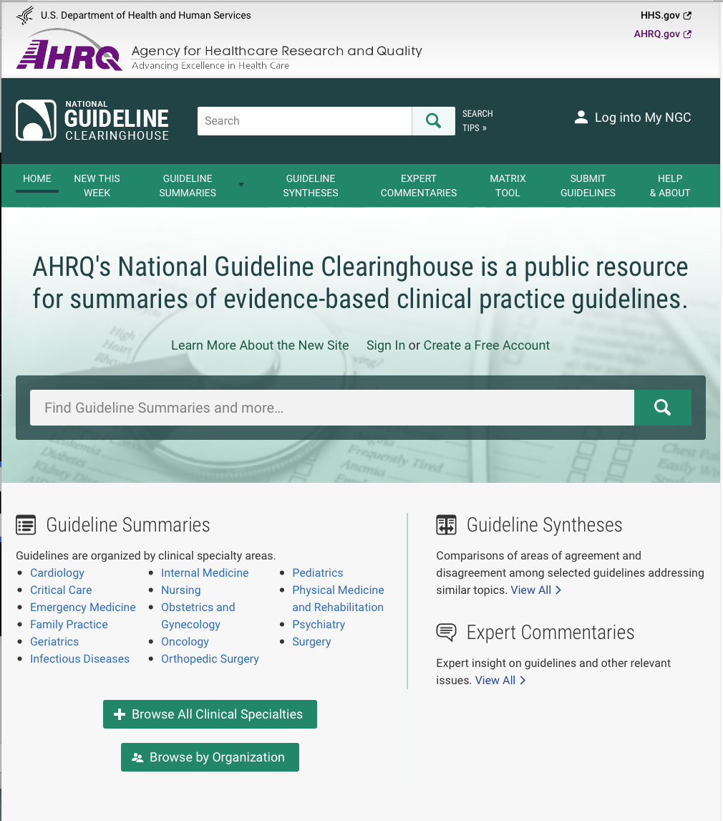
www.guideline.gov

Slide 62

Many Information Resources
are Mobile!

Slide 63
www.ttuhsc.edu/libraries
Click Mobile Resources

Slide 64
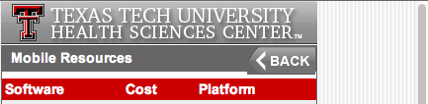

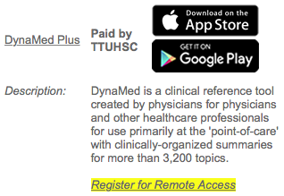
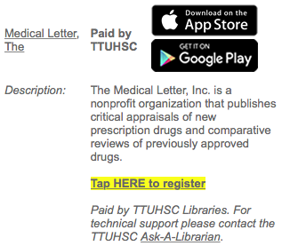
Scroll to resource
Click appropriate links for your device

Slide 65
www.ttuhsc.edu/libraries
Ask-A-Librarian

Slide 66
The End
July 2017

