Slide 1
Welcome
Database Searching for
Evidence Based Medicine
Literature
Peggy Edwards, AMLS
TTUHSC - Preston Smith Library
Lubbock, Texas 79430
Feb, 2018

Slide 2


When searching library applications, use
It is TTUHSC IT’s supported browser!

Slide 3
Learning Goals
1) Determine database search results differences between:
  ACP Journal Club
  Cochrane Central Register of Controlled Trials
  Cochrane Database of Systematic Reviews
  Comparative Effectiveness Research
2) Determine the depth of information in the articles from each database.
3) Determine the level of evidence.
4) Use the 5 steps of the EBM process.

Slide 4
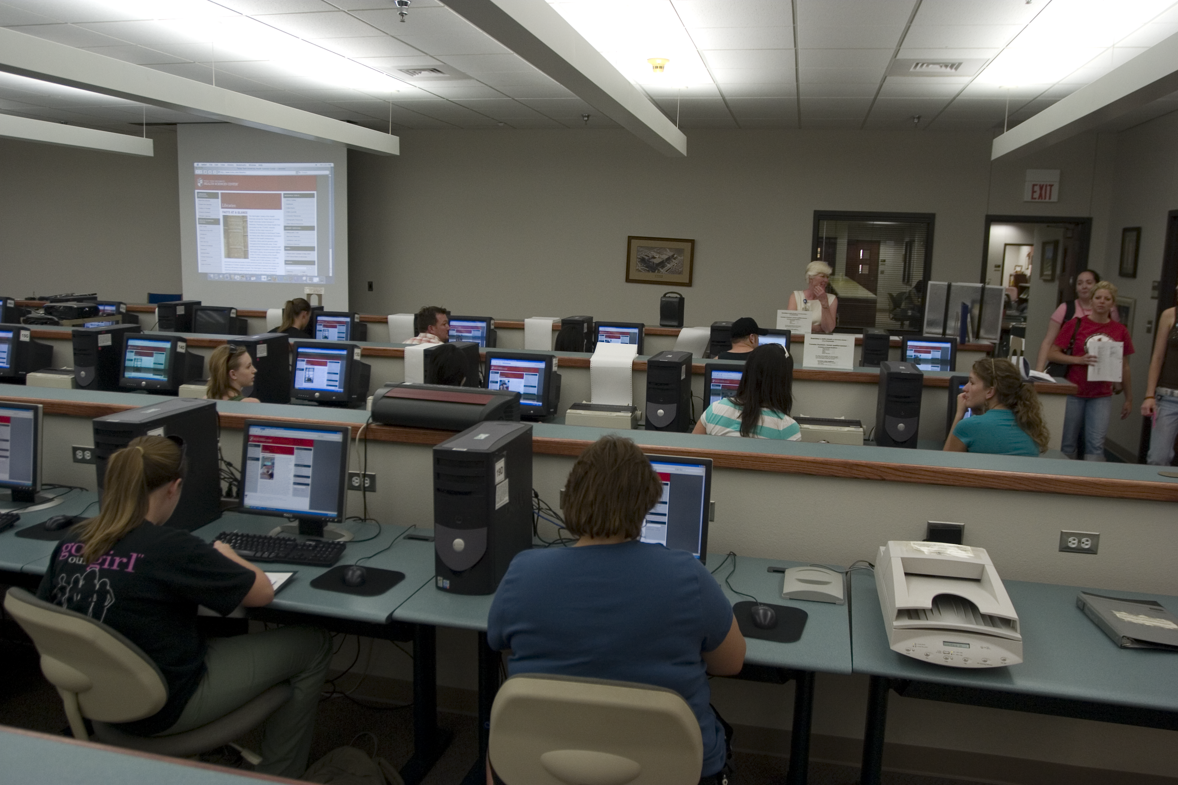
1) Database Searching- Mandatory Attendance J
  how to search the Cochrane EBM Databases &
    Comparative Effectiveness Research
  PowerPoint lecture and hands-on follow along
  search for article(s) that answer your question
  one-on-one searching guidance with assigned librarian

Slide 5
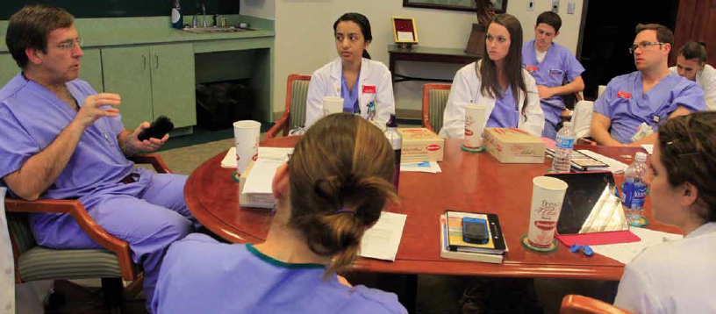
Group Discussion “EBM Journal Club” with Dr. Griswold
  in the Library’s Rare Books Conference Room
  state your focused, well-articulated PICO question
  describe databases searched and search strategy
  state author, article title, journal, and date published
  discuss study design, validity and reliability, research findings
  commentary and q & a from Dr. Griswold
  turn in your EBM report including PICO question worksheet, critical appraisal worksheet, copy of the article, and cover sheet
  casual atmosphere and bring your own lunch!

Slide 6
Course Materials

Slide 7
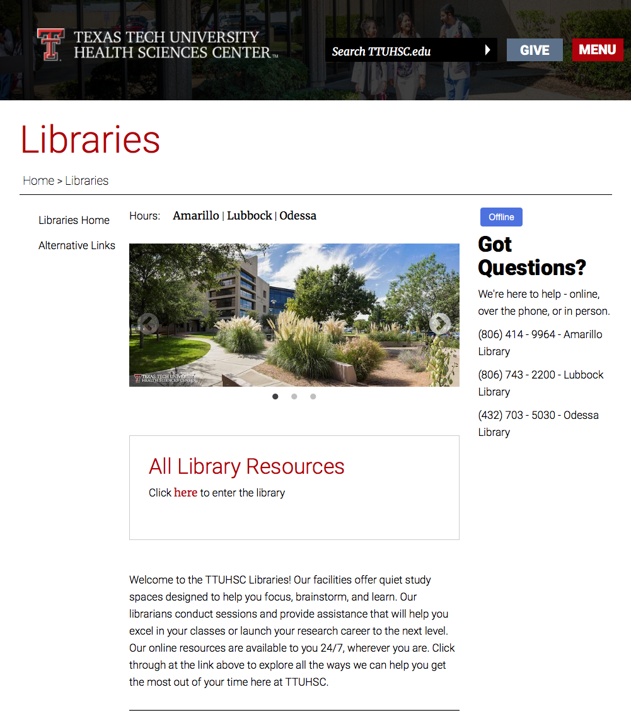
www.ttuhsc.edu/libraries
Click here to go to library resources

Slide 8
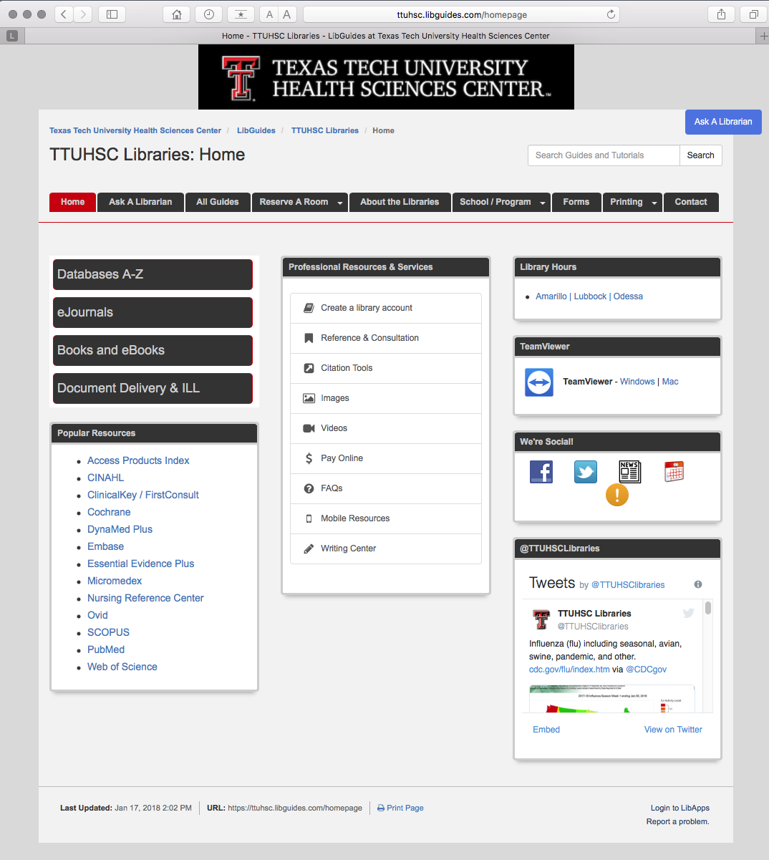
Click All Guides

Slide 9
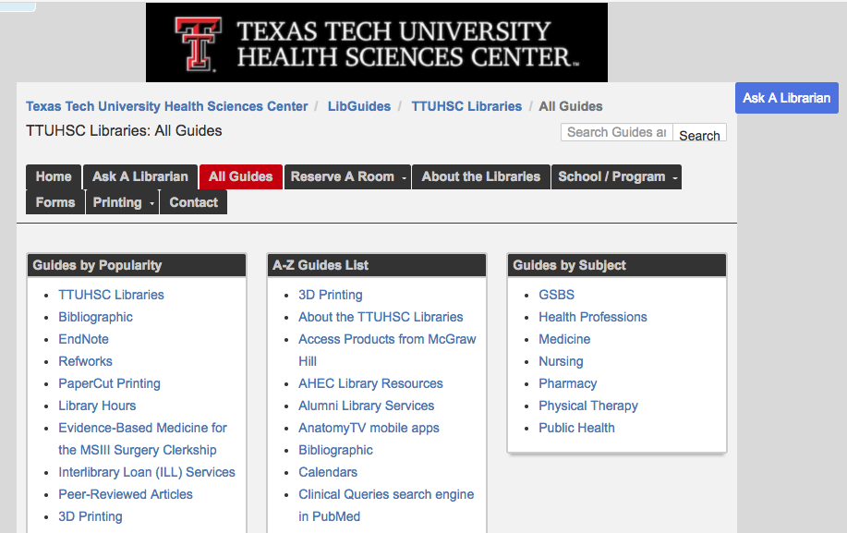
Click EBM for MSIII Surgery Clerkship

Slide 10
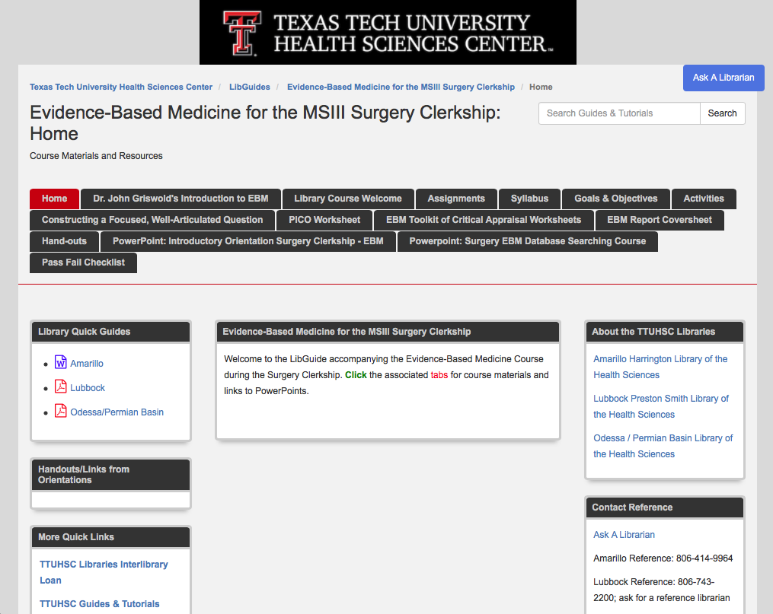

Slide 11
EBM Report a
a
Turned in at end of
Group Discussion Class

Slide 12
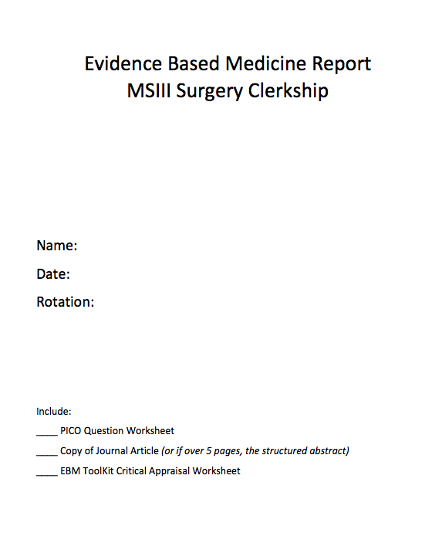
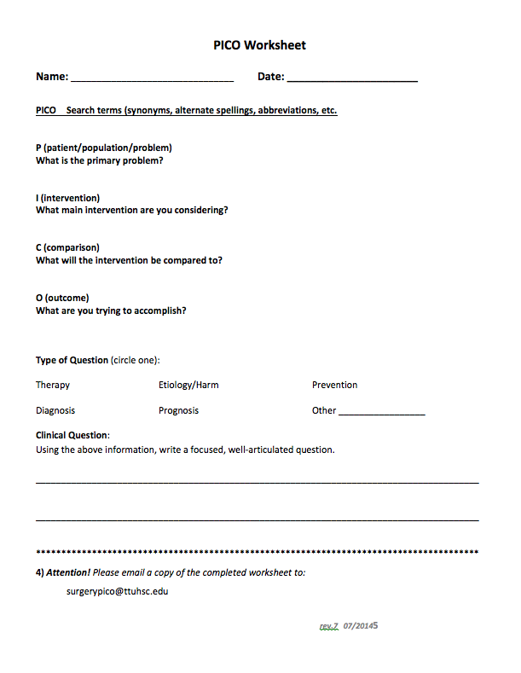
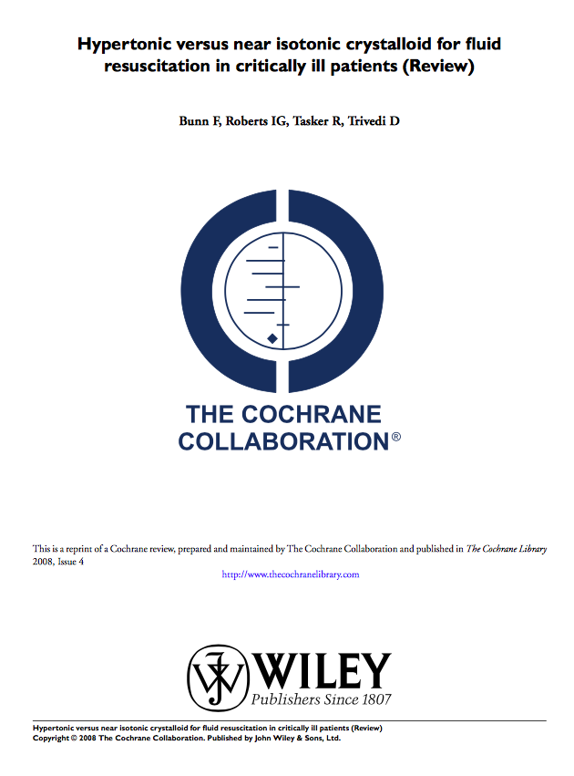
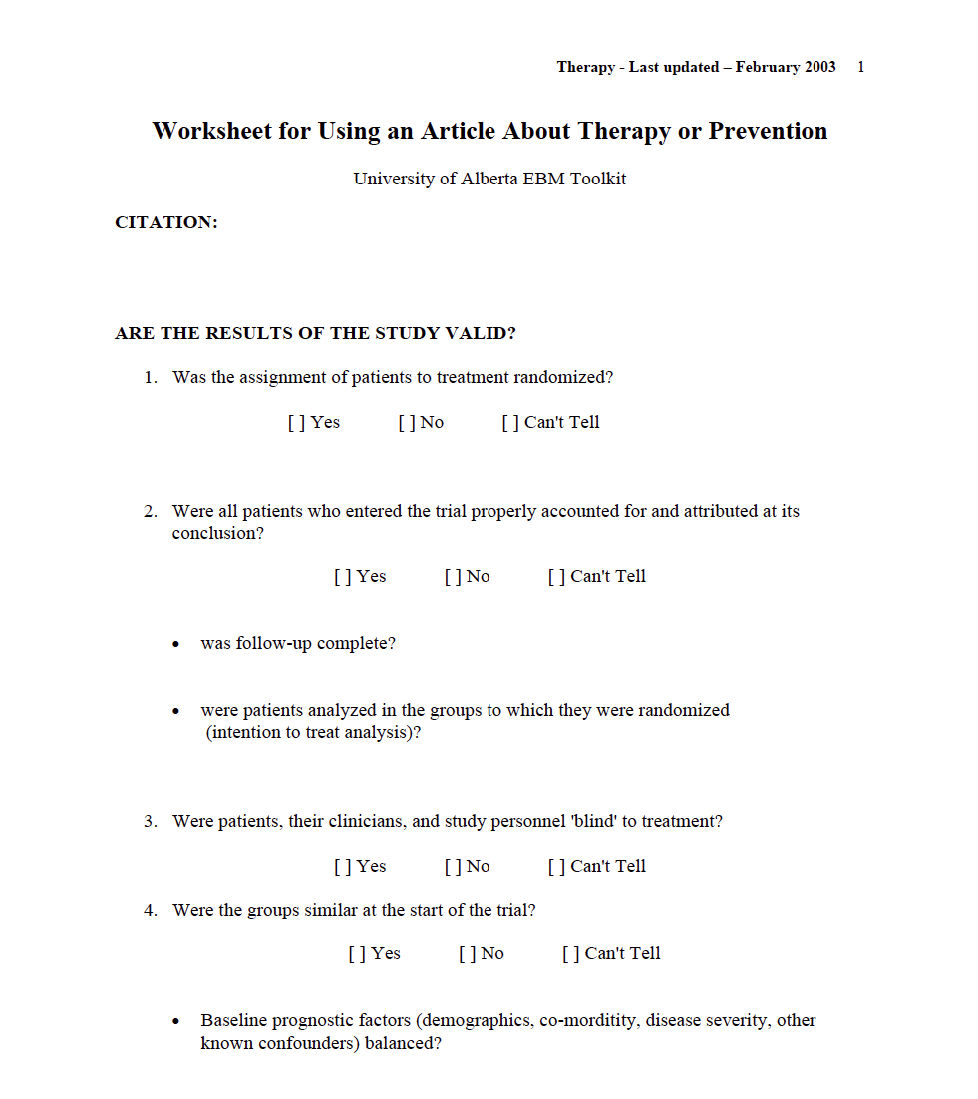
EBM Report
Cover Sheet
PICO Worksheet
Article
Critical Appraisal

Slide 13


Evidence-Based Practice is guided by thoughtful integration
of the best available scientific knowledge with clinical expertise.

Slide 14
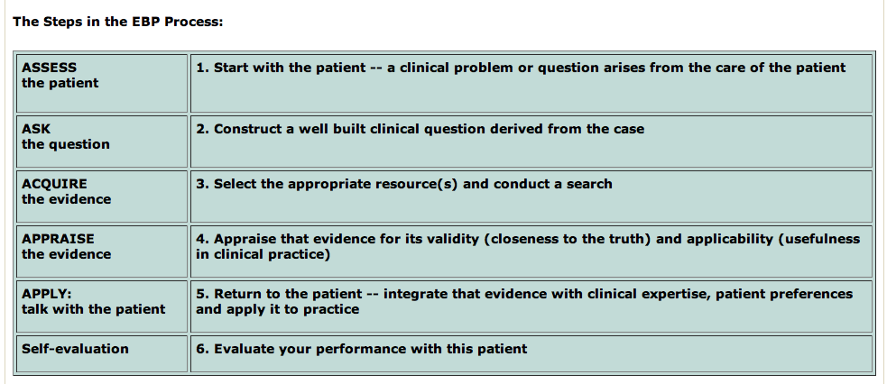
Steps in the Evidence-Based Process are:
(Duke University Medical Center, accessed 8/2/2013)
http://guides.mclibrary.duke.edu/content.php?pid=431451&sid=3529499

Slide 15
1. Assess the patient

Slide 16
How can you recognize and formulate clinical questions as they occur?
pay careful attention to the questions that spontaneously occur to you
questions often are about:
diagnosis therapy etiology prognosis
mentally formulate a PICO question

Slide 17
2. Ask the question

Slide 18
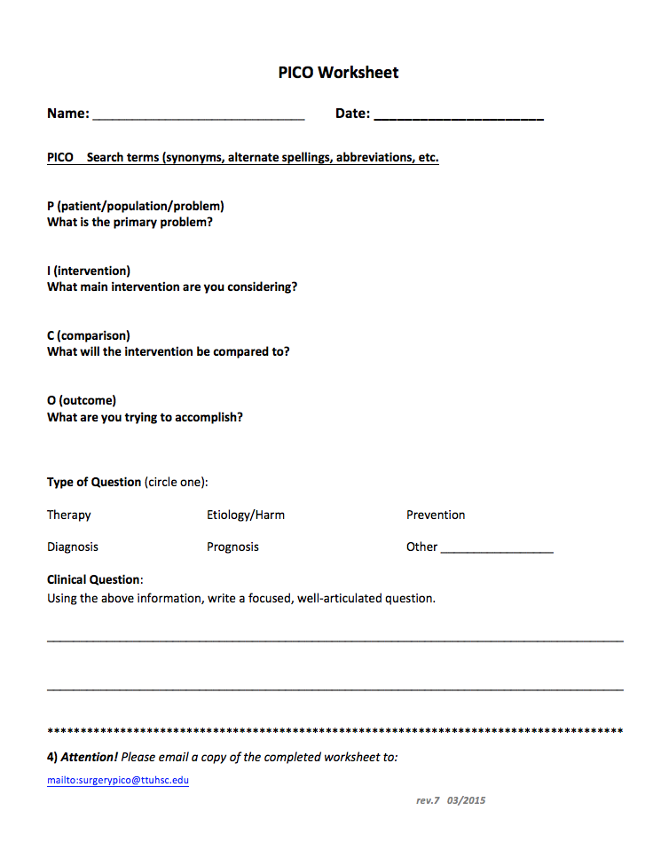
Does influenza vaccination reduce cardiovascular events in adults?
P
adults
I
influenza vaccination
C
non-vaccination
O
reduction of cardiovascular events

Slide 19
What if too many questions arise?
Patients may have several active problems:
  your questions may be too numerous to even ask, let alone answer.
What is the most important issue for this patient now?
Which question, when answered, will help me most?
Select from the many questions
the few questions that are most important to answer right away.
Dawes, Martin. Centre for Evidence-Based Medicine, Learning EBM. Hp. April 9, 2001.
Powerpoint: Practice of Evidence-Based Medicine. University of Oxford.
Available: http://www.cebm.net/learning_ebm.asp. 10 Apr. 2005.

Slide 20
What is the study category?
Determine if your PICO question is about:
diagnosis
therapy
etiology
prognosis

Slide 21
Study Category
Suggested Best Method of Investigation
Therapy
RCT>cohort>case control>case series
Diagnosis
prospective, blind comparison to a gold standard
Etiology/Harm
RCT>cohort>case control>case series
Prognosis
cohort>case control>case series
Prevention
RCT>cohort>case control>case series
Clinical Exam
prospective, blind comparison to a gold standard
Cost
Economic Analysis
Medical Library Association. MLANET, Education, Web-based Learning. Hp. Nov, 2001.
Web-based Courses: EBM and the Medical Librarian.
Available: http://www.mlanet.org/education/web/web_courses.html 10 Apr. 2005.
See hand-out

Slide 22
3. Acquire the evidence
Comparative Effectiveness Research
Cochrane Collaboration Databases

Slide 23
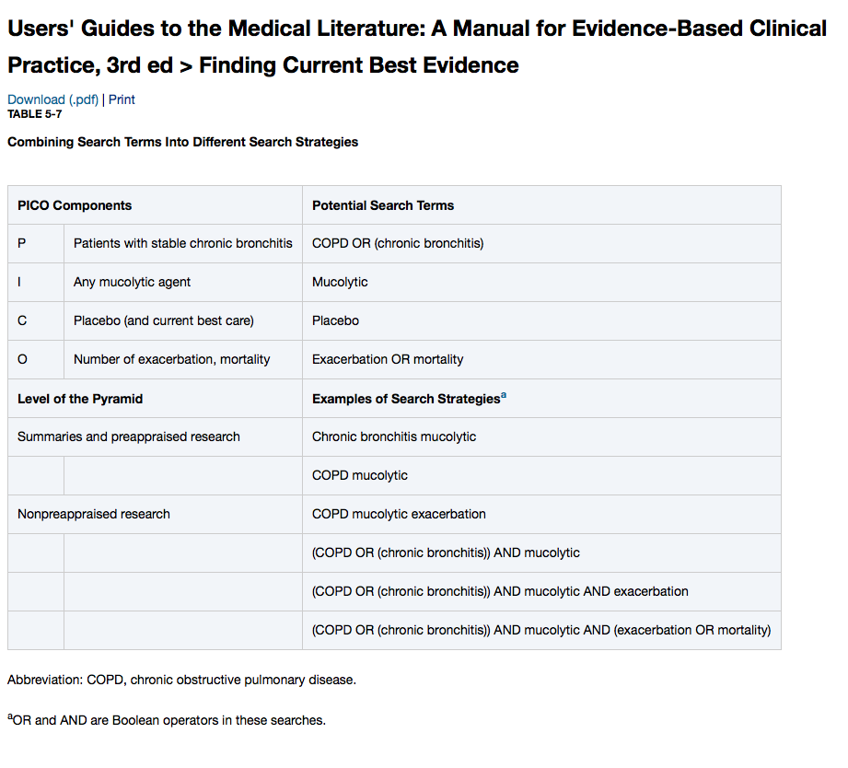
Translate your question into search terms

Slide 24
Searching Process
Search with your first term, look at the number of results
Search your second term, look at the number of results
AND the first two terms together, look at the number of results
Depending on the results, either continue to AND terms together, or filter with language, publication dates

Slide 25
Comparative Effectiveness
Research

Slide 26
Federal Coordinating Council for
Comparative Effectiveness Research
Comparative Effectiveness:
conduct and synthesize research
compares benefits and harms of different interventions/strategies
prevent, diagnose, treat and monitor
health conditions in ‘real world’
Purpose:
improve health outcomes
develop and disseminate evidence-based information
Determine:
which interventions are most effective
for which patients under specific circumstances

Slide 27
https://ttuhsc.libguides.com/homepage
Click PubMed

Slide 28
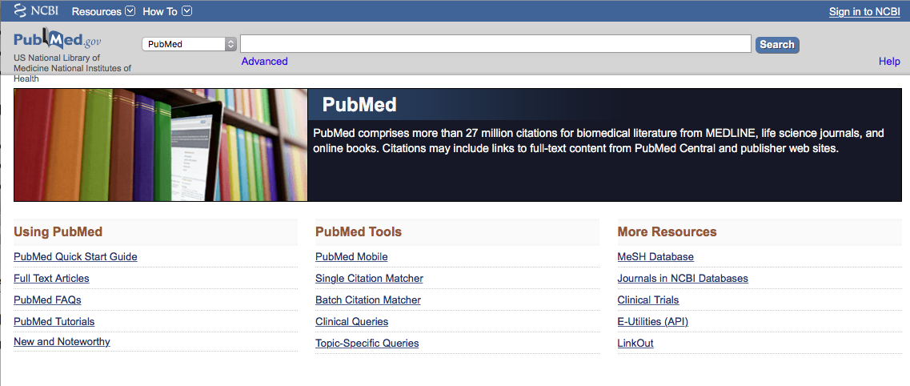
Click Topic-Specific Queries

Slide 29
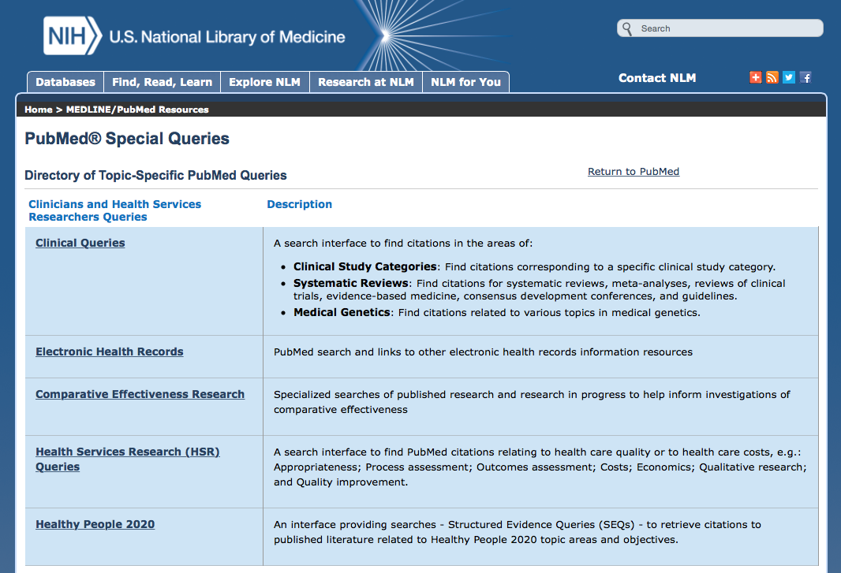
Click

Slide 30
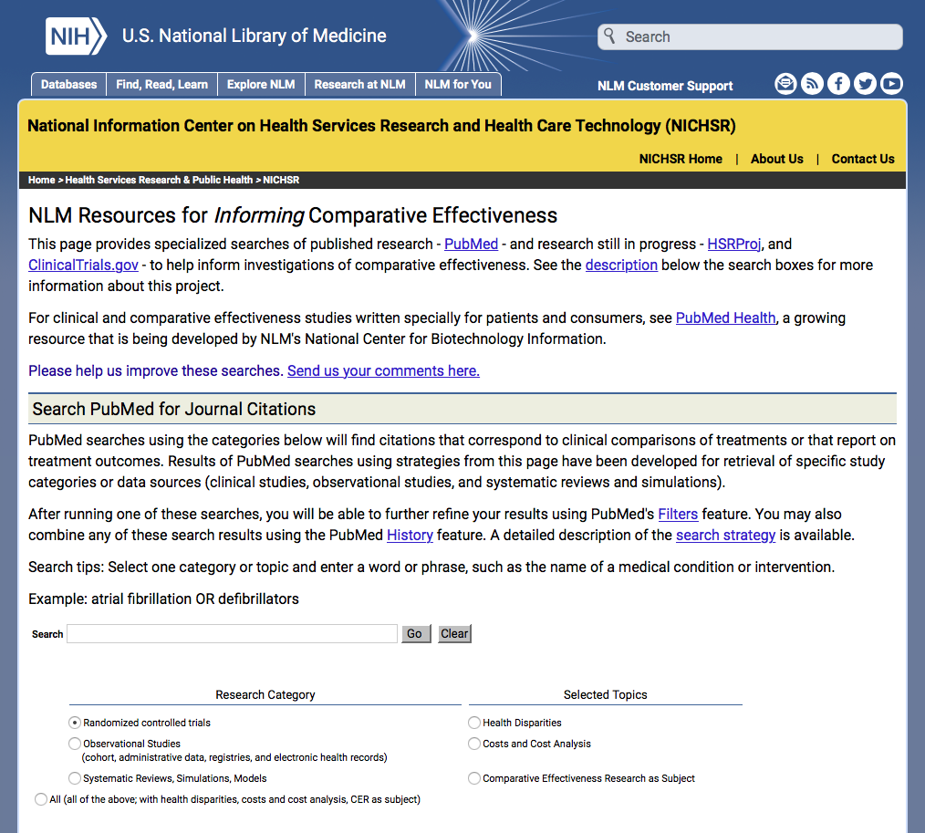
Search PubMed for articles on:
clinical comparisons of treatments
OR
reports of treatment outcomes

Slide 31
Select Research Category:
clinical studies
randomized controlled trials
observational studies
systematic reviews
simulations

Slide 32
Select Topics:
Health Disparities
Costs and Cost Analysis
Comparative Effectiveness Research
as Subject
or

Slide 33
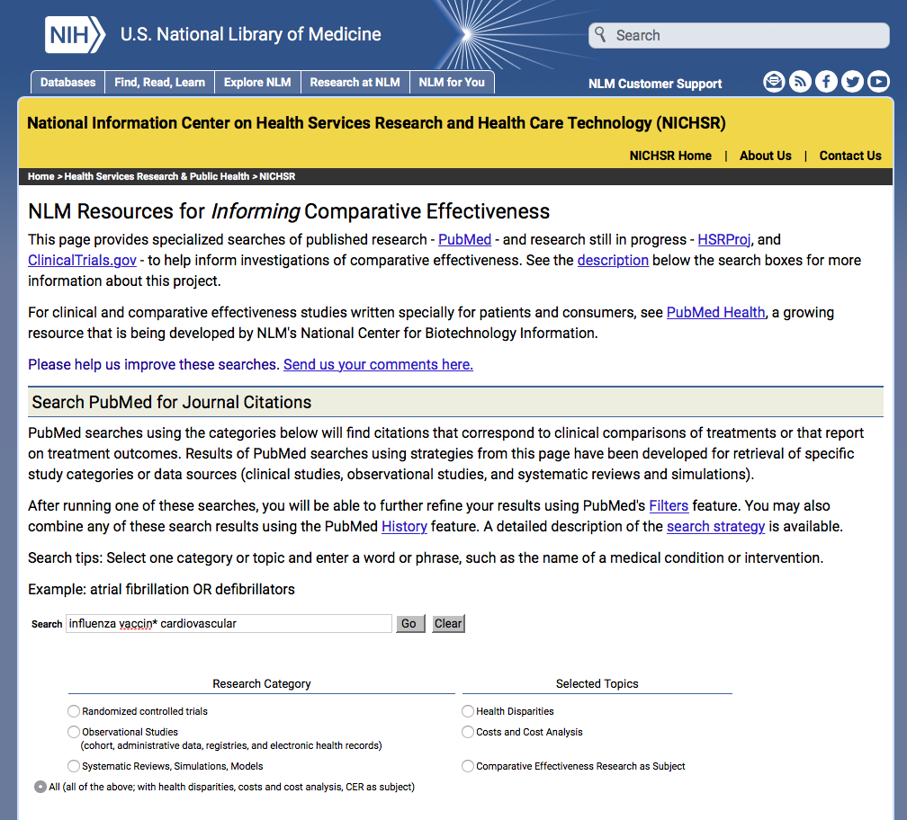
Enter influenza vaccin* cardiovascular
OR
keywords for your PICO search question

Slide 34
Click
Go
Select:
All (of the above; with health disparities, costs and cost analysis, CER as subject)

Slide 35
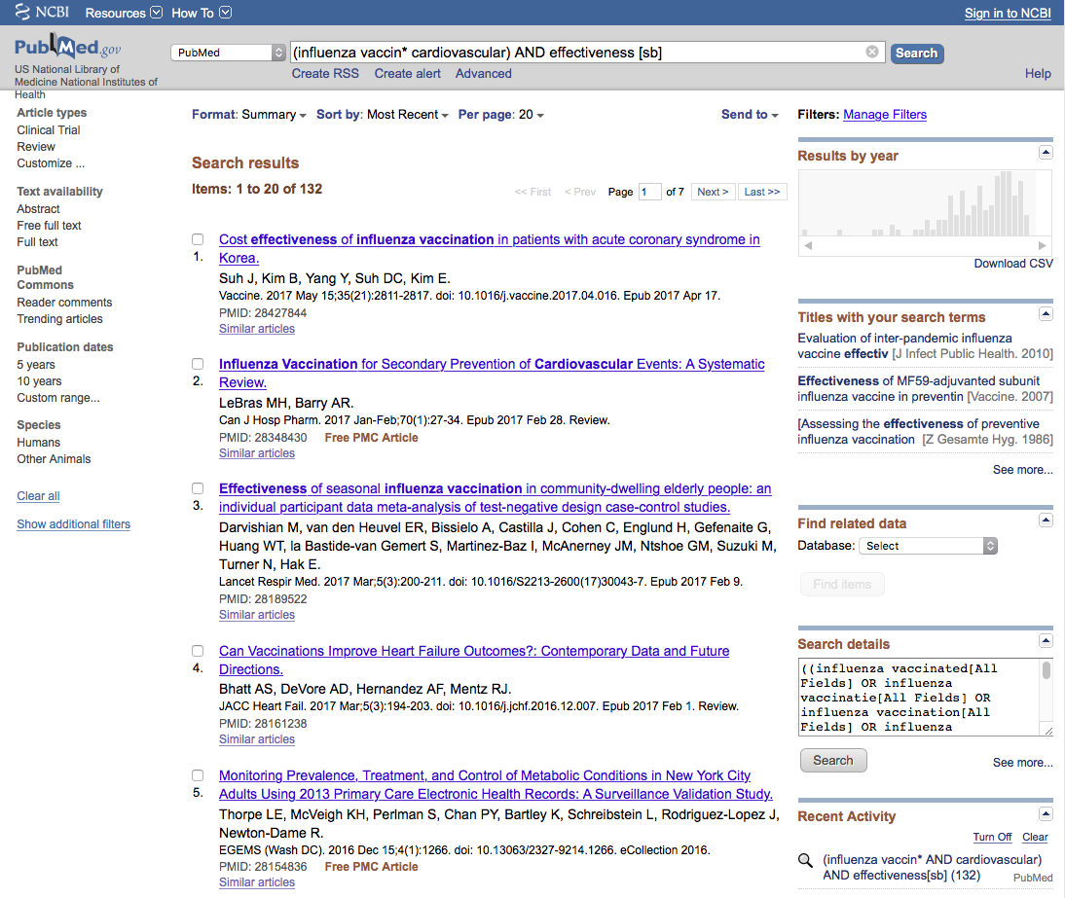
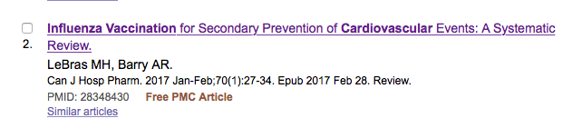
Cl
ick
Results from search example

Slide 36
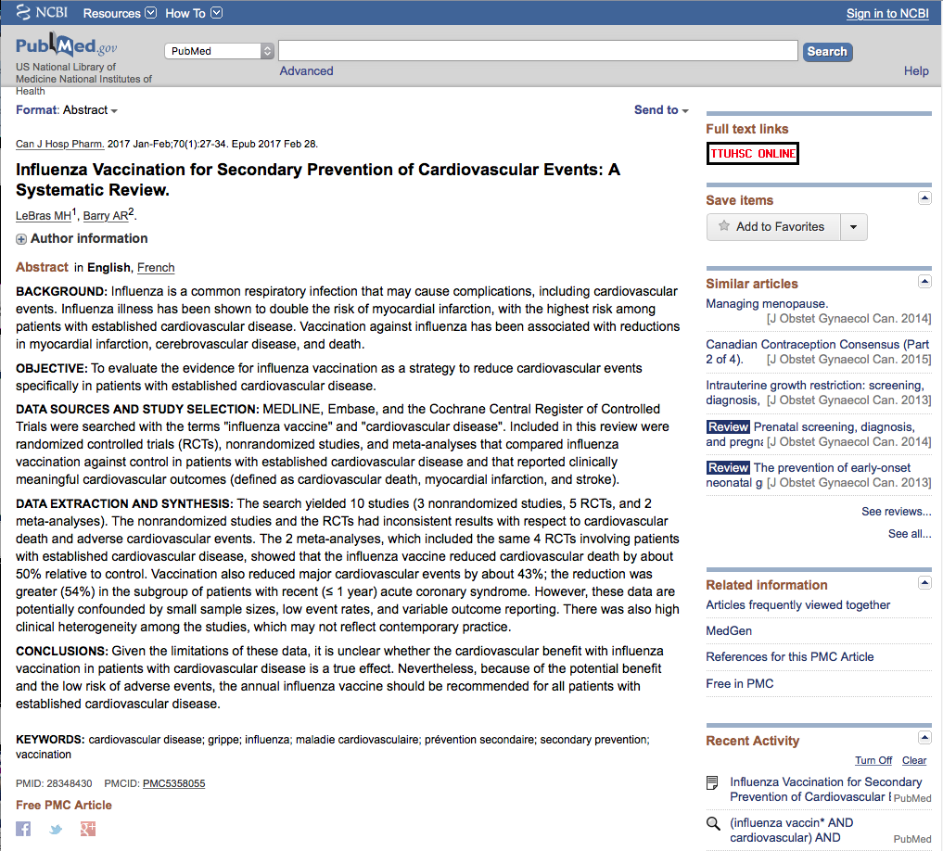
Click TTUHSC ONLINE for full-text

Slide 37
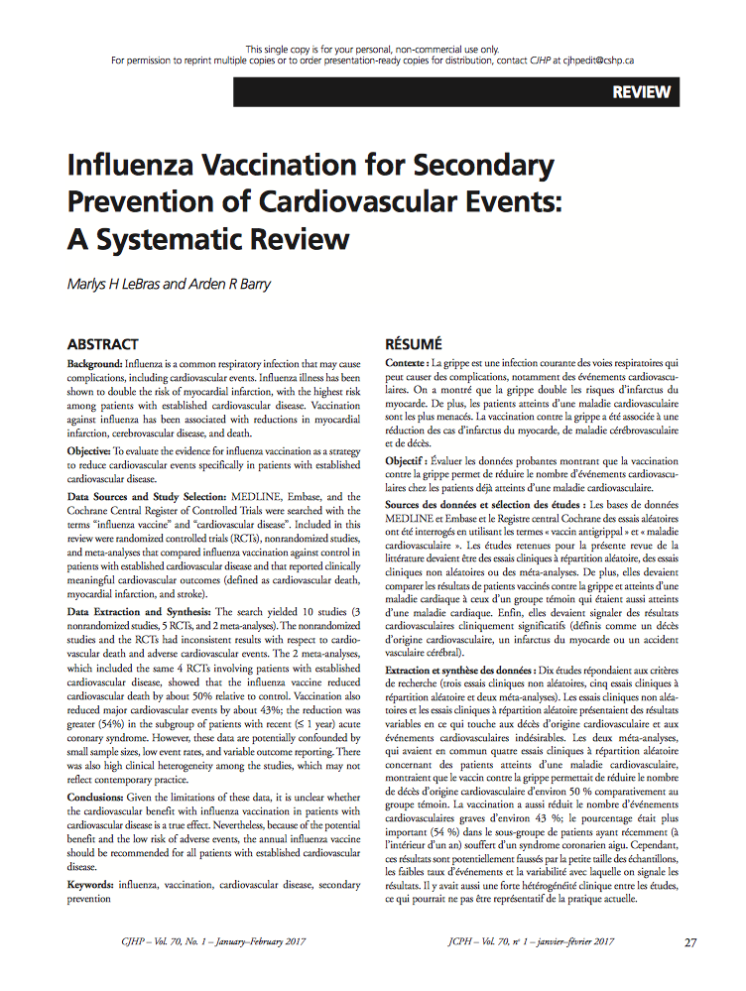
Full-text

Slide 38
Brief Student Discussion of
Search Experience
State your PICO question.
2) What keywords did you use?
3) How many results did you get?

Slide 39
Questions?

Slide 40
EBM and the
Cochrane Databases

Slide 41
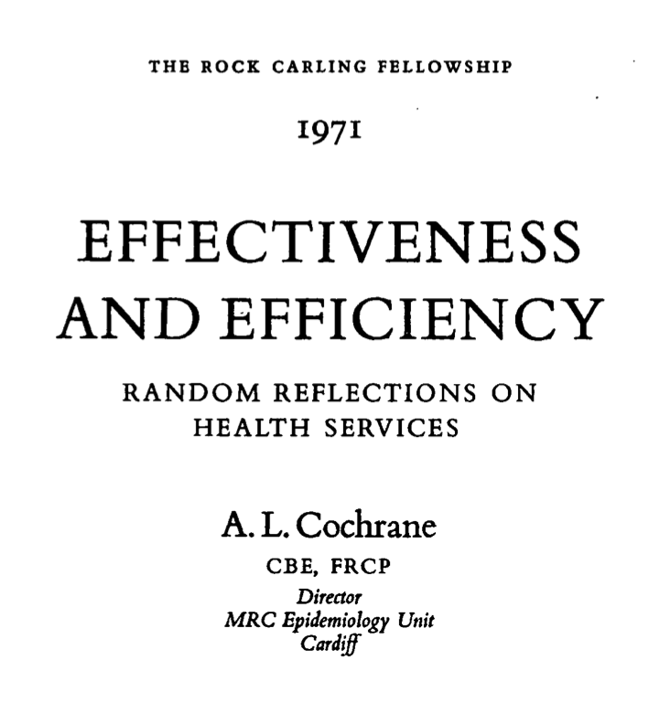
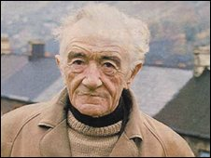

How EBM and the Cochrane Databases Got Started
Archie Cochrane, M.D.
https://www.nuffieldtrust.org.uk/research/
effectiveness-and-efficiency-random-reflections-on-health-services

Slide 42
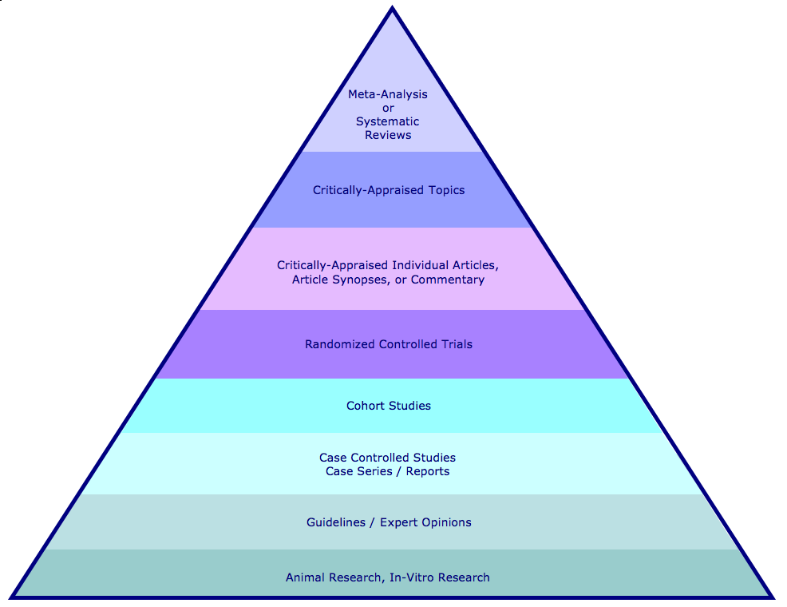
Hierarchy of Evidence and Corresponding Databases
Cochrane Database of Systematic Reviews
ACP Journal Club
Cochrane Database of Randomized Controlled Trials

Slide 43
Cochrane Databases available via the Web

Slide 44

Go to www.thecochranelibrary.com
Partial databases freely available via the web

Slide 45
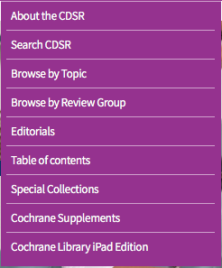
Click:
Cochrane Reviews
Select:
Search CDSR

Slide 46
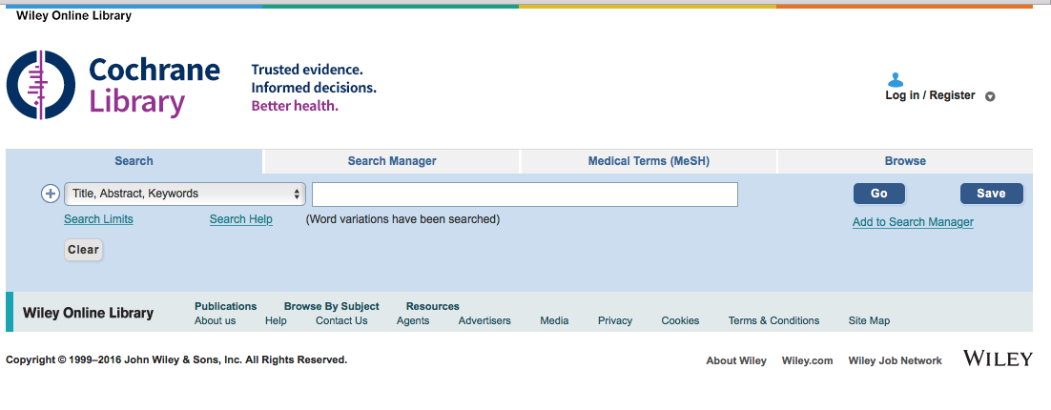
Search menu for:
Cochrane Database of Systematic Reviews

Slide 47

Click Trials for:
Cochrane Central Register of Controlled Trials

Slide 48
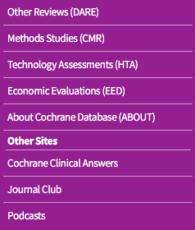
Click More Resources
Scroll to Browse by Topic

Slide 49
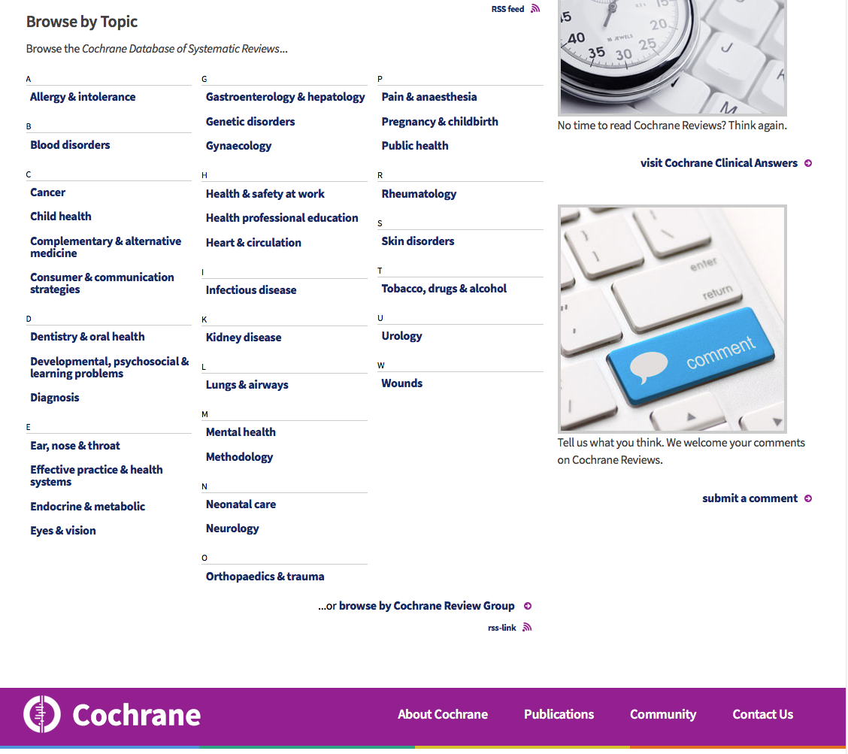
Browse by Topic
or browse by Cochrane Review Group

Slide 50
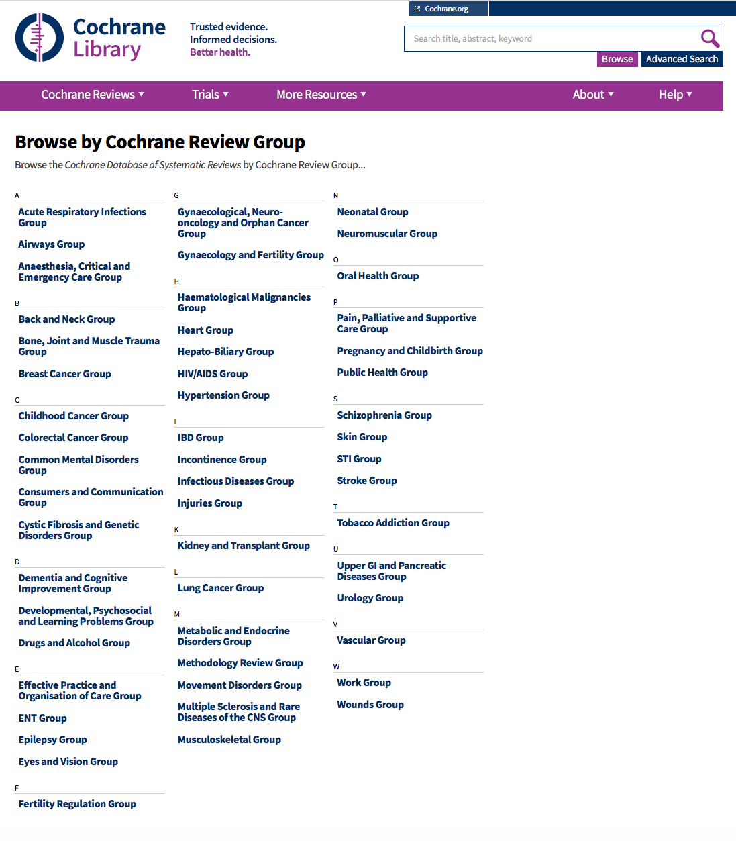
*Reviews prepared by authors who register with a group.
*Groups led by coordinating editor, editorial team, managing editor, and information specialist.
*Groups provide review authors with methodological and editorial support.
*Coordinating editors form Editorial Board for Cochrane Database of Systematic Reviews.
Select Group for list of reviews

Slide 51
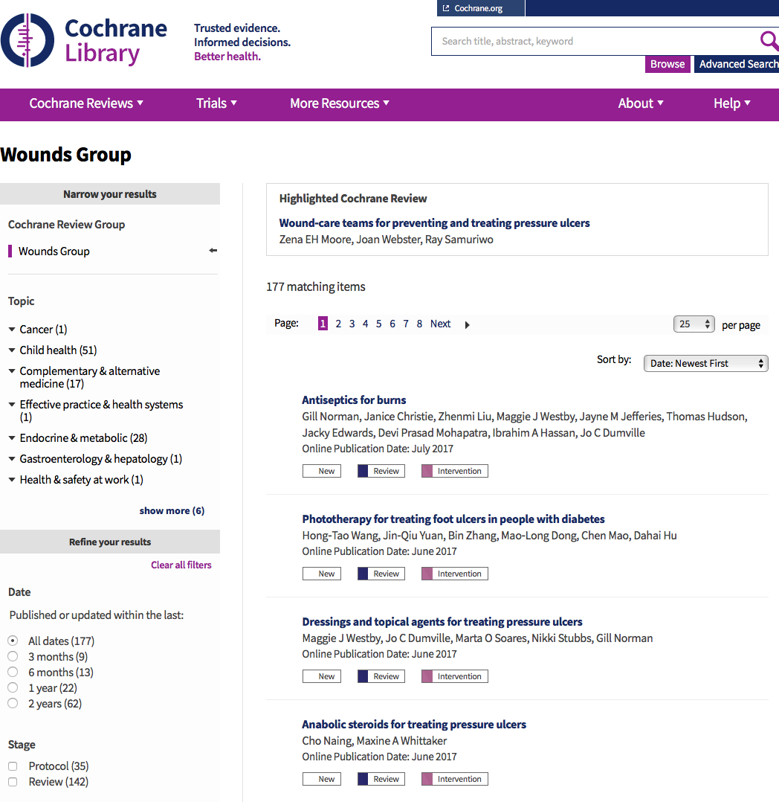
Article table of contents
Click title for structured abstract

Slide 52
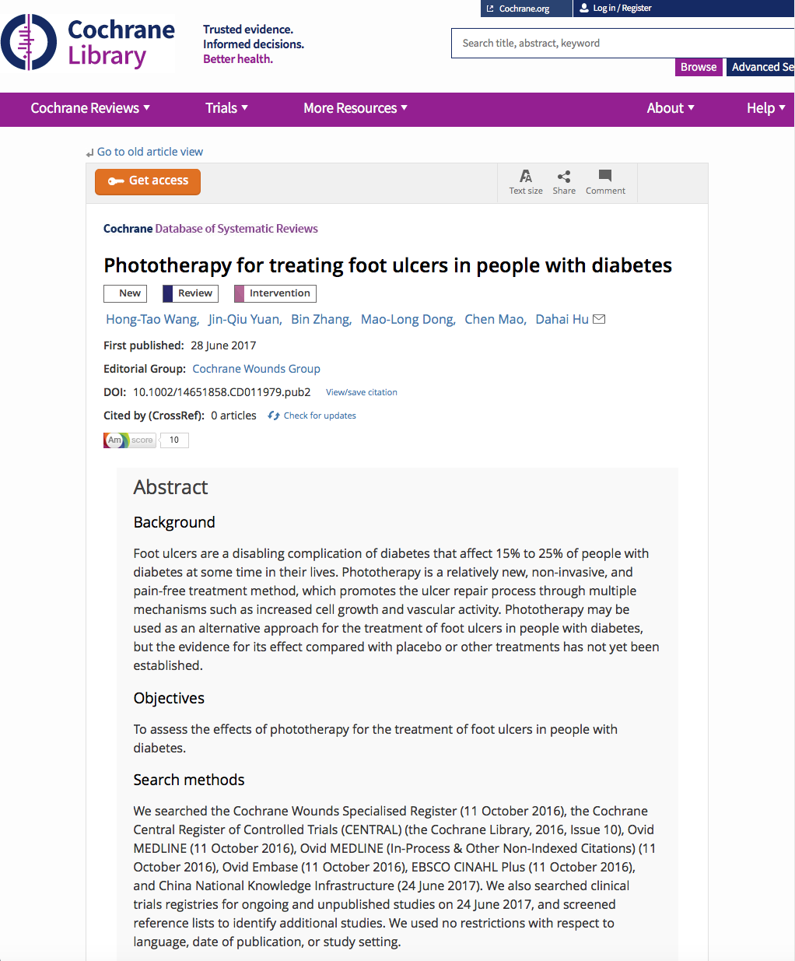
Structured abstract.
Full-text available via OVID.

Slide 53
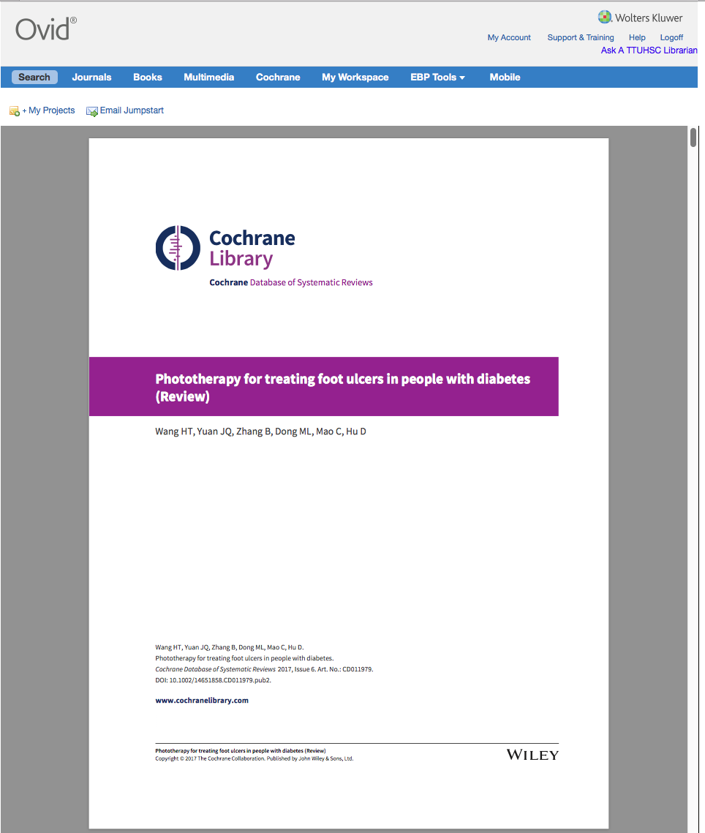
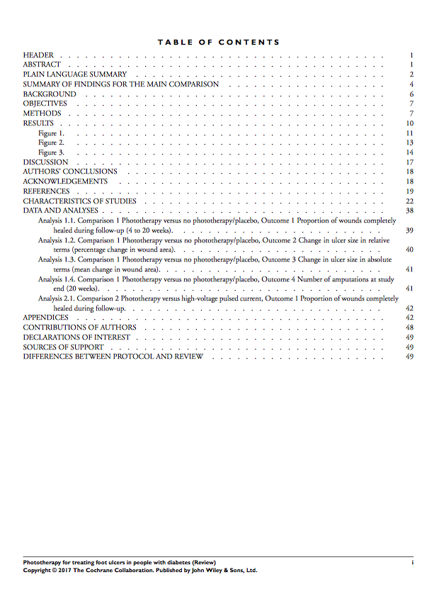
NOTE: Complete Systematic Review is 49 pages long.
Full-text available
via OVID.

Slide 54

Go to www.cochrane.org/evidence
Evidence summaries are free!

Slide 55
ACP Journal Club

Slide 56
ACP Journal Club: The Best New Evidence for Patient Care
online journal:
ACP Journal Club by the American College of Physicians
Screens over 110 top clinical journals:
original studies and systematic reviews
methodologically sound clinically relevant
warrant immediate to important advances in Internal Medicine and sub-specialties
Identifies Study Categories:
Diagnosis Etiology
Prognosis Prevention or treatment
Information summarized in structured abstracts
Objectives Methods
Results Evidence-based conclusions
Brief commentaries by clinical experts:
context methods
clinical application of findings
Use ACP Journal Club to keep current!

Slide 57
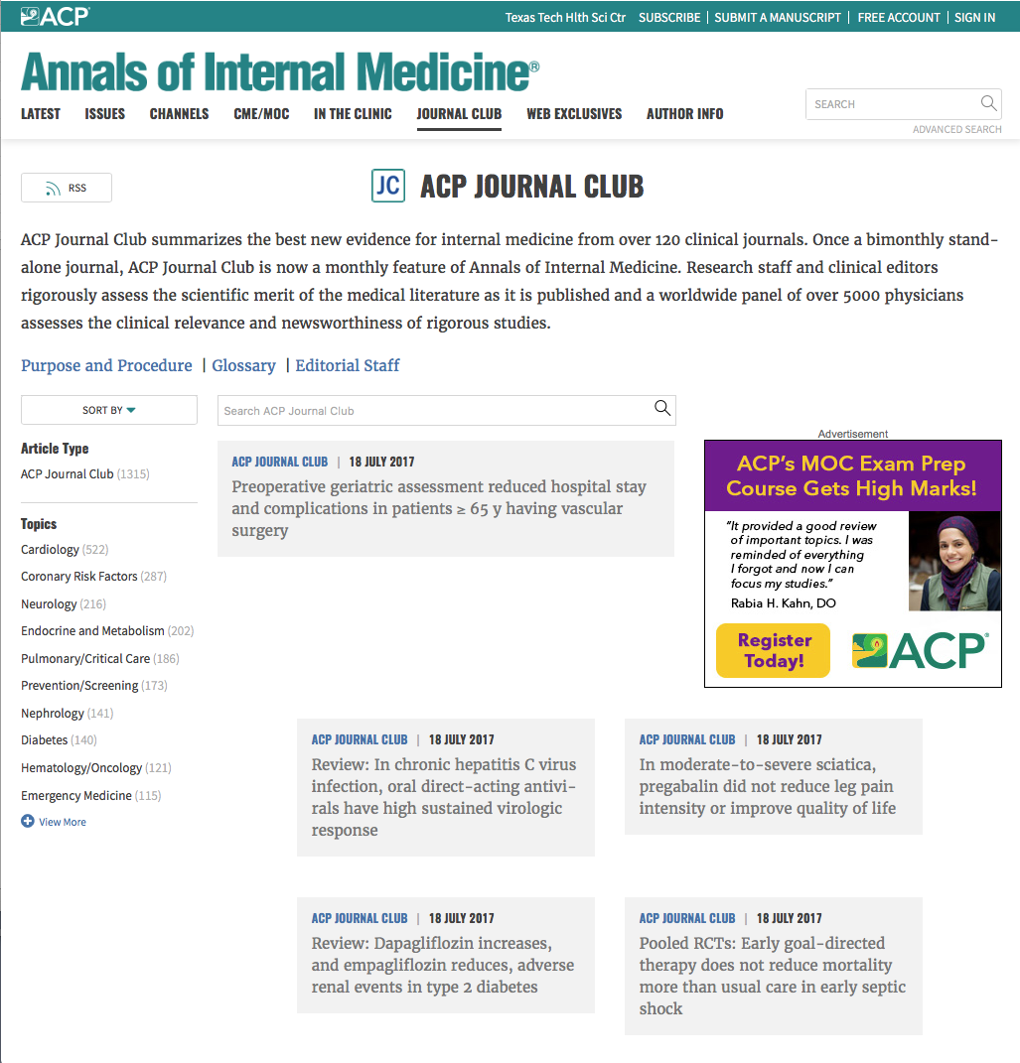
Create Free Account
www.annals.org/aim/journal-club

Slide 58
Cochrane Databases available via the OVID

Slide 59
https://ttuhsc.libguides.com/homepage
Normally, you will access the Cochrane databases here

Slide 60
But for today’s class, please go to the training site at http://ovidsp.ovid.com

Slide 61
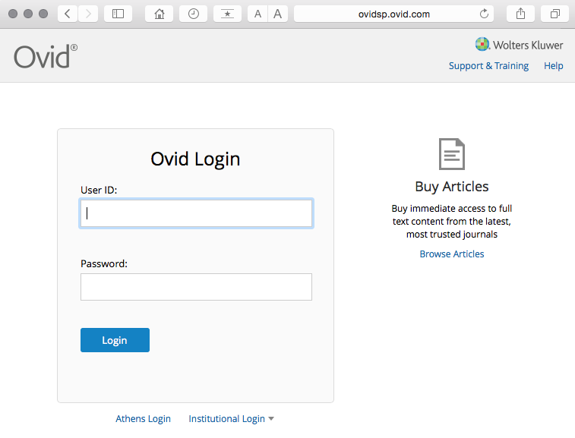
Web Address: http://ovidsp.ovid.com
ID: thsclibtrain
Password: learn99

Slide 62
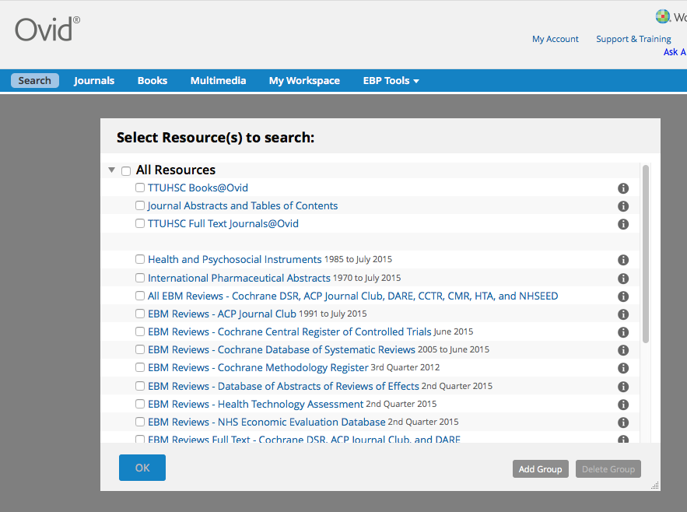
Select ACP Journal Club
✔
Click
OK

Slide 63
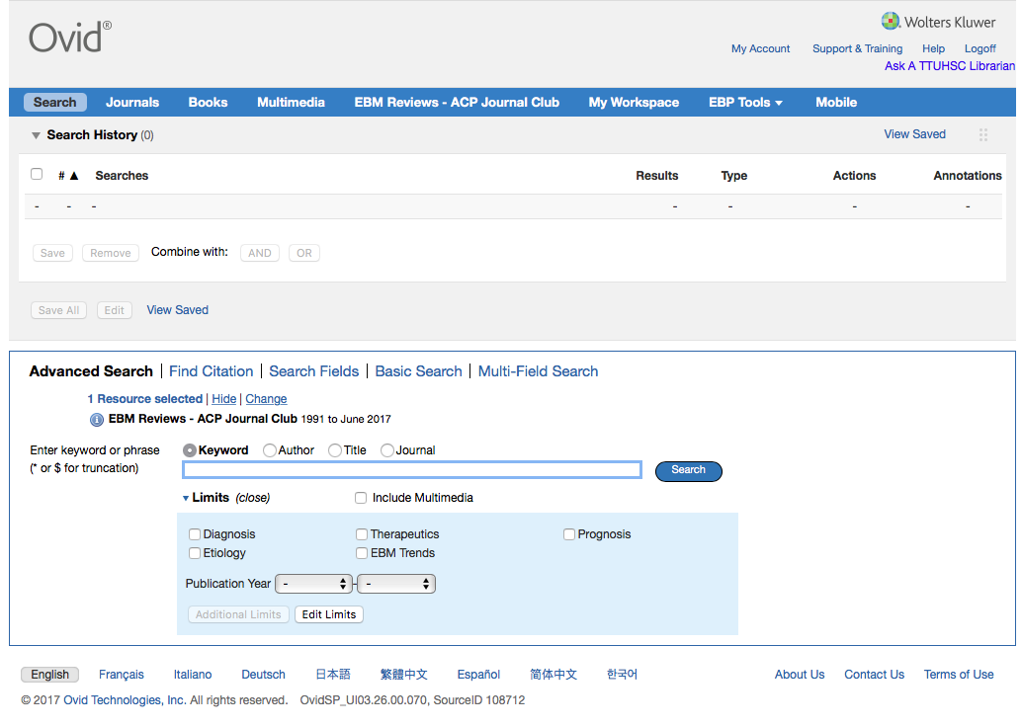
Database(s) selected to search
Home Page

Slide 64
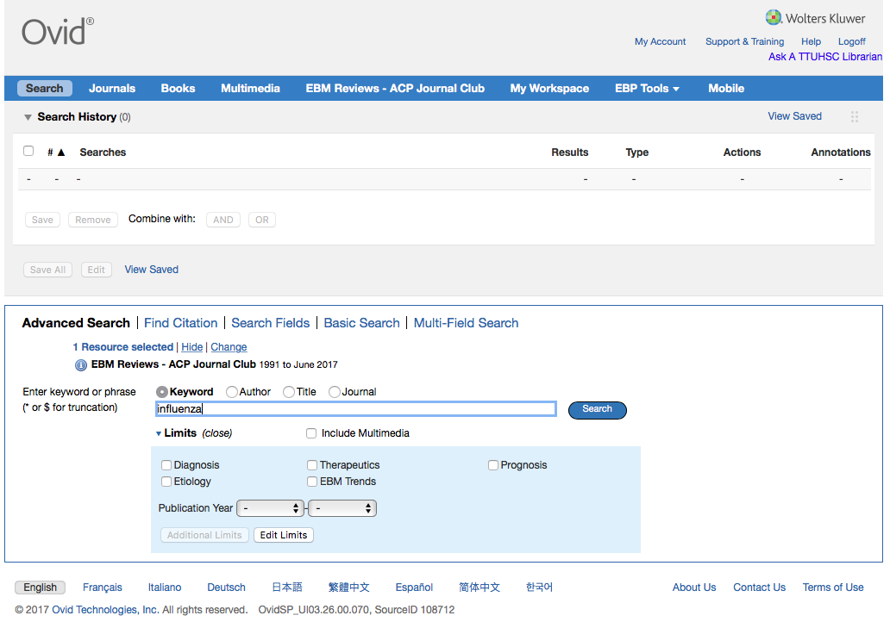
Click Search
Limit the search for words appearing
only in the Title.
Enter
influenza

Slide 65
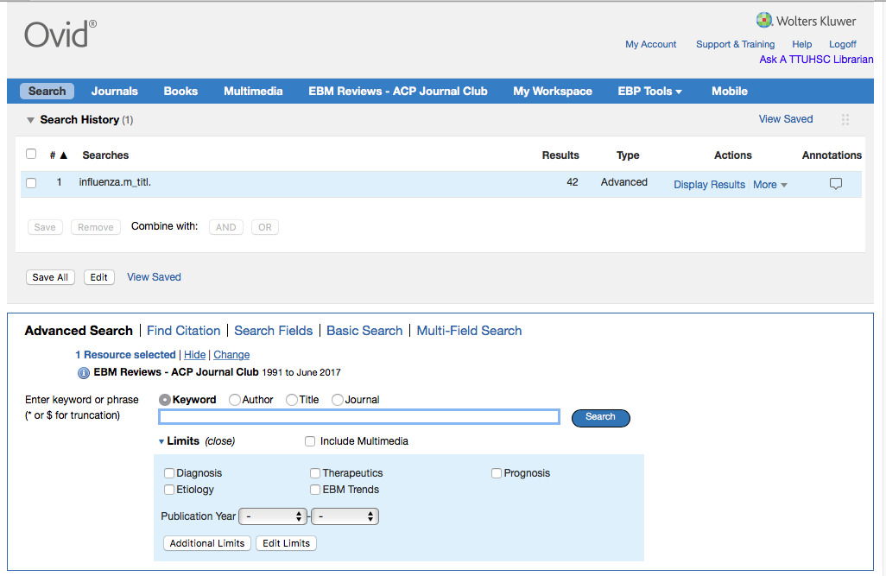
Results in the
first search set.

Slide 66

Click Search
This time, do a keyword search.
Enter
vaccin*

Slide 67
Truncation locates suffix variations in one step!
Enter an asterisk * after the prefix.
vaccine retrieves 89 articles
vaccines retrieves 64 articles
vaccinate retrieves 9 articles
vaccinated retrieves 28 articles
vaccination retrieves 89 articles
vaccin* retrieves 122 articles
vaccin* retrieves all the variants!

Slide 68
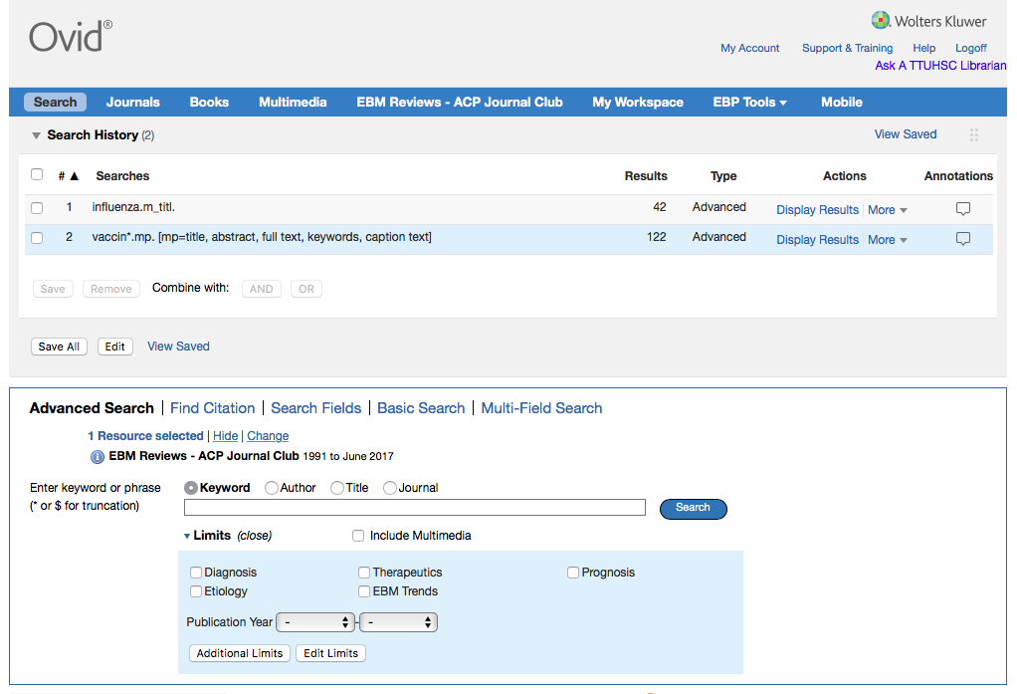
Click And
X
X
AND
Click on the boxes
next to set 1 and set 2.

Slide 69
Boolean Logic - AND
influenza
vaccin*
and

Slide 70
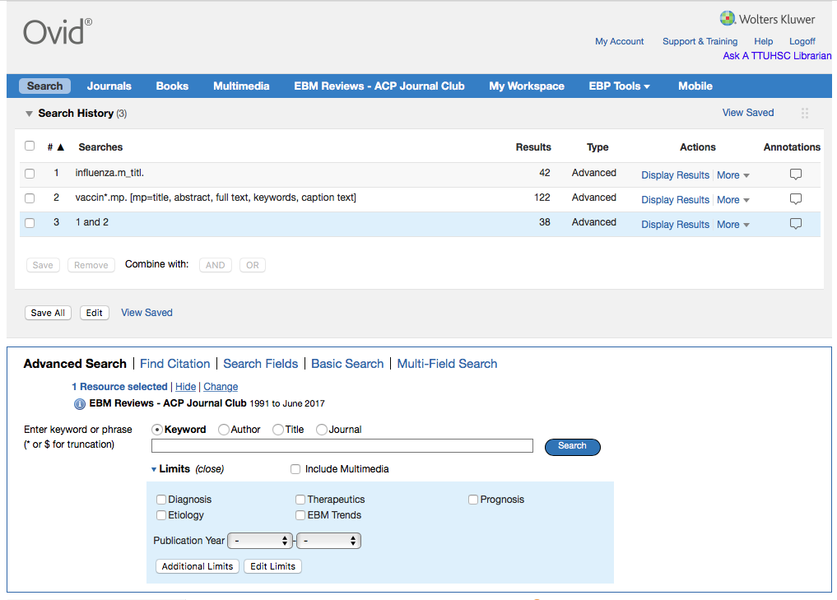
Results of AND combination.
(Note that AND narrows results.)

Slide 71
Other search techniques:
intradermal OR intranasal
Use Boolean OR
Note: “OR” broadens a result
intradermal
or
intranasal

Slide 72
Search Results

Slide 73
Scroll screen to
view results

Slide 74
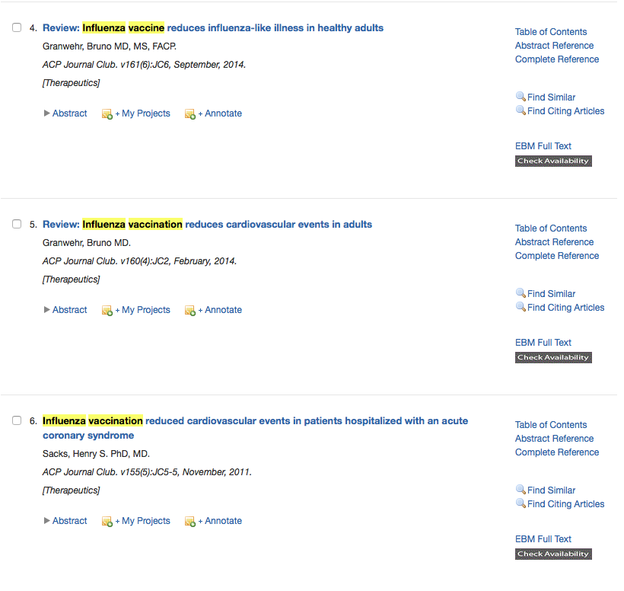
Click EBM Full Text

Slide 75
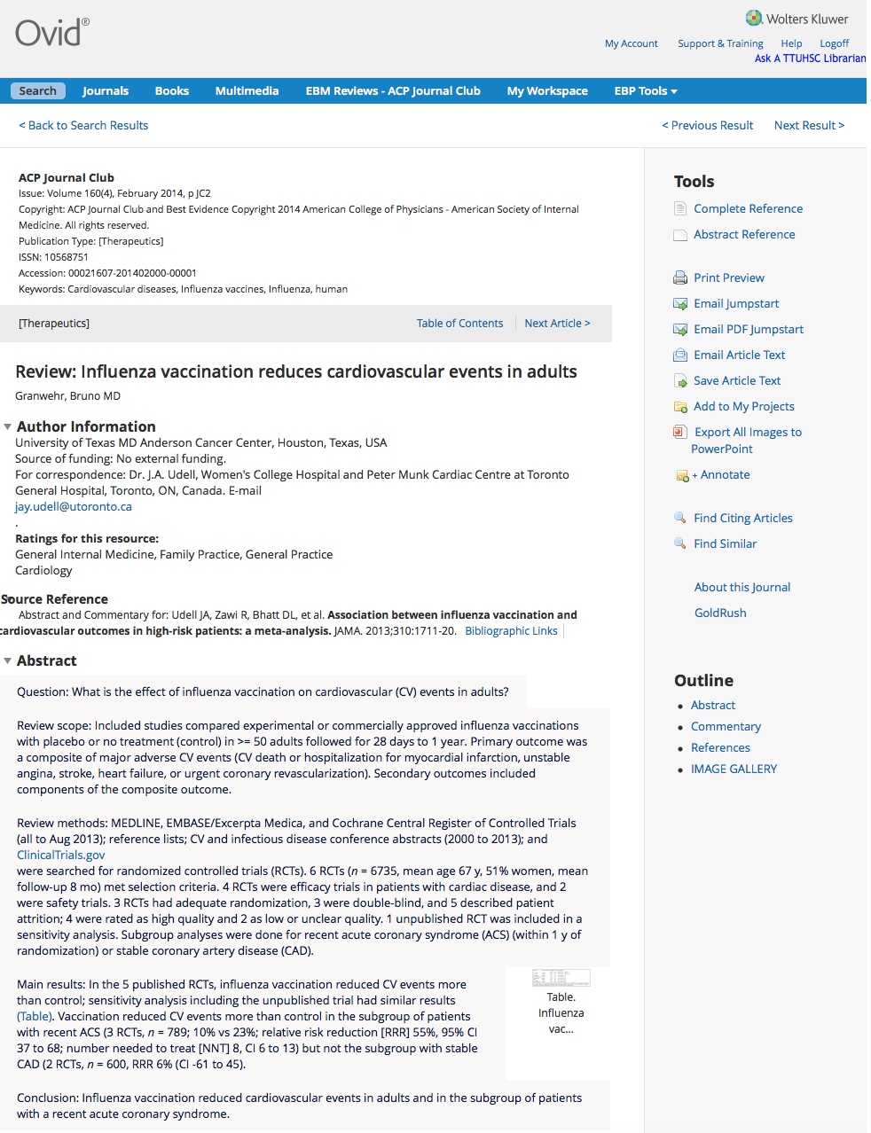
Use GoldRush
under E-journals
on the library homepage to access
full-text
brief
structured abstract

Slide 76
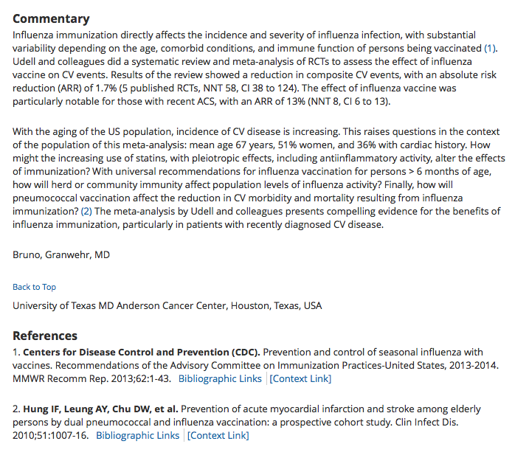
Commentary by clinical experts

Slide 77
Click to start a
new Search
Can Email results

Slide 78
What is a Systematic Review?
Systematic review
reviews a clearly formulated question
uses systematic and explicit methods to:
select and critically appraise relevant research
collect and analyze data from studies included in the review
Meta-analysis
uses statistical techniques in a systematic review to integrate the results
When searching for evidence-based literature
start by trying to locate a meta-analysis or a systematic review
From: Cochrane Collaboration Glossary at http://www.cochrane.org/resources/glossary.htm

Slide 79
Cochrane Central Register of Controlled Trials
3/5th’s from PubMed
relevant records from Embase
other published and unpublished sources
conference proceedings
Cochrane Database of Systematic Reviews
contains systematic review assessments of randomized trials combines data to produce a more statistically reliable result
screens over 800 international journals
structured abstracts created by the Cochrane Collaboration Groups
contains appraised and synthesized evidence

Slide 80
Change
Click

Slide 81
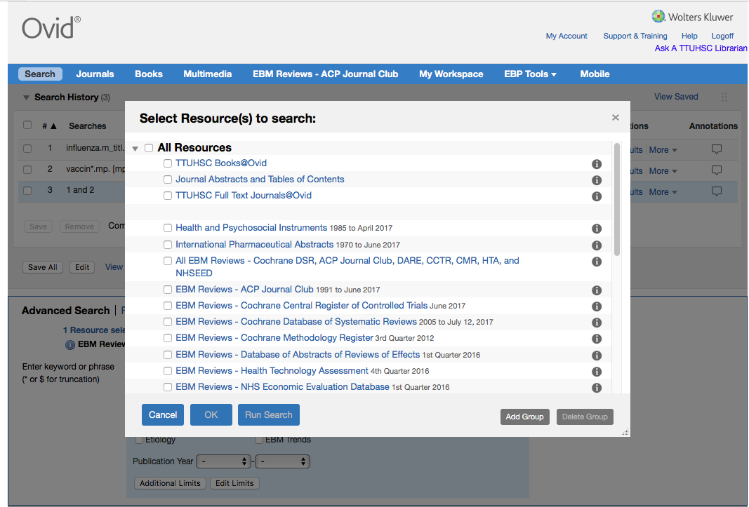
Select
Cochrane Central Register of Controlled Trials
and
Cochrane Database of Systematic Reviews
✔
✔
Click
Run Search

Slide 82
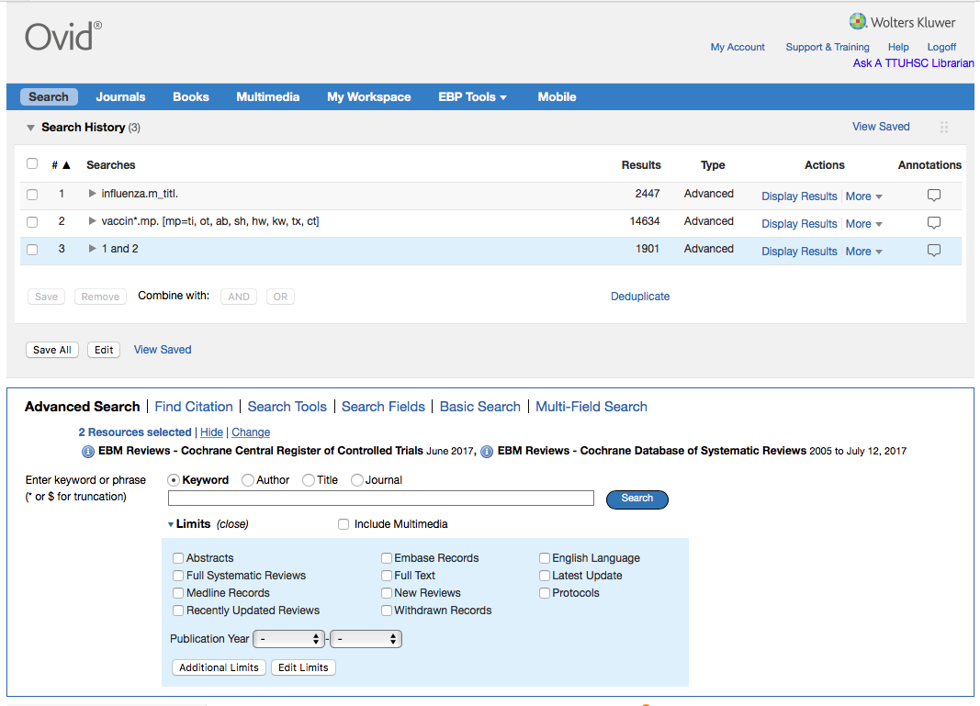
Scroll screen to
view results

Slide 83
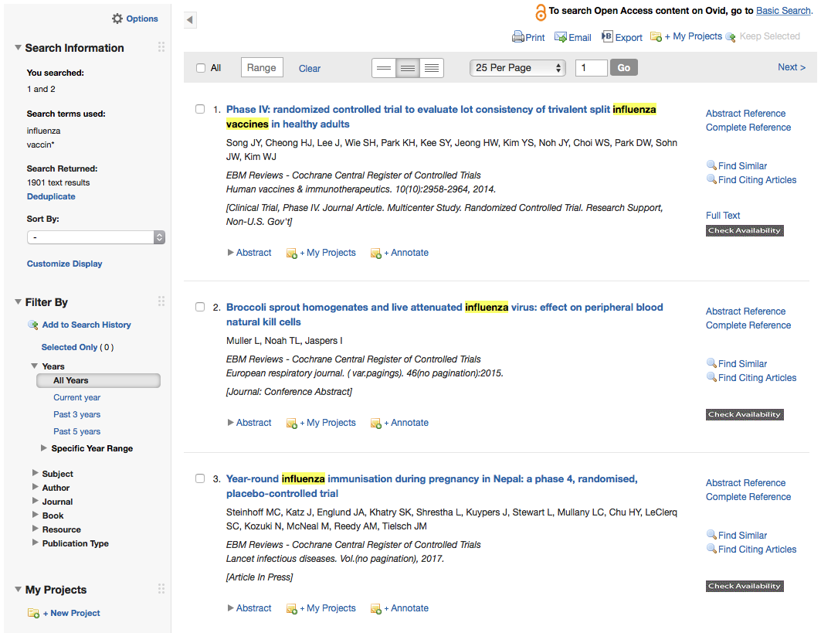
NOTE: Results from Cochrane Central Register of Controlled Trials are listed first.

Slide 84
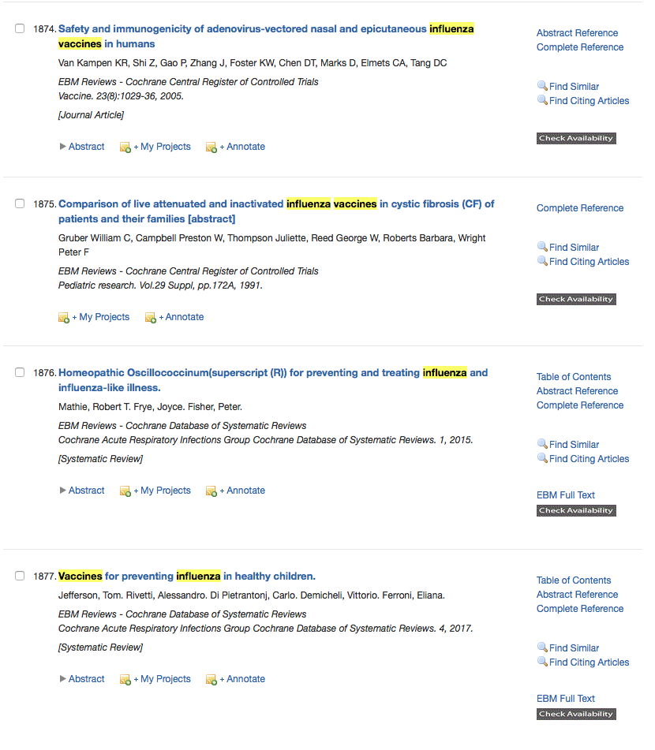
To view results from the
A
aCochrane Database of Systematic Reviews,
A
ayou must go to article number 1876
A
ain this search example.

Slide 85
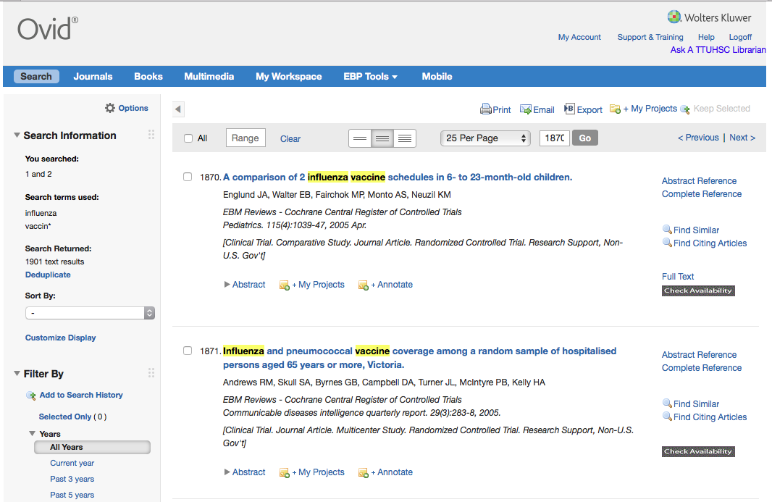
Click Search

Slide 86
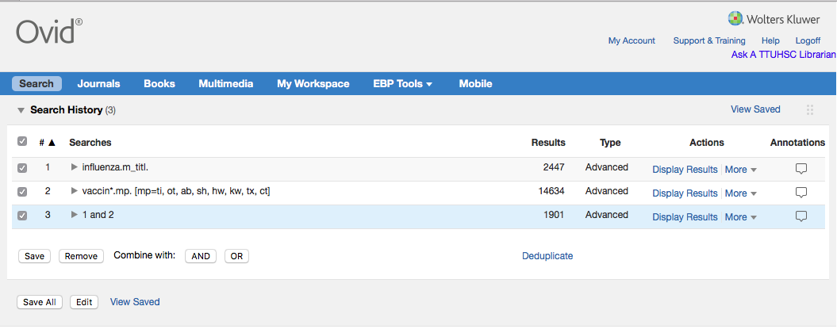
Click box
to select all
✔
Remove
Click

Slide 87
4. Appraise the evidence

Slide 88

What is Critical Appraisal?
“The process of assessing and interpreting
evidence by systematically considering its
validity, results, and relevance.”
The Cochrane Collaboration Glossary http://www.cochrane.org/glossary/5#letterc

Slide 89

“Critical appraisal is the first step in transferring research knowledge into practice.”
Das, K., Malick, S., & Khan, K. (2008). Tips for teaching evidence-based medicine in a clinical setting: lessons from adult learning theory. part one. Journal of the Royal Society of Medicine, 101(10), 493-500. doi: 10.1258/jrsm.2008.080712 web address: http://www.ncbi.nlm.nih.gov/pmc/articles/PMC2586873/?tool=pubmed

Slide 90

Purpose of Critical Appraisal
“Randomized controlled trials and systematic reviews are the highest levels of evidence but they are not automatically of good quality and should always be appraised critically.”
Das, K., Malick, S., & Khan, K. (2008). Tips for teaching evidence-based medicine in a clinical setting: lessons from adult learning theory. part one. Journal of the Royal Society of Medicine, 101(10), 493-500. doi: 10.1258/jrsm.2008.080712 web address: http://www.ncbi.nlm.nih.gov/pmc/articles/PMC2586873/?tool=pubmed
A Consultation of Surgeons, old negative no. 62-116 [engraving]. [Bethesda, MD., United States of America]: Images from the History of Medicine, U.S. National Library of Medicine, National Institutes of Health; accessed June 12, 2012. The National Library of Medicine believes this item to be in the public domain. print: 11 x 16 cm.

Slide 91

http://www.ebm.med.ualberta.ca/

Slide 92


Mouse over
Domains,
Study Category,
and select
Worksheet.
Look at Calculations.
Then look at
Systematic Review.

Slide 93
Critical Appraisal Worksheet

Slide 94



Critical Appraisal Worksheet Example

Slide 95
PICO Question Search

Slide 96

Searching Tips
1) Select both the Cochrane Central of Controlled Trials and the Cochrane Database of Systematic Reviews
2) Enter different concepts separately then combine as below:
X
X
AND
3) The truncation symbol is the asterisk *
4) Narrow results by searching for words only in titles.

Slide 97
5. Apply the evidence

Slide 98
2) Group Discussion “EBM Journal Club” with Dr. Griswold
Turn in your EBM Report!

Slide 99
Have Questions?

Slide 100
https://ttuhsc.libguides.com/homepage
Ask-A-Librarian
Click All Guides for tutorials

Slide 101
Evaluation

Slide 102




Instructors:
Peggy Edwards
Margaret Vugrin
Micah Walsleben

