Slide 1
Welcome
Searching for
Evidence Based Medicine
Literature
Peggy Edwards, AMLS
TTUHSC - Preston Smith Library
Lubbock, Texas 79430
Feb 2014

Slide 2
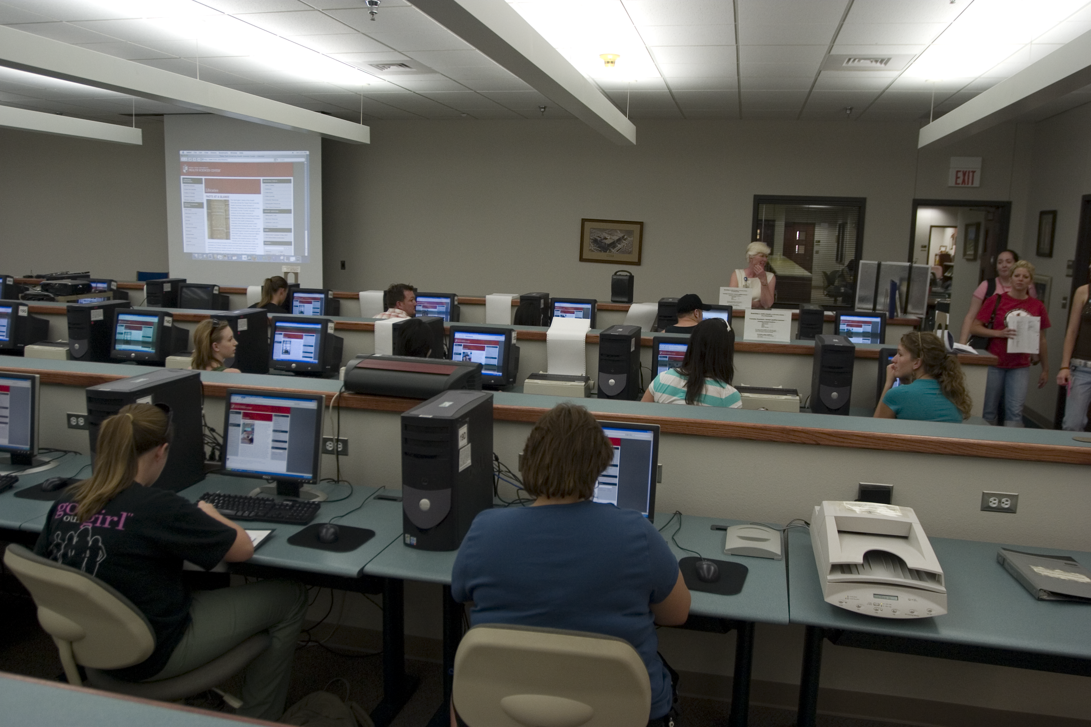
Session 1A & 1B - Mandatory Attendance J
  in the Learning Resources Center
  how to search the Cochrane EBM Databases
  PowerPoint lecture and hands-on follow along
  formulate your PICO question
  search for article(s) that answer your question
  one-on-one searching guidance with assigned librarian

Slide 3
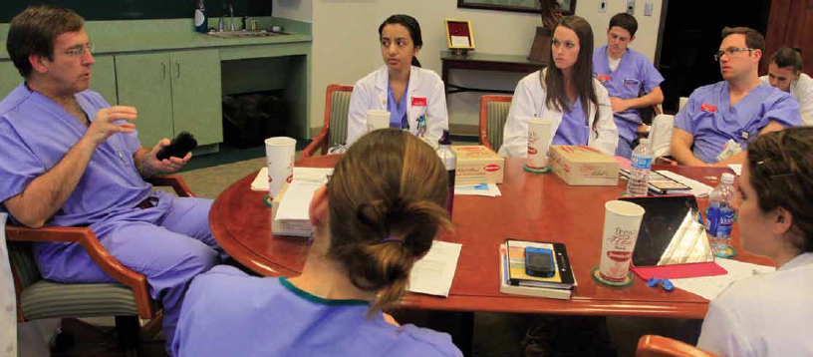
Group Discussion “EBM Journal Club” with Dr. Griswold
  in the Library’s Rare Books Conference Room
  state your focused, well-articulated PICO question
  describe databases searched and search strategy
  state author, article title, journal, and date published
  discuss study design, validity and reliability, research findings
  commentary and q & a from Dr. Griswold
  turn in your EBM report including PICO question worksheet, critical appraisal worksheet, copy of the article, and cover sheet
  casual atmosphere and lunch courtesy of Dr. Griswold!

Slide 4
What is Evidence-Based Medicine?
The goal of (EBM) is to be aware of the evidence on
which one’s practice is based, the soundness of the
evidence, and the strength of inference the evidence
permits. The strategy employed requires a clear
delineation of the relevant questions(s); a thorough
search of the literature relating to the questions;
a critical appraisal of the evidence, and its application
to the clinical situation; and a balanced application of
the conclusions to the clinical problem.a
a
Preface (2002). In Guyatt GH, Rennie D. (Eds.),
User’s Guides to the Medical Literature (pp. xiv). Chicago: AMA Press.

Slide 5
The Exponential Growth of the Literature
PubMed "indexed journals represent an increasingly smaller
portion of the broader universe of medical information.
NLM (National Library of Medicine) estimates that currently
about 14,000 biomedical journals are published and it selects
only about one-quarter of new submissions for indexing based
on quality and relevance to biomedical topics. These biomedical
journals, in turn, represent only a small fraction of the growing
array of information sources on the Web."
Druss, BG, et al. Growth and decentralization of the medical literature:
implications of evidence-based medicine. JMLA. 2005;93(4):499-501

Slide 6
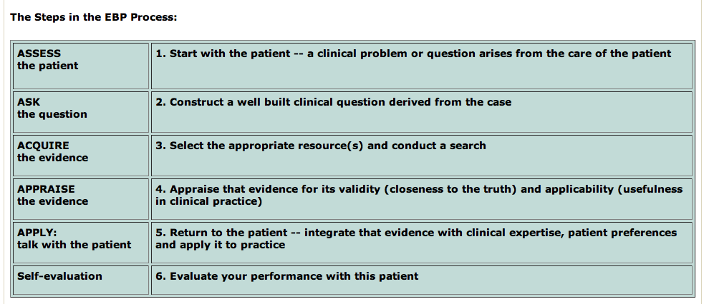
Steps in the Evidence-Based Process are:
(Duke University Medical Center, accessed 8/2/2013)
http://guides.mclibrary.duke.edu/content.php?pid=431451&sid=3529499

Slide 7
1. Assess the patient

Slide 8
How can you recognize and formulate clinical questions as they occur?
pay careful attention to the questions that spontaneously occur to you.
listen for the question behind the question:
What can I use for a sprain?a
    might become
    Is a topical NSAID like aspirin more effective than paracetamol at enabling resumption of sports activities at 1 week?
Dawes, Martin. Centre for Evidence-Based Medicine, Learning EBM. Hp. April 9, 2001.
Powerpoint: Practice of Evidence-Based Medicine. University of Oxford.
Available: http://www.cebm.net/learning_ebm.asp. 10 Apr. 2005.

Slide 9
2. Ask the question

Slide 10
What if too many questions arise?
Patients may have several active problems:
  possible questions about diagnosis, prognosis, therapy for each problem
  your questions may be too numerous to even ask, let alone answer.
What is the most important issue for this patient now?
Which question, when answered, will help me most?
Select from the many questions
the few questions that are most important to answer right away.
Dawes, Martin. Centre for Evidence-Based Medicine, Learning EBM. Hp. April 9, 2001.
Powerpoint: Practice of Evidence-Based Medicine. University of Oxford.
Available: http://www.cebm.net/learning_ebm.asp. 10 Apr. 2005.

Slide 11
Clinical Questions and Study Design
“There are 5 fundamental types of clinical questions:
1) therapy
2) harm
3) differential diagnosis
4) diagnosis
5) prognosis” (Guyatt, 2008)
It is important “to correctly identify the category of study, because, to answer your question, you must find an appropriately designed study.” (Guyatt, 2008)

Slide 12
Study Category
Suggested Best Method of Investigation
Therapy
RCT>cohort>case control>case series
Diagnosis
prospective, blind comparison to a gold standard
Etiology/Harm
RCT>cohort>case control>case series
Prognosis
cohort>case control>case series
Prevention
RCT>cohort>case control>case series
Clinical Exam
prospective, blind comparison to a gold standard
Cost
Economic Analysis
Medical Library Association. MLANET, Education, Web-based Learning. Hp. Nov, 2001.
Web-based Courses: EBM and the Medical Librarian.
Available: http://www.mlanet.org/education/web/web_courses.html 10 Apr. 2005.

Slide 13
3. Acquire the evidence

Slide 14
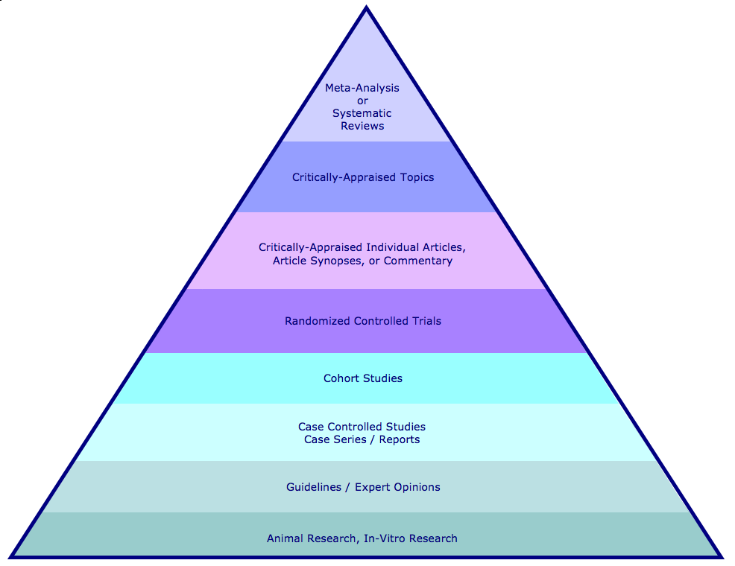
Hierarchy of Evidence and Corresponding Databases
Filtered Information
Cochrane Database of Systematic Reviews
Topic Reviews in the Cochrane Database of Systematic Reviewsa
a
Database of Abstracts of Reviews of Effectiveness (DARE)
NHS Economic Evaluation Database
Cochrane Methodology Register
ACP Journal Club
Unfiltered Information
Cochrane Central Register of Controlled Trials
PubMed
PubMed
National Guideline Clearinghouse
Health Technology Assessment
PubMed

Slide 15
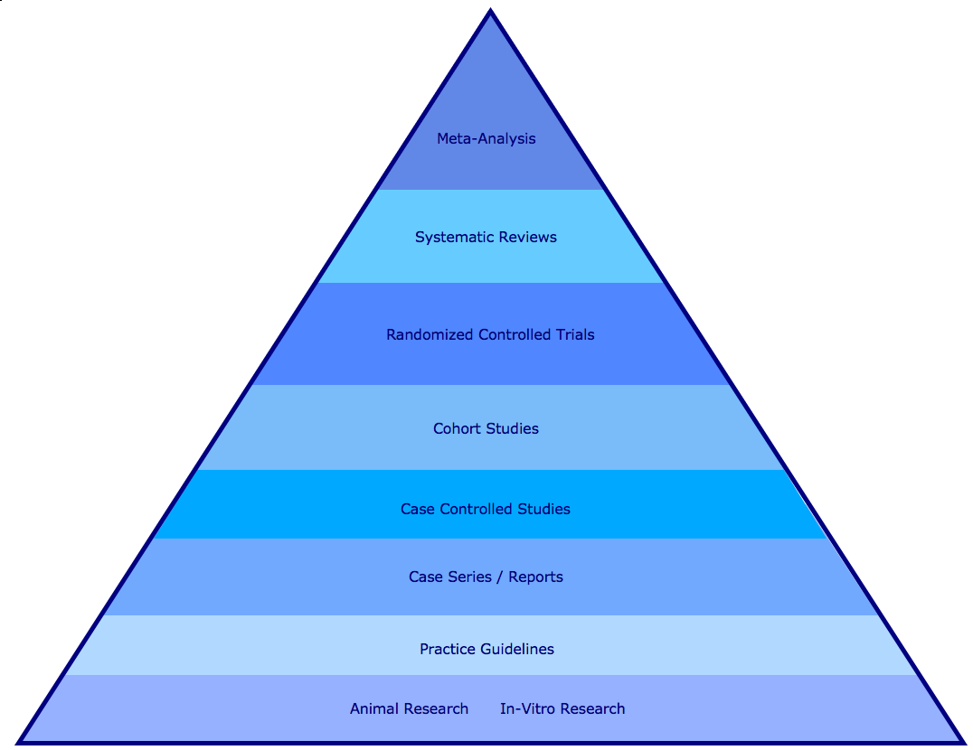
Hierarchy of Evidence and PubMed Search Strategies
Search for meta-analysis using the publication type limit.
Search for systematic review using the subset limit.
Search for randomized controlled trials using the publication type limit.
Search for cohort studies as a MeSH term.
Longitudinal studies, follow-up studies, and prospective studies will be included unless the Do Not Explode function is used.
Search for case control study as a MeSH term.
Retrospective studies included unless Do Not Explode is used.
Search for case report using the publication type limit.
Search for practice guideline using the publication type limit.
Search for animal research using the animal limit. Search for in-vitro research using in vitro as a publication type limit.

Slide 16

www.cochrane.org

Slide 17
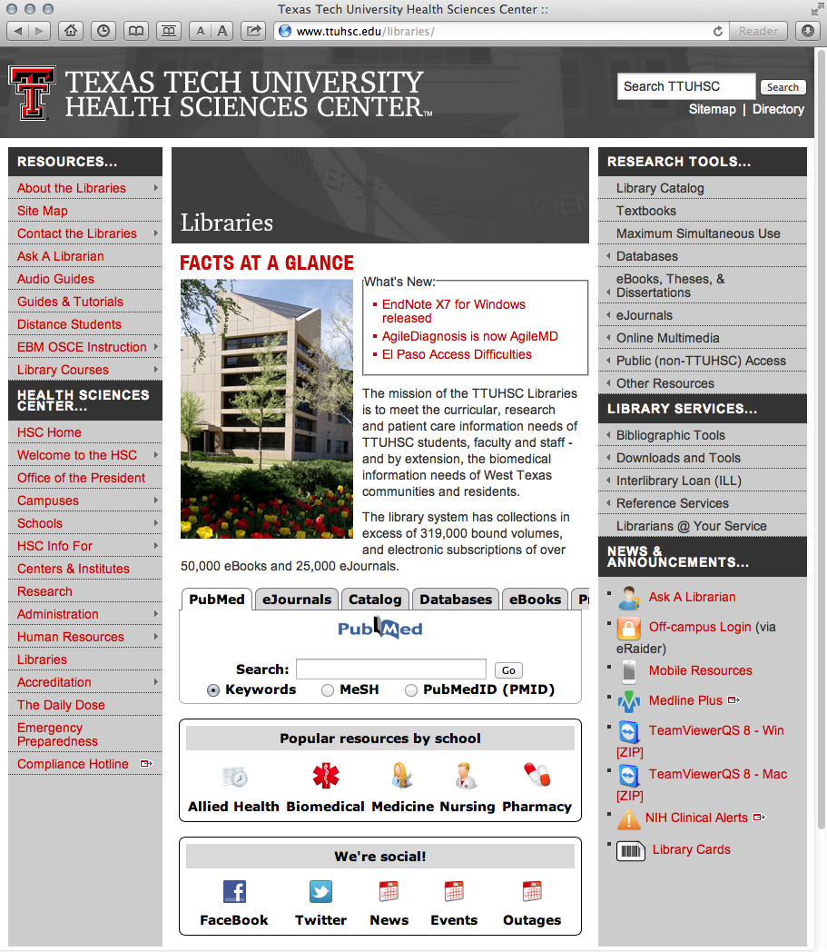
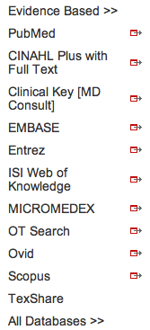
EBM Reviews via OVID
www.ttuhsc.edu/libraries
Normally you would mouse over Databases
and click OVID

Slide 18
Go to the training site at
http://ovidsp.ovid.com

Slide 19
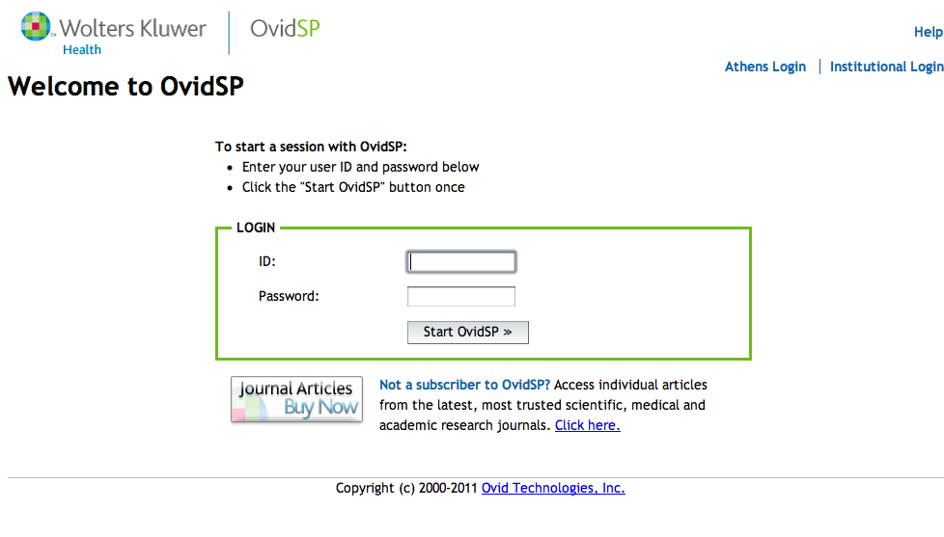
Web Address: http://ovidsp.ovid.com
ID: thsclibtrain
Password: learn99

Slide 20
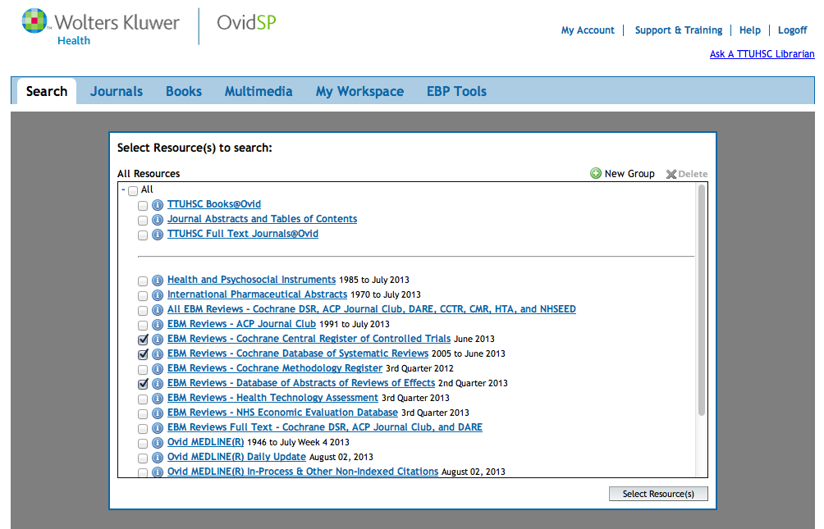
Select
Cochrane Central Register of Controlled Trials
✔

Slide 21
Select
Cochrane Database of Systematic Reviews
✔

Slide 22
Select
DARE: Database of Reviews of Effects
✔

Slide 23
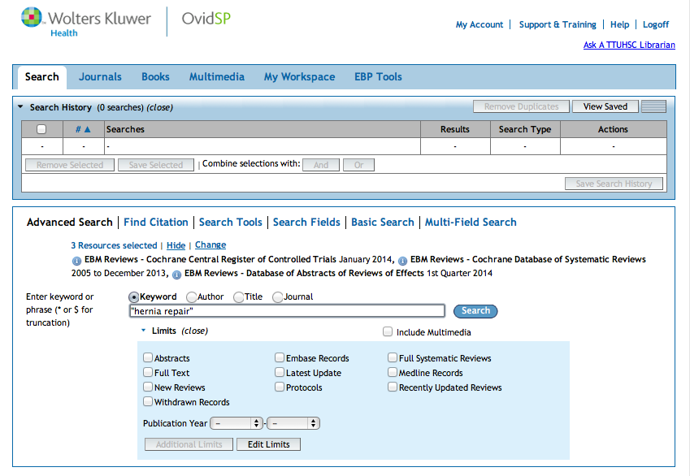
Click Search
Enter
as the first keyword search.
“hernia repair”

Slide 24
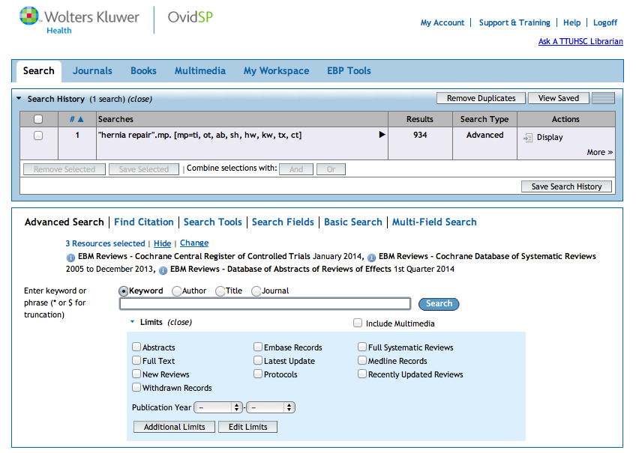
Results in the
first search set.

Slide 25
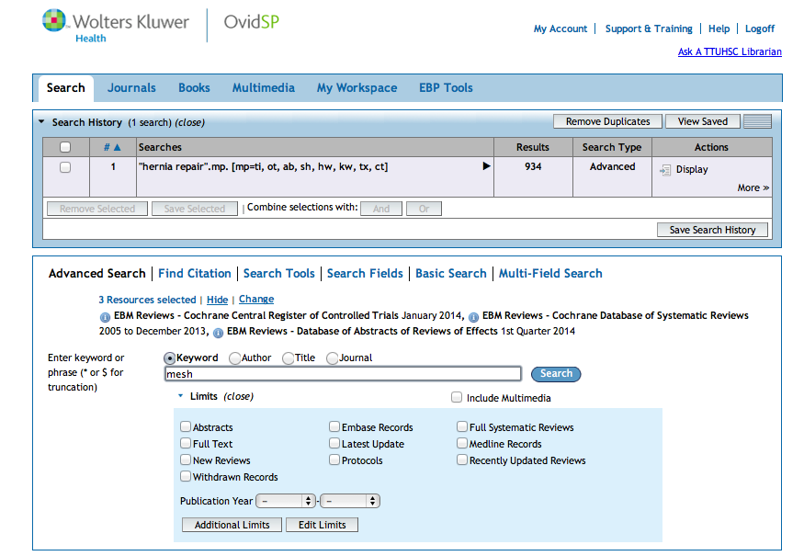
Click Search
Enter as the
second keyword search.
mesh

Slide 26
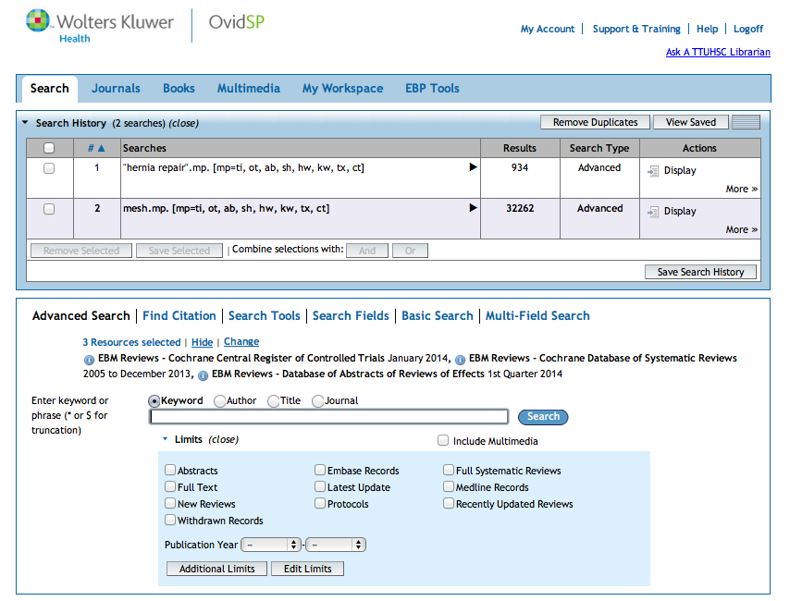
Click And
X
X
AND
Click on the boxes
next to set 1 and set 2.

Slide 27
Boolean Logic - AND
hernia
repair
mesh
and

Slide 28
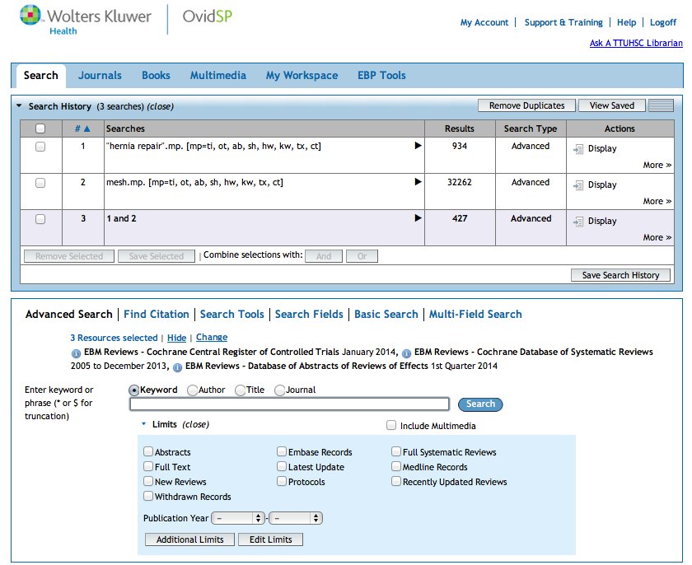
Results of AND combination.
(Note that AND narrows results.)

Slide 29
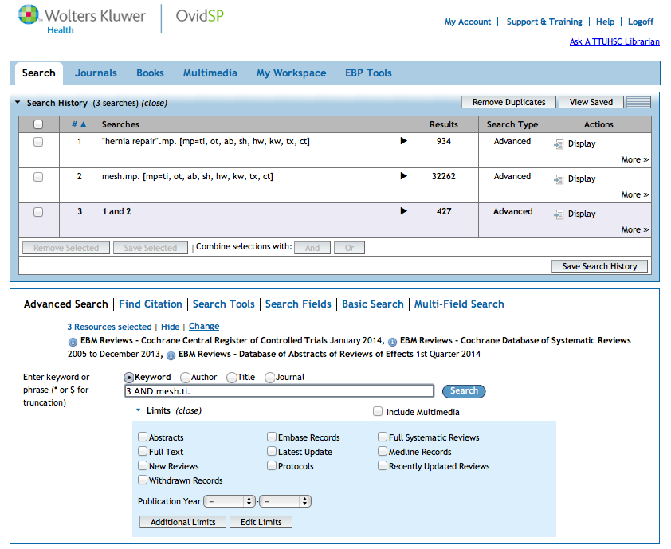
Click Search
Enter
3 AND mesh.ti.
to narrow to
articles with mesh as a word in the title.

Slide 30
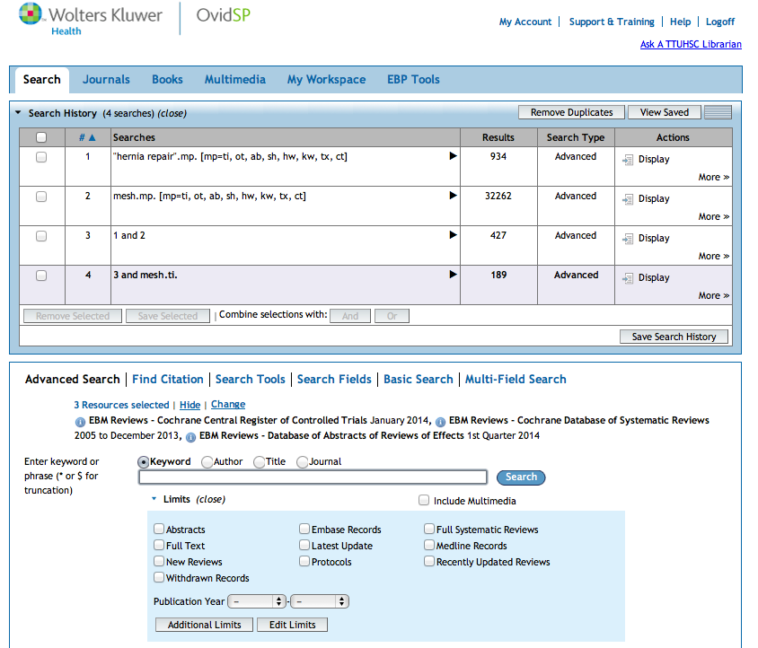
Results are narrowed
to 189 articles.

Slide 31
Other search techniques:
lightweight or heavy weight
Use Boolean OR
Note: “OR” broadens a result
lightweight
or
heavy weight

Slide 32
By entering an asterisk*after a word, the computer searches for any suffix of a word.
Example: gene* will retrieve
genes, genetic, generation, etc.
This is called truncation.

Slide 33
Click Display
to view articles

Slide 34
Search Results

Slide 35
Cochrane Central
Register of
Controlled Trials

Slide 36
Cochrane Central Register of Controlled Trials
details of published articles:
3/5th’s records are from PubMed
relevant records from Embase
other published and unpublished sources
reports from conference proceedings
Cochrane Review Groups
maintains a collection of controlled trials relevant to its own field of interest
known as “Specialized Registers”

Slide 37
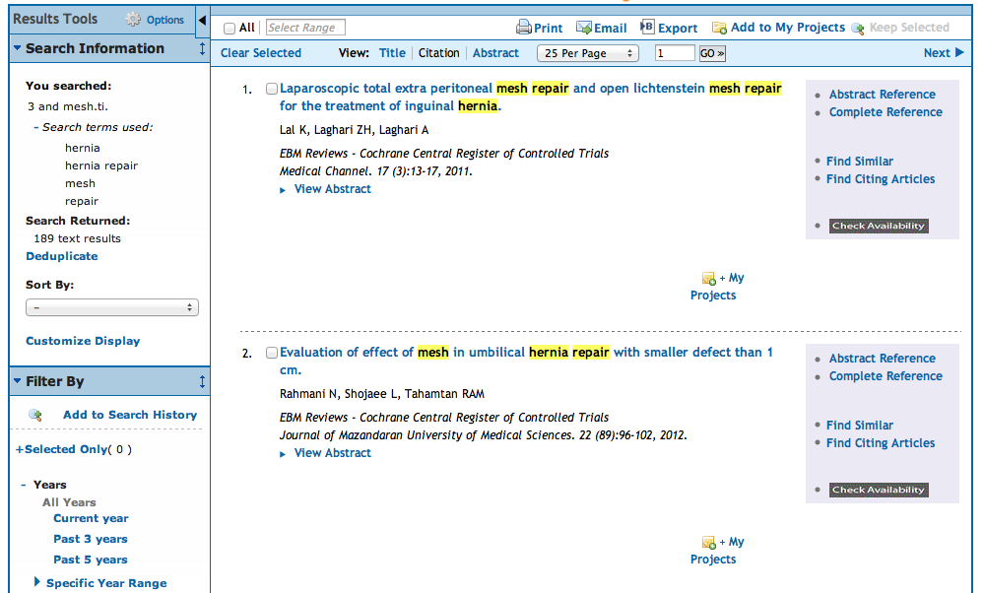
Go to article 45

Slide 38
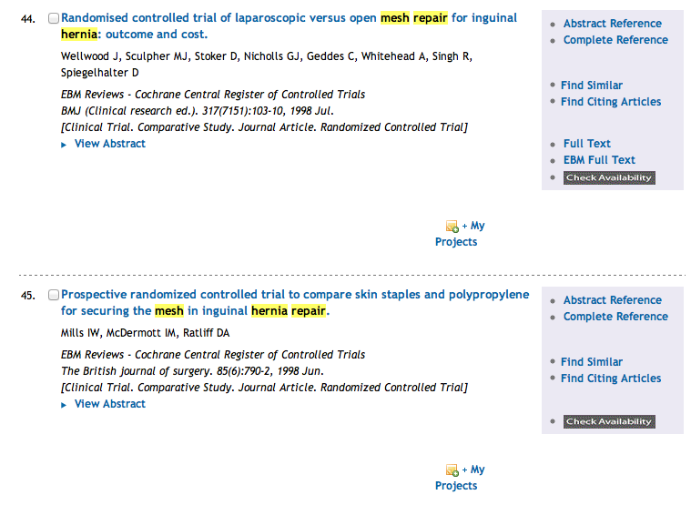
  Click
Check Availability

Slide 39
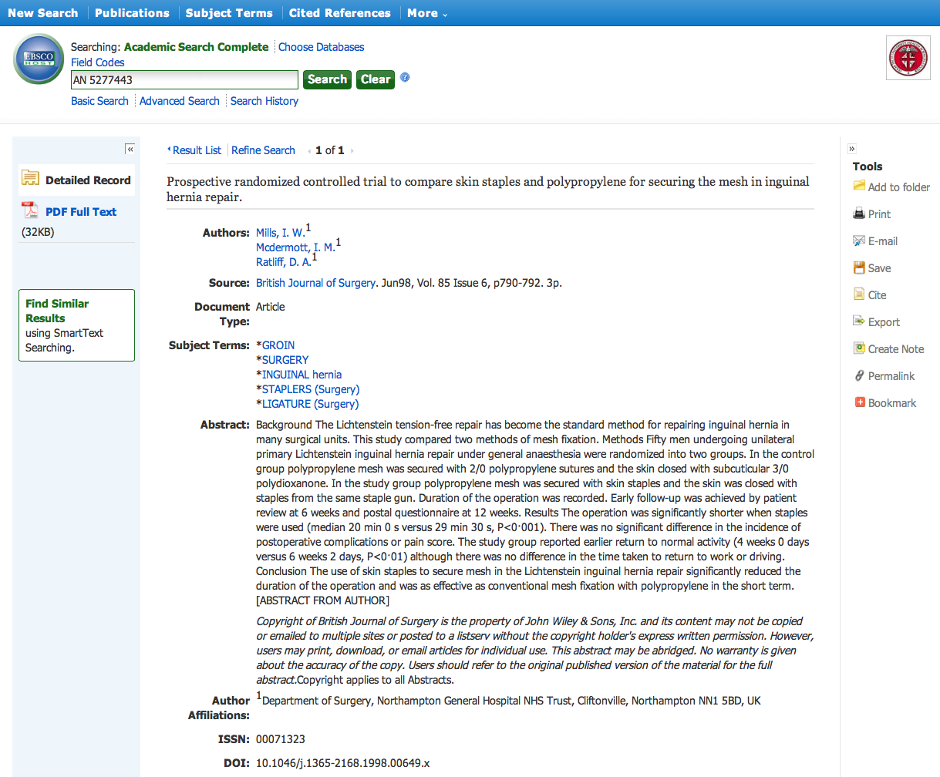

Automatically Opens

Slide 40
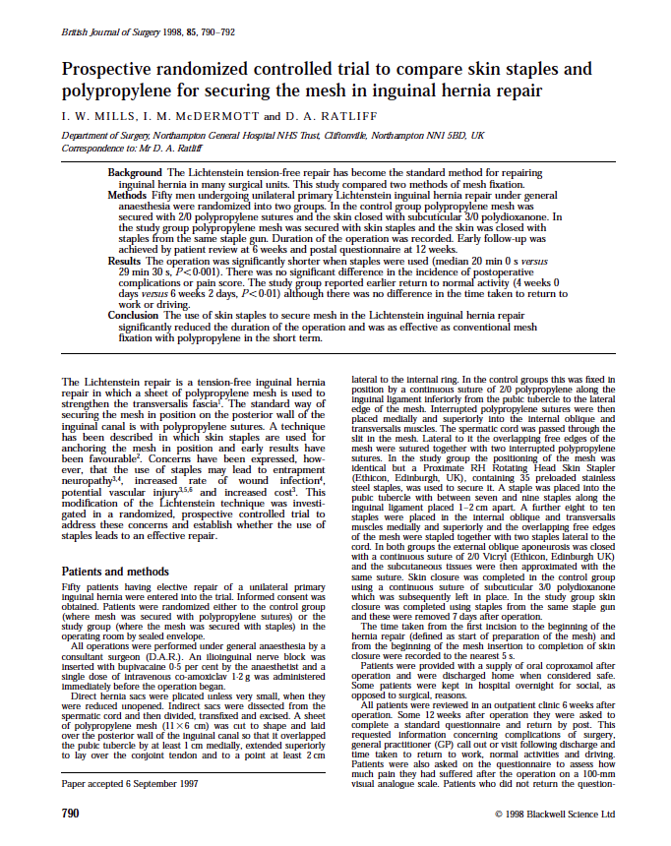
Full Text
Close Article Screen

Slide 41
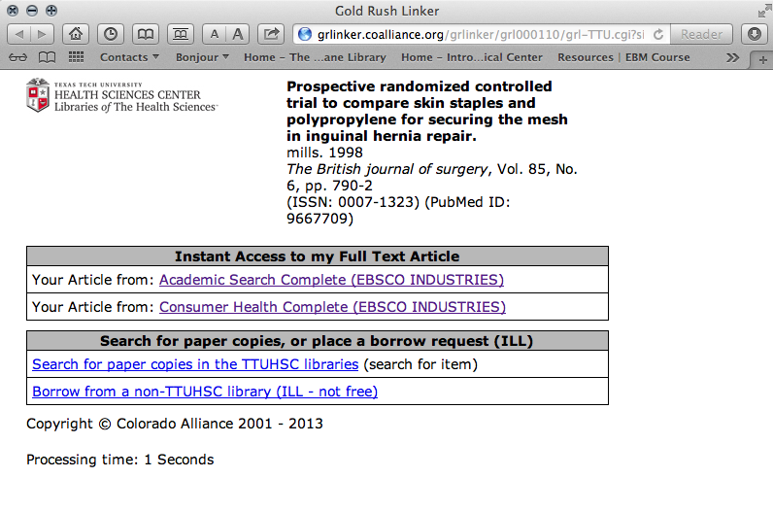
Close Linker Screen

Slide 42
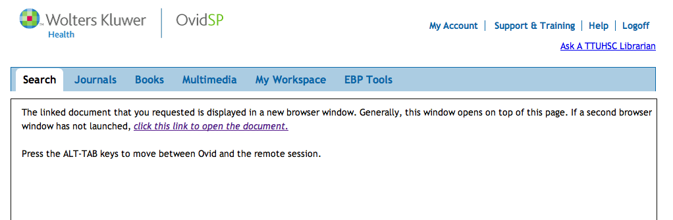
click Search

Slide 43
Type in 149 and click Go
149

Slide 44
Cochrane Database of Systematic Reviews

Slide 45
What is a Systematic Review?
Systematic review
review of a clearly formulated question
uses systematic and explicit methods
these methods identify, select, and critically appraise relevant research
methods also collect and analyze data from studies included in the review
Statistical methods (meta-analysis)
may or may not be used to analyze and summarize the results
Meta-analysis
use of statistical techniques in a systematic review
integrates results of included studies
From: Cochrane Collaboration at http://www.cochrane.org/resources/glossary.htm

Slide 46
Cochrane Database of Systematic Reviews
Systematic Reviews
assess randomized trials
comprehensive summary of available evidence
Evidence assessed with
explicit quality criteria
minimizes bias and ensures reliability
Trials meeting assessment criteria
combined to produce a more statistically reliable result
increase the power of the findings of numerous studies
may be studies that on their own are too small to produce reliable results
Cochrane Database of Systematic Reviews
over 800 international journals are searched to locate articles
Authors in the Cochrane Collaboration Groups
appraise and synthesize evidence
When searching for evidence-based literature
start by trying to locate a meta-analysis or a systematic review

Slide 47
Cochrane Groups
Acute Respiratory Infections
Airways Group
Anesthesia Group
Back Group
Breast Cancer
Colorectal Cancer
Consumers & Communication
Cystic Fibrosis & Genetic Disorders
Dementia & Cognitive Improvement
Depression, Anxiety, & Neurosis
Developmental, Psychosocial & Learning Problems
Drugs & Alcohol
Ear, Nose and Throat Disorders
Effective Practice & Organization of Care
Epilepsy
Eyes & Vision
Fertility Regulation
Gynecological Cancer
Hematological Malignancies
Heart Group
Hepato-Biliary Group
HIV/AIDS
Hypertension
Incontinence
Infectious Diseases
Inflammatory Bowel Disease
Injuries Group
Lung Cancer
Menstrual Disorders & Sub-Fertility Group
Metabolic & Endocrine Disorders
Methodology Review Group
Movement Disorders
Multiple Sclerosis
Musculoskeletal Group
Musculoskeletal Injuries Group
Neonatal Group
Neuromuscular Disease
Oral Health
Pain, Palliative Care & Supportive Care
Peripheral Vascular Diseases
Pregnancy & Childbirth
Prostatic Diseases & Urologic Cancers
Renal Group
Schizophrenia Group
Sexually Transmitted Diseases Group
Skin Group
Stroke Group
Tobacco Addiction
Upper Gastrointestinal & Pancreatic Diseases
Wounds Group

Slide 48
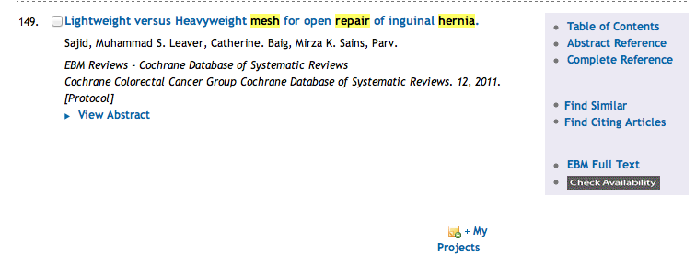
Click EBM Full Text

Slide 49
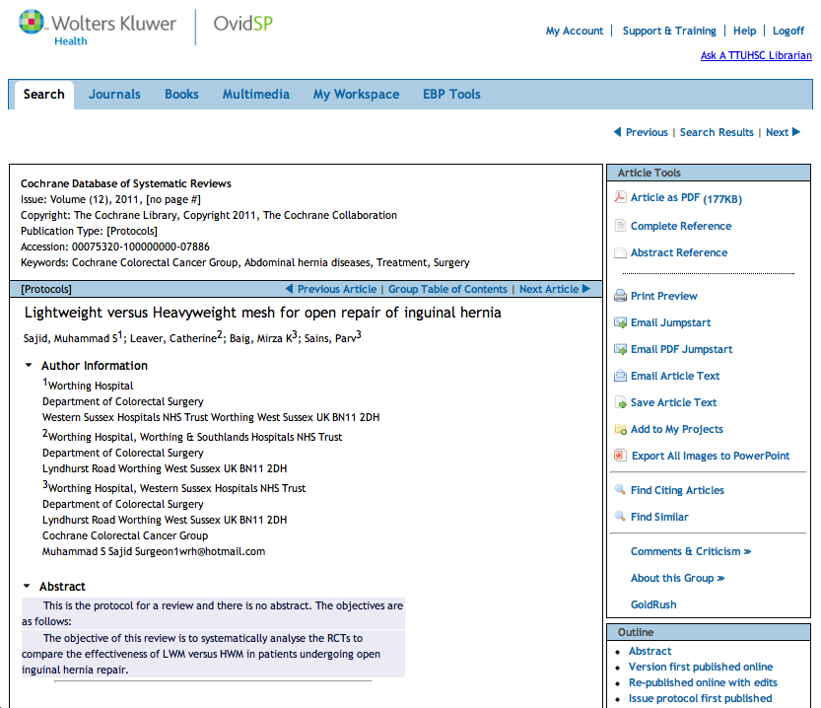
Protocol
(outline for future structured abstract)
Prepared by authors participating in the Cochrane Collaborative Groups.

Slide 50
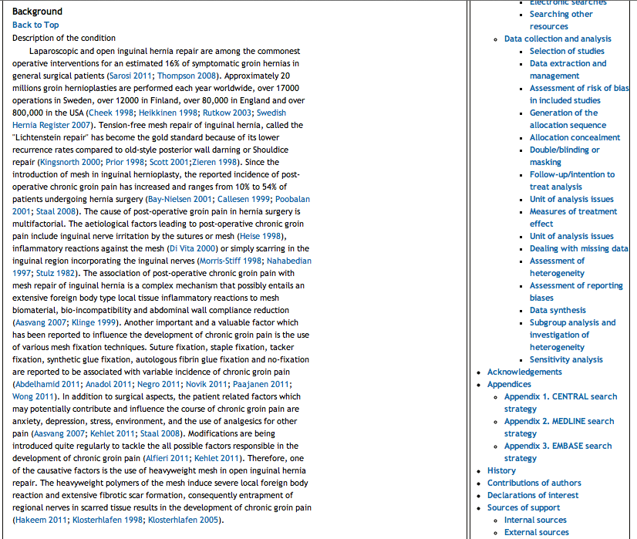

Slide 51
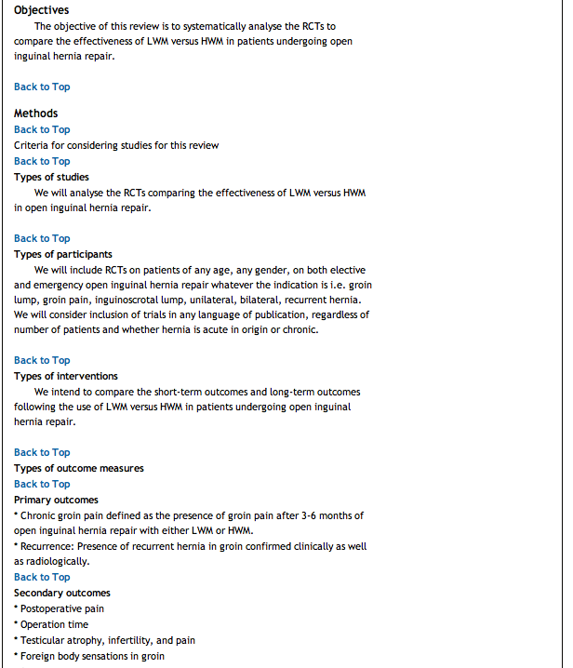
Scroll back to the top

Slide 52
Article as PDF

Slide 53


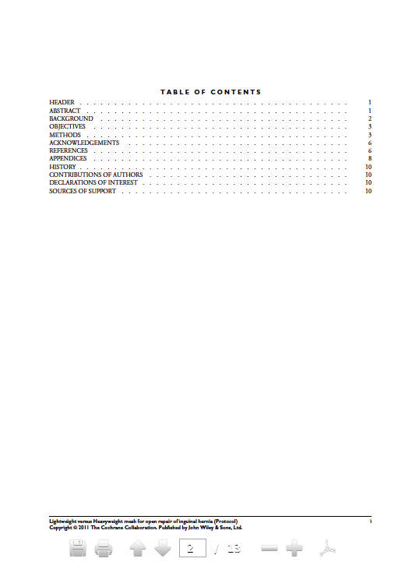
click Search
Close Article Screen

Slide 54
click Search

Slide 55
Type in 157 and click Go
157

Slide 56
DARE

Slide 57
DARE: Database of Abstracts of Reviews of Effects
produced by:
Centre for Reviews and Dissemination
University of York, UK
DARE contains:
abstracts of systematic reviews that have been quality assessed
summary reviews with critical commentaries
reviews not yet carried out by the Cochrane Collaboration
DARE covers a broad range:
health related interventions, diagnostic tests, surgery, pharmacology
public health, health promotion, organization and delivery of care

Slide 58
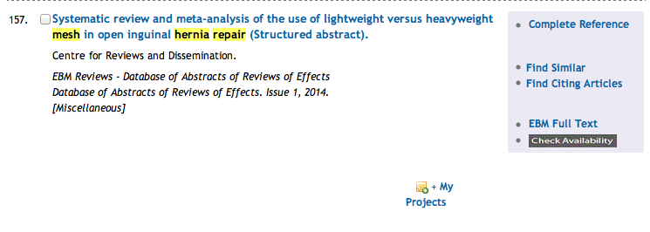
Click EBM Full Text

Slide 60
Scroll back to the top

Slide 61
click Search

Slide 62
click Change

Slide 63
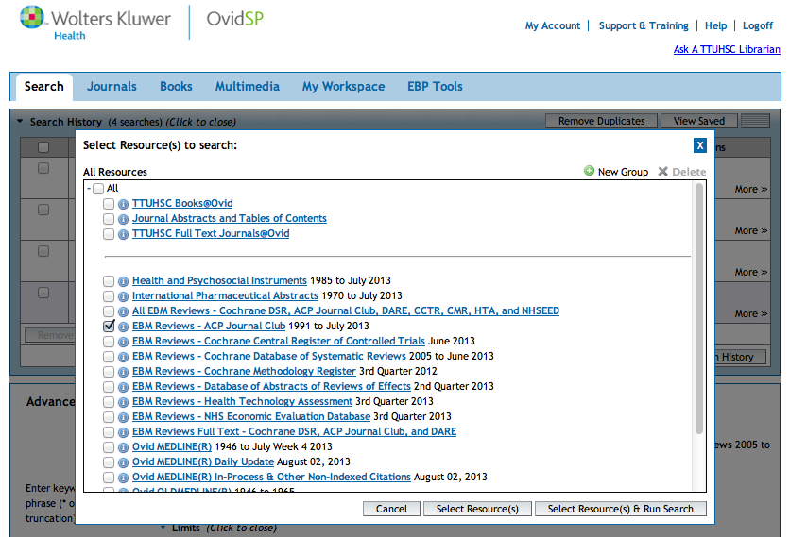
Select
ACP Journal Club
✔
click Select Resource(s) & Run Search

Slide 64
ACP Journal Club

Slide 65
ACP Journal Club
joint online journal:
ACP Journal Club by the American College of Physicians
Evidence-Based Medicine by the British Medical Journal Group
Screens 100 top clinical journals:
original studies
methodologically sound
clinically relevant
Information summarized in structured abstracts include:
Methods Design
Intervention
Identifies Study Categories :
Diagnosis Etiology
Prognosis Prevention or treatment
Brief commentaries on:
methods
clinical application of findings

Slide 66
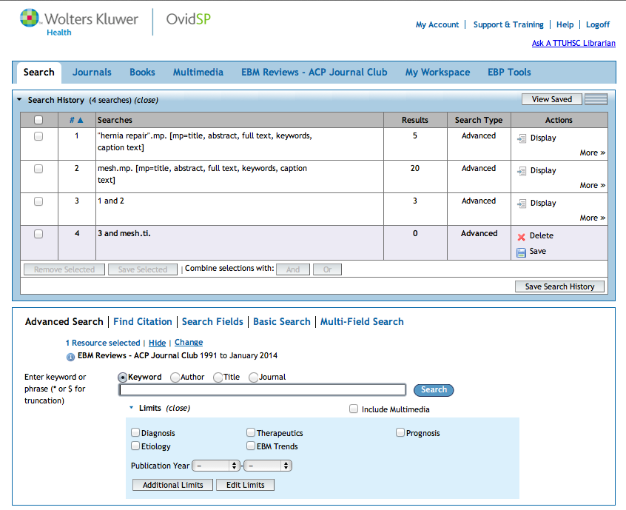
Click Display
to view articles

Slide 67
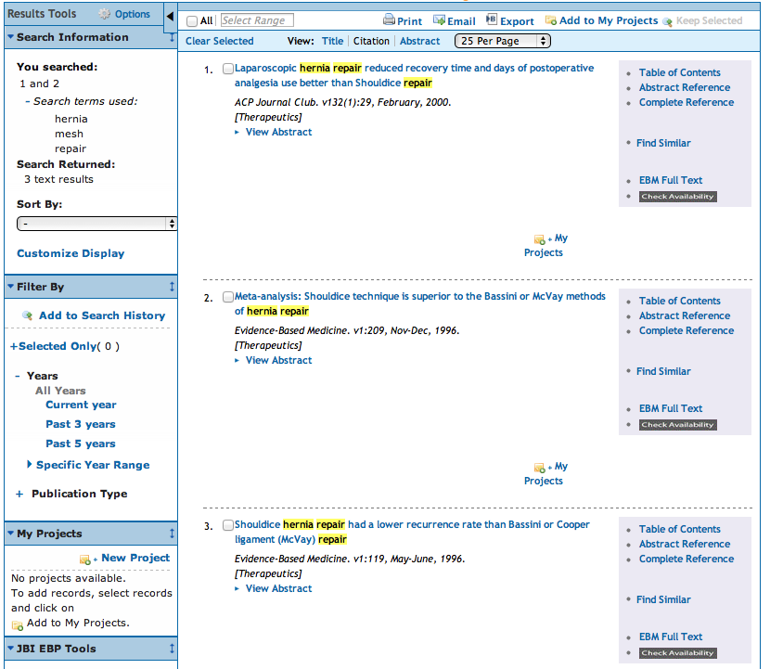
Click EBM Full Text

Slide 68
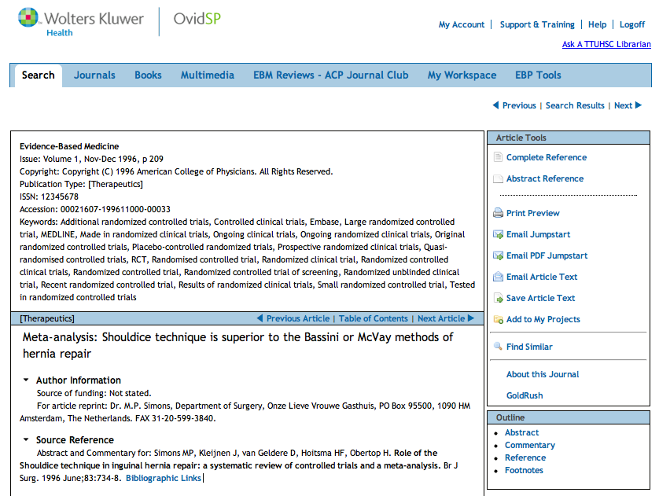

Slide 69
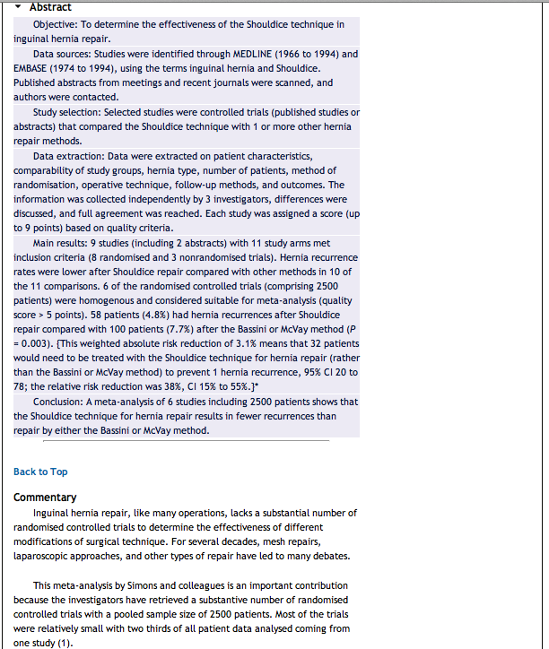

Slide 70
Click Logoff

Slide 71
4. Appraise the evidence

Slide 72
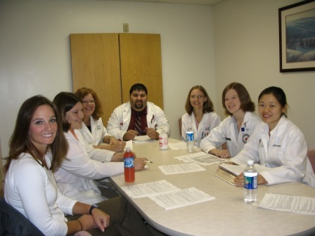
What is Critical Appraisal?
“The process of assessing and interpreting
evidence by systematically considering its
validity, results, and relevance.”
The Cochrane Collaboration Glossary http://www.cochrane.org/glossary/5#letterc

Slide 73


“Critical appraisal is the first step in transferring research knowledge into practice.”
Das, K., Malick, S., & Khan, K. (2008). Tips for teaching evidence-based medicine in a clinical setting: lessons from adult learning theory. part one. Journal of the Royal Society of Medicine, 101(10), 493-500. doi: 10.1258/jrsm.2008.080712 web address: http://www.ncbi.nlm.nih.gov/pmc/articles/PMC2586873/?tool=pubmed

Slide 74
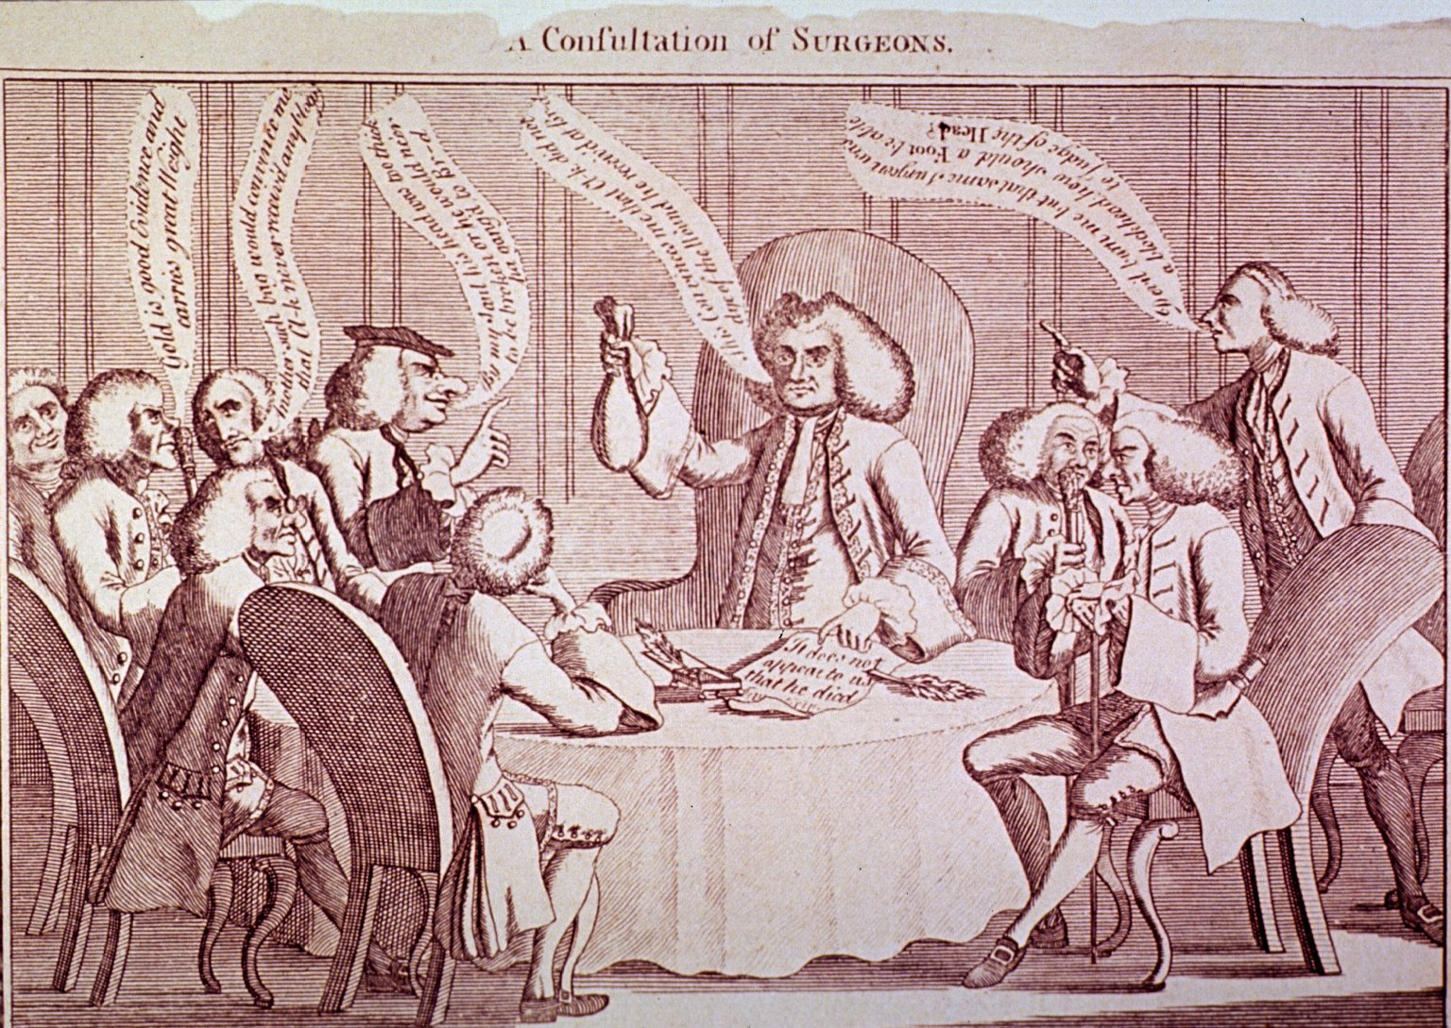
Purpose of Critical Appraisal
“Randomized controlled trials and systematic reviews are the highest levels of evidence but they are not automatically of good quality and should always be appraised critically.”
Das, K., Malick, S., & Khan, K. (2008). Tips for teaching evidence-based medicine in a clinical setting: lessons from adult learning theory. part one. Journal of the Royal Society of Medicine, 101(10), 493-500. doi: 10.1258/jrsm.2008.080712 web address: http://www.ncbi.nlm.nih.gov/pmc/articles/PMC2586873/?tool=pubmed
A Consultation of Surgeons, old negative no. 62-116 [engraving]. [Bethesda, MD., United States of America]: Images from the History of Medicine, U.S. National Library of Medicine, National Institutes of Health; accessed June 12, 2012. The National Library of Medicine believes this item to be in the public domain. print: 11 x 16 cm.

Slide 75

http://www.ebm.med.ualberta.ca/

Slide 76


Mouse over
Domains,
Study Category,
and select
Worksheet.
Look at Calculations.
Then look at
Systematic Review.

Slide 77
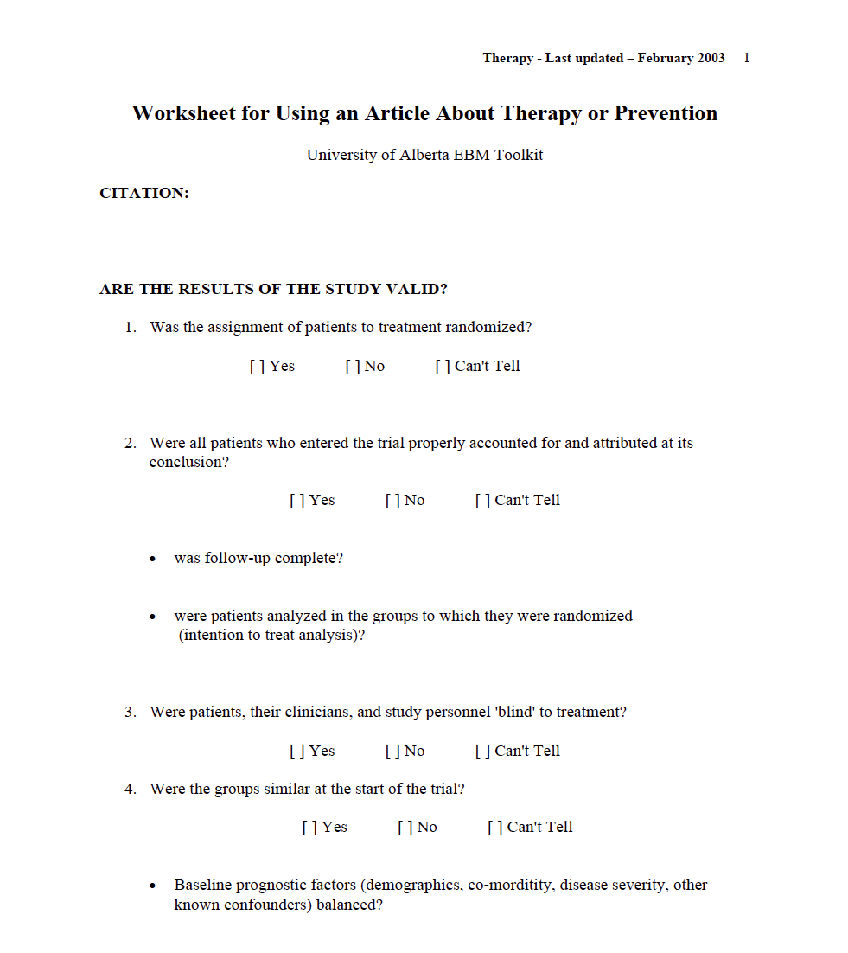
Critical Appraisal Worksheet

Slide 78
Hierarchy of Strength of Evidence for Prevention & Treatment Decisions
• N–of–1 randomized trial
• Systematic reviews of randomized trials
• Single randomized trial
• Systematic review of observational studies addressing patient–important outcomes
• Single observational study addressing patient–important outcomes
• Physiologic studies (studies of blood pressure, cardiac output, exercise capacity, bone density, and so forth)
• Unsystematic clinical observations
(Guyatt, 2008)

Slide 79

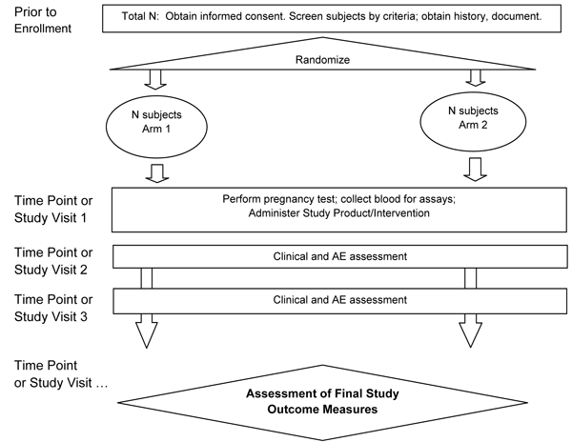
Evidence–Based Treatment
“Clinicians should use the results of randomized controlled trials (RCTs) of groups of patients to guide their clinical practice. However, clinicians cannot always rely on the results of RCTs … To determine the best care for an individual patient, clinicians can conduct n–of–1 randomized controlled trials in individual patients.” (Guyatt, 2008)

Slide 80
N–of–1 Randomized Controlled Trials
Experiment designed to
  determine effect of an intervention/exposure on a single study participant
In a one N–of–1 design
  the patient undergoes pairs of treatment periods
  1 period involves the use of the experimental treatment
  1 period involves the use of an alternate treatment/placebo
  if possible, patient and clinician are blinded
  outcomes are monitored
Treatment periods are replicated
  until clinician and patient are convinced that
treatments are definitely different
or definitely not different
(Guyatt, 2008)

Slide 81
5. Apply the evidence

Slide 82
Group Discussion “EBM Journal Club” with Dr. Griswold
  in the Library’s Rare Books Conference Room
  state your focused, well-articulated PICO question
  describe databases searched and search strategy
  state author, article title, journal, and date published
  discuss study design, validity and reliability, research findings
  commentary and q & a from Dr. Griswold
  turn in your EBM report including PICO question worksheet, critical appraisal worksheet, copy of the article, and cover sheet
  casual atmosphere and lunch courtesy of Dr. Griswold!

Slide 83
Have Questions?

Slide 84
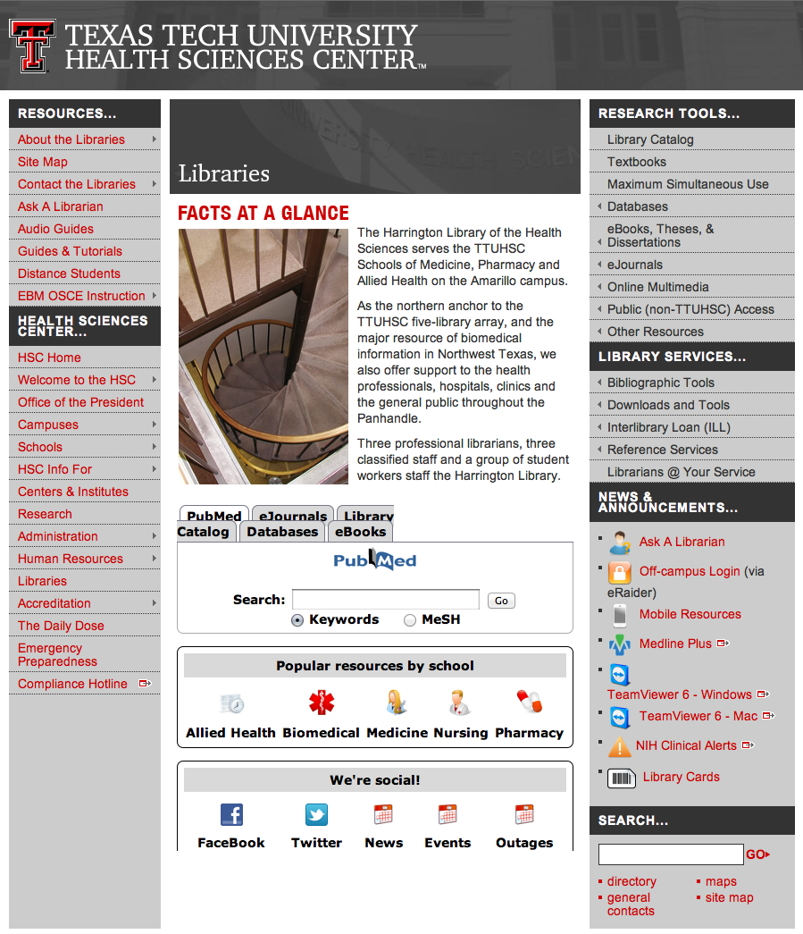

www.ttuhsc.edu/libraries
email us

Slide 85
Please contact us at:
Lubbock
(806) 743-2200
Amarillo
(806) 354-5448
El Paso
(915) 545-6652
Odessa
(432) 335-5171

Slide 86
The End
Jan 2012

