Slide 1
TTUHSC Preston Smith Library
presents
Pharmacy
Information Resources
Rev. 08/2014

Slide 2
EBP Literature from
PubMed’s Clinical Queries

Slide 3



PubMed Database
Biomedical and life sciences journal literature
International scope
Developed and maintained by the:
National Center for Biotechnology Information
    at the U.S. National Library of Medicine
    at the National Institutes of Health

Slide 4

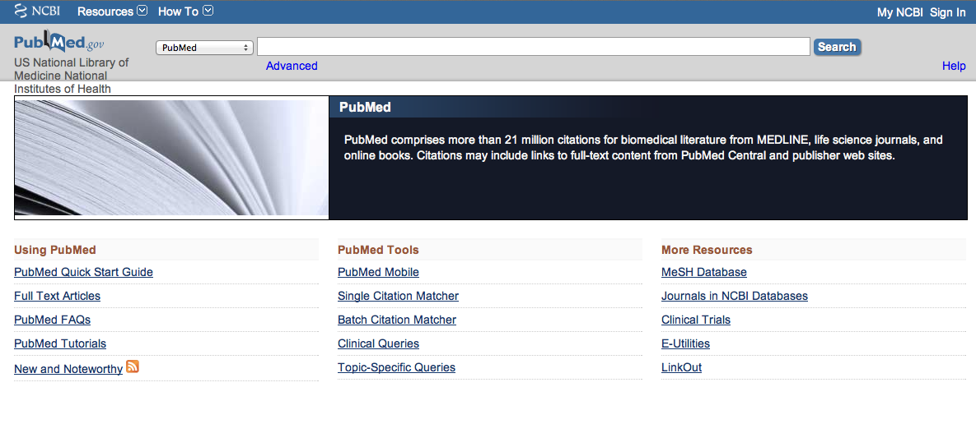
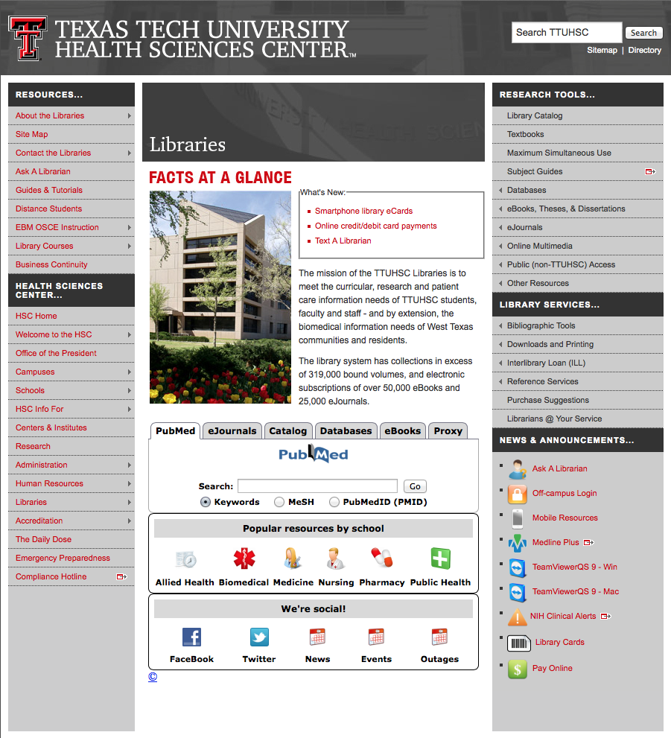
Accessing PubMed
Freely available over the Internet
@ www.pubmed.gov
Also through library’s home page

Slide 5


Evidence-Based Practice is guided by thoughtful integration
of the best available scientific knowledge with clinical expertise.

Slide 6
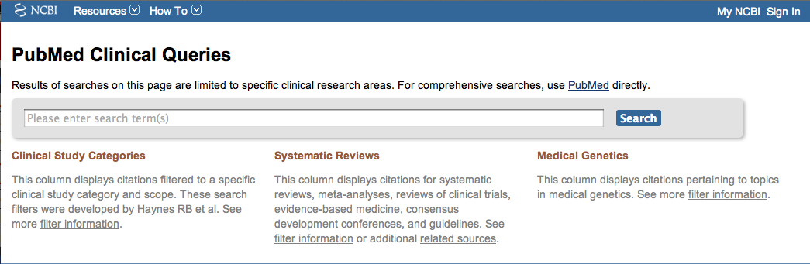
PubMed’s Clinical Queries
tool that searches for evidence-based literature

Slide 7

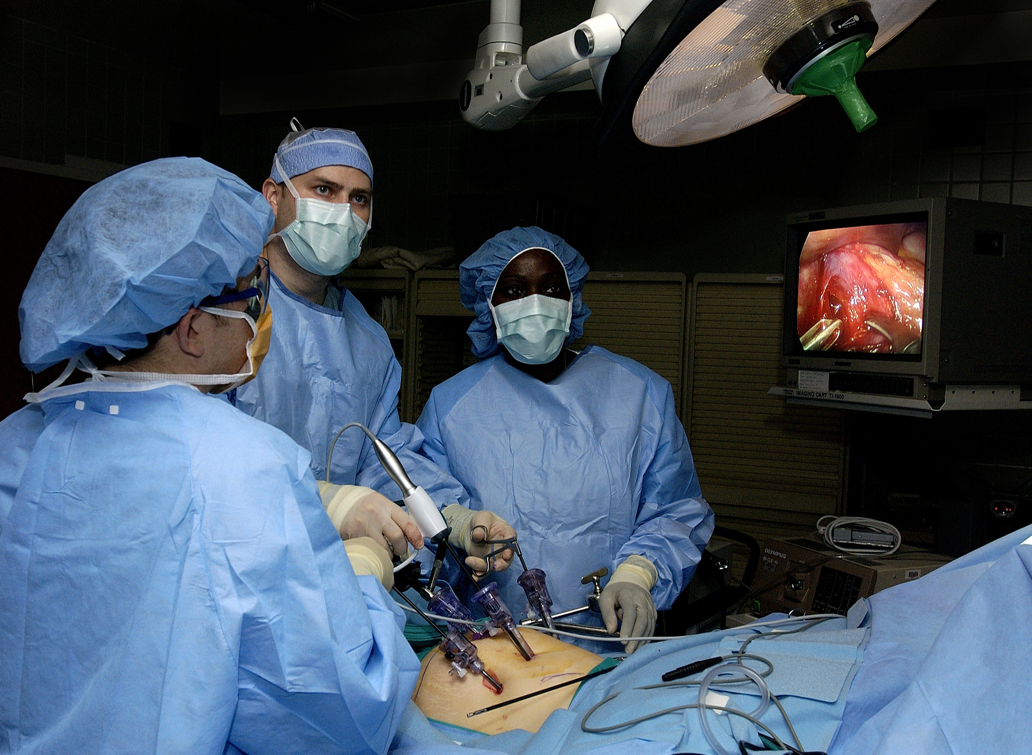
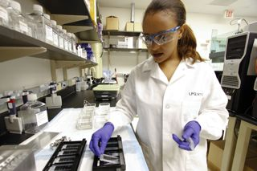
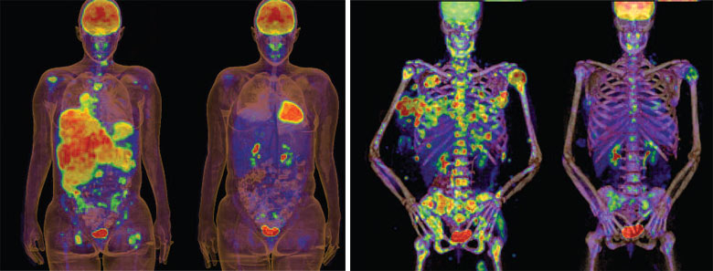
Clinical Queries Searchable by:
Diagnosis
Therapy
Prognosis (prediction of probable outcome)
Etiology (cause)

Slide 8
Clinical Queries Searchable by:
Diagnosis
Therapy
Prognosis (prediction of probable outcome)
Etiology (cause)

Slide 9
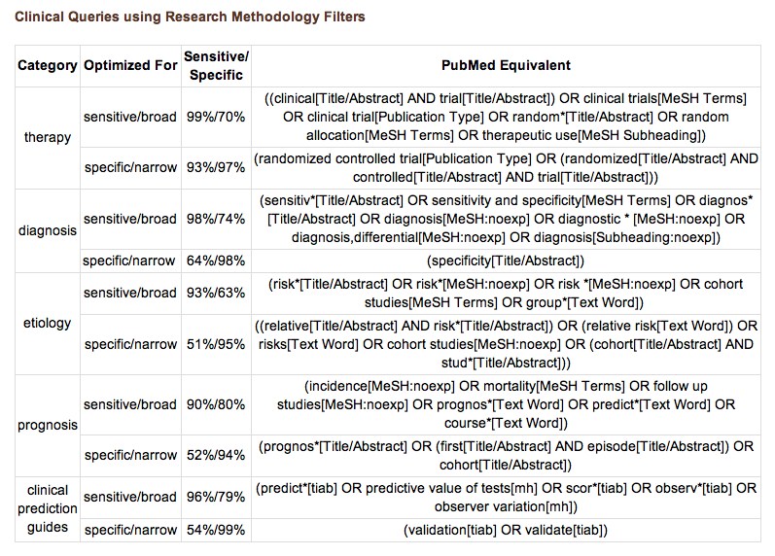
PubMed’s Clinical Queries
uses pre-formulated search strategies with a keyword search

Slide 10
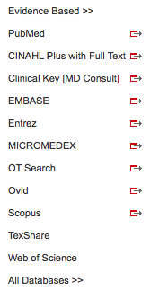
www.ttuhsc.edu/libraries
Mouse over Databases
Click PubMed

Slide 11
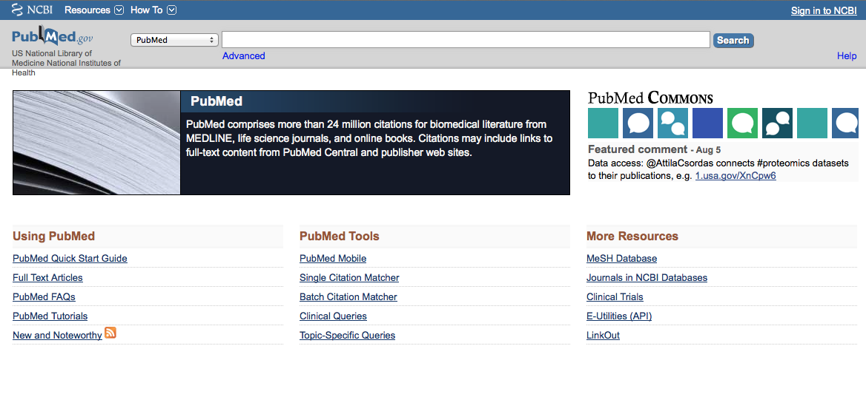
Click Clinical Queries

Slide 12
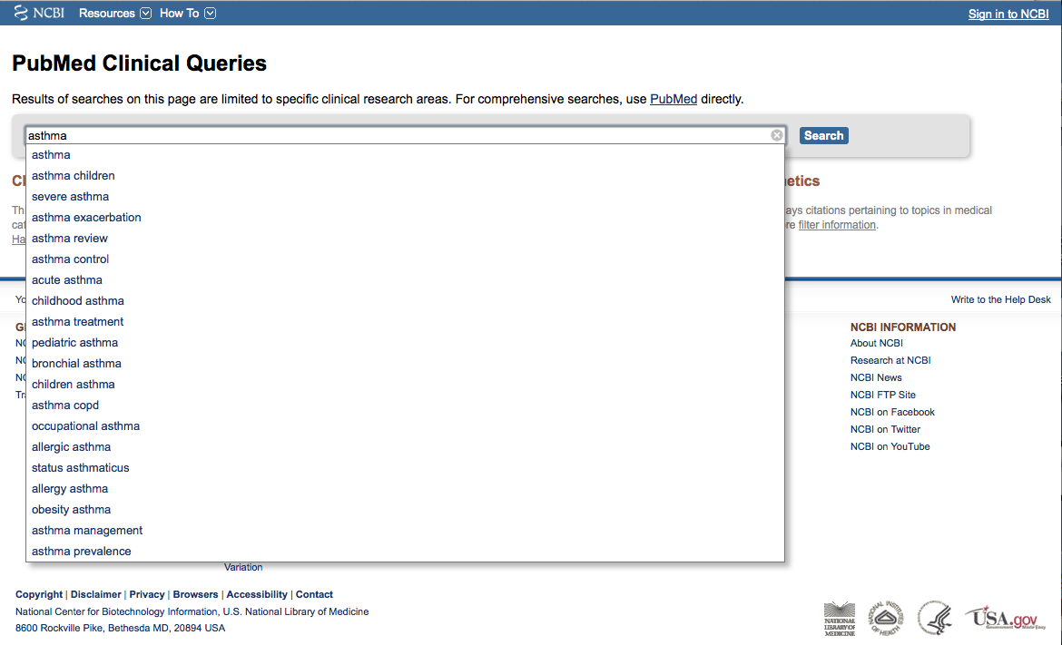
Enter asthma
Click
Search

Slide 13
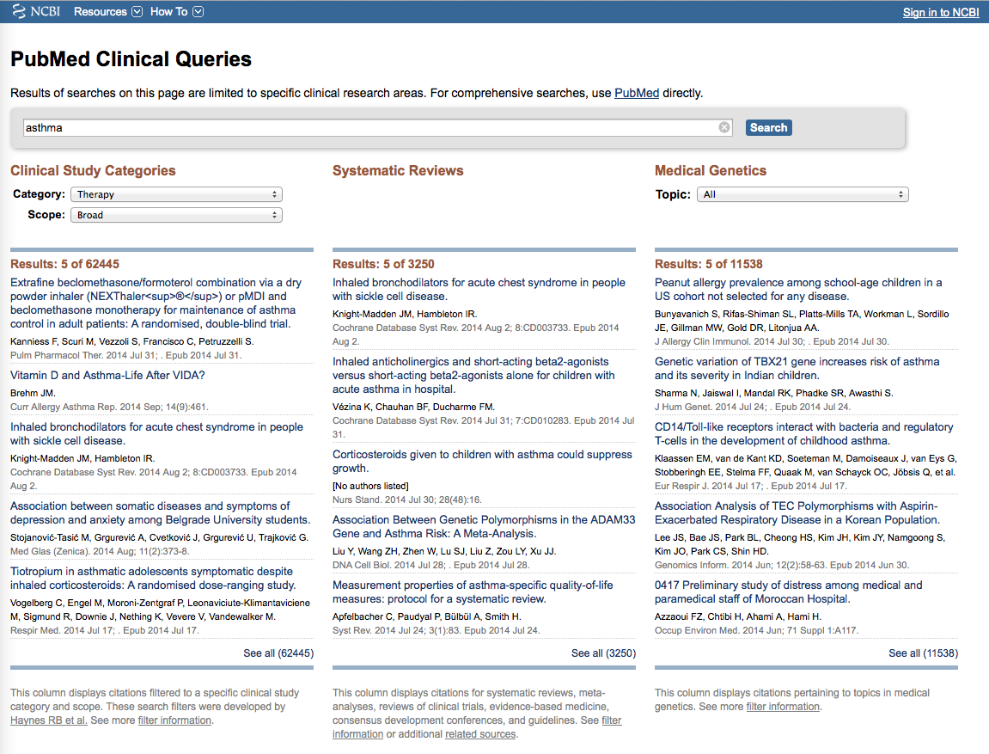
Results for Therapy and
Broad Scope
Change to Narrow Scope

Slide 14
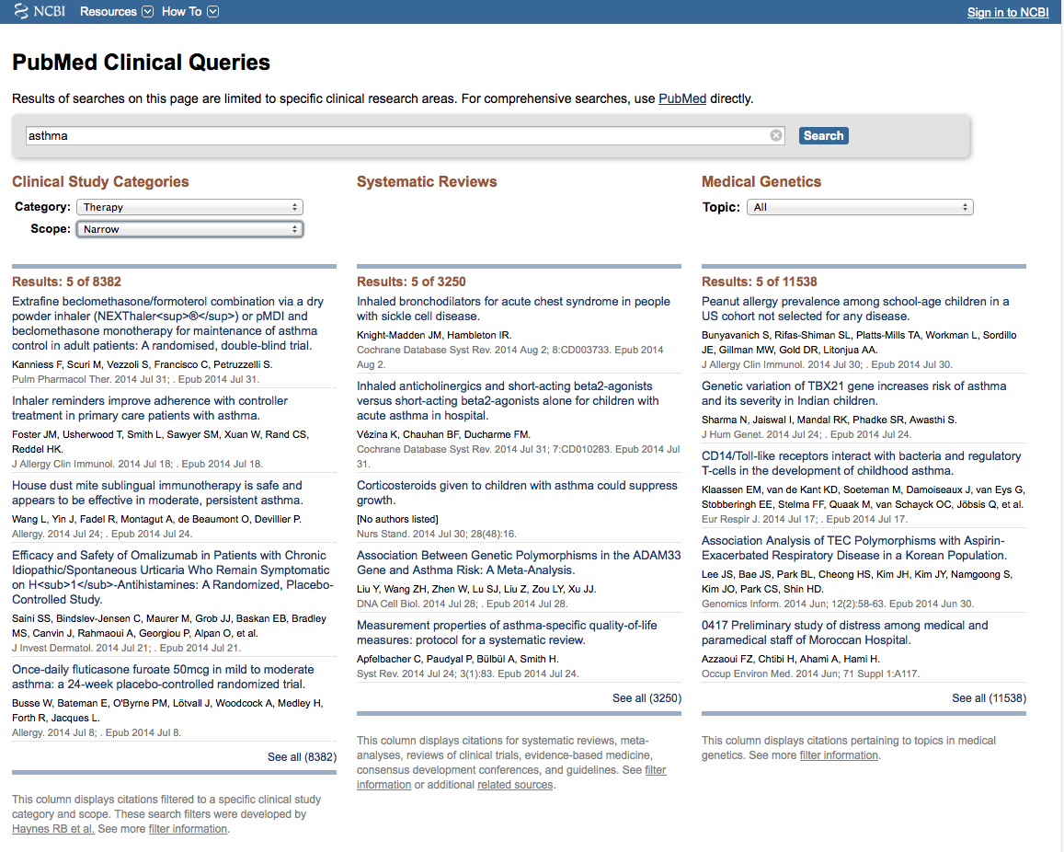
Results for Therapy and
Narrow Scope
Click See all (8382)

Slide 15
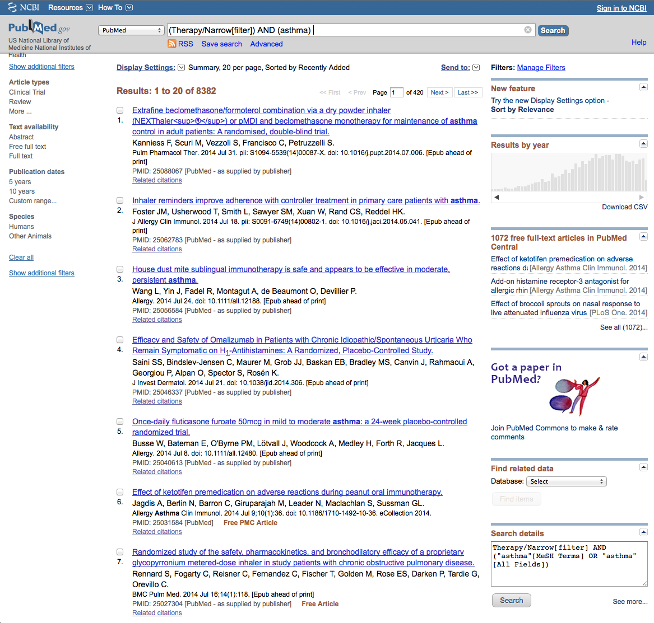
Click Limits

Slide 16
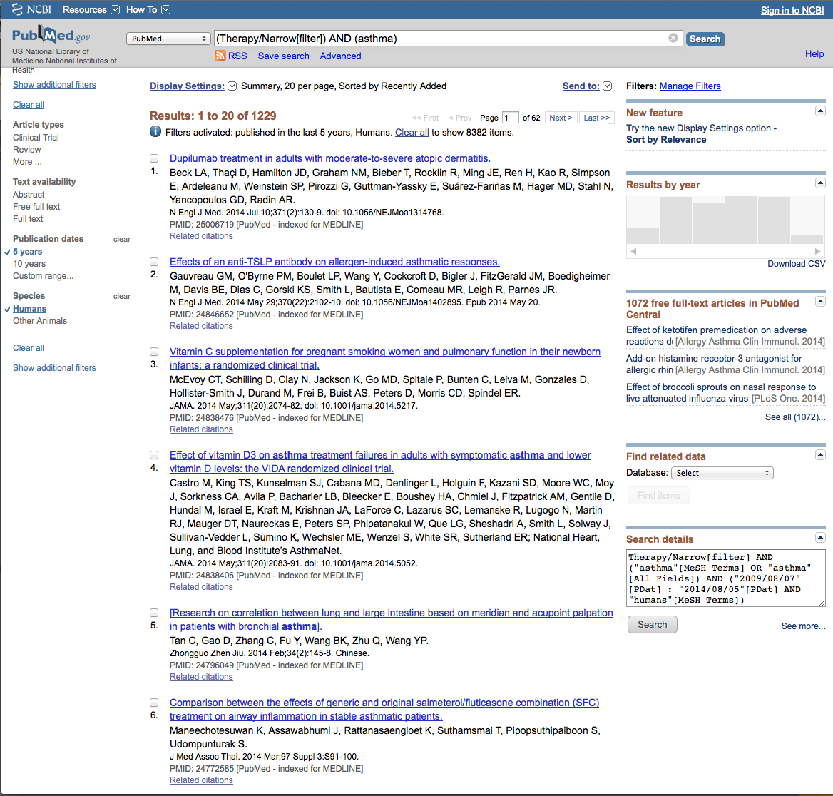
Click Show additional filters

Slide 17
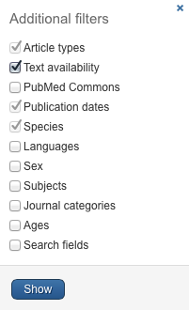
Select
Languages
✔
Click Show

Slide 18
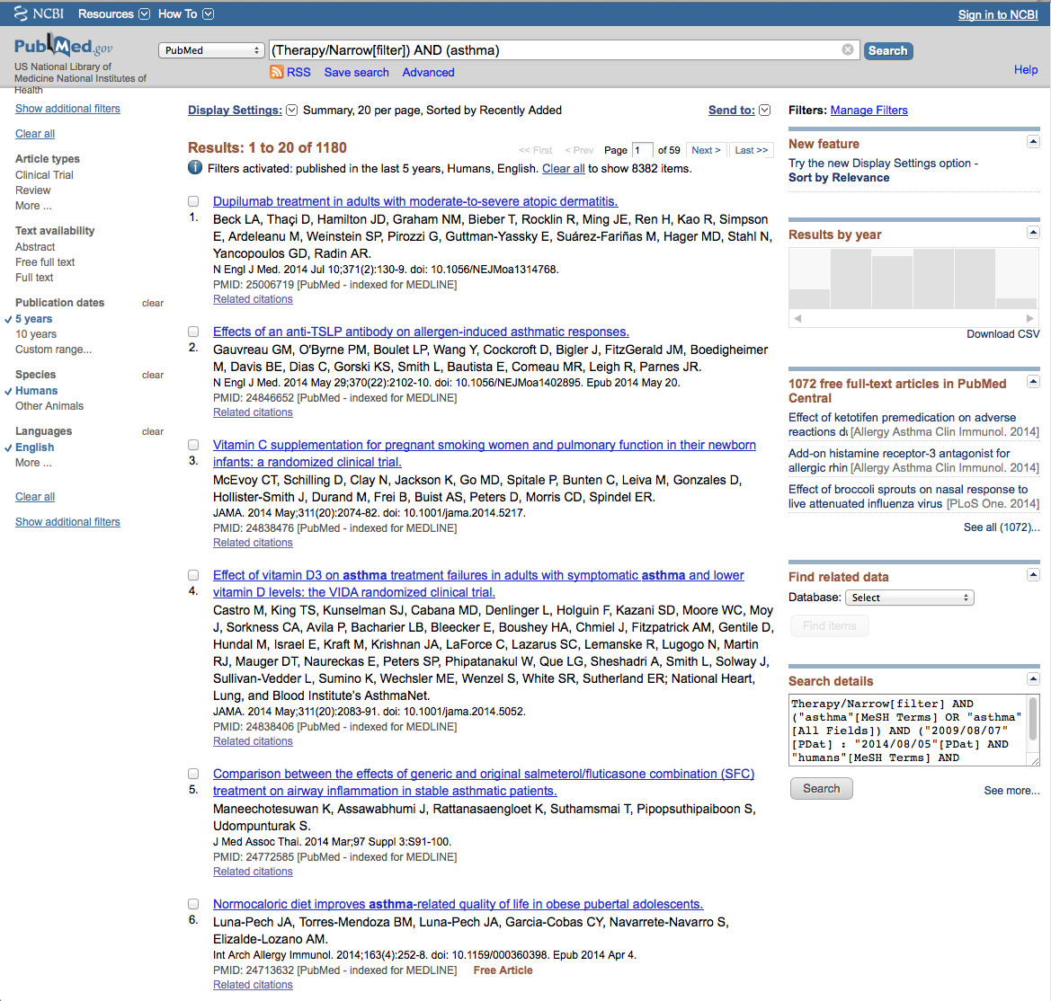
Click More…

Slide 19
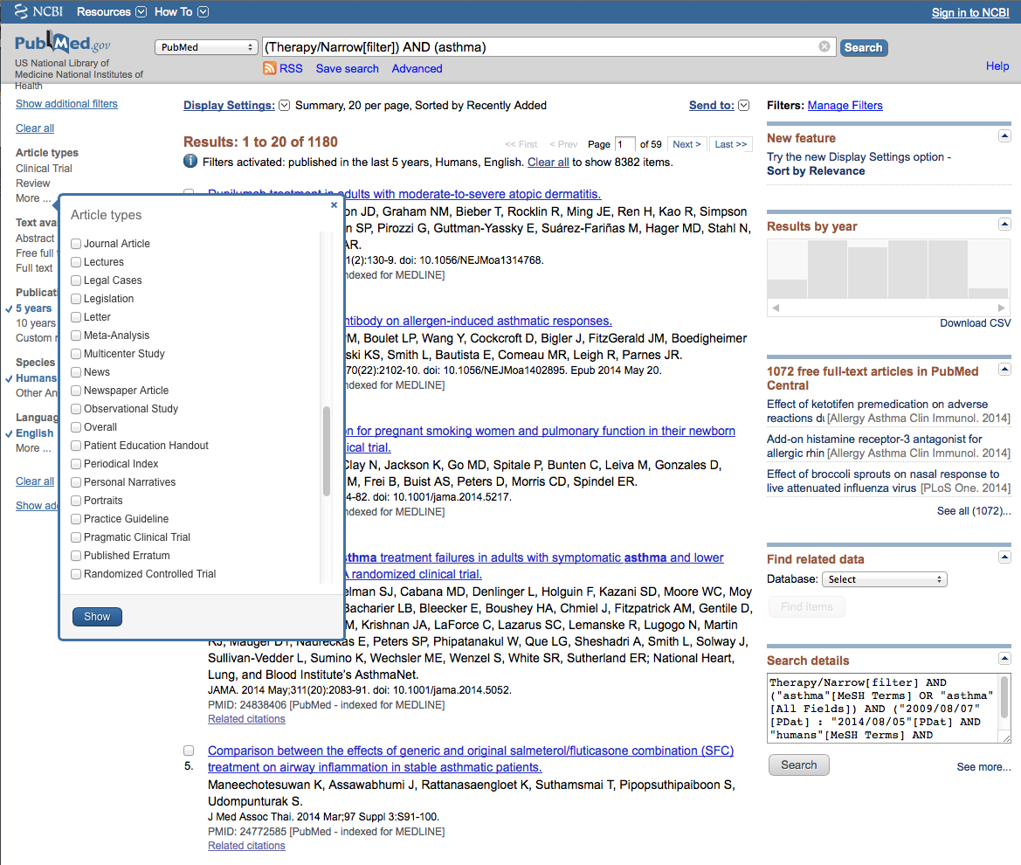
Select
Meta-Analysis
✔

Slide 20
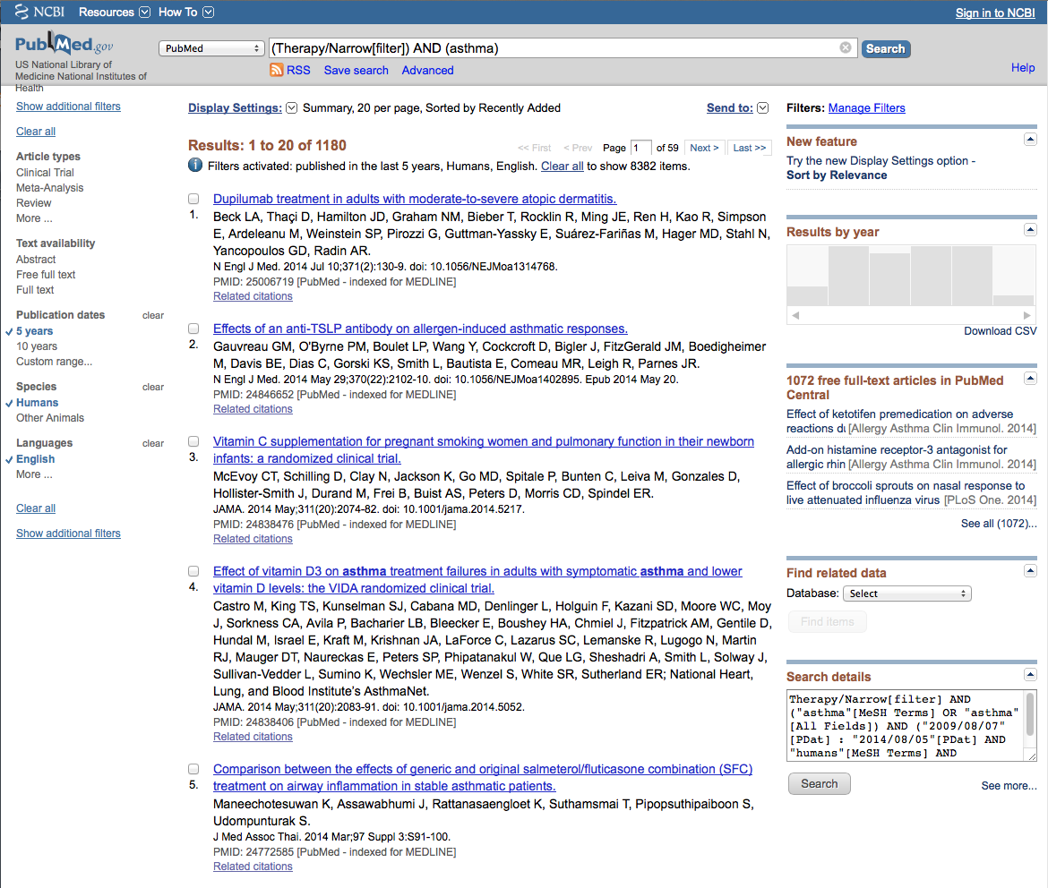
Click Meta-Analysis
to activate filter

Slide 21
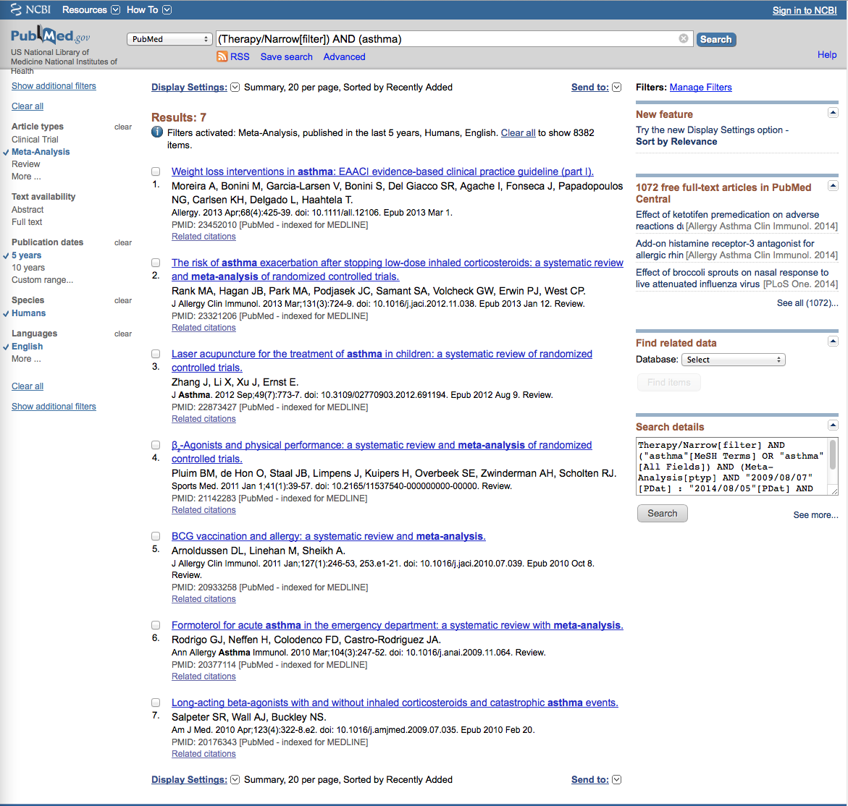
Results have narrowed to 7 articles

Slide 22
Click on the article title you wish to read

Slide 23
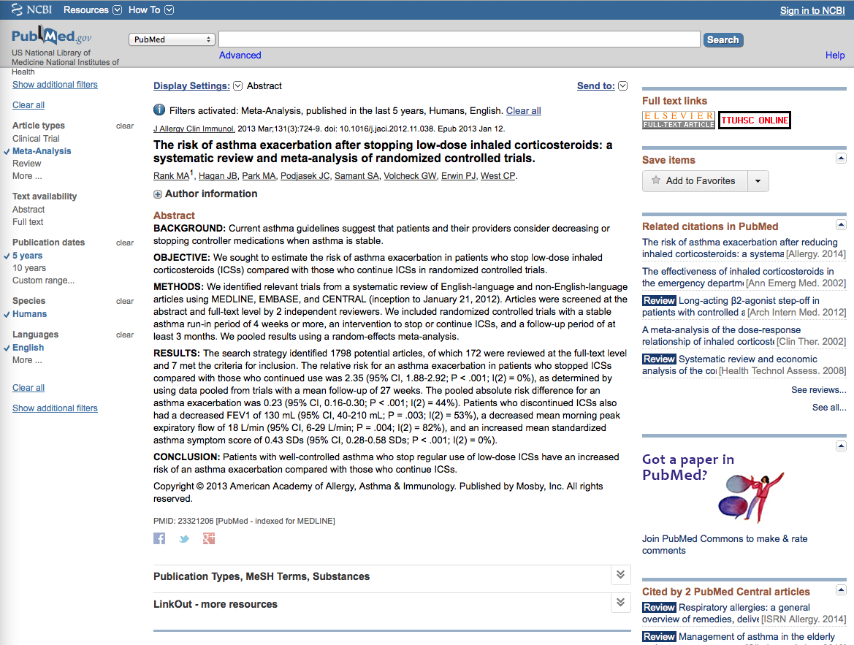
Click for Free Full Text
TTUHSC ONLINE

Slide 24
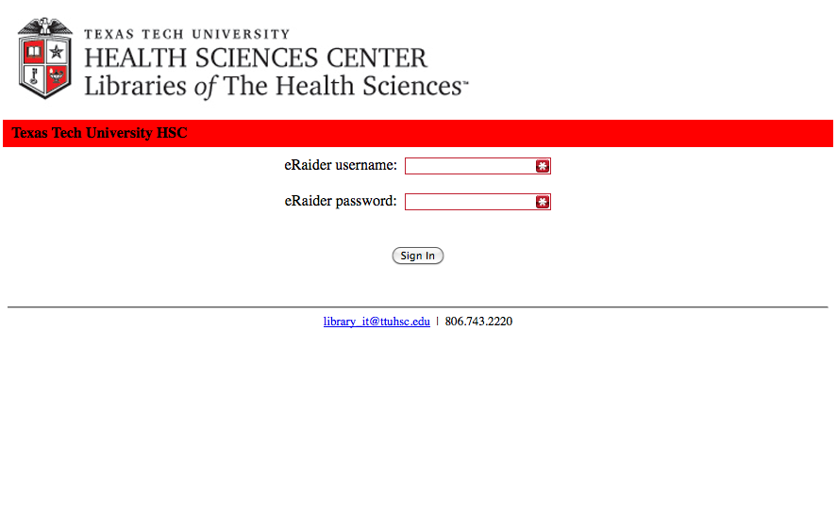
TTUHSC Libraries - Proxy Server
When Searching from Off Campus:
Enter the
Eraider username and password
assigned to you
by Information Services.
A
Problems with eRaider call: 806-743-1234a

Slide 25

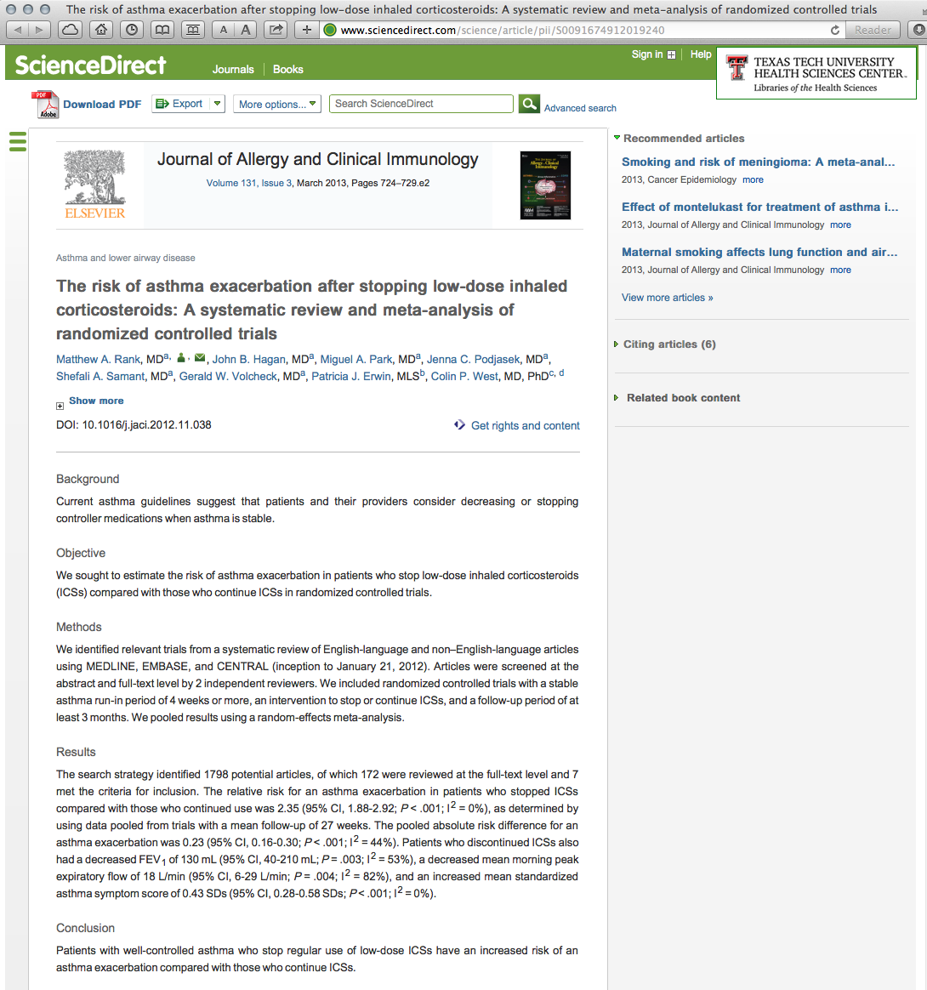
Click

Slide 26
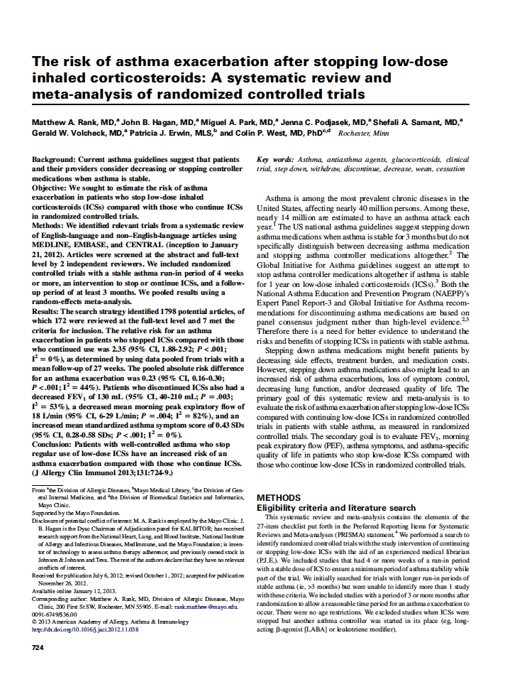
Full Text

Slide 27
PubChem

Slide 28
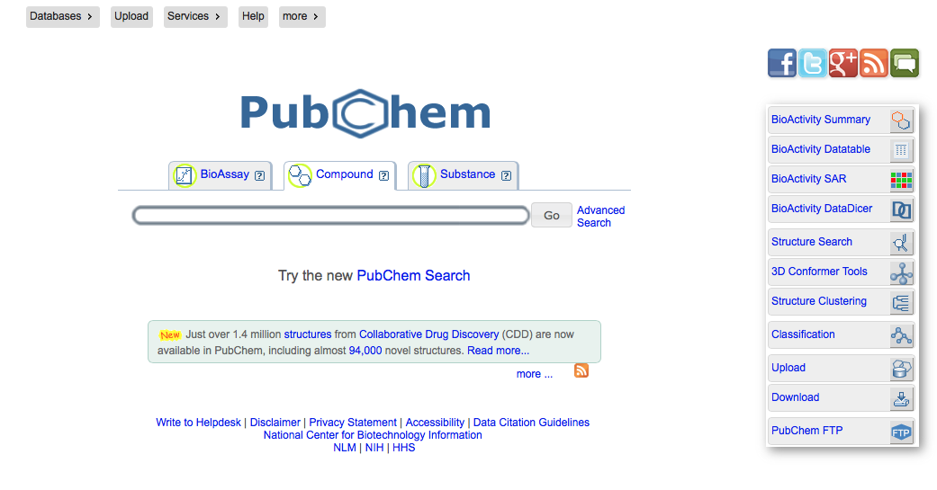

Slide 29
Other NLM Databases

Slide 30
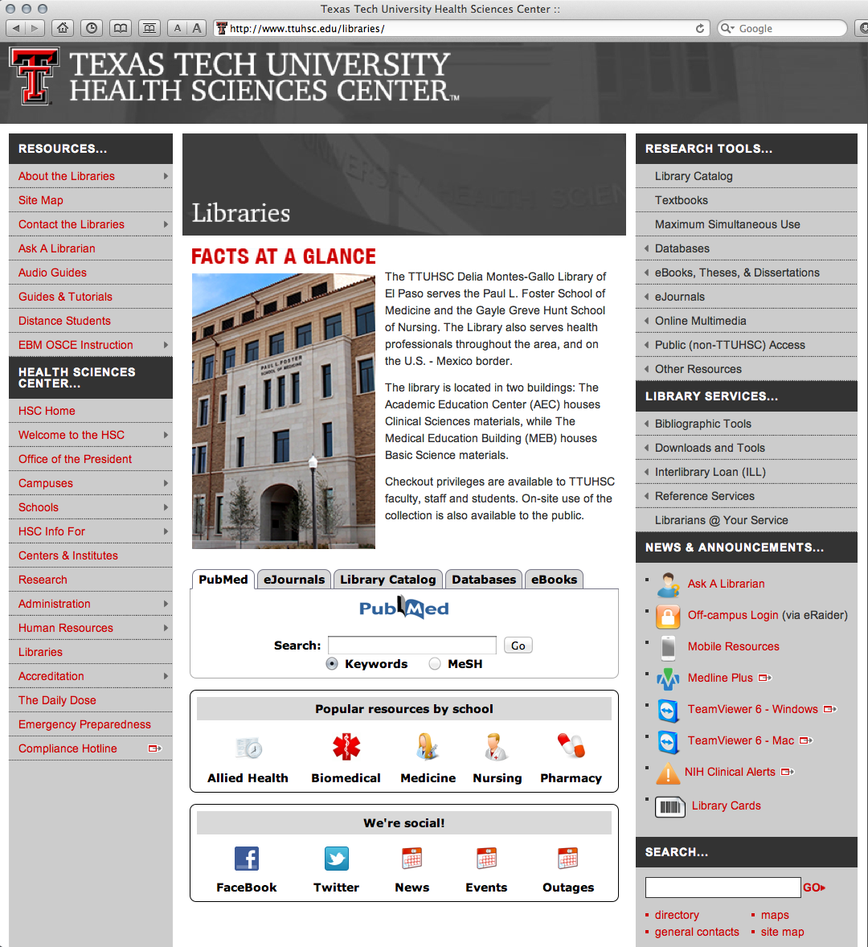
www.ttuhsc.edu/libraries
Click Databases

Slide 31
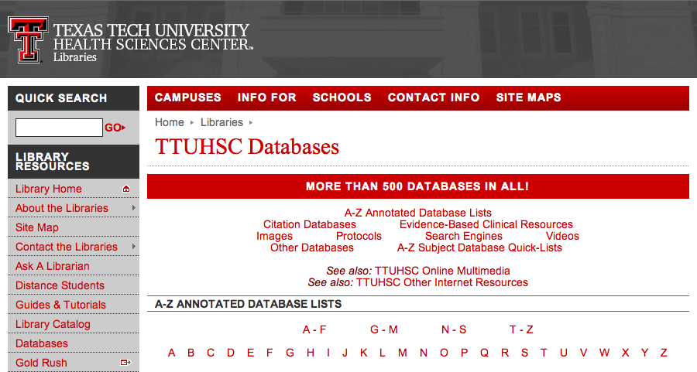
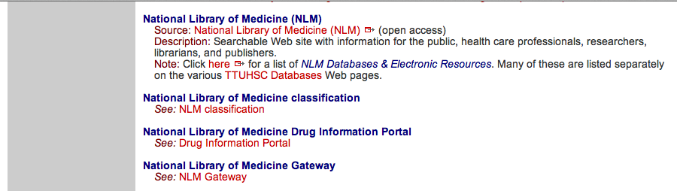
Click “N”
Scroll and click National Library of Medicine

Slide 32
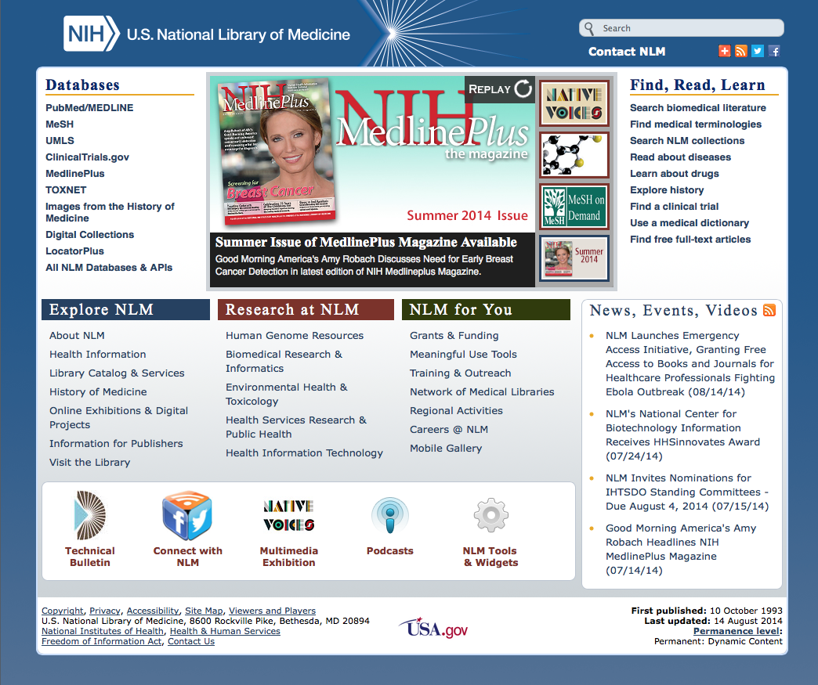
Click All NLM Databases & API’s

Slide 33
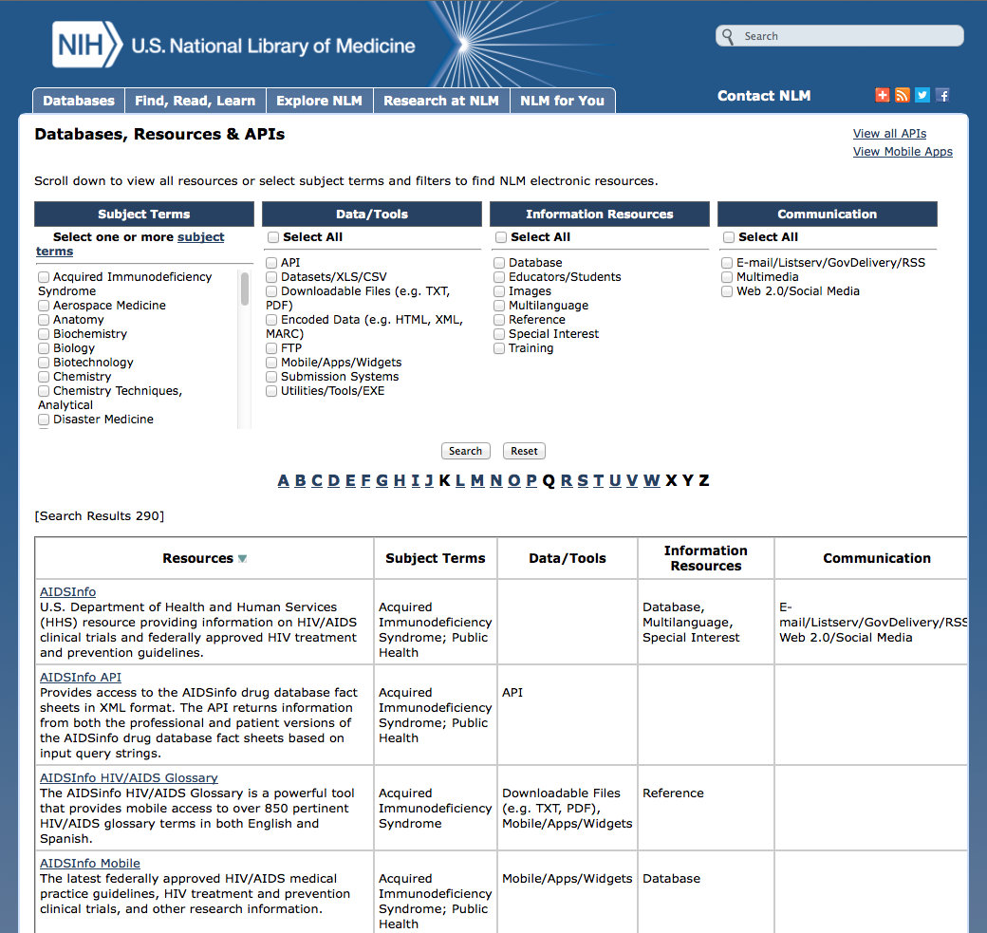
Locate and Click Database Name

Slide 34
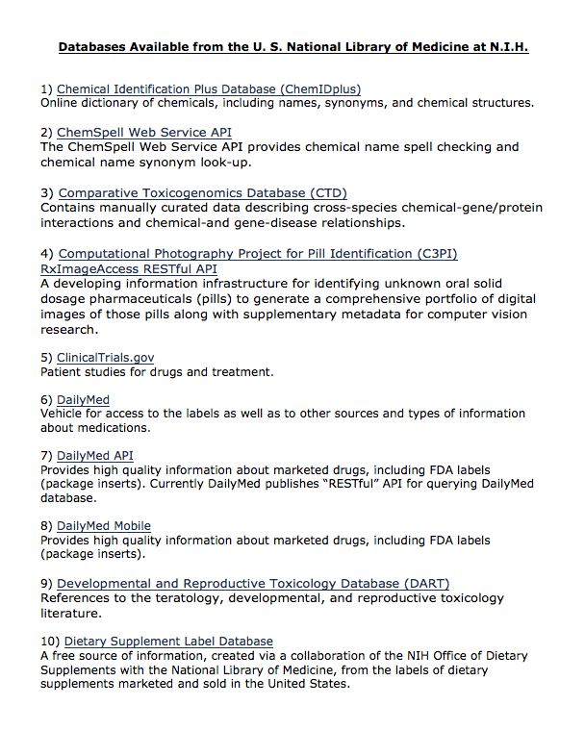


Slide 35
NCBI

Slide 36
National Center for Biotechnology Information
Mission:
create automated systems
store and analyze information
molecular biology
biochemistry
genetics
facilitate use of databases by the research and medical community

Slide 37
Click DNA Helix to go
to the NCBI databases

Slide 38
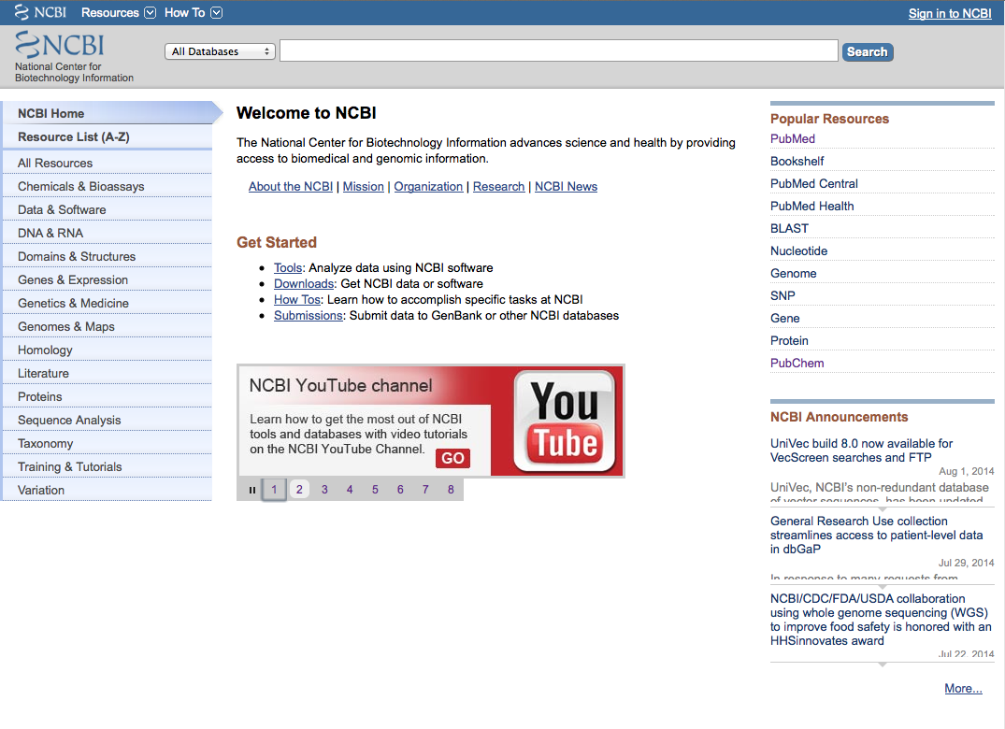

Slide 39
National Center for Biotechnology Information Databases
Assembly GSS (short single-read transcript sequences)
BioProject HomoloGene
BioSample Nucleotide Database
BioSystems Online Mendelian Inheritance in Man
ClinVar PopSet
CloneDB Probe
Conserved Domain Database Protein Database
Database of Genomic Structural Variation RefSeqGene
Database of Genotypes and Phenotypes Reference Sequence (RefSeq)
Epigenomics Sequence Read Archive
EST (short single-read transcript sequences) SNP
Gene Structure (Molecular Modeling Database)
Genome Taxonomy
GEO Datasets UniGene
GEO Profiles

Slide 40
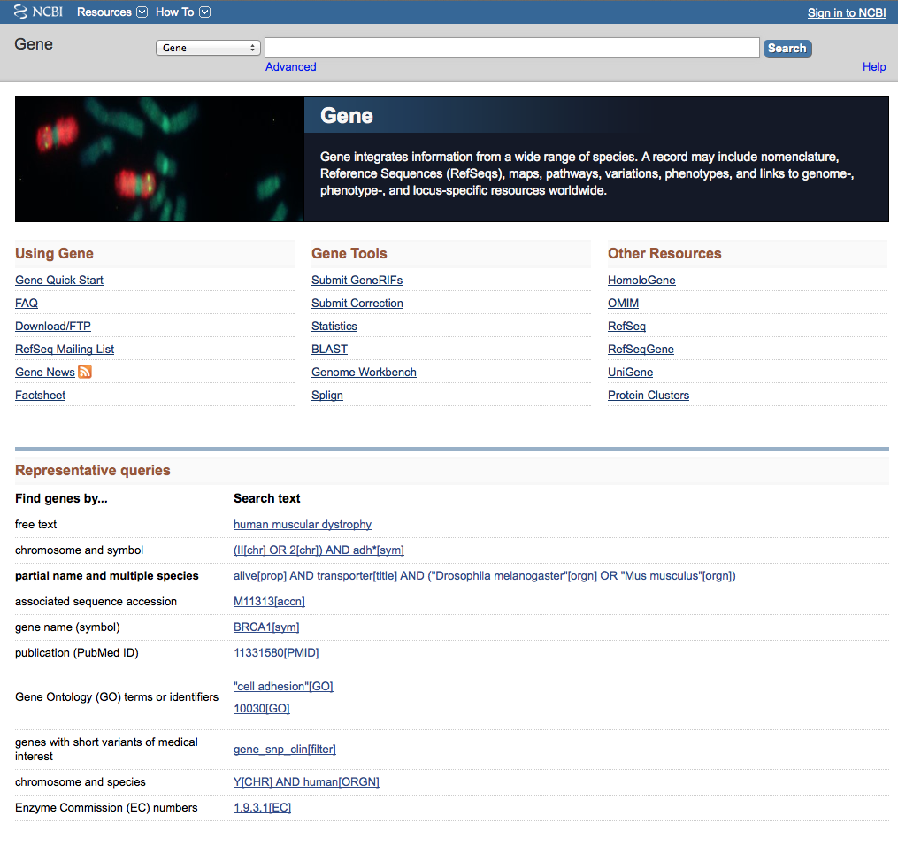
Search CFTR

Slide 41
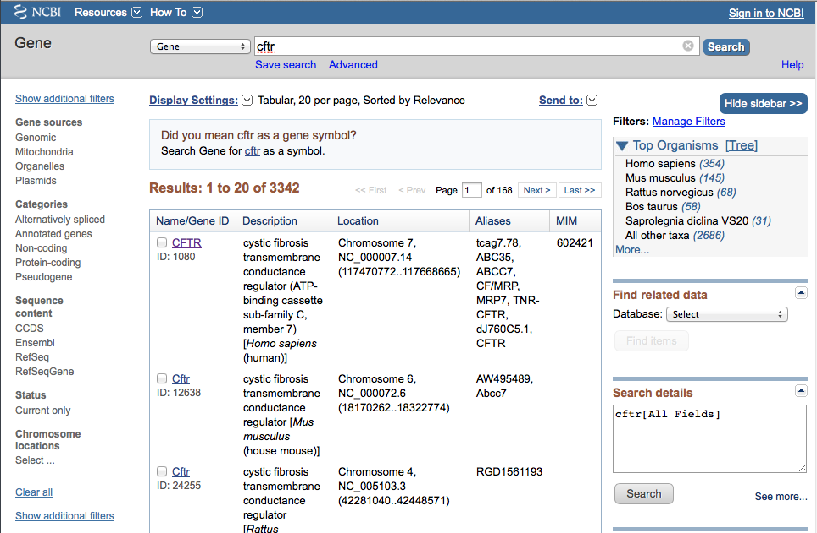
Click

Slide 42
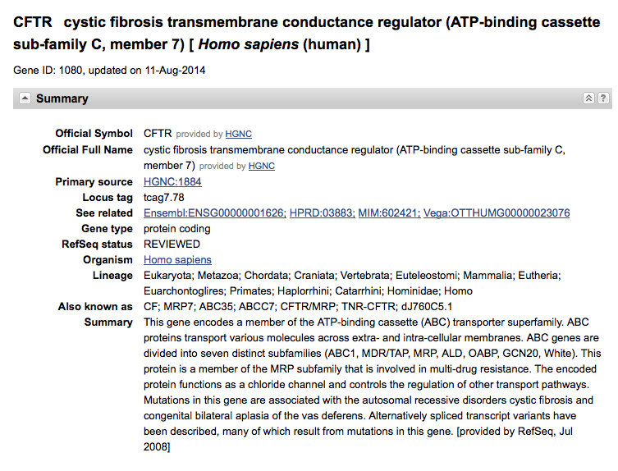

Slide 43
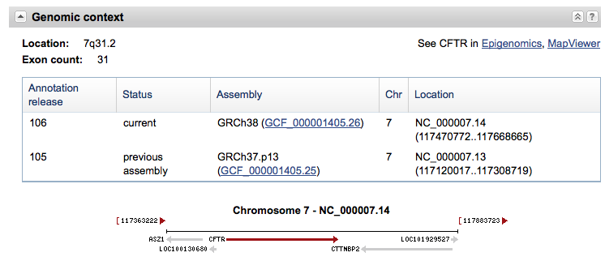

Slide 44
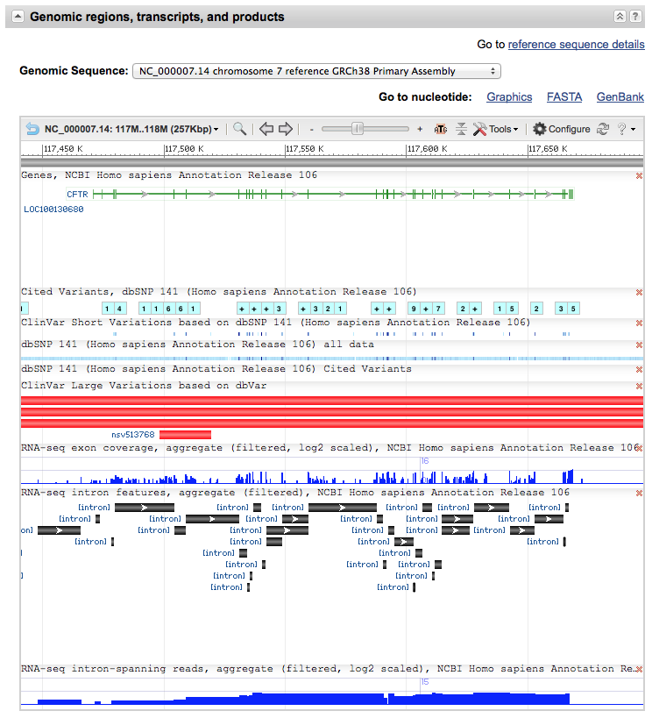

Slide 45
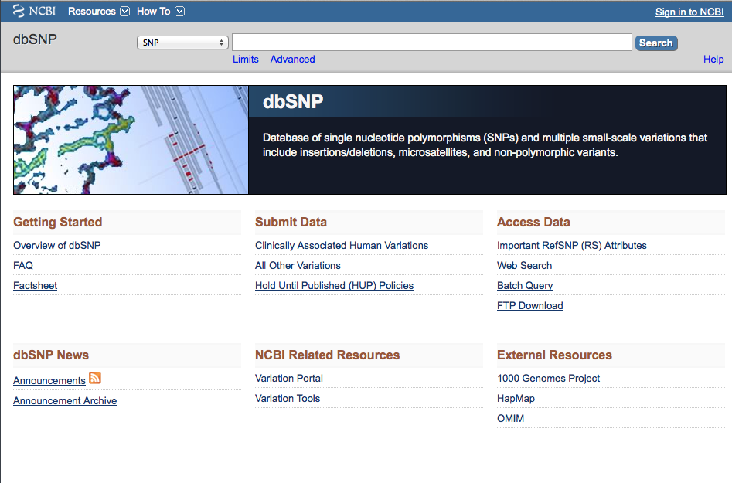
Click Advanced

Slide 46
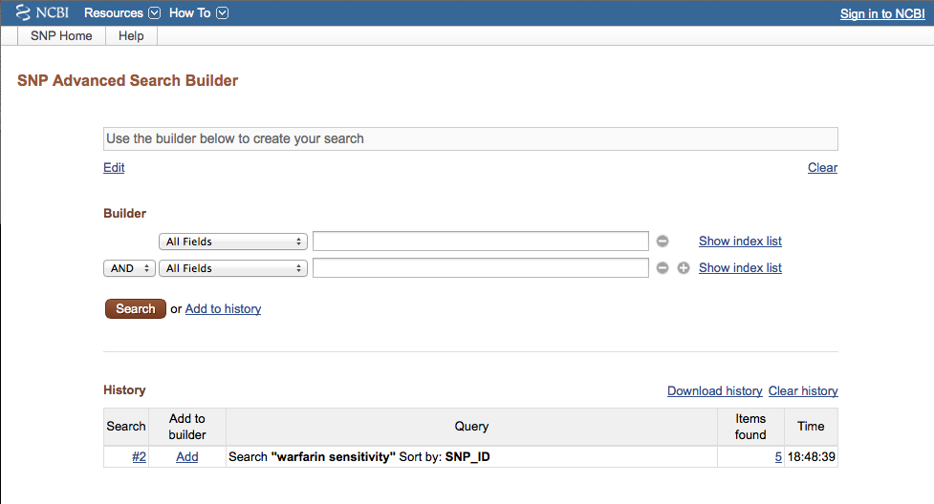
Search

Slide 47
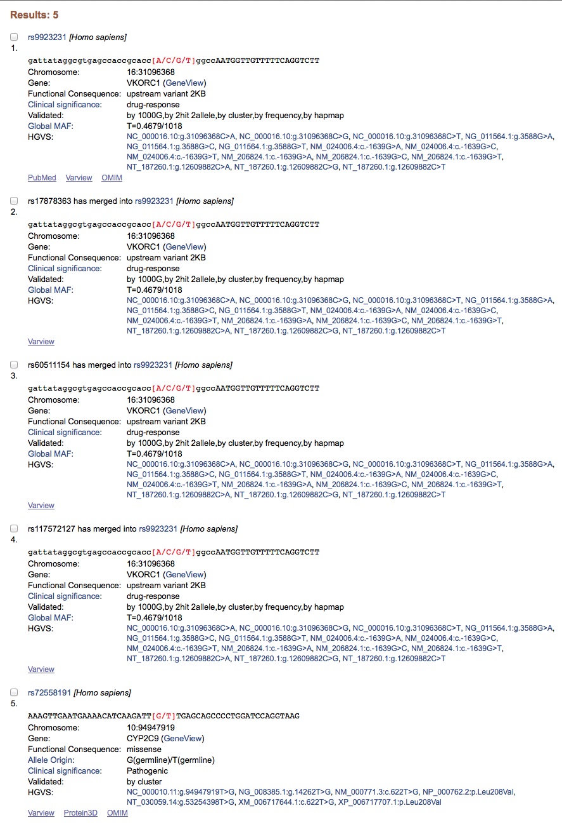
5 variants with sensitivity to Warfarin

Slide 48
Have Questions?

Slide 49
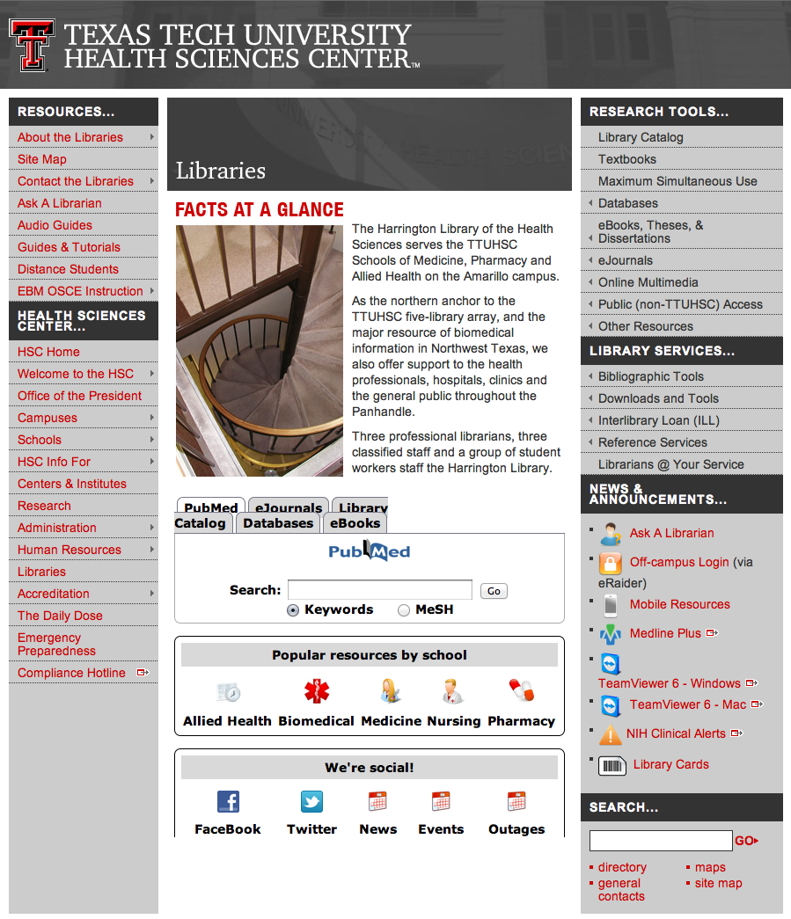

www.ttuhsc.edu/libraries
email us

Slide 50
Thank You!

