Slide 1
TOXNET
TOXICOLOGY DATA NETWORK
http://toxnet.nlm.nih.gov/
Jennifer Yack, MSIS

Slide 2
FYI
TOXNET received an new interface on May 16, 2014.
The National Library of Medicine is still working on the new interface. If it does interesting things while you are in the databases, take a deep breath and try again. ☺
There is a mobile version of TOXNET: http://toxnet.nlm.nih.gov/pda/

Slide 3
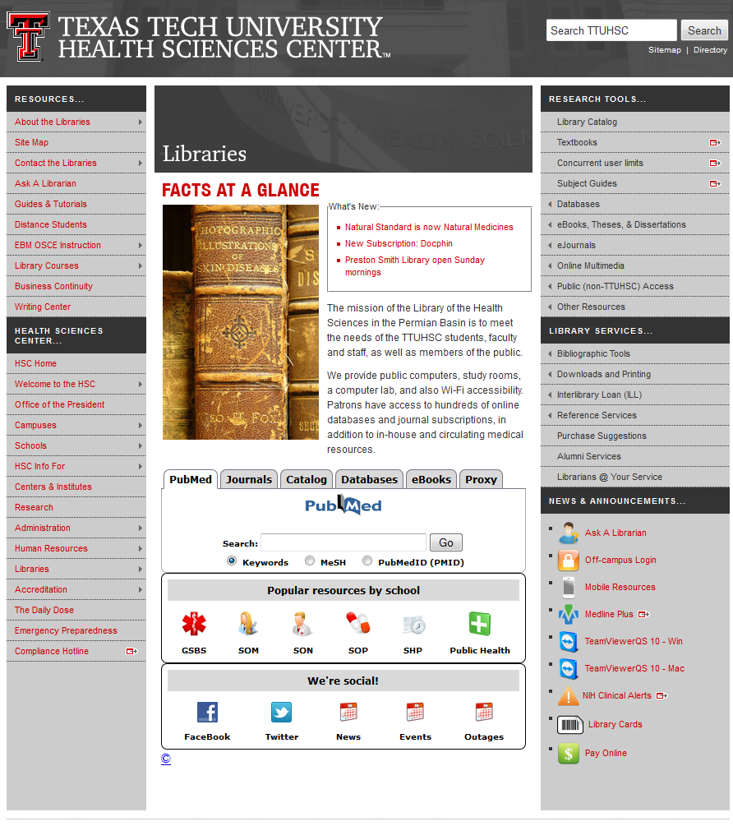
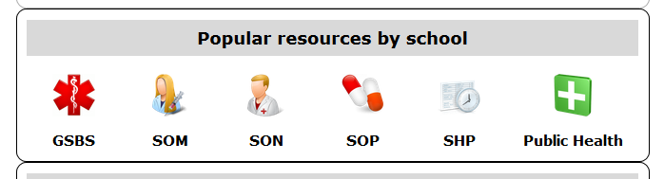
TTUHSC Library Homepage
http://www.ttuhsc.edu/libraries/

Slide 4
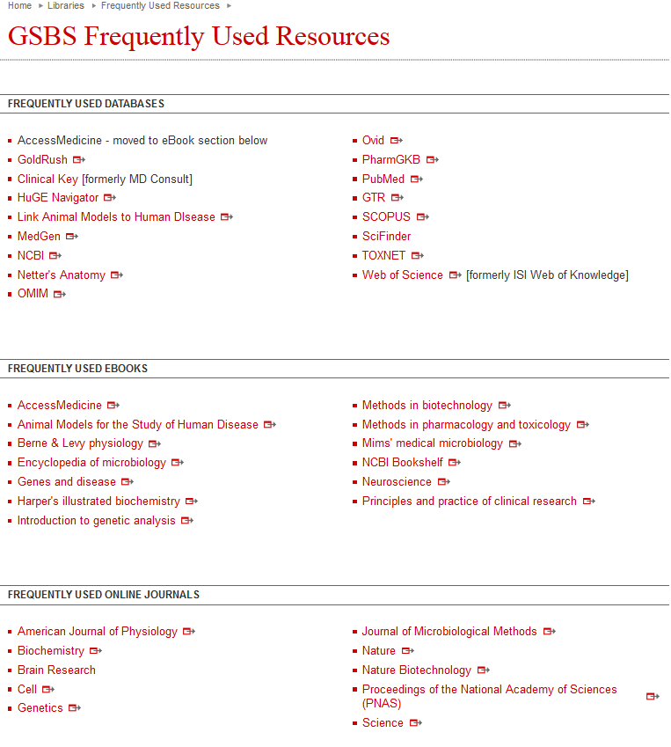
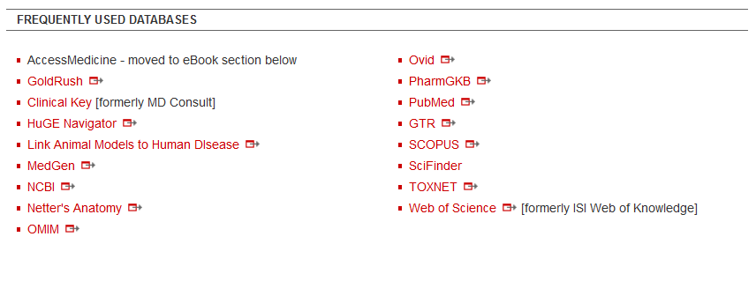
GSBS Frequently Used Resources

Slide 5
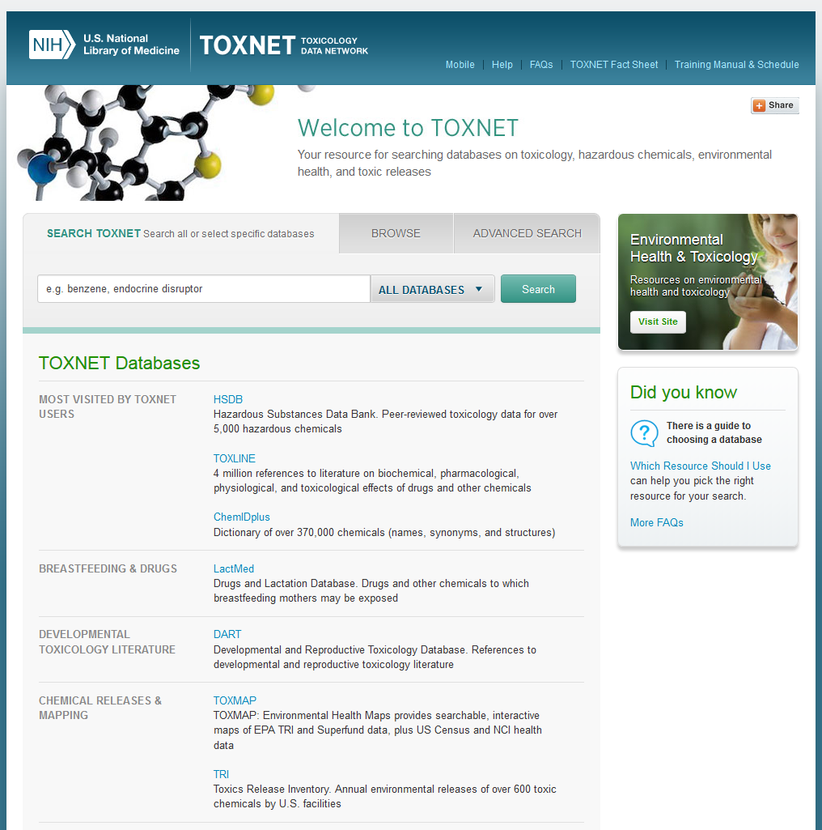
TOXNET Home page

Slide 6
TOXNET
TOXicology data NETwork is a group of databases covering:
Chemicals and drugs
Diseases and the environment
Environmental health
Occupational safety and health
Poisoning
Risk assessment and regulations
Toxicology

Slide 7
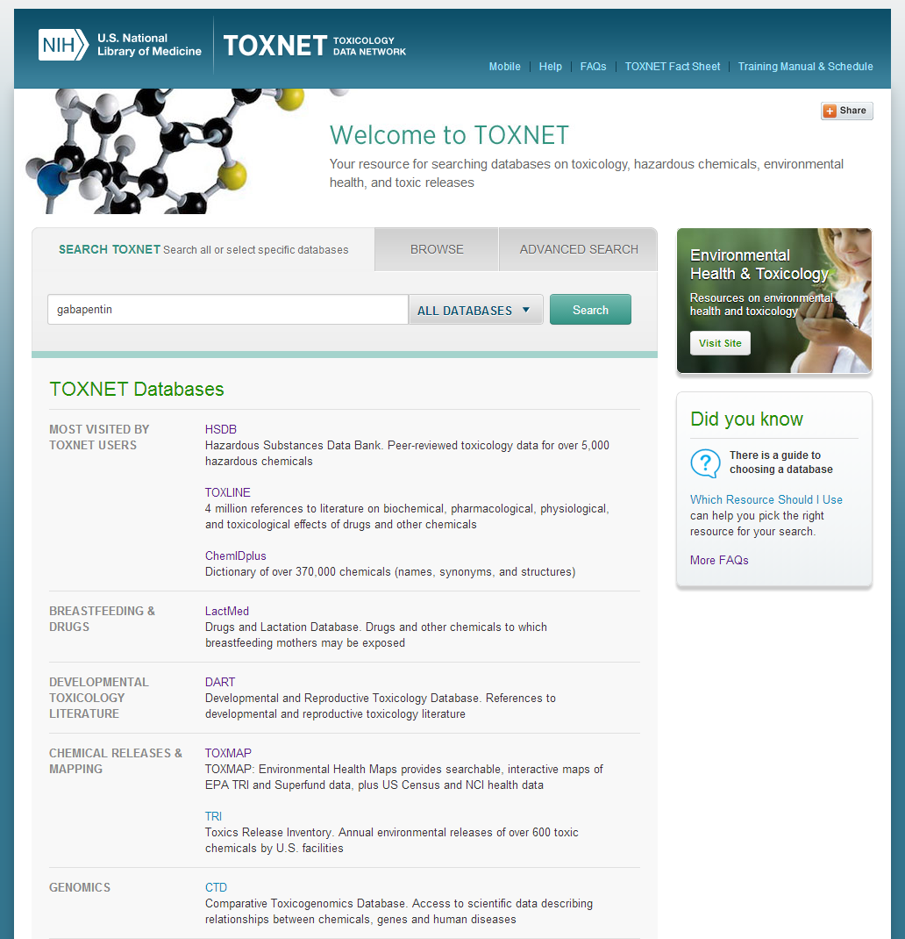
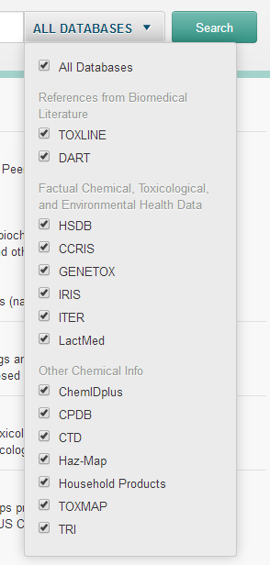
TOXNET
Type gabapentin, make sure that the search bar states ALL DATABASES and click Search
gabapentin

Slide 8
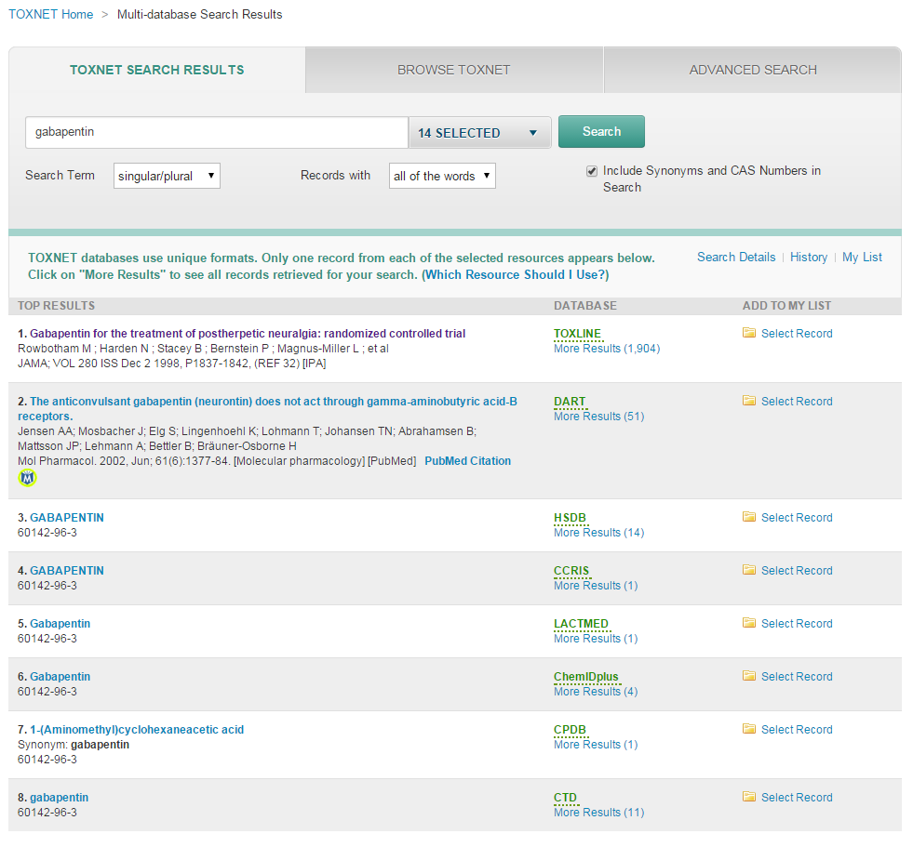
TOXNET > Multi-database Search Results

Slide 9
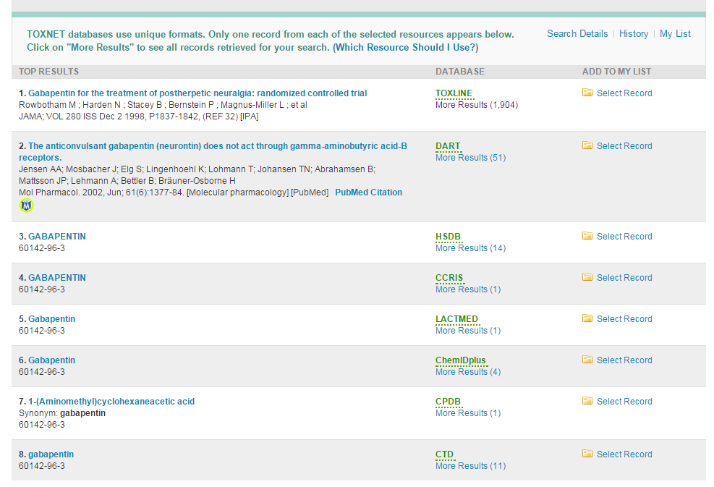
TOXNET > Multi-database Search Results

Slide 10
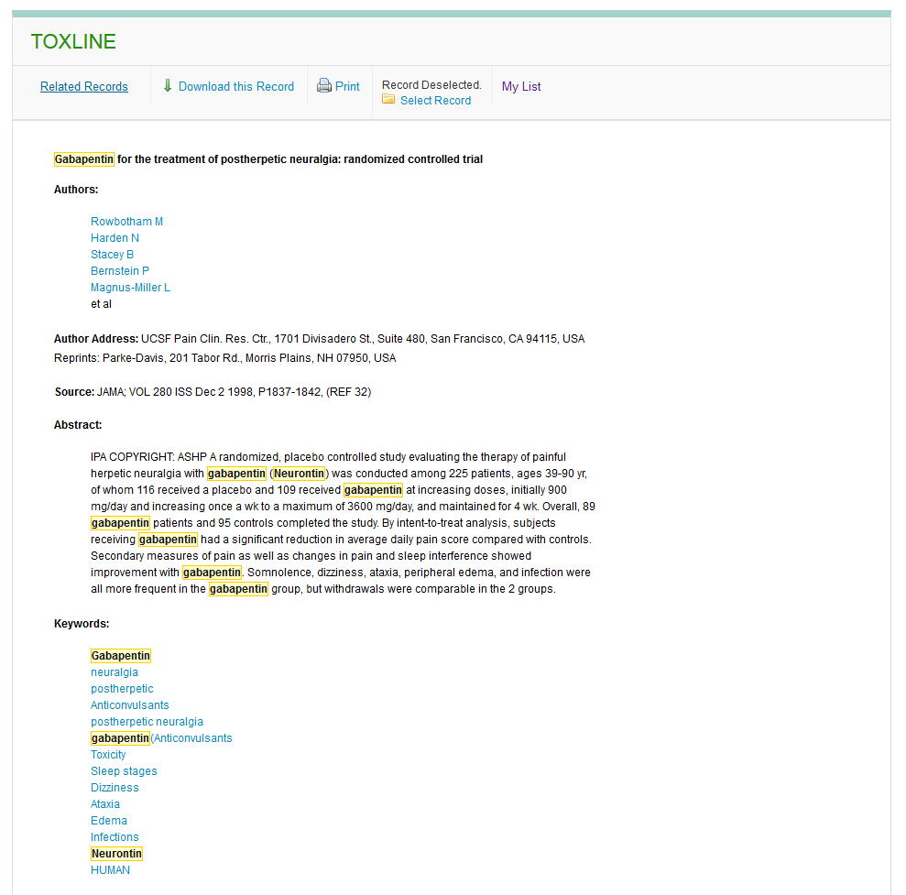
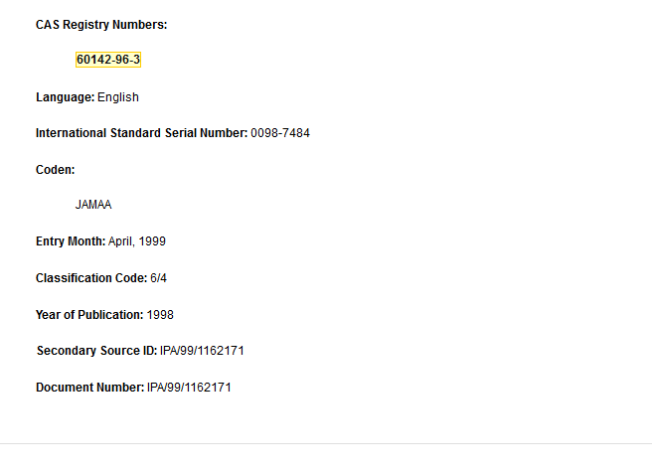
TOXLINE
CAS Registry Number: Chemical Abstracts Service Number

Slide 11
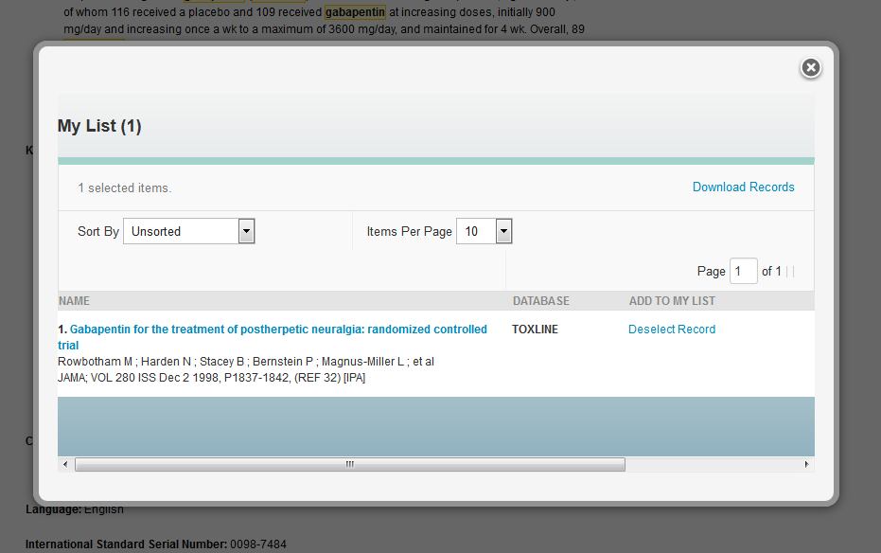
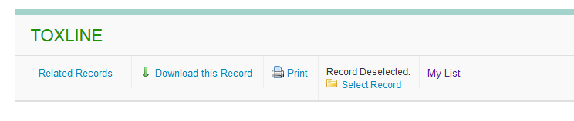
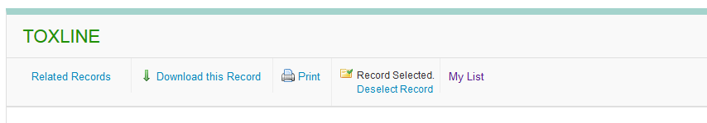
TOXLINE

Slide 12
TOXNET > Multi-database Search Results

Slide 13
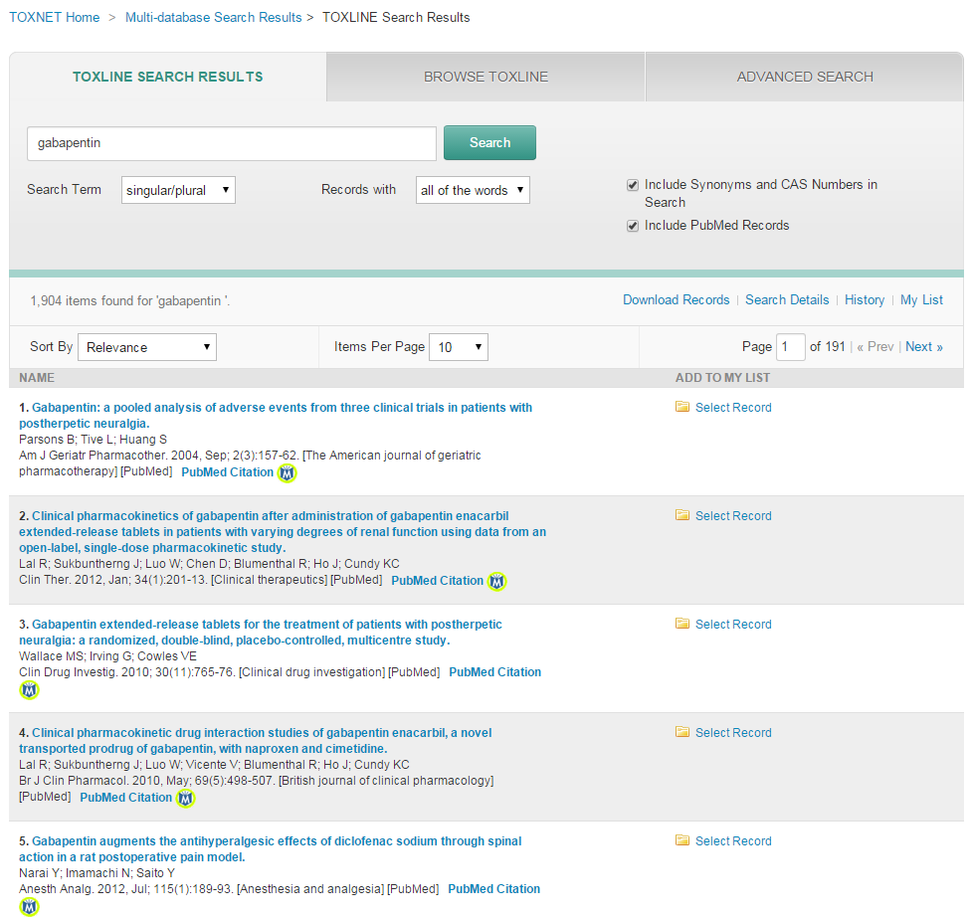
TOXNET > Multi-database Search Results> TOXLINE Search Results
Clicking on PubMed Citation takes you to the PubMed website

Slide 14
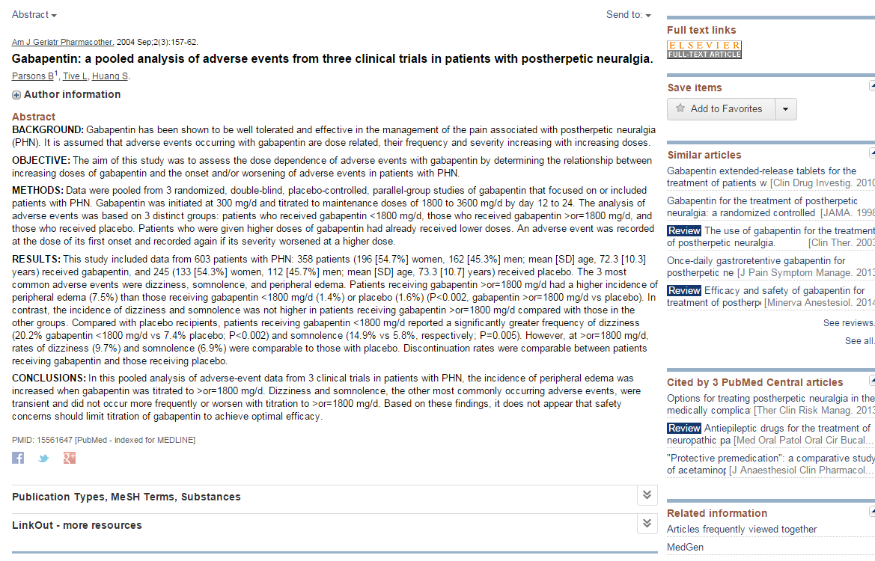

TOXNET > Multi-database Search Results > TOXLINE Search Results

Slide 15
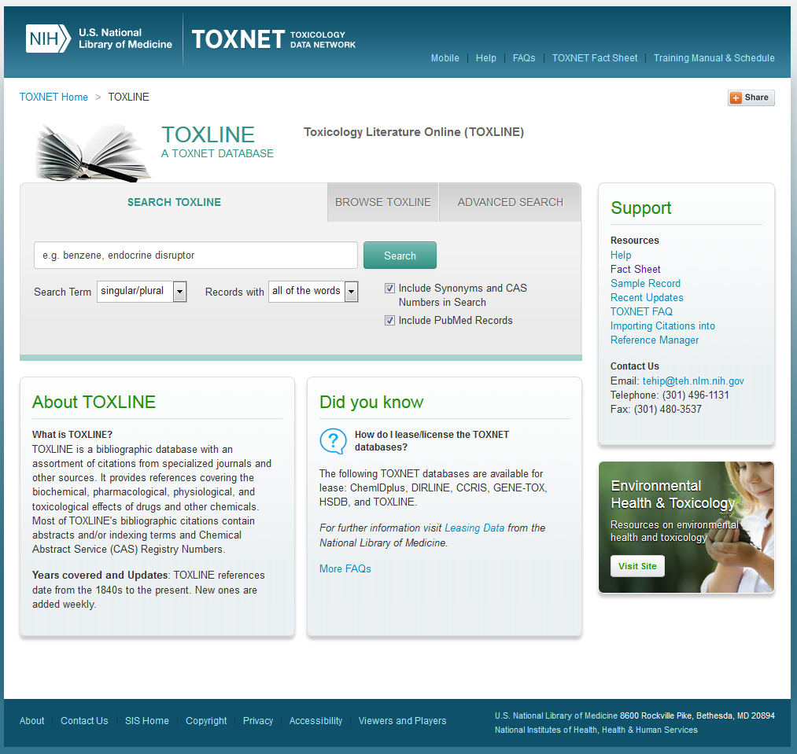
TOXLINE
Type gabapentin and click Search
gabapentin

Slide 16
TOXNET Home page

Slide 17
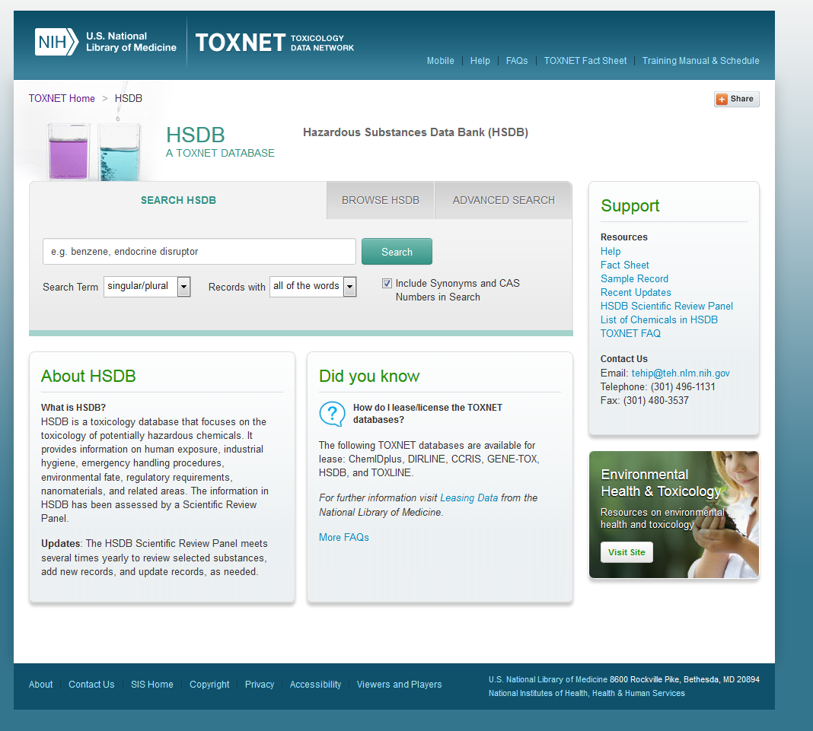
HSDB Home page

Slide 18
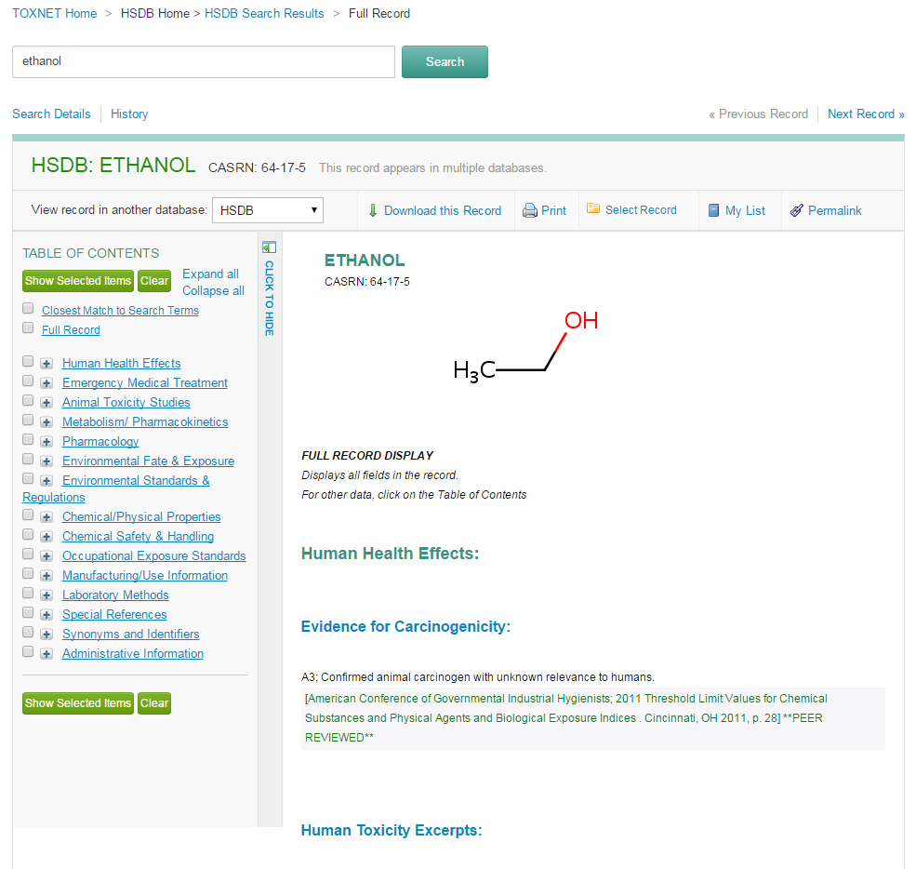
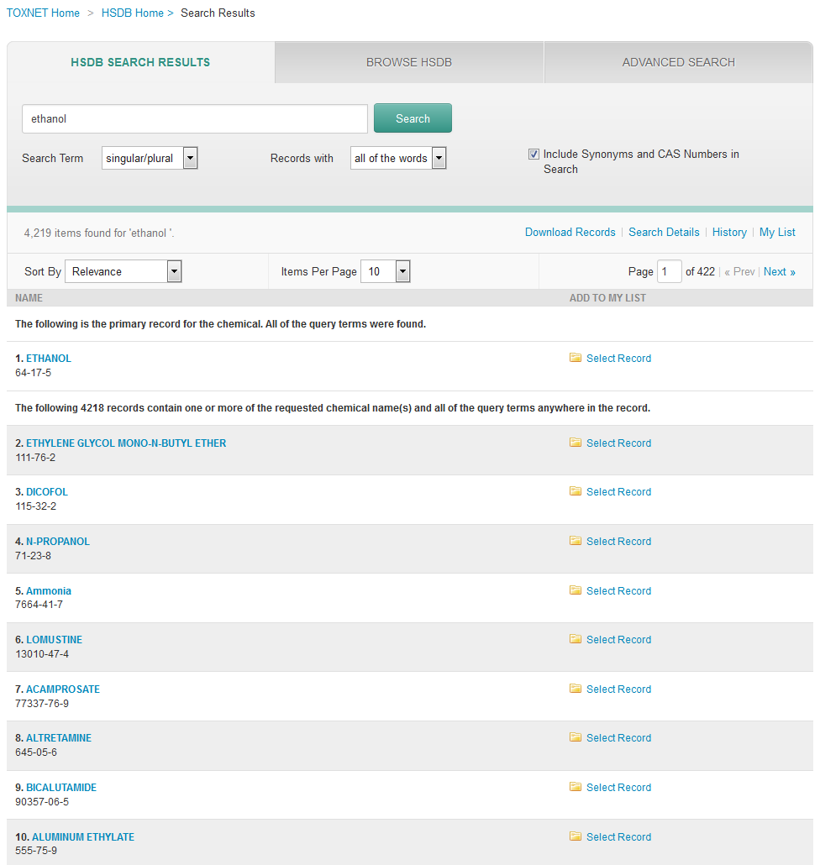
HSDB Search Results

Slide 19
TOXNET Home page

Slide 20
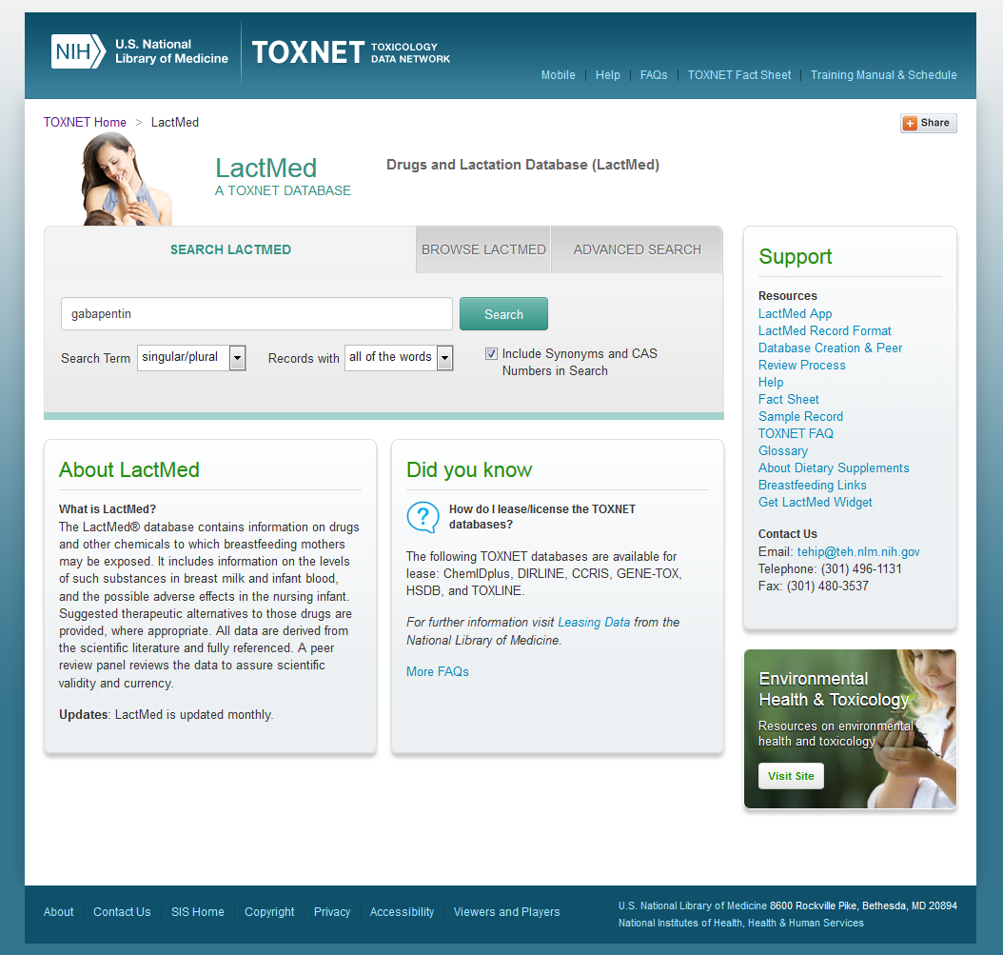
LactMed Home page

Slide 21
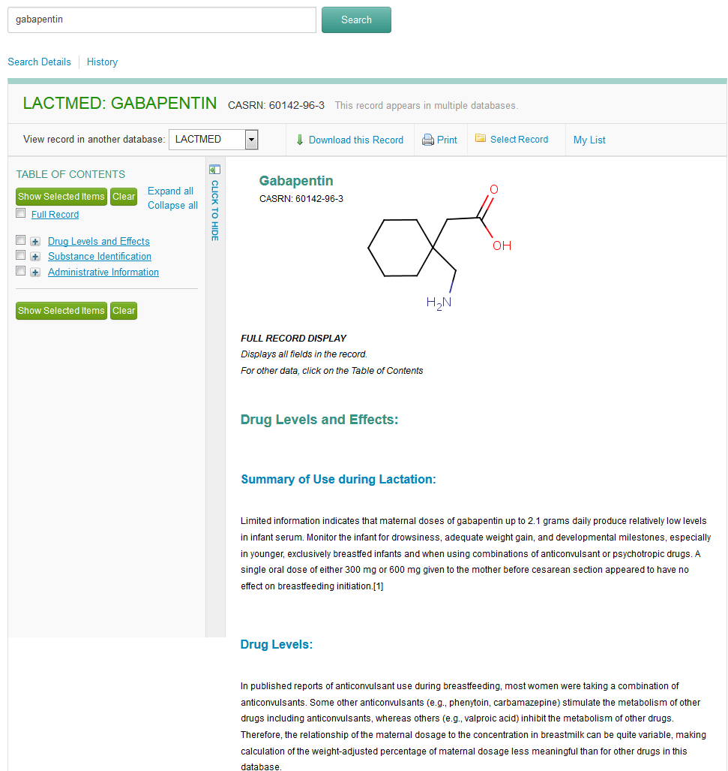
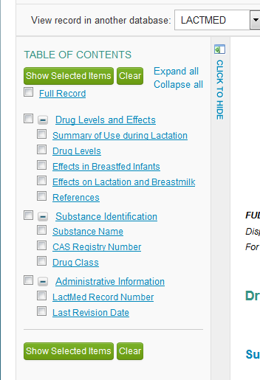
LactMed Results
You can expand your Table of Contents

Slide 22
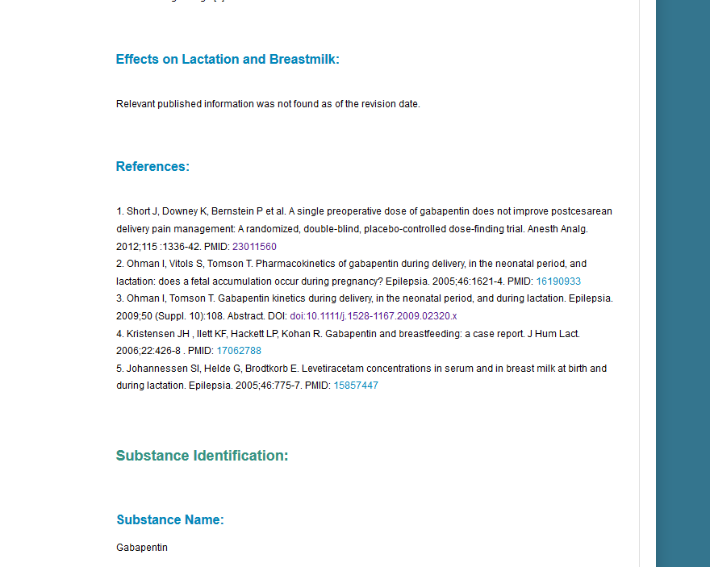
LactMed Results
You can click on the hyperlinks and it will take you directly to that source.

Slide 23
TOXNET Home page

Slide 24
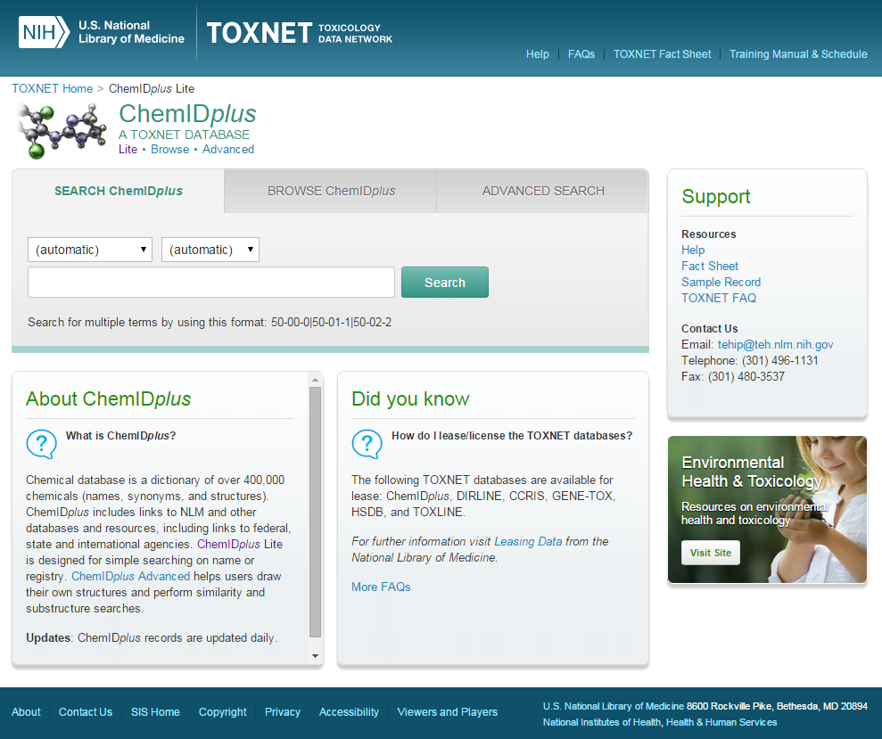
ChemIDplus
gabapentin

Slide 25
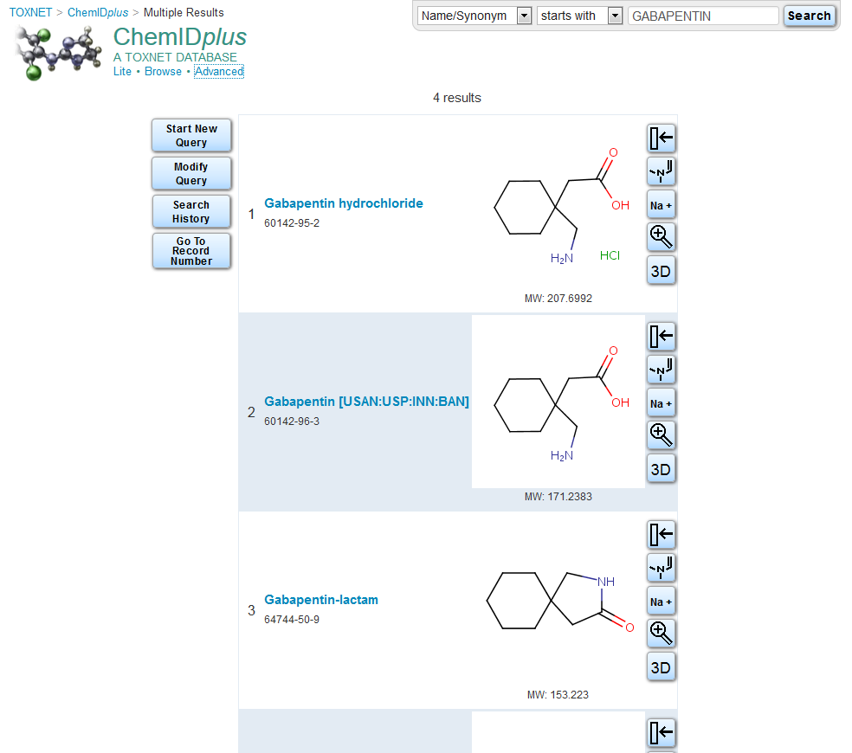
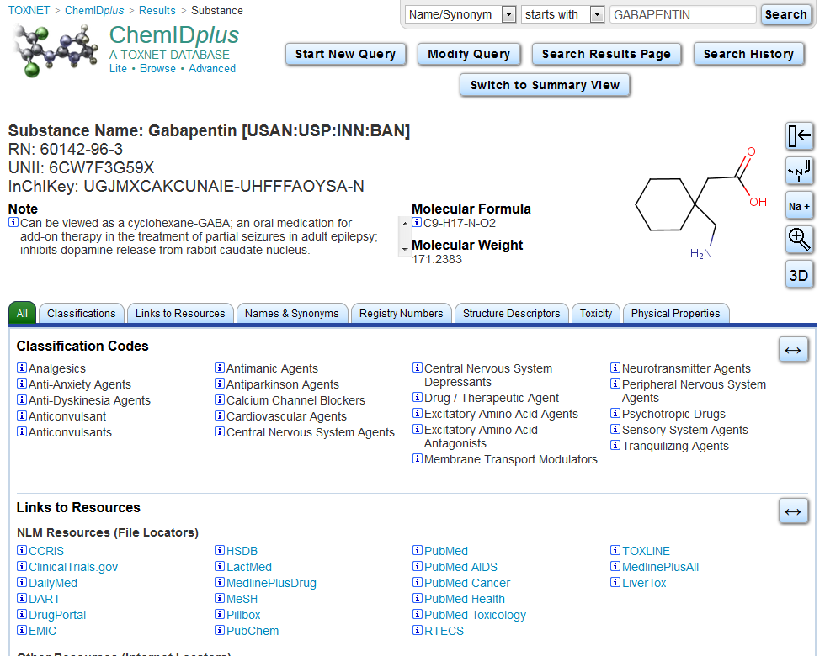
ChemIDplus

Slide 26
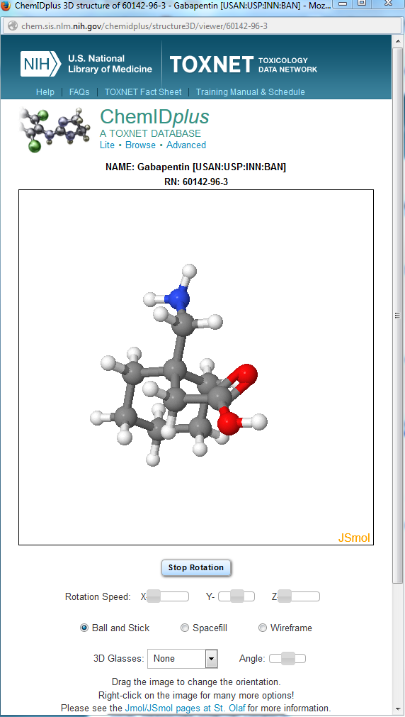
ChemIDplus

Slide 27
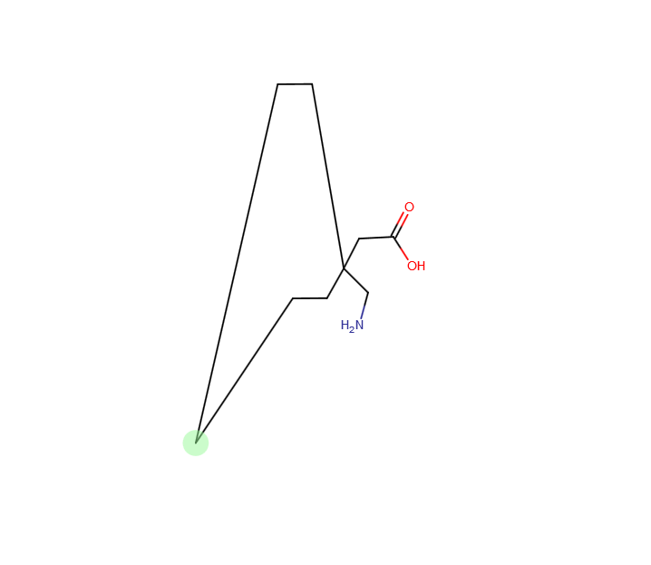
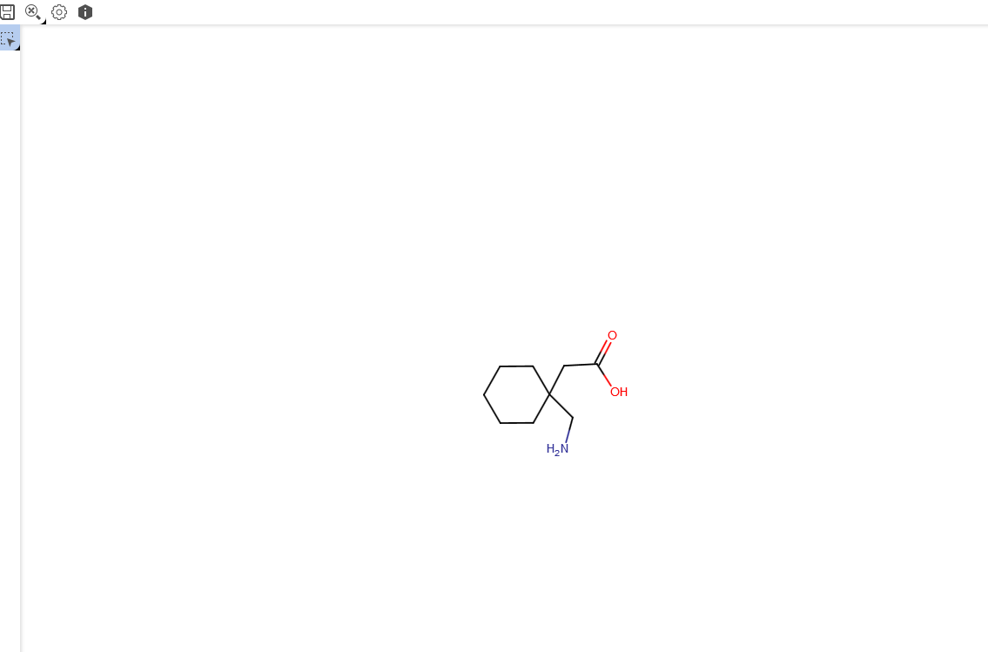
ChemIDplus

Slide 28
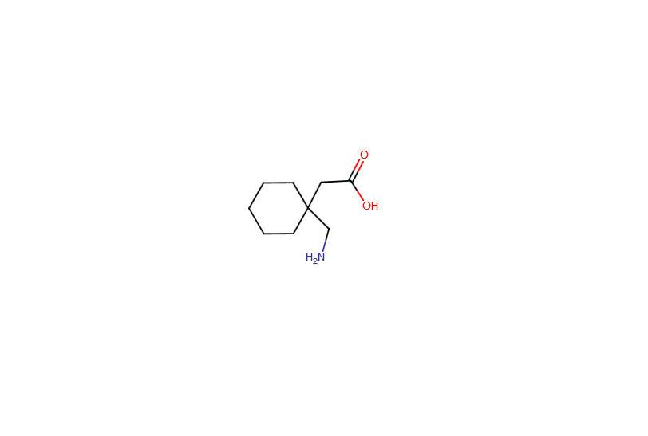
ChemIDplus
Take a few moments to explore!

Slide 29
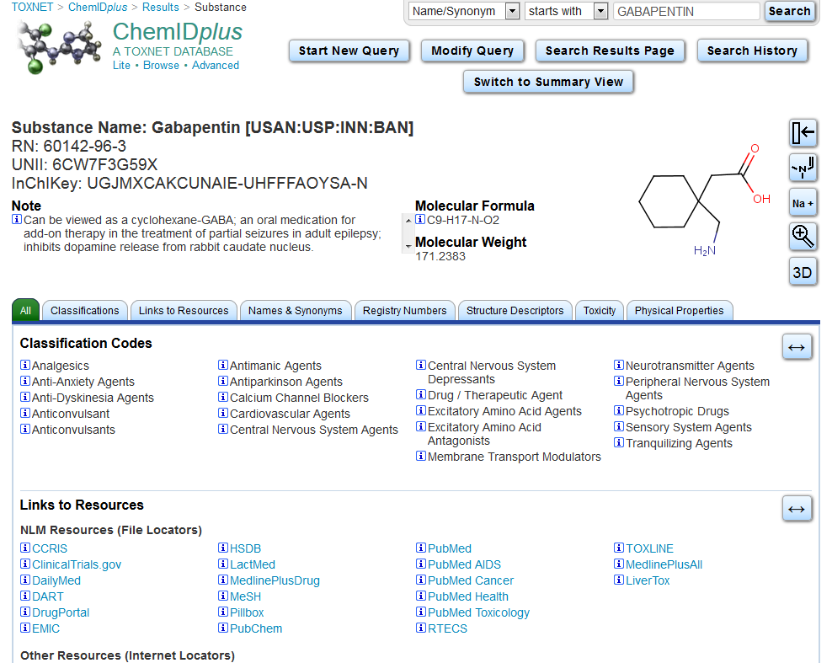
Scroll down to see the full record

Slide 30
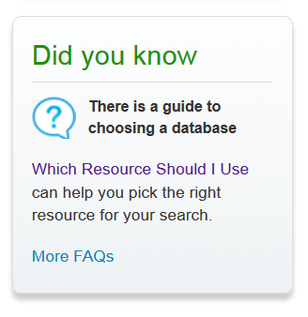
TOXNET Home page

Slide 31
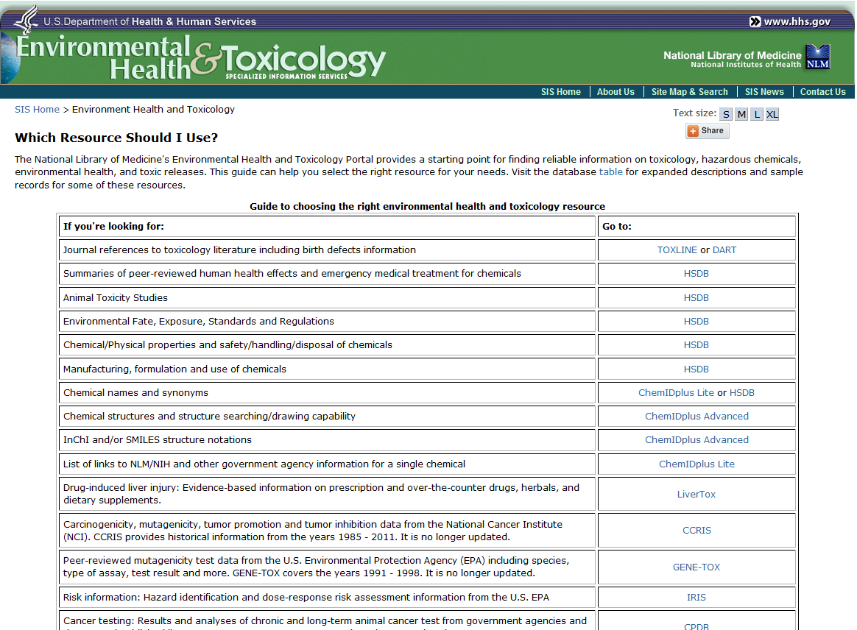
Which Resource Should I Use?
Scroll Down

Slide 32
Any Questions?

