Slide 1
How to document citations for promotion & tenure:
A step Beyond PubMed
Margaret Vugrin, MSLS, AHIP, MPH
September 20, 2017

Slide 2
On the 3x5 card please write:
Your name - On the front – Underline
The institutions that you have worked for – on the back– Underline below the last

Slide 4
John Andrew Smith
Maria Gonzales de Martinez

Slide 10
Naming Conventions
Through out one’s life names may be modified
Western culture: women may choose to take husbands name or not
They may hyphenate both names or keep their maiden name
In some cultures the woman takes her husband’s first name as her last name
Foreign names may be shortened when coming to the states to make it easier

Slide 11
Mexican naming system
Mexican naming system is the way in which apellidos (surnames) are exchanged through marriage. Usually the wife will drop her second apellido and replace it with her husband´s first apellido.
Also, sometimes they will insert a “de” in front of the husband´s first apellido before it replaces the wife´s second apellido.
For EXAMPLE: Hilda Rivas Aguilar. After marriage to her husband Ivan Rosado Nuñez, she can be known as Hilda Rivas Rosado or Hilda Rivas de Rosado.
Not all Hispanic cultures follow the same pattern

Slide 12
Why is this important?

Slide 13
When publishing, tenure and promotion packets…
Our Name
Institution’s Name
Database
Publisher

Slide 14
Institution
Texas Tech University
Texas Tech University Health Sciences Center
TTUHSC, SON, Amarillo
TTUHSC, School of Medicine

Slide 15
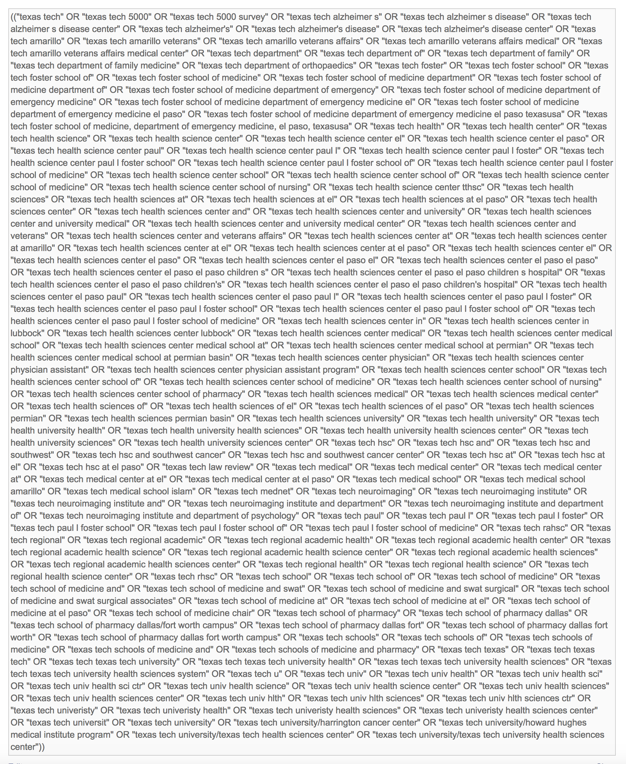
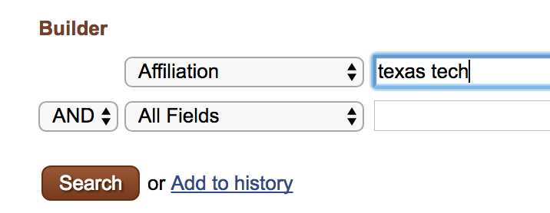
This is a problem!

Slide 16
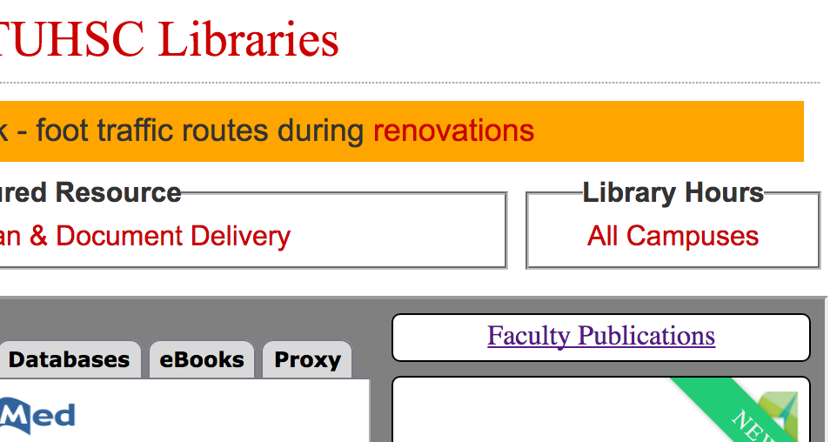
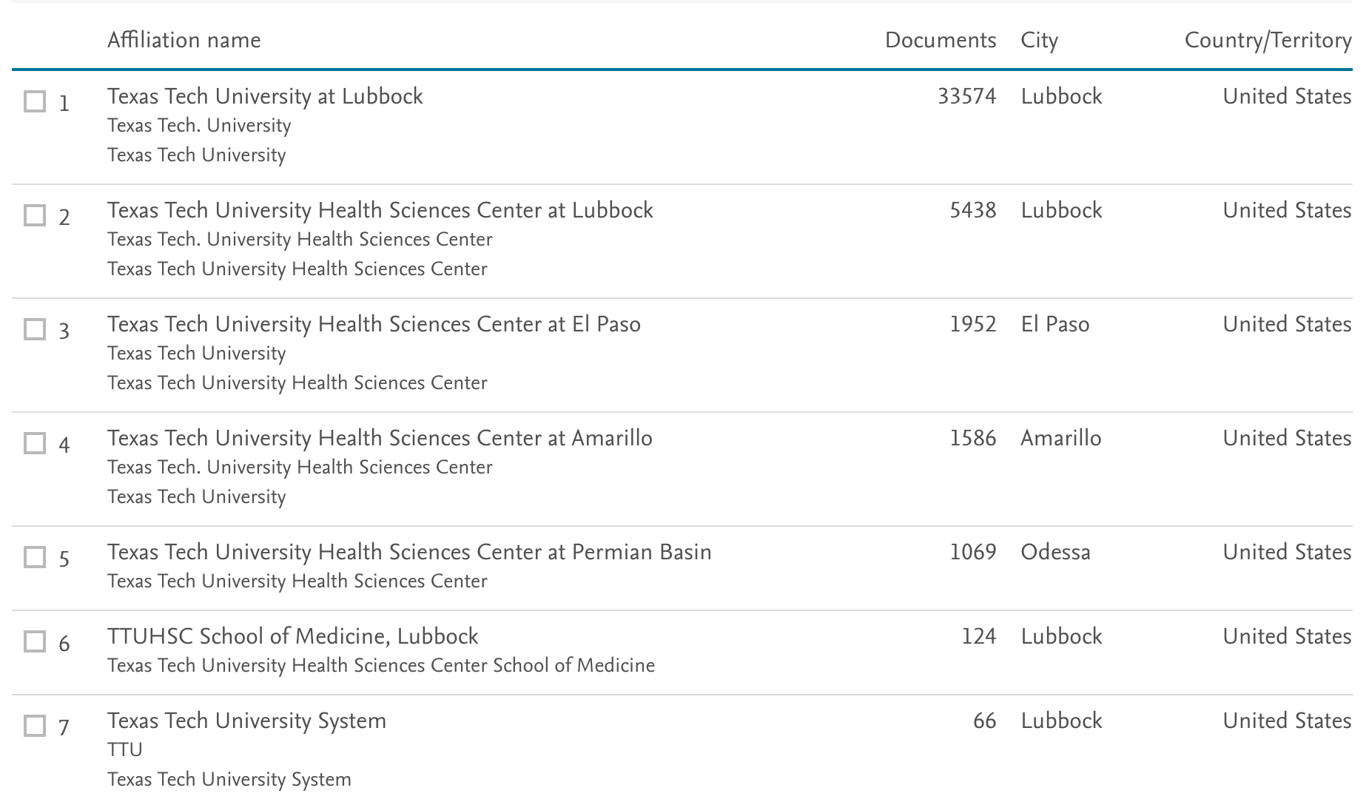
Scopus

Slide 17
Publisher – Example: John Andrew Smith, III
John A. Smith
John Smith
J Smith
J A Smith, III

Slide 18
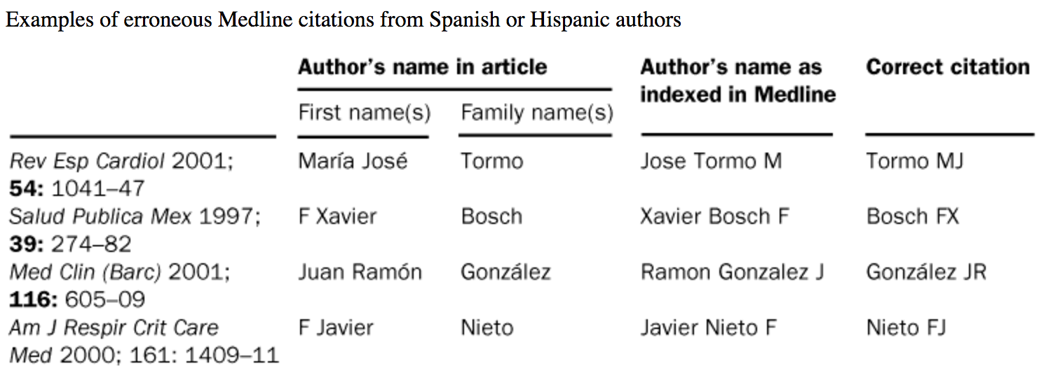
Database – Medline
John Smith
Fernández, E., & García, A. M. (2003). Accuracy of referencing of spanish names in medline. Lancet (London, England), 361(9354), 351-352. doi:10.1016/S0140-6736(03)12356-2

Slide 19
Our Name
Institution’s Name
Database
Publisher

Slide 20
Faculty publish:
Journal articles
Books
Book chapters
Presentations
Posters
Conference abstracts
Clinical trials
Web sites
Etc.
Oftentimes, we, ourselves, don’t use the same version of our own name, when we publish.

Slide 21
Types of Materials – Indexed in certain databases
Medline (either PubMed or Ovid) retrieves roughly 80% to 95% of the existing journal article citations for any given author, depending on the topic. For instance, articles in fields some fields are not indexed.
Book chapters or books are only indexed in a few places, e.g. Scopus, EBSCO databases, Google Scholar, or WorldCat, or the publisher site.
Conference abstracts, papers, posters, brochures, websites (also known as the "gray literature") can also be hard to locate and must be searched in particular databases, e.g. EMBASE, Scopus, Web of Science, WorldCat or Google Scholar.
Clinical trials or grants must be searched separately from the other publication types.
Rios, G.LibGuides: Medical library research guide: Author searching. Retrieved from http://iupui.campusguides.com/medlibresearch/authors

Slide 22
Why?
PubMed = 111 articles
Scopus + 6
Embase + 15
Web of Science + 13
Google Scholar + 15
New Total = 160 unique articles

Slide 23
Digital Measures
Enters the data that you send to them and organizes your bibliography for you
READ: “that you send to them”

Slide 24
Look at your card…
Are there other variants of your name that should be considered?
Please add them to the card.
What about the institution’s names?
Are there other ways that your institution can be called.
Please add them to the card.
Also, please add your contact email to the card.

Slide 25
What can you do?
To have a more complete bibliography?

Slide 26
Databases
PubMed = 6,000+ journals back into the 60s and before, 27 million records
Scopus = It covers nearly 22,000 titles from over 5,000 publishers, of which 20,000 are peer-reviewed journals in the scientific, technical, medical, and social sciences (including arts and humanities) 55 million records. Also incorporate searches of patent databases.
EMBASE = Embase provides unparalleled coverage of the biomedical literature, with 32 million+ records from almost 8,300 currently published journals. Embase includes six million+ records and 2,900+ journals that are not covered by MEDLINE. Also, Embase Classic provides access to data going back to 1947.
EMBASE: includes conference abstracts from important biomedical, drug and medical device conferences dating back to 2009. It currently indexes 7,000+ conferences covering over 2.4 million conference abstracts-advanced information that can’t be found searching MEDLINE alone.
EMBASE – double indexing of drug/chemical data

Slide 27
Databases
Web of Science= encompasses over 50,000 scholarly books, 12,000 journals and 160,000 conference proceedings, 90 million records.
Google Scholar
Subject Specialty databases:
CINAHL Plus, Full text for more than 770 journals
  Full-text coverage dating back to 1937
  Indexing for more than 5,000 journals
  More than 5.3 million records

Slide 28

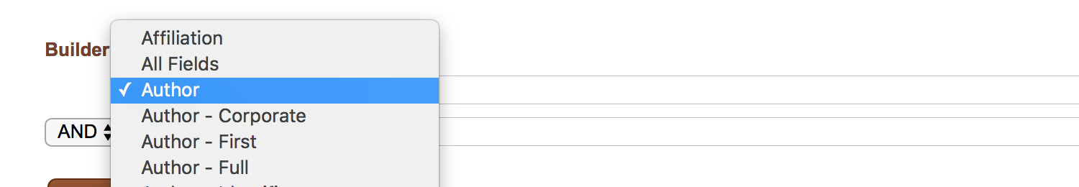
PubMed

Slide 29
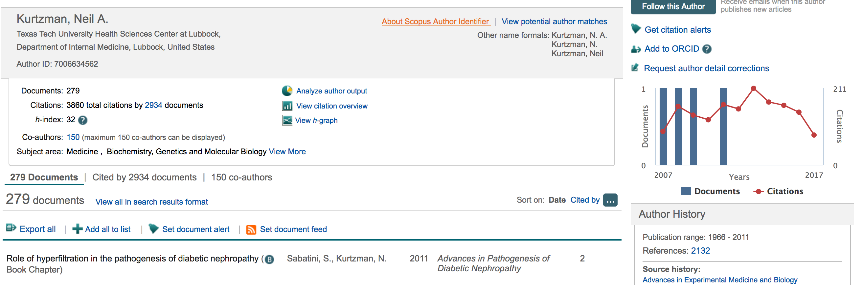
FIXES
Scopus

Slide 30
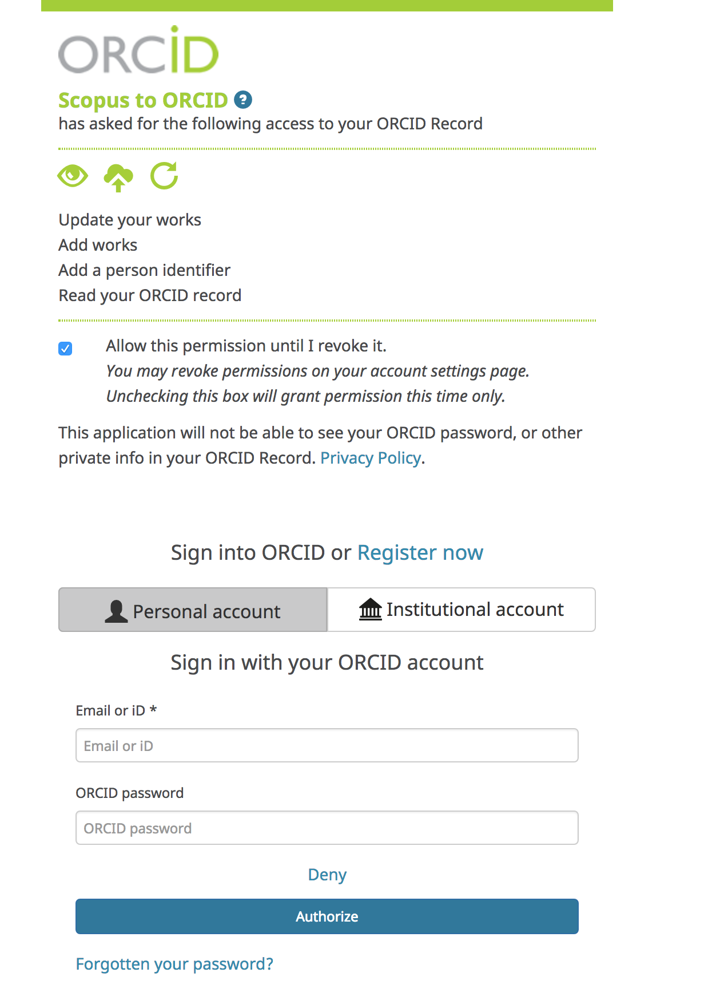
FIXES – ORCHID.ORG

Slide 31
FIXES
Author indexing: Google Scholar allows researchers to create a public profile and pool their papers together. If the author has a Scholar profile, then it is much easier to find her/his work (and also influence, measured by h-indexes and citation counts).

Slide 32
Export
All the citations that you locate to a bibliographic software program
e.g. RefWorks or EndNote
Then: Deduplicate (depending on the numbers, you might want to manually dedup)

Slide 33
Librarians of Preston Smith Library
Can assist you with your author search!

Slide 34
Questions
Thank you!

