Slide 1
Review of the Autonomic Nervous System Part 1
Thomas E. Tenner, Jr., Ph.D.
Dept. of Medical Education
Dept. Pharmacology & Neuroscience
tom.tenner@ttuhsc.edu
743-7169

Slide 2
Recommended Background Reading :
Chapter 6
“Introduction to Autonomic Pharmacology”
Basic and Clinical Pharmacology
Bertram Katzung
(13th Edition)

Slide 3
Learning Objectives:
Be able to:
Describe the functions of the sympathoadrenal (SAS) and parasympathetic (PNS) systems of the Autonomic Nervous system, and their interactions.
2) Name the major cholinoceptors and adrenoceptors of the Autonomic Nervous System and identify their important receptor subtypes.
3) Associate the actions of membrane receptor subtypes with appropriate “second messenger” systems.
4) Describe the interplay of SAS and PNS
5) Explain Autonomic control of Blood Pressure

Slide 4
Function of the ANS

Slide 5
Peripheral Nervous System
Somatic Nervous
System
Autonomic Nervous
System
Parasympathetic
Nervous System
Sympathetic
Nervous System
Discrete
Activation
Diffuse
Activation
Skeletal
Muscle
Glands, Smooth Muscle
& Cardiac Muscle

Slide 6
Parasympathetic System: ‘Trophotropic’
Rest and Digest - Maintains essential body functions and IS essential for life:
Protects the Eye
Constriction of the pupils (Miosis), Near vision (Accommodation), Lacrimation
Protects Heart
Bradycardia
Protects the Respiratory System
Broncho-constriction / Broncho-secretion
Aids in Digestion:
Salivation, Peristalsis, Gastric acid secretion
Aids in Urination, Defecation
Aids in Procreation

Slide 7
SympathoAdrenal System: ‘Ergotropic’
Fight or Flight - used to adjust the body to stressful situations but is not needed for life:
Dilation of pupils (Mydriasis)
Dilation of bronchi, (↓) nasal, pulmonary secretions
(↑) heart rate and BP
(↓) blood flow to the skin and internal organs
(↑) blood flow to skeletal muscles, brain, and heart
Mobilize energy stores
Inhibits Urination, Defecation
Aids in Procreation

Slide 8
Notes:
Naphazoline eye drops vasoconstrictor

Slide 9
Describe the neurochemistry of Acetylcholine, Norepinephrine, and Epinephrine

Slide 10
Cholinergic Neurotransmission
Synthesis
Choline Acetyl Transferase
Storage
Vesicles
Release – Na⁺ / Ca²⁺
Receptor Activation
Musc / Nic
Termination of Action
Acetyl cholinesterase

Slide 11
Adrenergic Neurotransmission
Synthesis
Tyrosine Hydroxylase**
Dopadecarboxylase
Storage
Dopamine-β hydroxylase
Release – Na⁺ / Ca²⁺
Receptor Activation:
α₁,,β₁
Autoreceptor Activation
α₂,
Termination of Action:
Diffusion / COMT / MAO

Slide 12
Autonomic Receptors and Signal Transduction Mechanisms

Slide 13
Autonomic Receptors:
Cholinoceptor (acetylcholine)
Nicotinic – ionotropic (n, m)
Muscarinic – G-protein coupled (M1-5)
Adrenoceptor (epinephrine, norepinephrine)
Alpha (α1_{ABD}, α2_{ABC}): G-protein coupled
Beta (β1-3): G-protein coupled
Dopaminergic receptors (dopamine)
D1-5 (2S, 2L): G-protein coupled

Slide 14
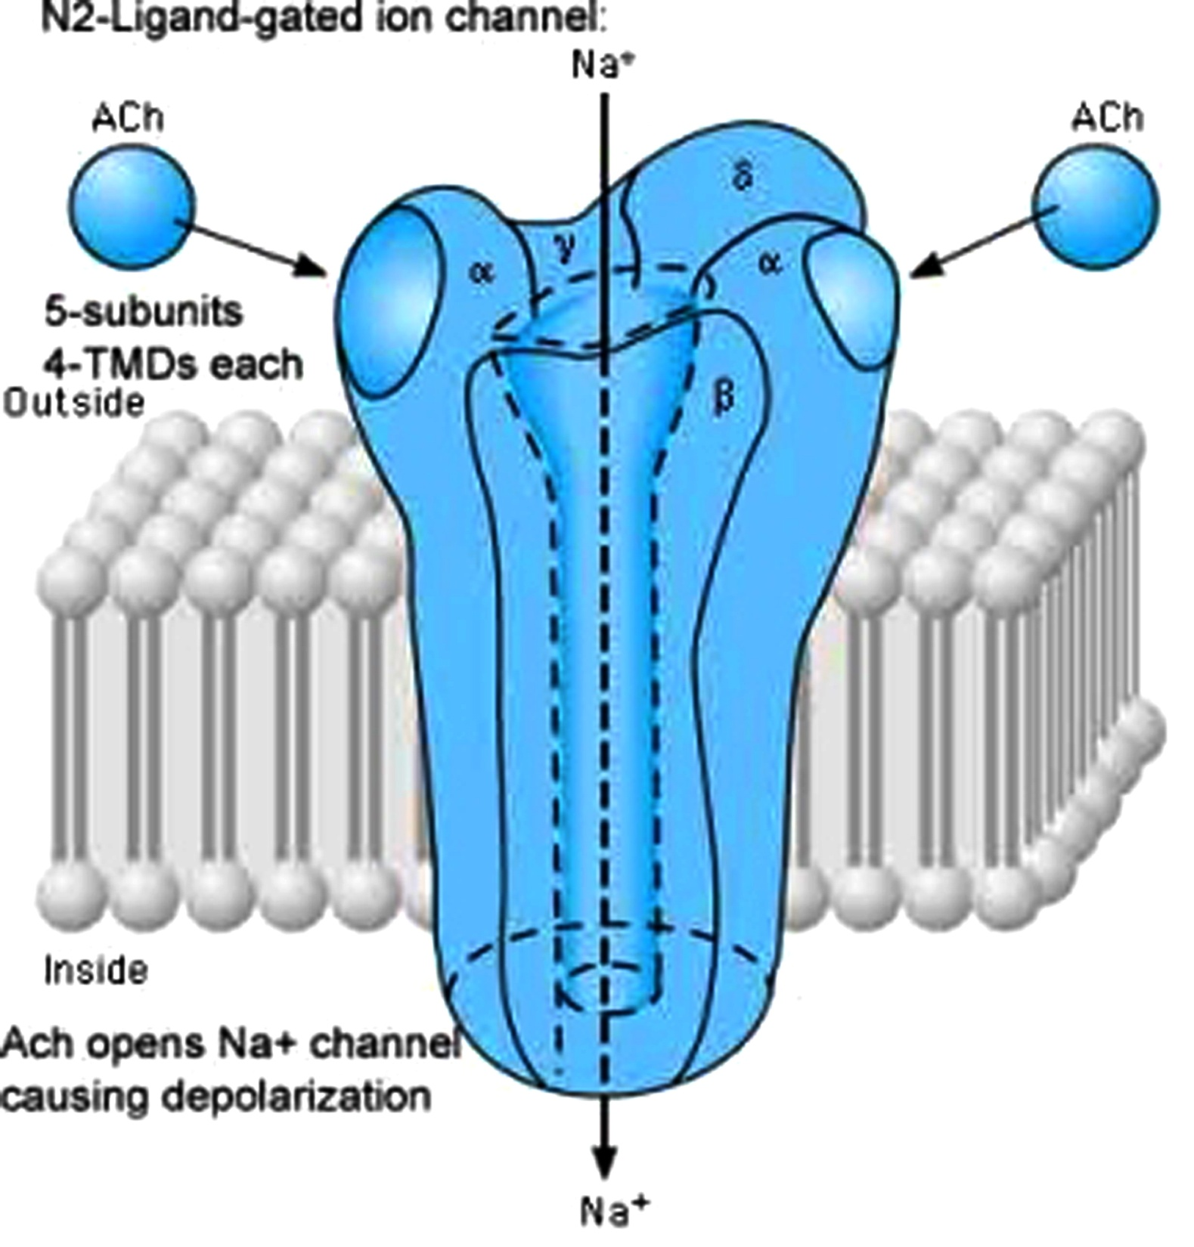
Nicotinic receptors: ion channel

Slide 15
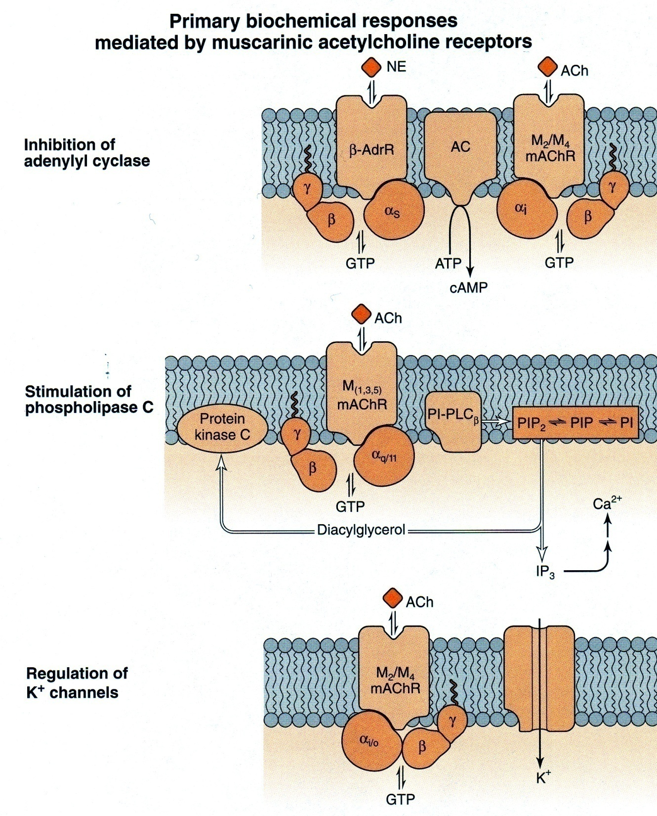
Muscarinic receptors: G-protein coupled

Slide 16
Raymond Ahlquist (1948)
“Alpha receptors are excitatory everywhere but the gut”
“Beta receptors are inhibitory everywhere but the heart”

Slide 17
Adrenergic Neurotransmitters: Rank Order of Potency
Isoproterenol: β ₁ = β ₂ = β ₃ >>>> α₁ = α₂
Norepinephrine : α₁ = α₂ = β ₁ = β ₃ >>>> β ₂
Epinephrine: α₁ = α₂ = β ₁ = β ₂ = β ₃
Dopamine : DA ₁> β ₁> α₁

Slide 18
Adrenergic Receptors: Receptors Activated by EPI/NE
α-adrenergic receptors
(Epinephrine>Isoproterenol)
β-adrenergic receptors
(Isoproterenol>Epinephrine)
α
α ₁-adrenergic
receptors
(Phenylephrine>Clonidine)
β ₁-adrenergic
receptors
(EPI = NE)
β ₂-adrenergic
receptors
(EPI>NE)
α ₂-adrenergic
receptors
(Clonidine>Phenylephrine)
β ₃-adrenergic
receptors
(NE>EPI)

Slide 19
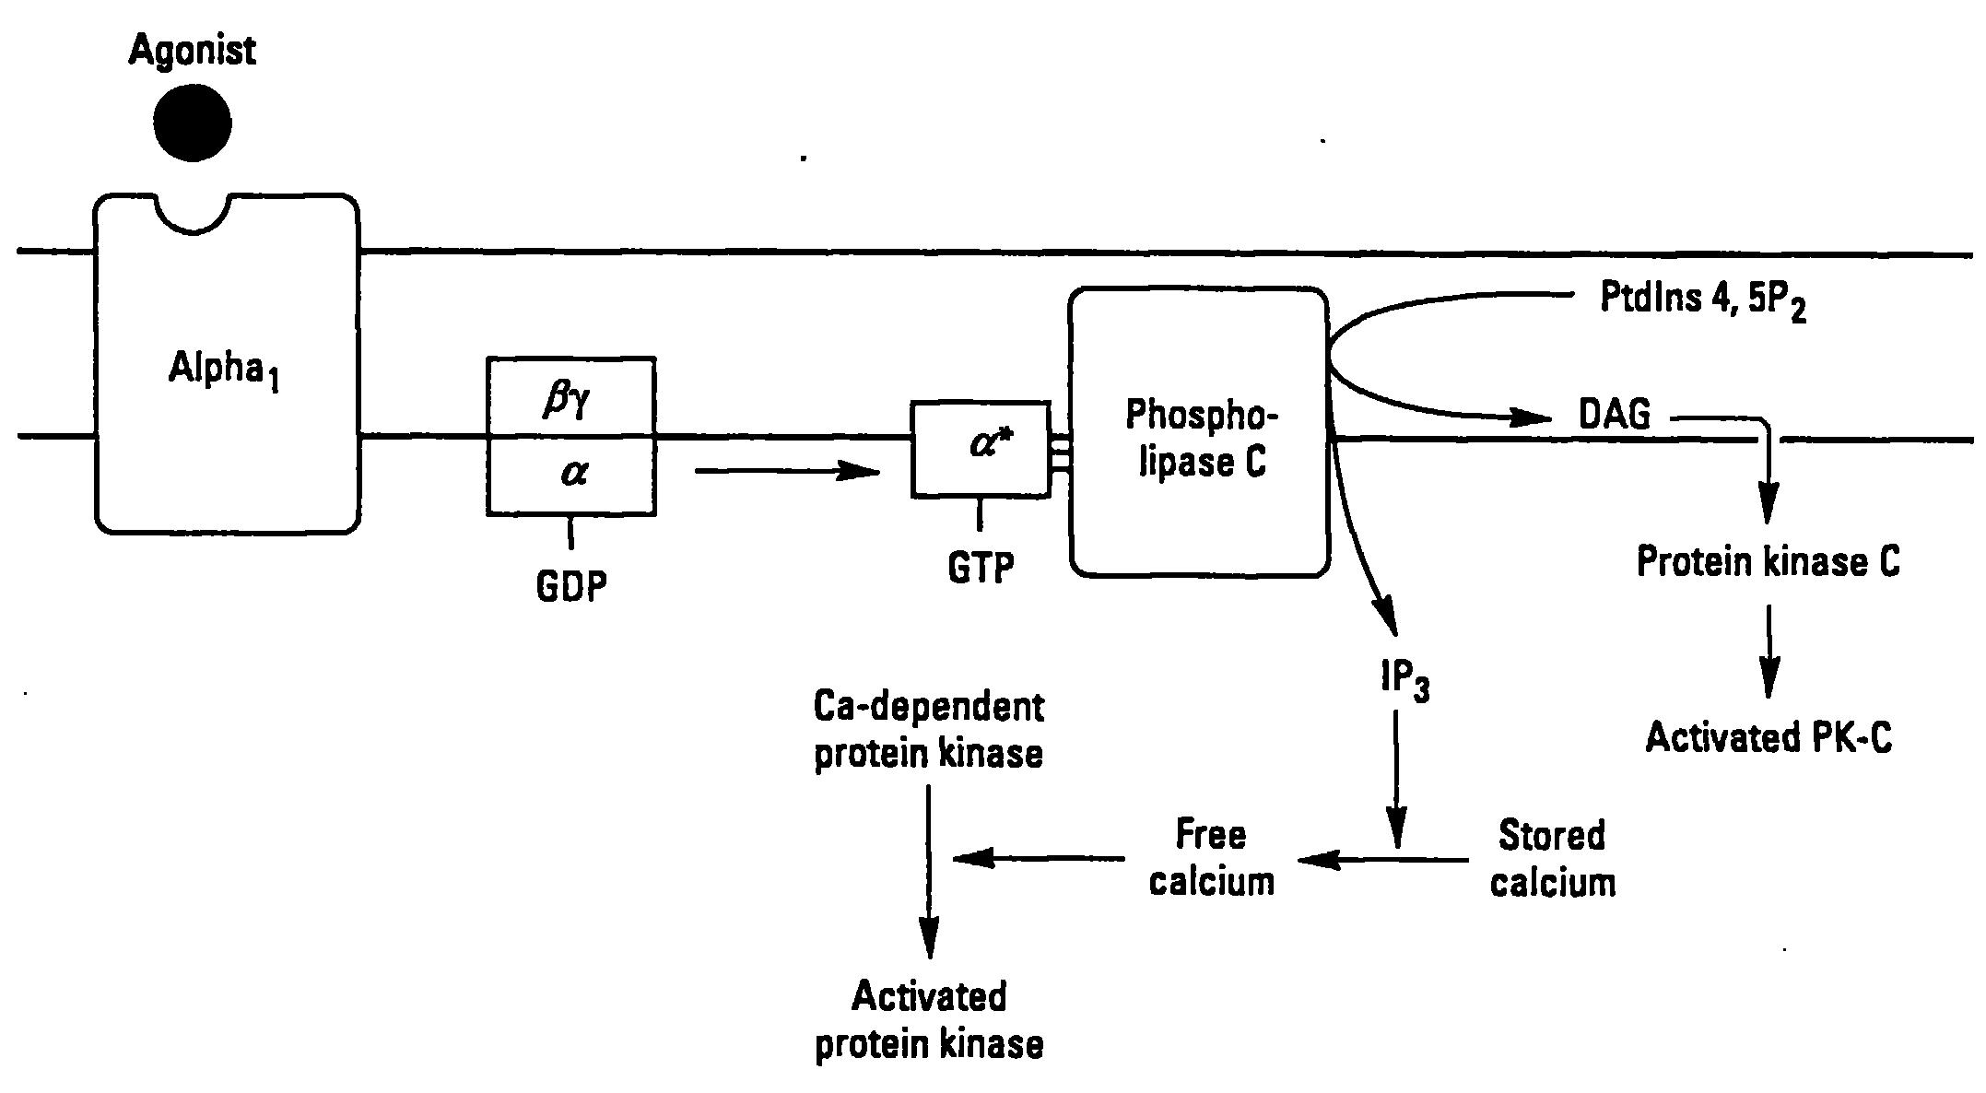
Signal Transduction by α₁ - Adrenergic Receptors
G_{q}

Slide 20
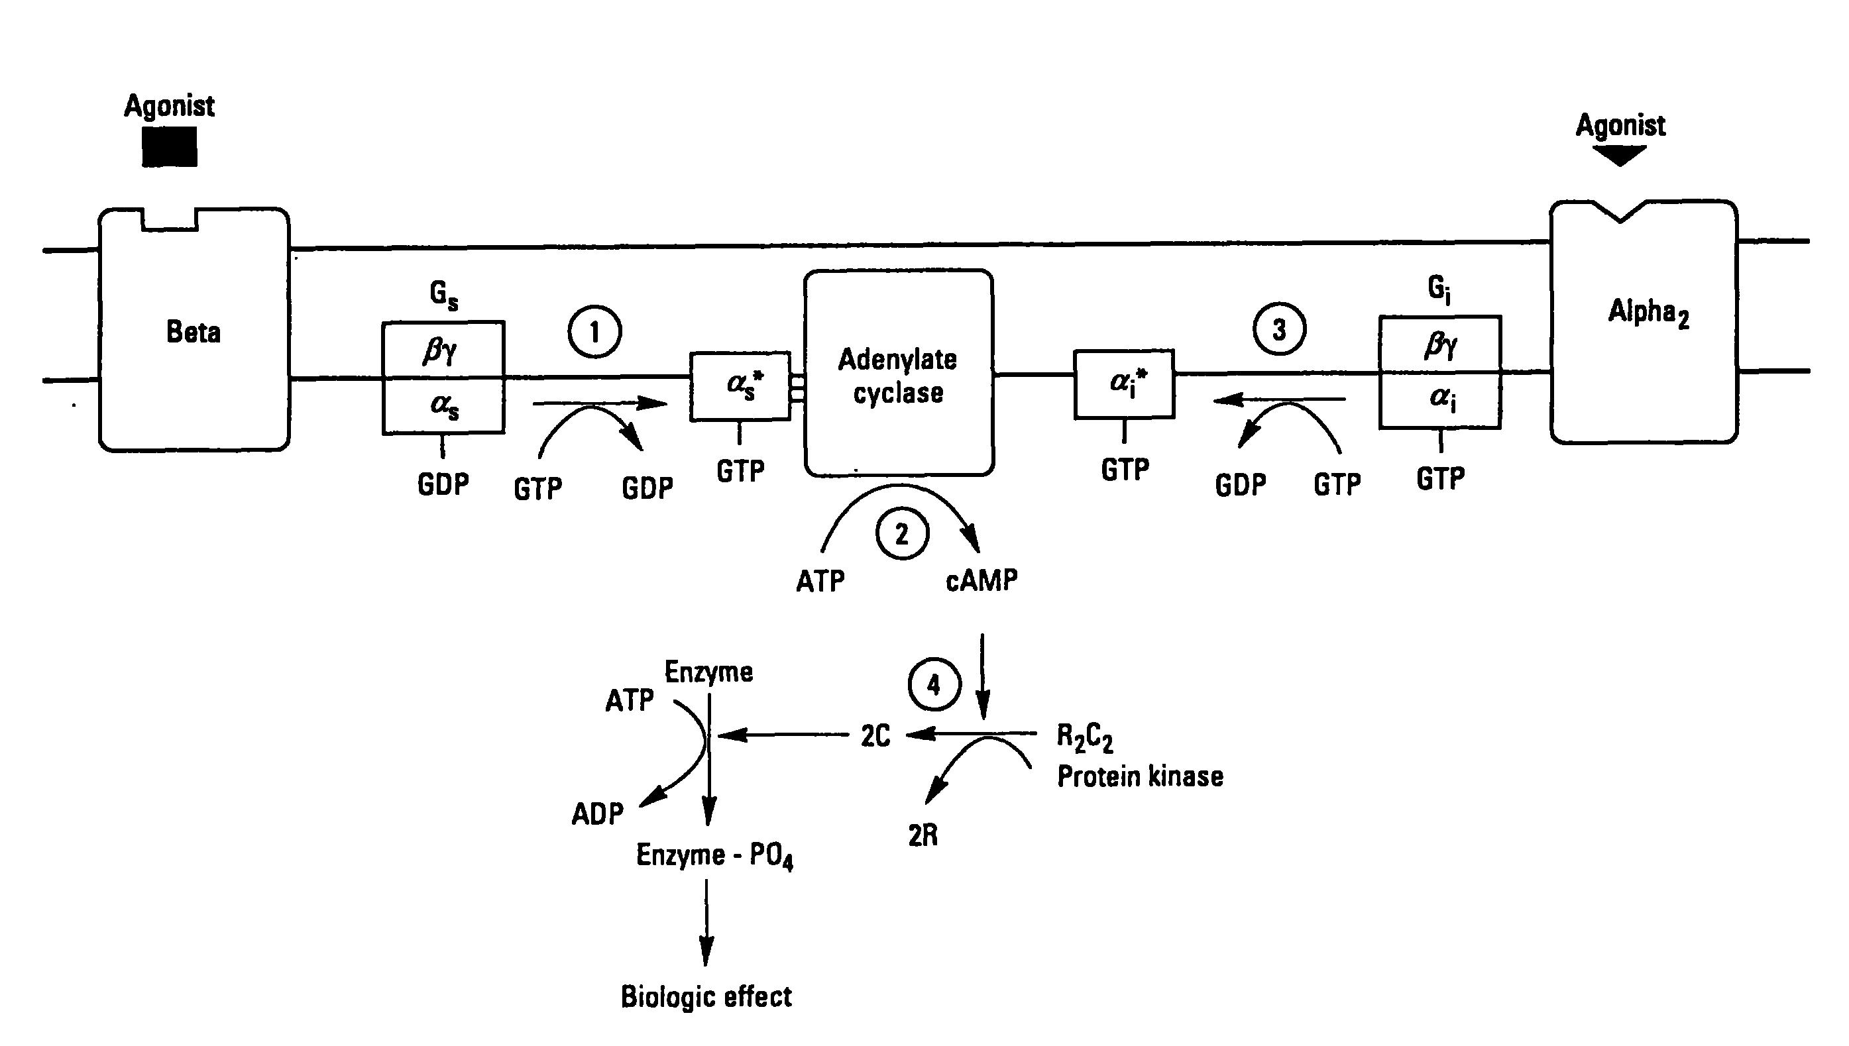
Signal Transduction by α₂- and β-Adrenergic Receptors

Slide 21
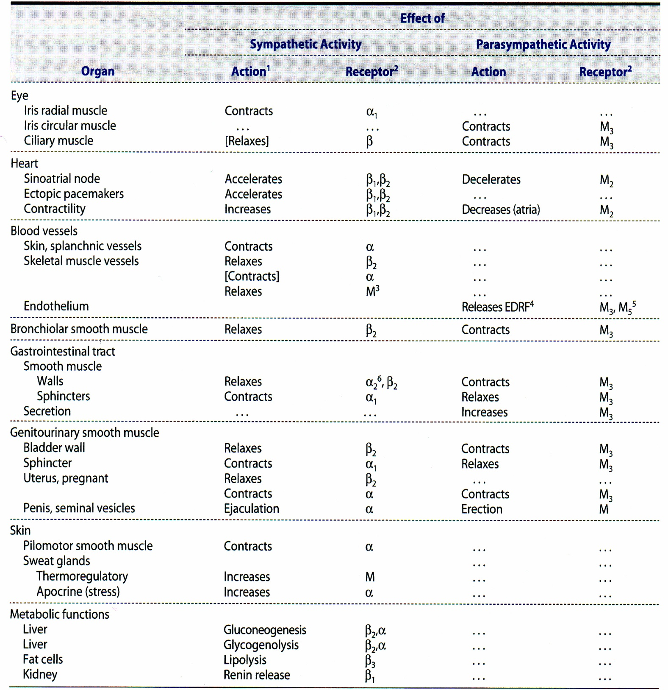
Notes:
Table 6-3, Katzung, 2015

Slide 22
Interplay of SAS and PNS
Neuromodulation
Presynaptic receptors
Physiological Antagonism
HR
Iris
Physiological Cooperation
Male reproduction

Slide 23
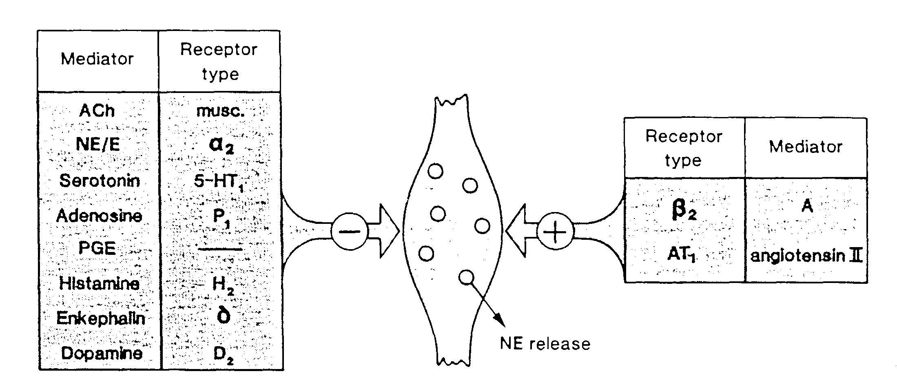
Mechanisms of Neuromodulation
Epi

Slide 24
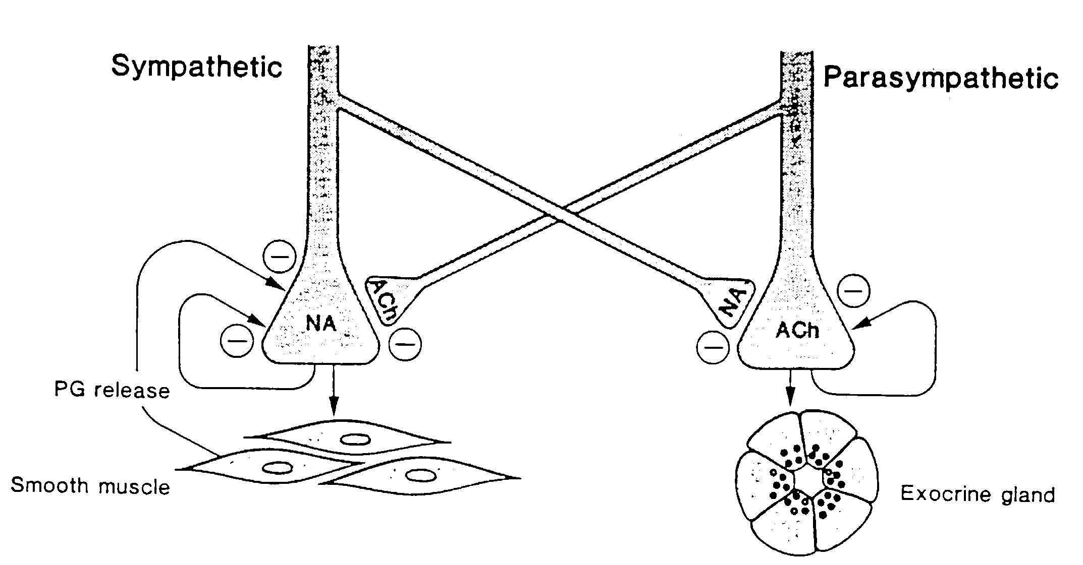
Mechanisms of Neuromodulation
NE

Slide 25
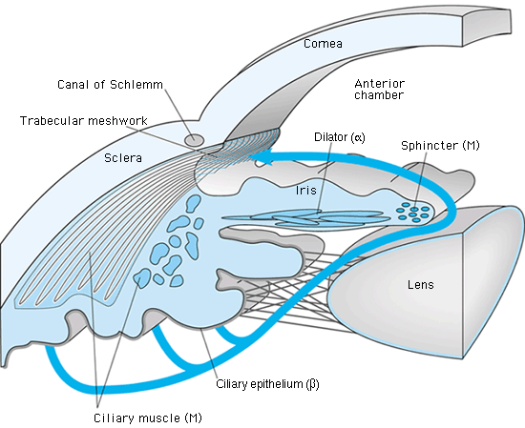
Autonomic control in the eye:

Slide 26
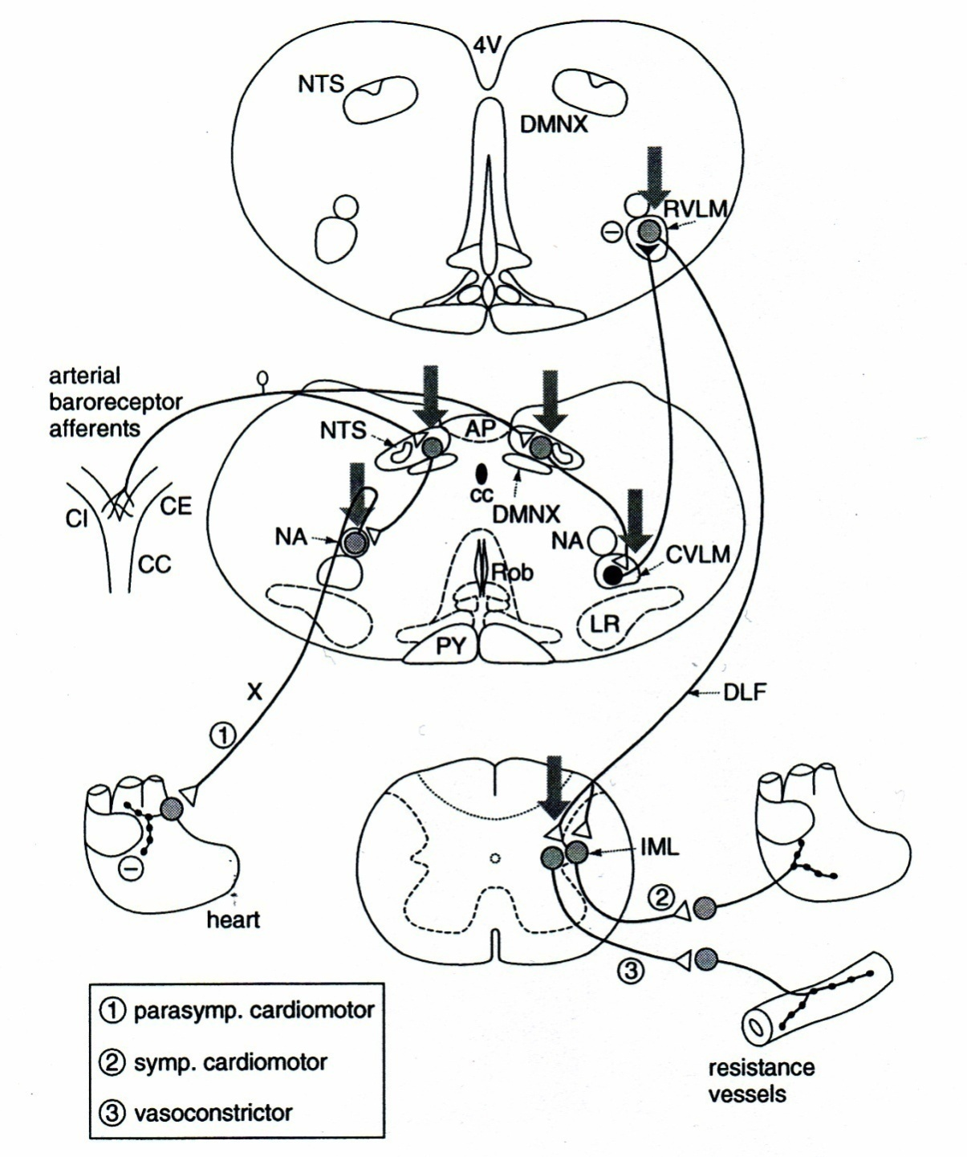
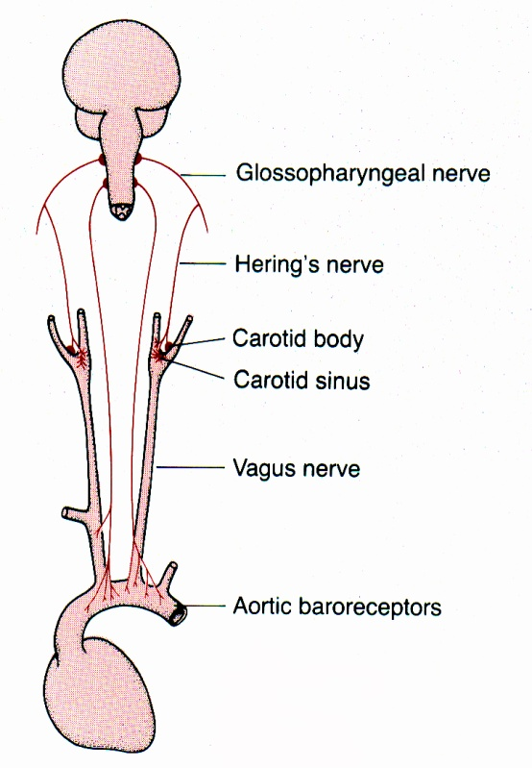
Baroreflex:

Slide 27
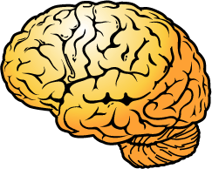
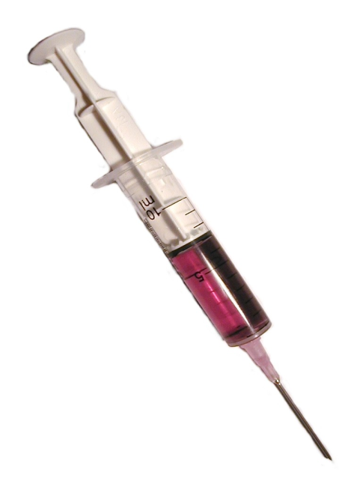
Control of Blood Pressure
Arterial - Afterload
mABP = CO x TPR
Cardiac -
Chronotropy
HR SV
Cardiac - Inotropy
CF VR
Venous – Preload
Notes:
5
Norepinephrine and reflex tachycardia

Slide 28
Drugs to know…

Slide 29
Process Affected | Drug Example | Site | Action
Transmitter Storage | Reserpine | Adrenergic vesicles | Depletes NE,DA (Also Epi from Adrenal Medulla)
Transmitter Release | NE/EPI/ACh/ ANG-II* (See Slide 20) | Activate/block Pre-junctional receptors at Adrenergic/Cholin-ergic terminals | Modulate release
 | Botulinum Toxin | Cholinergic terminals | Prevents release
 | Alpha-Latrotoxin** | Cholinergic terminals | Explosive release
 | Amphetamine/ Tyramine | Adrenergic vesicles | Promotes release
Transmitter Reuptake | Cocaine, TCA’s/SNRIs*** | Adrenergic terminals | Inhibit reuptake
Enzymatic Inactivation of Transmitter | Neostigmine | Acetylcholinesterase Inhibitor | Intensifies Ach action at Muscarinic and Nicotinic receptors
 | Tranylcypromine | MonoAmineOxidase (MAO) Inhibitor | Intensifies NE/DA action.
Notes:
Angiotensin II (ANG-II)
**Alpha Latrotoxin- black widow spider venom
***TriCyclicAntidepressants (TCA’s) ; SNRI – Serotonin, Norepinephrine reuptake inhibitors

