Slide 1
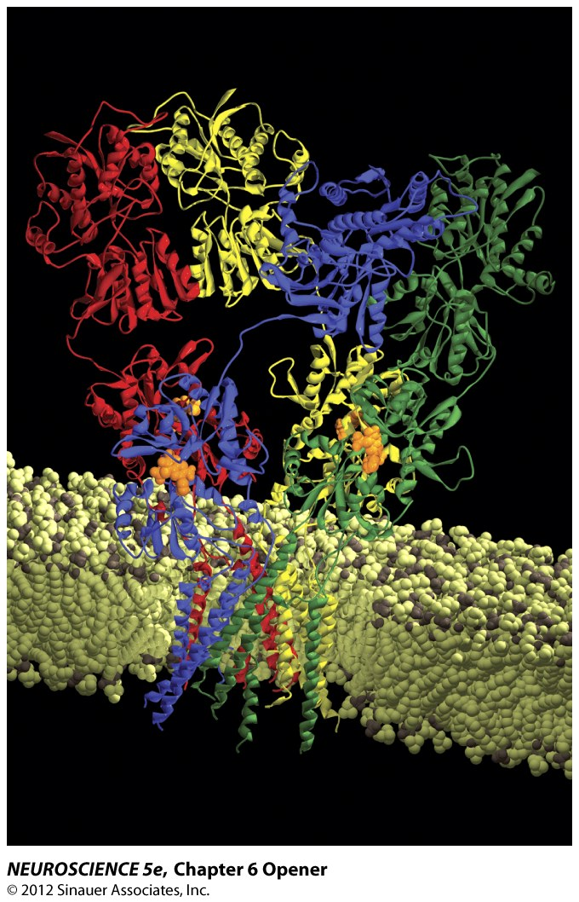
Neurotransmission:
Introduction to neurotransmitters, channels, and transporters
Michael P. Blanton
Professor, Department of Pharmacology and Neuroscience
Chapters 4 and 6 in Neuroscience 5th Edition text (Purves et al.)

Slide 2
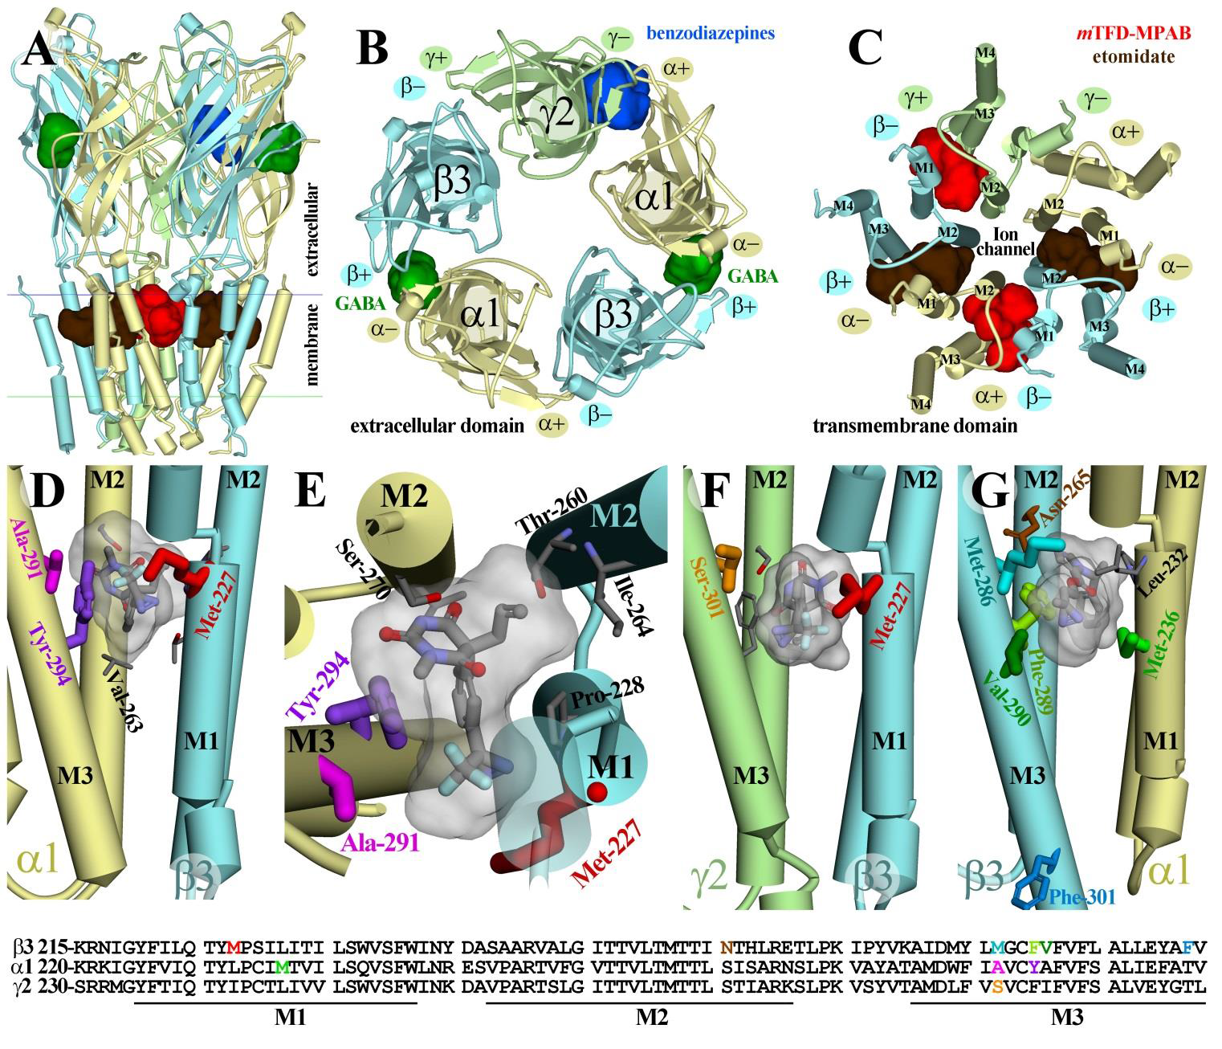
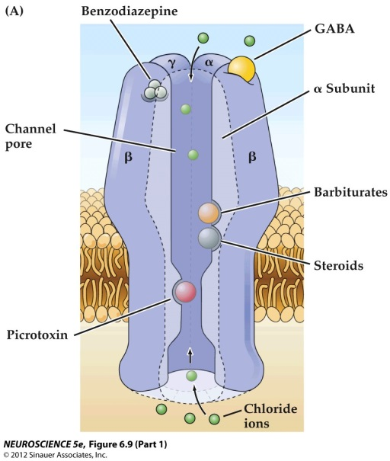
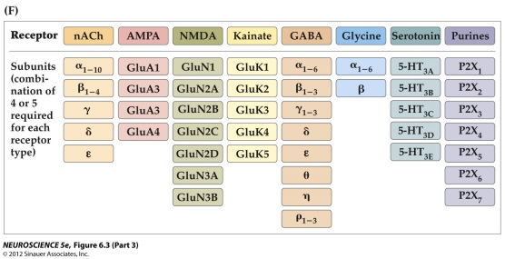
GABA_{A} Receptor
– chloride conducting ligand gated ion channel
target for general anesthetics, benzodiazepines, barbiturates, alcohol, etc

Slide 3
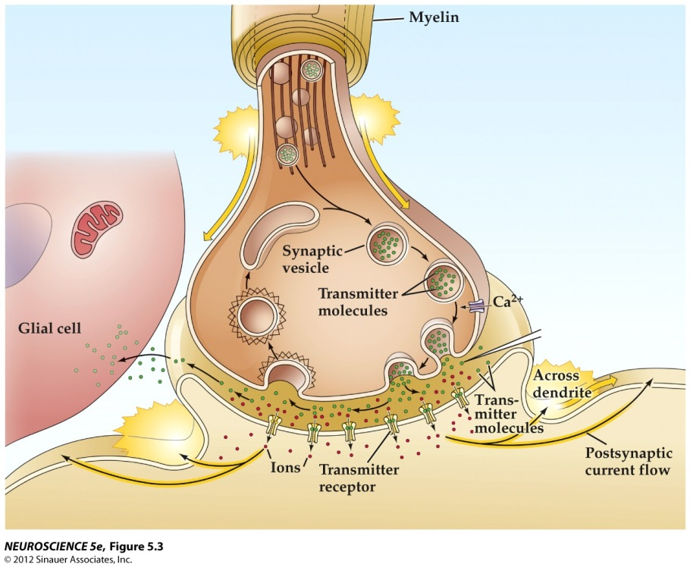
Synaptic Transmission
-Ion Channels
-ligand-gated ion channels
-voltage-gated ion channels
-ion channels gated by pH, heat, etc
-Transporters
-active transporters
-ion exchangers
- co-transporters

Slide 4
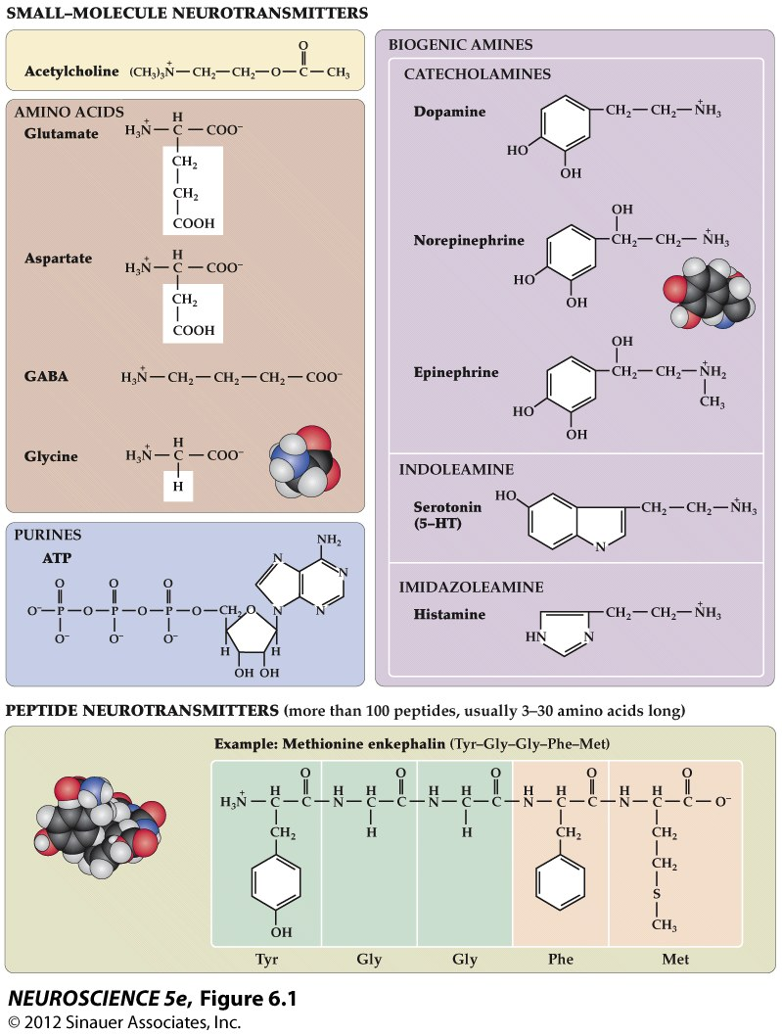
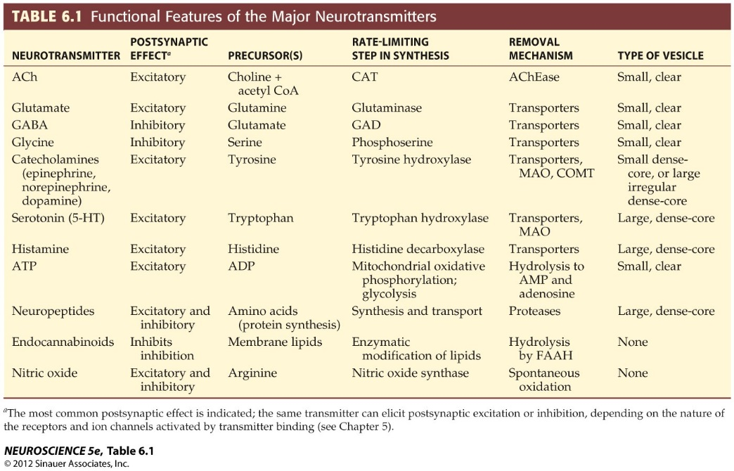
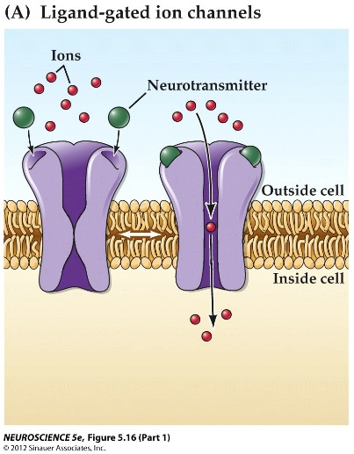
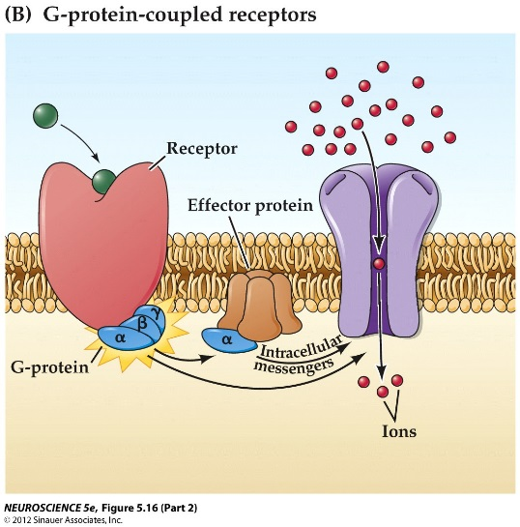
Neurotransmitters

Slide 5
Synaptic Transmission
-Ion Channels
-ligand-gated ion channels
-voltage-gated ion channels
-ion channels gated by pH, heat, etc
-Transporters
-active transporters
-ion exchangers
- co-transporters

Slide 6
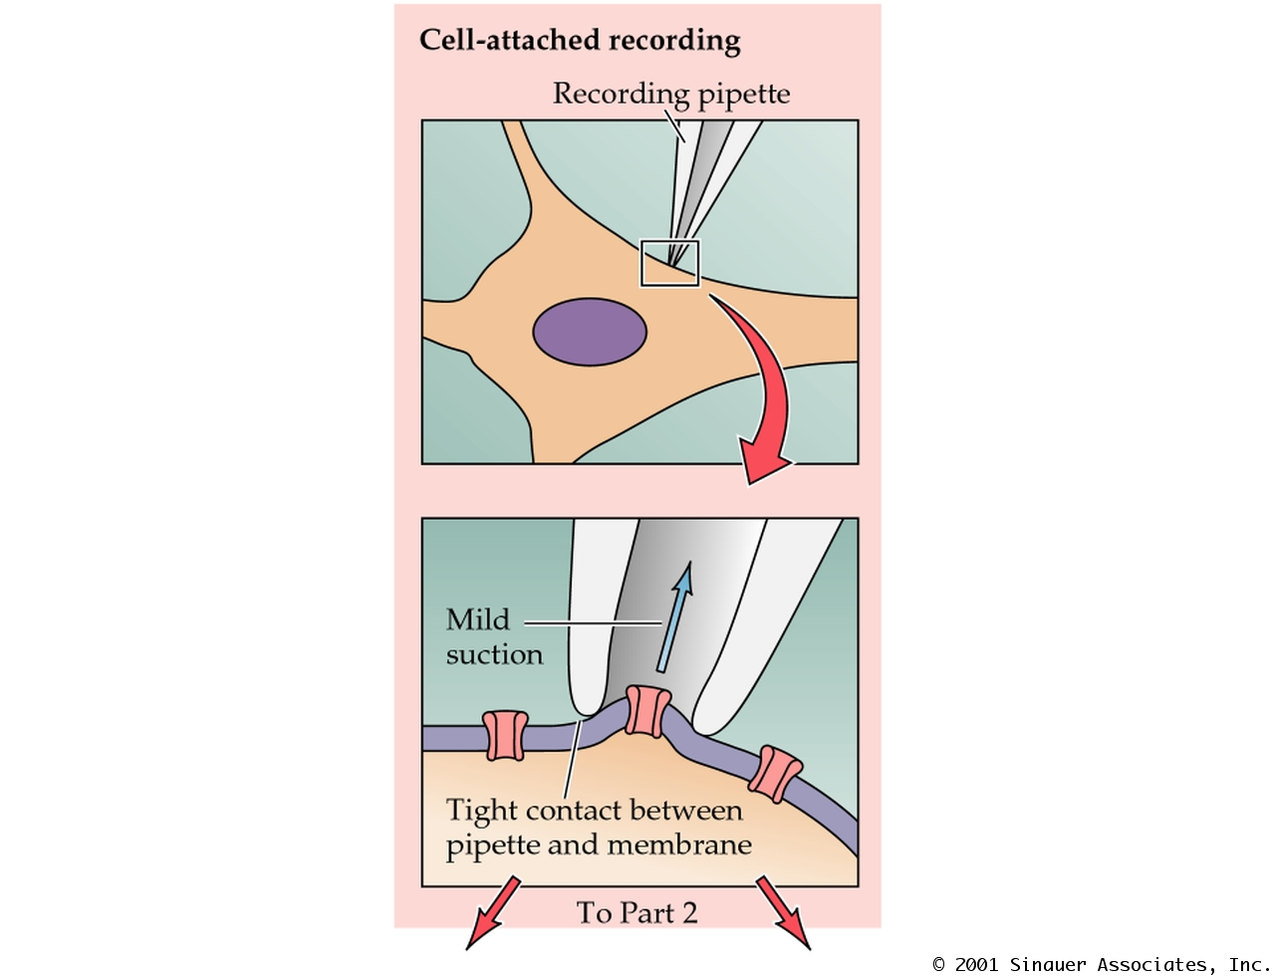
The Patch Clamp Method
PN04BA1.JPG

Slide 7
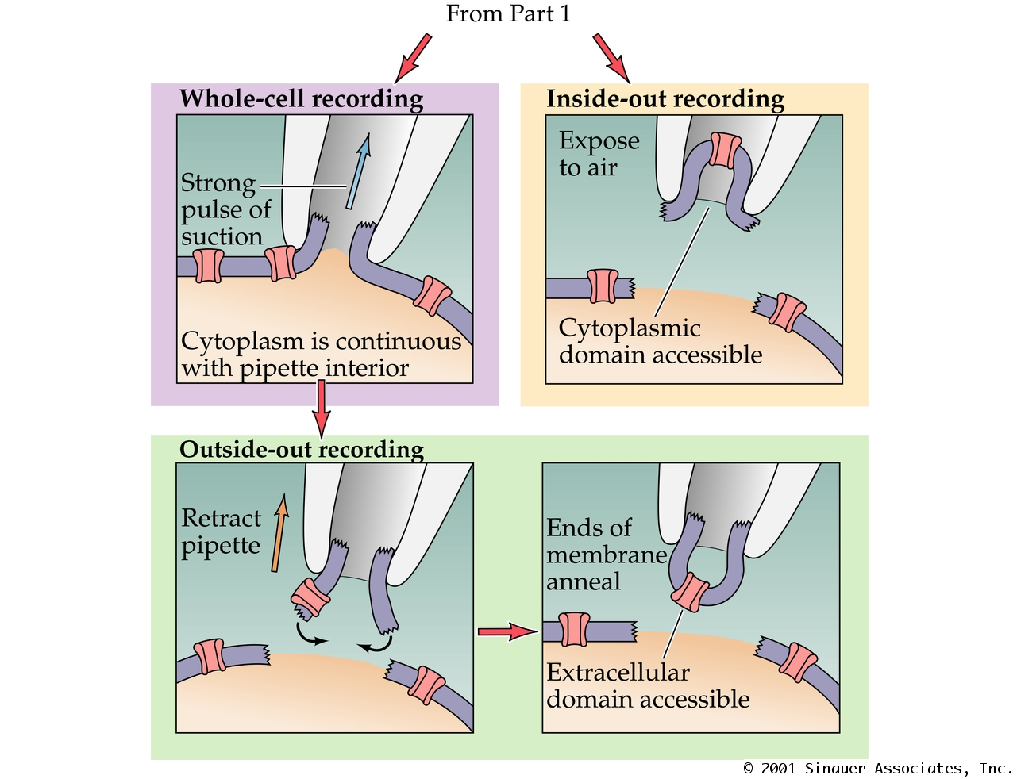
The Patch Clamp Method
PN04BA2.JPG

Slide 8
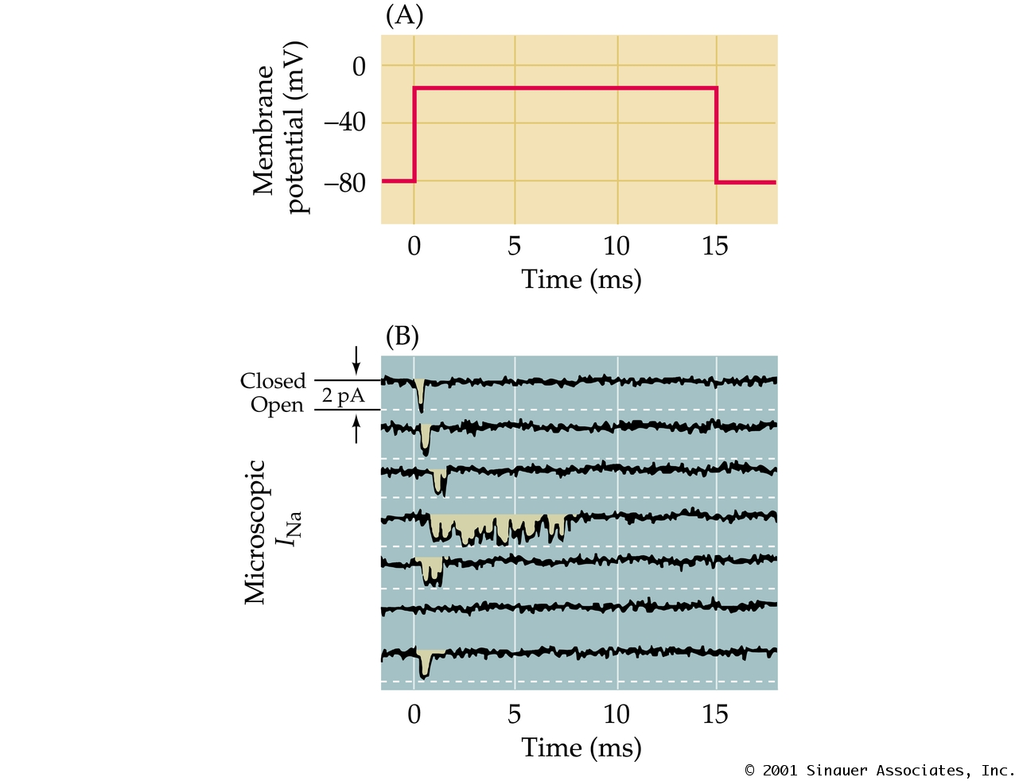
Measurements of Ionic Currents Flowing through Single N+ Channels
PN04011.JPG

Slide 9
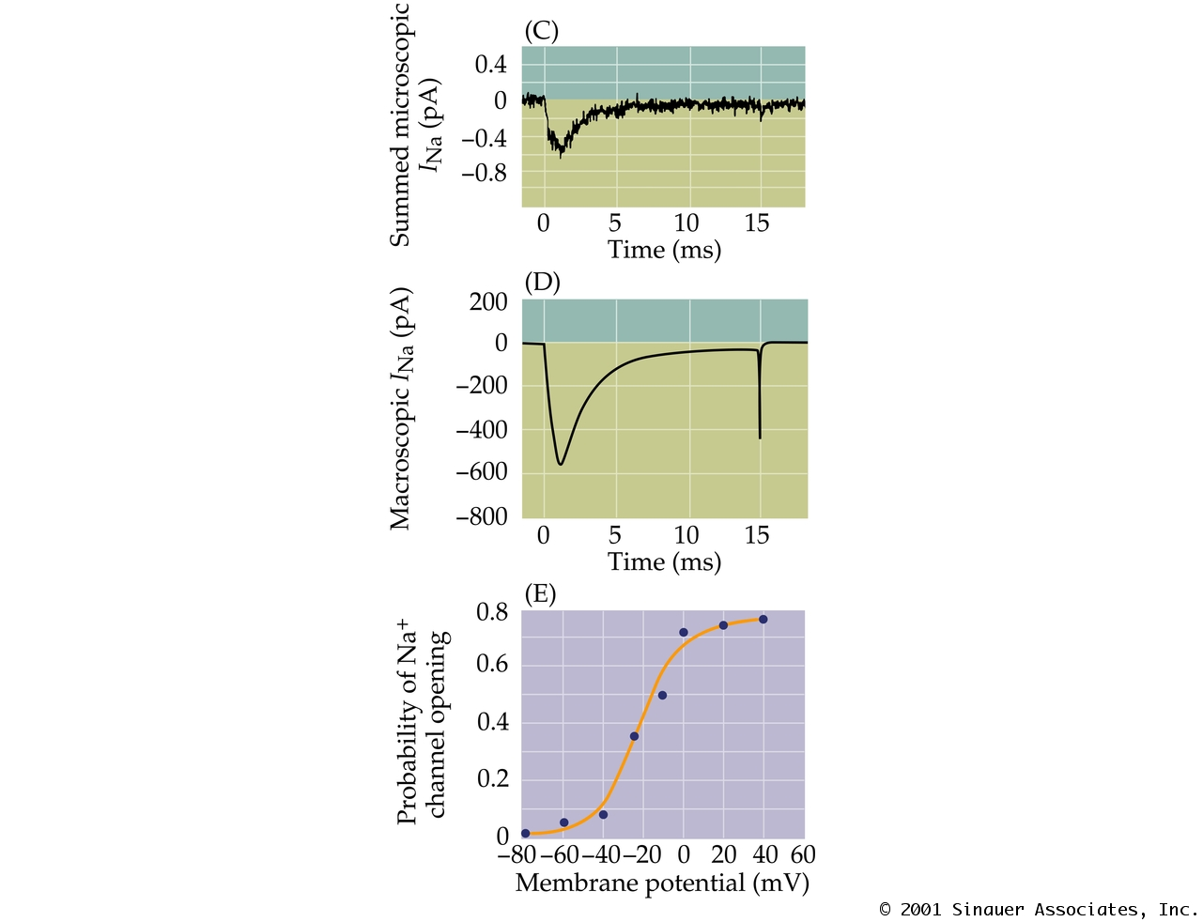
Measurements of Ionic Currents Flowing through Single N+ Channels
PN04012.JPG

Slide 10
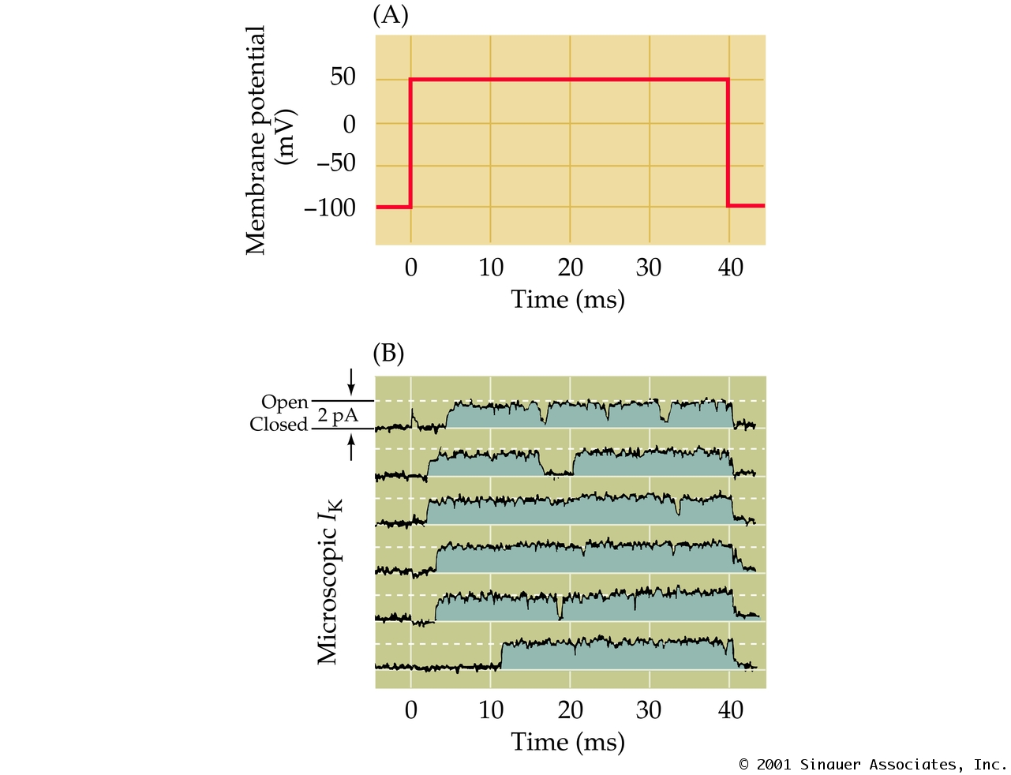
Measurements of Ionic Currents Flowing through Single K+ Channels
PN04021.JPG

Slide 11
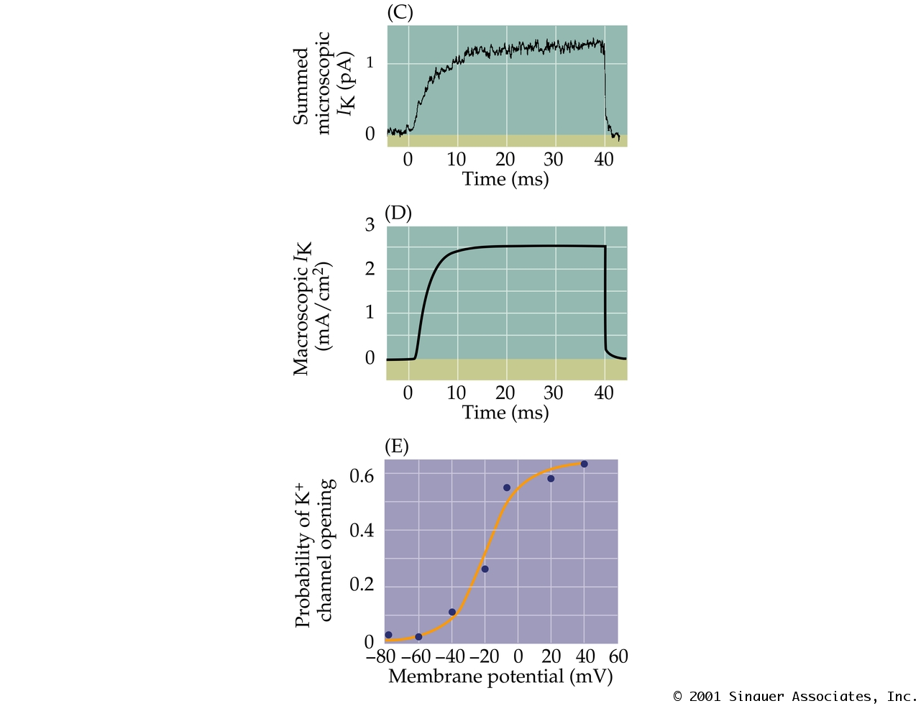
Measurements of Ionic Currents Flowing through Single K+ Channels
PN04022.JPG

Slide 12
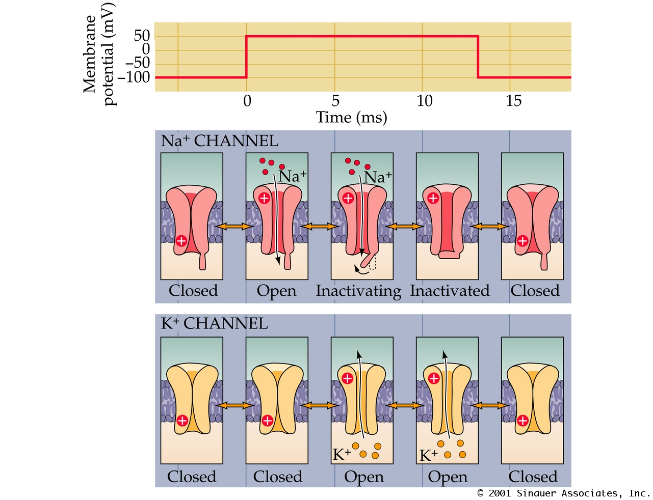
Functional States of Voltage-Gated Na+ and K+ Channels
PN04030.JPG

Slide 13
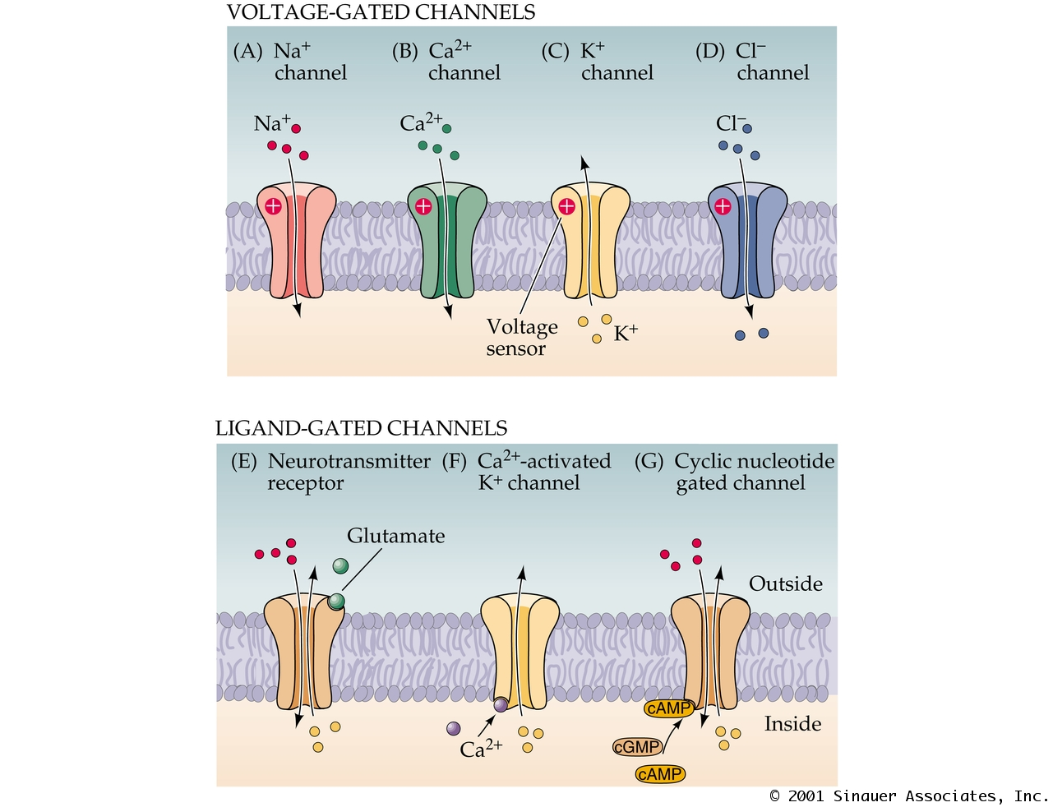
Types of Voltage-Gated Ion Channels
PN04040.JPG

Slide 14
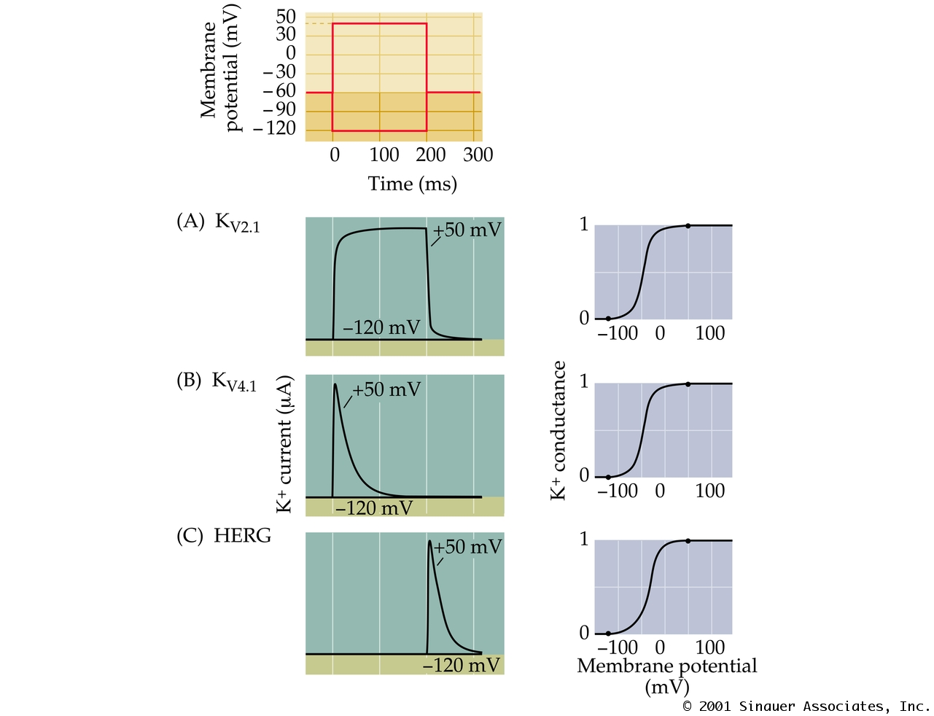
Diverse Properties of K+ Channels
PN04051.JPG

Slide 15
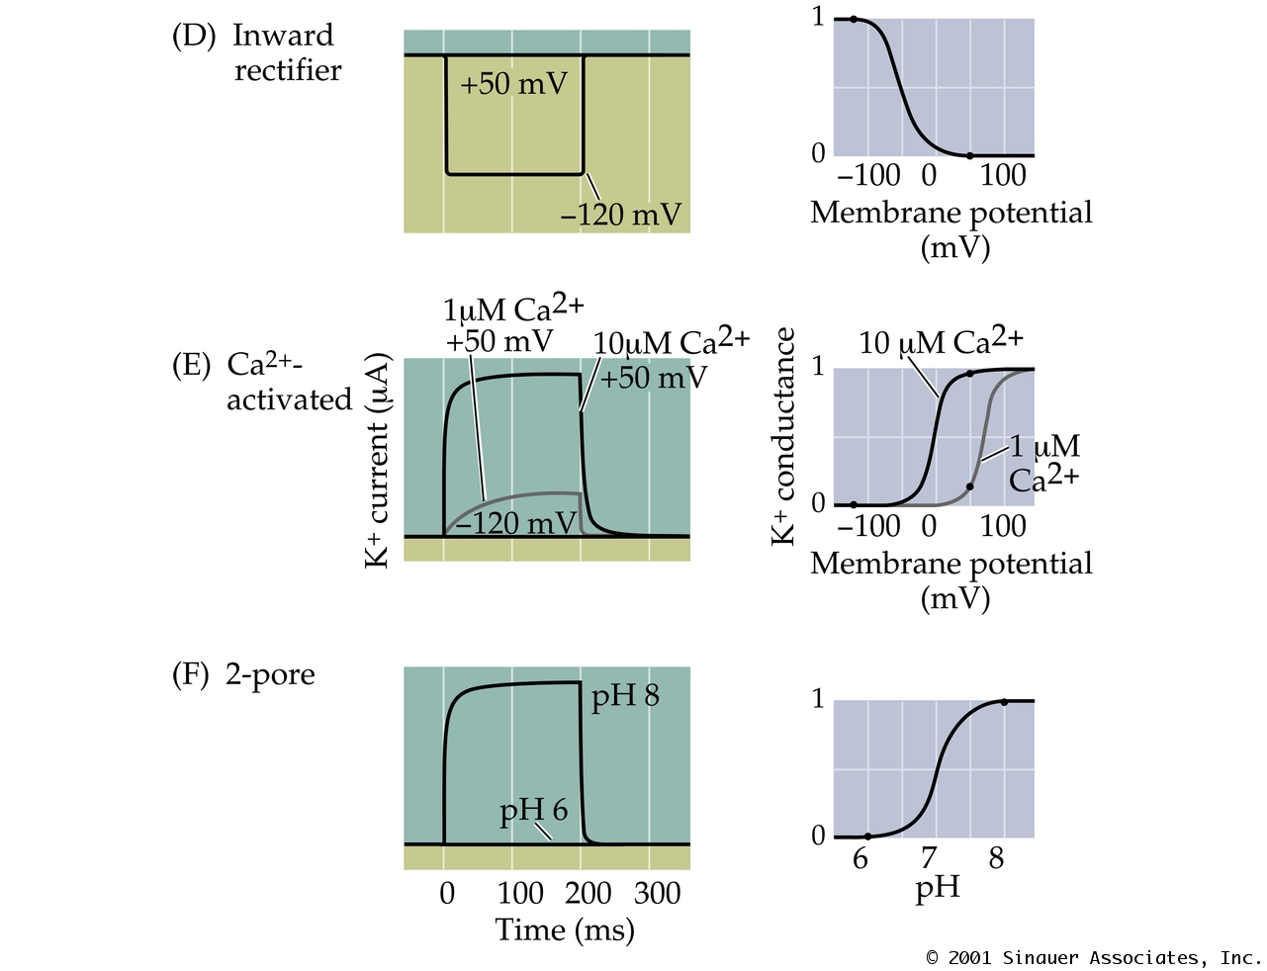
Diverse Properties of K+ Channels
PN04052.JPG

Slide 16
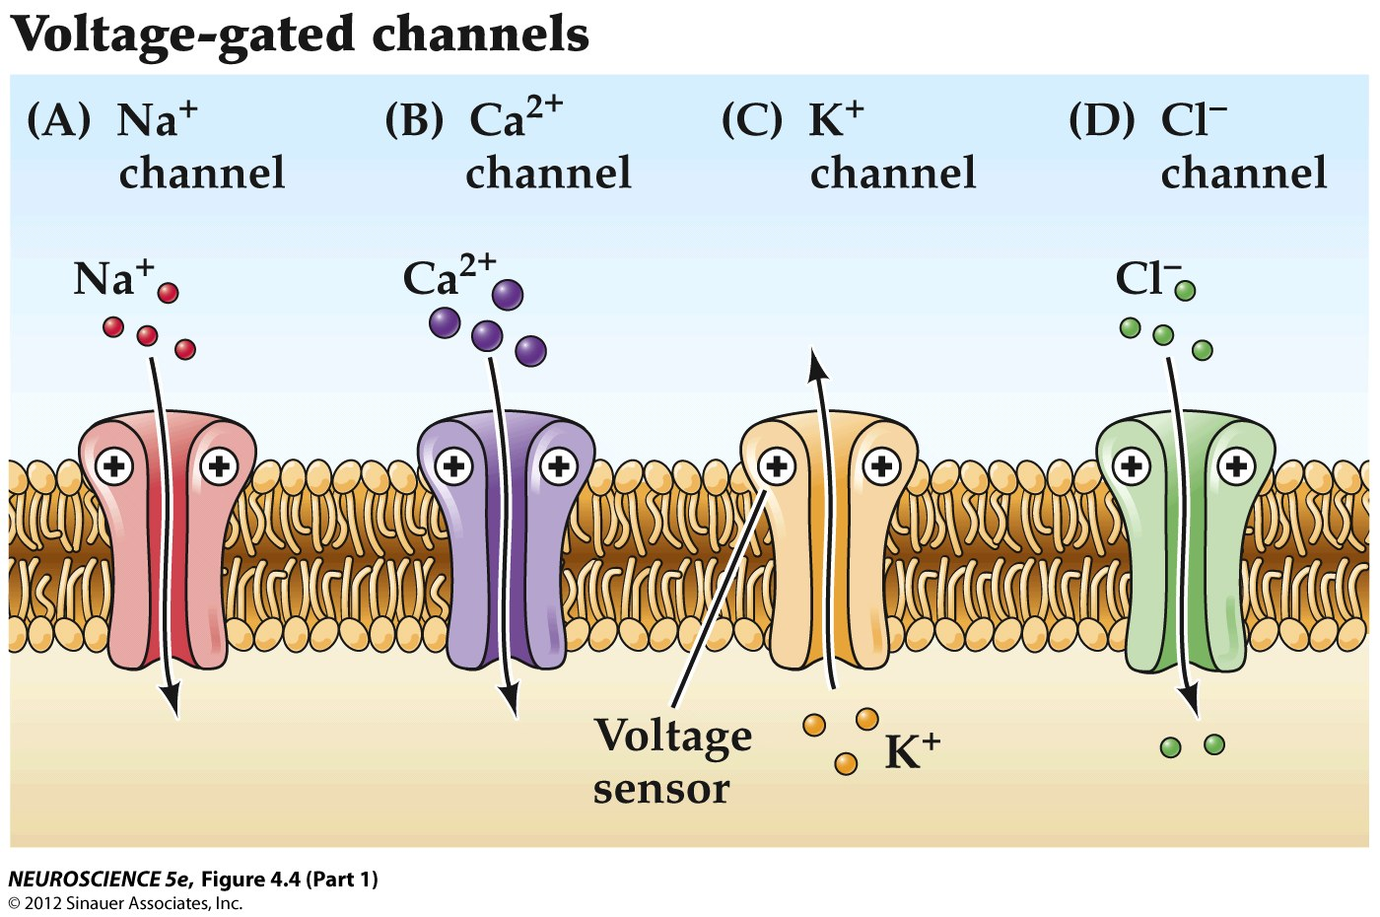

Slide 17
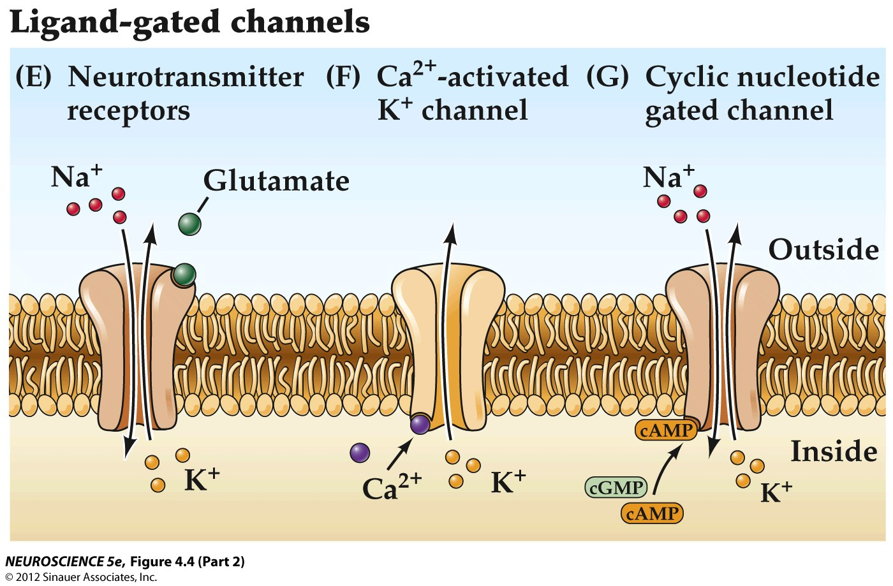


Slide 18
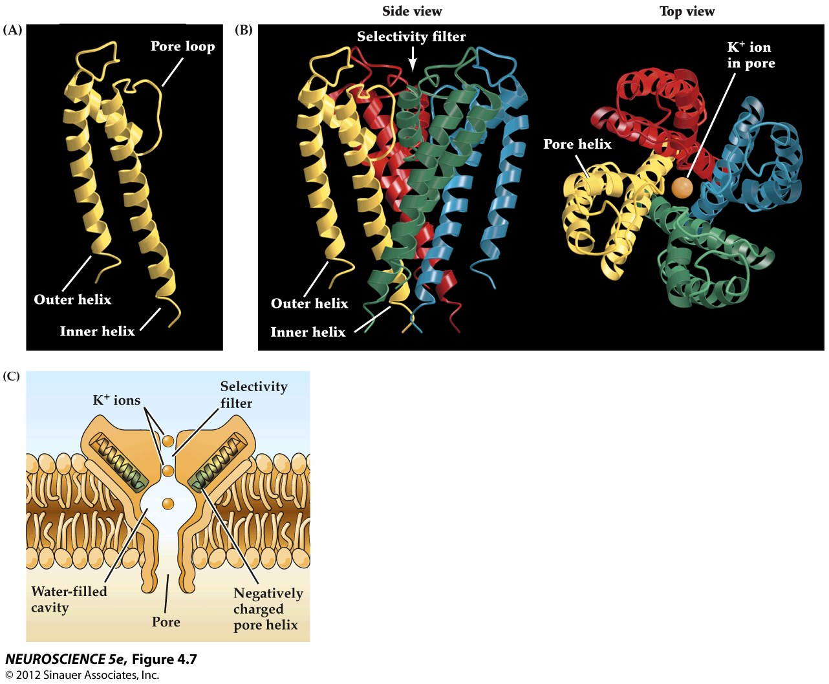
Structure of KcsA- a simple bacterial potassium channel

Slide 19
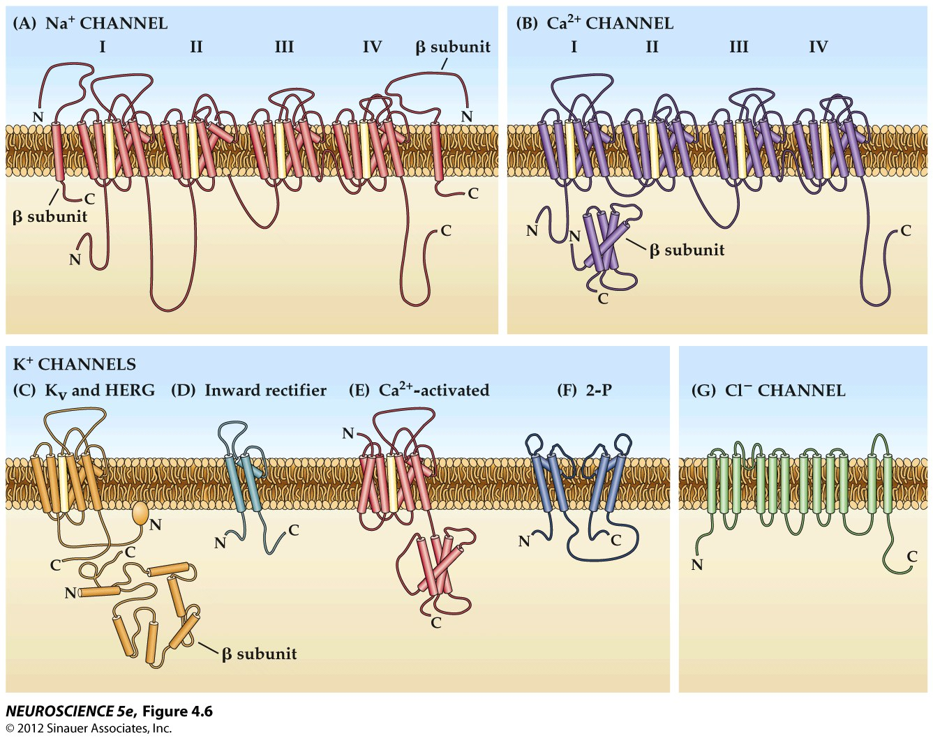

Slide 20
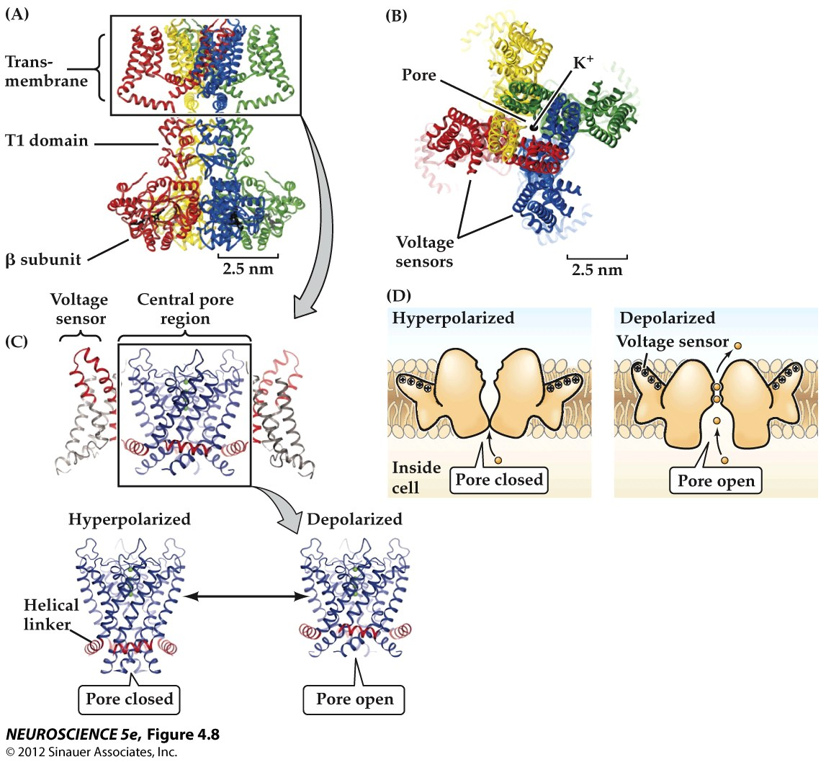

Slide 21
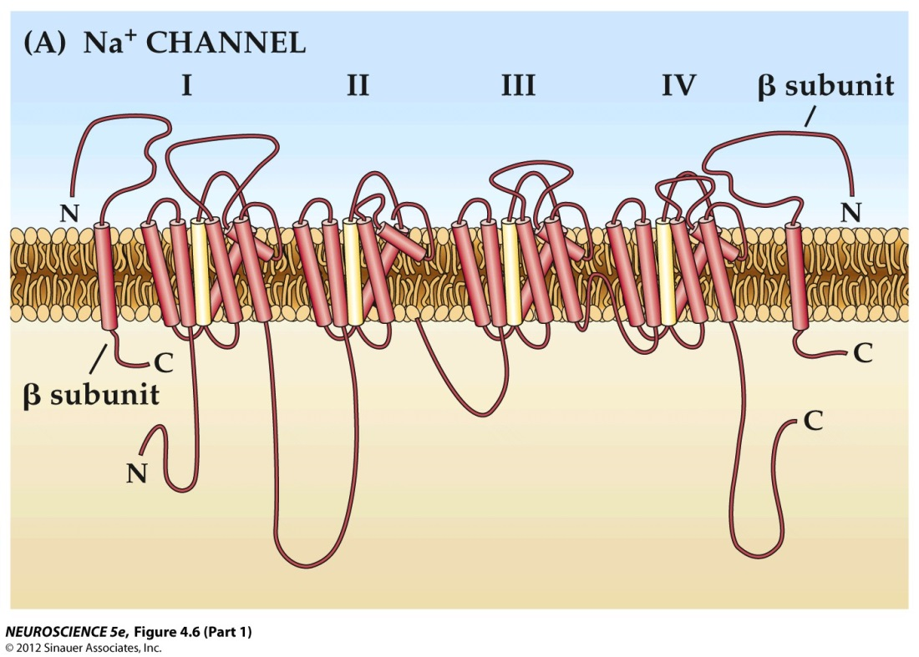
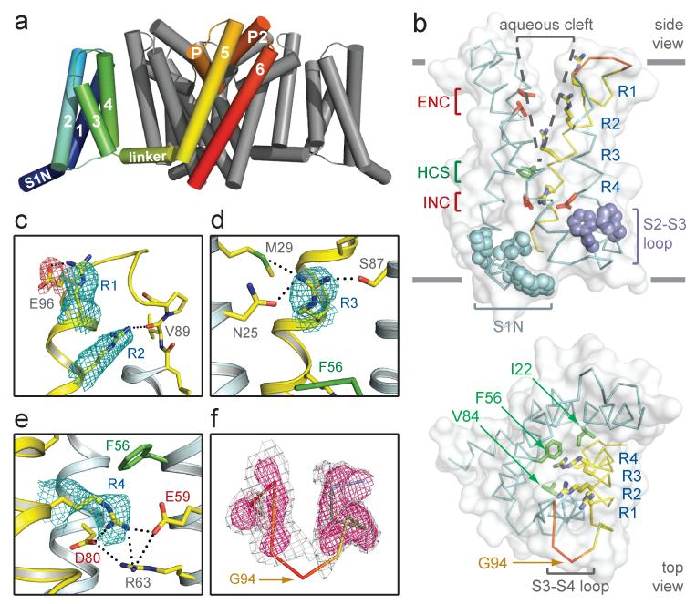
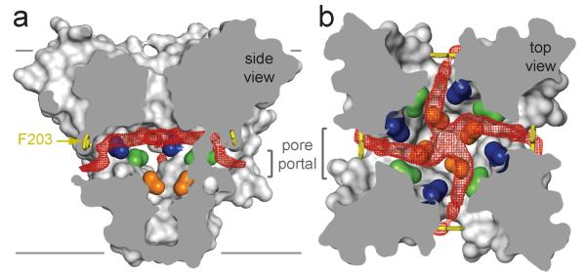
Structure of a voltage-gated sodium channel
(Payandeh et al. 2011 Nature 475)
Pathway to binding sites for CNS drugs- local anesthetics (lidocaine) and anticonvulsant drugs (phenytoin and carbamazepine)

Slide 22

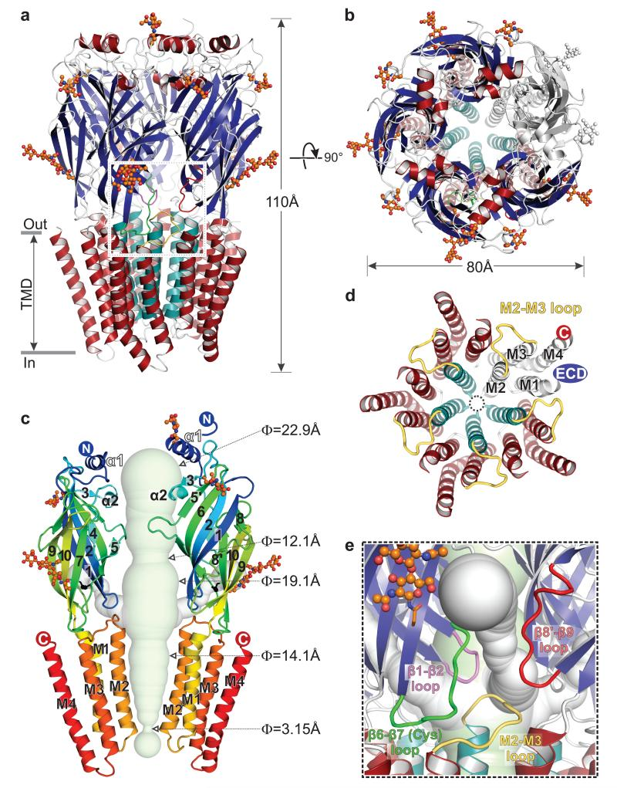

3-D Structure of a human GABA_{A}R: Ligand Gated Ion Channel

Slide 23
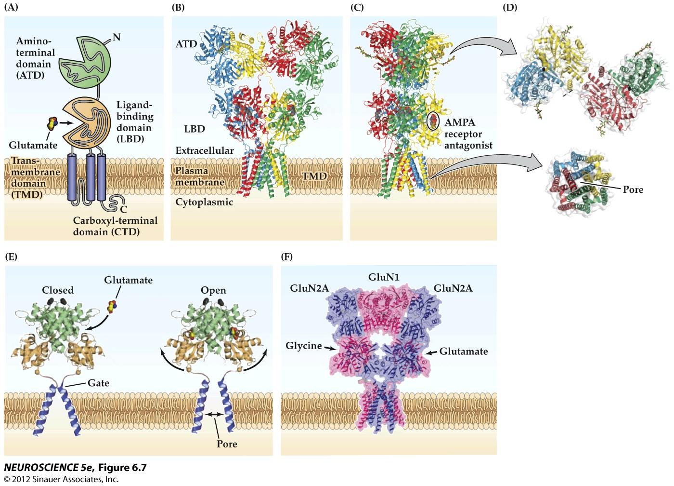
Structure of the AMPA Receptor: Ligand Gated Ion Channel

Slide 24
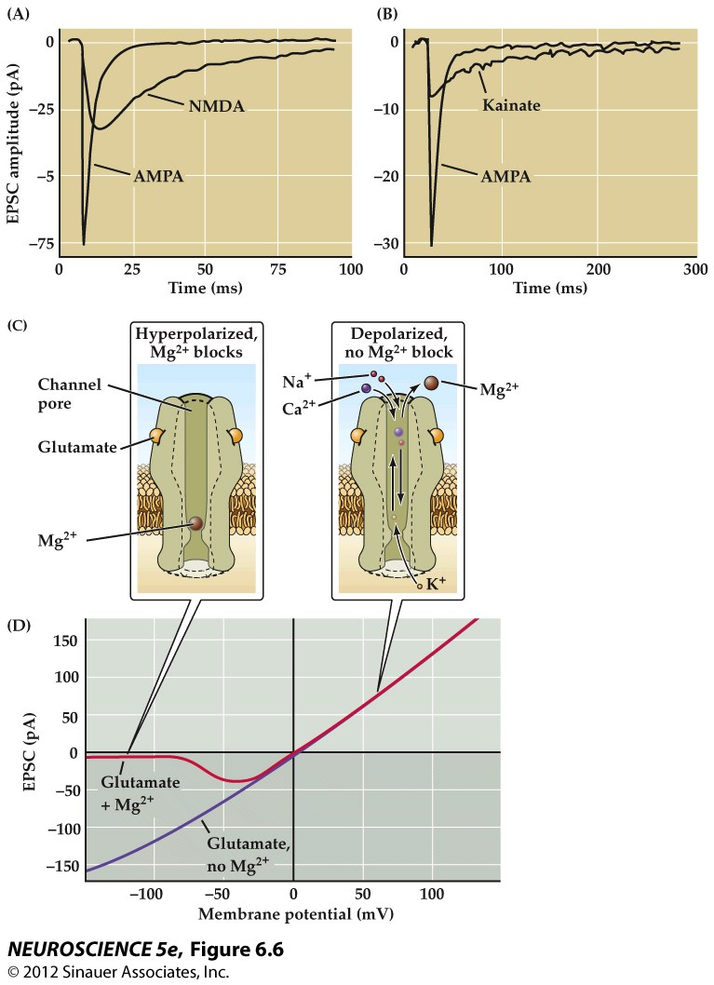
Postsynaptic responses mediated by NMDA receptors

Slide 25
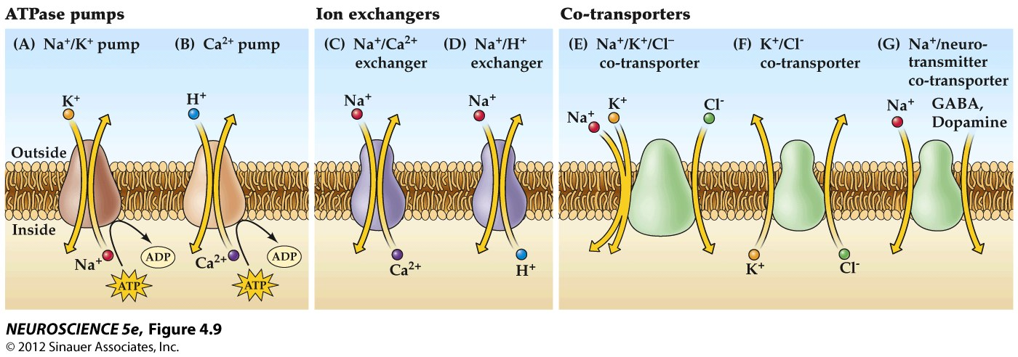
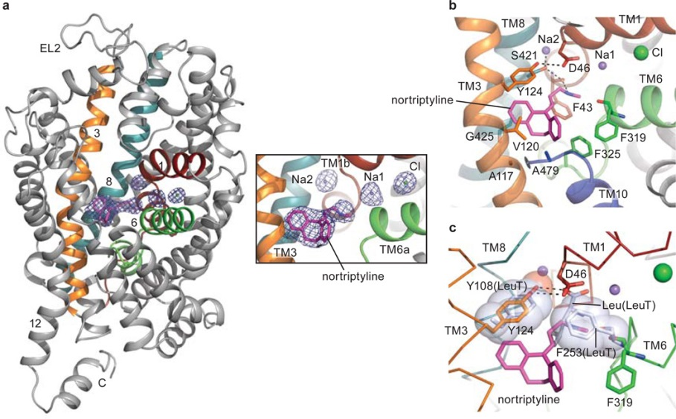
Transporters: ATPase pumps; Ion Exchangers, Co-transporters
Structure of Dopamine/Na⁺ Co-transporter (DAT) complexed with the Tricyclic Antidepressant (TCA) Nortriptyline
Penmatsa et al (2013) Nature 503

Slide 26
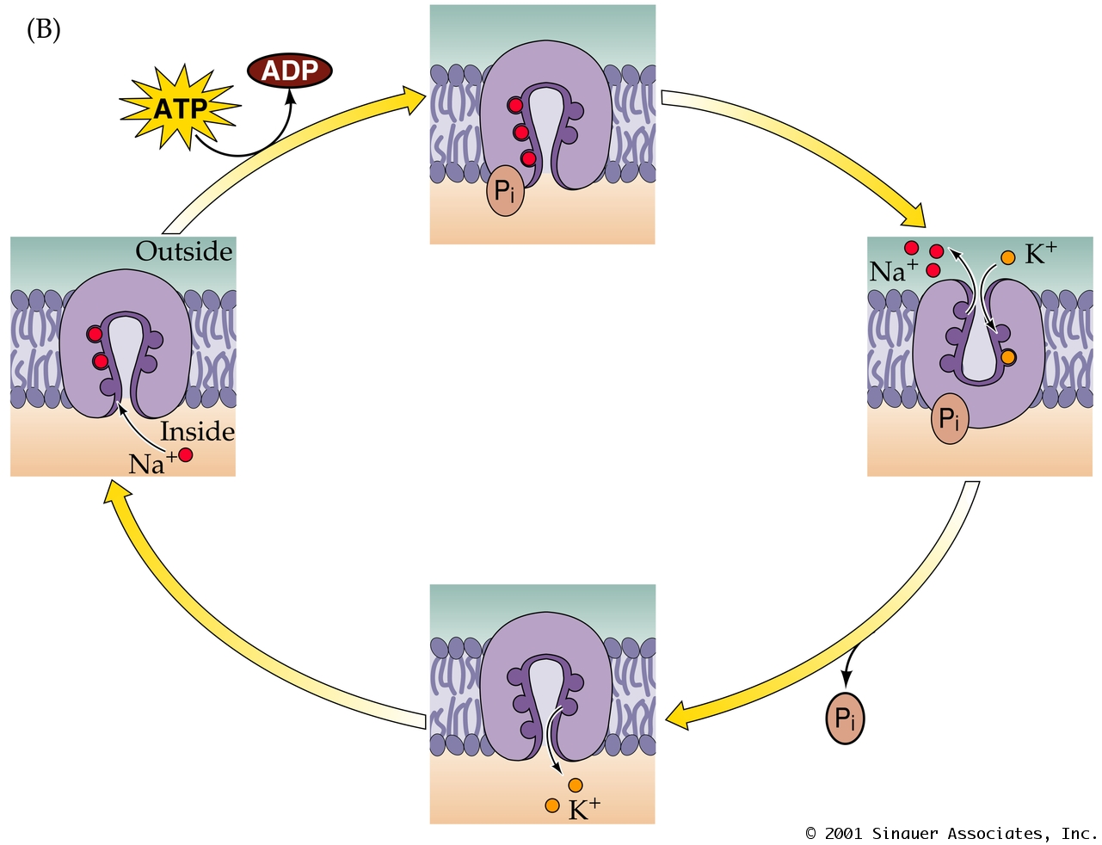
Ionic Movements Due to the Na+/K+ Pump
PN04102.JPG

Slide 27
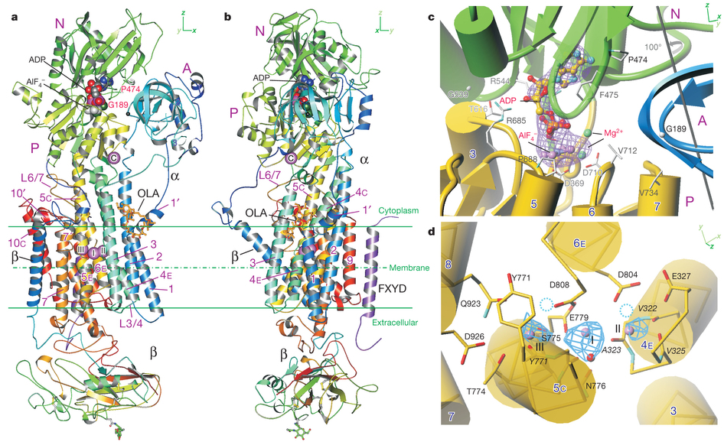
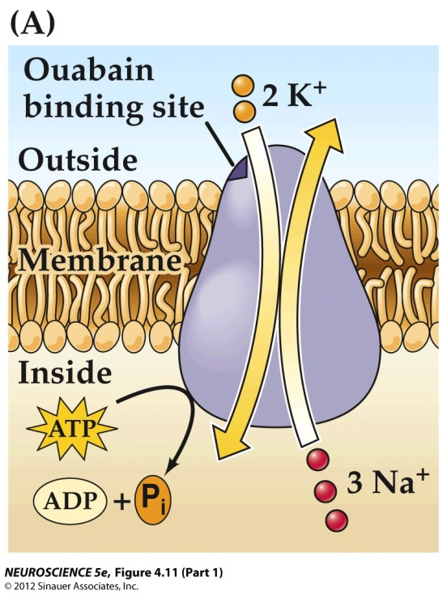
Structure of a mammalian Na, K-ATPase
Kanai et al. (2013) Nature 502

Slide 28
Study Guide:
-no structures!
Voltage-Gated Ion Channels- what are the properties of these channels that contribute to synaptic transmission (ion-selectivity; voltage-sensing, etc),what are the functional states.
Ligand-Gated Ion Channels- what are the properties of
these channels that contribute to synaptic transmission
(neurotransmitter selectivity; ion-selectivity; subunit composition,
etc.) that contribute to synaptic transmission.
Transporters- what are the different types of transporters and
how do they each contribute to synaptic transmission.

