Slide 1
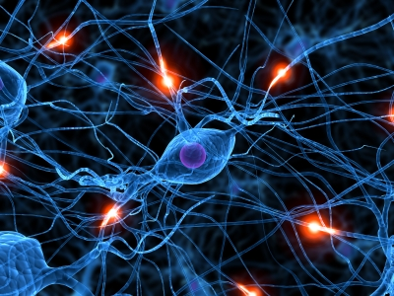


Review of Electrophysiology:
Fundamental principles in electrical signaling and
synaptic transmission
J. Josh Lawrence
Associate Professor,
Department of Pharmacology and Neuroscience
Why this review?
Reports of missed questions on USMLE Step 1.
Integrated Neuroscience is claiming “ownership” of this material – 2 lectures in MS1 is not enough.
Provides an important conceptual foundation that will enable you to gain insight into disease and therapeutic mechanisms.
Chapters 2,3,5,8
Required text
Notes:
Slide 1
My name is Josh Lawrence, I am an Associate Professor in the Department of Pharmacology and Neuroscience. My expertise is in cellular and synaptic physiology. It is my pleasure to give you this review.
Why now? First, there were reports of missed questions on USMLE Step 1 about this material. Second, it’s really part of Integrated Neuroscience. MS1 is not enough of a background for you. Third, this material provides an important conceptual foundation that will enable you to gain insight into disease processes and therapeutic mechanisms.
This review is based on chapters 2,3,5, and 8 of the Purves Neuroscience textbook (6th edition), which is required for Integrated Neuroscience. Most of the slides I am going to use come directly from the textbook. I don’t think I can do justice to the chapter material but this lecture will perhaps motivate you to want to dedicate time to reading these chapters.
I’ll be using Turning Point to probe your understanding of the material, so get your clickers out!

Slide 2
Chapters 2-8 in Neuroscience 6th Edition (Purves et al.)
Chapter 2* Lawrence Electrical Signals of Nerve Cells
Chapter 3* Lawrence Voltage-Dependent Membrane Permeability
Chapter 4 Blanton Ion Channels and Transporters
Chapter 5* Lawrence Synaptic Transmission
Chapter 6 Blanton Neurotransmitters and Their Receptors
Chapter 7 (skipped) Molecular Signaling within Neurons
Chapter 8* Lawrence Synaptic Plasticity
*Two learning objectives/chapter
Notes:
Slide 2
This slide will give you a sense for how this review’s content aligns with the textbook material.
For each of the 4 chapters I’ll touch on, I have structured the content into two learning objectives.

Slide 3
Chapters 2-8 in Neuroscience 6th Edition (Purves et al.)
Chapter 2 Lawrence Electrical Signals of Nerve Cells
Learning Objectives:
1) Understand how ion movements produce electrical signals (p. 39-45).
resting membrane potential, passive electrical responses, hyperpolarization, depolarization, threshold, equilibrium potentials, electrochemical equilibrium, Nernst equation
Starts with the Na⁺/K⁺ ATPase! Review Pablo Artigas’ lecture
2) Understand the ionic basis of action potentials (p. 46-48).
Goldman equation, resting membrane potential, action potential, Na⁺ permeability, K⁺ permeability, repolarization
Notes:
Slide 3
First, we’ll cover the Chapter 2 objectives. The first objective is to understand how ion movements produce electrical signals.
For this objective, an important prerequisite is to know the Na+/K+ ATPase, which is critical for understanding how electrochemical gradients are established.
The second objective is to understand the ionic basis of action potentials.

Slide 4
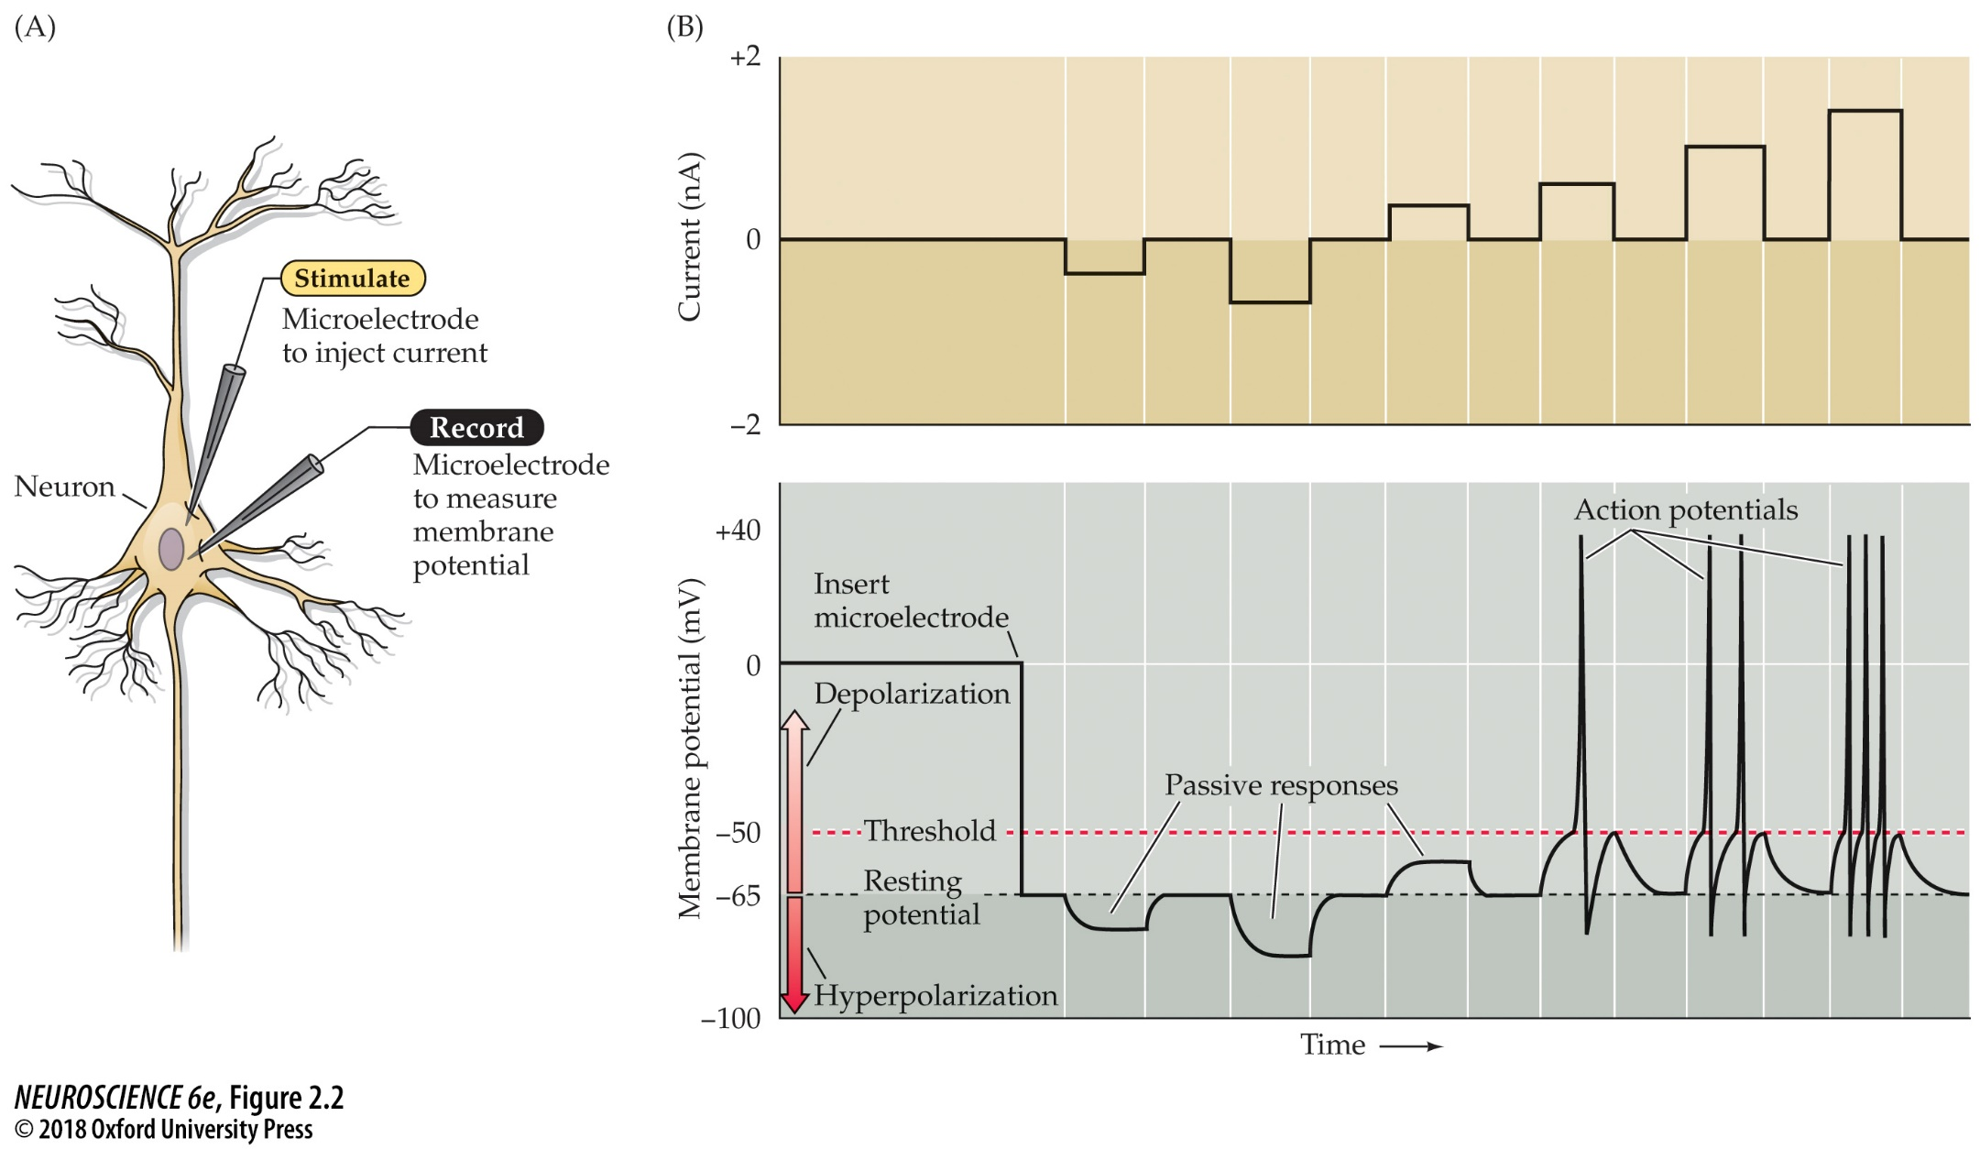
Passive and active electrical signals in a neuron
Passive responses
are “Ohmic”
Ohm’s Law
V = IR
V = voltage
(or potential)
I = current
R = resistance
Active responses
are non-Ohmic;
R depends on V
resting potential, passive electrical responses, hyperpolarization, depolarization, threshold
Notes:
Slide 4
This slide gives you an overview of the passive and electrical properties of neurons.
The configuration is in A here – you can inject current, in amps, with one electrode and record membrane potential, in volts.
For this, you need to know Ohm’s lab. V = IR, where V= voltage, I = current, and R = resistance.
Here is an experiment to help you understand how passive and active properties are examined in a living neuron.
The first thing you notice is that when you insert a recording electrode, the membrane potential moves from 0 to -65 mV. This is the resting potential of a neuron.
When the voltage moves more positive to the resting potential, this is called depolarization; when the voltage moves more negative, this is called hyperpolarization.
Upon injection of a negative current, the neuron hyperpolarizes. A larger negative current gives a larger hyperpolarization. A small injection of positive current will give a subthreshold depolarization. These are considered passive responses, and are governed by Ohm’s law, in which injection of any current, whether it’s negative or positive, gives a predictable voltage that is determined by the specific resistance of the neuron.
At higher currents, the voltage reaches threshold. Here, everything changes. Rather than see a passive response, the current injection elicits an active response in the form of an action potential.
Larger currents cause more action potentials. This is often referred to as a “rate code”.
This is the overview. Now we’ll get into the ionic basis of the resting membrane potential.
FIGURE 2.2 Recording passive and active electrical signals in a nerve cell. (A) Two microelectrodes are inserted into a neuron; one of these measures membrane potential while the other injects current into the neuron. (B) Inserting the voltage-measuring microelectrode into the neuron (bottom) reveals a negative potential, the resting membrane potential. Injecting current through the other microelectrode (top) alters the neuronal membrane potential. Hyperpolarizing current pulses produce only passive changes in the membrane potential. While small depolarizing currents also elicit only passive responses, depolarizations that cause the membrane potential to meet or exceed threshold additionally evoke action potentials.

Slide 5
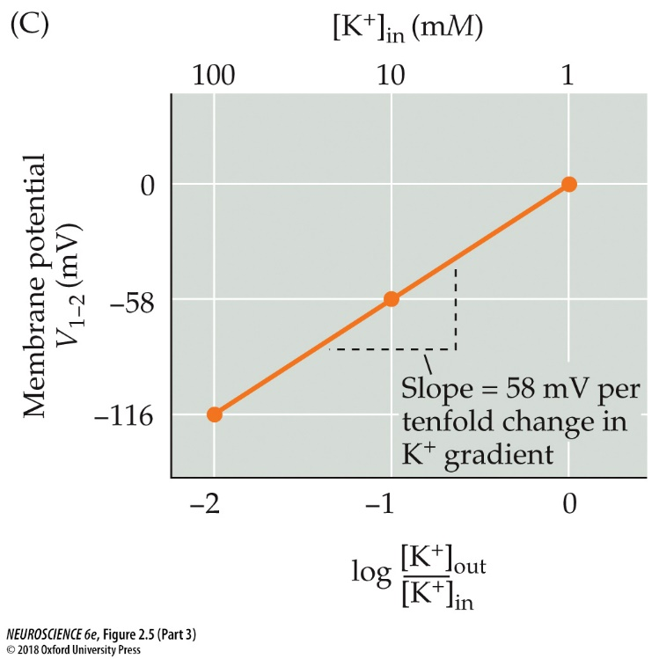
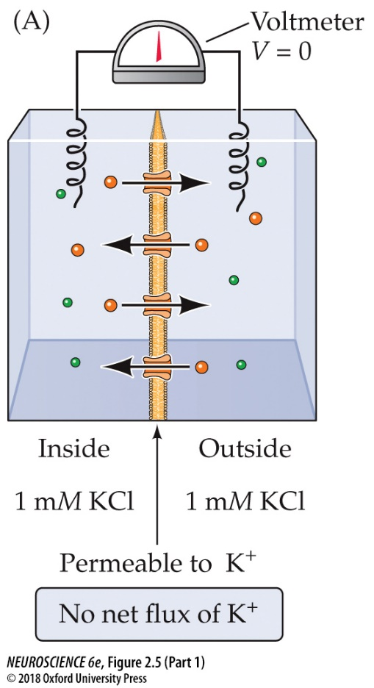
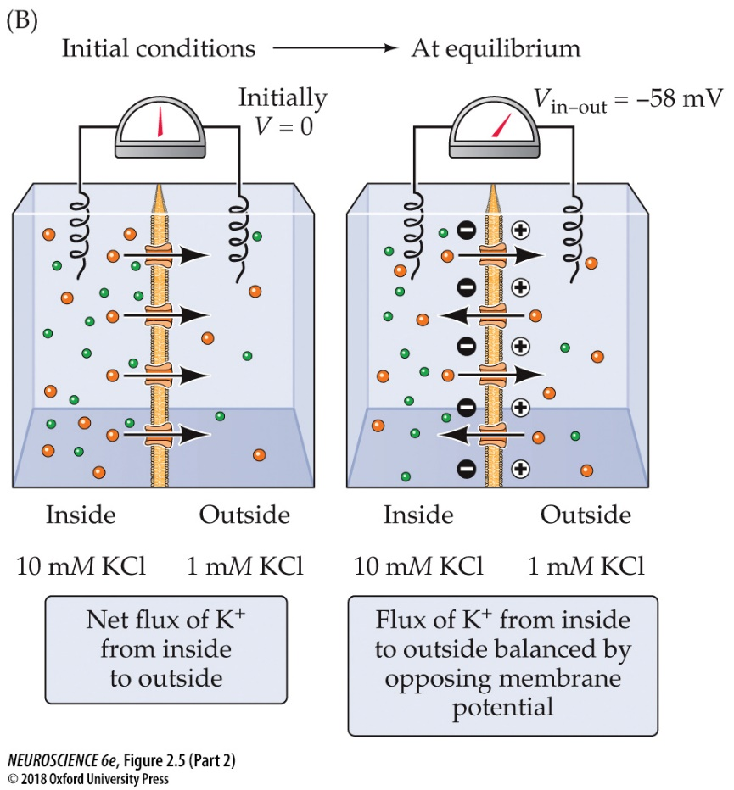
How Ion Movements Produce Electrical Signals
The Nernst potential for E_{K}:
[K⁺]out
EK
=
58
log
[K⁺]in
Nernst Equation
(generalized form)
For a permeant K⁺ ion with a 10:1 ratio of [K⁺]_{in}:[K⁺]_{out} gradient, K⁺ ions flow down their concentration gradient, leaving behind intracellular negative charges, establishing an electrochemical equilibrium.
RT
[X]out
EX
=
ln
zF
[X]in
R = gas constant
equilibrium potentials, electrochemical equilibrium, Nernst equation
T = temperature
EX = equilibrium
potential
for ion X
z = valence
F = Faraday constant
Notes:
Slide 5
To understand the basis of the resting membrane potential, we start with just one ion, the potassium ion, and a membrane that is permeable to potassium, as shown here in A. The voltmeter reads zero.
However, when you start with potassium being 10-fold higher on the inside than outside, the voltage changes. K ions flow down their concentration gradient, leaving behind impermeant anions. There is an accumulation of negative charge on the inside of the cell, which generates an electrical force that opposes the force that causes K to flow down its chemical gradient.
There is a voltage in which the electrical voltage exactly counterbalances the chemical gradient – this is called the electrochemical equilibrium or Nernst potential. It is approximately 58 volts for every 10-fold difference in concentration between outside and inside.
The more generalized Nernst equation is shown here, which takes into account the valence of the ion and the temperature.
FIGURE 2.5 Electrochemical equilibrium. (A) A membrane permeable only to K⁺ (gold spheres) separates the inside and outside compartments, which contain the indicated concentrations of KCl. (B) Increasing the KCl concentration of the inside compartment to 10 mM initially causes a small movement of K⁺ into the outside compartment (initial conditions) until the electromotive force acting on K⁺ balances the concentration gradient, and there is no further net movement of K⁺ (at equilibrium). (C) The relationship between the transmembrane concentration gradient ([K⁺]_{out}/[K⁺]_{in}) and the membrane potential. As predicted by the Nernst equation, this relationship is linear when plotted on semilogarithmic coordinates, with a slope of 58 mV per tenfold difference in the concentration gradient.

Slide 6
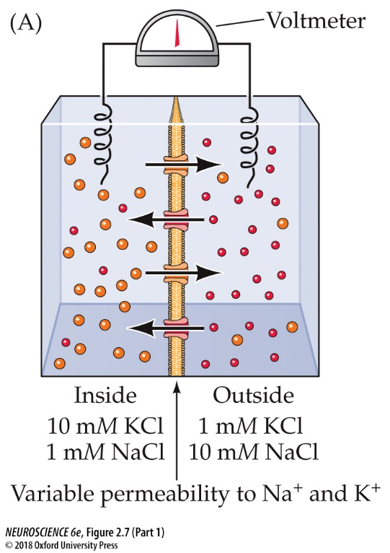
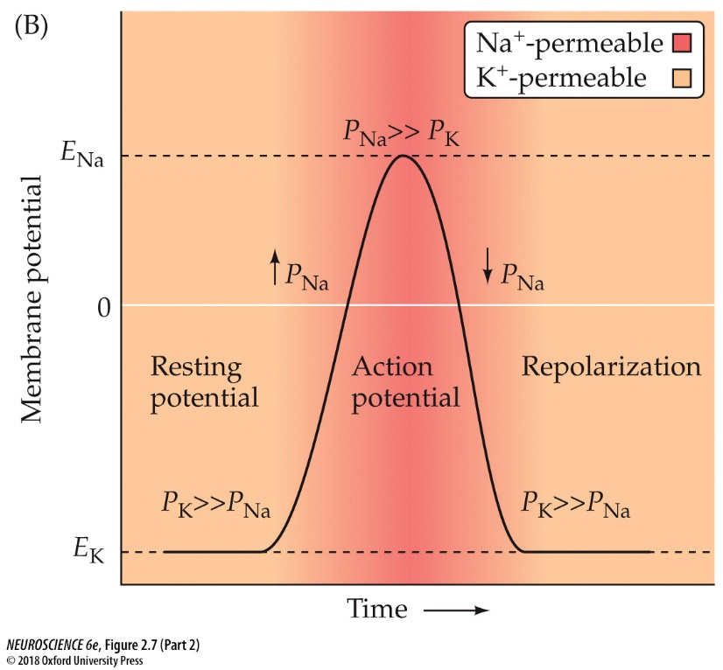
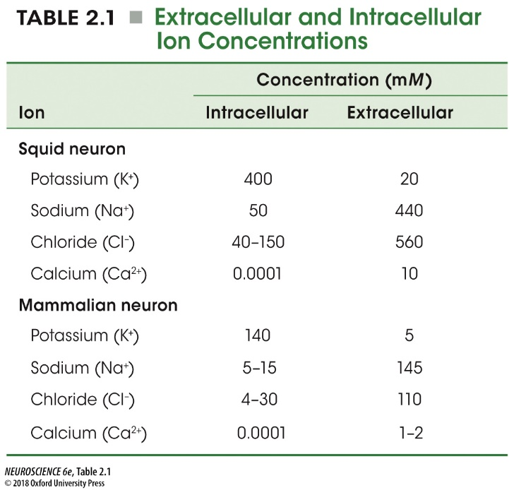
The Ionic Basis of Action Potentials
+67mV
-84 mV
For K⁺ ions in mammalian neurons,
Goldman Equation
[K⁺]out
[5]out
P_{K}[K]_{out} + P_{Na}[Na]_{out}
EK
=
58
log
=
58
log
=
-84 mV
[K⁺]in
[140]in
Vm
=
58 log
P_{K}[K]_{in} + P_{Na}[Na]_{in}
For Na⁺ ions in mammalian neurons,
When P_{K}>> P_{Na}, Vm ≈ E_{K}
[Na⁺]out
[145]out
When P_{Na}>> P_{K}, Vm ≈ E_{Na}
ENa
=
58
log
=
58
log
=
+67 mV
[Na⁺]in
[10]in
(assuming P_{Cl} = 0)
The Na+/K+ ATPase establishes these gradients!
Goldman equation, Na⁺ permeability, K⁺ permeability, resting membrane potential, action potential, repolarization
Notes:
Slide 6
From the Nernst equation, you can now understand the ionic basis of the action potential.
This table lists the intracellular and extracellular concentrations of important ions. For K, Ek = -84. For Na, ENa = +67. Remember the Na+/K+ pump is responsible for establishing K and Na gradients!
The action potential can be described as swinging form EK to ENa and back again.
At the resting membrane potential, permeability to K dominates, as so Vm is near EK.
During an action potential, there is a transient increase in Na permeability, which causes Vm to move towards ENa.
During the repolarization of the action potential, K permeability again dominates, and Vm is near EK again.
The relationship between K and Na ions is described by the Goldman equation. This equation also includes the relative permeability of each ion, termed PK and PNa.
You can see how domination of either P_{K} or P_{Na} can reduce the Goldman equation down to the Nernst equation for E_{K} or E_{Na}.
FIGURE 2.7 Resting and action potentials rely on permeabilities to different ions. (A) Hypothetical situation in which a membrane variably permeable to Na⁺ (red) and K⁺ (gold) separates two compartments that contain both ions. For simplicity, Cl– ions are not shown in the diagram. (B) Schematic representation of the membrane ion permeabilities associated with resting and action potentials. At rest, neuronal membranes are more permeable to K⁺ (gold) than to Na⁺ (red); accordingly, the resting membrane potential is negative and approaches the equilibrium potential for K⁺, E_{K}. During an action potential, the membrane becomes very permeable to Na⁺ (red); thus, the membrane potential becomes positive and approaches the equilibrium potential for Na⁺, E_{Na}. The rise in Na⁺ permeability is transient, however, so the membrane again becomes primarily permeable to K⁺, causing the potential to return to its negative resting value.
TABLE 2.1 Extracellular and Intracellular Ion Concentrations

Slide 7
Chapters 2-8 in Neuroscience 6th Edition (Purves et al.)
Chapter 3 Lawrence Voltage-Dependent Membrane Permeability
Learning Objectives:
3) Understand how action potentials are generated through voltage-dependent membrane permeability (p. 48-56).
Ohm’s Law, membrane conductance, electrochemical driving force, rising phase, overshoot phase, undershoot
4) Understand long-distance signaling by means of action potentials (p. 57-63).
conduction velocity, myelination, nodes of Ranvier, saltatory conduction
Notes:
Slide 9
Now we’re on to Chapter 3. The first objective is to understand how action potentials are generated through voltage-dependent membrane permeability.
The second objective is to understand how propagation of action potentials works.

Slide 8
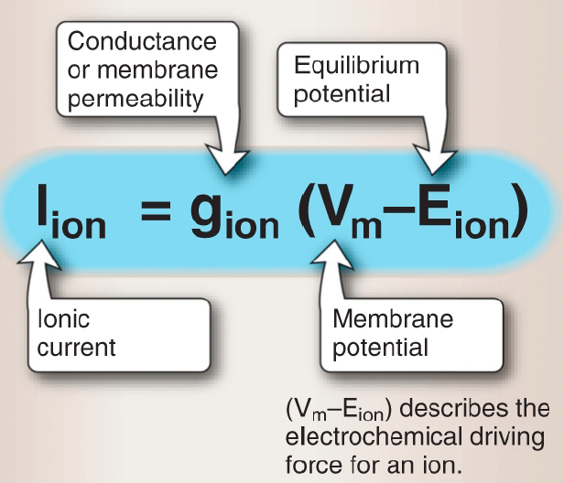
Voltage-dependent membrane permeability
Ohm’s Law
IK = gK (Vm - EK)
V
V_{m} = I_{ion}R_{ion}
I =
EK = -84 mV
R
V = voltage
1
g_{ion} =
INa = gNa (Vm - ENa)
I = current
R
R = resistance
ENa = +67 mV
g = conductance
I_{ion} =
g_{ion}V_{m}
When V_{m} ≈ E_{K}, V_{m}-E_{Na} = -84 – 67 = -151 mV
At the resting membrane potential, there is a large driving force on Na⁺.
When V_{m} = E_{Na}, V_{m}-E_{K} = 67 – (-84) = +151 mV
At the peak of the action potential , there is a large driving force on K⁺.
Ohm’s Law, membrane conductance, electrochemical driving force
Notes:
Slide 10
To understand voltage-dependent membrane permeability, we come back to Ohm’s Law.
I previously introduced Ohm’s Law in the context of passive properties of neurons. You introduce a fixed current, whether it’s positive or negative, and you get a fixed voltage response because of a constant resistance.
However, we now introduce the idea that the active properties of a neuron are non-Ohmic. The resistance is partly dependent on the membrane potential.
Also, we know that membrane permeability for sodium and potassium are occur depend on the voltage.
To incorporate this idea, we introduce the concept of conductance. Ohm’s law can be re-written as I = V/R. Conductance, or g, is the inverse of resistance – you can view g as how leaky, or permeable, the cell is for a particular ion. So we end up with I_{ion} = g_{ion}V_{ion}.
Iion is the ionic current. Gion is the membrane conductance. Then you have the membrane potential Vm and the equilibrium potential, or Nernst potential, for a particular ion.
Vm-Eion is referred to as the electrochemical driving force. This term has to be not negative to generate a current, if the conductance is not zero.
I_{ion} = g_{ion}(V_{m}-E_{ion}) is a generic equation for any ion, but it can be customized for potassium and sodium conductances, because they have different permeabilities and different equilibrium potentials. So you have I_{K} = g_{K}(V_{m} – E_{K}) and I_{Na} = g_{Na}(V_{m}-E_{Na}).
To give you a better sense for how the driving force is important, let’s do some calculations. At the resting potential Vm, the membrane is mostly permeable to potassium and is therefore near EK. However, if you calculate the driving force on sodium, it’s large: -151 mV. So if gNa suddenly changes, then it will generate a large inward (negative) current.
At the peak of the action potential, when the membrane potential is near ENa, there is less current flow. However, there is now a large driving force on potassium – V_{m}-E_{K} = +151 mV. So when gK is active, it will cause a large outward current that will bring the membrane potential back down towards EK.

Slide 9
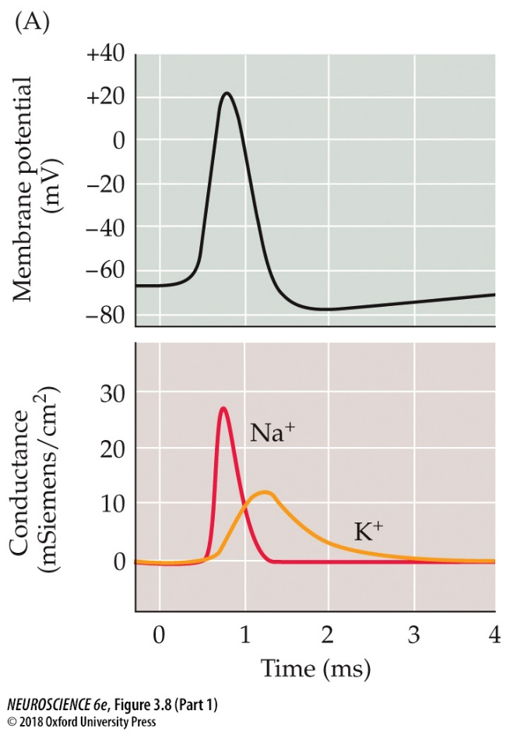
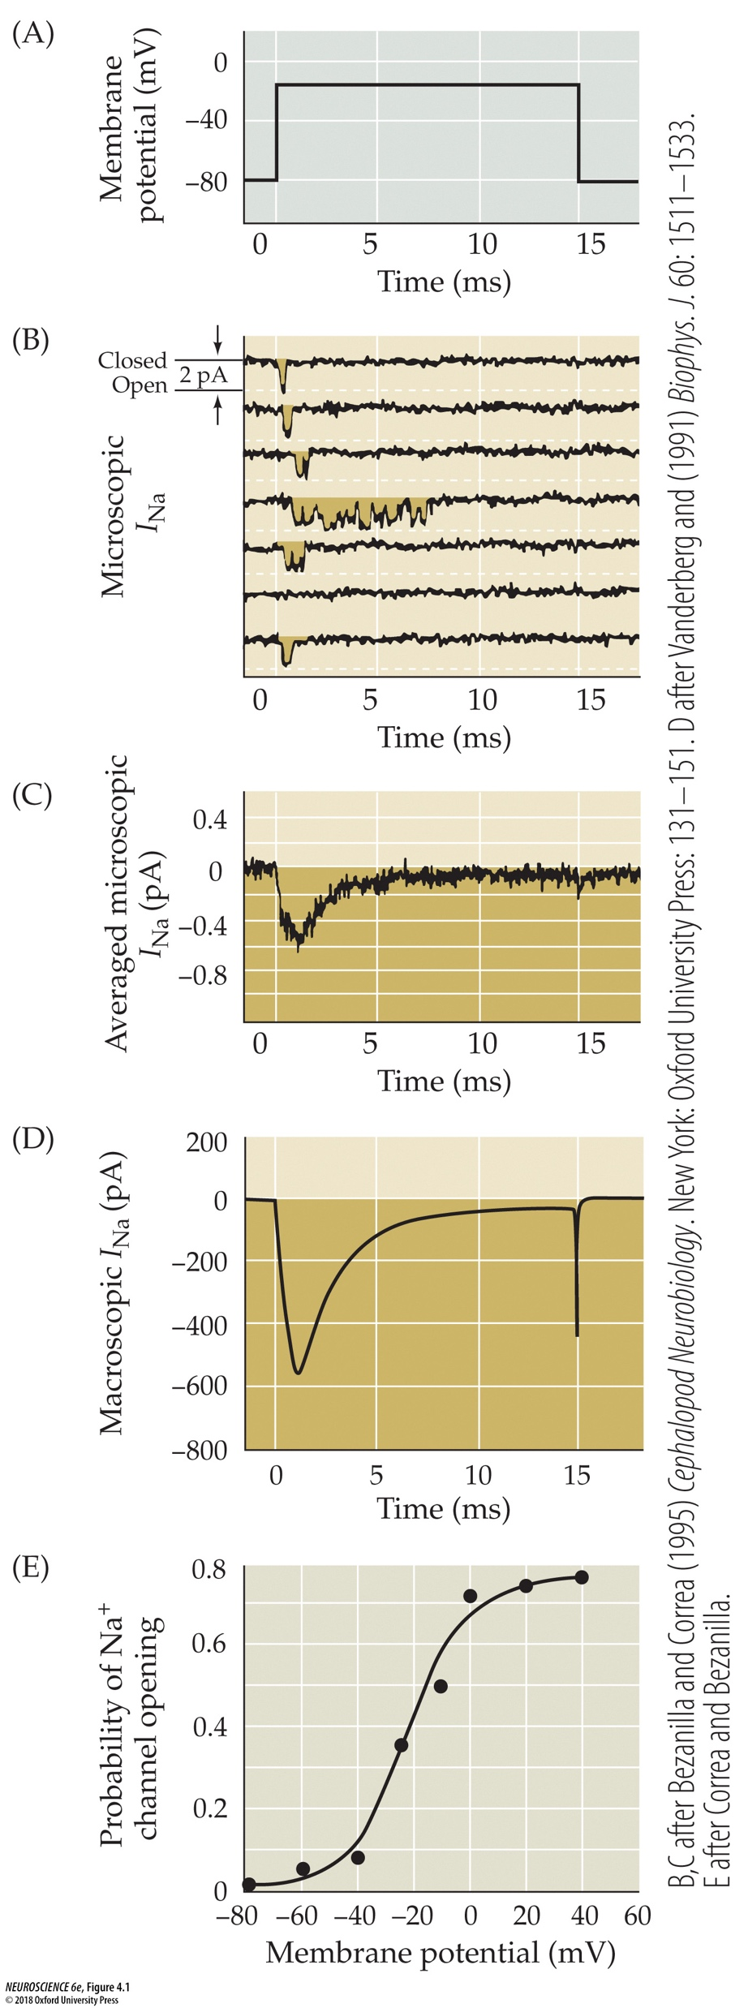
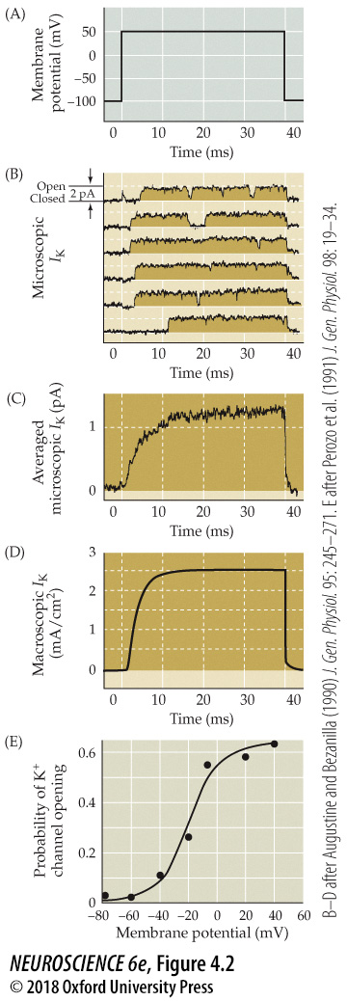
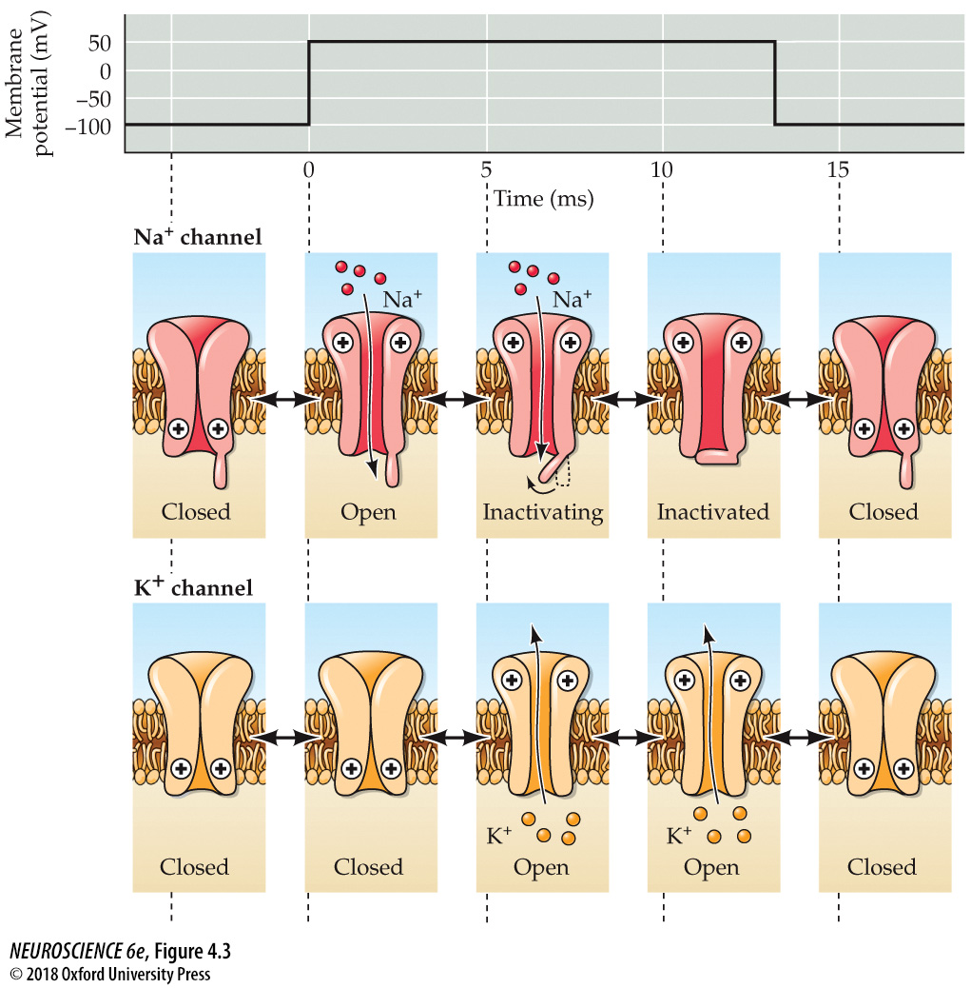
Voltage-dependent membrane permeability
IK = gK (Vm - EK)
2
INa = gNa (Vm - ENa)
1
At resting Vm:
3
1
gK >> gNa; Vm ≈ EK;
(Vm - ENa) = large
4
2
During the rising
phase:
gNa >> gK; I_{Na} is large;
Vm nears ENa
3
During the falling
phase:
Na+ channels inactivate (gNa = 0);
gK >>> gNa;
(Vm - EK) = large
4
During the
undershoot:
gK >>> gNa;
Vm ~ EK
4
back to
1
:
gK deactivates
(Ch 4 Blanton)
(Ch 4 Blanton)
Notes:
Slide 11
These terms – I,g, and V, change dynamically during an action potential.
At the resting potential, gK exceeds gNa; therefore Vm is near EK (Goldman equation). The driving force (Vm-ENa) is large.
During the rising phase of the action potential, gNa suddenly exceeds gK. Becaue (Vm-ENa) is large, INa is large. As a result, Vm approaches ENa.
During the falling phase of the action potential, gNa drops to near zero because of a molecular mechanism called inactivation – a gate in the Na channel itself causes the Na channel to become nonconducting. Meanwhile gK becomes large and (Vm-EK) is large, causing a large IK which forces Vm back towards EK.
During the undershoot, it takes a while for gK to turn off, so Vm hovers near EK before eventually the K+ channels close and equilibrate around Vm.
The key to the action potential is that really the intrinsic properties of the Na and K channels themselves. The inactivation of sodium channels is an important mechanism that makes the sodium channel current transient – this is shown here in one of Dr. Blanton’s figures. Likewise, the delayed, non-inactivating response of K channels to depolarization is also important in providing the repolarizing force during an action potential.

Slide 10
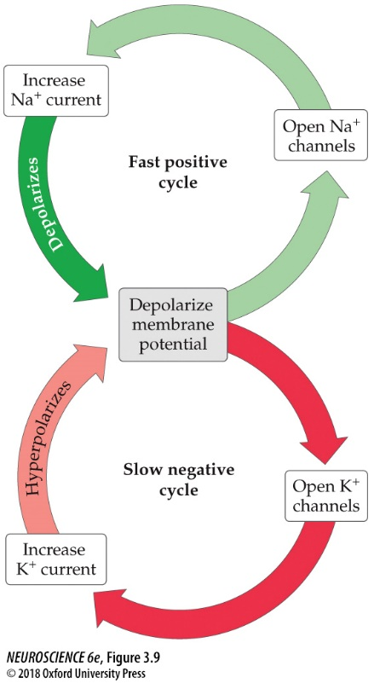
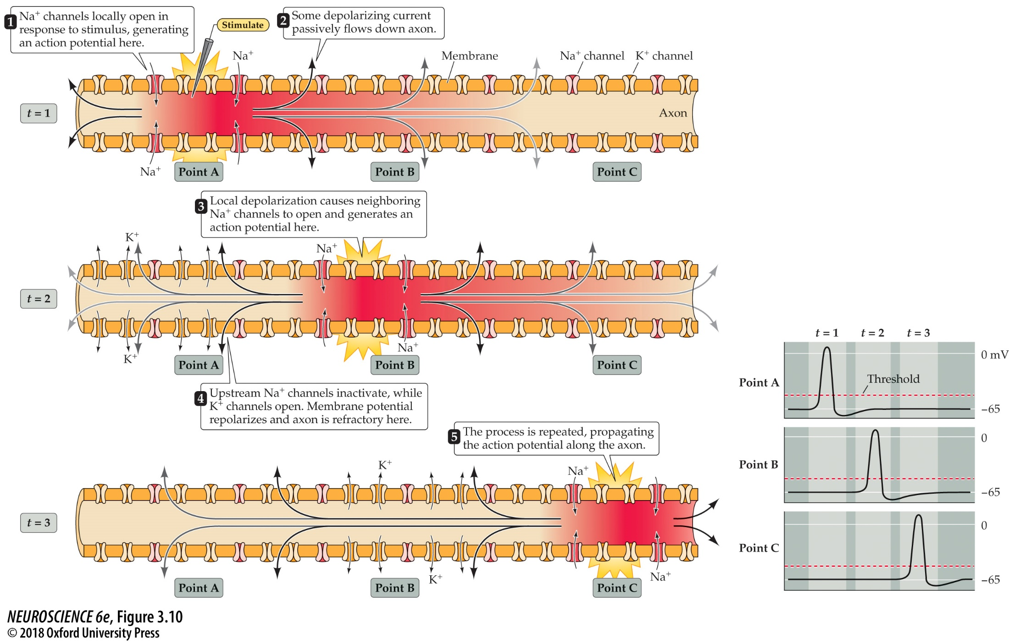
Long-distance signaling by means of action potentials
Notes:
Slide 13
Now that you have had action potentials, it’s important that you know how they propagate down an axon.
This is shown in this schematic here. First, upon injection of a current at Point A, an action potential is generated locally.
Some of the depolarizing current passively flows down the axon to Point B.
Local depolarization at Point B generates an action potential. Meanwhile, at Point A, Na channels inactivate and potassium channels open.
Some of the depolarizing current generated in Point B passively flows down the axon to Point C, causing generation of an action potential at Point C.
Note that backward propagation of the action potential is prevented by sodium channel inactivation, which causes a refractoriness immediately after the action potential is generated. This mechanism allows action potentials to propagate in one direction down an axon.
FIGURE 3.10 Action potential conduction requires both active and passive current flow. Depolarization opens Na⁺ channels locally and produces an action potential at point A of the axon (time t = 1). The resulting inward current flows passively along the axon, depolarizing the adjacent region (point B) of the axon. At a later time (t = 2), the depolarization of the adjacent membrane has opened Na⁺ channels at point B, resulting in the initiation of the action potential at this site and additional inward current that again spreads passively to an adjacent point (point C) farther along the axon. At a still later time (t = 3), the action potential has propagated even farther. This cycle continues along the full length of the axon. Note that as the action potential spreads, the membrane potential repolarizes due to K⁺ channel opening and Na⁺ channel inactivation, leaving a “wake” of refractoriness behind the action potential that prevents its backward propagation. The lower panel shows the time course of membrane potential changes at the points indicated.

Slide 11
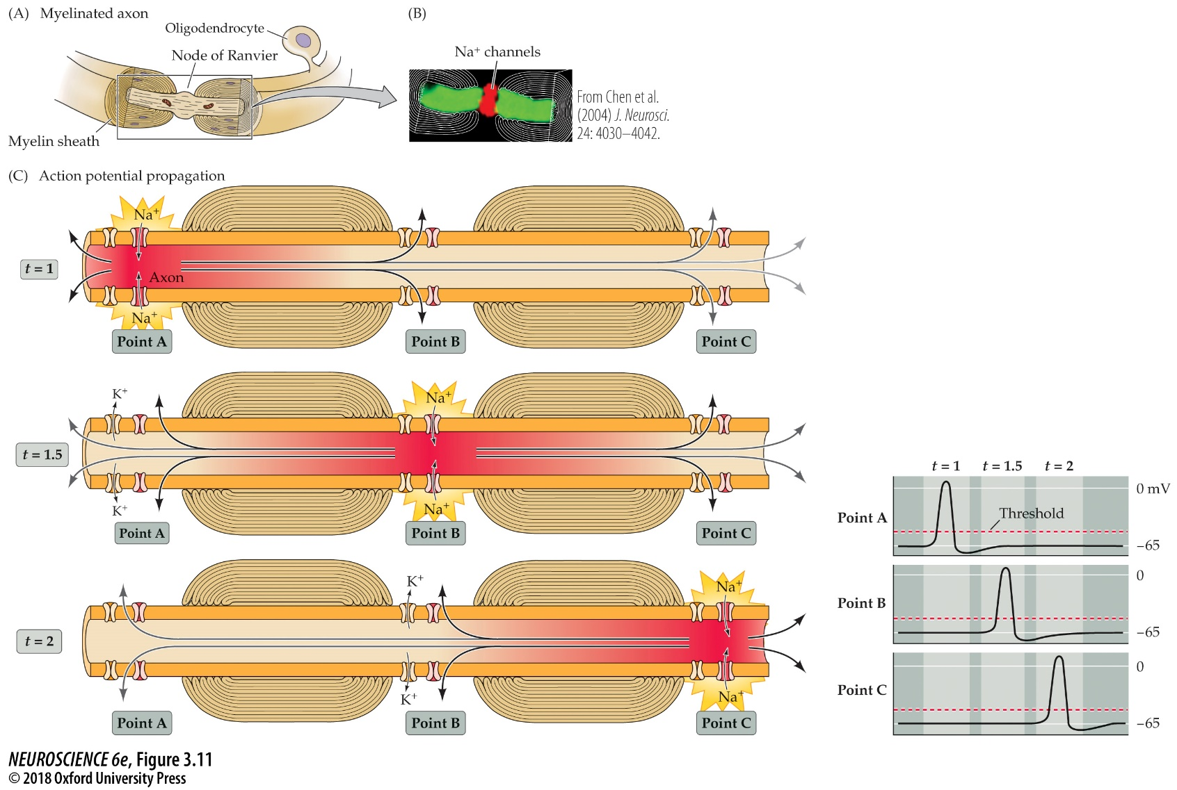
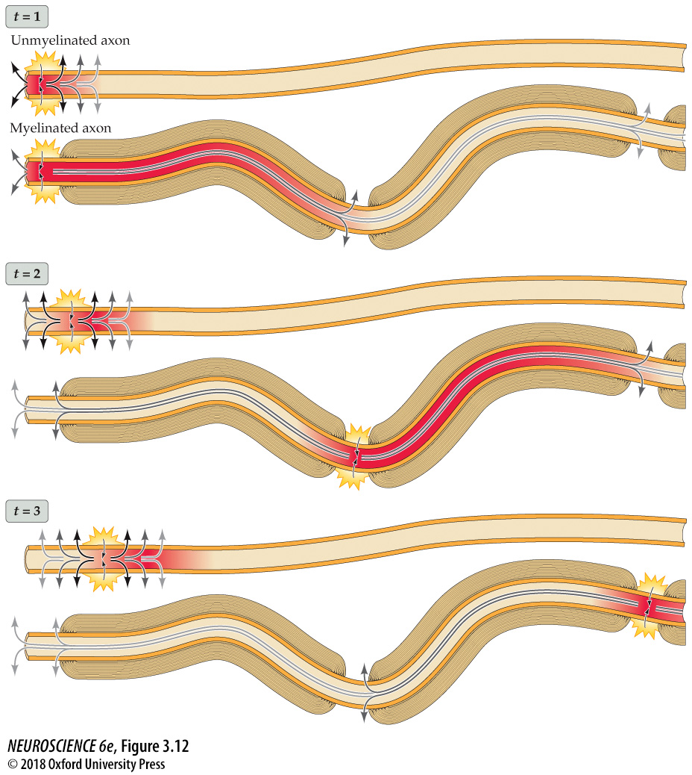
Long-distance signaling by means of action potentials
conduction velocity, myelination, nodes of Ranvier, saltatory conduction
Notes:
Slide 14
Now we’ll cover action potential propagation down a myelinated axon.
In a myelinated axon, oligodendrocytes form myelin sheaths. Located periodically along the axon are nodes of Ranvier, which is where sodium channels are concentrated.
When an action potential is initiated in the axon, it occurs in the Nodes of Ranvier. The passive current then passes into the myelinated region of the axon. Because the axon has very few if any channels in this region, the resistance in this part of the axon is very high, which prevents loss of current and speeds propagation.
The passive current then arrives at Point B, and an action potential is initiated in the Node of Ranvier.
The right panel compares the conduction velocity of unmyelinated to myelinated axons.
FIGURE 3.11 Saltatory action potential conduction along a myelinated axon. (A) Diagram of a myelinated axon. (B) Localization of voltage-gated Na⁺ channels (red) at a node of Ranvier in a myelinated axon of the optic nerve. Green indicates the protein Caspr, which is located adjacent to the node of Ranvier. (C) Local current in response to action potential initiation at a particular site flows locally, as described in Figure 3.10. However, the presence of myelin prevents the local current from leaking across the internodal membrane; it therefore flows farther along the axon than it would in the absence of myelin, reaching several adjacent nodes (for clarity, only one node is shown). Moreover, voltage-gated Na⁺ channels are present only at the nodes of Ranvier (voltage-gated K⁺ channels are present at the nodes of some axons, but not others). This arrangement means that the generation of active, voltage-gated Na⁺ currents need occur only at these unmyelinated regions. Bottom panel: The more rapid conduction of action potentials is illustrated by the more rapid timing of action potentials at the points indicated.
FIGURE 3.12 Myelin increases action potential conduction speed. The diagram compares the speed of action potential conduction in unmyelinated (upper panel in each pair) and myelinated (lower panels) axons. Passive conduction of current is shown by arrows.

Slide 12
Chapters 2-8 in Neuroscience 6th Edition (Purves et al.)
Chapter 5 Lawrence Synaptic Transmission
Learning Objectives:
5) Understand fundamental mechanisms of synaptic transmission (p. 85-102).
presynaptic, postsynaptic, gap junctions, synaptic cleft, quantal release, calcium, synaptic vesicles, exocytosis
6) Understand postsynaptic membrane permeability changes during synaptic transmission (p. 102-112).
end plate current, reversal potential, postsynaptic currents, postsynaptic potentials, summation
Notes:
Slide 16
So we are on to Chapter 5 now, Synaptic Transmission.
The first learning objective is to understand fundamental mechanisms in synaptic transmission.
The second learning objective is to understand postsynaptic membrane permeability changes during synaptic transmission.

Slide 13
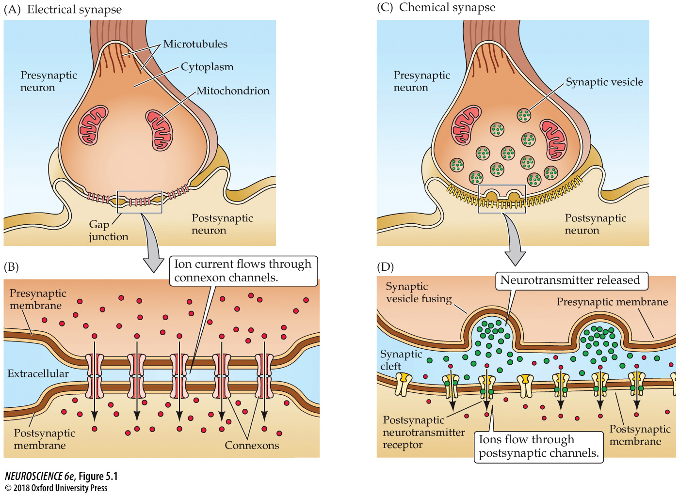
Fundamental mechanisms of synaptic transmission
presynaptic, postsynaptic, gap junctions, synaptic cleft, synaptic vesicles
Notes:
Slide 17
There are two fundamental mechanisms of synaptic transmission.
The first is electrical synapses. These synapses contain gap junctions within the synapse. The gap junctions are formed from connexon channels.
The other type is chemical synapses. At chemical synapses, the action potential goes down the axon, arrives at the presynaptic terminal, causes neurotransmission through the fusion of synaptic vesicles containing neurotransmitter, and then is converted back to an electrical signal once it crosses the synapse through the action of neurotransmitter receptors.
FIGURE 5.1 Electrical and chemical synapses differ fundamentally in their transmission mechanisms. (A) At electrical synapses, gap junctions occur between pre- and postsynaptic membranes. (B) Gap junctions contain connexon channels that permit current to flow passively from the presynaptic cell to the postsynaptic cell. (C) At chemical synapses, there is no intercellular continuity, and thus no direct flow of current from pre- to postsynaptic cell. (D) Synaptic current flows across the postsynaptic membrane only in response to the secretion of neurotransmitters, which open or close postsynaptic ion channels after binding to receptor molecules on the postsynaptic membrane.

Slide 14
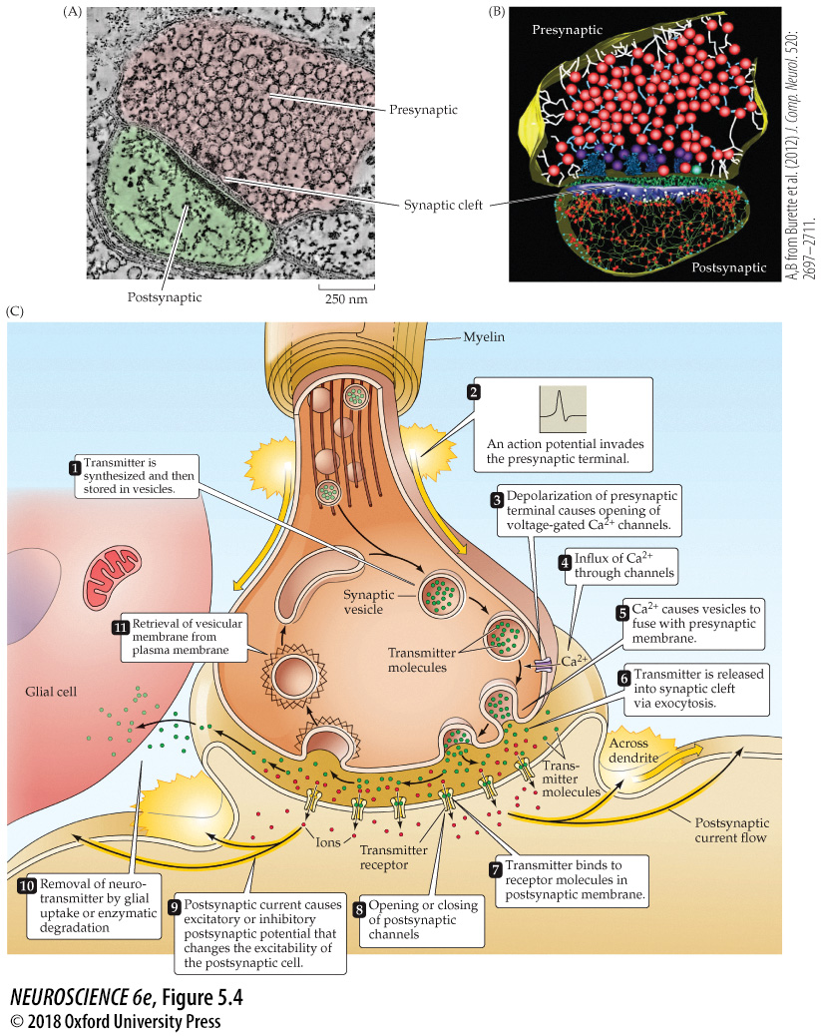
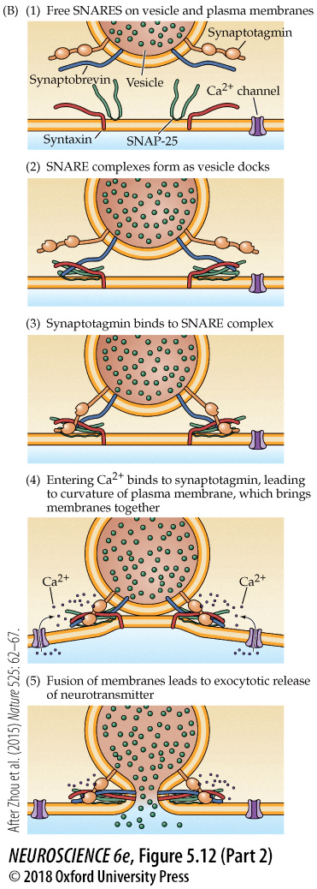
Fundamental mechanisms of synaptic transmission
calcium, exocytosis
Notes:
Slide 18
There is a sequence of steps for chemical transmission.
Neurotransmitter is synthesized and stored in synaptic vesicles.
An action potential arrives at the presynaptic terminal.
The action potential induces a depolarization which causes the opening of voltage-gated calcium channels.
There is influx of calcium through the calcium channels.
Calcium binds to special calcium sensors on the synaptic vesicles called synaptotagmins, which then causes the association of proteins on both the pre-and postsynaptic membrane. This draws the synaptic vesicle towards the presynaptic membrane and eventually causes fusion, or exocytosis.
Neurotransmitter is then released into the synaptic cleft.
Neurotransmitter binds to neurotransmitter receptors on the postsynaptic membrane.
The neurotransmitter receptor then activates, causes a change in ionic conductance.
There is then a change in cellular excitability.
The neurotransmitter is then removed from the synaptic cleft through uptake mechanisms or degradation.
Finally, there is endocytosis, or retrieval of the synaptic vesicle from the plasma membrane and refilling of the synaptic vesicle with neurotransmitter.
FIGURE 5.4 Structure and function of chemical synapses. (A) Structure of a chemical synapse in the cerebral cortex. A presynaptic terminal (pink) forms a synapse with a postsynaptic dendrite (green). (B) Three-dimensional reconstruction of the synapse shown in (A). Inside the presynaptic terminal, spheres indicate synaptic vesicles at various stages of their trafficking cycle, linear elements indicate intracellular filaments, and dark blue indicates dense projections associated with the active zone. Inside the postsynaptic neuron, the blue structure is the postsynaptic density, green structures represent filaments, red spheres indicate points where the filaments branch. Green material within the synaptic cleft indicates structures of unknown function. (C) Sequence of events involved in transmission at a typical chemical synapse. (A, B from Burette et al., 2012.)
FIGURE 5.12 Molecular mechanisms of exocytosis during neuro-transmitter release. (B) A model for Ca²⁺-triggered vesicle fusion. During docking of the synaptic vesicle, SNARE proteins on the vesicle and plasma membranes form a complex (as in A) that brings together the two membranes. Synaptotagmin binds to this SNARE complex. Subsequent binding of Ca²⁺ to synaptotagmin causes the cytoplasmic region of this protein to insert into the plasma membrane to produce the membrane curvature that catalyzes membrane fusion. (A from Sutton et al., 1998, and Madej et al., 2014; B after Zhou et al., 2015.)

Slide 15
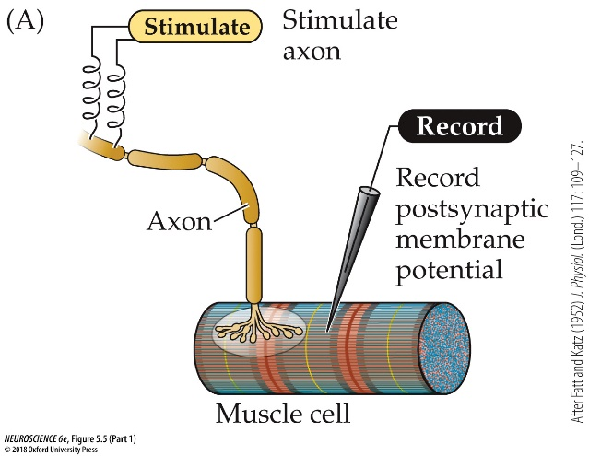
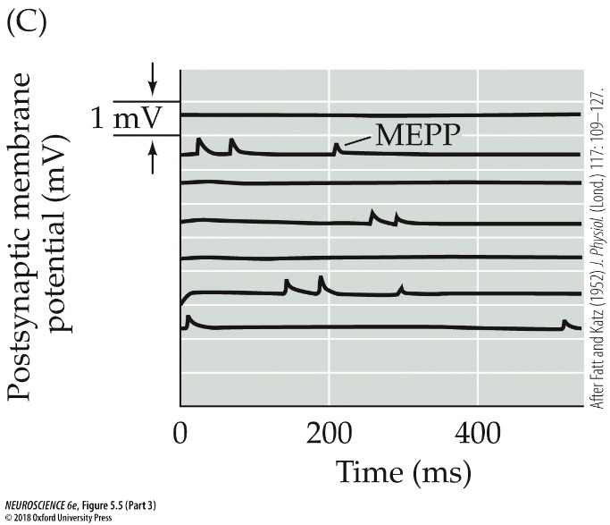
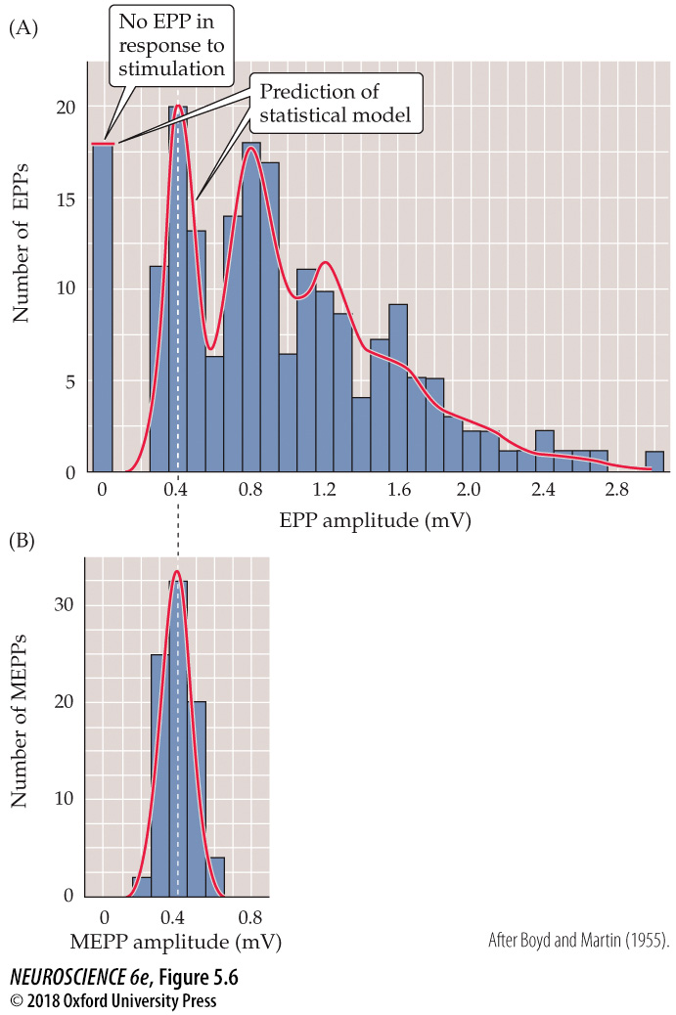
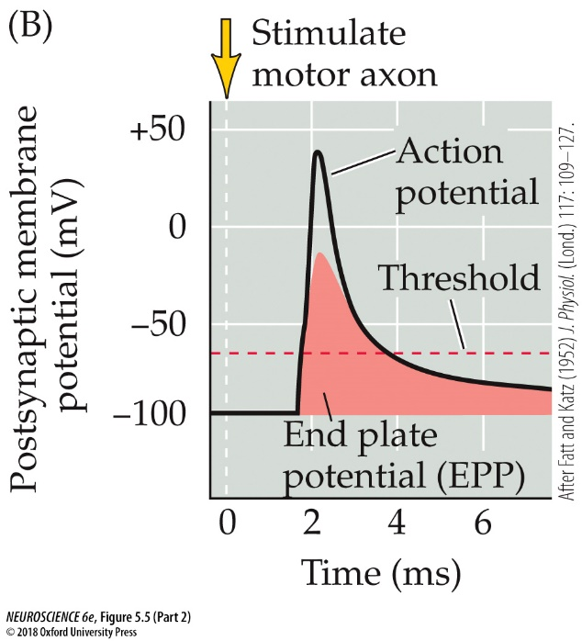
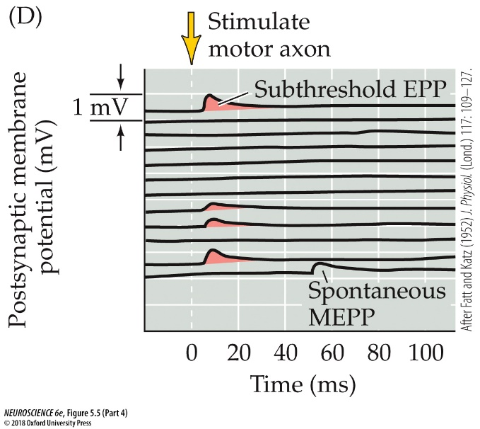

Postsynaptic membrane permeability changes during synaptic transmission
Katz
end plate potential, miniature end plate potential, calcium,
quantal release
Notes:
Slide 19
What is happening postsynaptically when neurotransmitter bings neurotransmitter receptors?
This is best explained by revisiting the pioneering work of Bernard Katz at the frog neuromuscular junction.
Katz stimulated a presynaptic motor nerve that innervated a muscle while recording from the postsynaptic membrane potential in a muscle cell.
He observed an end plate potential (EPP) that drove the postsynaptic action potential in induced a twitch in the muscle fiber (shown in red).
Katz also observed small, spontaneous potentials that he called miniature end-plate potentials or MEPPs.
When he lowered calcium, the amplitude of the EPP was reduced and a subset of the EPPs had the same amplitude as the MEPP, which is shown in amplitude histograms on the right.
He called the MEPP a quantal response, and proposed that the EPP was composed of multiple MEPPs. Before even the discovery of synaptic vesicles, Katz proposed that neurotransmitter was released in packets, or quanta.
FIGURE 5.5 Synaptic transmission at the neuromuscular junction. (A) Experimental arrangement: The axon of the motor neuron innervating the muscle fiber is stimulated with an extracellular electrode, while an intracellular microelectrode is inserted into the postsynaptic muscle cell to record its electrical responses. (B) End plate potentials (shaded area) evoked by stimulation of a motor neuron are normally above threshold and therefore produce an action potential in the postsynaptic muscle cell. (C) Spontaneous miniature EPPs (MEPPs) occur in the absence of presynaptic stimulation. (D) When the neuromuscular junction is bathed in a solution that has a low concentration of Ca²⁺, stimulating the motor neuron evokes EPPs whose amplitudes are reduced to about the size of MEPPs. (After Fatt and Katz, 1952.)
FIGURE 5.6 Quantized distribution of EPP amplitudes evoked in a low-Ca²⁺ solution. Peaks of EPP amplitudes (A) tend to occur in integer multiples of the mean amplitude of MEPPs, whose amplitude distribution is shown in (B). The leftmost bar in the EPP amplitude distribution shows trials in which presynaptic stimulation failed to elicit an EPP in the muscle cell. The red curve indicates the prediction of a statistical model based on the assumption that the EPPs result from the independent release of multiple MEPP-like quanta. The observed match, including the predicted number of failures, supports this interpretation. (After Boyd and Martin, 1955.)

Slide 16
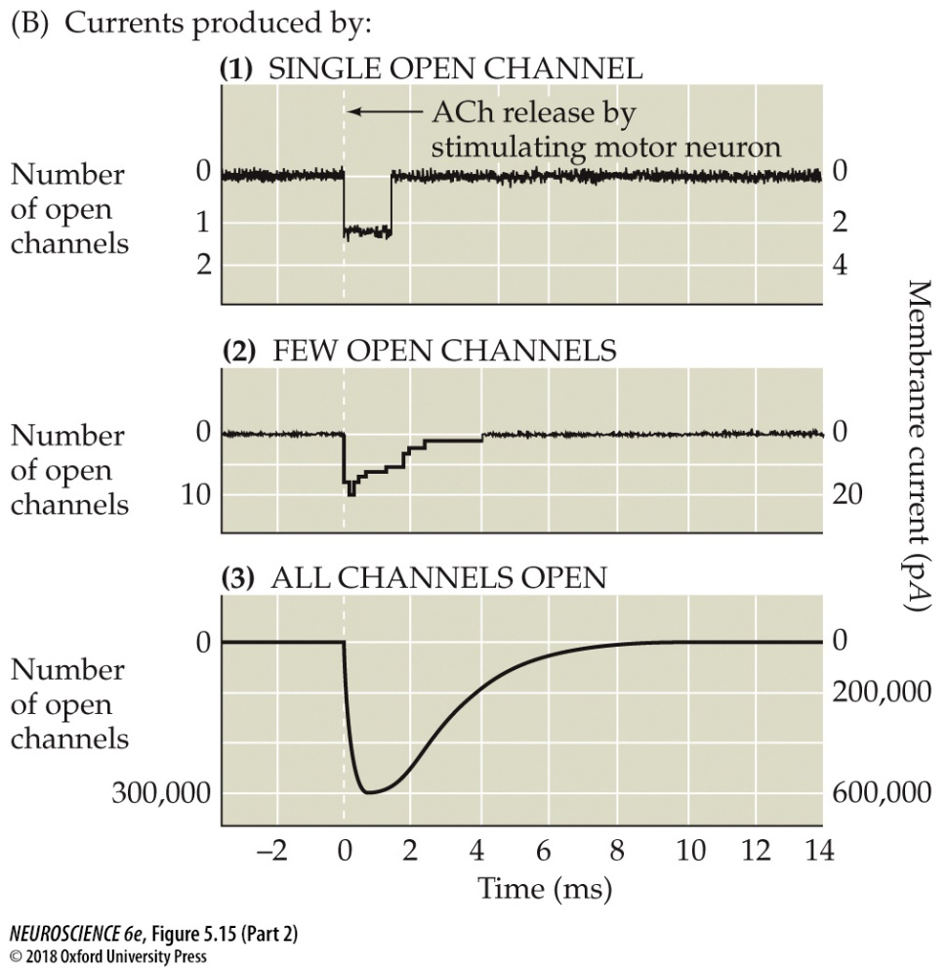
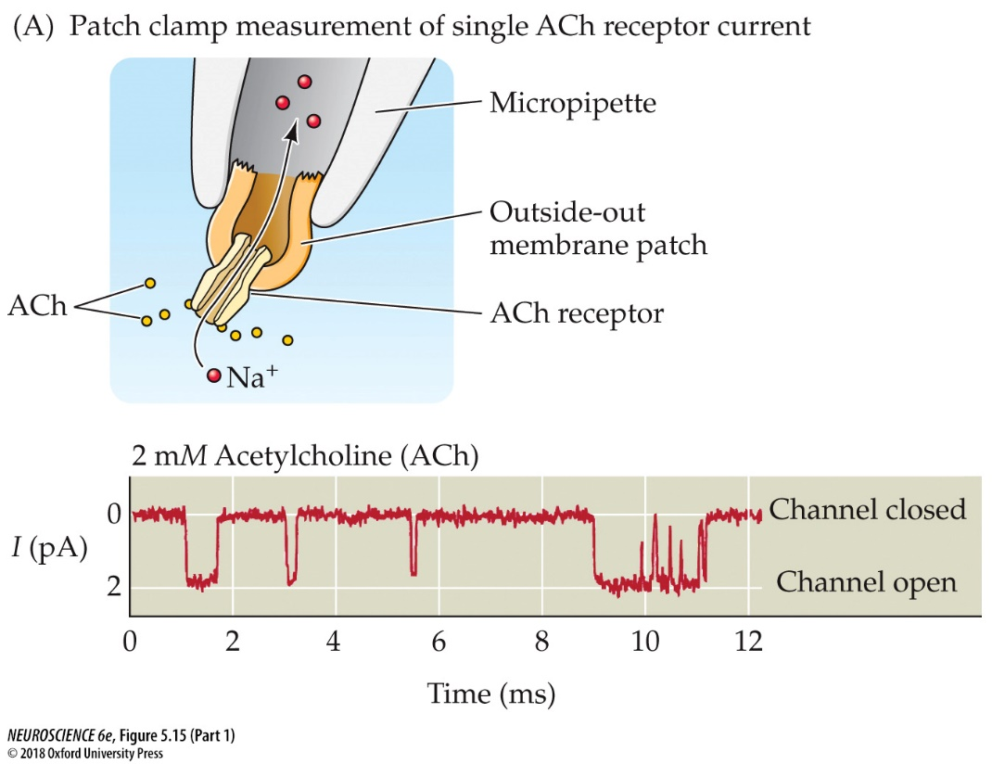
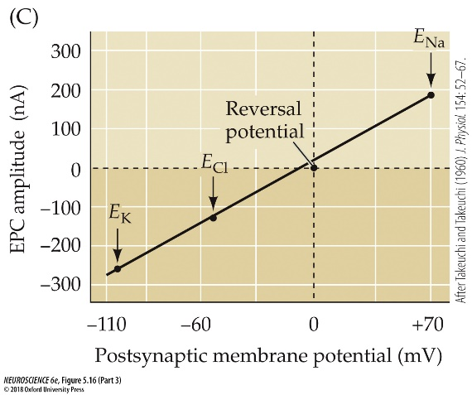
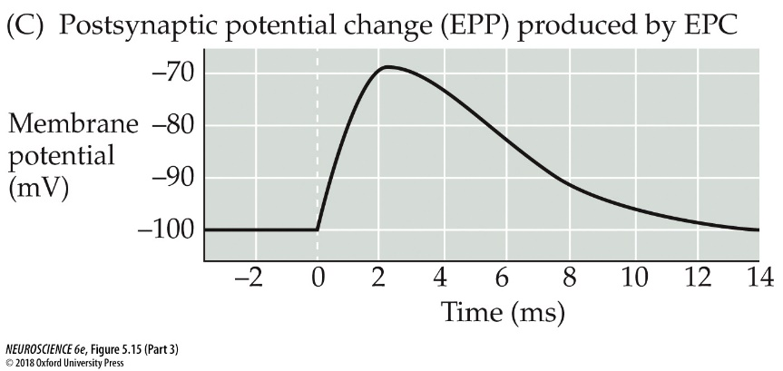
Postsynaptic membrane permeability changes during synaptic transmission
ACh receptors are permeable to both Na⁺ and K⁺, so:
E_{K} < EACh < E_{Na}
IACh = gACh (Vm - EACh)
reversal potential, end plate current, postsynaptic potentials
Notes:
Slide 20
How do the postsynaptic receptors generate electrical signals? At the neuromuscular junction, the receptors are nicotinic acetylcholine receptors (nAChRs). Here is a picture of the flow of ions through a single nAChR.
The nAChRs are permeable to both sodium and potassium, so the reversal potential for these channels is between ENa and EK.
Current flow through nAChRs follows Ohm’s law. I_{ACh} = g_{ACh}(V_{m}-E_{ACh}).
So if you start with a single channel and add more, you eventually build to an end plate current or EPC.
At the resting potential, opening of the nAChRs causes a depolarization, which moves the resting membrane potential towards E_{ACh}, causing the EPP.
FIGURE 5.15 Activation of ACh receptors at neuromuscular synapses. (A) Patch clamp measurement of single ACh receptor currents from a patch of membrane removed from the postsynaptic muscle cell. When ACh is applied to the extracellular surface of the membrane, the repeated brief opening of a single channel can be observed as downward deflections corresponding to inward current (i.e., positive ions flowing into the cell). (B) Synchronized opening of many ACh-activated channels at a synapse being voltage clamped. (1) If a single channel is examined during the release of ACh from the presynaptic terminal, the channel can be seen to open transiently. (2) If several channels are examined together, ACh release opens the channels almost synchronously. (3) The opening of a very large number of postsynaptic channels produces a macroscopic EPC. (C) In a normal muscle cell (i.e., not being voltage clamped), the inward EPC depolarizes the postsynaptic muscle cell, giving rise to an EPP. Typically, this depolarization generates an action potential (not shown; see Figure 5.5B).
FIGURE 5.16 Influence of the postsynaptic membrane potential on end plate currents. (A) A postsynaptic muscle fiber is voltage clamped using two electrodes, while the presynaptic neuron is electrically stimulated to cause the release of ACh from presynaptic terminals. This experimental arrangement allows the recording of EPCs produced by ACh. (B) Amplitude and time course of EPCs generated by stimulating the presynaptic motor neuron while the postsynaptic cell is voltage clamped at four different membrane potentials. (C) The relationship between the peak amplitude of EPCs and postsynaptic membrane potential is nearly linear, with a reversal potential (the voltage at which the direction of the current changes from inward to outward) close to 0 mV. Also indicated on this graph are the equilibrium potentials of Na⁺, K⁺, and Cl– ions. (D) The identity of the ions permeating postsynaptic receptors is revealed by the reversal potential (E_{rev}). Activation of postsynaptic channels permeable only to K⁺ (yellow) results in currents reversing at E_{K}, near –100 mV, while activation of postsynaptic Na⁺ channels results in currents reversing at E_{Na}, near +70 mV (red). Cl–-selective currents reverse at E_{Cl}, near –50 mV (green). (A–C after Takeuchi and Takeuchi, 1960.)

Slide 17
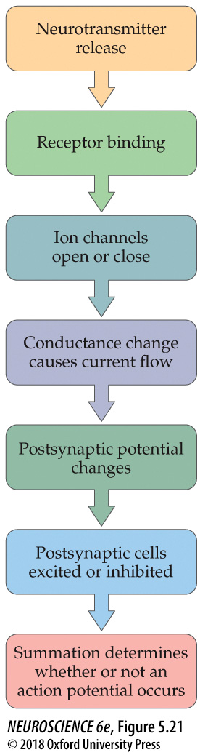
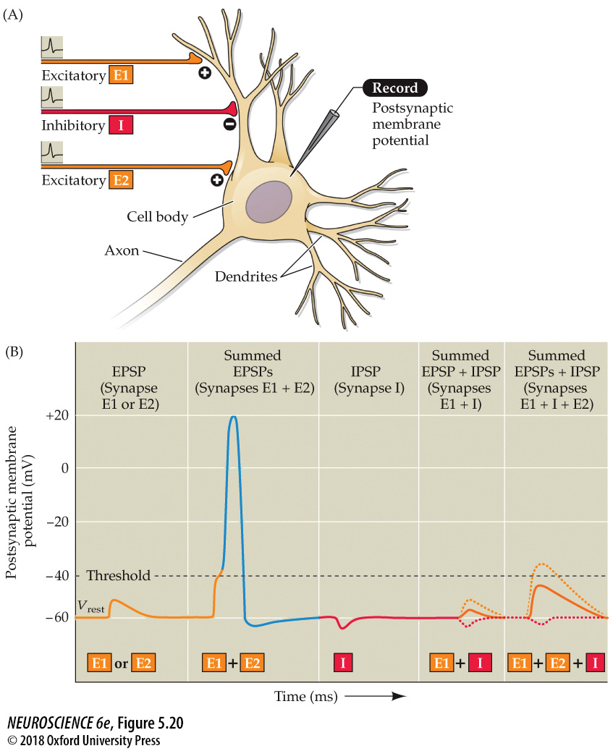
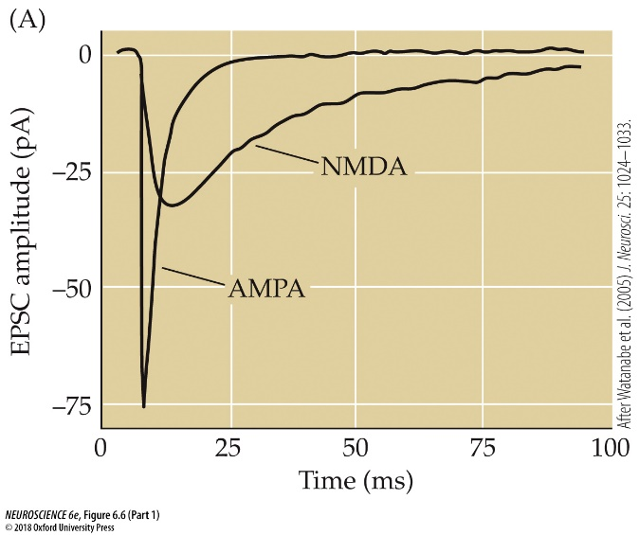
Postsynaptic membrane permeability changes during synaptic transmission: summation
E1
E2
EGlu = 0 mV
IAMPA = gAMPA (Vm - EAMPA)
INMDA = gNMDA (Vm - ENMDA)
I
EGABA = -80 mV
IGABA = gGABA_{A} (Vm – EC l)
postsynaptic potentials, summation
Notes:
Slide 21
Now we move these principles of synaptic transmission from the NMJ to central synapses. There are more neurotransmitters, but the principles remain the same.
In the CNS, there are gluamatergic synapses – they release then neurotransmitter glutamate and bind two different types of glutamate receptors. AMPA receptors are cationic channels like nAChRs have an equilibrium potential near zero.
NMDA receptors are also cationic channels, but they are slower to activate and slower to decay, as visualized by superimposing the AMPA and NMDA receptor mediated excitatory postsynaptic currents.
OK suppose there are two glutamate synapses, E1 and E2. Both have AMPA and NMDA receptors.
If either E1 or E2 are stimulated, this typically results in a subthreshold excitatory postsynaptic potential (EPSP). Release of glutamate causes the activation of AMPA and NMDA receptors, which open to allow influx of cations, causing the resting membrane potential to move towards EGlu.
If multiple EPSPs are activated in a short time window, they will summate. In this example, E1 and E2 are activated together, which cause a larger depolarization and allow the voltage to reach threshold. An action potential is triggered when the voltage reaches threshold.
In addition to multiple glutamatergic synapses, there are also inhibitory synapses that release the neurotransmitter GABA. We will call that synapse I.
GABAA receptors are GABA gated chloride channels. ECl can vary from cell to cell and during development, but typically EGABA has a hyperpolarized reversal potential – let’s say -80 mV.
Since EGABA is more negative than the resting membrane potential, activation of GABAA receptors will result in a hyperpolarizing inhibitory postsynaptic potential, or IPSP.
The summation of E1 and I will essentially reduce the effect of E1, and not allow E1 to depolarize the cell as much. In other words, the amplitude of the EPSP will be reduced by the simultaneous activation of the IPSP.
In the case of the activation of E1 and E2 summing to cause a suprathreshold EPSP, in the presence of the IPSP, the EPSP falls subthreshold. This shows how powerful the activation of an IPSP can be on influencing excitatory synaptic transmission.
The summation of numerous EPSPs with IPSPs enables neurons to make computations. The bombardment of EPSPs and IPSPs and their summation determines when and if an action potential occurs.
FIGURE 5.20 Summation of postsynaptic potentials. (A) A microelectrode records the postsynaptic potentials produced by the activity of two excitatory synapses (E1 and E2) and an inhibitory synapse (I). (B) Electrical responses to synaptic activation. Stimulating either excitatory synapse (E1 or E2) produces a subthreshold EPSP, whereas stimulating both synapses at the same time (E1 + E2) produces a suprathreshold EPSP that evokes a postsynaptic action potential (shown in blue). Activation of the inhibitory synapse alone (I) results in a hyperpolarizing IPSP. Summing this IPSP (dashed red line) with the EPSP (dashed yellow line) produced by one excitatory synapse (E1 + I) reduces the amplitude of the EPSP (solid orange line), while summing it with the suprathreshold EPSP produced by activating synapses E1 and E2 keeps the postsynaptic neuron below threshold, so that no action potential is evoked.
FIGURE 5.21 Overview of postsynaptic signaling. Neurotransmitter released from presynaptic terminals binds to its cognate postsynaptic receptor, which causes the opening or closing of specific postsynaptic ion channels. The resulting conductance change causes current to flow, which may change the membrane potential. The postsynaptic cell sums (or integrates) all of the EPSPs and IPSPs, resulting in moment-to-moment control of action potential generation.

Slide 18
Chapters 2-8 in Neuroscience 6th Edition (Purves et al.)
Chapter 8 Lawrence Synaptic Plasticity
Learning Objectives:
7) Describe forms of short-term synaptic plasticity (p. 169-175).
synaptic facilitation, synaptic depression, potentiation, augmentation, post-tetanic potentiation
8) Describe long-term synaptic plasticity (p. 176-190).
long-term potentiation, long-term depression, NMDA receptors, AMPA receptors
Notes:
Slide 24
Finally, I’ll cover Chapter 8 Synaptic Plasticity.
The first learning objective is to describe forms of short-term synaptic plasticity.
The second learning objective is to describe long-term synaptic plasticity.

Slide 19
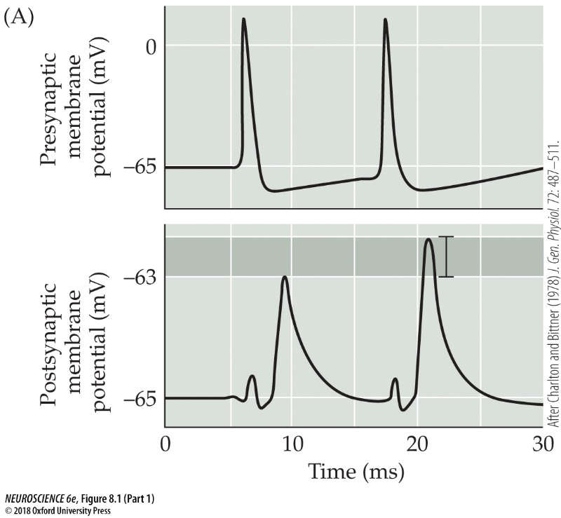
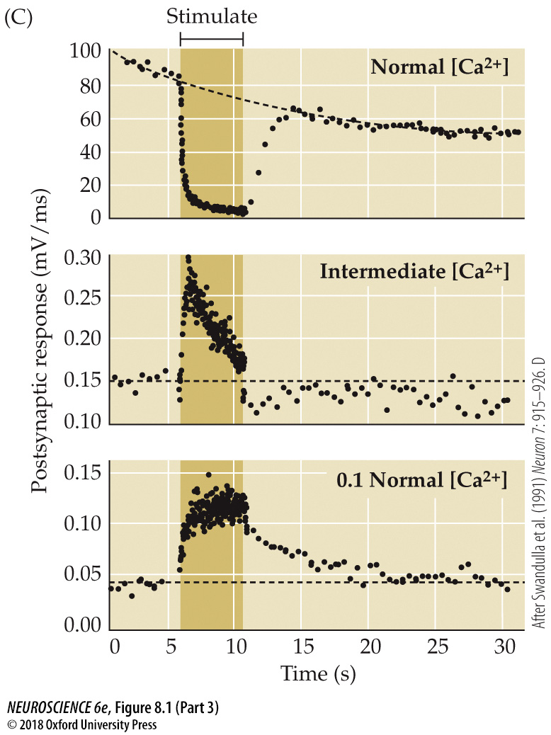
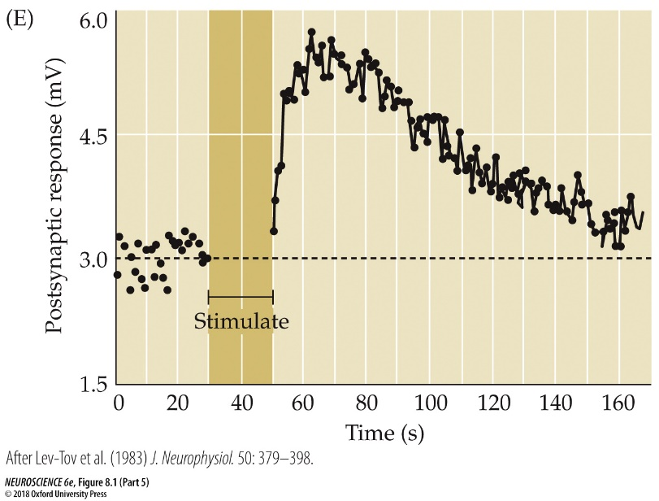
Synapses can perform activity-dependent computations.
Forms of short-term synaptic plasticity
synaptic depression
Mechanism of
facilitation/
augmentation/
post-tetanic
potentiation:
residual
calcium
synaptic
facilitation
augmentation/depression
Mechanism of depression:
depletion of
vesicles
augmentation
These synaptic mechanisms are not mutually exclusive – can occur at same synapse!
post-tetanic potentiation
synaptic facilitation, synaptic depression, potentiation,
augmentation, post-tetanic potentiation
Notes:
Slide 25
Finally, I’ll cover Chapter 8 Synaptic Plasticity.
The first learning objective is to describe forms of short-term synaptic plasticity.
The second learning objective is to describe long-term synaptic plasticity.
Slide 25
There are many forms of short-term synaptic plasticity. Repetitive activation of a synapse causes the second EPSP to be larger than the first. This phenomenon is called synaptic facilitation. Note that this phenomena should not be mistaken for summation – the second EPSP is larger even though the first EPSP decays fully back to baseline.
Augmentation and postsynaptic potentiation are similar but occur at different time scales to facilitation.
Synaptic depression is an activity-dependent weakening of synaptic strength.
The mechanism of action of facilitation/augmentation/post-tetanic potentiation is a that there is a memory of a previous event – this is thought to involve calcium or calcium binding proteins that alter the nature of the presynaptic terminal.
The mechanism of depression is likely to involve depletion of vesicles.
These mechanisms are not mutually exclusive and can occur at the same synapses, with each mechanism happening at a different time scale.
This type of short-term plasticity enables synapses to perform complex activity-dependent computations which essentially act as a filter during transmission.
FIGURE 8.1 Forms of short-term synaptic plasticity. (A) Facilitation at the squid giant synapse. A pair of presynaptic action potentials elicits two excitatory postsynaptic potentials (EPSPs). Because of facilitation, the second EPSP is larger than the first. (B) By varying the time interval between pairs of presynaptic action potentials, it can be seen that facilitation decays over a time course of tens of milliseconds. (C) Under typical physiological conditions, a high-frequency tetanus (darker bar) causes pronounced depression of EPSPs at the squid giant synapse (top). Lowering the external Ca²⁺ concentration to an intermediate level reduces transmitter release and causes a mixture of depression and augmentation (middle). Further reduction of the external Ca²⁺ eliminates depression, leaving only augmentation (bottom). (D) Synaptic depression at the frog neuromuscular synapse increases in proportion to the amount of transmitter released from the presynaptic terminal. (E) Application of a high-frequency tetanus (bar) to presynaptic axons innervating a spinal motor neuron causes a post-tetanic potentiation that persists for a few minutes after the tetanus ends. (A,B after Charlton and Bittner, 1978; C after Swandulla et al., 1991; D from Betz, 1970; E after Lev-Tov et al., 1983.)

Slide 20
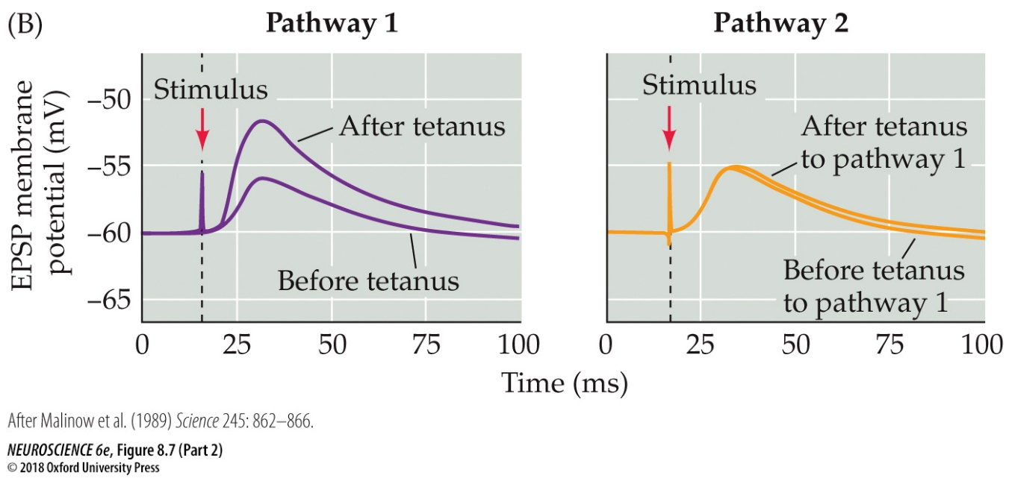
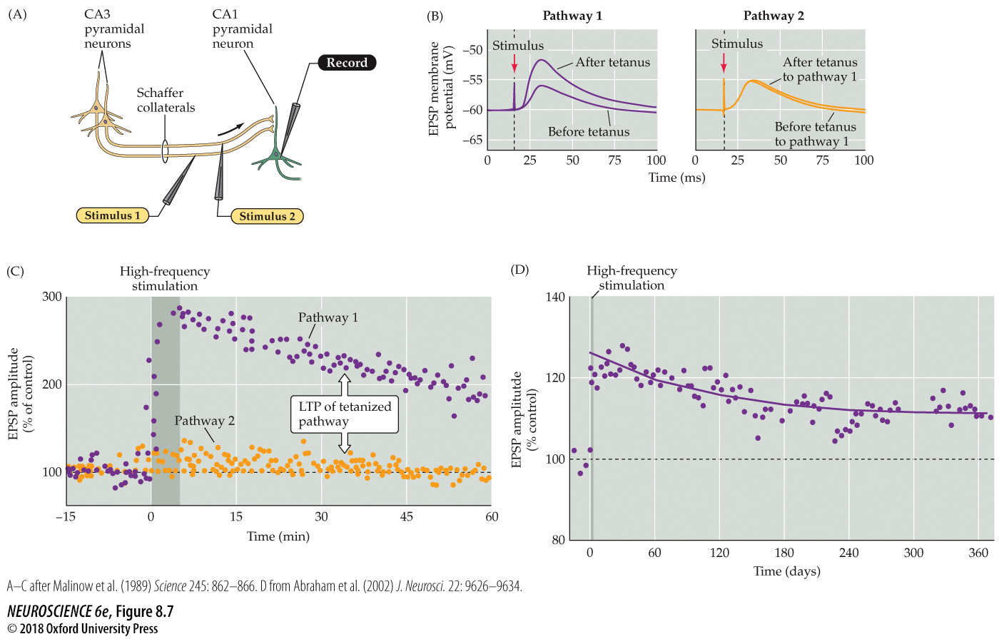
Long term synaptic plasticity: long-term potentiation (LTP)
long-term potentiation (LTP)
Notes:
Slide 27
Finally, we’re on to long-term synaptic plasticity.
This phenomenon involves a long-term increase in synaptic transmission.
The recording configurations involves recording from a CA1 pyramidal cell in the hippocampus.
Two stimulus electrodes, Stimulus 1 and Stimulus 2, stimulate the Schaffer collaterals, which are the axons of the CA3 pyramidal cells. This way, EPSPs that are associated with different glutamate synapses can be generated onto the same CA1 pyramidal cell.
The EPSP amplitude is monitored at low stimulation. At time zero, a high frequency train of stimuli are applied to Pathway 1. There is a post-tetanic potentiation but it is maintained for up to an hour after tetanus was applied.
Meanwhile, EPSPs that are associated with Stimulus 2, which did not receive the tetanus, were unaltered.
This phenomenon is referred to as long-term potentiation, or LTP. It is a persistent increase in the strength, or efficacy of excitatory synaptic transmission. When monitored in vivo, it can last for up to 6 months!
FIGURE 8.7 LTP of Schaffer collateral–CA1 synapses. (A) Arrangement for recording synaptic transmission. Two stimulating electrodes (1 and 2) activate separate populations of Schaffer collaterals, providing test and control synaptic pathways. (B) Left: Synaptic responses recorded in a CA1 neuron in response to single stimuli of synaptic pathway 1, minutes before and 1 hour after a high-frequency train of stimuli. The high-frequency stimulus train increases the size of the EPSP evoked by a single stimulus. Right: The size of the EPSP produced by stimulating synaptic pathway 2, which did not receive high-frequency stimulation, is unchanged. (C) Time course of changes in the amplitude of EPSPs evoked by stimulation of pathways 1 and 2. High-frequency stimulation of pathway 1 (darker bar) enhances EPSPs in this pathway (purple dots). This LTP of synaptic transmission in pathway 1 persists for more than an hour, while the amplitude of EPSPs produced by pathway 2 (orange dots) remains constant. (D) Recordings of EPSPs from the hippocampus in vivo reveal that high-frequency stimulation can produce LTP that lasts for more than 1 year. (A–C after Malinow et al., 1989; D from Abraham et al., 2002.)

Slide 21
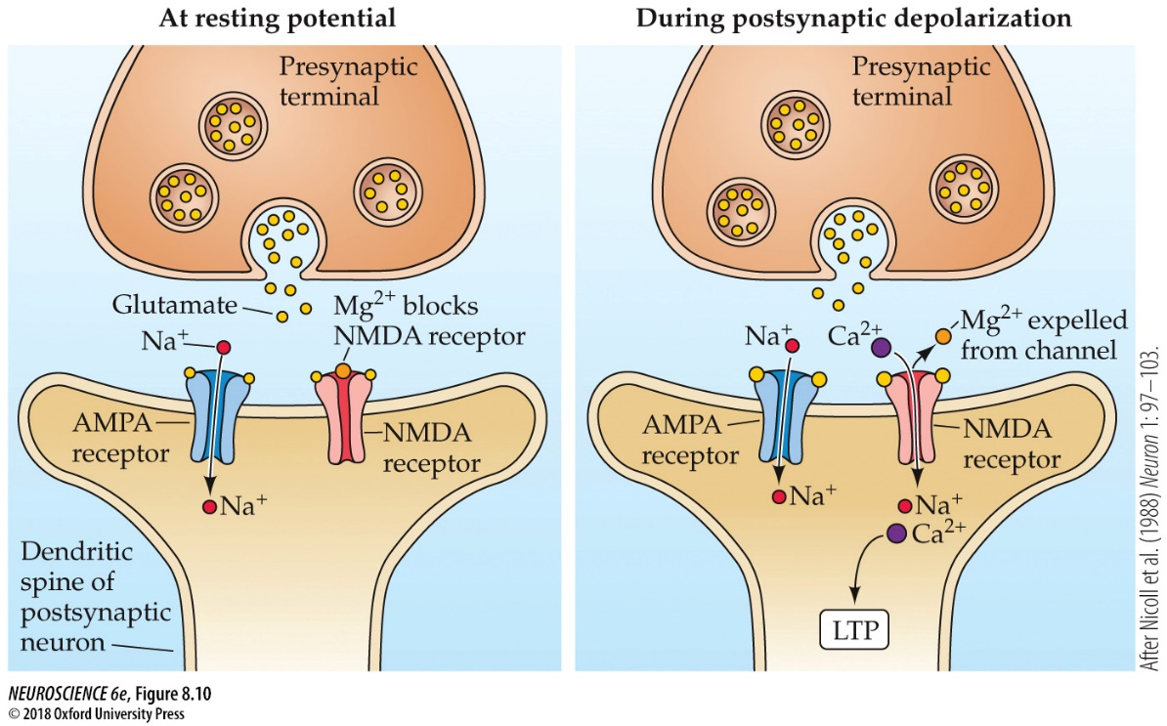
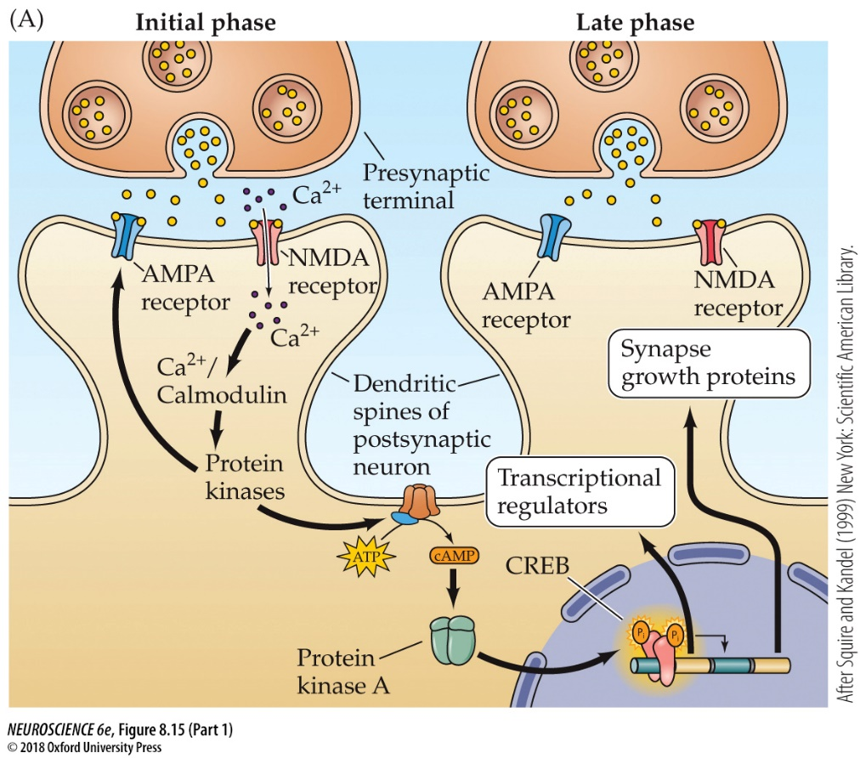
Long term potentiation: mechanisms
Initial phase:
Induction
Simultaneous depolarization of pre- and postsynaptic neurons during tetanus causes the unblock of Mg²⁺, influx of calcium through NMDA receptors, and activation of CaMKII.
Expression
Increased AMPA receptor function/number at the synapse.
Late Phase:
Requires the synthesis of new proteins.
CREB signaling and transcription of synapse growth proteins that stabilize and enhance dendritic spine growth.
NMDA receptors, AMPA receptors
Notes:
Slide 28
The mechanism of LTP is shown on the next slide.
The two glutamate receptors, the AMPA and NMDA receptors, are involved.
LTP has an initial induction and expression phases. At the resting potential, glutamate transmission proceeds mostly through AMPA receptors because at the resting membrane potential, NMDA receptors are blocked by magnesium ions that occlude to the pore of the NMDA receptor channel.
During induction of LTP, there is a sufficient depolarization to expel the Mg²⁺ from the NMDA receptor, allowing calcium to flow into the postsynaptic neuron. The calcium influx triggers the activation of calmodulin and calmodulin-dependent protein kinase (CaMKII).
During the expression phase, activation of CaMKII results in increased function of existing AMPA receptors and insertion of AMPA receptors in the postsynaptic neuron, which contributes to the increased amplitude of the EPSP observed after LTP induction.
The late phase involves the activation of protein kinase A, which activates the transcription factor CREB signaling (cAMP response element binding protein). CREB induces the transcription of proteins that stabilize and enhance dendritic spine growth.
FIGURE 8.10 The NMDA receptor channel can open only during depolarization of the postsynaptic neuron from its normal resting potential. Depolarization expels Mg²⁺ from the NMDA channel, allowing current to flow into the postsynaptic cell. This leads to Ca²⁺ entry, which in turn triggers LTP. (After Nicoll et al., 1988.)
FIGURE 8.15 Mechanisms responsible for long-lasting changes in synaptic transmission during LTP. (A) The late component of LTP is the result of PKA activating the transcriptional regulator CREB, which turns on expression of several genes that produce long-lasting changes in PKA activity and synapse structure. (B,C) Structural changes associated with LTP in the hippocampus. (A after Squire and Kandel, 1999)

Slide 22
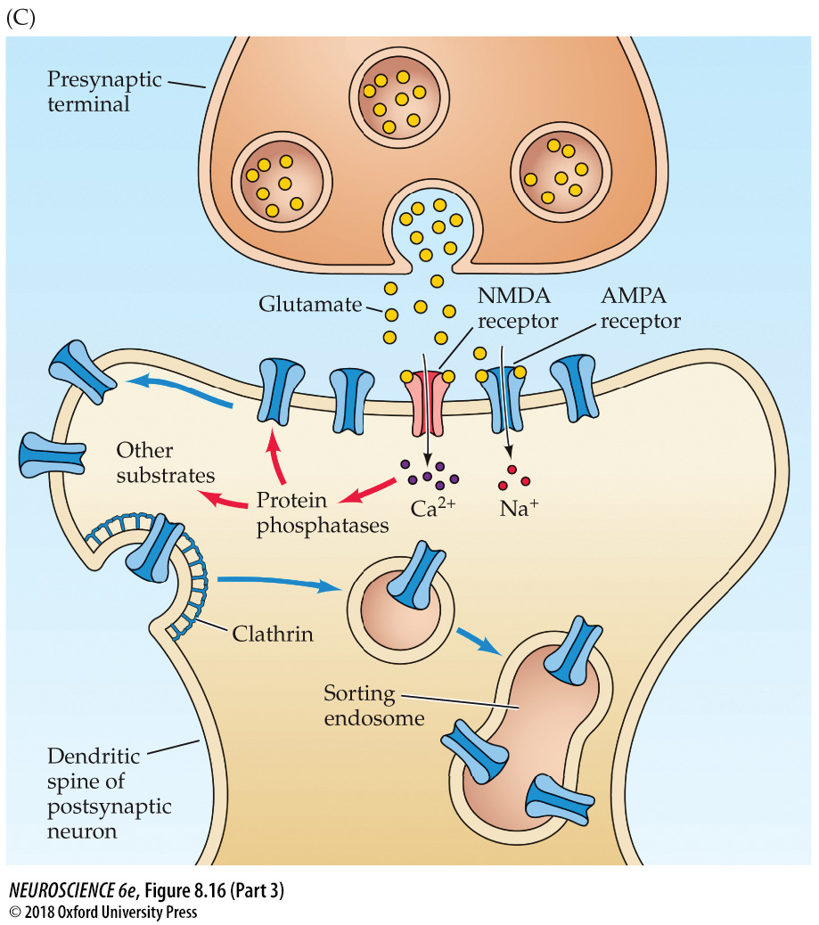
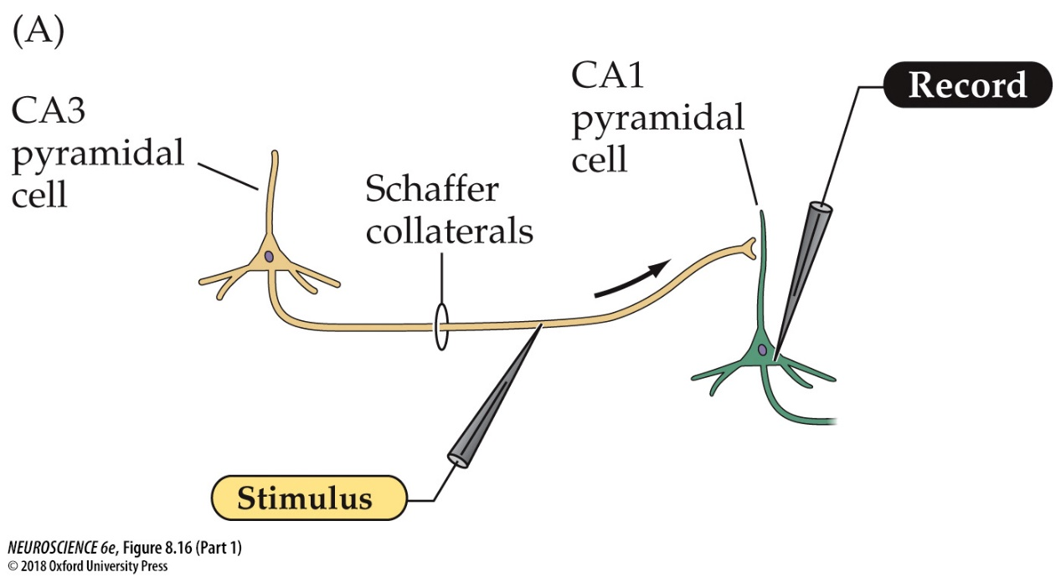
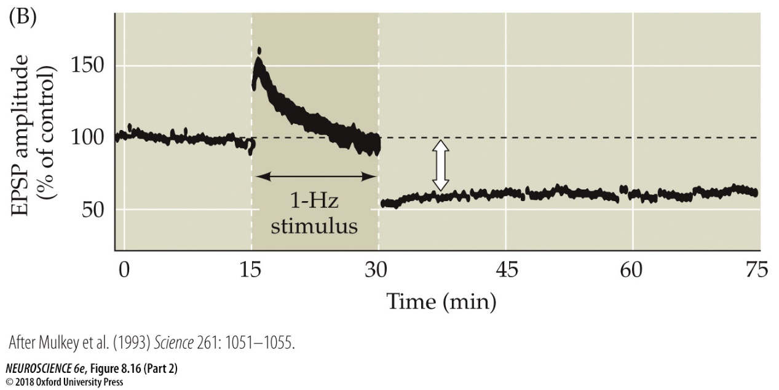
Long term synaptic plasticity: Long term depression (LTD)
Induction
Influx of calcium through NMDA receptors and activation of protein phosphatases.
Expression
Reduced AMPA receptors at the synapse
NMDA receptors, AMPA receptors
Notes:
Slide 29
In addition to a mechanism by of long-term plasticity that leads to an long-term enhancement of synaptic transmission, there is a mechanism that leads to long-term weakening of synaptic transmission. This is called long-term depression.
This phenomenon is demonstrated the same recording and stimulating configuration as for LTP.
Upon monitoring the EPSP amplitude, one can apply a lower frequency stimulus (1 Hz) to the Schaffer collateral pathway. There is an initial augmentation that declines over the course of the 1 Hz stimulus. Upon resumption of the EPSP, the EPSP amplitude is observed to be reduced, and this reduced amplitude persists for the duration of the recording.
The mechanism is similar to LTP in the sense that NMDA receptors are involved. The influx of calcium through the NMDA receptor instead activates protein phosphatases, which lead the internalization of AMPA receptors in the postsynaptic membrane.
FIGURE 8.16 Long-term synaptic depression in the hippocampus. (A) Electrophysiological procedures used to monitor transmission at the Schaffer collateral synapses on CA1 pyramidal neurons. (B) Low-frequency stimulation (one per second) of the Schaffer collateral axons causes a long-lasting depression of synaptic transmission. (C) Mechanisms underlying LTD. A low-amplitude rise in Ca²⁺ concentration in the postsynaptic CA1 neuron activates postsynaptic protein phosphatases, which cause internalization of postsynaptic AMPA receptors, thereby decreasing the sensitivity to glutamate released from the Schaffer collateral terminals. (B after Mulkey et al., 1993.)

