Slide 1
Q&A
Autonomic Pharmacology:
Neuropsychopharmacology
Thomas E. Tenner, Jr., Ph.D.
Dept. of Medical Education
Dept. Pharmacology & Neuroscience
tom.tenner@ttuhsc.edu
743-7169
October 22, 2018

Slide 2
Session Plan:
Cholinergic Agonists
  Review of Glaucoma Medications
Cholinergic Antagonists
Adrenergic Agonists
Adrenergic Antagonists

Slide 3
Cholinergic Agonists
Muscarinic/Nicotinic
Direct/ Indirect

Slide 4
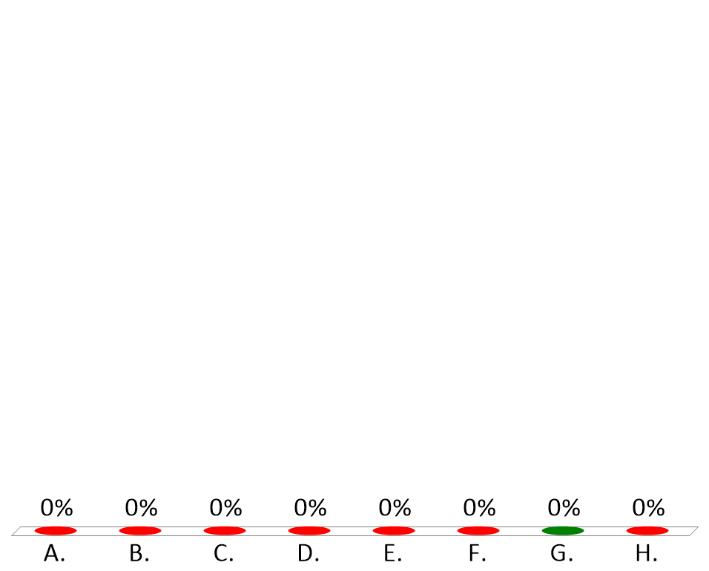
A 15-year-old female suspected to have asthma undergoes a test to establish a ‘bronchial hyperactivity diagnosis’. Which of the following autonomic receptors will be challenged?
Alpha - 1 adrenergic
Alpha - 2 adrenergic
Beta - 1 adrenergic
Beta - 2 adrenergic
Dopamine - 1 adrenergic
Dopamine - 2 adrenergic
Muscarinic
Nicotinic
Notes:
G
Methacholine Asthma test
Bronchial Hyperactivity diagnosis

Slide 5
“DUMBBELSS” - Muscarinic effects
D - Diarrhea
U - Urination
M - Miosis
B - Bradycardia
B - Bronchoconstriction
E - Emesis
L - Lacrimation
S - Salivation
S - Sweating
Notes:
Sludwarmf /Dumbells

Slide 6
“SLUDWARMF” - Muscarinic and Nicotinic
Sweating
Lacrimation
Urination
Diarrhea
Wheezing
Accommodation
Rhinorrhea
Miosis
Skeletal Muscle Fasciculations
Muscarinic
Nicotinic

Slide 7

An Alzheimer's patient receives a “cholinergic agonist” which results in all of the adverse effects listed below. Which specific adverse effect proves that the patient is receiving an ‘indirect-acting’ rather than ‘direct-acting’ muscarinic agonist?
Bradycardia
Dyspepsia
Rhinorrhea
Skeletal muscle fasciculations
Sweating
Notes:
D
Could be:
Donepezil (Aricept, Aricept ODT)
Galantamine (Razadyne, Razadyne ER)
Rivastigmine (Exelon) – tertiary amine

Slide 8
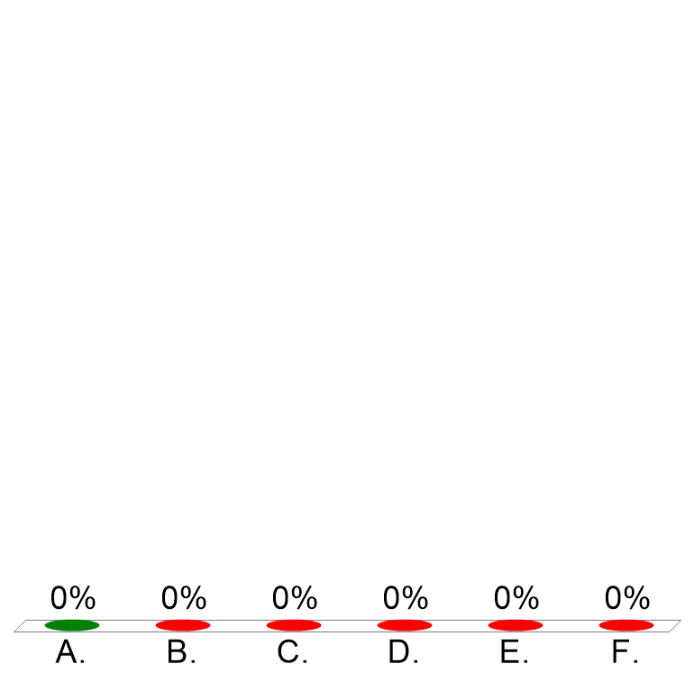
All of the following cholinergic drugs could cause muscle fasciculations, respiratory arrest, and malignant hyperthermia EXCEPT
Bethanechol
Echothiophate
Edrophonium
Pyridostigmine
Rivastigmine
Succinylcholine
Notes:
A-no capability to stimulate nicotinic receptors
Other drugs with Nicotinic agonist activity

Slide 9
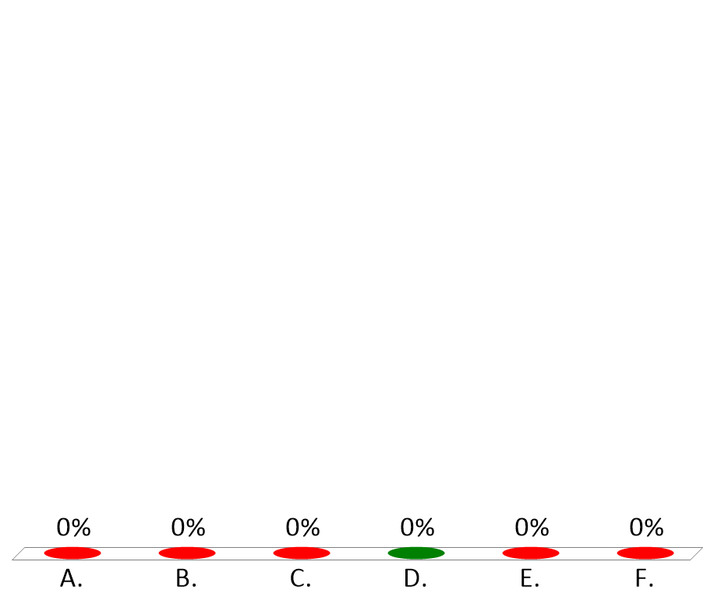
This drug, now rarely used to treat glaucoma and lower intraocular pressure (IOP), can result in pupillary miosis, lacrimation, salivation, and rhinorrhea when applied topically to the eye. To what class of drugs does it belong?
Alpha-2 Adrenoceptor agonist
Beta- blocker
Carbonic Anhydrase inhibitor
Muscarinic receptor agonist
Nicotinic receptor agonist
Prostaglandin analog
Notes:
D

Slide 10
Drugs (topical) used to treat glaucoma
Alpha 2 adrenergic agonists**
  Apraclonidine [Lopidine]
  Brimonidine [Alphagan P]
Beta blockers *:
  Carteolol
  Timolol [Timoptic]
Cholinergic agonists***:
  Direct - Pilocarpine
  Indirect (Anticholinesterase agents) Echothiophate [Phospholine]
Carbonic anhydrase inhibitors **:
  Brinzolamide [Azopt]
  Dorzolamide [ Trusopt ]
Prostaglandin analogs*:
  Bimatoprost [Lumigan]
  Latanoprost [Xalatan]
Notes:
Drugs of first choice
** Second/Third line choice
*** Drugs of last choice

Slide 11
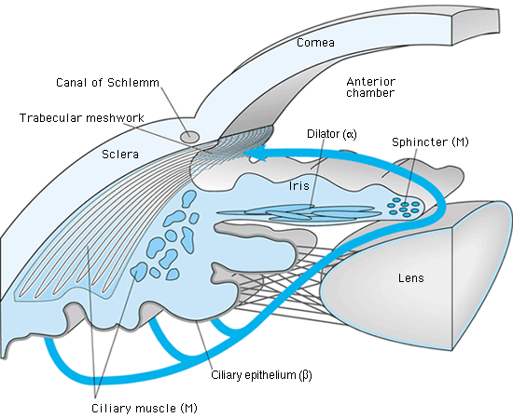
Autonomic control in the eye:
Notes:
Alpha 2 adrenergic agonists – Decrease aqueous humor formation
Beta blockers – Decrease aqueous humor formation
Cholinergic agonists – Cause miosis and Ciliary muscle contraction to expand Trabecular meshwork and egress through Canal of Schlem
Carbonic anhydrase inhibitors – Decrease aqueous humor formation
Prostaglandin analogs - Increase access of aqueous humor to uveoscleral outflow pathway

Slide 12
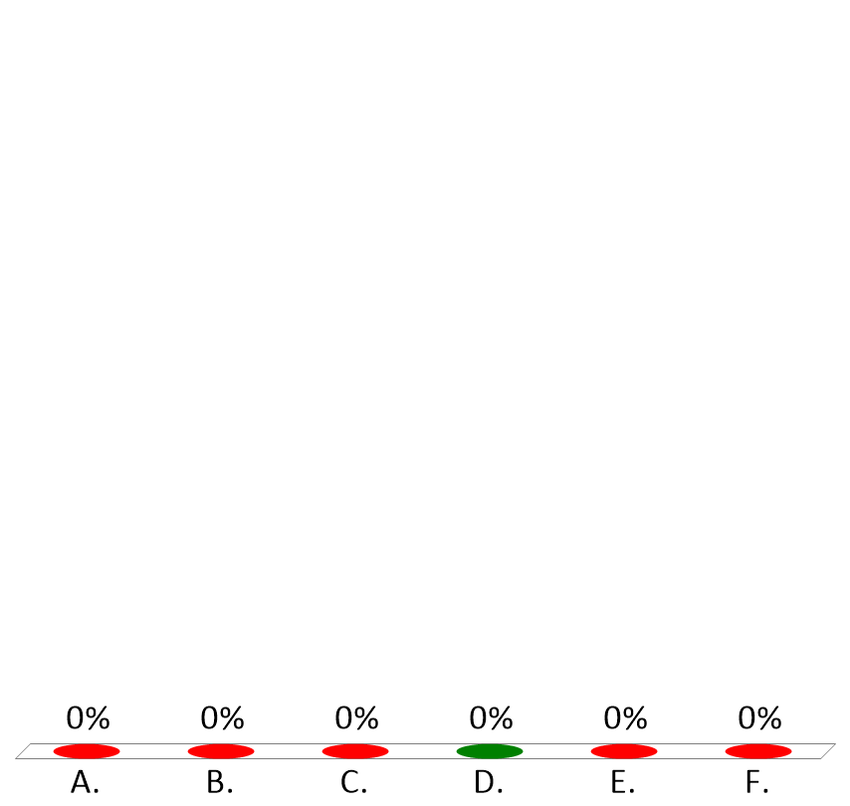
Patient receives a cholinergic agonist that results in tachycardia and hypertension. Which drug was administered?
Atropine
Bethanechol
Echothiophate
Nicotine
Pyridostigmine
Succinylcholine
Notes:
D

Slide 13
Cholinergic Antagonists:
Muscarinic/Nicotinic

Slide 14

Which of the following could precipitate an acute attack of narrow angle glaucoma?
Atropine
Echothiophate (Phospholine Iodide)
Physostigmine
Pilocarpine (Isopto, Carpine, Pilopine)
Timolol (Timoptic)

Slide 15
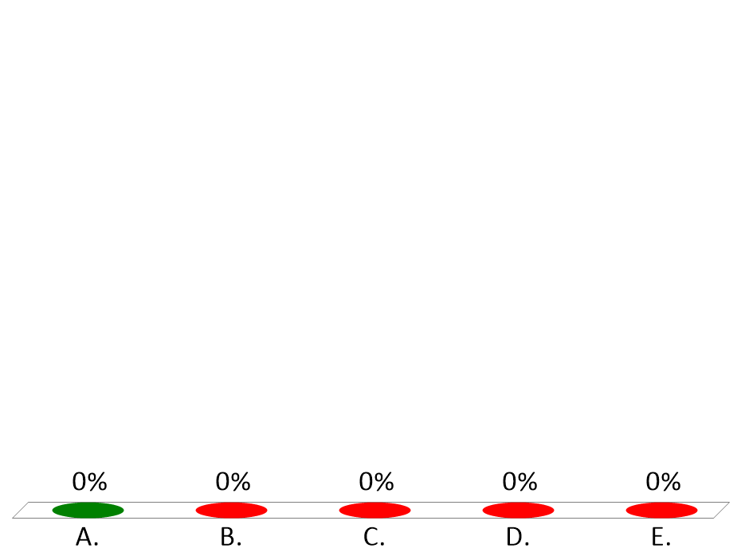
Patient taking the antidepressant, Amitriptyline, for relief of neuropathic pain, complains of blurred vision, xerostomia, tachycardia, hyperthermia, constipation, and urinary retention. These adverse effects of amitriptyline result from
blockade of muscarinic receptors.
blockade of alpha-1 adrenoceptors.
blockade of Beta-1 adrenoceptors.
blockade of Dopamine-2 adrenoceptors.
inhibition of Norepinephrine and Serotonin reuptake.
Notes:
A

Slide 16

In severe neuromuscular blockade requiring respiratory ventilation, neostigmine would be most effective as an antidote when the toxicity was the result of
edrophonium (Tensilon).
echothiophate.
pancuronium (Pavulon).
pyridostigmine (Mestinon)
succinylcholine (Anectine).
Notes:
C

Slide 17

This drug, FDA approved for prevention of chronic migraine, can produce a “flaccid” paralysis of skeletal muscle fibers by blocking acetylcholine release from cholinergic nerve terminals.
Black widow spider venom
Echothiophate (Phospholine Iodide)
OnabotulinumtoxinA (Botox)
Pyridostigmine (Mestinon)
Succinylcholine (Anectine)
Notes:
C

Slide 18
Adrenergic Agonists:
Alpha/Beta
Direct/ Indirect/Mixed

Slide 19
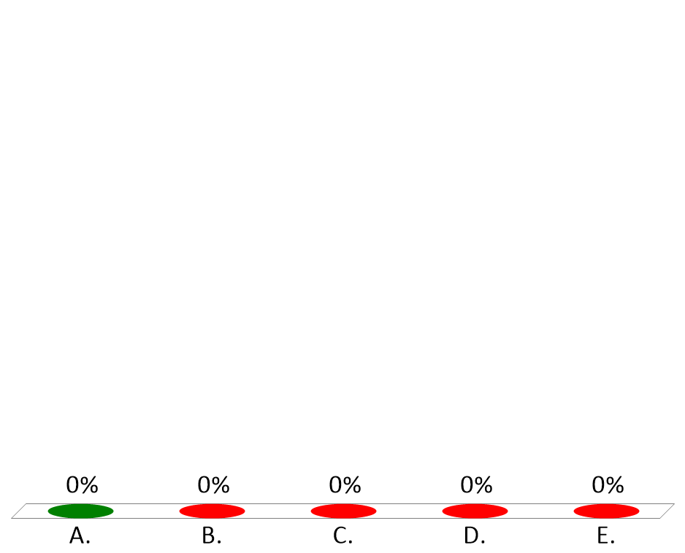
Oral phenylephrine has been shown to be no better than placebo in the treatment of rhinorrhea associated with allergies and the common cold. Oral pseudoephedrine and intranasal oxymetazoline were both found to be superior to phenylephrine. Which adrenoceptor is responsible for the decongestant action?
Alpha-1 adrenoceptors
Alpha-2 adrenoceptors
Beta-1 adrenoceptors
Beta-2 adrenoceptors
Beta-3 adrenoceptors
Notes:
A

Slide 20

When pupillary dilation but not cycloplegia is desired, a good choice would be:
a muscarinic antagonist.
a beta-2 agonist.
a nonselective beta-blocker.
a muscarinic agonist.
an alpha agonist
Notes:
E

Slide 21
Which of the following could precipitate an acute attack of narrow angle glaucoma?
Epinephrine
Isoproterenol
Pilocarpine (Isopto, Carpine, Pilopine)
Prazosin
Timolol (Timoptic)
Notes:
A

Slide 22
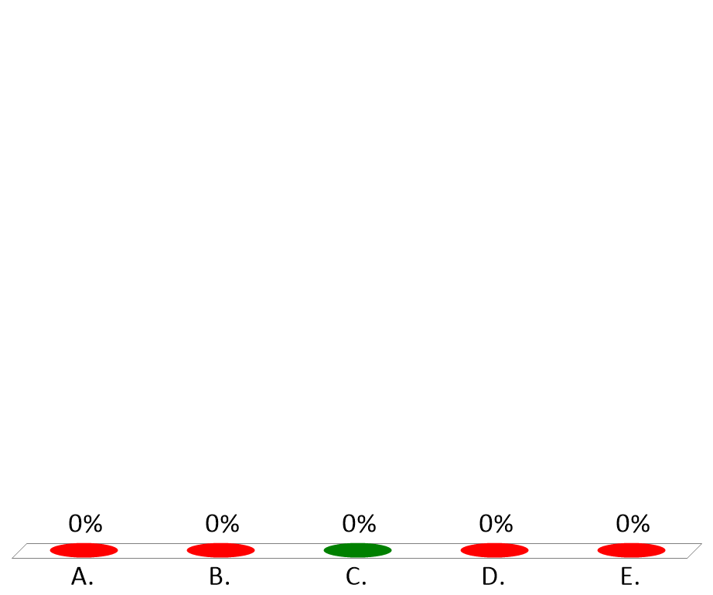
A patient presents with Horner’s Syndrome. You observe that the right eye pupil diameter is smaller (miosis) than that seen in the left eye. However, when topical phenylephrine is added in both eyes, the mydriasis observed is greatest in the right eye. You could argue that these observations result from
Parasympathetic predominance in the left eye
Loss of Parasympathetic innervation in the right eye.
Loss of sympathetic innervation in the right eye.
Loss of sympathetic innervation in the left eye.
Sympathetic predominance in the right eye.
Notes:
C
Parasympathetic predominance in the left eye. – Incorrect - would result in greater miosis in the left eye under normal conditions
Loss of Parasympathetic innervation in the right eye. – Incorrect - Would result in mydriasis not miosis in the right eye under normal conditions.
Loss of sympathetic innervation in the right eye. – Correct – this would result in relative parasympathetic predominance and miosis in the affected (right) eye. PE would produce exaggerated mydriasis due to Withdrawal Supersensitivity in the right eye.
Loss of sympathetic innervation in the left eye. - Incorrect - this would result in relative parasympathetic predominance and miosis in the affected (left) eye. PE would produce exaggerated mydriasis due to Withdrawal Supersensitivity in the left eye.
Sympathetic predominance in the right eye. – Incorrect - This would result in mydriasis in the right eye not miosis under normal conditions

Slide 23
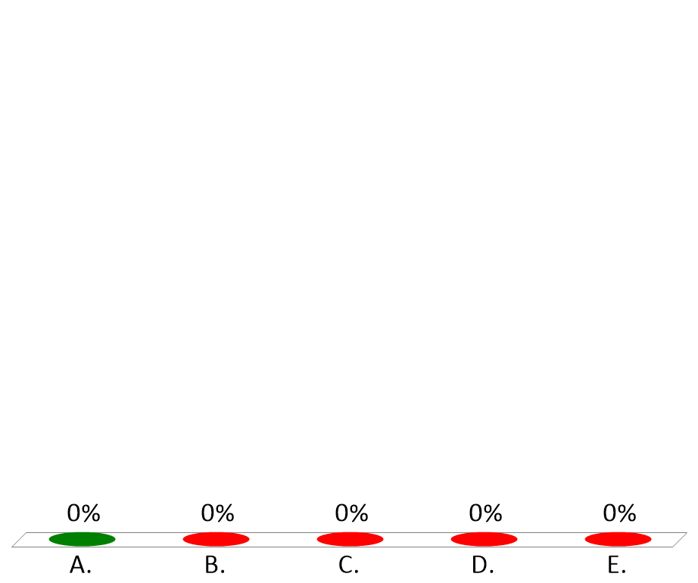
A patient presents with Horner’s Syndrome. You observe that the right eye pupil diameter is smaller (miosis) than that seen in the left eye. Which of the following drugs would dilate the pupil (mydriasis) in left eye but NOT in the right eye?
Amphetamine
Isoproterenol
Phenylephrine
Prazosin
Tropicamide
Notes:
A

Slide 24

A patient is brought into the ER having overdosed with amphetamine. A likely cardiovascular response you could expect would be ?
Bradycardia
Decreased splanchnic arterial pressure
Diminished preload
Increased total peripheral resistance
Negative Inotropic response in cardiac ventricles
Notes:
D

Slide 25
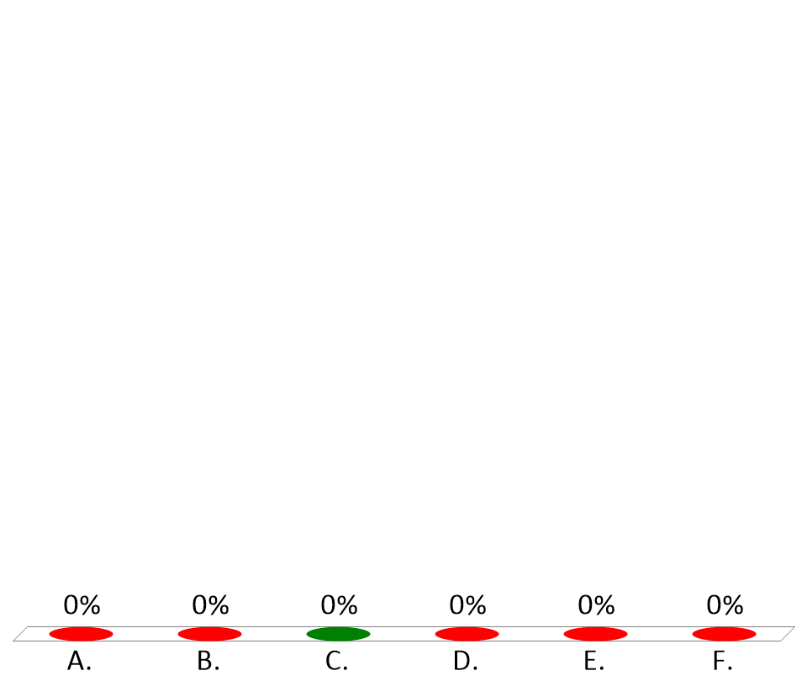
While the exact mechanism of action is unknown, this drug, used in the treatment of Attention Deficit Hyperactivity Disorder (ADHD), is known as an alpha-2 agonist.
Apraclonidine (Lopidine)
Brimonidine (Alphagan-P)
Clonidine (Catapres)
Oxymetazoline (Afrin)
Phenylephrine (Sudafed)
Pseudoephedrine (Sudafed, Zephrex-D)
Notes:
C

Slide 26
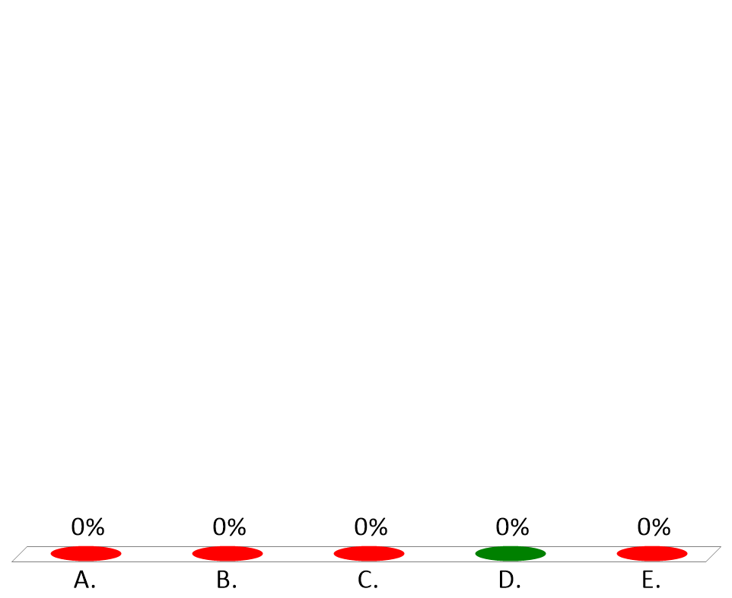
Hospitalized patient experiences anaphylactic reaction to medication and receives epinephrine. As anaphylaxis resolves you noticed fine skeletal muscle tremors. These result from Epinephrine stimulation of
Alpha-1 adrenoceptors
Alpha-2 adrenoceptors
Beta-1 adrenoceptors
Beta-2 adrenoceptors
Beta-3 adrenoceptors
Notes:
D

Slide 27
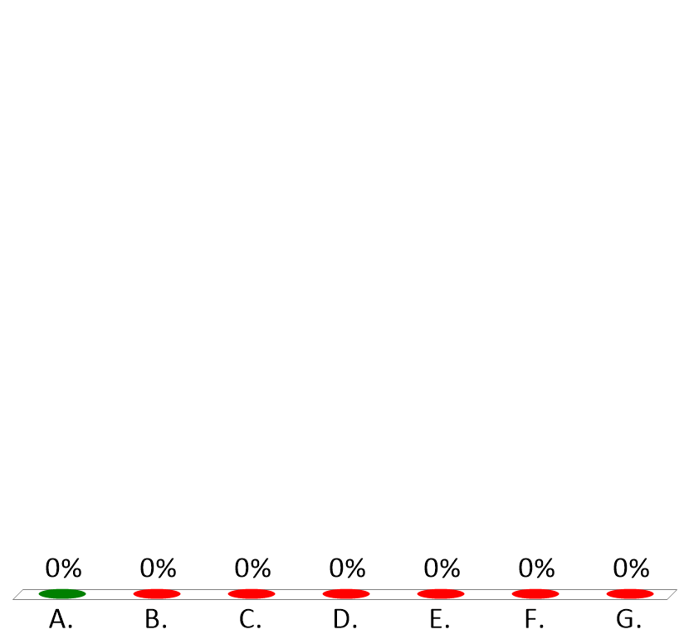
A 15-year-old female receives inhaled methacholine to establish a “bronchial hyperactivity diagnosis”. She immediately experiences intense bronchoconstriction Which one of the following would best be administered to relieve these symptoms?
Albuterol
Brimonodine
Epinephrine
Ephedrine
Formoterol
Isoproterenol
Timolol
Notes:
A

Slide 28
Adrenergic Antagonists:
Alpha/Beta

Slide 29
An adverse effect commonly seen with initiation of therapy of the Alpha-1 selective antagonist, Prazosin (Minipress), is?
Bradycardia
Hypertension
Mydriasis
Syncope
Urinary Retention
Notes:
D

Slide 30
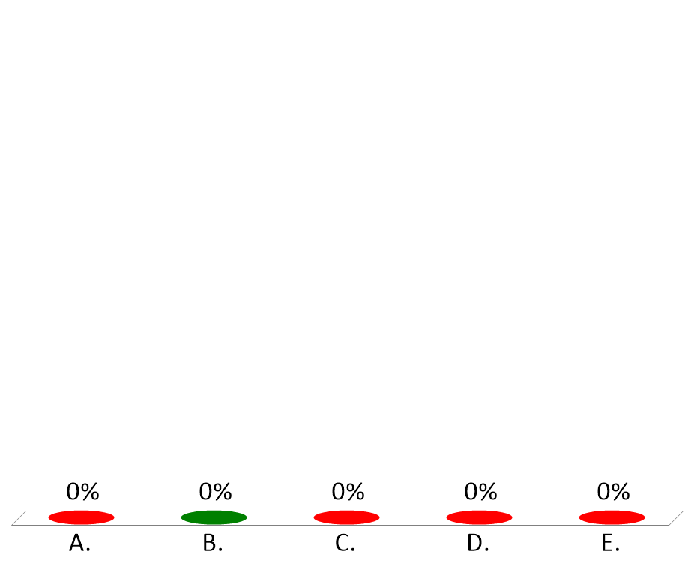
Patient taking the antidepressant, Amitriptyline, for relief of neuropathic pain, complains of light headedness and occasional syncope. This adverse effect of amitriptyline results from
Blockade of muscarinic receptors.
Blockade of alpha-1 adrenoceptors.
Blockade of Beta-1 adrenoceptors.
Blockade of Dopamine-2 adrenoceptors.
Inhibition of Norepinephrine and Serotonin reuptake.
Notes:
B

Slide 31
A contraindication for using the non-selective beta adrenoceptor antagonist, Propranolol (Inderal), is:
COPD
Migraine
Angina
Hypertension
Pheochromocytoma
Notes:
A

Slide 32

A new drug blocks the release of neurotransmitter from nerve terminals. The mechanism of action is most likely similar to:
Alpha Latrotoxin (black widow spider venom)
Amphetamine (Dyanavel).
Botulinum toxin (Botox).
Cocaine.
Reserpine (Serpasil®).
Notes:
c

Slide 33
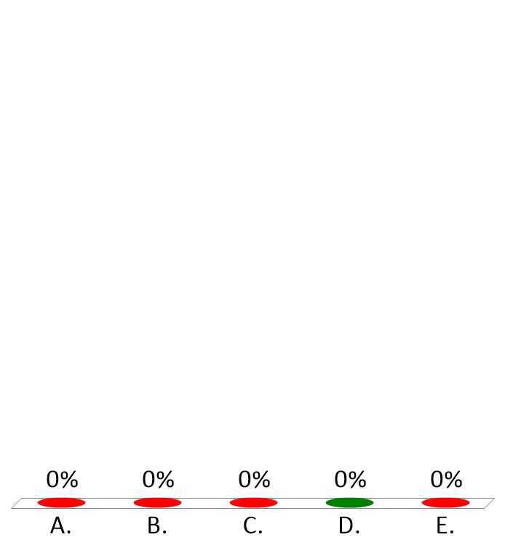
Following chronic pretreatment with a sympatholytic drug, intravenous phenylephrine causes an increase in blood pressure, but amphetamine has no effect. Which one of the drugs, administered several days as pretreatment, would be responsible for these observations?
Atenolol (Tenormin)
Labetalol (Trandate)
Prazosin (Miniporress)
Reserpine
Tamsulosin (Flomax)
Notes:
D

Slide 34
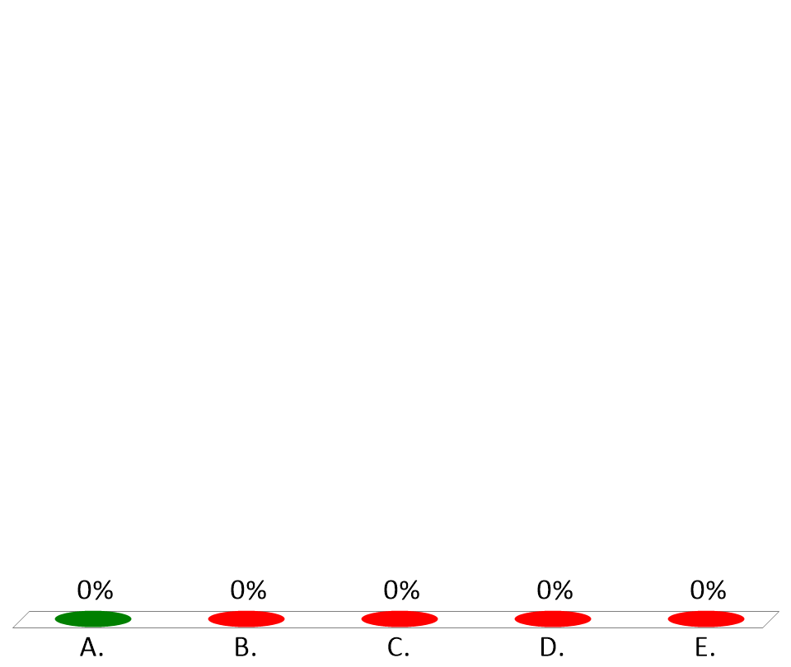
What cardiovascular effect should one expect when injecting norepinephrine or phenylephrine intravenously?
Bradycardia
Hypotension
Rhinorrhea
Skeletal muscle tremors
Venous pooling
Notes:
A Reflex Bradycardia

Slide 35

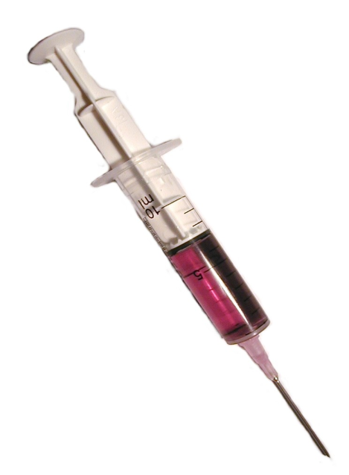
Control of Blood Pressure
Arterial - Afterload
mABP = CO x TPR
Cardiac -
Chronotropy
HR SV
Cardiac - Inotropy
CF VR
Venous – Preload
Notes:
5
Norepinephrine and reflex bradycardia

