Slide 1
NARCOTIC ANALGESICS- I
Blanton
Narcotic- refers to narcosis-
stupor or somnolence
Opiate/ Opioid- refers to
analgesia

Slide 2

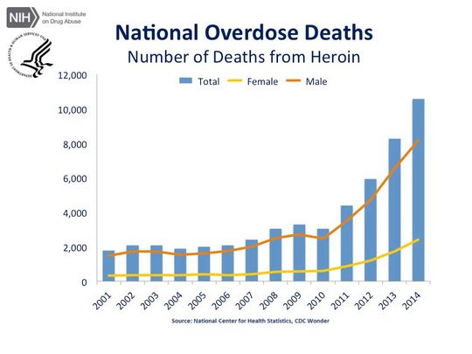
Graphic Photos Of Overdosed Adults With Child In Car Put Ohio Heroin Epidemic In Spotlight

Slide 3

HISTORY
Opium Poppy
Papaver somniferum
-Opium = crude extract
-Morphine = purified constituent
from Morpheus-Greek god of dreams

Slide 4
Uses of Opiates
-Analgesia
-Preanesthetic Medication (sedative)
-Pulmonary Edema
-Anesthesia
-Spinal Analgesia
-Cough
-Diarrhea
-Recreation

Slide 5
Opioid Compounds
-Extracts of Opium- morphine, codeine, papaverine, etc
-Synthetic Opioids- Agonists,
Antagonists, Mixed Agonist/
Antagonists
-Opiopeptins- β-endorphin,
Enkephalins, Dynorphin

Slide 6
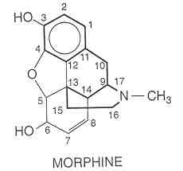
Morphine Derivatives
Agonists- substitutions: at 3, 6, 17 positions.
Antagonists- substitutions:
At 17 position (or at 14)

Slide 7
Opiates- Phamarmacology
Mechanism(s) of Action
-*mu receptor
-kappa receptor
-delta receptor
-N/OFQ- nociceptin,
-Orphanin FQ

Slide 8
Opiates- Mechanisms
-G-protein coupling
-Inhibition of cAMP formation
(1) Activation of K⁺ channels
(postsynaptic)
-Hyperpolarization of Neuron

Slide 9
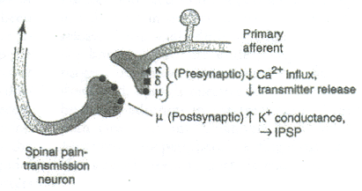
Opiates- Mechanism
(2) Inhibition of VG Ca++ channels
(presynaptic)
-Depression of Neurotransmitter
Release:
-NE, DA
-5-HT
-ACh
-Substance P

Slide 10
Endogenous Ligands
Morphine and Related Ligands
Peptides:
-Proopiomelanocortin-POMC:
endorphins
-Proenkephalin A:enkephalins
-Proenkephalin B:dynorphins

Slide 11
Endogenous Ligands
CNS and Nonnervous Tissues
POMC: CNS- pain areas
Pituitary, and Pancreas
Proenkephalin A, B: CNS-
Widespread: pain, behavior,
motor, autonomic

Slide 12
Endogenous Peptides
Differential Processing of
Precursors = Different Peptide
Products in Tissues

Slide 13
Opiates- CNS Effects
Analgesia (mu receptors)
-change perception of pain
-change reaction to pain
-raise threshold for pain
-decrease nociceptive pain greater
than neuropathic pain

Slide 14
Opiates- Analgesia
-Dull pain
-Severe pain
-Drowsiness
-Impairment- variable
-Antagonism of Opiate Side
Effects

Slide 15
Mechanisms of Analgesia
Ascending Pathways-
spinothalamic tract
Descending Pathways-
bulbospinal pathways
Synergy of Two Pathways

Slide 16
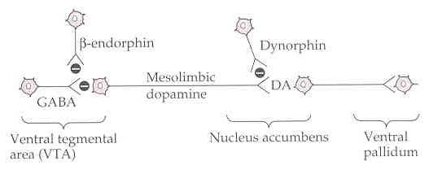
Opiates- CNS Effects
Ventral Tegmentum
Euphoria-
mu and delta receptors
Dysphoria-
kappa receptors

Slide 17
Opiates- CNS Effects
Alter Hypothalamic Heat
Regulatory Mechanism
Neuroendocrine (mu)-
Decrease LH, FSH, ACTH,
β-endorphin
Increase Prolactin, ADH

Slide 18
Opiates- CNS Effects
Miosis- (mu and kappa)-
Stimulation of PNS innervation
of pupil
Convulsions- (mu, kappa,delta)-
High concentrations, inhibition
of GABA release

Slide 19
Opiates- CNS Effects
Antitussive Effects- Depression
of medullary cough centers
Nausea and Vomiting-
Stimulation of CTZ

Slide 20
Opiates- Respiration
Therapeutic Concentrations
-Concentration Dependent
-Reduction in rate, minute
volume, and tidal exchange
Few Clinical Problems
* Exception: respiratory disease, coadministration of respiratory depressants

Slide 21
Opiates- Respiration
Suppression of Brainstem
1) Centers that control rhythm
2) Centers that sense pCO₂
Hypoxic Stimulation Intact-
O₂ ---> apnea

Slide 22
Opiates- Bronchoconstriction
Histamine release
-CNS depression of respiration
-CNS suppression of cough reflex
Caution: asthma, cor pulmonale
COPD

Slide 23
Opiates- Cardiovascular
Therapeutic Concentrations
-Supine Position
-Little Effects on bp, rate, rhythm
-Supine --> Standing Position
peripheral vasodilation
decreased peripheral resistance
inhibition of baroreceptor reflex

Slide 24
Opiates- CSF
May Increase CSF Pressure
Contraindicated in head injury,
intracranial lesions

Slide 25
Opiates- GI Effects
Inhibitory actions
-Delay gastric emptying
-Delay passage through small
and large intestines
-Increase anal sphincter tone
-Decrease defecation reflex
-Constipation

Slide 26
Opiates- Miscellaneous
-Contraction of the bile duct
and sphincter of Oddi
-Renal/Bladder Function
Depressed
-Labor Prolonged

Slide 27
Tolerance
High Degree None
Analgesia Miosis
Euphoria Constipation
Dysphoria Convulsions
Mental Clouding Antagonist
Sedation Actions
Resp. Depression
N & V
Cough Supression Moderate Bradycardia

Slide 28
Study Guide
Know:
1) Uses of Opioids
2) Classes of Opioids- Agonists,
Antagonists, etc.
3) Receptors associated with opiates-
mu vs kappa vs delta-
What functions do they serve?

Slide 29
Study Guide
4) Opiate analgesia- characteristics
5) Effects of opiates on GI tract
function, respiration,cardio-
vascular function, cough

Slide 30
NARCOTIC ANALGESICS- II

Slide 31
Opiates- Pharmacokinetics
Routes:
PO, SL, Nasal, Rectal, Dermal
IV, IM
First Pass Effect- (PO)- High
for Morphine (25% of the oral dose
is bioavailable)

Slide 32
Opiates- Pharmacokinetics
IV Route
more lipophilic- more penetrance
of BBB
Morphine- poor penetrance
Fentanyl- redistribution

Slide 33
Opiates- Pharmacokinetics
Metabolism of Morphine
Glucuronidation of the 3 or 6- OH
Morphine 6-Glucuronide is a
potent analgesic

Slide 34
Patient Controlled Analgesia
-Automated Device- delivery of opiate for postoperative pain, cancer pain, or other conditions
-Device programmed for dose and interval between doses

Slide 35
Opiate Use and Dyspnea
Pulmonary Edema-
Left Ventricular Failure
Reduction in fear/anxiety
Reduction in peripheral
resistance

Slide 36
Strong Agonists
Phenanthrene Class
Morphine
Oxycodone
Heroin
-More Potent
-Better Access to BBB
-Does not bind to opiate receptor itself. Is metabolized to morphine (the active agent)∗∗∗

Slide 37
Strong Agonists
Phenylheptylamine Class
Methadone
-similar analgesic action as morphine
-better bioavailability than morphine
-analgesic and addiction therapy

Slide 38
Strong Agonists
Phenylpiperidine Class
Meperidine (meh-pehr-ih-deen)
-less potent but higher availability
than morphine
-antimuscarinic actions
-less constipating
-not antitussive
-no effects on labor

Slide 39
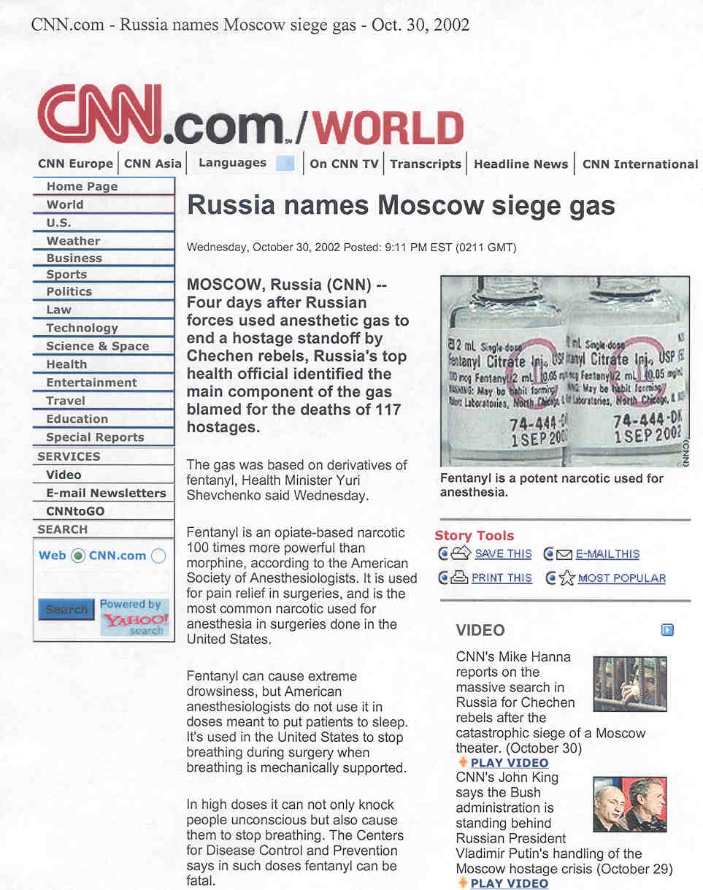
Strong Agonists
Phenylpiperidine Class
Fentanyl/Sufentanil (sue-fen-tuh-nil)
-analgesia >> morphine
-short duration
-useful in anesthesia
-postoperative analgesia

Slide 40
Moderate Agonists
Phenanthrene Class
Codeine
-less potent than morphine
-10% metabolized to morphine-
accounts for analgesia!
-oral- with aspirin or acetaminophen
-antitussive in its own right

Slide 41
Moderate Agonists
Phenylheptylamine Class
Propoxyphene (pro-pox-ee-feen; Darvon)
-related to methadone
-potency between aspirin and codeine
-no antitussive effect

Slide 42
Mild Agonists
Phenylpiperidine Class
Diphenoxylate/Loperamide
(die-fen-ox-ih-late/ low-pehr-uh-mide)
-not analgesic
-low abuse potential
-antidiarrheal activity

Slide 43
Agonist/Antagonists- Mixed
Developed for analgesia
with less liability
kappa agonists
mu antagonists or
weak agonists

Slide 44
Pentazocine (Mixed)
(pen-taz-oh-seen)
kappa agonist
mu agonist/antagonist
Comparison with Morphine:
-Less potent, addictive liability
-Precipitates withdrawal
-Similar respiratory depression

Slide 45
Butorphanol (Mixed)
(byoo-tore-fan-ahl)
-Similar to Pentazocine
-kappa agonist
-mu antagonist
-More potent than morphine
-Increases in cardiac workload

Slide 46
Buprenorphine
(byoo-pre-nore-feen)
-Partial mu agonist
-kappa antagonist?
-More potent than morphine
-Can precipitate withdrawals
-Addictive Liability, but good analgesic with reduced potential for abuse!

Slide 47
Uses of Opioid Antagonists
1) narcotic poisoning
2) reduce side effects in opioid
anesthesia
3) reverse neonatal respiratory
depression
4) opioid addiction treatment
5) alcoholism treatment

Slide 48
Naloxone
-Rapid Acting
-Short Duration
Multiple Doses

Slide 49
Naltrexone
-Orally Effective
-Treatment for Alcoholism
-Liver Dysfunction

Slide 50
Naloxegol (Movantik)PEGylated-Naloxone
-Peripherally acting mu receptor antagonist
(PEGylated form of naloxone- does not penetrate the blood brain barrier)
-oral treatment for opioid-induced constipation in adults with chronic non-cancer pain (FDA approved 2014).

Slide 51
Opiate Toxicity
Triad
-Pinpoint Pupils
-LOW Respiratory Rate
-Stuporous --> Comatose
Death- Respiratory Failure

Slide 52
Treatment of Poisoning
-Maintain airway
-Reverse the respiratory effects
with opiate antagonists
-Monitor carefully- be aware
of other sedatives on board

Slide 53
Misc. Dextromethorphan
-Isomer of levorphanol
-NOT active at opioid receptors
-Antitussive- Acts at central
cough receptors
-OTC drug

Slide 54
Study Guide
1) Drug List- Know whether drug is
agonist, mixed agonist/antagonist,
antagonist (drugs listed in lecture script and ppt)
Know uses and limitations of the
drugs NO structures, chemical classes

Slide 55
Study Guide
Know the signs of opiate poisoning
and the treatment, including antagonists.
FIRST AID
BASIC SCIENCES
2nd Edition
Chaper 5, pp 406-407; Chapter 6, pp 519-520; 536

