Slide 1
General Anesthetics
USMLE topic: Central and Peripheral Nervous System
Principles of therapeutics: Mechanisms of action and use of drugs for treatment of disorders of the nervous system - anesthetics.
Related resources:
USMLE First-Aid, Organ Systems, 2nd Ed., pp. 534-536.
Goodman and Gillman, The Pharmacological Basis of Therapeutics, 12th Ed., pp. 527-564.
Katzung and Trevor, Basic and Clinical Pharmacology, 13th Ed., pp. 421-439.
Brenner and Stevens Pharmacology, 4th Ed., Chapter 21.

Slide 2
Drug Classes and Drugs to Consider
Inhalational
Primary agents Secondary agents
Desflurane
Isoflurane
Sevoflurane
Nitrous Oxide (N₂O)
Intravenous
Primary agents Secondary agents
Etomidate methohexital
Ketamine thiopental
Propofol
Intravenous Adjuncts
Fentanyl alfentanil
Midazolam remifentanil
Morphine sufentanil

Slide 3
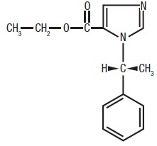
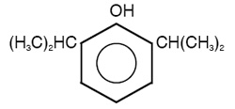
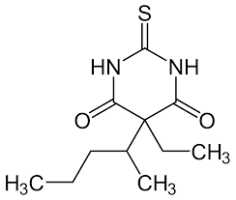
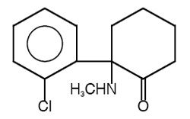
Intravenous Anesthetics
propofol
etomidate
ketamine
thiopental

Slide 4
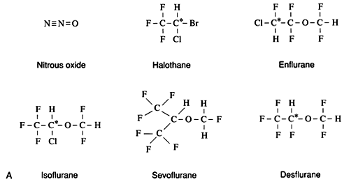
Inhalation Anesthetics

Slide 5
Learning Objectives
Define “general anesthesia” and “balanced anesthesia.”
  State the objectives of anesthesia, characteristics of the ideal anesthetic, and the stages of anesthesia.
Mechanism of Action
  Explain the current theories of the mechanisms of action of inhalation and intravenous anesthetics.
Pharmacokinetics
  For inhalation anesthetics, explain the significance of the blood:gas partition coefficient for rates of absorption and induction of anesthesia.
  Compare commonly used intravenous anesthetics with respect to speed of onset and duration of action.
  Describe the relative roles of distribution and metabolism in determining duration of action and how duration of action may change with repeated administration of an intravenous anesthetic.

Slide 6
Adverse effects, drug interactions and contradictions
  List the complications that may ensue with nitrous oxide as a direct result of the high concentrations at which it is administered.
  Describe malignant hyperthermia, name the common triggering agents, and its treatment.
  Describe the utility and adverse effects of opioids, benzodiazepines, and neuromuscular blockers used as pre-anesthetic medications or in combination with inhalation anesthetics as part of “balanced anesthesia.”
Therapeutic uses
  Define MAC and name the property of an inhalation anesthetic that correlates best with its MAC.
  Discuss relative advantages and disadvantages of intravenous vs. inhalation anesthesia.
Clinical Pharmacology
  Increased risk of CV mortality with propofol due to concurrent hypokalemia (increased arrhythmia risk) – the result of not controlling serum potassium when propofol is used.

Slide 7
General Anesthesia
The induction of a state of unconsciousness with the absence of pain sensation over the entire body through the administration of anesthetic drugs. Used during certain medical and surgical procedures.

Slide 8
Purpose of General Anesthetics
Analgesia (pain relief)
Amnesia (blocking memory of the procedure)
Produce unconsciousness
Inhibit normal reflexes to make surgery safe and easier to perform
Relax skeletal muscle

Slide 9
Ideal Anesthetic
Smooth and reliable induction and/or maintenance of general anesthesia with minimal effects on other organ systems.
Safe for all ages and in pregnancy; for inhalational drugs, odorless or pleasant to inhale.
Rapid in onset and offset, and safe for exposure to OR staff.
Inexpensive to manufacture, easy to transport and store, with a long shelf-life.
Easy to administer and monitor with existing equipment, stable to light, plastics, metals, rubber, and soda lime.
Non-flammable and environmentally safe.

Slide 10
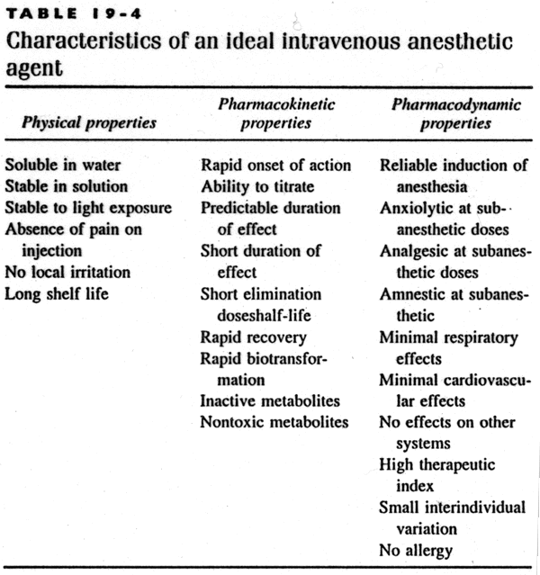

Slide 11
Stages of Anesthesia
Stage I – Analgesia. Patient remains conscious and can carry on a conversation (later in Stage I-amnesia).
Stage II – Excitement. May experience delirium or become violent. Increased and irregular BP and increased RR. This stage can be bypassed by administering a fast acting benzo-diazepine (Midazolam) or barbiturate (Thiopental or Methohexital)
Stage III - Surgical Anesthesia (unconscious, loss of spinal reflexes with relaxed muscles, breathing becomes regular, eye movements stop)
Stage IV - Medullary Paralysis. Respiratory and vasomotor depression. Death can result if patient cannot be revived quickly.

Slide 12
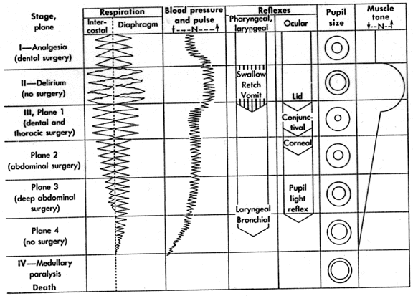
Guedel’s scheme of progressive CNS depression produced by the anesthetic ether. Changes in physiologic functions are shown for the different stages and planes of Guedel’s classification. Examples of surgery that can be performed at these anesthetic levels are given in parentheses.

Slide 13
Inhalation and Intravenous Anesthetics
The two forms are usually combined (Balanced Anesthesia), with an injection given to induce anesthesia and a gas used to maintain it. Example: fentanyl, propofol and sevoflurane.
Certain intravenous agents may be used for induction and maintenance of anesthesia. Example: propofol and remifentanil.

Slide 14
Balanced Anesthesia
A combination of drugs is used.
Primary agent (e.g., sevoflurane) may be administered in conjunction with a muscle relaxant, narcotic analgesic and inhaled oxygen-nitrous oxide mixture.
Each drug is used in an amount sufficient to optimally produce its major effect and to minimize undesirable effects.
Concept: administration of a mixture of small amounts of several agents summates the advantages but not the disadvantages of the individual components.

Slide 15
Mechanism of Action: General Anesthetics
  Originally thought to result from nonspecific interaction with the lipid bilayer of neuronal membranes.
  Meyer-Overton principle: a correlation of potency with lipophilicity supported the above hypothesis.
  Increase neuronal chloride (influx) and potassium efflux (both effects reduce excitability).
  Also decrease sodium (prevent firing) and calcium influx (prevent release).
  Bind to specific transmembrane residues of the GABA_{A} receptor (a chloride channel). Effect on chloride flux appears to be due to potentiation of GABA.

Slide 16
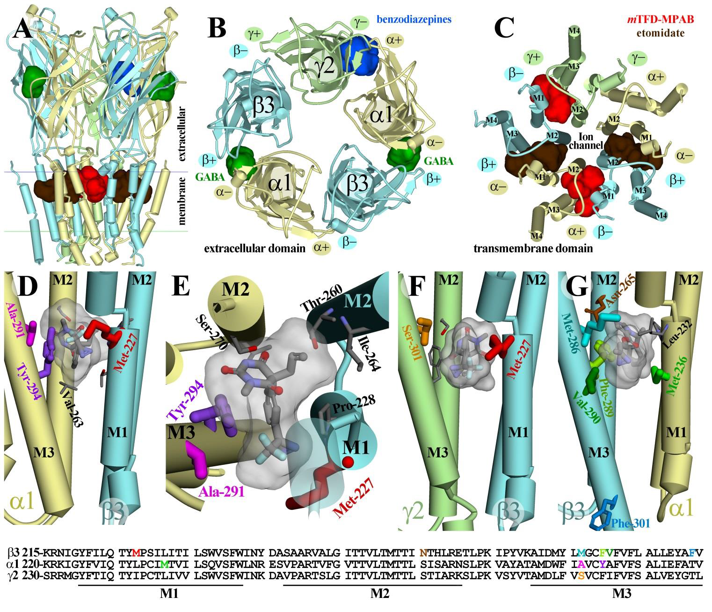
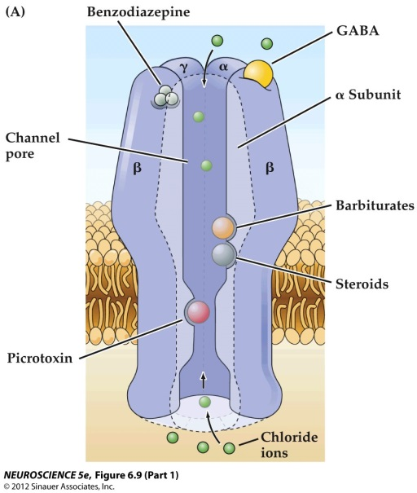
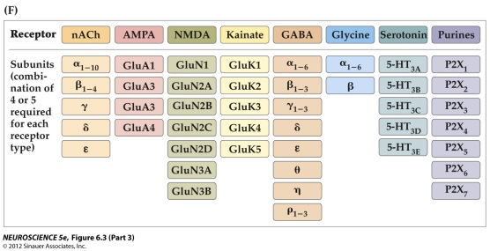
GABA_{A} Receptor
– chloride conducting ligand gated ion channel
target for general anesthetics, benzodiazepines, barbiturates, alcohol, etc

Slide 17
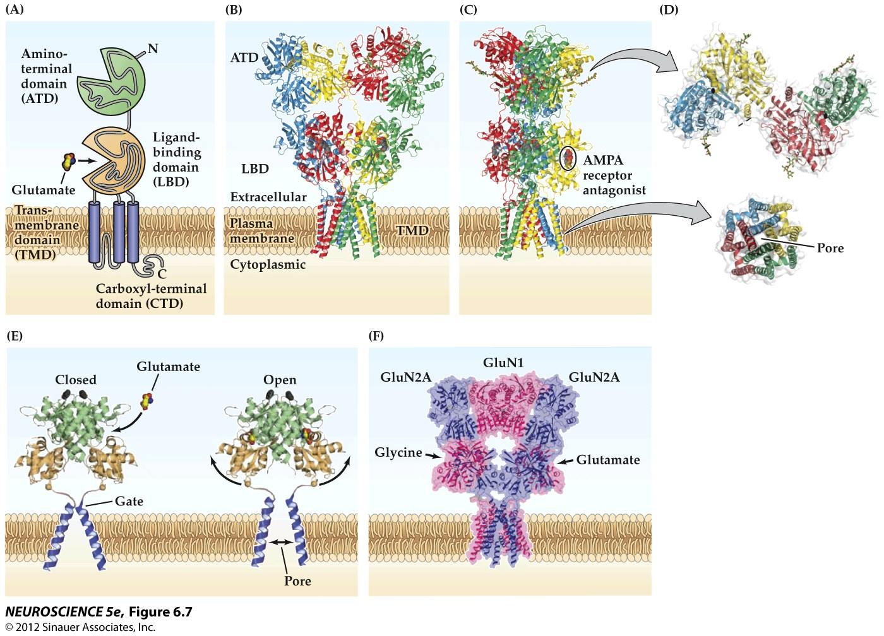
Mechanisms of Action: Intravenous General Anesthetic-Ketamine/NMDA Receptor

Slide 18
Types of General Anesthetics
Induction agents
  Induction agents usually administered IV.
  Can be inhalational for those who do not tolerate IV access.
Maintenance agents
  Maintenance agents are usually administered inhalationally or IV (with bolus or continuous infusion technique).

Slide 19
Intravenous General Anesthetics
Primary role as induction agents.
Maintenance with total intravenous anesthesia.
  Rapid redistribution
  Shorter half-lives
  Environmental risk of inhalational agents
Rapid distribution to vessel-rich tissues.

Slide 20
Intravenous General Anesthetics
High lipid solubility allows for rapid induction.
When redistributed out of the brain, effect decreases.
Advantages
  Rapid and complete induction
  Less CV depression

Slide 21
Intravenous General Anesthetics
Propofol* (Diprivan®) and Fospropofol♦
  Di-isopropyl phenol, unrelated to other general anesthetics. Has largely replaced thiopental for induction.
  Prepared as an oil-in-water emulsion.*
  Rapid onset (20 sec), short duration (5-10 min).
  Rapidly metabolically inactivated (unlike thiopental)
  Extensive plasma and tissue protein binding.
*Preparation: 1% propofol, 10% soybean oil, 1.2% purified egg phospholipid (emulsifier), 2.25% glycerol (adjusts tonicity), NaOH to adjust pH.
♦Water soluble prodrug of propofol

Slide 22
Intravenous General Anesthetics
Propofol
  Not analgesic (so combine with fentanyl, e.g.)
  Decreases MAP 20-30 % via vasodilation.
  Respiratory depression
  *Pain on injection.
  Low incidence of nausea and vomiting.
  *Increased risk of CV mortality if concurrent hypokalemia.

Slide 23
Intravenous General Anesthetics
Methohexital (Brevital®)
  (barbiturate)2.5 times more potent than thiopental
  Shorter duration of action than thiopental
  Sleep time: 5-7 min

Slide 24
Intravenous General Anesthetics
Etomidate (Amidate®)
  Structurally distinct from others.
  Short-acting
  Used for induction and sedation for short procedures
  Commonly used in ER for rapid induction.
  Little effect on BP.

Slide 25

Intravenous General Anesthetics
Fentanyl
  *Strong opiate analgesia for moderate-severe pain.
  Also administered epidurally or intrathecally.
  Decreases the MAC of inhalation agents.
  *Not amnestic or fully anesthetic.
  *Can cause chest wall rigidity (basal ganglia effect)
  *Primarily used as an adjunct, but also as primary agent in high-risk CV surgery in the elderly.
  *Respiratory depression, but less CV depression than other agents.

Slide 26

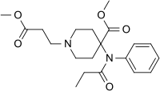

Intravenous General Anesthetics
Other Opiates
  Sufentanil (Sufenta®)
  Like fentanyl, can be used by the epidural or intrathecal route.
  Alfentanil (Alfenta®) and Remifentanil (Ultiva®) are ultra-short-acting opioids.
    Used for induction and for ambulatory surgery.
    Remifentanil metabolized rapidly by esterases.

Slide 27
Intravenous General Anesthetics
Ketamine (Ketalar®)
  Related to phencyclidine (PCP).
  *NMDA antagonist.
  Duration of anesthesia 5-20 min.
  *Increases HR, BP, and CO due to sympathomimetic effects; do not use in patients who will not tolerate this.
  *Emergence delirium (including hallucinations, confusion, disorientation and irrational behavior) phenomenon 5-30%. Diazepam co-administration can prevent this.

Slide 28
Intravenous General Anesthetics
Ketamine
  Dissociative anesthesia*
    Amnesia
    Analgesia
    Catalepsy
  Thalamocortical and limbic systems
  Protective reflexes maintained
*analgesia and amnesia with minimal effect on respiratory function. Patient does not appear to be anesthetized, can swallow and open eyes, but does not process information, appears to be dissociated from the environment. This form of anesthesia may be used for analgesia during brief, superficial operative procedures. Ketamine is used for trauma patients with very unstable, low blood pressure, for elderly patients and for pediatric patients (less likely to experience adverse effects than adults).

Slide 29
Intravenous General Anesthetics
Ketamine
  In addition to NMDA receptors, it affects mu and kappa opioid receptors, GABA_{A} receptors, anti-muscarinic, other effects.
  Onset and peak plasma concentrations
    1 min after IV
    5-15 min after IM
    30 min after oral

Slide 30
Intravenous General Anesthetics
Benzodiazepines
  Primarily used as adjuncts
    Cannot easily induce and maintain general anesthesia.
    Lack analgesic properties.
  Used for sedative and amnestic effects
  Midazolam (Versed®)
    Short-acting. Used for pre-op sedation and for certain diagnostic procedures.
    Little CV or respiratory effects.

Slide 31
Inhalational General Anesthetics
Absorbed and eliminated by the same organ.
Activity is due to molecules in the gas phase. So, molecules that enter the liquid phase and become soluble in blood decrease the onset of anesthesia.
Movement between tissues is determined by the partial pressure of the anesthetic. As partial pressure of the drug in blood increases, anesthetic molecules move across the BBB.
Induction Rate of Inhalational Anesthesia is Determined by:
alveolar partial pressure of anesthetic in inspired air.
ventilation rate.
*the rate at which the anesthetic partial pressure in blood increases as anesthetic is administered…

Slide 32
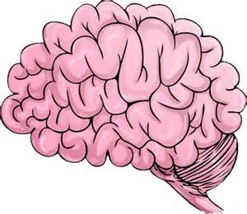
The Blood : Gas Coefficient is a Measure of the Anesthetic’s Solubility in Blood
Fast
Fast
N₂0
0.47
Halothane
2.3
Slow
Slow
Rate of absorption
Rate of induction
Blood:gas
partition
coefficient

Slide 33
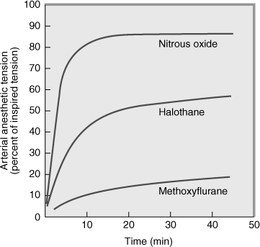
Blood : Gas Coefficient
The third factor is dependent on the blood : gas partition coefficient.
Anesthetics with a higher coefficient have a higher solubility in blood and a slower rate of induction as it takes longer for their partial pressure in blood to rise.

Slide 34
Minimum Alveolar Concentration
(MAC)
The concentration of anesthetic gas, measured as a percentage at 1 atmosphere (i.e., the partial pressure), that will provide surgical anesthesia so that 50% of subjects will not respond (i.e., with movement) to surgical incision (a set width and depth).
It is used to compare potencies among inhalation agents.

Slide 35
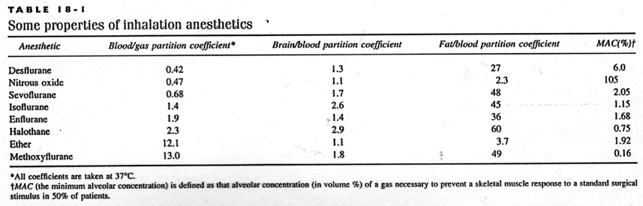

Slide 36
Pharmacologic Effects of Inhalation Agents
Cardiovascular
  Depression of myocardial contractility
    Sensitivity to catecholamines
    Concerns regarding bradycardia
  Decrease of peripheral vascular resistance
    hypotension
Respiration
  Depression of medullary responses and respiration. Most are bronchodilators.

Slide 37
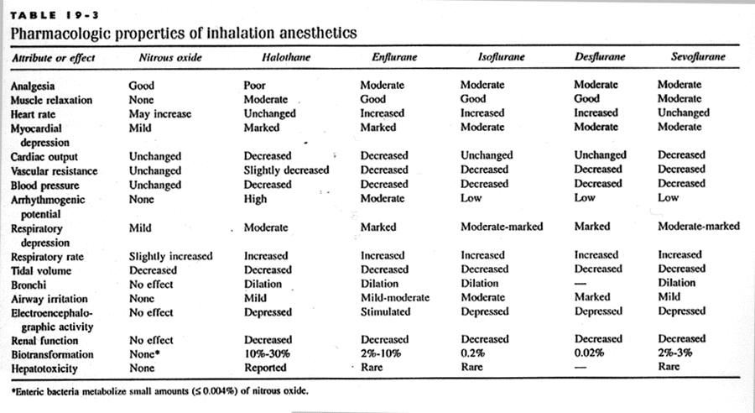

Slide 38
Inhalational General Anesthetics
Nitrous Oxide
  *The only non-halogenated inhalation anesthetic
  Blood/gas partition coefficient = 0.47, rapid onset/offset
  *MAC = 105% (hyberbaric conditions for full anesthesia alone).
  *Component of Balanced Analgesia: better analgesic than other inhalationals and lowers the needed dose of the other anesthetic.
  *Little or no respiratory or cardiovascular depression
  *Dysphoria and nausea with increased concentrations
  *Diffusion hypoxia (Fink effect or “third gas effect”)
  *Can induce changes in folate and amino acid metabolism, megaloblastic anemia (inhibits methylation via oxidation of vitamin B₁₂).

Slide 39
Halogenated Inhalational General Anesthetics
Halothane (no longer used in the USA)
  MAC = 0.75%
  Blood/gas partition coefficient = 2.3 (slow onset/recovery)
  Poor analgesic properties
  Incomplete muscle relaxation
  *Decreased MAP
  *Depressant effect on myocardial contractility

Slide 40
Halogenated Inhalational General Anesthetics
Halothane
  Vasodilator
  *Depressant effect on respiration
  Elimination: alveolar excretion and hepatic metabolism
  *Sensitizes heart to catecholamines: arrhythmia risk
  *Associated with acute hepatoxicity: halothane hepatitis
  *Trigger for malignant hyperthermia

Slide 41
Halogenated Inhalational General Anesthetics
Isoflurane (Forane®)
  *Anesthesic of choice
  Blood/gas partition coefficient = 1.4
  MAC = 1.15%
  *Pungent odor
  Can provide muscle relaxation (high concentrations)
  *Dose-dependent depression of myocardial contractility
  Coronary vasodilation
  CO maintained
  Can use catecholamines
  *Respiratory depression
  Neither nephrotoxic nor hepatotoxic

Slide 42
Isoflurane
Best agent to produce a controlled hypotension.
Agent of choice for most cardiac patients and neurosurgery patients.
Minimal effect on ICP, decreases brain oxygen consumption.

Slide 43
Halogenated Inhalational General Anesthetics
Enflurane (Ethrane®)
  Similar to Isoflurane.
  Its pungency limits use as induction agent.
  Enflurane and Isoflurane have lower blood:gas partition coefficents than halothane but higher coefficients than sevoflurane and desflurane.

Slide 44
Halogenated Inhalational General Anesthetics
Desflurane (Suprane®)
  Blood/gas partition coefficient = 0.42
  *Irritating to airway, can cause bronchospasm
  *Moderate respiratory depression
  MAC = 6%
  *Requires a heated vaporizer
  *Expensive compared to other anesthetic gases
  *Reduces systemic vascular resistance (SVR) and MAP, but increases heart rate, causing stable CO
  Low risk of hepatotoxicity
  Rapid depth and recovery

Slide 45
Halogenated Inhalational General Anesthetics
Sevoflurane (Ultane®)
  MAC = 2.05%
  Blood/gas partition coefficient = 0.68
  Mild airway irritant
  *Sweet-smelling, and suitable for mask induction
  Rarely, hepatotoxicity
  *Moderate-marked respiratory depression
  *“Close to an ideal anesthetic”; anesthetic of choice

Slide 46
Malignant Hyperthermia
*Halothane and other halogenated anesthetics can trigger this rare (genetic) condition.
Leads to muscle fiber breakdown, rhabdomyolysis, renal failure, muscle rigidity, fever, tachycardia.
Discontinue the anesthetic promptly, take measures to reduce body temp, control BP.
*Treat with dantrolene to prevent fatality.

Slide 47
Malignant Hyperthermia
Especially when combined with a neuromuscular blocker.
Due to mutations in ryanodine receptor gene.
Other chromosomal loci involved, e.g., muscle L-type calcium channels, leading to uncontrolled calcium release in muscle SR, leading to spasm, hyperthermia, autonomic lability.

Slide 48
A 32-year-old woman with pheochromocytoma has been scheduled for surgery to remove an abdominal tumor. Her BP is 190/120, and pulmonary and renal functions are normal. Her plasma catecholamines are elevated. Which agent is contraindicated in her anesthesia protocol?.
Desflurane
Fentanyl
Halothane
Midazolam
Thiopental
Answer Now
:01

Slide 49
Which anesthetic has a low blood:gas partition coefficient but is not used for induction of anesthesia because of the risk of airway irritation?
Desflurane
Enflurane
Halothane
Isoflurane
Sevoflurane
Answer Now
:30

Slide 50
An i.v. dose of thiopental leads to loss of consciousness in 10-15 sec. If no other drugs are given, the patient will regain consciousness in just a few minutes because thiopental is:
efficiently excreted renally.
exhaled rapidly.
rapidly metabolized hepatically.
Redistributed from brain.
Answer Now
:30

Slide 51
Flumazenil can reverse the respiratory depression produced by which agent?
Desflurane
Fentanyl
Ketamine
Midazolam
Propofol
Answer Now
:30

Slide 52
Which intravenous anesthetic produces dissociative anesthesia:
Midazolam
Ketamine
Fentanyl
Thiopental
Propofol
Answer Now
:30

Slide 53
A 30yr old man was taken to surgery for suspected acute appendicitis. He was administered general anesthesia consisting of halothane and succinylcholine. He suddenly developed hyperthermia, muscle rigidity, tachycardia and hypertension. The anesthetist suspected Malignant Hyperthermia and successfully managed the patient with medication. The medication likely worked by:
inhibiting the hypothalamus
blocking the atrio-ventricular bundle
peripheral vasodilation
stabilizing the autonomic system
impairing Ca²⁺-dep. muscle contraction
Answer Now
:30

