Slide 1
Local Anesthetics
Blanton
A. Block Nerve Conduction
B. Sensory and Motor Nerves
C. Reversible

Slide 2
Local Anesthetics- MOA
Blockade of Voltage-Dependent
Na⁺ Channels
B. Site at Cytoplasmic End of Channel
C. Reduction of Na⁺ Current

Slide 3
Local Anesthetics- MOA
Pore Blockade-
Frequency Dependent
B. Firing,  Susceptibility
C. Stabilization of Inactivated State

Slide 4
Local Anesthetics- MOA
A. Voltage-Dependent
B. RMP changes affect sensitivity
C. Depolarized: probability
Hyperpolarized: probability

Slide 5
Local Anesthetics: pH Considerations
A. Weak Bases: pKas of 8-9
B. In Tissues, Ionized Form
pH= pKa - log [prot./unprot.]
7=9-log [p/up]
2=log[p/up] = 100

Slide 6
Site of Anesthetic Action
extracellular
Na
charged
intracellular
uncharged

Slide 7
Blockade of Nerve Fibers
A. Any Nerve
B. Rate Factors:
-Diameter, Length
-Frequency of Firing
-Location in Bundle
C. Type C > B > A

Slide 8
Structure of Local Anesthetics
O C2H5
Ester: H2N- C-O-CH2 CH2-N
Procaine C2H5
Amide: CH2 O C2H5
NH-C-CH2-N
CH2 C2H5
Lidocaine

Slide 9
Reduction of Blockade-
Systemic Absorption
A. Drug Properties
B. Site of Injection
C. Vasodilator Activity
D. Drug-Tissue Binding
E. Presence of a Vasoconstrictor

Slide 10
Vasoconstrictors
A. Increase Duration by 50%
B. Reduced Toxicity
C. Epi, Norepi, Phenylephrine,
Vasopressin
D. Overdosage- Hypoxia (avoid extremities-fingers/toes/etc)
E. Cocaine- Natural Vasoconstrictor

Slide 11
Metabolism
Esters- Butyrlcholinesterase
Amides- Hepatic Microsomal
System

Slide 12
Esters
Procaine/Chloroprocaine
-short half-life
-hypersensivity reactions
-injectable
-not surface

Slide 13
Esters
Tetracaine
-Longer Duration of Action
-Topical and Injectable
-Ophthalmic

Slide 14
Esters- Cocaine
-Not widely used
-Respiratory Tract Anesthetic
-CNS Side Effects
-CV Side Effects

Slide 15
Esters
Benzocaine
-Topical only

Slide 16
Amides- Lidocaine
-Longer Lasting than Esters
-Efficiently Absorbed from
Mucous Membranes
-All Routes, except eyes

Slide 17
Amides- Bupivacaine
-Long Lasting
-Injectable
-Not Effective on Surface

Slide 18
Local Anesthetics- Toxicity
A. Immune System- Allergy
B. Cardiovascular System
C. Nervous System

Slide 19
Cardiovascular Toxicity
A. Excessive Absorption
B. Direct Suppression of Heart
C. Death to CV Collapse-
Arrhythmia, Suppression
of Electrical Activity
D. Cocaine: Sympathomimetic

Slide 20
CNS Toxicity
A. Intravascular Injection
B. Suppression of Inhibitory
Pathways
C. Convulsions, Coma, Cardio-
respiratory Arrest

Slide 21
Peripheral Nervous System
Motor and Sensory Deficits-
Chloroprocaine

Slide 22
Surface Anesthesia
-Aqueous Salts, Ointments
-All body surfaces, eyes
-Benzocaine- denuded areas,
poor absorption

Slide 23
Infiltration Anesthesia
A. Injection into a region without
regard to cutaneous nerve route
B. Superficial Tissues
C. Intraabdominal Organs

Slide 24
Nerve Block
-Injection into or about peripheral
nerves or nerve plexuses
-Sensory and Motor Block

Slide 25
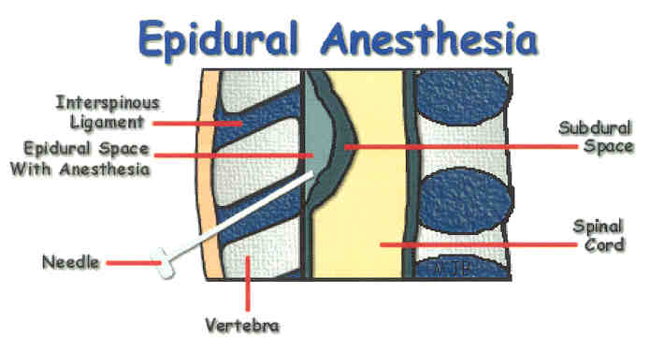
Epidural Anesthesia
A. Epidural Space
B. Sacral Hiatus, Lumbar,
Thoracic, or Cervical Regions
C. Large Doses- Diffusion

Slide 26
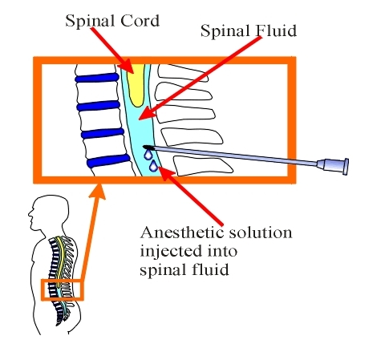
Spinal Anesthesia
A. Subarachnoid Space in Lumbar Region

Slide 27
Spinal Anesthesia
B. Positioning, Specific Gravity
of drug- desired height of block
C. CV Depression
D. Headache

Slide 28
Study Guide
A. MOA of Local Anesthetics
B. Differences Between Amides and
Esters
C. Drug List- Local Anesthetics
-Amides vs. Esters
-Distinguishing Properties, e.g.,
cocaine-vasoconstriction, SNS

Slide 29
Study Guide
D. Drug List (those listed in lecture script and ppt)
-What is the utility of the vasoconstrictors?
FIRST AID
BASIC SCIENCES
2nd Edition
Chapter 5, pp 407-408

