Slide 1
MOOD DISORDERS
SANGEETA SRIVASTAVA AWASTHI, MD
DIRECTOR OF ONCO-PSYCHIATRY
TEXAS TECH UNIVERSITY HEALTH SCIENCE CENTER

Slide 2


Slide 3
WHAT IS MOOD? WHAT IS AFFECT?
MOOD: “How do you feel?”
  A pervasive and sustained emotion that colors a person’s perception.
  Can be described by the person as: depressed, sad, empty, irritable, happy, angry
AFFECT: What does the clinician observe?
  Can be described as appropriate, inappropriate, mood-congruent, mood-incongruent, labile, flat, blunted, silly

Slide 4
WHAT IS A MOOD DISORDER?
Symptoms cause a disruption to functional status, relationships, education or employment
Major Depressive Disorder
Bipolar Disorder (BPD)
  Types I and II
  Mania
  Hypomania
Common- 35% of the population

Slide 5
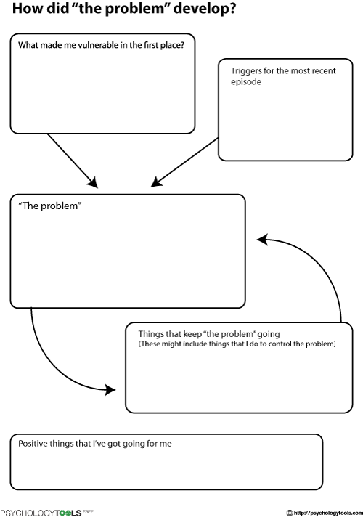
5 P’S OF CASE FORMULATION
Presenting problem(s)
Predisposing factors which make the person vulnerable
Precipitating factors which triggered the problem
Perpetuating factors which keep a problem going
Protective factors

Slide 6
ASSESSMENT
Psychiatric History
  History of depressive symptoms
  History of manic, hypomanic symptoms
  Comorbidities that would impact response: substance use, anxiety disorders, personality disorders
  Safety: suicide/homicide risk, ability to care for dependents
Medical History
  Current medications, drugs of abuse
  Medical illnesses, recent work-ups and lab results
Psychosocial History
  Modifiable stressors: domestic violence, lack of support system
  Triggers: divorce, termination, death of loved one..

Slide 7
LAB ASSESSMENTS
CBC with Differential
Complete Metabolic Panel
Magnesium
Thyroid functions: TSH, free T4, T3
Vitamin B12 and folate
Vitamin D
Urine toxicology
Consider RPR and HIV
Consider Homocysteine
Consider MTHFR mutation

Slide 8
AS NEEDED ASSESSMENTS
MRI: If any neurologic or cognitive changes
Urinalysis: In elderly, 20% admitted to the hospital have UTI
Pregnancy test: In any woman of childbearing age
EKG: If planning to use TCA, Lithium or Antipsychotic
Sleep Study: Sleep apnea

Slide 9
EKG
Antipsychotics: Can increase the QTc interval and have potential for Torsades de Pointes
Lithium: Risk of Supraventricular Arrhythmias
(Sick Sinus Syndrome and Sinoatrial Block) and rarely Ventricular Arrhythmias
TCAs: Increase PR, QRS, QTc intervals and have potential for Complete AV Block and Sudden Death

Slide 10
DEPRESSIVE DISORDERS

Slide 11
DEPRESSIVE DISORDERS
Major depressive disorder, single episode or recurrent
Persistent depressive disorder
Disruptive mood dysregulation disorder
Premenstrual dysphoric disorder
Substance/medication-induced depressive disorder
Depressive disorder due to another medical condition
Other specified depressive disorder
Unspecified depressive disorder

Slide 12
MAJOR DEPRESSIVE DISORDER

Slide 13
MAJOR DEPRESSIVE DISORDER
Lifetime prevalence 17%
Female:male ratio 2:1
25% risk to first degree relatives
50% of people will have a subsequent episode
  Risk of recurrence increases with age & number of episodes
50% recover within 6 months
15% lifetime suicide risk
Anxiety disorders common
10% develop psychotic features

Slide 14
SUICIDE IN DEPRESSION
10%-15% of all patients hospitalized for depression commit suicide
Factors suggesting increased risk for suicide
  Being divorced or living alone
  History of alcohol or drug abuse
  Being older than 40
  History of prior suicide attempt
  Suicidal ideation with a plan
  Family history of suicide

Slide 15
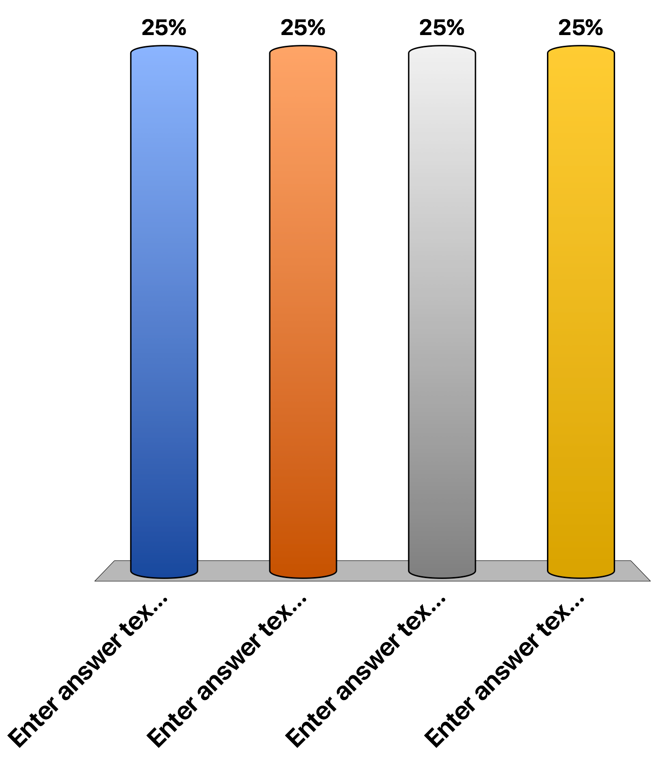
A 30-year-old man presents to your office complaining of being “down” the last month. He has been suffering from difficulty falling and staying asleep, severe fatigue, guilt, poor appetite, and thoughts of wanting to take his life. He does not ever recall feeling this bad. He has stopped talking with his friend and has no interest in doing anything. You believe he is suffering from a major depressive disorder. In order to diagnose this, which symptom must be present?
Decreased appetite
Fatigue
Insomnia
Loss of interest (anhedonia)

Slide 16
DEPRESSIVE SYMPTOMS- SIG E CAPS
Sleep disturbance
Interest
Guilt
Energy
Concentration
Appetite
Psychomotor Activity
Suicidal Ideation

Slide 17
MAJOR DEPRESSIVE EPISODE CRITERIA
5 or more symptoms present nearly every day during the same 2-week period (representing a change from previous functioning) where at least one symptom is either depressed mood or loss of interest or pleasure
  Depressed mood most of the day, nearly daily
  Diminished interest or pleasure
  Significant weight loss (5% of body weight in 1 month)
  Insomnia/Hypersomnia
  Psychomotor agitation/retardation
  Fatigue
  Feelings of worthlessness
  Difficulty concentrating
  Thoughts of death, or suicidal thoughts or behaviors

Slide 18
MAJOR DEPRESSION PATHOGENESIS
Biological Hypothesis of MDD Pathogenesis
Genetic
Family Study: MDD found to be 2-4 times more frequent in relatives of those with MDD.
Twin Study: MDD is 50 % in monozygotic twins Vs. 20 % in dizygotic .
Sleep Dysregulation
Increase in Nocturnal arousal & awakening,
Reduced REM latency, Increase REM density
Biogenic Amine Hypothesis
Hormonal Abnormalities
Brain images
Monoamine: Meds that deplete monoamines worsen the depression (Reserpine).
Serotonin: Low P 11 intracellular protein that recruit 5HT 1 A receptors to neuronal surface. P11 is low in depression. All Ads, ECT increase P11. Low CFS serotonin in Patient after suicide.
Hypothalamic-Pituitary- adrenal/thyroid Axis dysrequlation: Hypersecretion of cortisol is present, DST; NON-suppression of cortisol seen in 50% in Pts. with melancholia. 5%-10% of depressed patient have Abn. thyroid function. Blunted response to TRH challenge
MRI: Neurodegenerative disorders increase risks for depression; more hyperintensities in subcortical regions and reduced in hippocampus. PET scan show decreased prefrontal metabolism

Slide 19
MAJOR DEPRESSION COURSE OF ILLNESS
20% will continue to feel depressed after 2 years
30% will remit within 6-24 months
Average length of episode is 4-5 months,
6 months after episode 50% will have full recovery
Risk of relapse after one episode is 50%,
80% after third episode

Slide 20
PERSISTENT DEPRESSIVE DISORDER

Slide 21
PERSISTENT DEPRESSIVE DISORDER
Chronic and persistent disturbance in mood present for at least 2 years
Presence of at least 2/6 symptoms continuously for 2 years
  Poor appetite or overeating
  Insomnia or hypersomnia
  Low energy or fatigue
  Low self-esteem
  Poor concentration or difficulty making decisions
  Feelings of hopelessness

Slide 22
A 34 year old man complains of a depressed mood ”for as long as I can remember.” His sleep is poor, interest is fair, denies guilt, energy level is “decent”, concentration is fair, and appetite fluctuates, though he has not had any weight loss. He has trouble making decisions and his self-esteem is low. He denies suicidal ideation and any medical problems or drug use. Which treatments may be helpful?
Lithium
SSRIs
SNRIs
Cognitive behavioral therapy

Slide 23
DISRUPTIVE MOOD DYSREGULATION DISORDER

Slide 24
DISRUPTIVE MOOD DYSREGULATION DISORDER
Chronic, severe and persistent irritability, severe recurrent temper tantrums
Symptoms present for at least 12 months
Symptoms begin before age 10, occur in at least 2 settings
Diagnosis is not made before age 6 or after age 18
Cannot be comorbid with oppositional-defiant, bipolar or intermittent explosive disorders

Slide 25
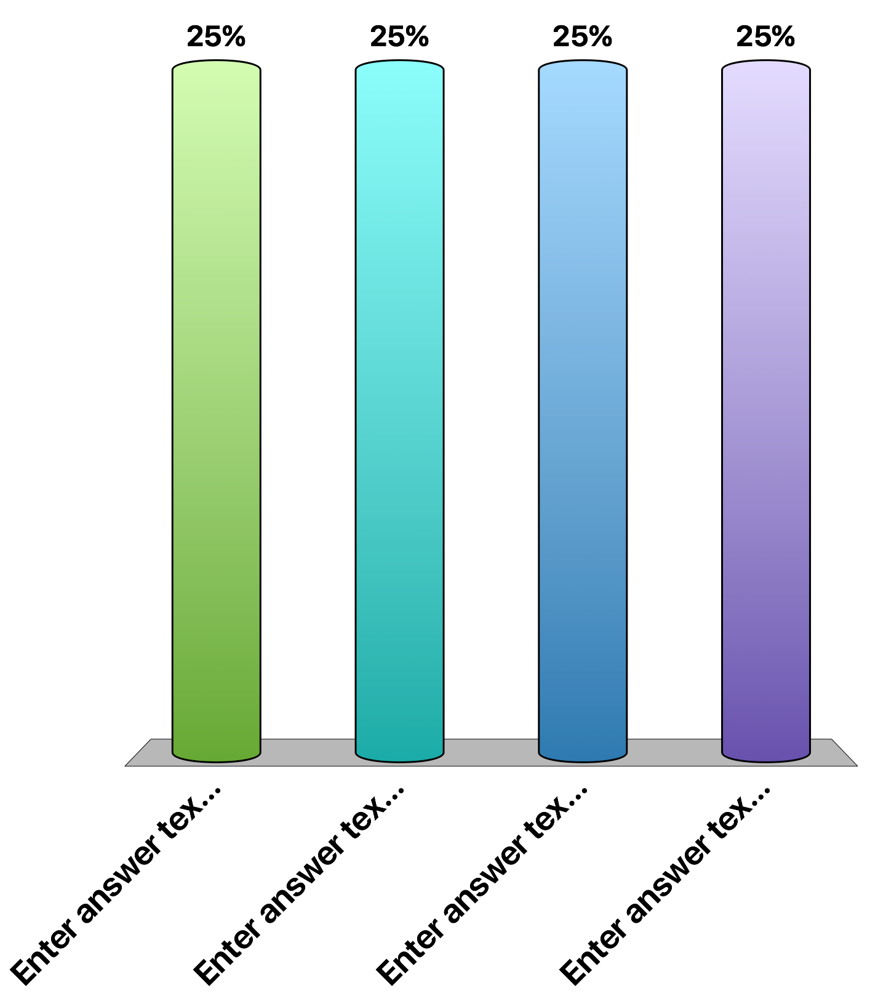
A 12 year old boy begins to have a new episodes of temper outbursts that are out of proportion to the situation. Which of the following is not a diagnostic possibility for this patient?
Bipolar disorder
Disruptive mood dysregulation disorder
Oppositional defiant disorder
Conduct disorder
Attention deficit/hyperactivity disorder

Slide 26
PREMENSTRUAL DYSPHORIC DISORDER (PMDD)

Slide 27
PREMENSTRUAL DYSPHORIC DISORDER (PMDD)
At least 5 symptoms total must be present in final week before menses, improve within a few days of menses, and become minimal after menses (in the majority of menstrual cycles)
Associated symptoms:
  Decreased interest
  Concentration difficulty
  Insomnia or hypersomnia
  Fatigue
  Easily overwhelmed
  Change in appetite
  Weight gain, bloating, muscle/joint pain, breast tenderness or swelling
  Mood symptoms:
  Marked affective lability, mood swings, sudden tearfulness, increased sensitivity to rejection
  Marked irritability, anger, increased conflicts
  Marked depressed mood, hopelessness, self-deprecating thoughts
  Marked anxiety, tension

Slide 28
RISK FACTORS FOR PMDD
Occurs in 3-8% of menstruating women
  Fluctuations in estrogen and progesterone leads to serotonin deficiency
History of depressive or anxiety disorder, especially peripartum depression
Increasing age
Lack of exercise
Stress
Low Calcium, Magnesium, Vitamin B6
Family history of PMDD

Slide 29
TREATMENT FOR PMDD
Pharmacologic
  SSRIs
  Anxiolytics
  Oral Contraceptive
  Supplements: Multivitamin, Calcium, Magnesium, Vitamin B6
  NSAIDs, Diuretics
Non-Pharmacologic
  CBT
  Exercise
  Light Therapy
  Carbohydrates (chocolate!)

Slide 30
A 23 year old graduate student presents with severe abdominal cramps, bloating and difficulty concentrating. She reports her studies have been suffering because of these symptoms. She recalls the same troublesome symptoms occurred last month around the same time, but resolved on their own after her period started. Her boyfriend states, “she has been so mean to me the last few days! It’s like anything I do or say sets her off.” She does not report any other medical problems. Which of the following is the first line treatment for these symptoms?
Lithium
Spironolactone
Fluoxetine
Maprotiline

Slide 31
PERI-PARTUM & POST-PARTUM
DEPRESSIVE DISORDERS

Slide 32
DEPRESSION WITH PERIPARTUM ONSET
Occurring during pregnancy or within 4 weeks following delivery
  Prevalence: 5% of pregnancies (half start during pregnancy)
  Anxiety and panic symptoms commonly comorbid
  Observe for psychosis, bipolar conversion or infanticide risk
Differentiate from post-partum or baby blues
  Very common, usually self-limited
Risk factors for Peripartum Depression
  Previous psychiatric illness
  Family history
  Limited social support
  Negative life events
  Low socioeconomic status
  Conflict with baby’s father
  Infant illness
  Baby Blues

Slide 33
Postpartum Disorders
 | Postpartum blues or “Baby Blue” | Postpartum Depression | Postpartum Psychosis
Which Number Child | Any | Usually 2nd | Usually 1st
Onset | Begins after birth and lasts up to 2 weeks | Begins within 1 month of birth and symptoms may continue | Begins within 1 month of birth and symptoms may continue
Mother cares about the baby | Yes | May have thoughts about hurting the baby | May have thoughts about hurting the baby
Symptoms | Mild depression | Severe depression | Severe depression and psychotic symptoms
Treatment | Self-limited; no treatment necessary | Antidepressant | Antidepressant and mood stabilizers or antipsychotics

Slide 34
SUBSTANCE/MEDICATION INDUCED DEPRESSIVE DISORDER

Slide 35
SUBSTANCE-INDUCED DEPRESSIVE DISORDER
Alcohol
Phencyclidine
Other Hallucinogens
Inhalant
Opioid
Sedative, Hypnotic, Anxiolytic
Amphetamine or other Stimulant
Cocaine
Other or unknown substance

Slide 36
A 16 year old girl comes in to the ER at the insistence of her parents with a chief complaint of suicidal ideation with a plan of taking an overdose of medications. She states that for the past week she has not felt life is worth living, that her mood is sad, she has no energy, no motivation to do things that she normally used to enjoy. Prior to 1 week ago, she had none of these symptoms. The patient states he has been sleeping 12-14 hours/day for the past week and ”eating everything in sight.” She says he has never been diagnosed with major depression or been seen by a psychiatrist. She is not aware of any medical problems. The patient states that up until 9 days ago she used cocaine on a daily basis for a month, but then stopped it when school started.
On mental status exam, the patient appears alert and oriented x 3. Her speech is normal, but her mood is “depressed”, and her affect is constricted and dysphoric. She denies having hallucinations or delusions but has suicidal ideation with a specific intent and plan. She denies having homicidal ideation. What is the most likely diagnosis? And what would be the course of action?
Major depressive disorder
Substance induced mood disorder
Cyclothymia
Bipolar disorder

Slide 37
SECONDARY DEPRESSION: MEDICAL ETIOLOGIES
Neoplasms
  Brain tumors
  Pancreatic cancer
  Paraneoplastic syndromes
Immune Disorders
  AIDS
  Systemic Lupus Erythematosus
Infectious Diseases
  Neurosyphilis
  AIDS
Cardiac
  Post-MI
Endocrine
  Thyroid Disease
  Cushing’s Syndrome
Neurologic
  Multiple Sclerosis
  Epilepsy
  Parkinson’s Disease
  Huntington’s Disease
  Alzheimer’s Disease
  Traumatic Brain Injury
  Stroke
Obstructive Sleep Apnea
Anemia

Slide 38
MEDICATIONS ASSOCIATED WITH DEPRESSION
Acyclovir
Anabolic Steroids
ACE Inhibitors
Anticonvulsants
Baclofen
Barbiturates
Benzodiazepines
B-Blockers
Bromocriptine
Calcium Channel Blockers
Ciprofloxacin
Clonidine
Corticosteroids
Digitalis
Disulfiram
Estrogen
Guanethidine
H2 Receptor Blockers
Interferon A
Interleukin-2
Isotretinoin
Levodopa
Methyldopa
Metoclopramide
Metronidazole
NSAIDS
Opioids
Pergolide
Reserpine
Sulfonamides
Thiazide Diuretics
Topiramate
Vinblastine
Vincristine

Slide 39
ANTIDEPRESSANTS

Slide 40
WHICH ANTIDEPRESSANT TO USE?
All antidepressant medications are equally effective but differ in side-effect profiles.
Medications usually take 4-6 weeks to fully work.
Look for prior history, family history or desired side effects

Slide 41
PHARMACOTHERAPY FOR DEPRESSION
  Selective serotonin reuptake inhibitors (SSRIs)
    Escitalopram, Citalopram, Fluoxetine, Paroxetine, Sertraline
  Serotonin-norepinephrine reuptake inhibitors (SNRIs)
    Venlafaxine and Duloxetine
  α2-adrenergic receptor antagonist
    Mirtazapine
  Dopamine-norepinephrine reuptake inhibitor
    Bupropion (do not use in anorexia or in seizure disorder)

Slide 42
DOSES OF ANTIDEPRESSANTS
SSRIs
  Escitalopram: 10-30 mg qd
  Citalopram: 20-40 mg qd
  Fluoxetine: 20-80 mg qd
  Paroxetine: 20-50 mg qd
  Setraline: 50 mg-200 mg qd
  Vilazodone: 20 mg-40mg qd
SNRIs
  Venlafaxine: 37.5 mg-225 mg qd
  Duloxetine: 60 mg-120 mg qd
  Desvenlafaxine: 50 mg qd
Mirtazapine: 15 mg-45 mg qhs
Buproprion: 150 mg-300 mg
Vortioxetine: 5 mg-20 mg qd

Slide 43
ANTIDEPRESSANT PHARMACOLOGY
Escitalopram: Headache, N/V, Decreased libido, Suicidality, QT prolongation
Citalopram: Decreased Libido, SIADH, QT prolongation, Suicidality
Fluoxetine: Headache, Tremor, SIADH, QT prolongation, Seizures, Altered platelet function
Paroxetine: Palpitations, Abdominal pain, SIADH, Suicidality, Seizures
Sertraline: N/V, Sexual dysfunction, SIADH, Seizures, Suicidality
Vilazodone: N/V, Sexual dysfunction, Arthralgia, Weight gain, SIADH, Suicidality
Venlafaxine: HTN, Palpitations, Flu syndrome, N/V, Headache, Elevated cholesterol, SIADH, Interstitial lung disease, Suicidality, Pancreatitis
Duloxetine: HTN, Elevated LFTs, Palpitations, N/V, Oropharyngeal pain, SIADH, Suicidality, Urinary retention, Syncope, Hypertensive Crisis, Arrhythmias, Seizures
Desvenlafaxine: HTN, SIADH, N/V, Decreased libido (men), Seizures, Suicidality
Mirtazapine: Agranulocytosis, Orthostatic hypotension, Akathisa, Rhabdomyolysis, Torsades de Pointes, Elevated LFTs, Tremor
Buproprion: Seizures, MI, HTN, Hepatotoxicity, Arrhythmias, Narrow angle glaucoma, Tinnitus, Anorexia, Abdominal pain, Blurred vision, Chest pain, Insomnia
Vortioxetine: SIADH, Suicidality, N/V, Sexual dysfunction, Pruritis, Abnormal dreams, Angioedema, Abnormal bleeding/Altered platelet function, Narrow angle glaucoma

Slide 44
A 36-year-old married man with a past history of a major depressive episode is brought into the emergency room by the police after stopping traffic on the highway proclaiming that he is “the Messiah.” His wife is contacted who states that he has been walking throughout the house all night for the last 7 nights, talking “nonstop,” and starting many home repair projects that remain unfinished. She confirms that he is taking sertraline for his depression and propranolol for high blood pressure. His blood alcohol level is less than 10, and his urine toxicology screen is negative. What is his likely diagnosis?

Slide 45
PHARMACOTHERAPY: ADJUNCT MEDICATIONS
Atypical Antipsychotics (second-generation)
  Olanzapine, Quetiapine, Risperidone, Aripiprazole, Ziprasidone
Thyroid Hormone: T3, T4
Lithium
L-Methyl Folate (Deplin)
Stimulants (Adderall)

Slide 46
DOSES OF ATYPICAL ANTIPSYCHOTICS
Olanzapine: 2.5 mg-20 mg qd
Quetiapine: 12.5 mg-400 mg qd
Risperidone: 0.25 mg-4 mg qd
Aripiprazole: 2mg-30 mg qd
Ziprasidone: 40-80 mg bid

Slide 47
SEROTONIN SYNDROME
Autonomic instability, hyperthermia, hyperreflexia (including myoclonus), and seizures
Coma or death may result
Increased risk if one multiple medications known to increase serotonin levels

Slide 48
A patient returns to your office for a medication check. Sertraline was started 4 months ago. The dose has been increased twice, and the patient has been taking 200 mg for 2 months. She feels the medication has provided some, but not total, relief from her symptoms, and she has tolerated the medication well. You augment with 40 mg of duloxetine. The next morning the patient calls to report she is not feeling well. She has a headache, chills, her heart is racing, and her temperature is 102 ° F (38.9 ° C). What instructions should you give your patient?
Have her come to your office this afternoon when you have an opening
Nothing. It is probably a virus.
Tell the patient to go directly to the emergency department
Have her call her primary care physician

Slide 49
MEDICATIONS THAT CAN INCREASE SEROTONIN
Antidepressants
  SSRIs, SNRIs
  Bupropion
  TCAs, MAOIs
Migraine Medications
  Triptans
  Tegretol, Depakote
Herbal Supplements
  St John’s Wort, Ginseng, Nutmeg
Cold and Cough Medications
  Dextromethorphan, Delsym
  Mucinex
Illegal Drugs
  LSD, Ecstasy
  Cocaine, Amphetamines
Lithium
Anti-Nausea Medications
  Zofran, Reglan, Droperidol
Antibiotic- Linezolid
Antiretroviral- Ritonavir
Pain Medications
  Meperidine
  Tramadol
  Fentanyl, Codeine, Oxycodone

Slide 50
TREATMENT FOR SEROTONIN SYNDROME
Mild
  Stop serotonergic medications
Moderate-Severe
  Muscle Relaxants: Benzodiazepines
  Serotonin-production Blocking Agents: Cyproheptadine
  Oxygen and IV Fluids: Treat dehydration and fever
  Control Heart Rate & Blood Pressure: Esmolol, Nitroprusside, Phenylephrine, Epinephrine
  Ventilator
  Medications to paralyze muscles

Slide 51
ELECTROCONVULSIVE THERAPY
(ECT)

Slide 52
ELECTROCONVULSIVE THERAPY: ECT
  May be useful in:
    Treatment-resistant depression
    Bipolar disorder
    Schizophrenia
    Life-threatening circumstances (e.g., catatonia, suicidal, or is malnourished as a result of severe depression)
  Side Effects: Retrograde and anterograde amnesia, which usually resolve within 6 months. Less memory loss with unilateral ECT.
  80-90% effective
  Advantage over medication: quicker, often starting within the first week

Slide 53
RELATIVE CONTRAINDICATIONS TO ECT
Myocardial infarction
Heart failure
Severe HTN
Pheochromocytoma
Recent stroke
Unruptured aneurysm (intracranial or otherwise)
AVM
Potential source of bleeding
Esophageal hernia
Pulmonary conditions

Slide 54
ECT
In unilateral ECT, the electrodes are placed on the right side
  Opposite the brain's learning and memory areas
  Less likely to cause memory problems
Causes a seizure that lasts generally less than one minute
ECT is administered about 3 times a week until depression improves
  Usually within 6 to 12 treatments
Maintenance treatment can be continued for 6 months.

Slide 55
OTHER BRAIN STIMULATION THERAPIES
Vagus nerve stimulation (VNS)
Repetitive transcranial magnetic stimulation (rTMS)
Magnetic seizure therapy (MST)
Deep brain stimulation (DBS)
HTTPS://WWW.NIMH.NIH.GOV/HEALTH/TOPICS/BRAIN-STIMULATION-THERAPIES/BRAIN-STIMULATION-THERAPIES.SHTML

Slide 56
NON-PHARMACOLOGICAL TREATMENT FOR DEPRESSION: PSYCHOTHERAPY
  Cognitive-behavioral therapy (CBT)
  Interpersonal psychotherapy
  Supportive therapy
  Psychodynamic psychotherapy
  Problem-solving therapy
  Family/ couples therapy

Slide 57


Slide 58
BIPOLAR DISORDERS

Slide 59
BIPOLAR AND RELATED DISORDERS
Bipolar I disorder
Bipolar II disorder
Cyclothymic disorder
Substance/medication-induced bipolar disorder
Bipolar disorder due to another medical condition
Other specified bipolar disorder
Unspecified bipolar disorder

Slide 60
DIG FAST: SYMPTOMS OF MANIA
Distractibility
Insomnia/Impulsive behavior
Grandiosity
Flight of ideas/Racing Thoughts
Activity/Agitation
Speech (pressured)
Thoughtlessness

Slide 61
MANIC EPISODE CRITERIA
  A distinct period of:
    Abnormally and persistently elevated or irritable mood
    And persistently increased goal-directed activity or energy
  Presence of at least 3 symptoms (4 if mood is only irritable)
    Inflated self-esteem or grandiosity
    Decreased need for sleep
    More talkative or pressure to keep talking
    Flight of ideas or subjective racing thoughts
    Distractibility
    Increase in goal-directed activity
    Activities with high potential for bad consequences
  Duration of 1 week, or requiring hospitalization

Slide 62
A 19-year-old man is brought into the emergency department after he is picked up by police for wandering around his neighborhood naked. On examination, the patient states that he is “receiving amazing messages from the cosmosphere” and that he believes that he is destined to do something “catastrophically wonderful” for the world. He is alternately euphoric and then irritable with the examiner. He states that he wants to go home in the new car he just charged on his American Express card. He denies medical illnesses. The urine drug screen is negative. Which of the following is the most likely diagnosis for this man?
Schizophrenia
Bipolar disorder
Narcissistic personality disorder
Cyclothymic disorder

Slide 63
BIPOLAR DISORDER
Bipolar Disorder has a poorer prognosis than MDD
90% of people after one manic episode will have a repeat mood episode within 5 years
Maintenance treatment with mood-stabilizers between episodes helps to decrease the risk of relapse

Slide 64
BIPOLAR DISORDER TYPE I

Slide 65
BIPOLAR DISORDER TYPE I
Occurrence of at least one manic or mixed episode
  Not better explained by a psychotic disorder
  Not due to a substance or another medical condition
  Marked impairment (major discriminator between mania and hypomania)
Typically recurrent episodes of mania and depression
Inter-episode functioning may be good or even excellent
No other mood episode is necessary for bipolar I diagnosis

Slide 66
BIPOLAR I FEATURES
Lifetime Prevalence: 1%
Male:Female ratio is 1:1
Average age of onset: 19 years
Up to 50% of patients attempt suicide
20% of patients complete suicide
50% have psychotic symptoms at some time
Substance abuse is common
Seasonal pattern is common
Usually starts with a depressive episode

Slide 67
A 20-year-old man presents to the ER accompanied by his parents, owing to a change in mental status and behavior, marked by uncharacteristic argumentativeness, eruptions of laughter, excessive talking, and unusual thoughts. He is being treated for depression and insomnia, and has recently been drinking more alcohol. For the past 2 weeks, he has missed college classes, while staying up most nights until 4 or 5 a.m., writing feverishly into several notebooks. When asked, he reports that he is writing 2 novels at the same time and also documenting his accomplishments in an autobiography. He denies any illicit substance use while admitting to increasing alcohol consumption "like all the great novelists do." Efforts by his family to understand his recent change in thinking and behavior have been met with loud and rambling discourses, and he angrily accuses them of wanting him to stay "subjugated by the tyranny of depression."

Slide 68
BIPOLAR DISORDER TYPE II

Slide 69
BIPOLAR DISORDER TYPE II
Periods of hypomania and depression
Genetic
High rate of comorbid substance abuse
Greater burden of depressive symptoms than bipolar I patients have

Slide 70
BIPOLAR II FEATURES
Hypomanic and depressive episodes are required;
No manic episodes
Lifetime prevalence: 1.1 %
  Additional 2.4% have sub-threshold symptoms
  Total bipolar spectrum prevalence: 4.4%
Differences with bipolar I disorder
  Depression is more prominent
  Suicide rates are comparable to Bipolar I
  Rapid cycling is common

Slide 71
HYPOMANIC EPISODE CRITERIA
A distinct period of:
  Abnormally and persistently elevated, expansive or irritable mood
  And persistently increased goal-directed activity or energy
Presence of at least 3 symptoms (4 if mood only is irritable)
  Inflated self-esteem or grandiosity
  Decreased need for sleep
  More talkative or pressure to keep talking
  Flight of ideas or subjective racing thoughts
  Distractibility
  Increase in goal-directed activity
  Activities with high potential for bad consequences
Duration: at least 4 consecutive days

Slide 72
HYPOMANIC EPISODE
Change in function that is uncharacteristic when individual is not symptomatic
Change is observable by others
Main difference from manic episode
  No marked impairment or need for hospitalization
  Hypomania can be diagnosed after only 4 days of symptoms

Slide 73
A 41-year-old self-employed male, presents with an eight year history of depression and mood instability. The depression was exacerbated two years ago when he had his house repossessed. Symptoms described included persistent low mood, and feeling like he wanted to “curl up and die”. He had lost motivation in completing his college course, and partaking in other activities of interest. He was also noticed to become increasingly socially withdrawn. Somatic symptoms include sleep-onset insomnia; nocturnal awakenings, loss of appetite and weight.
Over the course of the past one year he has had periods of elevated mood. During these periods, his friends noted him to be more talkative and irritable. He also reports difficulty falling asleep due to racing thoughts. These elevated moods last up to 4 days in duration.

Slide 74
CYCLOTHYMIA
At least 2 years of fluctuating hypomanic and depressive symptoms without ever meeting full criteria for hypomanic, manic, or major depressive episodes
These symptoms have been present for at least half the time and have not been absent for > 2 mo
Not better explained by another psychiatric disorder
Not induced by substances or a medical condition
Symptoms lead to significant distress and/ or impaired functioning
Prevalence: 1%
Age of onset: 15-25
M:F 1:1, but women tend to present more often for treatment

Slide 75
DIFFERENTIATING BIPOLAR DISORDERS
DIAGNOSIS | MANIA | HYPOMANIA | DEPRESSION
BIPOLAR I | YES | NOT NECESSARY | NOT NECESSARY
BIPOLAR II | NO | YES | YES
CYCLOTHYMIA | NO | HYPOMANIC SYMPTOMS X 2 YEARS | DEPRESSIVE SYMPTOMS X 2 YEARS
OTHER BIPOLAR DISORDER | NO | SYMPTOMS PRESENT BUT CRITERIA NOT MET | NOT NECESSARY

Slide 76
A 25 year old graduate student presents to a psychiatrist complaining of feeling down and “not enjoying anything.” Her symptoms began about a month ago, along with insomnia and poor appetite. She has little interest in activities and is having difficulty attending to her schoolwork. She recalls a similar episode 1 year ago that lasted about 2 months before improving without treatment. She also reports several episodes of increased energy in the past 2 years, lasting 1-2 weeks, during which time she is very productive, more sociable and outgoing, and requires less sleep. She has no medical problems and does not take any medications, drugs or alcohol. What is the most likely diagnosis?
Bipolar disorder !, depressed
Bipolar disorder II, depressed
Cyclothymic disorder
Major depressive disorder

Slide 77
SUBSTANCE/MEDICATION-INDUCED
BIPOLAR DISORDER
Elevated, expansive or irritable mood
Evidence from history, physical exam, labs or all
Not exclusively occurring during delirium
Specify if:
  With onset during intoxication
  With onset during withdrawal

Slide 78
SUBSTANCES THAT CAN INDUCE MANIA
ANABOLIC STEROIDS, CORTICOSTEROIDS
ANTIDEPRESSANTS
SYMPATHOMIMETICS: AMPHETAMINE, PCP, COCAINE, PSEUDOEPHEDRINE
DOPAMINE AGONISTS: L-DOPA, BROMOCRIPTINE
ISONIAZID
ANTIBIOTICS: CLARITHROMYCIN, CIPROFLOXACIN
INTOXICATION WITH DRUGS OF ABUSE

Slide 79
BIPOLAR DISORDER DUE TO
ANOTHER MEDICAL CONDITION
Persistent period of elevated, expansive or irritable mood and abnormally increased activity or energy
Not better explained by another mental disorder
Not exclusively during delirium
Significant distress or impairment

Slide 80
NEUROLOGIC ETIOLOGIES
CVA (OFTEN RIGHT-SIDED)
SEIZURE DISORDER (RIGHT TEMPORAL)
SUBDURAL HEMATOMA
TRAUMATIC BRAIN INJURY: 9% DEVELOP MANIA
BRAIN TUMORS
MULTIPLE SCLEROSIS
HUNTINGTON’S DISEASE, WILSON’S DISEASE
DEMENTIA
KLEINE-LEVIN SYNDROME
INFECTIOUS ETIOLOGIES
  HIV, NEUROSYPHILIS, LYME DISEASE, VIRAL ENCEPHALITIS,
    CRYPTOCOCCAL MENINGITIS

Slide 81
OTHER MEDICAL ETIOLOGIES
ENDOCRINE
  Hypo or Hyperthyroidism
  Hypercortisolemia
  Carcinoid
  Pheochromocytoma
SLEEP APNEA
METABOLIC
  Uremia
  Vitamin B12 deficiency
  Porphyria
  Hemodialysis

Slide 82
A 72 year old married male physician presented to the hospital for bladder cancer resection. He has no psychiatric history and has been working as an ER physician until a few days before hospitalization. Basic labs: CBC, CMP were WNL. He had a 7 day uneventful hospital stay. One week after discharge, the patient’s wife calls and yells at the urologist and says, “You all have done something to my husband- he has gone crazy! He is spending money, talking non-stop, can’t stay focused on anything, keeps starting projects and not finishing them, is angry at me all the time and says he wants to leave me. Please fix him!!!”

Slide 83
ORBITAL-FRONTAL SYNDROME PRESENTING AS MANIA
Disinhibited behavior
  Sexually disinhibited
  Aggressive
  Impulsive
  Incoherent language
  Socially inappropriate
Mood
  Irritable, labile
Psychosis
  Delusions
  Confabulation

Slide 84
PRIMARY VS SECONDARY MANIA
PRIMARY MANIA | SECONDARY MANIA
EARLY ONSET | LATE ONSET
NO OBVIOUS MEDICAL CAUSE | RELATED MEDICAL CAUSE
HIGH FAMILY HISTORY OF BIPOLAR DISORDER | LOWER FAMILY HISTORY OF BIPOLAR DISORDER
GOOD RESPONSE TO LITHIUM | POOR RESPONSE TO LITHIUM

Slide 85
PHARMACOLOGIC TREATMENT FOR BIPOLAR DISORDERS

Slide 86
TREATMENT FOR BIPOLAR DISORDERS
  Mood Stabilizers
    Lithium
    Oxcarbazepine, Carbamazepine, Valproic acid
    Atypical antipsychotics:
    Risperidone (1-4 mg qd)
    Olanzapine ( 2.5-20 mg qd)
    Quetiapine ( 50-400 mg qd)
    Aripiprazole (5-20 mg qam)
  Bipolar Depression
    Lamotrigine, Lurasidone

Slide 87
PHARMACOLOGIC SIDE EFFECTS
Lithium: Tremor, Polyuria, Polydipsia, Acne, Alopecia, Hypothyroidism, Ventricular Arrhythmias, Diabetes Insipidus, Renal Failure, Seizures, Coma, Epstein’s Anomaly, Floppy Baby Syndrome, Death
Lamotrigine: Stevens-Johnson Syndrome
Valproic Acid: Congenital Neural Tube Defects, SIADH,PCOS, Myelosuppresion
Valproic acid + Lamotrigine: Decrease lamotrigine dose by half
Carbamezapine: Aplastic anemia, SIADH, Pancreatitis, Ataxia
Oxcabazepine: Nystagmus, Ataxia, SIADH
Atypical Antipsychotics: Metabolic syndrome, NMS,
Clozaril: Agranulocytosis, Torsades de Pointes, Sialorrhea

Slide 88
SPECIFIERS

Slide 89
SEVERITY/COURSE SPECIFIERS
MILD
MODERATE
SEVERE
WITH PSYCHOTIC FEATURES
PARTIAL REMISSION
FULL REMISSION
UNSPECIFIED

Slide 90
ADDITIONAL SPECIFIERS
Specifiers that apply to mania, hypomania and depressive episodes
  With Mixed features
  With Rapid cycling
  With Peripartum onset
  With Seasonal pattern
  With Anxious distress
Specifiers that apply to mania and depression, but not hypomania
  With Mood-Congruent psychotic features
  With Mood-Incongruent psychotic features
  With Catatonia

Slide 91
MANIC OR HYPOMANIC EPISODE/MIXED FEATURES
Full criteria met for manic or hypomanic episode and at least 3 of the following are present during the majority of days of the most recent episode:
  Prominent dysphoria or depressed mood
  Diminished interest or pleasure in activities
  Psychomotor retardation nearly every day
  Fatigue or loss of energy
  Feelings of worthlessness or guilt
  Recurrent thoughts of death or suicide

Slide 92
BIPOLAR DISORDER WITH RAPID CYCLING
Can be applied to Bipolar I or Bipolar II
  Count all episodes: manic, hypomanic, depressed
Defined as at least 4 mood episodes a year
  More common in women
  Tends to respond better to Valproic acid than to Lithium
  Later in illness course
Ultra-rapid cycling
  Multiple cycles in 1 month
Ultra-ultra rapid cycling (Ultradian)
  Multiple cycles in 1 day

Slide 93
BIPOLAR DISORDER WITH SEASONAL PATTERN
Presence of a regular temporal relationship between onset of manic, hypomanic or major depressive depressive episodes at a particular time of year in bipolar I or II disorder
Full remissions also occur at a characteristic time of year
Pattern
  In the last 2 years this pattern maintained and no non-seasonal episodes have occurred
  Seasonal episodes substantially outnumber non-seasonal episodes
  Do not use specifier if seasonality better explained by seasonal psychosocial stressors

Slide 94
WITH ANXIOUS DISTRESS
Anxious distress symptoms during majority of days of manic, hypomanic or depressive episode (at least 2 are needed)
  Feeling keyed up or tense
  Feeling unusually restless
  Difficulty concentrating because of worry
  Fear that something awful will happen
  Fear of losing control

Slide 95
WITH CATATONIA
The clinical picture is dominated by 3 (or more) of the following symptoms
  Posturing: Spontaneous and active maintenance of a posture against gravity
  Mannerism: Odd, circumstantial caricature of normal actions
  Stereotypy: Repetitive, abnormally frequent non-goal directed movements
  Agitation, not influenced by external stimuli
  Grimacing
  Echolalia: Mimicking another’s speech
  Echopraxia: Mimicking another’s movements

Slide 96
CLINICAL ASSESSMENTS

Slide 97
CLINICAL ASSESSMENTS
PHQ-9: Patient Health Questionnaire-9
GAD-7: Generalized Anxiety Disorder-7
MDQ: Mood Disorder Questionnaire
MOCA: Montreal Cognitive Assessment
MMSE: Mini-Mental Status Exam
FACT-Cog: Functional Assessment of Cancer Therapy
QoL: Quality of Life Assessment

Slide 98


Slide 99
SMALL GROUPS
Formulate a clinical case
  Bipolar Type I
  Bipolar Type II
  Mood disorder secondary to another medical condition
  Major depressive disorder, severe with psychotic features
  Persistent depressive disorder
  Serotonin Syndrome
Present to class

Slide 100
Thank you!
QUESTIONS?
SANGEETA SRIVASTAVA AWASTHI, MD
SANGEETA.AWASTHI@TTUHSC.EDU

