Slide 1
Antidepressants
Blanton

Slide 2
Affective Disorders
SSRI’s (fluoxetine) and SNRI’s (venlaflaxine) are first line
treatment for most anxiety disorders
Major (Unipolar) Depression
Dysthymia (Persistent Depressive Disorder)
Bipolar Affective Disorder

Slide 3
Major (Unipolar) Depression
Two weeks or more of:
-depressed mood
-anhedonia
-changes in appetite/sleep
-psychomotor agitation/retardation
-decreased concentration
-thoughts of death/suicide

Slide 4
Dysthymia (Persistent Depressive Disorder)
Persistent (2 + years) of:
-depressed mood
-poor appetite/overeating
-insomnia/hypersomnia
-low energy, fatigue
-poor self esteem
-poor concentration
-hopelessness

Slide 5
Mixed Disorder
Baseline of Dysthymia with
intermittent bouts of major
depression

Slide 6
Treatment: Depression
Pharmacological: Focus today
1.Psychological- Counseling, CBT!
2. Electroconvulsive Therapy (ECT)
-Efficacy 80-90%
-minimal side-effects:
temporary retrograde amnesia
3. Transcranial Magnetic Stimulation (TMS)

Slide 7
Bipolar Disorder
Intermittent bouts of depression
with mania or hypomania
Subtypes of bipolar disorder
Strong hereditary component
Depressive Phase:
Varying degrees of depressed
mood

Slide 8
Bipolar Disorder
Mania
Inflated Self Esteem,
decreased need for sleep,
very talkative, flight of ideas, distractible,psychomotor agitation,
excessive preoccupation with pleasurable activities

Slide 9
Bipolar Disorder
Mania
Stages I-III: worse symptoms as
number increases, see panic, hallu-
cinations, looseness of association in
Stage III
Hypomania
Milder Manic Symptoms

Slide 10
Bipolar Disorder
Comorbid Psychiatric Disorders
Substance Abuse
Obsessive Compulsive Disorder
Panic Disorder
Bulimia

Slide 11
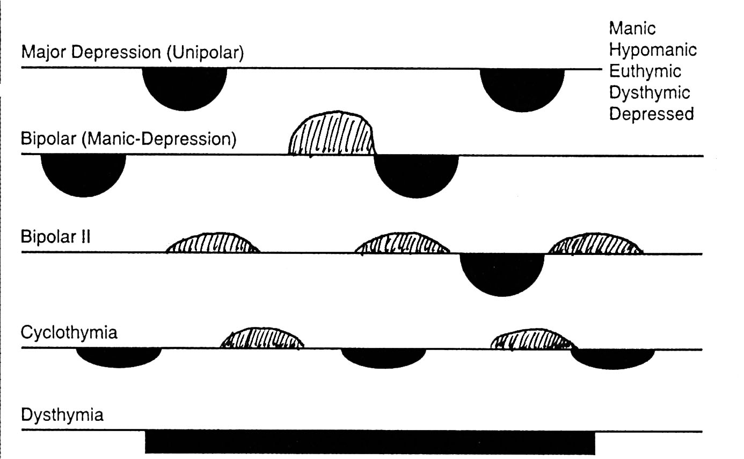

Slide 12
Treatment
Unipolar Depression/
Dysthymia
Similar Pharmacological
Treatment

Slide 13
Depression- Treatment
MAO Inhibitors- 1st Generation: increase of monoamines in synapse
Tranylcypromine- irreversible
inhibitor of MAO-A and B
Uncommon Use- Side Effects
Drug Interactions

Slide 14
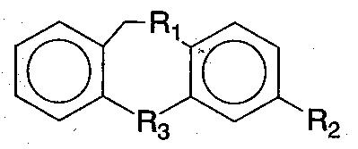
Depression- Treatment
Tricyclic Antidepressants: 2nd Generation
Inhibition of NE, 5-HT, DA
Transporters
Mechanism of Action:Time delay in therapeutic action, neuroadaptive processes are involved.

Slide 15
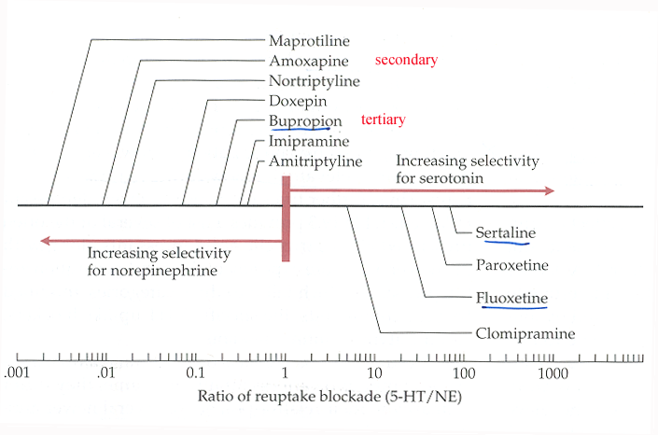
Tricyclic Antidepressants
Range of NE vs. 5-HT pump selectivity
Tertiary Amines: relatively equal
Secondary Amines: NE > 5-HT Selectivity

Slide 16
Tricyclic Antidepressants
Imipramine--> Desipramine
Amitriptylene--> Nortriptylene
Parent Drug + Active Metabolite
if tertiary amine is given

Slide 17
Tricyclic Antidepressants
Side Effects
Sedation: H1-R blockade?
Anticholinergic: M-R blockade
dry mouth, blurred vision
urinary retention/ileus/constipation
sexual dysfunction
delirium/confusion
precipitation of glaucoma

Slide 18
Tricyclic Antidepressants
Side Effects: Cardiovascular
Vascular: α1 blockade
orthostatic hypotension
Cardiac: quinidine-like effects
concentration dependent
T wave flattening or inversion
myocardial depression
arrhythmias (high conc.)

Slide 19
Tricyclic Antidepressants
Drug Interactions
Inhibition of P450 Enzymes
Reduction of AntihypertensiveActions
Reduction of Seizure Threshold
Additive Sedative Effects with Alcohol and other Depressants
Enhancement of Anticholinergics

Slide 20
Tricyclic Antidepressants
Toxicity/Overdose
Narrow therapeutic window
Restrict Rx amount
Overdose may result in:
Hypotension, shock, renal failure
Grand mal seizures
Hyperpyrexia
Conduction disturbances-->
Arrhythmias

Slide 21
Tricyclic Antidepressants
Toxicity/Overdose
Supportive Measures
respiratory, renal, cardiac
Physostigmine
Gastric Lavage
Cooling
Fluid Expansion

Slide 22
Tricyclic Antidepressants
Other Uses
Catalepsy (Narcolepsy)
OCD
Chronic Pain (Migraine)
Panic Disorder
Post-traumatic Stress Disorder
Enuresis
ADHD
Eating Disorders

Slide 23
Depression- Treatment
3rd Generation Antidepressants
Miscellaneous Drugs/Atypical Antidepressants
Heterocyclics
Trazadone
Bupropion
Serotonin Selective Reuptake
Inhibitors (SSRIs)

Slide 24
Misc. Antidepressants/ Atypical Antidepressants
Heterocyclics-
Amoxipine- nonselective
Maprotiline- NE selective
Trazodone (Oleptro)-5-HT selective
atypical , sedating
no antichol. actions
Bupropion- DA selective
smoking cessation, ADHD

Slide 25
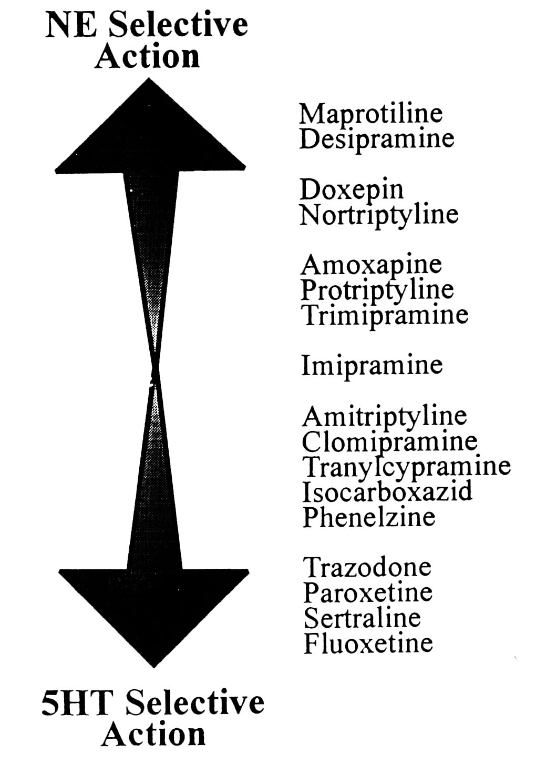

Slide 26
SSRIs
Revolution in the treatment
of depression: Safer!
Less side effects: No Effects on
Cholinergic, Histamine, or
α-adrenergic Receptors
Fluoxetine- Most prescribed antidepressant

Slide 27
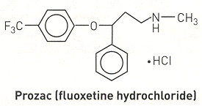
Fluoxetine (Prozac)
Major depression, OCD, bulimia,PMS,
panic disorder
Side Effects:
Headache, Anxiety,Insomnia, Drowsiness
Tremor, Restlessness,Sexual Dysfunction
N, D, Anorexia

Slide 28
Side-Effects of SSRI’s
1. FDA Block Box Warning (2004):
-weak but significant statistical link between SSRI’s and increased risk for suicide in adolescents.
2. Serotonin Syndrome: SSRI’s interaction with MAO inhibitors, altered mental status, fever, agitation, tremor, etc.

Slide 29
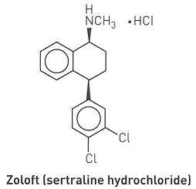
Sertaline (Zoloft)
Major Depression, OCD, PanicDisorder
Side Effects:
N, D, Dyspepsia
Dizziness, Insomnia
Sexual Dysfunction

Slide 30
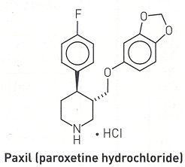
Paroxetine (Paxil)
Major Depression, OCD,Panic Disorder
June 28, 2013- FDA approved use of paroxetine (Brisdelle) for menopausal hot flashes (first non-hormonal treatment)
Side Effects:
N, D,
Insomnia, Headache
Sexual Dysfunction

Slide 31
Other SSRIs and SNRI’s
Citalopram (Celexa): racemic
Mixture
(2011 FDA warning that Celexa (citalopram) should not be used in doses greater than 40 mg per day because it can cause abnormal electrical activity in the heart)
Escitalopram (Lexapro):
S-enantiomer of Citalopram,
(100 X more potent)
..Other SNRI’s: Venlafaxine (Effexor), Duloxetine (Cymbalta)

Slide 32
How to choose an antidepressant?
-History of prior drug response
-Safety
-Side Effect Profile
-Compliance
-Expense
-Mechanism of Action

Slide 33
Bipolar Disorder
Lithium
Acute Mania
Prophylaxis (70% respond)
Side Effects:
Memory problems, weight gain,
tremor, poluria, drowsiness
Hypothyroidism
Cardiac Effects

Slide 34
Bipolar Disorder
-Valproate (anticonvulsant)
-Carbamazepine (anticonvulsant)
-Lamotrignine (anticonvulsant)
-Haloperidol (antipyschotic)
-Add-on agents, aripazole (Abilify),
atypical antipyschotic to help manage
mania

Slide 35
Study Guide
Learning Objectives in HO
(know drugs listed in lecture script and ppt)
FIRST AID
BASIC SCIENCES
2nd Edition
Chapter 6, pp 520-531; Chapter 7

