Slide 1
Hypnotic/Antianxiety Agents
Blanton

Slide 2
Hypnotic Agents
Hypnotic Agents Produce:
-state of drowsiness
-promote onset and maintenance
of sleep
Patient can be awakened readily.
-Treatment of Insomnia

Slide 3
Antianxiety Agents (Anxiolytics)
SSRI’s (fluoxetine) and SNRI’s (venlaflaxine) are first line
treatment for most anxiety disorders.
Since we covered those agents in Antidepressant lecture
today we will focus on other anxiolytic agents.
-Many are also hypnotics.
-Reduce tension, nervousness,
fear, and apprehension.

Slide 4
Insomnia
Short Term: stressor
Long Term:
psychiatric problems
non CNS disorders
misperception
age-related changes
sleep apnea

Slide 5
Hypnotics- Effects on Sleep
All have drawbacks.
Barbs BDZ
latency latency
REM REM
Stages 3 & 4
Some tolerance development

Slide 6
Hypnotics- Effects on Sleep
Tolerance to sleep facilitation.
Barbs- 2 weeks
BDZ- 4-6 weeks
Discontinuation- REBOUND REM
Sleep
Psychological Dependence

Slide 7
Hypnotics- Effects
Rebound insomnia upon
discontinuation
Promotion of psychological
dependence

Slide 8
Hypnotics/ Some Anxiolytics
Mechanisms
-Act at GABA_{A} Receptor
GABA- major CNS inhibitory
neurotransmitter

Slide 9
Hypnotics- GABA_{A}-R
Inhibition of Neuronal Activity
-40 mV
RMP PTX
-70 mV
GABA
-90 mV

Slide 10
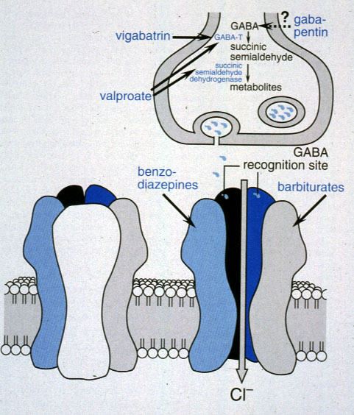
GABA_{A} Receptor

Slide 11
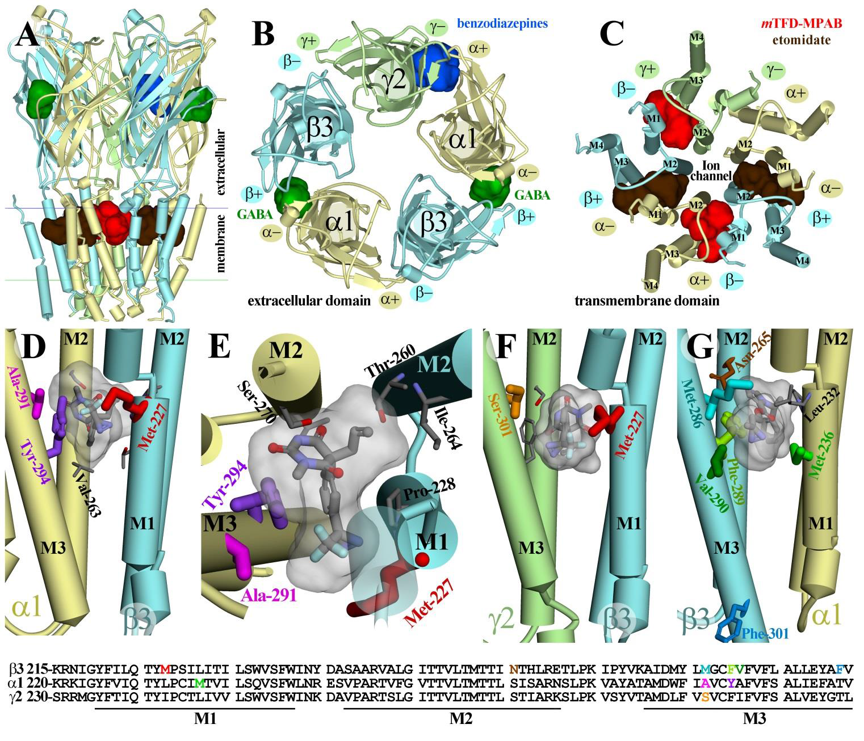
GABA_{A} Receptor

Slide 12
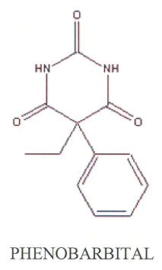
Barbiturates
Widely replaced by benzodiazepines
3 Categories of Barbiturates:
-long-acting (t ½ > 50 hrs)
(e.g. phenobarbital)
-short to intermediate acting
(<50 hrs)(e.g. secobarbital)
-ultrashort acting (< 10 hrs)
(e.g. thiopental)

Slide 13
Barbiturates- Pharmacokinetics
Most Routes
Oral Route- hypnotic
Well absorbed
Lipophilicity, acidosis- CNS entry

Slide 14
Barbiturates- Pharmacokinetics
Termination:
Redistribution- Lipophilicity
Metabolism
Renal Excretion- glucuronides,
phenobarbital- some unchanged

Slide 15
Barbiturate Action: Potentiation vs. Direct Activation
100
GABA + pentobarbital
GABA alone
Barbiturate alone
50
% of Maximal
Response
0
1.5
2.5
3.5
Log Drug

Slide 16
Barbiturates- CNS Effects
-Enhance GABA_{A}-R responses
by prolonging open time
-High doses- open channel
directly
Hyperpolarization……..
NEURONAL INHIBITION

Slide 17
Barbiturates- CNS Effects
-Sedation
-Hypnosis
-Cognitive Impairment
-Anesthesia (Laryngospasm)
-Respiratory Depression
-Death

Slide 18
Barbiturates- CV Effects
Slight decrease in blood pressure
Depression of vasomotor centers
at toxic doses -- > circulatory
collapse

Slide 19
Barbiturates- Hepatic Effects
Induction of P450 Enzymes
Enhanced Metabolism of Barb-
iturates and all drugs metabolized
by P450 Enzymes

Slide 20
Barbiturate Poisoning
-Phenobarbital- Alkalinize urine
-General supportive measures
-Maintain airway/ Give O2
-Consider lavage
-Severe Poisoning- CV, renal
collapse
-NO CNS Stimulants

Slide 21
Benzodiazepines
Have Replaced Barbiturates
Benzodiazepine Advantages
Safer- higher therapeutic index
Tolerance- lower
Addictive liability- lower
Less drug interactions

Slide 22
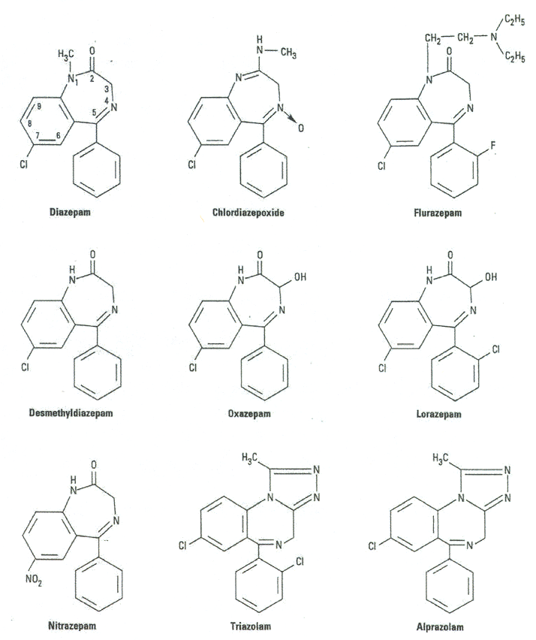
Benzodiazepine structures

Slide 23
Benzodiazepine Action: Potentiation
100
GABA + diazepam
GABA alone
Diazepam alone
50
% of Maximal
Response
0
1.5
2.5
3.5
Log Drug

Slide 24
Benzodiazepines
Agonists
Enhance (potentiate) GABA action
at GABA_{A} Receptors.
-increase frequency of opening
Are NOT GABA mimetics
Hyperpolarize- Enhance Neuronal Inhibition

Slide 25
Benzodiazepine- Categories
-Ultra- short acting (t ½ < 2 hrs)
-Short acting (t ½ < 6 hrs)
-Intermediate Acting ( 6-24 hrs)
-Long Acting (> 24 hrs)
Interchangeable
Half-life determines use

Slide 26
Benzodiazepines
Parent Compound and Metabolite(s)
pharmacologically active?
Duration of all active compounds
must be taken into consideration.

Slide 27
Ideal Hypnotic
Short Acting- facilitate sleep
and keep patient asleep
Short Acting BDZ Problems
-early AM awakening
-anxiety
-rebound insomnia

Slide 28
Side Effects and Toxicity
Mostly Psychomotor and Cognitive
More apparent in the elderly
High therapeutic index- usually not lethal

Slide 29
General Uses of Benzodiazepines
-Anxiety- w/ or w/o Depression
-Hypnosis
-Panic Disorders
-Spasticity
-Premedication for Surgery
-Alcohol Withdrawal
-Adjunct in disorders where
-anxiety may worsen condition

Slide 30
Flumazenil
Benzodiazepine Antagonist
-No activity in its own right
-Reverse the effects of ingested
or administered BDZ agonists
-Ineffective for most other sedatives

Slide 31
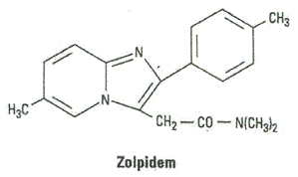
Zolpidem (Ambien)
Structurally not a benzodiazepine, but binds
to same site on GABA_{A}R as benzodiazepines.
-Good hypnotic, with less effects on stages of sleep
-Low incidence of rebound insomnia,
daytime sedation

Slide 32
Zolpidem (Ambien)
Sex and Gender-Specific Medicine:
May 15, 2013 The FDA approved lower recommended doses for Ambien (zolpidem) in women following studies that showed that women metabolize the drug more slowly (~40%) than do men, resulting in far more adverse events being reported.
The underlying mechanism for difference is not known. It is also likely that new dosing recommendations will be approved for other non-benzodiazepine hypnotics (lunesta, sonata,etc).

Slide 33
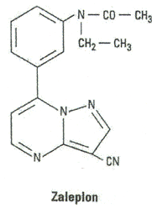
Zaleplon (Sonata)
Structurally not a benzodiazepine, but binds
to same site on GABAAR as benzodiazepines
-Good hypnotic, with less
effects on stages of sleep
-Low incidence of rebound
insomnia, daytime sedation
-Short half-life ~ 1 hour

Slide 34
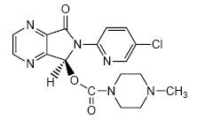
Eszopicline (Lunesta)
Structurally not a benzodiazepine, but binds
to same site on GABAAR as benzodiazepines
-Good hypnotic, with less
effects on stages of sleep
-Low incidence of rebound
insomnia, daytime sedation
-Short half-life ~ 1 hour

Slide 35
Chloral Hydrate
Metabolized to trichloroethanol
-Short duration
-No enzyme induction
-Tolerance/Dependence
Withdrawal can be severe

Slide 36
Buspirone
-Atypical Anxiolytic
-NOT A HYPNOTIC
-Not a GABA_{A}-R drug
-Acts at 5-HT1A and DA-2 receptor
-Cannot substitute for a BDZ
-Does not produce tolerance
and physical dependence

Slide 37
Ramelteon (ram el’ tee on)
-Hypnotic
-Not a GABA_{A}-R drug
-Not a controlled substance
-Agonist for melatonin MT1receptor
-which promotes onset of sleep
-Does not produce tolerance
and physical dependence
-Well tolerated, nausea/vomiting

Slide 38
Suvorexant (Belsomra- Merck 2014)
-Hypnotic
-Not a GABA_{A}-R drug
-Not a controlled substance
-Antagonist for orexin receptor
-which promotes onset of sleep
-Does not produce tolerance
and physical dependence
-day after somnolence-sometime severe

Slide 39
Miscellaneous Anxiolytics
Meprobamate- RARELY if
ever used. Similar to Barbs.
Beta- Blockers- useful in
alleviating performance anxiety.

Slide 40
Skeletal Muscle Relaxants
Baclofen- GABA_{B} receptor drug:
-inhibitory at cord and brain
-Antispasmodic useful in treatment of
multiple sclerosis or spinal injury
Not an Anxiolytic
Few side effects

Slide 41
Skeletal Muscle Relaxants
Dantrolene
-reduces spasticity
-interferes with Ca²⁺ release in
skeletal muscle
useful in malignant hyperthermia
due to general anesthetics

Slide 42
Study Guide
Know sedative/hypnotics’effects on
stages of sleep and their interaction with the GABA_{A}-R.
2) Know advantages of benzodiazepines over barbiturates.
3) Know that barbs enhance P450 metabolism and understand the consequences.

Slide 43
Study Guide
4) Know the significance of half lives
for benzodiazepines.
5) Drug list (those drugs listed in lecture script and ppt): uses, metabolism,
side effects, duration of action.
FIRST AID
BASIC SCIENCES
2nd Edition
Chapter 6: pp 517-519; Chapter 7

