Slide 1
Obsessive Compulsive and Related Disorders AND Post Traumatic Stress Disorder
David RM Trotter, PhD
Associate Professor

Slide 2
Objectives
By the end of this presentation, students will be able to:
  Identify the major Obsessive-Compulsive and Related Disorders
  Discuss the key characteristics of each disorder discussed
  Differentiate these disorders from other anxiety related disorders

Slide 3
Agenda
Review the Major Obsessive-Compulsive and Related Disorders
  Obsessive-Compulsive Disorder
  Body Dysmorphic Disorder
  Hoarding Disorder
  Trichotillomania (Hair-Pulling Disorder)
  Excoriation (Skin-Picking) Disorder
Review PTSD and Stress Disorders

Slide 4
Obsessive-Compulsive Disorder
Presence of obsessions, compulsions, or both:
  Obsessions are defined by (1) and (2):
  Recurrent and persistent thoughts, urges, or images that are experienced, at some time during the disturbance, as intrusive and unwanted, and that in most individuals cause marked anxiety or distress.
  The individual attempts to ignore or suppress such thoughts, urges, or images, or to neutralize them with some other thought or action (i.e., by performing a compulsion).
  Compulsions are defined by (1) and (2):
  Repetitive behaviors (e.g., hand washing, ordering, checking) or mental acts (e.g., praying, counting, repeating words silently) that the individual feels driven to perform in response to an obsession or according to rules that must be applied rigidly.
  The behaviors or mental acts are aimed at preventing or reducing anxiety or distress, or preventing some dreaded event or situation; however, these behaviors or mental acts are not connected in a realistic way with what they are designed to neutralize or prevent, or are clearly excessive.
  Note: Young children may not be able to articulate the aims of these behaviors or mental acts.
The obsessions or compulsions are time-consuming (e.g., take more than 1 hour per day) or cause clinically significant distress or impairment in social, occupational, or other important areas of functioning.
The obsessive-compulsive symptoms are not attributable to the physiological effects of a substance (e.g., a drug of abuse, a medication) or another medical condition.
The disturbance is not better explained by the symptoms of another mental disorder.

Slide 5
Obsessive-Compulsive Disorder (continued)
Specify if:
With good or fair insight: The individual recognizes that obsessive-compulsive disorder beliefs are definitely or probably not true or that they may or may not be true.
With poor insight: The individual thinks obsessive-compulsive disorder beliefs are probably true.
With absent insight/delusional beliefs: The individual is completely convinced that obsessive-compulsive disorder beliefs are true.
Specify if:
Tic-related: The individual has a current or past history of a tic disorder.

Slide 6




Slide 7
Obsessive-Compulsive Disorder (continued)
Psychological Treatments: Cognitive Behavioral Therapy
  CBT
  Exposure and Response Prevention
  Acceptance and Commitment Therapy

Slide 8
Body Dysmorphic Disorder
Preoccupation with one or more perceived defects or flaws in physical appearance that are not observable or appear slight to others.
At some point during the course of the disorder, the individual has performed repetitive behaviors (e.g., mirror checking, excessive grooming, skin picking, reassurance seeking) or mental acts (e.g., comparing his or her appearance with that of others) in response to the appearance concerns.
The preoccupation causes clinically significant distress or impairment in social, occupational, or other important areas of functioning.
The appearance preoccupation is not better explained by concerns with body fat or weight in an individual whose symptoms meet diagnostic criteria for an eating disorder.

Slide 9
Body Dysmorphic Disorder (continued)
Specify if:
  With muscle dysmorphia: The individual is preoccupied with the idea that his or her body build is too small or insufficiently muscular. This specifier is used even if the individual is preoccupied with other body areas, which is often the case.
Specify if:
  Indicate degree of insight regarding body dysmorphic disorder beliefs (e.g., “I look ugly” or “I look deformed”).
    With good or fair insight: The individual recognizes that the body dysmorphic disorder beliefs are definitely or probably not true or that they may or may not be true.
    With poor insight: The individual thinks that the body dysmorphic disorder beliefs are probably true.
    With absent insight/delusional beliefs: The individual is completely convinced that the body dysmorphic disorder beliefs are true.
Notes:
any individuals with body dysmorphic disorder have ideas or delusions of reference, believing that other people take special notice of them or mock them because of how they look(Phillips et al. 2008). Body dysmorphic disorder is associated with high levels of anxiety, social anxiety, social avoidance, depressed mood, neuroticism, and perfectionism as well as low extroversion and low self-esteem(Buhlmann et al. 2010; Phillips and McElroy 2000; Phillips et al. 2010b). Many individuals are ashamed of their appearance and their excessive focus on how they look, and are reluctant to reveal their concerns to others(Conroy et al. 2008; Grant et al. 2001). A majority of individuals receive cosmetic treatment to try to improve their perceived defects(Crerand and Sarwer 2010). Dermatological treatment and surgery are most common, but any type (e.g., dental, electrolysis) may be received(Crerand et al. 2005;Phillips et al. 2001). Occasionally, individuals may perform surgery on themselves(Crerand and Sarwer 2010). Body dysmorphic disorder appears to respond poorly to such treatments and sometimes becomes worse(Crerand and Sarwer 2010). Some individuals take legal action or are violent toward the clinician because they are dissatisfied with the cosmetic outcome.
Body dysmorphic disorder has been associated with executive dysfunction and visual processing abnormalities, with a bias for analyzing and encoding details rather than holistic or configural aspects of visual stimuli(Dunai et al. 2010; Feusner et al. 2010;Feusner et al. 2011; Hanes 1998; Phillips et al. 2010a). Individuals with this disorder tend to have a bias for negative and threatening interpretations of facial expressions and ambiguous scenarios(Phillips et al. 2010a).

Slide 10

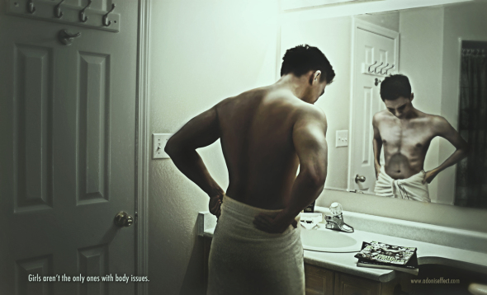


Slide 11
Body Dysmorphic Disorder (continued)
Prevalence:
  Point prevalence among U.S. adults is 2.4%
    2.5% in females
    2.2% in males
  9%–15% among dermatology patients
  7%–8% among U.S. cosmetic surgery patients
  8% among adult orthodontia patients
  10% among patients presenting for oral or maxillofacial surgery
Development and Course
  Mean age at disorder onset is 16–17 years
  Chronic course, but can respond well to evidence based treatments

Slide 12
Body Dysmorphic Disorder (continued)
Environmental Factors: Associated with higher rates of childhood abuse and neglect.
Genetic Factors: Prevalence is elevated among those with a first-degree relative with OCD
Gender Difference: Largely same presentation between men and women, except…
  Men more likely to have preoccupation with genitals
  Women more likely to have comorbid eating disorder

Slide 13
Hording Disorder
Persistent difficulty discarding or parting with possessions, regardless of their actual value.
This difficulty is due to a perceived need to save the items and to distress associated with discarding them.
The difficulty discarding possessions results in the accumulation of possessions that congest and clutter active living areas and substantially compromises their intended use. If living areas are uncluttered, it is only because of the interventions of third parties (e.g., family members, cleaners, authorities).
The hoarding causes clinically significant distress or impairment in social, occupational, or other important areas of functioning (including maintaining a safe environment for self and others).
The hoarding is not attributable to another medical condition (e.g., brain injury, cerebrovascular disease, Prader-Willi syndrome).
The hoarding is not better explained by the symptoms of another mental disorder (e.g., obsessions in obsessive-compulsive disorder, decreased energy in major depressive disorder, delusions in schizophrenia or another psychotic disorder, cognitive deficits in major neurocognitive disorder, restricted interests in autism spectrum disorder).

Slide 14
Hording Disorder (continued)
Specify if:
  With excessive acquisition: If difficulty discarding possessions is accompanied by excessive acquisition of items that are not needed or for which there is no available space.
Specify if:
  With good or fair insight: The individual recognizes that hoarding-related beliefs and behaviors (pertaining to difficulty discarding items, clutter, or excessive acquisition) are problematic.
  With poor insight: The individual is mostly convinced that hoarding-related beliefs and behaviors (pertaining to difficulty discarding items, clutter, or excessive acquisition) are not problematic despite evidence to the contrary.
  With absent insight/delusional beliefs: The individual is completely convinced that hoarding-related beliefs and behaviors (pertaining to difficulty discarding items, clutter, or excessive acquisition) are not problematic despite evidence to the contrary.

Slide 15

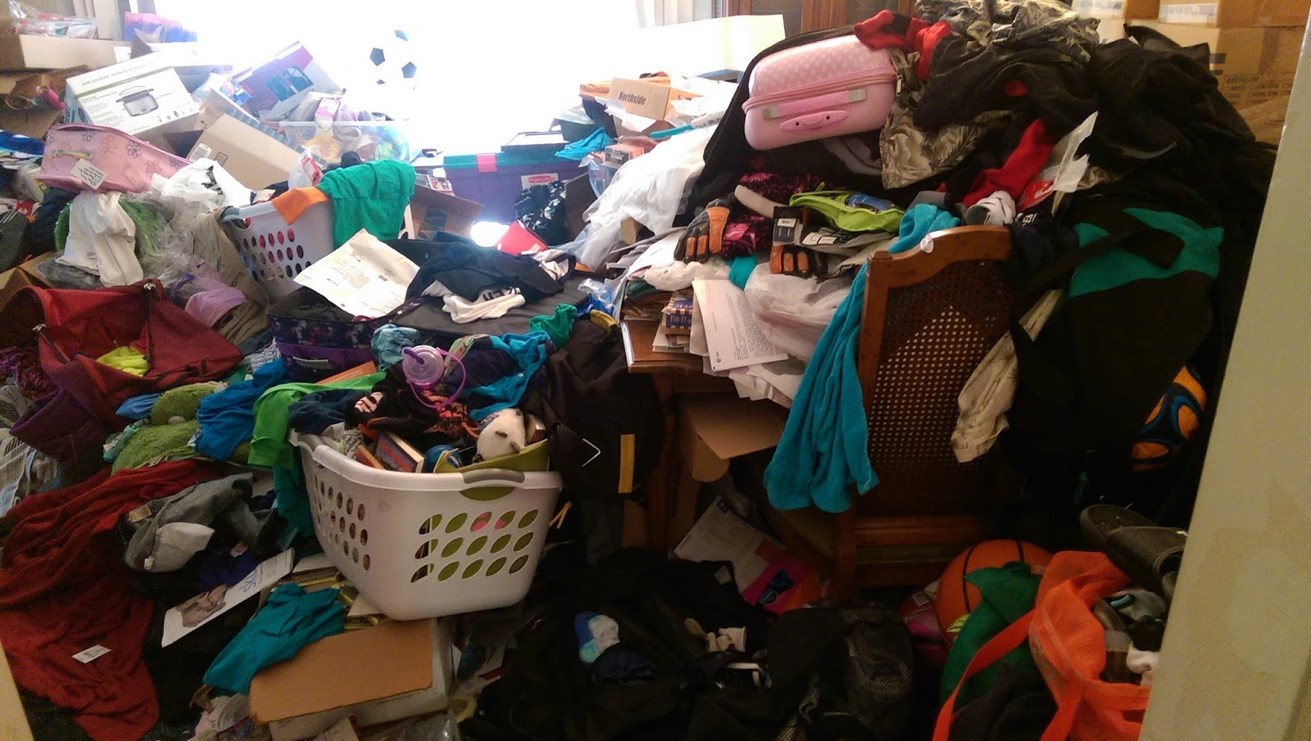
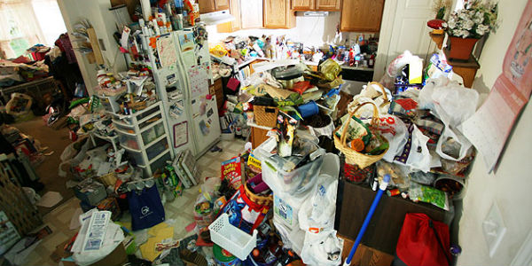

Slide 16
Hording Disorder (continued)
Point Prevalence: United States and Europe about 2%–6%
Three times more prevalent in older adults (ages 55–94 years) compared with younger adults (ages 34–44 years)
Can see signs in childhood, but it gets progressively more severe
Environmental Factors: Likely preceded by a stressful/traumatic event
50% of individuals who hoard reporting having a relative who hoards.
In twin studies, 50% of the variability in hoarding behavior is attributable to genetic factors

Slide 17
Trichotillomania (Hair-Pulling Disorder)
Recurrent pulling out of one’s hair, resulting in hair loss.
Repeated attempts to decrease or stop hair pulling.
The hair pulling causes clinically significant distress or impairment in social, occupational, or other important areas of functioning.
The hair pulling or hair loss is not attributable to another medical condition (e.g., a dermatological condition).
The hair pulling is not better explained by the symptoms of another mental disorder (e.g., attempts to improve a perceived defect or flaw in appearance in body dysmorphic disorder).

Slide 18

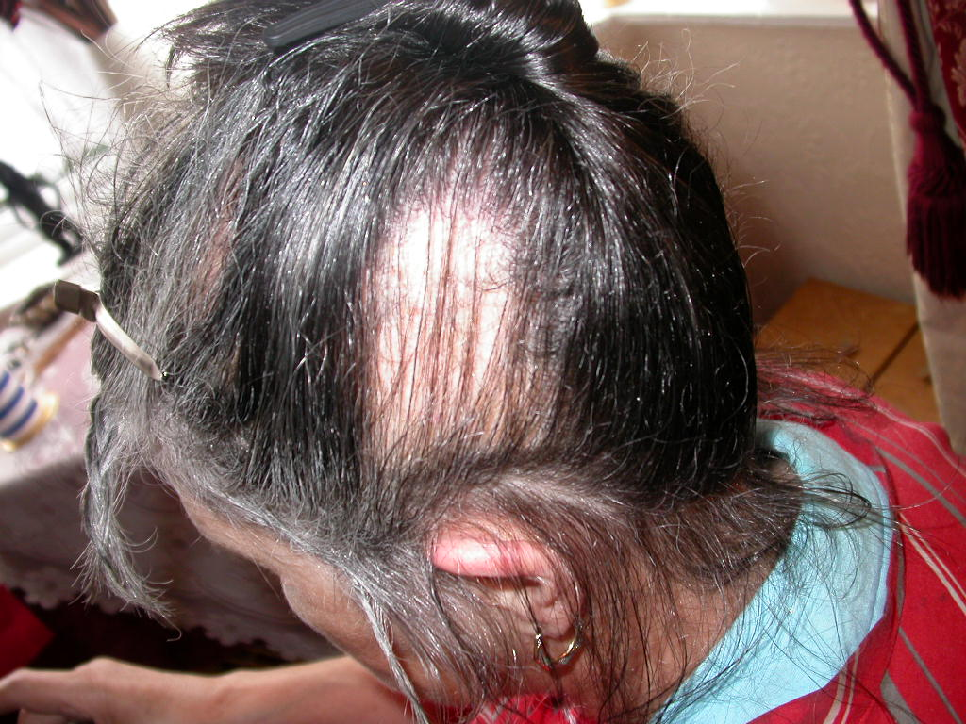


Slide 19
Trichotillomania (Hair-Pulling Disorder)
2-month prevalence estimate for trichotillomania in adults and adolescents is 1%–2%
10:1 Female to Male ratio
Typically chronic waxing and waning, unless treated
More common among those with a 1st degree relative with OCD

Slide 20
Excoriation (Skin-Picking) Disorder
Recurrent skin picking resulting in skin lesions.
Repeated attempts to decrease or stop skin picking.
The skin picking causes clinically significant distress or impairment in social, occupational, or other important areas of functioning.
The skin picking is not attributable to the physiological effects of a substance (e.g., cocaine) or another medical condition (e.g., scabies).
The skin picking is not better explained by symptoms of another mental disorder (e.g., delusions or tactile hallucinations in a psychotic disorder, attempts to improve a perceived defect or flaw in appearance in body dysmorphic disorder, stereotypies in stereotypic movement disorder, or intention to harm oneself in nonsuicidal self-injury).

Slide 21
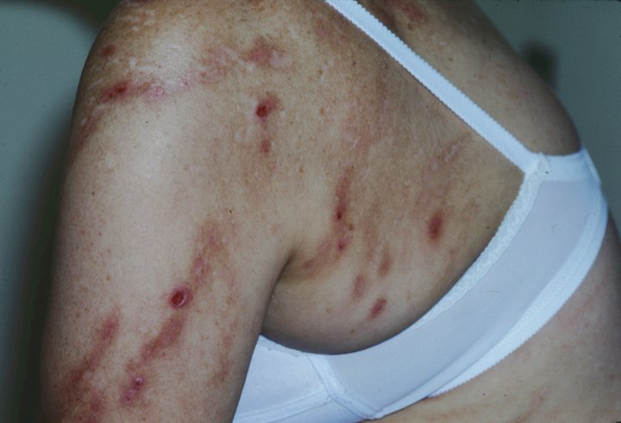
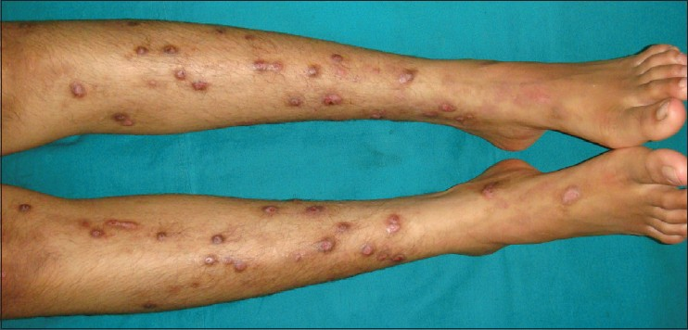

Slide 22
Excoriation Disorder (continued)
Lifetime prevalence for excoriation disorder in adults is 1.4%
Three-quarters or more of individuals with the disorder are female
Onset common with puberty and dermatological changes (ache)
Chronic waxing and waning if untreated
Genetic Factors: More common among those with OCD or their 1st degree relatives

Slide 23
Post Traumatic Stress Disorder (PTSD)
Exposure to actual or threatened death, serious injury, or sexual violence in one (or more) of the following ways:
  Directly experiencing the traumatic event(s).
  Witnessing, in person, the event(s) as it occurred to others.
  Learning that the traumatic event(s) occurred to a close family member or close friend. In cases of actual or threatened death of a family member or friend, the event(s) must have been violent or accidental.
  Experiencing repeated or extreme exposure to aversive details of the traumatic event(s) (e.g., first responders collecting human remains; police officers repeatedly exposed to details of child abuse).
    Note: Criterion A4 does not apply to exposure through electronic media, television, movies, or pictures, unless this exposure is work related.
Presence of one (or more) of the following intrusion symptoms associated with the traumatic event(s), beginning after the traumatic event(s) occurred:
  Recurrent, involuntary, and intrusive distressing memories of the traumatic event(s).
    Note: Spontaneous and intrusive memories may not necessarily appear distressing and may be expressed as play reenactment.
  Recurrent distressing dreams in which the content and/or affect of the dream are related to the traumatic event(s).
    Note: It may not be possible to ascertain that the frightening content is related to the traumatic event.
  Dissociative reactions (e.g., flashbacks) in which the child feels or acts as if the traumatic event(s) were recurring. (Such reactions may occur on a continuum, with the most extreme expression being a complete loss of awareness of present surroundings.) Such trauma-specific reenactment may occur in play.
  Intense or prolonged psychological distress at exposure to internal or external cues that symbolize or resemble an aspect of the traumatic event(s).
  Marked physiological reactions to reminders of the traumatic event(s)
Persistent avoidance of stimuli associated with the traumatic event(s), beginning after the traumatic event(s) occurred, as evidenced by one or both of the following:
  Avoidance of or efforts to avoid distressing memories, thoughts, or feelings about or closely associated with the traumatic event(s).
  Avoidance of or efforts to avoid external reminders (people, places, conversations, activities, objects, situations) that arouse distressing memories, thoughts, or feelings about or closely associated with the traumatic event(s).

Slide 24
Post Traumatic Stress Disorder (Continued)
Negative alterations in cognitions and mood associated with the traumatic event(s), beginning or worsening after the traumatic event(s) occurred, as evidenced by two (or more) of the following:
  Inability to remember an important aspect of the traumatic event(s) (typically due to dissociative amnesia and not to other factors such as head injury, alcohol, or drugs).
  Persistent and exaggerated negative beliefs or expectations about oneself, others, or the world (e.g., “I am bad,” “No one can be trusted,” “The world is completely dangerous,” “My whole nervous system is permanently ruined”).
  Persistent, distorted cognitions about the cause or consequences of the traumatic event(s) that lead the individual to blame himself/herself or others.
  Persistent negative emotional state (e.g., fear, horror, anger, guilt, or shame).
  Markedly diminished interest or participation in significant activities.
  Feelings of detachment or estrangement from others.
  Persistent inability to experience positive emotions (e.g., inability to experience happiness, satisfaction, or loving feelings).
Marked alterations in arousal and reactivity associated with the traumatic event(s), beginning or worsening after the traumatic event(s) occurred, as evidenced by two (or more) of the following:
  Irritable behavior and angry outbursts (with little or no provocation) typically expressed as verbal or physical aggression toward people or objects.
  Reckless or self-destructive behavior.
  Hypervigilance.
  Exaggerated startle response.
  Problems with concentration.
  Sleep disturbance (e.g., difficulty falling or staying asleep or restless sleep).
Duration of the disturbance (Criteria B, C, D, and E) is more than 1 month.
The disturbance causes clinically significant distress or impairment in social, occupational, or other important areas of functioning.
The disturbance is not attributable to the physiological effects of a substance (e.g., medication, alcohol) or another medical condition.

Slide 25
Post Traumatic Stress Disorder (Continued)
Specify whether:
  With dissociative symptoms: The individual’s symptoms meet the criteria for posttraumatic stress disorder, and in addition, in response to the stressor, the individual experiences persistent or recurrent symptoms of either of the following:
    Depersonalization: Persistent or recurrent experiences of feeling detached from, and as if one were an outside observer of, one’s mental processes or body (e.g., feeling as though one were in a dream; feeling a sense of unreality of self or body or of time moving slowly).
    Derealization: Persistent or recurrent experiences of unreality of surroundings (e.g., the world around the individual is experienced as unreal, dreamlike, distant, or distorted).
    Note: To use this subtype, the dissociative symptoms must not be attributable to the physiological effects of a substance (e.g., blackouts, behavior during alcohol intoxication) or another medical condition (e.g., complex partial seizures).
Specify if:
  With delayed expression: If the full diagnostic criteria are not met until at least 6 months after the event (although the onset and expression of some symptoms may be immediate).

Slide 26




Slide 27
Post Traumatic Stress Disorder (Continued)
Lifetime risk for PTSD using DSM-IV criteria at age 75 years is 8.7%
12 month prevalence among U.S. adults is about 3.5%
Can be chronic if untreated
Risk Factors: Pretraumatic factors
  Temperamental: These include childhood emotional problems by age 6 years and prior mental disorders.
  Environmental: These include lower socioeconomic status; lower education; exposure to prior trauma; childhood adversity (e.g., economic deprivation, family dysfunction, parental separation or death); cultural characteristics (e.g., fatalistic or self-blaming coping strategies); lower intelligence; minority racial/ethnic status; and a family psychiatric history. Social support prior to event exposure is protective.
  Genetic and physiological: These include female gender and younger age at the time of trauma exposure (for adults). Certain genotypes may either be protective or increase risk of PTSD after exposure to traumatic events.

Slide 28
Post Traumatic Stress Disorder (Continued)
Risk Factors: Peritraumatic factors
  Environmental: These include severity (dose) of the trauma (the greater the magnitude of trauma, the greater the likelihood of PTSD), perceived life threat, personal injury, interpersonal violence (particularly trauma perpetrated by a caregiver or involving a witnessed threat to a caregiver in children) and, for military personnel, being a perpetrator, witnessing atrocities, or killing the enemy. Finally, dissociation that occurs during the trauma and persists afterward is a risk factor.

Slide 29
Post Traumatic Stress Disorder (Continued)
Risk Factors: Posttraumatic factors
  Temperamental: These include negative appraisals, inappropriate coping strategies, and development of acute stress disorder.
  Environmental: These include subsequent exposure to repeated upsetting reminders, subsequent adverse life events, and financial or other trauma-related losses. Social support (including family stability, for children) is a protective factor that moderates outcome after trauma.
More common among Women

Slide 30
Post Traumatic Stress Disorder (Continued)
Psychological Treatments
  Cognitive Processing Therapy for Post-Traumatic Stress Disorder
  Prolonged Exposure Therapy for Post-Traumatic Stress Disorder
  Cognitive Therapy
  Cognitive Behavioral Therapy

Slide 31
Questions???

Slide 32
References
American Psychiatric Association. (2013). Diagnostic and statistical manual of mental disorders (5th ed.). Arlington, VA: American Psychiatric Publishing.
American Psychological Association Division 12 at https://www.div12.org/diagnoses (downloaded 10-22-2018)

