Slide 1
Antipsychotic Drugs
0
Michael P. Blanton Ph.D.
Department of Pharmacology and Neuroscience
Texas Tech University Health Sciences Center
Lubbock, TX.

Slide 2
Antipsychotic Drugs ; Learning Objectives:
0
1. Discuss role of dopamine and serotonin in the
pathophysiology of psychotic disorders.
2. Describe some of the consequences of dopamine
blockade, here we will talk about Extrapyramidal Symptoms
and Neuroleptic Malignant Syndrome .
3. List drugs used in the treatment of psychotic disorders,
grouped as “typical” (high vs low Potency) and “atypical”
4. Discuss the mechanism of action, selection and adverse
effects of each of the antipsychotic drugs.
5. Compare and contrast differences in typical and atypical
antipsychotic drugs.
6. Describe the “mood-stabilizing” effects of lithium, its low
therapeutic index and associated adverse effects and the
now commonly used mood-stabilizers, valproic acid and
carbamazepine.

Slide 3
Psychotic Disorders:
0
Long time theory rests on dopamine driven pathology.
It is now clear that multiple receptor/neurotransmitter systems are involved, including both dopamine and serotonergic mechanisms, and likely glutamate receptors are also involved.
A simplistic view is that increased dopamine/ serotonin results in psychosis; decreased dopamine/ serotonin results in depression
DSM-V:
Positive symptoms- delusions, hallucinations, disorganized speech/ thought, catatonic behavior, bizarre behaviors
Negative symptoms- (neurovegetative)- flat affect, poor eye contact and lack of goal-directed activity.
Most patients exhibit both types of symptoms

Slide 4
Antipsychotic Drugs:
0
Other names: neuroleptics, antischizophrenia drugs, antipsychotic, and major tranquilizers)-
Used to treat schizophrenia and other psychotic states
Side note: Electroconvulsive Therapy (ECT) is a very effective treatment for schizophrenia and other psychotic disorders, but is very expensive and generally reserved for patients that don’t respond well to antipsychotic drug treatment.
MOA : older neuroleptic drugs “Typical Antipsychotics” are competitive blockers of dopamine receptors (D2)
MOA : newer agents “Atypical Antipsychotics” are blockers of serotonin receptors (5HT2A) and to a lesser extent dopamine receptors (D2)
-The antipsychotic drugs also relieve the manic phase of bipolar affective disorder.
-Many also block muscarinic, alpha adrenergic and histamine receptors to a varying degrees
-These medications do not cure the underlying disease but they may permit the psychotic patient to function.
-All have Equivalent Therapeutic Efficacies. This is certainly the case for treating the positive symptoms, there is some evidence that the atypicals may be slightly more effective in treating the negative symptoms

Slide 5
0
Antipsychotic Drug List:
First generation Antipsychotic Agents (Low Potency):
  Chlorpromazine – Prototype
  Prochlorperizine (Compazine)
  Thioridazine (Mellaril)
First generation Antipsychotic Agents (High Potency):
  Fluphenazine (Prolixin)
  Haloperidol (Haldol)
  Thiothixene (Navane)
Miscellaneous
  Pimozide (Orap) only used for Tourette’s Syndrome
Second Generation Antipsychotic Agents“Atypical”:
  Clozapine (Clozaril )
  Risperidone (Resperdal )
  Olanzapine ( Zyprexa)
  Quetiapine (Seroquel)
  Ziprasidone (Geodone)
  Aripiprazole (Abilify)

Slide 6
0
Antipsychotic Drug Actions:
All reduce “positive” symptoms hallucinations and agitation by blocking dopamine receptors
  First generation most effective against “positive” symptoms.
  Newer (atypical) agents are arguably more effective in treating “negative” symptoms
  The antipsychotic effects take several weeks to be effective
  Calming effect (“Tranquilizers”)
  Used to handle agitated and disruptive behavior, parenteral
  administration for acute agitation
  Reduce spontaneous physical movement

Slide 7
0
Other actions that can be useful:
Antiemetic effect:
  Due to blockage of D2 in the chemoreceptor trigger zone (CTZ) of the medulla
  Second generation less effective
Anticholinergic effects:
  Helps minimize the risk of extra pyramidal symptoms (EPS) with first generation
Intractable Hiccups: (Chlorpromazine)
Pain control: (No Analgesic Effect!)

Slide 8
Adverse Effects of Dopamine Blockade
0
Typical >>Atypical: Haloperidol (high potency), Fluphenazine > Thioridazine, Chlorpromazine >> Risperidone, Clozapine
80% show adverse effects but therapeutic index is high
  Use lowest dose possible
Extra Pyramidal Symptoms-(EPS)- dopamine/ acetylcholine imbalance.
  Akathisia- feeling of restlessness, inability to sit still.
  Parkinson’s Like Disease (bradykinesia (slow moving, tremor, rigidity)
  Tardive Dyskinesia (TD) – stereotyped, repetitive oral facial dyskinesia, choreiform movements of limbs. (May be irreversible )
  Agents with higher potency for D2 receptor have greater propensity to induce EPS
  For agents with high EPS, can use antimuscarinic drugs(blunts excitatory tone).
Gynecomastia, amenorrhea and galactorrhea- prolactin release increased with D2 blockade.

Slide 9
Adverse Effects of Dopamine Blockade, Neuroleptic Malignant Syndrome:
Idiosyncratic (might develop after 2 weeks or 20 years of antipsychotic drug treatment)
Rare (0.5-1% receiving high potency neuroleptics)
Potentially fatal (mortality rate as high as 20%).
Presentation:
  Stupor,
  High fever,
  autonomic instability – hypertension, altered pulse rate
  muscle rigidity,
  stress leukocytosis (not related to infection),
  diaphoresis (sweating)
  elevated creatinine kinase.

Slide 10
Other Adverse Effects:
0
Anticholinergic (antimuscarinic):
  Xerostomia (dry mouth), urinary retention, constipation, Loss of accommodation, aggravation of glaucoma
Antiadrenergic (α1R blockade) :
  orthostatic hypotension, sexual dysfunction
Antihistaminic (H1R blockade):
  sedation
Antiserotonergic:
  weight gain, more prominent with atypicals
Diabetes Mellitus:
  hyperglycemia, more prominent with atypicals

Slide 11
0
Cautions/Warnings:
FDA Black Box – not to be used for dementia-related psychosis- increased risk of mortality in elderly dementia patients.
May cause drowsiness
Avoid alcohol and other depressants
  Acute agitation with alcohol may be aggravated with neuroleptics – benzodiazepines are preferred
Do not give to patients with glaucoma or prostatic hypertrophy
Caution in CVD or hepatic disease
Safety in pregnancy has not been established (Class C)

Slide 12
0
Chlorpromazine (Thorazine)
Introduced in 1959, First generation (low potency), antipsychotic
Uses:
  Antipsychotic,
  control manifestations of mania,
  intractable hiccups
(not used much anymore due to side effects)
Highest occurrence of sedation

Slide 13
0
Haloperidol (Haldol)
Introduced in 1967, First generation (high potency), antipsychotic
Uses:
Antipsychotic:
Recommended first-line drug for treatment of schizophrenia
for treating Acute agitation (rapid acting).
Common Extra-Pyramidal-Syndrome (EPS) due to dopamine
receptor
Blockade and low anticholinergic action.
Less drowsiness than other antipsychotics
Caution Neuroleptic malignant Syndrome
Available as po, im, decanoate (IM depot).

Slide 14
Fluphenazine (Prolixin)
0
Introduced in 1959, First generation (high potency), antipsychotic
Uses:
Antipsychotic:
Good in patients refusing oral medications because it
comes in depot injection (4 weeks)
Available as IM, decanoate (depot).

Slide 15
Pimozide (Orap)
0
Miscellaneous category- approved in1985 for Tourette’s syndrome
Use:
  Tourette’s syndrome
  used for suppression of motor and phonic tics
  second line after failure to respond to haloperidol
Contraindications:
  congenital long QT interval syndrome & long history of cardiac arrhythmias

Slide 16
Atypical Antipsychotics:
Becoming the drugs of choice for treatment of Psychosis
High affinity as 5-HT_{2A} (serotonin) receptor antagonists or partial agonists, but also are Dopamine D₂ receptor antagonists or partial agonists.
Bind less avidly to D₂ receptors in the striatum and hypothalamus than
the conventional antipsychotics therefore produce less EPS and
endocrine disturbance.
Somewhat better therapeutic profile
Appear to improve cognitive function as compared to conventional drugs.

Slide 17
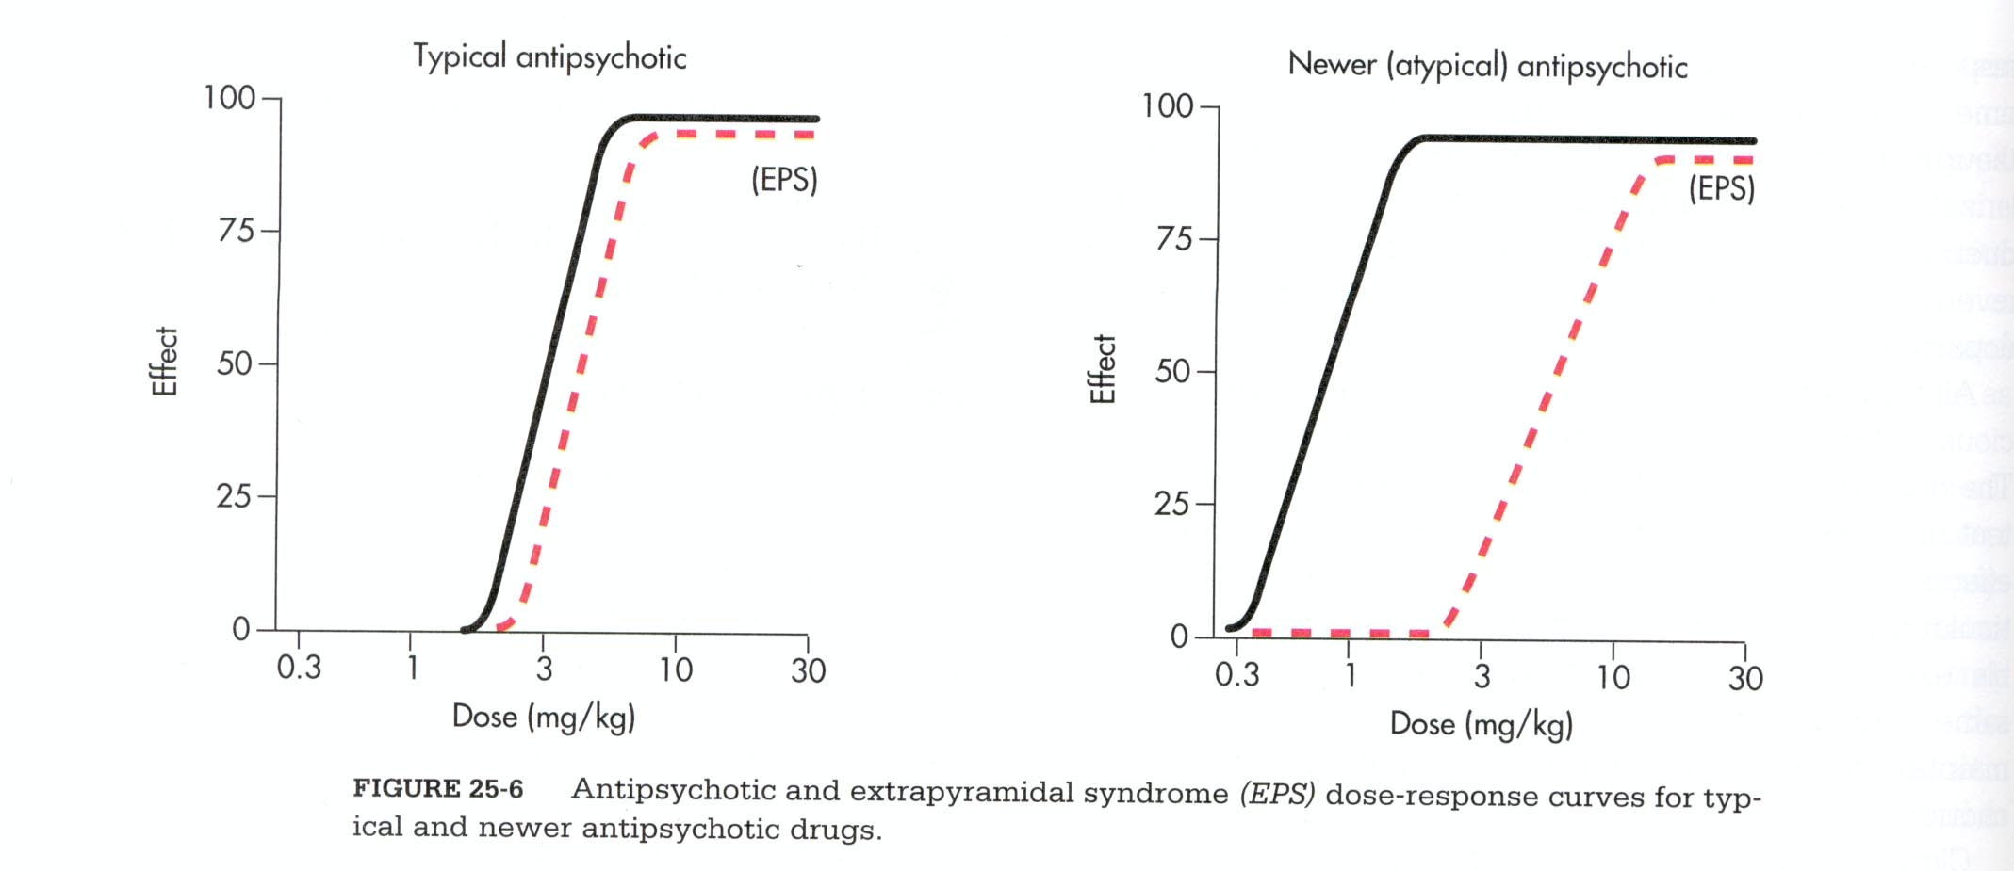

Slide 18
Atypical Antipsychotics
0
Clozapine (Clozaril), 1989
Risperidone (Risperdal), 1994
Olanzapine (Zyprexa), 1996
Quetiapine (Seroquel), 1997
Ziprasidone (Geodon), 2001
Aripiprazole (Abilify), 2002 (5-HT2A and D2 receptor partial agonists)
Paliperidone (Invega), 2006
Asenapine (Saphris), 2009; Lurasidone (Latuda), 2010; …….

Slide 19
0
Atypical Antipsychotics: Clozapine (Clozaril):
Use: Antipsychotic (very effective)
Excellent for negative symptoms.
Low risk for EPS or tardive dyskinesia.
Reserved for refractory patients due to High risk for agranulocytosis (can be deadly). Must have weekly CBC.
Last resort but Drug of Choice (DOC) for refractive schizophrenia

Slide 20
0
Atypical Antipsychotics: Risperiodone (Risperdal):
USE: Antipsychotic with fewer side effects than Clozapine, No agranulocytosis risk.
1st line therapy
Paliperidone (Invega)– major metabolite
Adverse Effects – weight gain, orthostatic hypotension and reflex tachycardia at start of treatment Fewer problems with EPS and TD

Slide 21
0
Atypical Antipsychotics:
Olanzapine (Zyprexa)*
  Weight gain is a major problem – 30% of patients on olanzapine gain more than 20 pounds.
  Diabetes can occur
Quetiapine (Seroquel)*
  Less weight gain noted
  Extra Black Box Warning- Suicidality in Children
  Diabetes can occur
  QT prolongation
Ziprasidone (Geodon)*
  No weight gain
  Diabetes can occur
  QT prolongation
  Available as both oral and injectable
Aripiprazole (Abilify)*
  Extra Black Box Warning- Suicidality in Children
  Weight gain (less weight gain)
  Diabetes can occur
* Low risk for EPS or TD with no agranulocytosis risk.

Slide 22
Guidelines for Treatment:
0
Use Atypicals if at all possible.
Contraindications include pregnancy, refractory patient and hypersensitivity.
Black Box Warning – ALL:
  Not approved for elderly or dementia related psychosis – increased mortality (CVD/infections?)
Always try to decrease dose needed after acute period.
Educate patient and assess compliance.
Watch closely for adverse effects.

Slide 23
0
FDA Requests Diabetes Information on Atypical Antipsychotic Drug Labels
The FDA has asked drug makers to include information on hyperglycemia and diabetes on the labels of all atypical antipsychotic treatments.
According to Eli Lilly, which received an agency letter, the FDA recognizes the relationship between hyperglycemia and antipsychotic drug use is vague and not entirely understood, but believes labeling should reflect medical concerns nonetheless. The drugs affected by the requested labeling change include Lilly's Zyprexa (olanzapine), Pfizer's Geodon (ziprasidone), Bristol-Myers Squibb's Abilify (aripiprazole), AstraZeneca's Seroquel (quetiapine), Novartis' Clozaril (clozapine) and Janssen's Risperdal (risperidone)

Slide 24
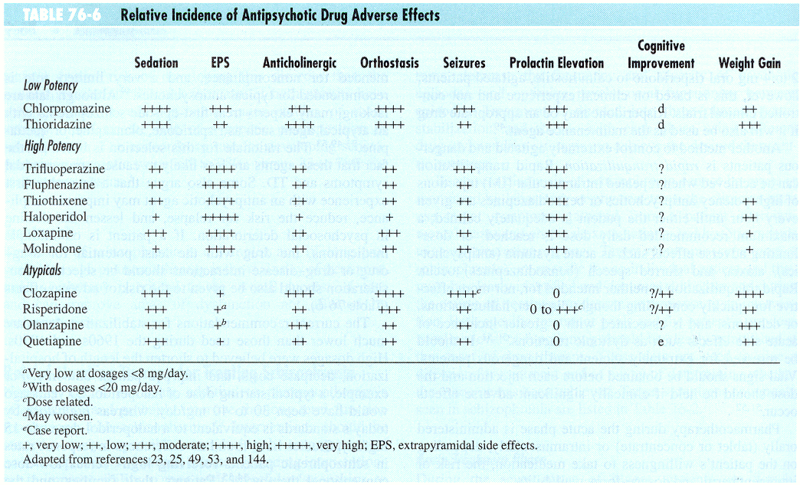
0

Slide 25
0
Bipolar Disorder: (see also Blanton Antidepressant lecture that covers Bipolar Disorders)
Since the 1970’s lithium carbonate has been the treatment for bipolar disorder. At therapeutic levels, Lithium has a mood-stabilizing effect, hence its value for treating bipolar disorder (~70% of patients respond) The mechanism of action is really not understood yet.
Unfortunately the therapeutic window for lithium is very small; the SE include: memory problems, weight gain, tremor, poluria, drowsiness, hypothyroidism, cardiac effects,etc
The therapeutic index is 1-2 and acute intoxication can cause vomiting, profuse diarrhea, ataxia, coma, and convulsions.
Treatment is mostly supportive and dialysis.

Slide 26
0
Bipolar Disorder Treatment:
Because of the low therapeutic index for lithium in recent years there has been increased use of alternative mood-stabilizing agents: these include several of the anticonvulsant agents, including valproic acid, carbamezepine, lamotrignine (the later is only used for maintenance), etc.
These anticonvulsants are nearly as effective as lithium and are far safer. How they stabilize mood is not really understood at all.
Option 1: Mood Stabilizer (lithium/valproic acid/carbamazepine) +/-
.. during depressive phase- add SSRI antidepressant (e.g.
fluoxetine)
… during manic phase- add atypical antipsychotic (e.g.
aripiprazole)
Option 2: Olanzapine (Pyrexia) + Fluoxetine (Prozac) [combination
Symbax].. paradoxical-SSRI combined with 5-HTR blocker?

Slide 27
A 40-year-old woman presents with a 6-month history of missed menstrual periods; she describes a milky secretion from her breasts. She is not sexually active. She states that she is on antipsychotics. A pregnancy test is negative and TSH is normal. What medication is she most likely responsible?
Aripiprazole (Abilify)
Haloperidol (Haldol)
Olanzapine (Zyprexa)
Quetiapine (Seroquel)
Thioridazine (Mellaril)
10

Slide 28
A 33-year-old woman is brought into the emergency room by ambulance. She has been diagnosed as having schizophrenic disorder, disorganized type, since the age of 17. She has been on antipsychotic medications since that time, which have controlled her symptoms well. Physical examination reveals a well-nourished female with a temperature of 103.2 degrees F, BP of 180/99, HR of 97, and copious perspiration. She is mute, has muscular rigidity, and appears to be obtunded. What is the likely diagnosis?
Acute dystonia
Akathisia
Dementia
Neuroleptic malignant syndrome
Tardive dyskinesia
10

Slide 29
Patient who has schizophrenia refractive to other medications is put on Thioridazine (Mellaril). Within days, patient complains of severe orthostatic hypotension. What is the mechanism of action responsible for this adverse effect?
Alpha-1-adrenoceptor blockade
Dopamine-2 receptor blockade
Histamine-1 receptor blockade
Muscarinic receptor blockade
Serotonin-(5HT-2A) receptor blockade
10

Slide 30
Based upon previous vignette, what medication would the patient with refractive schizophrenia ultimately be placed upon, being the only medication known to be effective?
Aripiprazole (Abilify)
Clozapine (Clozaril)
Haloperidol (Haldol)
Olanzapine (Zyprexa)
Quetiapine (Seroquel)
10

Slide 31
FDA “Black Box Warning” associated with all antipsychotics (low and high potency - typical and atypical antipsychotics) deals with
Agranulocytosis/neutro-penia.
Dementia and increased mortality.
Diabetes Mellitus.
Suicidality in young patients.
Tardive Dyskinesia.
10

