Slide 1
Neuropsychological Testing
Esther Schwartz, PhD & David Trotter, PhD

Slide 2
Objectives
Provide essential background information on neuropsychological assessment and common tests
Help you be informed consumers of neuropsychological data in your future medical practice
Present material that could be covered in the USMLE Step 1

Slide 3
A little context
Old paradigm: Lesion method
Take case history from patient + neuropsychological test data→ make an educated guess about lesion location
Since the advent of CT scans of the 1970s and MRIs in the 1980s, neuroimaging make it possible to localize structural abnormalities in the brain with far greater reliability and precision

Slide 4

A little context
Brain-behavior relationships are complicated
Presence of significant brain changes can be associated with nearly normal cognitive functioning, while individuals with no lesions detectable on imaging can have substantial cognitive and functional limitations
Uncertainty exists about the exact delineation of brain areas involved in specific cognitive processes (hard to characterize processing stages involved in a particular tasks)
Complex mental processes are made up of functional systems that are, in turn, based on the combined work of a dynamic structure of cortical zones working together
Notes:
Neuroimaging: Focus on structure
Neuropsychology: Focus on function

Slide 5
What is neuropsychological assessment?
Normatively informed application of performance-based assessments of various cognitive skills
Integrates multiple data sources such as history, observation, neuroimaging, test and qualitative data to understand individual patterns of performance
Can be used to understand brain dysfunction, damage, or disease but also a person’s neurocognitive assets and reserve (strengths)

Slide 6
What neuropsychological evaluation covers
Typically, use a battery approach, which involves tests of a variety of cognitive ability areas, with more than one test per ability area.
Cognitive and psychological domains covered:
Orientation
General intelligence
Attention/Concentration
Memory
Perceptuomotor performance
Language
Abstract reasoning
Executive functioning
Objective personality testing (e.g., MMPI, PAI)

Slide 7
Common applications of neuropsychological assessment

Slide 8
Applications of Assessment
Characterize the cognitive capacities of patients
Determine rehabilitation needs, return to work, recommendations for independent living
Baseline assessment should be performed early in the recovery period when patient is awake and alert enough to engage in testing
Use assessment to track patients who have undergone medical or surgical treatment for neurological disease.
Help monitor neuropsychological changes that occur due to a particular treatment
Examples: Drug therapy for patients with Parkinson’s disease or seizure disorders, surgical interventions in patients with brain tumors, seizure disorders, normal pressure hydrocephalus
Distinguishing organic from psychiatric disease
A common diagnostic dilemma faced by both neurologists and psychiatrists is distinguishing between “true dementia” (e.g., neurocognitive disorder due to Alzheimer’s disease) and “pseudodementia” (e.g., cognitive impairment associated with depression)
Notes:
blocked in some way. This causes the ventricles to enlarge, putting pressure on the brain.

Slide 9
Applications of Assessment con’d
Medicolegal situations
In some cases, “objective” signs of brain dysfunction are absent (e.g., weakness, sensory loss, impaired balance), neuroimaging are normal, and the entire “case” for impairment rests on claims of cognitive deficits.
Competence
Is a patient mentally competent to execute legal decisions, draw up a will, make decisions about their medical care, etc.?
Driving privileges
Is a patient competent and safe to operate a motor vehicle?
Developmental disorders
Neuropsychological assessment can help to identify developmental learning disorders
Examples: dyslexia, ADHD, nonverbal learning disorder
Notes:
abilities.

Slide 10
Applications of Assessment con’d
Conditions in which known or suspected neurological disease is not detected by standard neurodiagnostic procedures (e.g., structural neuroimaging, EEG, neurological exam)
Examples: Mild closed head trauma, early stages of Alzheimer’s disease or Pick’s disease, early HIV-related dementia, severe acceleration/deceleration forces in the absence of head trauma
Monitoring changes in cognitive functioning across time
Examples: degenerative dementias; early on patient may meet criteria for mild cognitive impairment but follow up neuropsych evals can provide confirming or disconfirming evidence regarding patient’s status.
Wada testing
The intracarotid amobarbital procedure (Wada & Rasmussen, 1960) performed in patients prior to surgery for pharmacoresistant epilepsy, to establish hemispheric dominance for language and other verbally mediated functions (memory).

Slide 11
Common Neuropsychological Tests

Slide 12
Folstein Mini-Mental State Exam
Used for: Delirium and dementia
11 question measure; takes 5-10 minutes
Commonly used bedside assessment; older community dwelling, hospitalized, and institutionalized patients
Scoring: 23-30 suggests competence; 18 or lower suggests incompetence (cognitive impairment)

Slide 13
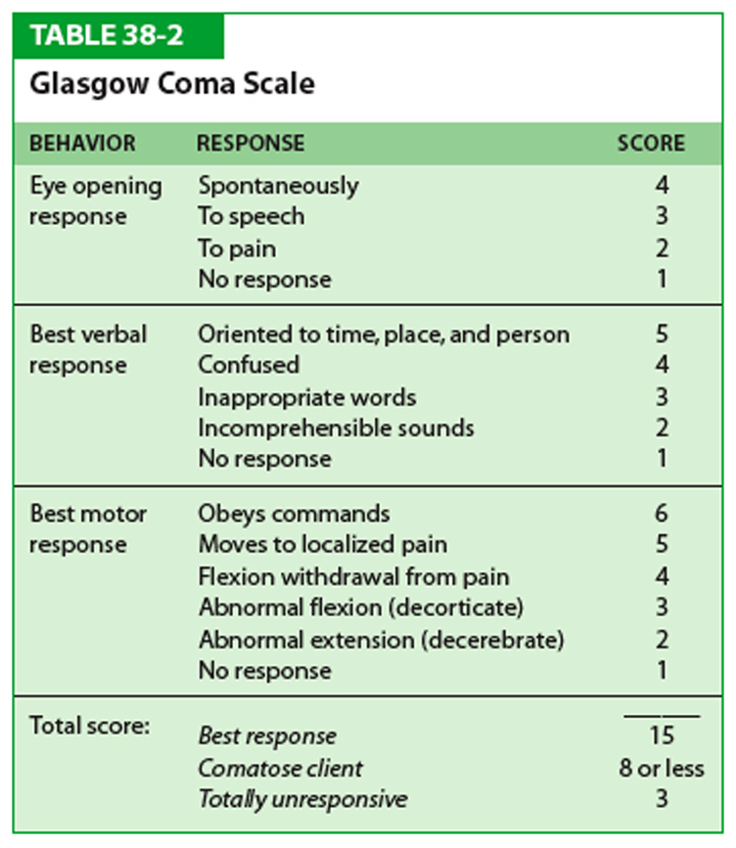
Glasgow Coma Scale (GCS)
Used for: Level of consciousness
Often used to describe level of consciousness following TBI
Scoring:
15: Maximum score
13-15: Mild neurological imp
9-12: Moderate neurological imp
<9 : Severe neurological imp
Notes:
Eye, verbal, motor
Gauge severity of acute brain injury

Slide 14

Repeatable Battery for the Assessment of Neuropsychological Status
RBANS consists of 10 subtests which gives scores of the domains of immediate memory, delayed memory, visuospatial/constructional, language, and attention.
Takes about 30 minute to administer; currently over 25 linguistically and culturally validated translations; has good cross-cultural applicability and generalizability of results.
RBANS is currently widely used for clinical diagnostic purposes and has recently been deployed in multinational clinical trials of investigational compounds for AD.

Slide 15
Halstead-Reitan Battery
Comprehensive neuropsych battery used for: Brain lesion localization and effects
Category Test
Tactual performance test (“foam board test”)
Trail-making Test
Seashore rhythm test
Speech-sounds perception test
Finger oscillation test
Grip strength
Sensory perceptual exam
Aphasia screening test
Wechsler Adult Intelligence Scale (WAIS)
Minnesota Multiphasic Personality Inventory (MMPI)
Notes:
For clinicians favoring a standard battery approach, the predominant test battery has been the HRB.
No underlying theory.

Slide 16
Luria-Nebraska Neuropsychological Battery
Used for: Cerebral dominance; types of brain dysfunction, such as dyslexia
Fixed battery consists of 11 clinical scales (269 items):
Major areas of neuropsychological functioning (motor functions, rhythm, tactile functions, visual functions, receptive speech, expressive speech, writing, reading, arithmetic, memory, intellectual processes) and two
Two sensorimotor scales (left hemisphere, right hemisphere)
Three summary scales (pathognomonic, profile elevation, impairment)
Notes:
Items of LNNB are designed to assess cognitive impairment according to Luria's theory of higher cortical functions.
The second advantage of the LNNB was one of practicality. The LNNB requires half the administration time as the
HRB. Both batteries equally effective at identifying brain damage (discriminant analysis).

Slide 17
Bender Visual Motor Gestalt
Used for: Visual and motor functioning through reproduction of designs
2nd edition consists of 16 figures, each on its own card. The cards are presented individually and test subjects are asked to redraw each one from memory before the next card is shown.
Test results are scored based on the accuracy and organization of the reproductions.

Slide 18
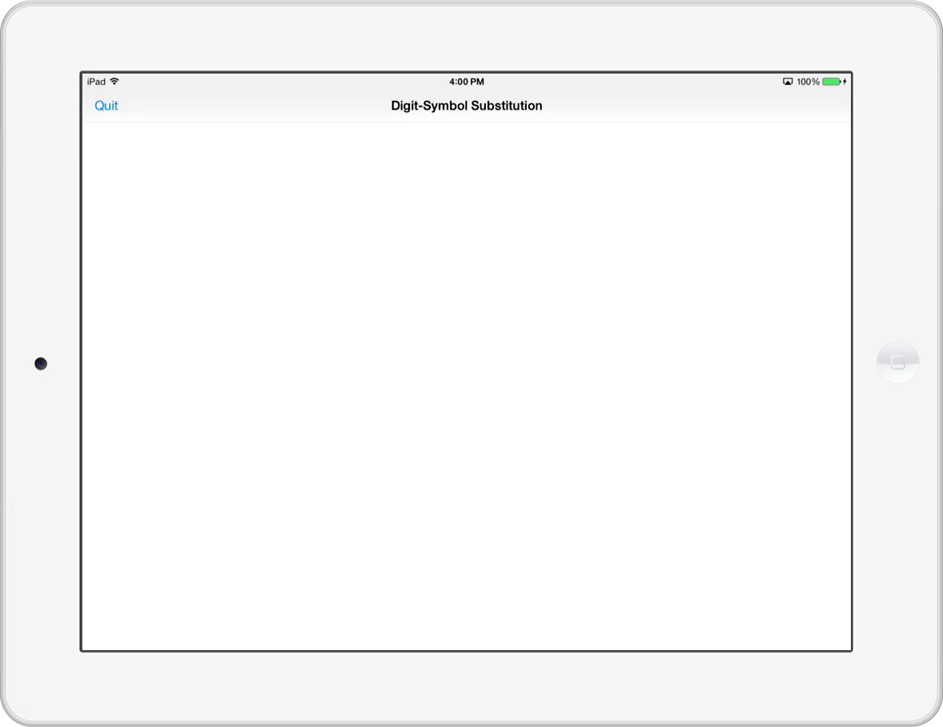
Digit Symbol Substitution
Used for: Dementia, depression, and age-related cognitive decline
Notes:
The DSST requires response speed, sustained attention, visual spatial skills and set shifting. It is part of the Wechsler Adult Intelligence Scale, one of the most widely used measures of intelligence.

Slide 19
Boston Naming Test
Used for: Dementia
60-item test confrontation naming test
Assesses word retrieval abilities for language disturbance caused by CVA, Alzheimer’s disease, dementia.

Slide 20
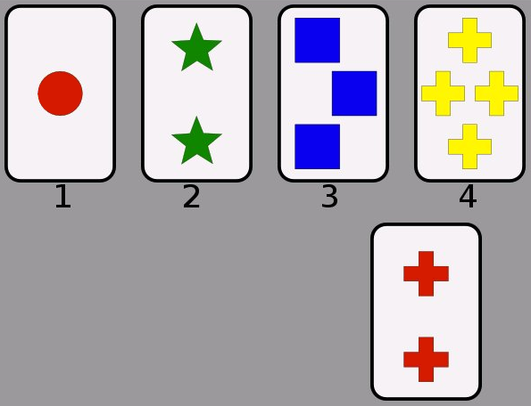
Wisconsin Card Sort
Used for: Executive function
WCST is widely used as an index of prefrontal cortical function
Test takers have to classify cards according to different criteria. People have four different ways to classify a card (e.g., color, shape, number of shapes). Only feedback is whether they do it correctly or not. The classification rule changes every 10 cards. Participant will start making one or more mistakes when the rule changes. The task measures how well people can adapt to the changing rules. Or, do they perseverate (keep applying old rule).

Slide 21
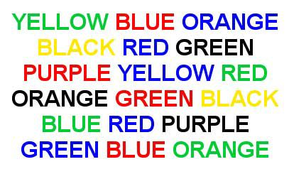
Stroop Color-Word Test
Used for: Directed attention; executive function
The Stroop consists of 3 tests:
(1) Word Page with color words printed in black ink;
(2) Color Page with ‘Xs’ printed in color;
(3) Color-Word Page –color words printed in colored ink that does not match the word.
An Interference score, which is useful in determining the individual’s cognitive flexibility, creativity, reaction to cognitive pressure, verbal inhibition ability.

Slide 22
References
Benton, A.L. (1991). Basic approaches to neuropsychological assessment. In S. R. Steinhauer, J.H. Gruzelier & J. Zubin (Eds.), Handbook of schizophrenia (Vol. 5). Amsterdam: Elsevier.
Tranel, D. (2008). Theories of clinical neuropsychology and brain-behavior relationships: Luria and beyond. In J.E. Morgan & J.H. Ricker (Eds.), Textbook of Clinical Neuropsychology. New York: Taylor & Francis.
Broshek, D.K. & Barth, J.T. (2000). The Halstead-Reitan Neuropsychological Test Battery. In G. Groth-Marnat (Ed.), Neuropsychological Assessment in Clinical Practice: A Guide to Test Interpretation and Integration. New York: John Wiley and Sons.
Karantzoulis, S., Novitski, J., Gold, M., Randolph, C. (2013). Repeatable Battery for the Assessment of Neuropsychology (RBANS): Utility in Detection and Characterization of Mild Cognitive Impairment due to Alzheimer’s Disease. Archives of Clinical Neuropsychology, 28, 837-844.

