Slide 1
Disorders of Consciousness
John W. Culberson, MD
Associate Professor of Family and Community Medicine
Program Director, Geriatric Fellowship

Slide 2
Reading
Blumenfeld Pages 625-648

Slide 3
Objectives
Describe the CNS structures crucial for normal consciousness
Describe the role of neurotransmitters in the CNS
Discuss the clinical approach to disorders of consciousness

Slide 4
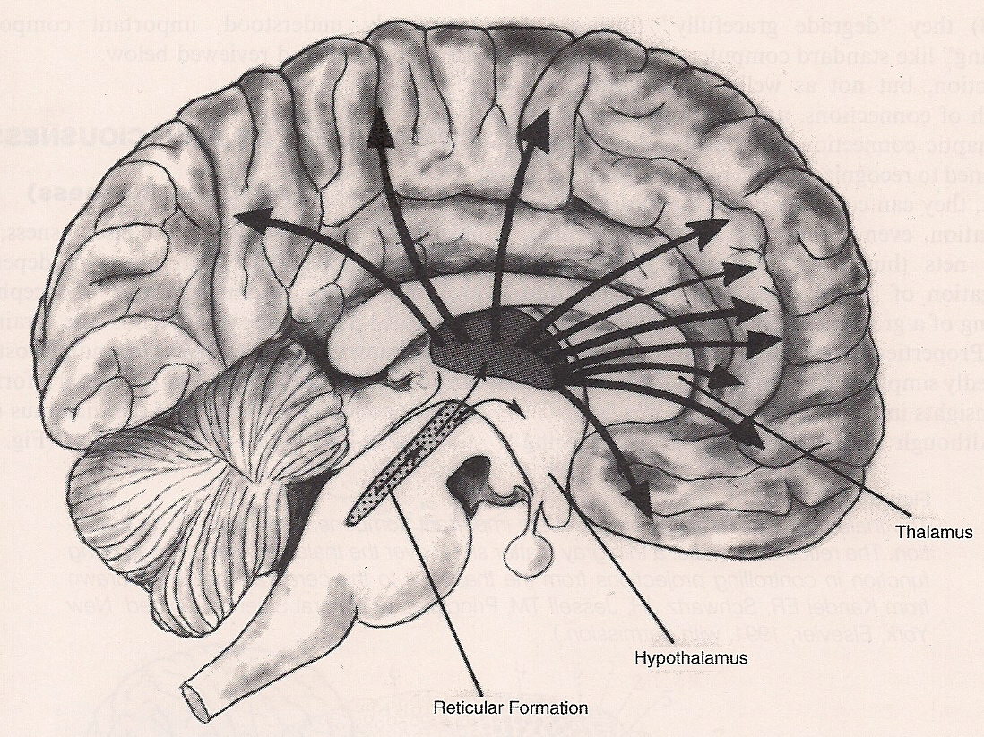

Slide 5
Consciousness System
Medial and lateral frontoparietal cortex
Arousal circuits in the upper brainstem and diencephalon
  Ascending Reticular Activating System (ARAS): rostral projection into thalamus and hypothalamus
    Alertness
    Sleep/Wake Cycle

Slide 6
Consciousness System
Level of Consciousness
  Alertness
    Brainstem->Diencephalon
  Attention
    Brainstem-->Frontoparietal Cortex
  Awareness
    Brainstem-> Complex Cortex
    Sensory, Motor, Emotional, Memory

Slide 7
Clinical Case
53 yo woman with h/o of HTN and DM
  Shopping, felt “funny,” left eye crossed
  Slurred speech, normal comprehension
  Numbness, left arm and leg, Ataxic gait
  CT Head normal
  Progressive respiratory arrest
  Pupils: Small, responsive
  Unresponsive with Decerebrate posturing

Slide 8
Locked-In Syndrome
Awake and Aware
Corticospinal and Corticobulbar tracts
disrupted by brainstem infarct at tegmentum of midpons
(posterior circulation)
Aphonic, Quadriplegic, eye-movement limited to vertical tracking

Slide 9
Disorders of Consiousness
Coma
  unarousable unresponsiveness
  no evidence of awareness
  Vegetative State
    sleep-wake cycles, eye-opening
    no awareness to environment
  Minimally Conscious State
    variable awareness to environment
    delirium

Slide 10
Assessment of the Comatose patient
  History is ALWAYS most important!
  Neck injury
  Airway, Circulation, Breathing
  Assess levels of consciousness - GCS
  pupillary responses, eye movements
  motor patterns, deep tendon reflexes
  Fundoscopic exam

Slide 11
Assessment of the Comatose patient
  Unconscious in the ED
    Differential Diagnosis
    “Horses and Zebras”
    Time to treatment
    Imaging
    Laboratories

Slide 12
Glasgow Scoring
Category | Response | Points
Eye opening | Spontaneous, open with blinking at baseline | 4
 | Opens to verbal command, speech, or shout | 3
 | Opens to pain, not applied to face | 2
 | No response | 1
Verbal response | Oriented conversation | 5
 | Disoriented, confused conversation, able to answer questions | 4
 | Inappropriate responses, words discernible | 3
 | Incomprehensible speech | 2
 | No response | 1
 | Intubated | 1+T
Motor response | Obeys commands for movement | 6
 | Purposeful movement to painful stimulus | 5
 | Withdraws from pain | 4
 | Abnormal (spastic) flexion, decorticate posture | 3
 | Extensor (rigid) response, decerebrate posture | 2
 | No response | 1

Slide 13
GCS: Prognosis
Highest score observed during 1st 24 hours after injury | Good recovery or Moderate disability | Vegetative or Dead
3-4 | 7% | 87%
5-7 | 34% | 53%
8-10 | 68% | 27%
11-15 | 82% | 12%

Slide 14
Major causes of coma
1. Structural lesions:
  supra-tentorial: usually focal signs
    Trauma, hemorrhage
    Rostral to caudal progression
  infra-tentorial
    Vascular, CVA
2. Metabolic and Toxic causes
  often non-focal signs
3. Psychogenic unresponsiveness

Slide 15
Traumatic Brain Injury
Contact
  Cerebral contusion swelling/hemorrhage
  Hypoxia
Acceleration/Deceleration
  Contra Coup lesions opposite of contact
  Diffuse axonal injury and sheering
  Bridging Veins vulnerable due to atrophy

Slide 16
Intracranial Hemorrhage
Subdural Hematoma
  Bridging veins vulnerable with brain atrophy in the elderly (anticoagulation risk)
Subarachnoid hemorrhage
  Spontaneous, Hypertensive Emergency
  Worst Headache of Life
  Congenital “Berry” Aneurysm
  Rapid progression
    Image before Lumbar Puncture

Slide 17
Clinical Case
89 yo man with Atrial fibrillation on anticoagulation brought to ED “confused.” No history available.
GCS: 13→repeat 9
Purposeful movement
R pupil > L pupil
EOM conjugate on calorics

Slide 18
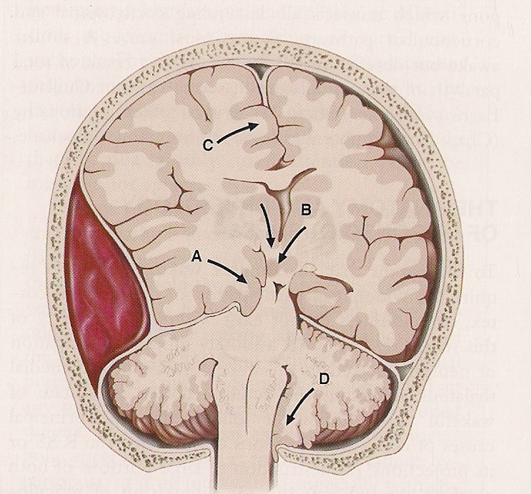
Herniation syndromes

Slide 19
Rostral to Caudal Progression
Third Nerve Phase
  Ipsilateral pupil fixed and dilated (Blown)
Mid-Brain/Upper Pons Phase
  EOMs dysconjugate on calorics
  Decorticate to decerebrate posturing
Lower Pons/Medulla Stage (irreversible)
  Both pupils fixed
  Minimal motor response, no EOMs

Slide 20
Increased Intracranial Pressure
Decompression
Steroids
Intracranial Pressure Monitoring
Mannitol
Induced Coma
Serial Neurological exams

Slide 21
Clinical Case
42yo man with Diabetes found “down”
  To ED in cervical collar; GCS: 6
  Non-focal CN exam; withdraws to pain
  Differential:
    Trauma
    Intracranial Bleed
    Drugs
    Seizure
    Diabetic Ketoacidosis or Hypoglycemia (meds)
    Infection, Cardiopulmonary insult

Slide 22
Toxic Metabolic Causes of Coma
Drug Overdose (Opiate antagonist)
Global ischemia (Cardiopulmonary)
Infection
Hypothermia/Hyperthermia
Electrolyte imbalance
Diabetic Ketoacidosis, Hyperosmolar
Hypoxia (Co2 Narcosis)
Extensive work-up

Slide 23
Vegetative State
Progression for Coma in <4 weeks
  Neurodegenerative/Congenital disorders
  Diffuse cortical dysfunction
  Regain sleep-wake cycles
  Open eyes to stimuli with reflexive movement (no tracking)
  Movement, speech is not purposeful

Slide 24
Minimally Conscious State (2002)
Minimally Responsive State (1995)
Ethical dilemma
A condition of severely altered consciousness that is distinguished from the vegetative state by the presence of minimal but clearly discernible behavioral evidence of self or environmental awareness.

Slide 25
Brain Death
No evidence of cortical or brainstem function (spinal cord reflexes may persist)
Protocol typically involves EEG (flat pattern) and nuclear imaging demonstrates no cerebral metabolism
Withdrawal of “life-support”
Organ donation

Slide 26
Traumatic Brain Injury
Static encephalopathy
  Decision-making Capacity?
Full spectrum of awareness deficits
  Sensory
  Motor
  Memory
  Emotions

Slide 27
Delirium and Confusional States
Commonly encountered in patients with medical illness
  Hospitalized, elderly
Key Features:
  Acute onset, initial fluctuating course
  Disturbance in attention
  Change in cognition (not due to dementia)

Slide 28
Delirium and Confusional States
Most often reversible (variable time)
Etiology poorly understood
May be hyperactive or hypoactive
Must be treated urgently:
  Toxic metabolic
  Infection
  Brain injury
  Cardiopulmonary (hypoxia)
  Seizure (EEG: Delta slow wave activity)

Slide 29
Delirium and Confusional States
Risk factors:
  Age (Blood brain barrier, inflammation)
  Dementia (Sundowning)
  Polypharmacy (anticholinergic)
  Vision impairment
  Severe illness (sympathetic drive)
  Post-operative (General anesthesia)
  ICU
  Pain (Sleep deprivation)

Slide 30
Delirium Tremens
Alcohol withdrawal
  3-5 days after last drink
  Sympathetic hyperactivity
  Delirium with hallucinations
  Relatively high mortality

Slide 31
Clinical Case
90 yo female nursing home patient is admitted for a urinary infection. Nurse calls to report “agitation.”
Complete work-up is negative
Physician gives a sedative-hypnotic
Length of hospitalization is prolonged with numerous complications

Slide 32
Delirium and Confusional States
Prevention is difficult in current system
  Decrease risk, particularly medications
Treatment:
  Identify underlying cause
  Familiarize the environment
  Limit sleep disruption
  Mobilization (avoid restraints)
  Antipsychotic: Dopaminergic antagonist
    Haldol 0.5mg (low dose titration)
    Increased risk of death in dementia

Slide 33
Neurotransmitters and Consciousness
Acetylcholine
  Efferent PNS, neuromuscular junction
  Neuromodulatory in CNS (facilitatory)
    Brainstem->thalamus
    Basal forebrain->wide cortex
    Anticholinergic medications: sedation
    Acetylcholinesterase Inhibitors: activating
      Decrease sympathetic outflow led to increase mortality in ICU delirium prevention trial

Slide 34
Neurotransmitters and Consciousness
Dopamine
  Nigrostriatal: deficit = movement disorder
  Mesolimbic: excess = delusions
  Mesocortical:
    Deficit = cognitive disorder of Parkinsons
Dopaminergic antagonists to treat behavioral symptoms of dementia cause considerable side-effect

Slide 35
Neurotransmitters and Consciousness
Serotonin
  Raphe nuclei of midbrain, pons, medulla
  Widespread inhibitory and excitatory projections
    Complex behavior (Depression, Anxiety)
    Pain modulation
    Sleep/Wake Cycle
  SSRI (Serotonin Reuptake Inhibitors)

Slide 36
Neurotransmitters and Consciousness
Histamine
  Mostly in mast cells, allergic response
  CNS activity may increase alertness
  Antihistamines cause significant sedation in the CNS
    Over-the-Counter for insomnia
    Do not use in the elderly

Slide 37
Neurotransmitters and Consciousness
GABA
  Numerous inhibitory projections
  Benzodiazepines cause sedation
    Often used for insomnia
  CNS tolerance (motor/sedation) incomplete
    High fall risk
    Use carefully in the elderly

Slide 38
Neuromodulation of arousal
Orexin (hypocretin): posterior lateral hypothalamus projecting to brainstem arousal systems promoting “awake state.” Orexinergic agonists new treatment for narcolepsy.
Caffeine may block inhibitory activity at adenosine receptors in the thalamus and cortex.

Slide 39
Neurotransmitters and Consciousness
Pharmacology principle 1.
  All drugs have activity at a variety of receptor types.
Pharmacology Principle 2.
  Pharmacodynamic and pharmacokinetic interactions increase with number
Pharmacology Principle 3.
  Volume of distribution changes with age

Slide 40
Summary
Level and content of consciousness are complex CNS functions that involve a combination of anatomical and neurochemical variables, and are subject to a variety of clinical conditions that confront the physician on a regular basis.

