Slide 1
Dementia Disorders
John W. Culberson, MD
Associate Professor of Family and Community Medicine
Program Director, Geriatric Fellowship

Slide 2
Readings
Blumenthal:
  Pages 838-844
  Pages 926-936

Slide 3
Objectives
Describe clinical presentation and diagnostic criteria of the common dementia disorders
Discuss the pathophysiology, including genetic and clinical risk factors for specific dementia disorders
Describe treatment strategies and emerging research in diagnosis and treatment of Alzheimers Disease

Slide 4
Cognition
Working memory
  Prefrontal association cortex
  Digit sequence (5-7)
Recent memory
  Medial temporal/diencephalic structures
  Hippocampus
  5 min recall
Remote memory
  Cortical structures

Slide 5
Dementia
Decline in cognitive abilities to impaired functional status
  Abrupt or step-wise (not fluctuating)
    Trauma/Toxic Metabolic
    Vascular
    Normal Pressure Hydrocephalus
  Insideous and Progressive
    Alzheimers
    Lewy Body/Parkinson
    Alcohol Related

Slide 6
Dementia
Alzheimers Disease 60%
Vascular Dementia 10-15%
  Mixed with AD 40%
Lewy Body /Parkinsons Disease 25%
Normal Pressure Hydrocephalus 6%
Alcohol Induced Dementias 4 - 20%
Frontotemporal Dementia 3 - 20%

Slide 7
Early Detection
Essential to proper diagnosis
  Onset, Qualities, Progression
  Overlapping clinical presentation over time
History
  Patient, family, employer
  Forgetfulness vs Functional decline
Screening
  Assymptomatic: not recommended

Slide 8
Case #1
72 yo former schoolteacher frequently “losing her keys”
  Lives alone, pays bills, manages medications
  Normal physical and labs
  Mental status exam score: Low normal

Slide 9
“Normal” (Typical) Memory Loss
Decline in mental Processing Speed
Difficulty learning new material
“Dementia” is NOT normal, and
Aging is NOT a disease

Slide 10
Mild Cognitive Impairment (MCA)
Cognitive Impairment in aging that does not meet the criteria for dementia
  Memory impairment w/o functional loss
Seen in 15-20% of adults >65 years
  80% diagnosed with dementia in 8 years
  Is this “Pre-dementia”
  Treatment based on clinical condition AND
  Patient-Centered Discussion

Slide 11
Dementia
Memory impairment
AND
Aphasia, Apraxia, Agnosia, or Impaired Executive Function
Significant Impairment in social or occupational functioning

Slide 12
Cognitive Terminology
Aphasia – inability to understand what is being said, naming items, reading and/or writing
Apraxia – inability to plan or follow certain movements (Motor processing error)
Agnosia – inability to recognize familiar
objects or people (Sensory processing error)

Slide 13
Executive Function
Ability to plan, initiate, sequence, and monitor complex behaviors
“He can cook an egg, but he can’t make breakfast”

Slide 14
Dementia vs Delerium
Dementia:
  Insideous onset
  Not fluctuating
  No lack of attention
Difficult differential when neuropsychiatric symptoms are present
Dementia is a significant risk factor for delirium (including sundowning)

Slide 15
Screening for Dementia
Sensitive and Specific
  Harm of false positive
Reliable
  Administration and interpretation
Validated in population
  Race, Language, Education, etc
Efficiency
    Primary Care vs Specialty Care
Screening Tests ARE NOT diagnostic

Slide 16
Mini-Mental Status Exam
MMMS: Folstein, 1987
  30 items (memory, language, visuospatial)
  Pros
    Widely used, 5-10 min
  Cons
    Normative scoring (+ at 24-26/30)
    Sensitivity 18% for MCI, 78% for Dementia
      Using Cut<26 score
    Requires patient cooperation
    Copywrite

Slide 17
Montreal Cogitive Assessment
“MoCHA” 30-items
        Nasreddine, 2005
Less verbal, Higher sensitivity
Detects Mild Cognitive Impairment
  When MMSE>27
Specificity is diminished
More Time Consuming

Slide 18
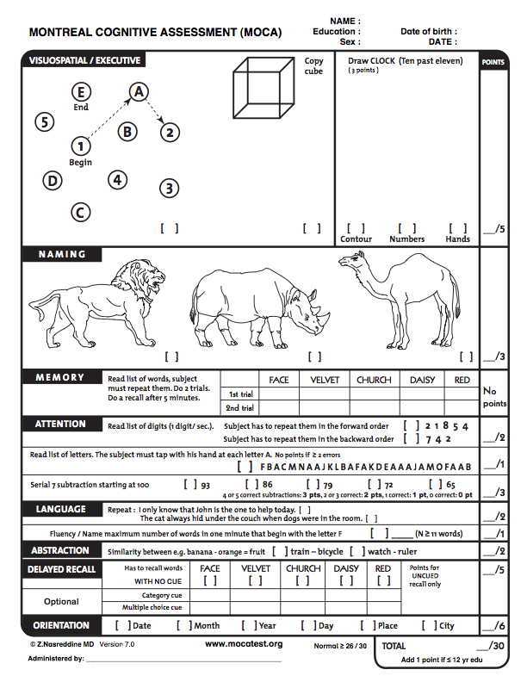

Slide 19
Clock-Drawing/Mini-Cog
Rapid clinic tool
  Low sensitivity, not diagnostic
“Draw a clock face showing the time is 10 minutes after 11 o’clock.”
  Mini-Cog addition of 3-item recall
    Clock score either “0 or 2”
    One point for each object recalled
    <3/5 points possible impairment

Slide 20
Evaluation
History and Physical
Cognitive Screening Test
Reversible Causes
Neuroimaging
History!
  Include family, others who know over time

Slide 21
History
Time course
  Initial onset, pattern
Function (ADL’s, IADL’s)
  IADL’s
    Medication management, Bill Paying, Shopping, Cooking, Driving
  ADL’s
    Dressing, Bathing, Toileting, Eating, Transfers
Behavioral/Social Function
Depression (Geri Depression Scale, PHQ-2)
Obstructive Sleep Apnea symptoms

Slide 22
History
Confounding factors
  Hearing
  Anxiety
  Medications
  Sleep
  Delirium
  Family denial/concern
  Medical conditions
    Mobility impairment, incontinence, Vision
    Undiagnosed psychiatric conditions

Slide 23
Reversible Causes
Drug toxicity
Metabolic
Normal Pressure Hydrocephalus
Mass lesion (Subdural)
Infectious
Endocrine
Collagen-Vascular

Slide 24
Reversible Causes
Lab:
  CBC, Electrolytes, Liver function
  Thyroid Stimulating Hormone (TSH)
  B12, Folate
  HIV
  Syphilis

Slide 25
Neuroimaging
CT usually adequate
  Rule out reversible causes (bleeding)
  Regional/global atrophy late finding
MRI if vascular dementia suspected
  Will minimize cardiovascular risk anyway
  Diagnosis of midbrain (lacunar) stroke
  May change management (Risk/Benefit)
PET/fMRI
  Highly sensitive for early dementia
  Cost inhibiting, area of research

Slide 26
Lumbar Puncture
B amyloid, tau protein levels
  Invasive, inadequate specificity
  Area of research (minimum invasive LP)
    Blood, saliva B amyloid, tau levels
Normal Pressure Hydrocephalus
Neurosyphilis, Creutzfeldt-Jakob rare
EEG may be considered
  Seizure disorders rare cause

Slide 27
Neuropsychological Testing
The “Gold Standard”
Psychometric specialist consultation
  Time consuming
  Expensive
    Court contested cases
    Early stage
    Diagnostic
    Guides treatment

Slide 28
Decision-Making Capacity
Licensed Physician in Texas certifies capacity in deposition to court
  Probate judge determines “Competency”
Evolution of “Partial Competency”
  “How much money can be managed?”
  Capable of Independent living?
  Ability to Consent for Medical Treatment?
    Guardian assigned by court
    Power of Attorney designated by individual

Slide 29
Driving: The Ultimate ADL
Laws variable by State (Texas)
  Age 79+, renew in-person every 6 years
    May require vision test, medical evaluation
  Citizen report to DPS: Panel evaluation
    Family responsibility
Driving Skills largely preserved
  Multiple fender benders
  Difficulty navigating new places
  Limiting one’s driving is a major risk factor
Limiting one’s driving is a major risk factor

Slide 30
Dementia “Evaluation”
Screening
Differential Diagnosis
Treatment: A patient-Centered Decision
Management: Family-centered decision
  Home safety evaluation
  Independent living, driving, Capacity
Reimbursement? Society-centered
  Long-Term Care
  Memory Unit

Slide 31
Case #2
89 year old woman seen with her daughter visiting from out-of-state, who notes malnourishment and “lots of trouble with her memory.” Her daughter is concerned because she never wants to leave the house. She notes that “things have been getting worse” lately.
She takes no medications and hasn’t seen a doctor in several years.

Slide 32
Alzheimers Dementia (AD)
Most prevalent form of dementia
  Age 65: 5-8%
  Age 75: 15-25%
  Age 85: 25-50%
Doubles every 5 years after age 60

Slide 33
Risk Factors for AD
Age!
Family history (Early onset only)
Gender (female?)
Vascular Risk Factors
  Hyperlipidemia
Head Trauma
  Genetic: AD in relative = four-fold increase
Ethnicity or education
  No clear evidence

Slide 34
Alzheimers Disease (AD)
Extreme Cost including Disease Burden
  “The Aging Baby Boomers”
Ethical considerations
  Decision-Making Capacity
  Long-Term Care Financing
  Cure vs Care

Slide 35
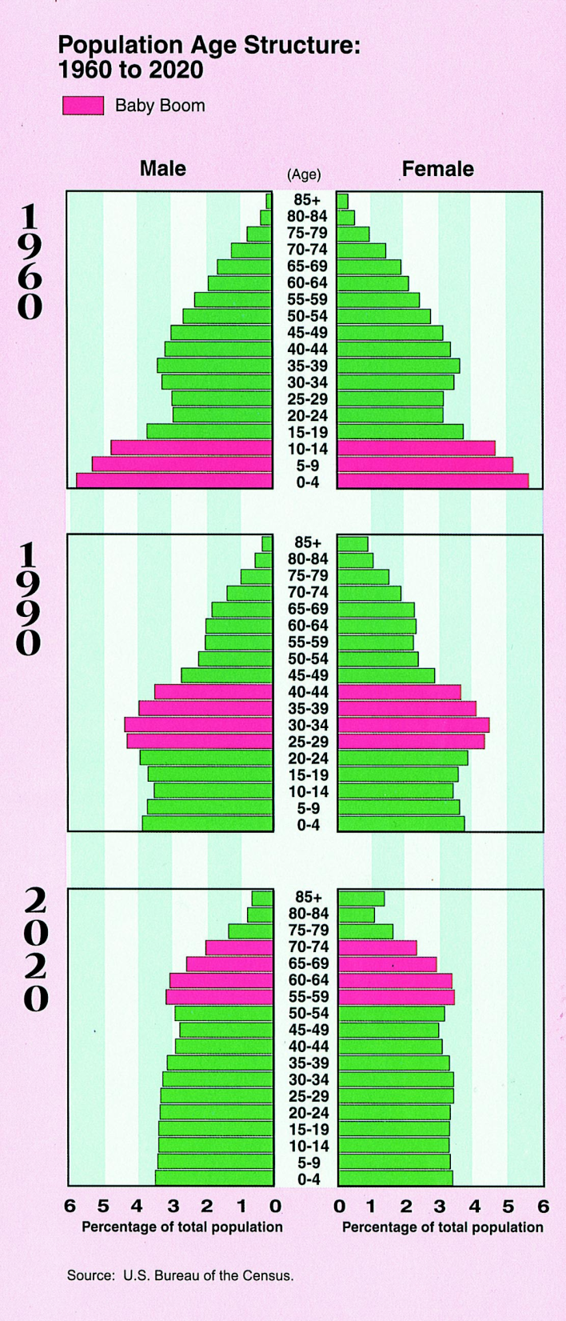

Slide 36
Aging and Alzheimers Disease
Insulin-Like Growth Factor Receptor
  IGF1R Activation accelerates aging
    Cerebrovascular dysfunction
      Does hypoxic stress result in AD?
  Inhibition delays AD and Diabetes
Frailty and Sarcopenia (loss of muscle)
  Inflammatory chronic disease burden
  Exercise maintains muscle mass
    Potent anti-inflammatory
    Delays progression of AD

Slide 37
Glucose Metabolism in the CNS
Possible role of impaired glucose metabolism in pathophysiology of Alzheimers Dementia (Type 3 Diabetes)
  Neuronal dependence on glucose
  Glucose uptake mechanisms
  Axonal transport
  Glial cell factors
  Mitochondrial DNA and products

Slide 38
Alzheimers Disease (AD)
Senile Plaques (Beta-Amyloid Peptide)
  Most common in neocortex
  Genetics related to Apolipoprotein E4
  Amyloid Precursor Protein (APP)
    APP->Secretase-> B Amyloid
    Potential pharmacologic intervention
  Chromosome 1,4,21;
    Early onset AD in Trisomy 21
    Mutation on APP gene

Slide 39
Alzheimers Disease (AD)
APO-E – Apolipoprotein E
  Chromosome 19
  Allele variants: APO-E4, APO-E3, APO-E2
  APO-E4 carriers
    4 fold increased risk of Early Onset AD
  APO-E 2 and APO-E3
    Increase risk of Late Onset AD

Slide 40
Alzheimers Disease (AD)
Neurofibrillary Tangles
  Highly phosphorylated Tau proteins
  Found in neuronal cytoplasm
  Phosphorylation = Potential pharmacologic intervention
Neuronal and synaptic loss
  Direct cause of dementia
  Hippocampus, Posterior cingulate, corpus callosum
    Acetylcholine Deficiency
    Pharmacologic intervention

Slide 41
Alzheimers Dementia
Predictable Loss of Function over Time
Early Stages
  Progressive Memory Loss
  Impairment in language in 40-50%
  Impaired executive dysfunction

Slide 42
Alzheimers Dementia
Typical Disease Progression
Moderate
  Decline in fuction
  Personality changes
  Increasing passivity
  Apathy
  Restlessness/Hyperativity

Slide 43
Alzheimers Disease
“Severe” or “Late Stage”
  Loss of language function
  Increased behavioral symptoms
  Poor gait (Falls)
Diagnosis is often late
  Difficult to differentiate type of Dementia

Slide 44
Alzheimers Dementia
Functional Assessment Screening Test
                Reisberg,1988
FAST 1-5, 6a-e, 7a-f Years
  Stage 3 (- executive function) 10-13 Stage 4 (iADL’s)
  Stage 5 (supervision with ADL’s) 3-5 Stage 6 (dependent for ADL’s)
  Stage 7a (speaks 6 words) 1-3

Slide 45
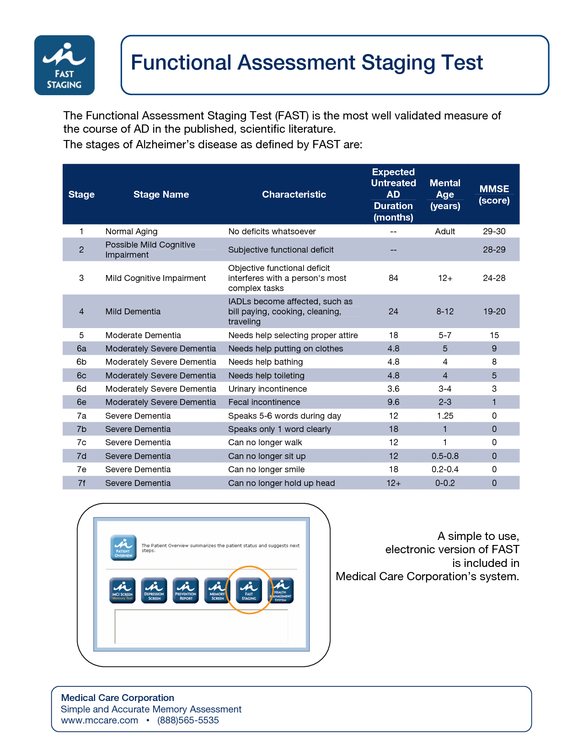

Slide 46
Neuropsychiatric Symptoms
Occur Late in the Disease Progression
MMSE score of <20/30
  Agitation
  Aggression
  Sleep disturbance
  Apathy
  Anxiety
  Disinhibition
  Hallucinations
  Delusions

Slide 47
Environmental Causes
Poor sensory function
Unfamiliar environment
High noise and activity
Comorbid illness
Medications
Behavioral management, environmental changes are always first-line

Slide 48
Pseudodementia
Depression is common (10-15%) in the elderly
Symptoms of apathy, memory impairment, disrupted sleep may mimic dementia
“Rule out” depression before diagnosing dementia
  Validated Geriatric Depression Scale)
  More than 30% of patients with AD develop depression

Slide 49
Vascular Dementia (VaD)
Step-wise progression
Risk factors, sub-cortical changes
Motor/constructive and Attention/concentration deficits
  Constructional apraxia of intersecting polygons on MMSE
Verbal skills relatively preserved
  Word-list generation screen: “Name animals at the zoo” in 1 minute. (>20)
  VD cluster animals (language)

Slide 50
Vascular Dementia
Minimize cardiovascular risk factors
  Hypertension
  Diabetes
  Smoking
  Hyperlipidemia
Aspirin
Evaluate for Atrial Fibillation and carotid stenosis
  Anticoagulation to reduce risk of thromboembolic disease

Slide 51
Case #3
74 year old man with difficulty concentrating for 3 months, now requiring assistance with dressing. Wife also reports 3 falls in the past month and increasing urinary incontinence.

Slide 52
Normal Pressure Hydrocephalus
Abnormality of production, absorption, or flow of cerebrospinal fluid resulting in ventricular dilitation
Classic triad of gait or balance disturbance, urinary incontinence, and cognitive deficits
Potentially reversible with intraventricular shunt

Slide 53
Parkinson’s Disease Dementia
Cognitive decline one decade after motor symptoms
Occurs in 33% of Parkinson’s patients
  Predictors:
    Older onset, non-tremor or bilateral prominent
Diagnostic challenge:
  Parkinson’s Medications affect cognition
  Substantial coexisting Alzheimer’s Disease

Slide 54
Dementia with Lewy Bodies
M>F; onset 50-80 years
  Early visual hallucinations (delusions)
  Fluctuating cognitive impairment
  Early visuospatial and attention deficits
  REM sleep behavior disorder
  Parkinsonian symptoms (70%)
    Bilateral often no tremor, falls
    Depression, autonomic dysfunction

Slide 55
Dementia with Lewy Bodies
Neuronal spherical intracytoplasmic inclusions of alpha synuclein
Apolipoprotein E4 at autopsy
  50% show Lewy Bodies
  Widely underdiagnosed
Often misdiagnosed as psychiatric illness
  Hypersensitivity to antipsychotic medications

Slide 56
Motor Impairment in Alzheimers Dementia(AD)
Motor symptoms
  Gait, motor speed, balance, activity level
  Occurs even in mild stages
Supports over-lap between AD and Lewy body dementia

Slide 57
Head Trauma
Head trauma is a risk factor for both Alzheimers Dementia and Parkinsons Disease
Damage to Substantia nigra
Accelerated Neurodegeneration
  Upregulation of Amyloid genes
  Increased Tau phosphorylation

Slide 58
Frontotemporal Dementia
Mean onset mid-fifties
Insidious change in personality or inappropriate behavior
Sparing of:
  Visuospatial skills and verbal memory
Profound, bilateral frontal lobe atrophy and hypometabolism on PET scan
  Tau and non-tau pathology progressive to temporal cortices and basal ganglia

Slide 59
Frontotemporal Dementia
Pick’s Disease – relatively rare
  Spongiform atrophy of Pyramidal neurons
  Tau pathology of dentate gyrus
    Spared in Alzheimers Disease
Progressive Supranuclear palsy
  Vertical gaze palsy, increased axial tone, dysphagia, spastic dysarthria
  60% present with falls
  Apathy, compulsions, perseveration
  Slowing cognitive performance

Slide 60
Case #4
A medical student performs a history and physical on a 68 year old man. He notes that dementia is listed on the problem list, however, noted no cognitive impairment during the encounter.

Slide 61
Alcohol Related Dementia
Mild to moderate alcohol (<3 drinks/day) use reduces risk of AD and VaD
Prolonged excess alcohol consumption:
  Prominent Features: Visuospatial deficiencies, Apathy, Loss of Executive function, attention; Self-neglect
  Confabulation: perseveration and denial of impairment

Slide 62
Alcohol Related Dementia
Wernicke-Korsakoff Syndrome
  Acute onset followed by chronic progressive phase
  Impaired Frontal and Cerebellar function
  Memory impairment, including remote
  Acute deficiency in thiamine
  “Yellow Bag”: Emergency Room
    Thiamine, Folate, Glucose

Slide 63
Treatment
Cognitive Enhancement
  Acetylcholinesterase inhibitors (AChEI)
  Decrease rate of cognitive decline
    Clinical efficacy? Activating = Placebo effect
    Benefit outweighs cost
    Decrease agitation?
  FDA approved for AD and VD
    Well-tolerated, GI side-effects
    Dose titration and compliance challenges
    Transdermal preparation available

Slide 64
Treatment
Memanttine: NMDA Antagonist
Moderate Dementia (Alzheimers)
  May inhibit Glutamate excitotoxic destruction of cholinergic neurons and B Amyloid production
  Preserves memory in animal models
  ? Efficacy with neuropsychiatric symptoms
  Extended Release Preparation

Slide 65
Environment
Home
  Education and caregiver support
  Respite or placement
  Pharmacology
Hospital
  Avoid restraints of all types
  Look for a cause (pain, delerium)
  Antipsychotics: Atypical vs typical
  Benzodiazepines, Antihistamines only if necessary

Slide 66
Treat Symptoms not Dementia
Psychosis = Antipsychotic
  Document behavior
  Atypicals - Black box warning for stroke
  -Recent study questions efficacy
  Haldol 0.5mg repeat dose if necessary
  Atypicals with discussion of risk vs benefit

Slide 67
Atypical Antipsychotics
Risperidone
  May cause Extrapyramidal Symptoms
Olanzapine
  Incresed fall risk
Quetiapine
  May cause Hyperglycemia
All can also cause orthostasis
  Postural autonomic dysfunction and falls

Slide 68
Other Medication Options
Insomnia
  Increase daytime activity, treat pain/nocturia
  Trazadone (Older antidepressant)
  Melatonin: Increase daytime activity
  AVOID benzodiazepines, antihistamines
Mood stabilizers - agitation
  Valproic Acid – low dose
Serotonin Reuptake Inhibitors
  Depressive AND behavioral symptoms

Slide 69
Summary
The burden of disease for Dementia is extremely high, and while current diagnostic and treatment challenges exist, specialized interdisciplinary management can improve quality of life and delay or prevent institutionalization

