Slide 1
Manish Aligeti, M.D., M.H.A.
Child and Adolescent Psychiatrist,
Clinical Assistant Professor
Department of Psychiatry,
Texas Tech Health Sciences Center
ADHD & Impulse Control Disorders

Slide 2
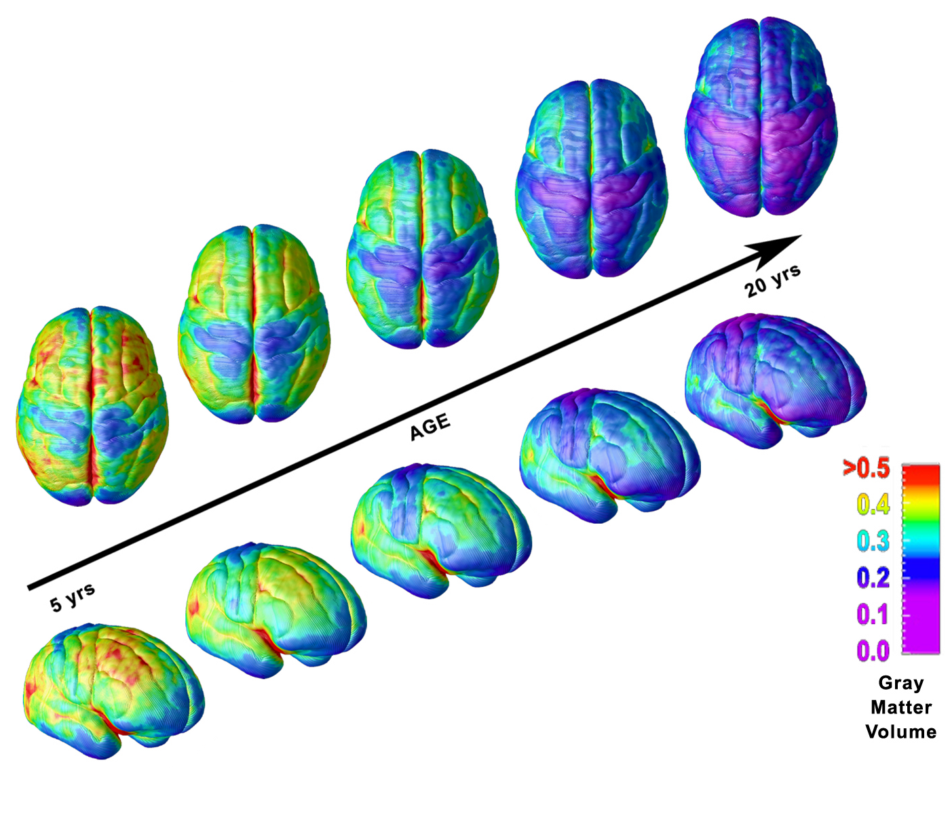
Brain Development Continues Through Age 25
Myelin
Pruning
Reorganization
Giedd, NIMH

Slide 3
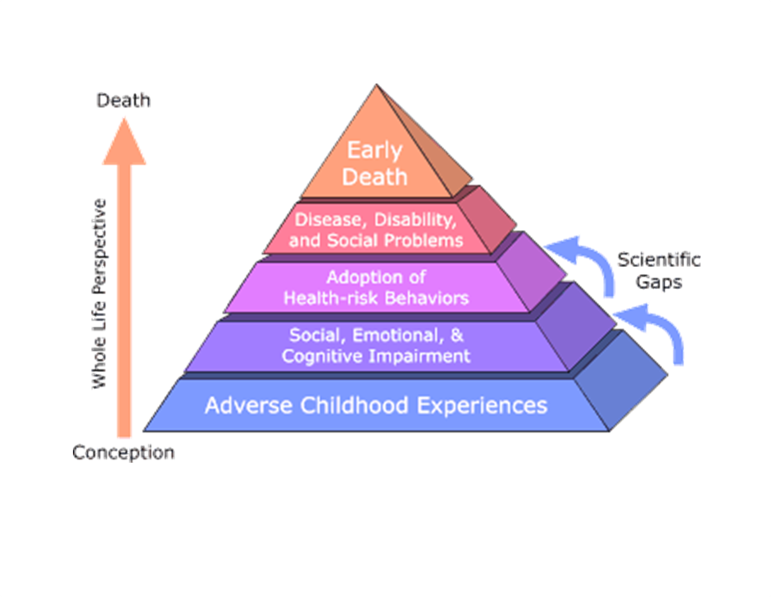
Psychiatric Disorders

Slide 4
DSM-5: Disruptive, Impulse-Control, & Conduct Disorders
ADHD
ODD/Conduct Disorder
Pyromania/Kleptomania
Intermittent Explosive Disorder (IED)

Slide 5
Disorders
ADHD

Slide 6
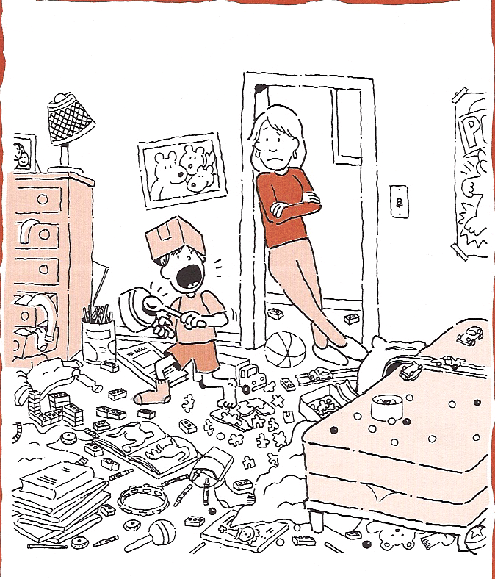

Slide 7
ADHD Prevalence
ADHD – most common neurobehavioral disorder in children
Increased from 7.8% in 2003 to 11% in 2011; a 42% increase in this decade!
Median age of diagnosis: 6 years (2011)
Medications: 4.8% in 2007, 6.1% in 2011,

Slide 8
ADHD (DSM-5)
3 types of presentation (not types):
  ADHD Inattentive Type
  ADHD Hyperactive/Impulsive Type
  ADHD Combined
Often persists into adult years.
Must cause functional impairment across settings (home/school), and must be developmentally relevant
Some symptoms should be present before age 12

Slide 9
ADHD: Core Symptom Area
Inattention
Six or more of the following >6 months :
Inattention to details/
makes careless mistakes
Difficulty sustaining attention
Seems not to listen
Fails to finish tasks
Difficulty organizing
Avoids tasks requiring sustained attention
Loses things
Easily distracted
Forgetful
*DSM-IV, 1994.

Slide 10
ADHD: Core Symptom Areas
Impulsivity/Hyperactivity
Six or more of the following >6 months
Impulsivity
Blurts out answer before question is finished
Difficulty awaiting turn
Interrupts or intrudes on others
Hyperactivity
Fidgets
Unable to stay seated
Inappropriate running/climbing (restlessness)
Difficulty in engaging in leisure activities quietly
“On the go”
Talks excessively
*DSM-IV, 1994.

Slide 11
Preschoolers
No consensus guidelines.
MUST RULE OUT DELAYS, Hearing & Vision loss, and speech or language impairment. Perform developmental screening.
Inquire about abuse, trauma, developmental issues, foster care, stress, domestic violence
Worry: If the child is a danger to self or others.
Remember attention span is not the primary objective. Hyperactivity and Impulsivity are more problematic in this age.
Medications: Paradoxical effects.

Slide 12
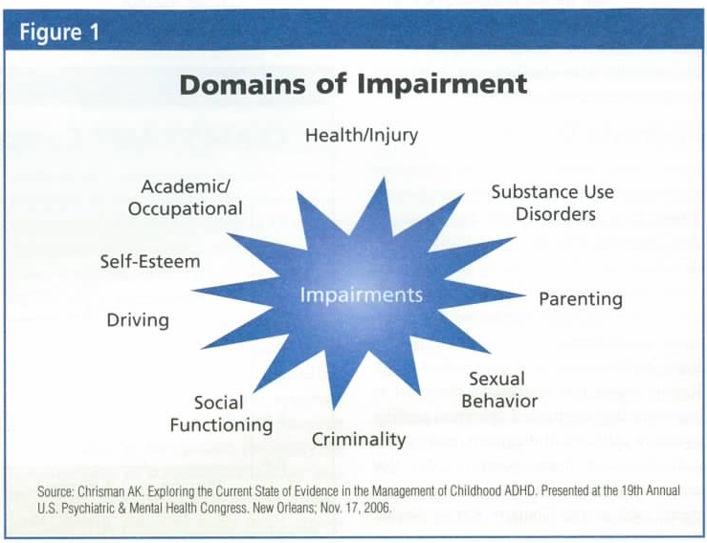

Slide 13
How ADHD Affects Parents
Increased stress
  Worry — Anxiety
  Frustration — Anger
Lower self-esteem
  Self-blame — Depression
  Social isolation
Increased employment disruption
Increased marital disruption
Increased alcohol/substance abuse
Murphy D, Barkley B. Am J Orthopsychiatry. 1996;66:93-102.

Slide 14
Risk factors for ADHD
Prenatal smoking/drug/alcohol use by mother
Maternal complications at delivery (prematurity, infection, trauma, etc).
Low-birth weight (<1500 grams)
Syndromes often present with symptoms earlier.
Inborn errors of metabolism may be associated with severe hyperactivity
Family interactions – unlikely to cause ADHD but may influence its course

Slide 15
ADHD: Etiology
ADHD is a heterogeneous behavioral disorder
with multiple possible etiologies
Environmental
factors
Neuroanatomical
neurochemical
ADHD
CNS
insults
Genetic
origins
CNS = central nervous system
Notes:
ADHD is most likely caused by a complex interplay of factors
Biologic factors that predispose an individual for ADHD include post-traumatic or infectious encephalopathy, lead poisoning, and fetal alcohol syndrome
Environmental influences include abuse or neglect, family adversity, and situational stress (affects course rather than cause ADHD)
Emerging literature provides support for the hypothesis that abnormalities in frontal networks or frontal-striatal dysfunction and catecholamine dysregulation are involved
Family and twin studies reveal compelling data regarding the genetic origin of ADHD; and recent advances in neuroimaging techniques have promoted closer study of neuroanatomic correlates

Slide 16
Dopaminergic Pathways (methyphenidate binding sites)
Nigrostriatal pathway
Motor control
Substantia Nigra to Basal Ganglia (caudate and putamen)
Mesolimbic pathway
Motivated behavior;
Reinforcement learning
Ventral Tegmental Area to Subcortical Limbic Regions (nucleus accumbens, olfactory tubercle)

Slide 17
Increased Lifetime Substance Abuse in Untreated Adults with ADHD
60
55%
ADHD (n=239)
50
Control (n=268)
40
Lifetime rate of substance abuse in referred ADHD adults
27%
30
20
10
0
Biederman, et al. Biol Psychiatry. 1998;44:269-273.
Notes:
Onset of substance abuse in subjects with ADHD averaged 3 years earlier than controls (late adolescence/early adulthood)
ADHD was a significant risk factor independent of comorbid diagnoses

Slide 18
Increased Smoking with ADHD
Adult Patients with ADHD; n=71
48.5%
50
40.8%
40
29%
ADHD
30
25.8%
General population
Current smokers (%)
20
10
0
Smokers
Quit ratio
Pomerleau, et al. J Subst Abuse. 1995;7:373-378.
Notes:
Pomerleau et al studied 71 adults with ADHD (55 males, 16 females with a mean age of 34 years) and found higher rates of smoking compared with controls
Results of the study suggest smokers with ADHD find exceptional difficulty in cessation, (despite numerous attempts to quit) compared with the general population
Although no definite conclusions regarding motives for smoking can be reached, authors reviewed the subjective and behavioral effects of nicotine:
Smoking is shown to:
Improve concentration and the ability to tune out irrelevant stimuli
Enhance memory recall
Increase alertness and arousal
Reduce anxiety and tension
When used as a psychostimulant, nicotine might improve symptoms in ADHD patients

Slide 19
Increased Traffic Violations and Motor Vehicle Accidents in Adolescents and Adults with ADHD
90
P=0.004
ADHD n=25
Control n=23
P=0.07
80
70
P=0.07
60
Subjects (%)
P=0.01
50
40
30
20
10
0
Traffic violations
Speeding violations
Drunk
driving
License suspended
Driver-caused accidents
Barkley RA, et al. Pediatrics. 1996;98:1089-1095.
Notes:
To evaluate the association of motor vehicle violations and accidents with ADHD, 25 young adults with ADHD and 23 controls were observed [Barkley 1996 p1090]
Subjects were evaluated on the basis of structured interviews, behavior ratings, video tests of driving knowledge, computer simulated driving tests, and official motor vehicle records [Barkley 1996 p1090-1091]
No differences were observed in driving skills or knowledge during the tests [Barkley 1996 p1091-1092]
Young adults with ADHD were more frequently cited for speeding, more likely to have their license suspended, and were involved in more motor vehicle accidents than age-matched controls [Barkley 1996 p1091-1092]
In a separate study, ADHD hyperactivity and inattention symptoms were examined with respect to driving violations and accidents
There was a significant association between ADHD or conduct disorder and driving offenses in male subjects [Nada-Raja 1997 p518]
In females, ADHD symptoms were more closely associated with motor vehicle offenses and accidents than with any other condition or no condition [Nada-Raja 1997 p518-519]

Slide 20
Pharmacotherapy Significantly Reduces Substance Abuse in Adults with ADHD
Effect of Pharmacotherapy
40
30
20
10
0
32%
P<0.001
% of study population
12%
10%
Unmedicated
ADHD
Medicated
ADHD
Control
(n=137)
(n=19)
(n=56)
Biederman J, et al. Pediatrics. 1999;104:e20-e25.
Notes:
The incidence of drug abuse was compared in 56 medicated ADHD patients, 19 non-medicated ADHD patients, and 137 non-ADHD control subjects
[Biederman 1999 pe21]
Non-medicated ADHD patients were at a significantly higher risk for substance abuse than controls or medicated ADHD patients [Biederman 1999 pe22-23]
There was no significant difference between medicated ADHD patients and controls (chi-squared=3.7, P=0.15) [Biederman 1999 pe22-23]
Medication is associated with an 85% reduction in the risk of substance abuse in ADHD patients [Biederman 1999 pe22-23]
Poor compliance is often a more significant problem than addiction [Garland 1998 p387-388]

Slide 21
ADHD Co-morbidities
ADHD rarely occurs as sole diagnosis
Comorbid conditions may diminish overall treatment responsiveness
Some comorbidities may diminish with effective treatment of ADHD
Others will require separate treatment strategies

Slide 22
Common Comorbidities with ADHD

Slide 23
Differential Diagnosis
Mental Retardation
Developmental Disorder
Chronic Illness
Sleep Disorders
Trouble seeing or hearing
History of Abuse
Anxiety
Depression
Severe Aggression
Seizure Disorder
Medical: Thyroid, Lead, Anemia
Age appropriate behaviors in active children

Slide 24
Learning Disabilities
ADHD
  All subjects affected with more difficulties in math and history
  Forgetfulness and disorganization.
  1:1 redirection improves grades/function
  Does better when motivated.
Learning Disabilities
  Grades lower in subject that is affected.
  History of speech delay.
  1:1 redirection not beneficial
  Child avoids that subject area specifically.

Slide 25
ODD and CD
Descriptive diagnosis does not imply etiology.
ODD may be secondary to ADHD.
ODD or CD may occur even without ADHD.
They are sometimes due to environmental factors (late onset) and usually due to multiple causes.
Key is that these children need to be monitored carefully and aggressively (Parent Management Training, etc.)

Slide 26
Anxiety
Always screen for anxiety.
Second try to determine if primary (comorbidity?) or secondary (situational). Management depends on this determination.
Anxiety can cause hyperactivity/impulsivity and inattention, and vice versa.

Slide 27
Depressive Disorders
Major Depressive Disorder
Dysthymia
Adjustment Reaction with depressed mood.
Adolescents and unhappiness
Screen for depression and again determine if depression is primary or secondary and address appropriately.

Slide 28
Bipolar Disorder
1% is prevalence of bipolar in children and adolescents.
Key is screen for bipolar and mood disorders.
Key questions: Decreased need for sleep, grandiosity, increased interest in sex/sexually acting out, and mood swings.
Aggression is a symptom not a diagnosis.

Slide 29
DIAGNOSIS

Slide 30
Steps in Diagnosis
Assessment
  History
  DSM criteria
  Interview — parents, teachers, and patient
    Determine functional impairment in home and school/job settings
  Rating scales to corroborate clinical diagnosis
  Physical exam, vital signs, physical explanation for disorder, secondary conditions
  Make assessment for comorbid conditions
  May need 2-3 visits for full work-up
Notes:
Once a child is identified by parents or teachers as displaying inattention behaviors, hyperactivity, and/or impulsivity, several steps are required to make a definitive diagnosis of ADHD
The clinician must first conduct a complete physical examination, including family history and vital signs. The exam is necessary to determine the possibility of an alternative medical explanation for symptoms, complicating secondary conditions, or potential drug contraindications [AACAP 1997 p86S]
Second, a series of interviews must be conducted with the patient, the parents, and teachers. This is necessary to fully characterize the symptoms. Though the clinician must evaluate the patient directly, the child may be able to maintain attention or behavior control while in the office. Therefore, the doctor must learn how the patient behaves in the home and school [AACAP 1997 p86S]
The interview process is also important for assessing comorbid conditions
[AACAP 1997 p86S]
The extent of the disorder must be determined by the use of rating scales
[AACAP 1997 p86S]

Slide 31
Questionnaires
Questionnaires are very helpful in obtaining objective information.
Cons: over/under reporting and bias; look for a pattern and do not use to strictly diagnose/rule out a diagnosis but add to your assessment.
BASC, SNAP IV, Conner’s, Vanderbilt, Brown, CBCL, ANSER etc.
Depends on your ability to score and interpret information.

Slide 32
Practice Guidelines
In children who have good primary care, other diagnostic tests are not routinely indicated
  EEG’s indicated only if a history of seizure d/o or clinically significant lapses in consciousness exists
  Continuous Performance Tests (CPT’s) are useful in research settings only
    measures of vigilance / distractibility which have low odds ratios in differentiating children with and without ADHD

Slide 33
Neuro-Imaging
ADHD children show 3-4% smaller brain volumes in all regions: frontal lobes, temporal gray matter, caudate nucleus, and cerebellum
Children that were medicated - the brain volumes in the regions increased and matched that of controls.
Children never medicated - continued with abnormally small volume of white matter.

Slide 34
MANAGEMENT

Slide 35
ADHD Management: Goals
  Improved academic performance
  Decreased disruptive behaviors
  Improvements in relationships
  Increased independence
  Improved self-esteem
  Enhanced safety

Slide 36
Three Components of ADHD Treatment
Education/Classroom interventions
Psychosocial interventions
Pharmacotherapeutic interventions
Notes:
There are 3 components to the treatment of ADHD
Education of patients and caregivers to create a framework for understanding and managing behavior
Psychosocial interventions to improve socialization and interpersonal interactions
Pharmacotherapeutic interventions to treat physiologic manifestations of the disorder

Slide 37
Educational Interventions
Classroom strategies and modifications
  Behavior modifications at school
  504 (Rehab Act of 1973 )/ Individualized Educational Plans (IEP): Allows (legally mandated) for classroom accommodations such as preferential seating, modified tests, more time for exams
Parent Education and Empowerment
  Parent Management Training for behavior
  Use naturally occurring consequences to teach social skills
  Reinforce positive behaviors and correct negative behaviors
  Establish and maintain house rules

Slide 38
Psychosocial Interventions in ADHD Treatment
Social skills training
  Target specific behaviors, i.e., playground aggression
  More effective in groups and natural environments like school or camp
  Stress conflict-resolution
  Support Groups: Scouts, Sports, Friends, Music, Church
Academic skills training
  Individual or group training
  Focus on following directions, time management, and study skills
AACAP. J Am Acad Child Adolesc Psychiatry. 1997;36:85S-121S.
Notes:
Strategies for attending to and rewarding positive child behavior
Often include modeling of specific parenting strategies
Improves parent behavior-management skills
Increases child compliance
Enhances parents’ sense of competence
Results last up to 6 months
Social skills training is a common part of multimodal treatment strategy
Since the child or adolescent often lacks the impulse control necessary for normal interaction, this training is used in peer relationships and social settings to improve interaction skills, conflict resolution, anger management, and problem solving [AACAP 1997 p100S]
Results of this strategy are inconsistent [AACAP 1997 p100S]
Individual training is not useful due to lack of self-observation in patients with ADHD [AACAP 1997 p100S]
Group training is more effective because target behaviors are displayed naturally and can be addressed by modeling, practice, feedback, and reinforcement [AACAP 1997 p100S]
Training in natural environments such as school or summer camps improves accuracy of results over clinic-based programs [AACAP 1997 p100S]

Slide 39
Role of Psychotherapy in ADHD
Cognitive-Behavioral Treatment
  Impulse control
  Anger management
Behavior Therapy
  Provide rewards and consequences
  Daily Schedule
  Cut down on distractions
  Set small appropriate goals
  Limit choices
  Use calm discipline
  Find activities at which your child can succeed

Slide 40
ADHD Treatments (Medication options)
Diets and supplements are not recommended
Psychostimulants remain the drugs of choice for ADHD
Warnings about ADHD drugs should NOT dissuade providers from using these drugs

Slide 41
Special Issues: Pharmacotherapy in Youth
Clinician must have good working alliance with both the patient AND the parents (a dual alliance)
Children (especially teens) may be reluctant consumers
Psychoeducation
Importance of school placement and teacher-doctor alliance
Each school may have different requirements for medicating children
From MTA study: parents recognize side effects and teachers recognize efficacy

Slide 42
Classes of Medication Used to Treat ADHD
FDA-approved
  Stimulants (methylphenidate, amphetamine)
  Non-stimulants:
    Atomoxetine – norephinephrine reuptake inhibitor
    α2-adrenergic agonists (antihypertensives) (clonidine ER, guanfacine ER)
Off-label
  Antidepressants (tricyclics, bupropion, venlafaxine)

Slide 43
ADHD Treatments (medication options)
Possible efficacy
  Omega 3-6-9 Fatty Acids (not FDA approved)
    For excellent review, see Freeman, et al. Jnl Clin Psychiatry 2006
Likely ineffective
  SSRIs
  Caffeine
  St. John’s Wort

Slide 44
Background: Stimulants
“Psychostimulant” - if nucleus accumbens is activated (FDA)
“Stimulate” certain areas of the brain to address ADHD symptoms
In use for “behavioral disorders” in children since 1930’s; well established by 1970’s
U.S. – 80% of worldwide consumption of stimulants
2 million prescriptions/month (2003, CDC) for methylphenidate (MPH), amphetamine (AMPH), and atomoxetine

Slide 45
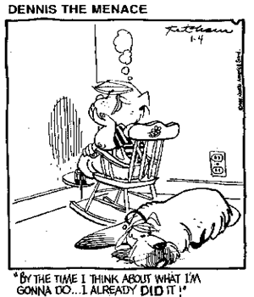
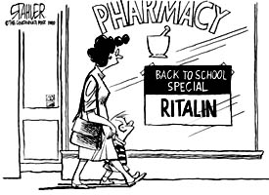

Slide 46
ADHD Treatments (medication options):
I: Stimulants
Two classes: methylphenidate (MPH) or amphetamines (AMP)
Efficacy: MPH=AMP; effect rate: >90%
MPH: Concerta, Ritalin, Focalin, Metadate, Daytrana, Quillivant , Methylin
AMP: Vyvanse, Adderall, Procentra, Dexedrin
Age-approved: 6 and above (except a couple that are 3 years and above)

Slide 47
Preparations
Single-pulse
(Immediate release)
Sustained release
Bead-filled capsule
(Extended release)
Some are immediate-release
Osmotic release oral system (OROS)
Capsule with MPH is slowly released as water is absorbed from the gut
? Variability of release
Rest are enteric coated delayed-release beads
20% dose initially released; osmotic pressure “pumps” rest out over 8-12 hours (Concerta)

Slide 48
Preparations
Transdermal
Daytrana patch
Activation of
pro-drug (Vyvanse)
lisdexamfetamine is activated once ingested
lysine in cleaved from AMPH

Slide 49
Adverse Effects
Most tolerate well
5% discontinue due to negative effects
Side effects are dose dependent
Most common side effects:
Insomnia (50% +)
Loss of Appetite (50% +)
Headaches (20-40%)
Stomach Aches (20-40%)
Irritability, tearfulness (<10%)
Nervous Habits & Mannerisms (<10%)
Tics (<3%) and Tourette’s (Rare)
Mild Weight Loss (Average 1-4 pounds; transient)
Small effect on height during 1st year (Approx 1cm) Increased heart rate (3-10 bpm)
Increased blood pressure (1.5-14 mmHg)
Psychosis (<3%)

Slide 50
Dealing With Adverse Effects
Insomnia – Sleep hygiene; Clonidine, Melatonin, Trazodone, or an antihistaminic agent
If only partial efficacy with stimulants, can “mix and match” with other anti-ADHD drugs (e.g., clonidine / guanfacine, bupropion, atomoxetine TCAs)
Dysphoric at days end: add MPH to Concerta at the end of the school day (no later than 3:30PM)
Appetite loss: high caloric snack, late PM snack, Endocrine referral, Periactin for appetite stimulation

Slide 51
ADHD Treatments (other medication options): II: Atomoxetine (Strattera)
Selective Norepinephrine Reuptake inhibitor (akin to SSRI (antidepressants) mechanisms)
No “on and off”
Effects seen at 2-4 weeks; not immediately
GI complaints, sedation
Can check LFT’s: not routine
Works best: if comorbid anxiety with ADHD

Slide 52
ADHD Treatments (medication options):
III: Antihypertensives
Alpha-2-agonists: clonidine ER (Kapvay), guanfacine ER (Intuniv)
Non-stimulants; effects seen at 2-4 weeks; not immediately
Common side effects: drowsiness, fatigue
    Monitor BP and HR for hypotension and bradycardia
Congruent with stimulant side-effects: stimulants can cause increase BP; these drugs will decrease it

Slide 53
ADHD Treatments (medication options):
Off-label
Clomipramine
  non-selective SRI
  data to show efficacy, but side-effects limit use
  possible use in co-morbid OCD
  high seizure risk (1.5% annual risk in adults)
Bupropion (Wellbutrin / Zyban)
  may have special use with comorbid depression or substance abuse
  side effects: seizures, insomnia, agitation, psychosis
Venlafaxine (Effexor)
  more benefits on behavioral than cognitive symptoms
  anecdotal reports: useful in OCD, perseveration, depression, anxiety, agitation

Slide 54
Course
Approximately 50% of children with ADHD have a favorable prognosis.
Nearly 25% develop Antisocial Personality Disorder
Almost half of the children with ADHD continue residual symptoms during their adulthood.
Reduction of hyperactivity in adults is attributed to the use of coping (cognitive) skills
Adults with ADHD have difficulties with concentration, organizing tasks and memory all of which are related to executive functions.

Slide 55
DSM-5: Disruptive, Impulse-Control, & Conduct Disorders
Oppositional Defiant Disorder (ODD)
Conduct Disorder (CD)
Pyromania
Intermittent Explosive Disorder (IED)
Kleptomania

Slide 56
Oppositional Defiant Disorder (ODD)
Angry/Irritable mood (3 symptoms): loses temper, easily annoyed, angry & resentful
Argumentative/Defiant behavior (4 symptoms): authority figures, non-compliant with rules, deliberately annoys, blames others
Vindictiveness (1 symptom): twice/6months
4/8 symptoms
<5 years: most days/week x6 months
>5 years: 1/week x6 months

Slide 57
Conduct Disorder (CD)
Aggression to people & Animals (7 symptoms): Bully, physical fights, weapon, physically cruel to people/animals, stealing while confronting a victim, forcible sexual activity
Destruction of property (2 symptoms): destruction of property, fire
Deceitfulness/Theft (3 symptoms): burglary, “cons”, stealing without confrontation (forgery, shoplifting)
Serious violation of rules (3 symptoms): breaks curfews, run away from home, truancy
3/15 symptoms in past 12 months
“Callous” (lacks empathy), lacks remorse

Slide 58
Etiology: ODD & CD
Biological Factors:
  Moderate degree of heritability for aggression, delinquency, and antisocial behavior (especially CD)
  Elevated levels of dehydroepiandrosterone sulfate (DHEAS) in children with ODD
  Maternal smoking during pregnancy: increases risk for CD
  Low-level salivary cortisol: predictive of CD to antisocial personality disorder
Psychological Factors:
  Stimulated by possible reward; less sensitive to the possibility of punishment.
Notes:
NOTES:________________________________________________________________________________________________________________________________________________________________________________________________________________________________________________________________________________________________________________________________________________________________________________________________________________________________________________________________________________________________________________________________________________________________________________________________________________________________________________________________________________________________________________________________

Slide 59
Etiology: ODD & CD
Sociological Factors:
  Lower socioeconomic status
  Family stresses and resulting dysfunction.
  Poor parenting practices, parental discord, domestic violence, low family cohesion, child abuse, and parental mental disorder, especially substance abuse and antisocial personality disorder
  Mothers of children at increased risk for oppositional and disruptive behaviors report feeling less competent as parents, having fewer solutions for child behavior problems, and being less assertive in management of child misbehavior
  Harsh or inconsistent limit setting is predictive of later oppositional and antisocial behaviors
Notes:
NOTES:________________________________________________________________________________________________________________________________________________________________________________________________________________________________________________________________________________________________________________________________________________________________________________________________________________________________________________________________________________________________________________________________________________________________________________________________________________________________________________________________________________________________________________________________

Slide 60
Treatment: ODD & CD
Pharmacological Treatments: No evidence exists to support an indication for specific medication use in treatment of ODD; can use for symptomatic rx
Psychotherapeutic Treatments:
  Parent management training and child problem-solving skills training have demonstrated the greatest efficacy
  Children: CBT (Cognitive Behavior Therapy)
  Early intervention appears to increase the chances for improvement.
Notes:
NOTES:________________________________________________________________________________________________________________________________________________________________________________________________________________________________________________________________________________________________________________________________________________________________________________________________________________________________________________________________________________________________________________________________________________________________________________________________________________________________________________________________________________________________________________________________

Slide 61
Intermittent Explosive Disorder (IED)
Recurrent behavioral outbursts & failure to control aggressive impulses (verbal or physical); not premediated/no tangible gain (money, power, intimidation), patient is distressed by actions
Magnitude of outburst out of proportion to the trigger
One-year prevalence in US: 2.7%
Environmental risk factors: trauma
Genetic risk factors: runs in family; Serotonergic abnormalities globally but mostly in limbic system and orbitofrontal cortex
fMRI studies – Amygdala responses to anger stimuli greater
Most common co-morbid conditions: Mood, Anxiety, Substance-abuse

Slide 62
Pyromania
Deliberate fire setting
Tension or affective arousal before the act
Pleasure and gratification during and after; relief on setting/witnessing/aftermath of fire
Advance preparation, satisfaction, don’t care @ consequences
Not for monetary gain or political statement
Poor social skills, Learning difficulties, Alcohol use, Gambling, Mood Disorders

Slide 63
Kleptomania
Recurrent failure to resist impulses to steal objects that are not needed for personal use or for their monetary gain
Tension before the act; pleasure/gratification/relief at the time of theft.
Aware that their act is wrong and senseless
Guilty/depressed @ their thefts
Greater in females
Serotonin, Dopamine, Opioid systems involved
Compulsive buying, Mood d/o, Anxiety, Eating d/o, Personality d/o, Substance-abuse d/o

Slide 64
Any Questions???

Slide 65
Possible acquired etiological influences in ADHD include:
Low socio economic status
Elevated intake of sugar containing foods during early childhood
High birth weight (>4000 g)
Prenatal exposure to alcohol or nicotine
All of the above

Slide 66
Hyperactive children are often
Accident prone
Explosively irritable
Unable to resist blurting out answers
Excessively talkative
All of the above

Slide 67
Which of the listed disorders is the most common co-morbidity with ADHD in children?
Learning disorders in Math
Learning disorders in expressive language
Oppositional defiant disorder
Separation anxiety disorder
Gender Identity Disorder of Childhood

Slide 68
Which of the following statements about Wellbutrin (bupropion) is true?
It should not be used in youth with a history of seizure disorder
It should not be used in youth with a history of eating disorder
It can be associated with serum sickness
It has off-label use for ADHD
All of the above

