Slide 1
Eating Disorders
Kelly Bennett, MD
Associate Professor
Department of Family Medicine

Slide 2
Objectives
Describe the diagnostic criteria for anorexia, bulimia, and binge eating disorders
Describe the signs and symptoms for anorexia and bulimia
Describe the objective findings for anorexia and bulimia
Describe the treatments for anorexia and bulimia
Be able to discuss the teamwork approach in the treatment of eating disorders

Slide 3
DSM 5 Classification
Anorexia Nervosa
  Restrictive type
  Binge Eating/Purging type
Bulimia Nervosa
Binge-Eating Disorder

Slide 4
Anorexia Nervosa
Diagnostic Criteria
  Restriction of caloric intake relative to requirement leading to significantly low body weight
  Intense fear of gaining weight
  Disturbance in the way in which one’s body weight or shape is experienced

Slide 5
Subtypes
Restrictive
  Weight loss is accomplished through dieting, fasting, and/or excessive exercise
Binge eating/purging
  Also engaging in binge eating or purging behavior (vomiting, , misuse of laxative, diuretics or enemas)
Specify if in partial or full remission

Slide 6
Severity of Anorexia
Based on World Health Organization categories for malnutrition
Mild: BMI > 17
Moderate: BMI 16-16.99
Severe: BMI 15-15.99
Extreme: BMI < 15

Slide 7
Prevalence of Anorexia
12 month prevalence in young women
  0.4%
10:1 Female to Male ratio

Slide 8
Development and Course
Begins during adolescence or young adulthood
Generally will go into remission within five years
If severe enough to be hospitalized (medical facility) remission rate lower
Mortality rate is 5% per decade (from medical complications or suicide)

Slide 9
Risk Factors
Higher rate of development in people with anxiety disorders or obsessive compulsive disorders
Environments of extreme fitness or thinness
  Athletics, modeling, acting, dancing
Genetic: increased risk among first degree relatives; concordance rates in monozygotic twins is very high

Slide 10
Case 1
22 white female presents with fatigue and shin pain
HPI: patient has felt tired for several months; exercises two to three hours daily on treadmill; admits to excessive calorie counting
Physical Exam:
  Thin in appearance; can see strap muscles on neck
  Heart bradycardic; lungs clear
  Abdomen: cachectic; normal bowel sounds
  Extremities: muscle wasting
Labs:
  H/H: 5/15
  CMP: elevated LFTs, low calcium
  X-rays: tibias fractured bilaterally

Slide 11
Case 1 continued
BMI: 14
Admitted patient to the hospital
Troponin 5 x normal
ECHO: hypo kinesis; cardiology consulted
Bone scan: osteopenia; started on Fosamax and calcium
Placed by orthopedics in bilateral walking boats
Patient started on TPN; was in house for two weeks
Transferred to In patient treatment center

Slide 12
Symptoms
Amenorrhea
Depression
Pain in extremities
Cold intolerance
Constipation
Insomnia
Pre-syncope and Syncopal episodes

Slide 13
Physical signs
Emaciation
Hypotension
Hypothermia
Bradycardia
Lanugo
Sallow color of skin
Osteopenia

Slide 14
Objective Findings
Hematology: leukopenia, anemia
Chemistry: elevated triglycerides, elevated low density lipid (LDL), elevated Liver function tests, low magnesium, low phosphate
Endocrine: low T4 and T3; females with low estrogen, males with low testosterone
EKG: bradycardia, prolongation of the QT interval
Bone mass: low bone mineral density

Slide 15
Differential Diagnosis
Hyperthyroidism
Occult malignancy
HIV/AIDS
Gastro Intestinal disorder
Substance use (meth, stimulants)

Slide 16
Psychological Characteristics
Refusal to eat despite feeling hungry
Body dysmorphia (believing fat while emaciated)
Lack of sex drive
Interfamily conflicts
Excessive exercising
Generally was/is a good student (honors, AP)

Slide 17
Treatment
Team approach:
  Primary care doctor
  Nutritionist/Dietician
  Therapist
  +/- psychiatrist
  CAUTION with group therapies
Intensive outpatient behavioral/psychological treatment
In patient behavioral/psychological treatment programs
In patient medical hospitalization
Family therapy

Slide 18
Hospital Treatment
Medical hospitalization sometimes required for those with severe malnutrition and always with extreme malnutrition (generally less than BMI of 16)
Re-feeding syndrome
  Too much food into the non active gut can cause massive electrolyte shifts resulting in high magnesium and phosphate levels
  This can lead to fatal arrhythmias
  Discovered after World War II when concentration camp victims were fed too quickly by allied personnel
Must use TPN first (total parental nutrition) before starting oral feeds

Slide 19
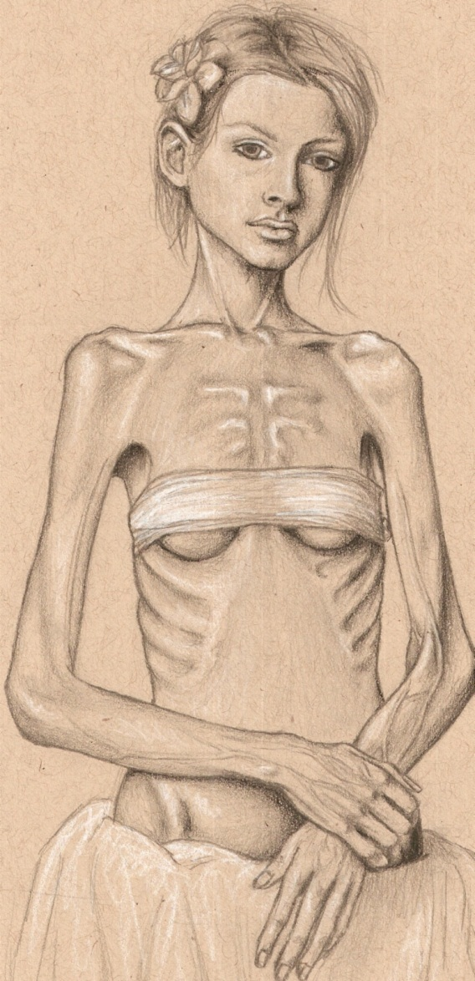

Slide 20
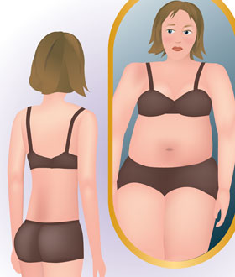

Slide 21
Bulimia Nervosa
Recurrent episodes of binge eating
  Within a discrete time period an amount larger than the average individual would eat
  Sense of lack of control
Recurrent inappropriate compensatory behaviors
  Self induced vomiting
  Misuse of laxatives, diuretics, enemas
  Fasting or excessive exercise
This behavior is noted at least once weekly for three months
Body weight is not influenced (can be normal or overweight)

Slide 22
Bulimia
Can be in partial or full remission
Severity:
  Mild: 1-3 episodes per week
  Moderate: 4-7
  Severe: 8-13
  Extreme: > 14

Slide 23
Associated features
Eating in private
Feeling shameful about eating
Hiding purging (hiding vomiting or meds for diuresis or laxatives)
Most patients with BMI 18-30
12 month prevalence is 1-1.5%
10:1 Female to male ratio

Slide 24
Risk factors
Low self esteem, social anxiety, dysthymia
Environments of thin culture
Genetic: childhood obesity and early puberty increase the risk; familial transmission not as strong as anorexia

Slide 25
Case 2
18 Hispanic female presents due to excessive heartburn
HPI: patient admits to binging and purging; vomits four to five times daily; exercises to extreme; admits to depression
Physical:
Patient with enlarged parotids, scars on back of hands; dental enamel deteriotion; otherwise physical is normal
Labs: EKG, CBC, CMP, TSH all normal
Diagnosis: GERD due to frequent emesis
Treated with antidepressants, counseling, nutritionist
Ended up having to have partial parotidectomy and dentures

Slide 26
Symptoms
Parotid gland pain
Gastro esophageal reflux
Constipation
Menstrual irregularities

Slide 27
Signs/lab work
Many times no abnormalities are noted on physical exam or lab testing
Parotid enlargement
Poor dentition
Scarring on hands (Russell sign)
Electrolyte abnormalities
Melanosis coli (blackened colon walls noted on colonoscopy if misusing laxatives)

Slide 28
Treatment
Team approach
  Primary care physician
  Nutritionist/Dietician
  Therapist
  +/- psychiatrist
  Antidepressants {usually SSRIs; bupropion (Wellbutrin) contraindicated due to lowered seizure threshold}
  Again caution with Group therapy; must be supervised
Intensive outpatient or inpatient behavioral/psychological treatment
Rarely needs medical hospitalization

Slide 29
Binge-Eating Disorder
Recurrent episodes of binge eating
  Eating in a period of time an amount above what an average person would eat
  Sense of lack of control
Associated with 3 or the following 5:
  Eat more rapidly than normal
  Eat until feeling uncomfortably full (sick)
  Eating when not hungry
  Eating while alone due to embarrassment
  Feeling disgusted after eating
There is NO COMPENSATORY behavior of restricting calories through fasting, purging, exercise

Slide 30
Binge Eating
Partial versus full remission
Severity
  Mild: 1-3 episodes of binge eating in one week
  Moderate: 4-7
  Severe: 8-13
  Extreme: >14
Ratio Female to Male closer to the same

Slide 31
Binge-Eating
Patients generally >18 BMI
Generally there are no signs or symptoms
Treatment
  Primary Care Physician
  Nutritionist/Dietician
  Therapist

Slide 32
Bibliography
Diagnostic and Statistical Manual of Mental Disorders. Fifth Edition; pages 338-353.
First Aid for the Basic Sciences: Organ Systems. Second Edition; pages 567-572.
Board Review Series: Behavioral Science. Sixth Edition; pages 148-149.

