Slide 1
Obesity Overview and Pharmacology
Nancy Beck, MD nancy.beck@ttuhsc.edu

Slide 2
Objectives
Review the health consequences of overweight and obesity.
Review the advantages of weight loss.
Review methods used to identify overweight and obese states.
Discuss medications used as adjuncts in the treatment of obesity.

Slide 3
ROAD MAP
Review of obesity
Medications used as adjuncts in the treatment of obesity:
    Lorcaserin
    Phentermine/Topiramate
    Orlistat
    Bupropion/Naltrexone

Slide 4
Obesity Trends* Among U.S. Adults
BRFSS, 1990, 1999, 2009
(*BMI ≥30, or about 30 lbs. overweight for 5’4” person)
1990
1999
2009
No Data <10% 10%–14% 15%–19% 20%–24% 25%–29% ≥30%

Slide 5
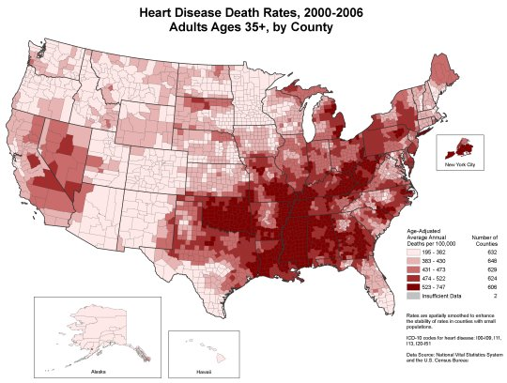
Source: US Census Bureau

Slide 6
Health Consequences of
Obesity & Overweight
Hypertension
Dyslipidemia
Type 2 diabetes
Coronary artery disease
Stroke
Gallbladder disease
Osteoarthritis
Low back pain
Sleep apnea and respiratory problems
Certain cancers
Associated with higher mortality from all causes
Identification, Evaluation, & Treatment of Overweight & Obesity in Adults, NHLBI, NIH 2000; Bates, p. 130

Slide 7
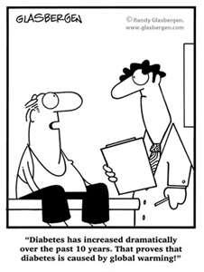

Slide 8
Advantages of weight loss
Weight loss of 0.5-9 kg (n=43,457) associated with 53% reduction in cancer-deaths, 44% reduction in diabetes-associated mortality and 20% reduction in total mortality
Survival increased 3-4 months for every kilogram of weight loss
Reduced hyperlipidemia, hypertension and insulin resistance
Improvement in severity of diseases
Person feels ‘fit’ and mentally more active

Slide 9
What is Obesity?
Obesity means excess accumulation of fat in the body
Once it develops it is difficult to ‘cure’ and usually persists throughout life
Obesity is usually diagnosed on the basis of calculation of
  Body mass index
  Measurement of waist circumference
        Bates, pp. 104-108, 112-113

Slide 10
Body Mass Index (BMI)
BMI defined as: Weight (kg)
Height (m²)
or Weight (lbs) X 703
Height (inches)²
BMI replaces the Metropolitan Life height/weight tables
BMI is calculated the same for men, women, and children
BMI correlates significantly with body fat, morbidity and mortality
Clinical judgment must be used in interpreting BMI
May be an overestimate of body fat in very muscular individuals, large skeletal mass, presence of edema

Slide 11
Definition of Obesity Using Body Mass Index
Classification | BMI (kg/m²)
Underweight | < 18.5
Normal Weight | 19 - 24.9
Overweight | 25 - 29.9
Class I Obesity | 30 -34.9
Class II Obesity | 35 - 39.9
Class III Obesity | ≥ 40
  NHLBI Clinical Guidelines on the Identification, Evaluation and Treatment of Overweight and Obesity in Adults-the Evidence Report. Obesity Research 1998:(suppl.) 53S.

Slide 12
Body Mass Index Chart
WEIGHT lbs | 100 | 105 | 110 | 115 | 120 | 125 | 130 | 135 | 140 | 145 | 150 | 155 | 160 | 165 | 170 | 175
HEIGHT
5’0” | 20 | 21 | 21 | 22 | 23 | 24 | 25 | 26 | 27 | 28 | 29 | 30 | 31 | 32 | 33 | 34
5’1” | 19 | 20 | 21 | 22 | 23 | 24 | 25 | 26 | 26 | 27 | 28 | 29 | 30 | 31 | 32 | 33
5’2” | 18 | 19 | 21 | 22 | 22 | 23 | 24 | 25 | 26 | 27 | 27 | 28 | 29 | 30 | 31 | 32
5’3” | 18 | 19 | 20 | 21 | 21 | 22 | 23 | 24 | 25 | 26 | 27 | 27 | 28 | 29 | 30 | 31
5’4” | 17 | 18 | 20 | 21 | 21 | 21 | 22 | 23 | 24 | 25 | 26 | 27 | 27 | 28 | 29 | 30
5’5” | 17 | 17 | 19 | 20 | 20 | 21 | 22 | 22 | 23 | 24 | 25 | 26 | 27 | 27 | 28 | 29
5’6” | 16 | 17 | 19 | 19 | 19 | 20 | 21 | 22 | 23 | 23 | 24 | 25 | 26 | 27 | 27 | 28
5’7” | 16 | 16 | 18 | 19 | 19 | 20 | 20 | 21 | 22 | 23 | 23 | 24 | 25 | 26 | 27 | 27
5’8” | 15 | 16 | 17 | 18 | 18 | 19 | 20 | 21 | 21 | 22 | 23 | 24 | 24 | 25 | 26 | 27
5’9” | 15 | 16 | 17 | 18 | 18 | 18 | 19 | 20 | 21 | 21 | 22 | 23 | 24 | 24 | 25 | 26
5’10” | 14 | 15 | 17 | 17 | 17 | 18 | 19 | 19 | 20 | 21 | 22 | 22 | 23 | 24 | 24 | 25
5’11” | 14 | 15 | 16 | 17 | 17 | 17 | 18 | 19 | 20 | 20 | 21 | 22 | 22 | 23 | 24 | 24
6’0” | 14 | 14 | 16 | 16 | 16 | 17 | 18 | 18 | 19 | 20 | 20 | 21 | 22 | 22 | 23 | 24
6’1” | 13 | 14 | 15 | 16 | 16 | 16 | 17 | 18 | 18 | 19 | 20 | 20 | 21 | 22 | 22 | 23
6’2” | 13 | 13 | 15 | 15 | 15 | 16 | 17 | 17 | 18 | 19 | 19 | 20 | 21 | 21 | 22 | 22
6’3” | 12 | 13 | 14 | 14 | 15 | 16 | 16 | 17 | 17 | 18 | 19 | 19 | 20 | 21 | 21 | 22
6’4” | 12 | 13 | 13 | 14 | 15 | 15 | 16 | 16 | 17 | 18 | 18 | 19 | 19 | 20 | 21 | 21
Underweight | Normal | Overweight | Obese

Slide 13
Body Mass Index Chart
WEIGHT lbs | 180 | 185 | 190 | 195 | 200 | 205 | 210 | 215 | 220 | 225 | 230 | 235 | 240 | 245 | 250
HEIGHT
5’0” | 35 | 36 | 37 | 38 | 39 | 40 | 41 | 42 | 43 | 44 | 45 | 46 | 47 | 48 | 49
5’1” | 34 | 35 | 36 | 37 | 38 | 39 | 40 | 41 | 42 | 43 | 43 | 44 | 45 | 46 | 47
5’2” | 33 | 34 | 35 | 36 | 37 | 37 | 38 | 39 | 40 | 41 | 42 | 43 | 44 | 45 | 46
5’3” | 32 | 33 | 34 | 35 | 35 | 36 | 37 | 38 | 39 | 40 | 41 | 42 | 43 | 43 | 44
5’4” | 31 | 32 | 33 | 33 | 34 | 35 | 36 | 37 | 38 | 39 | 39 | 40 | 41 | 42 | 43
5’5” | 30 | 31 | 32 | 32 | 33 | 34 | 35 | 36 | 37 | 37 | 38 | 39 | 40 | 41 | 42
5’6” | 29 | 30 | 31 | 31 | 32 | 33 | 34 | 35 | 36 | 36 | 37 | 38 | 39 | 40 | 40
5’7” | 28 | 29 | 30 | 31 | 31 | 32 | 33 | 34 | 34 | 35 | 36 | 37 | 38 | 38 | 39
5’8” | 27 | 28 | 29 | 30 | 30 | 31 | 32 | 33 | 33 | 34 | 35 | 36 | 36 | 37 | 38
5’9” | 27 | 27 | 28 | 29 | 30 | 30 | 31 | 32 | 32 | 33 | 34 | 35 | 35 | 36 | 37
5’10” | 26 | 27 | 27 | 28 | 29 | 29 | 30 | 31 | 32 | 32 | 33 | 34 | 34 | 35 | 36
5’11” | 25 | 26 | 26 | 27 | 28 | 29 | 29 | 30 | 31 | 31 | 32 | 33 | 33 | 34 | 35
6’0” | 24 | 25 | 26 | 26 | 27 | 28 | 28 | 29 | 30 | 31 | 31 | 32 | 33 | 33 | 34
6’1” | 24 | 24 | 25 | 26 | 26 | 27 | 28 | 28 | 29 | 30 | 30 | 31 | 32 | 32 | 33
6’2” | 23 | 24 | 24 | 25 | 26 | 26 | 27 | 28 | 28 | 29 | 30 | 30 | 31 | 31 | 32
6’3” | 22 | 23 | 24 | 24 | 25 | 26 | 26 | 27 | 27 | 28 | 29 | 29 | 30 | 31 | 31
6’4” | 22 | 23 | 23 | 24 | 24 | 25 | 26 | 26 | 27 | 27 | 28 | 29 | 29 | 30 | 30
Underweight | Normal | Overweight | Obese

Slide 14
Body Fat Distribution
People store body fat in two general ways; either above or below the waist.
  Android (or abdominal, central, males, apple shape)
  Gynoid (below waist, females, pear-shape)
In both men and women, excess intra-abdominal adipose tissue correlates strongly with cardiovascular disease, dyslipidemia, hypertension, stroke and type 2 diabetes.
Documenting body fat distribution, in conjunction with BMI, is important to assess health risk.

Slide 15
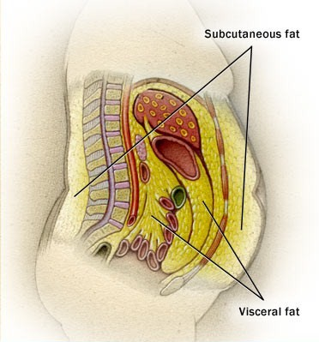
Visceral Fat
(Intra-abdominal Fat)

Slide 16
Body Fat Distribution
Waist circumference - measured at the mid-point between the ileac crest and the lower rib.
Correlates strongly with intra-abdominal adipose tissue as assessed by CT and MRI.
Increased risk of type 2 DM, HTN, dyslipidemia, CHD, metabolic syndrome.
> 40 in. males, > 35 in. females – “high risk”.
Abdominal fat releases excess free fatty acids into the portal circulation which is associated with insulin resistance at the level of the liver and muscle.

Slide 17
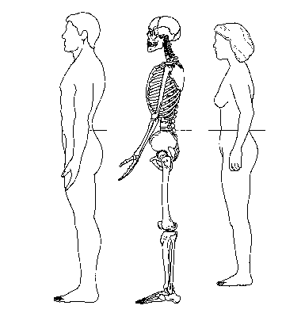
Waist Circumference

Slide 18
Etiology of Obesity
Dietary Intake
Increased caloric intake result of:
  Increased portion sizes (“super-size”)
  Increased frequency of eating outside the home
  Fat-free foods perceived as low calorie or calorie free
  Increased fast food consumption
Ernst N. Am J Clin Nutr 1997;66(suppl):965S-72S.

Slide 19
Prevalence of Obesity
in Four Surveys

Slide 20
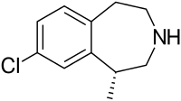
LORCASERIN (BELVIQ)
Selective 5-H_{2C} receptor agonist
Acts as an appetite suppressant
Unlike non-selective serotonergic agonists (fenfluramine & dexfenfluramine), lorcaserin is selective for 5-H_{2C} receptor – not likely to be associated with serotonin-related valvulopathy.
Clinical evidence that when used as adjunct to lifestyle modification for 1-2 years, assoc. w/significant weight loss.

Slide 21
LORCASERIN (BELVIQ)
Thought to work through the pro-opiomelanocortin system of neurons.
Has an affinity for 5-HT_{2C} receptors approx. 15 times that for 5-HT_{2A} receptors, and 100 times that for 5-HT_{2B} receptors.
Important since activation of 5-HT_{2A} receptors can lead to neuropsychiatric side effects, while 5-HT_{2B} receptor activation assoc. w/development of valvulopathy and primary pulmonary htn.

Slide 22
LORCASERIN (BELVIQ)
PHASE III TRIALS:
BLOOM (Behavioral Modification and Lorcaserin for Overweight and Obesity Management) Study
BLOSSOM (Behavioral Modification and Lorcaserin Second Study for Obesity Management)

Slide 23
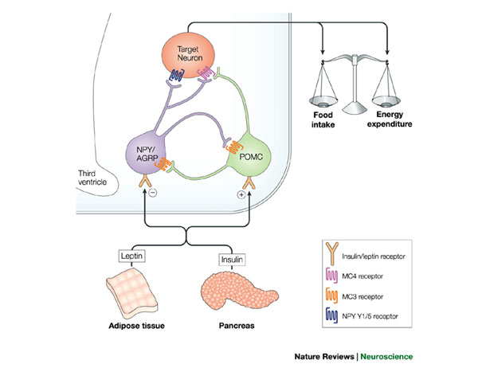
Leptin and insulin inhibit activity of neuropeptide Y/agouti-related peptide (NPY/AGRP) neurons while stimulating activity of pro-opiomelanocortin (POMC) neurons. NPY and AGRP (a melanocortin receptor antagonist) can potently increase food intake and result in accumulation of increased stored calories. POMC is a precursor for several biologically active peptides, including α-melanocyte stimulating hormone (α-MSH). α-MSH acts as a melanocortin receptor agonist. Through these disparate actions on distinct cell types in the arcuate nucleus, adiposity signals can influence the amount of NPY and melanocortin signaling in downstream target neurons.

Slide 24
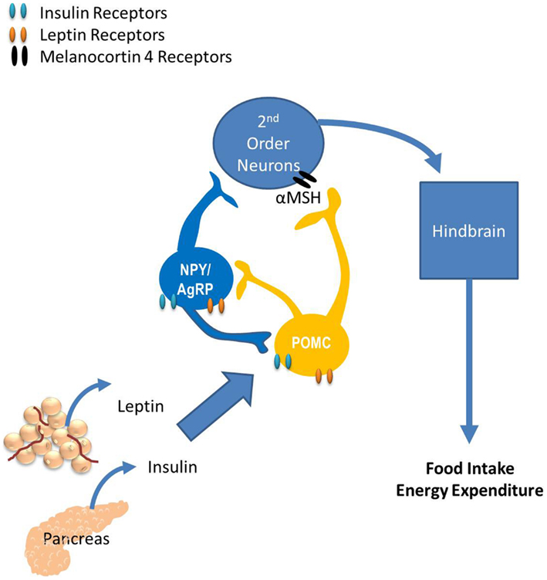

Slide 25
LORCASERIN (BELVIQ)
BLOOM Study:
  3,182 participants with BMI 30-45 kg/m² or 27-45 kg/m² with an obesity-related comorbidity.
  Lorcaserin 20 mg/day or placebo for one year alongside weight-loss program.
  After one year, signif. more pts. in lorcaserin group had lost ≥ 5% of baseline body weight (47.5% vs. 20.3%; P < .0001).
  Mean weight change over one year: lorcaserin -5.8 kg; placebo -2.2 kg.

Slide 26
LORCASERIN (BELVIQ)
BLOOM Study:
  In pts. who achieved weight loss of ≥ 5% at one year, a significantly higher proportion of those who continued to receive lorcaserin maintained ≥ 5% weight loss at 2 years compared with those who switched to placebo at one year (67.9% vs. 50.3%, P < .001).
  Fasting glucose, insulin, and HbA_{1C} significantly lower after 1 year of lorcaserin tx. vs. placebo.
  However, fasting glucose and insulin levels tended to increase with body weight overall during 1-year extension.

Slide 27
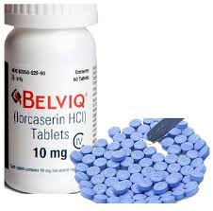
LORCASERIN (BELVIQ)
BLOOM Study:
  Significant improvements in markers of cardiovascular risk compared with placebo:
    Systolic and diastolic blood pressure
    Levels of fibrinogen
    C-reactive protein (CRP)

Slide 28
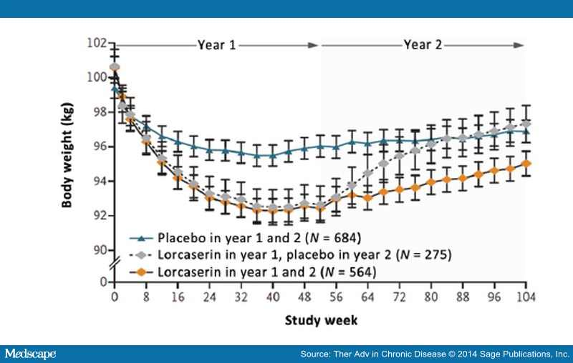

Slide 29
LORCASERIN (BELVIQ)
BLOOM-DM Study:
  This study evaluated weight loss and glycemic control in pts. with type 2 diabetes:
      Weight decreased by -4.5% with lorcaserin bid and -5.0% with lorcaserin qd vs. -1.5% with placebo (P < 0.001).
      Hemoglobin A1c levels also decreased in lorcaserin groups (-0.9% with lorcaserin bid; -1.0% with lorcaserin qd; 0.4% with placebo).

Slide 30
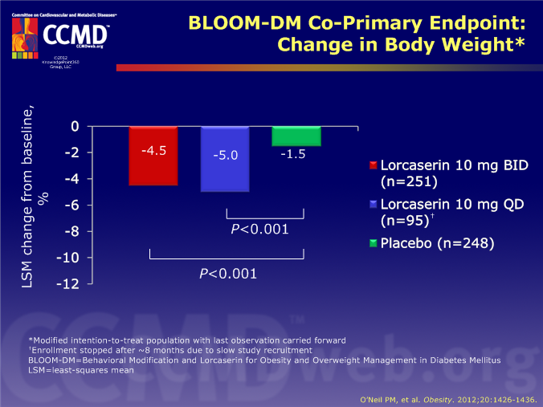

Slide 31
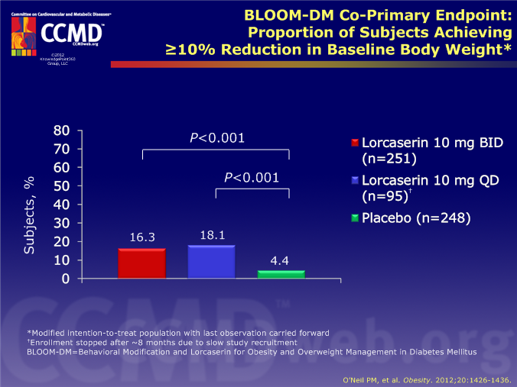

Slide 32
LORCASERIN (BELVIQ)
BLOSSOM Study: 4,008 patients with BMI of 30-45 kg/m² or 27-29.9 kg/m² with an obesity-related comorbidity.
  Randomized in 2:1:2 ratio to receive lorcaserin 20 mg/day, 10 mg/day, or placebo for one year, in conjunction with diet and exercise.
  Significantly more pts. receiving lorcaserin (at either dose) lost ≥ 5% body weight compared with placebo.
  Mean wt. changes were -5.8 kg and -4.7 kg in lorcaserin 20 mg and 10 mg, respectively, and -2.9 kg in placebo.

Slide 33
LORCASERIN (BELVIQ)
  POST-HOC ANALYSIS OF POOLED DATA FROM BLOOM AND BLOSSOM:
    Superiority of lorcaserin over placebo with regard to weight loss
    Conversion to type 2 diabetes in pts. with pre-diabetes at baseline was less frequent in lorcaserin group (3.4%) than the placebo group (5.5%).
    Across both studies, most frequently reported adverse events (AEs) :
    Headache, upper respiratory tract infection, nausea, dizziness, sinusitis, and nasopharyngitis, with fatigue and UTI also among most frequently reported in BLOSSOM.

Slide 34
LORCASERIN (BELVIQ)
44% of patients who were treated with lorcaserin 10 mg bid lost 4.5% or more of their body weight by 3 months of treatment.
These people went on to have a 10.5% weight loss by 1 year.
Thus, lorcaserin therapy should be evaluated at 12 weeks.
If pt. has not lost at least 5% of body weight by 12 weeks it is recommended to discontinue therapy (since it will likely not be effective).

Slide 35
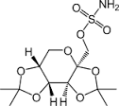
PHENTERMINE/TOPIRAMATE
Commercial name is Qsymia.
Phentermine is an amphetamine analog,
  with activity as an appetite suppressant.
Mechanism of action is attributed to its sympathomimetic action, which is related to catecholamine release in hypothalamus.
Topiramate also reduces caloric intake.

Slide 36
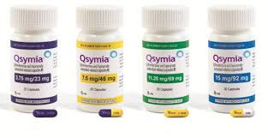
PHENTERMINE/TOPIRAMATE
Topiramate’s MOA not fully understood.
Reduces compulsive & addictive food craving via antagonism of α-amino-3-hydroxy-5-methyl-4-isoxazolepropionic acid (AMPA) receptors and kainate receptors (ionotropic receptors that respond to the neurotransmitter glutamate).
Decreases lipogenesis.
Modification of food taste
via inhibition of carbonic
anhydrase isoenzymes.

Slide 37
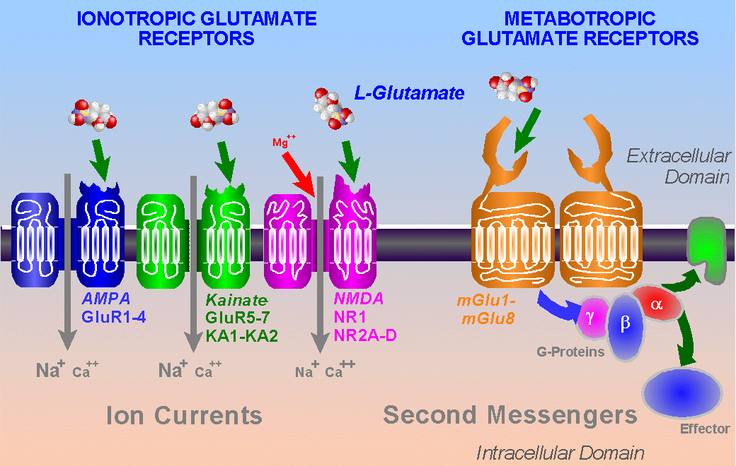

Slide 38
PHENTERMINE/TOPIRAMATE
Topiramate increases energy expenditure via activation of γ-aminobutyric acid (GABA) receptors.
3 Phase III trials have evaluated the efficacy & safety of Qsymia – suggest it may support weight loss in obese patients for over 2 years.
Rationale for combining 2 drugs was that lower doses of each drug would minimize side effects, while using drugs acting on different pathways would have an additive effect on weight loss.

Slide 39
PHENTERMINE/TOPIRAMATE
EQUIP Study:
  56 weeks
  1,267 patients
  BMI ≥ 35 kg/m²
  Phen/Tpm 15/92 mg vs. Phen/Tpm 3.75/23 mg vs. placebo, with restricted diet
  High-dose Qsymia pts. lost signif. more weight from baseline (10.9%) vs. low-dose (5.1%) vs. placebo (5.1%).
  Percentage of pts. achieving ≥ 5% weight loss in each group was 66.7%, 44.9%, and 17.3%, respectively.

Slide 40
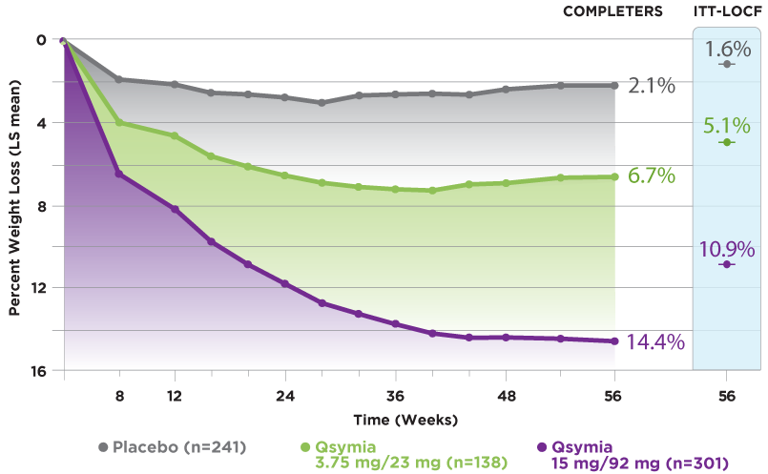
EQUIP RESULTS

Slide 41

PHENTERMINE/TOPIRAMATE
CONQUER Study:
  Another 56-week trial
  2, 487 individuals with BMI of 27-45 kg/m² AND
    ≥ 2 obesity –associated comorbidities (including type 2 diabetes)
  Participants randomized 2:1:2
  to Phen/Tpm 15/92 mg,
  Phen/Tpm 7.5/46 mg, or
  placebo.

Slide 42
PHENTERMINE/TOPIRAMATE
CONQUER Study:
  Higher dose: 70% lost ≥ 5% of body weight (9.8%)
  Lower dose: 62% lost ≥ 5% of body weight
  (7.8%)
  Placebo: 21% lost ≥ 5% of body weight
  (1.2%)

Slide 43
PHENTERMINE/TOPIRAMATE
CONQUER Study:
  Subset of type 2 diabetes: greater reductions in HbA1c from baseline at 56 weeks in Qsymia compared with placebo
    15/92 → -0.4%
    7.5/46 → -0.4%
    Placebo → -0.1%

Slide 44
PHENTERMINE/TOPIRAMATE
CONQUER Study:
  Significant improvements observed in both treatment groups:
    Blood pressure
    Waist circumference
    Glycemia
    Lipid concentrations
    Blood inflammatory markers

Slide 45
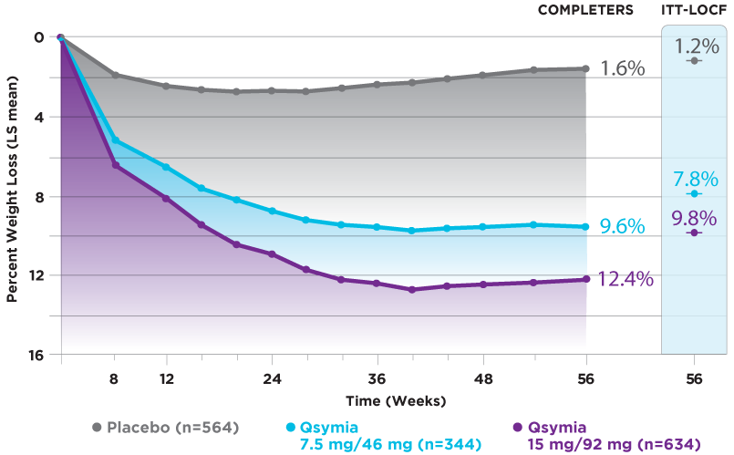
CONQUER RESULTS

Slide 46
PHENTERMINE/TOPIRAMATE
SEQUEL Study:
  52-week extension of CONQUER
    Demonstrated that weight loss could be maintained up to 108 weeks.
    Weight loss frombaseline was 10.5%, 9.3%, and 1.8% with 15/92, 7.5/46, and placebo, respectively.

Slide 47
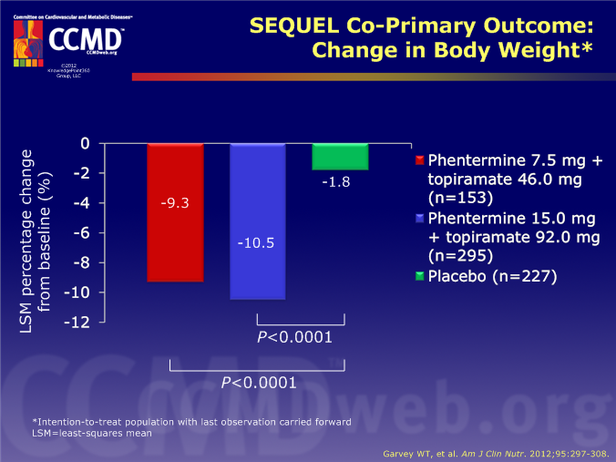

Slide 48
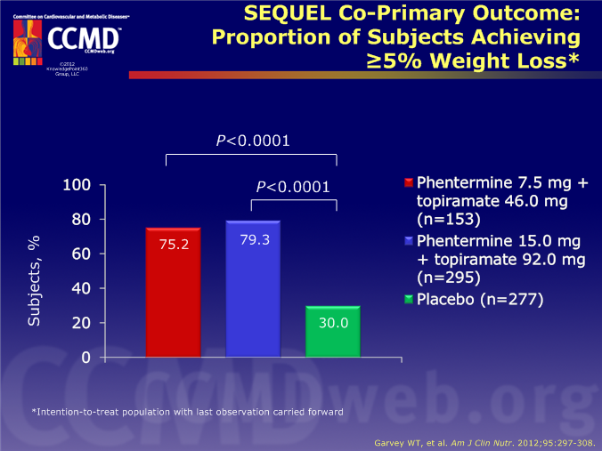

Slide 49
PHENTERMINE/TOPIRAMATE
CONQUER and SEQUEL showed Qsymia assoc. w/decreased risk of conversion to type 2 diabetes.
The ability of Qsymia to effect conversion to type 2 diabetes was related to the extent of weight loss.

Slide 50
PHENTERMINE/TOPIRAMATE
Most common treatment-emergent adverse events:
  Upper respiratory tract infection
  Constipation
  Paresthesia
  Sinusitis
  Dry mouth

Slide 51
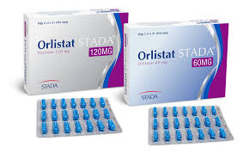
ORLISTAT (Xenical or Alli)
Gastric & pancreatic lipase inhibitor
Acts by reducing absorption of dietary fat by approximately 30%.
Available for long-term mgmt. of obesity in conjunction with reduced calorie diet.
Available OTC at ½ of prescription dose (Alli).

Slide 52
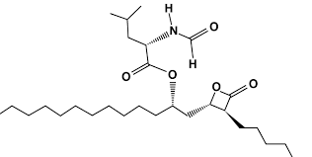
ORLISTAT (Xenical or Alli)
Multiple RCTs have shown
after 1-2 years, mean
weight loss is 2.7-3.19 kg
greater than placebo.
Proportion of pts. who respond to achieve ≥ 5% weight loss after 1 year is 15-30% more than placebo.

Slide 53
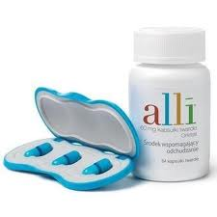
ORLISTAT (Xenical or Alli)
Orlistat assoc. with improvements in:
  Blood pressure
  Insulin resistance
  Serum lipid levels
    (Total and LDL improve more than
    expected due to direct inhibition
    of fat absorption.)
  Adjunctive orlistat administration over 4-year period demonstrated to reduce risk of progression to T2DM more than diet or exercise alone.

Slide 54
ORLISTAT (Xenical or Alli)
Most common side effects are gastrointestinal:
  Oily spotting
  Flatus with discharge
  Fecal urgency
  Steatorrhea
Reductions in fat-soluble vitamins A, D, E, and K noted in some pts.
May want to consider daily vitamin supplement containing these vitamins – take at least 2 hours before or after orlistat.

Slide 55
NALTREXONE/BUPROPION (CONTRAVE)
Bupropion – noradrenaline & dopamine inhibitor
Naltrexone – opioid receptor antagonist
Thought to have synergistic effects on CNS:
  Bupropion stimulates pro-opiomelanocortin (POMC) neurons.
  Naltrexone blocks opioid-mediated pro-opiomelanocortin auto-inhibition.

Slide 56
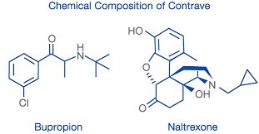
NALTREXONE/BUPROPION (CONTRAVE)

Slide 57
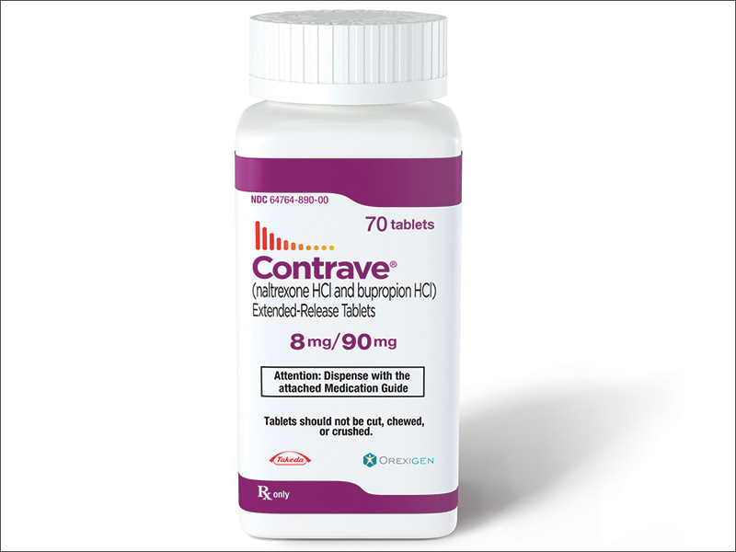
NALTREXONE/BUPROPION (CONTRAVE)
Approved by FDA as treatment option for chronic weight management in obese adults (BMI ≥ 30 kg/m²)
  OR adults who are overweight (BMI ≥ 27 kg/m²) & have at least one weight-related condition (e.g., htn., T2DM, lipidemia).

Slide 58
NALTREXONE/BUPROPION (CONTRAVE)
3 Phase III trials in obese, non-diabetic individuals
  COR-I: 1,742 subjects
  Reduced body weight over 56 weeks vs. placebo
    -5.0 kg with 32/360
    -6.1 kg with 16/360
    -1.3 kg with placebo

Slide 59
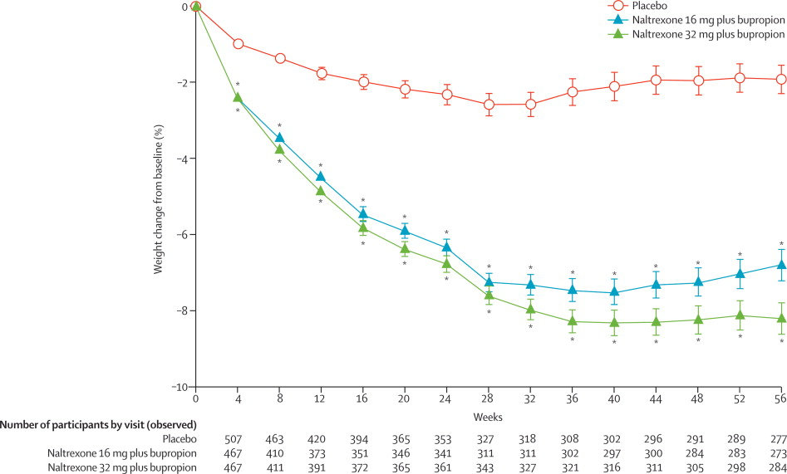

Slide 60
NALTREXONE/BUPROPION (CONTRAVE)
Significantly higher proportion of pts. lost ≥ 5% body weight with Contrave:
  48% with 32/360 mg
  39% with 16/360 mg
  16% with placebo

Slide 61
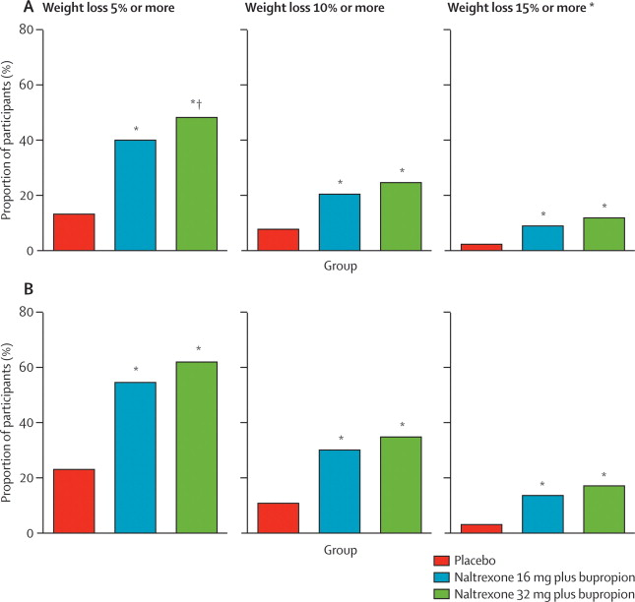

Slide 62
NALTREXONE/BUPROPION (CONTRAVE)
Most frequent adverse event was nausea.
Subsequent studies were COR-BMOD & COR-II:
  Similar results to COR-I.
Currently Phase III study assessing long-term cardiovascular effects of Contrave.

Slide 63
ROAD MAP
Review of obesity
Medications used as adjuncts in the treatment of obesity:
    Lorcaserin
    Phentermine/Topiramate
    Orlistat
    Bupropion/Naltrexone

