Slide 1
Maximizing Investigators’ Research Award (MIRA) for Established Investigators
PAR-19-367 ( R35 for established investigators)
Zhongzhen Nie, PhD
Chief, Pharmacological and Physiological Sciences Branch PPBC, NIGMS

Slide 2
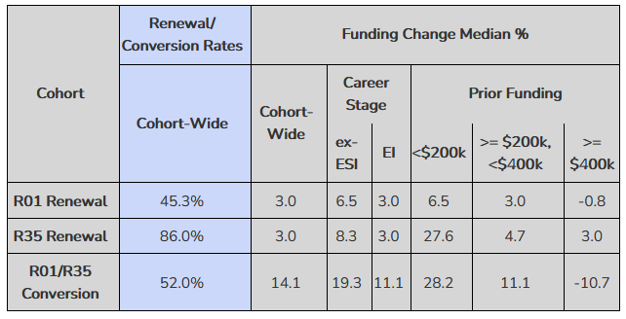
MIRA Award Rates as Compared with R01

Slide 3
Key Elements of the MIRA Concept
A single NIGMS grant per PI to support the NIGMS-related research in an investigator’s lab, reduced administrative burden
PI relinquishes other NIGMS support with some exceptions, e.g., resource, training, small business grants
Award levels somewhat different from current support in return for increased award length, stability, flexibility, and reduced administrative burden
Plan for future renewals – lower application numbers, higher success rates, flexible funding levels

Slide 4
Eligibility for MIRA Application
For new applications
A single-PI R01-equivalent GM award (DP1, DP2, R01, R37, SC1)
End of the next fiscal year after the original project expiration date
A PD/PI may have more than one qualifying award
For renewal applications
Both EI and ESI MIRAs will be renewed as EI MIRAs
End of the 2nd fiscal year after the original project expiration date

Slide 5
Distinct Features of MIRA Applications
Features of MIRA Applications
No specific aims: flexible to follow new research directions
Research strategy: 6 pages (background, recent progress, future research)
Biosketch: tailored
Budget request: A single line of budget for each year, no detailed budget
Receipt and Review Dates
Current FOA Expires on: May 18, 2022 (A new FOA will be issued)
Receipt date | January 2022 | May 2022
Scientific review | May/June 2022 | October/November 2022
Advisory council | September 2022 | January 2023
Earliest start date | January 1, 2023 | April 1, 2023

Slide 6
Most Common Page Allotment
(6 pages for research strategy)
Background and key knowledge gaps
One to one and half pages
Recent progress by the PD/PI
One to one and half pages
Focus on the past five years
Overview of future research
Three to four pages

Slide 7
Biosketches
Personal Statement
Tailored to the unique attributes and requirement of MIRA
Service to the scientific community (beyond your institutional duties)
Contributions to Science
Focus on the past five years (but is not “limited to”)
Within the NIGMS mission (emphasized in the FOA)
Supported by NIGMS (emphasized in the FOA)
List grant citations as acknowledged in the publications (emphasized)
Do NOT use hotlinks other than for Bibliography
New requirement from OER about Biosketch and Other Support !!!
(No section D now. MIRA FOA requires an independent attachment)
Personal Statement
Tailored to the unique attributes and requirement of MIRA

Slide 8
MIRA Budget Request and Award Level
Budget request
No detailed budget (only DC, F&A, Total Costs for each year)
No inflationary escalations
Indirect costs should be requested
Equipment purchase with the $750,000 budget limit
No prior approval required if annual DC over $500K
New MIRA award levels adjusted based on current GM support
>400K: 12% reduction in general
$250K - $400K: same, reduced, or slightly increased
<$250K: increase to $250K in most cases
MIRA for Grantee Institutions

Slide 9
Frequently Asked Questions
Am I eligible if I have more than one MPI R01 from NIGMS?
No. The qualifying award must be a single-PI R01 or equivalent.
Why letters from collaborators are not encouraged?
Flexibility of MIRA research (specific techniques, reagents).
Consortium will be rare and extremely well justified.
Can I submit again if my application does not review well?
Yes, if eligible. Subsequent applications will be A0s.
Why are A1s NOT accepted?
Reviewer consideration of responsiveness vs scientific merit.
Eligibility time window vs the 37 month rule between A0 and A1.
Personal Statement
Tailored to the unique attributes and requirement of MIRA

Slide 10
Frequently Asked Questions
What should I do if my T2A0 doesn’t score well?
Don’ts
  Do not submit an T2A1 application. It will be a T1A0.
  Do not talk about previous review in your new application.
  Do not include an introduction page.
  Do not include a progress report publication list.
Dos
  Cite publications in Biosketch under contributions to science (5 areas with 4 papers under each, with grant #s).
  Report progress in section II under Research Strategy: “recent progress by the PD/PI which focuses on the past 5 years.”
Personal Statement
Tailored to the unique attributes and requirement of MIRA

Slide 11
Frequently Asked Questions
Will I receive bridge funding for unsuccessful T2 applications?
(What we are doing now with MIRA renewals)
Maintain a high success rate for renewal applications
(significantly lower the number of unsuccessful renewals)
Fund T2 applications with higher scores at reduced budget
(5 yr funding, much better than short term bridge funding)
Expanded the eligibility time window for renewals
(2 fiscal years, at least 2 more opportunities to get a new MIRA)
Personal Statement
Tailored to the unique attributes and requirement of MIRA

Slide 12
Frequently Asked Questions and Answers
Where can I obtain information about MIRA
Answers to frequently asked questions about MIRA PAR 19-367
1. MIRA Program Description
2. Eligibility Information
3. Application and Submission Information
4. Budget Information
5. Review Information
6. Post Review issues
7. Award Process Information
8. Post Award concerns
9. Prior Approval Issues
Personal Statement
Tailored to the unique attributes and requirement of MIRA

Slide 13
MIRA Eligibilities for the Next FOA
(to be published after 05/18/2022)
Personal Statement
Tailored to the unique attributes and requirement of MIRA
Current MIRA Eligibilities: to remain unchanged
  Renewal of MIRAs (both EI and ESI)
  New MIRAs converted from single-PI R01-equivalent awards
Defined here as R01, R37, SC1, DP1, and DP2
Expanded Eligibility: new investigators (NI) will be eligible
Will increase & potentially broaden the pool of MIRA PIs, including PI
backgrounds and entry from new scientific fields
Plan for Enhancing Diverse Perspective (PEDP)
A summary of strategies to increase the merit of research via inclusivity
A one-page attachment required for all applications
A scorable criterion in review

