Slide 1
Antimicrobial Stewardship In the Ambulatory Setting
Jacob Nichols, M.D.
Chief, Division of Infectious Diseases

Slide 2
Disclosures
No financial disclosures

Slide 3
Objectives
Review outpatient prescribing statistics
Define asymptomatic bacteriuria vs urinary tract infection (UTI)
Define uncomplicated vs complicated UTI
Review guidelines for treatment of uncomplicated and complicated UTI
Review guidelines for treatment of community acquired pneumonia (CAP)

Slide 4
Prescribing Statistics
Approximately 80-90% of human antibiotic use occurs in the outpatient setting
211.1 million courses of antibiotics dispensed to outpatients in U.S. in 2021
Estimated 30% or more of outpatient antibiotics are unnecessary
Antibiotic-resistant pathogens cause approximately 35,000 deaths in the U.S. yearly
Estimated to be the cause of 10 million deaths yearly worldwide by 2050

Slide 5
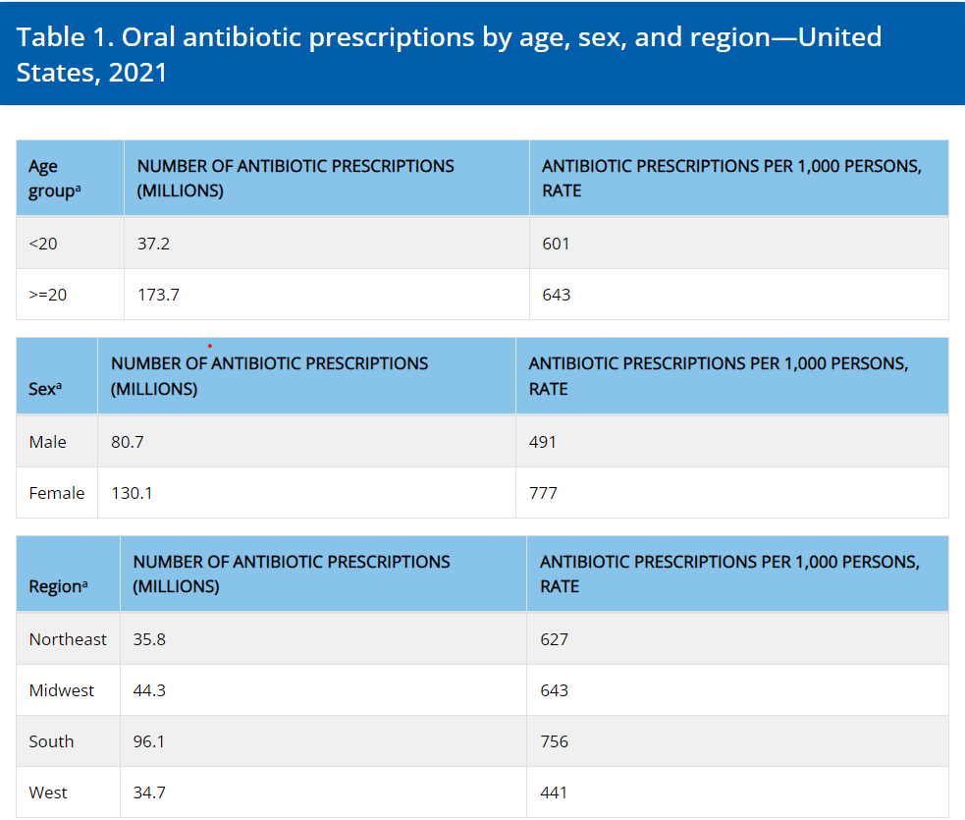

Prescribing Practices

Slide 6
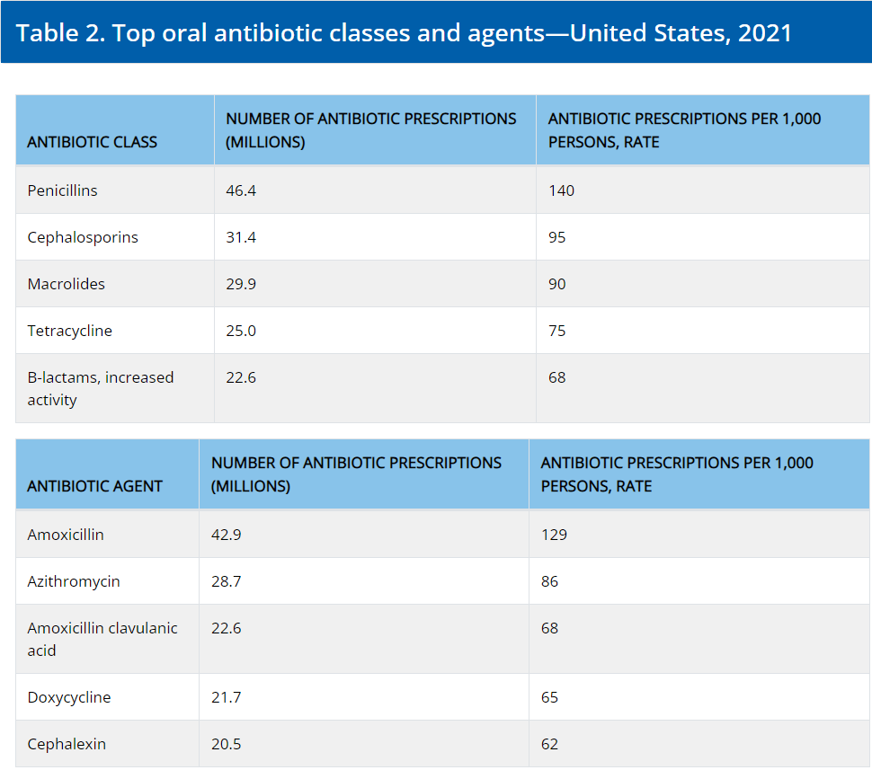
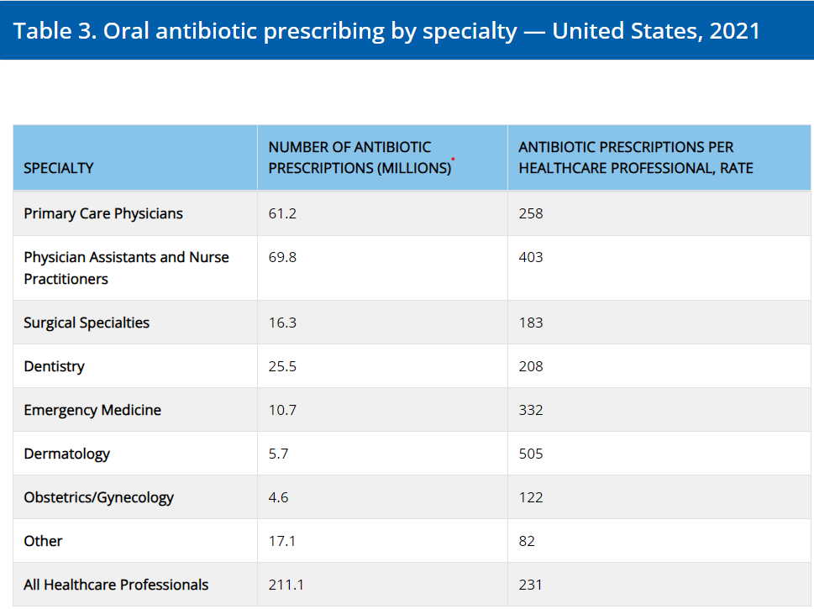
Prescribing Practices

Slide 7
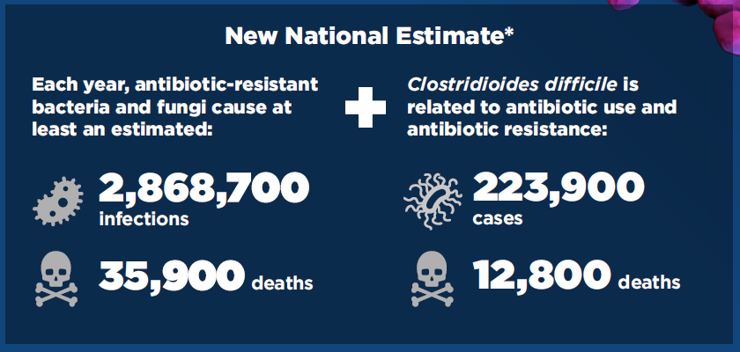
Threat of Resistance in the U.S.

Slide 8
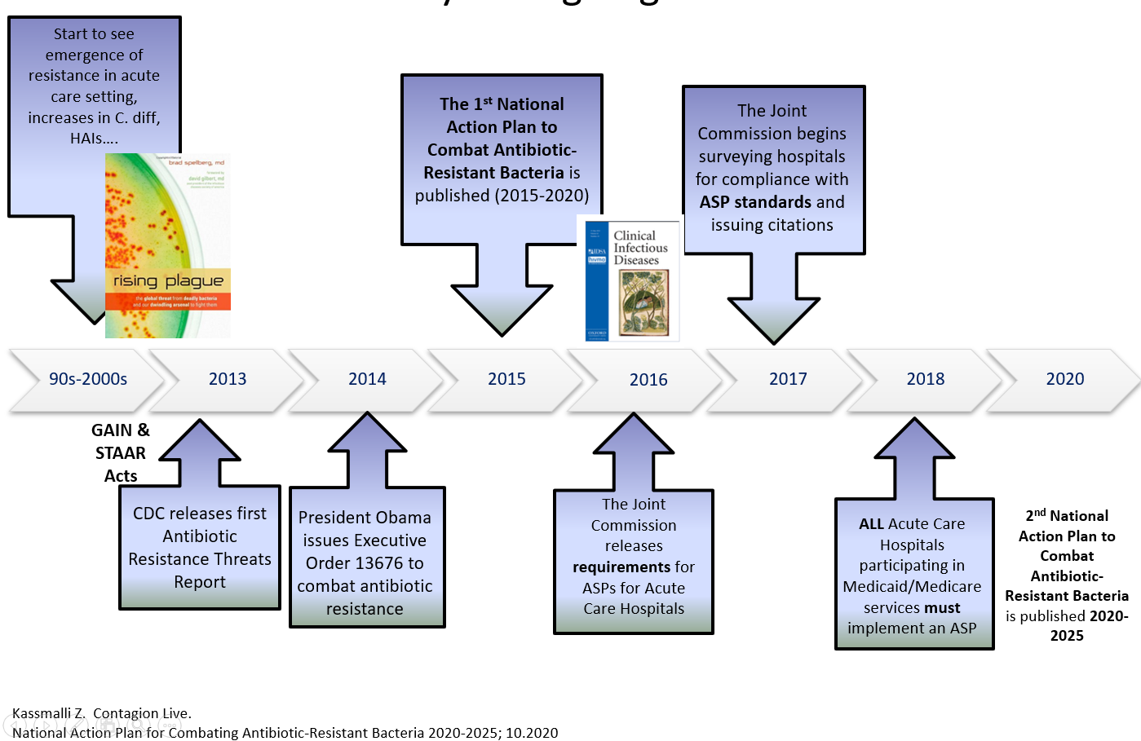
Timeline

Slide 9
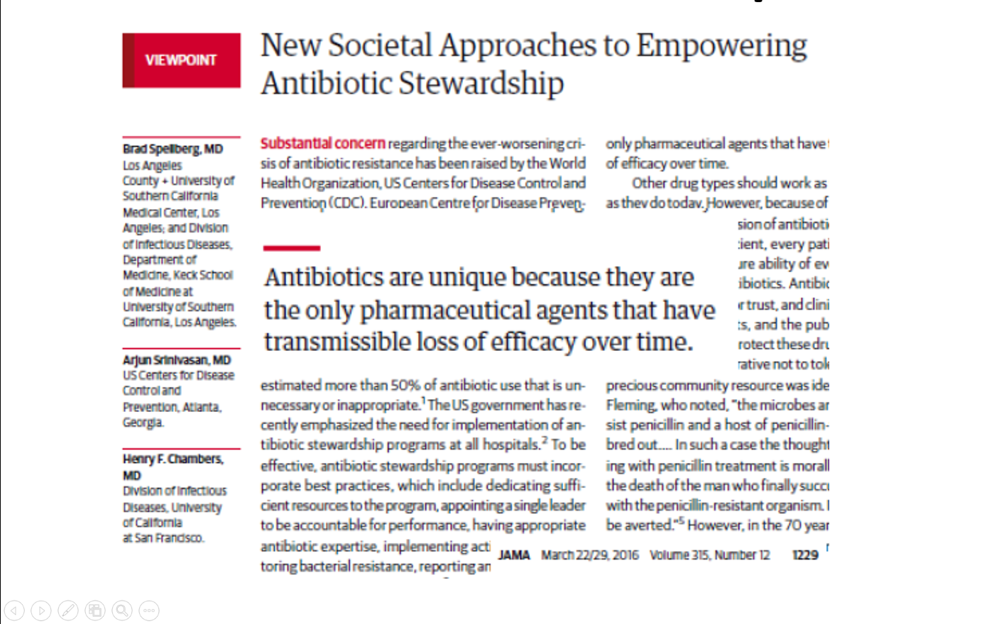
Need for Stewardship

Slide 10
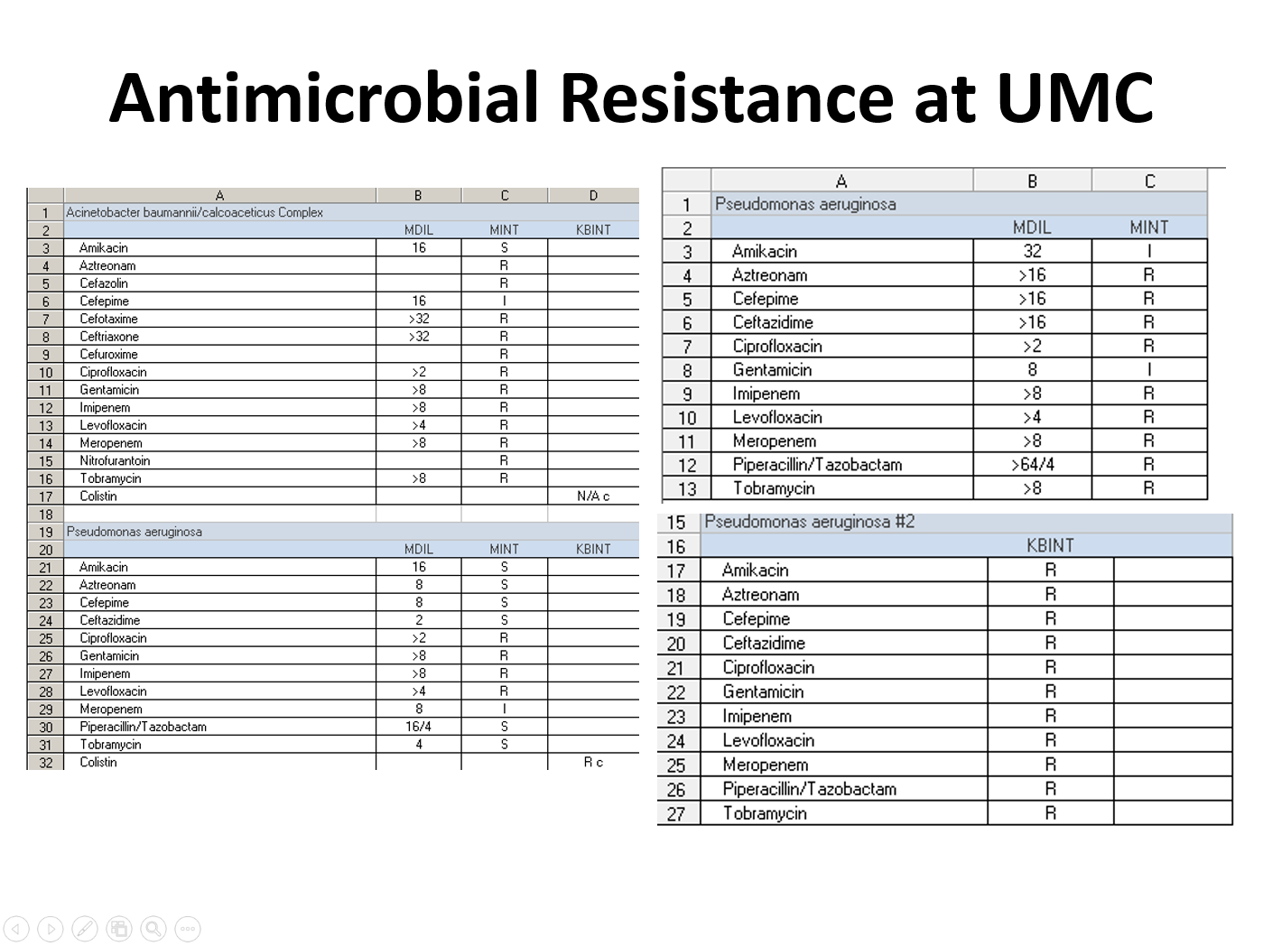

Slide 11
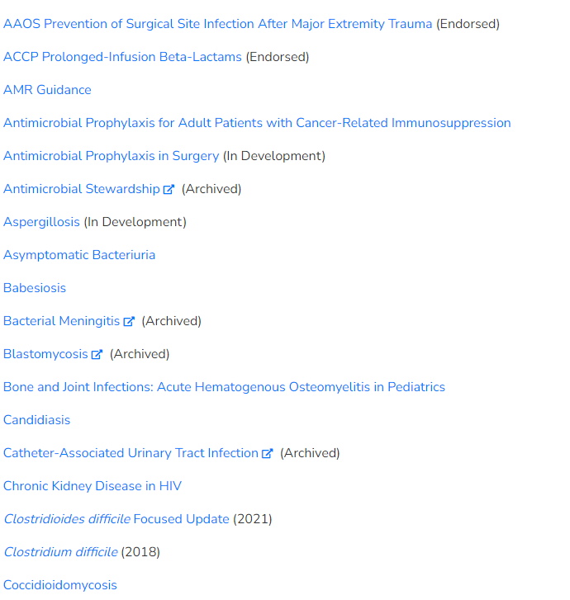
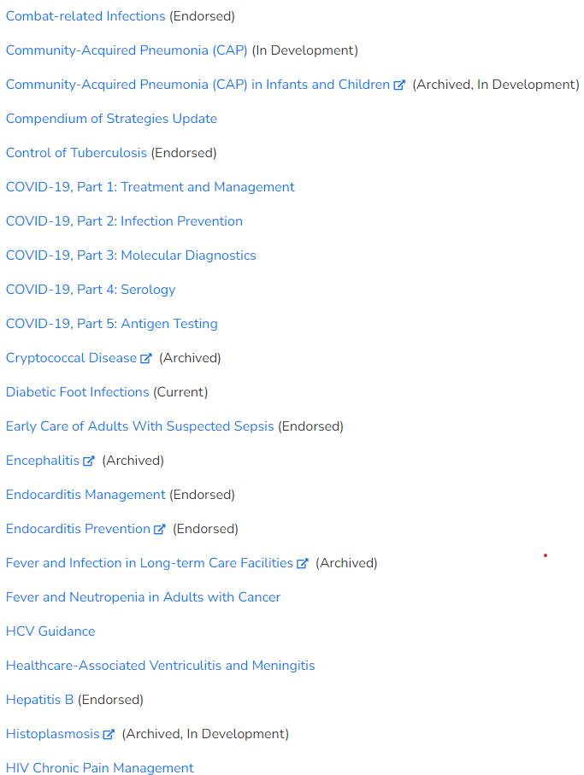
IDSA Clinical Practice Guidelines

Slide 12
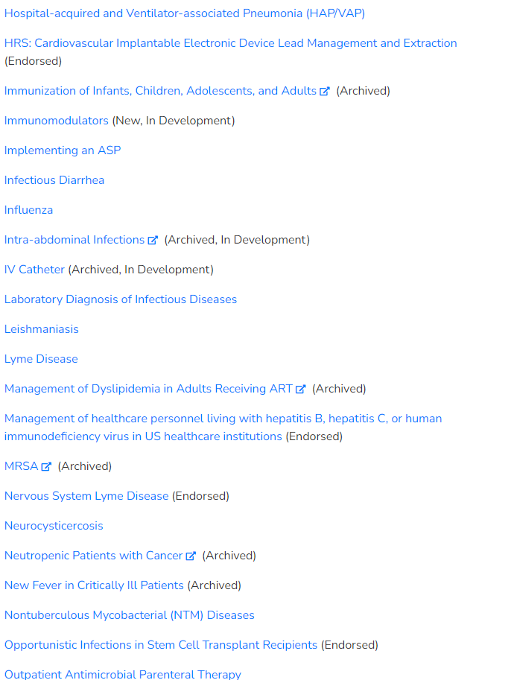
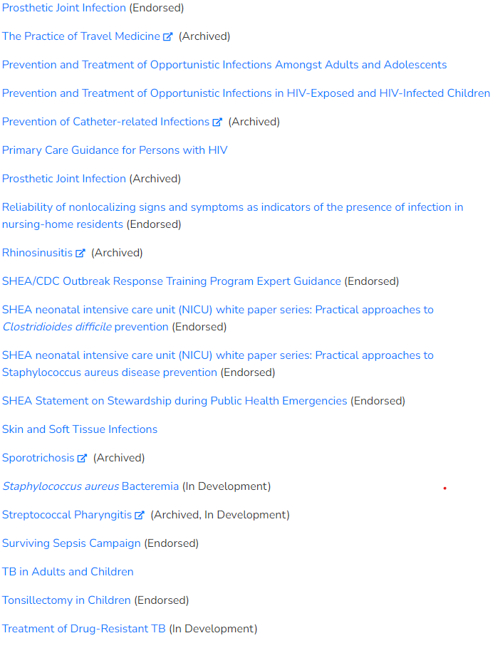
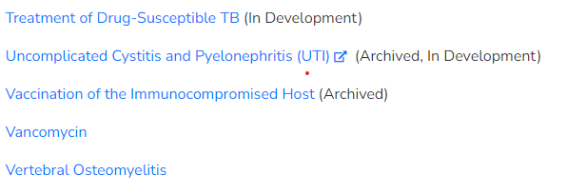
IDSA Clinical Practice Guidelines

Slide 13
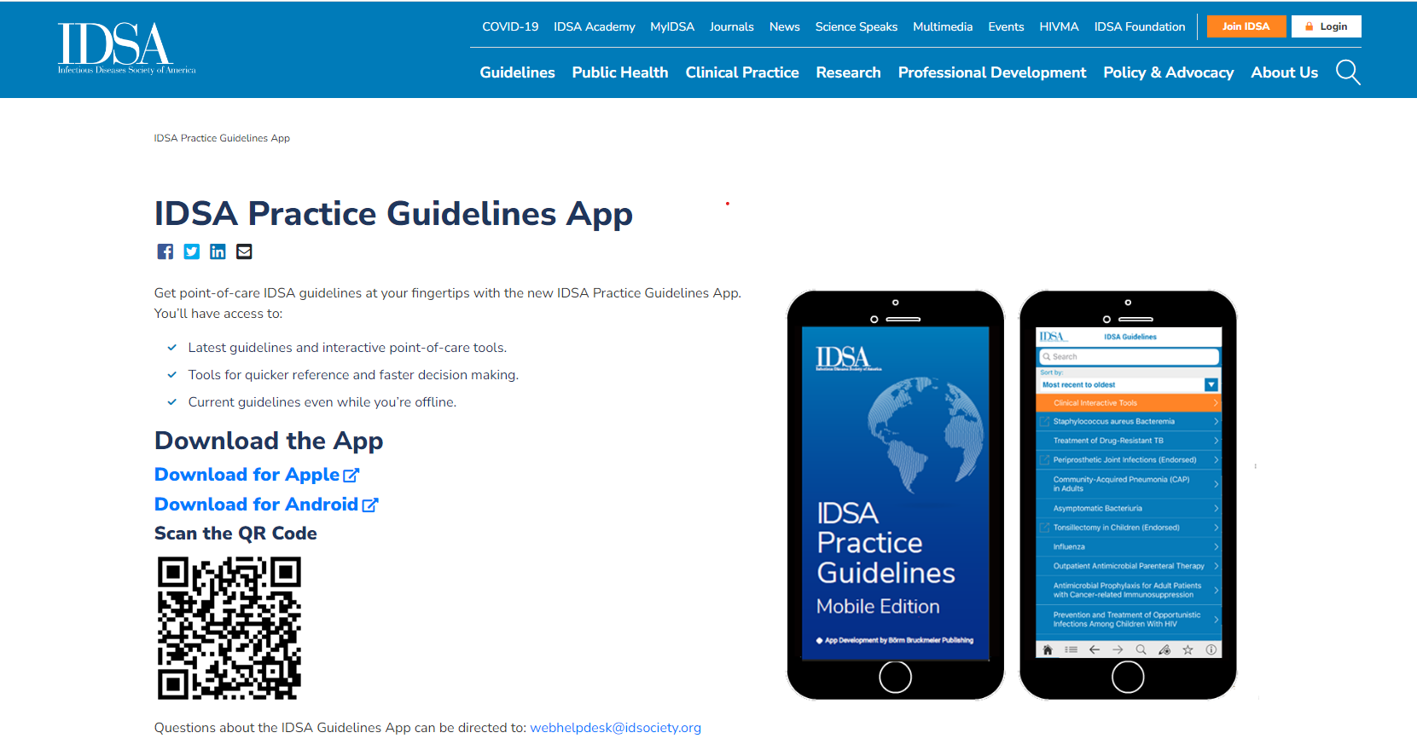

Slide 14
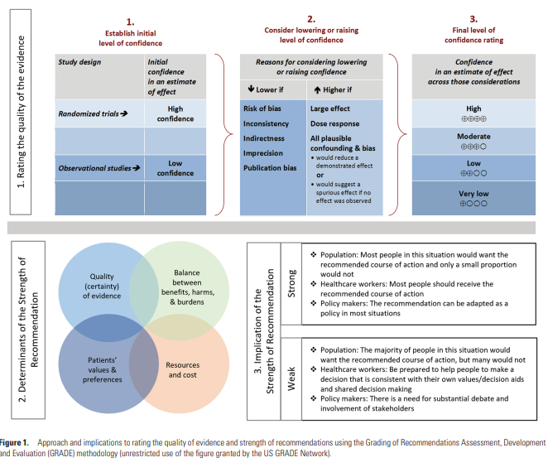
IDSA Clinical Practice Guidelines

Slide 15
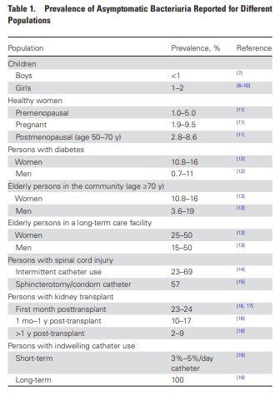
Asymptomatic Bacteriuria
Has been recognized as an important contributor to inappropriate antimicrobial use, leading to adverse effects and antimicrobial resistance
IDSA updated guideline in 2019
“The presence of 1 or more species of bacteria growing in the urine at specified quantitative counts (> 10⁵ CFU/mL), irrespective of the presence of pyuria, in the absence of signs or symptoms attributable to urinary tract infection

Slide 16
Asymptomatic bacteriuria
IDSA Guidelines 2019
Should ASB be screened for and treated in pediatric patients?
  Recommend against screening for or treating ASB (strong recommendation, low-quality of evidence)
Should ASB be screened for or treated in healthy, nonpregnant women?
  Recommend against screening for or treating ASB (strong, moderate-quality)
  Symptomatic UTIs are more common, however reports show no differences in rates of hypertension, CKD, abnormal IV pyelograms or mortality
  Some studies actually show an increase in subsequent symptomatic UTIs following treatment for ASB

Slide 17
Asymptomatic bacteriuria
IDSA Guidelines 2019
Should ASB be screened for and treated in pregnant women?
  Recommend screening for and treating ASB (strong, moderate-quality)
  Suggest 4-7 days of antimicrobial treatment rather than a shorter duration (weak, low-quality)
  Numerous studies show a significant decrease in the risk of pyelonephritis (35-40% to 1-4%)
  Some studies also show a decrease in risk of low birth weight as well as preterm labor

Slide 18
Asymptomatic bacteriuria
IDSA Guidelines 2019
Should ASB be screened for and treated in functionally impaired older women or men residing in the community?
  Recommend against screening for or treating ASB (strong, low-quality)
Should ASB be screened for and treated in older resident of long-term care facilities?
  Recommend against screening for or treating ASB (strong, moderate-quality)
Multiple studies have shown increased rates of antimicrobial resistance and adverse effects without evidence of benefit
One study showed in an 8.5 -fold increase risk of C. difficile infection in the 3 month period following treatment for ASB compared to those who were not

Slide 19
Asymptomatic bacteriuria
IDSA Guidelines 2019
Should diabetic patients be screened or treated for ASB
  Recommend against screening for or treating ASB (strong, moderate quality)
  A 36-month randomized control trial did not show difference in rates of symptomatic UTI (40% vs 42%) or pyelonephritis
  Treatment related adverse events were more common (18% vs 6%)
  Subsequent antimicrobial use for symptomatic UTI, prophylaxis or other infections was significantly more common in the treatment group; received almost 5 times more days of antimicrobial therapy

Slide 20
Asymptomatic bacteriuria
IDSA Guidelines 2019
Should patients who have received a kidney transplant be screened or treated for ASB?
  In renal transplant recipients who have had renal transplant surgery >1 month prior, we recommend against screening for or treating ASB (strong, high-quality)
  Insufficient evidence to inform a recommendation for or against screening or treatment in the first month following transplant
Should patients who have received a solid organ transplant other than a renal transplant be screened or treated for ASB?
  Recommend against screening for or treating ASB (strong, moderate quality)
Should patients with neutropenia be screened and treated for ASB?
  In patients with high-risk neutropenia (ANC <100cells/mm³ , >7 days duration following chemotherapy) we make no recommendation for or against screening for or treatment of ASB (knowledge gap)

Slide 21
Asymptomatic bacteriuria
IDSA Guidelines 2019
Should patients undergoing elective, non-urologic surgery be screened and treated for ASB?
  Recommend against screening for or treating ASB (strong, low-quality)
  Based on review of 1 RCT and 2 cohort studies
  One study showed an overall increased risk of prosthetic joint infections in the group with ASB than non-ASB (4.3% vs 1.4%)
    However, in the ASB group there was no significant difference in PJI rate between treated and untreated patients (3.9% vs 4.7%)
    It was also noted that the infecting organisms did not correlate to the isolates from urine cultures

Slide 22
Asymptomatic bacteriuria
IDSA Guidelines 2019
Should patients undergoing endourological procedures be screened for or treated for ASB?
  In patients who will undergo endoscopic urologic procedures with mucosal trauma, we recommend screening for and treating ASB prior to surgery (strong, moderate-quality)
  In patients who will undergo endoscopic urologic procedures, we suggest that a urine culture be obtained prior to the procedure and targeted antimicrobial therapy prescribed rather than empiric therapy (weak, very low-quality)
  In patients with ASB who will undergo a urologic procedure, we suggest a short course (1 or 2 doses) rather than more prolonged therapy (weak, low-quality)

Slide 23
Asymptomatic bacteriuria
IDSA Guidelines 2019
Should patients undergoing implantation of urologic devices or living with urologic devices be screened for or treated for ASB?
  In patients planning to undergo surgery for an artificial urine sphincter or penile prosthesis implantation, suggest not screening for or treating ASB (weak, very low-quality); however, all patients should receive standard perioperative antimicrobial prophylaxis prior to device implant
  In patients living with implanted urologic devices, suggest not screening for or treating ASB (weak, very low-quality)
  Only one study evaluating treatment of ASB prior to implantation, no benefit found

Slide 24
Asymptomatic bacteriuria
IDSA Guidelines 2019
In older, functionally or cognitively impaired patient, which non-localizing symptoms distinguish ASB from symptomatic UTI?
  In older patients with functional and/or cognitive impairment with bacteriuria and delirium (or falls) and without local genitourinary symptoms or other systemic signs of infection (eg, fever or hemodynamic instability), we recommend assessment for other causes and careful observation rather than antimicrobial treatment (strong, very low-quality)
  Multiple studies evaluating treatment vs non-treatment show no improvement in functional or behavioral scores
  One study showed a trend towards worsening behavioral function
  C. difficile infections again were increased in treatment groups

Slide 25
Asymptomatic bacteriuria
IDSA Guidelines 2019
Should ASB be screened for or treated in individuals with impaired voiding following spinal cord injury?
  Recommend against screening for or treating ASB (strong, low-quality)
  Typical signs and symptoms of UTI may be lacking in patients with SCI, so atypical presentation of UTI should be considered. Fever, malaise, lethargy or sense of unease, new or worsening incontinence or leaking around the catheter, spasticity, cloudy urine, malodorous urine, back pain, and/or autonomic dysreflexia
  Multiple studies showing treatment of ASB in this population did not improve outcomes, and were quickly recolonized with more resistant strains
  Evidence suggests ASB may have a protective effect; 2 small RCTs inoculated patients with neurogenic bladders with nonpathogenic E. coli strains found a statistically significant decrease in the number of symptomatic UTIs

Slide 26
Asymptomatic bacteriuria
IDSA Guidelines 2019
Should patients with an indwelling urethral catheter be screened or treated for ASB?
  In patients with short-term indwelling urethral catheters (<30 days), we recommend against screening for or treating ASB (strong, low-quality)
    Multiple studies and reviews of thousands of patients show that a low percentage of patients who develop ASB subsequently develop a symptomatic UTI; and <1% develop a bacteremia that is attributable to the bacteriuria
  No recommendation for or against screening for and treating ASB at time of catheter removal (knowledge gap)
  In patients with long-term indwelling catheters, we recommend against screening for or treating ASB (strong, low-quality)
For the above, considerations are likely similar for patients with indwelling suprapubic catheters

Slide 27
American Urological Association
Screening for ASB
Without symptoms, bacteriuria of any magnitude is considered “ASB.” While pregnant women and patients scheduled to undergo invasive urinary tract procedures do benefit from treatment, substantial evidence supports that other populations, including women with diabetes mellitus and long-term care facility residents, do not require or benefit from additional evaluation or antimicrobial treatment.
In women with rUTIs, there is no evidence that identification of ASB between UTI episodes provides useful prognostic information. Prospective observational studies have found no differences in rates of hypertension, chronic kidney disease, renal dysfunction, abnormal renal imaging, or mortality in women with or without bacteriuria. Additionally, evidence exists to suggest a lack of effectiveness of treatment for ASB, which serves as indirect evidence that identification of ASB by surveillance testing would not result in improved clinical outcomes, unless an alternative effective treatment exists.

Slide 28
American Urological Association
Treating ASB
No evidence that treatment of ASB results in improved clinical outcomes, and there is clear evidence that these practices can cause harm
One randomized trial of women (n=673) with a history of rUTIs and ASB found that antibiotic treatment was associated with an increased risk of symptomatic recurrence (47% versus 13%) and development of antibiotic-resistant organisms.
  Suggests that ASB may prevent the development of symptomatic UTIs.
Evidence also indicates that screening/treatment of ASB does not reduce UTI rates, morbidity, or mortality in “high-risk” patients (elderly, immunosuppressed, renal transplant patients, diabetics)
The only clearly recognized indications for screening/treatment of ASB are 1) pregnant women, and 2) patients undergoing elective urologic surgery

Slide 29
Uncomplicated Cystitis and Pyelonephritis
2010 Update of the clinical practice guidelines by the IDSA and European Society for Microbiology and Infectious Diseases
Co-sponsoring organizations:
  American Congress of Obstetricians and Gynecologists
  American Urological Association
  Association of Medical Microbiology and Infectious Diseases-Canada
  Society for Academic Emergency Medicine

Slide 30
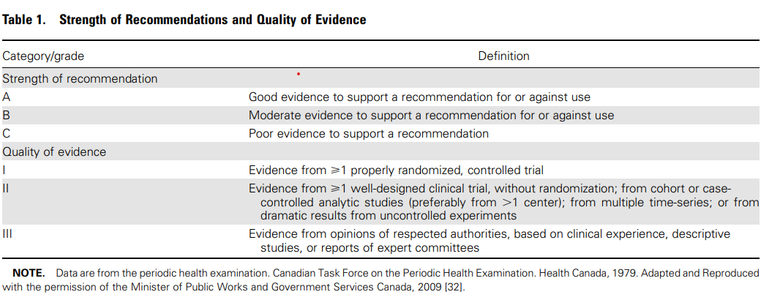
IDSA Clinical Practice Guidelines

Slide 31
UTI – Uncomplicated vs Complicated
Definition varies among professional societies
Some consider patients with underlying urologic abnormalities, immunocompromising conditions or poorly controlled diabetes mellitus as complicated
Others use site of infection, meaning those isolated to the bladder as uncomplicated, and anything above the level of the bladder as complicated
Signs and symptoms suggesting infection beyond the bladder indicating a complicated infection or pyelonephritis include:
  Fever, chills, rigors
  Flank pain or costovertebral angle tenderness
  Signs of sepsis
Complicated infection includes pyelonephritis

Slide 32
Acute, Uncomplicated Cystitis
Evaluation
Suspect in females with dysuria, increased frequency or urgency, suprapubic pain, new incontinence
Presence of vaginal pruritus or discharge suggests against cystitis (STIs, vaginal candidiasis, bacterial vaginosis)
Symptoms such as chronic nocturia, chronic incontinence, cloudy or foul smelling urine alone should not be considered a UTI
Mental status changes in elderly patients without localizing symptoms of a UTI should not prompt testing or treatment
Physical exam may reveal suprapubic discomfort, but should not have fever, CVA tenderness or generalized abdominal pain

Slide 33
Acute, Uncomplicated Cystitis
Urinalysis
Urinalysis not routinely necessary in those with typical signs and symptoms
May be useful in atypical situations; can be done by dipstick or microscopy
Lack of pyuria strongly suggests against cystitis
Presence of hematuria may be helpful as it is more commonly seen in cystitis than urethritis or vaginitis
Positive testing for leukocyte esterase and nitrite can be helpful to support a positive diagnosis; negative results should not rule out infection

Slide 34
Acute, Uncomplicated Cystitis
Culture
Not necessary in typical cases
Should be obtained in patients at risk for more serious infection, including those with underlying urologic abnormalities, immunocompromised or poorly controlled DM
Also obtain in those with risk factors for resistant organisms, which include any of the following in the past 3 months:
  Multi Drug Resistant Gram negative isolate or FQ resistant P. aeruginosa
  Inpatient stay in a health care facility
  Use of FQ, TMP-SMX or broad-spectrum beta-lactam

Slide 35
Acute, Uncomplicated Cystitis
Culture
E. coli represents 75-95% of cases; less common causes include different species of Enterobacteriaceae and other bacteria, such as S. saprophyticus
In healthy, nonpregnant females, growth of lactobacilli, enterococci, Group B streptococci and coagulase-negative staphylococci (other than S. saprophyticus) likely represents contamination

Slide 36
Acute, Uncomplicated Cystitis
Treatment
Nitrofurantoin monohydrate/macrocrystals 100mg PO twice daily for 5 days (A-I)
TMP-SMX 1DS tab PO twice daily for 3 days, if local resistance rates do not exceed 20%, or if susceptible on culture (A-I)
Fosfomycin trometamol 3g PO single dose (A-I)
Ciprofloxacin, levofloxacin and ofloxacin for 3 day regimens (A-I), but should be considered as an alternative due to increased risk for adverse effects and need to reserve for other indications
Beta-lactams, such as amoxicillin-clavulanic acid, cefdinir, cefaclor and cefpodoxime in 3-7 day regimens are appropriate when recommended agents can not be used (B-I)
Other beta-lactams, such as cephalexin, are less well studied, but may be appropriate in certain clinical settings (B-III)
Beta lactams generally have more adverse effects and have inferior efficacy

Slide 37
Acute, Complicated Cystitis and Pyelonephritis
Evaluation and Treatment
All patients with suspected complicated cystitis should have urine culture and susceptibility performed (A-III)
Ciprofloxacin 500mg PO twice daily for 7 days, with or without an initial 400mg intravenous dose, is appropriate for patients not requiring hospitalization and where resistance rates are <10% (A-I)
If an initial IV agent is used, a long acting antimicrobial, such as 1g of ceftriaxone or a consolidated 24-h dose of an aminoglycoside can be used (B-III)
If local prevalence of FQ resistance is >10%, an initial 1-time IV dose of a long-acting parenteral agent is recommended (B-III)

Slide 38
Acute, Complicated Cystitis and Pyelonephritis
Treatment
Once-daily oral FQ, such as ciprofloxacin 1000mg extended release for 7 days or levofloxacin 750mg PO daily for 5 days (B-II)
Oral TMP-SMX 1DS tab PO daily for 14 days if the pathogen is known to be susceptible (A-I)
Oral beta-lactams are less effective than other agents for pyelonephritis (B-III). If used, an initial IV dose of a long-acting parenteral antimicrobial is recommended (B-III)

Slide 39
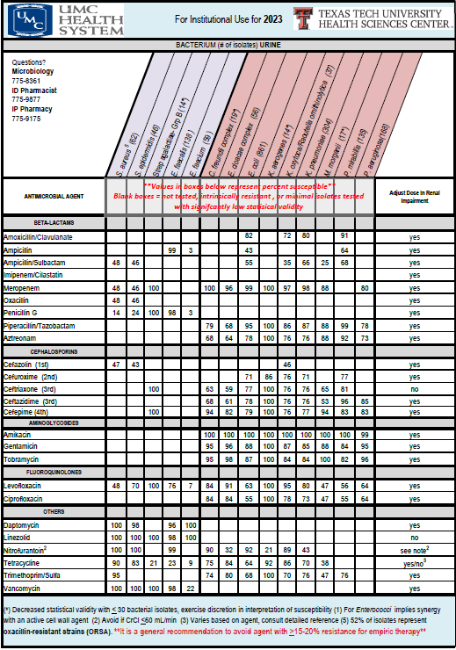
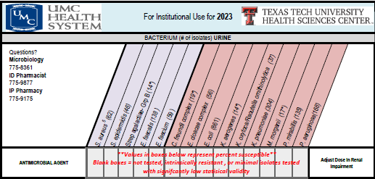
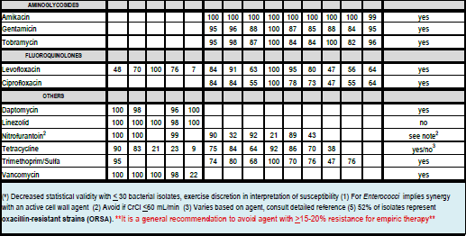

Slide 40
Community Acquired Pneumonia
Epidemiology
Acute infection of the pulmonary parenchyma acquired outside of the hospital
Accounts for over 4.5 million outpatient and ED visits annually
Second most common cause of hospitalization and most common infectious cause of death
Risk factors include older age, chronic comorbidities (COPD, chronic lung disease, CHF, stroke, diabetes mellitus, malnutrition)
Impaired airway protection
Smoking, alcohol overuse and opioid use increase risk

Slide 41
Community Acquired Pneumonia
Microbiology
Typical bacteria
Atypical bacteria
Respiratory viruses
S. pneumoniae
H. influenzae
M. catarrhalis
S. aureus
Group A streptococci
Aerobic gram negatives
Microaerophilic bacteria and anaerobes
Intrinsically resistant to beta-lactams
Legionella species
M. pneumoniae
Chlamydia pneumoniae
Chlamydia psittace
Coxiella burnetii
Influenza A and B viruses
SARS-CoV-2
Other coronaviruses
Rhinoviruses
Parainfluenza viruses
Adenoviruses
RSV
Human metapneumovirus
Human bocaviruses

Slide 42
Community Acquired Pneumonia
Often difficult to distinguish between viral and bacterial pathogens and they may often coexist
Bacterial
  Tend to develop more suddenly with high fever, often >102F, productive cough, fatigue, dyspnea, pleuritic chest pain
  Findings on pulmonary exam and chest radiographs more often unilateral
Viral infections often more insidious in onset with dry cough
  Often more insidious in onset with dry cough and upper respiratory symptoms
  Pulmonary exam radiographs may be normal or with bilateral abnormalities

Slide 43
CAP Guidelines
Diagnosis
In adults with CAP, should Gram stain and culture of lower respiratory secretions be obtained at the time of diagnosis?
  Recommend not routinely obtaining in adults with CAP managed in the outpatient setting (strong, very-low quality)
Should blood cultures be obtained at the time of diagnosis?
  Recommend not obtaining blood cultures in the outpatient setting (strong, very-low quality)
Should Legionella and pneumococcal urinary antigen testing be performed at the time of diagnosis?
  Suggest not routinely testing (conditional, low quality)
Should a respiratory sample be tested for influenza virus at the time of diagnosis?
  Recommend testing for influenza with a rapid influenza molecular assay of a rapid influenza diagnostic test when influenza is circulating in the community (

Slide 44
CAP Guidelines
Treatment
Which antibiotics are recommended for empiric treatment of CAP in adults?
Healthy adults without comorbidities or risk factors for resistance, recommend
  Amoxicillin 1g PO three times daily (strong, moderate quality) OR
  Doxycycline 100mg PO twice daily (conditional, low quality) OR
  A macrolide (azithromycin 500mg first day, then 250mg daily or clarithromycin 500mg twice daily or clarithromycin ER 1000mg daily) only in areas with pneumococcal resistance to macrolides <25% (conditional, moderate quality
With comorbidities such as chronic heart, lung, liver or renal disease; diabetes mellitus; alcoholism; malignancy; or asplenia
  Amoxicillin/clavulanic acid 500mg/125mg TID or amoxicillin/clavulanic acid 875mg/125mg BID or amoxicillin/clavulanic acid 2000mg/125mg BID or a cephalosporin (cefpodoxime 200mg BID or cefuroxime 500mg BID)
  AND
  Macrolide or doxycycline 100mg twice daily (conditional, low quality evidence for combination)
  OR
  Monotherapy with a respiratory fluoroquinolone such as levofloxacin 750mg daily, moxifloxacin 400mg daily (strong, moderate quality

Slide 45
CAP Guidelines
Treatment
In adults with CAP who test positive for influenza, should the treatment regimen include antiviral therapy?
  Suggest that anti-influenza treatment be prescribed for adults with CAP who test positive for influenza in the outpatient setting, independent of duration of illness before diagnosis (conditional, low quality)
In adults with CAP who test positive for influenza, should the treatment regimen include antibacterial therapy?
  Recommend that standard antibacterial therapy be initially prescribed for adults with clinical and radiographic evidence of CAP who test positive for influenza in the inpatient and outpatient settings (strong, low quality)
What is the appropriate duration of antibiotic treatment?
  Recommend that the duration of antibiotic therapy should be guided by clinical stability, but for no less than 5 days.

Slide 46
Community Acquired Pneumonia
An RCT in 2021 compared efficacy of 3d vs 8d of beta-lactam therapy
  Both groups received 3d of treatment, then randomized to additional 5d of treatment vs placebo
  Cure at day 15 occurred in 68% vs 77% in the treatment vs placebo respectively, indicating non-inferiority

Slide 47
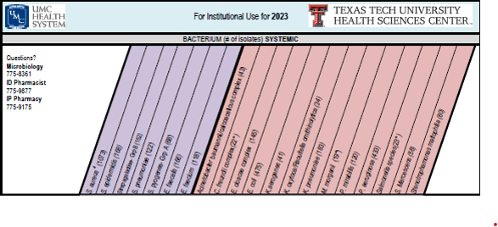
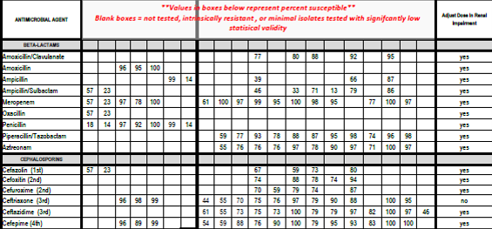
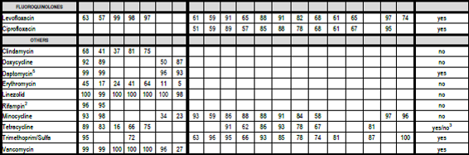

Slide 48
What about HCAP?
Previously referred to individuals who were considered to be higher risk for resistant organisms such as MRSA and Pseudomonas, ie long term care facilities, chronic dialysis, recent hospitalization, etc
No longer recommended as a classification category
Risk for resistant organisms should be based on previous infection with MRSA or Pseudomonas or receipt of parenteral antibiotics in the previous 90 days
Otherwise, should be treated according to CAP guidelines

Slide 49
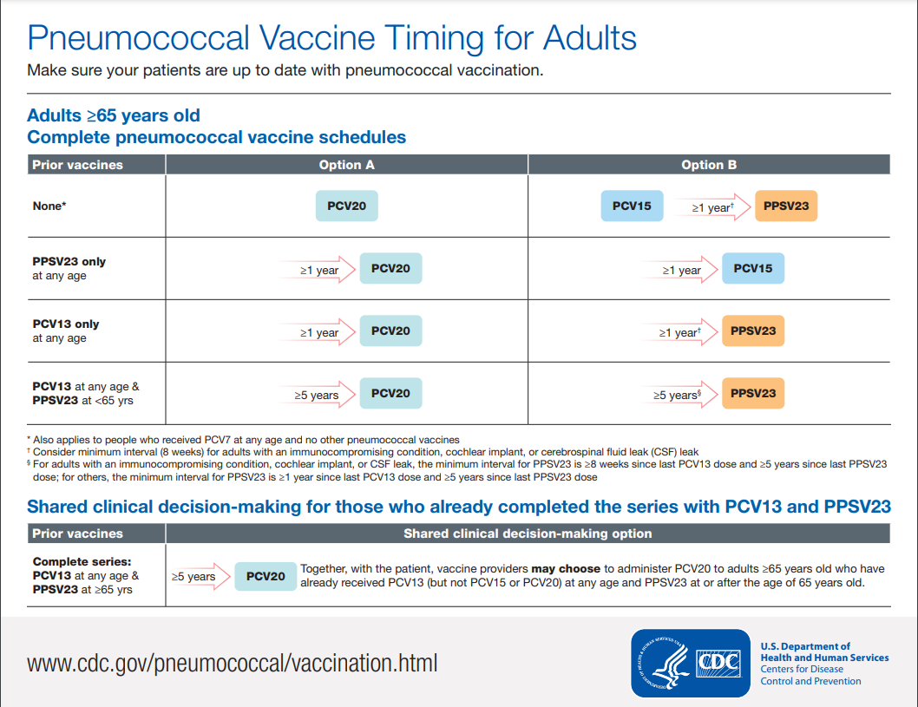

Slide 50
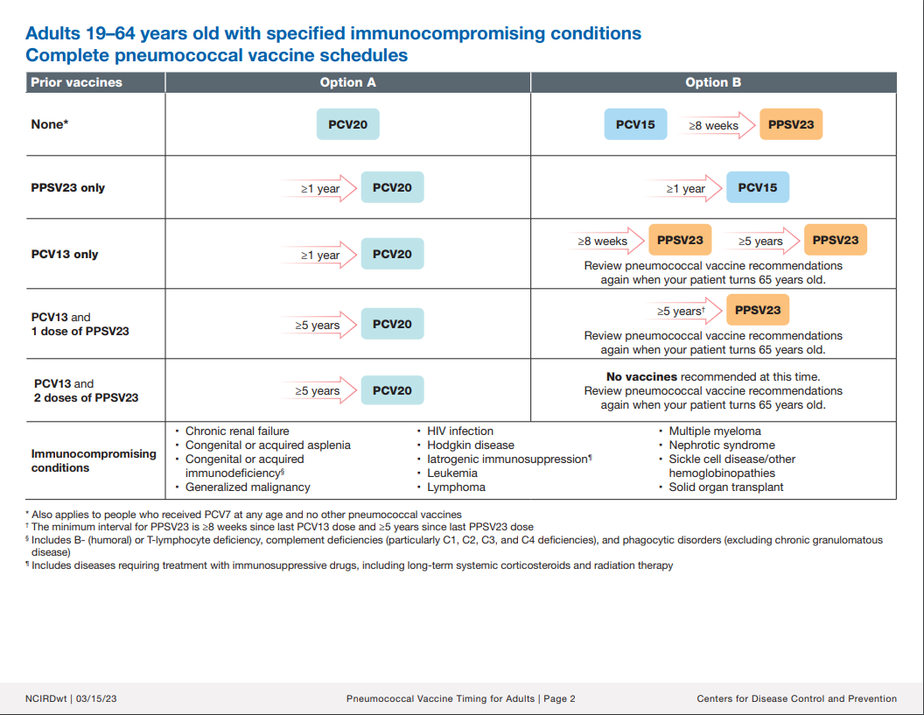

Slide 51
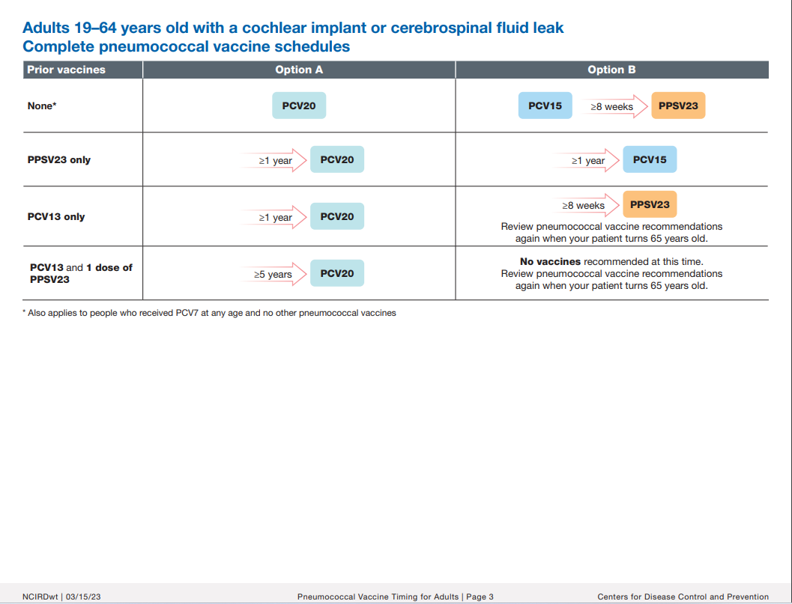

Slide 52
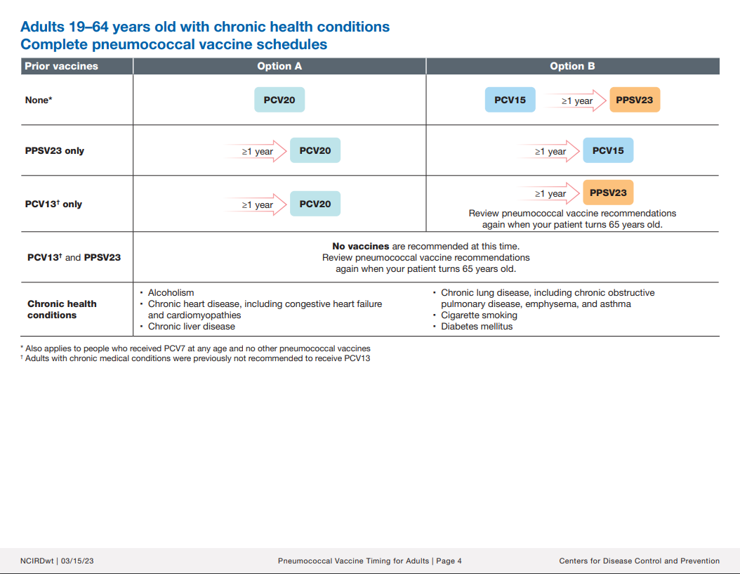

Slide 53
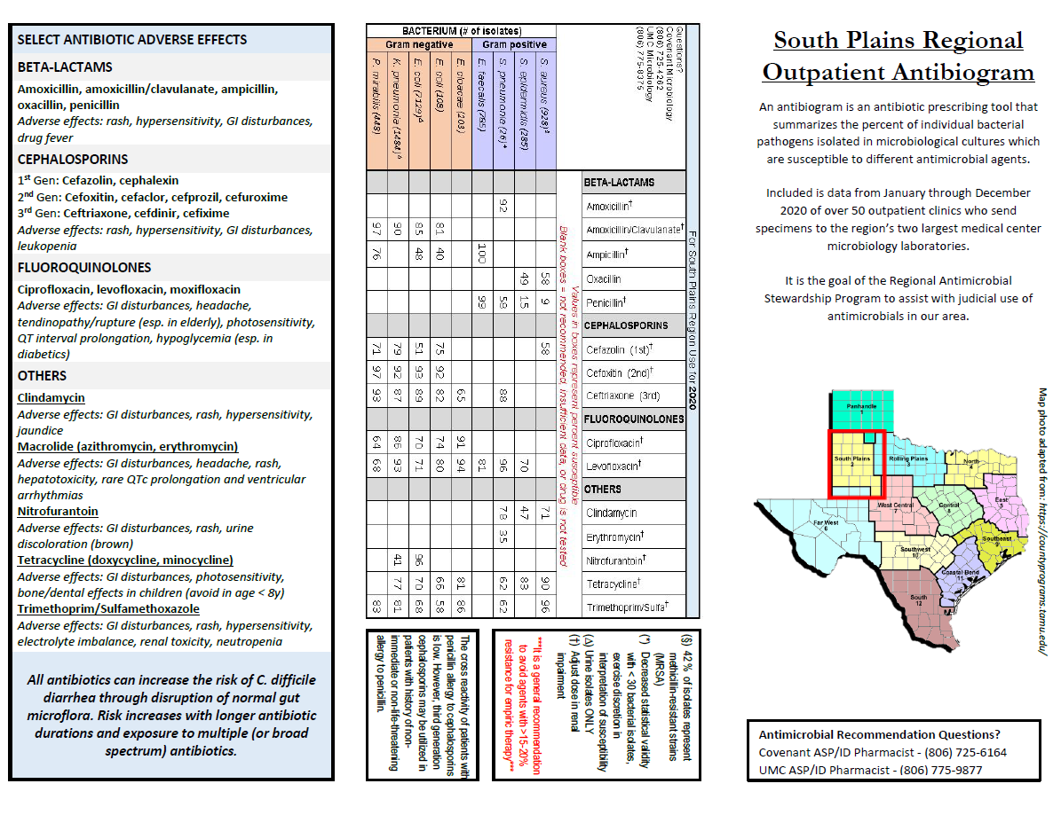

Slide 54
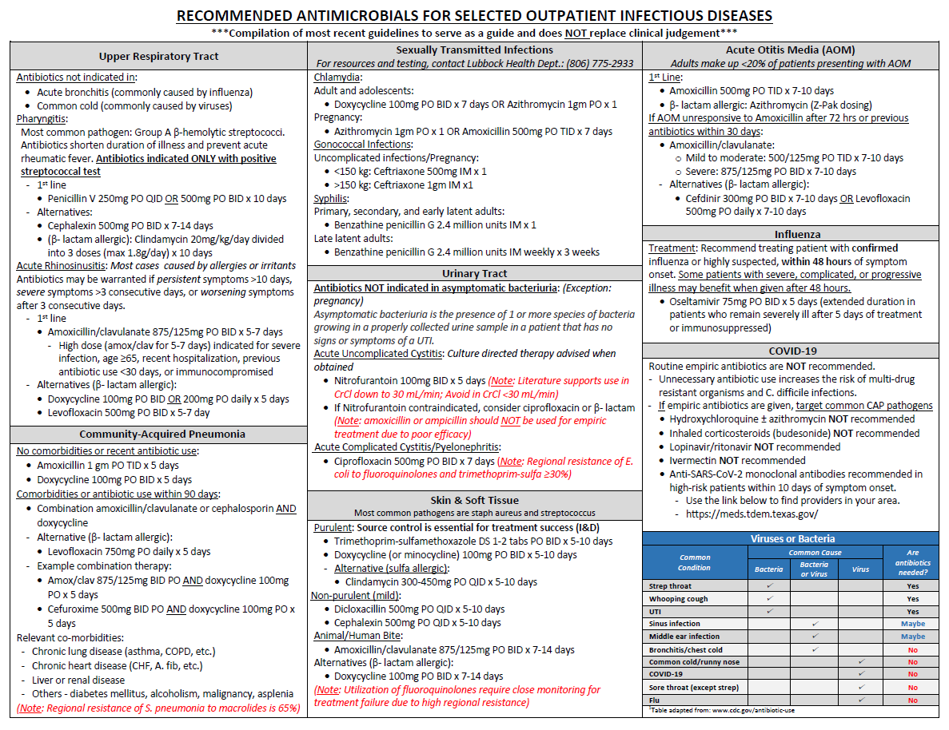

Slide 55
References
File, TM. Treatment of community-acquired pneumonia in adults in the outpatient setting. In: UpToDate, Post TW (Ed), Wolters Kluwer. https://www.uptodate.com Accessed September 5th 2023.
Gupta, K. Acute simple cystitis in females. In: UpToDate, Post TW (Ed), Wolters Kluwer. https://www.uptodate.com. Accessed August 12th 2023.
Gupta K, Hooton TM, Naber KG, et al. Infectious Diseases Society of America; European Society for Microbiology and Infectious Diseases. International clinical practice guidelines for the treatment of acute uncomplicated cystitis and pyelonephritis in women: A 2010 update by the Infectious Diseases Society of America and the European Society for Microbiology and Infectious Diseases. Clin Infect Dis. 2011 Mar 1;52(5):e103-20. doi: 10.1093/cid/ciq257. PMID: 21292654.
Metlay JP, Waterer GW, Long AC, et al. Diagnosis and treatment of adults with community-acquired pneumonia: an official clinical practice guideline of the American thoracic society and infectious diseases society of America. Am J Respir Crit Care Med. 2019;200(7):e45–e6
Nicolle L, Gupta K, Bradley S, et al. Clinical Practice Guideline for the Management of Asymptomatic Bacteriuria: 2019 Update by the Infectious Diseases Society of America, Clinical Infectious Diseases, Volume 68, Issue 10, 15 May 2019, Pages e83–e110, https://doi.org/10.1093/cid/ciy1121
Sousa R, Muñoz-Mahamud E, Quayle J, et al. Is asymptomatic bacteriuria a risk factor for prosthetic joint infection? Clin Infect Dis 2014; 59:41–77
Dinh A, Ropers A, Duran C, et al. Discontinuing β-lactam treatment after 3 days for patients with community-acquired pneumonia in non-critical care wards (PTC): a double-blind, randomised, placebo-controlled, non-inferiority trial.Lancet. 2021; 397: 1195-1203
McAteer J, Lee JH, Cosgrove S, et al. Defining the Optimal Duration of Therapy for Hospitalized Patients With Complicated Urinary Tract Infections and Associated Bacteremia, Clinical Infectious Diseases, Volume 76, Issue 9, 1 May 2023, Pages 1604–1612, https://doi.org/10.1093/cid/ciad009

