Slide 1
Hereditary Cancer Syndromes
Lindsay Eckert, PA-C
TTUHSC Department of Internal Medicine
Hematology/Oncology

Slide 2
Objectives
To understand the difference between a somatic and germline mutation
To review testing available
To understand the limitations and meaning of a negative genetic test
To identify which patients are at risk for a hereditary cancer syndrome and should undergo genetic testing
To manage patients with various genetic mutations and hereditary cancer syndromes

Slide 3
Why Should we do Genetic Testing
About 5-10% of cancer is hereditary
Treatment implications (PARP inhibitors)
Risk of other cancers
Family risk

Slide 4
Somatic vs. Germline
Mutations
May be paired together
Somatic (tumor) testing
  Predicts response or resistance to drug therapy
  Helps determine favorable/unfavorable prognosis
  Can be diagnostic of cancer type
  Can potentially show germline mutations
Germline testing
  Helps determine risk for cancer predisposition
  Predicts response or resistance to drug therapy (PARP inhibitors)
  Will impact both patients and their families

Slide 5
What Type of Test Should I Order:
Multi-gene Panel vs. Single Site Testing
No established guidelines exist for when a multi-gene panel vs. single site testing should be ordered
Consider multi-gene panel when 1 or more syndromes may explain the family history or if young age of cancer diagnosis
Stepwise testing may present a higher cost to the patient (additional testing, multiple clinic visits)
Lack of knowledge of family history

Slide 6
Interpretation of Test Results
Positive
Negative
VUS

Slide 7
BRCA1
BRCA1 increases the risk of female breast cancer (>60%), male breast cancer (1.2%), ovarian cancer (39-58%), prostate cancer (7-26%) and pancreatic cancer (<5%).
BRCA1 mutations make up about 50% of hereditary breast cancers and about 70% of hereditary ovarian cancers
More BRCA1 mutations in triple negative breast cancers

Slide 8
BRCA2
BRCA2 increases the risk of female breast cancer (>60%), male breast cancer (7.1%), ovarian cancer (13-29%), prostate cancer (19-61%), pancreatic cancer (5-10%) and melanoma.
BRCA2 mutations make up about 30% of hereditary breast cancers and about 20% of hereditary ovarian cancers
BRCA2 mutations are more associated with DCIS than BRCA1 mutations

Slide 9
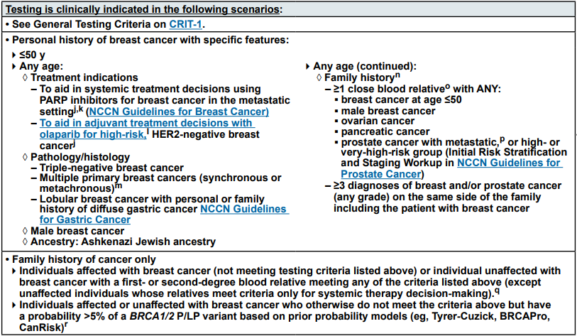
Hereditary Breast and Ovarian Cancer Syndrome (HBOC)
BRCA 1/2

Slide 10
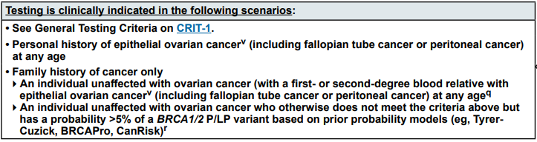
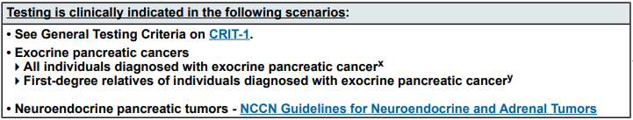
Hereditary Breast and Ovarian Cancer Syndrome (HBOC)
BRCA 1/2

Slide 11
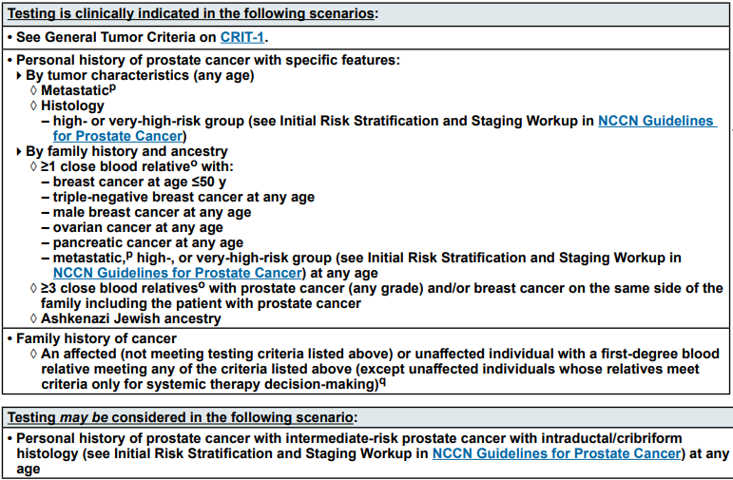
Hereditary Breast and Ovarian Cancer Syndrome (HBOC)
BRCA 1/2

Slide 12
HBOC Management
Female breast cancer
  Self breast exams beginning at age 18 and clinical breast exam every 6-12 months beginning at age 25
  Annual breast MRI beginning at age 25 and mammogram beginning at age 30 or 10 years younger than earliest breast cancer diagnosis in the family
  Discuss option of risk reducing mastectomies (RRM)
  Chemoprevention with tamoxifen
Male breast cancer screening with self-exam and annual clinical exam at 35
Ovarian cancer
  Recommend risk reducing Salpingo-Oophorectomy (RRSO) between 35 and 40 after completion of childbearing
  Consider ovarian suppression for delayed surgery and annual transvaginal u/s with CA-125 monitoring
Pancreatic cancer
  Consider screening with annual abdominal MRI/MRCP and EUS beginning at age 50 or 10 years prior to earliest diagnosis in the family
Prostate cancer screening with PSA every 1-2 years if <3 beginning at age 40 and consideration of DRE
Melanoma screening with annual dermatology visits and risk management discussion

Slide 13
Hereditary Nonpolyposis Colon Cancer (HNPCC)
Lynch Syndrome
MLH1, MSH2/EPCAM, MSH6, PMS2
The most common hereditary colorectal cancer syndrome
Estimated to occur in over 1.2 million individuals in the US (1 in 279).
Increases the risk of colorectal, endometrial, ovarian, gastric, urinary tract, small bowel, bile duct cancers and sebaceous skin tumors
Limited evidence of association with breast cancer (absolute risk <15)
Accounts for 1 out of every 25 (4%) colorectal cancers with a mean age of diagnosis at 45
Accounts for 1 out of every 30 (3%) endometrial cancers
Individuals with a personal or family history of
Tumor screening with immunohistochemistry (IHC) and microsatellite instability (MSI) should strongly be considered on colorectal and endometrial tissue (recommended by CDC, NCCN).

Slide 14
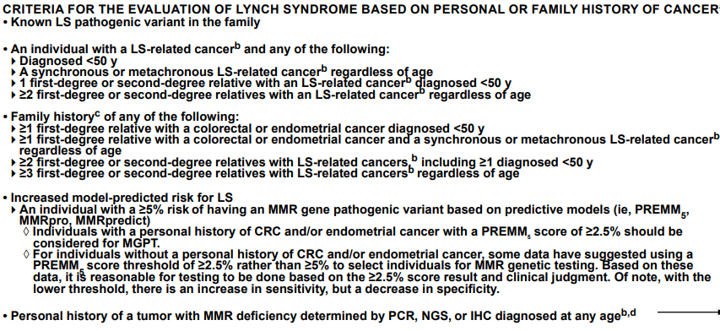
Lynch Testing Criteria

Slide 15
Lynch Syndrome Management
Colorectal cancer risk (46-61%)
  High quality colonoscopy every 1-2 years beginning at age 20-25 years
  Use of daily aspirin to reduce future risk of CRC
Endometrial cancer risk (34-57%)
  Patients should be educated about abnormal uterine bleeding or postmenopausal bleeding
  Consideration of endometrial biopsy every 1-2 years starting at age 30
  Consideration of risk reducing hysterectomy after childbearing
Ovarian cancer risk (4-38%)
  Consideration of RRSO after childbearing
  Consider ovarian suppression for delayed surgery and annual transvaginal u/s with CA-125 monitoring
Urothelial cancer risk (0.2-28%)
  No clear evidence for surveillance but may consider annual urinalysis beginning at age 30

Slide 16
Lynch Syndrome Management
Cont.
Gastric and Small bowel cancer risk (0.4-11%)
  Upper GI with EGD every 2-4 years beginning at age 30
Pancreatic cancer risk is 5-10% (insufficient evidence for pancreatic cancer screening with PMS2)
  Consider screening with annual abdominal MRI/MRCP and EUS beginning at age 50 or 10 years prior to earliest diagnosis in the family
Prostate cancer risk(4.4-23.8%)
  Consider screening with PSA every 1-2 years beginning at age 40 and consideration of DRE
Breast cancer risk: Annual mammograms beginning at age 40 or 10 years prior to earliest diagnosis in the family
Brain (0.7-7.7%): Patients should be educated regarding signs/symptoms of neurologic cancer and prompt reporting of symptoms
Skin: Consider skin exam every 1-2 years with dermatology due to risk of both malignant and benign skin tumors

Slide 17
Muri-Torre Syndrome
A subtype of Lynch syndrome
Sebaceous neoplasms in combination with one or more visceral malignancies
  Sebaceous hyperplasia
  Sebaceous adenoma
  Sebaceous epithelioma
  Basal cell epithelioma with sebaceous differentiation
  Keratoacanthoma
  Sebaceous carcinomas

Slide 18
Familial/Attenuated Adenomatous Polyposis (FAP/AFAP)
APC
Increases the risk of colorectal, gastric, duodenal and thyroid cancers, desmoid tumors (approximately 10-20% of patients with FAP), hepatoblastoma and brain tumors
Testing is recommended for a personal history of 20 or more cumulative adenomas, known APC mutation in the family or multifocal/bilateral congenital hypertrophy of the retinal pigment epithelium (CHRPE)
Testing should be considered for a personal history of 10-19 cumulative adenomas, desmoid tumor, hepatoblastoma, cribiform-morular variant of papillary thyroid cancer, unilateral CHRPE, family history of polyposis and family is unwilling or unable to undergo testing

Slide 19
Classical FAP
Up to 30% of cases are due to de novo mutations (spontaneous mutation in the patient’s germ cell)
100s-1000s of polyps with about 50% of carriers having adenomas by age 14 and 90% by age 30.
Untreated polyposis leads to 100% risk of cancer
Mean age of colorectal cancer (CRC) diagnosis at age 39 and mean age of death from CRC at age 42.
Extraintestinal features epidermoid cysts, osteoma, supernumerary teeth and adrenal gland adenomas.

Slide 20
AFAP
<100 polyps with and increased frequency of right-sided distribution
Colon cancer risk approaches 705 for untreated polyposis
Later onset than FAP with mean age of 50 for CRC
Extraintestinal manifestations not as common as with classical FAP

Slide 21
FAP Management
High quality colonoscopy annually beginning between ages 10-15 years
Prophylactic surgery (proctocolectomy or total colectomy)
  Post-op still needs screening
Upper endoscopy beginning at age 20-25 years
Evidence for small bowel screening is lacking but may be considered
Baseline thyroid u/s in late teenage years, then every 2-5 years if normal
Abdominal symptoms should prompt immediate abdominal imaging with CT or MRI due to risk of intra-abdominal desmoids
Consideration of abdominal u/s and AFP every 3-6 months for the first 5 years of life due to hepatoblastoma risk
Chemoprevention with Aspirin

Slide 22
MUTYH Associated Polyposis (MAP)
(MUTYH)
Autosomal recessive inheritance pattern (must inherit one mutation from each parent)
Increases the risk of colorectal and duodenal polyps and cancer
Typically fewer than 100 adenomas with 70-90% of colon cancer if left untreated
High-quality colonoscopy every 1-2 years beginning no later than 25-30 years
Consider colectomy or proctocolectomy if dense polyps
Baseline upper endoscopy beginning at age 30-35 years
No increased screening for monoallelic carriers without a family history

Slide 23
Hereditary Diffuse Gastric Cancer (HDGC)
CDH1
An autosomal dominant syndrome characterized by the development of diffuse (signet ring cell) gastric cancers at a young age.
Increases the risk of gastric and breast cancers (mostly lobular)
Causes 1-3% of gastric cancers with an estimated risk of gastric cancer of 67% for men and 83% for women by age 80.
Average age of diagnosis of gastric cancer is 37.
Lobular breast cancer observed in 20-40% of female carriers

Slide 24
HDCG Testing Criteria
Genetic testing for CDH1 mutations should be considered when any of the following criteria are met:
  Two gastric cancer cases in a family, one confirmed diffuse gastric cancer regardless of age
  Diffuse gastric cancer diagnosed before age 50 without a family history
  Personal or family history of diffuse gastric cancer and lobular breast cancer, one diagnosed before age 70
  Two cases of lobular breast cancer in family members before age 50
  Bilateral lobular breast cancer before age 70

Slide 25
HDGC Management
Breast cancer screening with annual mammogram and consideration of breast MRI beginning at age 30 with consideration of RRM
Prophylactic total gastrectomy is recommended between ages 18 and 40 but may be considered earlier based on family history
CDH1 mutation carriers who elect not to undergo prophylactic gastrectomy, should be offered screening every 6–12 months by upper endoscopy with multiple random biopsies. Unfortunately, the diffuse type of stomach cancer in difficult to diagnose because the cancer is not visible on upper endoscopy and many cancers are diagnosed at late stages.

Slide 26
Li-Fraumeni syndrome (LFS)
TP53
High Penetrance mutation
Young age at first diagnosis (<20 years) with continuing risk of new tumors throughout lifespan.
Increased risk of breast cancer in females, brain tumors, leukemia, adrenocortical carcinoma (“signature cancer for Li-Fraumeni), and sarcoma.

Slide 27
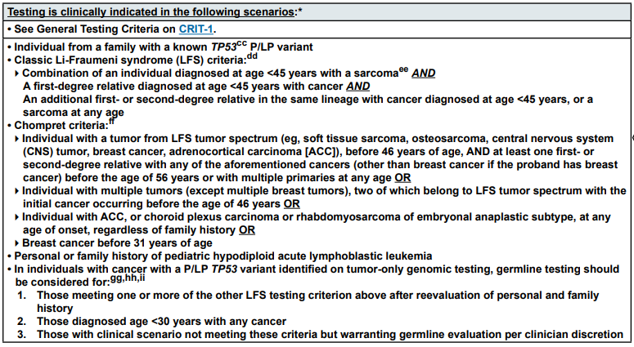
LFS Testing Criteria

Slide 28
LFS Management
Breast cancer risk: >60%
  Annual breast MRI beginning at age 20 and annual mammogram at age 30
  Consideration of RRM
Other cancer risks
  Comprehensive physical exam including neurologic examination
  Colonoscopy and upper endoscopy every 2-5 years starting at age 25
  Annual dermatologic exam beginning at age 18
  Annual whole body MRI
  Annual brain MRI
  Annual PSA beginning at age 40

Slide 29
CHEK2
Breast cancer risk: 20-40%
  Annual mammogram at age 40 and consider breast MRI beginning at age 30-35
  Insufficient evidence to recommend RRM; manage based on family history
Colorectal cancer risk: 5-10%
  Colonoscopy every 5 years beginning at age 40
Prostate cancer risk is emerging
  Consider screening with PSA beginning at age 40

Slide 30
ATM
Breast cancer risk: 20-30%
  Annual mammogram at age 40 and consider breast MRI beginning at age 30-35
  Insufficient evidence to recommend RRM; manage based on family history
Ovarian cancer risk: 2-3%
  Insufficient evidence to recommend RRSO; manage based on family history
Pancreatic cancer risk: 5-10%
  Screen carriers with a family history of pancreatic cancer
Prostate cancer risk is emerging
  Consider screening beginning at age 40

Slide 31
Cowden Syndrome
PTEN
Macrocephaly, acral keratosis, oral mucosa cobblestoning, breast, uterine, thyroid and kidney cancers, autism spectrum disorder
Breast cancer risk: 40-60%
  Annual mammogram and breast MRI beginning at age 30 or 10 years prior to earliest known breast cancer in the family
  Discuss option of RRM based on family history
Colorectal cancer
  Colonoscopy starting at age 35 or 10 years prior to earliest known CTC in family and repeat every 5 years or more frequent if polyps or symptoms
Uterine cancer
  Screening beginning at age 35 via endometrial biopsy every 1-2 years
  Transvaginal u/s has not been shown to be sensitive or specific but may be considered
  Discussion of hysterectomy upon completion of childbearing
Kidney cancer: consider renal u/s every 1-2 years beginning at age 40
Thyroid cancer: annual u/s beginning at age 7

Slide 32
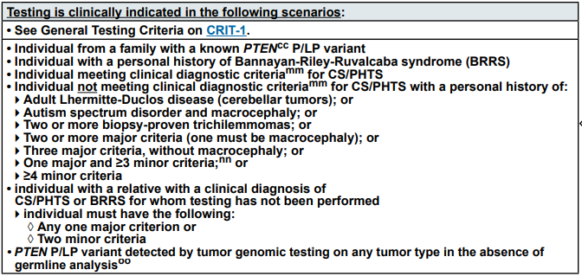
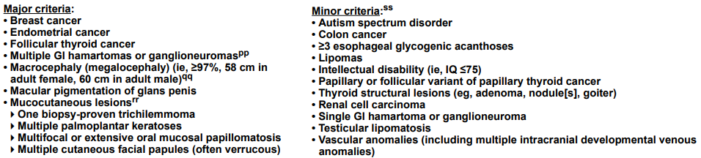
Cowden Syndrome Testing Criteria

Slide 33
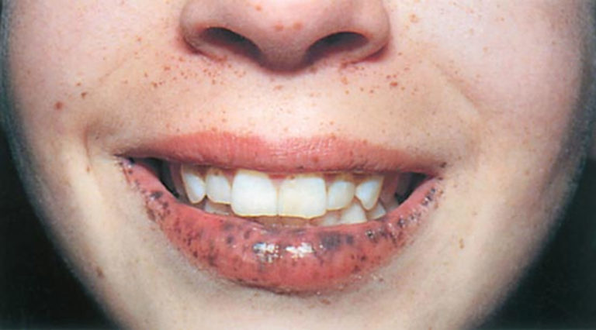
Peutz-Jeghers Syndrome (PJS)
STK11
Increased risk of GI, breast, thyroid, lung, pancreatic, uterine, ovarian sex cord tumors and Sertoli cell testicular tumors.
Causes hyperpigmented macules on buccal mucosa and lips
Associated with hamartomatous polyps

Slide 34
PJS Diagnosis
A clinical diagnosis of PJS can be made when an individual has two or more of the following features:
  Two or more Peutz-Jeghers-type hamartomatous polyps of the GI tract
  Mucocutaneous hyperpigmentation of the mouth, lips, nose, eyes, genitalia, or fingers
  Family history of PJS •
Clinical genetic testing is recommended for any patient meeting the above criteria or with a family history of PJS. The majority of cases occur due to pathogenic variants in the STK11 gene.

Slide 35
Peutz-Jeghers Management
Colon/Gastric cancer risk: 39-29%
  Upper endoscopy and colonoscopy beginning at age 8-10. If no polyps, resume at 18 every 2-3 years. If polyps, repeat every 2-3 years.
Breast cancer risk: 32-54%
  Annual mammogram and breast MRI beginning at age 30
  Discuss option of RRM
Pancreatic cancer risk: >15%
  Annual imaging of the pancreas with EUS or MRI/MRCP beginning in early 30s
Annual testicular exam beginning at age 10.
Non-Epithelial Ovarian cancer: >10%
  Annual pelvic exam and u/s beginning at age 1-20 years

Slide 36
Multiple Endocrine Neoplasia (MEN)
MEN1
Pituitary adenoma (20%)
Hyperparathyroid (95%)
pNET (20-80%)
Duodenal gastrinoma (up to 25% of gastrinomas are MEN1 positive)

Slide 37
MEN2
RET
  Type 2A
    Hyperparathyroidism (~25%)
    Medullary thyroid cancer (~90%)
    Pheochromocytoma (~50%)
  Type 2B
    Marfanoid habitus
    Mucosal neuromas
    Medullary thyroid cancer (near 100%)
    Pheochromocytoma (~50%)
  Elective thyroidectomy age 1 for MEN2B and 5 or older for MEN2A
  Annual calcium and metanephrine levels

Slide 38
Other Notable Symdromes
Von Hippel Lindau (VHL) - Increased risk of renal cell carcinoma, retinal angioma, cerebellar hemangioblastoma, pheochromocytoma, pancreatic cysts/pNETs, islet cell tumors and epididymal cystadenoma
Birt-Hogg-Dube (FLCN) - Increases the risk of renal cancer and cysts, pulmonary cysts and noncancerous tumors (thyroid nodules)
Familial melanoma (CDKN2A) - Increases the risk of melanoma (28-76% depending on other risk factors) and pancreatic cancer (>15%)
Hereditary leiomyomatosis and renal cell (FH) – renal cancer, leiomyomas, adrenal hyperplasia
Hereditary papillary renal cell
SDHx-related hereditary paraganglioma syndrome (SDHA, SDHB, SDHC, SDHD, SDHAF2) – paragangliomas, renal cell carcinoma, pituitary tumors, GIST
Juvenile polyposis (BMPR1A or SMAD4) – colon, gastric, small bowel and pancreas
Serrated polyposis (RNF43 soft linkage)

Slide 39
Pediatric Cancer Syndromes
Retinoblastoma (RB1)
Wilms tumor (WT1)
Rhabdoid predisposition syndrome (SMARCB1, SMARCA4)
Nevoid basal cell carcinoma syndrome, medulloblastoma (PTCH)
Neurofibromatosis (NF1)
Familial neuroblastoma (ALK, PHOX2B, RET)
Tuberous sclerosis (TSC1, TSC2)

Slide 40
References
City of Hope Division of Clinical Cancer Genomics Duarte, Caliornia Intensive Course in Genomic Cancer Risk Assessment November 9, 2018 – March 14, 2019.
Edaily, Sarah and Hikmat Abdel-Razeq. “Management Strategies of Breast Cancer Patients with BRCA1 and BRCA2 Pathogenic Germline Variants." Dovepress July 27, 2022
Fauci et al. Harrison’s Principles of Internal Medicine, 17th edition
“Hereditary Diffuse Gastric Cancer (HDGC)." Johns Hopkins. www.hopkinsmedicine.org/health/conditions-and-diseases/hereditary-diffuse-gastric-cancer-hdgc
Kohlmnn W, Gruber SB. “Lynch Syndrome." 2004 Feb 5 [Updated 2014 May 22]. In: Pagon RA, Adam MP, Ardinger HH, et al., editors. Gene Reviews. Seattle (WA): University of Washington, Seattle; 1993-2014
Le DT et al. “PD-1 Blockade in Tumors with Mismatch-Repair Deficiency." New England Journal of Medicine 2015; 372 (26): 2509-20.
Massari G et al. “Frequency of CDH1 Germline Mutation in Non-Gastric Cancers." Cancers 2021 May 13(10) 2321
"NCCN Guidelines – Genetic/Familial High-Risk Assessment: Breast, Ovarian and Pancreatic." NCCN.org, version 2.2024, National Comprehensive Cancer Network, www.nccn.org/professionals/physician_gls/pdf/genetics_bop.pdf
"NCCN Guidelines – Genetic/Familial High-Risk Assessment: Colorectal." NCCN.org, version 1.2023, National Comprehensive Cancer Network, www.nccn.org/professionals/physician_gls/pdf/genetics_colon.pdf
Vasen HFA et al. “Guidelines for the Clinical Management of Lynch Syndrome (Hereditary Non-polyposis Cancer)." Journal of Medical Genetics 2007 Jun; 44(6): 353-362

