Slide 1
Eating Disorder Identification and Management in
Primary Care
Critical Points for Early Recognition & Medical Risk Management in the Care of Individuals with Eating Disorders
Jessica Gray, MD, FAAFP
Board Certified Family Medicine Physician
Fellow of the American Association of Family Practice
TTUHSC Clinical Assistant Professor

Slide 2
Objectives
Increase level of familiarity with screening and understanding the importance of identifying eating disorders in primary care or specialty care settings.
Define eating disorders as common behavioral disorders associated with substantial psychological and physical morbidity and mortality.
Recognize persons with eating disorders frequently present to primary care providers, who may be also responsible for their general medical management.
Identify patients with eating disorders in need of hospitalization or higher level of care.
Describe treatment approaches to eating disorders and the importance of utilizing a multidisciplinary team.

Slide 3
Key Guidelines
All eating disorders (EDs) are serious mental illnesses with significant, life-threatening medical and psychiatric morbidity and mortality, regardless of an individual’s weight.
Patients with EDs have the highest mortality rates of any psychiatric disorder.
The risk of premature death is 6-12 times higher in women with Anorexia Nervosa (AN) as compared to the general population, adjusting for age.

Slide 4
Key Guidelines
Early recognition and timely intervention, based on a developmentally appropriate, evidence-based, multidisciplinary team approach (medical, psychological & nutritional) is the ideal standard of care, whenever possible.
Members of the multidisciplinary team may vary and will depend upon the needs of the patient and the availability of these team members in the patient’s community.
In communities where resources are lacking, clinicians, therapists, and dietitians are encouraged to consult with the Academy for Eating Disorders (AED) and/or ED experts in their respective fields of practice.

Slide 5

Defining Eating Disorders
Anorexia nervosa (AN): Restriction of energy intake relative to an individual’s requirements, leading to a significantly low body weight in the context of age, sex, developmental trajectory and health status. Disturbance of body image, an intense fear of gaining weight, lack of recognition of the seriousness of the illness and/or behaviors that interfere with weight gain are also present.
  (F50.01): Restricting type: During the last 3 months, the individual has not engaged in recurrent episodes of binge eating or purging behavior (i.e., self-induced vomiting or the misuse of laxatives, diuretics, or enemas). This subtype describes presentations in which weight loss is accomplished primarily through dieting, fasting, and/or excessive exercise.
  (F50.02): Binge-eating/purging type: During the last 3 months, the individual has engaged in recurrent episodes of binge eating or purging behavior (i.e., self-induced vomiting or the misuse of laxatives, diuretics, or enemas).

Slide 6

Defining Eating Disorders
Bulimia Nervosa (BN): Binge eating (eating a large amount of food in a relatively short period of time with a concomitant sense of loss of control) with purging/compensatory behavior (e.g. self-induced vomiting, laxative or diuretic abuse, insulin misuse, excessive exercise, diet pills) once a week or more for at least 3 months. Disturbance of body image, an intense fear of gaining weight and lack of recognition of the seriousness of the illness may also be present.
  Mild: An average of 1–3 episodes of inappropriate compensatory behaviors per week.
  Moderate: An average of 4–7 episodes of inappropriate compensatory behaviors per week.
  Severe: An average of 8–13 episodes of inappropriate compensatory behaviors per week.
  Extreme: An average of 14 or more episodes of inappropriate compensatory behaviors per week.

Slide 7

Defining Eating Disorders
Binge Eating Disorder (BED): Binge eating, in the absence of compensatory behavior, once a week for at least 3 months. Binge eating episodes are associated with eating: rapidly, when not hungry, until extreme fullness, and/or associated with depression.
Other Specified Feeding and Eating Disorder (OSFED): An ED that does not meet full criteria for one of the above categories, but has specific disordered eating behaviors such as restricting intake, purging and/or binge eating as key features shame or guilt.
Unspecified Feeding or Eating Disorder (UFED): ED behaviors are present, but they are not specified by the care provider.
Avoidant/Restrictive Food Intake Disorder (ARFID): Significant weight loss, nutritional deficiency, dependence on nutritional supplement or marked interference with psychosocial functioning due to caloric and/or nutrient restriction, but without weight or shape concerns.
Consult www.aed.org, DSM-5 or ICD-10 for full diagnostic descriptions

Slide 8

Important Facts About Eating Disorders
EDs do not discriminate. They can affect individuals of all ages, genders, ethnicities, socioeconomic backgrounds, and with a variety of body shapes, weights and sizes.
Weight is not the only clinical marker of an ED. People who are at low, normal or high weights can have an ED and individuals at any weight may be malnourished and/or engaging in unhealthy weight control practices.
Individuals with an ED may not recognize the seriousness of their illness and/or may be ambivalent about changing their eating or other behaviors.
All instances of precipitous weight loss or gain in otherwise healthy individuals should be investigated for the possibility of an ED as rapid weight fluctuations can be a potential marker of an ED.
In children and adolescents, failure to gain expected weight or height, and/or delayed or interrupted pubertal development, should be investigated for the possibility of an ED.
The medical consequences of EDs can go unrecognized, even by an experienced clinician.

Slide 9
Common Myths
Patients need to be under weight to have complications from their eating disorder. “Your anorexia must not be that bad since your weight is normal.”
All patients respond physically the same to the same degree of restriction/binge/purge behaviors.
Think about the 103-year-old man who says that drinking 4 Dr. Peppers a day and smoking cigars is the reason for his longevity. Genetics plays a role.
“Her bradycardia is because she is an athlete and runs 4 miles a day”.
As a wise cardiologist once said, “this is the equivalent to saying a morbidly obese patient is a professional sumo wrestler”.
This is not due to her athletic ability and healthy increased vagal tone. The increase vagal tone is from starvation and body in a “hibernation state” (think hibernating bears).

Slide 10
Case Example: Runner with Broken Foot at Urgent Care
CC: C/o left foot pain x 4 weeks.
History of Present Illness
19yoF is an avid runner and ran a half marathon 2 months ago. No known trauma or injury at that time. Shortly thereafter she began to have pain to the top of her left foot. She stopped running for a 1-2 week period and tried to run again, but unable to due to the intense pain to the top of the left foot. No previous history of trauma or injury to her foot. She's been taking OTC medication and using prn ice with minimal relief.
Physical Exam Vitals & Measurements HR: 45 BP: 96/58 HT: 162.56 cm WT: 47.63 kg BMI: 18.02
Respiratory: respirations non labored, normal respiratory rate.
Extremities: no deformity, bilateral pes cavus, left foot has edema/ecchymosis and moderate tenderness over the proximal 1st metatarsal and extensor tendon, no distal neurovascular deficit, full painless ROM in ankle and all toes, no ankle pain.
Neurological: oriented x 4, LOC appropriate for age.
Psychiatric: cooperative, affect appropriate for age.
Assessment/Plan 1. Left foot pain M79.672 X-ray today is concerning for an occult fracture to the proximal 1st metatarsal, which certainly correlates with her pain/symptoms. MD advised her that since the injury was about 3-4 weeks ago, that she needs to avoid impact activities, ice OTC tylenol/motrin along with ice for pain control. MD asked her to follow up in 6 weeks if her symptoms persist for repeat x-ray or further workup/imaging.

Slide 11
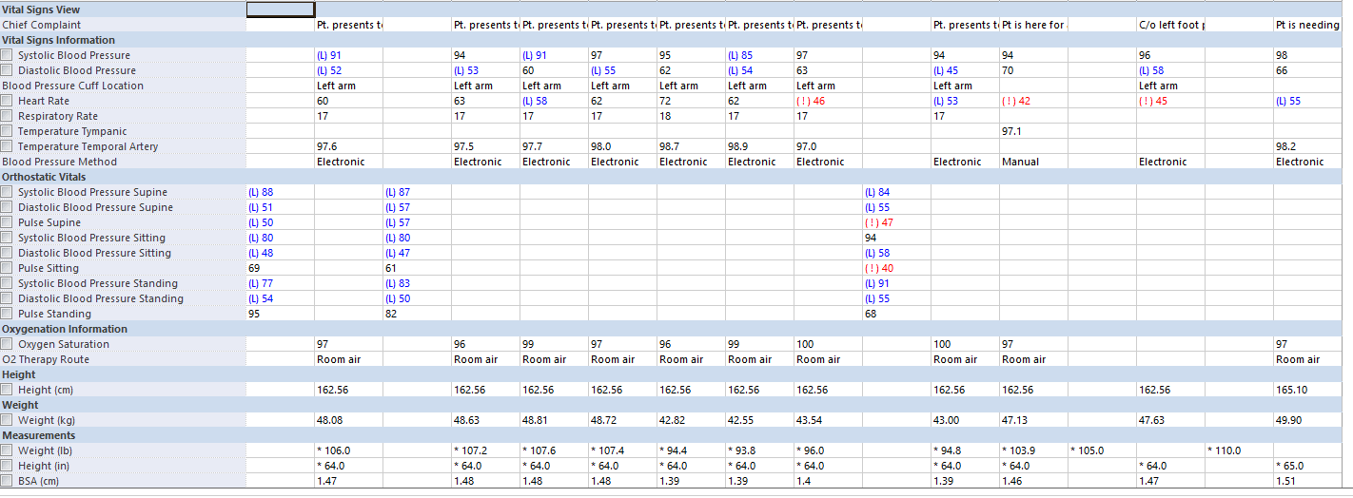

Slide 12
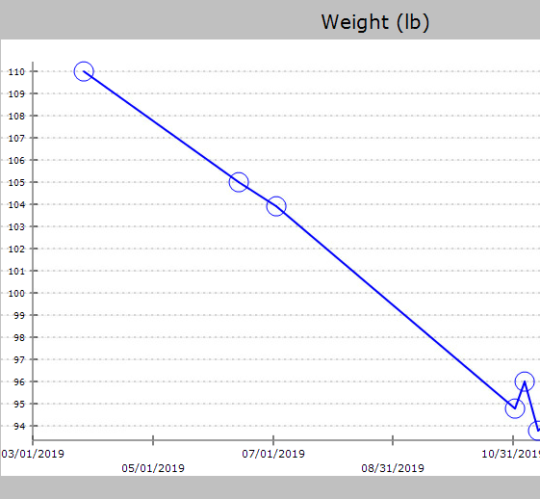

Slide 13
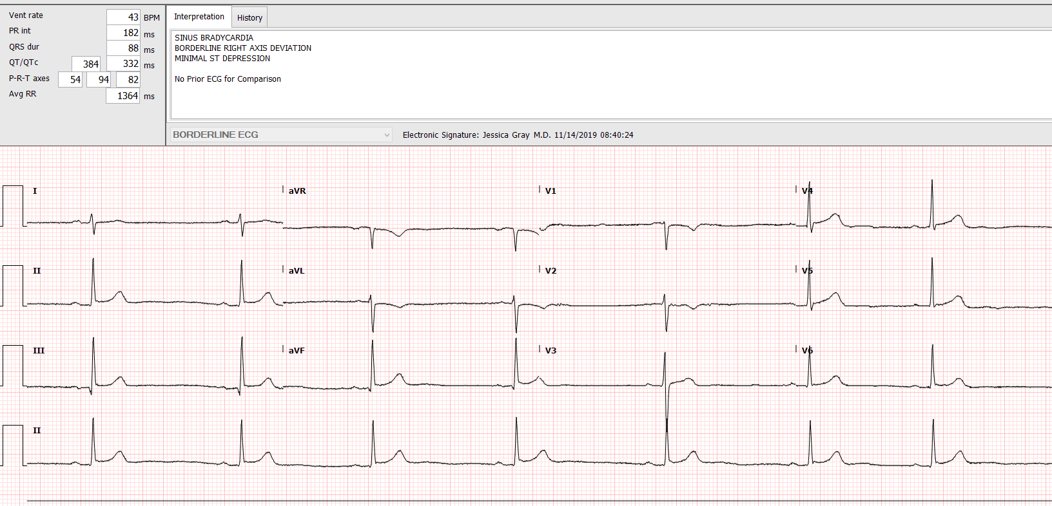



Slide 14
Case Example: 17yoF with Thyroid Concerns
Chief Complaint: concern about thyroid issues
History of Present Illness: 17yoF presents to clinic accompanied by mother due to concern that patient has thyroid issues. Mother reports that she noticed the patient has lost 20lbs over the last 8 weeks and 10lbs in the last 1 week. Mother was initially concerned that patient may have hyperthyroidism as patient “has always been a thinner child" but had lost significantly more weight since July 2019. Patient denies any restriction, purging, or compulsory exercise habits. Reports that she eats for breakfast fruit, toast, chicken, eggs. For lunch she also endorses eating foods such as chicken bread, and the same is reported for dinner. Mother says she does see her eat some of these food "but not as much as she thinks she is eating". Patient admits to doing 20 minutes of light weight training at home for about 20min q2 days, stretching in her room daily for 15-20 min, and walks her dog 2-3 miles for 1 hour daily. Was running but says mother made her stop in November because mother was concerned about her weight (was running about 3 miles q2 days). Patient denies syncope, abdominal pain, chest pain, SOB, dyspnea, constipation, diarrhea.

Slide 15
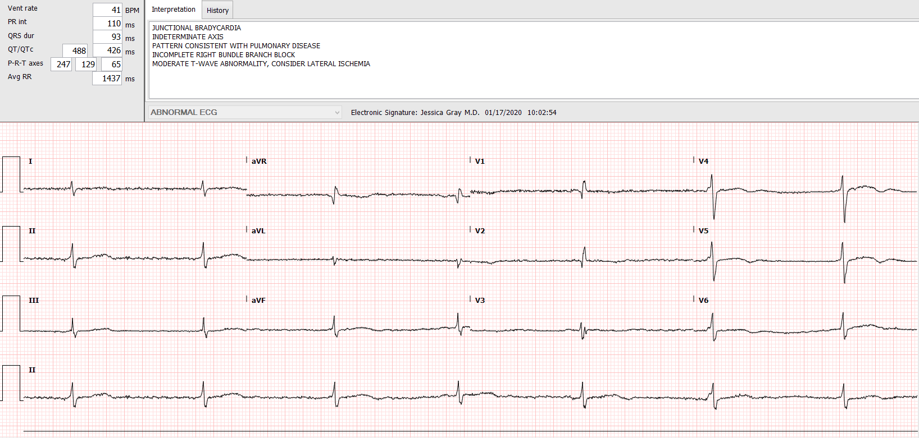

Slide 16




Slide 17
Higher Level of Care
Eating Disorder Treatment Centers
Inpatient
24/7 observation and nursing support
Residential
Full day programming, 7 days per week with medically supervised living
Partial Hospitalization Program
8 hour per day, 7 day per week program
Intensive Outpatient
Patients “test” recovery skills at home or in housing or local hotels near treatment center
Medical monitoring, dietary education and monitoring, supported meals and multifamily education
9-15 hours of treatment per week with additional treatment including weekly therapy and nutrition appointments
Daytime medical and psychiatric supervision
Emphasis on medical stabilization, weight restoration, and interruption of eating disordered thoughts and behaviors
Team includes psychiatrists, primary care physician, individual and family therapists, registered dietitians, RN, art therapists, movement therapist
Round the clock nursing
Medical and psych supervision

Slide 18
Presenting Signs & Symptoms
GENERAL:
CARDIORESPIRATORY:
Marked weight loss, gain, fluctuations or unexplained change in growth curve or BMI percentiles in a child or adolescent who is still growing and developing
Cold intolerance
Weakness
Fatigue or lethargy
Presyncope (dizziness)
Syncope (fainting)
Hot flashes, sweating episodes
Chest pain
Heart palpitations
Orthostatic tachycardia/hypotension (low blood pressure)
Dyspnea (shortness of breath)
Edema (swelling)
Sudden cardiac death
Bradycardia
QTc-prolongation**
Cardiac structural changes
  Left ventricular atrophy
  Mitral valve prolapse
  Substantial reduction in left ventricular myocardial mass with preserved EF
Notes:
Sudden cardiac death along with other medical complications and suicide account for approximately 60% of the deaths.
The exact cause of sudden death in anorexia nervosa remains unknown. Autopsy studies do not reveal evidence of obstructive coronary artery disease. It has been postulated that alterations in cardiac con- duction and repolarization contribute to heightened mortality though a single unifying mechanism.
Generally, bradycardia is noted in patients and reflects heightened vagal tone in the setting of substantial weight loss. This often recovers with restoration of body weight. A resting heart rate of less than 60 beats per minute, for example, was seen in 95% of patients
Sinus bradycardia in and of itself does not require specific therapy, but current guidelines recommend hospitalization for a heart rate less than 40 beats per minute.
**Patients may present with prolongation of the QTc interval on surface electrocardiography, and a commonly held belief was that this is the primary cause of sudden cardiac death. However, this relationship is confounded by concurrent QTc-prolonging medications and depletion of serum potassium and magnesium levels.
In a series of patients with severe anorexia nervosa, marked QTc interval prolongation (>500 ms) was actually uncommon in the absence of contributing factors.
Severe anorexia nervosa is also known to change cardiac structure. Many patients develop left ventricular atrophy and subsequent annular changes that lead to mitral valve pro- lapse. Patients occasionally develop pericardial effusions, which are generally self-limited and resolve with weight restoration. Among the most prominent cardiovascular structural abnormalities is a substantial reduction in left ventricular myocardial mass with preserved left ventricular systolic function. This is generally reversible with refeeding.

Slide 19
Presenting Signs & Symptoms
ORAL AND DENTAL:
GASTROINTESTINAL:
Oral trauma/lacerations
Perimyolysis (dental erosion on posterior tooth surfaces) and dental caries (cavities)
Parotid gland enlargement
Dysphagia
  Due to weakened and uncoordinated pharyngeal muscles
Delayed gastric emptying
  Epigastric discomfort
  Abdominal bloating
  Early satiety (fullness)
Acute gastric dilation -> gastric perforation
Superior mesenteric artery syndrome
Gastroesophageal reflux (heartburn)
Hematemesis (Mallory Weiss tears)
Hemorrhoids and rectal prolapse
Constipation due to slowing of colonic function
Elevated liver enzymes (ALT>AST) 2-4x elevated
HEMATOLOGIC:
Anemia (40%)
Leukopenia (30%)
  Do not manifest typical febrile response to infections which can delay diagnosis of an infection
Thrombocytopenia (10%)
Serum B12 and folate increased
  Artificial increase due to hepatocyte dysfunction with leakage of the vitamins from these cells
Notes:
As anorexia nervosa becomes worse, there is trilinear hypoplasia causing anemia, leukopenia, and thrombocytopenia. Anemia occurs in 40% of these patients, with leukopenia noted in 30% and thrombocytopenia in approximately 10%. The cytopenia are due to gelatinous marrow transformation with atrophy of the normal fat content in the marrow and replacement by a mucopolysacharide.
Typically, iron deficiency is not found, and red cell indices are normal. Although often neutropenic, surprisingly, these patients do not appear to be more susceptible to infectious complications.
However, they also do not manifest a typical febrile response to infections and inflammatory markers are suppressed, which can cause a delay in the diagnosis of an infection.
Plasma levels of vitamin B12 and folate recently have been found to be increased. The increase is artificial because it was found to be due to hepatocyte dysfunction with leakage of the vitamins from these cells.
Dysphagia can frustrate the ingestion of oral calories during the early stages of refeeding. It is due to weakened and uncoordinated pharyngeal muscles. As a
result, patients may experience coughing with eating or have a history of aspiration pneumonia. The diagnosis is made by a modified barium swallow test, and the treatment depends on weight restoration and input from a speech therapist to define proper food consistencies.
Patients with anorexia nervosa have significantly slowed gastric emptying at their nadir weights that is accompanied by early satiety, nausea, and bloating. This gastroparesis ultimately resolves with weight gain, but symptoms may respond early on to low- dose, short-term use of metoclopramide before meals.
Acute gastric dilatation is a serious condition that can lead to gastric perforation if not recognized early. It can occur independently as an isolated finding in the early phases of refeeding or as a result of the superior mesenteric artery syndrome. Acute gastric dilation is first treated by gastric decompression with a nasogastric tube, followed by treatments similar to those used in superior mesenteric artery syndrome.
Superior mesenteric artery syndrome is defined by the extrinsic compression of the third portion of the duodenum by the superior mesenteric artery, due to loss of a fatty tissue pad that normally maintains the angle between the superior mesenteric artery and the aorta. Significant left upper quadrant abdominal pain with eating, emesis during the meal, and early satiety should prompt an evaluation for gastric dilatation or superior mesenteric artery syndrome via an abdominal radiograph or computed tomography scan. Treatment of superior mesenteric artery syndrome is aimed at weight restoration to reconstitute the fat pad. This can be achieved by a soft or liquid oral diet or by enteral feeds via a nasojejunal tube or a percutaneously placed one.
Just as there is slowing of the proximal gastrointestinal tract, there is also slowing of colonic function, resulting in constipation as an accompanying symptom in anorexia nervosa. Osmotic laxatives are useful along with reassurance that the patient’s prior bowel pattern should return over a few weeks with ongoing progressive nutritional rehabilitation.
Elevated liver transaminases occur frequently at patients’ nadir weights. This generally represents apoptosis, a programmed hepatocyte death as a result of malnutrition. AST and ALT are the most frequently affected in a range of 2 to 4 times elevated, but severe elevations also have been reported to occur. ALT is more elevated AST.
The prevalence of liver enzyme abnormalities correlates with lower body mass index, hypoglycemia, and the development of refeeding hypophosphatemia. Progressive nutritional support will resolve these elevations over the first few weeks of refeeding. Typically, alkaline phosphatase and bilirubin are not affected.

Slide 20
Presenting Signs & Symptoms
ENDOCRINE:
NEUROPSYCHIATRIC:
Amenorrhea or oligomenorrhea
  Reversion to a prepubertal state
  Pulsatile gonadotropin-releasing hormone secretion is reduced leading to low FSH and LH
  Resumption of menses generally occurs at the weight that periods stopped or at more than 90% of ideal body weight
Loss of libido
Stress fractures due to low bone mineral density/osteoporosis
  Osteoporosis occurs early in disease for AN with decreased bone density after 1 year
Infertility
Thyroid function abnormalities mimicking sick euthyroid syndrome
  Resolve with weight restoration
Hypoglycemia
  Due to depleted glycogen stores
  Poor prognostic sign requiring close monitoring
Brain atrophy changes occur as a result of the malnutrition of anorexia nervosa.
Neurocognitive functioning may be permanently impaired even though brain atrophy improves with weight restoration; both gray and white matter are affected.
Depressive/Anxious/Obsessive/ Compulsive symptoms and behaviors
Memory loss
Poor concentration
Insomnia
Self-harm
Suicidal thoughts, plans or attempts
Seizures
Notes:
Amenorrhea in AN is due to a reversion to a prepubertal state wherein pulsatile hypothalamic gonadotropin-releasing hormone secretion is reduced, causing low levels of follicle stimulating hormone and luteinizing hormone.
Thus, amenorrhea is noted commonly in most, but not all female patients with anorexia nervosa. Leptin may have a causal role in the amenorrhea.
Resumption of menses generally occurs at the weight that the periods ceased or at more than 90% of ideal body weight.
However, some patients have prolonged amenorrhea even after weight restoration, and fertility may be permanently adversely affected.87 In male patients with anorexia nervosa, the low testosterone levels affect potency, libido, and muscle strength.
Osteoporosis is common in anorexia nervosa and occurs early in the disease.71 Decreased bone density is evident after just 1 year of anorexia nervosa, notwithstanding the relatively young age of these patients.
In contrast to postmenopausal osteoporosis, in anorexia nervosa the loss of bone mineral density is due to both decreased bone formation along with increased bone resorption. Also, trabecular bone is more affected than cortical bone.
There are currently no treatments specifically approved for the osteoporosis of anorexia nervosa. Weight gain and resumption of menses are key and associated with significant increases in spine and hip bone mineral density.
However, estrogen therapy does not seem to be of much value in anorexia nervosa. Many randomized controlled trials have found it to be ineffective, a fact that is under- appreciated in the medical community. Also, the withdrawal bleeding associated with its use can mislead patients into believing they are getting better.
Transdermal estrogen patches have shown promising results in adolescents. Calcium and vitamin D by themselves do not restore bone density. Bisphosphonates have been shown to be effective in anorexia nervosa with an increase of 3% to 4% in spine bone mineral density after 12 months of treatment.
Male patients with anorexia nervosa actually have more severe degrees of osteoporosis then their female counterparts
Hypoglycemia occurs as anorexia nervosa becomes more severe, as a result of depleted hepatic glycogen stores. It is a poor prognostic sign that requires close monitoring.

Slide 21
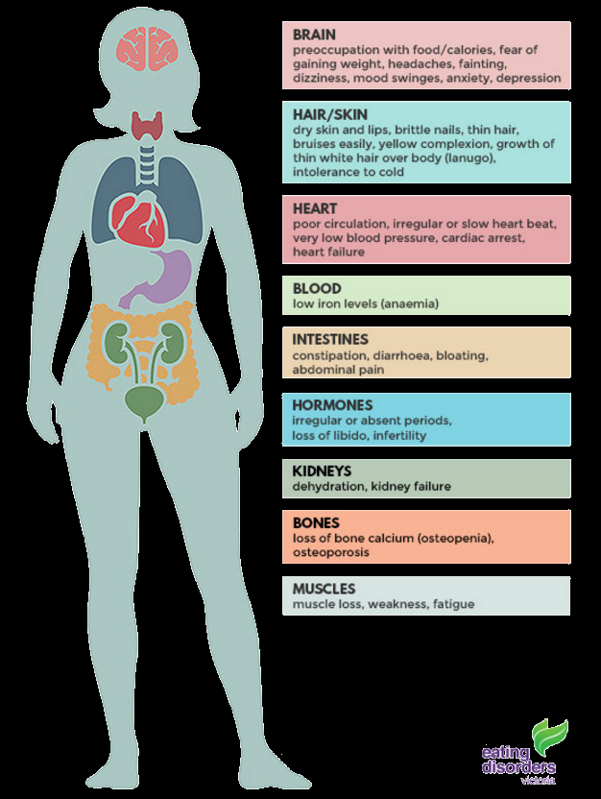
Presenting Signs & Symptoms
DERMATOLOGIC:
Lanugo hair on spine and sides of face
Hair loss
Carotenoderma (yellowish discoloration of skin)
Russell’s sign (Calluses or scars on the back of the hand)
Poor wound healing
Dry brittle hair and nails
Increased acne
Notes:
None of these are signs of virilization, but rather are related to reduced subcutaneous tissue or to the body’s attempt to maintain core temperature and prevent heat loss. They all resolve with weight gain.

Slide 22
Validated Screening Tools
The SCOFF:
S Do you make yourself Sick because you feel uncomfortably full?
C Do you worry you have lost Control over how much you eat?
O Have you recently lost more than One stone (6.35 kg or 14 lb) in a three-month period?
F Do you believe yourself to be Fat when others say you are too thin?
F Would you say Food dominates your life?
*Two or more positive responses on the SCOFF indicates a possible ED and should prompt referral for further evaluation.

Slide 23
Early Recognition
Consider evaluating an individual for an ED who presents with any of the following:
Precipitous weight changes (significant weight lost or gained) or fluctuations
Sudden changes in eating behaviors (new vegetarianism/veganism, gluten-free, lactose free, elimination of certain foods or food groups, eating only “healthy” foods, uncontrolled binge eating)
Sudden changes in exercise patterns, excessive exercise or involvement in extreme physical training
Body image disturbance, the desire to lose weight despite low or normative weight, or extreme dieting behavior regardless of weight
Abdominal complaints in the context of weight loss behaviors
Electrolyte abnormalities without an identified medical cause (especially hypokalemia, hypochloremia, or elevated CO2).

Slide 24
Early Recognition
Consider evaluating an individual for an ED who presents with any of the following:
Hypoglycemia
Bradycardia
Amenorrhea or menstrual irregularities
Unexplained infertility
Type 1 diabetes mellitus with poor glucose control or recurrent diabetic ketoacidosis (DKA) with or without weight loss
Use of compensatory behaviors (i.e., such as self-induced vomiting, dieting, fasting or excessive exercise) to influence weight after eating or binge eating
Inappropriate use of appetite suppressants, caffeine, diuretics, laxatives, enemas, ipecac, artificial sweeteners, sugar-free gum, prescription medications that affect weight (insulin, thyroid medications, psychostimulants, or street drugs) or nutritional supplements marketed for weight loss

Slide 25
Criteria for Hospitalization for Acute Medical Stabilization
PRESENCE OF ONE OR MORE OF THE FOLLOWING:
1. ≤ 75% median BMI (or ideal body weight) for age, sex, and height
2. Hypoglycemia
3. Electrolyte disturbance (hypokalemia, hyponatremia, hypophosphatemia and/or metabolic acidosis or alkalosis)
4. ECG abnormalities (e.g., prolonged QTc > 450, bradycardia,
other arrhythmias)
5. Hemodynamic instability (bradycardia, hypotension, hypothermia)
6. Orthostasis
7. Acute medical complications of malnutrition (e.g., syncope, seizures, cardiac failure, pancreatitis, etc.)
8. Comorbid psychiatric or medical condition that prohibits or limits appropriate outpatient treatment (e.g., severe depression, suicidal ideation, obsessive compulsive disorder, type 1 diabetes mellitus)
9. Uncertainty of the diagnosis of an ED

Slide 26
Criteria for Hospitalization for Acute Psychiatric Stabilization
PRESENCE OF ONE OR MORE OF THE FOLLOWING:
1. Acute food refusal
2. Suicidal thoughts or behaviors
3. Other significant psychiatric comorbidity that interferes with ED treatment (anxiety, depression, obsessive compulsive disorder)
OTHER CONSIDERATIONS REGARDING HOSPITALIZATION:
1. Failure of outpatient treatment
2. Uncontrollable bingeing and/or purging by any means
3. Inadequate social support and/or follow up medical or psychiatric care

Slide 27
Timely Interventions
Patients with EDs may not acknowledge that they are ill, and/or they may be ambivalent about accepting treatment.
This is a symptom of their illness. Patients may minimize, rationalize, or hide ED symptoms and/or behaviors. Their persuasive rationality and competence in other areas of life can disguise the severity of their illness.
Outside support and assistance with decision-making will likely be necessary regardless of age.

Slide 28
How to keep clinic “ED Friendly”
Train staff to all know how to be sensitive with ED patients (i.e. blind weights, avoiding small talk, chart designation, not asking chief complaint details)
Blind weights for ED patients if not universally
Avoid discussing weight with patient as the provider unless necessary for HLOC purposes
Avoid triggering statements about appearance
Screen on an electronic scale not visible to the patient.
Patient can turn backward on the scale or screen can sometimes be turned
Analog or weighted scales may be more difficult to hide the weights
Nursing staff needs to learn a good “poker face”
As simple as “you look nice today” or “that is a nice top”
ED patients reframe as a reflection on their physical appearance
“nice top” -> “this top used to be my fat girl top” -> “this top now feels tighter on my body” -> “she likes it because I am now a fat girl in this top”-> “Fat. Fat. Fat.”

Slide 29
Timely Interventions
Parents/guardians are the frontline help-seekers for children, adolescents, and young adults with EDs. Need to have open communication with parents even in young adult, college age patient.
Trust their concerns. Even a single consultation about a child’s eatingbehavior or weight/shape concerns is a strong predictor of the presence or potential development of an ED.
Diffuse blame. Help families understand that they did not cause the illness; neither did their child/family member choose to have it. This recognition facilitates acceptance of the diagnosis, referral, treatment, and minimizes undue stigma associated with having the illness.

Slide 30
Timely Interventions
Monitor physical health including vital signs and laboratory tests. Patients with an ED should be regularly monitored for acute and chronic medical complications. Blind weights are recommended in obtaining vitals.
Assessments should be interpreted in the context of physiological adaptation to malnutrition and purging behavior.
Clinicians need to remember that physical exam and laboratory tests may be normal even in the presence of a life-threatening ED.

Slide 31
Timely Interventions
Keep psychiatric risk in mind with each visit.
Always assess for psychiatric risk, including suicidal and self-harm thoughts, plans and/or intent.
Up to 1/2 of deaths related to EDs are due to suicide.

Slide 32
Ongoing Management
Following initial stabilization, ongoing evidence-based treatment delivered by healthcare professionals with expertise in the care of patients with Eds is essential for full recovery.
Optimal care includes a multidisciplinary team approach by ED specialists including medical, psychological, nutritional, and psychopharmacologic services.
Families (i.e., parents, spouses, partners) should be included in ED treatment whenever possible.
In low weight patients with ED, restoration of an appropriate, healthy weight will significantly improve their physical, psychological, social, and emotional functioning. Failure to fully restore weight correlates with poor outcomes and maintenance of a healthy weight strongly correlates with improved outcomes.
For full recovery from an ED, however, weight restoration is not enough for full recovery. It is equally important that distorted body image and other ED thoughts/behaviors, psychological comorbidities and any social or functional impairments be addressed by qualified professionals during the treatment of patients with EDs.

Slide 33
References
Westmoreland, P., Krantz, M. J., & Mehler, P. S. (2016). Medical Complications of Anorexia Nervosa and Bulimia. The American Journal of Medicine, 129(1).
Uniacke, B., & Walsh, B. T. (2022). In the clinic: Eating Disorders. Annals of Internal Medicine. https://doi.org/10.7326/AITC202208160
Ovidio, O., Devlin, M., Dooley-Hash, S., Guarda, A., Katzman, D. K., Madden, S., McGilley, B. H., Michel, D., & Rome, E. S. (n.d.). (rep.). Eating Disorders: A guide to medical care - Critical Points for Early Recognition & Medical Risk Management in the Care of Individuals with Eating Disorders (3rd ed.).
Garber AK, Sawyer SM, Golden NH, Guarda AS, Katzman DK, Kohn MR, Le Grange D, Madden S, Whitelaw M, Redgrave GW. (2016).
A Systematic Review of Approaches to Refeeding in Patients
with Anorexia Nervosa. International Journal of Eating Disorders. 49(3), 293-310.
Mond JM, Myers TC, Crosby RD, Hay PJ, Rodgers B, Morgan JF,
Lacey JH, Mitchell JE. (2008). Screening for Eating Disorders in Primary Care: EDE-Q versus SCOFF. Behaviour Research and Therapy. 46, 612–622.
Sachs K, Andersen D, Sommer J, Winkelman A, Mehler PS. (2015). Avoiding Medical Complications During the Refeeding of Patients with Anorexia Nervosa. Eating Disorders. 23(5), 411-421.
The Society for Adolescent Health and Medicine. (2015). Position Paper of the Society for Adolescent Health and Medicine: Medical Management of Restrictive Eating Disorders in Adolescents and Young Adults.
Journal of Adolescent Health. 56(1), 121–125.
The Society for Adolescent Health and Medicine. (2014). Refeeding Hypophosphatemia in Hospitalized Adolescents with Anorexia Nervosa: A Position Statement of the Society for Adolescent Health and Medicine. Journal of Adolescent Health. 55(3), 455-457.

Slide 34



