Slide 1

Obesity Medicine Basic Concepts
Ann Hughes Bass, MD

Slide 2
AGENDA
Obesity
Stigma
Physiology and Pathophysiology
Treatment Strategies
Questions
Epidemiology

Slide 3




OBESITY...
“…chronic, progressive, relapsing, and treatable multifactorial, neurobehavioral disease, wherein an increase in body fat promotes adipose tissue dysfunction and abnormal fat mass physical forces, resulting in adverse metabolic, biomechanical, and psychosocial health consequences.”
Obesity Medicine Association
Obesity Algorithm, 2023

Slide 4

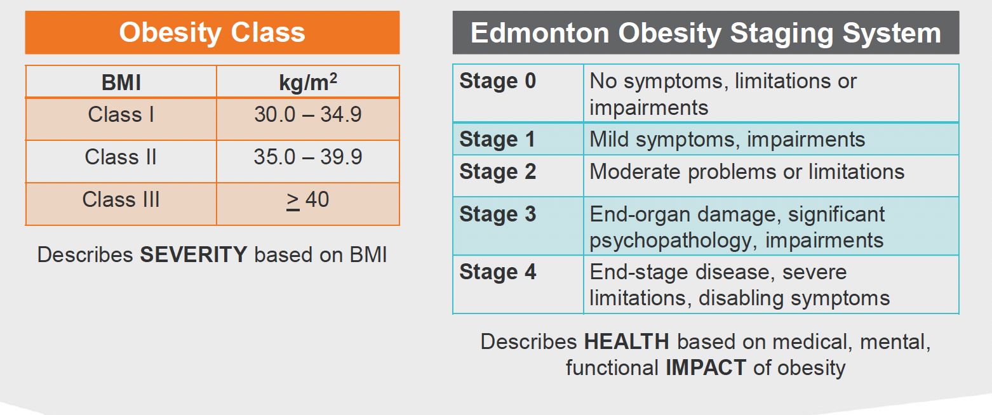




Slide 5
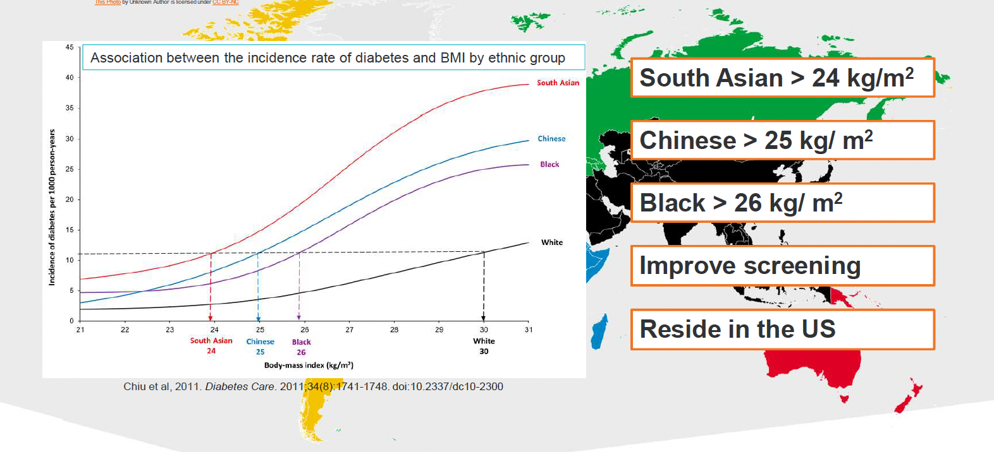

Slide 6
AGENDA
Obesity
Stigma
Physiology and Pathophysiology
Treatment Strategies
Questions
Epidemiology

Slide 7
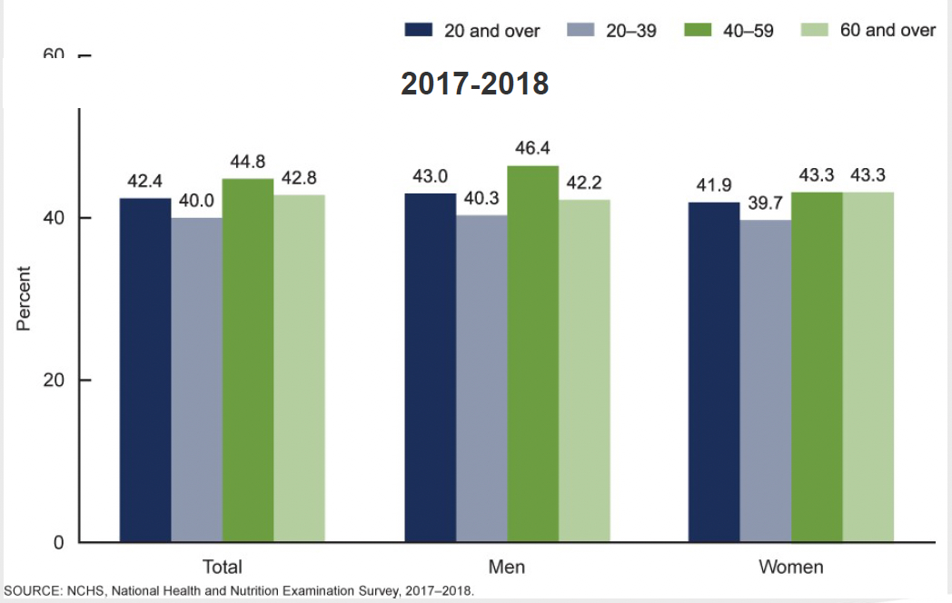

Slide 8
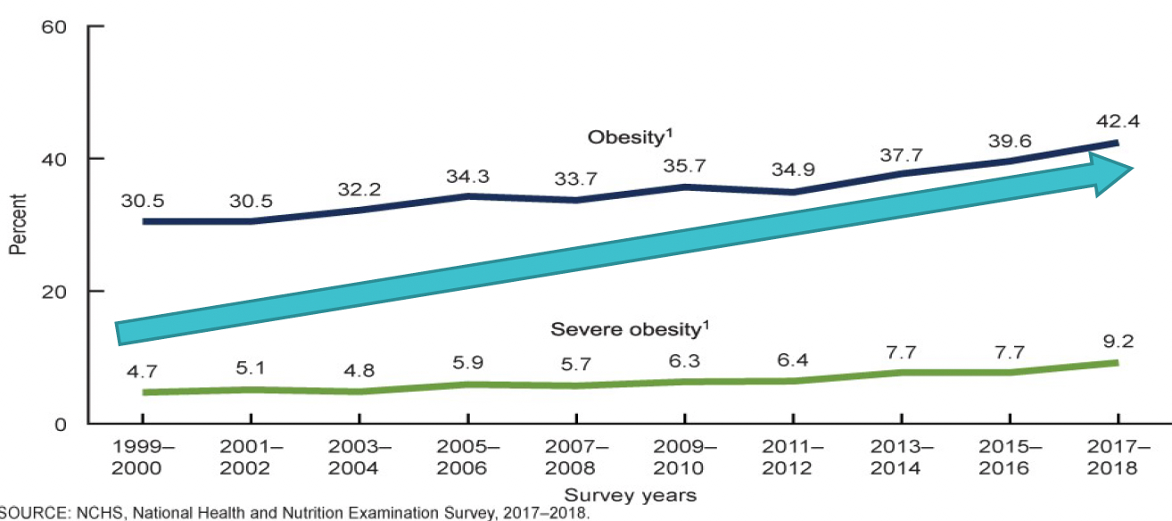

Slide 9
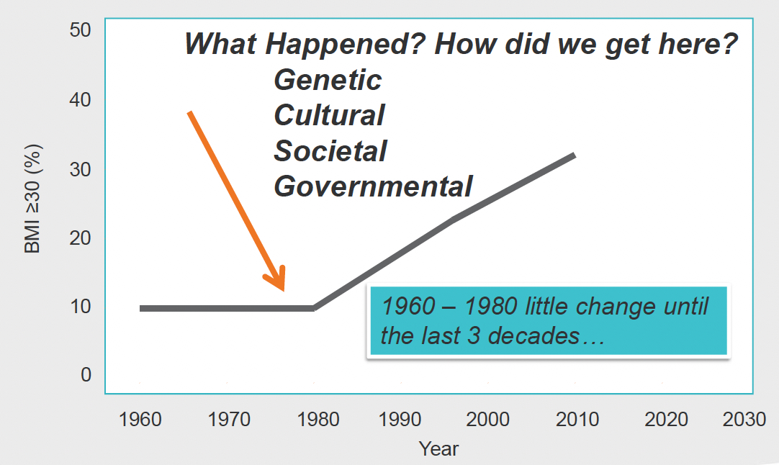

Slide 10
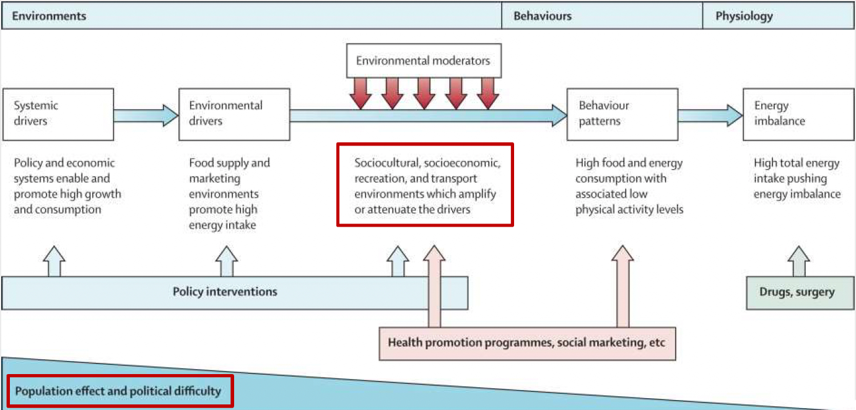

Slide 11
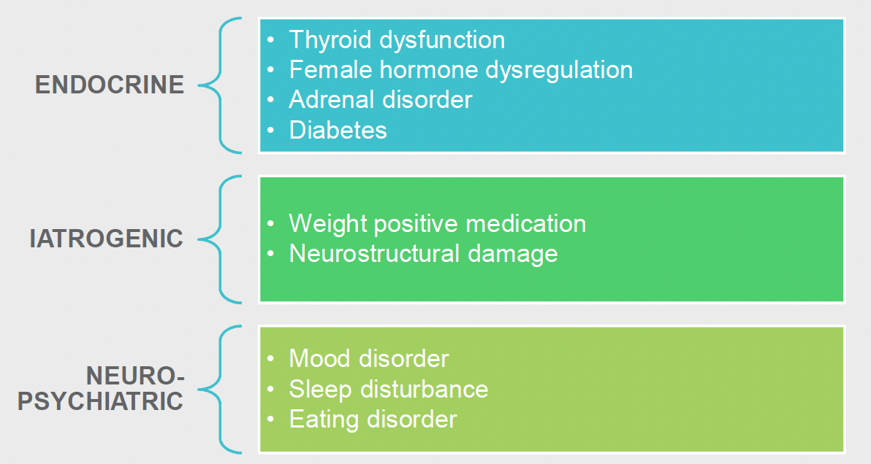

Slide 12
AGENDA
Obesity
Stigma
Physiology and Pathophysiology
Treatment Strategies
Questions
Epidemiology

Slide 13
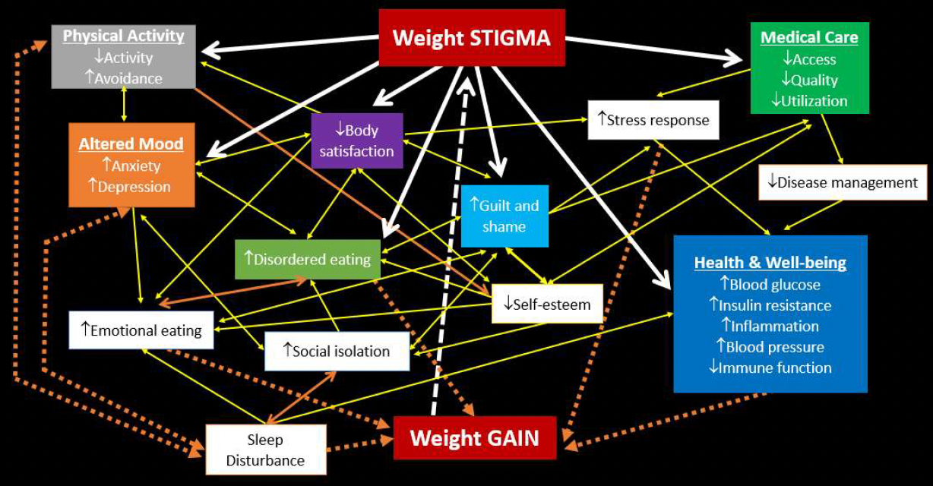

Slide 14
AGENDA
Obesity
Stigma
Physiology and Pathophysiology
Treatment Strategies
Epidemiology
Questions

Slide 15
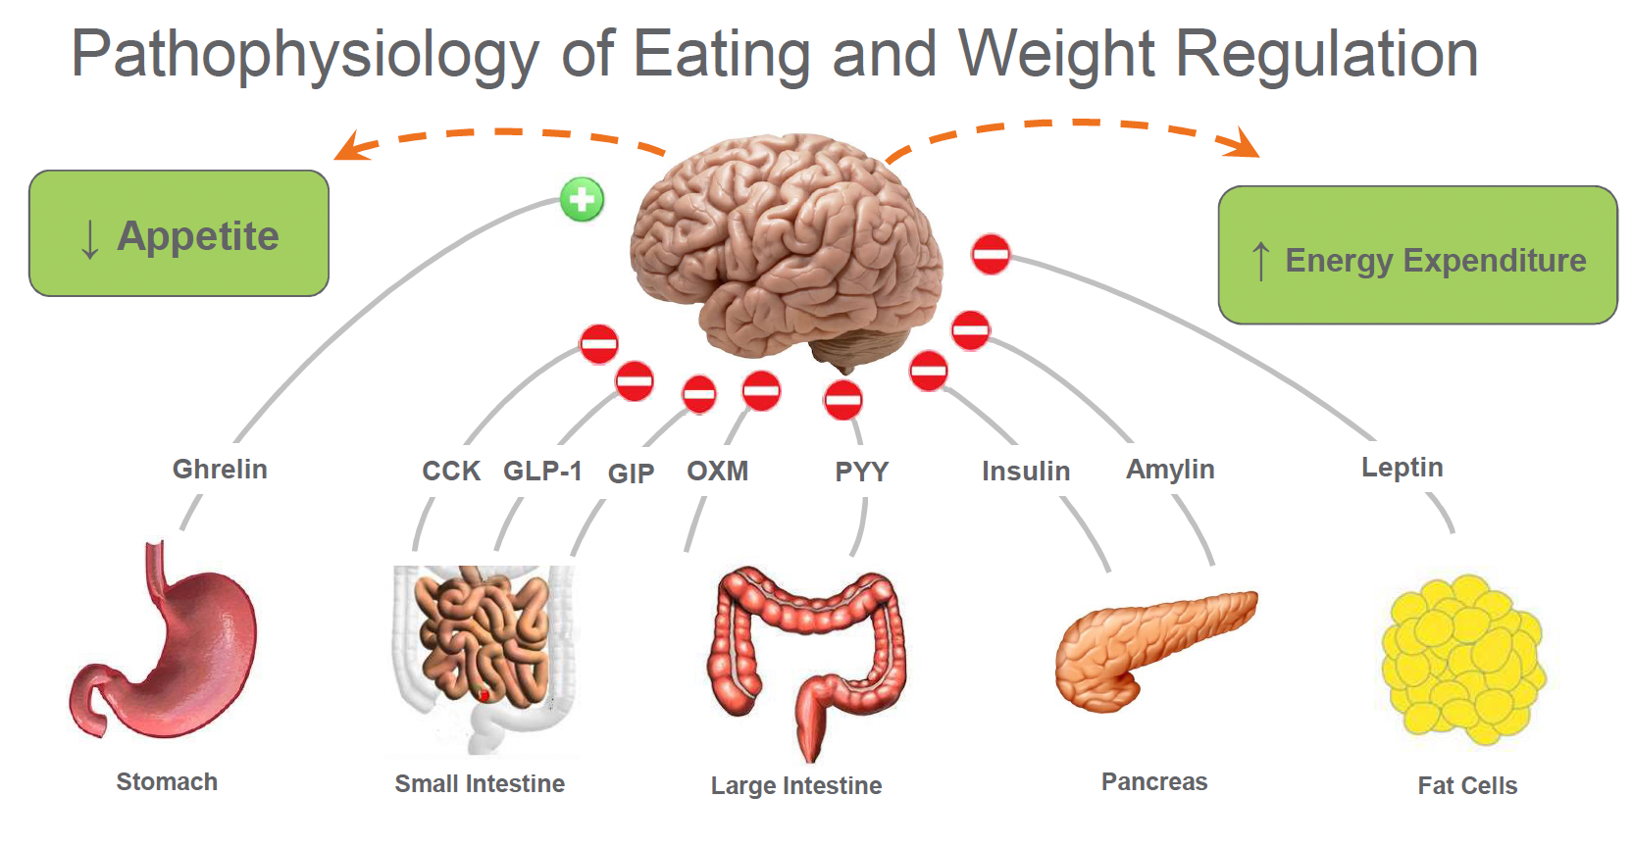

Slide 17
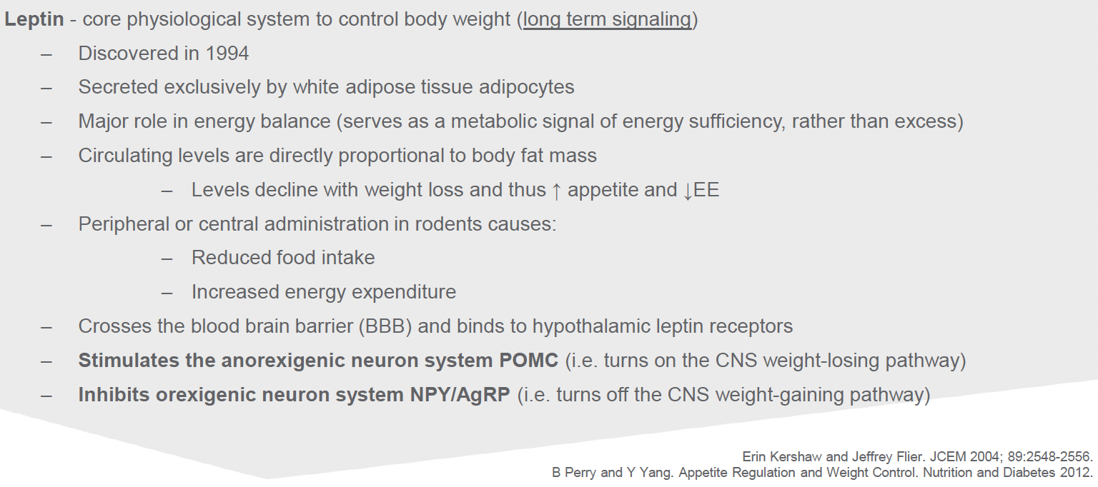

Slide 18
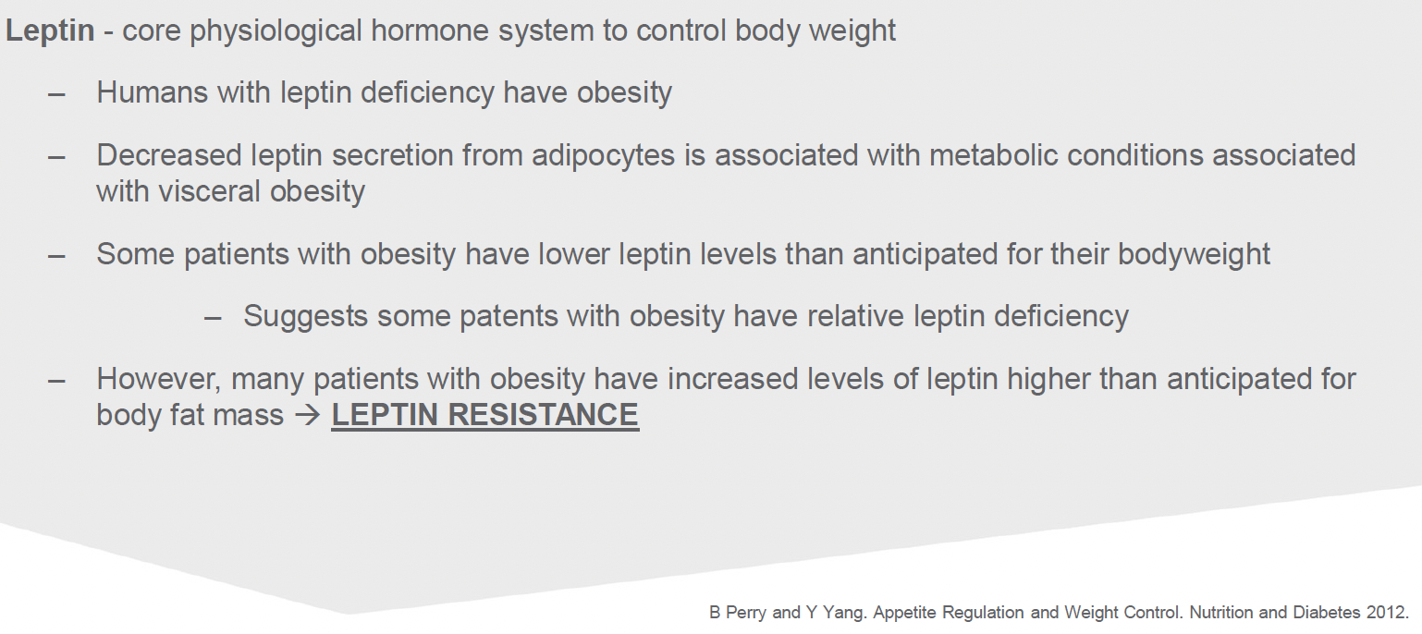

Slide 19
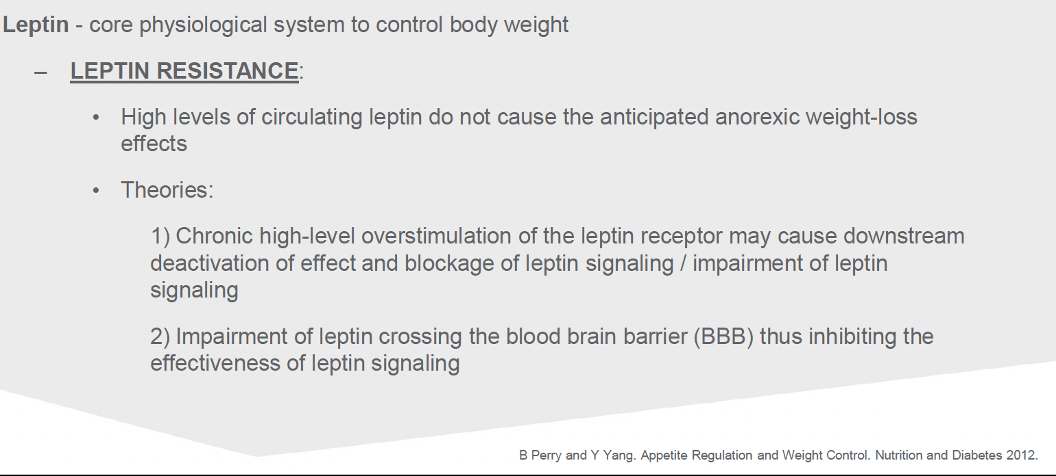

Slide 20
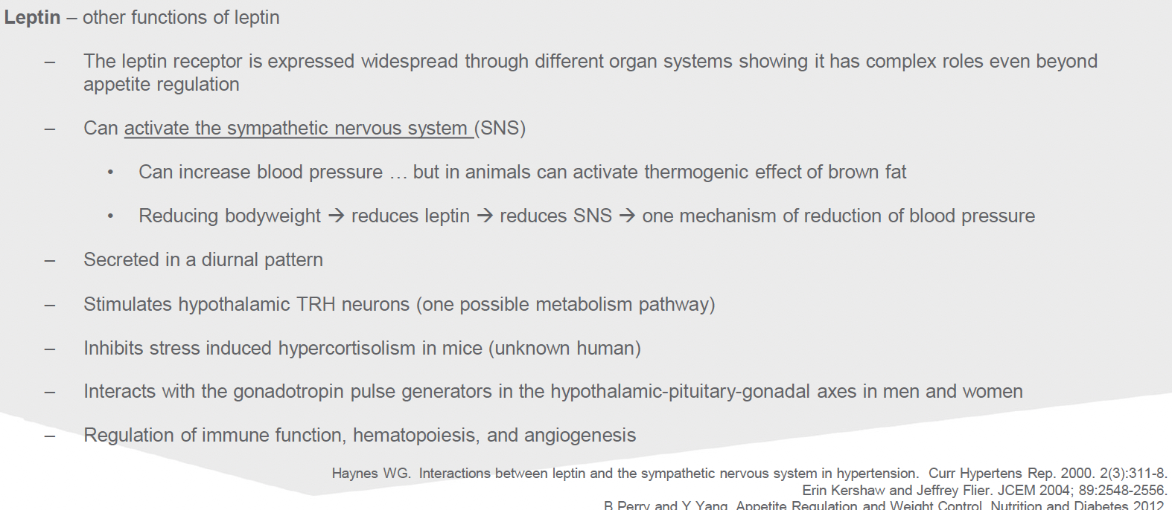

Slide 21
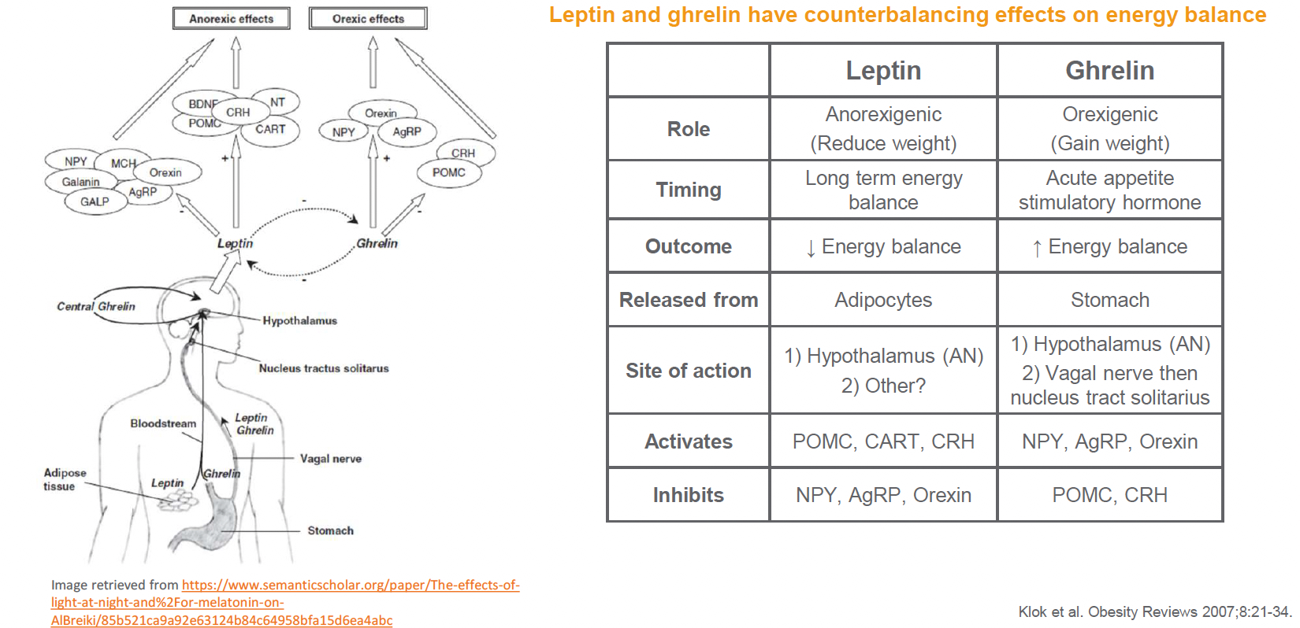

Slide 22
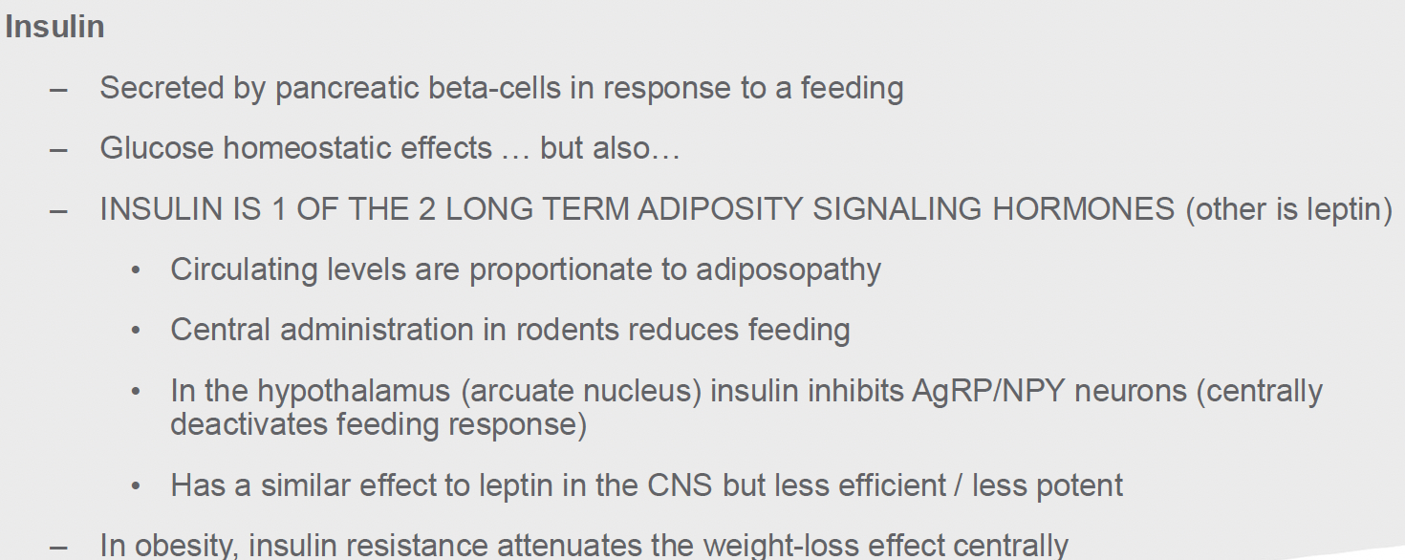

Slide 24
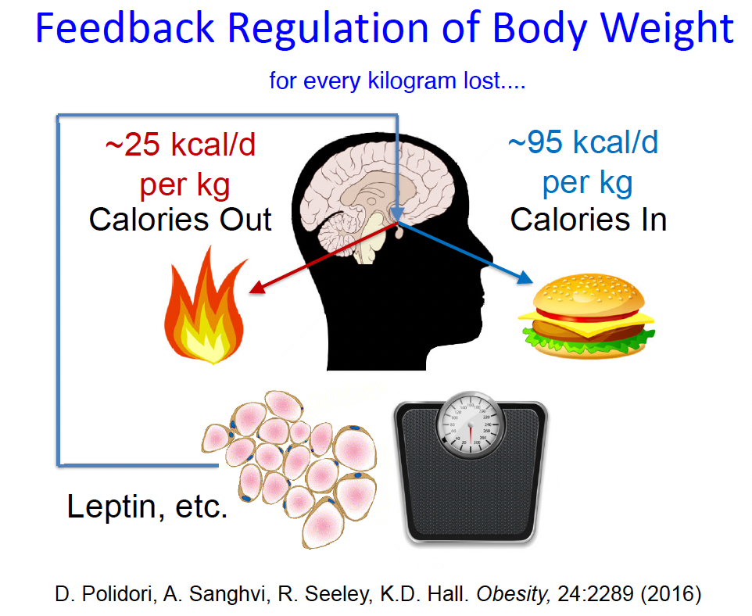

Slide 25
A 10% loss in fat mass produces a 65% reduction in Leptin

Slide 26
A patient with long term obesity may literally never experience fullness/satiety, always be hungry,
and experience
reward feedback on par with opiate addiction
A 10% loss in fat mass produces a 65% reduction in Leptin

Slide 27
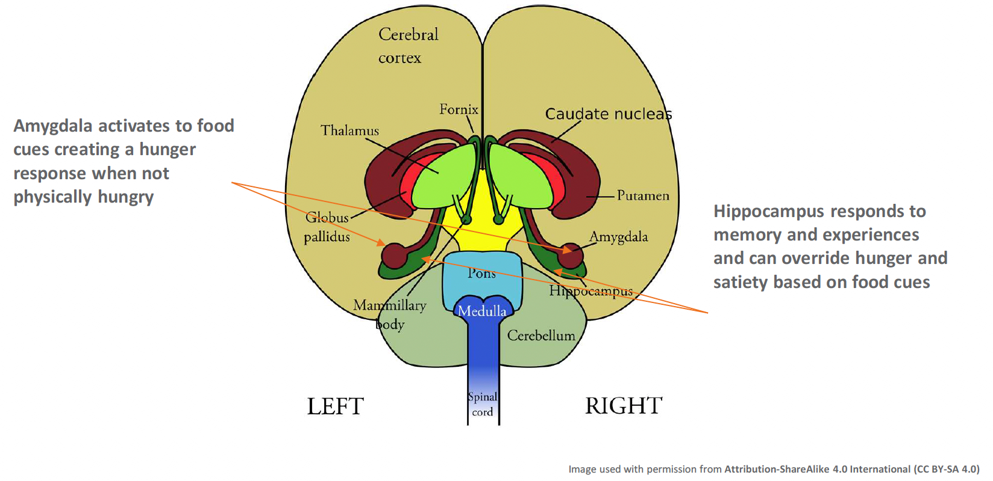

Slide 28
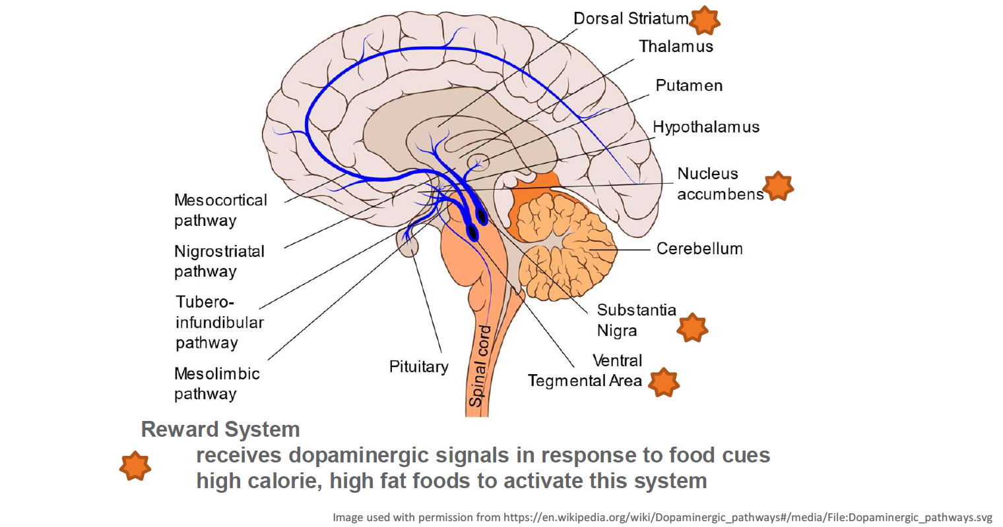

Slide 29
Ultra processed foods cause weight gain at matched calorie and macro feeding and increased consumption

Slide 30
Ultra processed foods cause weight gain at matched calorie and macro feeding and increased consumption
The rise in UPF consumption matches the rise in obesity

Slide 31
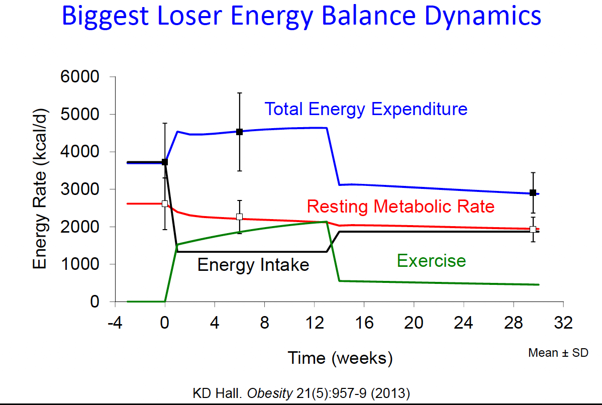

Slide 32
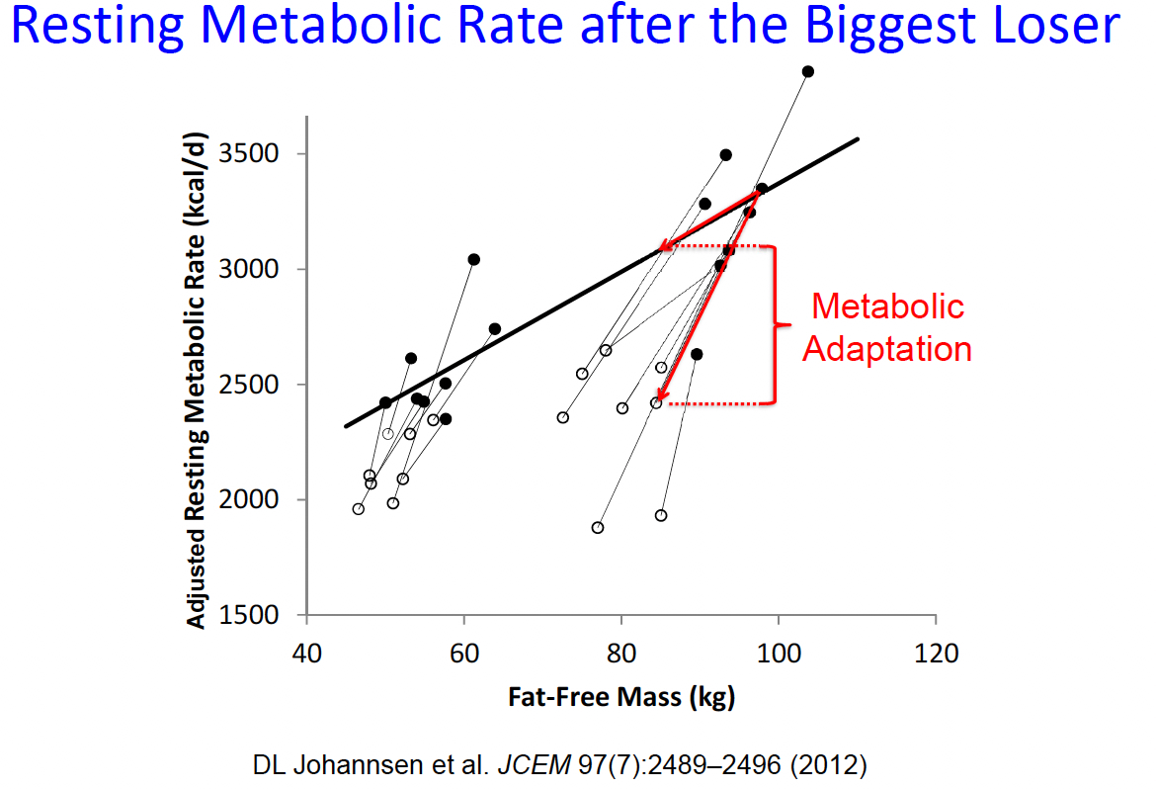

Slide 33
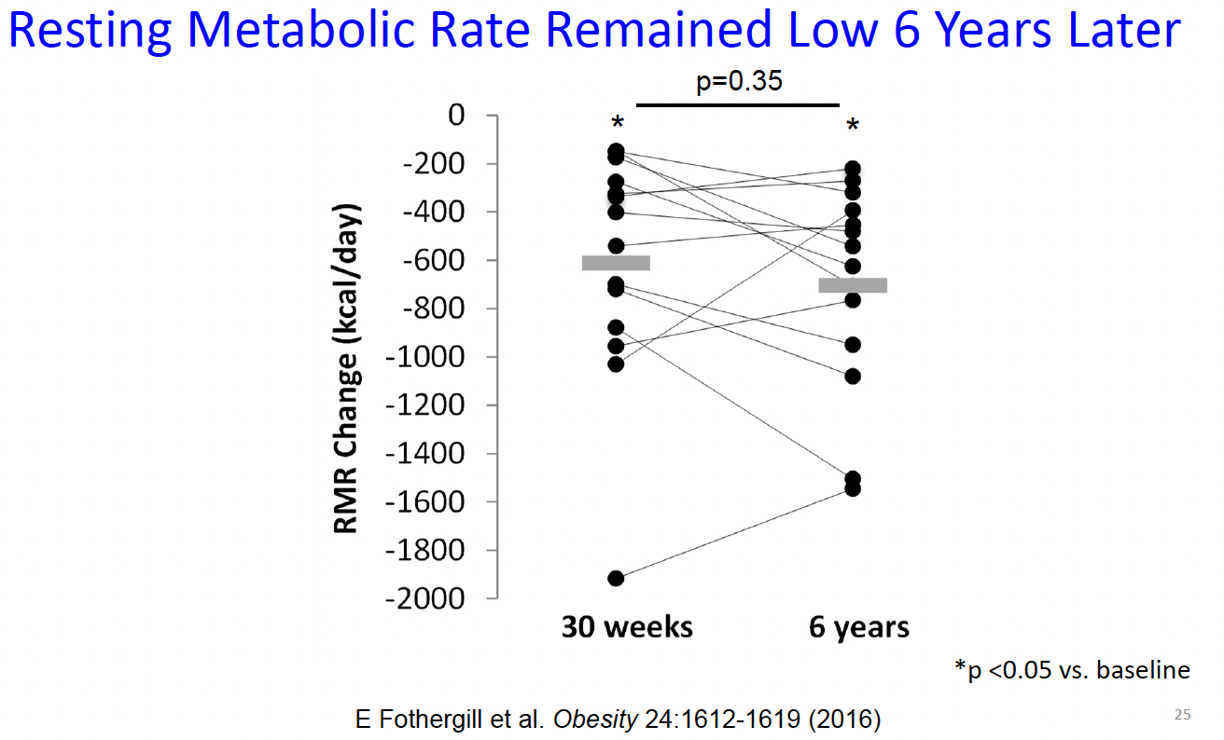

Slide 34
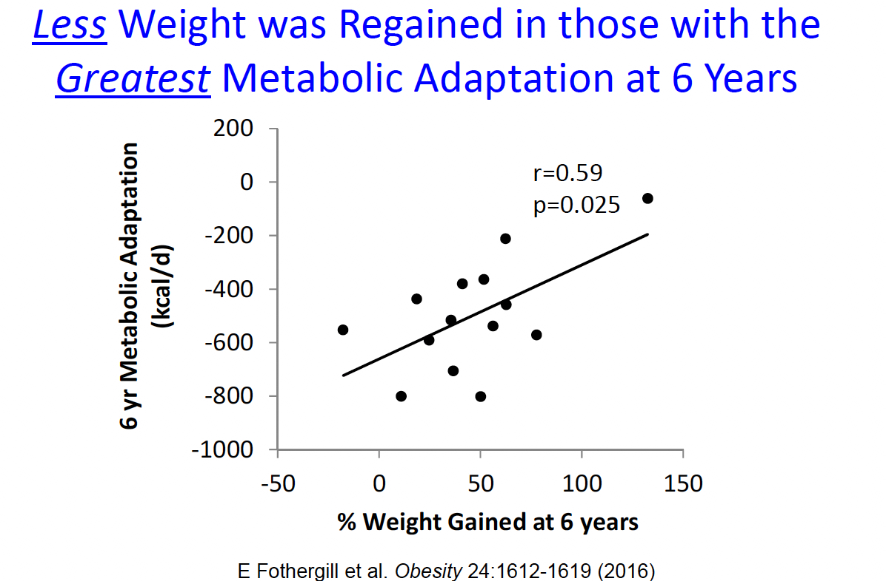

Slide 35
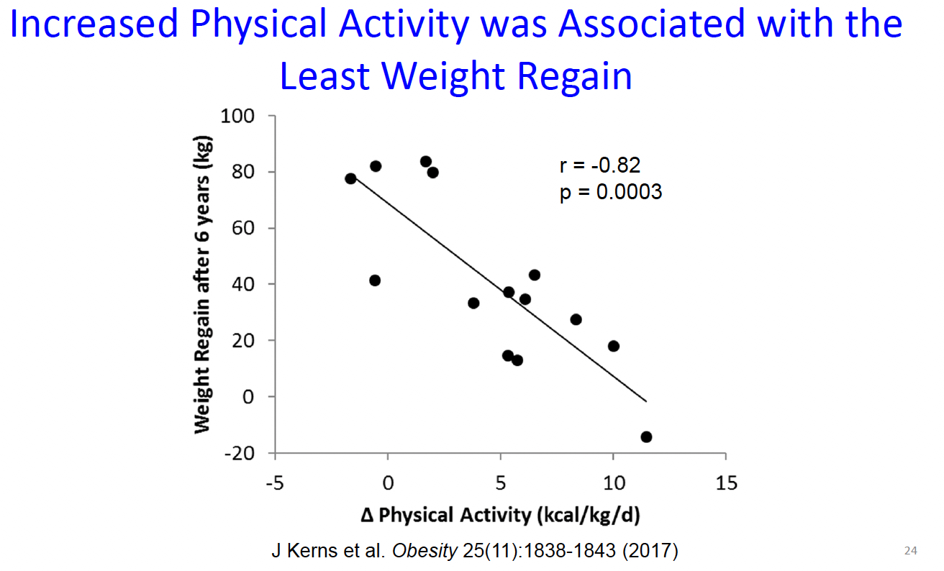

Slide 36
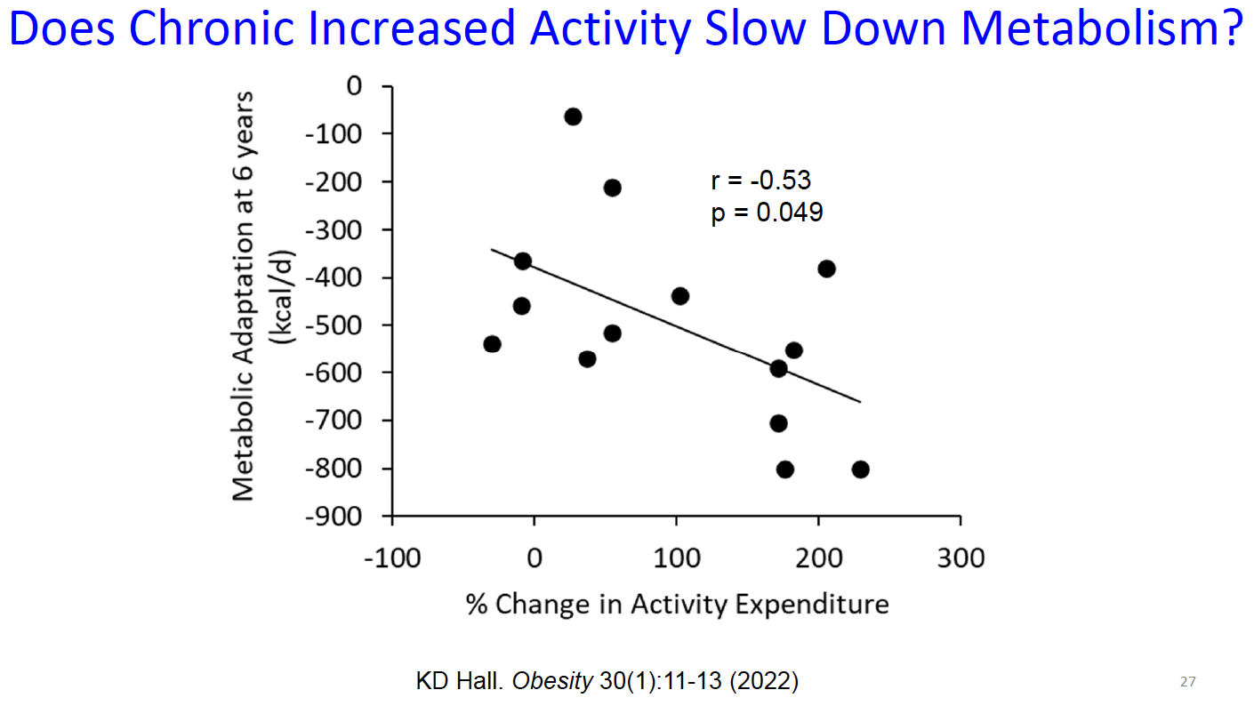

Slide 37
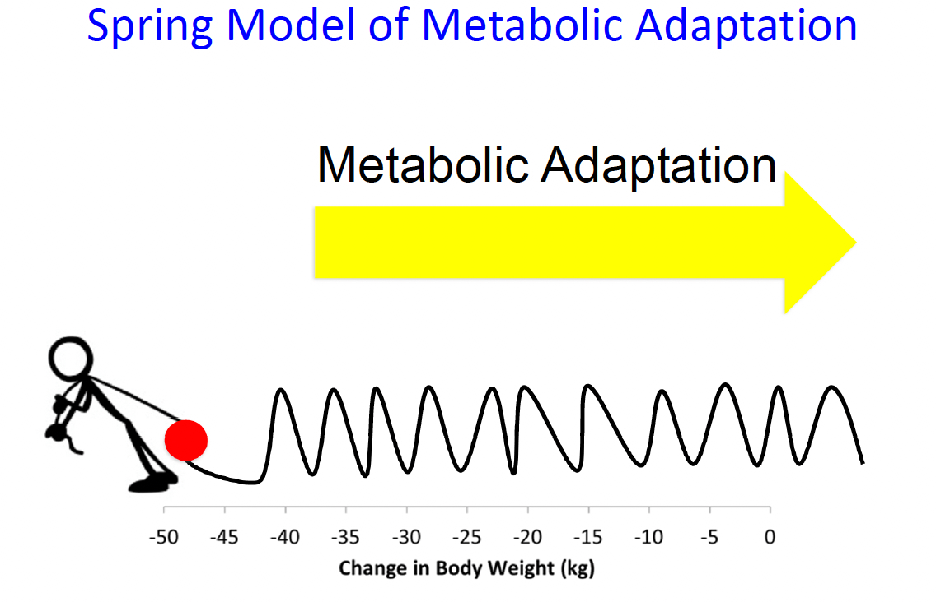

Slide 38
A reason to exercise caution with timing and intensity of AOM initiation

Slide 39
AGENDA
Obesity
Stigma
Physiology and Pathophysiology
Treatment Strategies
Epidemiology
Questions

Slide 40
Pillars of Obesity Medicine
Nutrition
  Tracking
  Calorie Control
  Macros
  Meal Replacement
Physical Activity
  SLOW INCREASE
  Enjoyable
  Goal is to get to 60min daily by end of treatment window/transition to maintenance
Medicine
  Ideally after lifestyle interventions have begun
  With consideration of expected plateaus and goals
Behavior
  Trumps all of above – intake history is CRITICAL
  Is there any concern for BED or NES (up to 66% of patients with long term obesity)

Slide 41
Intake Visit
Adequate time
  At least 30 minutes
Focus on education
  Lifelong disease
  No cure
  Expected plateaus/obstacles
  Metabolic adaptation and it's permanence
Labs
  Focused by weight history with consideration of PCOS, hyperinsulinemia, etc
  Critical to correct medication choice
Initial goals
  Classes of obesity -> overweight
  Target BMR (adjusting for metabolic adaptation if prior >10% loss)
  Discuss possibility of multiple medications & advise when a plateau may be expected
  Plan for action – what will be done WHEN the plateau happens
  BMI target based on RISK REDUCTION vs size, weight, or appearance

Slide 42
Why so much effort when we could just prescribe?
This is a lifelong disease, and your patient will need tools and information.
Selecting the right medication
Very often, a patient will need to lose more than any one medication or strategy could accomplish
Ideally:
  Habits -> 5-17% loss
  Initiate weight loss medications at first plateau (usually around 10% loss)
  If any indication of hyperinsulinemia, metabolic syndrome, PCOS – metformin may be needed to maximize effectiveness of GLP-1s
  Never underestimate the psychology – building confidence in sustainable habits and a new lifestyle are POWERFUL

Slide 43
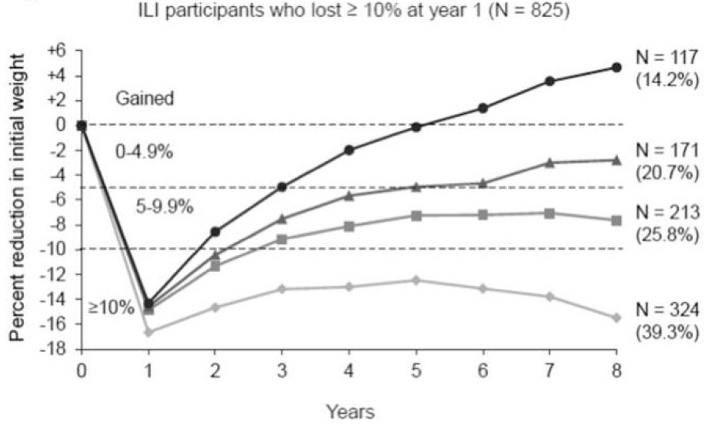
Intensive Lifestyle Intervention

Slide 44
Pharmacotherapy
Contrave (buproprion/naltrexone)
  Mean weight loss: 7% (vs. placebo: 2%)
  Clinically significant weight loss:
  ≥ 5% wt. loss: 56%
    ≥ 10% wt. loss: 27%
    ≥ 15% wt. loss: 10%
Qysmia (phentermine/topiramate)
  Mean weight loss:
  EQUATE 28-week study: overall mean = 9% (vs. placebo: 2%)
  SEQUEL 56-week extension study: overall mean = 10% (vs. placebo: 2%)
  Clinically significant weight loss:
  ≥ 5% wt. loss: 66% at top dose (EQUATE), 79% at top dose (SEQUEL)
    ≥ 10% wt. loss: 41% at top dose (EQUATE), 54% at top dose (SEQUEL)
    ≥ 15% wt. loss: N/A (EQUATE), 32% at top dose (SEQUEL)
    ≥ 20% wt. loss: N/A (EQUATE), 15% at top dose (SEQUEL)

Slide 45
Pharmacotherapy
GLP-1
  Liraglutide
    Mean weight loss: 8% (vs. placebo: 3%)
    Clinically significant weight loss:
  ≥ 5% wt. loss: 63%
      ≥ 10% wt. loss: 33%
      ≥ 15% wt. loss: 14%
  Semaglutide
    Mean weight loss: 15% (vs. placebo: 2%)
    Clinically significant weight loss:
≥ 5% wt. loss: 86%
      ≥ 10% wt. loss: 69%
      ≥ 15% wt. loss: 51%
      ≥ 20% wt. loss: 32%
  Tirzepatide (off-label)
    Mean weight loss: 21% (vs. placebo: 3%)
    Clinically significant weight loss:
≥ 5% wt. loss: 91%
      ≥ 20% wt. loss: 57%

Slide 46
Pharmacotherapy
Metformin (off-label)
  5.6-12.1% loss
  Significantly more loss with insulin resistance
  Trials included BMI 27 and above
  Exp Clin Endocrinol Diabetes. 2013 Jan;121(1):27-31

Slide 47
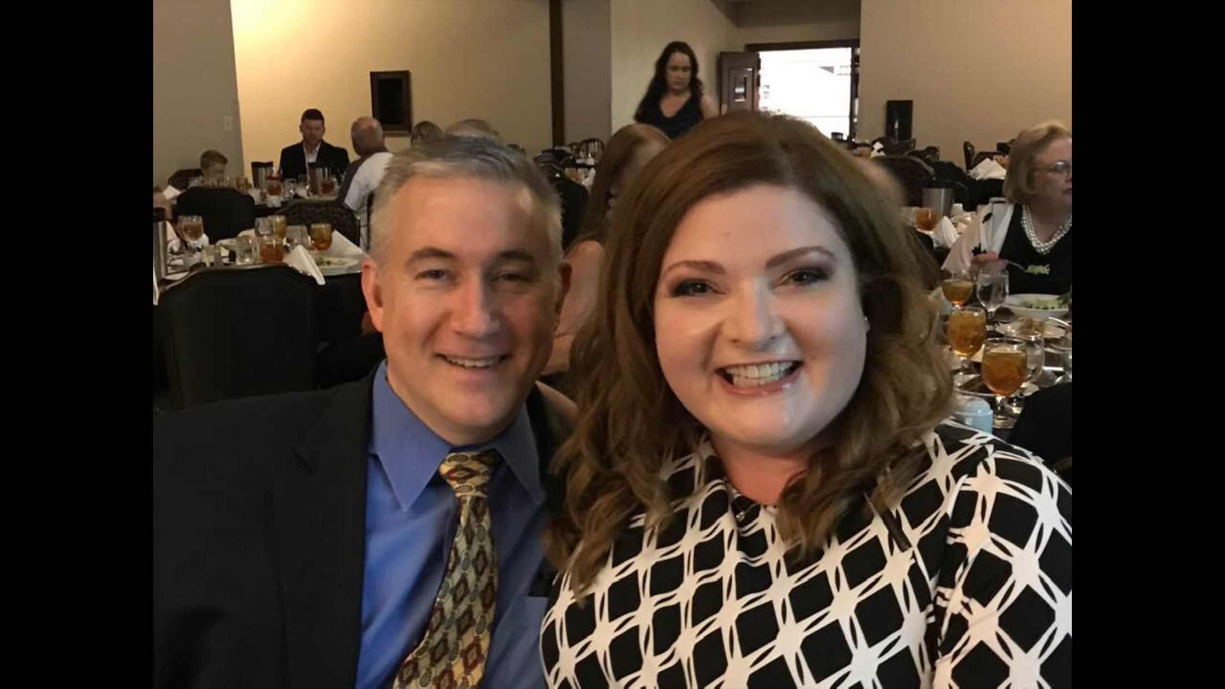

Slide 48
AGENDA
Obesity
Stigma
Physiology and Pathophysiology
Treatment Strategies
Questions
Epidemiology

Slide 49
THANK YOU
Ann.hughes.bass2@umchealthsystem.com

